Slide 2
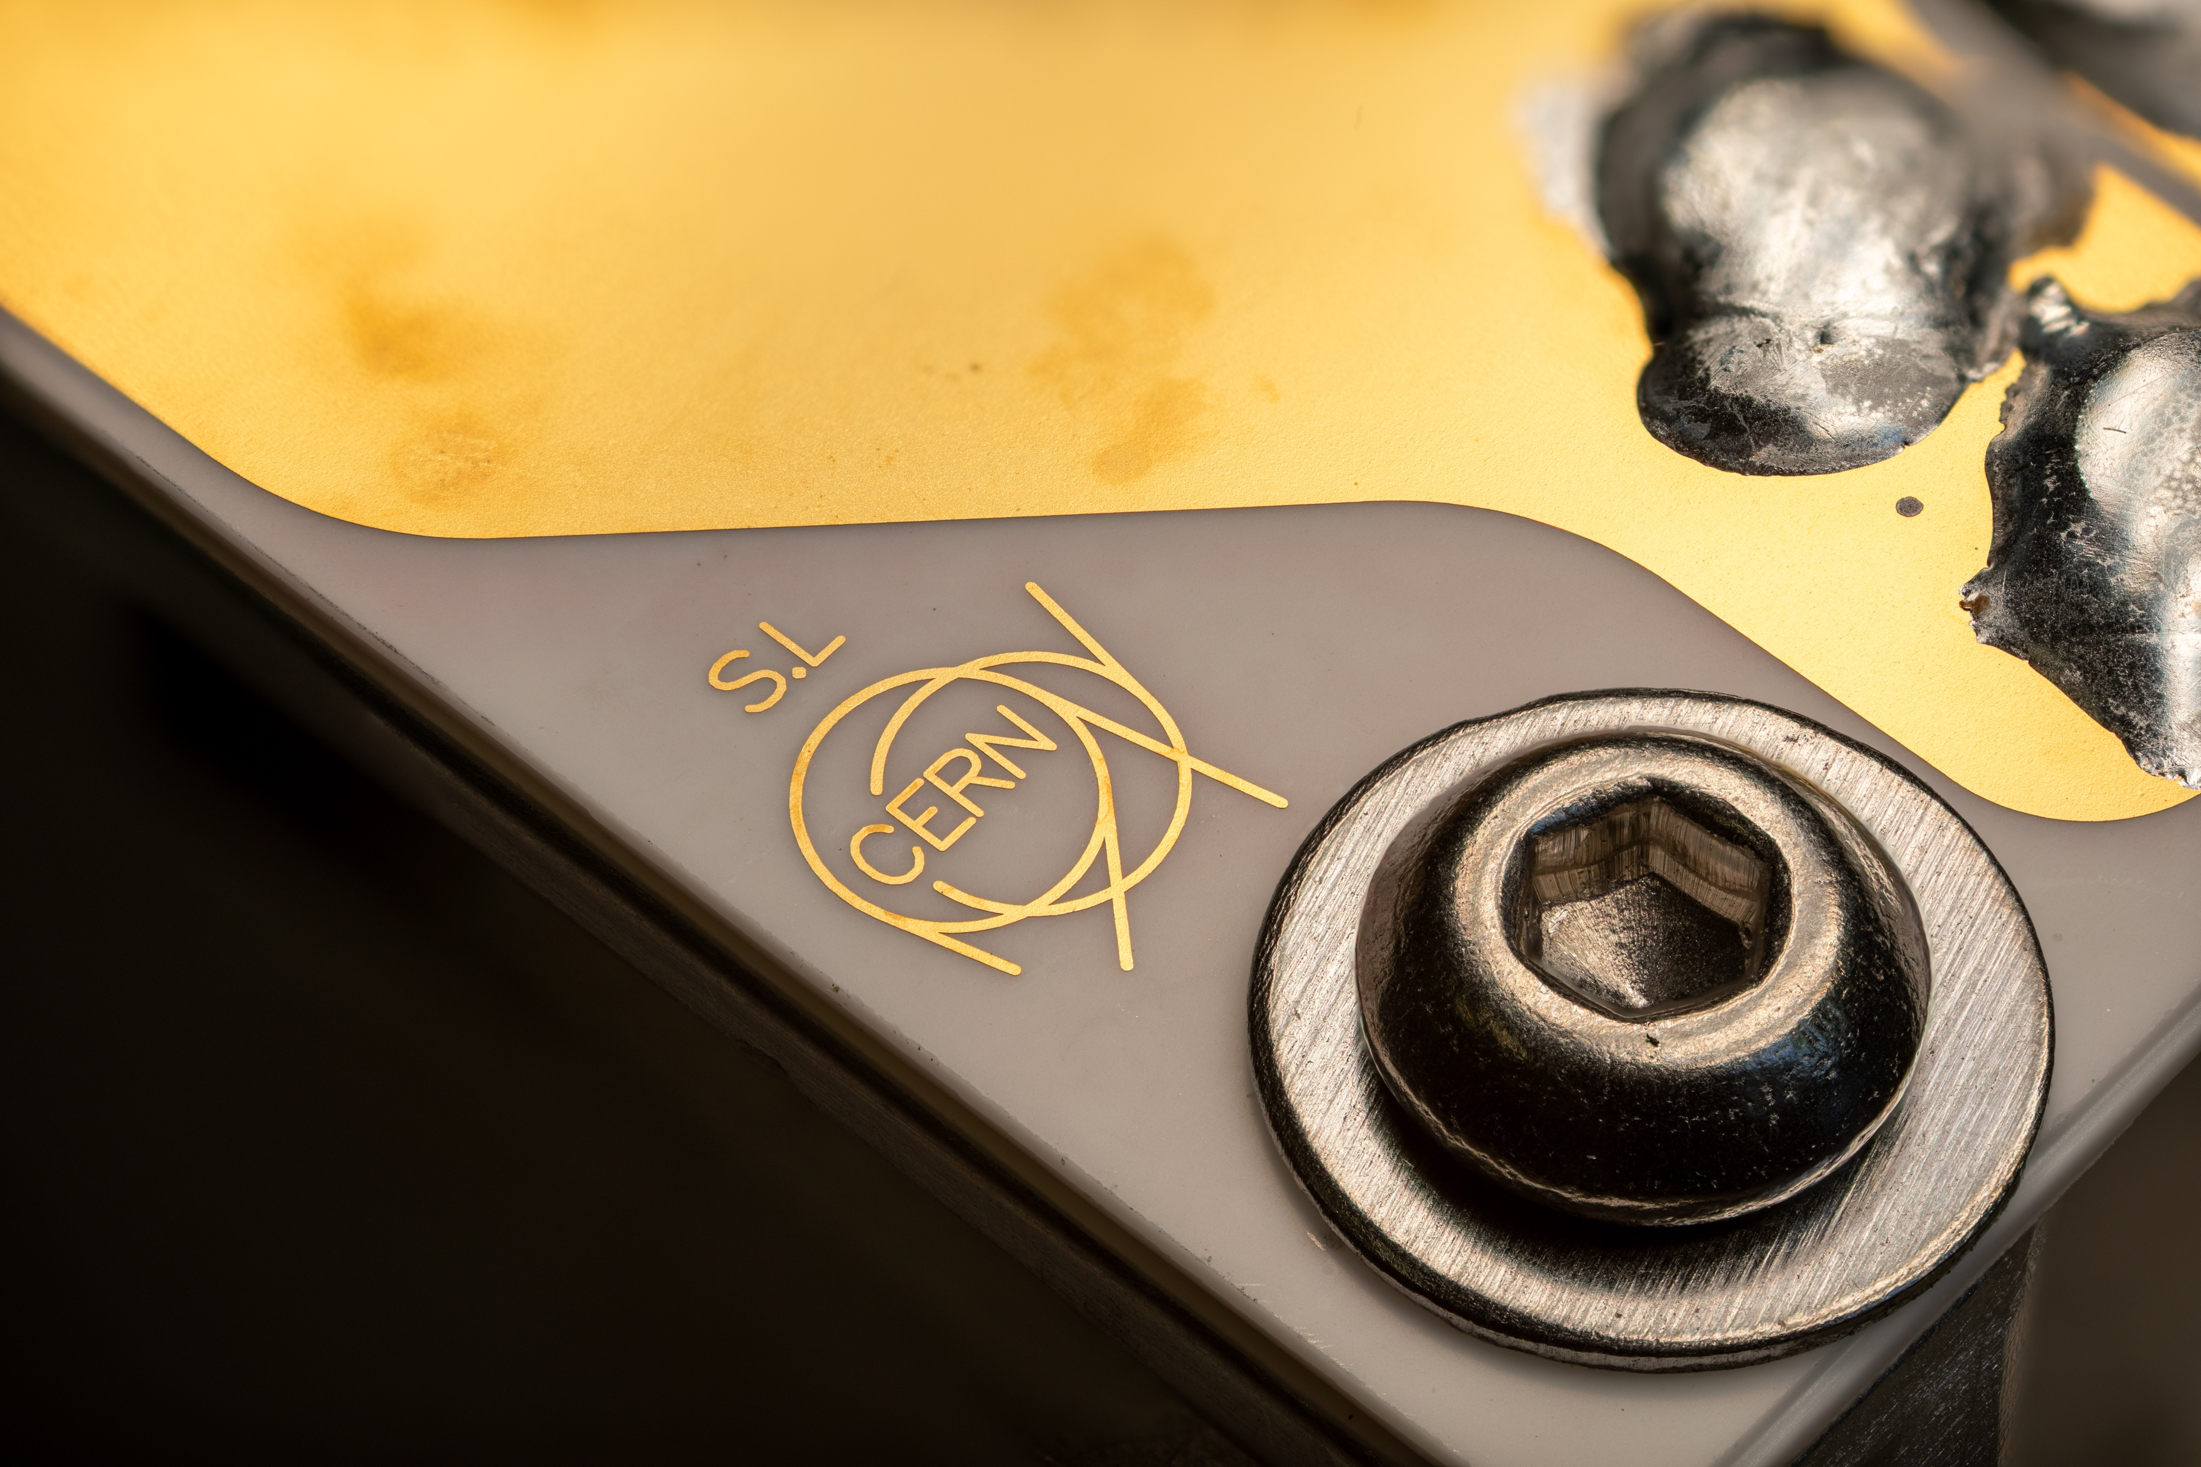
A Quick Introduction to PS-BGI
Swann Levasseur
CERN BE-BI-BL
Acknowledgements:
J. Storey, H. Sandberg

Slide 3
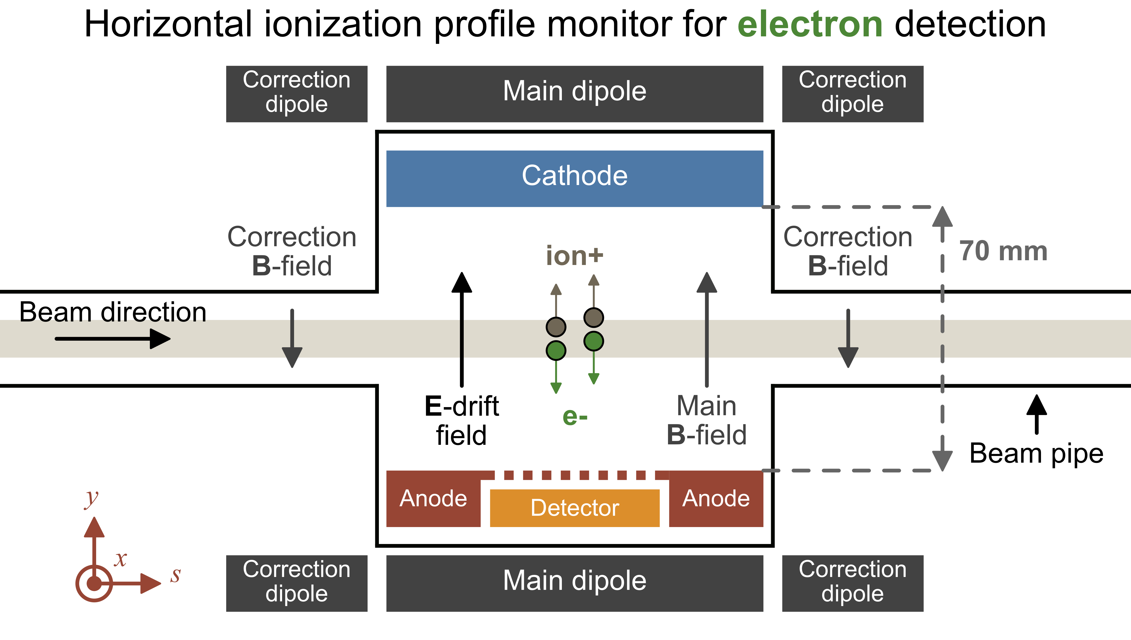
PS-BGI – In a few words
What is it?
Proton Synchrotron Beam Gas Ionization Profile Monitor
Measures the transverse profile of a beam of particles (p+ or Ions)
Why do we need?
Make sure the beam is what we want it to be.

Slide 4
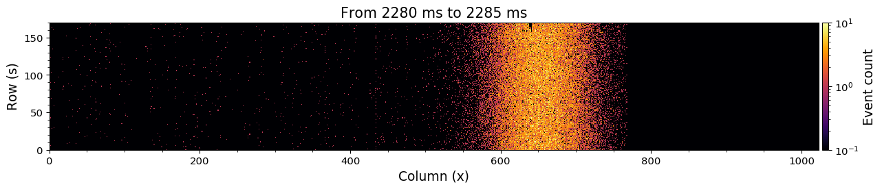
PS-BGI – In a few words
Raw detector image (2D Projection of the beam)
Measured beam profile (1D integration of raw image)

Slide 5
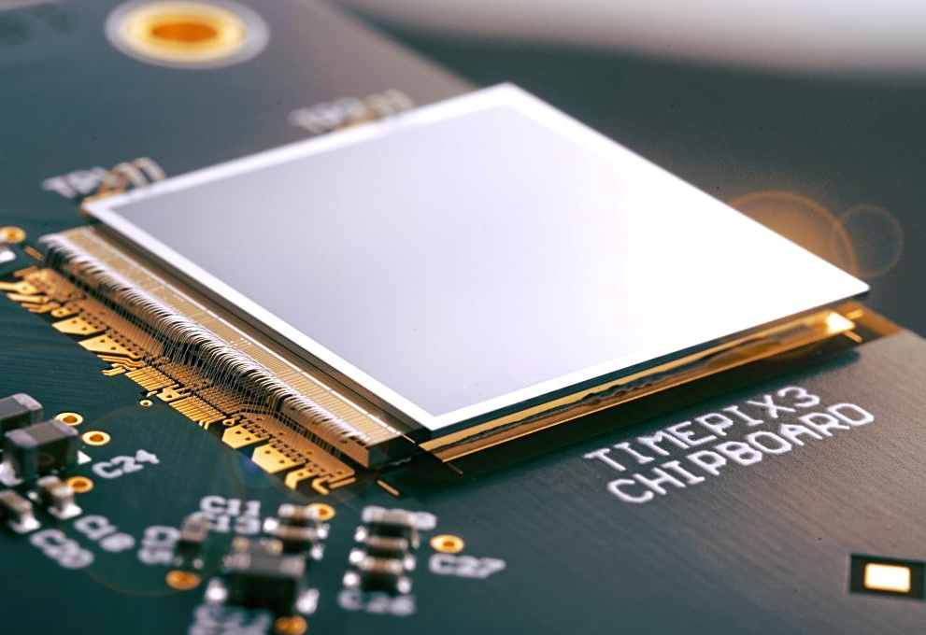
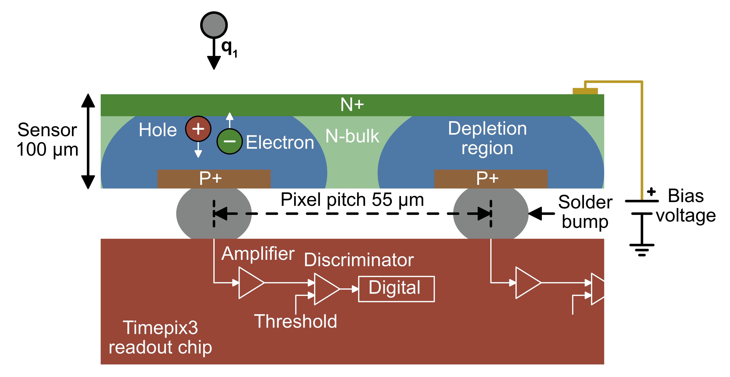
PS-BGI – In a few words
Timepix3 Hybrid Pixel Detector:
Hybrid: Combination of a pixelated sensor and readout chip.
Incoming ionizing radiation create e-/hole pair in the sensor.
The readout chip measures the charge deposited and digitize it.
  It measures Position (column and row), time of arrival and energy
Timepix3 Hybrid Pixel Detector
Hybrid Pixel Detector representation

Slide 6
PS-BGI – In a few words
How does it work?
Beam traverse the instrument and ionizes the rest gas and creates electron ion pairs.
Assuming that the rest gas is homogeneously spread in the vacuum chamber, the distribution of the generated electron/ion pair is representative of the particle distribution in the beam.
A vertical electric and magnetic field direct the electrons to a detector.
The detector measures the position, time-of-arrival and energy of each electron.
The back-end computer, extract the beam profile from this information.
What is the working environment?
UHV around 10^-10 mBar
Mixed field ionizing radiation (1 to 10 kGy/yr)
  Access impossible most of the year (two/three opportunity/year)

Slide 7
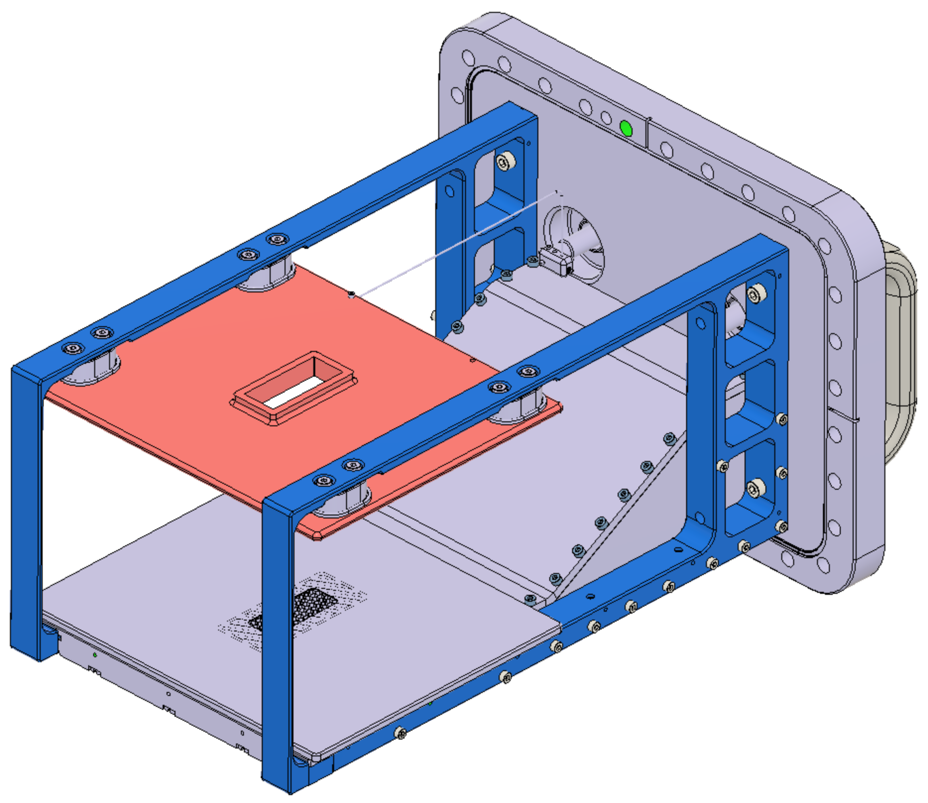
PS-BGI – How does it looks?
Flange
Cathode (-20kV)
Anode
(GND)
Faraday cage
Support arms
Detector opening/honeycomb

Slide 8
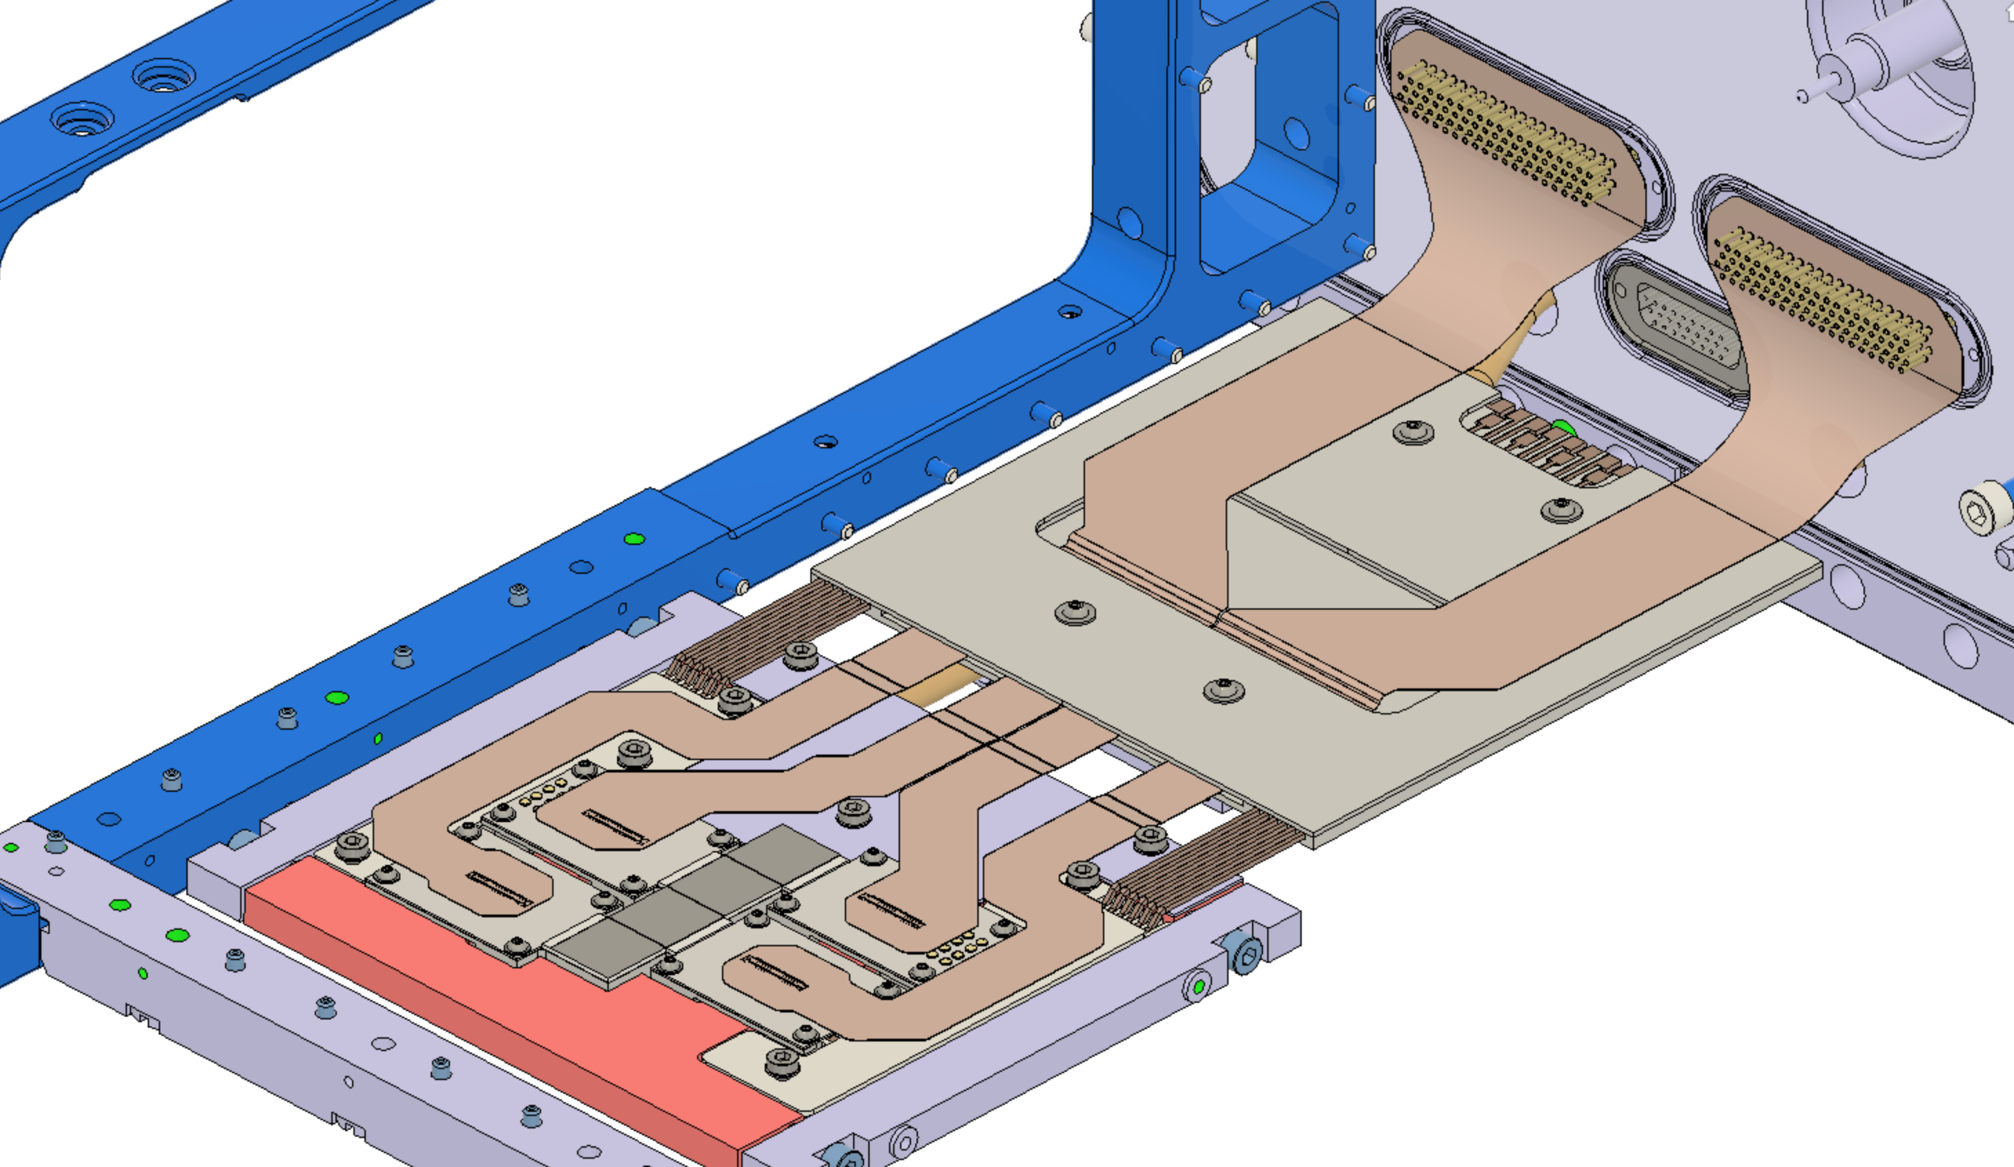
PS-BGI – How does it looks?
Flexible Cables (2x)
(data-in/out)
TPX3 Detector modules (4x)
(detect e-)
Low-voltage distribution
(power-in/out)
Cooling plate @ 6 °C
(keep detectors cool)

Slide 9
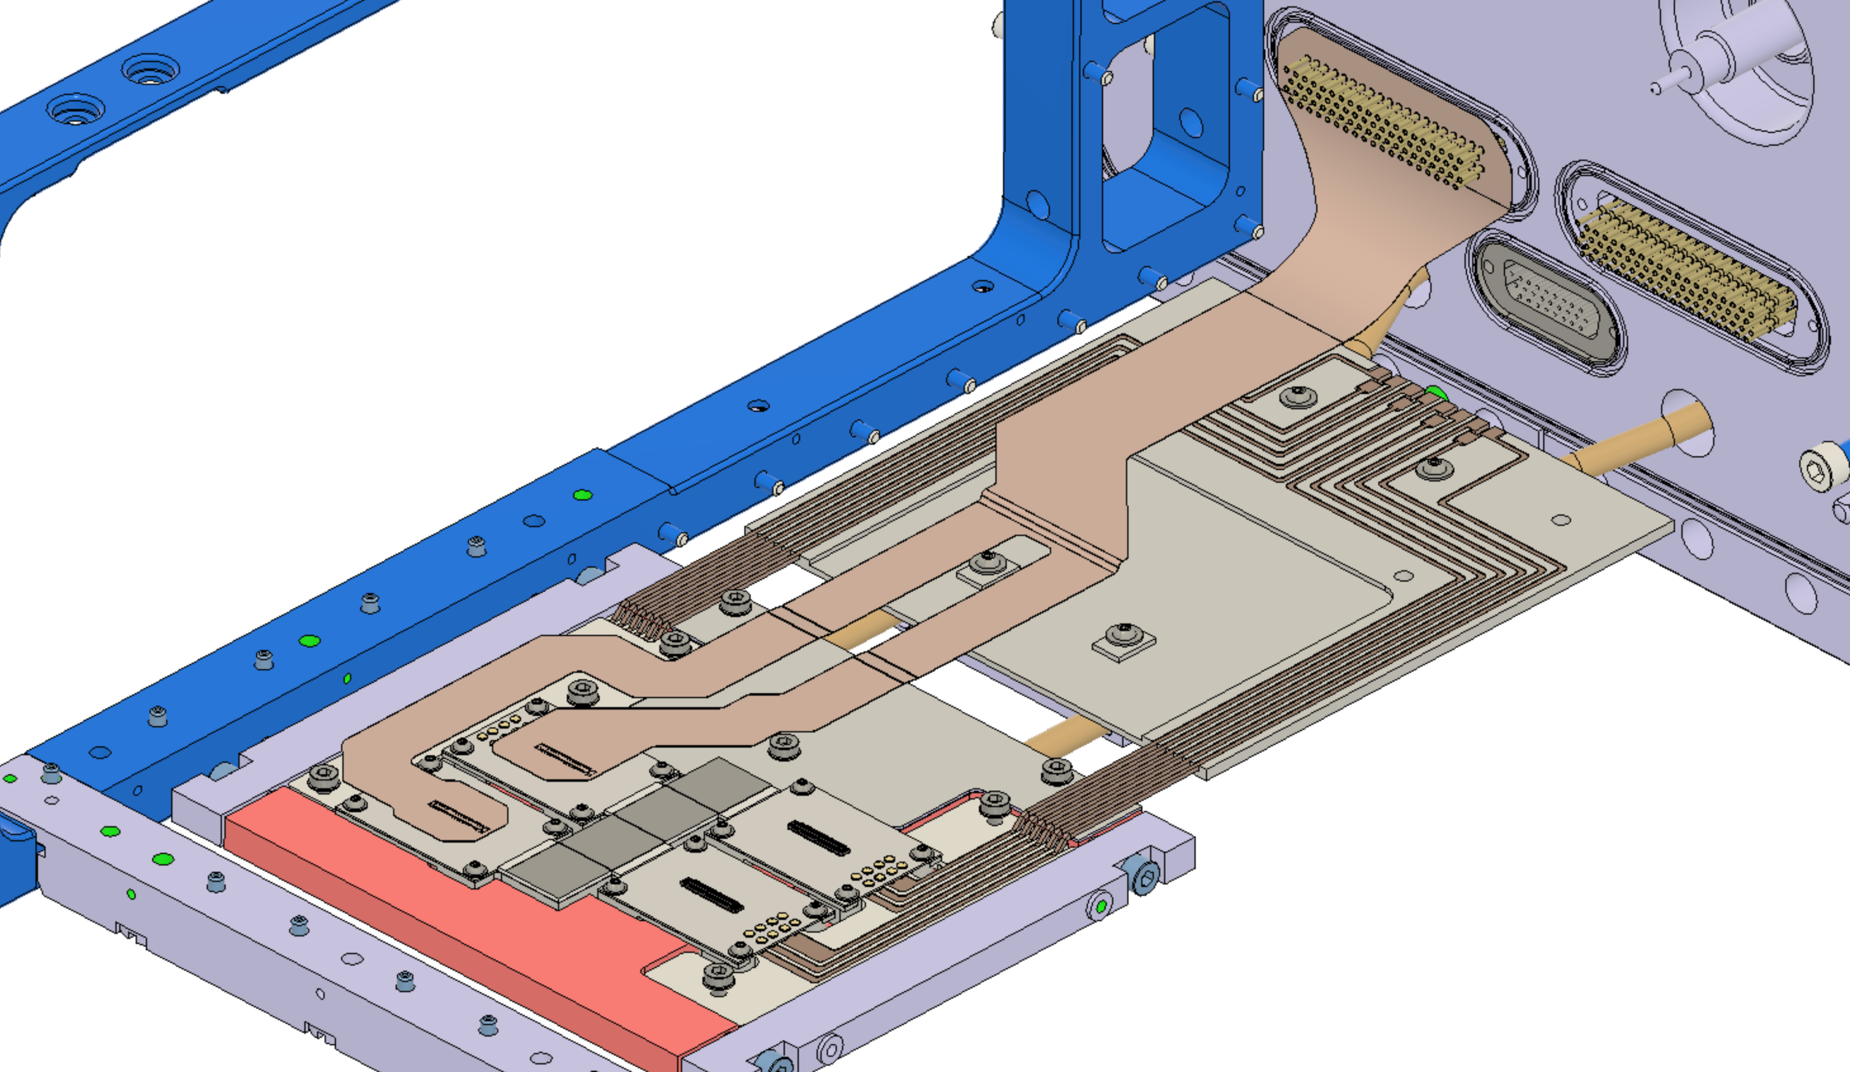
PS-BGI – How does it looks?
Low-voltage distribution
(power-in/out)

Slide 10
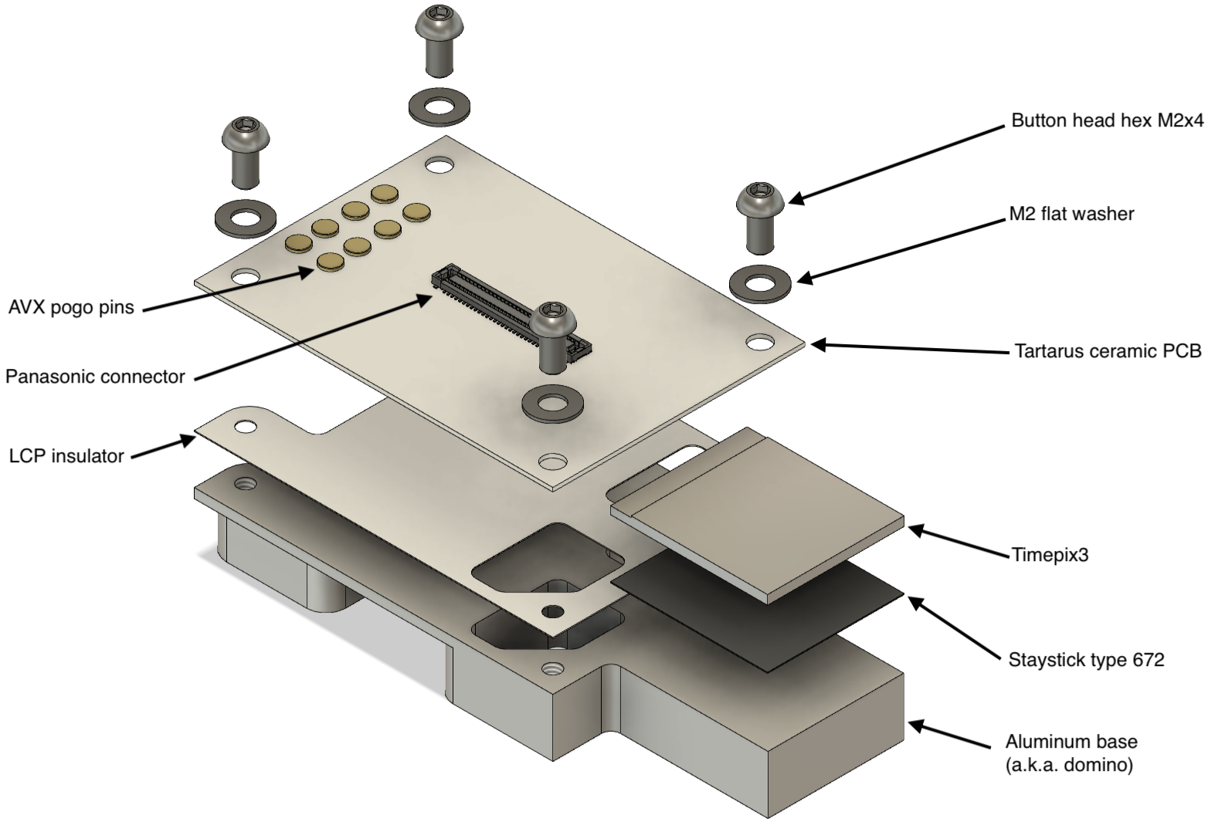
PS-BGI – How does it looks?
Detector module

Slide 11
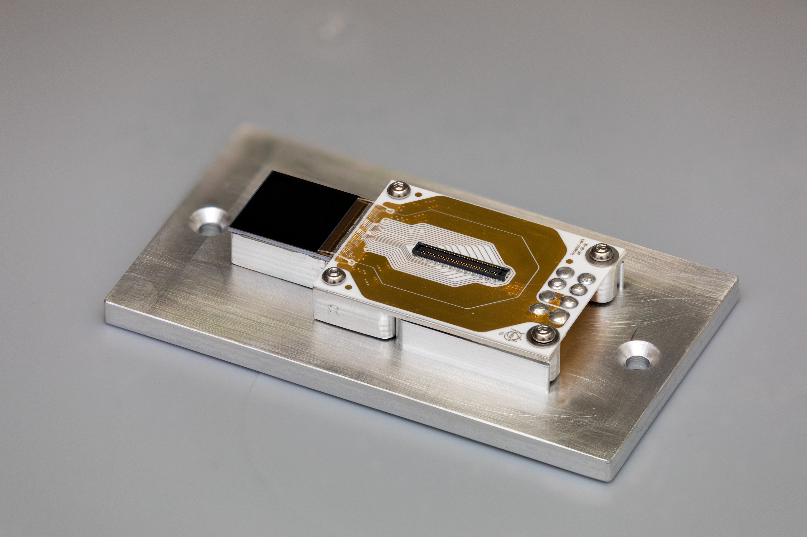
PS-BGI – How does it looks?
Detector module

Slide 12
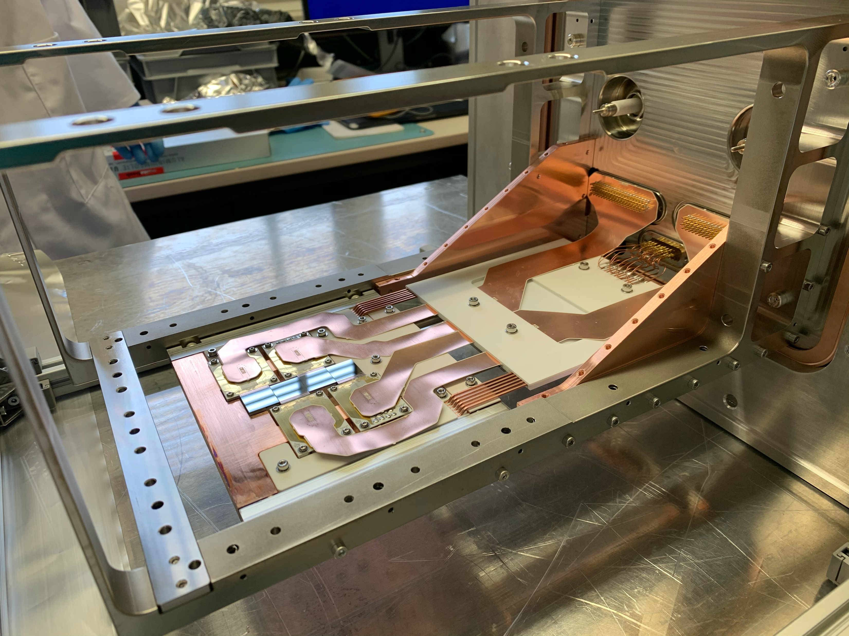
PS-BGI – How does it looks?
MkIII Detector

Slide 13
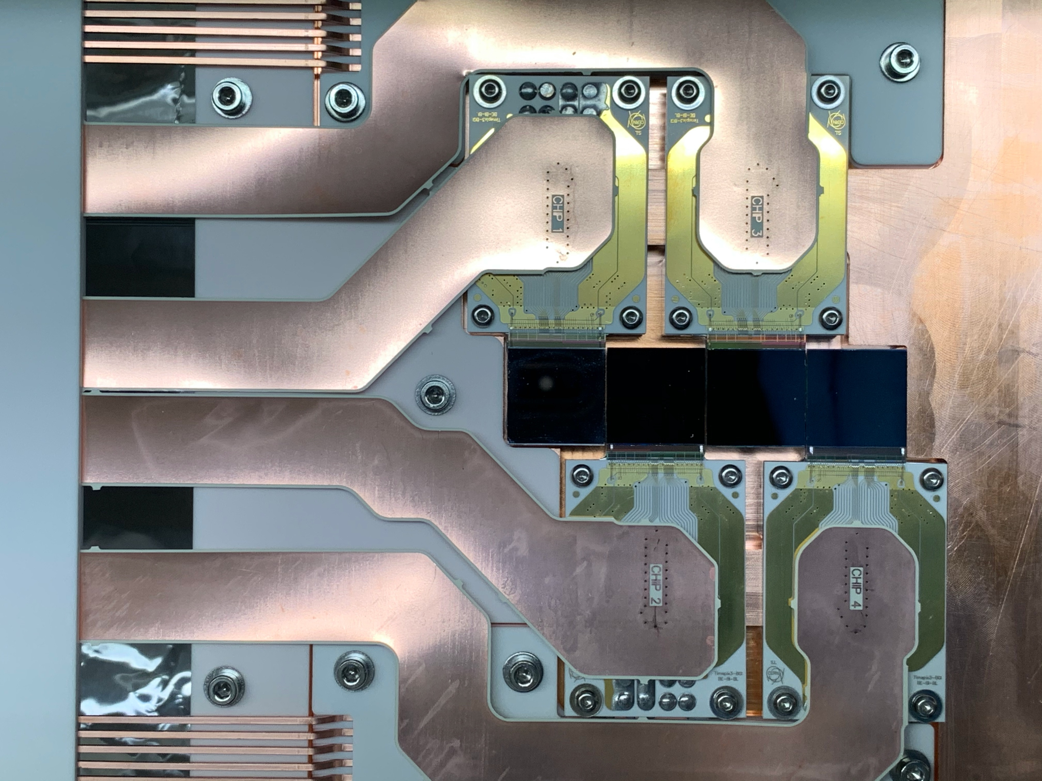
PS-BGI – How does it looks?
MkIII Detector

Slide 14
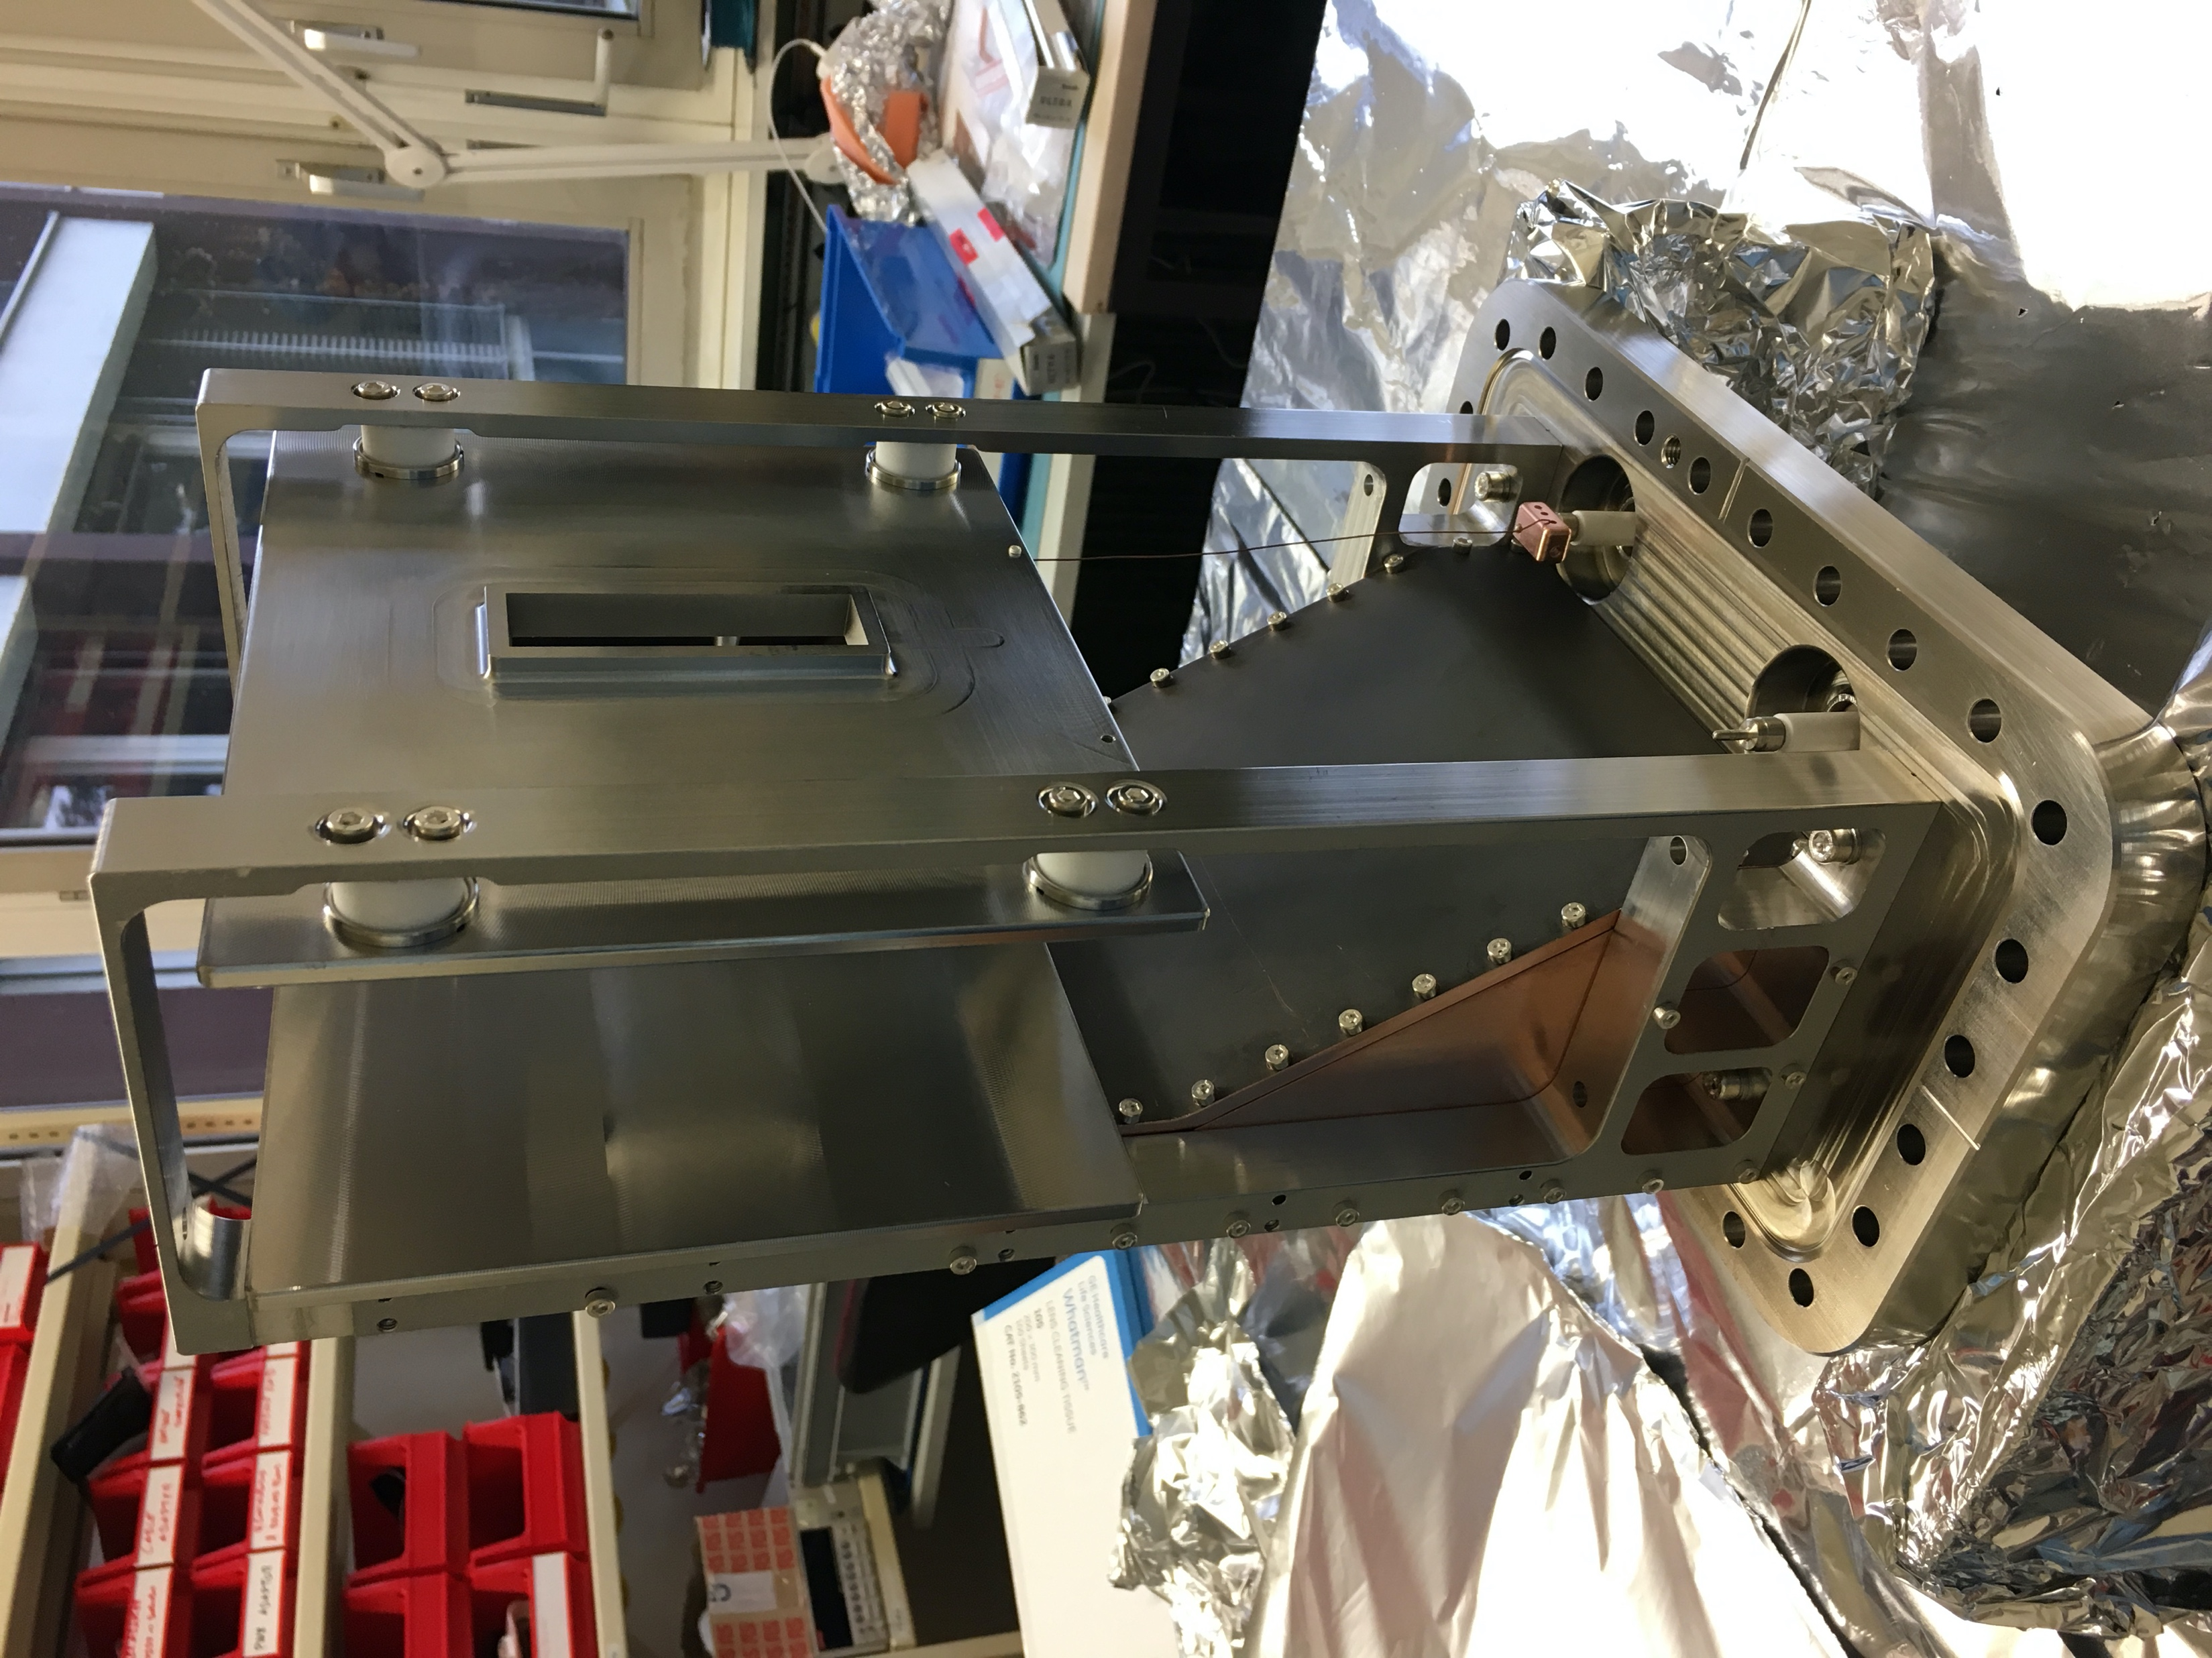
PS-BGI – How does it looks?
Full Instrument PS-BGIH

Slide 15
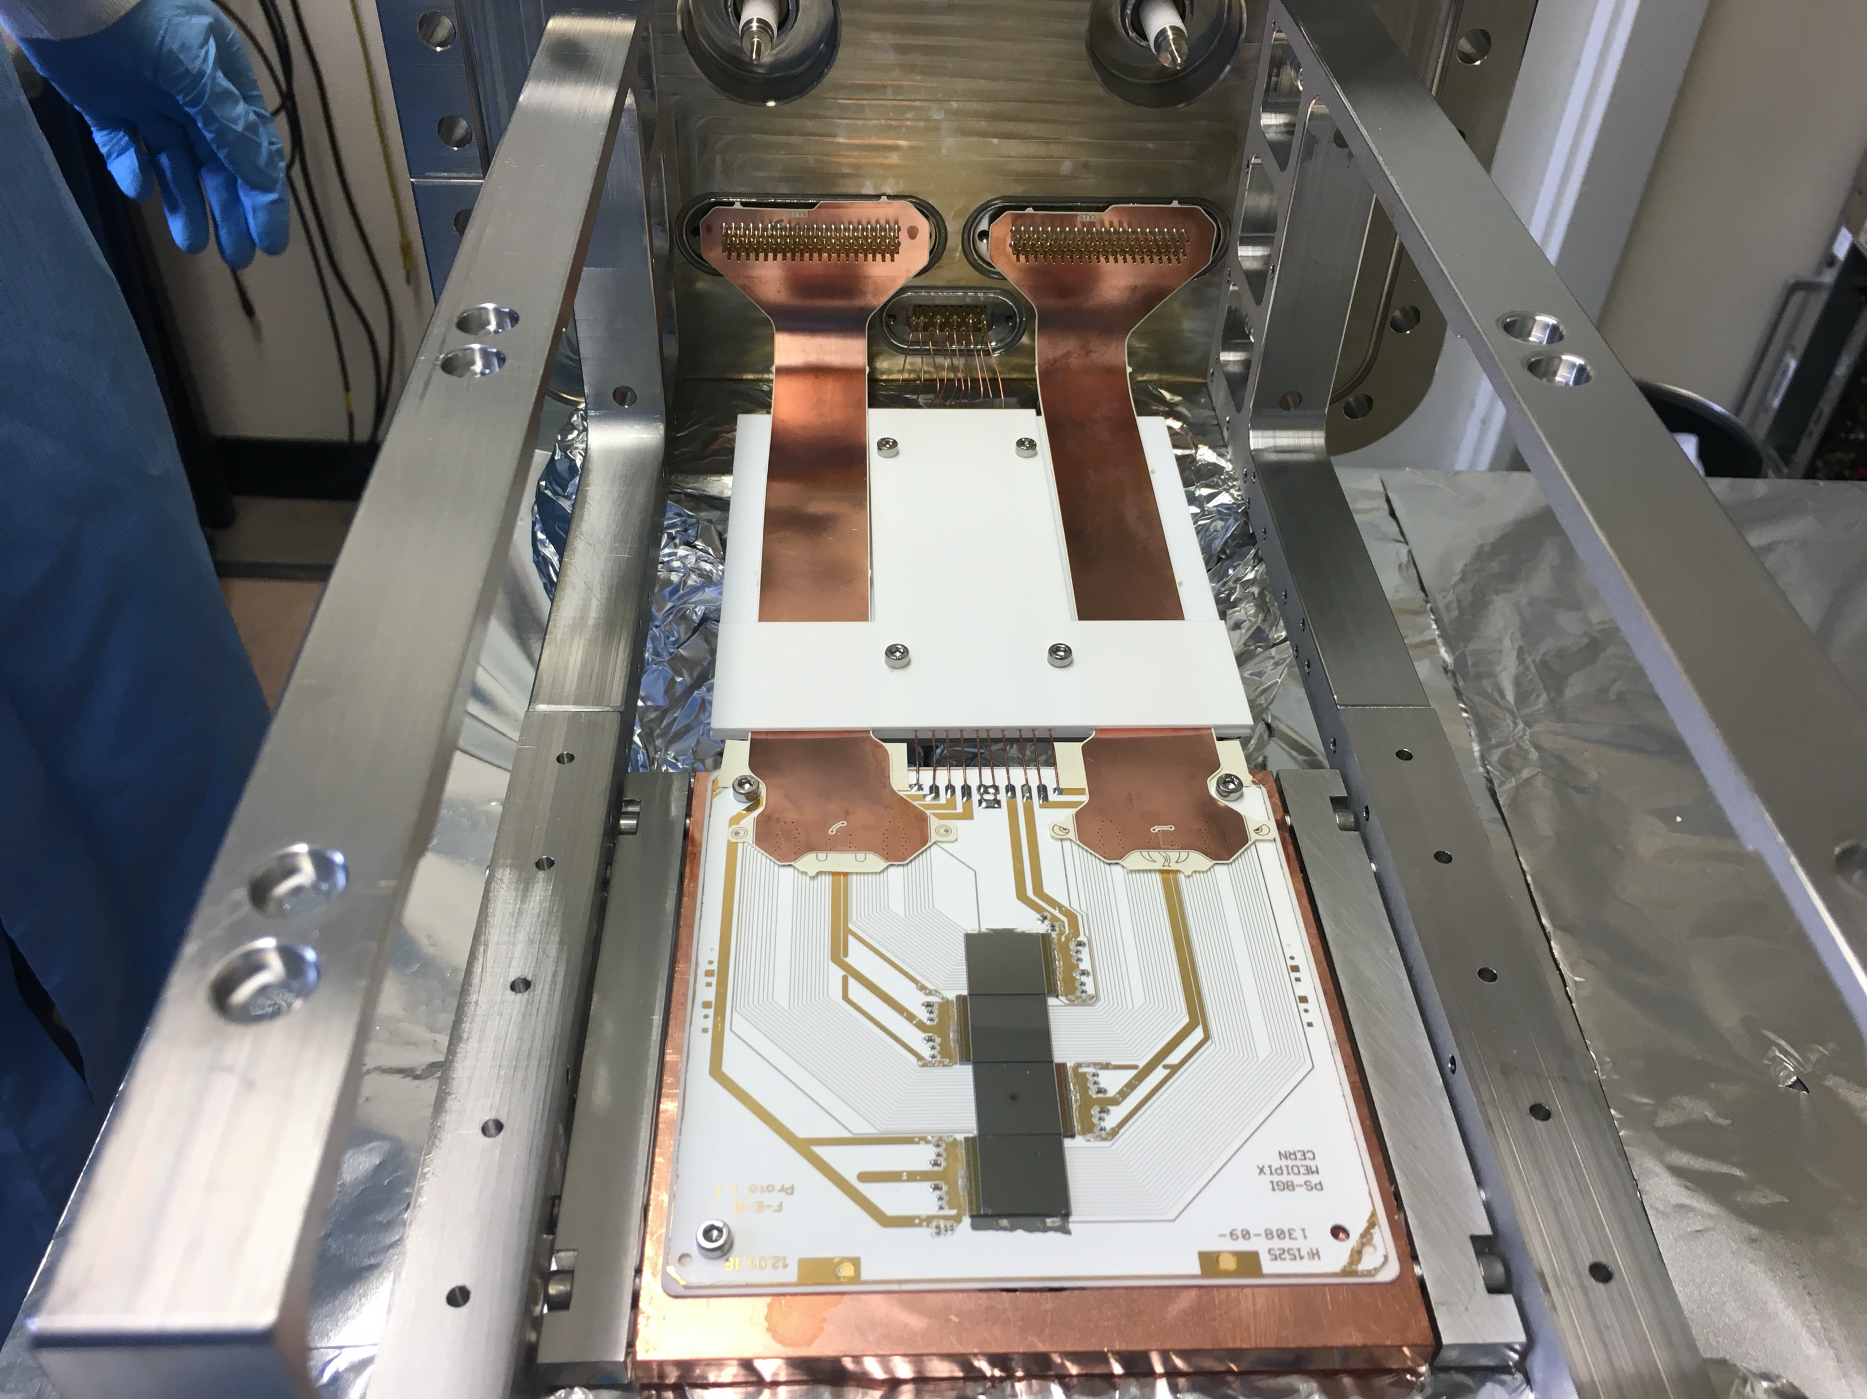
PS-BGI – How does it looks?
MKII detector (older version)

