Slide 1



Beam-beam with longitudinal impedance
E. Carideo, D. De Arcangelis, M. Migliorati, Y. Zhang, M. Zobov

Slide 2
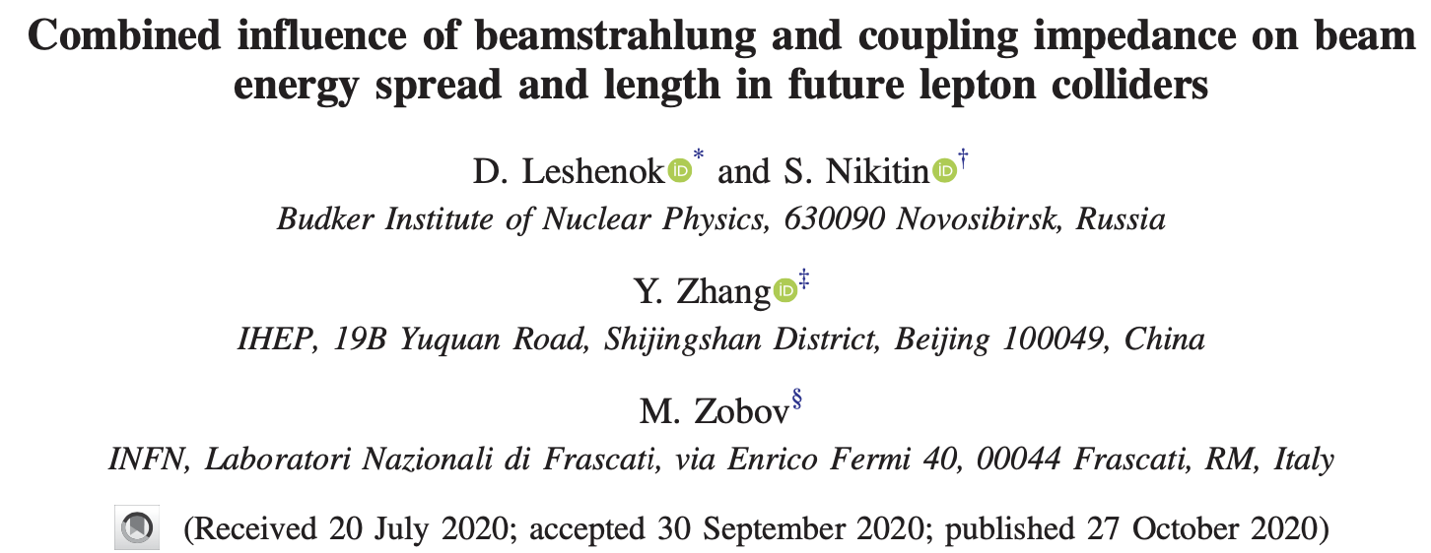
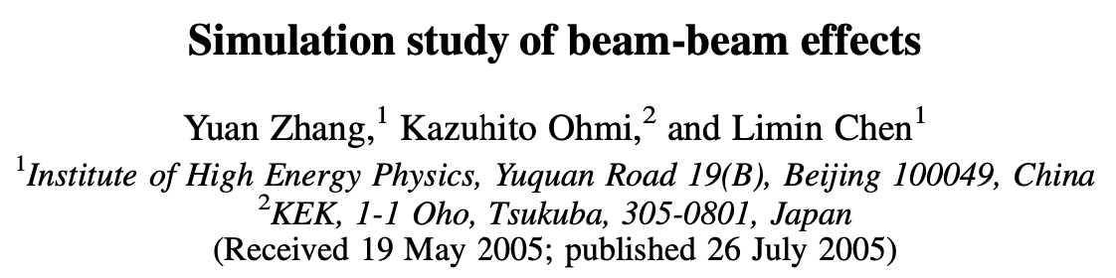
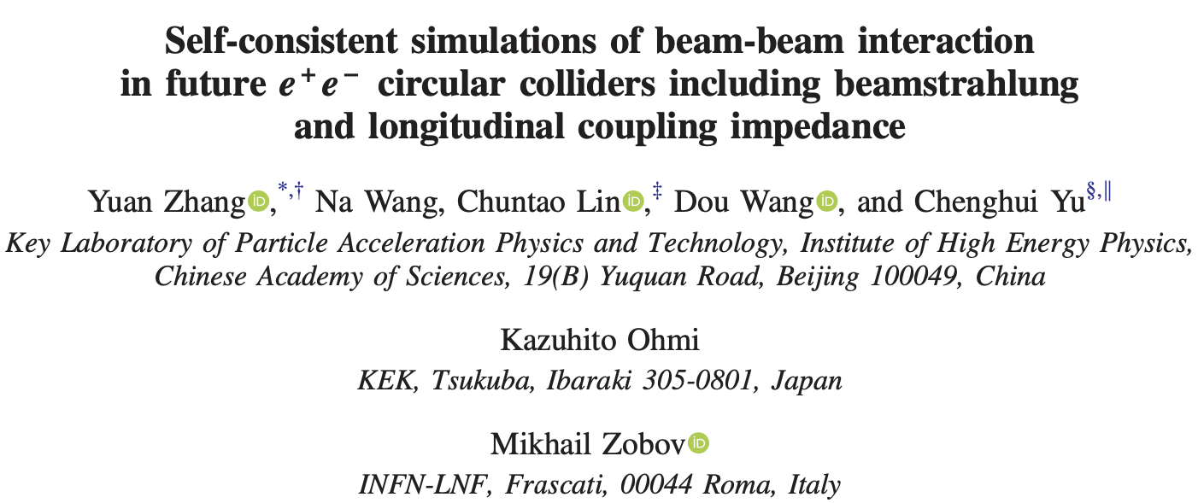
Yuan Zhang code: IBB
PRAB 23, 101003 (2020)
PRAB 8, 074402 (2005)
PRAB 23, 104402 (2020)

Slide 3
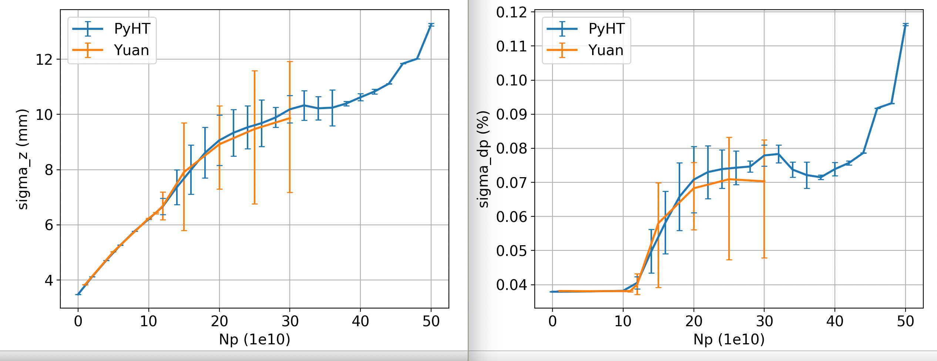
Comparisons between PyHEADTAIL and IBB

Slide 4
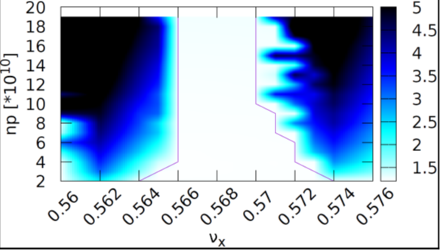
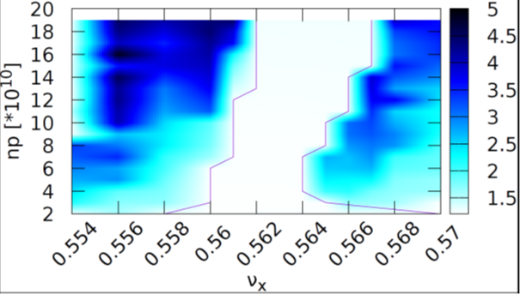
X-Z instability tune scan (blow-up of horizontal beam size)
Without impedance
RW impedance
total impedance

Slide 5
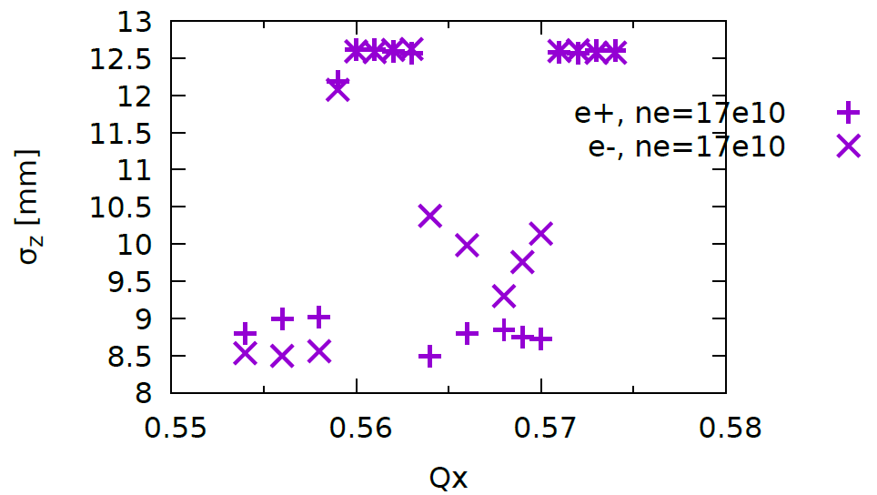
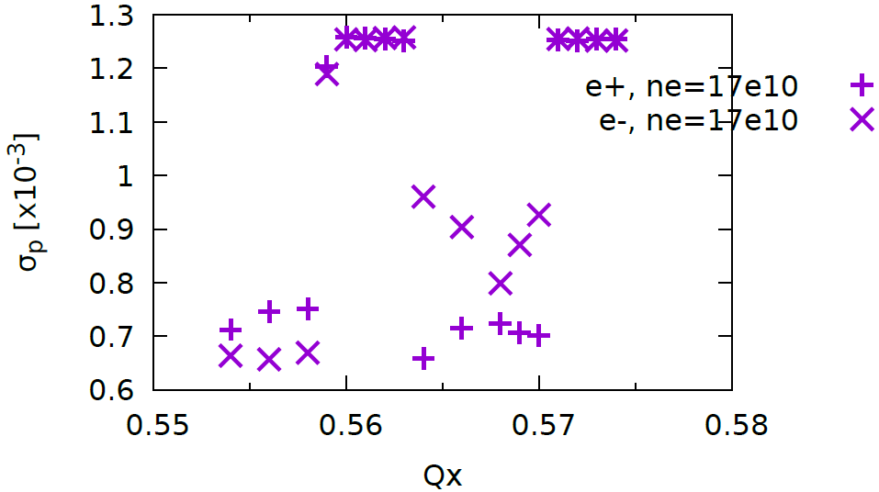
SigmaZ & SigmaP versus Qx(Ne=17e10)

Slide 6
SigmaP versus turn (Ne=17e10, Qx=0.561)

Slide 7
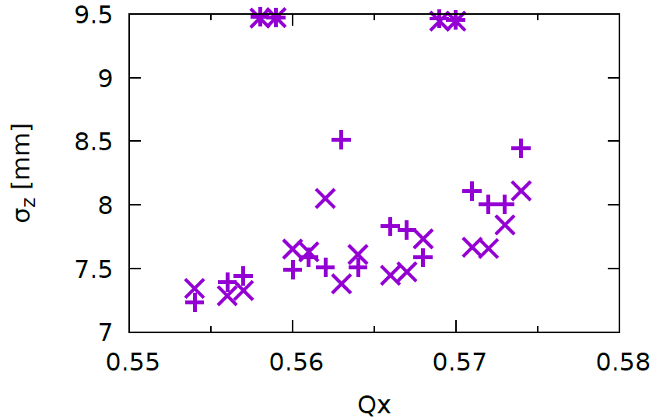
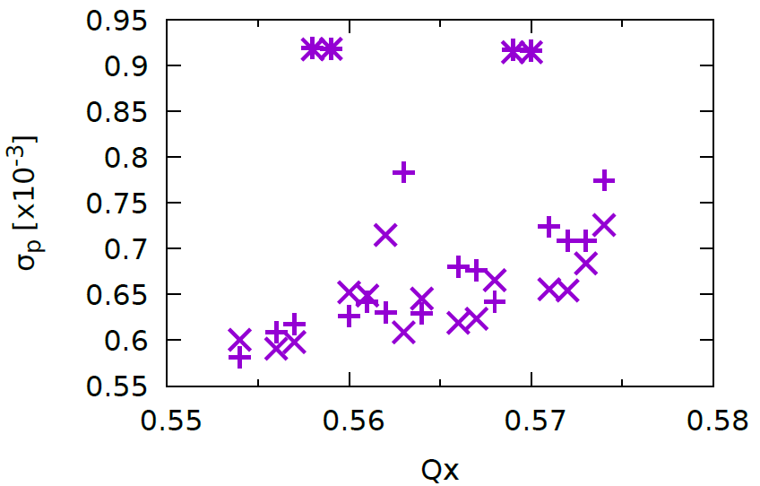
SigmaZ & SigmaP versus Qx(Ne=10e10)

