Slide 1
PyHT results and the Impedance model of Future Circle Collider (FCCee)
E. Carideo, D. De Arcangelis, M. Migliorati, Y. Zhang, M. Zobov

Slide 2
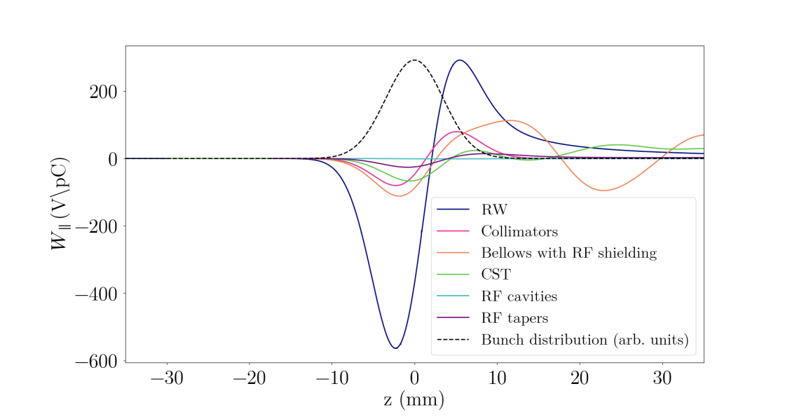
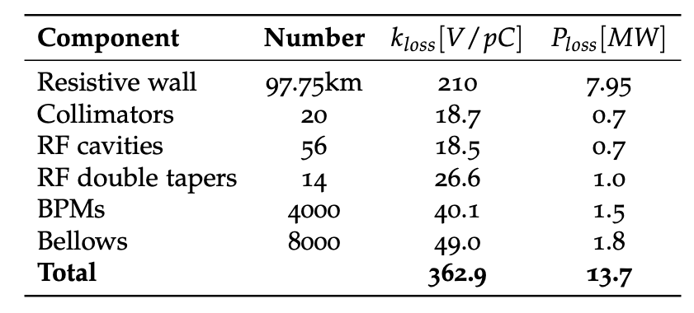
Impedance Sources (PyHT simulations)
Longitudinal wake potentials for a Gaussian bunch with nominal bunch length σ_{z} = 3.5mm due to the main FCC-ee components.
Power loss contribution of the main FCC-ee components at nominal intensity and bunch length, in the lowest energy case of 45.6 GeV
Component | Number | K_{loss}(3.5mm)[V/pC] | K_{loss}(12.1mm)[V/pC]
Resistive Wall | 97.75 km | 210 | 51.78
RF cavities | 56 | 18.5 | 9.44
BPMs | 4000 | 40.1 | 4.81
Bellows | 8000 | 49 | 4.7e-5
RF double tapers | 14 | 26.6 | 2.5116

Slide 3
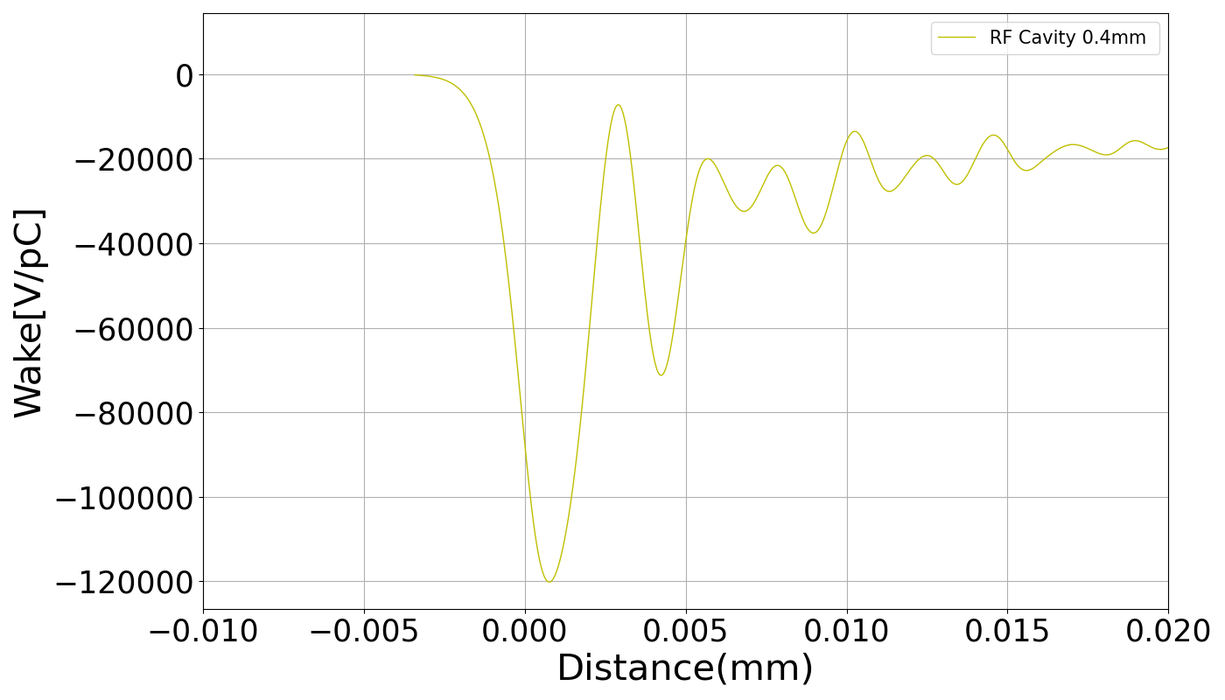
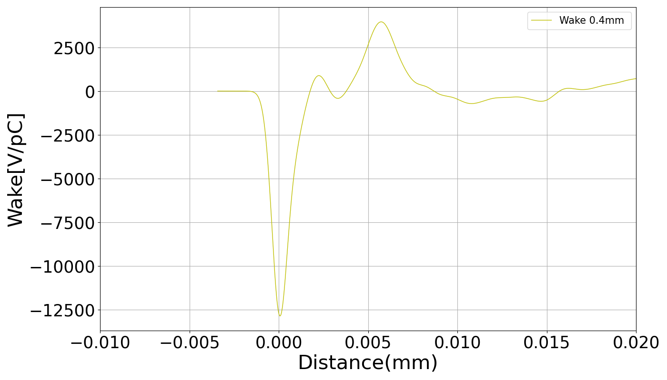
Wake potential of 0.4mm bunch length used as input for PyHT.
BPMs
RF Cavity

Slide 4
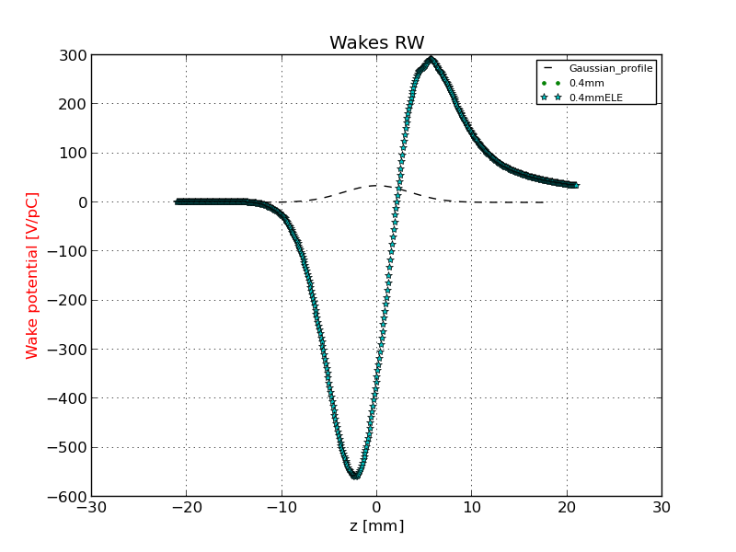
Comparison of the wake potential of 3.5 mm bunch length between PyHT and IW2D: Resistive Wall
3.5 mm
3.5 mm_IW2D

Slide 5
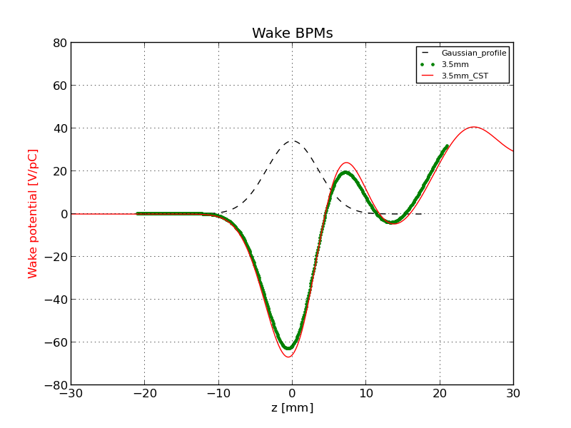
Comparison of the wake potential of 3.5 mm bunch length between PyHT and CST: BPMs

Slide 6
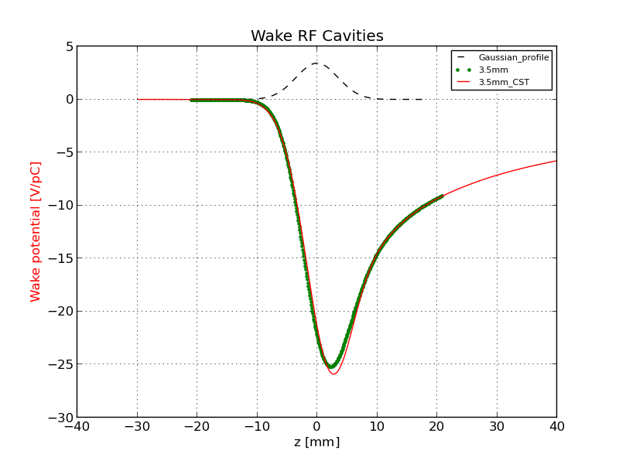
Comparison of the wake potential of 3.5 mm bunch length between PyHT and CST: RF Cavity

Slide 7
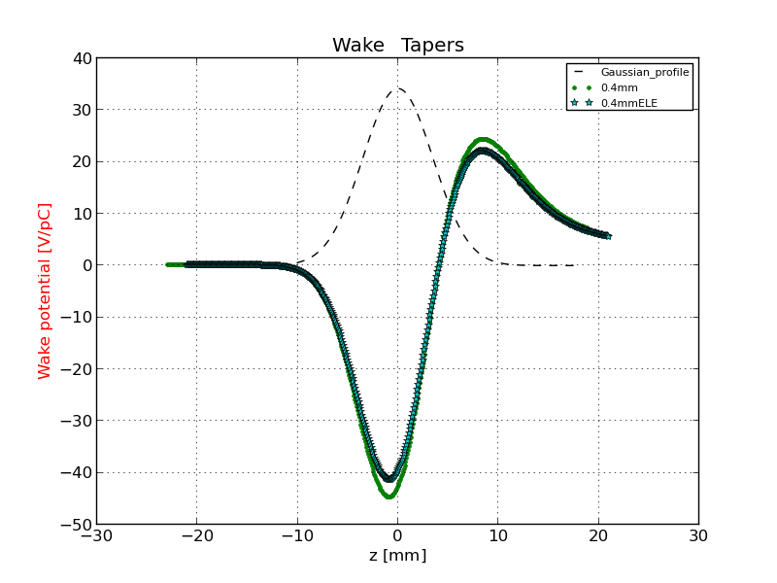
Comparison of the wake potential of 3.5 mm bunch length between PyHT and CST: RF double taper
3.5 mm
3.5_ABCI

Slide 8
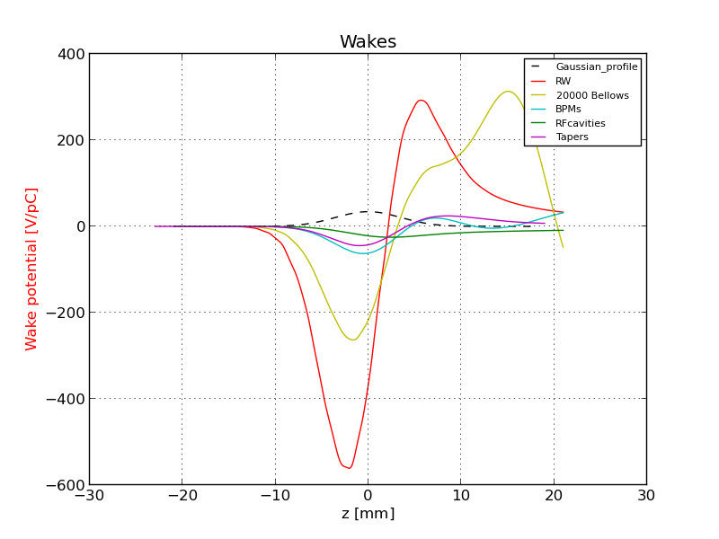
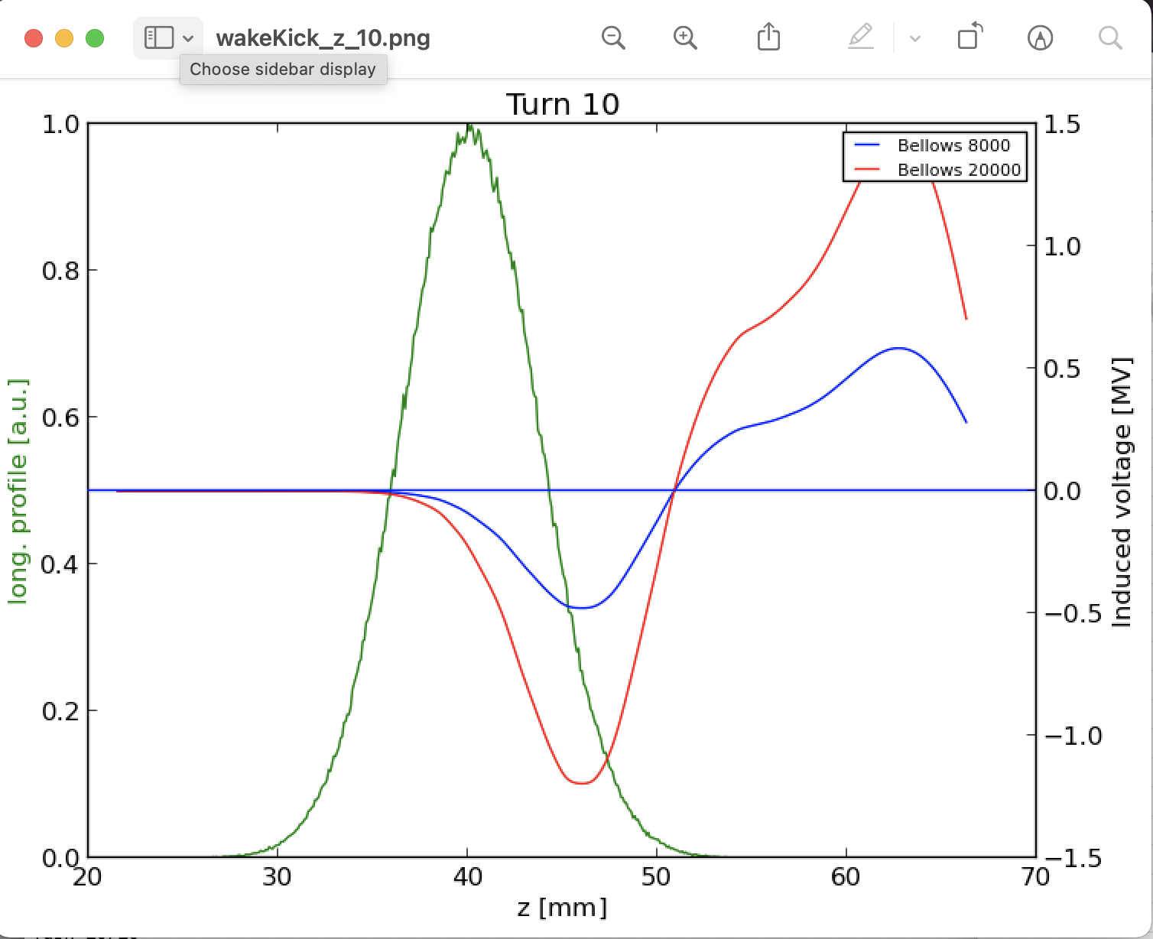
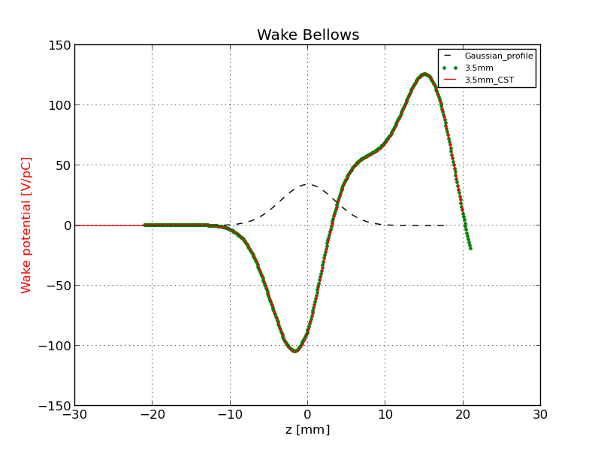
Comparison of the wake potential of 3.5 mm bunch length between PyHT and CST: Bellow
In this case we considered 8000 Bellows
BUT
85% of archs (~ 79 km)
Every arch is 8m long
X2 because we have another bellow before any quadrupole
~ 20000 Bellows

Slide 9
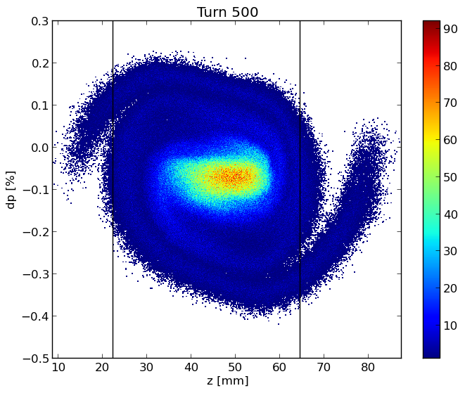
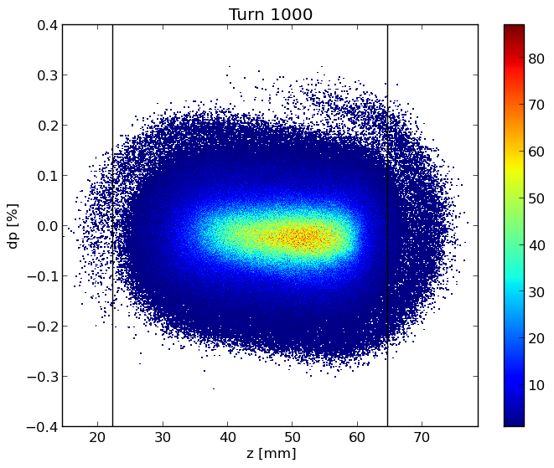
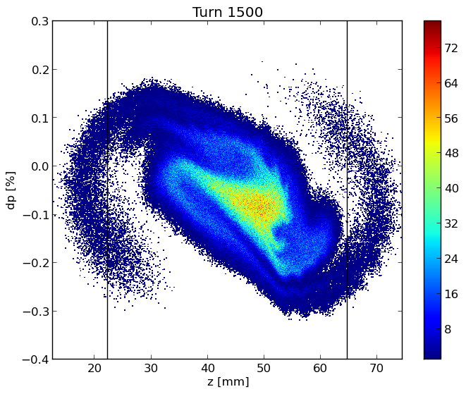
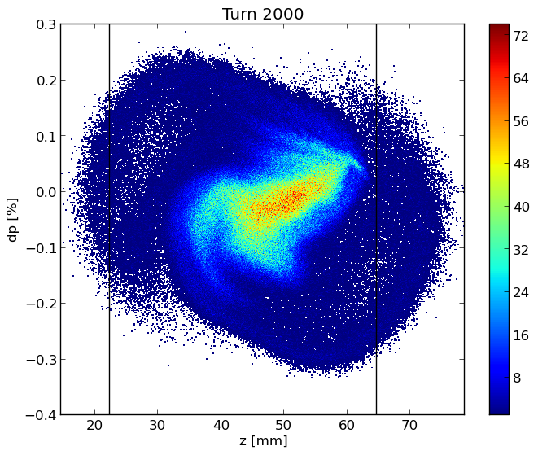
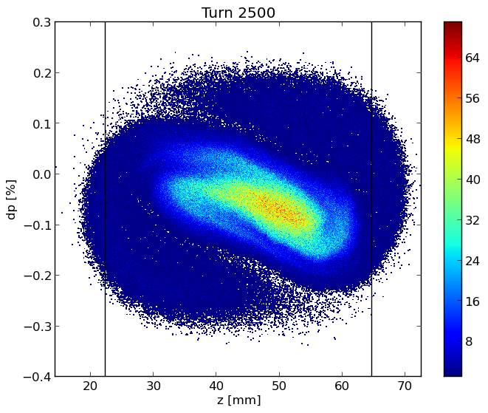
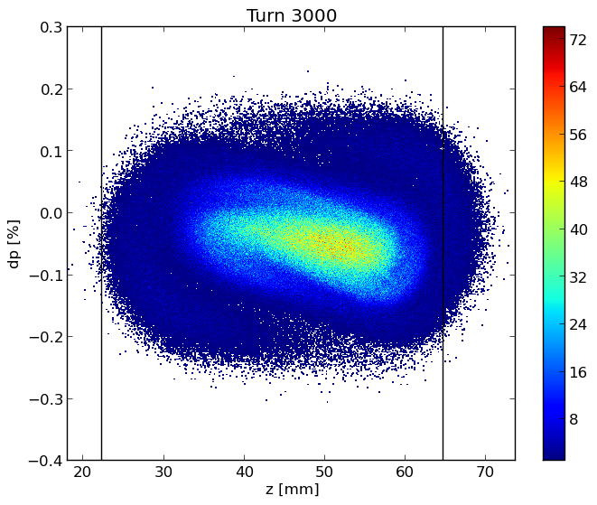
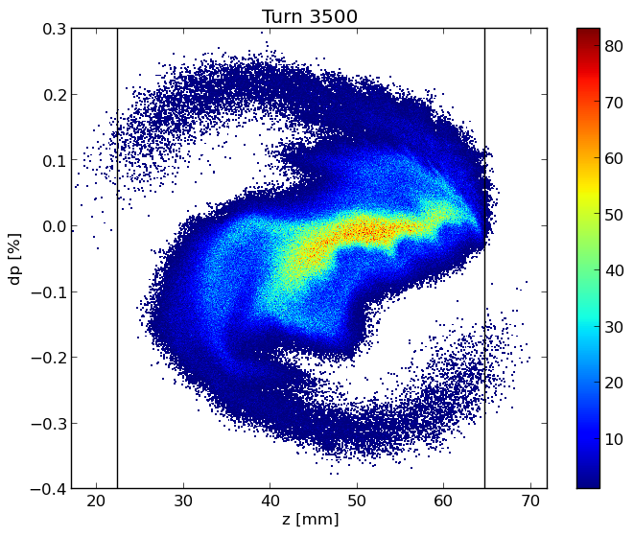
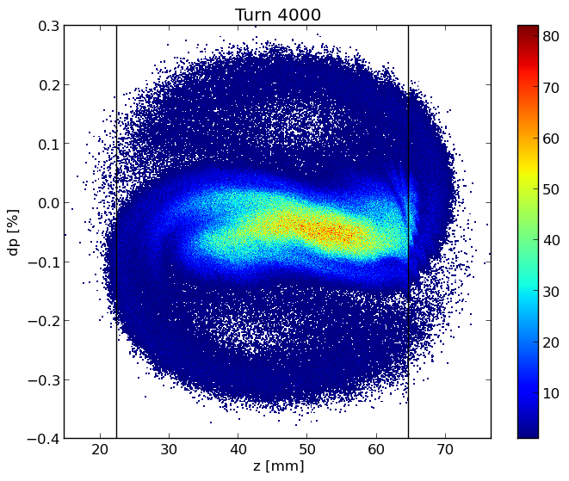
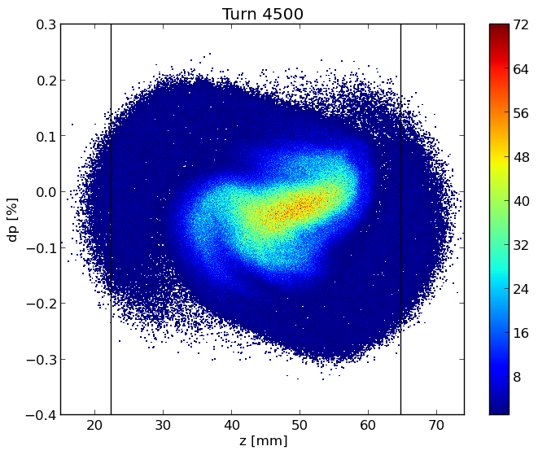
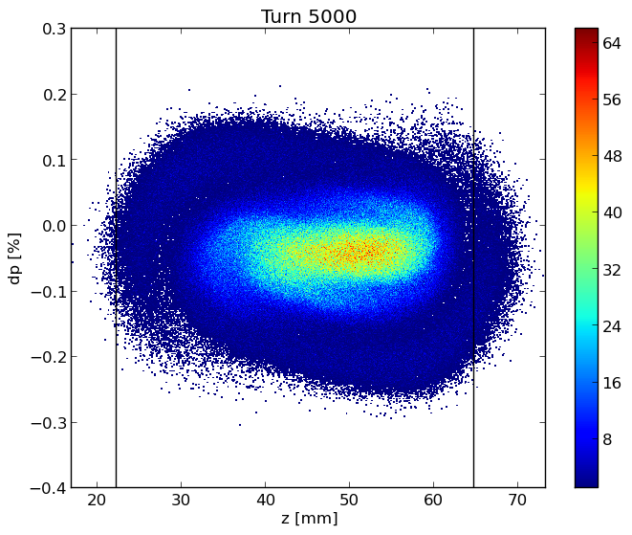
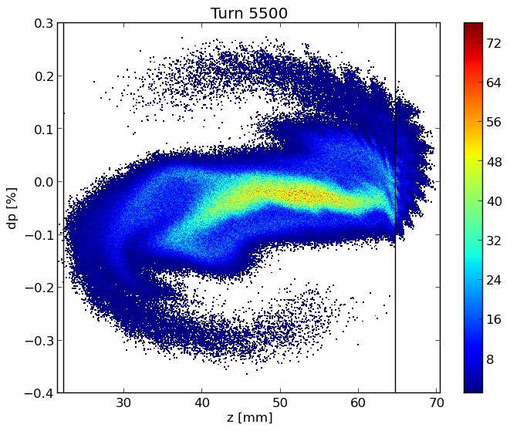
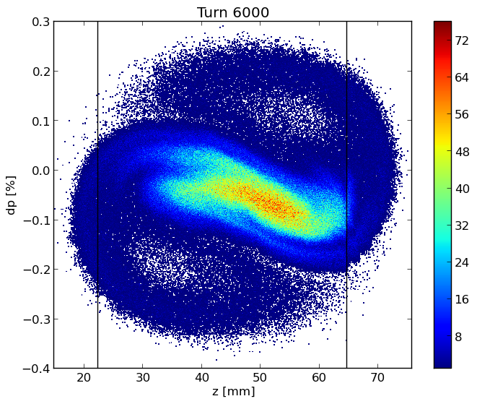
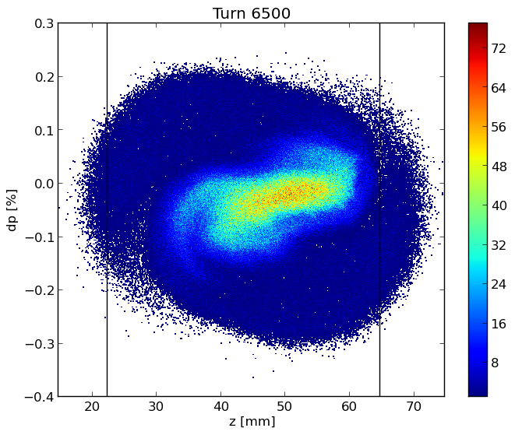
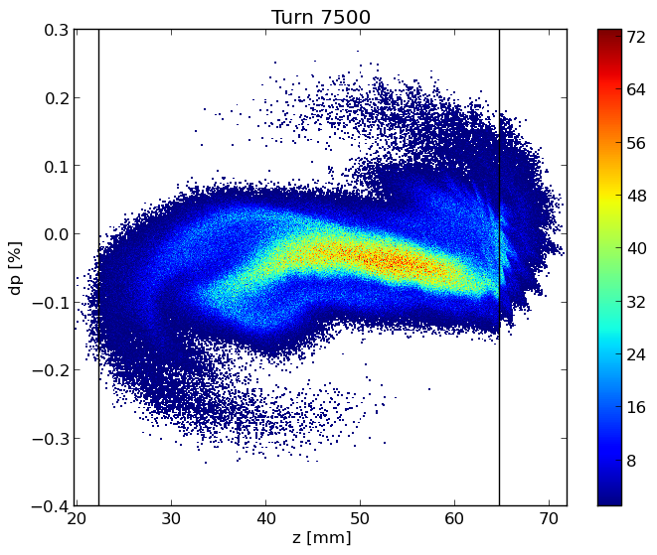
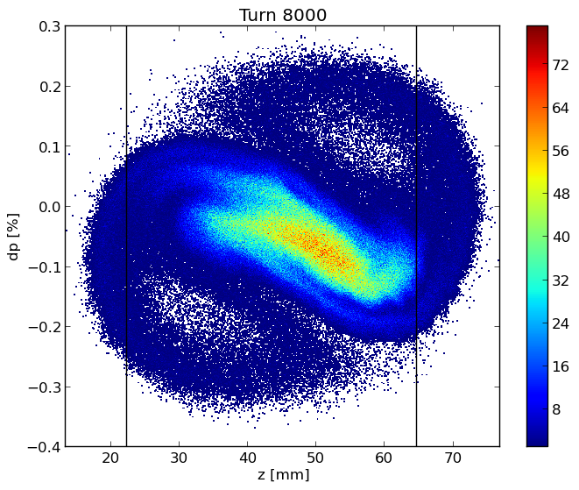
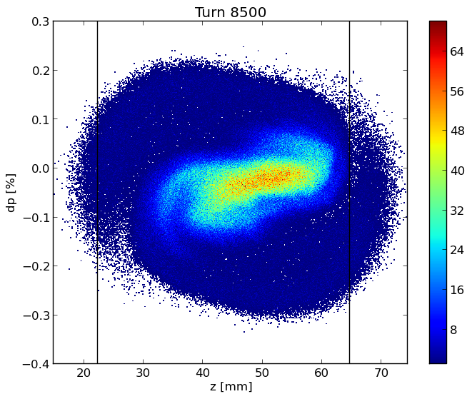
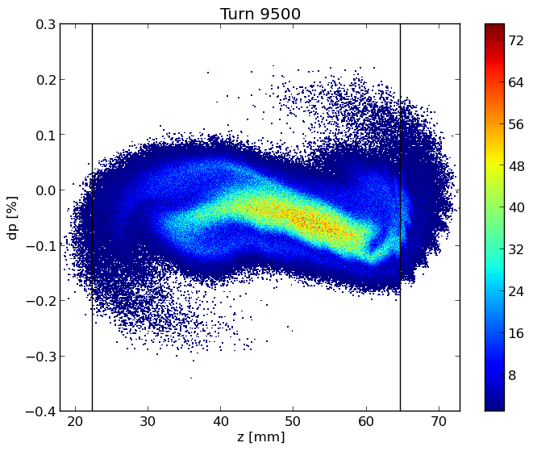
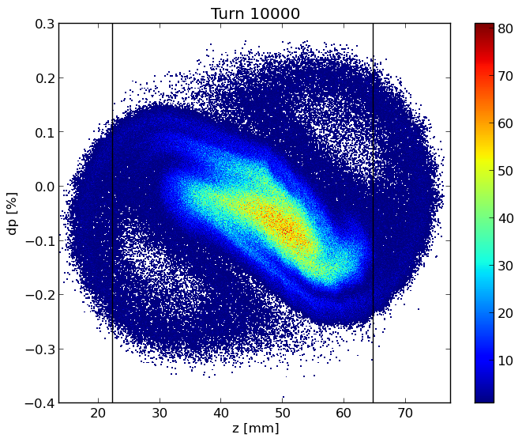
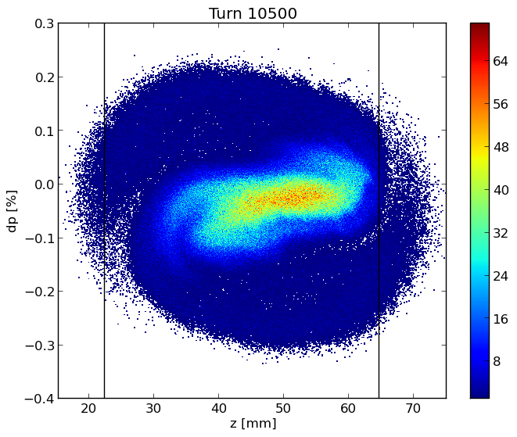
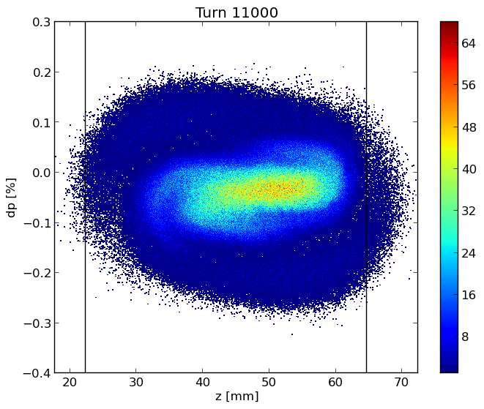
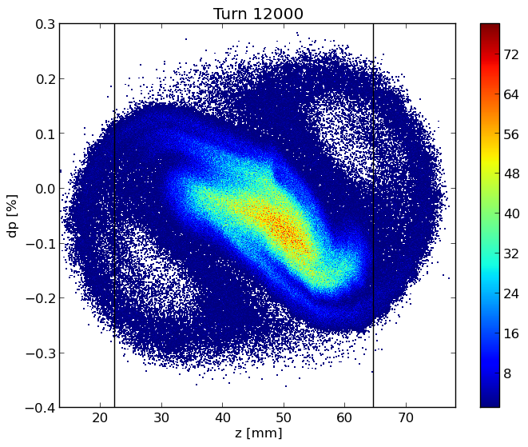

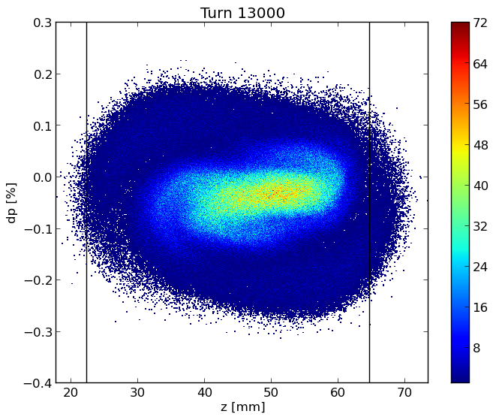
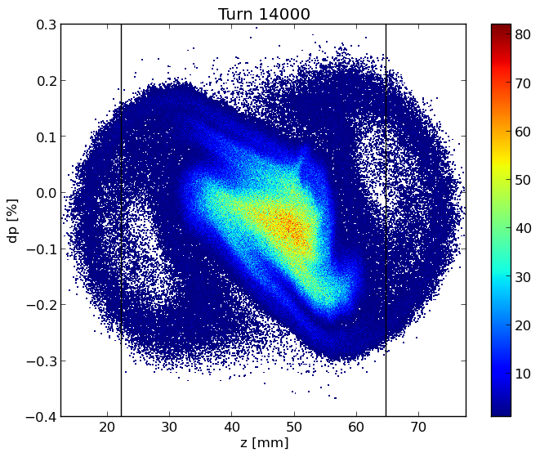
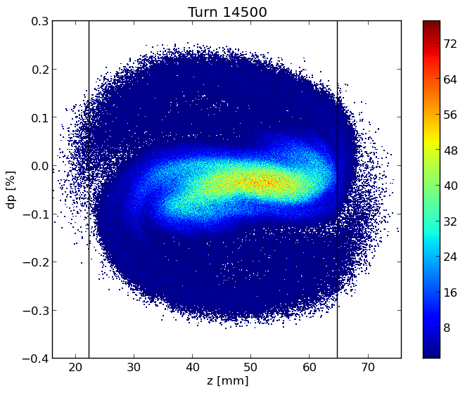
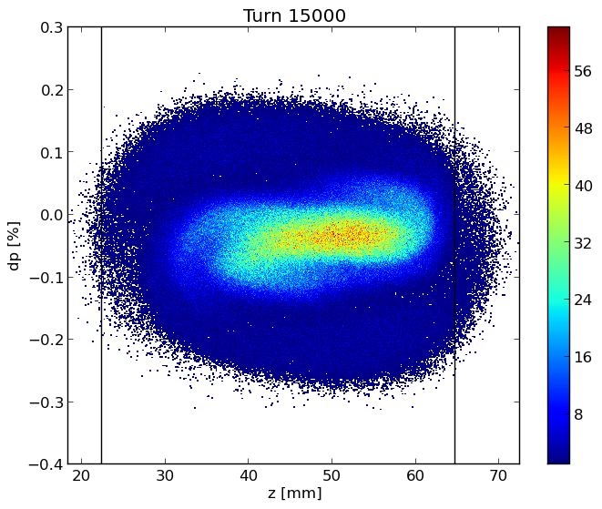
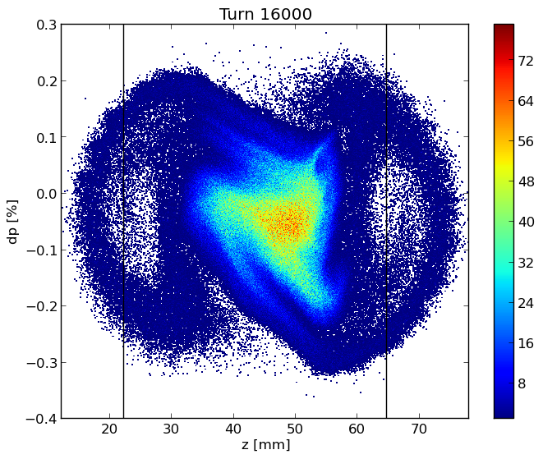
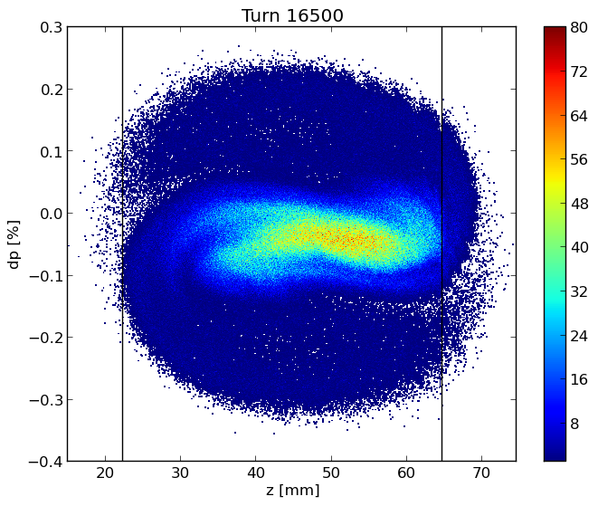

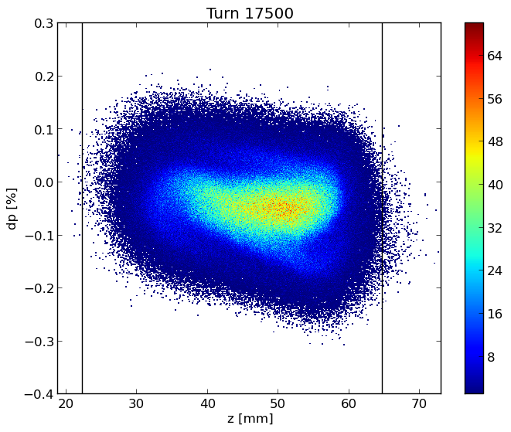
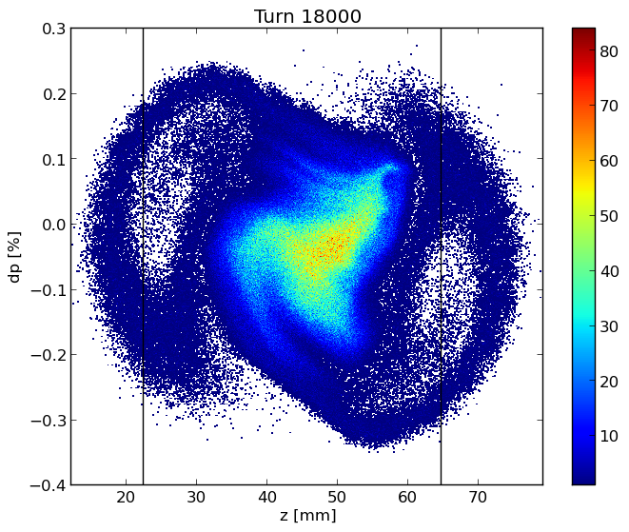
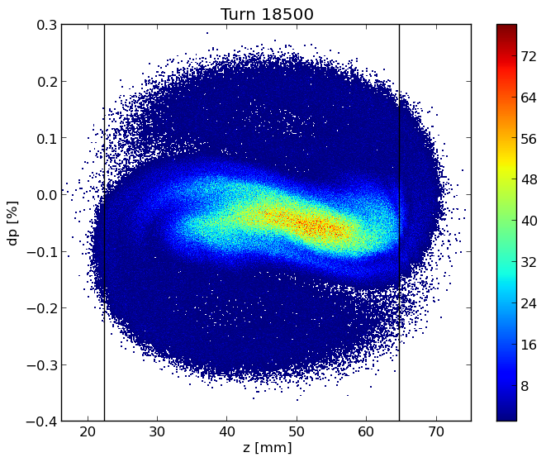
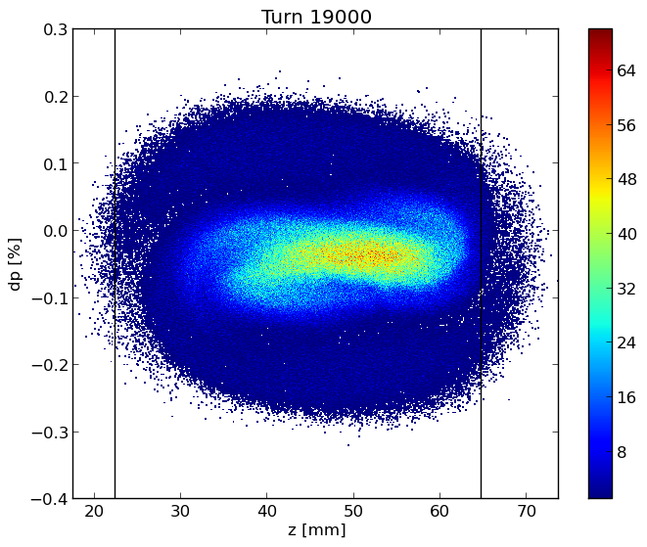
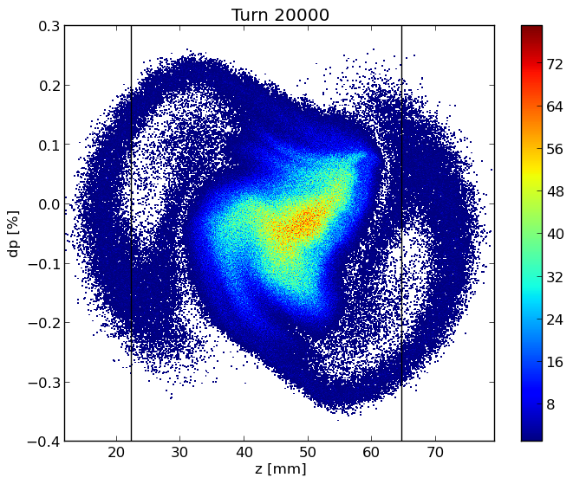
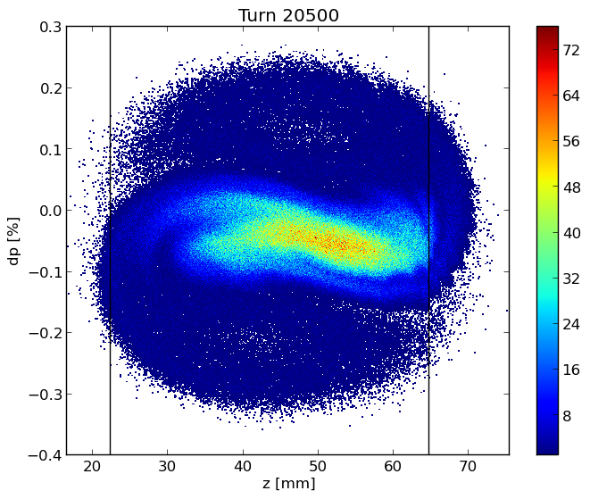
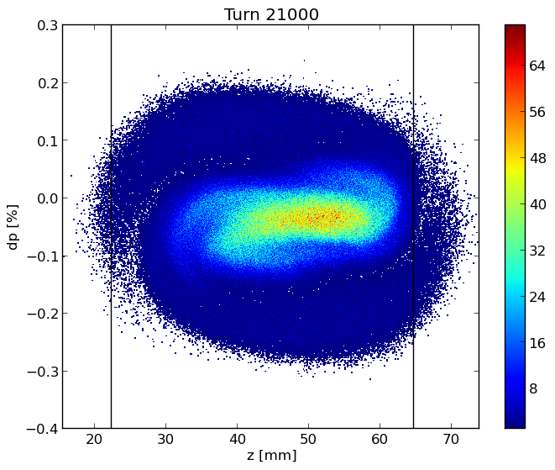
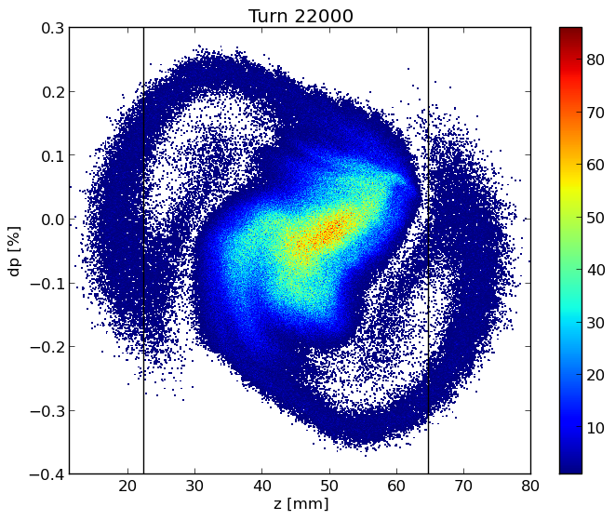
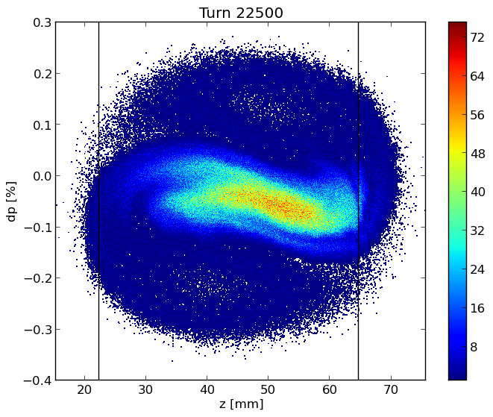
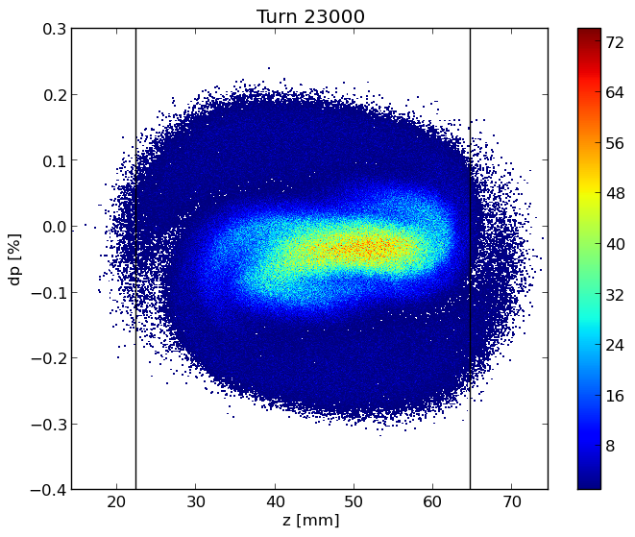
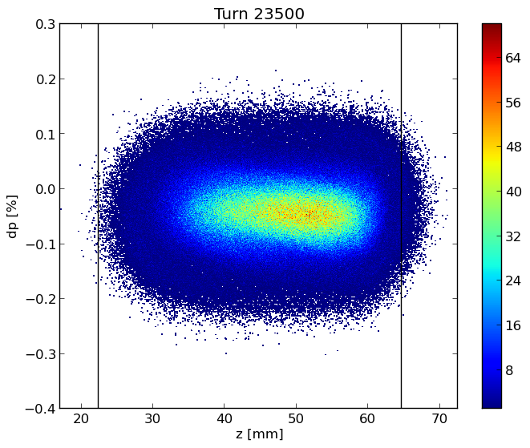
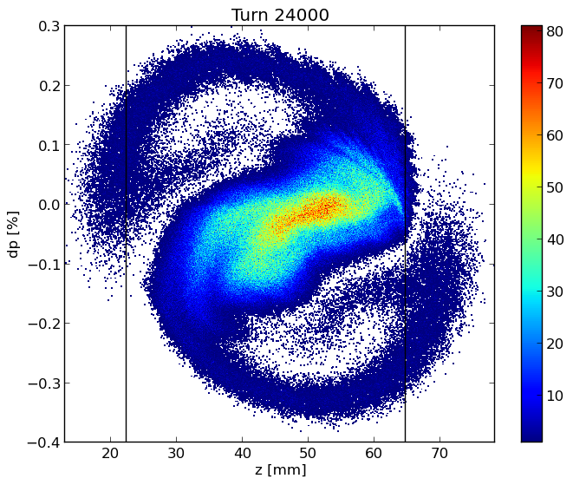












Slide 10


Single beam instabilities considering the only RW

Slide 11


Single beam instabilities take into account every elements (bunch length of 3.5 mm)

Slide 12


Evaluation of the single beam instability for different bunch length considering 20000 Bellows

Slide 13
Thanks for your attention!

