Slide 1
Optics Repository, Documentation and Product Breakdown Structure
Ghislain ROY -- 134th FCC-ee Optics Meeting
12th March 2021

Slide 2
Optics repository and Documentation
  Initial thoughts based on experience and discussions with a few people
  This talk should trigger reflexion and discussions
  You are all encouraged to contact me with your thoughts, experience, needs and requirements
Product Breakdown Structure
  A primer with timeline

Slide 3
Optics Repository
Repository : a place where we keep our common and valuable assets for FCC machine and optics design and development
Our assets are immaterial but very valuable given the efforts and work invested to ensure best performance and operability of the FCC.
  In industry we would invoke Intellectual Property.
  Although we must publish the results of our work, we do not have to make it public before publication.
Assets in the form of computer files and codes for now; later in databases
Common assets implies that within the team
they can be shared;
they shall be easily understood and mastered;
and they shall be easily used further and built upon
Loop over many years between now and FCC operation
  Asset volume and value will grow
Valuable Common Assets
Collective efforts and work

Slide 4
Optics Repository
Some pitfalls:
  Newcomers need to find their way through the data and its history; avoid losing time in induction,
  self-exploration, digging for information
  Avoid exploring a path already treaded ; document the loose ends and roadblocks
  Who remembers why we did it like this ?
  Using standardised version of the optics as firm ground for further studies (beam-beam, collimation,…) and for valid comparison between studies
Repository shall also hold pertinent documentation of the data files and the process that led to their development
  Documentation can be inline (comments to explain, guide, clarify…) or as extra files (or links)
  Documentation also needs structuring and discipline
    “JD: moved third collimator left of IP by 4cm”
    Who ? John Doe or Julia Double ? Why ? When ? Where exactly ? …

Slide 5
Optics Repository
Holds a structured set of files including the documentation
Common approach to be decided together and then enforced collectively
Quality Control to be implemented as a set of tools, and a common mindset
Optics Repository is not a dump and shall only hold valuable data
  tmp1.txt and toto.dat have no place there. Keep them in your private space if you need them. I do!
Everybody in the team has ReadOnly access
Few people, a team of librarians, have ReadWrite access

Slide 6
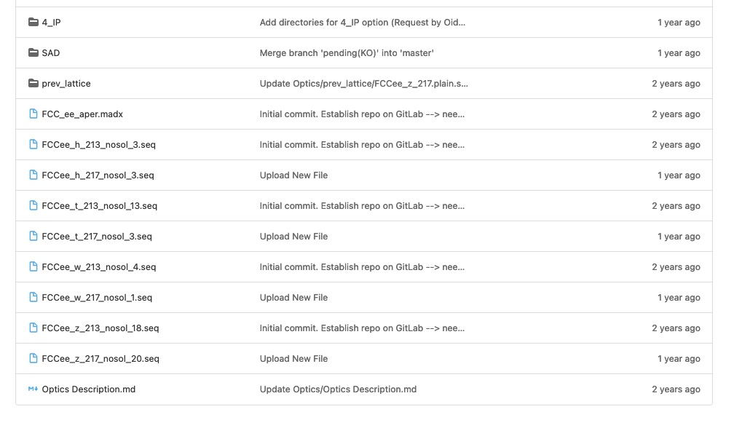
Current situation for FCC : Gitlab
https://gitlab.cern.ch/fcc-optics/FCC-ee-lattice
Needs identification
109 members in the team;
a few are “developers” with RW access
Master and two branches
Two versions of the optics
  213 (CDR) and 217 (post CDR) at 4 energies each
  Optics in one single file
  Not much more…
Gitlab is good for code development,
master is the reference set and branches are for development, exploration…

Slide 7
How many reference optics do we need ?
Name versions with “publication friendly names”
proposal: V21.02 for the second reference version in 2021
Each reference version can have multiple filesets
  4 different energies
  Multiple optics configurations ?
  no ramp or squeeze as in LEP, but do we want detuned optics as well ?
  2 beams and therefore 2 sequences;
  but also two machines in some parts and different excitation sets.
  but avoid the beam2 paradigm of LHC !
  2 IP’s vs 4 IP’s
  Thick lenses vs thin lenses
  Study or MD optics
Define the mandatory sets and the optional parts
Define the directory tree.

Slide 8
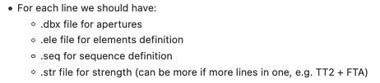
Good practice and return on experience
Avoid single file with everything
Split optics and machine description in several files with “engineering” view
  Element definitions ; “just the hardware”,
  with classes of elements and mechanical characteristics (length, basic aperture)
  QD: Quadrupole, L=1.6, apertype=ellipse, aperture={0.3,0.1}
  Symmetries of excitations; “no values, just logic”
  for example when two magnets are connected to the same bus-bar.
  KQS0.L2 := KQS0.2 ; KQSQ0.R2 := KQS0.2
  Excitations of circuits; “Here be values !”
  KQS0.2 = 0.3792
  Layout as Line or Sequence description; “only the geometry !”
    Line description for conceptual studies, exploiting repetitions and symmetries… but define drifts !
    Sequence descriptions have no drift but need to know precise positions
  Specialised files: marker sets, instrumentation, detailed aperture models, solenoids, impedance…

Slide 9
Good practice and return on experience
Optics files must be complemented with
  Test jobs (madx | numdiff or other tools)
  Sample jobs (MAD-X or SAD)
Sample jobs
  are used for example to build special configurations,
  e.g. tapering, installing solenoids, loading imperfections, install specific observation points, etc…
  Can serve as “tutorial material” and are easily reused by cut and paste
  in MAD-X or SAD language ; but avoid the HUGE macro libraries of LHC…
MAD-8 had a SAVE / RELOAD feature to dump a binary representation of a machine (CPU dependent) and later reload it. This saved some time and ensured consistency across studies.

Slide 10
Good practice and return on experience
Tests are mandatory to evaluate the state of a development
and ensure quality control before a new version is officially released.
Provide specific MAD-X or SAD jobs with standardized results that can be validated, either internally or through post-processing. Automated process !
Examples:
  Closure of the ring, basic Q and Q’ values, optics functions at IP, optics functions at other specific locations (eg cavities, BI…), SR parameters at specific locations…
  e+ vs e- ; thin optics vs thick optics …
  Run SAD on translated MAD-X files; check results; run MAD-X on re-translated SAD files; check results
  Translate to SAD and optimise momentum acceptance; check results
Tests provided by you as well !!

Slide 11
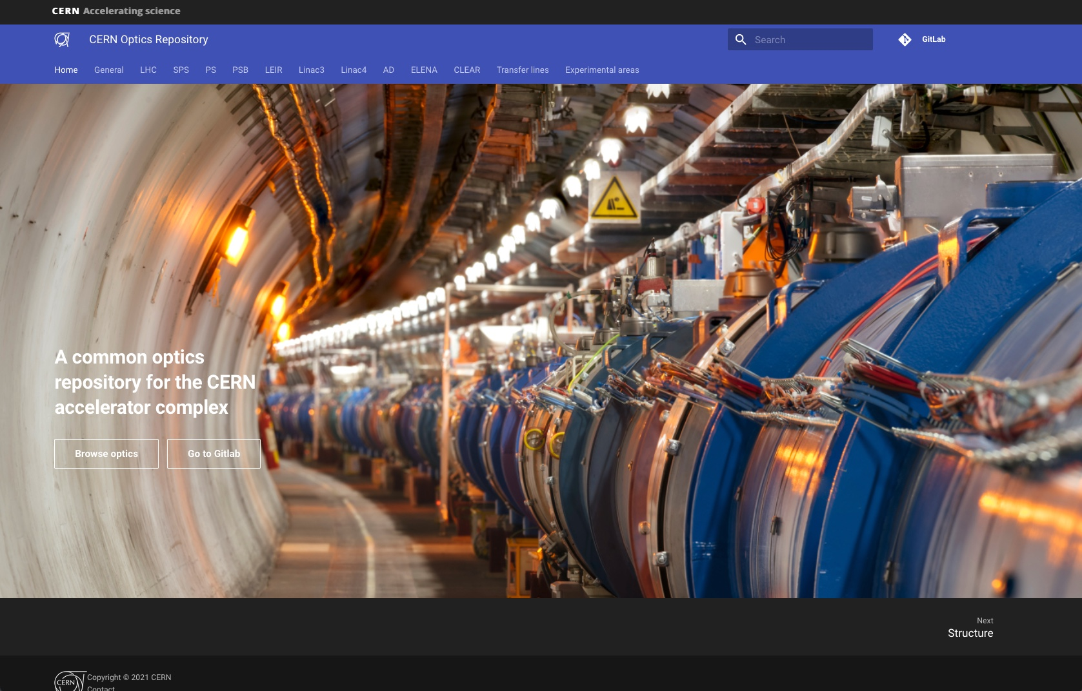

Slide 12
CERN Optics repository https://acc-models.web.cern.ch/acc-models/
Based on Gitlab
Documentation and website files also stored on Gitlab
Website generated from files on Gitlab, including MAD-X output files for plots…
Git clones of optics files are provided for easy linking through AFS and EOS:
  /afs/cern.ch/eng/acc-models/
  /eos/project/a/acc-models/public
  ‘Call, file=“/eos/project/a/acc-models/public/…’ in a MAD-X job
Most everybody probably goes to website for info and reference values,
and calls EOS files from their MAD-X jobs for their studies.
No Git cloning necessary unless you develop a new branch…

Slide 13
FCC Optics repository
Based on Gitlab
Web interface for information retrieval and browsing
Links of stable reference versions on AFS and EOS
Documentation and website stored in Gitlab
Based on standard IT-provided tools as much as possible
Owned and maintained by service accounts and e-groups
Complemented by a review procedure…

Slide 14
Reference Optics sets
When a new reference set is ready for publication
AND it passes all the tests…
Organise a review (special FCC-ee optics meeting ?)
where everyone contributes to QC evaluation (is anything broken in their studies ? are there any adverse effects?),
including a review of the associated documentation (clear and useful ?).
When the review is positive the new set can be published on Gitlab (either as merge or as a new master version), appears on website and is linked on EOS and AFS
Procedure to be written and agreed upon.

Slide 15
Extension of repository
The repository shall be extensible to
  FCC-ee Booster
  Transfer lines
  FCC-hh
The repository shall also be extensible to specialised and linked studies
  Aperture model
  Collimation studies
  Machine Detector Interfaces
  Impedance model
  …

Slide 16
Plans
This presentation is meant primarily to trigger reflexion and discussion;
nothing is fixed at this point….
Next steps are:
Further collect your thoughts, needs and requirements
Build a “demo” website for FCC-ee based on existing files on Gitlab
Deploy the links on AFS and EOS through automated process
Setup a branch on Gitlab for a first “engineering” revision of the latest “217 2-IP nosol” optics, in view of standardising elements (e.g. magnet lengths)
This last point is not just an OCD but is needed for the PBS.

Slide 17
Product Breakdown Structure
Milestone in WP2 ; due on 1st July 2021
Draft version for “engineering check” in early June
Initial effort now,
to be established as a process on the medium term through the feasibility phase
Huge task needs kickstarting

Slide 18
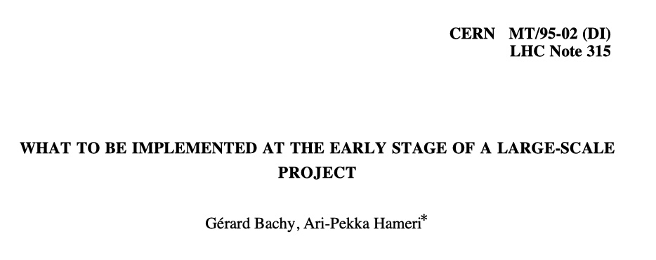
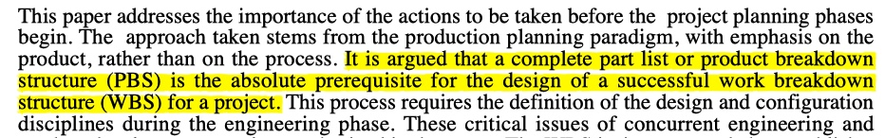
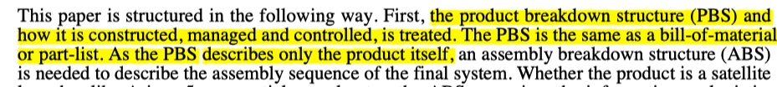
What is a PBS ?

Slide 19
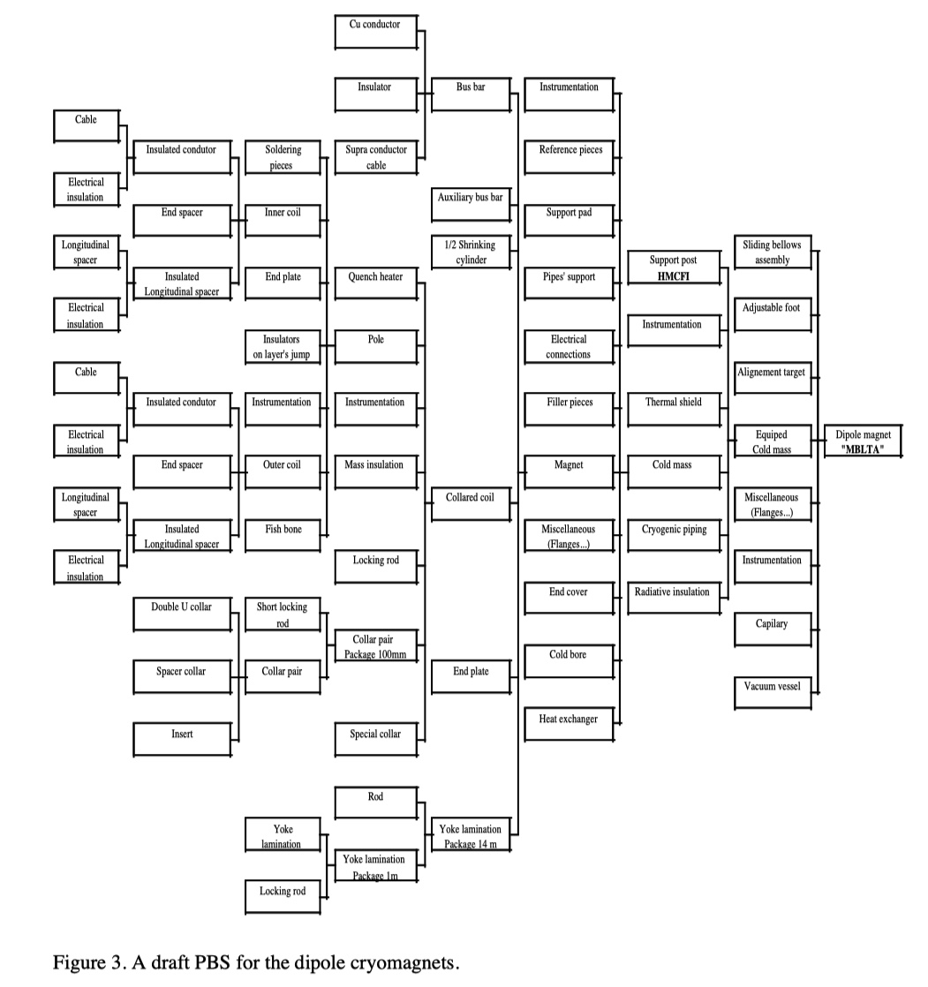

Slide 20
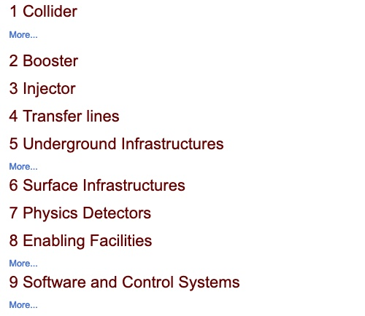
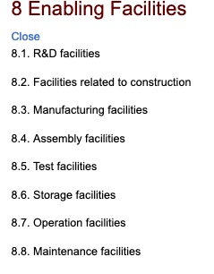
FCC-ee PBS… at top level

Slide 21
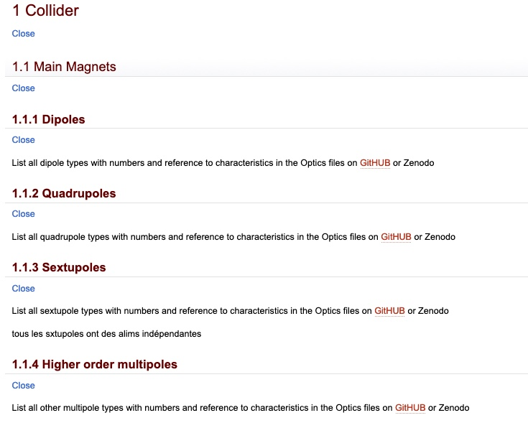
FCC-ee PBS
Cannot provide everything in a such a short time…
But we can
  structure the top level tree
  start exploring the “collider” branch
  for a given configuration (e.g. ttbar)
  down to the individual elements in the MAD-X sense
  Hence why we need an engineering revision of
  the optics with standardisation of elements
  List all elements required on and around the beam lines
  (beam pipes, vacuum equipment, instrumentation)
  Start involving equipment groups for completeness
  at equipment level

Slide 22
FCC-ee PBS
Long term effort which needs to take into account
  Naming conventions
  Databases and documentation systems (EDMS, CDD…)
  Standard engineering processes at CERN
Start with a Web and Excel-based representation
  Elements
  Number of instances
  Basic characteristics
  Requirements (eg powering, cooling, controls, DAQ…)
Involve all accelerator support groups
Involve all accelerator equipment groups

Slide 23
FCC-ee PBS
Work has started…
Optics team mostly involved through the collider description at element level
Any help is welcome !

