Slide 1
HL-LHC Hollow Electron Lens (production) kick off meeting
HEL Overall design
13.04.2021
Diego Perini EN-MME
On behalf of WP5 team

Slide 2
Outline
HEL configuration. Design choices.
Assembly procedures - Tolerances.
Conclusions.
Work carried out under the WP5 HL study
Collaboration with:
  LUAS Kemi (Fin), design,
  FNAL, general development, gun,
  BUT 北京工業大學 (Beijing), cathodes.

Slide 3
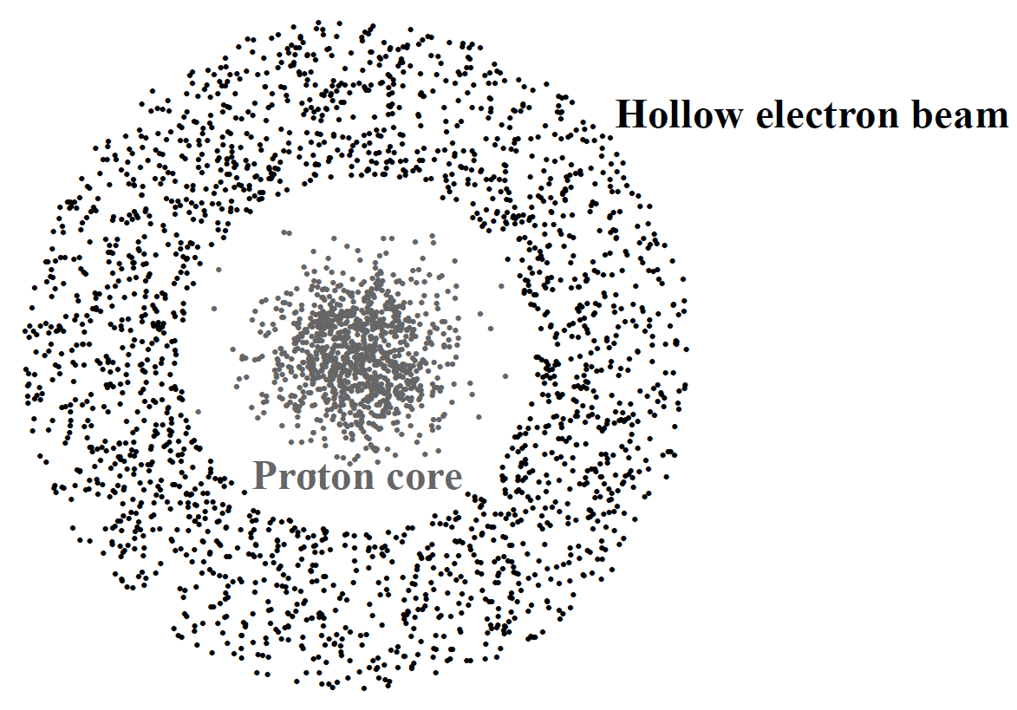
Functional specifications
beam-beam overlapping: ~3m
e current intensity: up to 5 A
use at injection and at collision level => different ring size
Ø ~ 2.2 mm
In terms of design this means that:
The working electron current is about 5 times larger than in the previously designed similar equipment. Large cathode, high compression -> high magnetic fields.
The tuning of the beam size during operation is a challenging requirement. The easy way to change the beam shape is to change the cathode (but it is not possible for this application).
6 years ago we started from far and zero resources.
The HL-LHC HEL was a new, complex device.
Today it is just complicate.

Slide 4
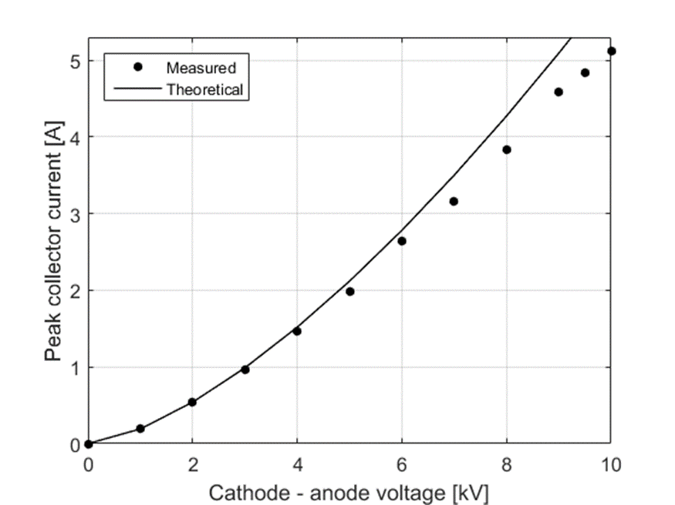
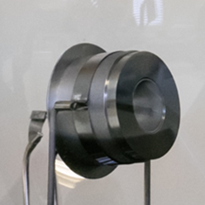
Two axis of development
Find adequate cathodes and design an electron gun able to deliver the required current.
Design a magnetic system able to drive the electrons along the correct path and able to tune the electron ring size.
BVERI (Beijing)
G. Stancari (FermiLab)
Where r₀ and r₁ are the radii of the electron beam in point 0 (cathode) and 1 (main solenoid) and B₀ and B₁ are the magnetic field in points 0 and 1 respectively.
Importance of a sound, robust system of magnets (large margin, easy protection). No R&D, just build and use. An often quenching system is not compatible with HL-LHC operations.

Slide 5
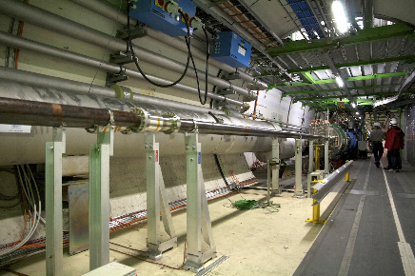
Constraints due to the location
The electron lenses will be installed in RB-44 and RB-46 at Point 4, on each side of the interaction region IR4.
The beam to beam distance is 420 mm. The QRL and other services are just beside.
The longitudinal available space is limited.
Compact design
Elegant way to say that there will be little space for the hands during assembly. Importance of the details.
We went far in the design to be sure that it can be assembled.

Slide 6
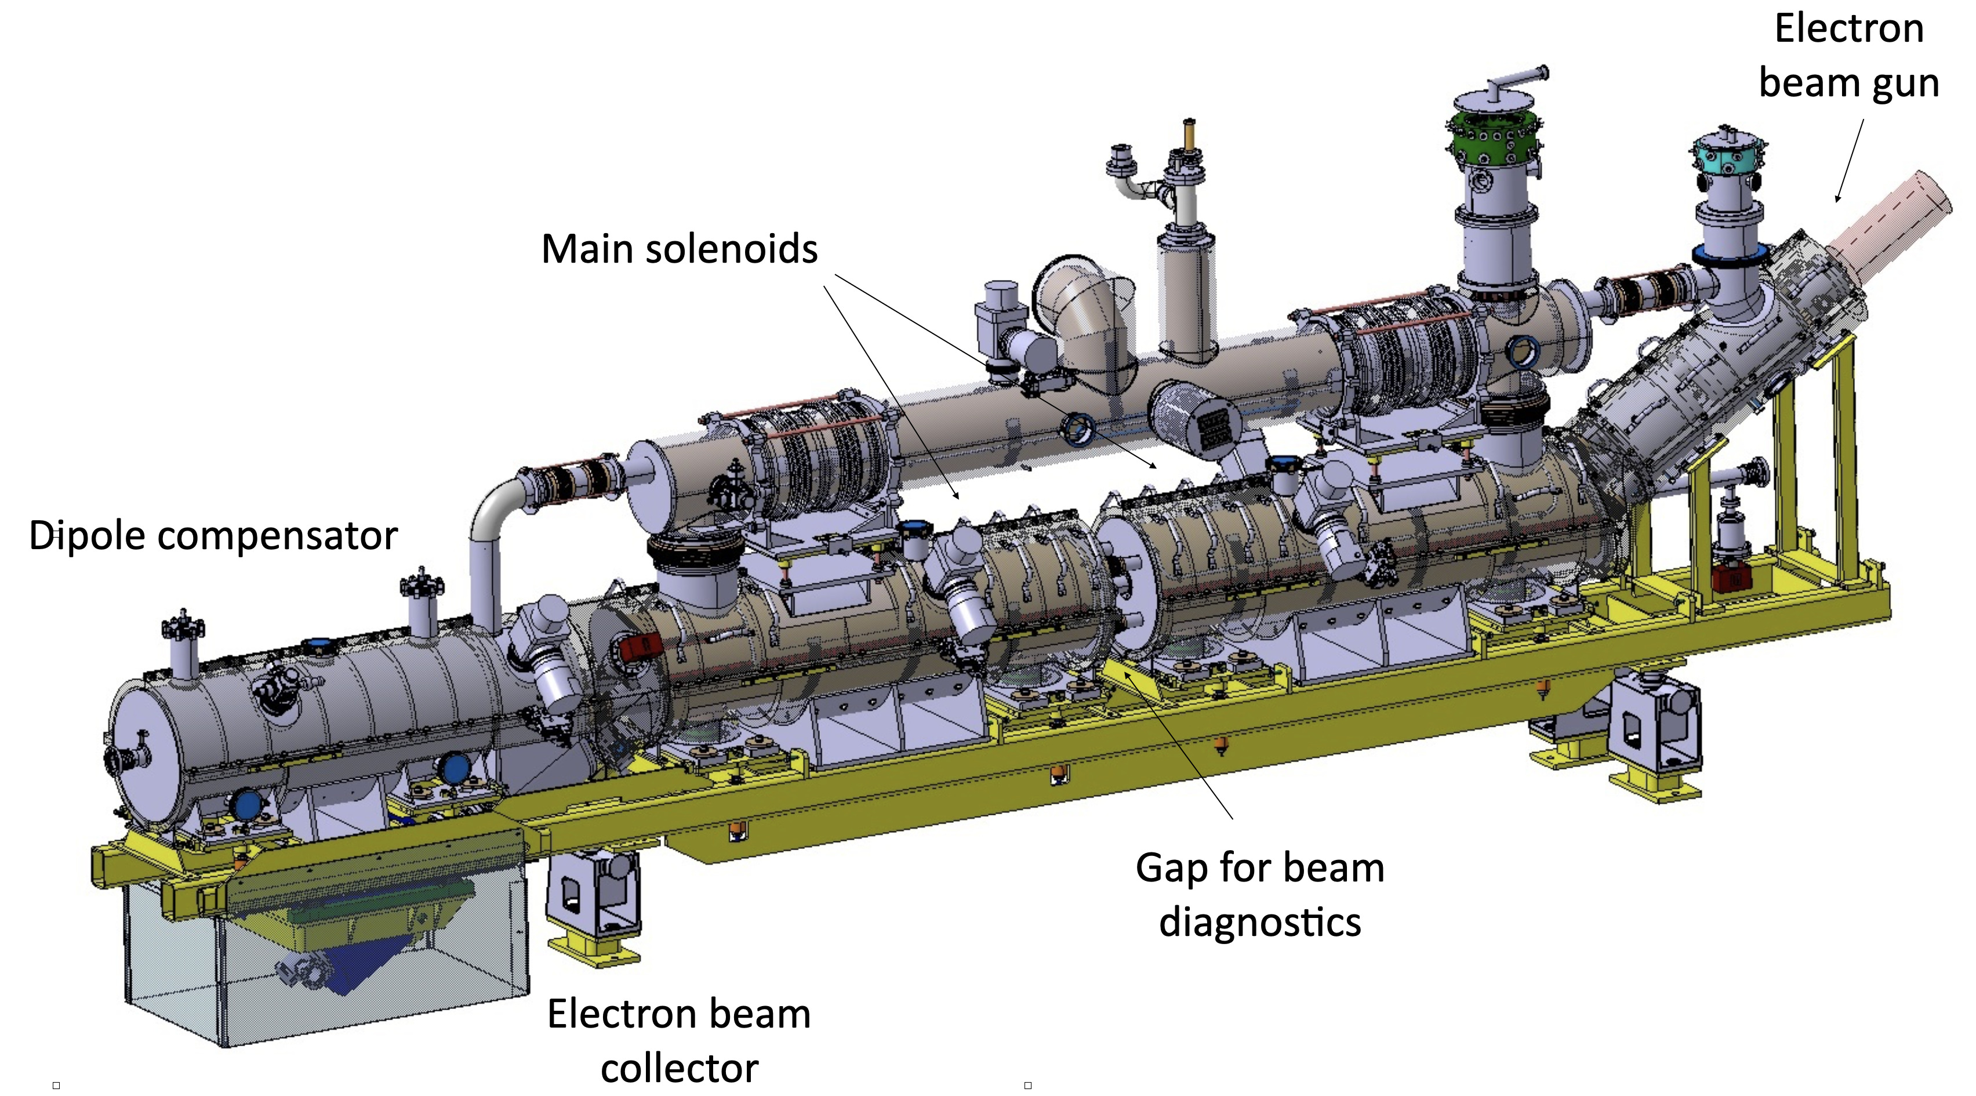
The electron beam is generated by an e-gun.
A system of superconducting solenoids cooled at 4.5K defines the magnetic field to tune de size and steer the trajectory of the electron ring.
Electron ring
Electron beam
LHC beam
This is a short superconducting transfer line

Slide 7
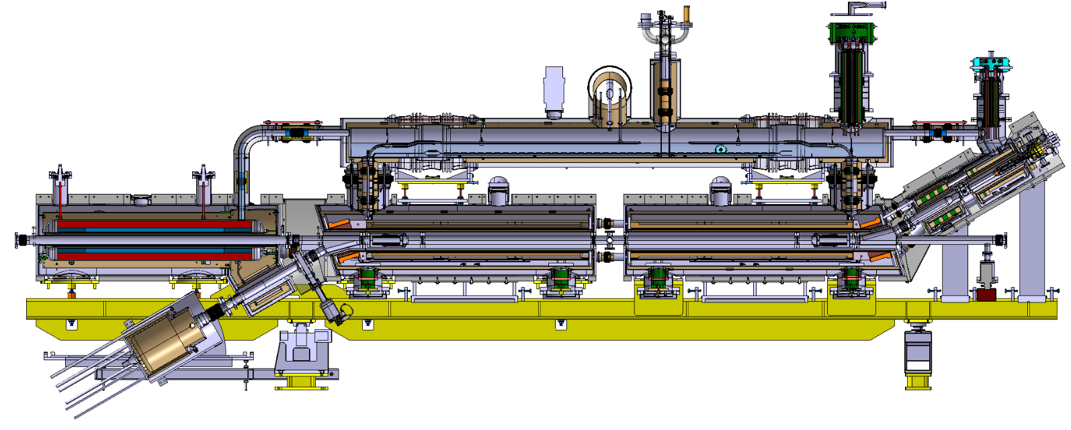
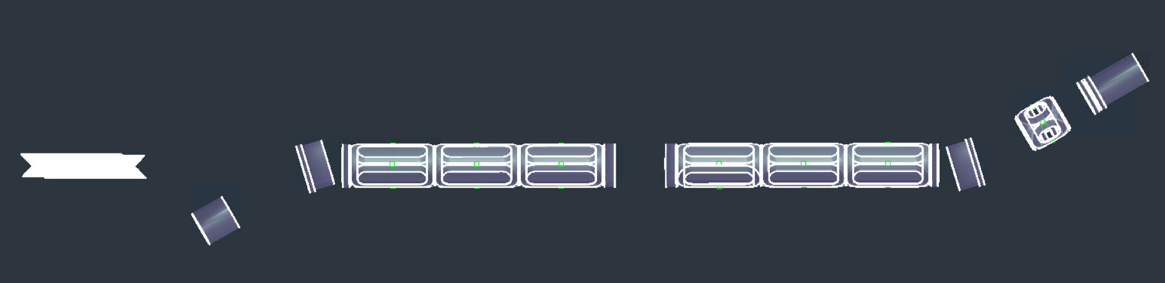
A. Kolehmainen
A. Foussat

Slide 8
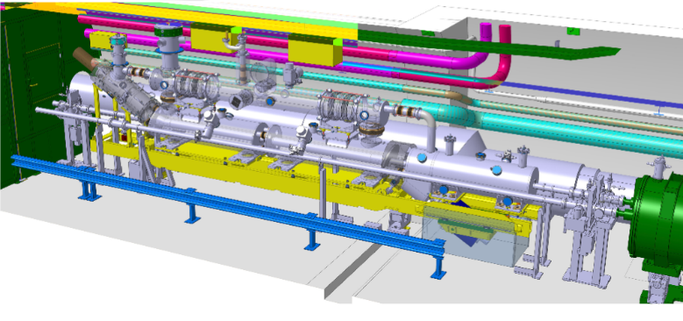
João Oliveira
Importance of the details. It fits but very little space all around. Compromise on survey precision (?).

Slide 9
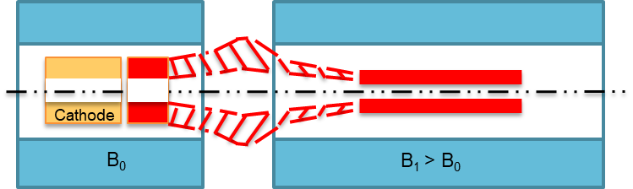

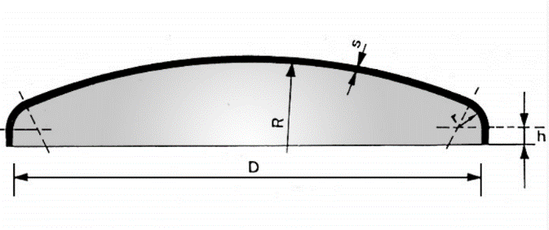
Fringe field and electron trajectory
Solenoids must be as close as possible but there are room temperature components in between some of them.
High attraction between adjacent solenoids > Connection bars.
No space for domes at the end of the He tanks, just plates as thin as possible > Attention to the nominal operating pressure.
Little space for hands and tools during the assembly.
Little space for the central BGM.

Slide 10
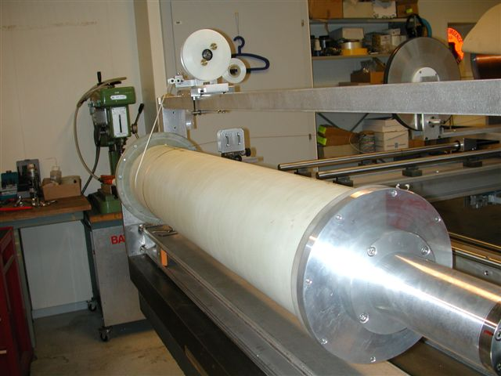
Property | Specification
Main solenoidal field | 5 T
Inner cold bore radius | 80 mm
Inner warm bore radius | 60 mm
Warm beam aperture radius | 30 mm
Range of gun solenoid field | 0.2 – 4.0 T
Magnetic compression factor range | 1.1 – 5
Target compression factor for 7 TeV operation | 3.7 (0.375 T at gun)
Range of collector solenoid fields | 0.2 – 0.4 T
NbTi wire: 1.65 mm x 1.05 mm
insulated.
Cu:SC ratio = 4:1.
AEGIS solenoids
Robust solenoids, very similar to AEGIS system (happily working since more than 10 years).
A. Dudarev, D. Perini
2010

Slide 11
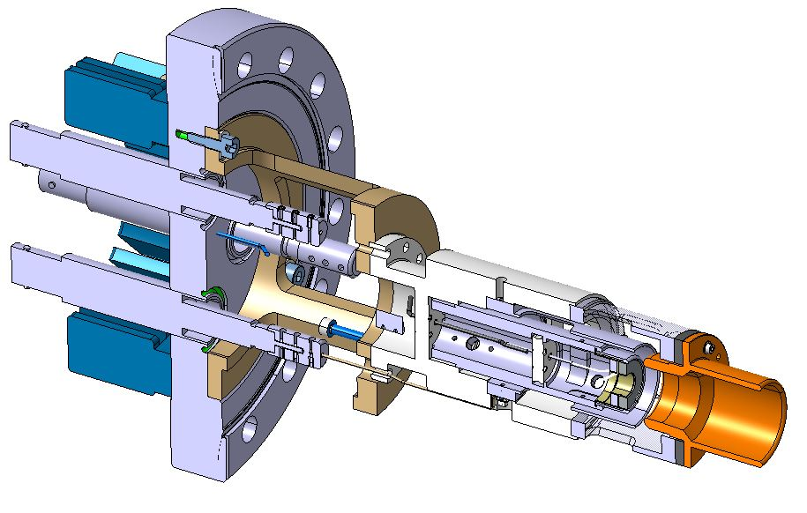
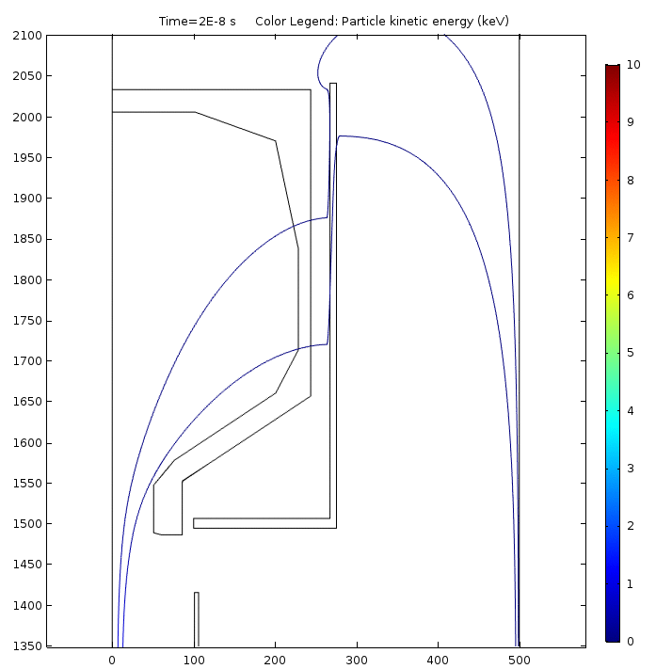
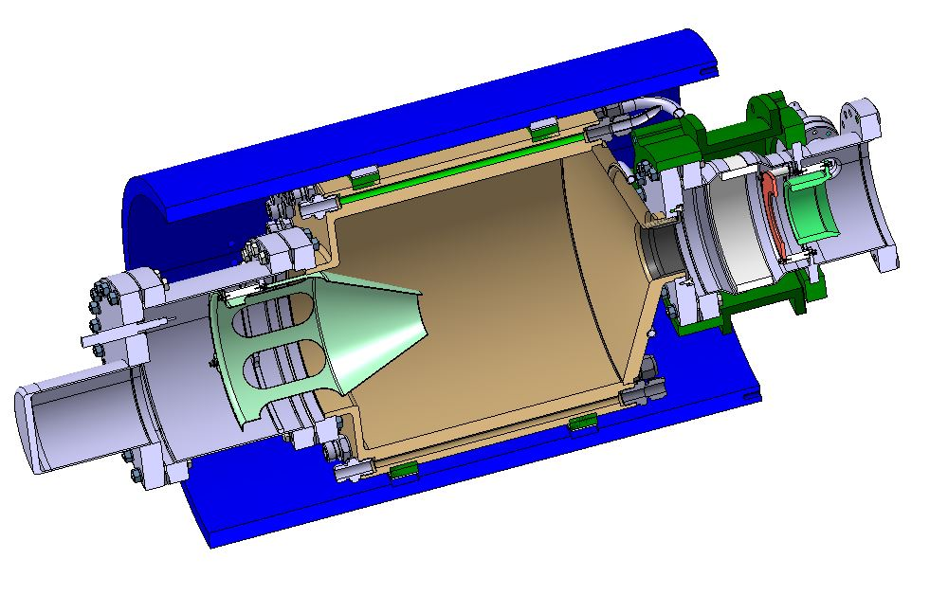
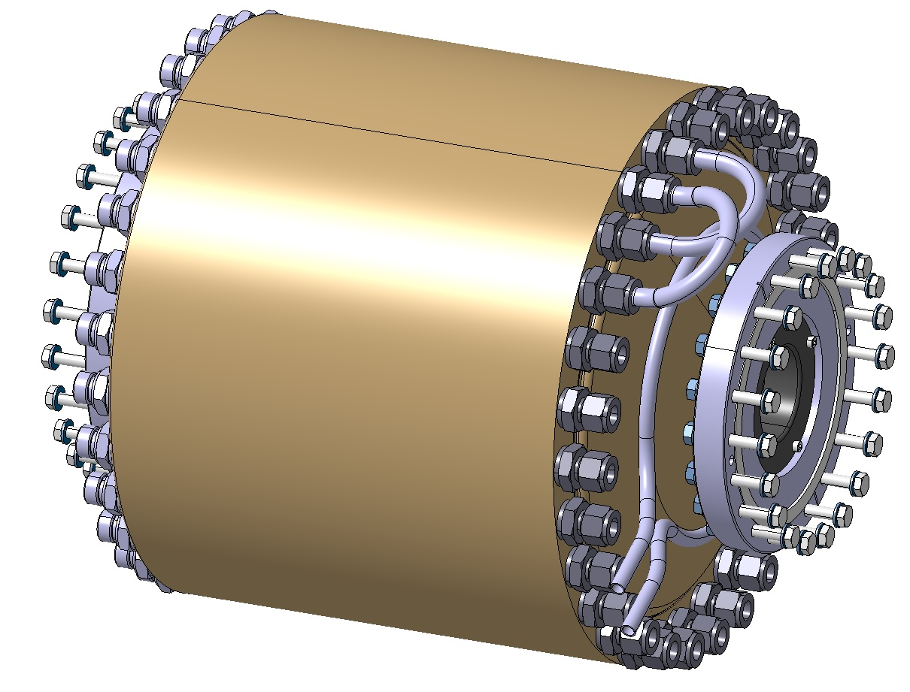
E-gun and Collector
Prototypes under construction

Slide 12
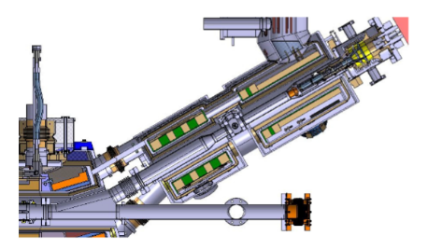
Effect of tolerances (dimension and shape)
Cathode axis
Gun
Vacuum chamber
e-gun vacuum tank
e-gun cryostat
Main solen. 1 cryostat
Main solen. 2 cryostat
Electron nominal path
e-gun solenoid
Main solenoid 1
Main solenoid 2
Sub-assembly interface
E-gun solenoid axis
Main solen. 1 axis
Main solen. 2 axis

Slide 13
Tolerances of size and shape.
Lever arm effect.
From the axis of the cathode to the axis of the main solenoid 1 there is a chain of 54 tolerances of size and shape. 16 of these tolerances are on welded connections.
Assuming an average tolerance of +0.05 mm for machined parts and + 0.5 mm for a welded connection we have:
38 x 0.05 + 16 x 0.5 = 1.9 + 8 = 9.9 mm Worst case
38 x 0.05 + 16 x 0.5 = 0.31 + 2 = 2.31 mm Statistical
Small contribution of machined parts – useless to increase the precision of these tolerances.

Slide 14
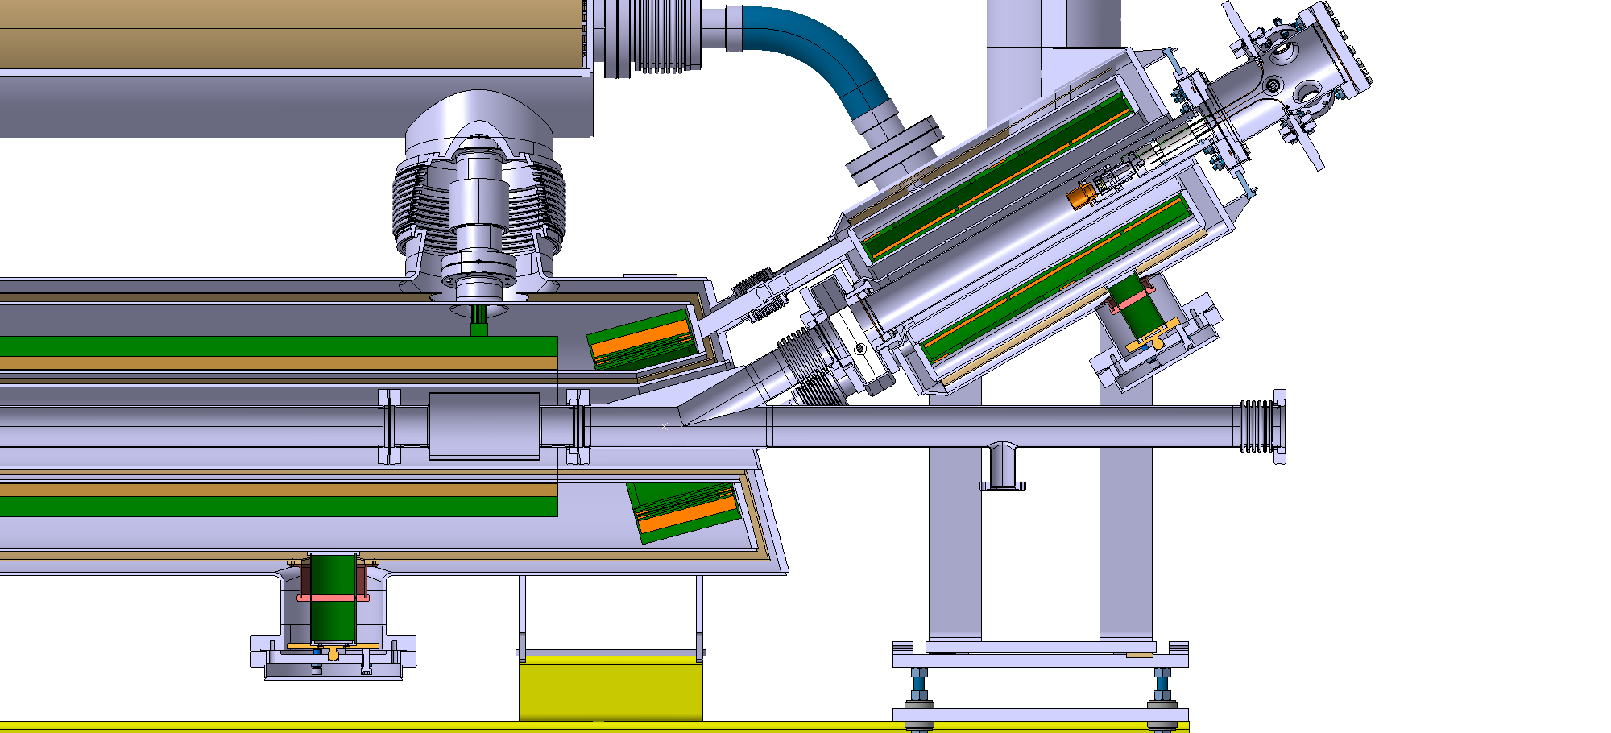
Measure and tune (correct with shims):
  the cathode position respect to the gun flange,
  gun position respect to the gun solenoid,
  gun solenoid respect to the main solenoid,
  etc. etc. at each assembly step,
during the construction.
Total tolerance: + 0.8 / + 0.55 mm – We can stay within 1 / 1.5 millimetres.
The final assembly phase is the key point to have a good result.

Slide 15
Importance of the final assembly – welds – safety file.
The correct execution of the welds, the measurement and correction of the positions are the key factors to have a precise construction.
The cryostats are pressure vessels. The construction must fulfil the requirements of the norms. Welders and weld must be qualified, we need traceability, adequate quality control and a correct safety file. Documentation.
If we do not follow these procedures we can not install the HELs.
The solenoids are surrounded by several vessels welded one after the other. Before making the weld N+1 we must be sure that the weld N is well executed (stresses, leak tightness, etc.). NDC, documentation.
Maintenance / modifications after years. It is important to know what there is inside. Documentation.

Slide 16
Strategy for the in kind contribution
Manufacturing of the components, winding and testing of the separate solenoids – Contributor premises.
In kind technicians from the contributor here at CERN to carry out the final assembly.
Control of assembly, definition of shims. – Contributor and CERN.
Assistance from the main workshop to qualify welders and welding procedures, to prepare the safety file and the documentation of the equipment.

Slide 17
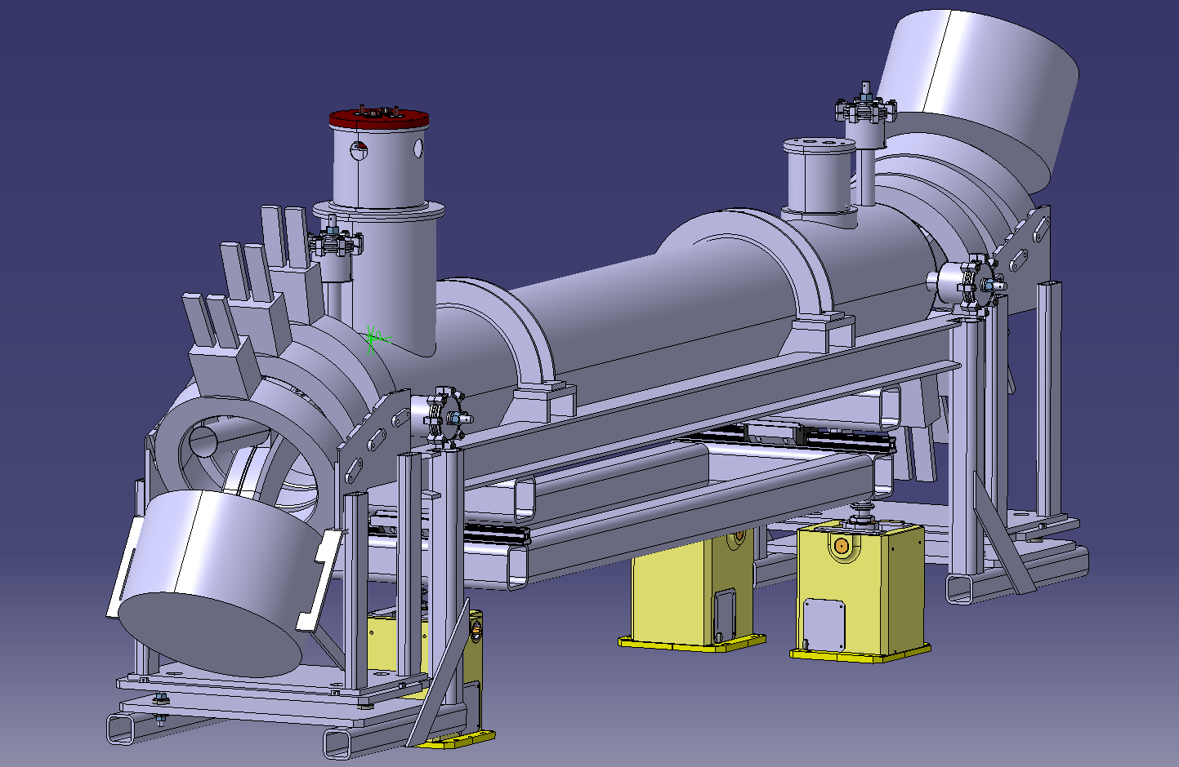
Conclusions
The design of the HEL is close to the conclusion. Last details under definition in collaboration with BINP.
Attention to the quality of the final assembly (dimensions, welds).
First sketch 6 years ago
The required strict tolerances can be achieved but the assembly process must be extremely well controlled.

Slide 18
Thank you for your attention

