Slide 1

WP5 HL-LHC Hollow Electron lens magnet system status
HL WP5 HEL Review kick-off meeting,
13^{td} April 2021
Arnaud Foussat TE-MSC, Antti Kolehmainen EN-MME, Mariusz Wosniak TE-MPE, Gerard Ferlin TE-CRG
With many contributions from HL WP5 HEL: Adriana Rossi SY-BI, Stefano Redaelli BE-ABP, Diego Perini EN-MME
TE-MSC, HL-QA team, HL ATS-DO, TE-MPE, TE-CRG, SY-EPC, SY-BI, BE-GM, EN-MME groups
Alexey Bragin and BINP Magnet group.
Indico Link
HL WP5 HEL review meeting, Magnet system status 13td April 2021 A. Foussat

Slide 2
Outline
Status
HL-WP5 HEL Magnet system
Functional magnet specifications
Scope of collaboration with BINP
HEL SC Magnet system CAD model
HEL engineering magnet interfaces
Preliminary magnet specifications
Schedule, Resource plan on HEL magnet system
Cold test strategy
Summary
References
HL WP5 HEL review meeting, Magnet system status 13td April 2021 A. Foussat

Slide 3
Status
Magnet functional specification under finalisation
Preliminary conceptual study well advanced, need finalisation of functional specification
First contact with BINP initiated. Need to define the detailed scope of the in-kind contribution.
Since Dec. 2020, when magnet group took in charge the magnet system, PBS and WBS have been set up.
Crucial that BINP establishes a continuity on CERN site activity to support the finalization of the conceptual design
  thereafter to perform the engineering design in collaboration with the other concerned teams.
HL WP5 HEL review meeting, Magnet system status 13td April 2021 A. Foussat
Notes:
Since Dec. 2020, the magnet project scope (PBS, WBS), its deliverables and a baseline resource loaded schedule have been initiated by MSC [7][8].
Consolidation of functional interfaces key parameters ( magnetic model, protection circuits, cryogenics) and magnet conceptual design changes based on manufacturability (Joint regular CERN-BINP magnet meetings) to initiate HEL magnet functional technical and procurement Specifications
Conceptual design stage where it is crucial to start discussions with manufacturer, to assess detail and manufacture design. BINP design support resources shall be expected on CERN site.

Slide 4
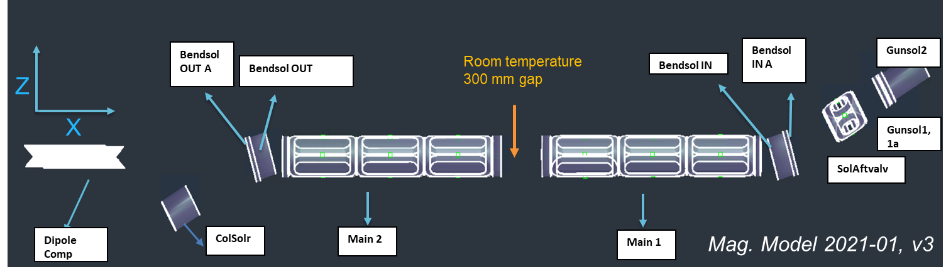
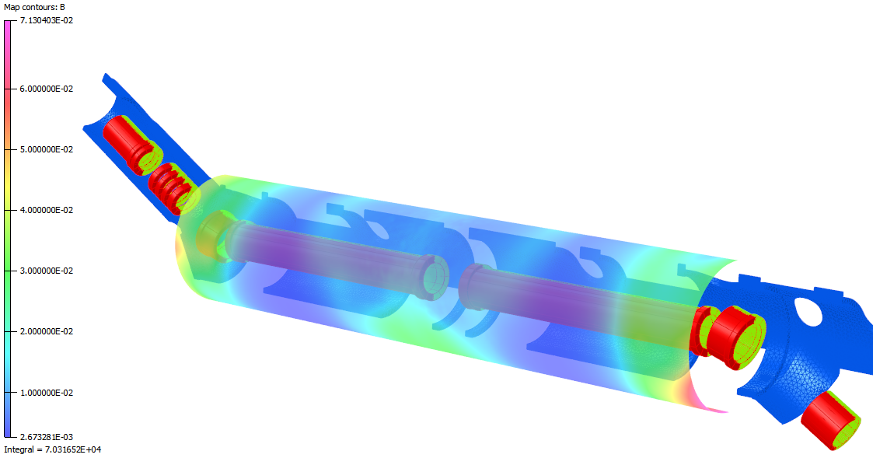
HEL superconducting magnet system
The Hollow Electron Lens ensures transport, guiding and position tuning of e-electrons ( See D. Perini’s slides)
The Magnet system is composed of :
  Guiding e-beam:
    2 Main solenoids, 2 bending solenoids, 4 solenoids after valve, e-gun, collector solenoids
  Correcting system:
    6 correctors (H,V) per main solenoid, 4 for bending, 2 for the e-gun, one orbit dipole compensator
HL WP5 HEL review meeting, Magnet system status 13td April 2021 A. Foussat
Notes:
The Hollow Electron Lens superconducting magnets system ensures the transport of electrons from the cathode to the collector, and achieve the tuning—by adiabatic magnetic compression of the electron beam size in the interaction region, and to allow precise positioning of the electron beam on the high-energy proton beam

Slide 5
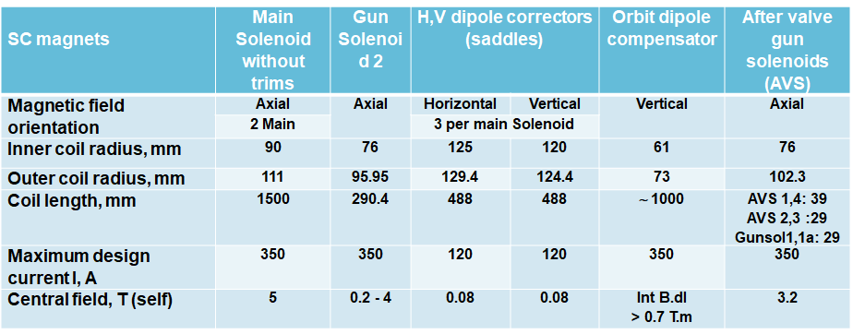
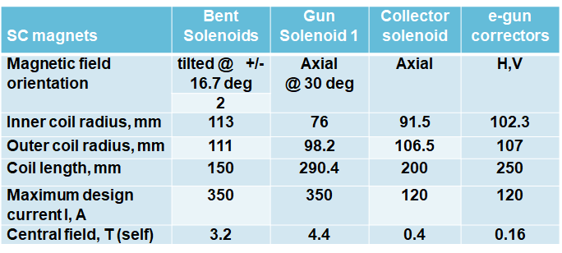
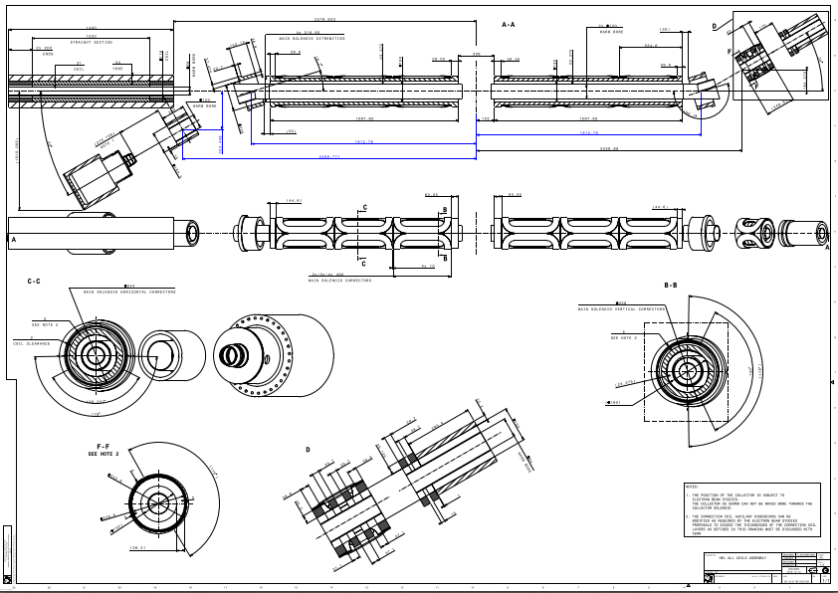
Functional magnet specification
Magnet specification in line with HEL functional specification
All magnet design meet specified hot spot temperature T_{h} < 120 K, Vmax < 500 V at operating 4.2K temperature.
HEL engineering functional drawing
magnets space and location
Notes:
This table summarises the functional main requirements ( field , current, space) of individual magnets which have been further detailed

Slide 6
Scope of collaboration with BINP
Support to finalisation of the functional specifications
Engineering design performed by BINP team on CERN site
In-kind supply of three HL-LHC WP5 Hollow electron Lens (HEL) assembly units ( one spare, two series).
The supply consists of :
  manufacture of the magnet system, cold masses, vessels parts, QC coils cold tests at BINP.
  Assembly of cold masses at BINP/CERN and in-cryostating at CERN site,
  Support to commissioning cold acceptance test of each final HEL assembly on surface at CERN
  Support to tunnel installation at LHC IR4 point .
HL WP5 HEL review meeting, Magnet system status 13td April 2021 A. Foussat
Notes:
In-kind contribution with BINP institute (Russia) for the supply of three HL-LHC WP5 Hollow electron Lens (HEL) assembly units ( one spare, two series).
Manufacture of the magnet system, cold masses, vessels parts, QC coils cold tests at BINP. Assembly of cold masses at BINP/CERN and in-cryostating at CERN site, tunnel installation at LHC IR4 point .
Commissioning cold acceptance test of each final HEL assembly on surface at CERN (proposal on FAIR 4th test line) before hand-over to SY.
Main project timeline steps ( end 2020 baseline) with assumed official collaboration start from Q1-2021.
HL-LHC WP5 HEL units manufacture design phase until 2022
Construction of prototype HEL-0, series HEL-1,2 units over period 2022-2024
Commissioning cold test period at 4K from 2023 - 2025
Tunnel installation and operation over 2024 - 2025

Slide 7
List of in-kind supplies
Items | Components * | Spare | Series
Magnet System | Gun solenoids ( 4 T ) | 2 | 4
 | Solenoid After valves | 4 | 8
 | Bending solenoids (~ 3.5 T) ( incl trims) | 2 | 4
 | Main solenoids ( 5 T ) (incl. trims) | 2 | 4
 | Correctors at the gun [H+V] | 2 | 4
 | Correctors along the main (dipole) [H+V] | 12 | 24
 | Dipole corrector for bending solenoids | 1 | 2
 | Collector solenoid | 1 | 2
 | Cryostats (He vessels), piping | 5 + 1 | 10 + 1
 | Magnetic shielding * ( under evaluation) | 1 | 2
 | Leads high current (in & out), nominal 350 A | 14 | 28
 | Leads low current (in & out), nominal 120 A | 30 | 60
 | Magnet support external structure, chassis. | 1 | 2
 | Magnet instrumentation wiring ( V-taps, SC busbars) | Per design
Cold test | Fabrication cryogenic tests at BINP on sub magnet | 8 tests per unit (24)
Tooling | Cold mass and cryostat dedicated on CERN site assembly tooling | Per design
* About 108 individual windings to be built by BINP. Dedicated magnet manufacture cryo tests are planned for each magnet at BINP
HL WP5 HEL review meeting, Magnet system status 13td April 2021 A. Foussat
Notes:
For information only, the update of the scope of supply which details the auxiliaries of magnet system ( leads, instrumentation, shielding…) as the structures and tests. This scope needs to be updated within a amendment of current Agreement

Slide 8
Open procurement items
LHe pressure cold masses vessels design and cryostating by BINP shall be performed per PED 2014/68/EU requirements (EDMS 1891856), EN:13445 code.
The present baseline is that the manufacture of the cold masses and assembly are performed by BINP on CERN site. We are exploring if part of these activities can be performed on the BINP site.
In that case, the BINP activities on CERN site would focus on cold masses alignment & integration into cryostats, magnetic axis transfer, final unit assembly
HL WP5 HEL review meeting, Magnet system status 13td April 2021 A. Foussat
Notes:
On going discussion with BINP magnet group which has experience of PV construction per EN codes on FAIR project

Slide 9
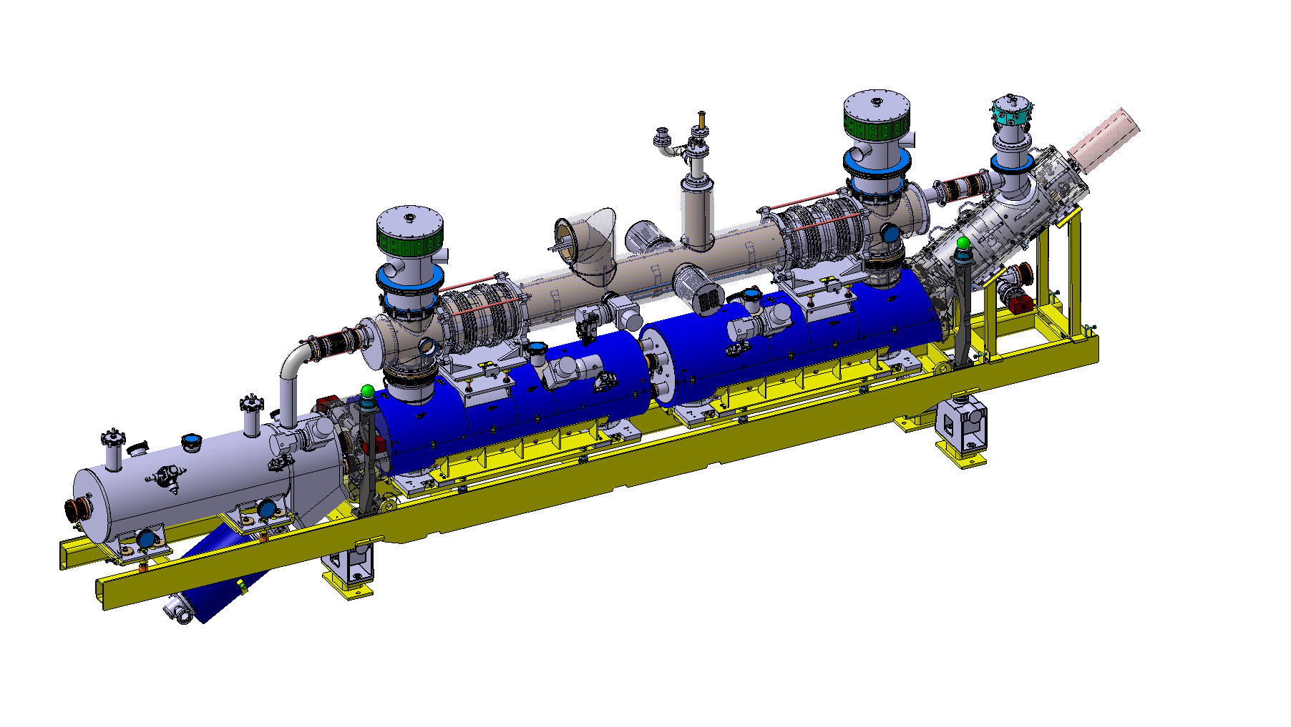
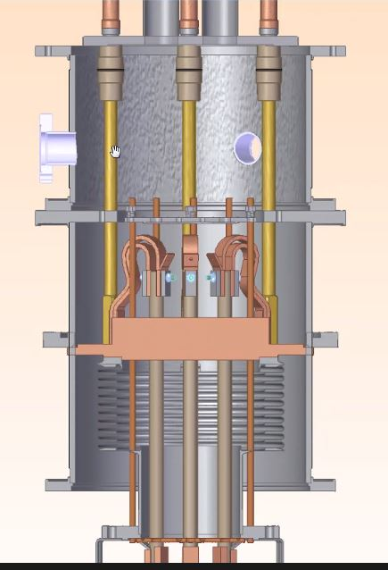
HEL SC Magnet system CAD model
HEL superconducting magnets cooled at 4.5K to tune the size and steer the electron beam ring from cathode to collector
Electron gun with
surrounding SC magnets
Connection to QRL
He collector
Dipole corrector and
Collector solenoid
Conceptual gas- cooled current leads cluster under study (BINP). Height envelop per integration (WP15)
Main & bending solenoids
3x H+V correctors
Electron beam collector
Number of 22 circuits recently shown that three multi leads cluster envelops are needed.
HL WP5 HEL review meeting, Magnet system status 13td April 2021 A. Foussat

Slide 10
HEL engineering magnet interfaces
Electromagnetic model, CAD model
TE MSC, WP5, WP2
Field profile, beam optics ✓
Magnets Protection
Protection baseline, modelling
Magnet circuits
SY EPC, WP6
Equipments code names, Circuit layout, choice of PCs✓
Magnet specification parameters, ( inductance, load table) ✓
SC conductors choice, operating Iss margins, specification in work
Shielding simulation, baseline with 30% efficiency (in work)
TE MPE, WP7
Energy extraction on individual coils (up to 30% ), hot spot temperature < 100 K, maximum voltage < 500 V
Main circuit parameters baseline (MCF) ✓
Start of mutual coupling assessment, back up pick up coils
Busbars & Instrumentation
Magnet quench detection scheme proposal
Magnet mechanical instrumentation, T sensors
Metrology
MSC, MPE
Cryogenic operation instrumentation pre-list
Magnet metrology steps, criteria (under evaluation)
BE-GM, EN-MME
Alignment process, survey marks needs
Internal SC busbar specification (in work)
HV feedtroughs, placeholder
Final achievable targets ( in work)
Update baseline as function of protection simulations
Current leads layout, functional integration space ( in work)
Definition of Magnetic measurement requirements
Cryogenics
TE CRG, (WP 9)
Internal HEL cryogenic piping sizing ✓
Integration
HEL unit envelop CAD model ✓
Vacuum system, diagnostics
TE-VSC (WP12), SY-BI,
Access space for assembly of BGC diagnostics ( on going)
Assessment of operating He pressure, safety valve devices (P< 4.5 b) ✓
WP5, HL ATS (WP15)
Cold mass and cryostat
Functional space definition, CAD model ( in progress)
Mechanics, structure
BINP, MSC
Overpressure in case if quench and vacuum loss ✓
Integration of cryo jumper, lines
Layout of vacuum pumps vs magnetic field ( in work)
Inter coil structure predimensionning ( in work)
TE MSC, EN MME
Detail assembly procedures, dimensioning, drawings, QC (BINP phase I & II, pending)
Transport tooling assessment, process ( in work)
Integration space in tunnel, HEL interface specification
External structure, girder, stabilisers, chassis compliance with integration
Integration of HEL magnet cold test cryogenic station ( pending)
Access to LHC vaccum port
Work in progress
HL WP5 HEL review meeting, Magnet system status 13td April 2021 A. Foussat
Notes:
Magnet interfaces and preliminary design are being discussed with interfacing groups & WPs. Substancial progress in definition of interfaces illustrated by list of référence documents

Slide 11
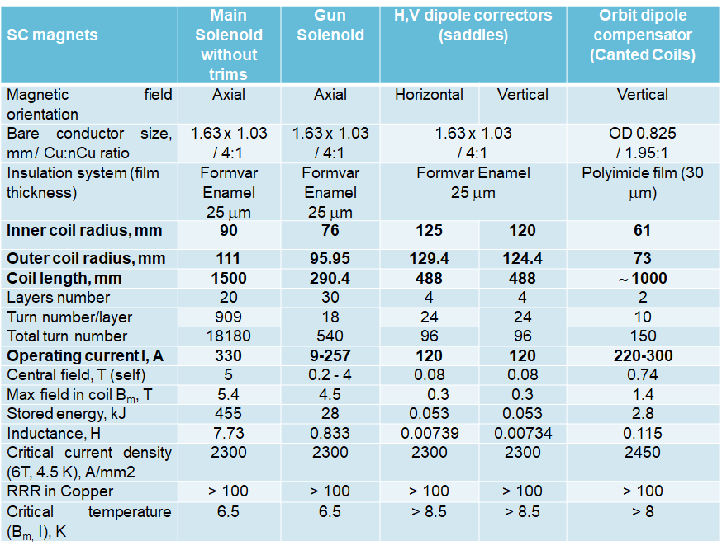
Preliminary magnet parameters
HL WP5 HEL review meeting, Magnet system status 13td April 2021 A. Foussat
Notes:
In bold the pristine functional initial specs developped in a set of electromagnetic design parameters

Slide 12
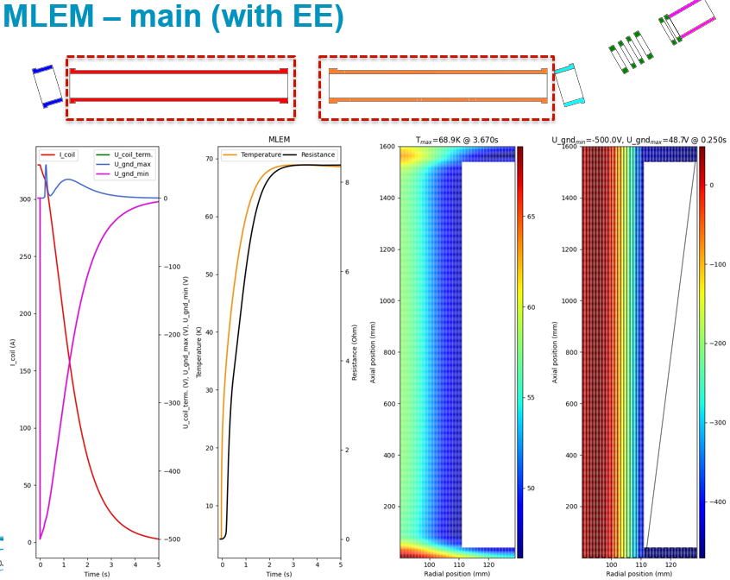
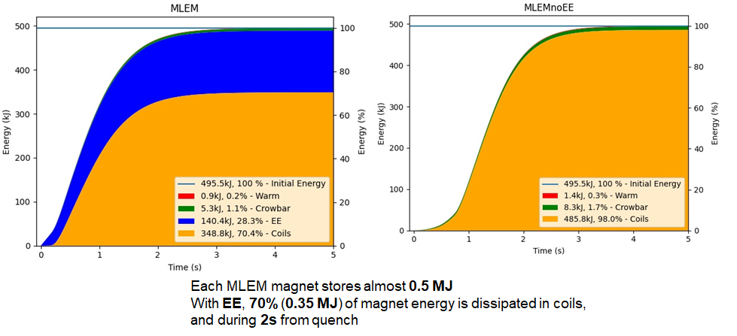
Quench protection scheme
HEL circuits inteface and protection scheme baseline reviewed in MCF 79 meeting.
Main solenoids quench protection analysis by MPE shown maximum 30 % dumped energy in external resistor of 1.4 Ohms ( E_{t} = 500 KJ per Main).
  Hot spot temperature Th ∼ 70 K < 120 K limit ✓
  Tau ∼ 1.5 sec, 500 V max design to ground. ✓
Next, detailed coupled simulations vs. alternative pick up coil, optimisation of small inductance circuit protection, circuits discharge scenarii.
Courtesy of M. Woszniak (TE-MPE) , MCF meeting, 23-04-21
HL WP5 HEL review meeting, Magnet system status 13td April 2021 A. Foussat

Slide 13
Cryogenic safety interface
Preliminary overpressure estimate by CRG during quench Energy adiabatic released of total 1.2 MJ in 2 sec and air inleak cases.
  Initial boiling film heat transfer h of 2 W/cm2
  Required safety system of 1600 mm² (inlet diameter) or >= DN50
Courtesy of G. Ferlin TE-CRG
P. Borges de Sousa, TE-CRG
Ref. MCF meeting 23th March
Overpressure mass flow of 3.6 kg/s to evacuate ✓
Design cryostat pressure update up to 4/5 bara ✓
Amount of helium released in the tunnel similar with neighboring DFBA or RF cryostat.
HL WP5 HEL review meeting, Magnet system status 13td April 2021 A. Foussat

Slide 14
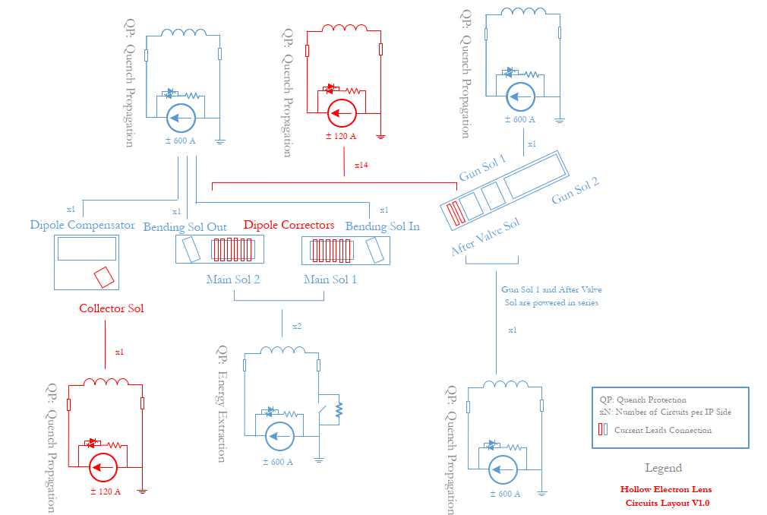
Power interfaces
22 HEL circuits per IP side: 7 x 600 A circuits (5 with energy extraction, 2 without) and 15 x120 A corrector circuits. [2]-[6]
circuit layout baseline confirmed after the protection studies by WP7.
Next magnetic coupling scenario, power converters control performance and stability (WP6B)
Courtesy of S. Yammine, M.Martino
HL WP5 HEL review meeting, Magnet system status 13td April 2021 A. Foussat
Notes:
22 HEL circuits per IP side: 7x600 A circuits (5 with energy extraction, 2 without) and 15 x120 A corrector circuits. [2]-[6]
circuit layout baseline confirmed after the protection studies by WP7. (circuit resistance, ramp rate required, inductance and nominal current)
magnetic coupling to be studied to establish the power converters control performance and stability (WP6B)

Slide 15
Open technical items
Integration conceptual design space for inter-coils structures, for diagnostics, access for mountability (ex: BGC, vacuum port, gun isolating valve..).
Multi current leads (44 off) clusters design space within specified heat loads.
Iron shielding need (max. efficiency assessed of 30% ), check need mu-metal local shielding
Pressure vessels predimensionning at newly operating 4.5 b and 5.6 b test He pressure,
Assembly, alignment sequence conceptual study (See in appendix) of highly compact HEL unit magnet
HL WP5 HEL review meeting, Magnet system status 13td April 2021 A. Foussat
Notes:
Integration space for conceptual design specifications of inter-coils structures compatible with nominal loads, for beam diagnostic, mountability or vaccum port access (ex: BGC, gun isolating valve).
Multi current leads clusters (44), Space design specifications of with limited specified heat loads.
Need for iron shielding to be confirmed (maximum efficiency of 30% ) wrt equipment field compatibility, local mu-metal shielding and beam dynamics
To check pressure vessels predimensionning integration spaces at newly proposed operating 4 - 4.5 b and 5.6 b test He pressure,
Assembly and alignment sequence study (See in appendix last metrology WGA criteria meeting ) of highly compact HEL unit magnet as a functional baseline

Slide 16
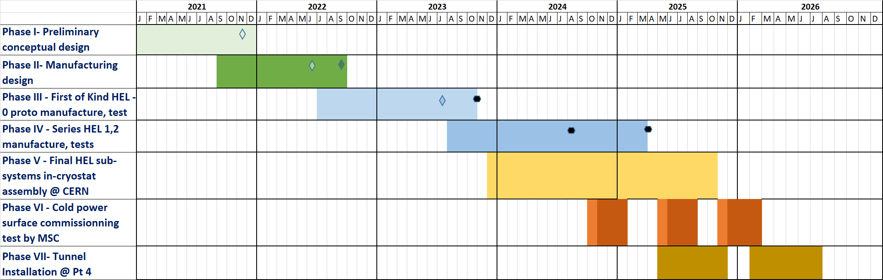
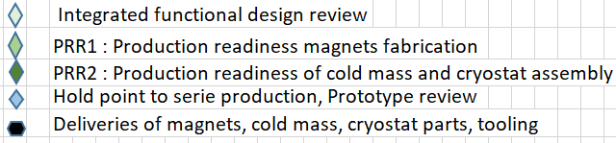
Schedule
Detailed Magnet schedule with phases, deliverables, milestones, approved by BINP, since Dec. 2020
  EDMS 2446949, WP5 HEL Magnet working schedule (see appendix)
  Assumed BINP design support resources at CERN from Q1-2021.
We need to define a detailed resource loaded BINP schedule.
HL WP5 HEL review meeting, Magnet system status 13td April 2021 A. Foussat
Notes:
Summary of detailed execution planning which describes the 7 main phases of the project.
Substanciated by a detailed schedule with deliverables
Note the first cold HEL test from end 2024 which implies preparation procurement start from 2022.

Slide 17
Resource plan on HEL magnet
  CERN resource are very limited ( table below) to steer, monitor the project and CERN is relying on the support of BINP.
  BINP PJAS support resources expected on CERN site for design support (phases I, II) from 2021 and during assembly phases (III-V)
  This does not include design and assembly project resources at BINP site estimated up to ∼ 25 FTEs.
2021-2025
HL WP5 HEL review meeting, Magnet system status 13td April 2021 A. Foussat
Notes:
Initial FTE resources table below updated since last 2019, including surface cold test
MPE : 2.4 FTEs ( maximum), incl. 0.7 to 0.9 FTE to be covered.
CRG : 4.7 FTEs, updated with surface test preparation
VSC : 0.3 FTEs, no change

Slide 18
Cold test strategy
  Manufacture factory cold test of each coil at BINP, ( 8 sub- assemblies / unit, 1 week per test, see appendix)
  Commissioning final acceptance cold test at 4K on integrated HEL unit at CERN.
      Preliminary HEL Magnet test manufacture and cold acceptance specification, (Draft ) EDMS 2509117. in discussion within MSC, WP5
      Magnet training performance, design limits, various quench operational regimes, Field quality, test in stray field of equipments
      Expected max. 12 weeks test duration per unit incl. cooling
  On going proposal to upgrade 4th cryo line on existing FAIR test station, to be released, approved for assessment and budgeted during 2021
    Benefit from existing infrastructures, electrical equipments (PCs and protection system), upgrade procurement needs.
    Assess the operation team resource and HL magnets test schedule during 2024-2025
HL WP5 HEL review meeting, Magnet system status 13td April 2021 A. Foussat
Notes:
Several benefits to test on FAIR were discussed with CRG, MPE, TM section on versatility and the use of existing infrastructure

Slide 19
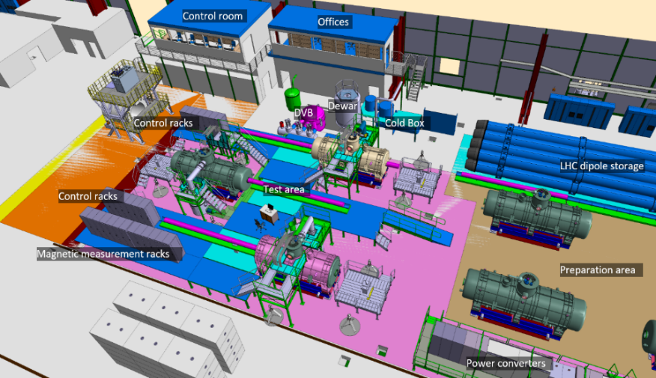
FAIR cold test station
Proposed HEL area ( former PANDA area)
EP work area
Courtesy of CRG
HL WP5 HEL review meeting, Magnet system status 13td April 2021 A. Foussat
Notes:
The proposed test area about 8 m x 3 m is illustrated on this top view, sideway to EP area.

Slide 20
Summary
Magnet functional specification under finalisation. The preliminary engineering conceptual design specifications, and the drawings are started, based on integration and performance requirements (end by September 2021).
Need to define the detailed scope of the in-kind magnet contribution. Some important option on Pressure vessel construction site, to be confirmed.
Pending technical issues to be closed for design specification completion ( inter spaces, diagnostics access, magnetic shielding)
Need of BINP resources on site to complete Phase I conceptual design and start of engineering detail design (phase II) to keep schedule
Detail scope of supply and resource loaded baseline schedule by BINP to be confirmed through all phases.
Commissioning cold test roadmap to be approved and test station proposal to be assessed for integration study, and test station upgrade.
HL WP5 HEL review meeting, Magnet system status 13td April 2021 A. Foussat

Slide 21
References
Main parameters of HEL electrical circuits, EDMS 2036694
Magnet circuit diagram v0.2 , https://espace.cern.ch/project-HL-LHC-Technical-coordination/MCF/HEL_Circuits_Tabl
Magnetic model magnets geometry, EDMS 2467472
Magnet Load table in nominal operating conditions ( BINP Opera), EDMS 2479912
HEL Magnet Instrumentation table, EDMS 2507516,
HL-LHC Hollow Electron Lens Circuits Table V0.1, MCF, S. Yammine.
WBS 1.0 HEL Magnet PBS and Project Tasks Items EDMS 2507886
WP5 HEL Magnet working schedule, EDMS 2446949
HL WP5 HEL Magnets resource plan, EDMS 2469326, (Draft)
HL WP5 HEL Estimate of support CERN groups resources on HEL WP5 Magnet project, EDMS 2515894, (Draft)
Preliminary HEL Magnet test manufacture and cold acceptance specification, EDMS 2509117 v.1 (Draft)
Center plane BGC field table from Opera model ( with iron), EDMS 2492784
Naming conventions for functional position codes in the new HL-LHC buildings and underground galleries, EDMS 2349917
MCF meeting, 23td March 2021: https://indico.cern.ch/event/1020639/
  First Estimations of the Quench Energy Dissipated in the HEL Cold Masses of the Main Solenoids - Mariusz Wozniak,
  Proposal of the Design Cryogenic Pressure for the HEL Magnets - Gerard Ferlin
HL WP5 HEL review meeting, Magnet system status 13td April 2021 A. Foussat
Notes:
As reference several documents as part of the preliminary conceptual design

Slide 22
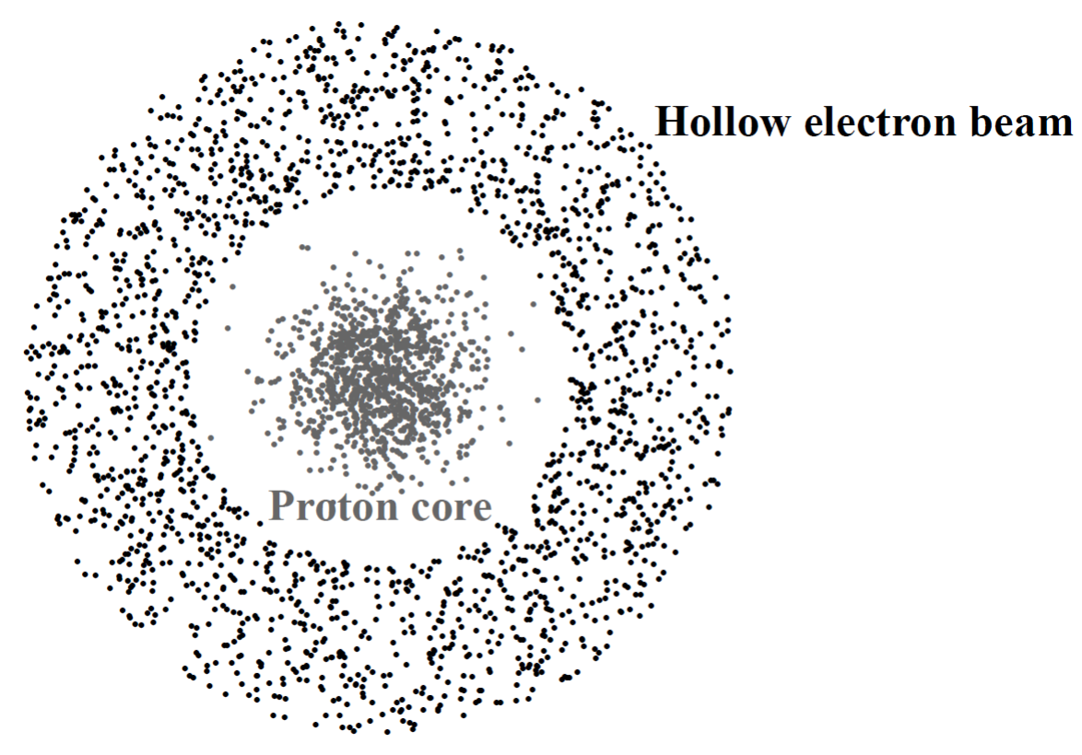

Thank you
for your attention
Do you have any questions …?
HL WP5 HEL review meeting, Magnet system status 13td April 2021 A. Foussat

Slide 23
BACK UP SLIDES

Slide 24
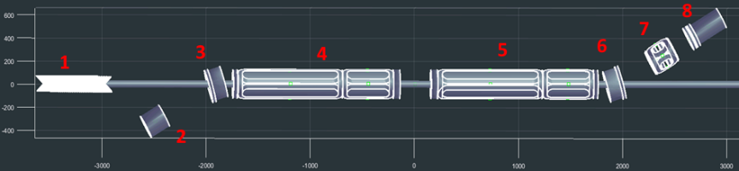
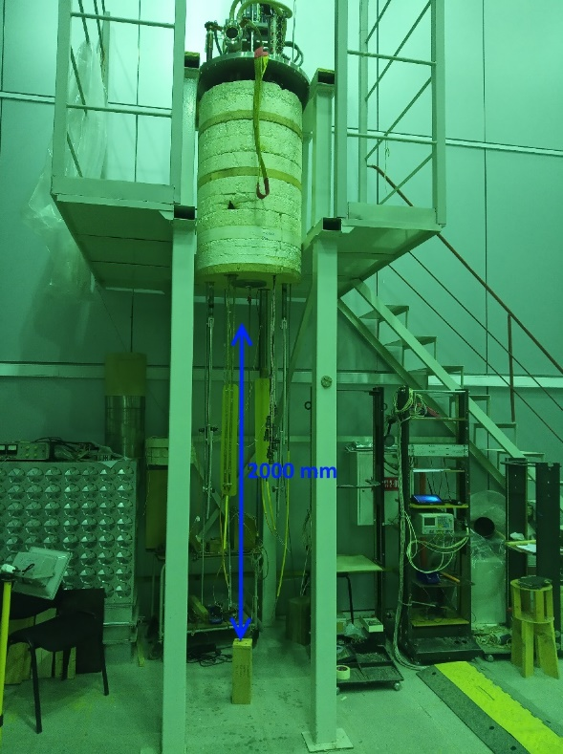
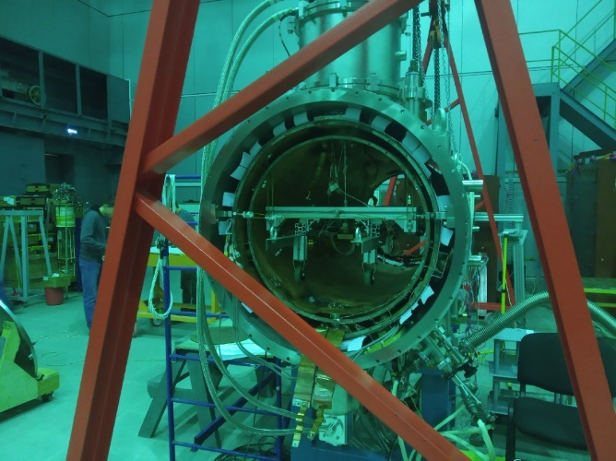
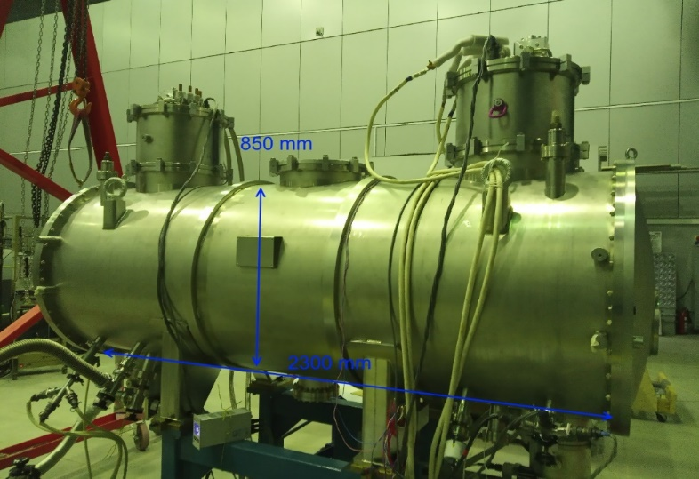
BINP factory cold tests plan
Large magnets to be tested in long BINP cryostats.
~ up to 2 weeks per magnet, incl magnetic measurement .
Available space in LHe vertical cryostat
∅ 700 mm, L ~ 2000 mm
Magnetic field measurements:
Hall sensors scanning along the axis.
Horizontal dry cryostat
∅ 680 mm, L ~ 1900 mm
More possibilities for magnetic field measurements, but longer cooling down time (heat pipes to increase cooling power.)
Vertical dry cryostat:
∅410 mm, L ~ 1600 mm – LHe volume
∅300 mm, L ~ 500 mm, LHe test cryostat
∅680 mm, L ~ 1900 mm
The dry cryostat has 4 pairs of current leads
Dry cryostat
HL WP5 HEL review meeting, Magnet system status 13td April 2021 A. Foussat

Slide 25
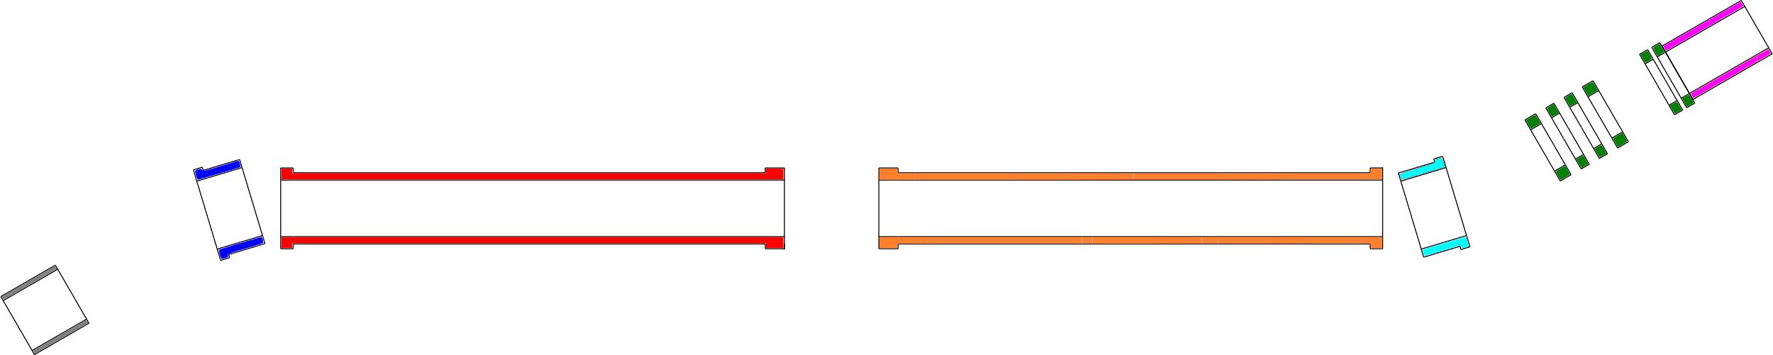
HEL solenoid magnets equipment codes
Magnet Solenoid E-lens (MLE…)
1 x MLEA
2 x MELB
1 x MLEC
1 x MLEG
2 x MELM
After valve/Gun1
MLEA
(RLEA)
HEL solenoid magnets:
5 types
7 magnets
Gun
MLEG
(RLEG)
Collector MLEC
(RLEC)
Bending MLEB
(RLEB)
Main
MLEM
(RLEM)
Main
MLEM
(RLEM)
Bending MLEB
(RLEB)
1m
Magnet name | MLEC | MLEB | MLEM | MLEA | MLEG
Wire length (km) | 1.055 | 1.771 | 13.033 | 2.406 | 2.021
 |  | 1.771 | 13.033
Total (km) | 35.090
magnets to scale
* Markus Zerlauth, MCF 79th
HEL Circuit and Magnet Naming Proposal
https://indico.cern.ch/event/1006067/
HL WP5 HEL review meeting, Magnet system status 13td April 2021 A. Foussat

Slide 26
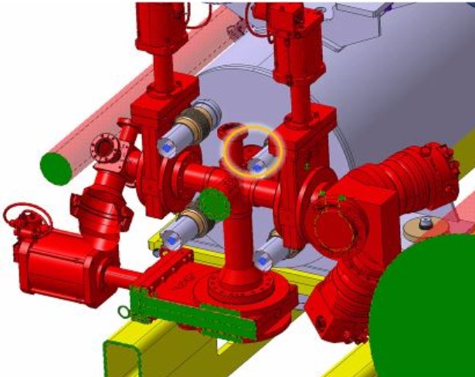
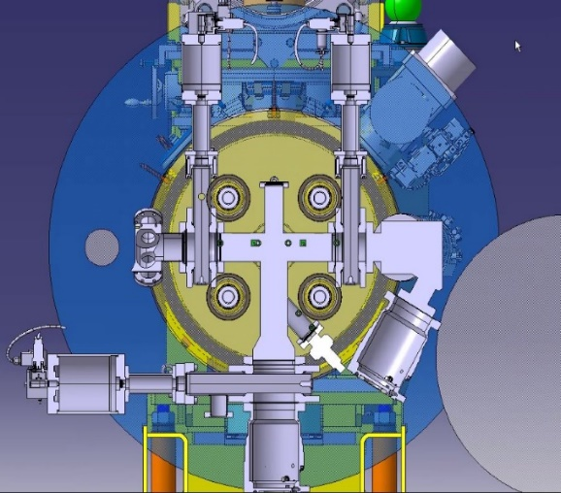
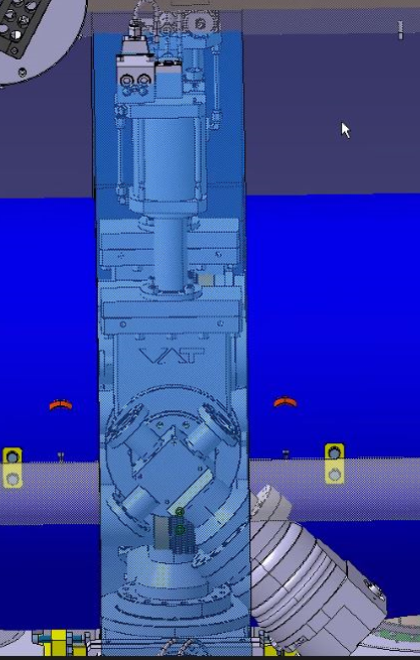
Functional Design item
BCG inter solenoids region
On going design of both Beam curtain Gas diagnostics and inter-coil reacting structure in tight gap ( ∼260 mm) requires an integrated design approach considering assembly steps.
  Design of accessible vacuum flanges, bolted vs welded.
  Discussion with SY on assembly sequence study, building of 1:1 mock-up
2019 BGC gap with inter solenoid structure
2020 inter solenoid structure
View of inter solenoid gap
HL WP5 HEL review meeting, Magnet system status 13td April 2021 A. Foussat

Slide 27
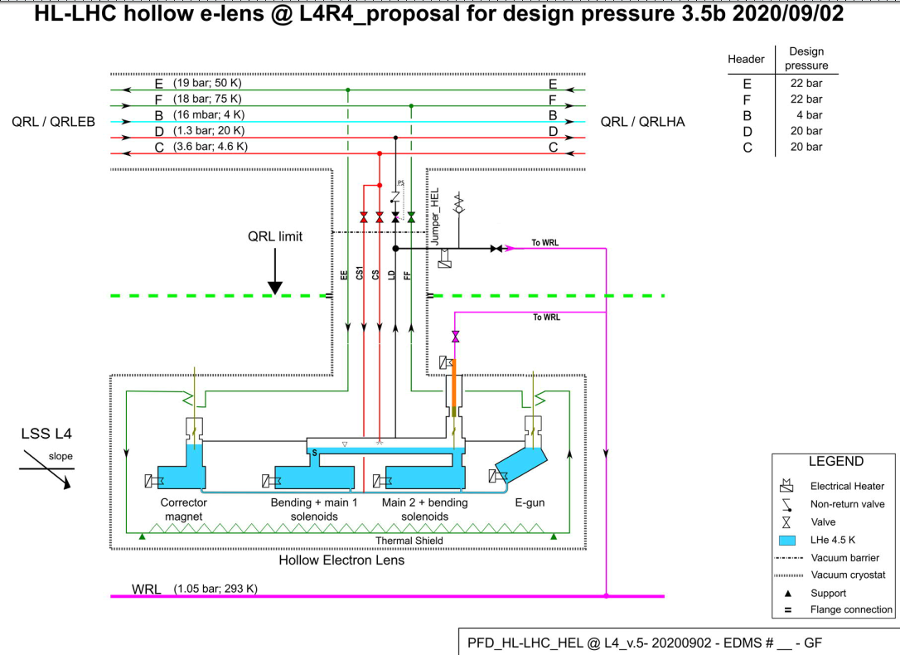
Functional Design item
HEL unit cryogenic PFD
Under progress
Next PFD update depending on on-going design technical discussion with BINP on all gas current leads.
HL WP5 HEL review meeting, Magnet system status 13td April 2021 A. Foussat

Slide 28
Functional Design item
Magnetic model with Iron shield
Recent detail magnetic model with shield shown a maximum efficiency η = (B0-Bs)/B0 of 30%
Shielding strategy to be confirmed as any improvement would have large design impact.
Check needs of individual local HEL equipments shielding ( mu metal)
HL WP5 HEL review meeting, Magnet system status 13td April 2021 A. Foussat

Slide 29
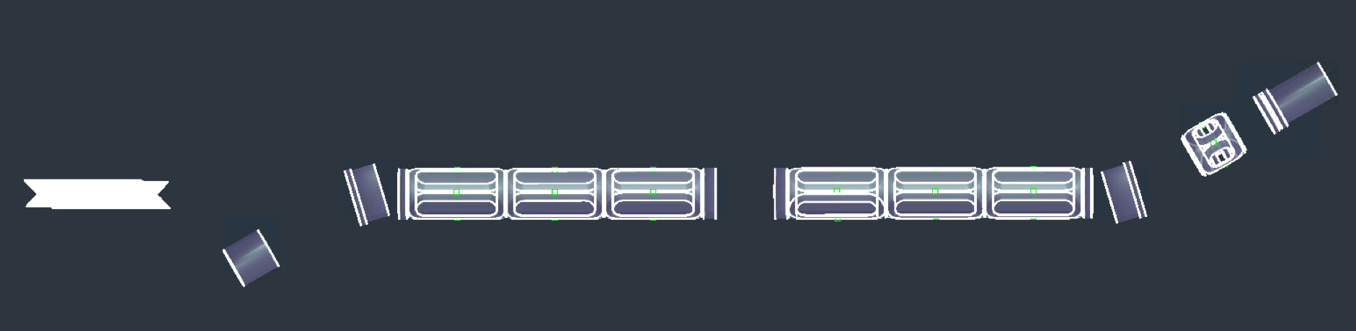
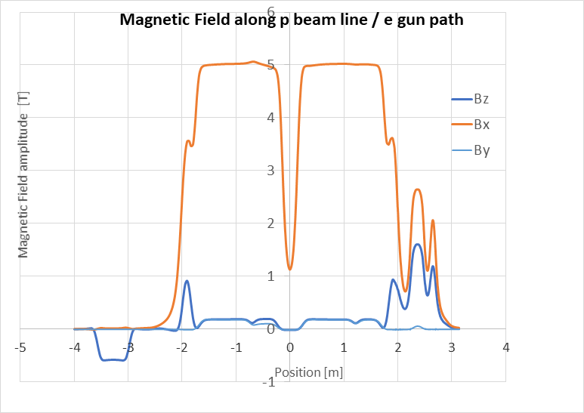
Electromagnetic design
Bendsol OUT A
Room temperature 300 mm gap
Bendsol IN A
Gunsol2
Z
Bendsol OUT
Bendsol IN
X
Gunsol1, 1a
SolAftvalv
Dipole Comp
ColSolr
Main 2
Main 1
Mag. Model 2021-01, v3
Parameter Main Sol. | Value
Insulated conductor size LxW | 1.65 x 1.05
Cu/Nb-Ti | 4:1
I_{c}(5 T, 4.2 K) | >= 750 A
I_{nom} | 330 A
L_{nom} | 7.8 H
B_{nom,max} | 5 T
Je | 191 A/mm²
V_{Rleads} @ I_{nom} | 1 V
N_{turns} | 18180
RRR | >=100
Field profile with all correctors ON.
MCF meeting HLLHC WP5 HEL MAGNETS A. Foussat 12 Jan 2021
HL WP5 HEL review meeting, Magnet system status 13td April 2021 A. Foussat

Slide 30
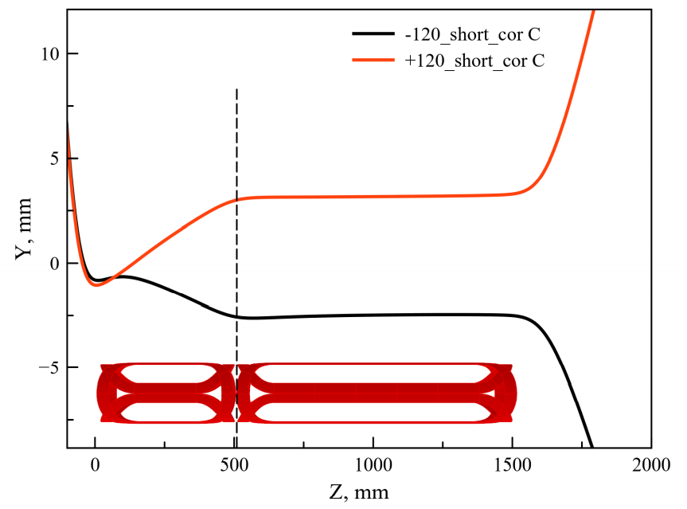
Functional Design item
Beam optics correctors interfaces
Updated saddle correctors design, 4 layers, 28 turns, 13440 A.turns, maximum current of 120 A
  Increased bore field of 0.11 T allows beam deflection over +/- 4 mm
  Specified corrector strength of 0.166 T.mm/A in 5 T background field
Pending study of e beam inlet correctors layout to reduce entrance trajectory bump. ( in progress at BINP)
Dec 2020 to be updated
Case with bore field 0.055 T
Vadim Pavlyuchenko and Danila Nikiforov, BINP

Slide 31
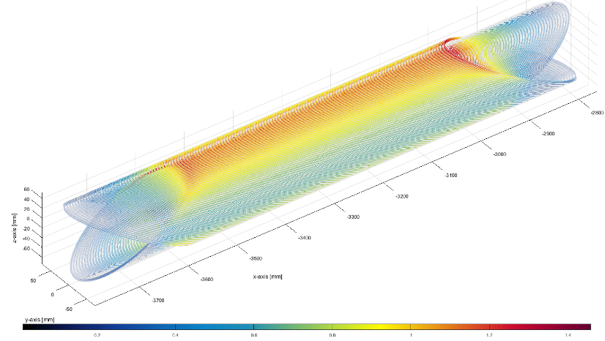
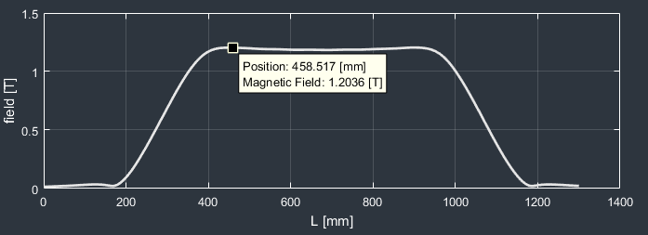
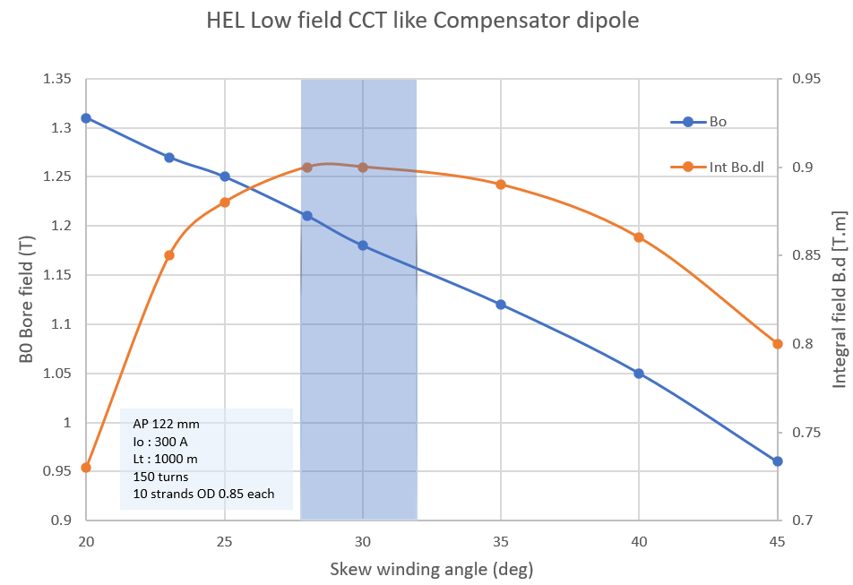
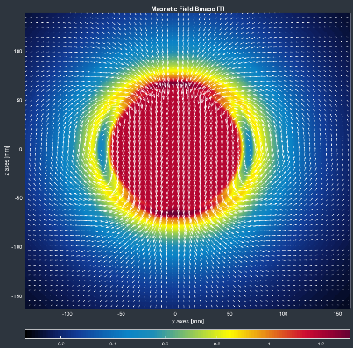
Orbit dipole compensator (CCT based)
Orbit dipole space of 1 m to compensate the net residual vertical dipole kick seen by the proton beam from both bent solenoids up to ∫ B.dl = 0.34 T.m.
Conceptual design based on CCT dipole using LHC NbTi ∅ 0.85 mm strand
Optimised coils at 300 A, B0 = 1.2 T with 0.92 T.m, int_field margin factor of 2.7
BINP shall confirm the dipole technology
Thanks to Glyn Kirby’s advices

Slide 32
Magnet system specifications
Two 5 T main solenoids, with a 180 mm bore inner diameter split in two sections of 1.5 m length (see Fig. 1) to allow some space at the centre of the straight beam for diagnostics ( 300 mm separation) as well as to reduce the individual stored EM energy to less than 500 KJ
Two tilted solenoids are used for the e-beam bending, in an “S” shape design that minimizes the effects on the proton beams from asymmetries at the e-beam entrance and exit
Hollow electron lens magnet system is housed in a common cryostat designed to operate at nominal 3.5 bars pressure and 4.2K saturated LHe II.
requirement of field quality straightness of the solenoid field lines set to ΔX ~ 0.2 m allows to prevent deviation of electrons trajectory off-center from a given fraction of the proton transverse beam size imposing a very small transverse field deviation of 10⁻⁴.
dipole compensator for the net residual vertical kick seen by the proton beam up to an integrated dipole field of 0.4 T.m.
The strength requirements of each of the six longitudinal individual dipole corrector is currently set at 0.125 T.mm/A with a self peak field at 76 mT allow to move the e- beam trajectory by +/- 4 mm in the 5 T main solenoid field. ( under study)

Slide 33
Key schedule phases
Phase I - Functional design: Review of magnet cold mass vessels (PED compliance, construction features), cryostats design and assembly sequence design
Phase II - Manufacturing design phase: review of HEL construction design, QA, assembly jig manufacture design files
Phase III-IV – Manufacture of HEL magnets and intermediate tests. Monitoring and approval of magnets, cold mass vessel, cryostat parts manufacture documents, inspection sheet. factory cold and magnetic acceptance test
Phase V – Cold mass construction In-Cryostating : Cold mass manufacture, qualification ( manufacture place under evaluation). Magnetic measurements, alignment and In-cryostating of cold masses at CERN with BINP assembly team
Phase VI – Commissioning acceptance Cold test: nominal operation test of cryostated magnets HEL assembly , final acceptance
Phase VII - Tunnel installation: approval of HEL magnet cryostat interface connections in tunnel, operation release.

Slide 34
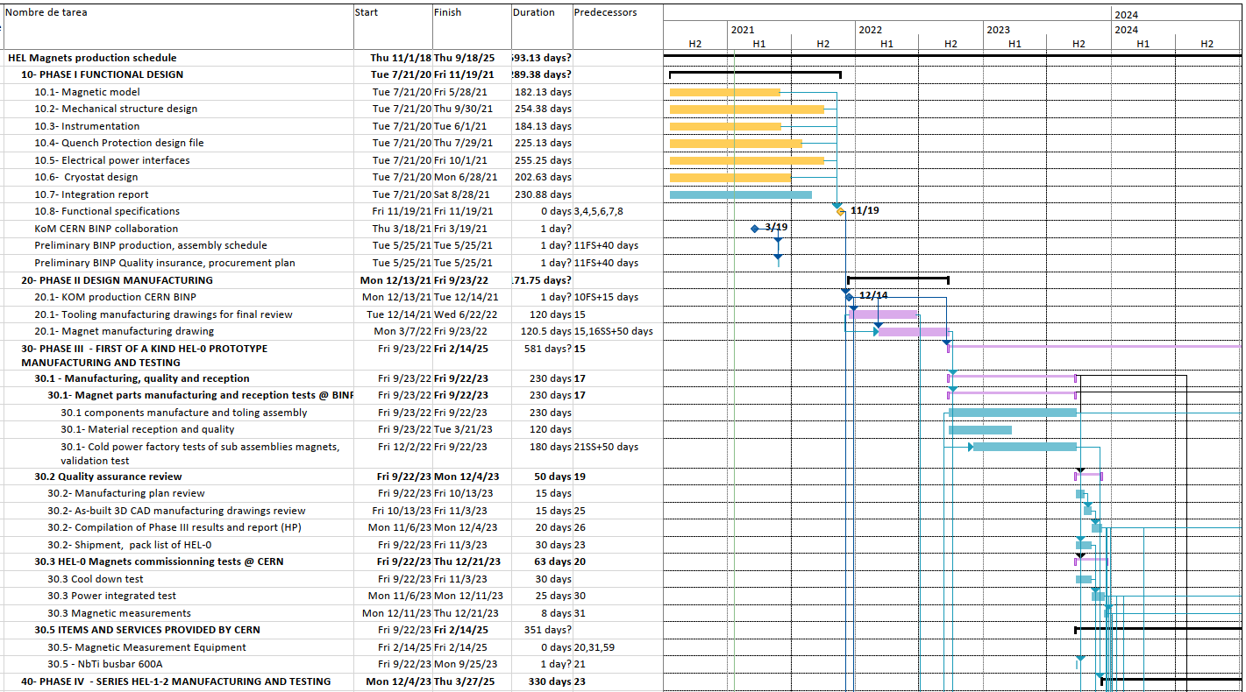
Baseline WP5 HEL Magnet Project v3.0

Slide 35
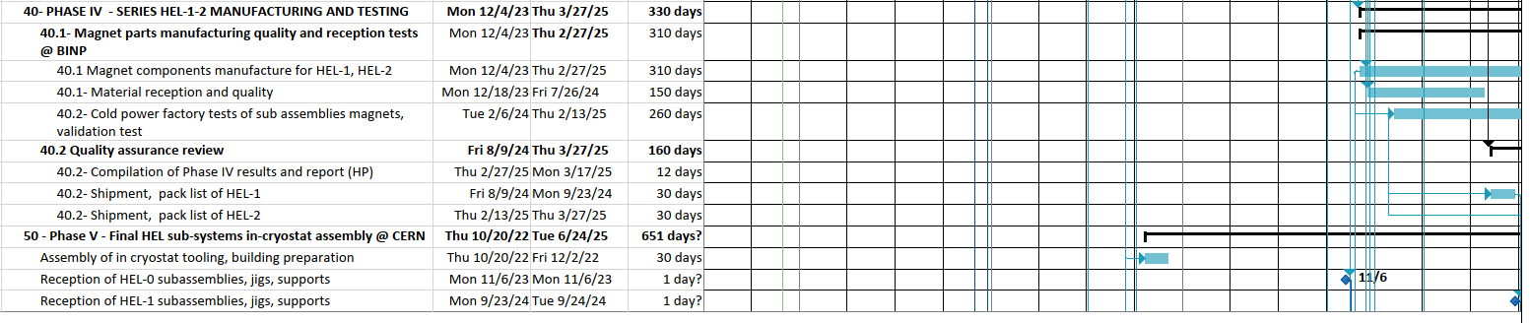
Baseline WP5 HEL Magnet Project v3.0

Slide 36
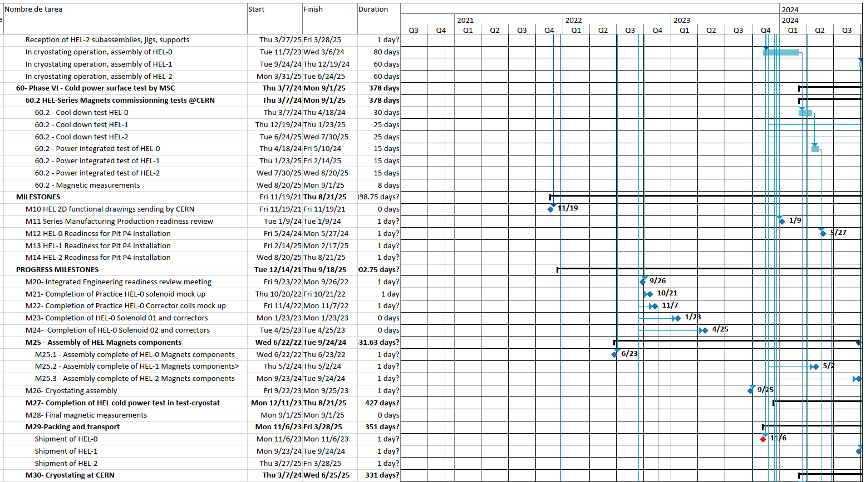
Baseline WP5 HEL Magnet Project v3.0

Slide 37
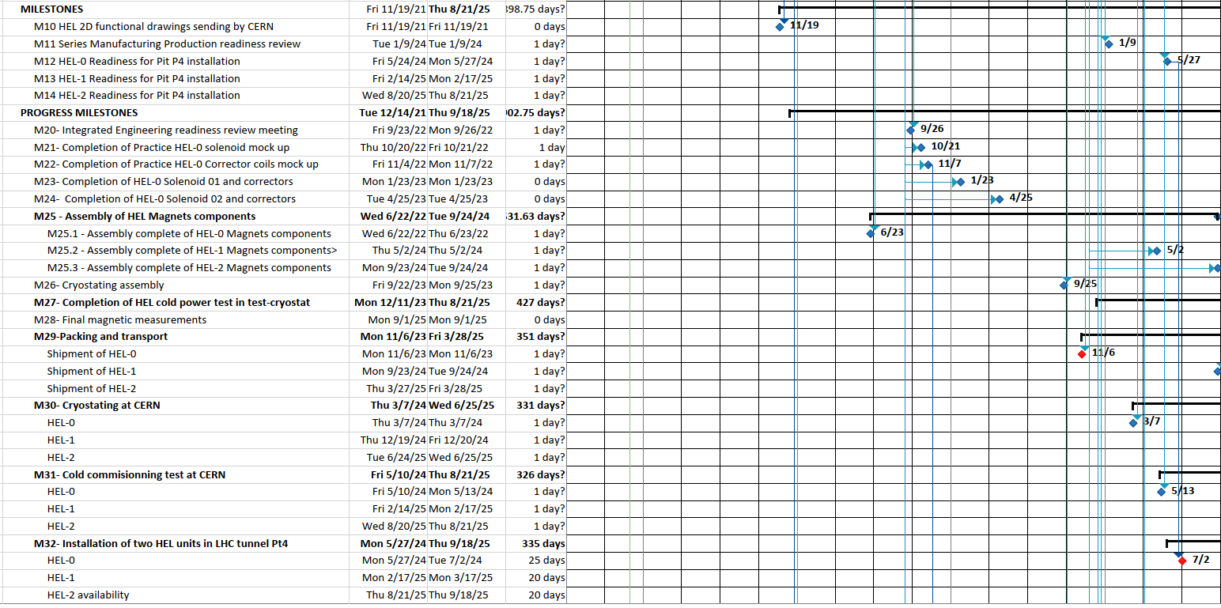
Main milestones

Slide 38
In-kind deliverables proposal
Project deliverables | Date
D1.1 - Manufacturing design files HEL-0 Magnets, cryostat | Thu 6/23/22
D1.2- One practice solenoid coil (trial full-scale coil built) with complete MTF traveller | Fri 10/20/23
D1.3 - One practice corrector coil (trial full-scale coil built) with complete MTF traveller | Mon 11/27/23
D1.4- Main solenoids assembly with complete MTF traveller | Mon 1/8/24
D1.5- Gun and collector solenoids assembly with complete MTF traveller | Tue 2/6/24
D1.6 - Assembly design files HEL-0 Magnets | Wed 8/28/24
D1.7 - Commissioning test summary report of HEL 0 main tooling | Fri 8/9/24
D1.8 - Completed HEL-0 Manufacturing and inspection plan | Wed 8/28/24
D1.9 - Commissionning test report of HEL-0 system | Fri 9/29/23
D1.10- Production readiness review outcome report approval | Fri 10/27/23
D1.11 - Assembly procedure report of HEL-0 system | Mon 11/27/23
D1.12 - Quality control and test reports | Wed 8/28/24
D1.13 - As-built 2D and 3D CAD manufacturing drawings of the HEL-0 magnet | Wed 8/28/24
D1.14 HEL Magnets complete MTF traveller and shipment file | Mon 10/9/23
D2.10 - Updated detailed schedule | Tue 12/14/21
D3.10 – Updated Quality Assurance plan | Fri 9/22/23

Slide 39
TE MSC resources
2021-2025
  MSC resource table (EDMS: 2469326) was revised since dec 2020 to include mandate of coordination of HEL magnets construction and test ( details in back up slides). Total estimate of 4.6 FTEs
  Assumed BINP PJAS supervision at CERN site (∼ 6.6 FTEs). On site assembly team manpower estimate ∼7-8 p for 3 years, to be confirmed by BINP
  TE MSC eng.1 is in charge to coordinate the HEL magnet functional specification, monitor the BINP design, the production packages, main deliverables and test interfaces.
  TE MSC eng,tec.2 estimate ( to be confirmed per mandate) in support as experts from sections (CMI, SCD, SMT, LMF, TM), involved in approval of key procurements, procedure review, link persons, building assembly site coordination, magnetic test.
EDMS: 2469326

Slide 40
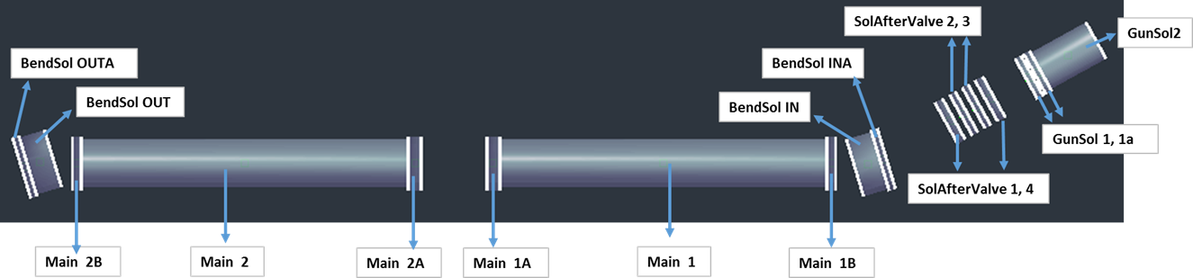

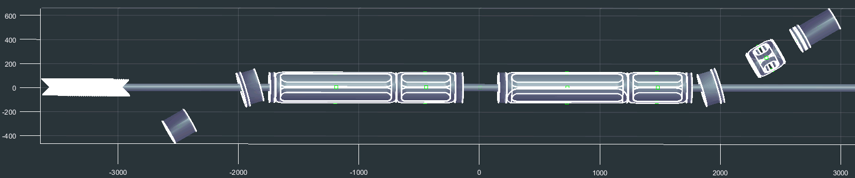
Update of magnetic model
2019 Magnetic model v.2
DipCorrr
ColSolr
2020 Magnetic model v.3, (FIELD Package, A. Foussat)
Main solenoids correctors (2/3, 1/3), CCT based dipole corrector
Gunsol 2
Bendsol OUT A
Bendsol IN
Bendsol IN A
Bendsol OUT
Gunsol 1, 1a
DipCorrr
Main 2
Main 1
ColSolr
MCF meeting HLLHC WP5 HEL MAGNETS A. Foussat 12 Jan 2021

Slide 41
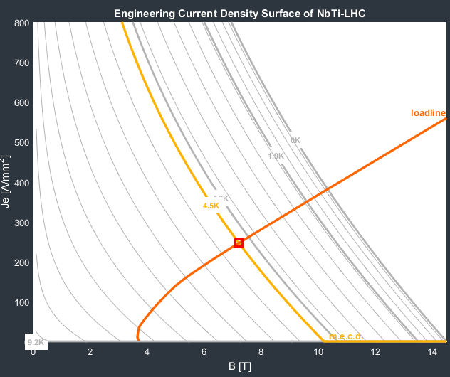
Main trim 1A (head of solenoid)
NbTi 1.65 x 1.05 mm²
Jc (4.5K, 5T)= 2800 A/mm²
insulation thickness ∼ 20 μm
Cu/nCu ratio: 4:1
In = 330 A
Je = 191 A / mm²
Bp = 5.84 T
Operation at I_{ss} at around 80 %.Iss
Reduction of operating margin by 5% due to trim coil field enhancement

Slide 42
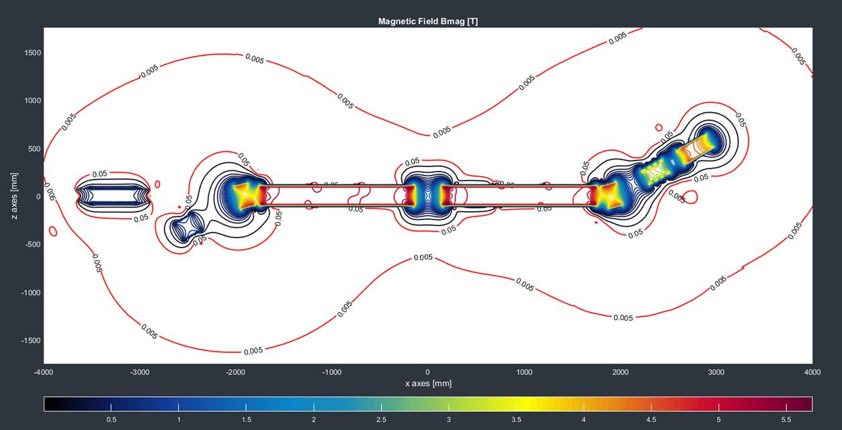
Stray magnetic field
The 5 mT limit line to be checked by WP5 HEL team wrt. Integration of Operating equipments

Slide 43
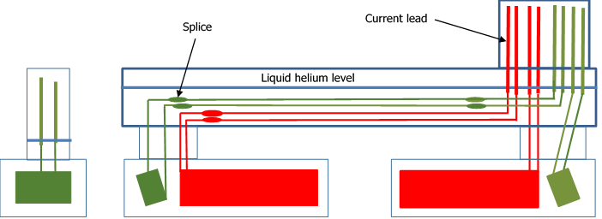
Circuit definition as per 2019-2020
Main circuits of the straight part (red) with the two main solenoids, I=350 A, the two tilted bending solenoids ( green)
MCF meeting HLLHC WP5 HEL MAGNETS A. Foussat 12 Jan 2021

Slide 44
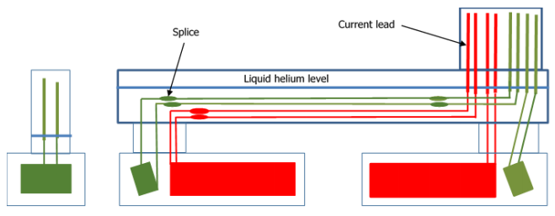
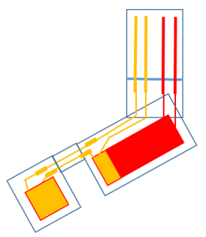
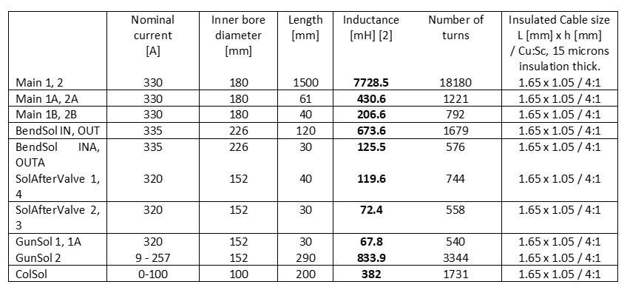
Updated Main Circuits per 2021
*A Foussat, D, Perin: Main parameters of HEL electrical circuits, 2020, EDMS 2036694
MCF meeting HLLHC WP5 HEL MAGNETS A. Foussat 12 Jan 2021

Slide 45
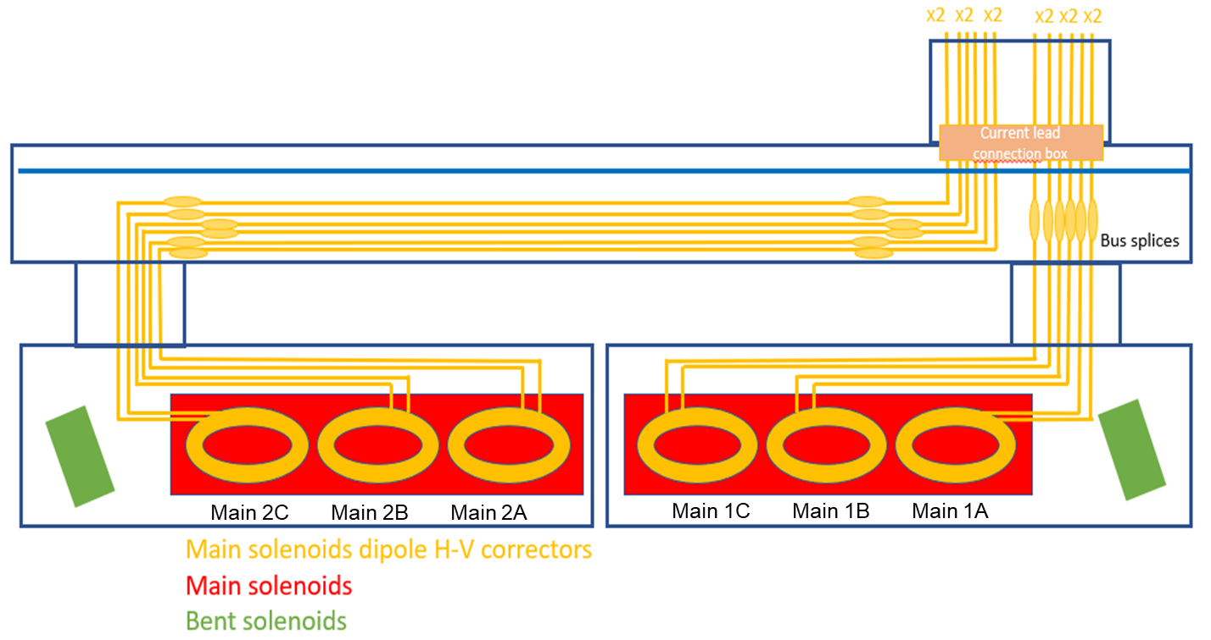
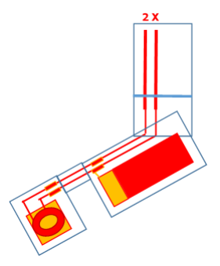
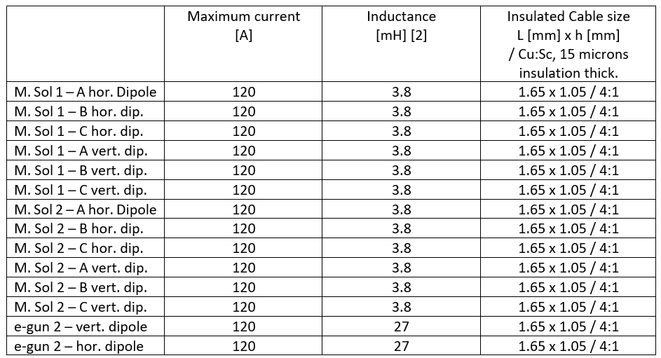
Updated Correctors Circuits per 2021
Corrector circuits in the straight part. Six circuits in main solenoid one (three horizontal dipoles and three vertical dipoles), six circuits in main solenoid two (three vertical dipoles and three horizontal dipoles). Maximum current for all circuits I=120 A.

Slide 46
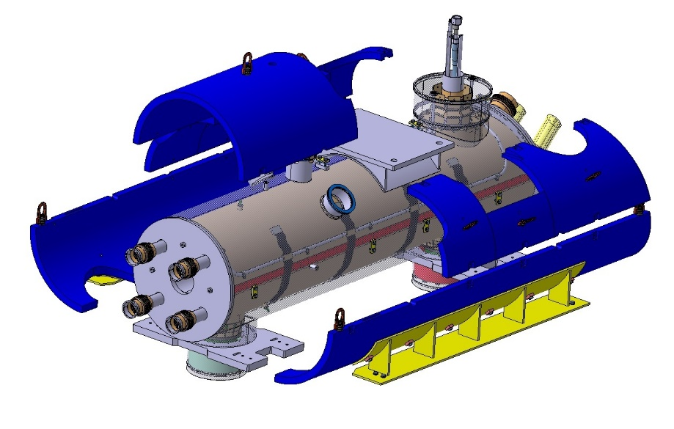
Built to specifications Survey criteria
WGA meeting, on 31st March 2021. Preliminary discussion
Main step actions | Responsible of survey exécution * | Criteria | Design features
Individual solenoid, sub assemblies end flanges, former geometry | BINP | Assembly tolerances : +/- 0.2 mm | Marks on coil former ends and global survey
Individual solenoid, sub assemblies RT magnetic axis measurement, | BINP | +/- 0.1 mm field lines straightness | Marks on coil former ends (3)
Cold mass assembly interfaces, RT magnetic axis transfer | BINP | +/- 0.2 mm transfer accuracy | Marks on cold mass ends (3), shells (2).
Cryostating, warm MM axis measurement check, axis transfer | BINP, CERN | +/- 0.1 mm accuracy network position | Marks on cryostat end flanges, beam pipe alignment reference.
Assembly of HEL units on surface, alignment of sub-cryostat virtual magnetic axis, adjustment jacking. | CERN | Axis alignment tolerances: Δx ∼Δy ∼ +/- 0.2 mm Δz ∼ 0.5 mm | End flanges cryostat 3 points, 2 longitudinal marks on cryostat
Check of assembly girder deformation | CERN | Vertical Δy < 0.6 mm, Maxi. Twist < 2 mrad | 3 marks along girders per side,
MM cold test of HEL unit | CERN | 0.2 mm OD cylinder field axis straightness | Magnetic axis wrt external network
Construction of HEL unit survey network for installation | CERN | Accuracy +/- 0.1 mm | HEL network survey targets
Under progress

Slide 47
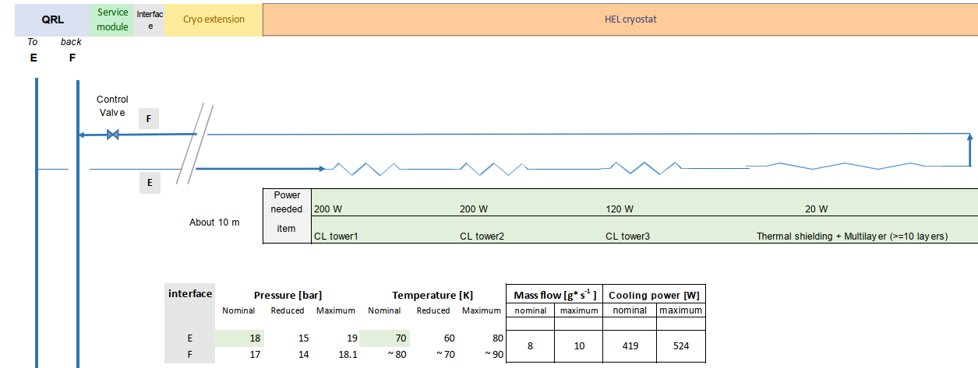
Cooling circuit heat load technical specification
Total specified heat loat budget at 77 K : 500 W
Total specified heat loat budget at 4 K : 20 W
On going definition of 77K thermal load budget for thermal shields and gas cooled currrent lead circuit
Courtesy of FG Ferlin
TE CRG

Slide 48
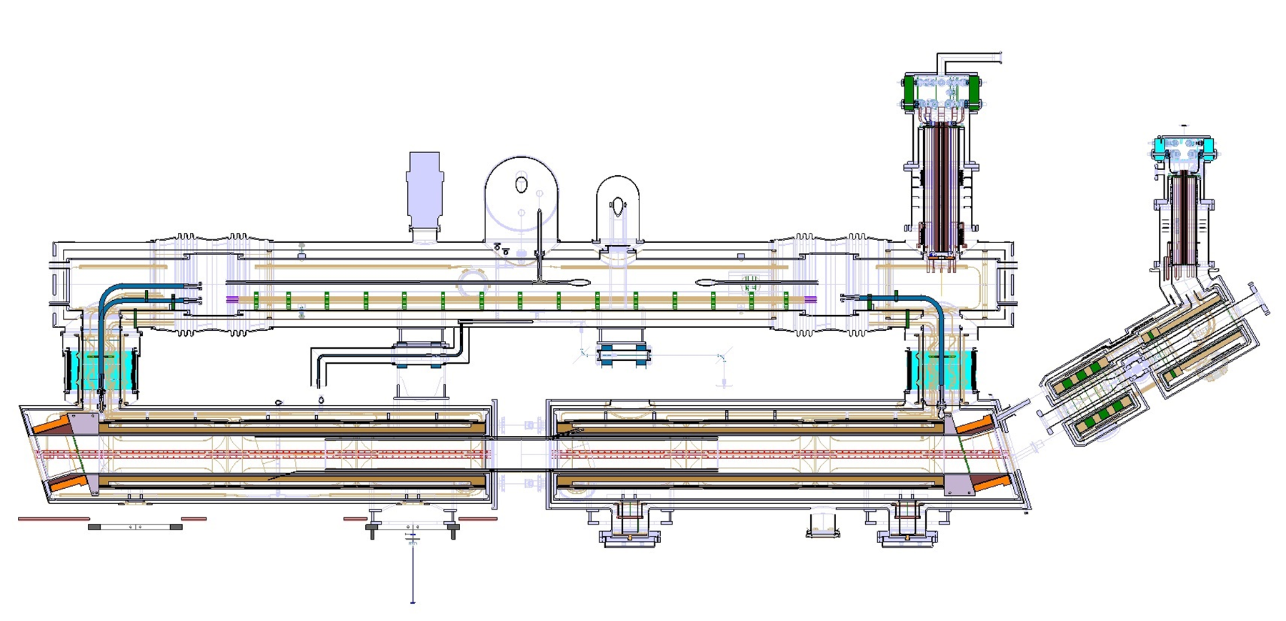
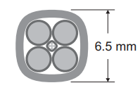
HEL electrical Mains circuit busbars
MAIN AND BENDING SOLENOID BUS ROUTING
On progress
LENGTH OF BUSBAR CABLE = 4800 mm
LENGTH OF BUSBAR CABLE = 1500 mm
CONNECTION OF MAIN AND BENDING SOLENOID WITH THE BUSBAR CABLE
600 A LHC NbTi busbar type
Total of 80 m need.
MCF meeting HLLHC WP5 HEL MAGNETS A. Foussat 12 Jan 2021

Slide 49
HEL electrical Correctors circuit interface
MAIN SOLENOID H+V CORRECTOR CIRCUITS
On progress
TWO BUSBAR CABLES
2100 mm
3100 mm
TWO BUSBAR CABLES:
5400 mm
6400 mm
MCF meeting HLLHC WP5 HEL MAGNETS A. Foussat 12 Jan 2021

Slide 50

Magnet system Load specifications
Benchmarked nominal load table based on BINP and CERN magnetic models
EDMS 2479912

