Slide 2

A final cooling scheme for muon colliders: a door opener for future discovery machines
Joint Annual Meeting of ÖPG and SPS 2021
Bernd Stechauner^{1,2}, Elena Fol², Jochen Schieck^{1,3}, Chris Rogers⁴ and Daniel Schulte²
¹University of Technology Vienna,
²CERN, Geneva
³Institute of High Energy Physics, Vienna
⁴STFC Rutherford Appleton Laboratory, Didcot

Slide 3
Overview
Muon collider motivation
Physics behind a final cooling cell
First emittance reduction simulations

Slide 4
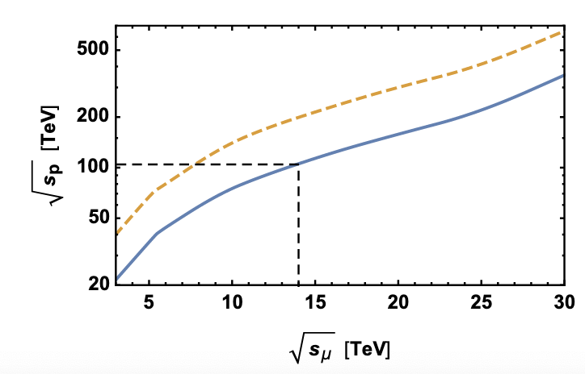

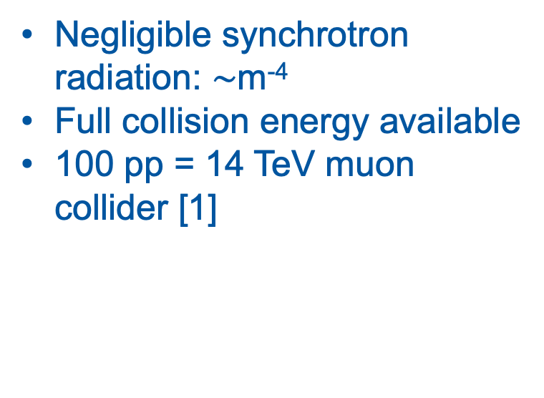
Motivation
[1]
Negligible synchrotron radiation: $\sim$m⁻⁴
Full collision energy available
100 pp = 14 TeV muon collider [1]
BUT: Lifetime 2.2$μs$
[1] arXiv:1901.06150v1
Notes:
Novel particle accelerator society whether a new collider should be built. It is more the question which
One opportunity is a MC
1960 with several options:
Synchrotron radiatiuon, 4th power inverse mass, no limit in energy, ee collider has limitation
No Pdf
Compare FCC-hh with MC, dashed line assumes comparable Feynman amplitudes
Physics potential point:
Higgs self coupling, shape of Higgs potential, EW symmetry break
Coupling of second and first particle generation
Couple to unknown particles

Slide 5
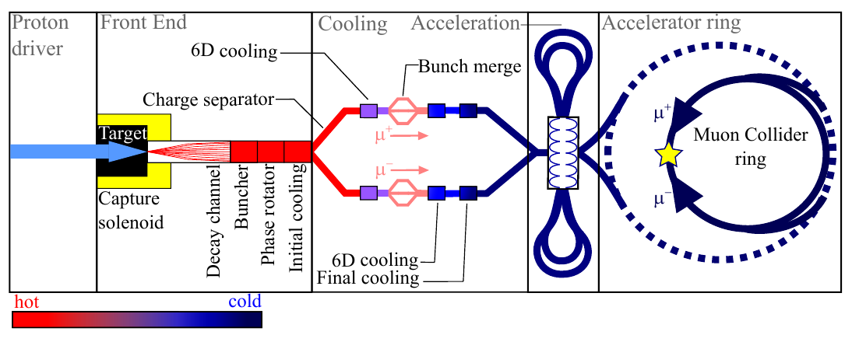
Current MC design
[2]
[2] U.S. Muon Accelerator Program

Slide 6
Emittance
HOT
COLD
Angle:
Emittance:
LI. Emittance:

Slide 7
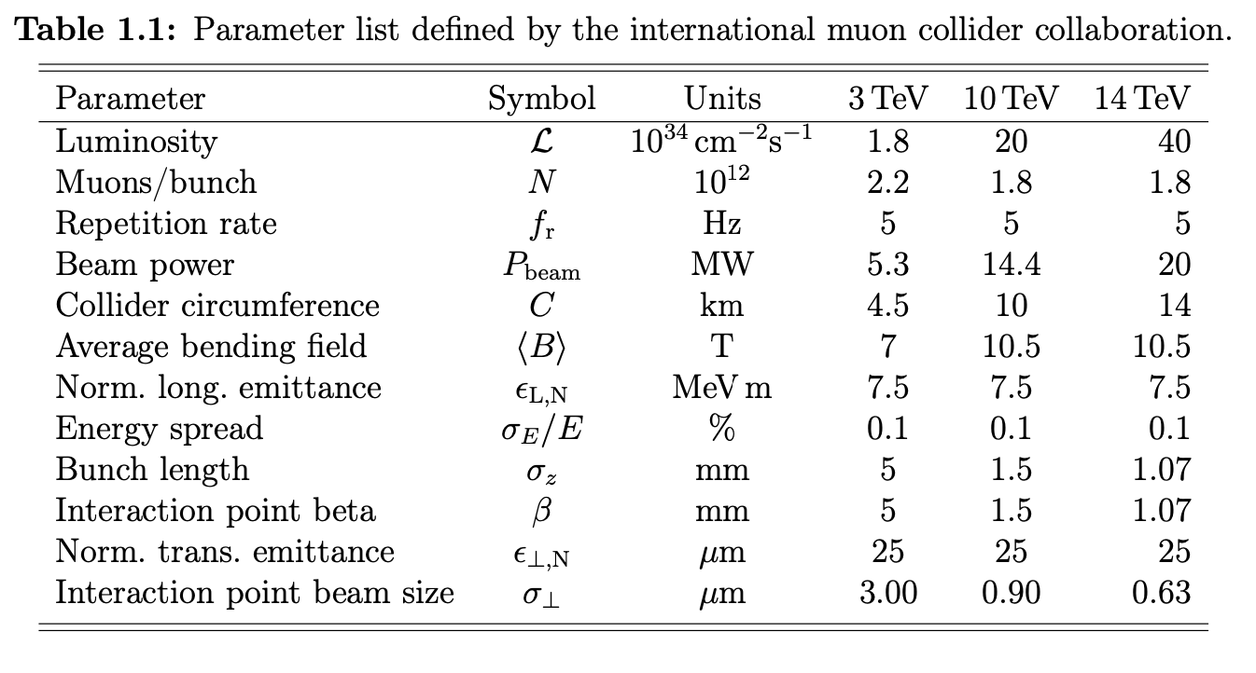
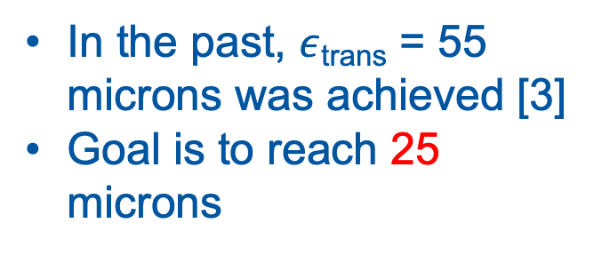
Target parameters
Emittance
In the past, $ε$_{trans} = 55 microns was achieved [3]
Goal is to reach 25 microns
[3] H. K. Sayed,10.1103/PhysRevSTAB.18.091001
Notes:
The Luminosity of decaying particles is quite different compared to standard Luminosities
Energy
Number
Circumference
Transversal emittance
Map reached only 55 because they included in their simulations only parameters which were achievable in the near future
We use other parameters for reaching the target emittance

Slide 8
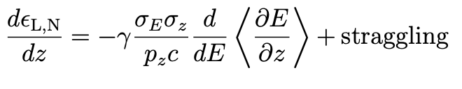
Ionization cooling
Notes:
For cooling emittance several techniques are available
Laser cooling
Electron cooling
Stochastic cooling
Only ionization cooling fast enough
Explain sketch

Slide 9
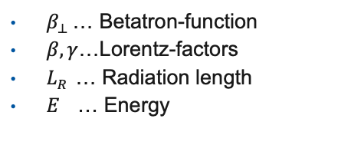
Final cooling cell structure
Cooling equation [4,5]:
$β_{⊥ }$… Betatron-function
$β,γ$…Lorentz-factors
$L_{R }$… Radiation length
$E$ … Energy
No correlations included!
Bethe-Bloch curve
[4] A. N. Skrinsky, V. V. Parkhomchuk 1981
[5] D. V. Neuffer 1993
Notes:
Components
Make a small simulation with different absorbers

Slide 10
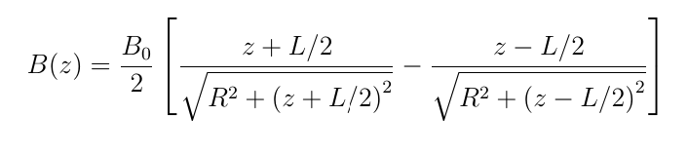
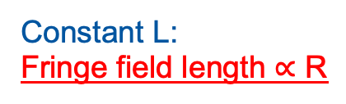
Parameter manipulation
Radius
Constant L:
Fringe field length $∝$ R

Slide 11
Fringe field optimization
Here: Minimize correlation

Slide 12
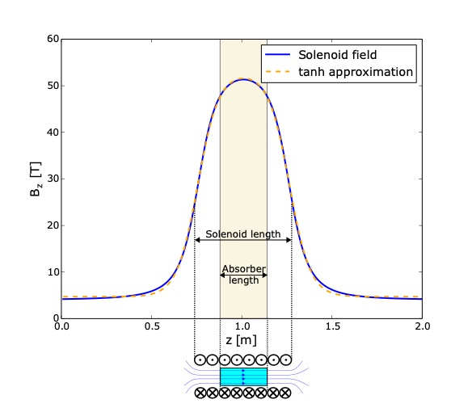

Cooling simulation
ICOOL simulation [6]
Initial beam parameters:
P_{z} = 80 MeV/c
Emittance = 55 microns
Absorber: liquid Hydrogen
26 cm
Cooling until 30 MeV/c
50 T solenoid
Cooling below 55 microns by means of higher fields possible

Slide 13
Bad fringe field optimization
Analytical estimation
ICOOL simulation

Slide 14
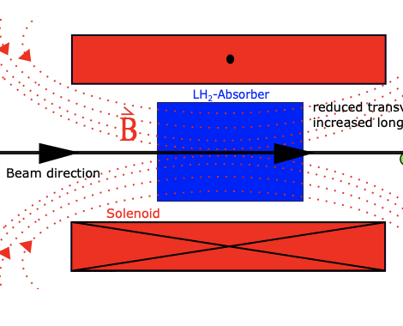
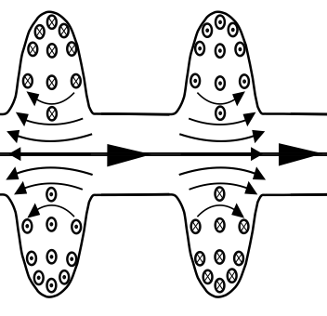
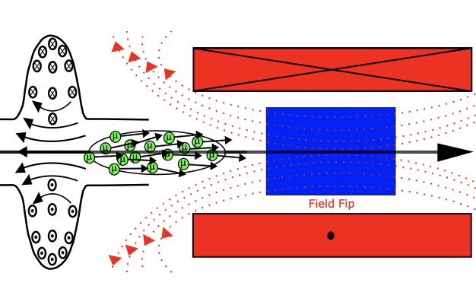
Summary and Outlook
Simulation of ionization cooling
Cooling under 55 microns possible
Next steps:
Reaccelerate the cooled beam
Field flip
Simulate couple of cooling cells
Notes:
These 5 points are relevant for simulating a hole cooling cell

Slide 15
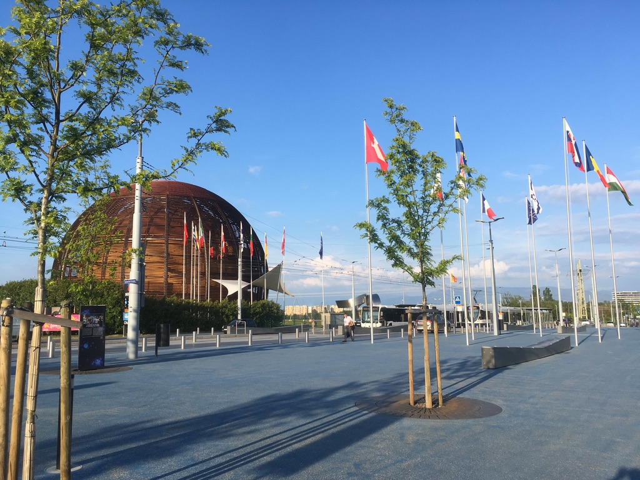

Thank you for your attention and wish me luck!!
Questions?

Slide 16
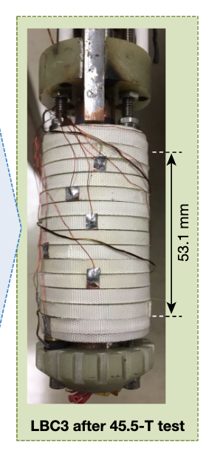
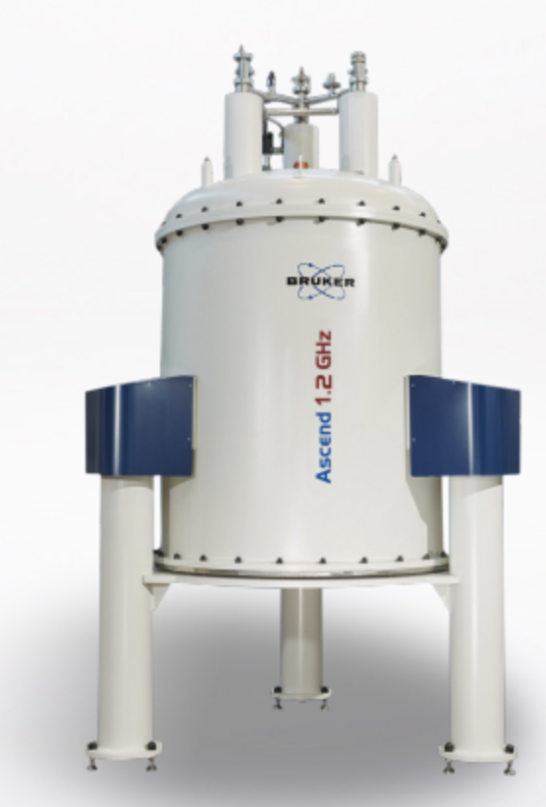
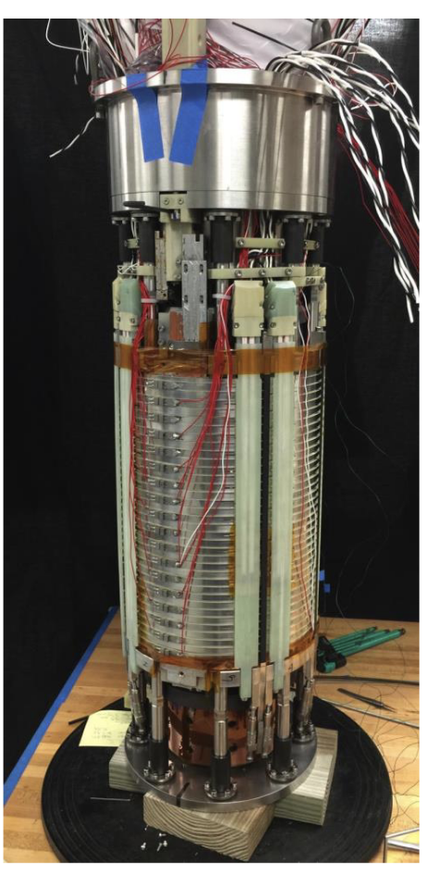
Appendix
Industrial use of high-resolution NMR at 28.2 T [7]
32 T solenoid with low temperature HTS [8]
45 T !! [9]
[7] www.bruker.com
[8] 10.1109/TASC.2011.2174952
[9] 10.1038/s41586-019-1293-1
Notes:
Components
Make a small simulation with different absorbers

