Slide 1



Novel Developments In R-Matrix Theory
Atominstitut, TU Wien:
H. Leeb, B. Raab, T.Stary, Th. Srdinko
This work has been carried out within the framework of the EUROfusion Consortium and has received funding from the Euratom research and training programme 2014-2018 and 2019-2020 under grant agreement No 633053. The views and opinions expressed herein do not necessarily reflect those of the European Commission.
support by the KKKÖ Matching Grant MG 2018-7 of
the Austrian Academy of Sciences is acknowledged.

Slide 2
Motivation - Background
There is a worldwide effort to determine the best knowledge
of nuclear reaction cross sections (nuclear data libraries)
This is an important prerequisite for the development of
new technologies in various fields (fusion research,
advanced reactor techniques, medicine, safety issues,
space science, materials testing,…
General problem is the resonant behaviour at low incident
collision energy, reflecting the many-body character of
nuclei. (Especially, in light nuclear systems.)

Slide 3
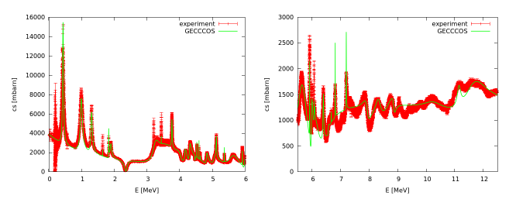
The total n+¹⁶O cross section
Example: Neutron Cross Sections on ¹⁶O

Slide 4
Challenges in Light Nuclear Systems
Problems:
Resonance range up to relatively high incident energies
No predictive quantitative microscopic models
R-Matrix Theory
No microscopic information,but satisfies all conservation rules
Proposed by Eisenbud and Wigner in the fifities of the last century

Slide 5
Standard R-Matrix Formalism: wave function
2-particle channel: cm-system
γ_{λc} γ_{λc‘}
Ε_{λ}−Ε
channel surface
R _{cc‘} = Σ_{λ}
incoming spherical wave
outgoing spherical wave
collision matrix, S-matrix
basis functions i=1,2,…
coefficients i=1,2,…

Slide 6
New R-Matrix Code: GECCCOS
GECCCOS (GEneral Coupled-Channel COde System)
A new comprehensive R-matrix code developed by T. Srdinko at TU Wien
New features compared with existing R-Matrix codes (SAMMY, AZUR, …)
but also compared to special codes like EDA, FRESCO, RAC, …
New Features:
Capability of calculabe R-Matrix calculations
Possibility of hybrid R-Matrix approach
Analysis procedures based on different optimization procedures
Allowing for combined analysis of observables and S-matrices
Transformation of R-matrices to different matching radii
Current Developments
Development of R-matrix formulations for three-body channels (breakup)
Reduced R-matrix parametrisations accounting for thresholds of
non-explicitly treated channel

Slide 7
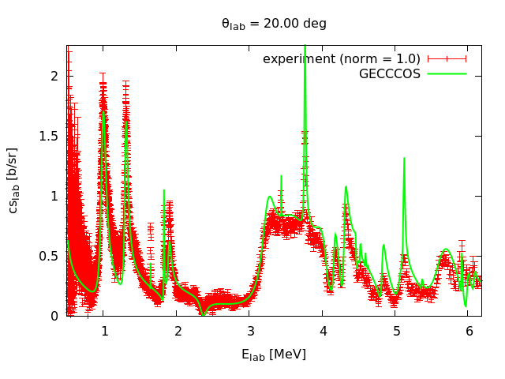
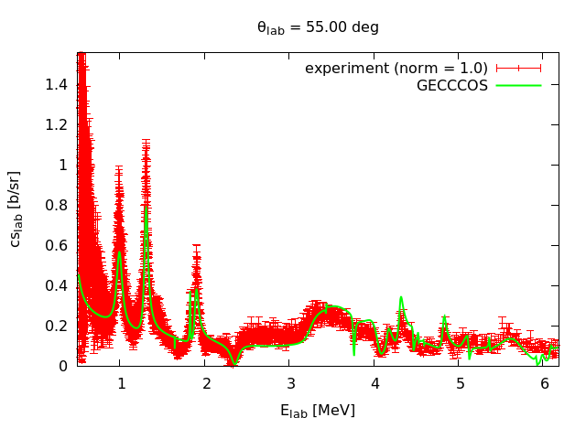
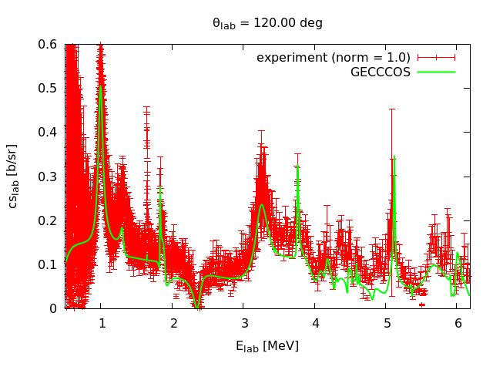
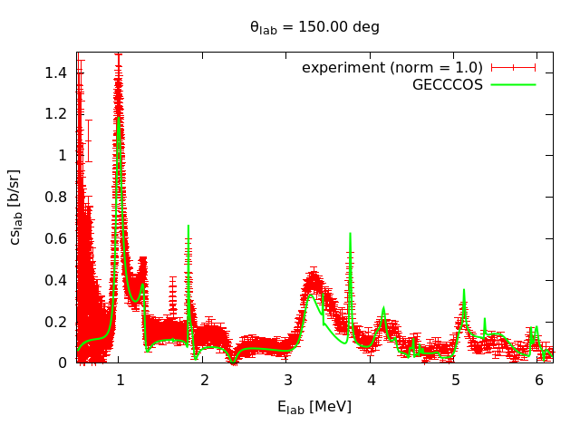
Elastic excitation functions
20 degree
55 degree
120 degree
150 degree

Slide 8
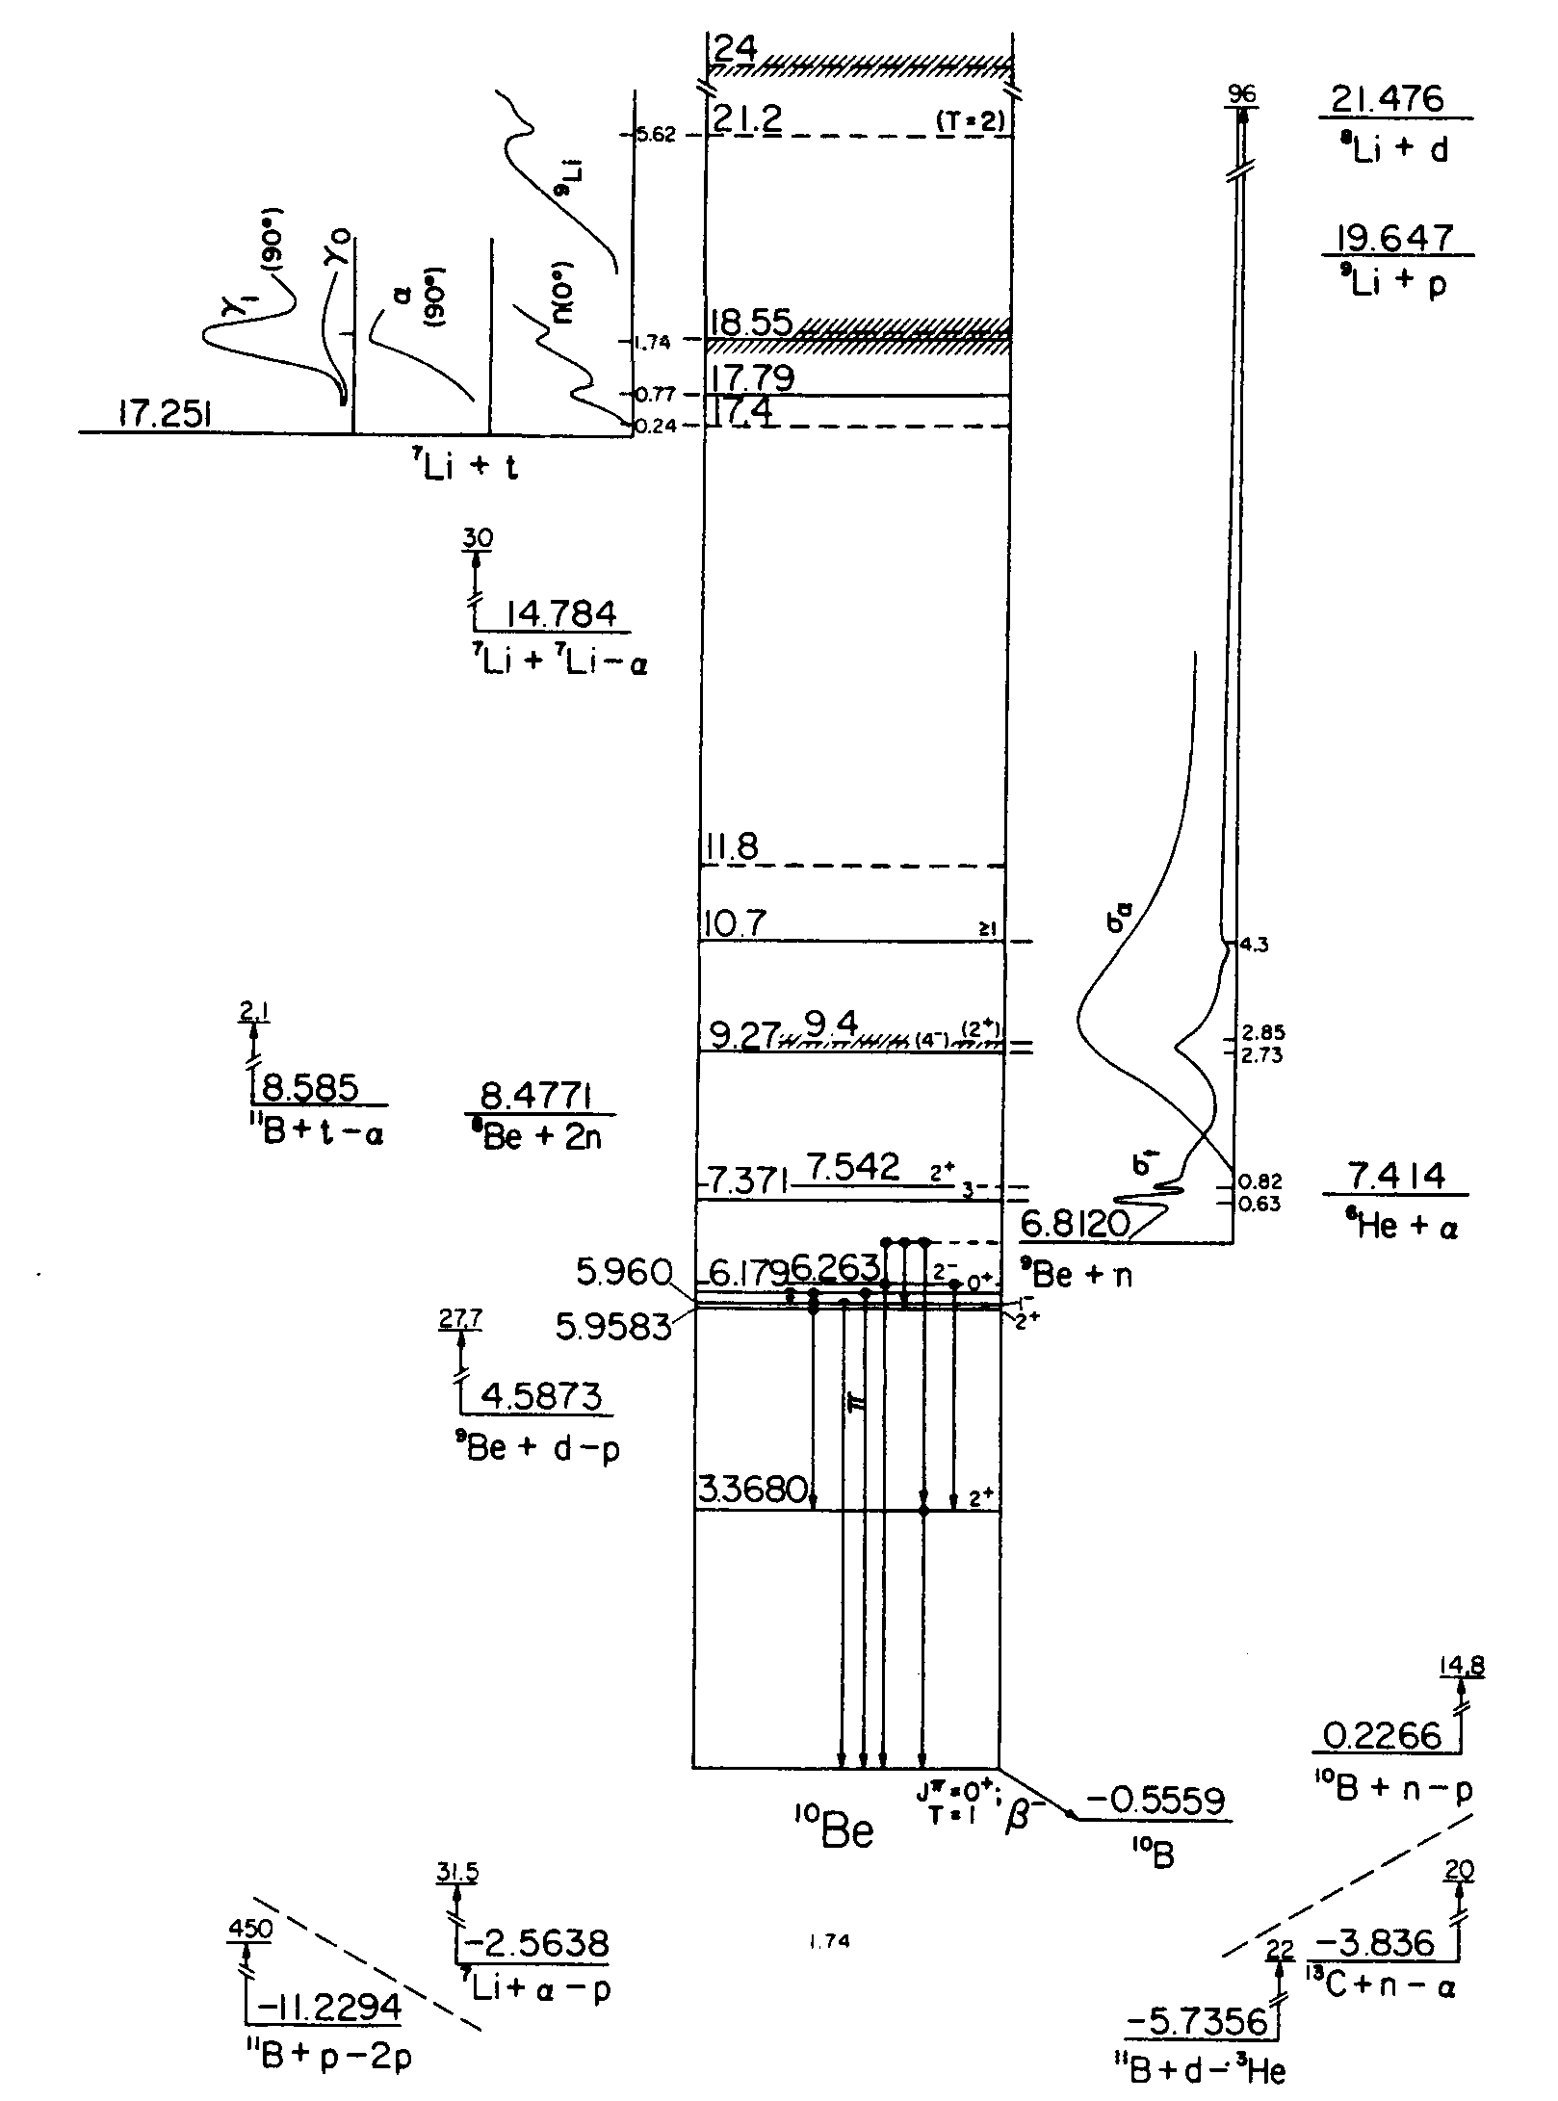
Light Nuclear Systems:
Further Challenge
n-induced Reactions
⁹Be(n,n)⁹Be Q= 0.0000 MeV
⁹Be(n,α)⁶He Q= -0.5971 MeV
⁹Be(n,2nα)⁴He Q= -1.6636 MeV
⁹Be(n,nα)(⁵He) Q= -2.3073 MeV
⁹Be(n,t)⁷Li Q=-10.4373 MeV
⁹Be(n,p)⁹Li Q=-12.8248 MeV
⁹Be(n,tα)t Q=-12.9049 MeV
⁹Be(n,d)(⁸Li) Q=-14.6615 MeV
⁹Be(n,t)(⁸Li) Q=-14.6615 MeV
⁹Be(n,nd)⁷Li Q=-16.6932 MeV
⁹Be(n,np)(⁸Li) Q=-16.8861 MeV
⁹Be(n,nt)⁶Li Q=-17.6871 MeV
⁹Be(n,α)⁶Li Q=-19.2874 MeV
⁹Be(n,pt)⁶He Q=-20.4108 MeV
⁹Be(n,³He)(⁷He) Q=-21.5845 MeV
⁹Be(n,pα)(⁵H) Q=-23.1857 MeV
¹⁰Be

Slide 9
R-Matrix Formalism: Concept
Standard
2-particle channel:
cm-system
Extension to 3-Particles
Problems:
no fixed channel surface in space
asymptotic form of wave function
in 3-body breakup
impact of off-shell behavior of
2-body t-matrix on breakup
channel
surface
Inter-action
region
Proposal of Glöckle: R-Matrix
Formulation based on the Faddeev
Equations (only s-waves)
variable channel surfaces
problem-adapted basis functions
Lane, Thomas, Rev. Mod. Physics 30, 257 (1958)
W. Glöckle, Z. Phys. 271, 31 (1974)

Slide 10
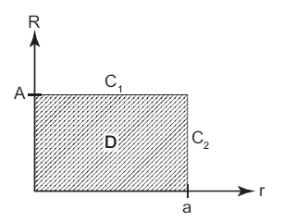
Three-body formalism of Glöckle
R, r Jacobi-cordinates of
three-body system
expansion of wave function in D: set of basis functions
algebraic system of
linear equations for
the coefficients c^{i}_{µ}
A.c=B[T_{b},T(k)]
boundary condiitons on C₁ and C₂
Faddeev equations in configuration space

Slide 11
Calculation of cross sections
Breakup cross section:
Elastic cross section:

Slide 12
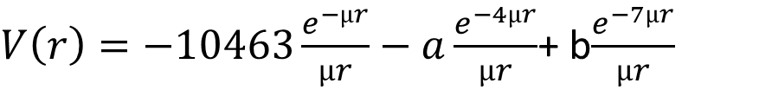
First system to be studied:Neutron-Deuteron system
E_{b}=-2.225 MeV
Potential of Reid soft core type:
$V\left(r\right)=−10463\frac{e^{−µr}}{µr}−a\frac{e^{−4µr}}{µr}$+ b$\frac{e^{−7µr}}{µr}$
a and b determined by fitting to Nijmegen phase shift data and E_{b}
(Phys. Rev. C 48 (1974)792)
for np interaction: a=1650.6 MeV, b=5371.5 MeV
for nn interaction: a=1210,4 MeV, b=4257,5 MeV
Regularization of the system of linear equations
A.c=B[T_{b},T(k)] → (A + η).c=B[T_{b},T(k)]

Slide 13
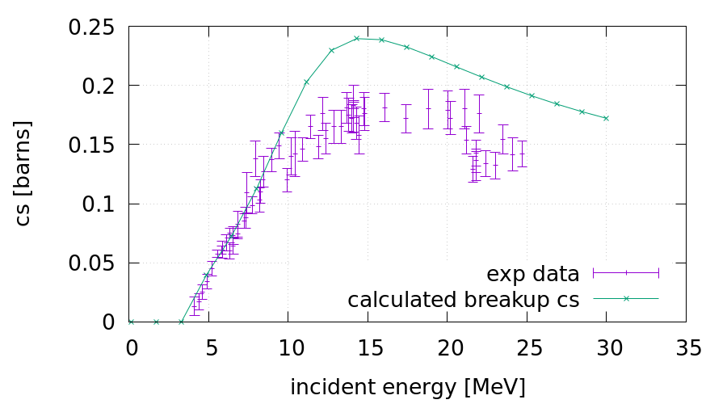
3-Body R-Matrix Calculation: Deuteron Breakup n+d → n+n+p
First calculation based on a three-body R-matrix:
required substantial modifications of original Glöckle formalism:
- conditions on basis functions, bound state corrections, …
- regularisation of linear equations
PhD thesis B. Raab

Slide 14
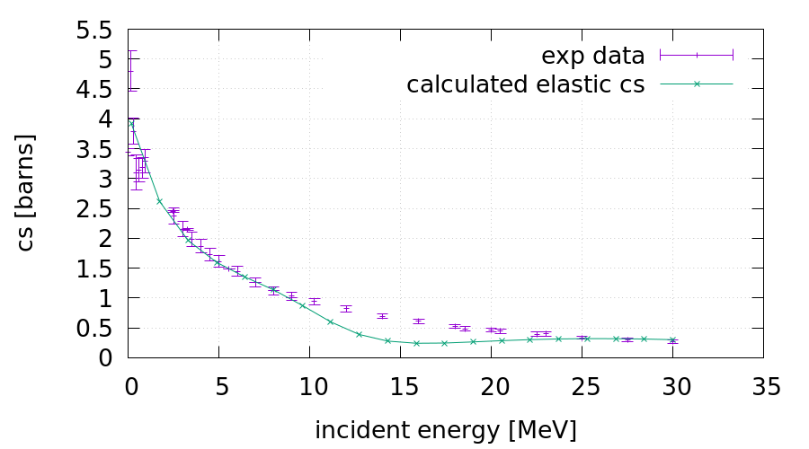
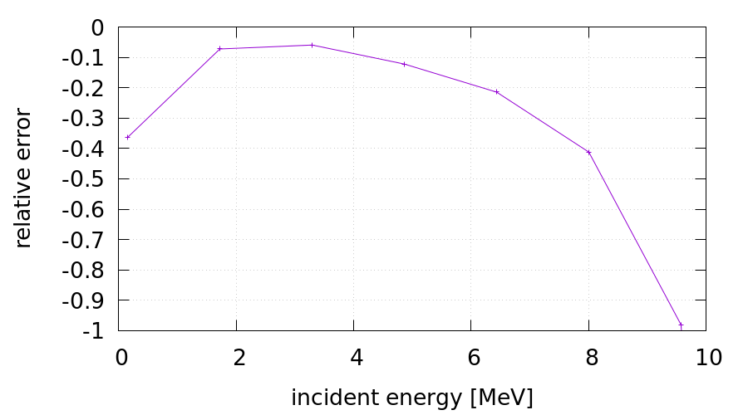
3-Body R-Matrix Calculation:
Elastic Scattering n+d → n+d
Optical Theorem
PhD thesis B. Raab

Slide 15
Summary and Outlook
Generation of basic tools for the evaluation of nuclear reaction data of light nuclear systems
Construction of the novel R-Matrix Code GECCCOS
Development and Implementation of the first R-Matrix analysis based on the Faddeev equations
Novel Parametrisation of the Reduced R-Matrix for analyses of incomplete reaction data

Slide 16
The Nuclear Data Team at TU Wien
Helmut Leeb
Benedikt Raab Tanja Stary
Thomas Srdinko and BA students
Thank you for your attention

Slide 17
Reduced R-Matrix Formalism:
Motivation
In nuclear physics the number of energetically open channels rises
significantly with increasing energy.
Unitary treatment of R-matrix description becomes increasingly difficult
experimental data are only available for a limited number of channels
there are channels which cannot be described by R-matrix theory
R-matrix analyses become numerically involved
Lane and Thomas introduced the
Reduced R-Matrix Formalism
A.M.Lane, R.G. Thomas, Rev. Modern Physics 30 (1958) 257 chapter 10

Slide 18
Development of adequate reduced R-matrix parametrisation
the R_{rr}-submatrix
is not unitary
Maintaining the S-matrix
elements of S_{rr} equivalent
leads to the following
relationship (Lane & Thomas)
R₁₁ R₁₂ ……. R₁₅ .. R_{1n}
R₂₁ R₂₂ ……. R₂₅ .. R_{2n}
R₃₁ R₃₂ ……. R₃₅ .. R_{3n}
R₄₁ R₄₂ ……. R₄₅ .. R_{4n}
R₅₁ R₅₂ ……. R₅₅ .. R_{5n}
… … ……. … .. …
R_{n1} R_{n2} ……. R_{n5} .. R_{nn}
R =
the complete
R-matrix is unitary
R_{ee} eliminated
channels

Slide 19
Novel Parametrisation for
Reduced R-Matrix Analyses
Proposal based on exact solutions for elimination of channels
In 2- and 3-channel systems
complex above threshold
Important feature: L(k_{m}a) =
real below threshold

Slide 20
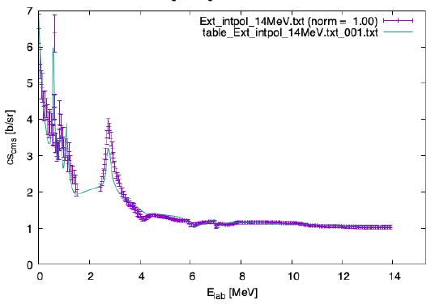
Preliminary Reduced R-Matrix Analysis: n+⁹Be elastic cross section
n+⁹Be σ_{elastic}
σ_{elastict} (mbarn)

Slide 21
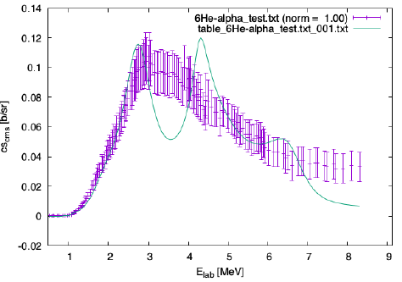
Preliminary Reduced R-Matrix Analysis:
Reaction: n+⁹Be→ ⁶He+⁴He

Slide 22
Summary and Outlook
Generation of Basic Tools for the Evaluation of Nuclear Reaction Data of Light Nuclear Systems
Construction of the novel R-Matrix Code GECCCOS
Development the first R-Matrix Analysis based on the Faddeev equation
Novel Parametrisation of the Reduced R-Matrix for analyses of incomplete reaction data

Slide 23
The Nuclear Data Team at TU Wien
Helmut Leeb
Benedikt Raab Tanja Stary
Thomas Srdinko and BA students
Thank you for your attention

Slide 24
Determination of R-Matrix
equation for the
coefficients c_{µ}
and the T-matrices
equation for the
coefficients c_{µ}
and the T-matrices

Slide 25
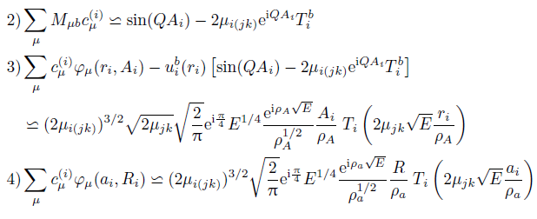
Boundary conditions
with

Slide 26
T-amplitudes
Transition amplitude from channel α to β:
Comment:
Corresponds for reactions
to the collision matrix
element U_{βα} usually defined
In three-body quantum
Scattering theory
Elastic or rearrangement
Breakup
with

