Slide 1


SPS/ÖPG Annual Joint Meeting 2021
FAKT session
31th August 2021
Search for the multilepton final state @LHCb
B⁺ → K⁺ J/ψ ɣ*(→μ⁺μ⁻)
Sonia Bouchiba, Vitalii Lisovskyi, Lesya Shchutska

Slide 2
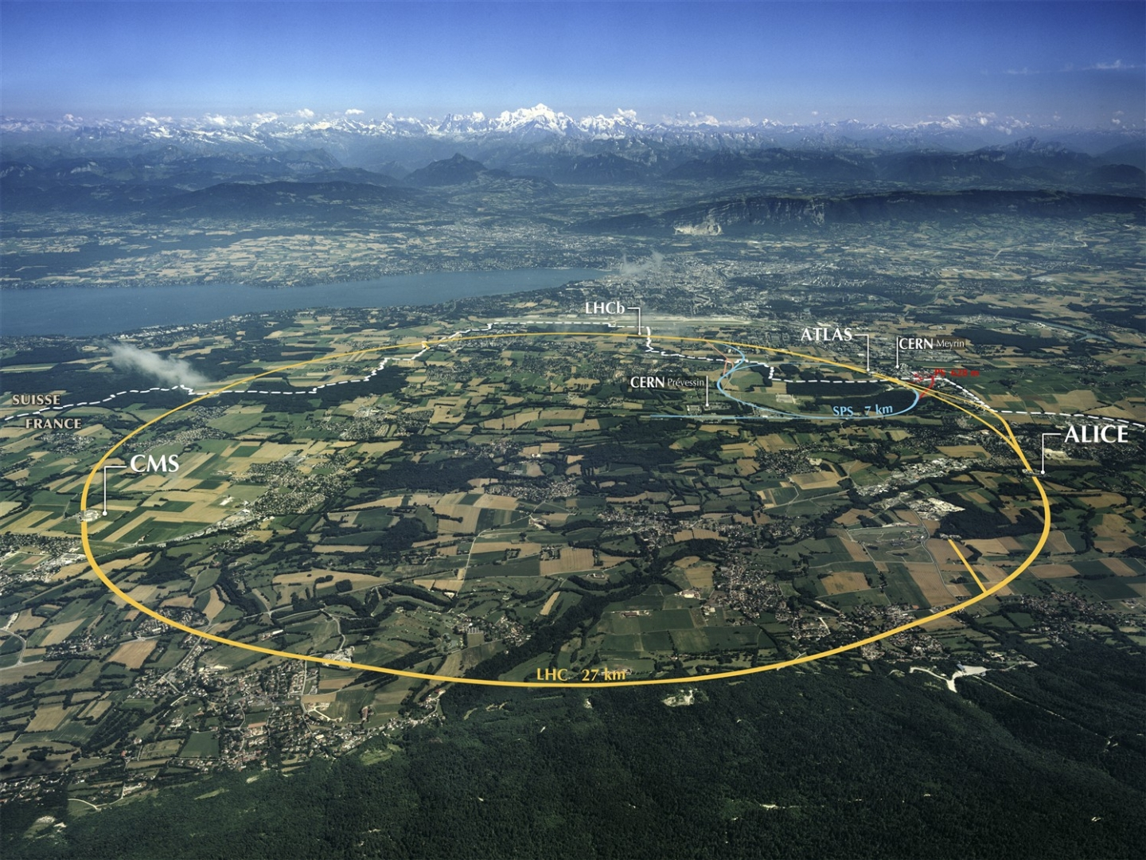
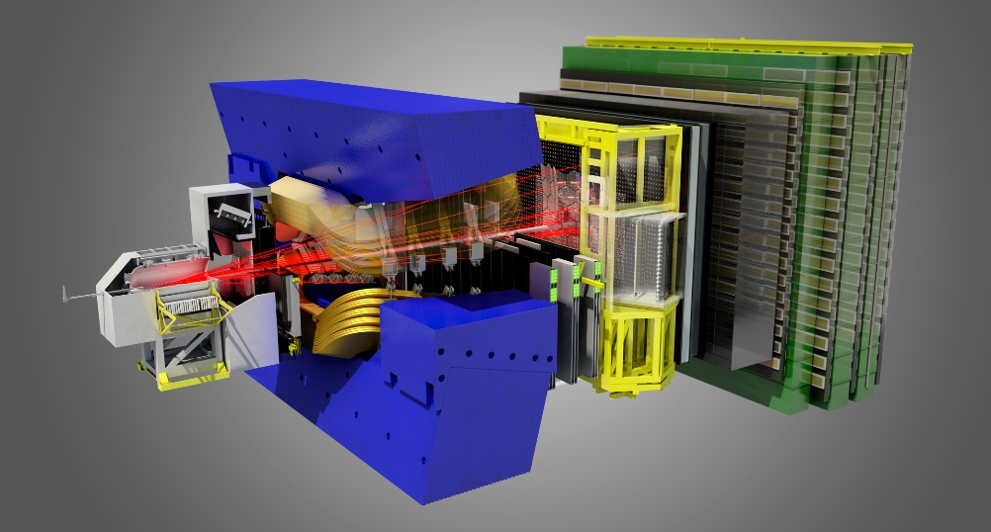
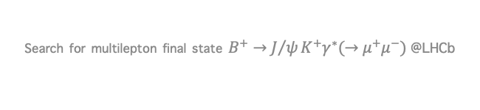
Large Hadron Collider @ CERN
Construction of knowledge on elementary particles and their interaction = constant interconnection between theory buildings and experimental observations
Observing new phenomena is a nice goal… but one must first make them happen!
LHC
27 km circumference
13 TeV proton-proton collisions
40 MHz collision rate
Sonia Bouchiba

Slide 3
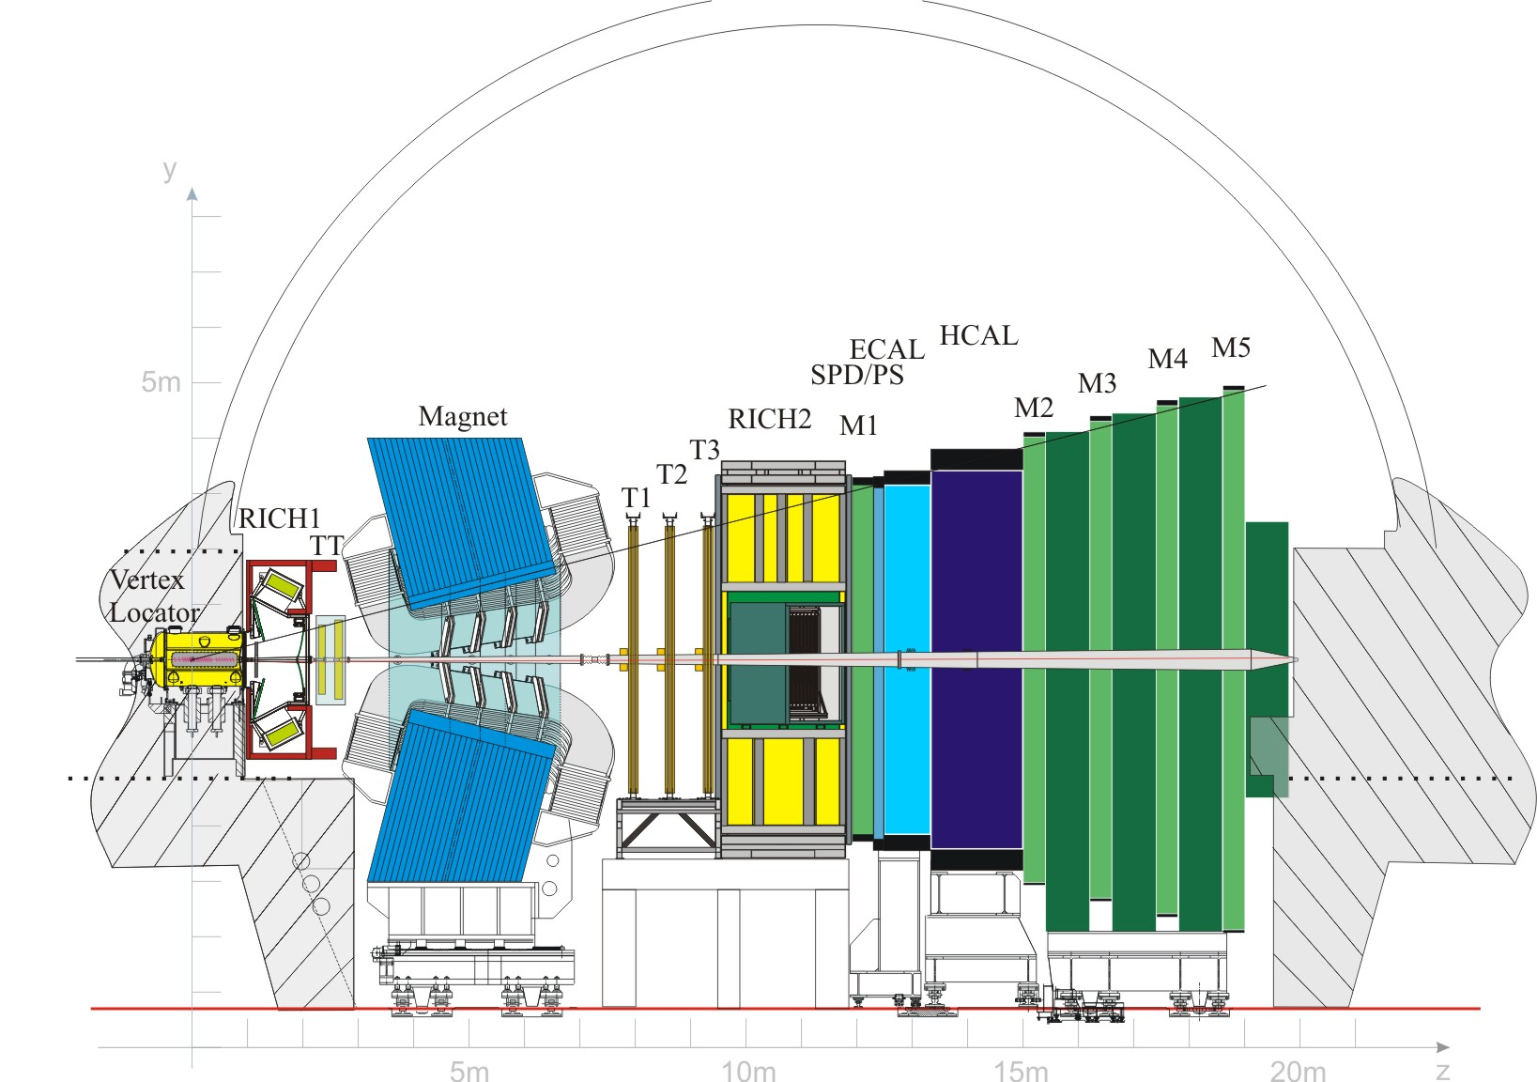

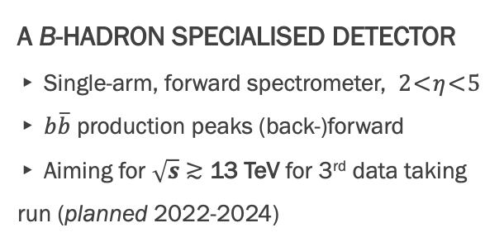
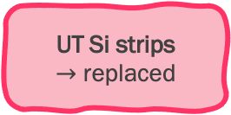

LHCb experiment
UPGRADED
RICH
Replace HPD and R/O
Calo PMTs
Replace R/O
Muons MWPC
almost compatible
A B-HADRON SPECIALISED DETECTOR
▸ Single-arm, forward spectrometer, $2<η<5$
▸ $b\overline{b}$ production peaks (back-)forward
▸ Aiming for $\sqrt{s}$ $≳$ 13 TeV for 3rd data taking run (planned 2022-2024)
MAJOR UPGRADE FOR RUN 3 (2022)
▸Event readout rate ⨉40
▸ Upgrade of ~all detectors
▸ Full software trigger, with increased computing power
VELO
Micro Si strips $→$ pixels
UT Si strips
$→$ replaced
Tracking stations
Si strips/gas tube
$→$ SciFi
REPLACED
Largely developed
@ !
Sonia Bouchiba

Slide 4


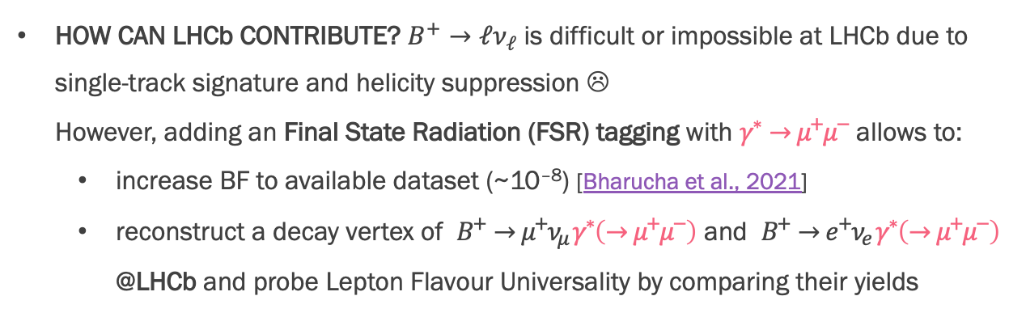






Ok... but why?
FLAVOUR ANOMALIES IN SEMILEPTONIC B-DECAYS
$$d$$
$$s$$
$$b$$
$b→cℓν_{ℓ}$shows anomaly @ 3𝜎 using yields of $τ$ vs. light leptons ($μ, e$) [HFLAV summary, 2019]
$b→uℓν_{ℓ}$can be probed in $B^{+}→ℓν_{ℓ}$ decays
Only measurement [Belle Collab,2004]
$\frac{BR\left(B^{+}→ {τν}_{τ}\right)exp}{BR\left(B^{+}→{τν}_{τ}\right)SM}$ = 1.31±0.27 @1.5𝜎
$$u$$
$$c$$
$$t$$
HOW CAN LHCb CONTRIBUTE? $B^{+}→ℓν_{ℓ}$ is difficult or impossible at LHCb due to single-track signature and helicity suppression ☹ However, adding an Final State Radiation (FSR) tagging with $γ^{∗}→μ^{+}μ^{−}$ allows to:
  increase BF to available dataset (~10^{–8}) [Bharucha et al., 2021]
  reconstruct a decay vertex of $B^{+}→μ^{+}ν_{μ} γ^{∗}\left(→μ^{+}μ^{−}\right)$ and $B^{+}→e^{+}ν_{e} γ^{∗}\left(→μ^{+}μ^{−}\right)$ @LHCb and probe Lepton Flavour Universality by comparing their yields
Experimental challenge 💪 → use of very soft muons
Sonia Bouchiba

Slide 5
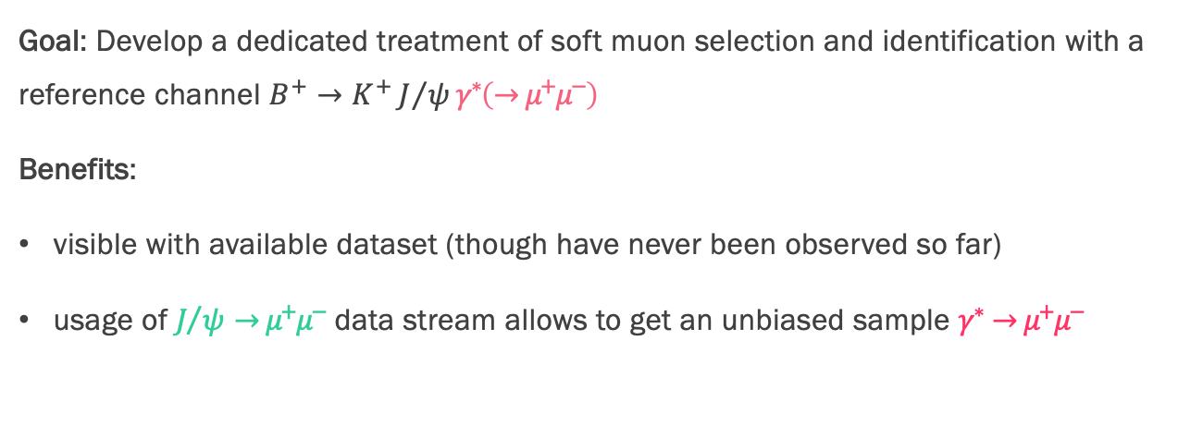
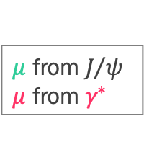
Experimental challenge 💪 → use of very soft muons
Goal: Develop a dedicated treatment of soft muon selection and identification with a reference channel $B^{+}→K^{+}J/ψγ^{∗}\left(→μ^{+}μ^{−}\right)$
Benefits:
visible with available dataset (though have never been observed so far)
usage of $J/ψ →μ^{+}μ^{−}$ data stream allows to get an unbiased sample $γ^{∗}→μ^{+}μ^{−}$
Momentum P
Transverse momentum PT
$μ$ from $J/ψ$
$μ$ from $γ^{∗}$
number of entries
number of entries
LHCb unofficial
LHCb unofficial
1
2
3
4
5
6
7
8
9
muon P [GeV/c]
muon PT [GeV/c]
imposes minimum P of 3 GeV on soft muons → make sure they reach the muon stations and can be identified
Sonia Bouchiba

Slide 6
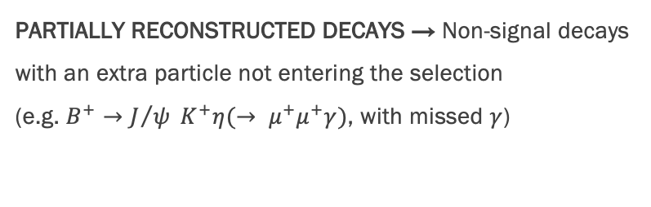
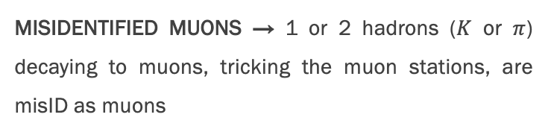
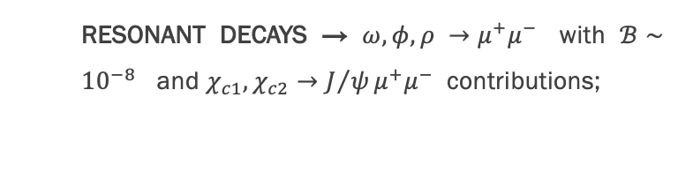
The challenge: dealing with different backgrounds!
MISIDENTIFIED MUONS → 1 or 2 hadrons ($K$ or $π$) decaying to muons, tricking the muon stations, are misID as muons
Dominant background
To be studied with a dedicated Boosted Decision Tree (BDT) only with Particle Identification (PID) vars
  RESONANT DECAYS → $ω, φ, ρ →μ^{+}μ^{−}$ with $ℬ∼{10}^{−8}$ and $χ_{c1}, χ_{c2}→J/ψμ^{+}μ^{−}$ contributions;
Peaking backgrounds
(dangerous!) Add in fit model / veto
COMBINATORIAL BACKGROUND → Random tracks put together by mistake by the selection algos
Exponential distribution
Supress with dedicated BDT
PARTIALLY RECONSTRUCTED DECAYS → Non-signal decays with an extra particle not entering the selection
(e.g. $B^{+}→J/ψ K^{+}η(→ μ^{+}μ^{+}γ)$, with missed $γ$)
Neglect / add in fit model
Sonia Bouchiba

Slide 7

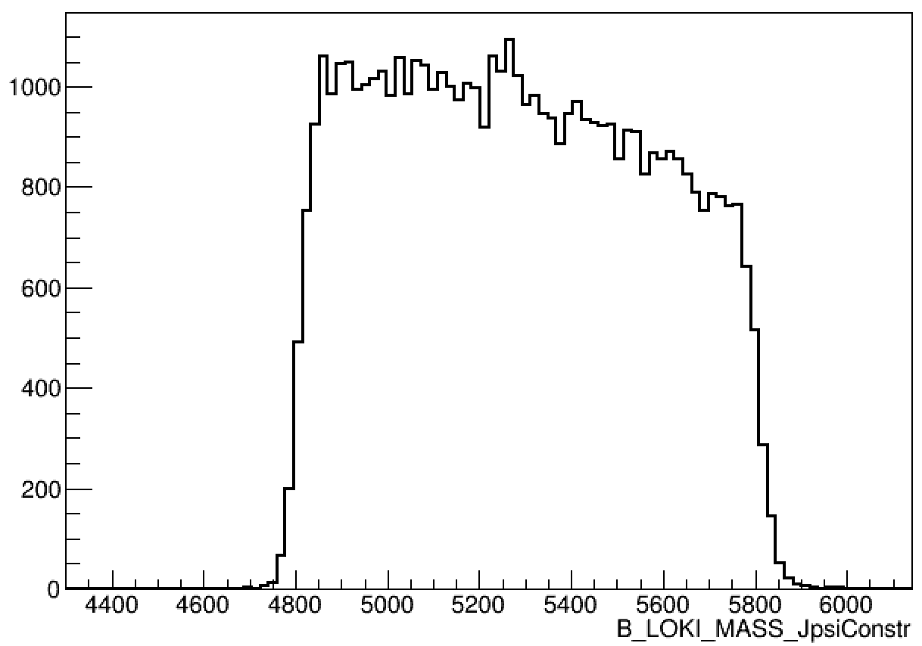
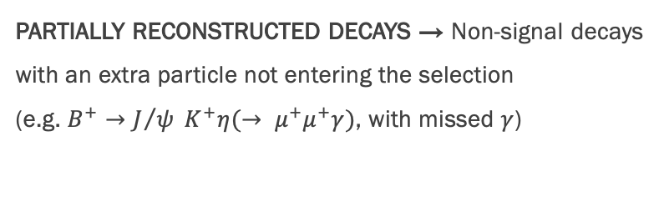
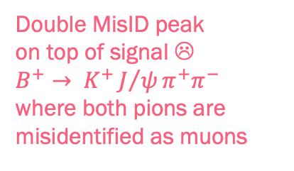
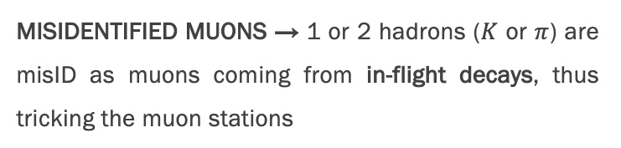
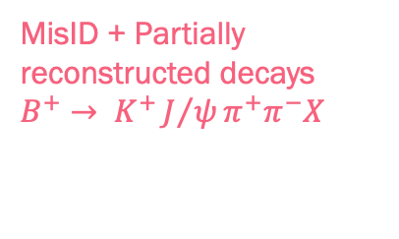
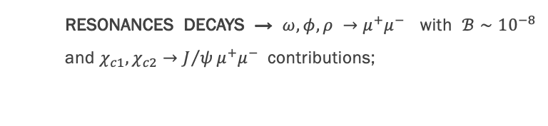
The challenge: dealing with different backgrounds!
MISIDENTIFIED MUONS → 1 or 2 hadrons ($K$ or $π$) are misID as muons coming from in-flight decays, thus tricking the muon stations
First look at a small subset of data
with the preselection applied :
Dominant background
Study & do a dedicated BDT only with PID vars
Double MisID peak
on top of signal ☹
$B^{+}→ K^{+}J/ψπ^{+}π^{−}$ where both pions are misidentified as muons
Peaky backgrounds
Add in fit model / vetoed (dangerous)
  RESONANCES DECAYS → $ω, φ, ρ →μ^{+}μ^{−}$ with $ℬ∼{10}^{−8}$ and $χ_{c1}, χ_{c2}→J/ψμ^{+}μ^{−}$ contributions;
number of entries
COMBINATORIAL BACKGROUND → Random tracks put together by mistake by the reconstruction algos
Exponential distribution
Supress by dedicated BDT
MisID + Partially reconstructed decays
$B^{+}→ K^{+}J/ψπ^{+}π^{−}X$
LHCb unofficial
PARTIALLY RECONSTRUCTED DECAYS → Non-signal decays with an extra particle not entering the selection
(e.g. $B^{+}→J/ψ K^{+}η(→ μ^{+}μ^{+}γ)$, with missed $γ$)
Neglect / add in fit model
M(K⁺ J/ψ μ⁺μ⁻) [MeV/c²]
Sonia Bouchiba

Slide 8
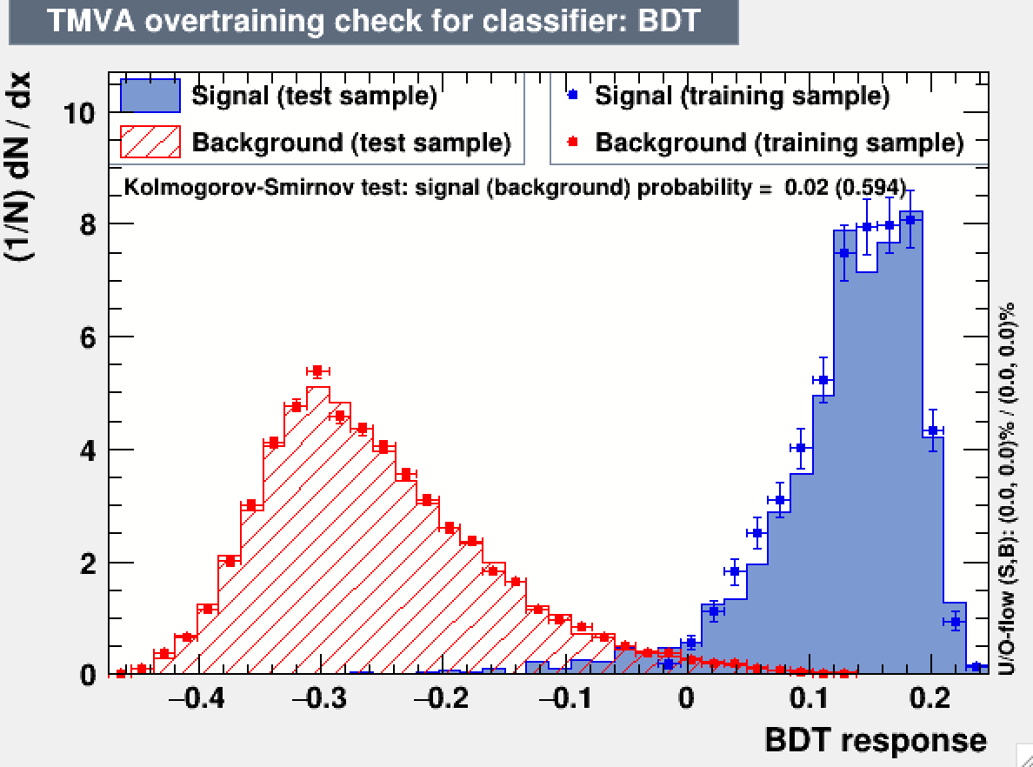
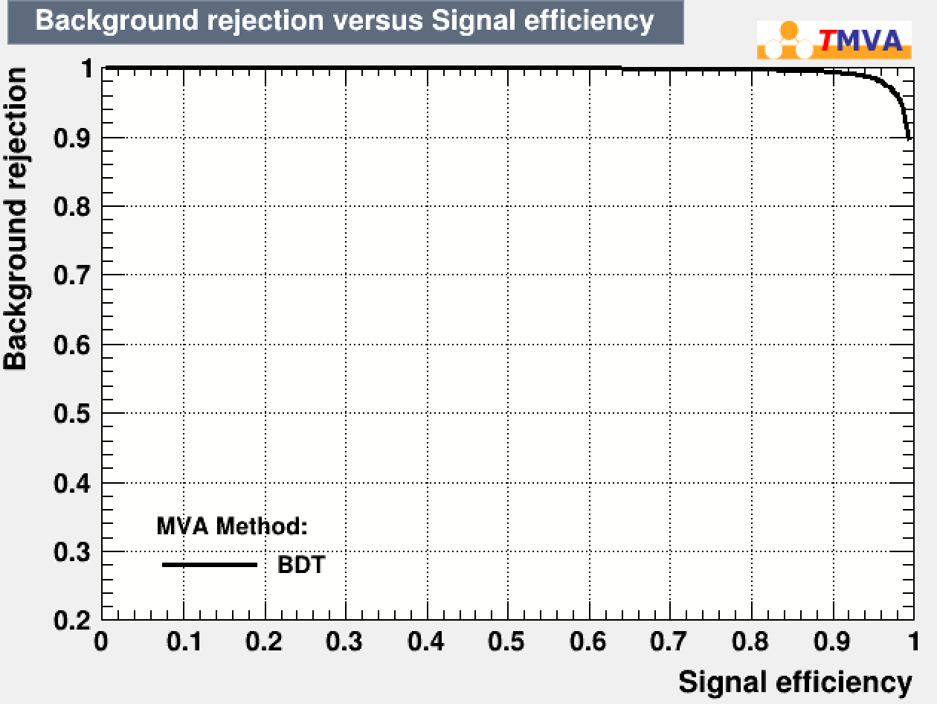
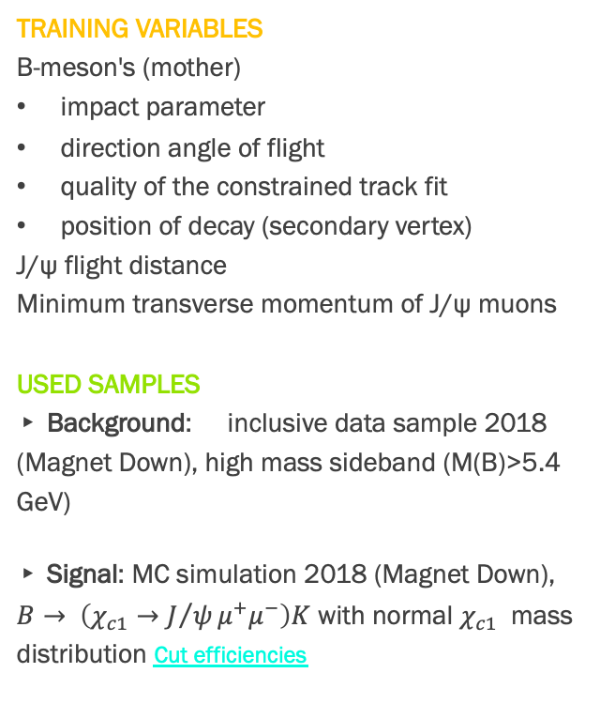
Combinatorial background Boosted Decision Tree (BDT)
Goal: have a very efficient selection with ~100% signal efficiency
TRAINING VARIABLES
B-meson's (mother)
impact parameter
direction angle of flight
quality of the constrained track fit
position of decay (secondary vertex)
J/ψ flight distance
Minimum transverse momentum of J/ψ muons
USED SAMPLES
▸ Background: inclusive data sample 2018 (Magnet Down), high mass sideband (M(B)>5.4 GeV)
▸ Signal: MC simulation 2018 (Magnet Down), $B→ \left(χ_{c1}→J/ψμ^{+}μ^{−}\right)K$ with normal $χ_{c1}$ mass distribution Cut efficiencies
LHCb unofficial
Sonia Bouchiba

Slide 9
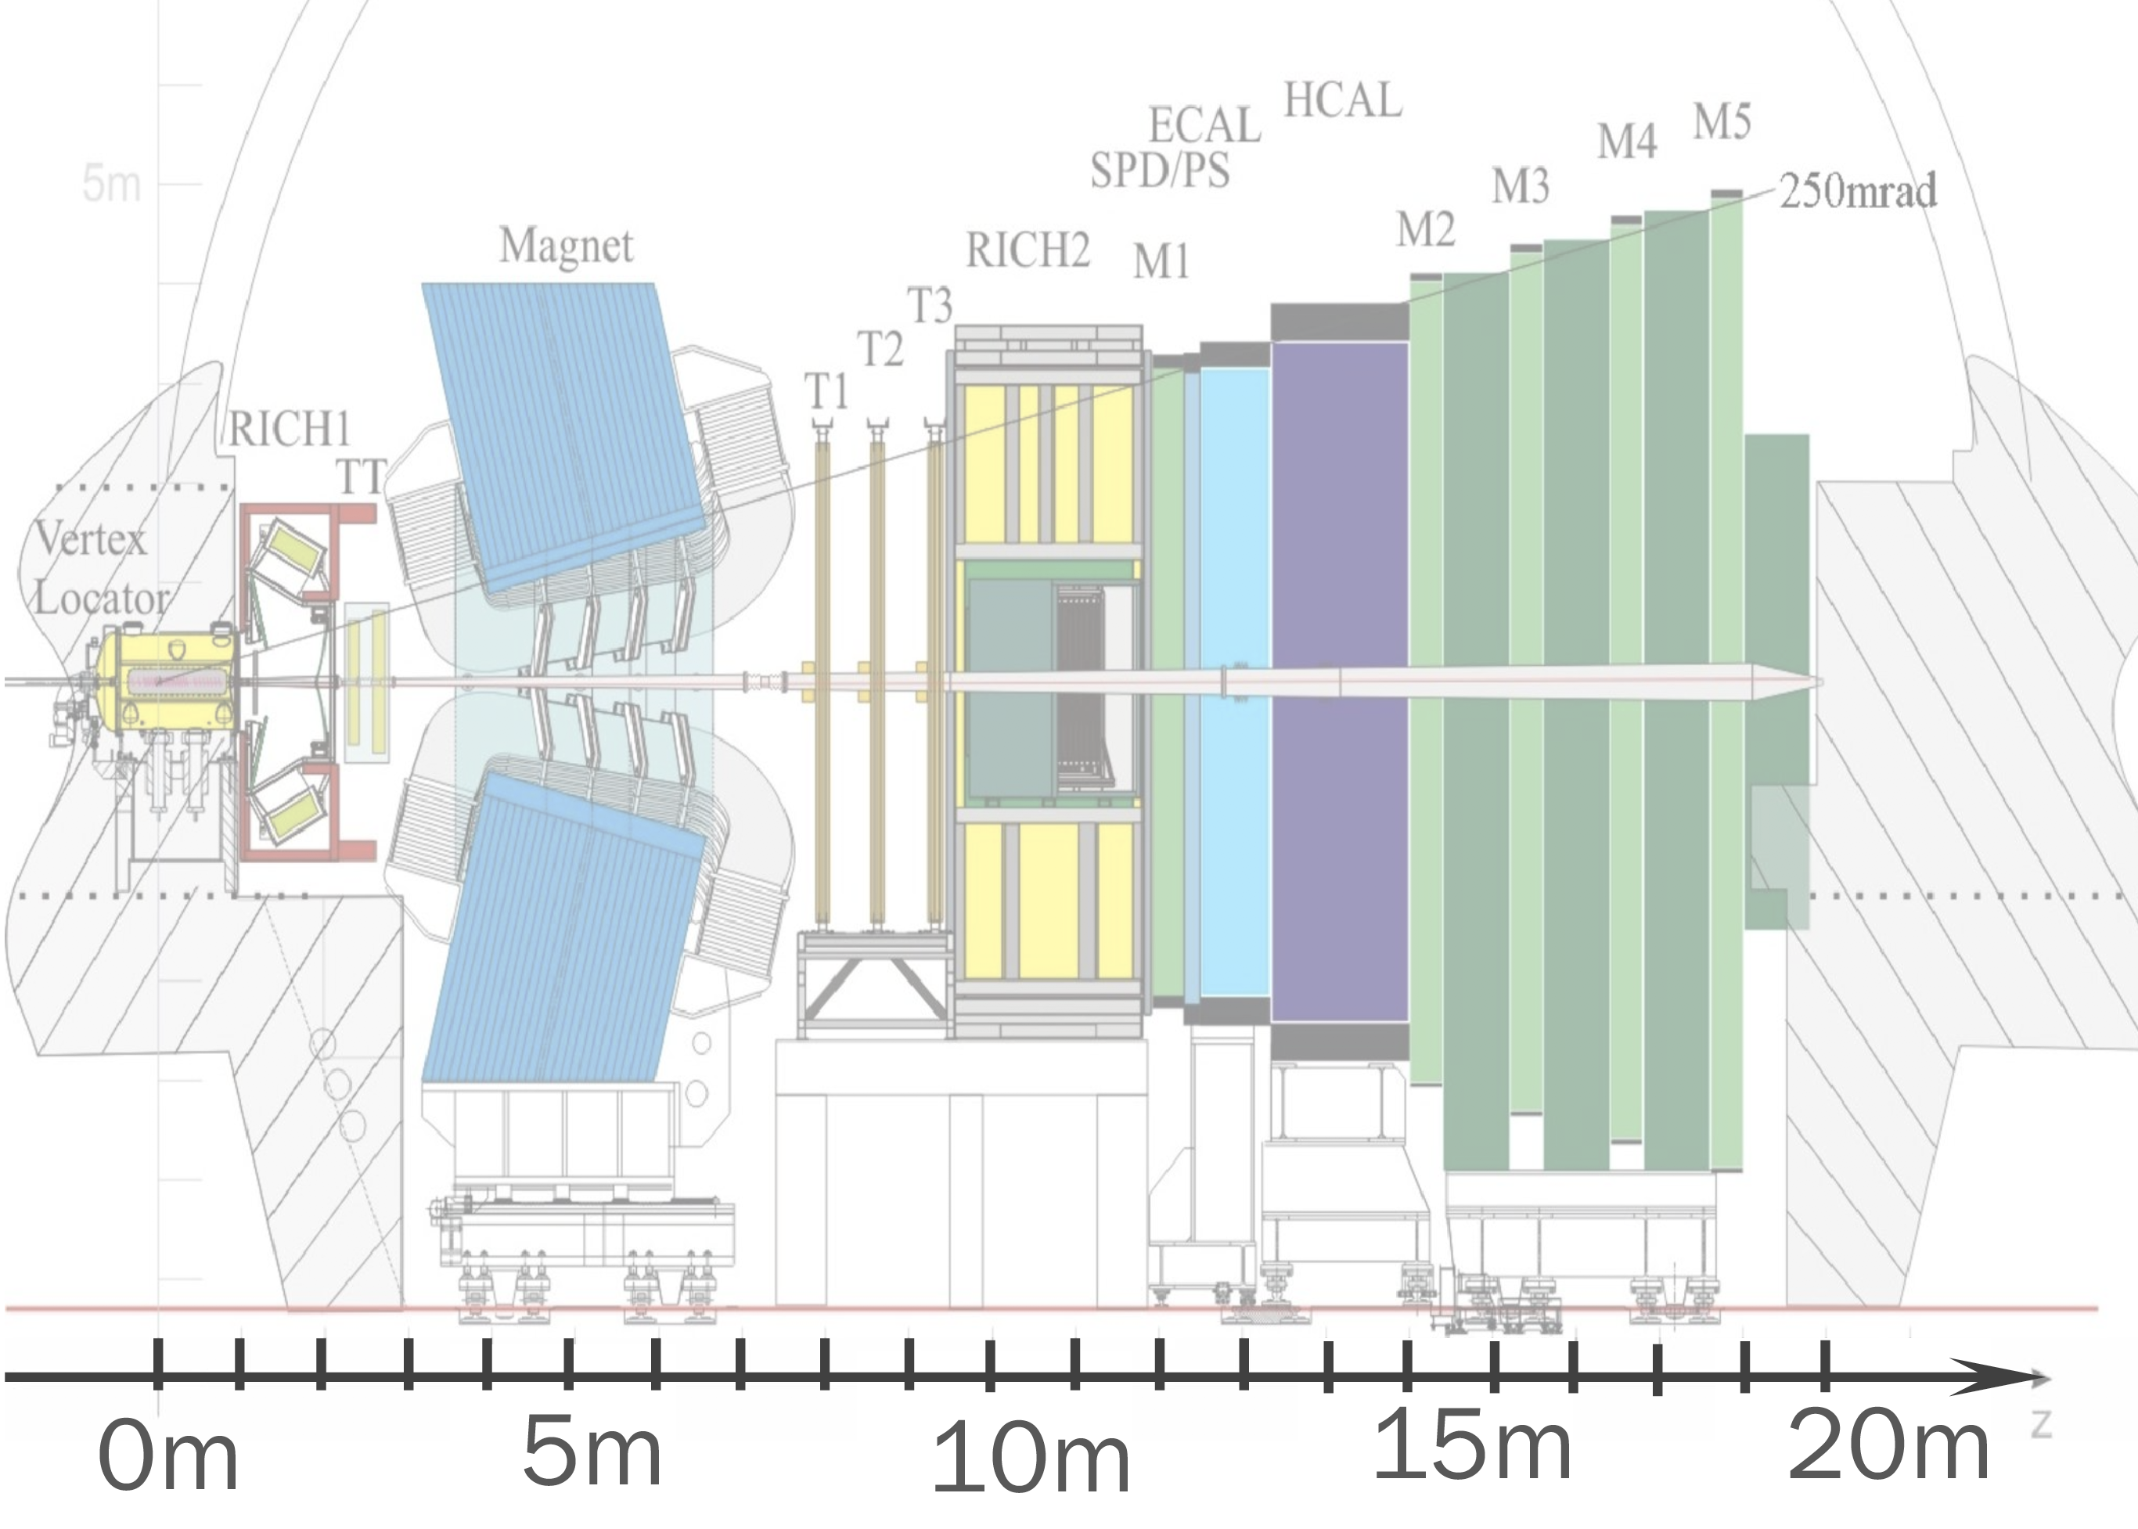




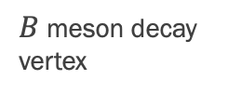
Rejecting misID soft dimuon background
The situation:
Muon system
$$μ$$
signal muon
Tracking system
$B$ meson decay vertex
$$μ$$
misID muon
$$K/π$$
$$(ν_{μ})$$
kink
Learn with simulation: $D^{0}→K^{−} π^{+}\left(→μ^{+}ν_{μ}\right),$ with reconstructed $K^{−}$and $μ^{+}$, and designed to access to generator level truth!
2 "types" of
features
muon identification parameters
track quality (kink finder) to discard $π→μν_{μ}$ decays in flight
Sonia Bouchiba

Slide 10
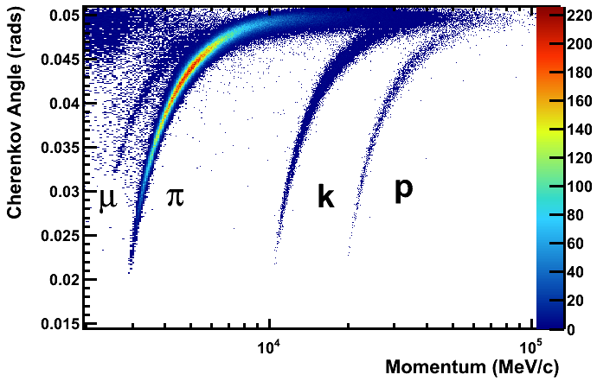
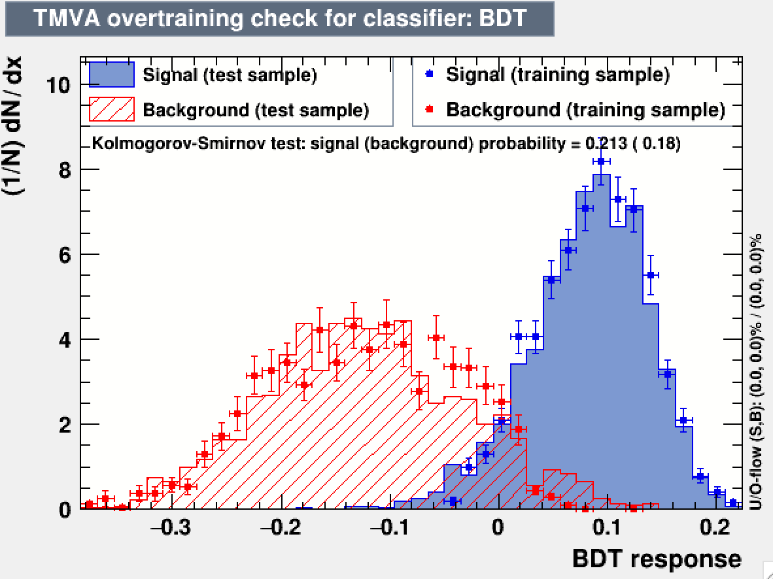
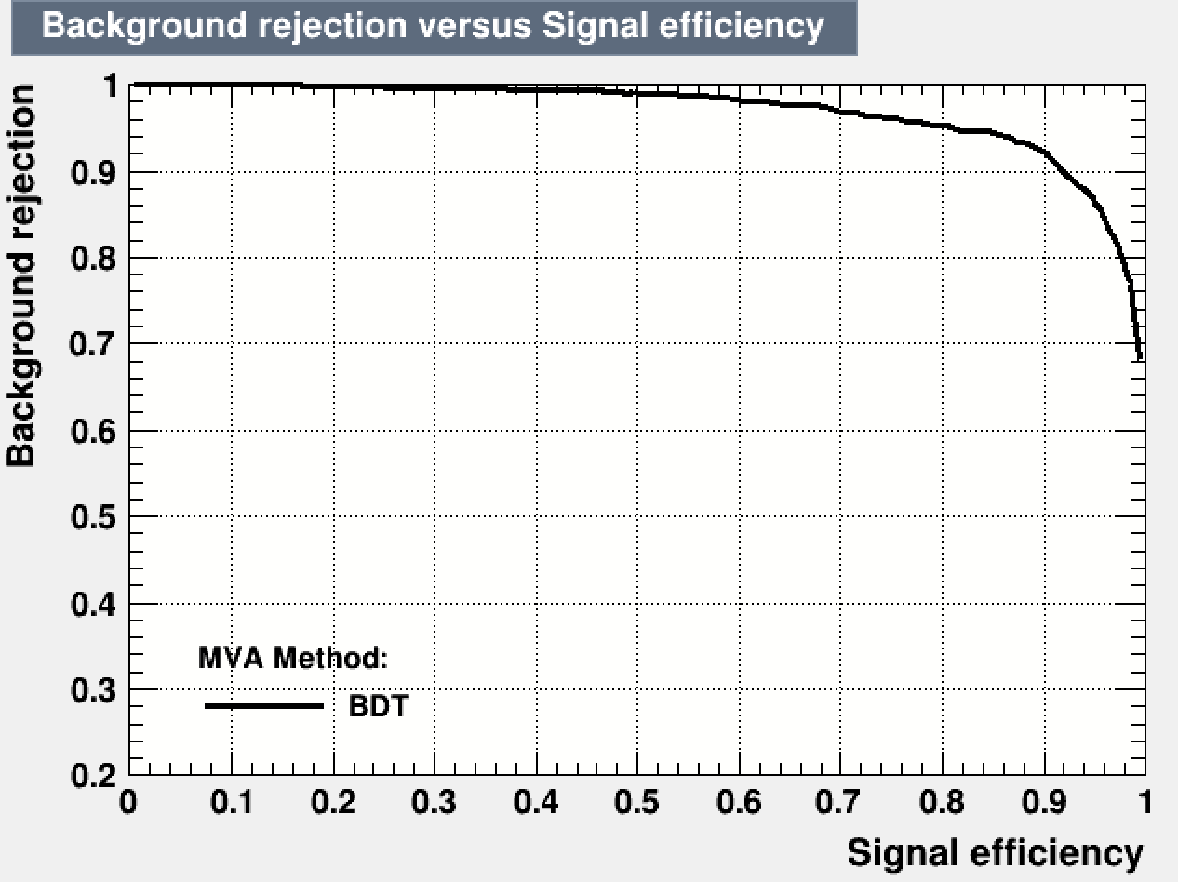
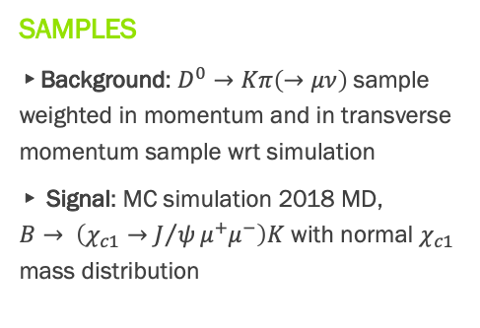
MisID soft muon BDT
Let's mix all this!
TRAINING VARIABLES (single soft muon only)
PID variables
Global NN-computed muon/kaon probability
Global pion likelihood: PID(X) = log(Likelihood(X)) - log(Likelihood(pi))
RICH pion likelihood
Kink-tracker
+kinematics to add dependency of the PID in the soft muon momentum
from [LHCb Rich Collab., 2012]
SAMPLES
▸Background: $D^{0}→Kπ\left(→μν\right)$sample weighted in momentum and in transverse momentum sample wrt simulation
▸ Signal: MC simulation 2018 MD, $B→ \left(χ_{c1}→J/ψμ^{+}μ^{−}\right)K$ with normal $χ_{c1}$ mass distribution
LHCb unofficial
LHCb unofficial
Sonia Bouchiba

Slide 11
Is our method more powerful than a standard PID cut?
↓ Signal efficiency ↓
↓ MisID background efficiency ↓
■ MVA response > 0.01
■ MVA response > 0.02
■ MVA response > 0.03
↓ soft muon BDT selection↓
LHCb unofficial
LHCb unofficial
■ mu3_ProbNNmu > 0.05
■ mu3_ProbNNmu > 0.075
■ mu3_ProbNNmu > 0.09
↓ standard muon ID algo ↓
LHCb unofficial
LHCb unofficial
Sonia Bouchiba

Slide 12
Cuts applied on data sample
Small data sample: inclusive J/ψ data sample.
Signal : 27±7 evts
Misidentified background: 17±17 evts
Combinatorial background: 386±25 evts
LHCb unofficial
Sonia Bouchiba

Slide 13
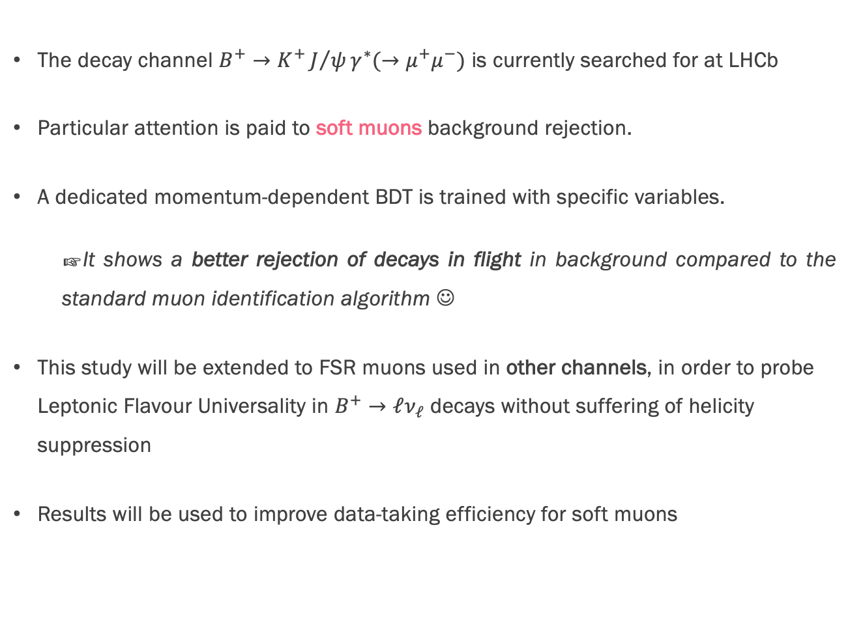
🏡 Take-home messages
The decay channel $B^{+}→K^{+}J/ψγ^{∗}(→μ^{+}μ^{−})$ is currently searched for at LHCb
Particular attention is paid to soft muons background rejection.
A dedicated momentum-dependent BDT is trained with specific variables.
  ☞It shows a better rejection of decays in flight in background compared to the standard muon identification algorithm ☺
This study will be extended to FSR muons used in other channels, in order to probe Leptonic Flavour Universality in $B^{+}→ℓν_{ℓ}$ decays without suffering of helicity suppression
Results will be used to improve data-taking efficiency for soft muons
Sonia Bouchiba

Slide 14
Thank you!

Slide 15
Backup

Slide 16
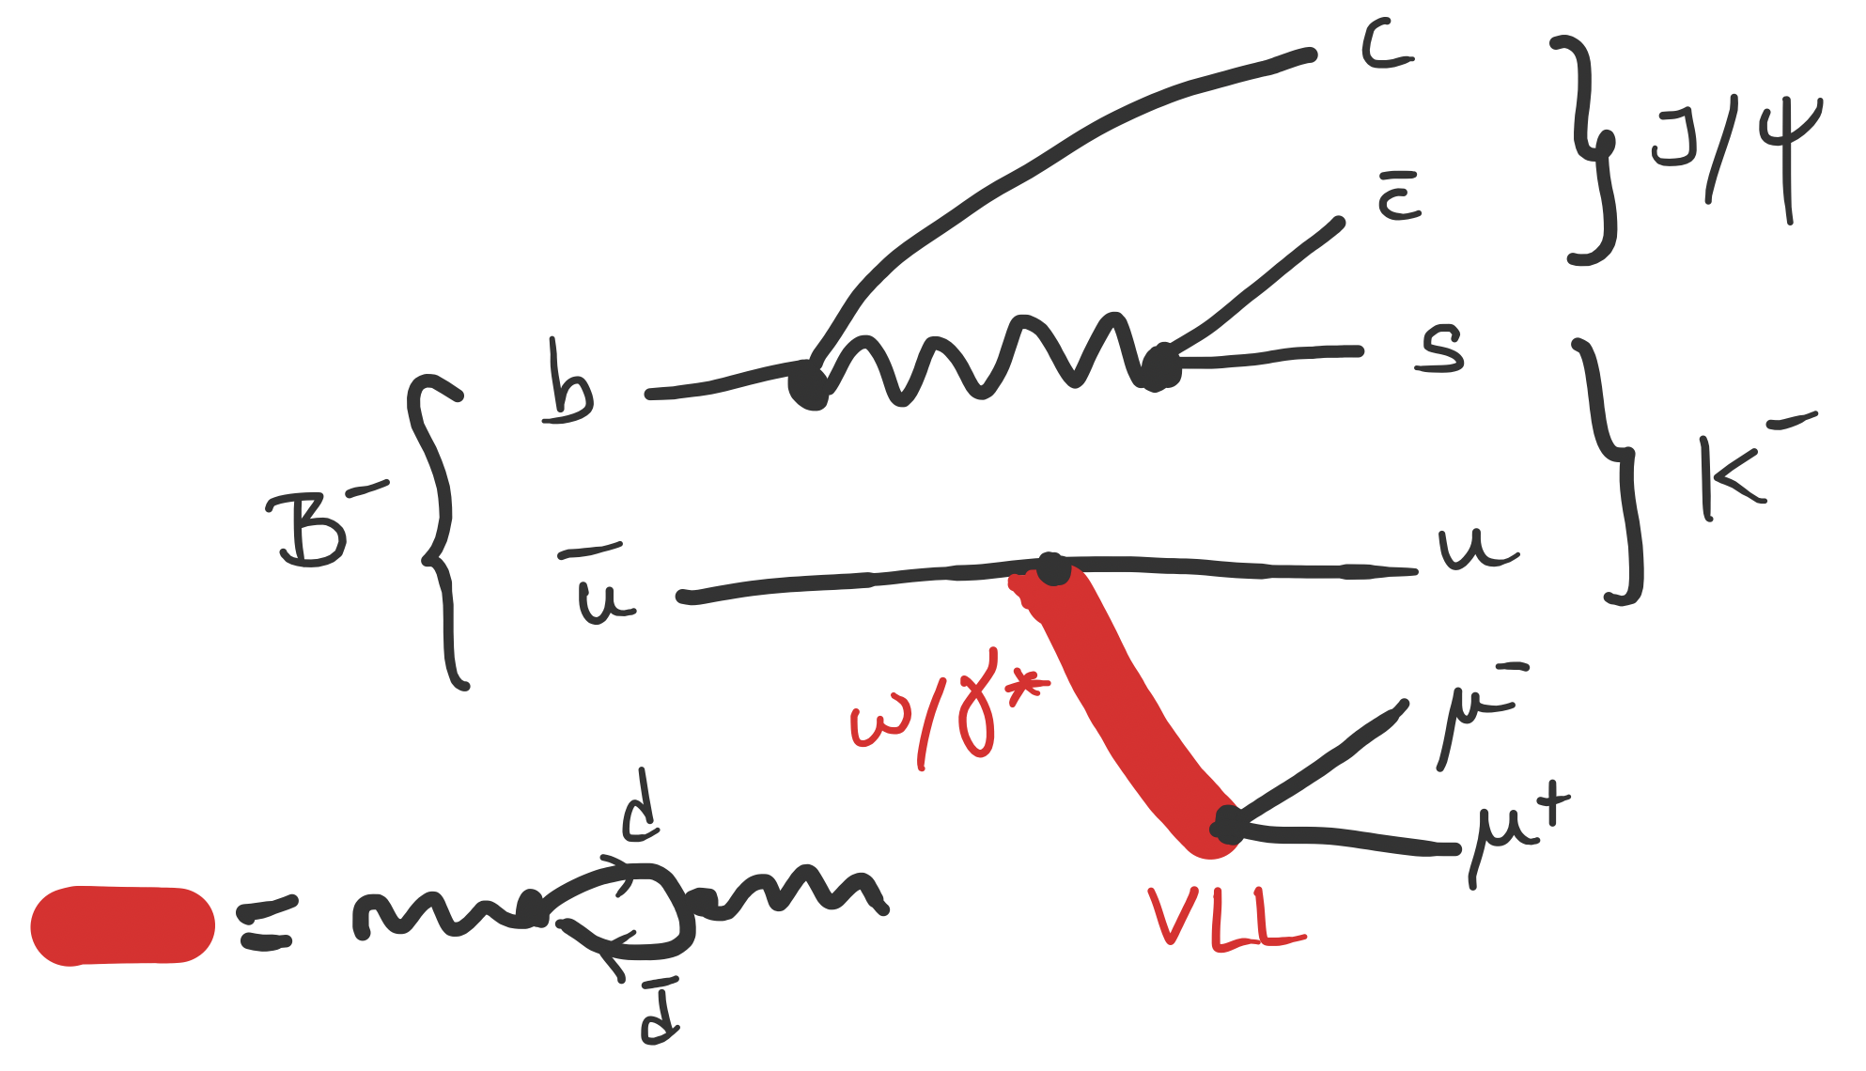
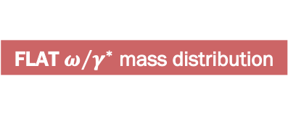
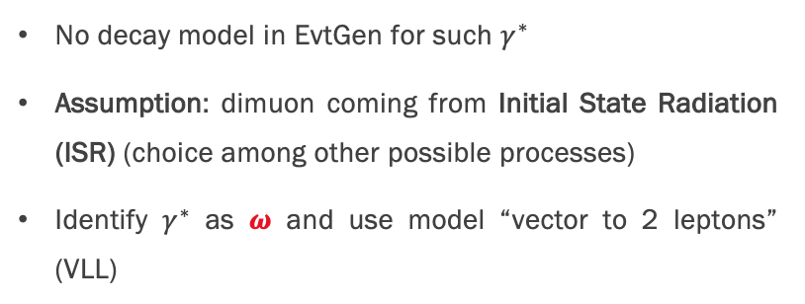
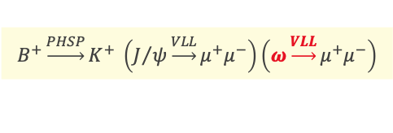
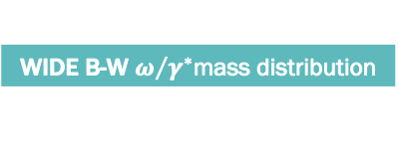
How to simulate $γ^{∗}→μ^{+}μ^{−}$ signal?
No decay model in EvtGen for such $γ^{∗}$
Assumption: dimuon coming from Initial State Radiation (ISR) (choice among other possible processes)
Identify $γ^{∗}$ as $ω$ and use model “vector to 2 leptons” (VLL)
LHCb unofficial
FLAT $ω/{γ^{∗}}$ mass distribution
WIDE B-W $ω/{γ^{∗}}$mass distribution
$$B^{+}\underset{→}{PHSP}K^{+} \left(J/ψ\underset{→}{VLL}μ^{+}μ^{−}\right)\left(ω\underset{→}{VLL}μ^{+}μ^{−}\right)$$
Fast simulation tool RapidSim (global LHCb response)
Requested full-sim sample (~0.5M) for flat mass distribution, can be reshaped later
LHCb unofficial

Slide 17
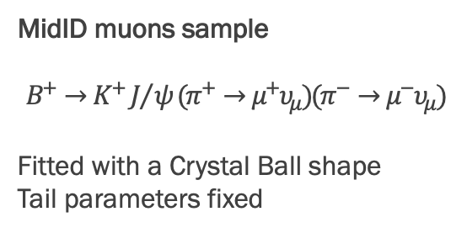
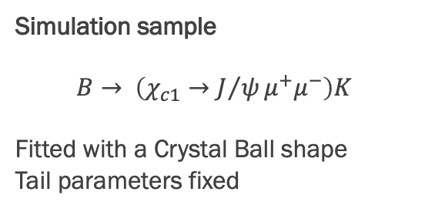
Data fitting
Simulation sample
$$B→ \left(χ_{c1}→J/ψμ^{+}μ^{−}\right)K$$
Fitted with a Crystal Ball shape
Tail parameters fixed
MidID muons sample
$$B^{+}→K^{+}J/ψ(π^{+}→μ^{+}υ_{μ})(π^{−}→μ^{−}υ_{μ})$$
Fitted with a Crystal Ball shape
Tail parameters fixed

Slide 18
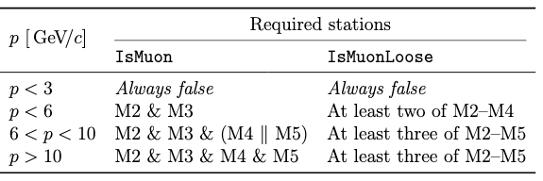
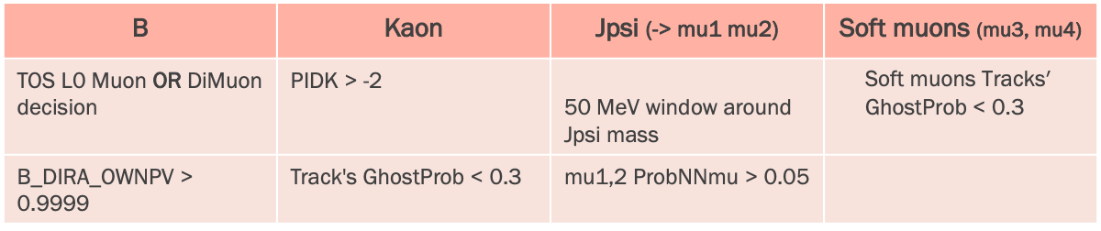
Preselection details
Preselection:
  Overall: require soft muons to both pass "isMuon" -> cut @P=3GeV
  (Correlated background cuts)
B | Kaon | Jpsi (-> mu1 mu2) | Soft muons (mu3, mu4)
TOS L0 Muon OR DiMuon decision | PIDK > -2 | 50 MeV window around Jpsi mass | $$\text{Soft} \text{muons} \text{Tracks}\text{′ }\text{GhostProb}\text{ < 0.3}$$
B_DIRA_OWNPV > 0.9999 | Track's GhostProb < 0.3 | mu1,2 ProbNNmu > 0.05

Slide 19
Soft dimuon misID background rejection
First blood
isMuon ALGORITHM
tracks are extrapolated to the muon stations
Requires 2 or 3 hits in the muon stations depending on particle momentum (backup)
↓ Misidentification probabilities for kaons and pions → more likely to miss muons at low momenta
Taken from [LHCb Collab., 2019]
ΔLL(X-Y) = log(Likelihood(X)) - log(Likelihood(pi))
gives the likelihood for the probed particle X to be an Y

Slide 20
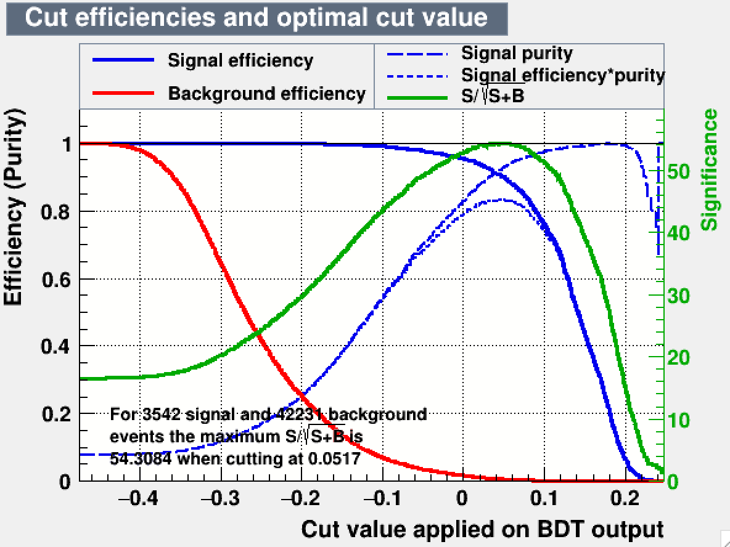
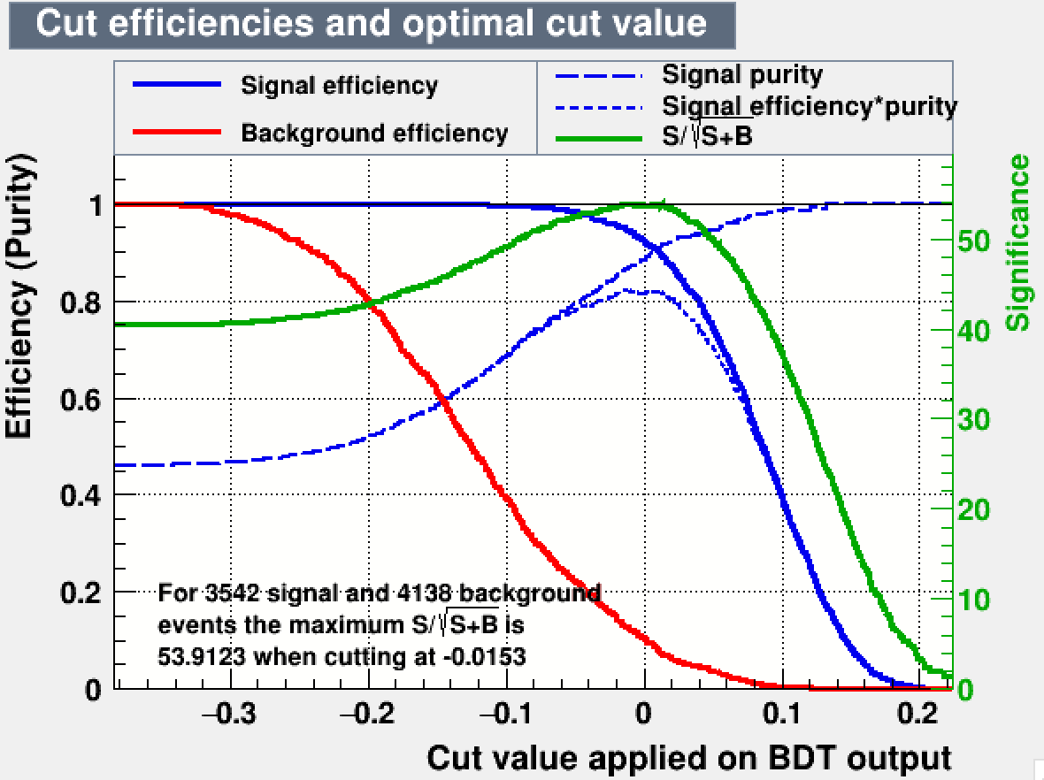
BDTs cut efficiencies
Benchmark Combinatorial BDT
Benchmark soft muon BDT
LHCb unofficial
LHCb unofficial

Slide 21
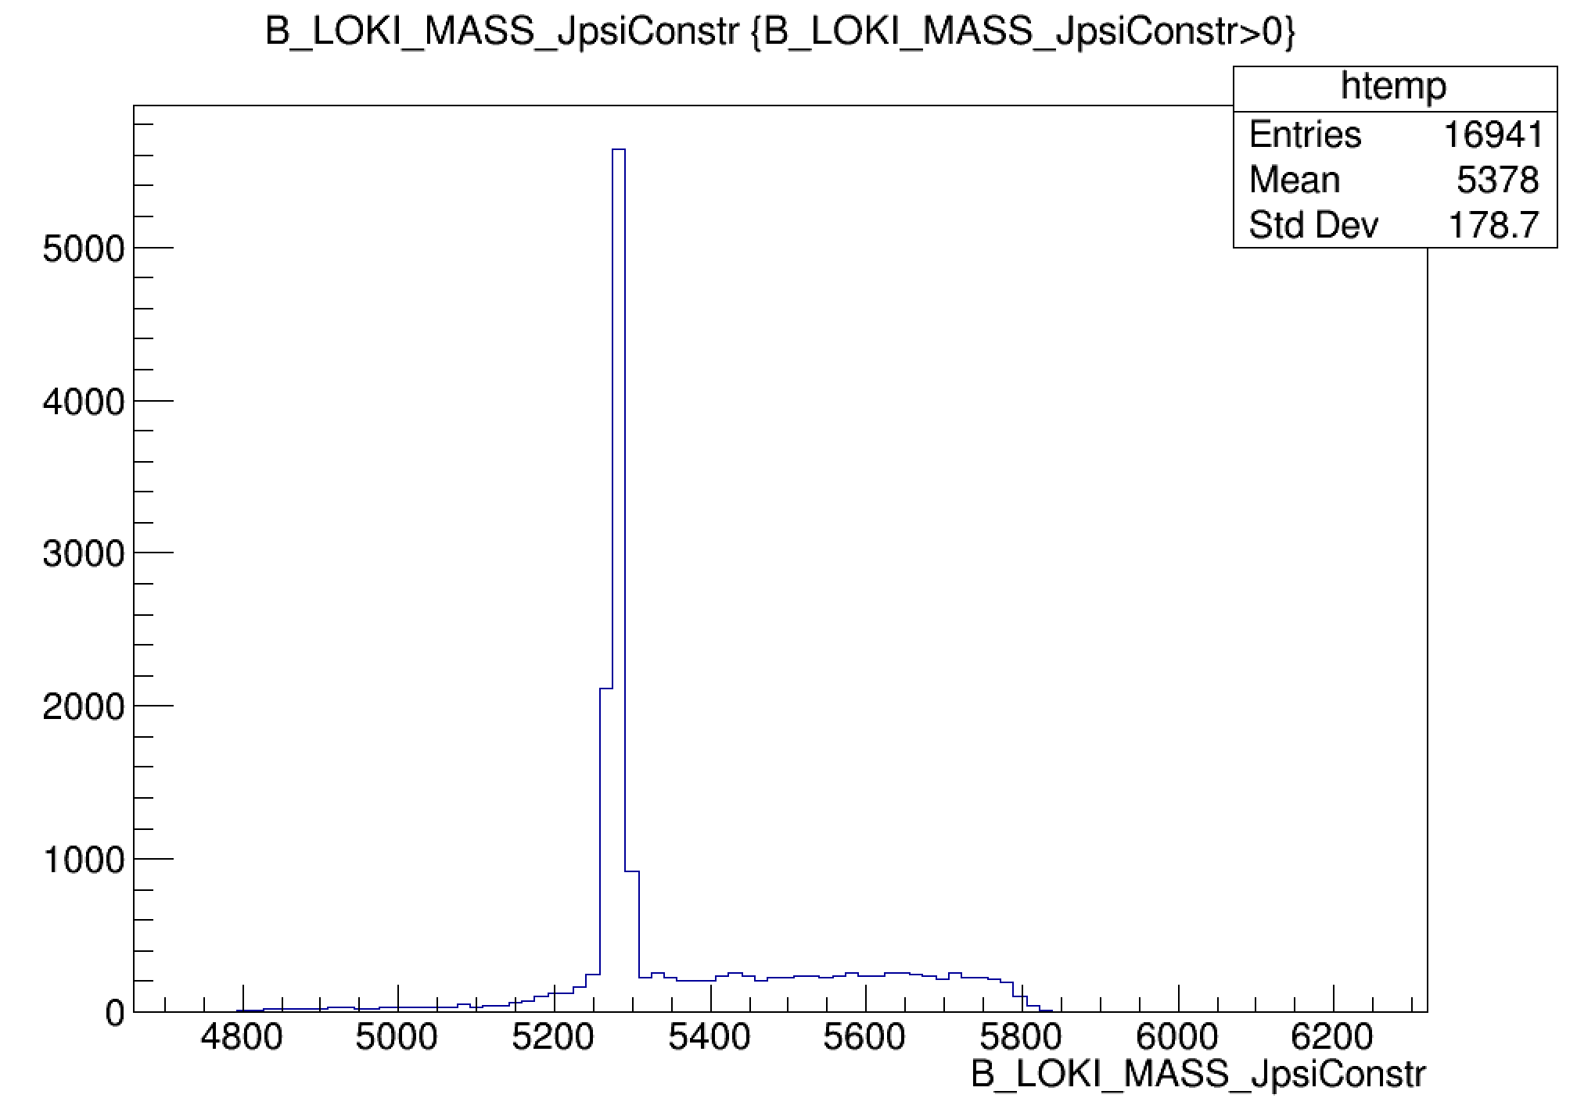
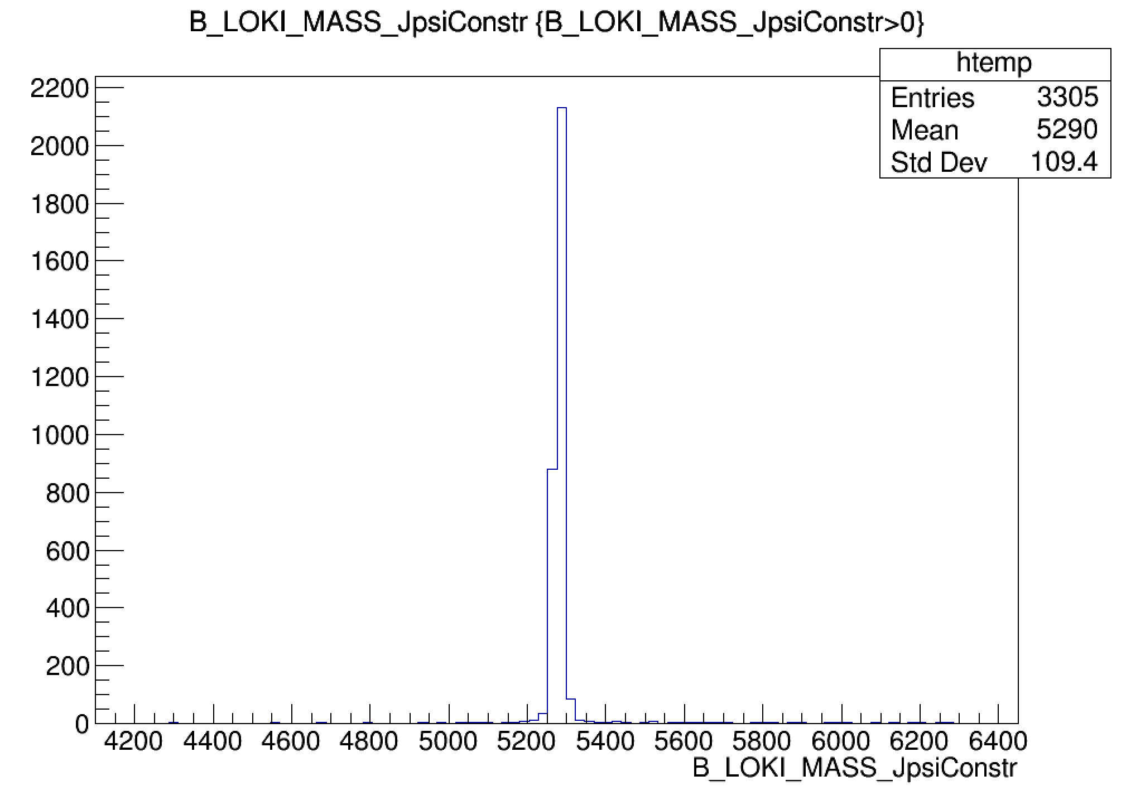
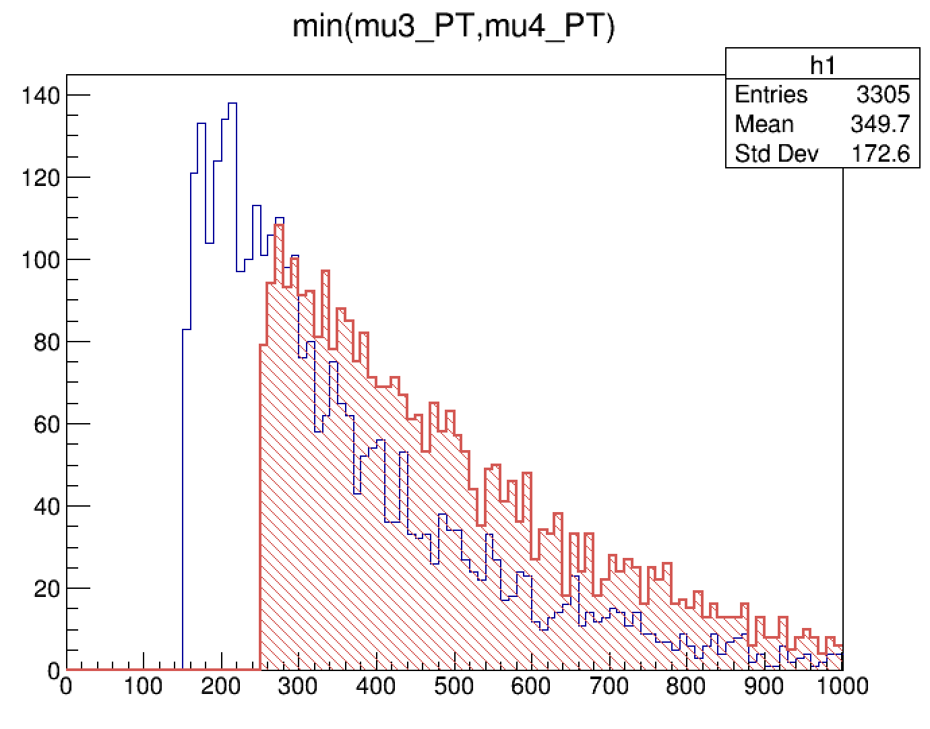
Comparison of stripping lines

Slide 22
Category BDT2 with different conditions on mu3_P
Category in TMVA
separate the training data (and accordingly the application data) into disjoint sub-populations exhibiting significantly different properties.
The separation into phase space regions is done by applying requirements on the input and/or spectator variables (in this case mu3_P is spectator)
In each of these disjoint regions (each event must belong to one and only one region), an independent training is performed using the most appropriate MVA method, training options and set of training variables in that zone.
According to TMVA devs, the division into categories in presence of distinct sub-populations reduces the correlations between the training variables, improves the modelling, and hence increases the classification and regression performance.

Slide 23
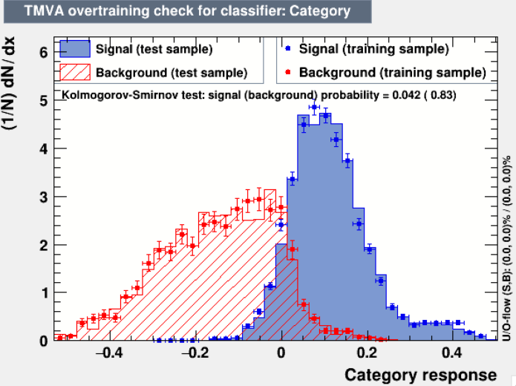
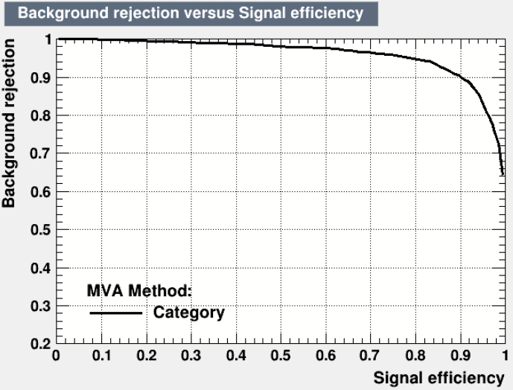
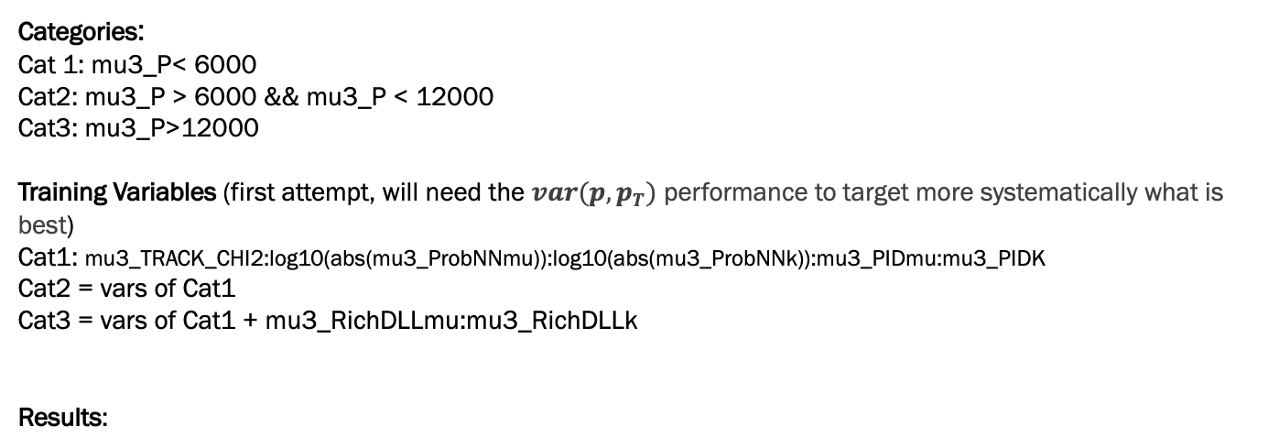
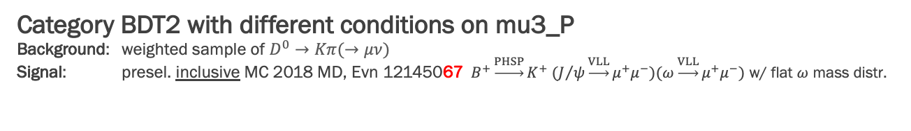
Category BDT2 with different conditions on mu3_P
Background: weighted sample of $D^{0}→Kπ(→μν)$
Signal: presel. inclusive MC 2018 MD, Evn 12145067 $B^{+}\underset{→}{PHSP}K^{+} (J/ψ\underset{→}{VLL}μ^{+}μ^{−})(ω\underset{→}{VLL}μ^{+}μ^{−})$ w/ flat $ω$ mass distr.
Categories:
Cat 1: mu3_P< 6000
Cat2: mu3_P > 6000 && mu3_P < 12000
Cat3: mu3_P>12000
Training Variables (first attempt, will need the $var(p,p_{T})$ performance to target more systematically what is best)
Cat1: mu3_TRACK_CHI2:log10(abs(mu3_ProbNNmu)):log10(abs(mu3_ProbNNk)):mu3_PIDmu:mu3_PIDK
Cat2 = vars of Cat1
Cat3 = vars of Cat1 + mu3_RichDLLmu:mu3_RichDLLk
Results:

Slide 24
Correlated background suppression
Motivation
Motivation: "combinatorial" background,
with 5 tracks random (not likely), IPChi2 already gives an information about compatibility (already cut on that)
mu1 0
Jpsi
mu2 1
mu3 2
phi
mu4 3
Kaon 4
Aim: check quality of [Kmu3mu4] or [Jpsimu3mu4] constrained vertex to discard the candidates with double misID
=> take the sum of the IP chi2 or the max

Slide 25
Temporary
Correlated background suppression
$K−μ_{3}μ_{4}$ correlations [234]

Slide 26
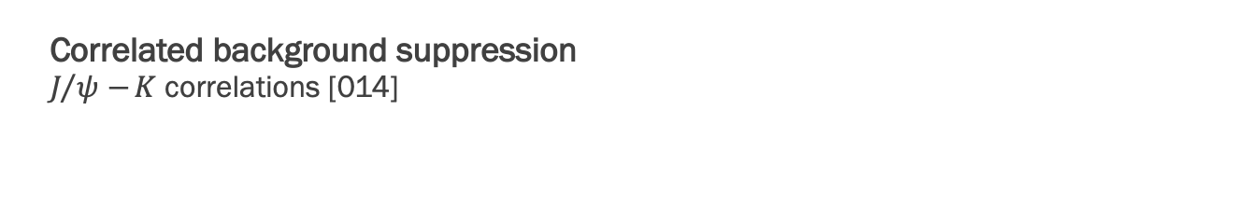
Temporary
Correlated background suppression
$J/ψ −K$ correlations [014]

Slide 27
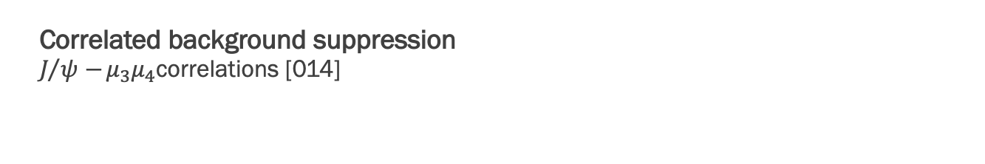
Temporary
Correlated background suppression
$J/ψ −μ_{3}μ_{4}$correlations [014]

Slide 28



Simulation sample
JpsiKpipi sample
data sample

Slide 29





Soft dimuon misID background rejection
Kink calculator tool: principle
Case A: "Fake signal muons" are muons, but coming from decays-in-flight of hadrons in the tracking stations.
2 body decay, so change of direction of the muon track. This change of slope is the "kink".
Tracking system
Muon system
$$PV$$
signal
$$μ$$
misID
$$K/π$$
$$μ$$
$$PV$$
$$(ν_{μ})$$
kink
Daughter muon associated with the track
track reconstructed
Interesting parameters
  TRACK_kinkChi2: for each point on the track, measure the track chi2 difference between forward and backward tracks. Return the maximum difference along one track.
  TRACK_kinkChi2z: returns the z-coord of the maximum track chi2 difference.
  MATCHChi2 : same as TRACK_kinkChi2 but only for kinks in the magnet
too sensitive to multiple scattering! ☹

Slide 30



Soft dimuon misID background rejection
Gen-level matching
Motivation:
MC truth gives the TRUEID but gives no info about the nature of the decay in flght. In particular, where did it happen?
Crosscheck Kink algorithm. Can we trust it? Can we use it in a MVA?
Decay-in-flight MC sample
No decay-in-flight MC sample
DecayTree $D^{0}→μπ$
MCDecayTree $D^{0}→μπ$
Reconstructed sample
DecayTree $D^{0}→Kμ$
"decay-in-flight" MatchedTree
"through-tracking" MatchedTree

Slide 31






Soft dimuon misID background rejection
Kink calculator tool: does it tell the (MC)truth?
Where are the kinks happening?
kinkZ is the z-coord. of the greatest change in ${ χ}^{2}$ along a track
Compare {MC TRUTH z} to {z-coord of max kinkChi2}
  Signal muon: prompt, created in VELO + multiple scattering in T1-3
  misID samples: muons created in-flight mostly
0m
5m
10m
15m
20m
Mu soft TRUEORIGINVERTEX_Z (MC TRUTH !)
Mu soft TRACK_kinkChi2z
Signal ${ γ}^{∗}→μμ$
$${ D}^{0}→\left(π→μ ν_{μ}\right)K$$
No mes. node
(magnet)
T1-3

Slide 32




Soft dimuon misID background rejection
Kink calculator tool: sounds good, doesn't work
⚑ generated $D^{0}→K\left(μν_{μ}\right)π$
⚑ reconstructed $D^{0}→μπ$ (glvl truth)
TRUE ORIGIN VERTEX Z [mm]
uncorrelated!
Plot the scatter plot
If kink algo works: kinkchi2z = TRUEORIGINVERTEX
But: we observe random distribution ☹
Probably due to multiple scattering that "steals" the max chi2 difference
“$μ$” max kink’s z@reco [mm]
max Δchi2
max Δchi2
“$μ$” origin vertex z @glvl [mm]
Expectation
Reality
=> Not adding kink tool in the MVA since not trusting them

Slide 33
Kink code
More sophisticated: kink cmputer of the track, could spot on-flight creation of muons
$ℬ\left(K→μ{ ν}_{μ}\right)=$ 63.56 % [PDG 2019], $τ_{K}=1.2⋅{10}^{−8}$s
$ℬ\left(π→μ{ ν}_{μ}\right)=$ 99.99 % [PDG 2019], $τ_{π}=2.6⋅{10}^{−8}$s
Algorithm:
For each track, collect the batch of mes. nodes (collection of track states)
For each node (with step s):
chi2kink = ( chi2tot - chi2forward[i] - chi2backward[i + 1] ) / ndof;
Return the maximum one along the track.
S, ndof are hardcoded (4 and 5)
And zkink = 0.5 * ( measnodes[ikink]->z() + measnodes[ikink + 1]->z() );
.

Slide 34
Fake muons
Tracks stdy
Muons are creatin on-flight from hadrons
  Though, the reconstrcuted SV (ORIVX) are pretty similar
  … but the TRUE z-coord of muon creation is very different
  →much longer flight of K and pi -> muons tends to be created until T1-3 stations.. (then harsh cut)
Reco
Reality

