Slide 1



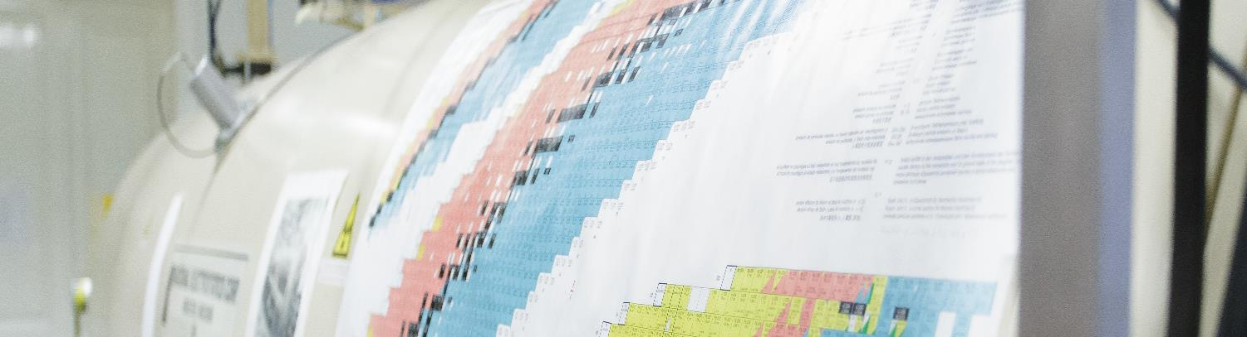
Relative Formation Probabilities for Fluoride and Oxyfluoride Anions of U, Np, Pu and Am in Accelerator Mass Spectrometry Measurements at VERA
Andreas Wiederin¹
R. Golser¹ , M. Kern¹, K. Hain¹, M. Martschini¹, A. Sakaguchi², P. Steier¹, A. Yokoyama³
¹University of Vienna, Austria ²University of Tsukuba, Japan ³Kanazawa University, Japan
Joint Annual Meeting of ÖPG and SPS 2021
Joint annual Meeting APS SPS Innsbruck 2021
Presenting author email: andreas.wiederin@univie.ac.at

Slide 2
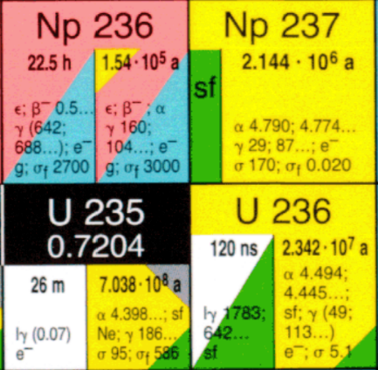
Why is this interesting?
²³⁷Np spike project
Second most abundant anthropogenic
actinide in the environment?
Released by nuclear weapons tests and industry
Potential environmental tracer
    Long lived and highly mobile in water
Magill et al., Nucleonica GmbH, 2006
1

Slide 3
Why is this interesting?
²³⁷Np spike project
Second most abundant anthropogenic
actinide in the environment?
Released by nuclear weapons tests and industry
Potential environmental tracer
    Long lived and highly mobile in water
Challenging to measure in general environment:
  Decay counting: very large samples (T_{1/2}!)
  MS: background from ²³⁸U, ²³⁵UH₂
  AMS: Lack of isotopic spike hinders quantification
Magill et al., Nucleonica GmbH, 2006
1

Slide 4
Why is this interesting?
²³⁷Np spike project
Second most abundant anthropogenic
actinide in the environment?
Released by nuclear weapons tests and industry
Potential environmental tracer
    Long lived and highly mobile in water
Challenging to measure in general environment:
  Decay counting: very large samples (T_{1/2}!)
  MS: background from ²³⁸U, ²³⁵UH₂
  AMS: Lack of isotopic spike hinders quantification
    Different isotope of Np to add to sample for relative measurements
Severely understudied!
Magill et al., Nucleonica GmbH, 2006
1

Slide 5
Why is this interesting?
²³⁷Np spike project
Plan: Develop isotopic spike for ²³⁷Np
  Joint Project: Universities of Vienna, Tsukuba and Kanazawa
  Current focus: ²³²Th(⁷Li,3n)²³⁶Np reaction
Magill et al., Nucleonica GmbH, 2006
2

Slide 6
Why is this interesting?
²³⁷Np spike project
Plan: Develop isotopic spike for ²³⁷Np
  Joint Project: Universities of Vienna, Tsukuba
  and Kanazawa
  Current focus: ²³²Th(⁷Li,3n)²³⁶Np reaction
Problem: Isobaric interference from ²³⁶U
  Co-production in irradiation for spike production?
    Need a method to distinguish ²³⁶U and ²³⁶Np!
  ²³⁶U in environmental samples
    U – Np Isobar separation necessary for ²³⁶Np spike
      ILIAMS?
Magill et al., Nucleonica GmbH, 2006
2

Slide 7
Fluoride molecular anions of actinides
AMS: negative ions
  Actinides do not form sufficient atomic anions
Molecular anions
3

Slide 8
Fluoride molecular anions of actinides
AMS: negative ions
  Actinides do not form sufficient atomic anions
Molecular anions
Fluoride molecular anions for actinides?
    [X.-L. Zhao et al., Nucl Instrum Methods Phys Res B 294 (2013), 356-360]
    [R.J. Cornett et al., Nucl Instrum Methods Phys Res B 361 (2015), 317-321]
3

Slide 9
Fluoride molecular anions of actinides
AMS: negative ions
  Actinides do not form sufficient atomic anions
Molecular anions
Fluoride molecular anions for actinides?
    [X.-L. Zhao et al., Nucl Instrum Methods Phys Res B 294 (2013), 356-360]
    [R.J. Cornett et al., Nucl Instrum Methods Phys Res B 361 (2015), 317-321]
  Research at VERA is focused on mixing oxide materials in Fe₂O₃ with PbF₂
    In situ fluoridization inside the Cs-sputter ion source
    [M. Kern, this meeting]
3

Slide 10
Fluoride molecular
anions of actinides
The relative formation probabilities for a range of (oxy-)fluoride molecular
anions of U, Np, Pu and Am have been systematically investigated
An stands for U, Np, Pu or Am
AnF₅– | AnF₄O– | AnF₃O₂–
AnF₃O– | AnF₂O₂– | AnF₄–
4

Slide 11
Fluoride molecular
anions of actinides
The relative formation probabilities for a range of (oxy-)fluoride molecular
anions of U, Np, Pu and Am have been systematically investigated
An stands for U, Np, Pu or Am
Isobaric contaminations can be monitored with this data
  First application:²³⁶U in prospective ²³⁶Np spike material
UF₄– , NpF₄– candidates for U – Np separation with ILIAMS
AnF₅– | AnF₄O– | AnF₃O₂–
AnF₃O– | AnF₂O₂– | AnF₄–
4

Slide 12
Materials and
Methods

Slide 13
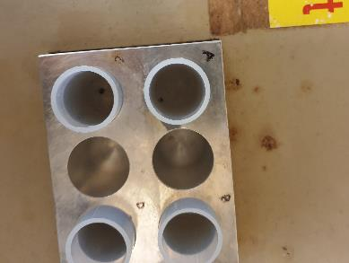
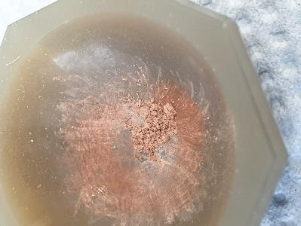
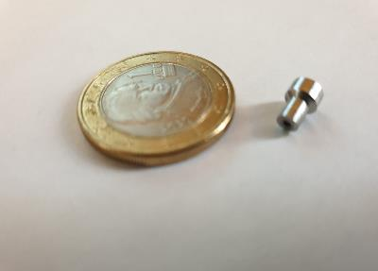
Sample preparation
Reference material
  ²³⁶U, ²³⁷Np, ²⁴²Pu, ²⁴³Am (3x10⁸ at) in nitric sol.
  Dried with 300µg Fe
  Ignition (800°C)
  Mixed with PbF₂ (1:9 mass ratio)
  Required in every beamtime
5

Slide 14
Sample preparation
Reference material
  ²³⁶U, ²³⁷Np, ²⁴²Pu, ²⁴³Am (3x10⁸ at) in nitric sol.
  Dried with 300µg Fe
  Ignition (800°C)
  Mixed with PbF₂ (1:9 mass ratio)
  Required in every beamtime
Material from ²³²Th(⁷Li,3n)²³⁶Np irradiation
  RIKEN Nishina Center for Accelerator Based Science
    Chemical purification at University of Tsukuba
  Previously measured at VERA in oxide form
    Residue mixed with PbF₂ for isobar analysis
5

Slide 15
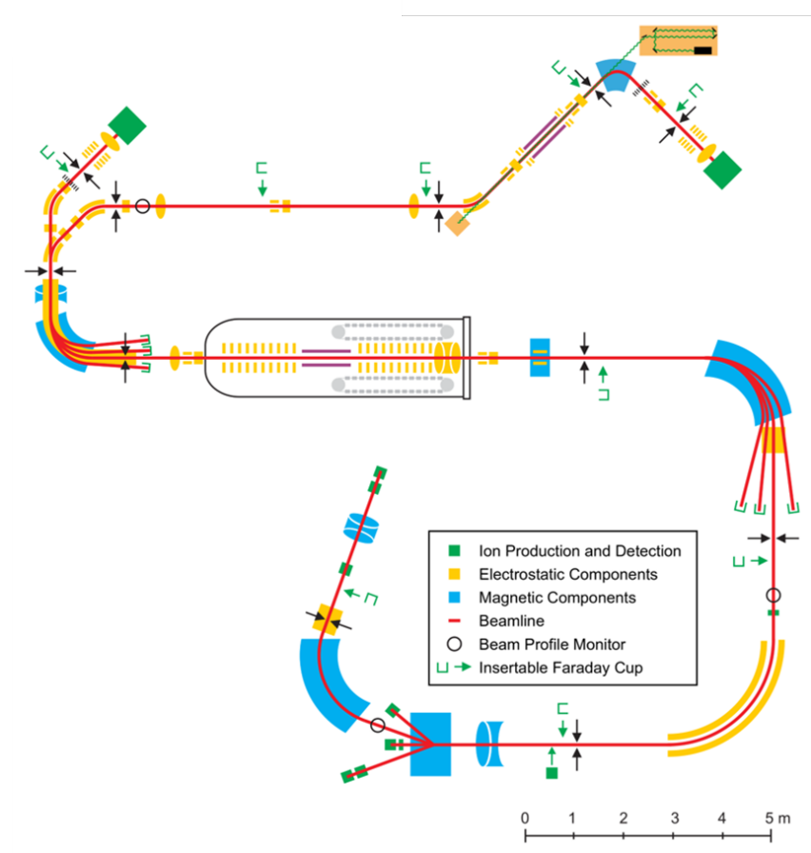
Measurements at VERA
AnF_{m}O_{n}¹⁻ selected by low
energy mass spectrometer
+1.7 MV
6

Slide 16
Measurements at VERA
AnF_{m}O_{n}¹⁻ selected by low
energy mass spectrometer
He-stripping destroys molecules
+1.7 MV
6

Slide 17
Measurements at VERA
AnF_{m}O_{n}¹⁻ selected by low
energy mass spectrometer
He-stripping destroys molecules
High energy mass spectrometer
selects An³⁺
+1.7 MV
6

Slide 18
Measurements at VERA
AnF_{m}O_{n}¹⁻ selected by low
energy mass spectrometer
He-stripping destroys molecules
High energy mass spectrometer
selects An³⁺
An³⁺ detected in Bragg type
ionization chamber
+1.7 MV
6

Slide 19
Measurements at VERA
AnF_{m}O_{n}¹⁻ selected by low
energy mass spectrometer
He-stripping destroys molecules
High energy mass spectrometer
selects An³⁺
An³⁺ detected in Bragg type
ionization chamber
24 machine setups with masses 306u to 338u measured on each target
  Only electrostatic components were adjusted
    magnetic rigidity constant for all setups
+1.7 MV
6

Slide 20
Results
All results are stated in the form of AnF_{m}O_{n}/AnF₅ ratios

Slide 21
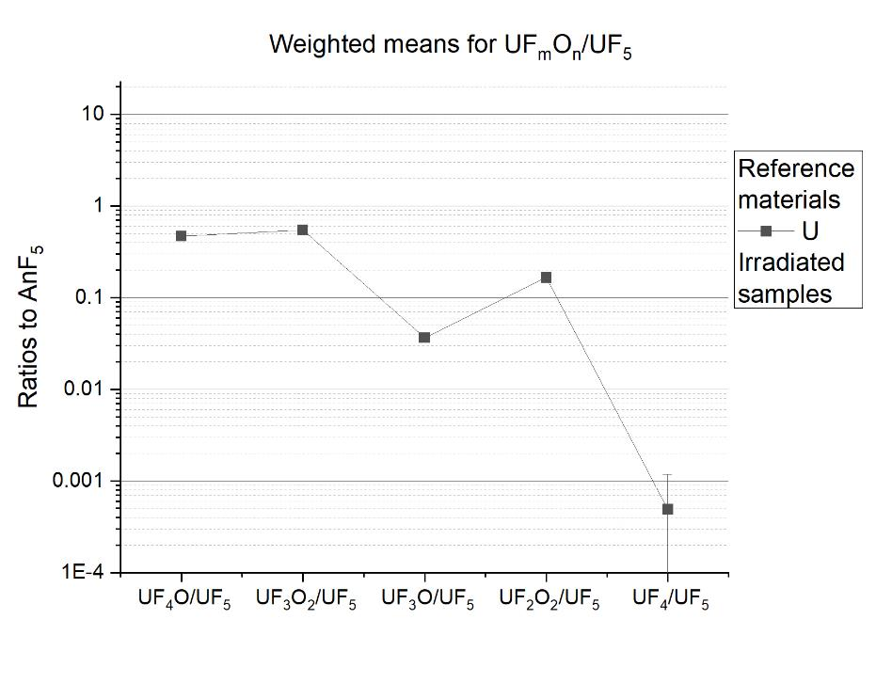
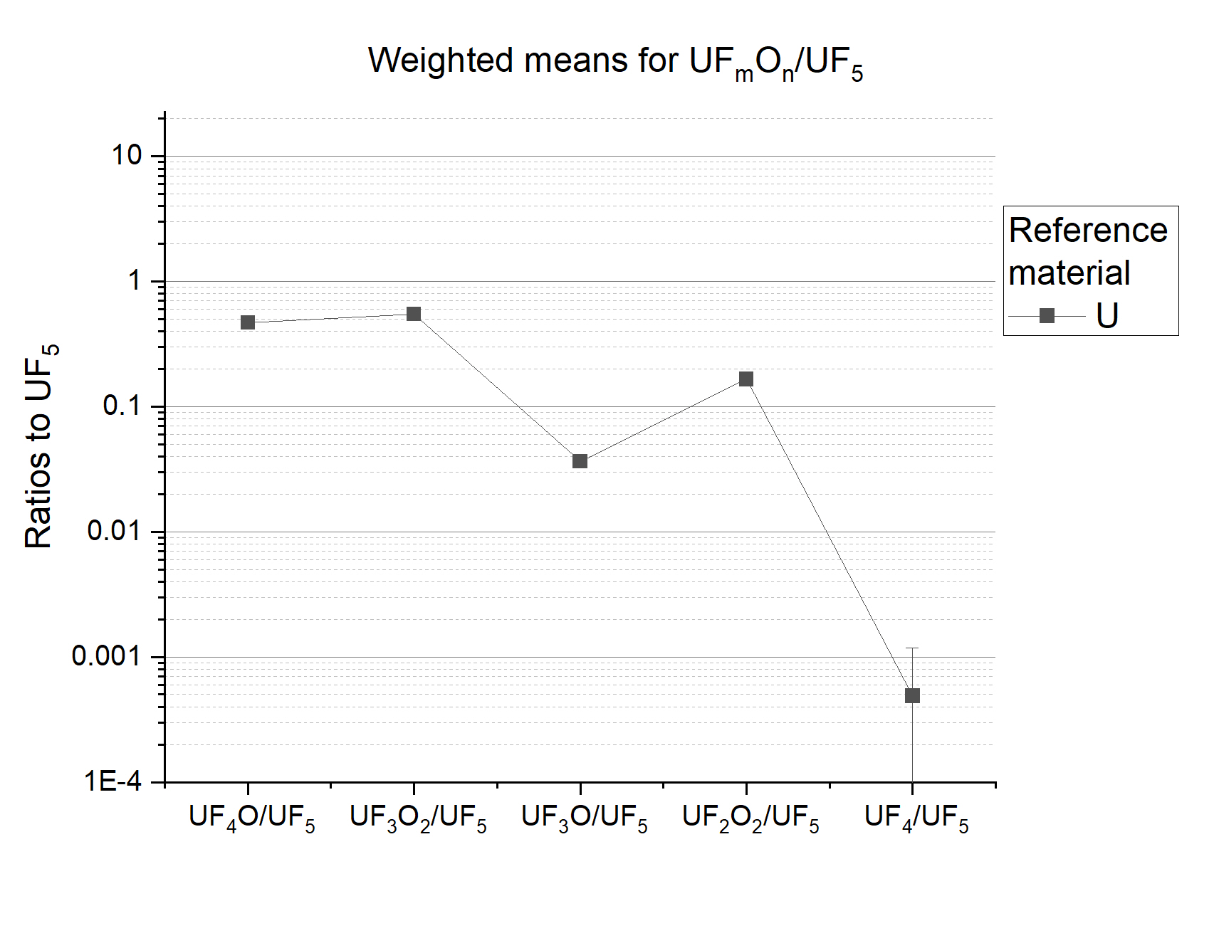
Formation distribution: reference materials
  Characteristic UF_{m}O_{n}– /UF₅–
  ratios
7

Slide 22
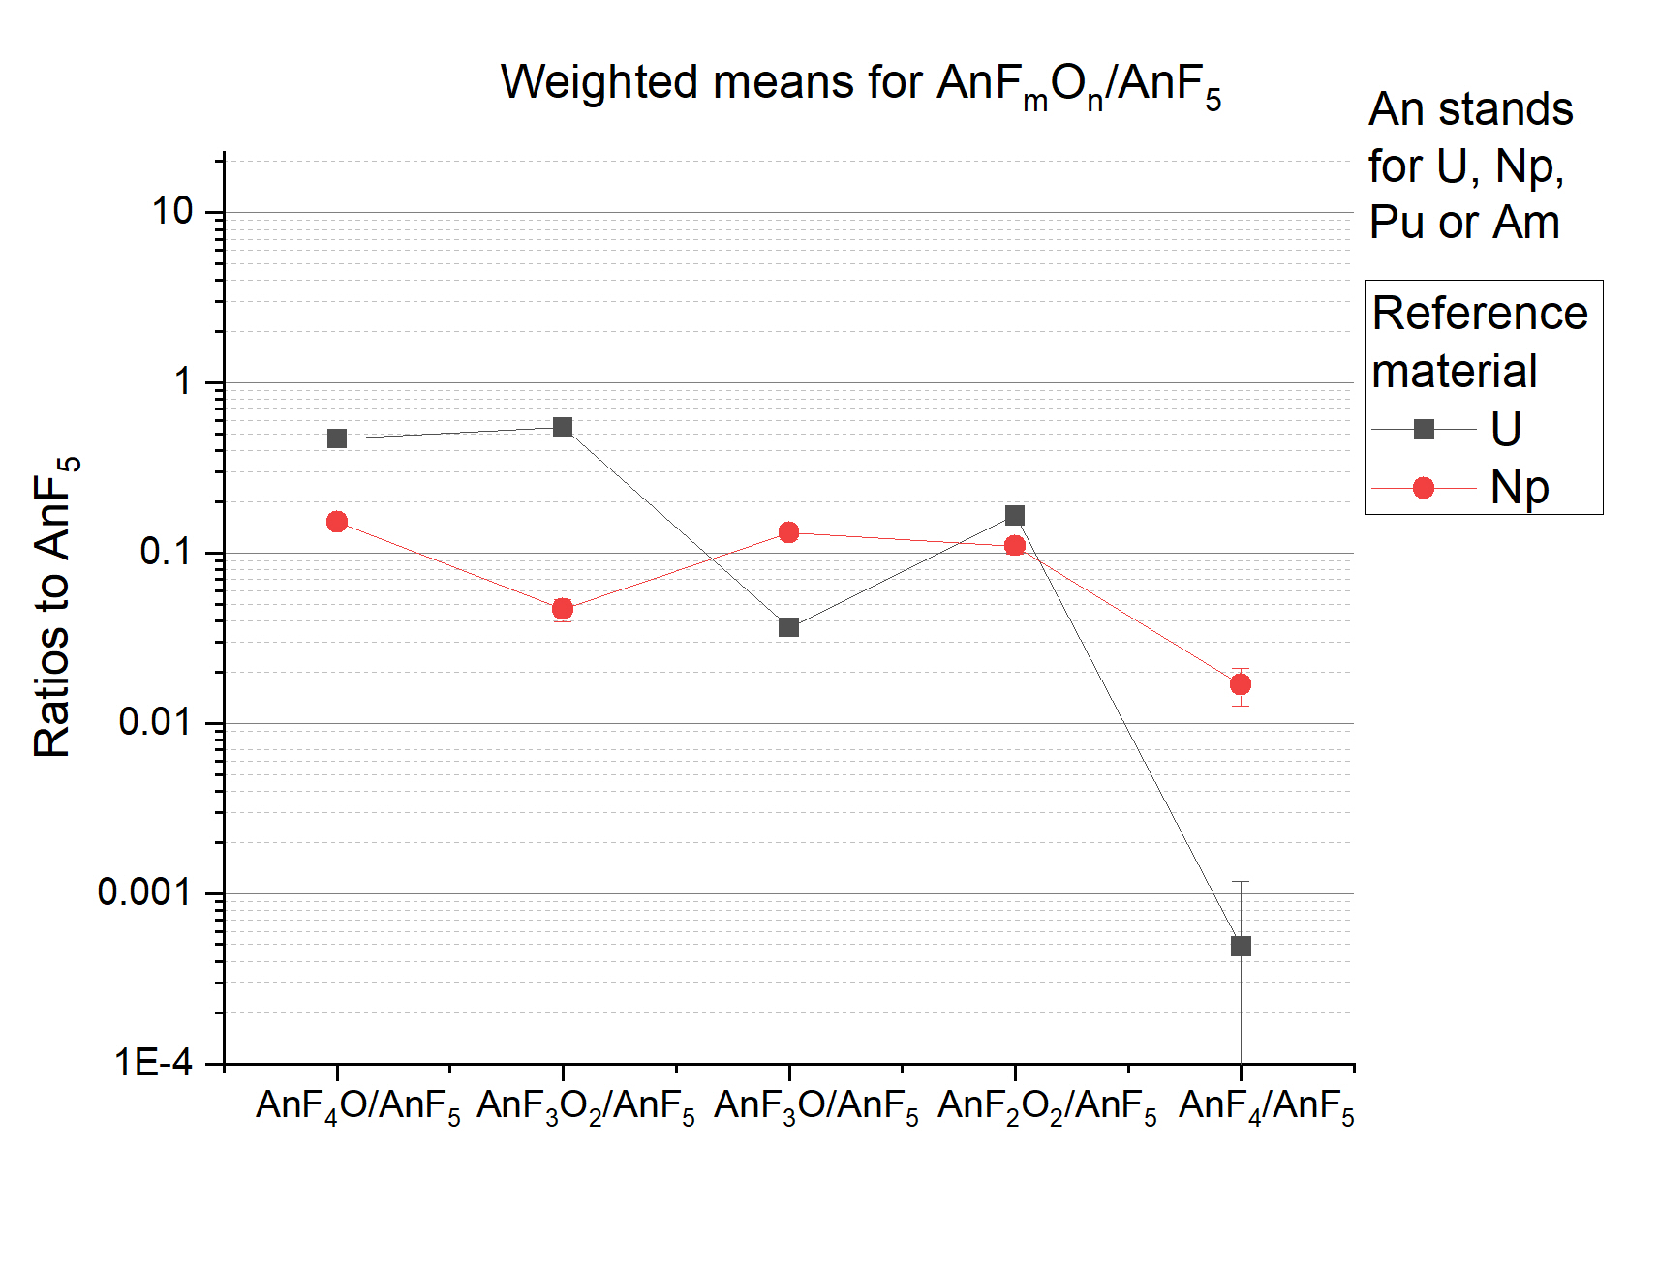
Formation distribution:
reference materials
  Characteristic AnF_{m}O_{n}– /AnF₅–
  ratios for U, Np
7

Slide 23
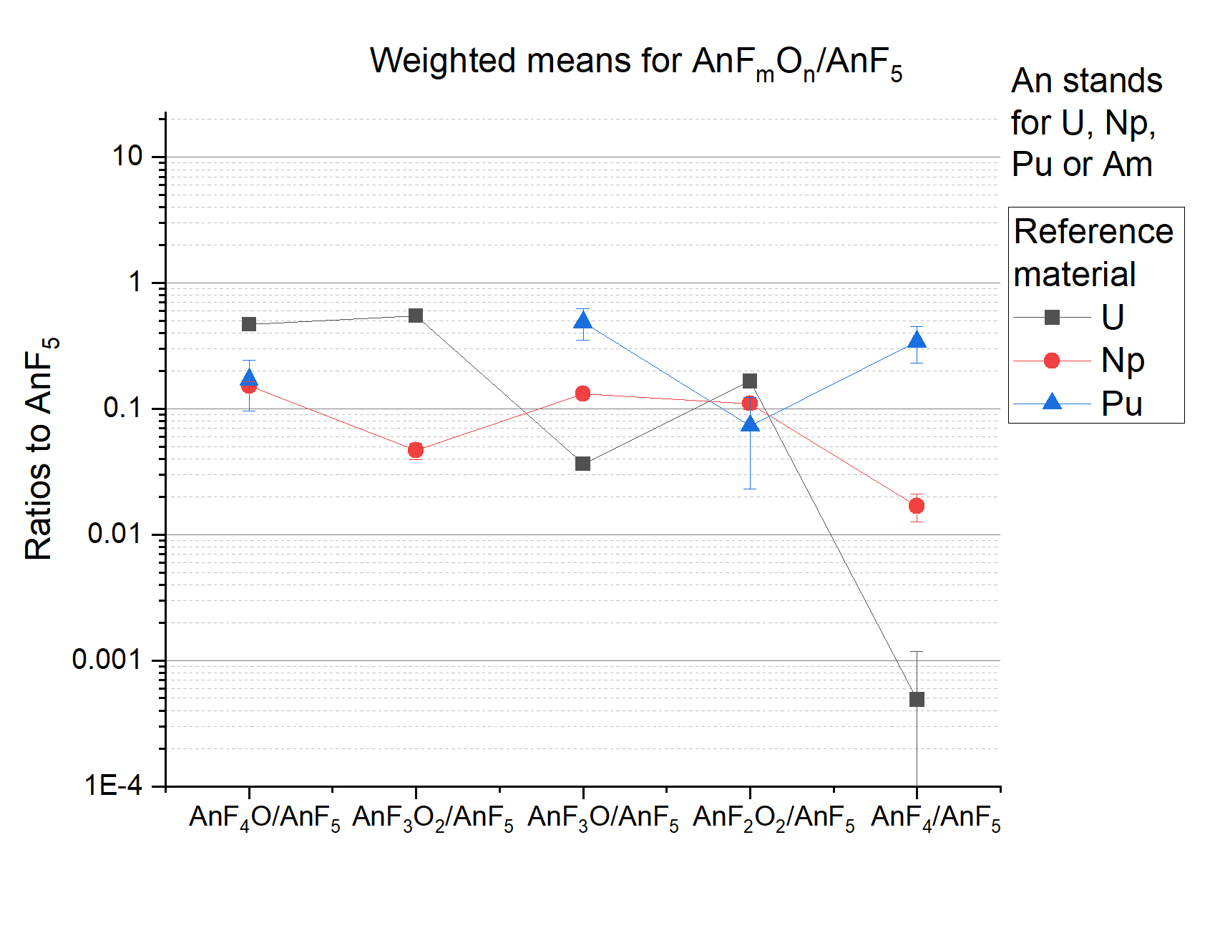
Formation distribution: reference materials
  Characteristic AnF_{m}O_{n}– /AnF₅–
  ratios for U, Np, Pu
7

Slide 24
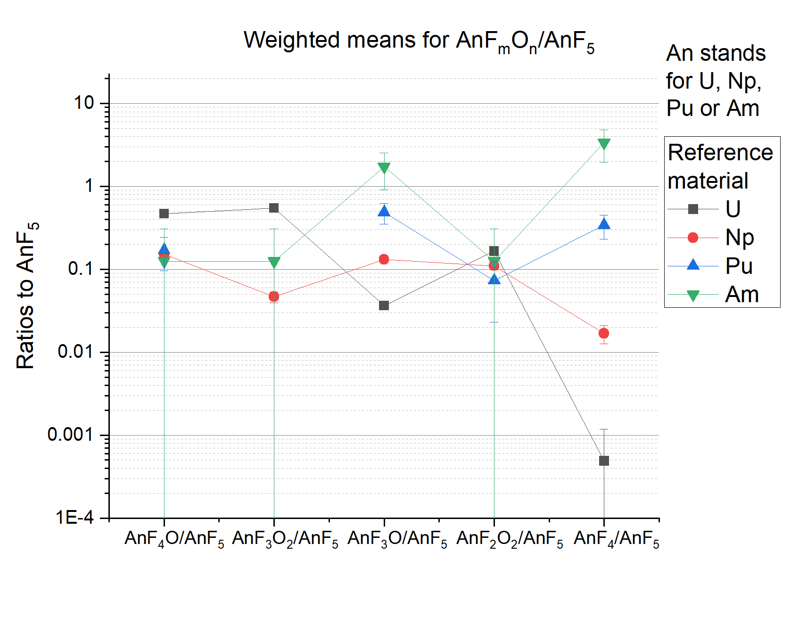
Formation distribution: reference materials
  Characteristic AnF_{m}O_{n}– /AnF₅–
  ratios for U, Np, Pu, Am
7

Slide 25
Formation distribution: reference materials
  Characteristic AnF_{m}O_{n}– /AnF₅–
  ratios for U, Np, Pu, Am
    Isobaric contaminations
    shift formation ratios
    AnF₄–/AnF₅–!
7

Slide 26
Formation distribution: reference materials
  Characteristic AnF_{m}O_{n}– /AnF₅–
  ratios for U, Np, Pu, Am
    Isobaric contaminations
    shift formation ratios
    AnF₄–/AnF₅–!
  UF₄ –, NpF₄ – for ILIAMS?
    Hypothesis: correlation
    anion formation ratio to
    e– detachment energy?
    Suppression of U vs Np by
    one order of magnitude
    in ion source
7

Slide 27
Analysis of irradiated samples
Ratios shift between beamtimes, separation for AnF4₄– remains stable
  reference materials for every beamtime
8

Slide 28
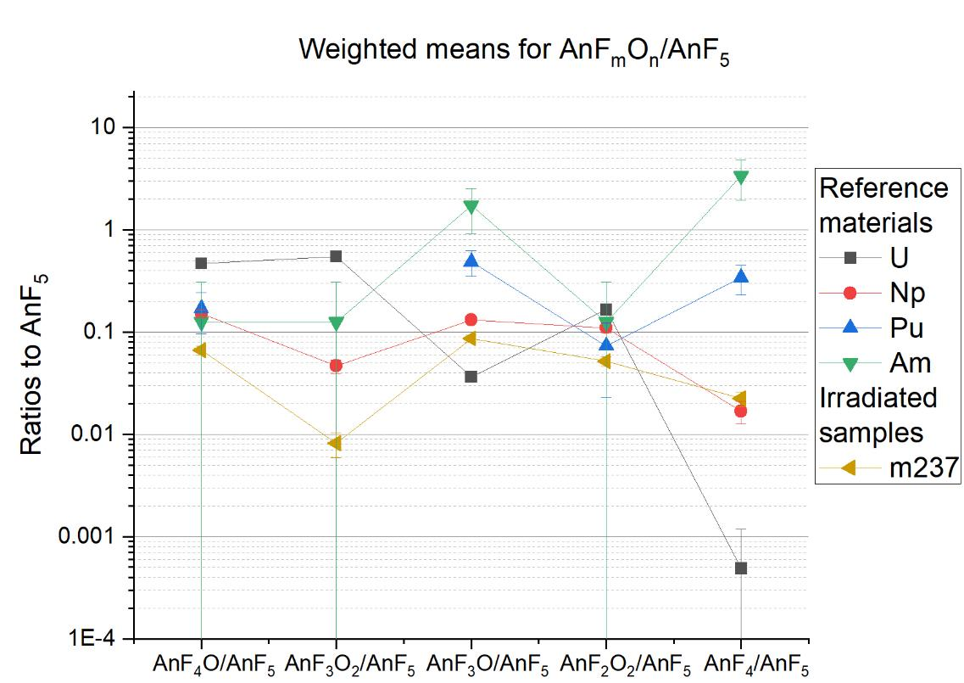
Analysis of irradiated samples
Ratios shift between beamtimes, separation for AnF₄–/AnF₅– is stable
  Reference materials for every beamtime
8

Slide 29
Analysis of irradiated samples
Ratios shift between beamtimes, separation for AnF₄–/AnF₅– is stable
  Reference materials for every beamtime
QC for measurement: m237 on irradiated targets (~ 10% of m236)
    Co-produced ²³⁷Np!
  m237 AnF₄–/AnF₅– ratio compatible with reference Np (1σ)
8

Slide 30
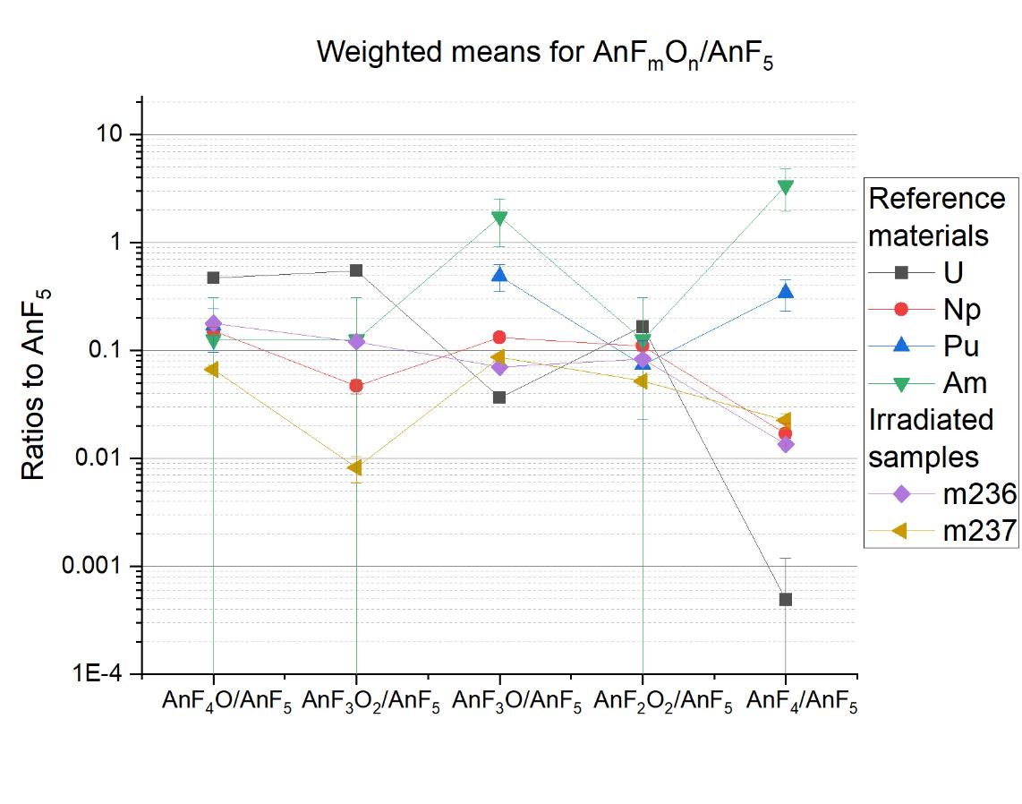
Analysis of irradiated samples
  m236 AnF₄–/AnF₅– ratio is compatible with ref. Np (1σ)
    Isobaric ²³⁶U interference
    is negligible
9

Slide 31
Analysis of irradiated samples
  m236 AnF₄–/AnF₅– ratio is compatible with ref. Np (1σ)
    Isobaric ²³⁶U interference
    is negligible
  The production and
  separation of ²³⁶Np
  was successful
9

Slide 32
Conclusion and outlook
The relative formation probabilities for
are characteristic for U, Np, Pu and Am
  This distribution can be used to identify isobaric contaminations
This method could show that ²³⁶Np was successfully produced
and chemically separated from ²³⁶U
  Isotopic spike for environmental ²³⁷Np?
The next steps:
  ILIAMS separation of U and Np
  Maximize NpF₄– formation
AnF₅– | AnF₄O– | AnF₃O₂–
AnF₃O– | AnF₂O₂– | AnF₄–
10

Slide 33
Appendix

Slide 34
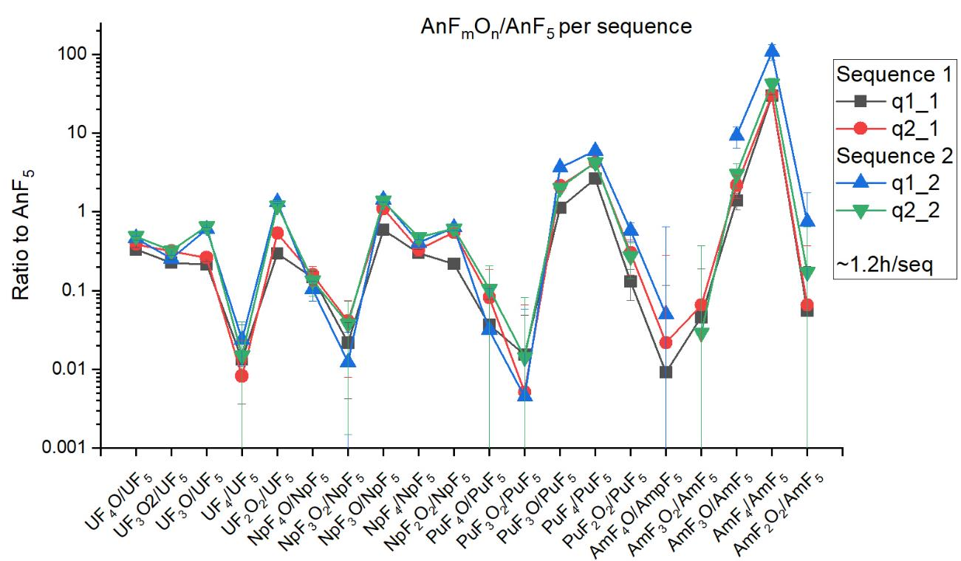
How stable are the ratios with increasing duration of the measurement?

Slide 35
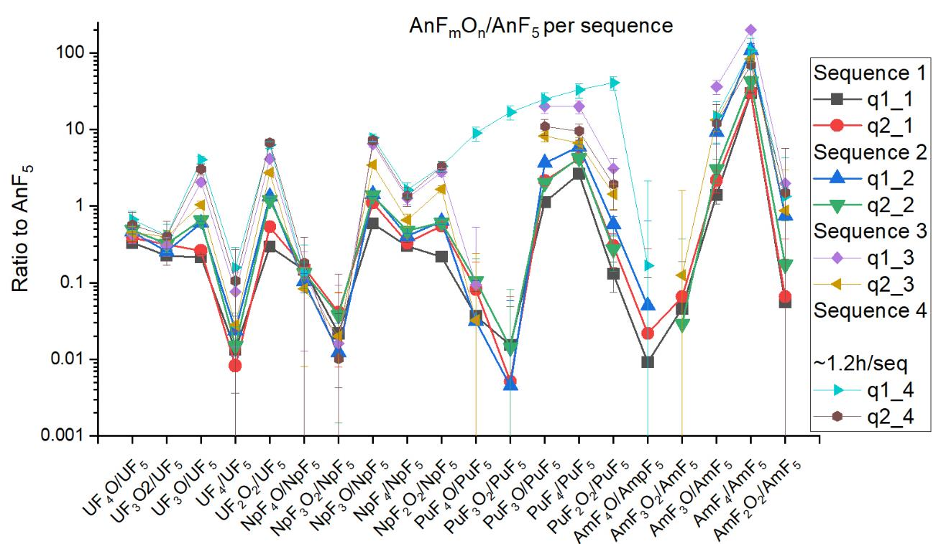
How stable are the ratios with increasing duration of the measurement?
Ratios change significantly after the first two sequences
All targets should be measured for 2 sequences (~2.5h) for consistent results

Slide 36
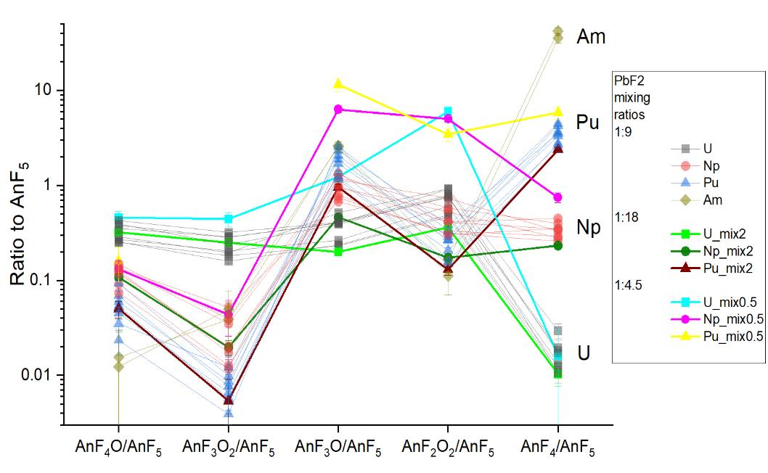
How stable are the ratios for different mixing rates with PbF₂?
Reducing mixing ratios to 1:4.5 increases lower fluorides/oyxfluorides
    Similar to long measurement duration
    Fluorine supply affects formation probablilities
Increasing PbF₂ further (1:18) has no significant effect

Slide 37
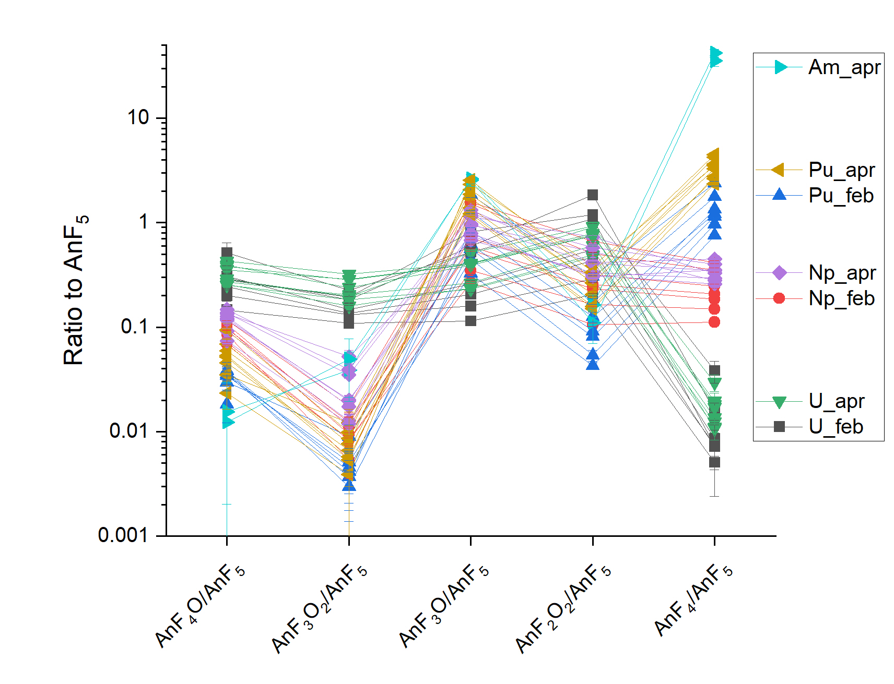
How stable are the ratios between Beamtimes
AnF_{m}O_{n}–/AnF₅– ratios change between beamtimes
  Ion source conditions?
  Tuning?
Separation for AnF₄/AnF₅ remains stable
  Method is robust against tuning variations!
Reference samples have
to be included in every measurement

