Slide 1
“Consideration on optimal dipole length from the point of view of optics”
Jérémie Bauche, Antoine Chance, Barbara Dalena, Roberto Kersevan, Bastian Harer, Mike Koratzinos, Attilio Milanese, Katsunobu Oide, Dmitry Shatilov, Frank Zimmermann
FCC technologies meeting, 26 March 2021

Slide 2

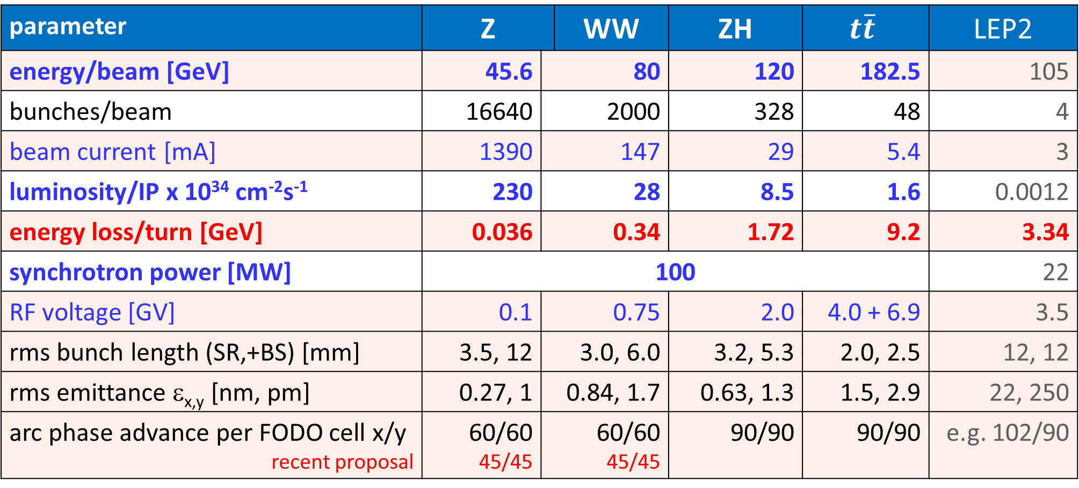
FCC-ee CDR baseline parameters
parameter | Z |  | WW | ZH | $$t\overline{t}$$ | LEP2
energy/beam [GeV] | 45.6 | 80 |  | 120 | 182.5 | 105
bunches/beam | 16640 | 2000 |  | 328 | 48 | 4
beam current [mA] | 1390 | 147 |  | 29 | 5.4 | 3
luminosity/IP x 10³⁴ cm⁻²s⁻¹ | 230 | 28 |  | 8.5 | 1.6 | 0.0012
energy loss/turn [GeV] | 0.036 | 0.34 |  | 1.72 | 9.2 | 3.34
synchrotron power [MW] | 100 |  |  |  |  | 22
RF voltage [GV] | 0.1 | 0.75 |  | 2.0 | 4.0 + 6.9 | 3.5
rms bunch length (SR,+BS) [mm] | 3.5, 12 | 3.0, 6.0 |  | 3.2, 5.3 | 2.0, 2.5 | 12, 12
rms emittance ε_{x,y} [nm, pm] | 0.27, 1 | 0.84, 1.7 |  | 0.63, 1.3 | 1.5, 2.9 | 22, 250
arc phase advance per FODO cell x/y recent proposal | 60/60 45/45 | 60/60 45/45 |  | 90/90 | 90/90 | e.g. 102/90
new proposal would impact the sextupoles

Slide 3
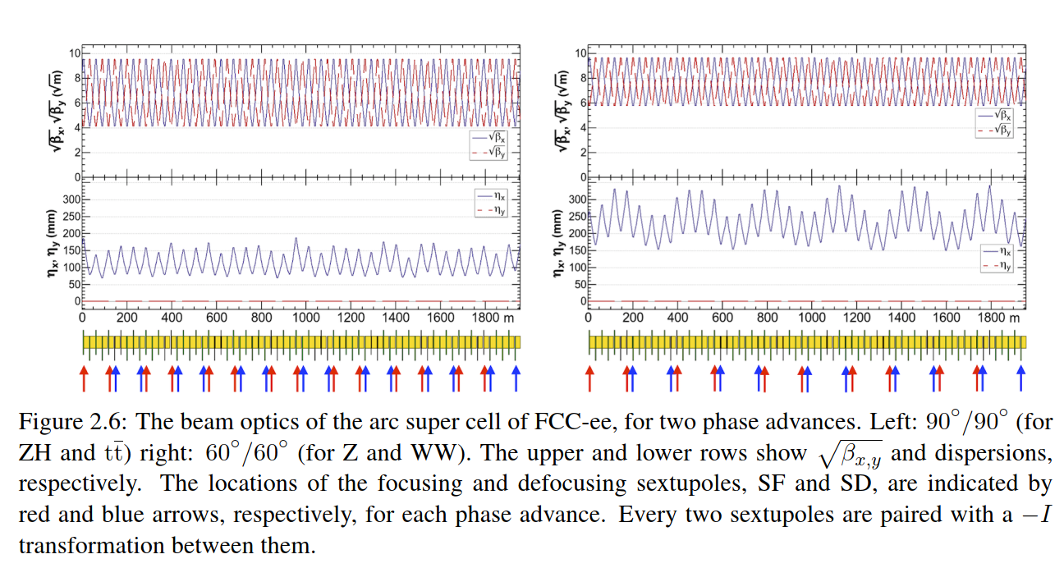
arc supercell for Z+W and for ZH+top operation
CDR
K. Oide

Slide 4
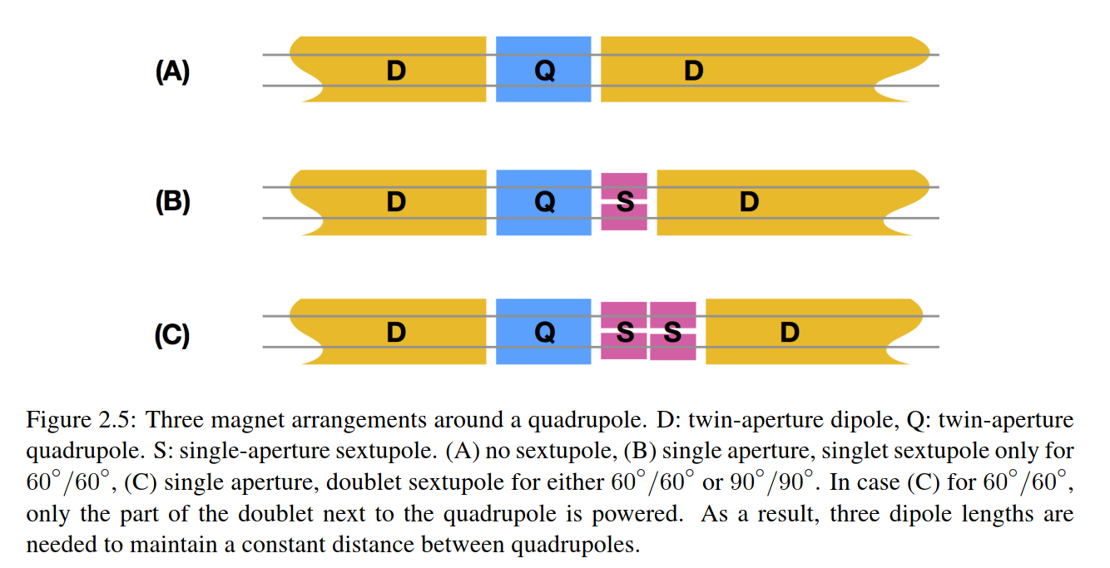
three types of short straight sections
All sextupole pairs are independently powered. There are 584 and 416 independent pairs per half ring for 90◦/90◦ and 60◦/60◦, respectively.
magnetic length
CDR
K. Oide
dipole length [m] | #units
21.232 | 1152
22.732 | 492
24.432 | 1256
half cell length
constant
27.9324 m

Slide 5
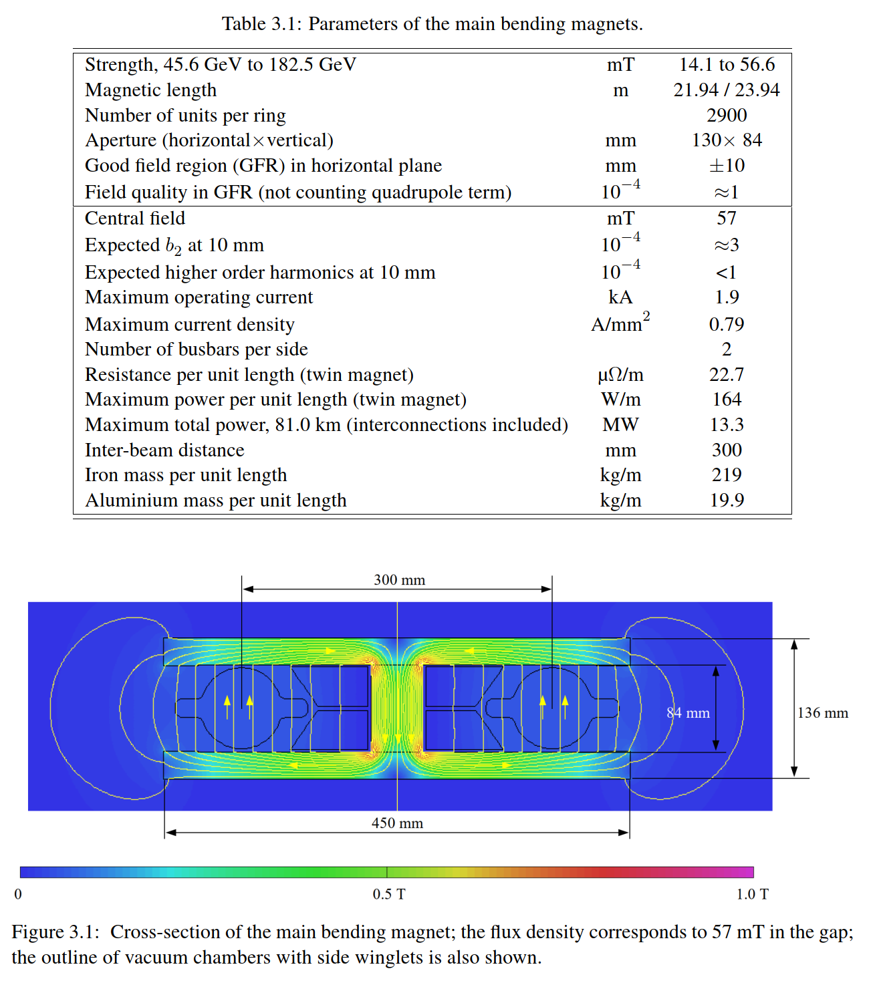
parameters of the main arc dipole magnets
CDR
A. Milanese
K. Oide

Slide 6
cross section of collider arc dipole magnet
CDR
A. Milanese

Slide 7
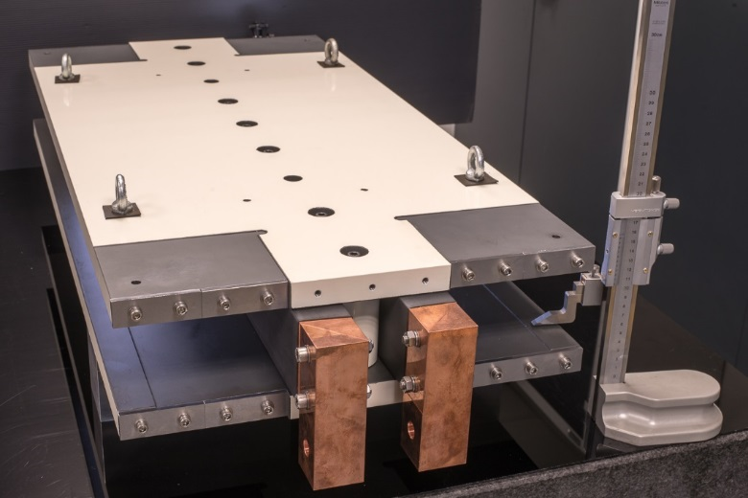
prototype collider arc dipole
two busbars
(plus shielding)
and two plates
-
could be assembled in the tunnel
A. Milanese et al.
access “gap” needed? –
for photon stops (every 4-5 m), water cooling, bellows, flanges, vacuum equipment etc.?

Slide 8
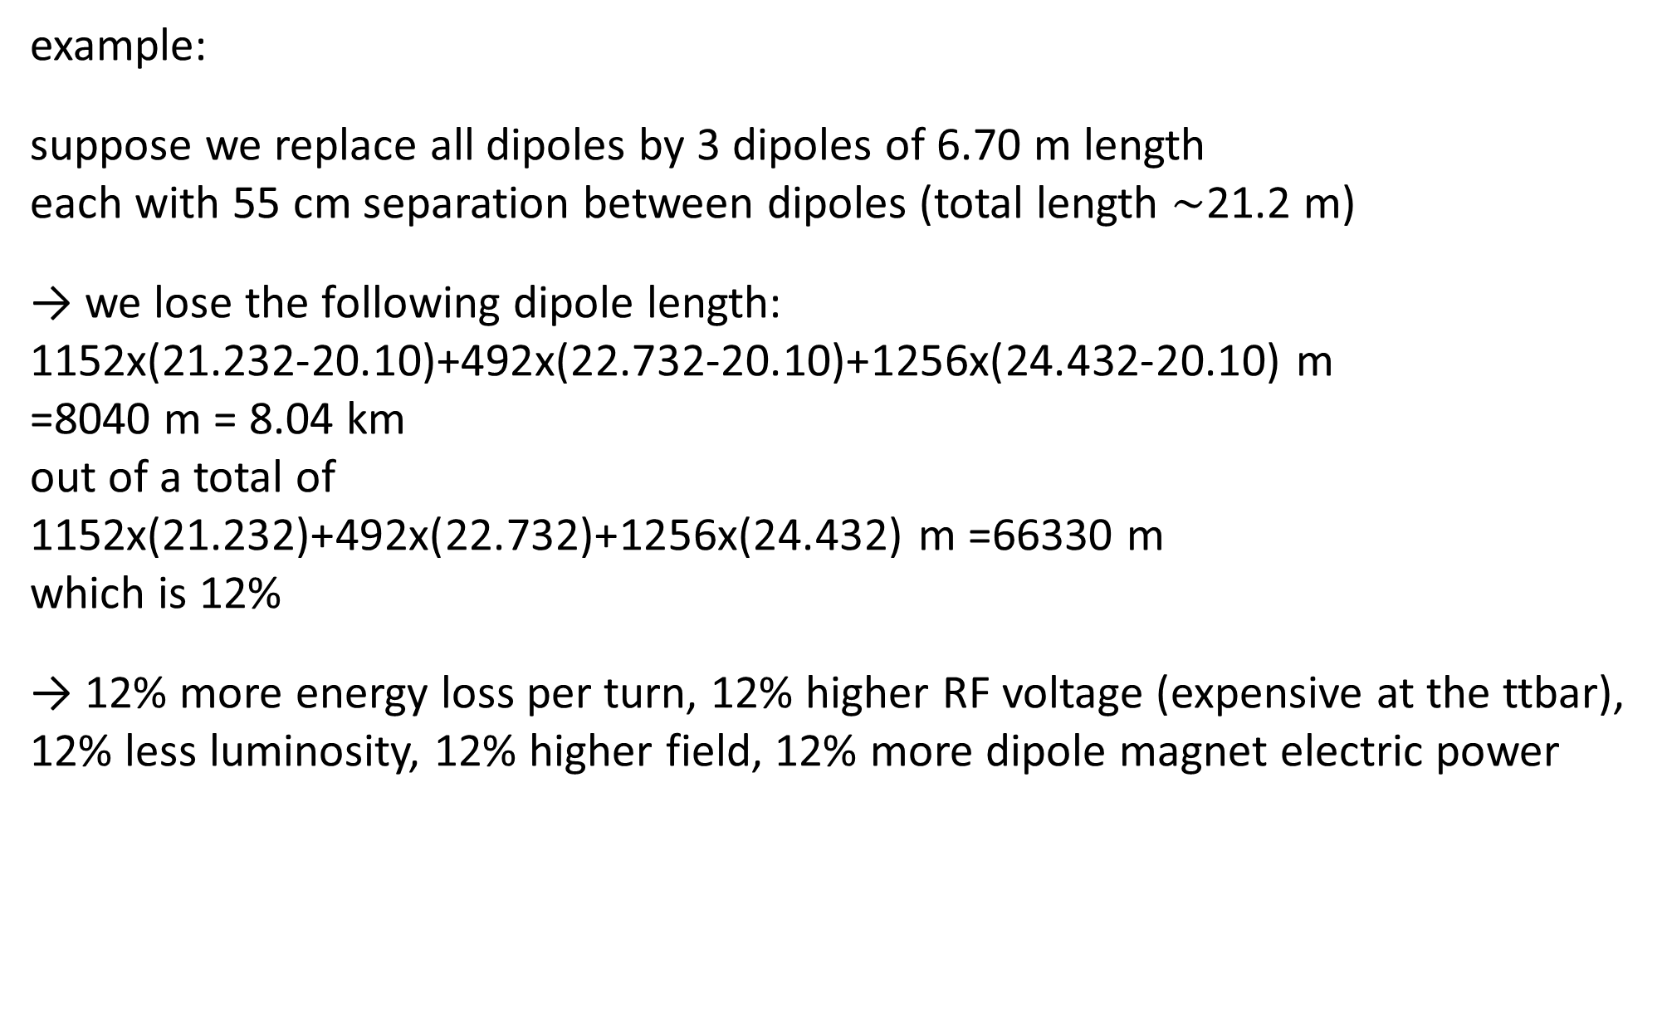
impact of equal & shorter dipoles on performance
example:
suppose we replace all dipoles by 3 dipoles of 6.70 m length
each with 55 cm separation between dipoles (total length $\sim$21.2 m)
→ we lose the following dipole length:
1152x(21.232-20.10)+492x(22.732-20.10)+1256x(24.432-20.10) m
=8040 m = 8.04 km
out of a total of
1152x(21.232)+492x(22.732)+1256x(24.432) m =66330 m
which is 12%
→ 12% more energy loss per turn, 12% higher RF voltage (expensive at the ttbar),
12% less luminosity, 12% higher field, 12% more dipole magnet electric power

Slide 9
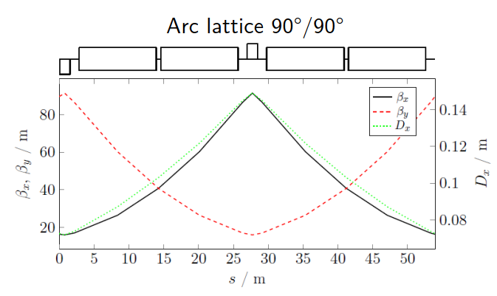
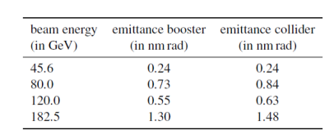

full energy booster
magnetic length
CDR
B. Harer
A. Chance
B. Dalena
dipole length [m] | #units
11.1 | 5176
field at injection 0.006 T
peak field 0.058 T
two optics for the high-energy booster similar to the collider: 60°/60° for Z & WW operation. 90°/90° for ZH & ttbar operation
The booster arc FODO cells are a bit shorter than in the collider: 54 m versus $\sim$55.865 m.
$→$Smaller equilibrium emittance: 1.3 nm against 1.48 nm at 182.5 GeV
$$ε_{x}∝{γ^{2}θ}_{b}^{3}F$$
0.27

Slide 10
conclusions
filling available arc space with dipoles gives maximum performance
long dipoles, ~22-24 m, could be installed in situ without gap if no other constraints
if there are other constraints, what are these – photon stops, cooling bellows? flanges…? which locations and gaps are required for these? which maximum continuous dipole length is allowed?
it might be advantageous to make the booster cell as long as collider cell; however, this would remove the emittance margin

