Slide 1
FCC-ee
Main Dipole Length Considerations
(from the Magnet Point of View)
J. Bauche, M. Karppinen, FCC-ee Technology meeting, 26th March 2021.
With contributions from:
C. Bertone, C. Colloca, J.-L. Grenard, B. Humann, R. Kersevan, E Mainaud-Durand, V. Mertens, A. Milanese, K. Oide, I. Ruehl, F. Valchkova-Georgieva, F. Zimmerman

Slide 2
Outline
26th March 2021 – FCC Technology Meeting
FCC-ee Main Dipole Length Considerations, J. Bauche, TE-MSC
Introduction
Dipole magnet design
  Cross section
  Parameters
  Half-cell configurations
Options for dipole magnet lengths
Interconnects
  Vacuum interconnects
  Booster integration
  Magnet power and cooling
Magnet constructional aspects
  Solid vs. laminated cores
  Logistics, transport and installation
  Supports and alignment
Conclusions and next steps

Slide 3
Introduction
26th March 2021 – FCC Technology Meeting
FCC-ee Main Dipole Length Considerations, J. Bauche, TE-MSC
Context of this presentation
Most of the material presented is based on information and parameters from the CDR version of the FCC-ee
The magnet designs, including their cross-sections, are being re-evaluated based on the latest assumptions and machine layout evolution
This presentation is intended to highlight the parameters and design considerations that have an impact on the optimal dipole length from the magnet point of view, including also considerations of transport, alignment, cooling, etc.
The objective is to determine areas where more information is needed to make an educated decision on the optimal dipole length

Slide 4
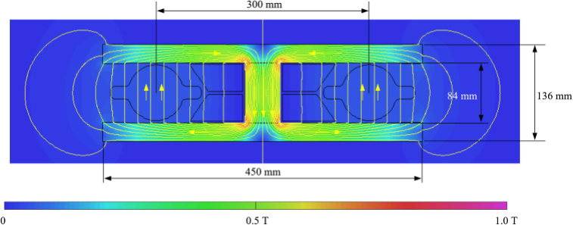
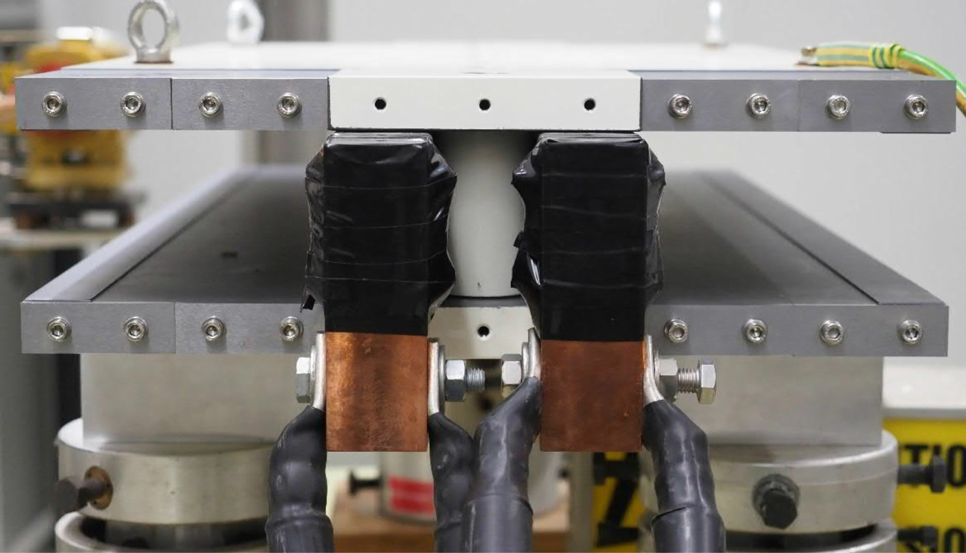
Dipole magnet design
26th March 2021 – FCC Technology Meeting
FCC-ee Main Dipole Length Considerations, J. Bauche, TE-MSC
Magnet cross section (CDR)
Interesting facts
  Twin aperture design, allows simple construction and low consumption (50% gain compared to two single aperture magnets)
  300 mm inter-beam distance shared between vacuum chamber size, SR absorbers, busbars and yoke return leg
  Yoke return leg presently made of columns interleaved with drift spaces to optimize iron permeability working point
  Pole geometry precision relies on column width
  Relatively weak mechanical inertia of flat I-shape
  DC operation, compatible with solid iron yoke construction, but alternatives are possible
  Air cooled aluminum busbar considered in CDR baseline design
Magnetic model, cross-section, B₀ max = 57 mT
Prototype 1m-long model, single busbar coil

Slide 5
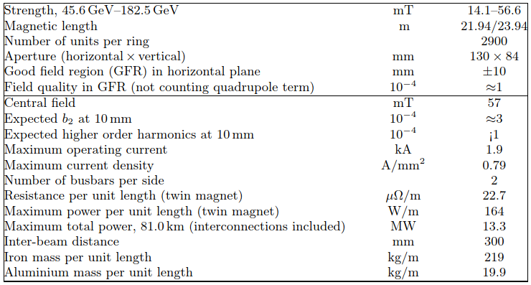
Dipole magnet design
26th March 2021 – FCC Technology Meeting
FCC-ee Main Dipole Length Considerations, J. Bauche, TE-MSC
Magnet parameters (CDR)
  Magnetic lengths have slightly evolved in recent layouts, still under study (1)
  Dissipated power evacuated by ventilation system if air-cooled conductor
  Total mass of dipoles ~15600 tons, with 10% of coils (similar to SPS main dipoles)
  ~65 km of dipoles for the whole ring
Main dipole parameter list, CDR version
¹ See K. Oide talk at https://indico.cern.ch/event/1017226/

Slide 6
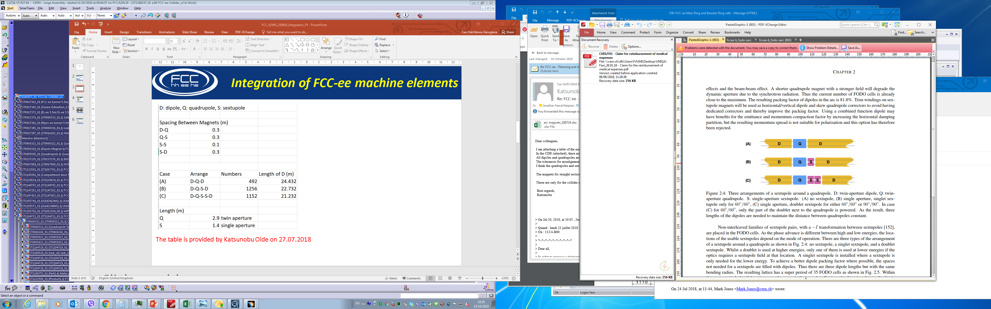
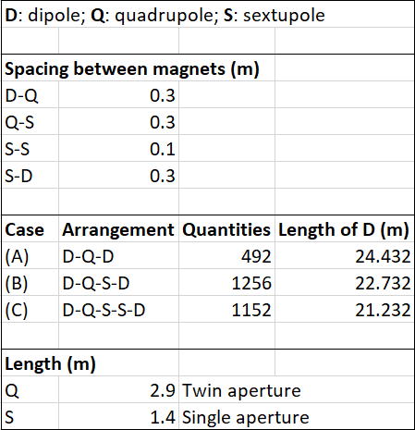
Dipole magnet design
26th March 2021 – FCC Technology Meeting
FCC-ee Main Dipole Length Considerations, J. Bauche, TE-MSC
Half-cell configurations
  Layout optimizing dipole packing factor to minimize SR power (5.3% gain by filling non-sextupole areas)
  3 configurations of dipole lengths, depending on presence of sextupole(s) in the half-cell
Arc half-cell configurations, courtesy K. Oide

Slide 7
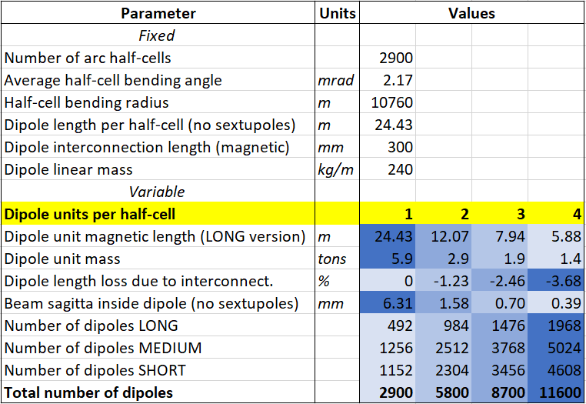
Options for dipole length
26th March 2021 – FCC Technology Meeting
FCC-ee Main Dipole Length Considerations, J. Bauche, TE-MSC
Fixed parameters
Based on CDR, except dipole length per half-cell slightly longer (2018)
  Dipole interconnection length to be assessed with mechanical design studies (see next slides)
(Preliminary assumption)
Variable parameters
Function of dipole splitting options
  Large magnet quantities whatever splitting option
  Magnet unit mass not a concern by itself, but long units would bring some challenges
  Loss of dipole packing factor for shorter units, to be checked in terms of beam optics
  Sagitta is of little concern, except for 24m version where it reaches ~30% of good field region

Slide 8
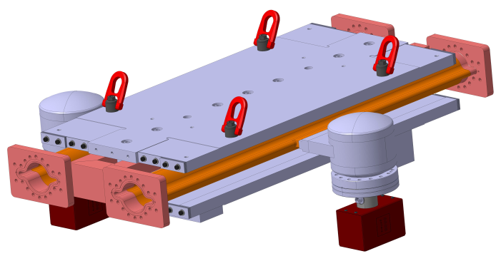
Interconnect's
26th March 2021 – FCC Technology Meeting
FCC-ee Main Dipole Length Considerations, J. Bauche, TE-MSC
What must fit into the interconnection space between dipoles?
  Power electrical connections
  Possibly cooling connections
  Vacuum connections
  Other integration constraints (see next slides)
Short model of FCC-ee dipole with vacuum chamber

Slide 9
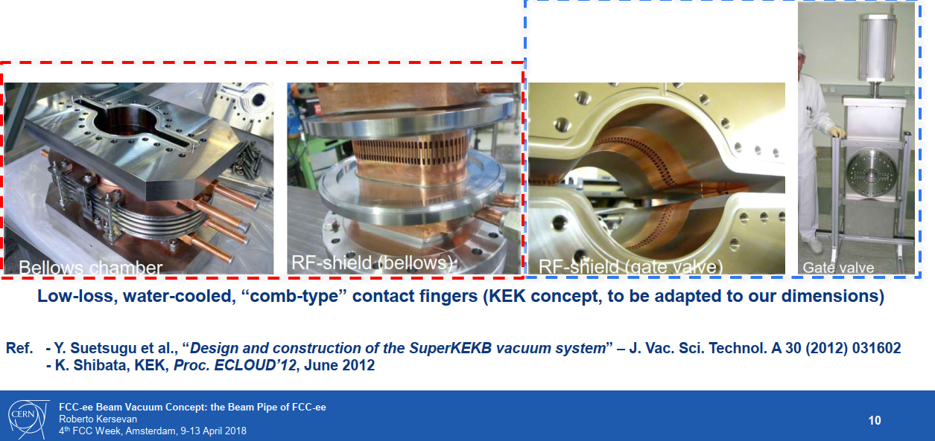
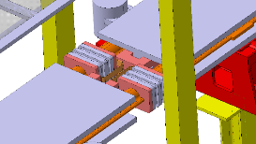
Interconnect’s
26th March 2021 – FCC Technology Meeting
FCC-ee Main Dipole Length Considerations, J. Bauche, TE-MSC
Vacuum connections
Example of KEK vacuum chamber bellow and RF shield (Courtesy R. Kersevan)
  Vacuum flanges are large and impinge on the busbar footprint (busbar connection cannot be straight)
  Water cooled contact fingers similar to KEK concept for FCC-ee? Would impinge more on busbar area. To be checked
  Length of bellow may have to match booster supporting pillars
Integration studies for booster on top of FCC-ee collider
(Courtesy F. Valchkova- Georgieva)

Slide 10
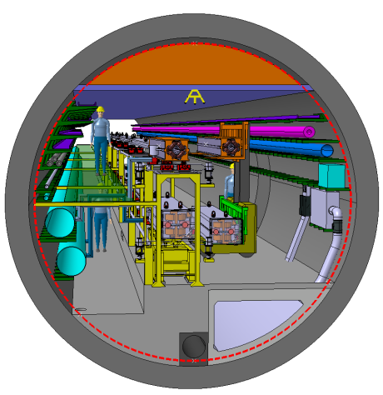
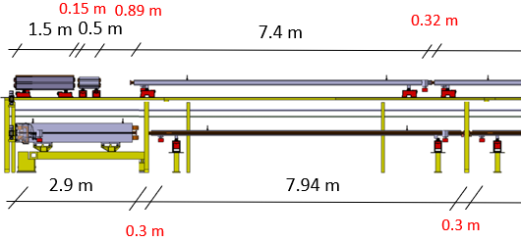
Interconnect's
26th March 2021 – FCC Technology Meeting
FCC-ee Main Dipole Length Considerations, J. Bauche, TE-MSC
Booster integration in tunnel
  Integration studies with booster on top to optimize use of tunnel cross-section… tight!
  Needs supporting structure for booster with pillars along collider equipment
  Distance between pillars should match dipole lengths to avoid booster disassembly/realignment in case of collider dipole replacement
  Pillar width to match interconnection length
  Other options: design booster supporting structure to allow removable pillars (temporary props); cantilever support; specific installation systems to slide dipole between pillars, etc.
  → to be further studied
Integration studies for booster on top of FCC-ee collider
(Courtesy F. Valchkova- Georgieva)

Slide 11
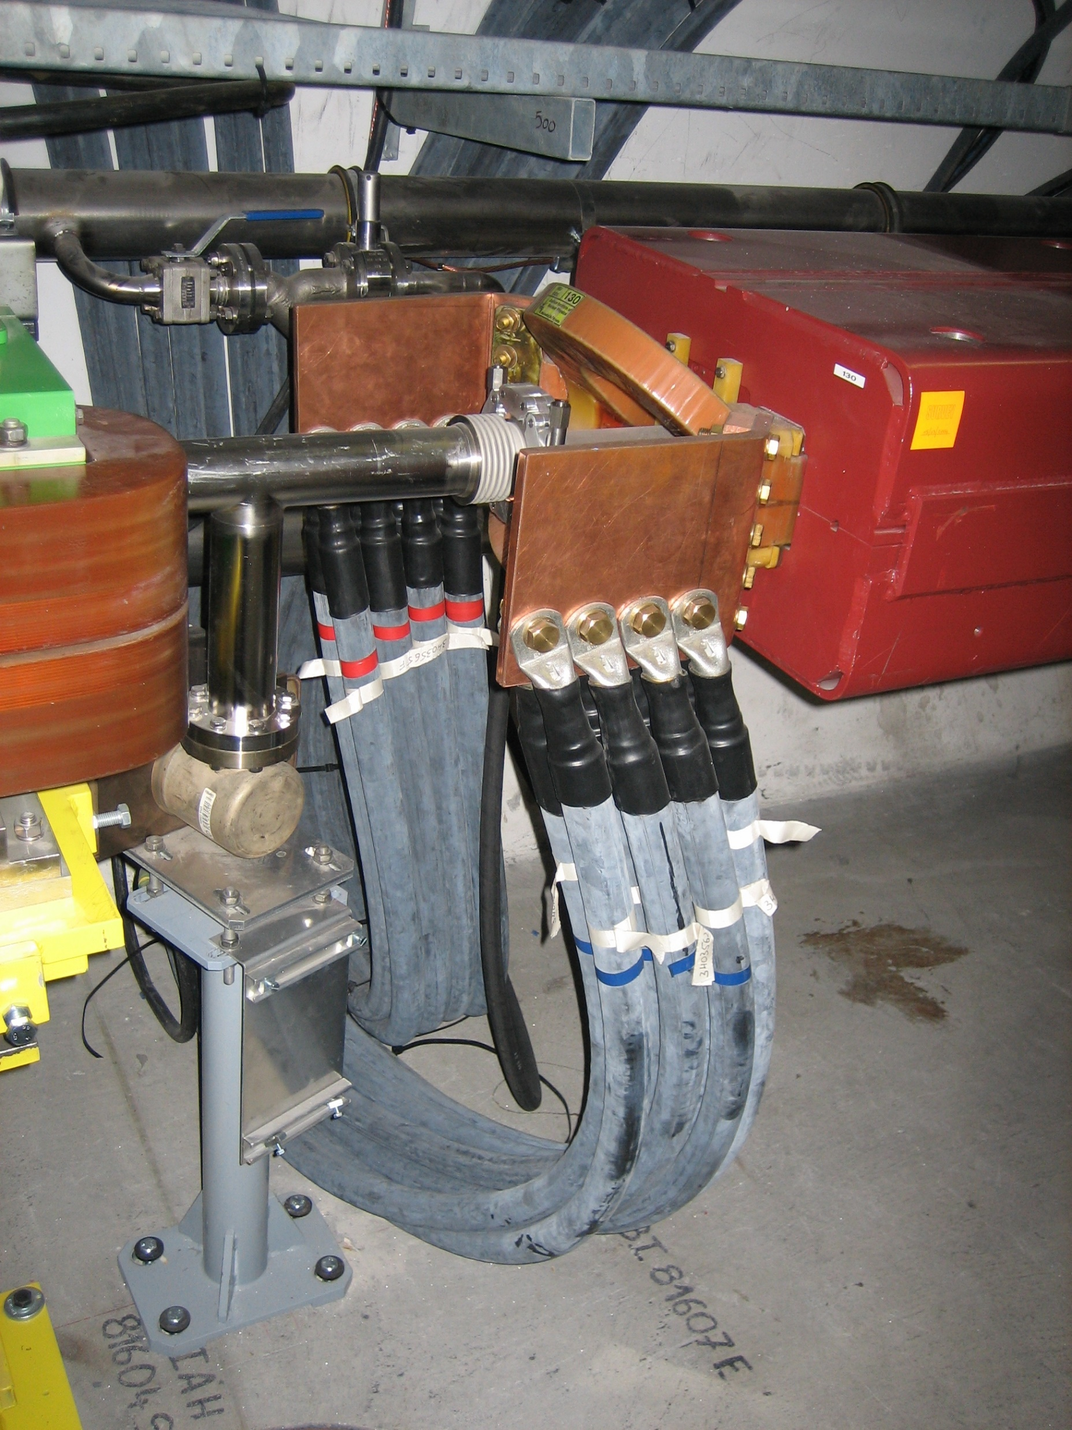
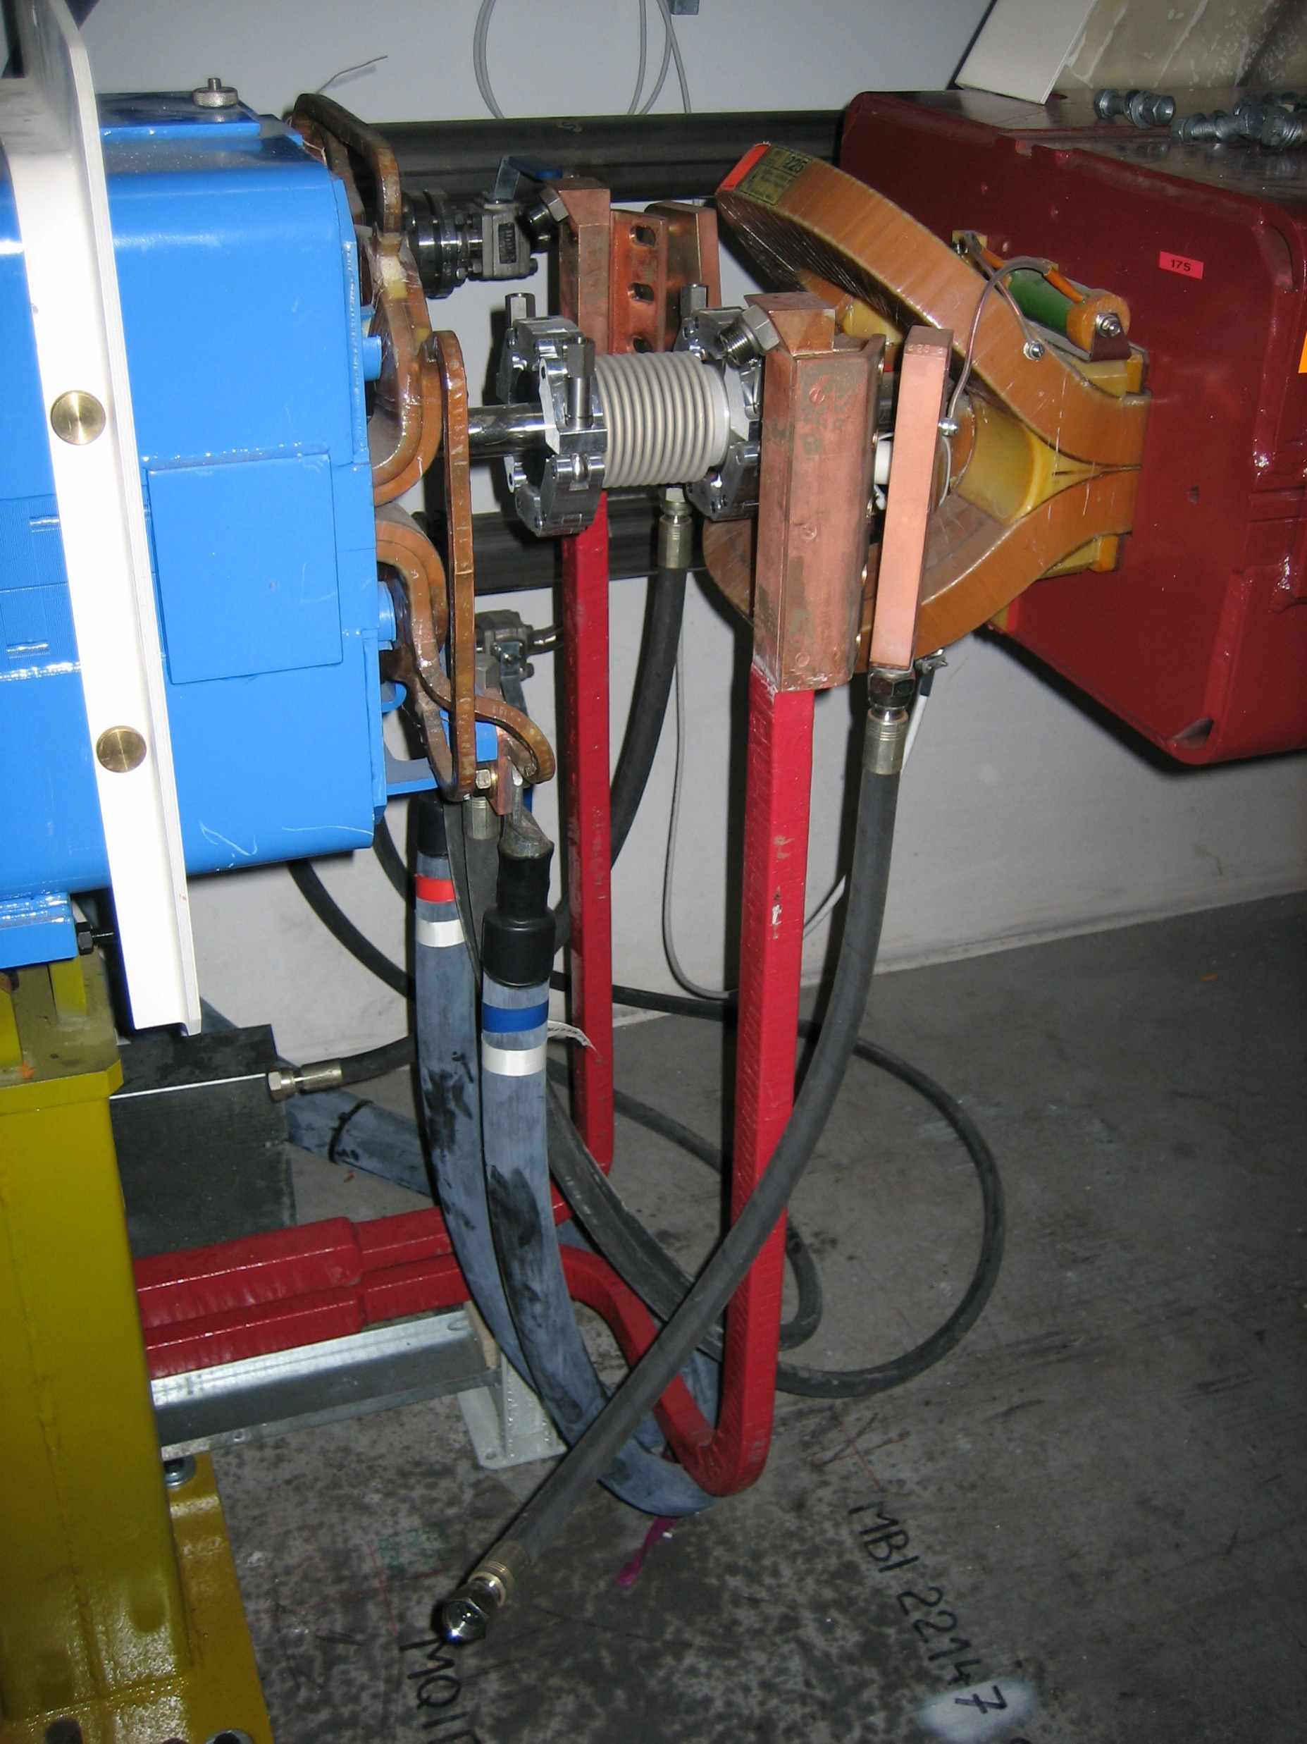
Interconnect’s
26th March 2021 – FCC Technology Meeting
FCC-ee Main Dipole Length Considerations, J. Bauche, TE-MSC
Power and cooling connection
  Power connection can be made with flexible braids bolted to the conductor sides at extremities, in a relatively simple way to bypass the vacuum flanges from the bottom
  If split busbar design (CDR) is confirmed, might require the top conductors to bypass the flanges on top
  Cooling connection would require brazed fittings at busbar extremities to connect the cooling hoses, which can take significant space. A distance shall be maintained between the fittings and the vacuum flanges for insulation
  For 2-4 kA current rating, the space needed can be significant
  → needs detailed mechanical design
TI2 – TI8 busbar connections

Slide 12
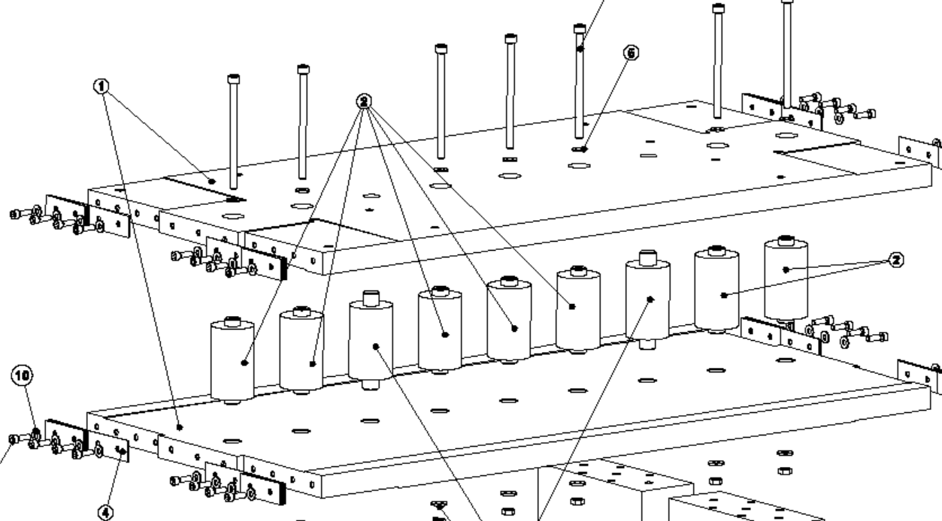
Magnet constructional aspects
26th March 2021 – FCC Technology Meeting
FCC-ee Main Dipole Length Considerations, J. Bauche, TE-MSC
Solid iron yoke |  | Laminated iron yoke
Need machining of every yoke part, even though little material to remove | - | Laminates easy and cheap to produce, and allow flexibility for additional features (notches, etc.) | ++
Material easily available might be an issue for long lengths | - | Steel procurement easy and cheap | ++
Automated machining | + | Automated stacking / gluing / welding | +
Fair stiffness, may still need reinforcement rib for long lengths | + | Poor stiffness, requires strong reinforcement ribs | - -
Stable material, but requires heat treatment (stress, coercivity) | + | Deformation during welding might be an issue | -
BH characteristics less homogeneous, sorting difficult | - | Homogeneous BH characteristics, sorting easy | +
Short model, solid iron yoke with central columns
Solid vs. laminated yokes
  Both options technically viable
  Technological choice might be driven by cost and schedule
  For long magnet versions, solid iron plates would be difficult to procure, but yoke could be assembled from shorter ones

Slide 13
Magnet constructional aspects
26th March 2021 – FCC Technology Meeting
FCC-ee Main Dipole Length Considerations, J. Bauche, TE-MSC
Logistics, transport and installation
  General considerations:
  Shorter magnets means more units to build, transport, install, connect, align, etc. (6m → 8m = -25% units; 8m → 12m = -33% units), and more interconnections
  For 24 m long dipole units:
  The logistics would become very complicated and expensive, with exceptional convoys for every movement (cat.2 > 20m)
  The tunnel access shafts size would need to be large, as well as some by-pass galleries due to large sweeping effect when objects are moved around, in particular around experimental caverns
  The option to assemble the magnets in the tunnel is to be avoided as it is more optimized to perform most of the assembly operations in dedicated buildings in surface rather than in a 100 km long tunnel

Slide 14
Magnet constructional aspects
26th March 2021 – FCC Technology Meeting
FCC-ee Main Dipole Length Considerations, J. Bauche, TE-MSC
Supports and alignment
  General considerations:
  The alignment tolerances of the dipoles are relatively comfortable, thanks to the field homogeneity. Mostly the roll angle needs particular attention
  Long magnets with weak mechanical inertia are subject to possible deformations (torsion, sag). Might require specific supporting scheme to compensate (> 3 points)
  Shorter magnets = more units = more supports, higher costs
  → needs detailed mechanical design (FEM)
RMS error and misalignment tolerances of FCC-ee magnets
(see T. Charles talk at https://indico.cern.ch/event/1017226/)

Slide 15
Conclusions
26th March 2021 – FCC Technology Meeting
FCC-ee Main Dipole Length Considerations, J. Bauche, TE-MSC
A preliminary design of I-shape double aperture dipole has been proposed in the CDR with a cross section satisfying the beam optics requirements, and showing interesting cost advantages
Some technological choices, in particular the coil conductor and yoke assembly, need further studies to optimize the interfaces with a number of other systems (power, cooling and ventilation, VC and SR absorbers, supports and alignment)
More detailed integration studies (booster position) and interconnection mechanical design is needed to define precisely the drift space needed for the magnet interconnections, as important inputs for the optics
At this stage, only the single dipole unit (~24 m) per half-cell appears as the option which brings more drawbacks than benefits, so we propose to discard it

Slide 16
Next steps
26th March 2021 – FCC Technology Meeting
FCC-ee Main Dipole Length Considerations, J. Bauche, TE-MSC
We propose to continue with the following work plan:
Dipole cross-section optimization (magnetic and mechanical), considering space sharing between vacuum pipe, SR absorbers and busbars, in collaboration with TE-VSC
Matching of magnet electrical parameters with powering requirements (single / split busbars), in collaboration with SY-EPC
Definition of busbar material (current density, water / air cooling), in collaboration with SY-EPC and EN-CV
Mechanical design studies of interconnections, in collaboration with TE-VSC, EN-ACE
Mechanical design studies of dipole mechanical stability and supporting/alignment scheme, in collaboration with BE-GM

Slide 17
Thank you for your attention.
Questions?
26th March 2021 – FCC Technology Meeting
FCC-ee Main Dipole Length Considerations, J. Bauche, TE-MSC
17

