Slide 1
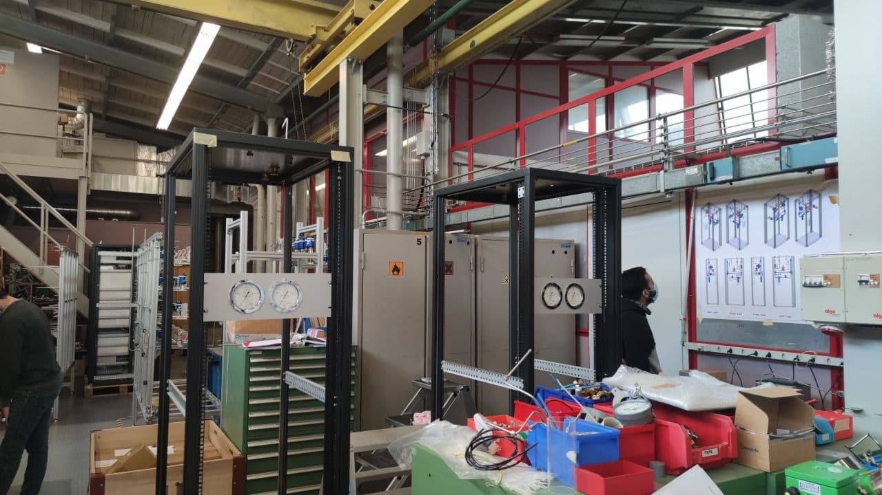
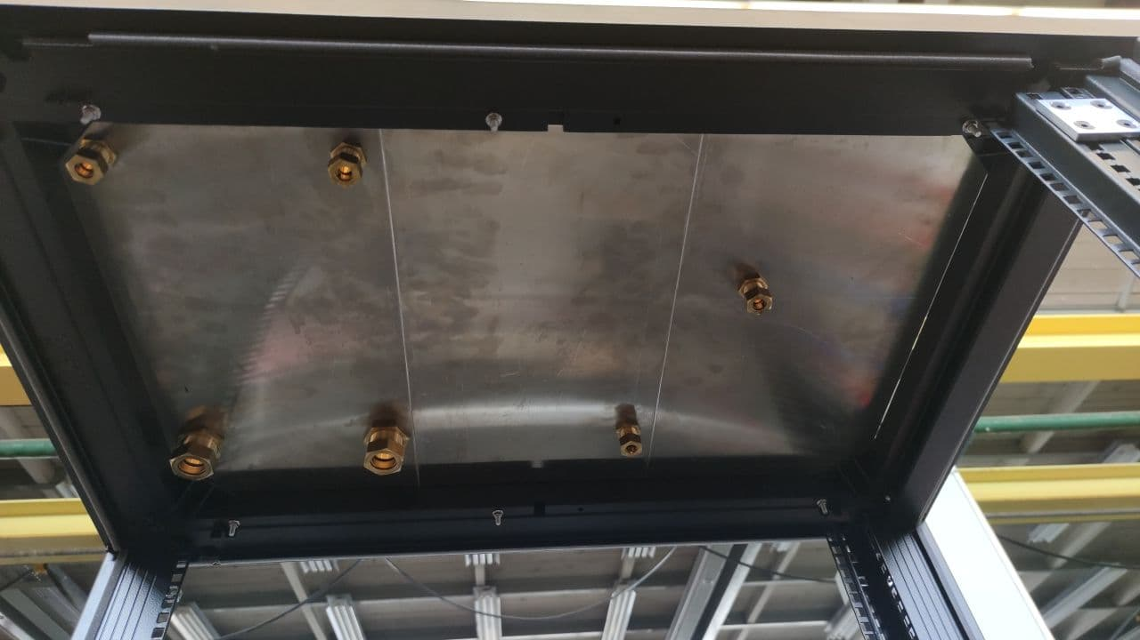
Exhaust NA61-ND280
Missing: 2 Flow controllers Bronkhorst

Slide 2
Distribution NA61
Missing:
2/3 Rotameters (Bronkhorst)
2 Pneumatic valves (FESTO)
2 Pressure regulators (Zimmerli)
Bubblers

