Slide 1
NA61/ND280 STATUS

Slide 2
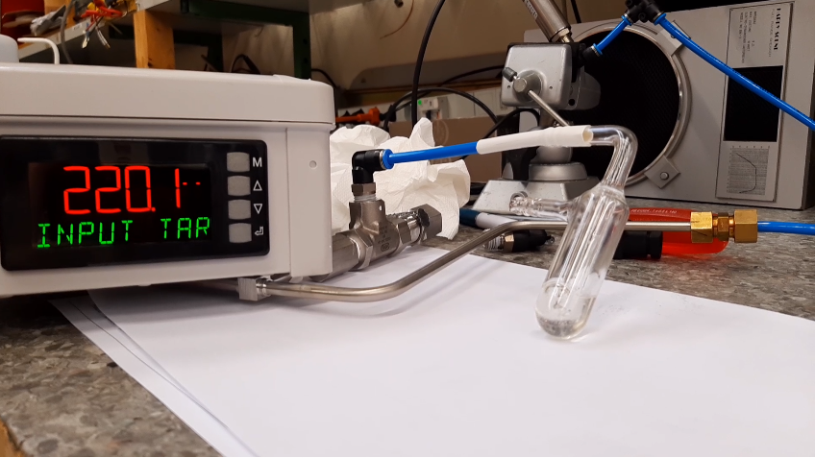
STATUS
SAFETY VALVE PROBLEM
There is a leak in the output already at 220 mbar.
- NA61,we took two safety valve from the atelier stock
- ND280, we need to contact the company

