Slide 1
Cultural Collisions
Gradačac

Slide 2
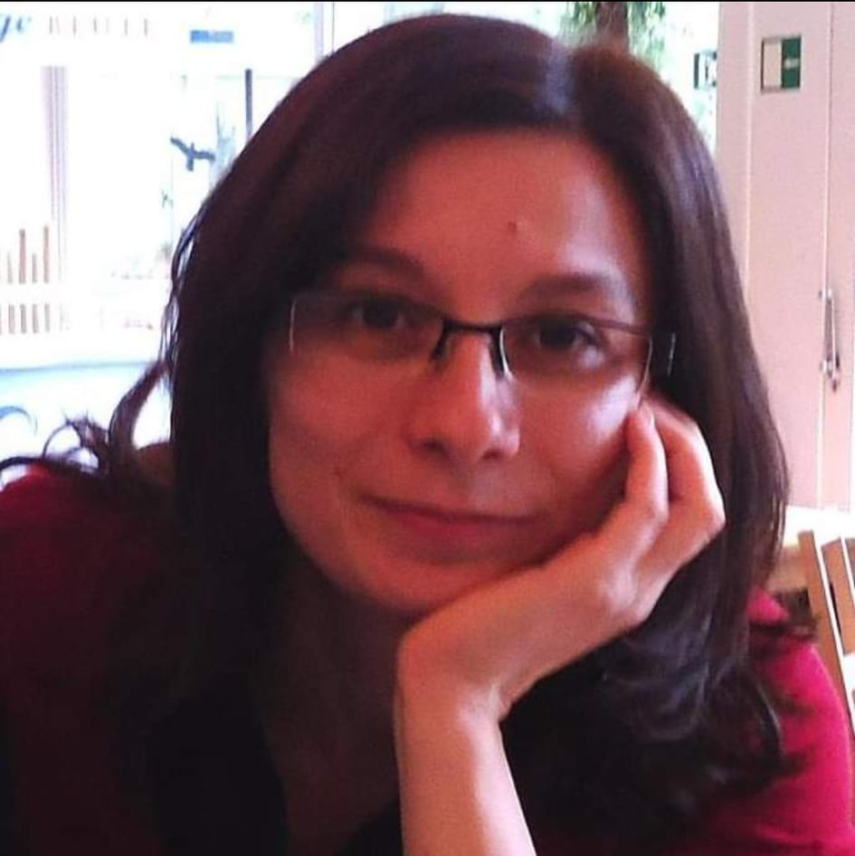
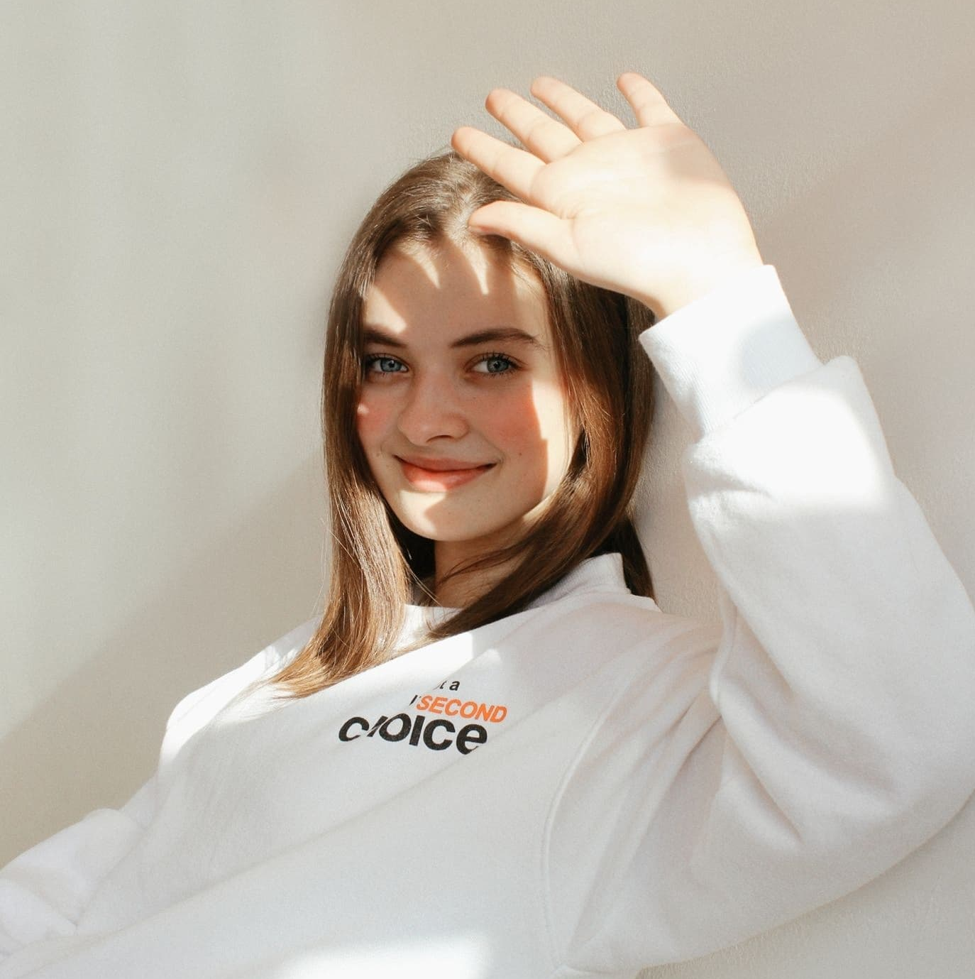
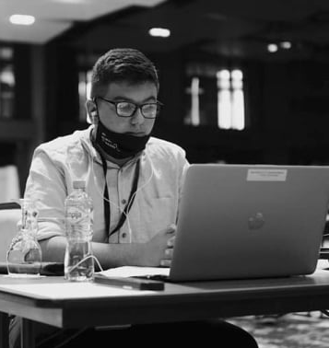
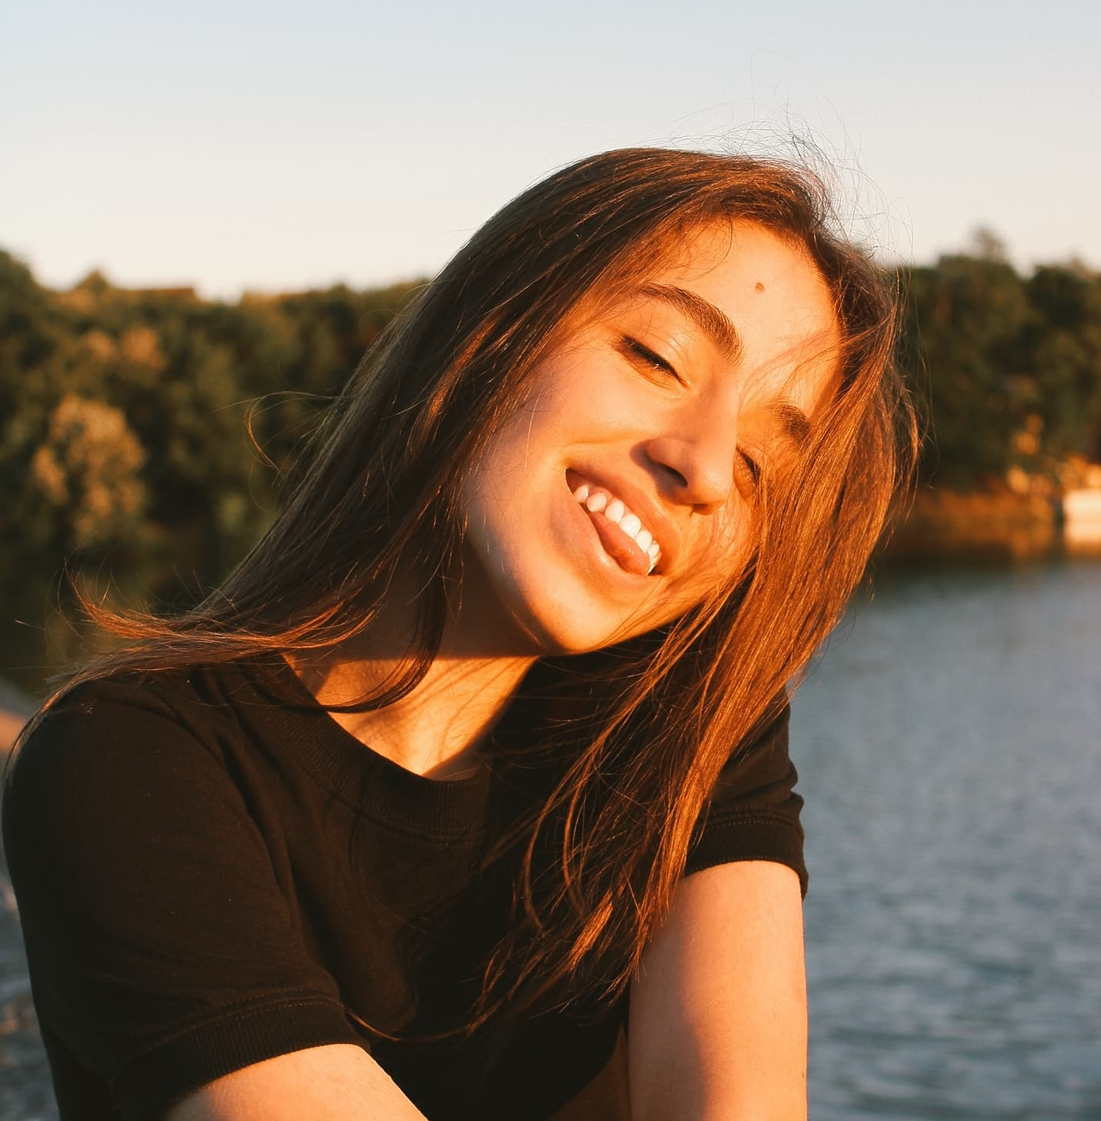
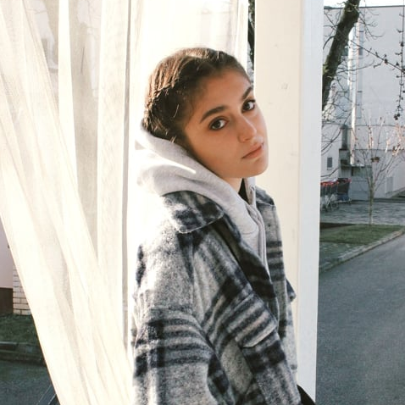
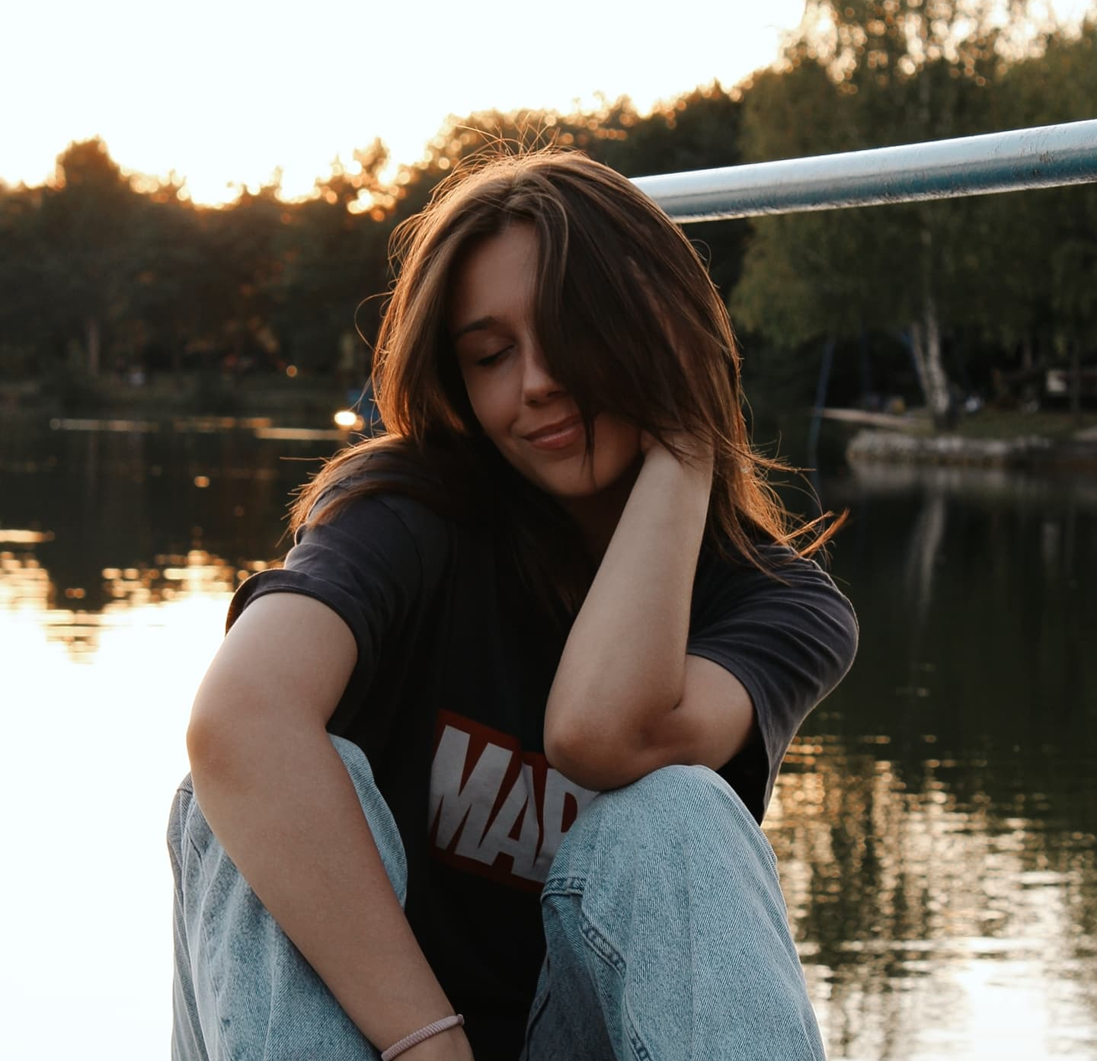
Who are the members of Team Gradačac?
Maida Hujdur
English teacher, mentor
Ernesa Ahmetović
Junior/ third grade
Ismar Ajkunić,
Sophmore/ second grade
Lamija Ćosić
Junior/ third grade
Lamija Muratagić
Junior/ third grade
Amina Omić
Junior/ third grade

Slide 3
What topic did we choose?
We chose the Big Bang Theory as the topic of our video.
We plan on focusing on the First Three Minutes of the Universe.

Slide 4
Why did we choose this topic?
There aren’t a lot of videos in Bosnian covering this topic
Not a lot of students have been taught this topic
We all find it very interesting
We have recently learnt about this topic in our physics class

Slide 5
What is our plan?
We are going to make a video explaining how the Universe began and what happened in the moments following the Big Bang, by drawing images on a whiteboard using different colored markers. That concept was popularised under the name ” Draw My Life”.
We plan to record a voiceover using a rap song explaining everything and putting English subtitles.

Slide 6
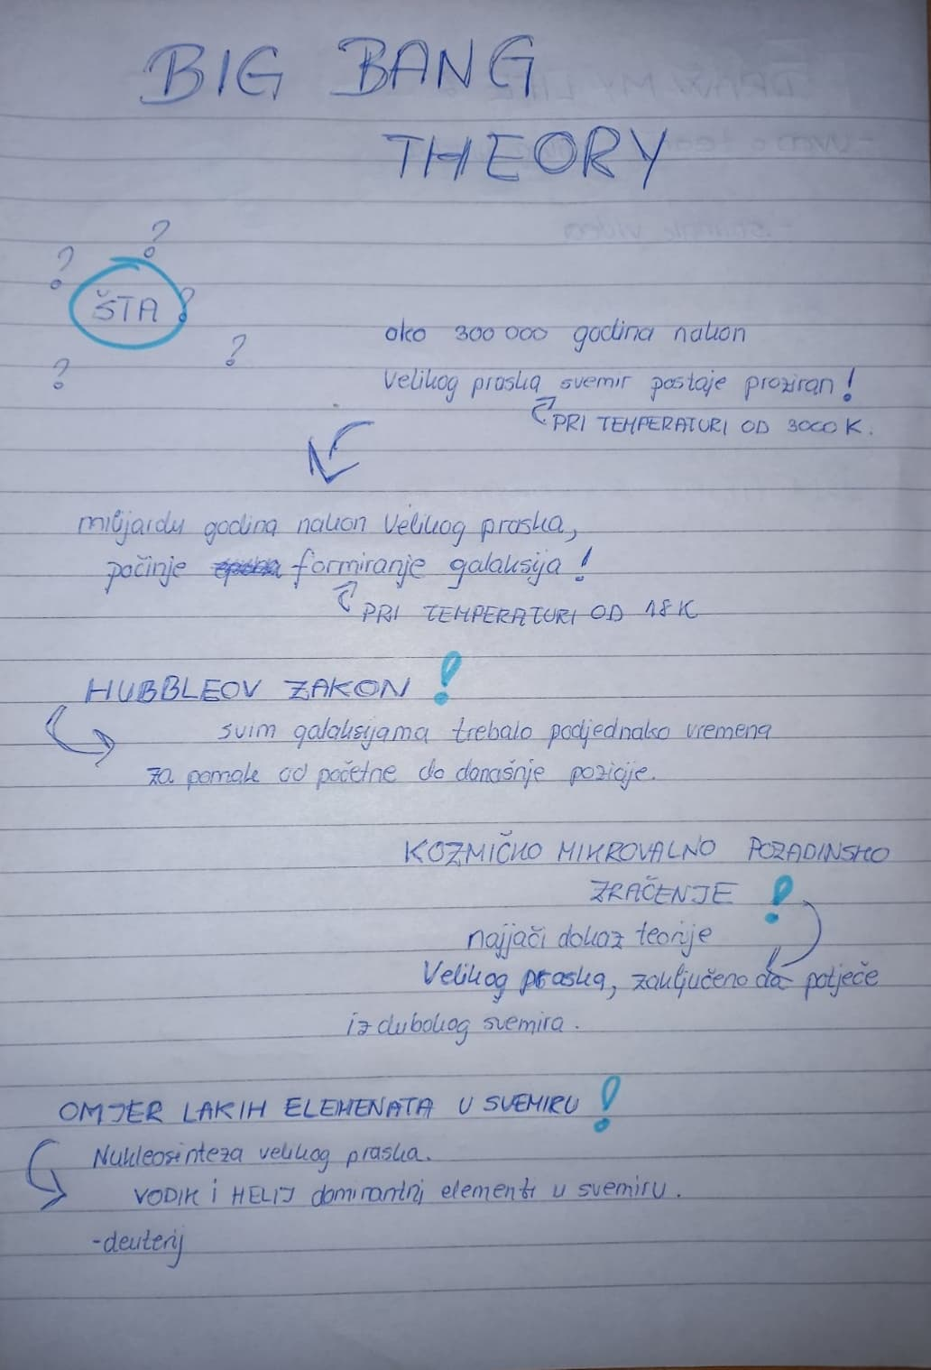
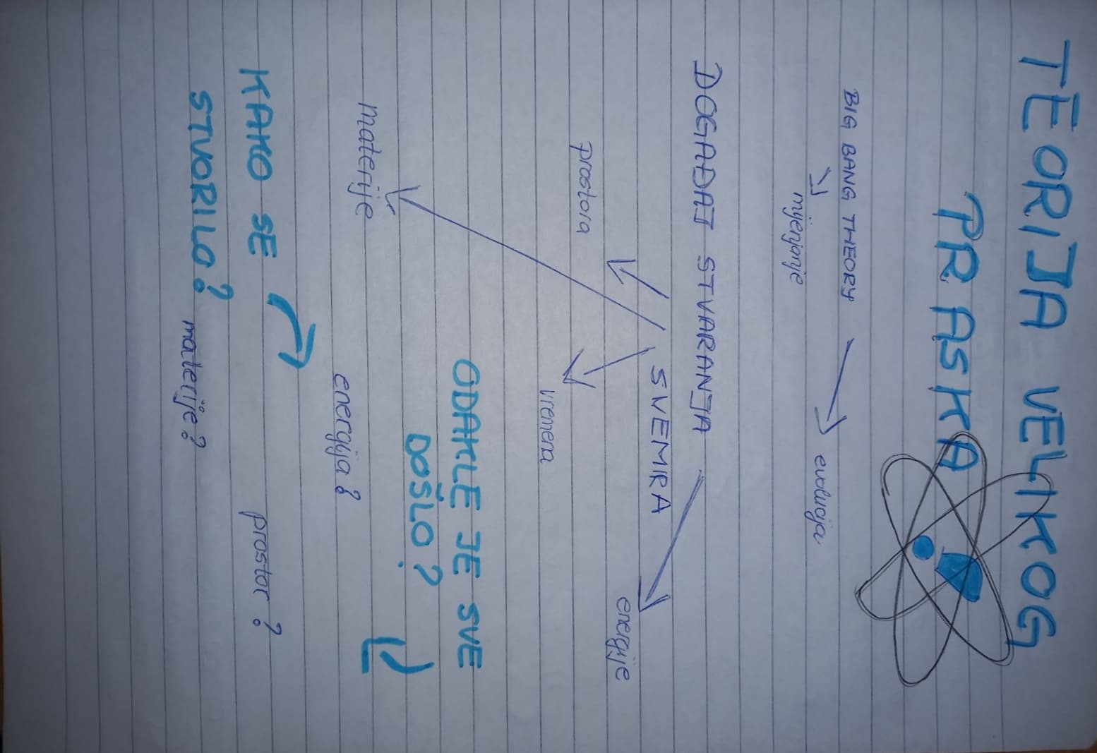
01
Meeting

Slide 7

What’s next?
March
January
Recording voiceover, video editing, adding English subtitles.
Collecting filming equipment and drawing supplies.
December
Reading literature, making a script for the video, collecting data.
April
Editing the behind-the-scenes video, presenting the video to our classmates.
February
Choosing a location for filming, filming the video.

Slide 8
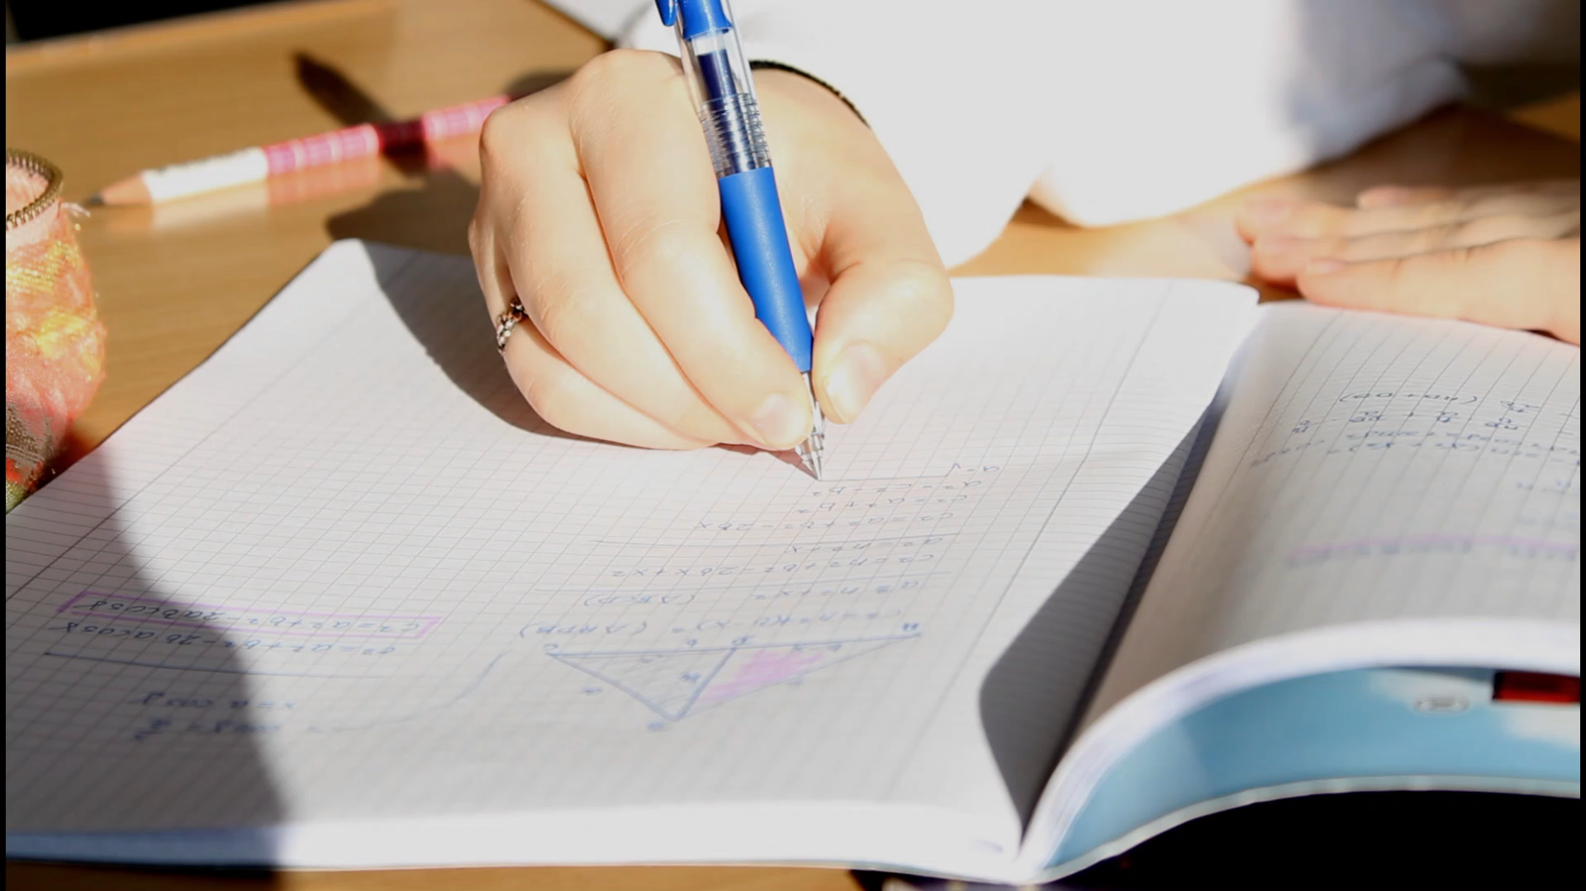

Slide 9
We are looking forward to filming our video as well as watching all the other videos ☺

