Slide 1
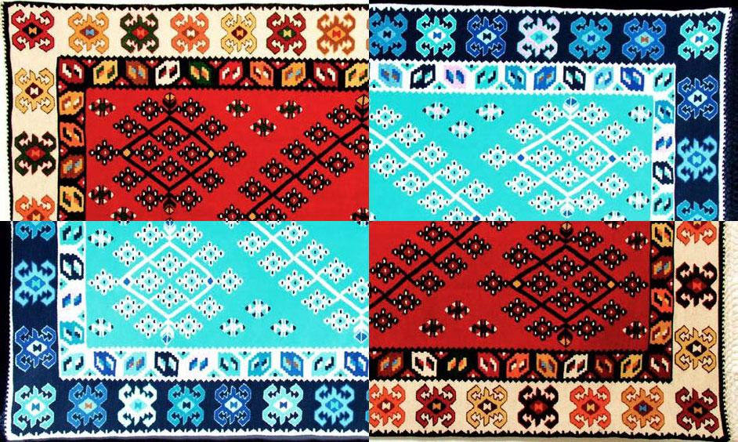
The future of science woven into our tradition
Cultural Collisions - Bosnia and Herzegovina (Nov 2020 - May 2021)
Zenica team

Slide 2
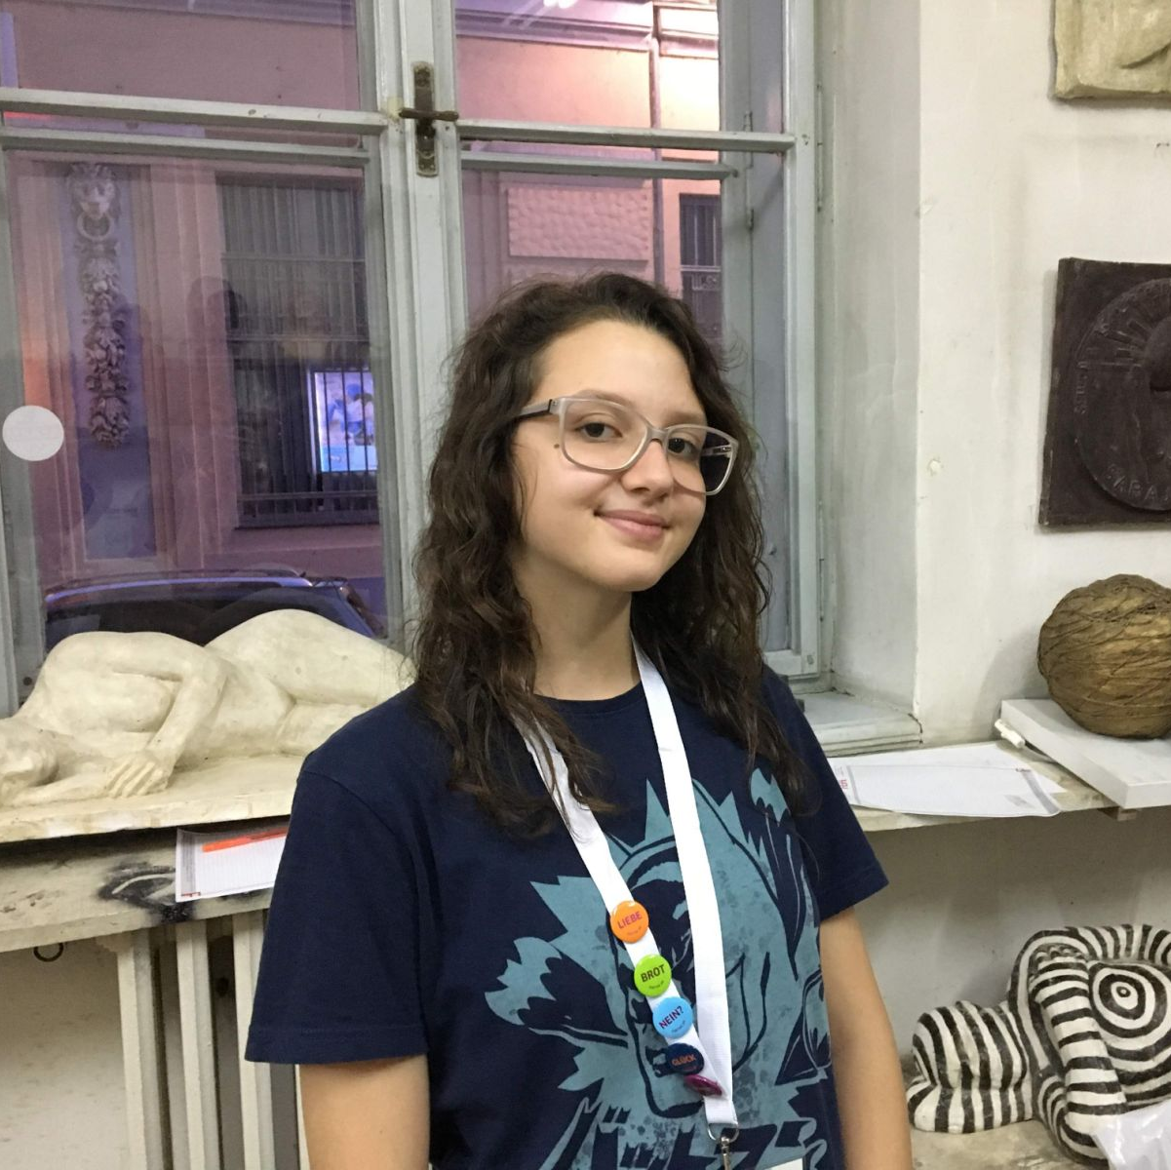
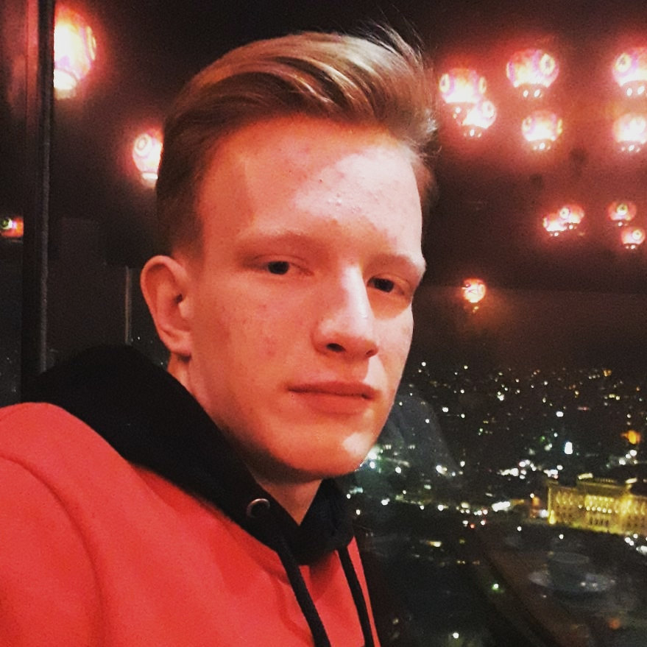
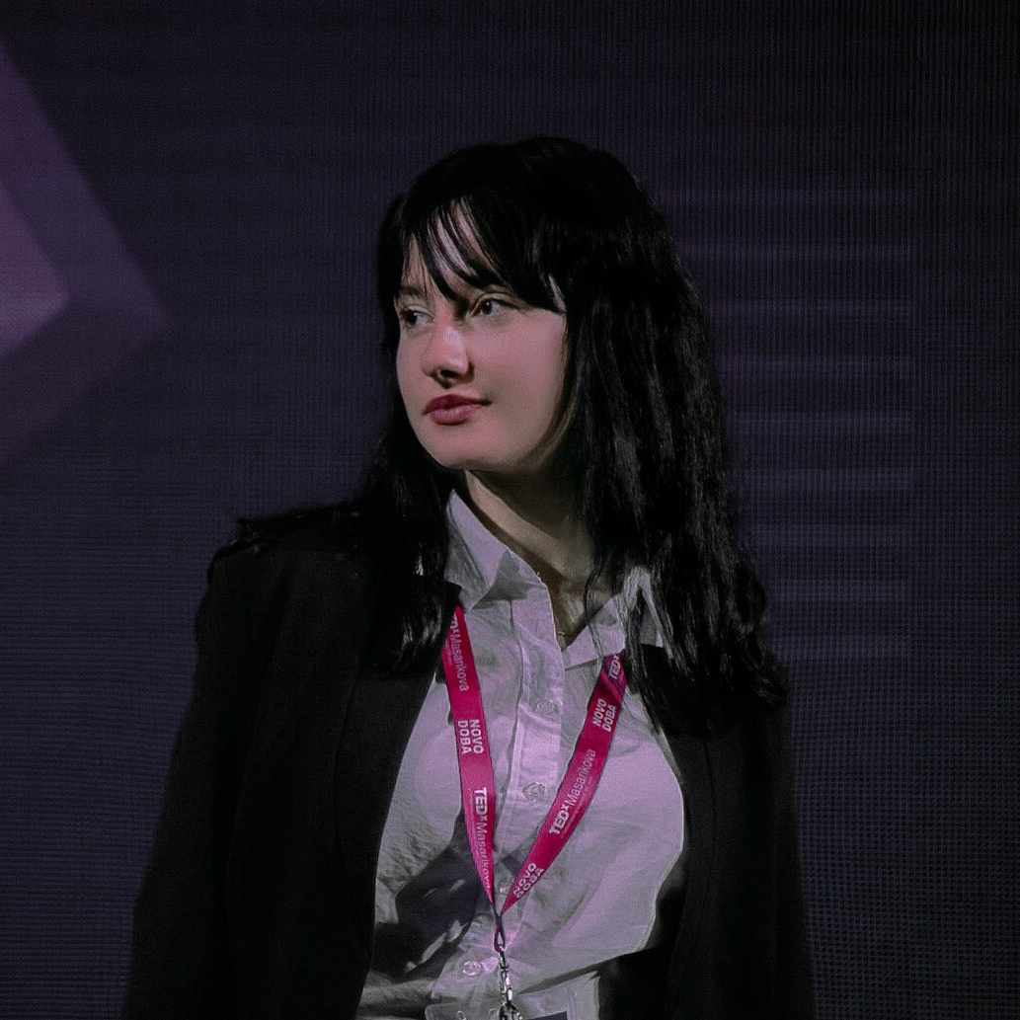
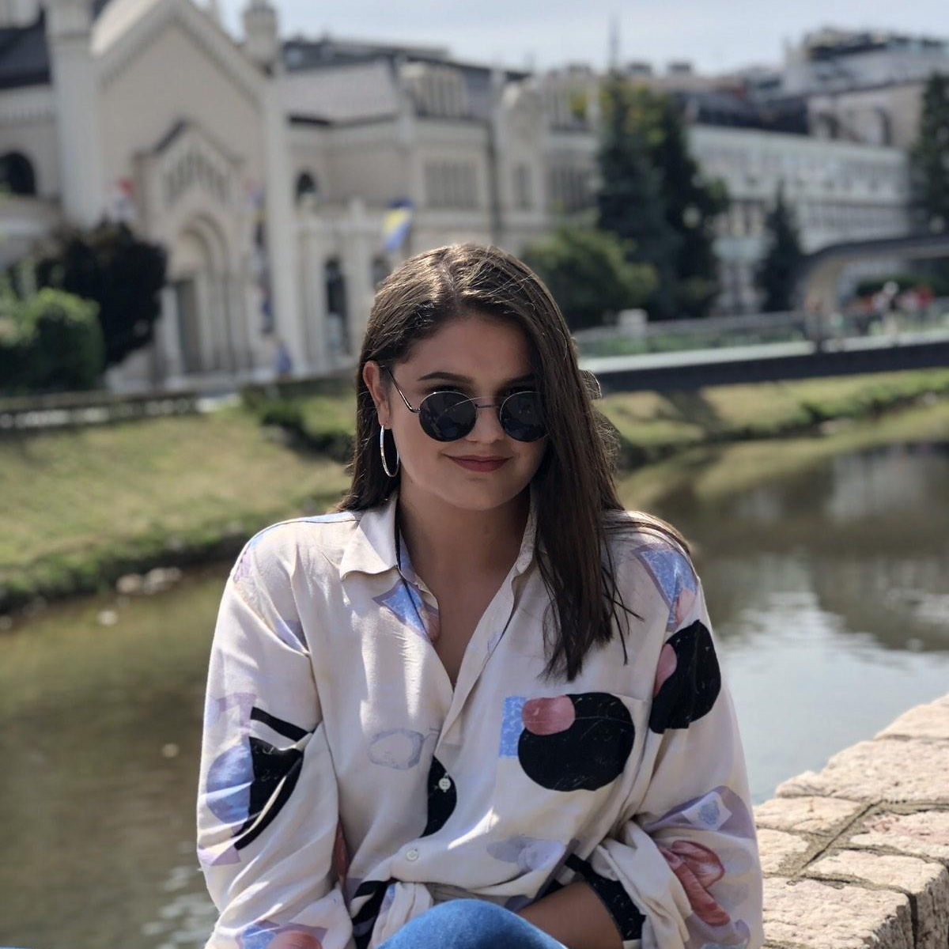
The team
Grandchildren of traditional artists and children of science
Bakunić Nejla
Čalkić Ahmed
Dedić Elma
Hajdarević Lamija

Slide 3
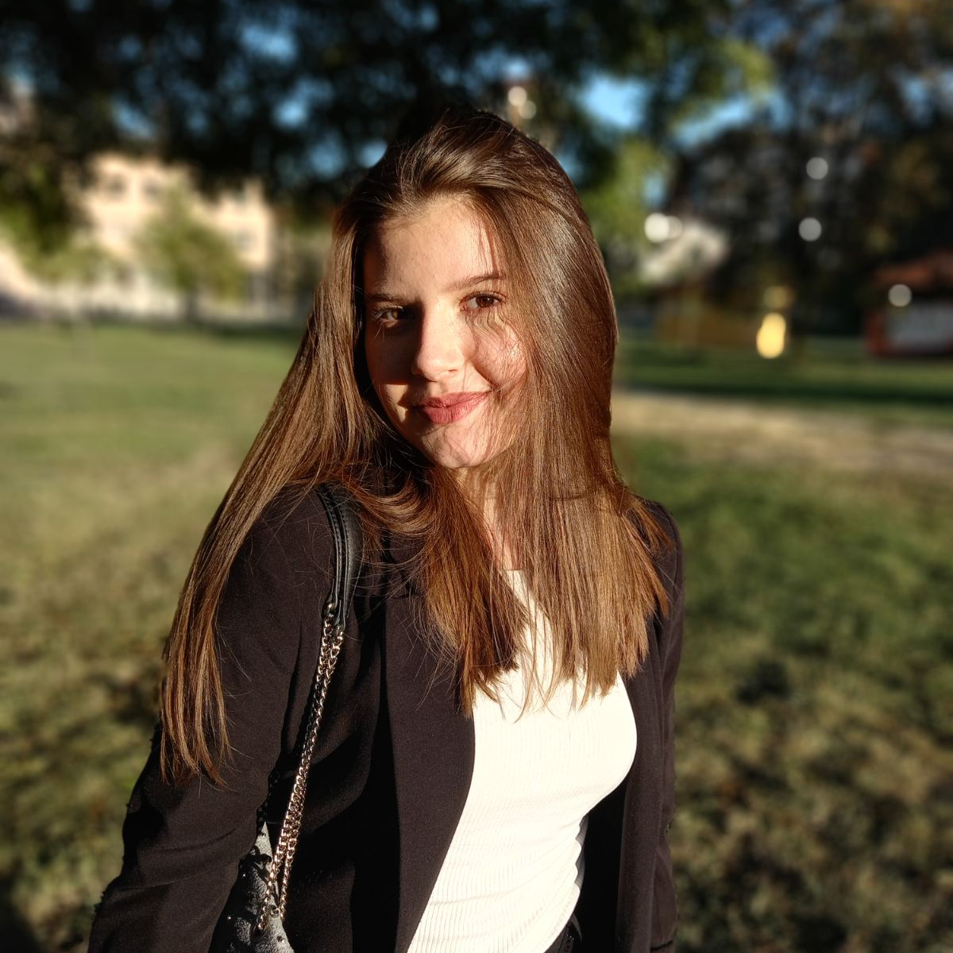
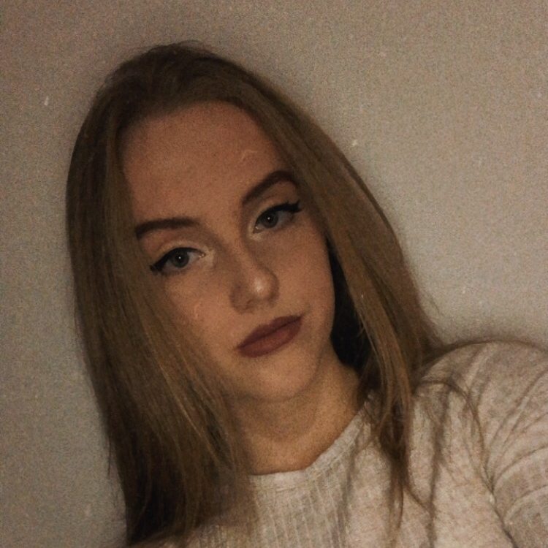
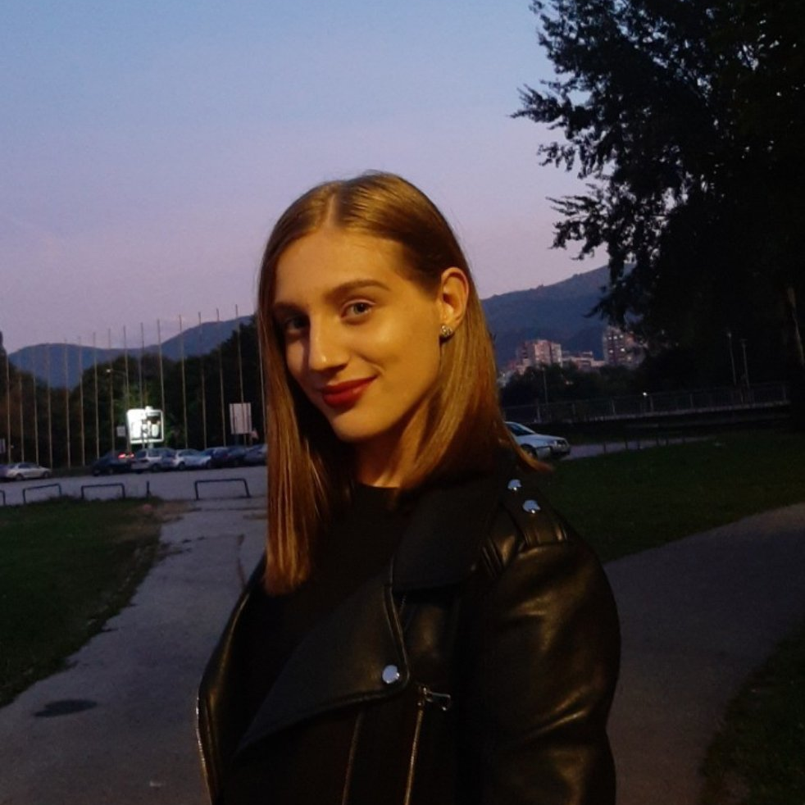
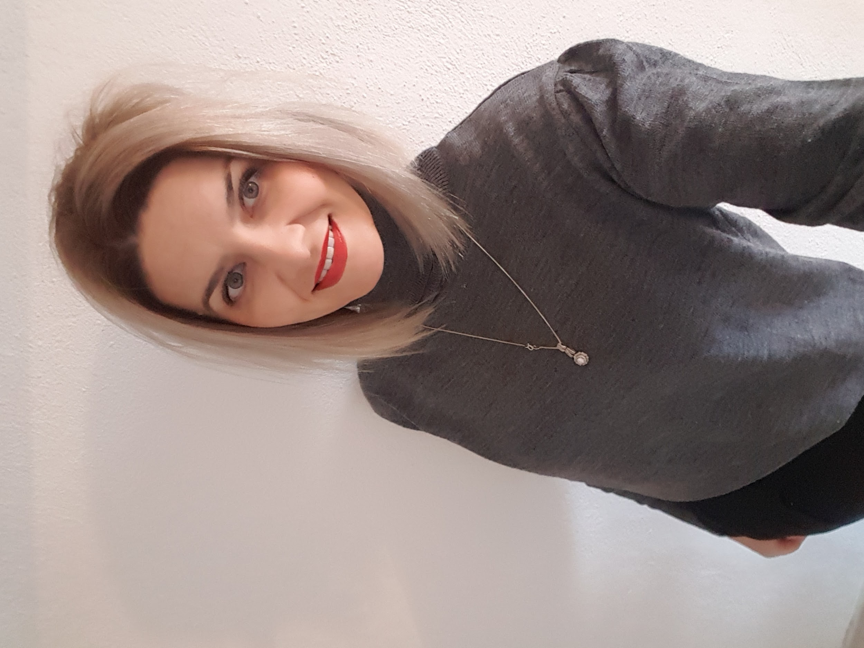
The team
Grandchildren of traditional artists and children of science
Heleg Lejla
Kablar Ilma
Spahić Ilma
Omerović Selma, prof.

Slide 4
Areas covered:
Dark matter and energy
Matter and antimatter
Dark holes
Symmetry

Slide 5
Artistic field of choice:
Traditional art: embroidery, crocheting, weaving - traditional kilims

Slide 6
Why embroidery, crocheting, and kilims?
A part of our childhoods
Local tradition
Complex processes can be presented through familiar, traditional and unique concepts
Unexpected and interesting parallels:

Slide 7
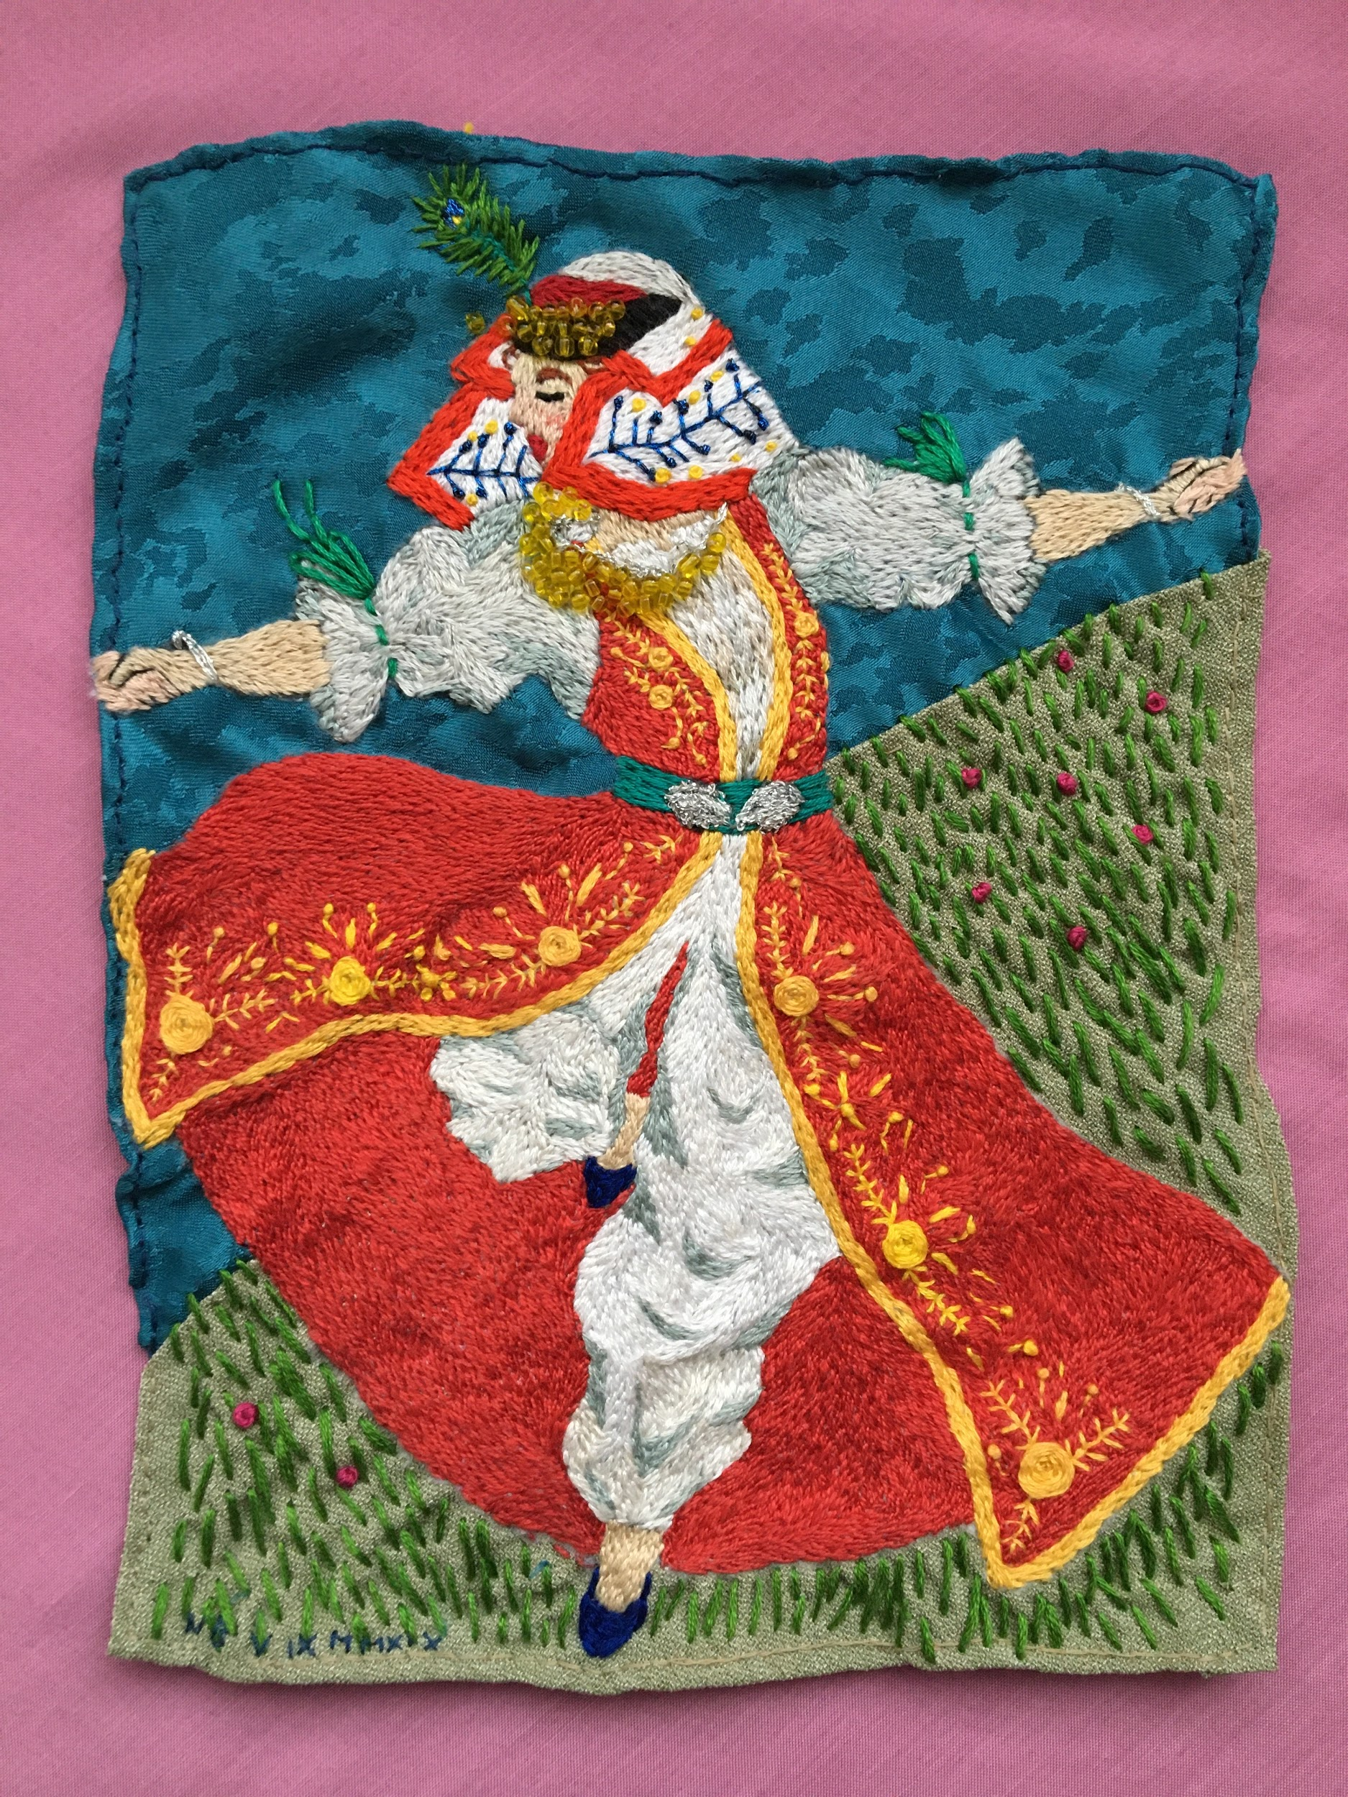
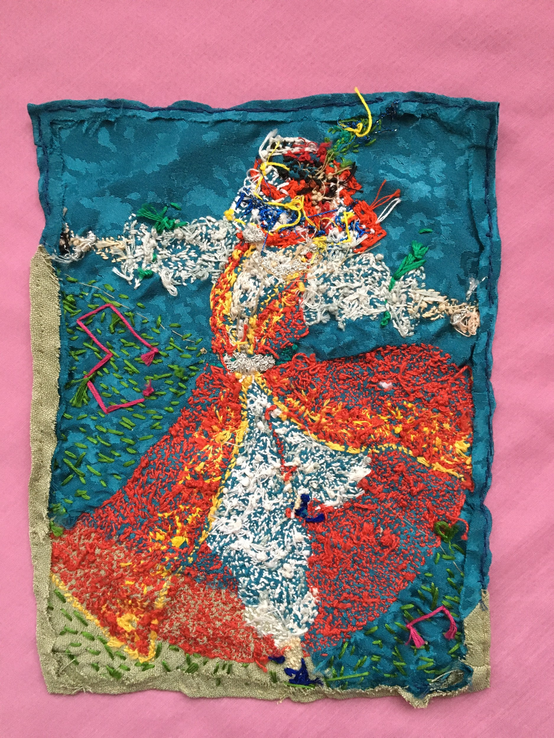
Credit: Nejla Bakunić
Matter and dark matter

Slide 8
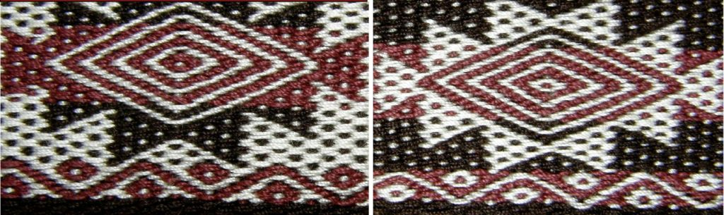
Matter and antimatter

Slide 9
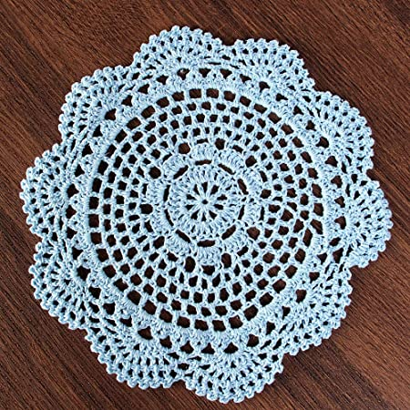
Black holes and galaxies

Slide 10
Stages of our work

Slide 11
Research and selection/elimination of topics
Making parallels between science and art
How to put everything together in one video?
7.11.2020 - 12.12.2020
Understanding antimatter, dark matter, dark energy and black holes
Choosing an artistic field: traditional arts

Slide 12
Point out the beauty and importance of traditional arts
Our goals:
Spark interest for broader fields of physics
Remind that science is absolutely all around us

Slide 13
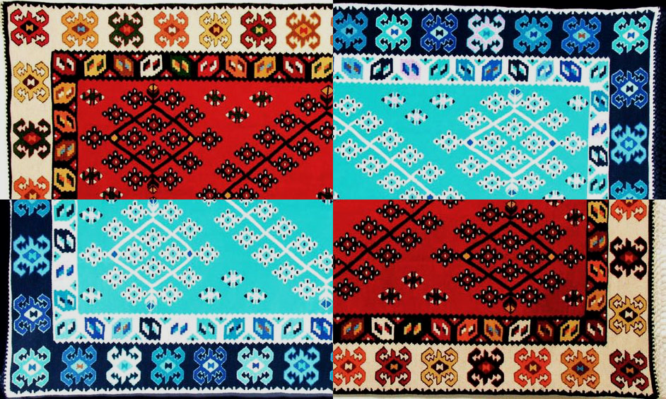
Thank you for your attention!
Original photo: Amila Smajović
Inspiration: Michael Hoch

