Slide 1

HL-LHC Project risks assessment
EDMS 2505691
Hector Garcia Gavela, Lorcan Quain Solis
MARP meeting #33 - https://indico.cern.ch/event/1015481/

Slide 2
Outline
Risk assessment. Main approach
Methodology
Risk Register – How is it done?
Main Outcomes from last exercise
Conclusions

Slide 3
Outline
Risk assessment. Main approach
Methodology
Risk Register – How is it done?
Main Outcomes from last exercise
Conclusions

Slide 4
Frame
Risks affecting organizations can have consequences in terms of economic performance and professional reputation.
Managing risk effectively helps organizations to perform well in an environment full of uncertainties.
The standards used worldwide are:
ISO 31000:2018 Risk management – Principles and guidelines, provides principles, framework and a process for managing risk. It can be used by any organization regardless of its size, activity or sector.
ISO Guide 73:2009, Risk management - Vocabulary complements
ISO 31000 by providing a collection of terms and definitions relating to the management of risk.
IEC 31010:2019, Risk management – Risk assessment techniques focuses on risk assessment.

Slide 5

What?
Risk assessment attempts to answer the following fundamental questions:
What can happen and why (by risk identification)?
What are the consequences?
What is the probability of their future occurrence?
Are there any factors that mitigate the consequence of the risk or that reduce the probability of the risk to occurr?

Slide 6
Why?
The purpose of risk assessment is to provide evidence-based information and analysis to make informed decisions on how to treat particular risks and how to select between options. Some of the principal benefits of performing risk assessment include:
Understanding the risk and its potential impact upon objectives;
Providing information for decision makers;
Contributing to the understanding of risks, in order to assist in their treatment options;
Identifying the important contributors to risks;
Comparing risks in alternative systems, technologies or approaches;
Assisting with establishing priorities;
Contributing towards incident prevention based upon post-incident investigation;

Slide 7
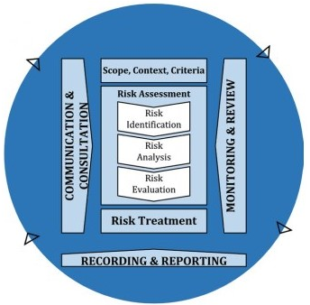
Steps to be done
Risk Identification
Risk Analysis
Risk Evaluation
Risk Treatment
Risk Monitoring and Review
Risk Communication

Slide 8
Risk identification
The purpose of risk identification is to identify what might happen or what situations might exist that might affect the achievement of the objectives of the system or organization. Once a risk is identified, the organization should identify any existing controls such as design features, people, processes and systems.
The risk identification process includes identifying the causes and source of the risk (hazard in the context of physical harm), events, situations or circumstances which could have a material impact upon objectives and the nature of that impact.

Slide 9
Risk Analysis
Risk analysis consists of determining the Consequences and their probabilities for identified risk events, taking into account the presence (or not) and the effectiveness of any existing controls
An event can have multiple consequences and can affect multiple objectives. Existing risk controls and their effectiveness should be taken into account
Vulnerability can replace Probability when a consequence can occur as a result of a range of different events or conditions, or where the specific event is not identified

Slide 10
Risk evaluation and Treatment
Risk evaluation involves comparing estimated levels of risk with risk criteria defined.
Risk evaluation uses the understanding of risk obtained during risk analysis to make decisions about future actions. Ethical, legal, financial and other considerations, including perceptions of risk, are also inputs to the decision. Decisions may include:
whether a risk needs treatment;
priorities for treatment;
whether an activity should be undertaken;
which of a number of paths should be followed.

Slide 11
Monitoring & review and communication
The risk assessment process will highlight context and other factors that might be expected to vary over time and which could change or invalidate the risk assessment. These factors should be specifically identified for on-going monitoring and review, so that the risk assessment can be updated when necessary.
Data to be monitored in order to refine the risk assessment should also be identified and collected.
The effectiveness of controls should also be monitored and documented in order to provide data for use in risk analysis. Accountabilities for creation and reviewing the evidence and documentation should be defined.

Slide 12
Outline
Risk assessment. Main approach
Methodology
Risk Register – How is it done?
Main Outcomes from last exercise
Conclusions

Slide 13
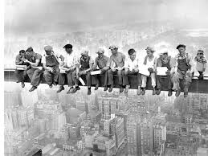
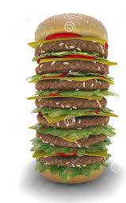
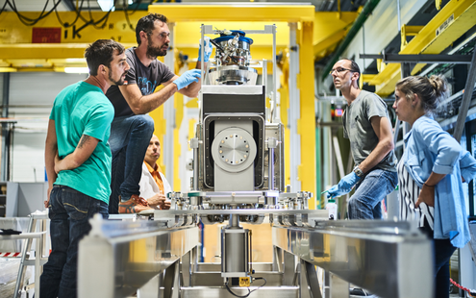
Risks and Risks
Risk is very subjective. Whatever methodology we use will be subject to the “willingness” to take risks and to the subjective appreciation of the impact of the identified risks

Slide 14
Methodology used
Since 2017 we have used the methodology implemented in 2012 for CERN as an action requested by the Council to the DG to be integrated within the Auditing System.
This implementation was supported by ‘Deloitte’ to implement at CERN a Risk management system adapted to our “Special nature”.
From the more than 50 known methodologies was selected the “Risk intelligence map” with Brainstorming sessions.
For HL-LHC, the same exercise is repeated within the WPs
(See EDMS 1518363 with the full procedure)
  From the Risk intelligence map, the HL-LHC management selects those that are applicable to the HL-LHC Project for further assessment
  The WPLs asses the impact and the vulnerability following a pre-agreed matrix
  The results are fine tuned (discussion between WPL and HL management for clarifications and /or major discrepancies
  The top risks are then identified and action plans are established
  The risks and the actions are re-evaluated every year

Slide 15
Risk Intelligence map
Standardized business catalog to inventory most critical risks
Governance | Corporate
 | Ethics & Compliance
Strategy and Planning | Corporate Responsibility & Sustainability
 | Strategy
 | Planning
 | External Factors
Delivering on mission | Hosting of Scientific Collaborations
 | Knowledge transfer and training
 | Research tools
Operations/Infrastructure | Infrastructure support
 | Corporate Image
 | Finance
 | Human Resources
 | Information Technology
 | Legal

Slide 16
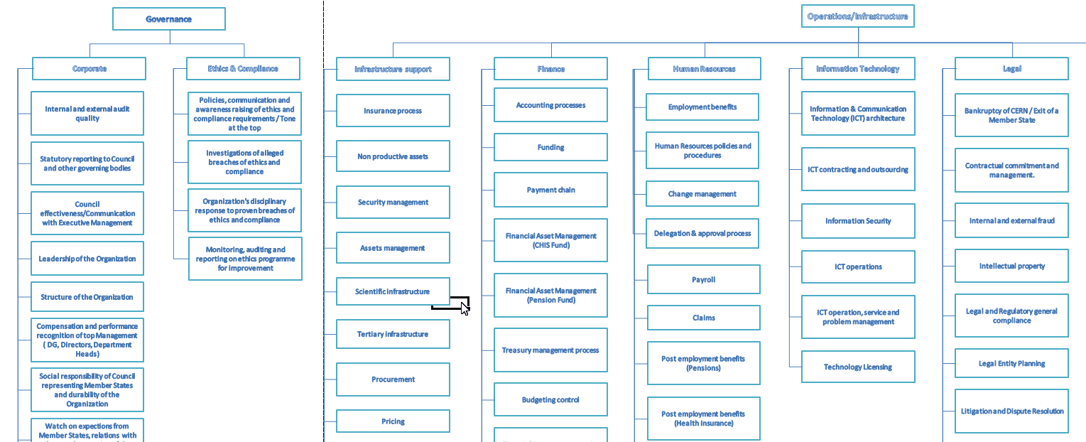
Risk Intelligence map
Adapted to our Organization
Every area that could create value also carries the potential for risk
For every area of activity, we should understand the threats and the opportunities, where we are weak and where we are strong
Risk Intelligence map

Slide 17
Assessing the Risk
There are several things that can go “wrong”
Danger can come from inside (Weakness) or from outside (Threats)
It can affect directly or indirectly the achievement of our objectives
Risk impact

Slide 18
Assessing the Risk
The same adverse event can affect us very differently if we have bust our resilience capacity
Do we have the right persons, control systems, or the experience to deal with this scenario …?
Risk vulnerability

Slide 19
Outline
Risk assessment. Main approach
Methodology
Risk Register – How is it done?
Main Outcomes from last exercise
Conclusions

Slide 20
Meetings
Once a year, a discussion takes place with the members of the HL-LHC Project Office and individually with each Work-package leader to:
Evaluate the action plan discussed during the previous exercise.
Reassess the Impact of the entries of the risk register considering the situation in the future.
Revise the Vulnerability to each risk based on the resilience achieved.
Establish an updated Action Plan.
Evaluate if any adverse events originated from previously non-identified risks.
Validation and discussion of the reports and the actions
WPL + HL-LHC Project Leader
Meeting
HL-LHC Risk Officer + WPL
Approval of the reports
WPL

Slide 21
Vulnerability matrix
Vulnerability assessment | Assessment scale | INTERNAL CONTROL Assurance Risk mitigation process Information system | PREVIOUS RISK EXPERIENCE | CAPABILITY People | RATE OF CHANGE Expansion or Contraction (business, people, process, systems)
Severe vulnerability | 5 | Absence of control | VERY HIGH recent previous adverse experience | No staff in the organization to manage the risk or VERY LIMITED competency | Risk is managed by or directly impacts people, processes, systems or businesses that have experienced a VERY HIGH rate of change over the last 6 months
High vulnerability | 4 | Lack of control | HIGH recent previous adverse experience | A limited # of staff or staff has LIMITED competency to manage the risk
Moderate vulnerability | 3 | Inadequate control | MEDIUM recent previous adverse experience | A limited # of staff or staff has MODERATE competency | Risk is managed by or directly impacts people, processes, systems or businesses that have experienced a MODERATE rate of change over the last 6 months
Mild vulnerability | 2 | Control adequate with risk | LOW recent previous adverse experience | Sufficient staff and has HIGH competency
No evidence of vulnerability | 1 | State-of-the-art control | VERY LOW recent previous adverse experience | All staff has HIGH competency (“right people, right place, right time”) | Risk is managed by or directly impacts people, processes, systems or businesses that have experienced a VERY LOW rate of change over the last 6 months

Slide 22
Impact matrix
Impact assessment | Assessment scale | Financial loss | Reputation | Legal/ Regulatory | Safety | Environmental | Alignment with Business Objectives
Catastrophic / Extreme | 5 | Greater than 1 MCHF | Large media (or scientific media) coverage - International coverage | Any State action | Several losses of life or permanent disability or multiple fatalities | Persistent environmental damage or sever nuisance extending over a large area | Occurrence of the risk will significantly deter the achievement of all of the entity's business objectives
Major | 4 | Up to 1 MCHF | Host MS press coverage - Scientific media - Escalating community activism | Any State scrutiny or Local action | Single loss of life or permanent disability or multiple fatalities | Significant nuisance or environmental damage over a large area | Occurrence of the risk will significantly hamper the achievement of the entity's business objectives
Moderate | 3 | Up to 100 KCHF | Local press coverage - Neighbourhood reputation (public, suppliers, etc.) | Any Local scrutiny | Extensive injury including permanent partial disability and occupational illness | Significant nuisance or environmental damage within the fenced perimeter or limited nuisance or environmental damage outside the fenced perimeter | Occurrence of the risk will have some adverse effect on the achievement of the entity's business objectives
Minor | 2 | Up to 10 KCHF | No one has heard of the occurrence of risk outside CERN; Problem dealt with at CERN's management level. |  | Minor reversible injury or health effects requiring medical attention but not causing permanent disability. | Sufficiently large contamination or discharge to damage the environment but within the fence and without lasting effect | Occurrence of the risk will have minimal impact on the achievement of the entity's business objectives
Negligible | 1 | Up to 1 KCHF | No one has heard of the occurrence of the risk outside he department who owned the risk; problem dealt at department management level |  | No injury or damage to health, or slight injury or health effects not causing disability | No significant environmental damage or slight reversible environmental damage within the fence and recoverable | Occurrence of the risk will have very little or no impact on the achievement of the entity's business objectives

Slide 23
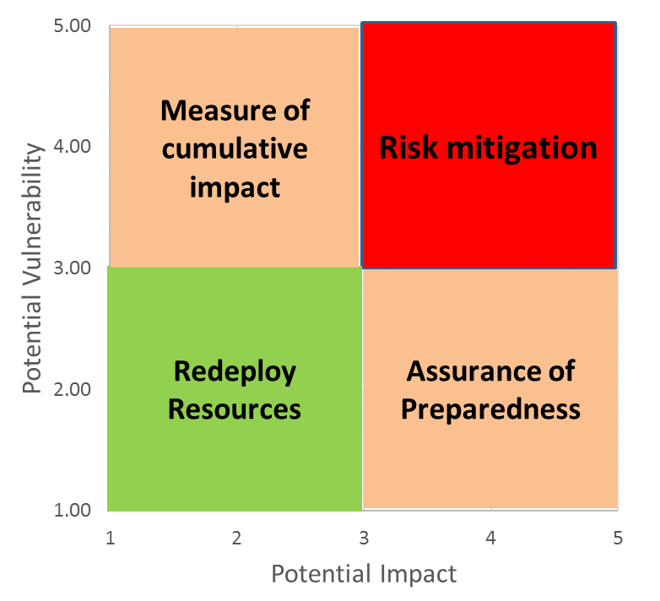
MARCI
Only the Risks with the highest impact and vulnerability require an action. A MARCI (Mitigate, Assure, Redeploy, and Cumulative Impact) chart has been used to define the risk requiring treatment strategy (I*V ≥ 9).

Slide 24
Action plan
Every action under “Risk mitigation” (I*V ≥ 9) has an Action Plan
Actions are revised by the Project Management together with the WPLs and monitored periodically.
Summary of updated actions for the year 2021: EDMS 2471805
WP | IxV | ID | Risk | Actions | Comments
WP2 | From 9 to 9 | 47 | Project management | Review of WP1 of all the potential options still open so that we can "close" them or give a deadline before the end of the year. | Not all the options are decided yet. It will be revaluated next year
WP2 | From 9 to 9 | 54 | Technology diversification | See Risk 47 | Still open options
WP2 | From 4 to 9 | 28 | Delegation & approval process | Explore some automatic control tools | The number of documents/drawings for approval is so high that there is the risk that one of the documents is not commented or not commented on time and there is also the factor of overloading and therefore delaying the process (time).
WP3 | From 16 to 9 | 5 | Delivery | Monitoring of the schedule including those of the collaborations | AUP accepted to have a version of their schedule without contingency for failures. It has been demonstrated that we can have coil manufacturing at the nominal speed.

Slide 25
Outline
Risk assessment. Main approach
Methodology
Risk Register – How is it done?
Main Outcomes from last exercise
Conclusions

Slide 26
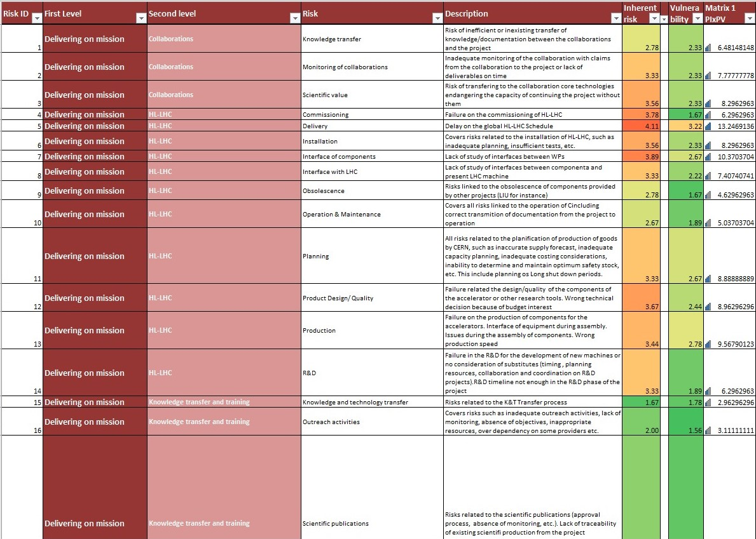
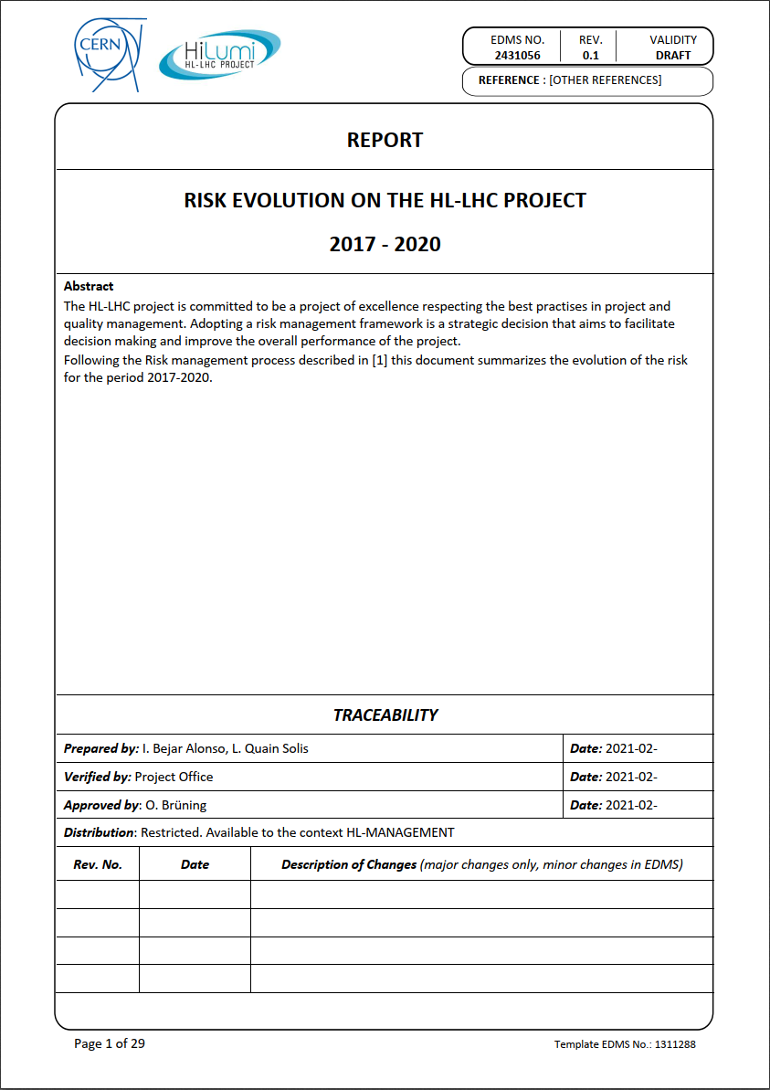
Outputs
EDMS 0000212513

Slide 27
Evolution
Increased
Decreased
Domains where the V* I has increased and decreased

Slide 28
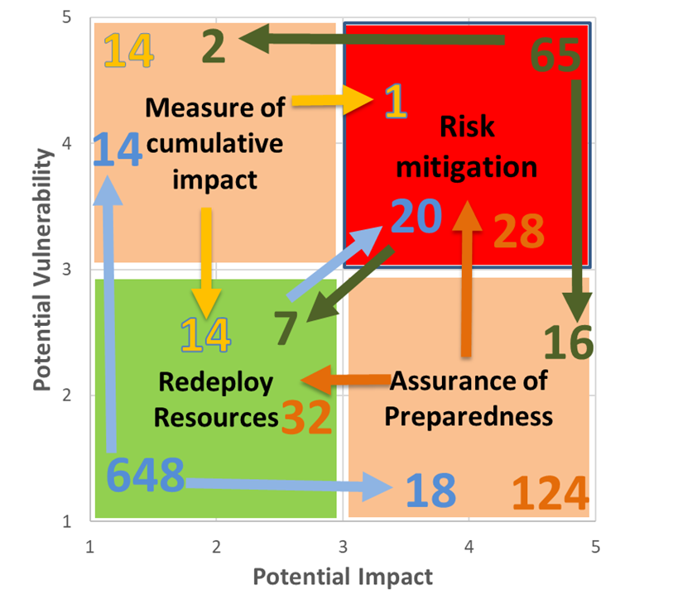
Effect of the actions

Slide 29
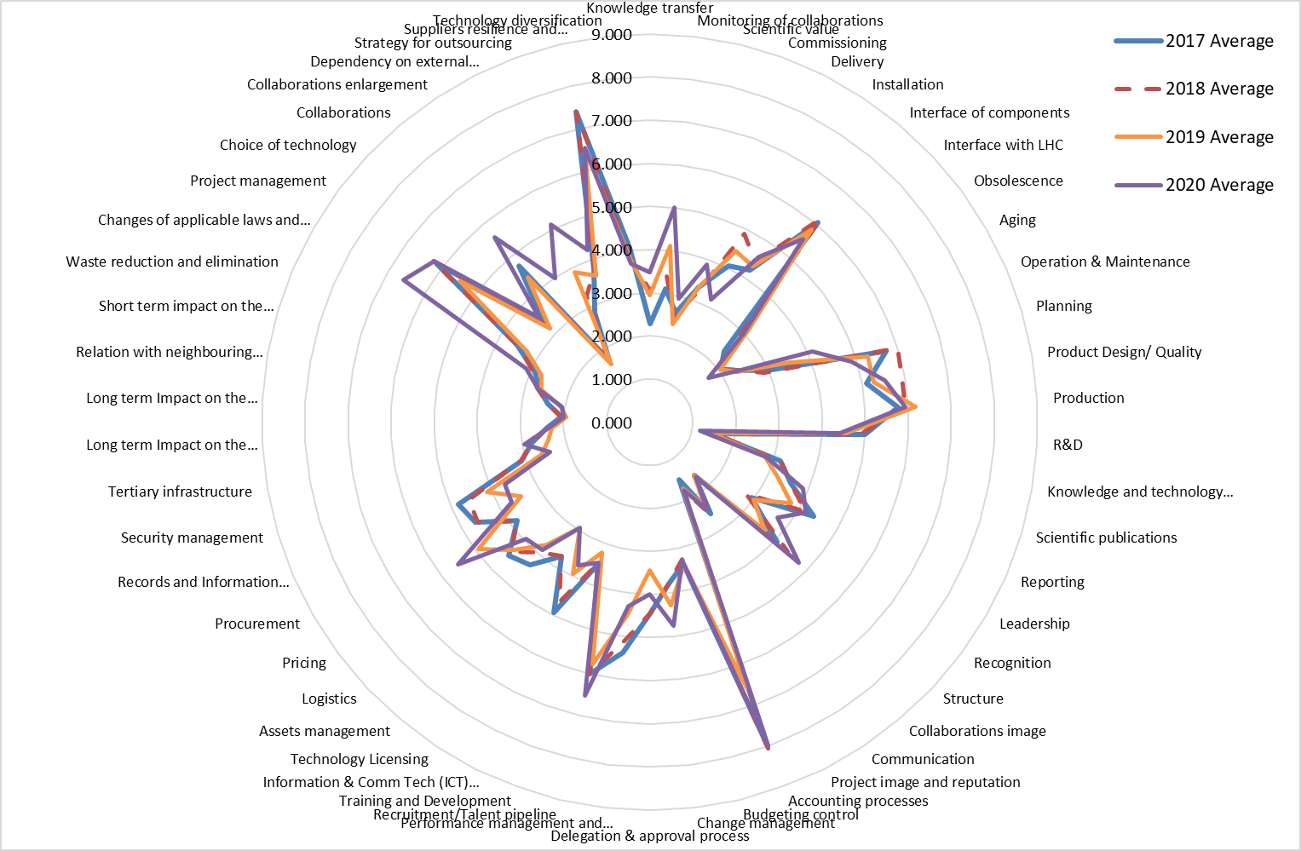
Evolution average I*V

Slide 30
GLOBAL VALUES
SINCE 2017

Slide 31
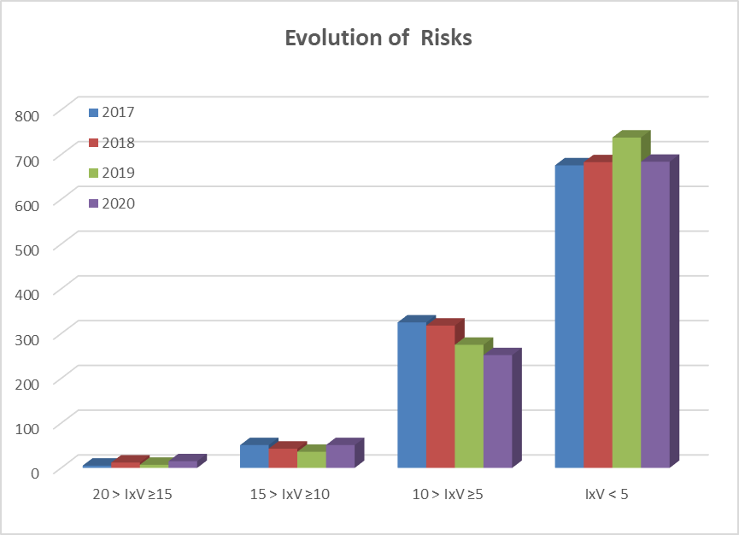
Evolution of the IxV

Slide 32
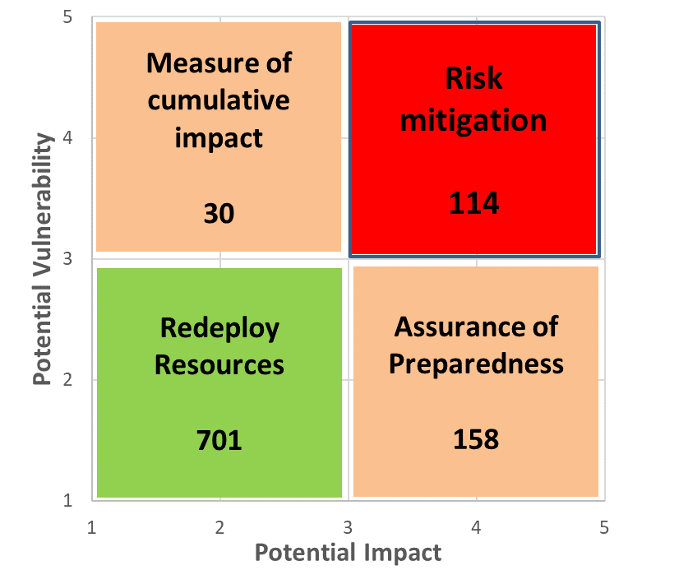
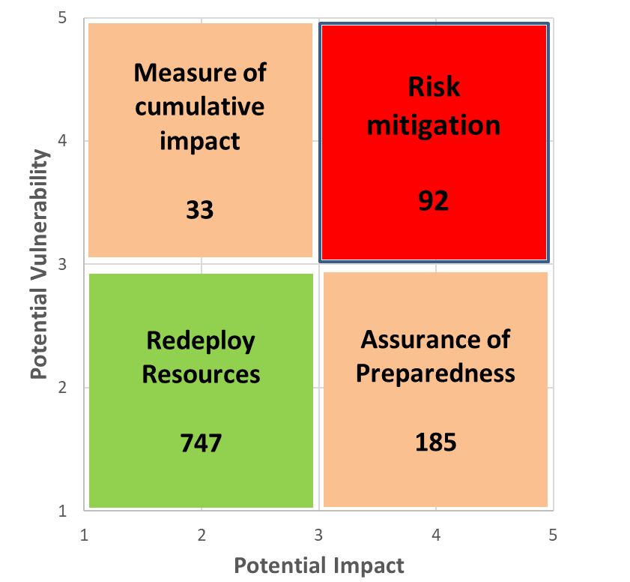
MARCI - GLOBAL
2020 2019
The average I*V has evolved from 3.59 in 2019 to 3.92 in 2020 in the WPs
WP1 accounts for 18% of the actions and its I*V has also evolved negatively, from 6.89 to 7.47

Slide 33

Risk Movements

Slide 34
“IN” AND “OUT” - OUT

Slide 35
“IN” AND “OUT” - IN

Slide 36
TOP BURNING

Slide 37
TOP DECREASE

Slide 38
TOP INCREASE

Slide 39
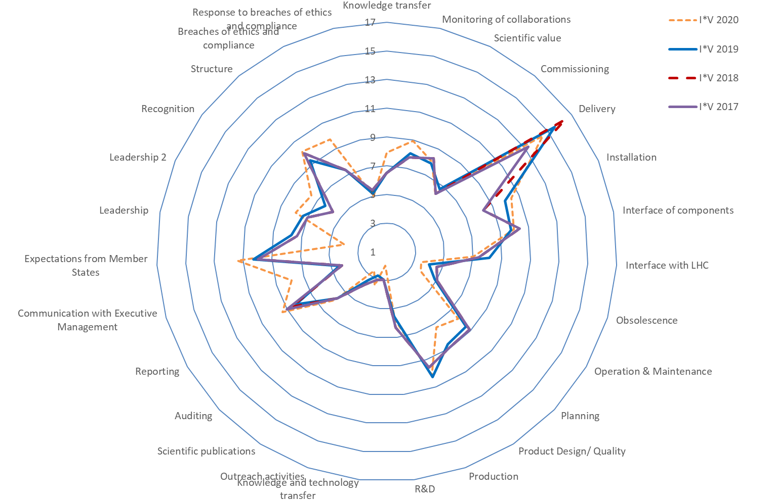
Delivery on mission & Governance

Slide 40
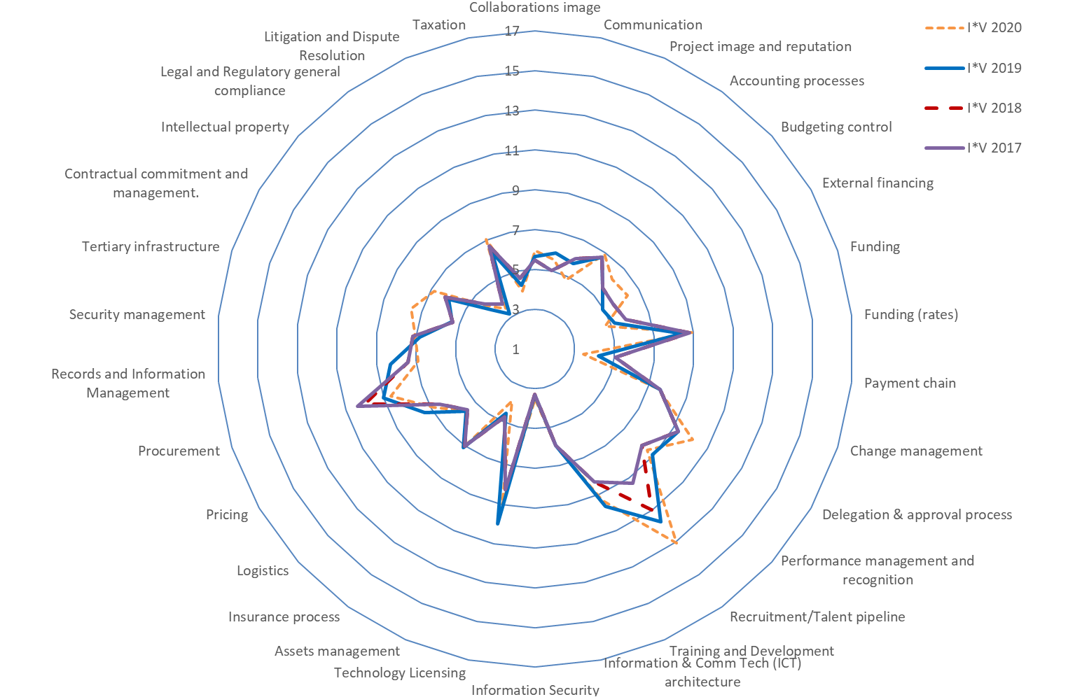
Operations/Infrastructure

Slide 41
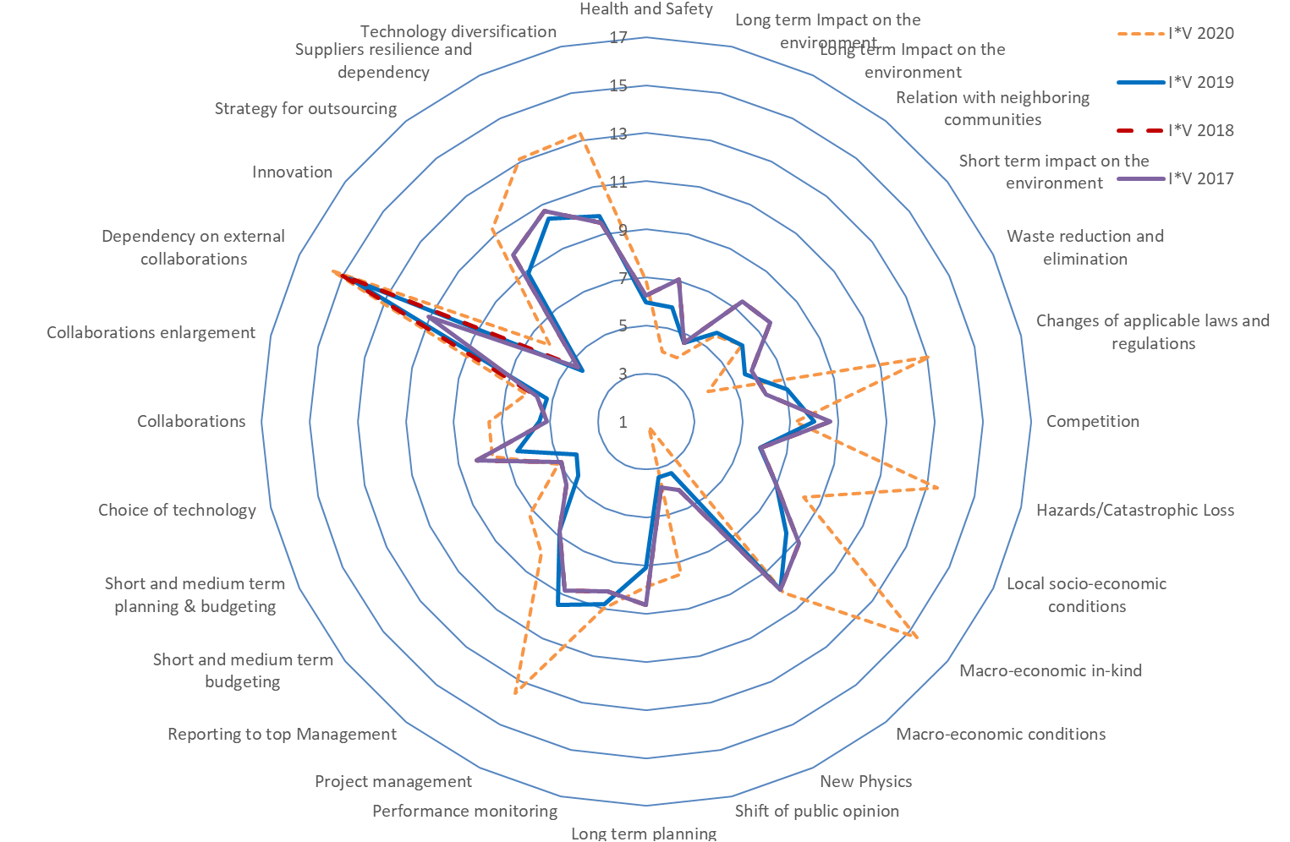
Strategy and Planning

Slide 42
Our Top Ten WP2-18 and WP1
WP2-18
WP1
Interface of components
Product Design/ Quality
Production
Accounting processes
Recruitment/Talent pipeline
Pricing
Changes of applicable laws and regulations
Project management
Collaborations
Suppliers resilience and dependency
Delivery
Expectations from Member States
Recruitment/Talent pipeline
Changes of applicable laws and regulations
Hazards/Catastrophic Loss
Macro-economic in-kind
Project management
Dependency on external collaborations
Suppliers resilience and dependency
Technology diversification

Slide 43
TOP RISKS

Slide 44
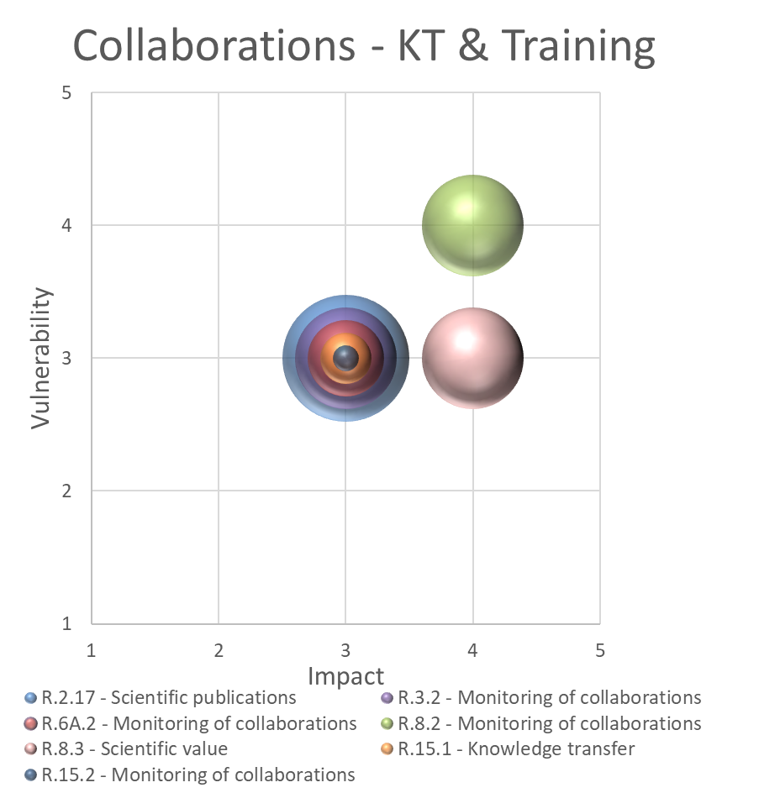
MARCI – TOP RISKS
DELIVERY ON MISSION
Increasing feeling of need to have efficient ways to monitor the collaborations
Awareness of the need of a good knowledge transfer before starting work on a collaboration
Concerns about the scientific value to attract collaborations

Slide 45
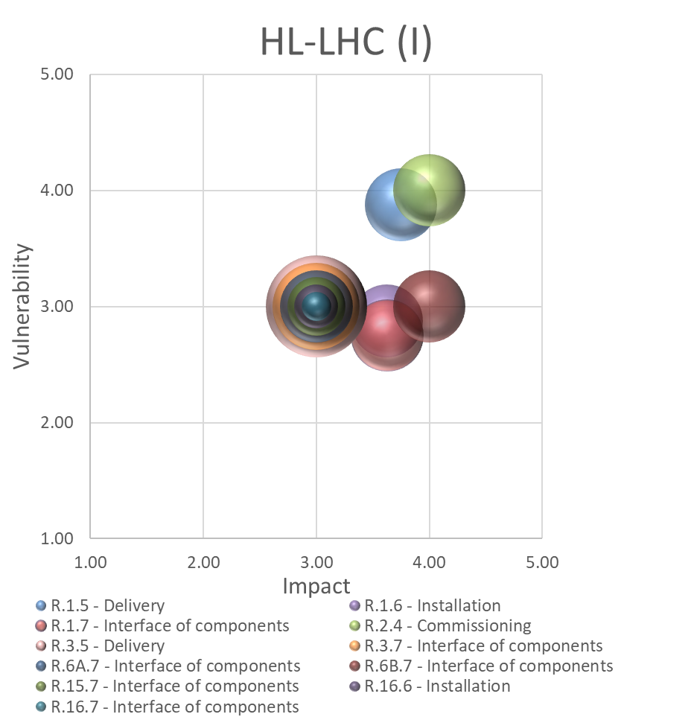
MARCI – TOP RISKS
DELIVERY ON MISSION
The extra year in the schedule caused several WPs to revaluate the Delivery risk decreasing the impact
Although there was important progress in the integration work, the remaining work has impeded the reduction of the Interface of components risk

Slide 46
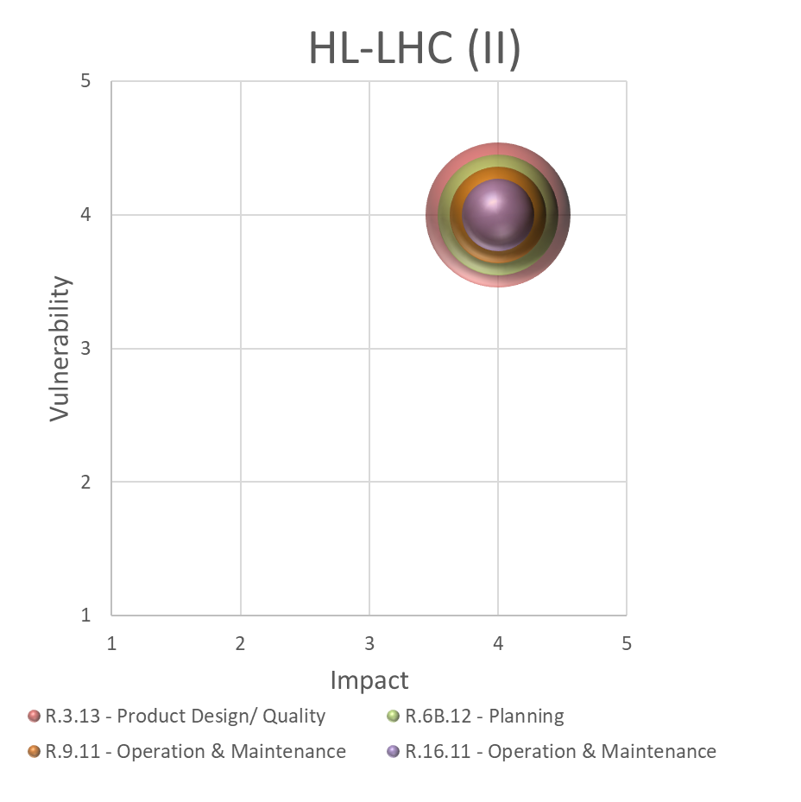
MARCI – TOP RISKS
DELIVERY ON MISSION
Operation and maintenance comes back as the extra year implies that several infrastructures will have to be operated during one extra year
Product Design/quality decreases for those that have finished the LS2 production. Vulnerability has increased for those that have found that some design choices make the production more difficult

Slide 47
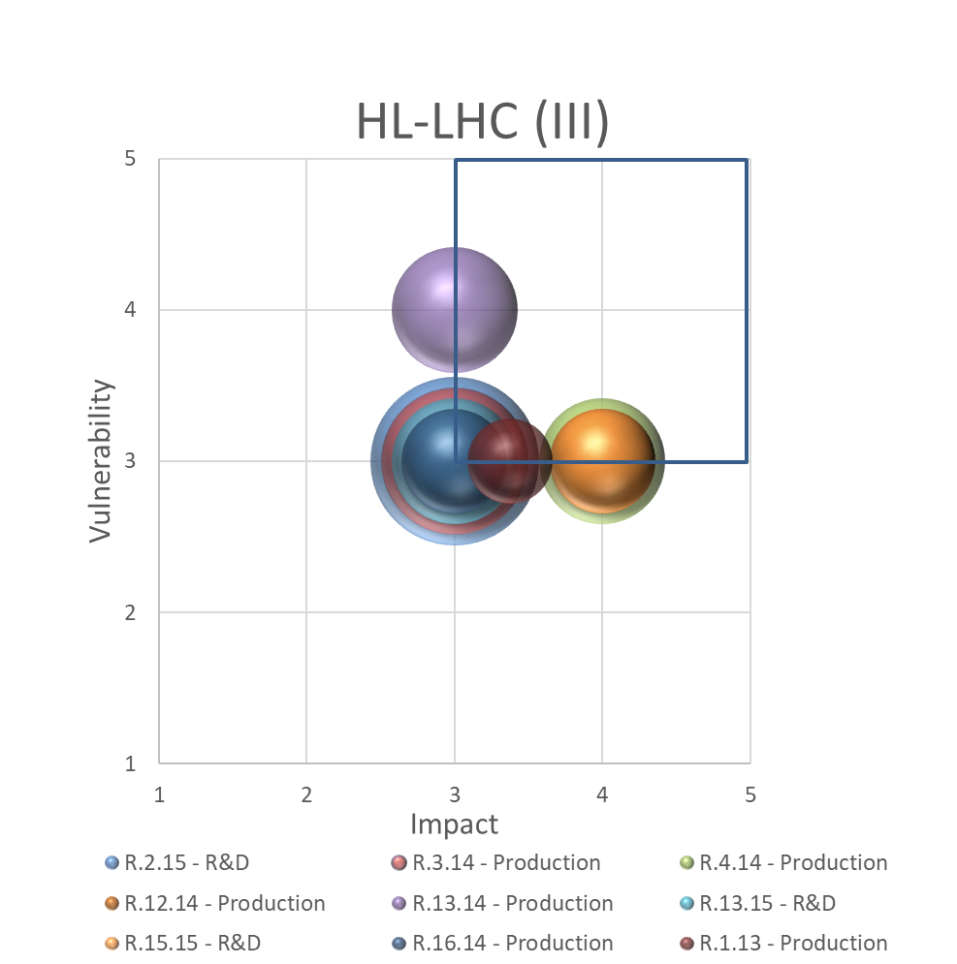
MARCI – TOP RISKS
DELIVERY ON MISSION
Mixed feelings on Production. While being always in our top ten risks values it is frequently under evaluated before start production
The Production risk has remained stable throughout the WPs
R&D has decreased for most WPs as this phase is now completed

Slide 48
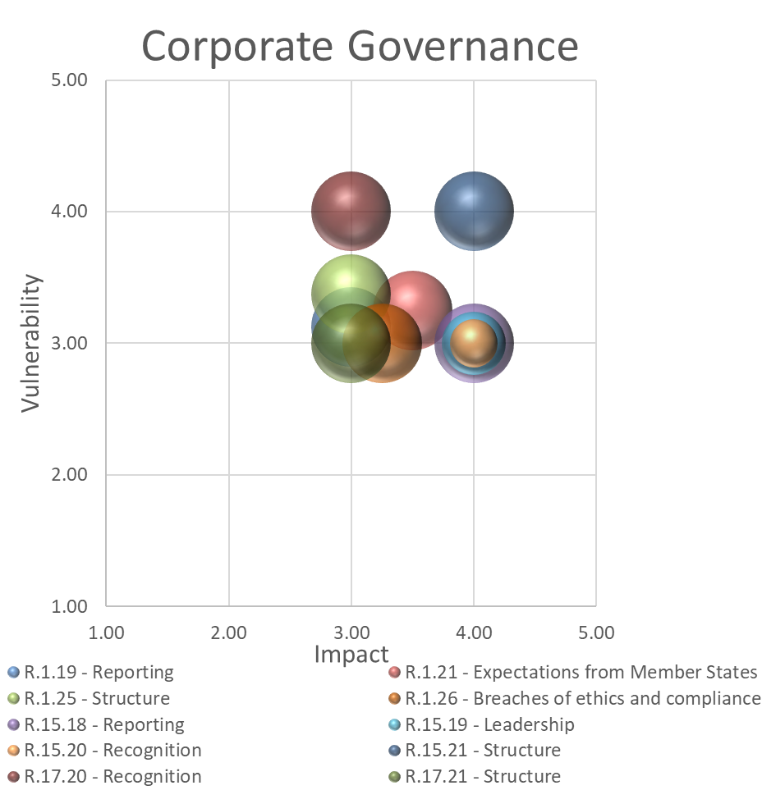
MARCI – TOP RISKS
GOVERNANCE
Increase in risks related to Structure and Recognition due to the reorganisation of groups and project structure that took place
General decrease of all risks linked to leadership. Possible effect of the maturity of the project

Slide 49
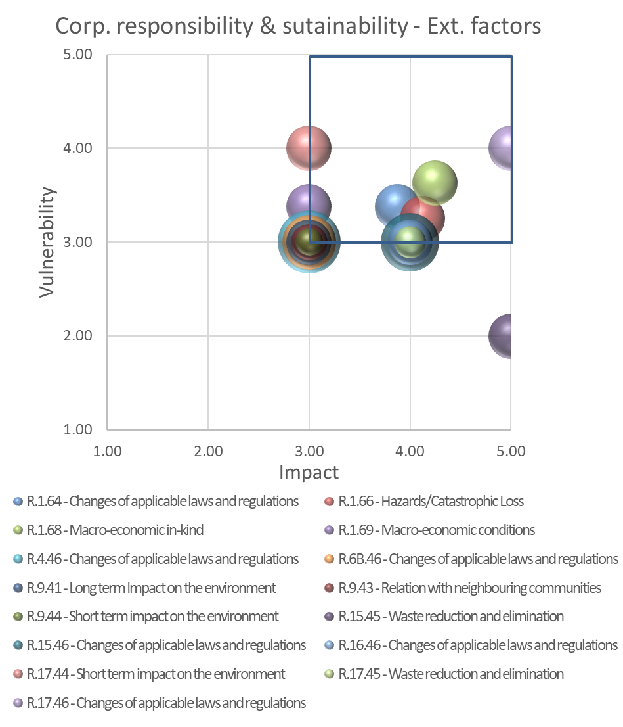
MARCI – TOP RISKS
STRATEGY AND PLANNING
Noticeable increase in the risk Changes of applicable laws and regulations caused by the new restrictions caused by COVID
Increase in Waste reduction and elimination risk after an adverse event
Still risks linked to cooling systems and noise, important for the Relation with neighbouring communities risk
There is a global awareness of the need of an organized plan for the elimination /reconditioning of components dismantled during LS3

Slide 50
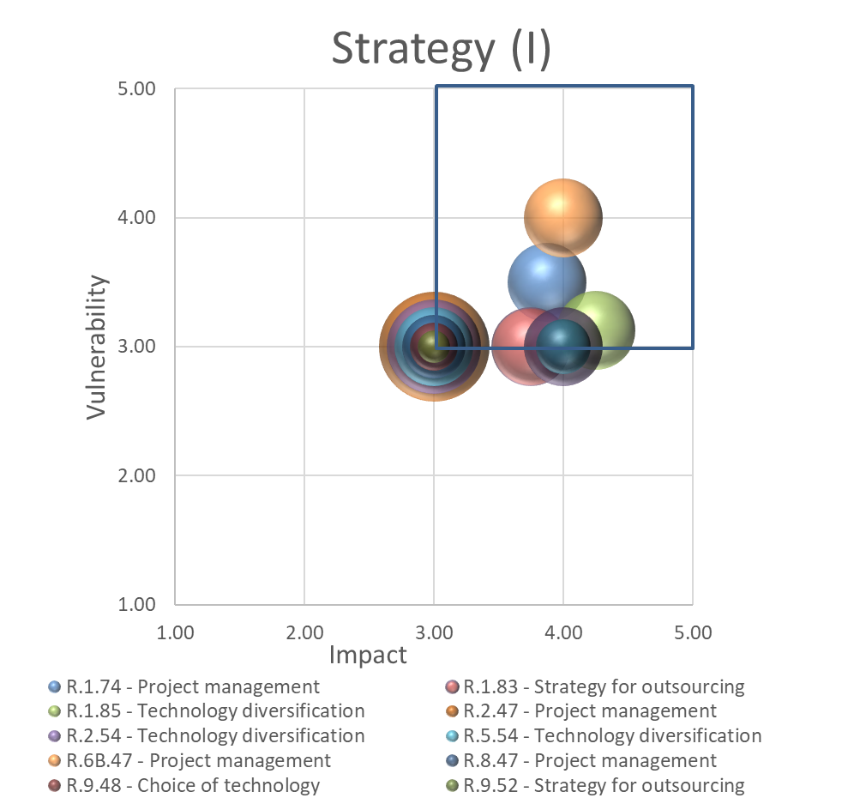
MARCI – TOP RISKS
STRATEGY AND PLANNING
Project management continues being on average in the top ten this year. For some WPs the impact has decreased because their management team has been reinforced but in general there is fear that the resources may not be sufficient to manage the new collaborations
The risk on technology diversification are strongly linked to the ones of R&D, which only remain for certain WPs.

Slide 51
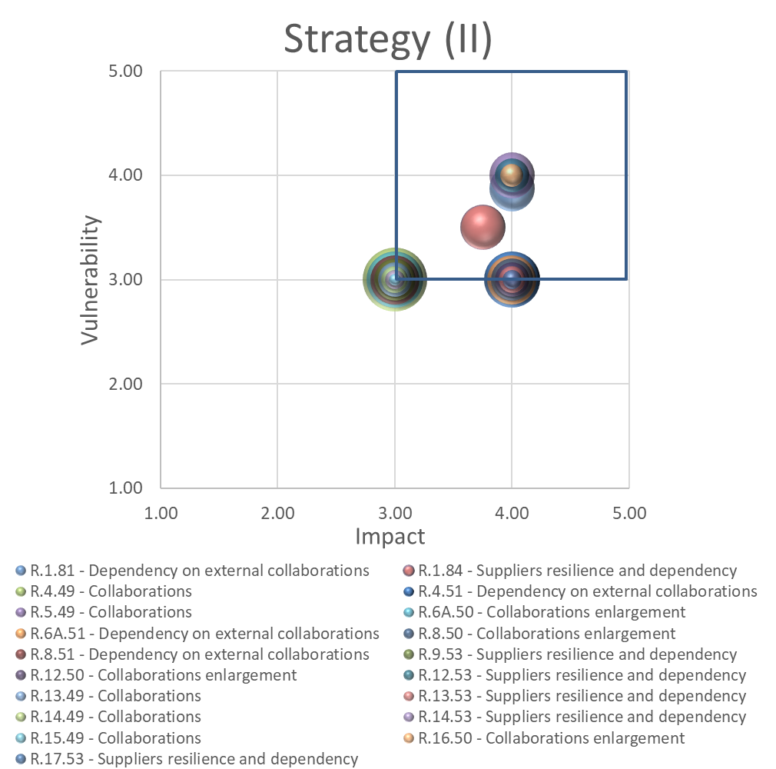
MARCI – TOP RISKS
STRATEGY AND PLANNING
The Collaborations and Collaborations enlargement risks have increased significantly due to the new collaborations and those that have not been signed yet
There is an increased awareness of our vulnerability to single suppliers as the Suppliers resilience and dependence remains stable in the top risks
Dependency on external collaborations increases due to the Russian collaboration

Slide 52
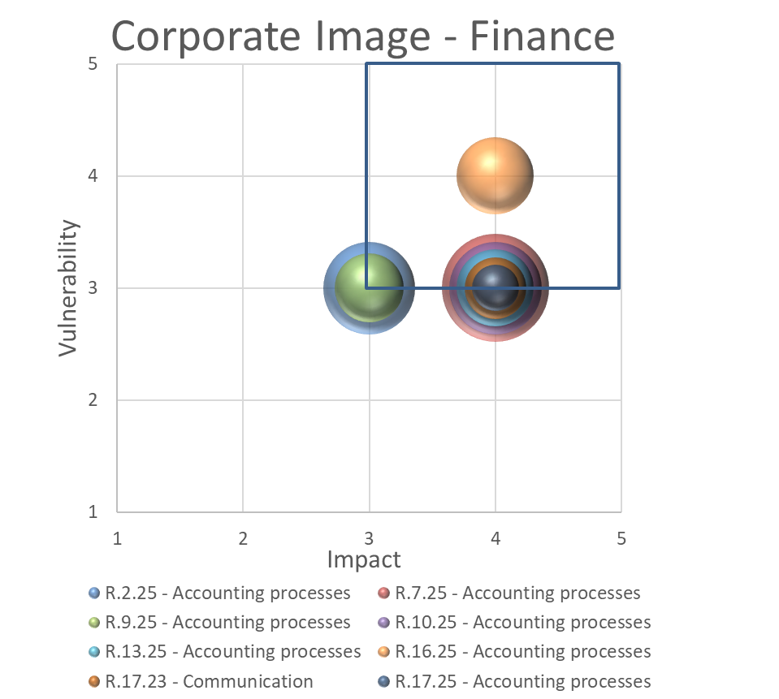
MARCI – TOP RISKS
OPERATIONS/INFRASTRUCTURE
Accounting processes has been historically our top risk. Some of the increased values are due to the last rebaselining exercise
In general the WPs feel more comfortable with the budget allocated for each one of their deliverables
The impression is that they feel more vulnerable on the MPA budget than on the material budget

Slide 53
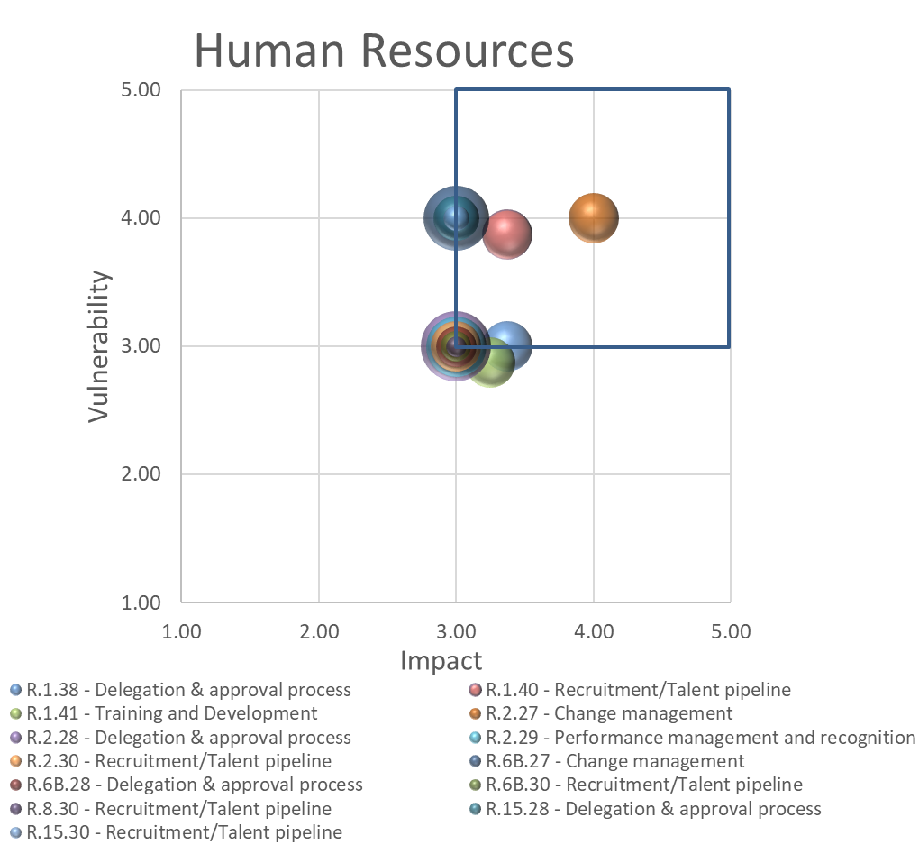
MARCI – TOP RISKS
OPERATIONS/INFRASTRUCTURE
The restructuring that took place has increased the Change management risk
Recruitment/Talent pipeline continues in the top 5 and increasing with the foreseen end of the PJAS program
Performance management and recognition has grown along the years, a factor to be monitored
The Delegation & approval process risk has increased due to the workload that it puts on the WPs

Slide 54
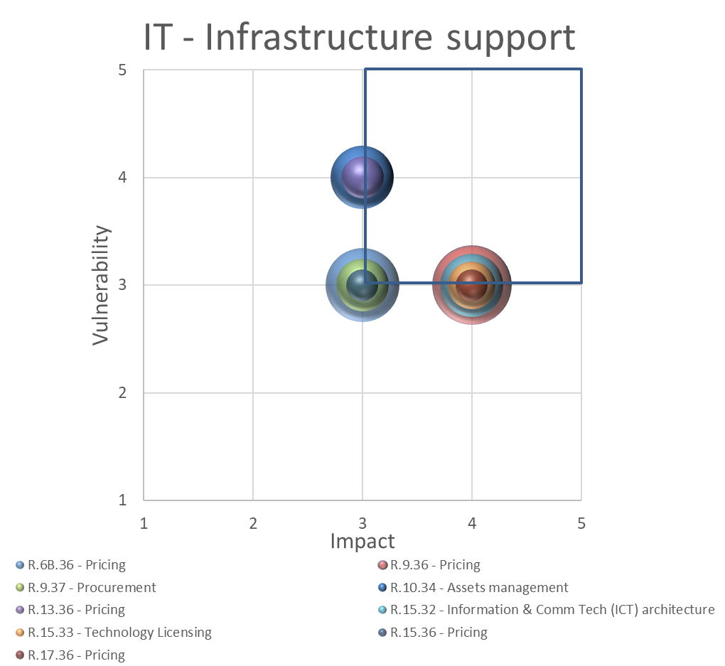
MARCI – TOP RISKS
OPERATIONS/INFRASTRUCTURE
Pricing is increasing for WPs that are approaching new big tenders. It is one risk that is systematically under evaluated
ITC risks, linked to SmartTeam, Fluka and MALT, have decreased as there is less uncertainty.

Slide 55
How has the perception of pandemic risk changed?
Impact Vulnerability
2019
2020

Slide 56
Present status by WP
Evolution risks, vulnerability and impact
Main actions

Slide 57
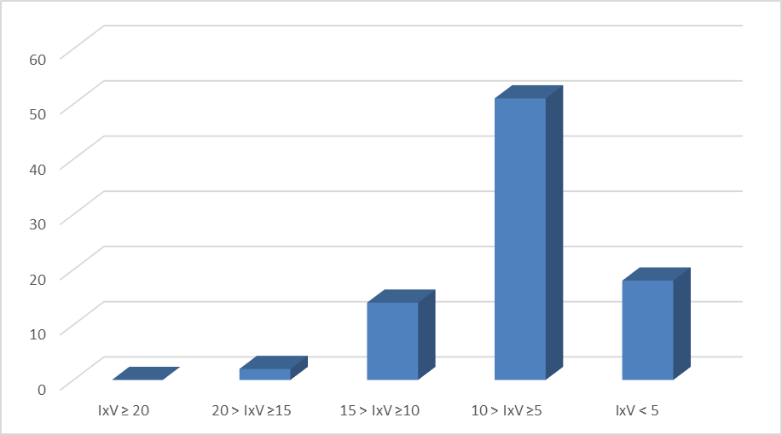
WP1

Slide 58
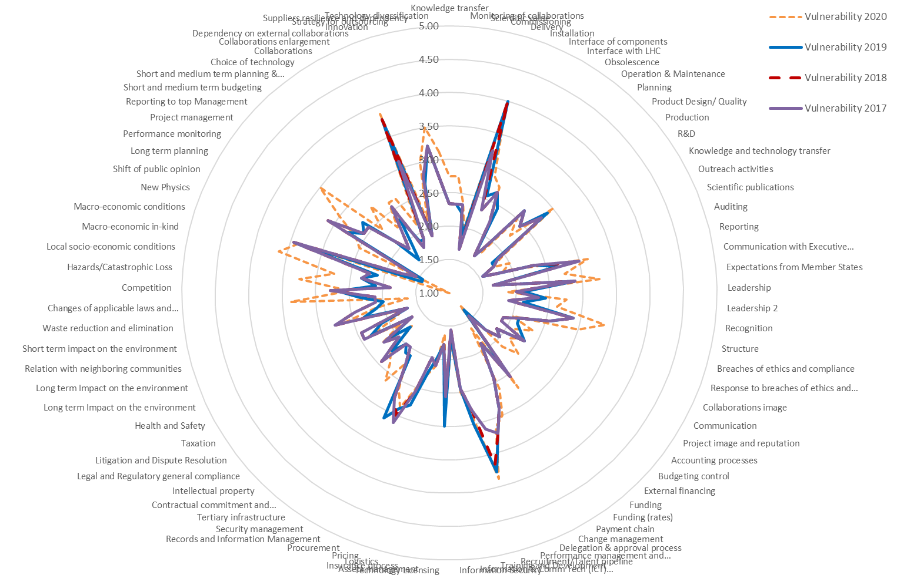
WP1

Slide 59
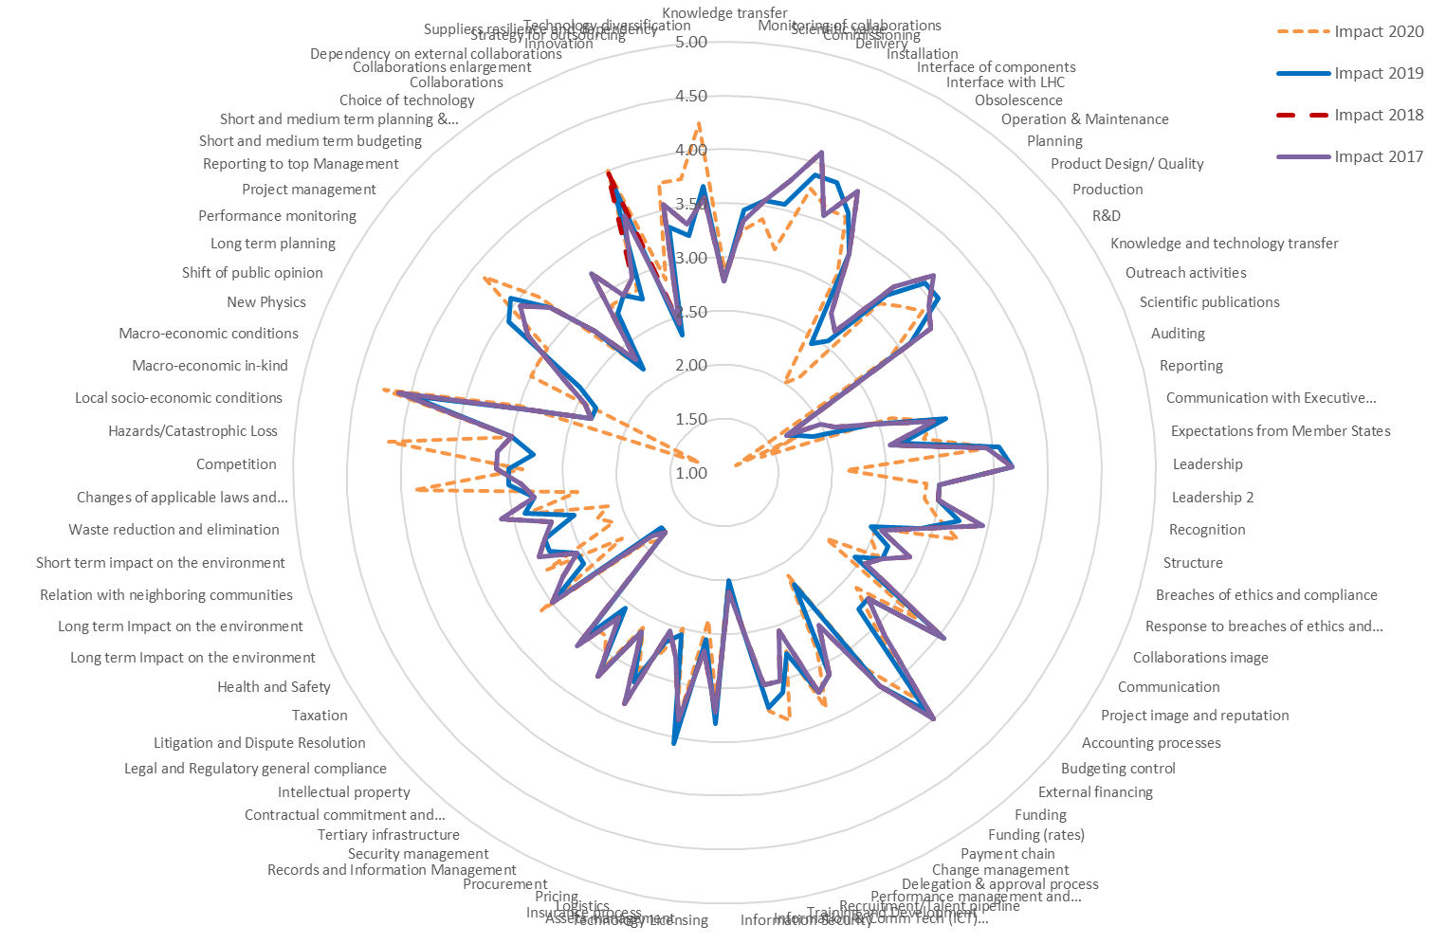
WP1

Slide 60
WP1 – MAIN ACTIONS
IxV | ID | Risk | Actions
From 15.6 to 14.5 | 5 | Delivery | The late delivery of components from the collaborations and the industry is considered a major risk. A great effort will be made to synchronize the arrival of both of them. In particular those for the IT string. Elaborate a planning that allows to identify the real margins that exist for the components (not only procurement but also production). Refine the installation schedule to be inside the 2.5-year window
From 14.7 to 15.5 | 81 | Dependency on external collaborations | Continue the close contact with the collaborators. The biggest risk comes from the uncertainty of the Russian collaboration and that Japan may not continue contributing
From 11.8 to 13.1 | 40 | Recruitment/Talent pipeline | Discuss with the new management which is the preferred solution (not cost neutral)
From10.4 to 13.1 | 84 | Suppliers resilience and dependence | Keep going with the actions (early procurement, payment for prototypes, identify second suppliers …). Continue having internal capability to produce the components in case of the failure of the contractors. Discussion with the Sector about how to maintain the interest from the industry for some technologies/materials. Consider a central support from CERN and not from the project.
From 9.8 to 10.0 | 7 | Interface of components | Keep the pressure on the creation of the ECRs (Technical ECRs to be discussed in the TCC, managerial aspects to be discussed on the PSM). Issue Conceptual specifications for new Baseline components including discussions of WPs/Groups. Ensure that the WPs are coordinated before the preparation of ECRs. Complete the interface specifications of all WPs
From 9 to 8.6 | 49 | Procurement | Keep an eye on the new structure.
From 10.0 to 10.1 | 69 | Macro-economic conditions | This risk is out of the control of the project. A preparedness action has been set: The action is to continue to report to the executive committee in a clear and transparent manner and to ask to be informed if a delay may affect the schedule and resources of the machine.
From 10.3 to 11.4 | 21 | Expectations from Member States | Clear reporting of the risks of the collaborations and of having contracts with companies that are not fully qualified but from poorly returned countries
From 9.3 to 10.1 | 25 | Structure | Ensure that close contact is maintained with the new management.
From 10.3 to 10.1 | 13 | Production | Reinforce PRRs and MRs (including interfaces with other WPs). Distribute the plan of PRRs and MRs to the GLs.
From 9.8 to 13.3 | 85 | Technology diversification | Ensure correct documentation on the technological choices, in particular for the technologies for which we do not have an alternative. Decision on the production of the MQXFB .
From 9.3 to 10.1 | 38 | Delegation & approval process | Rediscuss with GLs and WPs the delegation of authority for those WPs with new interfaces. Clarify the role of the HSE link and operational safety coordinator.
From 10.0 to 9 | 44 | Technology Licensing | Follow up of the implementation of ARAS (replacement of SmarTeam). Evaluate potential changes in the software for financing reporting (EVM).
From 9.9 to 10.4 | 6 | Installation | The lessons learnt from LS2 shall be integrated. Identify installation contact points for all the components added to the Baseline and complete the list of people responsible for installation. Continue with the installation studies.
From 9.7 to 9.3 | 41 | Training and Development | Continue the training of the companies in the usage of MTF and EDMS. Continue the training on EVM.
From 9.5 to 13.6 | 74 | Project management | Identification of resources needed during 2021 for discussion with new management.

Slide 61
WP1 – MAIN NEW ACTIONS
IxV | ID | Risk | Actions
From 8.9 to 11.3 | 83 | Strategy for outsourcing | Once more suggest GLs to reinforce contract supervision. Every contract should have two people following it and one has to be a Staff. Use the PSM to discuss this need with the GLs. Reinforce the message to the new management.
From 8.4 to 15.4 | 68 | Macro-economic in-kind | Under the responsibility of CERN management.
From 5.9 to 13.4 | 66 | Hazards/Catastrophic Loss | Global actions come from CERN management. Maintain actions for COVID as established for the 1st wave.
From 7 to 13.1 | 64 | Changes of applicable laws and regulations | Maintain actions for COVID as established for the 1st wave (visits to the companies through video, …).
From 7.4 to 9.8 | 26 | Breaches of ethics and compliance | Keep close contract with the top management for the plan to replace the PJAS.
From 8.3 to 9.4 | 19 | Reporting | Agree the structure of the project office and of the project in general in relation with the structure of the sector (including committees).
From 8.8 to 9 | 73 | Performance monitoring | Increase the number of check points in the schedule (granularity in EVM included).
From 8 to 8.9 | 2 | Monitoring of collaborations | Maintain the present reporting. Ensure that there is a “presential” annual meeting in 2021.
From 8.4 to 8.9 | 35 | Funding (rates) | We have no way to compensate in case it is needed (no contingency).

Slide 62
WP3 and WP4 – Mature WPs with well established Collaborations and in full production mode
Main risks: Monitoring of the very large collaborations involved and follow up of the production of the big amount of deliverables required.
Average I*V → 4.15

Slide 63
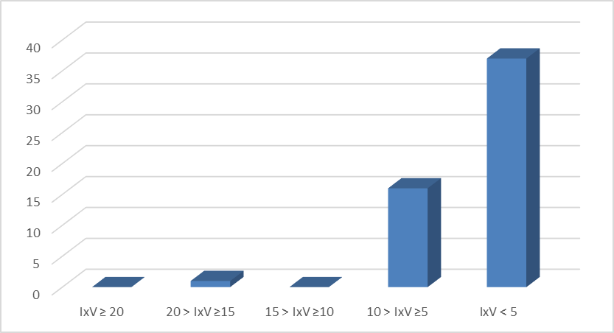
WP3

Slide 64
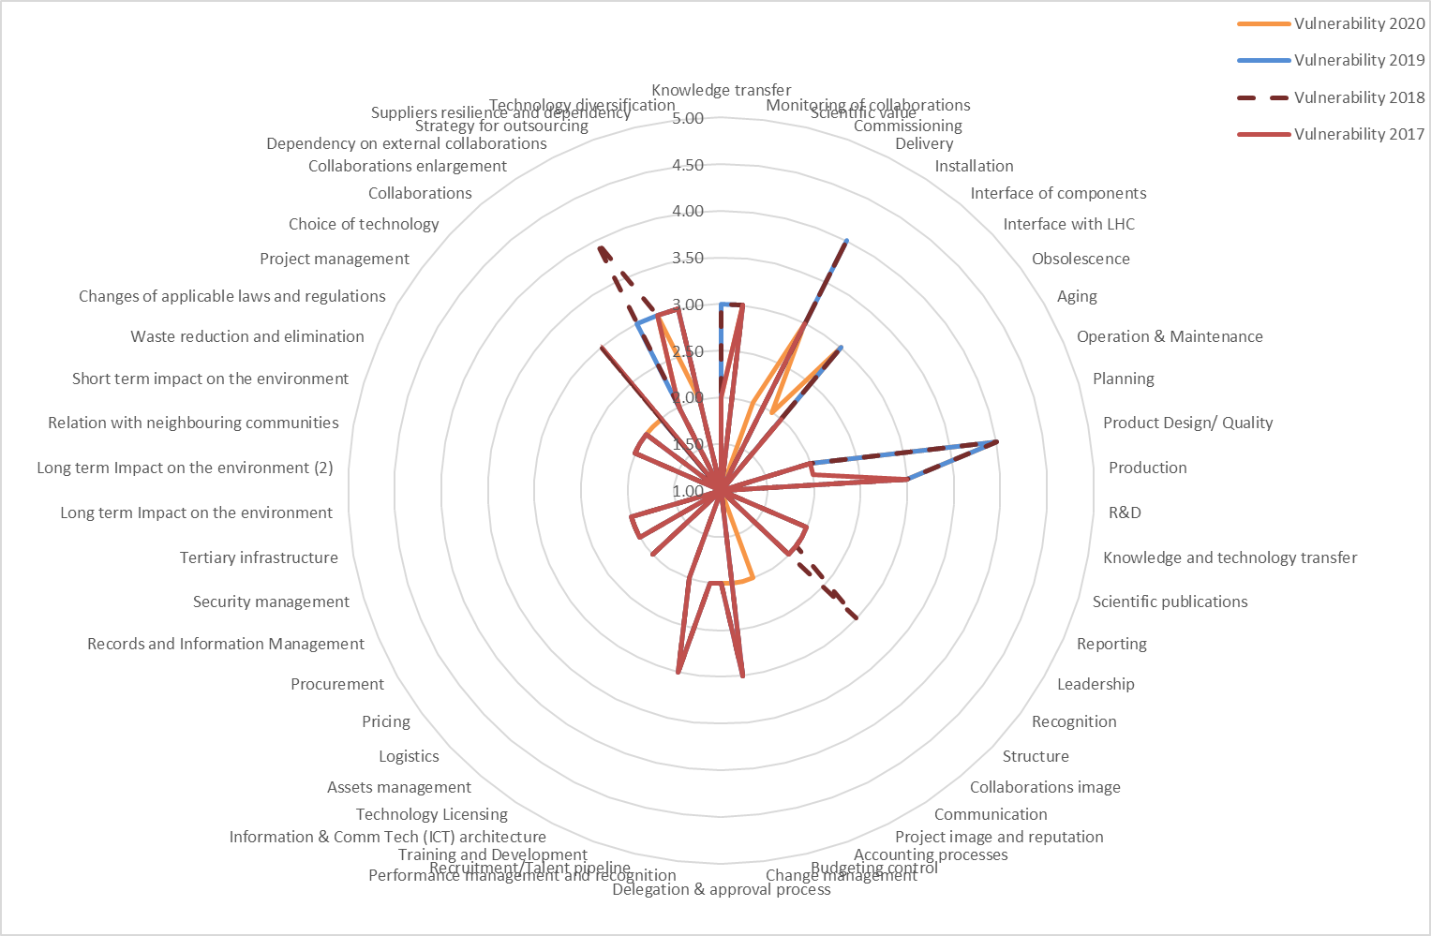
WP3

Slide 65
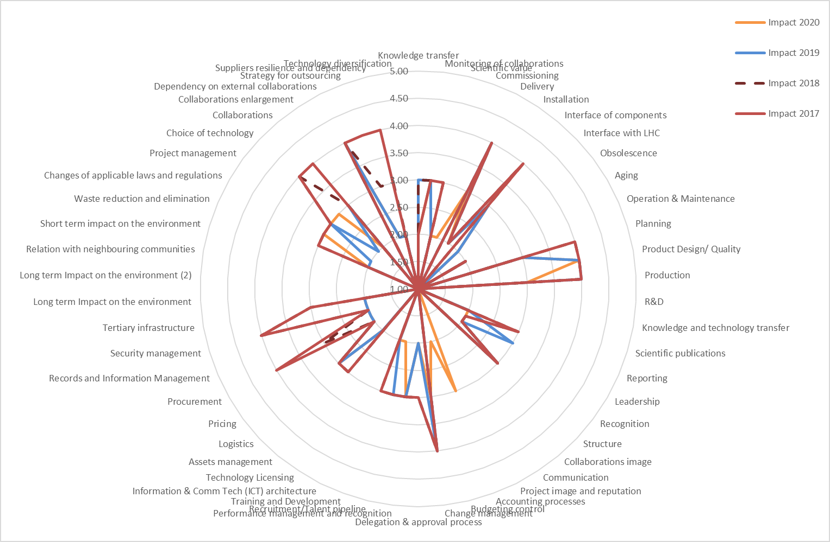
WP3

Slide 66
WP3 – MAIN ACTIONS
IxV | ID | Risk | Actions
From 16 to 9 | 5 | Delivery | Monitoring of the schedule including those of the collaborations
From 12 to 9 | 14 | Production | Maintain the monitoring of the nonconformities and the cross-pollination with the other teams
From 16 to 16 | 13 | Product Design/ Quality | Prototype for Q2. Two magnets will be tested in 2021 to assess performance of MQXFB.
From 9 to 9 | 7 | Interface of components | Finalise the interface specifications next year
From 9 to 9 | 2 | Monitoring of collaborations | Tight follow-up of the collaborations with visits on key moments of the production/testing phases

Slide 67
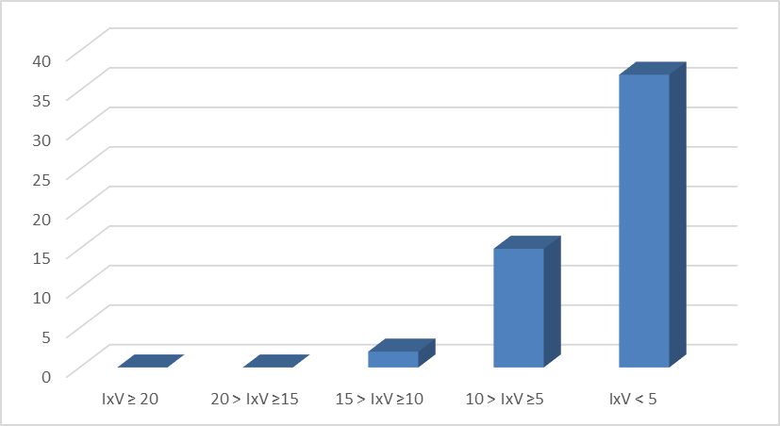
WP4

Slide 68
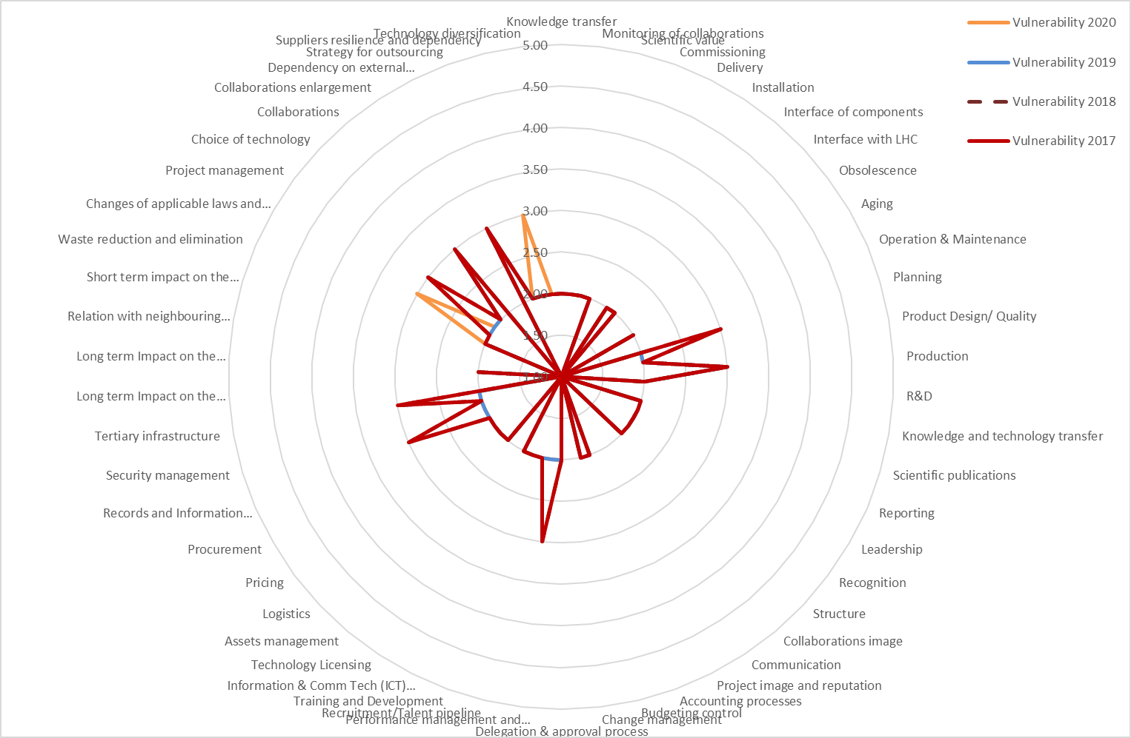
WP4

Slide 69
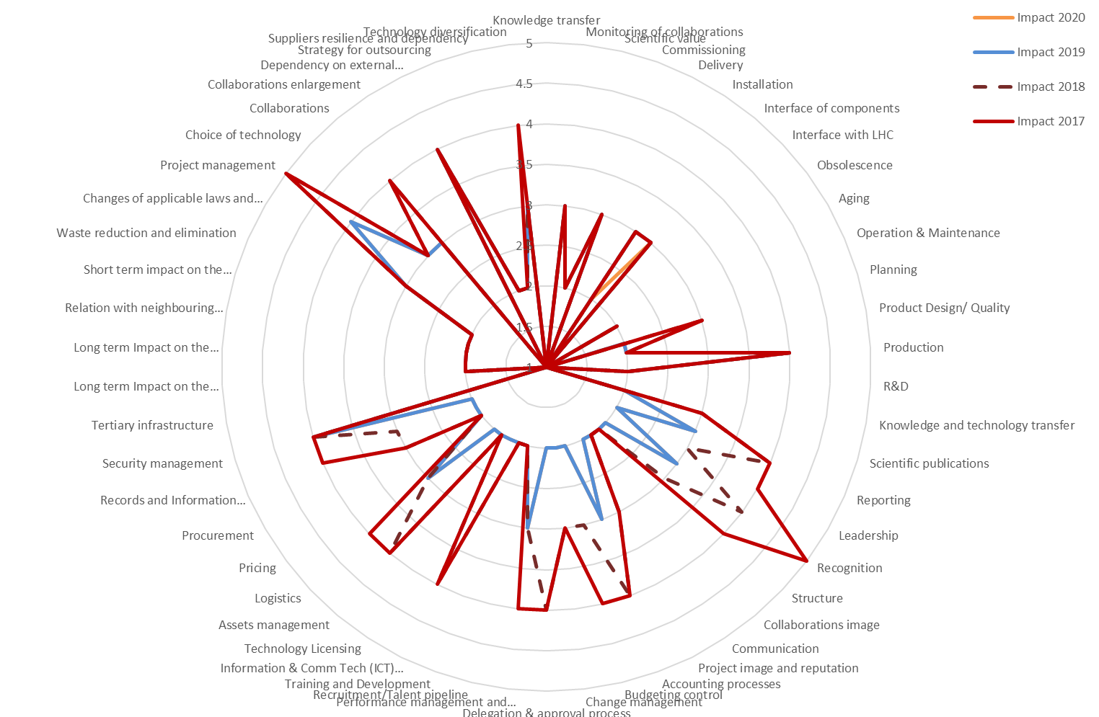
WP4

Slide 70
WP4 – MAIN ACTIONS
IxV | ID | Risk | Actions
From 12 to 12 | 14 | Production | Continue the close follow-up and ensure the follow-up of the HL-LHC Quality plan (MTF level)
From 9 to 9 | 49 | Collaborations | If there is a change of scope, CERN can act as a backup to retake the production.
From 12 to 12 | 51 | Dependency on external collaborations | If there is a change of scope, CERN can act as a backup to retake the production.

Slide 71
WP5 and WP8 – WPs with most of the LS3 Hardware coming from New Collaborations
Main risks: Collaboration enlargement (specially with the present restrictions in travel) and their monitoring in the initial phases.
Average I*V → 4.42

Slide 72
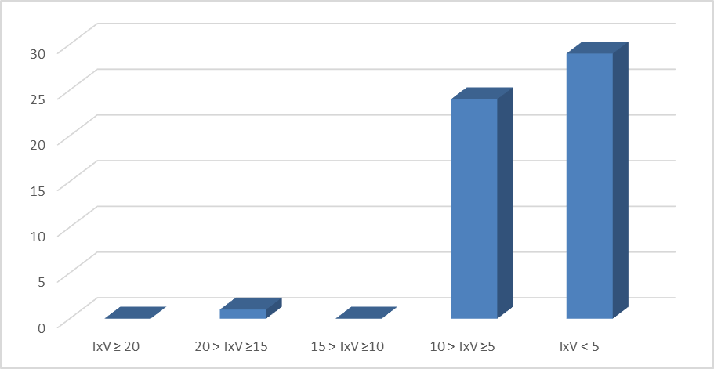
WP5

Slide 73
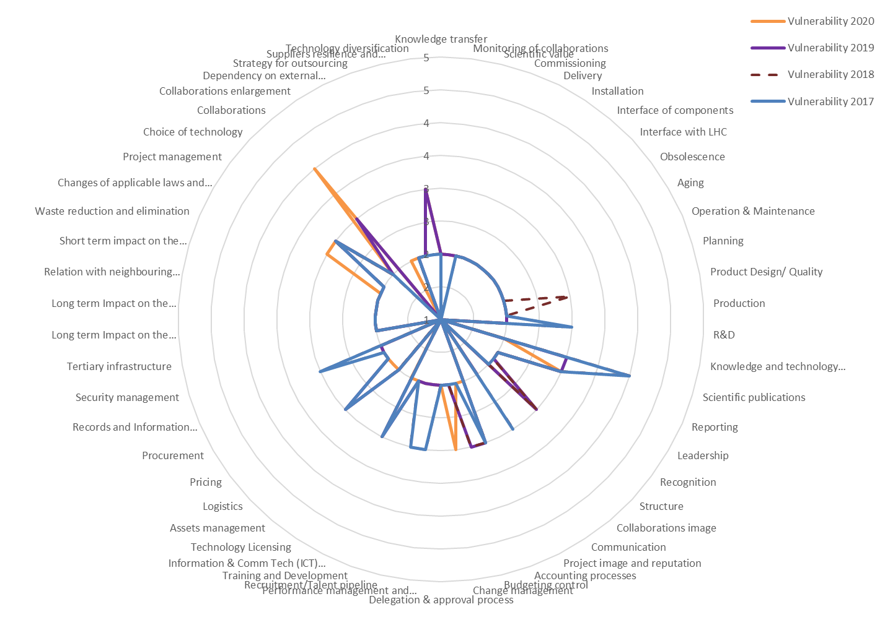
WP5

Slide 74
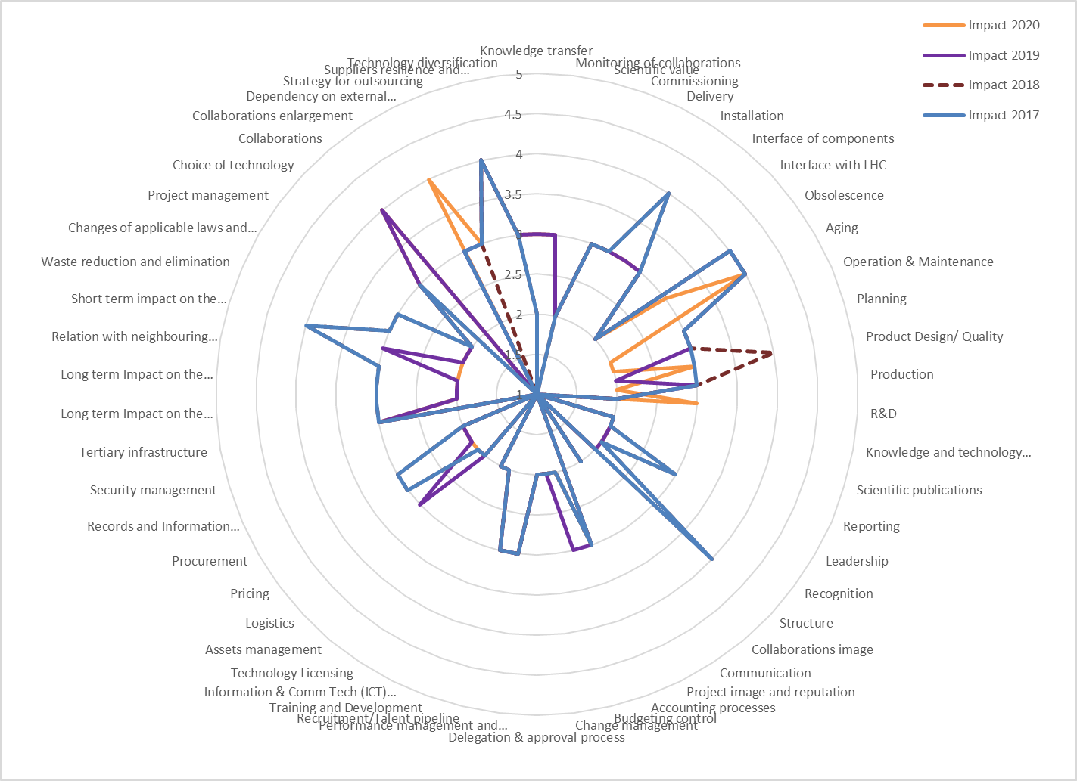
WP5

Slide 75
WP5 – MAIN ACTIONS
IxV | ID | Risk | Actions
From 12 to 16 | 49 | Collaborations | On WP1. Managerial follow up to obtain commitment that Russia will deliver on time. Timeline including the deadline (end of 2021) for a validated jaw.
From 9 to 9 | 54 | Technology diversification | WP1 must follow up this risk with Russia
From 4 to 6 | 27 | Change management | Follow up that they work on the transition and knowledge from the group.

Slide 76
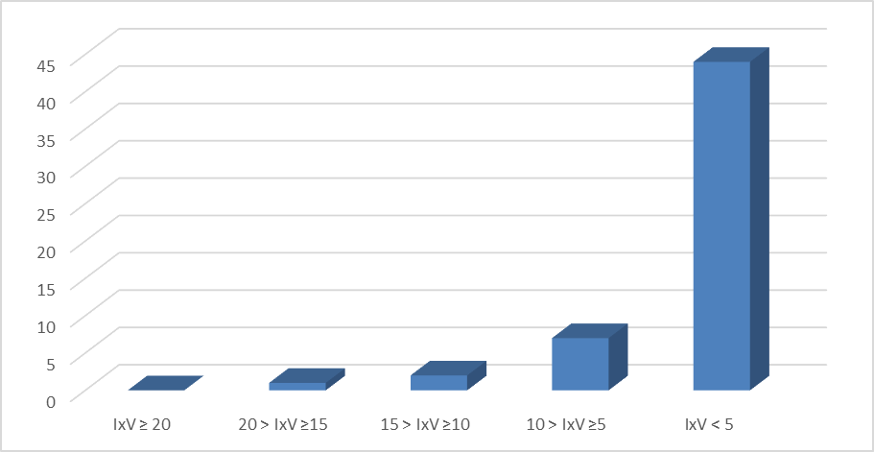
WP8

Slide 77
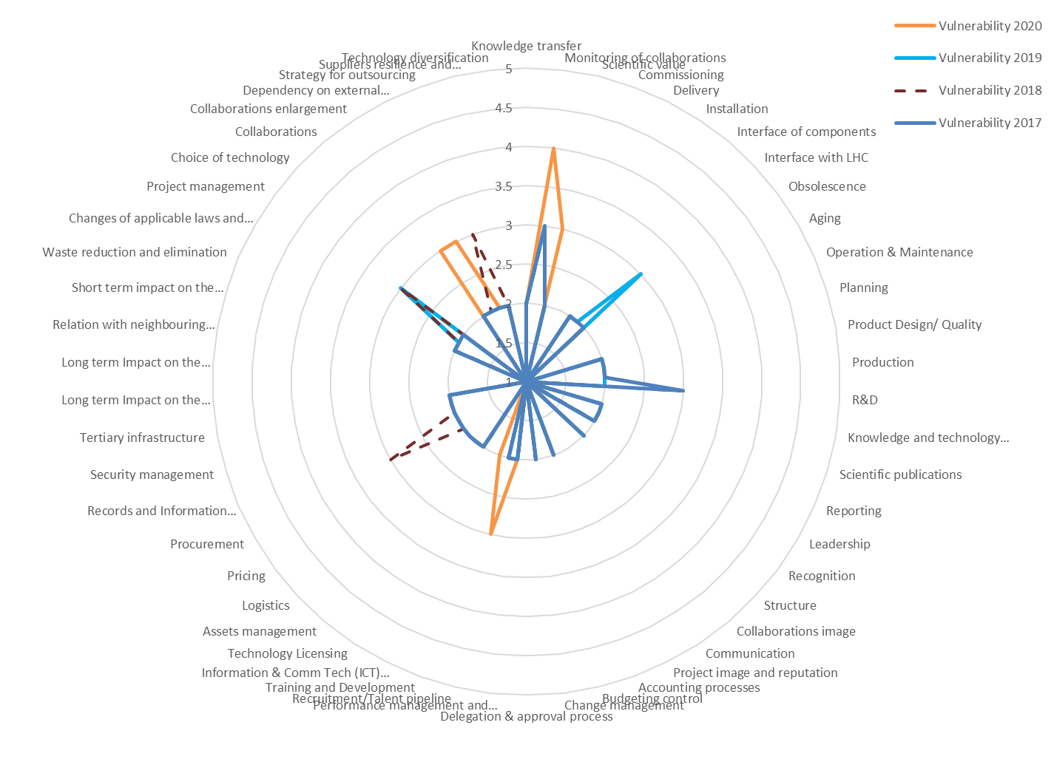
WP8

Slide 78
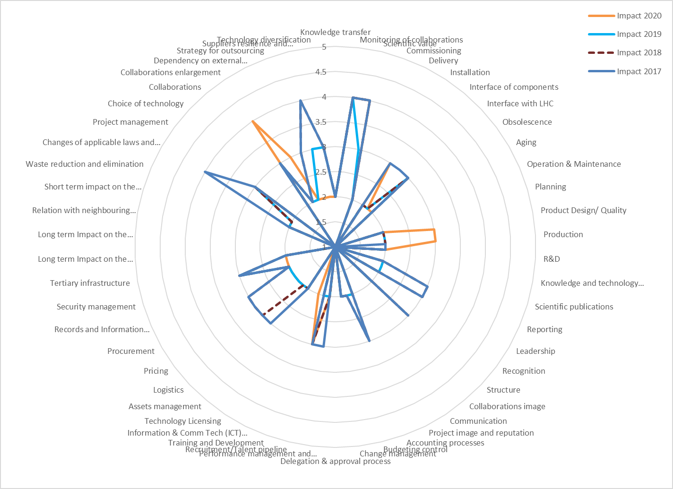
WP8

Slide 79
WP8 – MAIN ACTIONS
IxV | ID | Risk | Actions
From 12 to 16 | 2 | Monitoring of collaborations | Follow up the collaboration with Russia (BINP). Starting with the QP and a clear schedule and milestones.
From 9 to 9 | 47 | Project management | On the 26th November, the plan to create a mock-up of the TAXN – Q1 region will be presented in the TCC. This mock-up will ensure that the operation is feasible and will show any problem that has to be solved in advance. The discussions with the experiments will continue during 2021
From 6 to 12 | 50 | Collaborations enlargement | Call for more frequent Technical meetings. In case of failure will have to look for an alternative producer. The value of the collaboration is 2 MCHF and potentially the point of no return is in December 2021.
From 4 to 9 | 51 | Dependency on external collaborations | See previous action. An alternative plan exists in case it is not done by the Russian collaboration but will imply extra cost for the project
From 4 to 9 | 30 | Recruitment / Talent pipeline | Request in PSM that the money allocated for the PJAS is used for the recruitment of a fellow in the May committee
From 6 to 12 | 3 | Scientific value | Same action as for Risk 2

Slide 80
WP9 and WP17 – WPs with important LS3 Workload (but no Collaborations involved)
Main risks: Strategy for outsourcing, accounting processes and Pricing as there is a lot of upcoming procurement work; Suppliers resilience and dependence due to the large contracts that are involved, and Impact on the environment caused by the civil works required .
Average I*V → 4.36

Slide 81
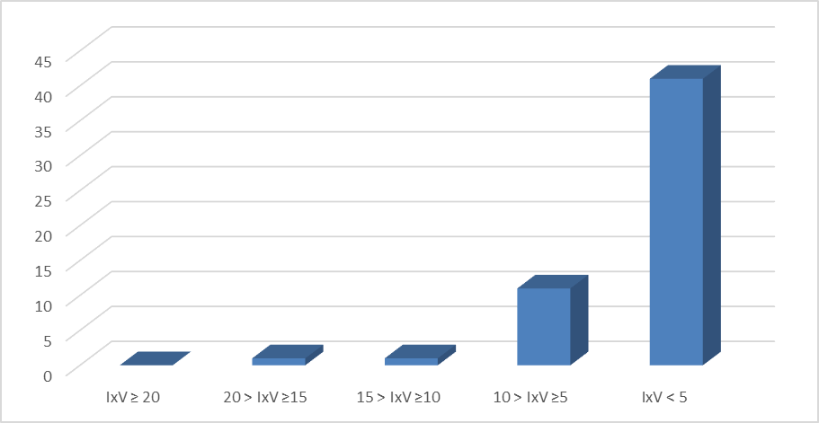
WP9

Slide 82
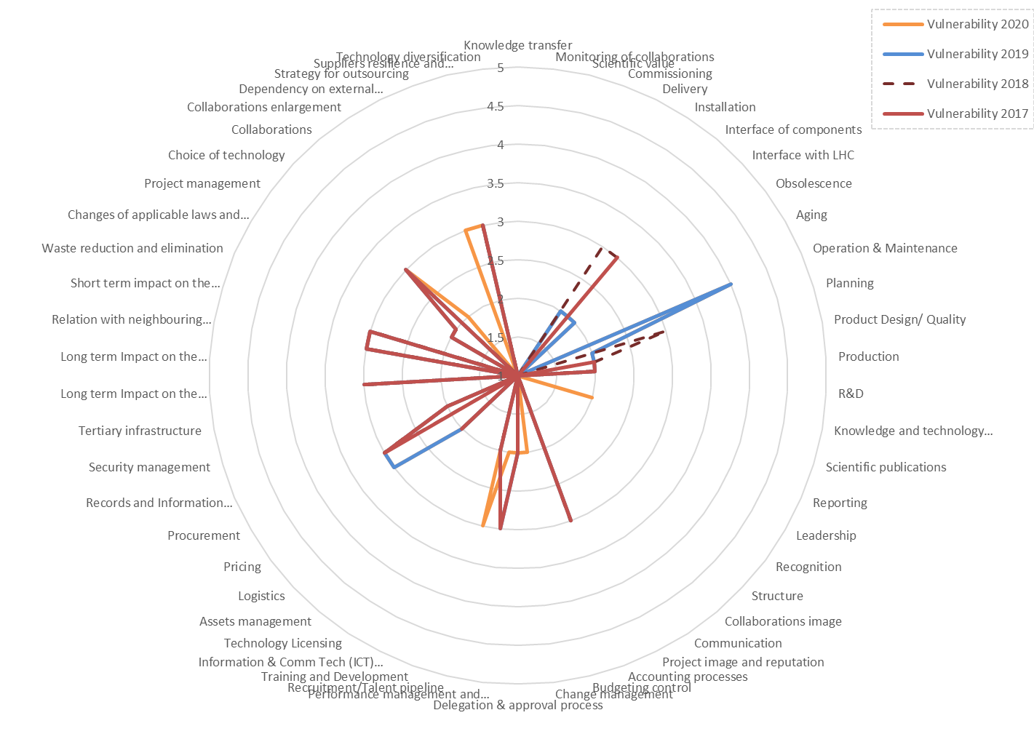
WP9

Slide 83
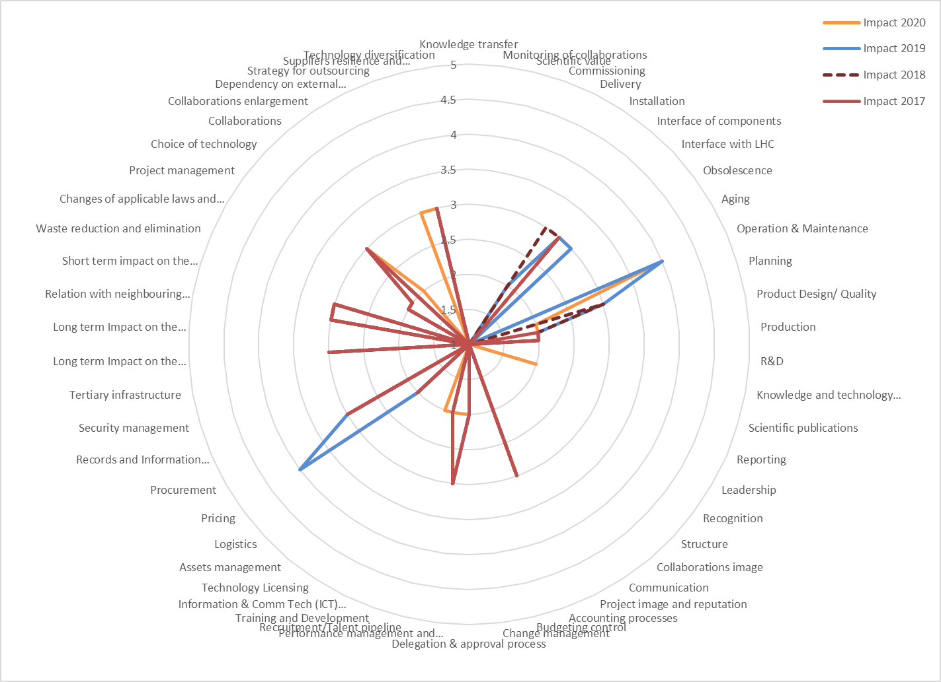
WP9

Slide 84
WP9 – MAIN ACTIONS
IxV | ID | Risk | Actions
From 9 to 9 | 25 | Accounting processes | Similar point will be done before the tendering
From 9 to 9 | 37 | Procurement | Clarify the Specification committee objectives and methods. This risk is transferred to WP1
From 9 to 9 | 41 | Long term Impact on the environment | Already discussed with SMB for calculation of cost of possible palliative solutions. Maybe information during the open days
From 9 to 9 | 43 | Relation with neighbouring communities | Maintain vigilance on noise
From 9 to 9 | 44 | Short term impact on the environment | Action on WP17.3 for SHM building. Continue studies on cool down.
From 9 to 9 | 48 | Choice of technology | The cold compressors will be treated with a feasibility study.
From 9 to 9 | 53 | Suppliers resilience and dependency | Maintain the open option for the Indian companies if they get the correct experience and validation of their work in ITER
From12 to 12 | 36 | Pricing | Not delaying the tendering so that we have the possibility of retendering if prices do not correspond to what it is expected. WP9 will launch studies with industry to minimise risk of misunderstanding
From 16 to 16 | 11 | Operation & maintenance | Waiting for the Working group to give an alternative solution for the cooling of adjacent sectors. The risk is maintained until a solution is agreed.
From 1 to 9 | 52 | Strategy for outsourcing | Market survey criteria. Possibility to reissue a new MS

Slide 85
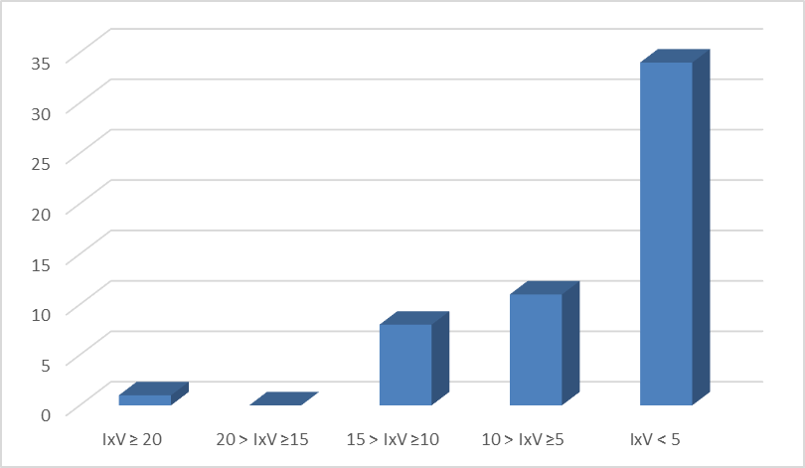
WP17

Slide 86
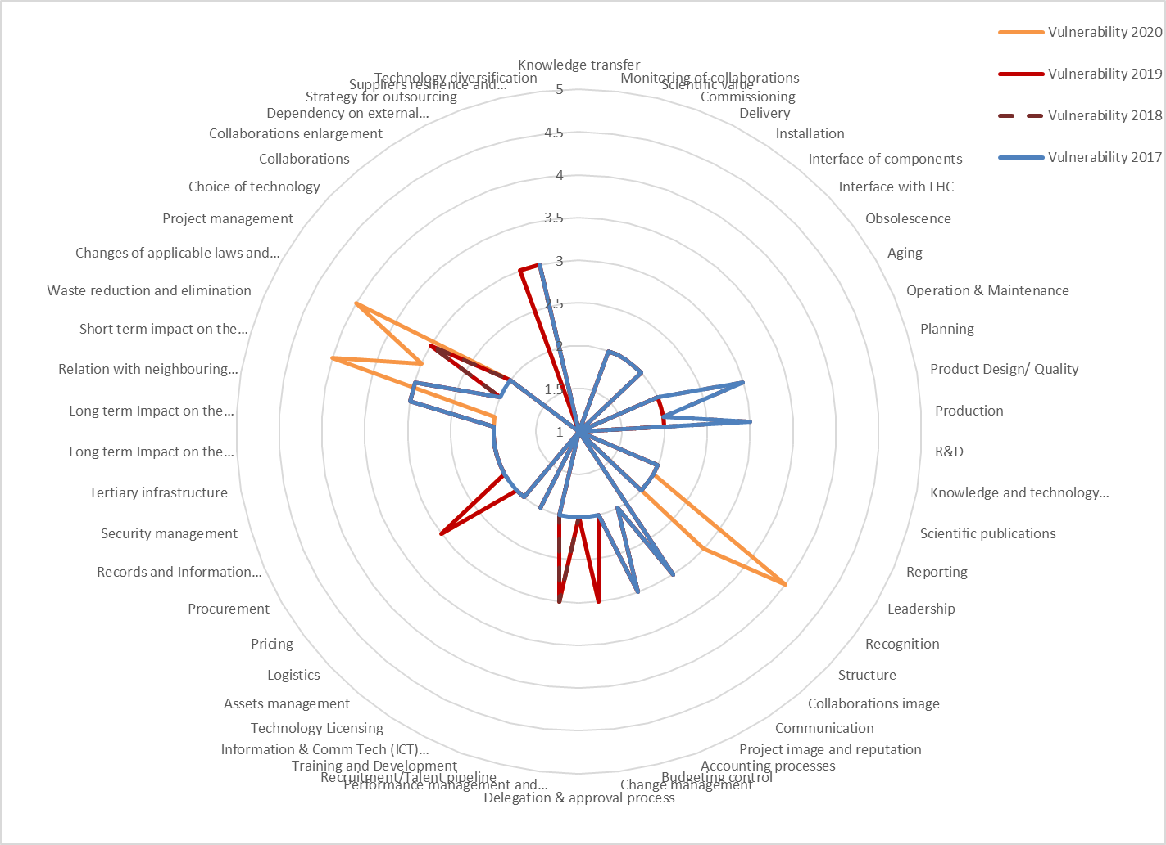
WP17

Slide 87
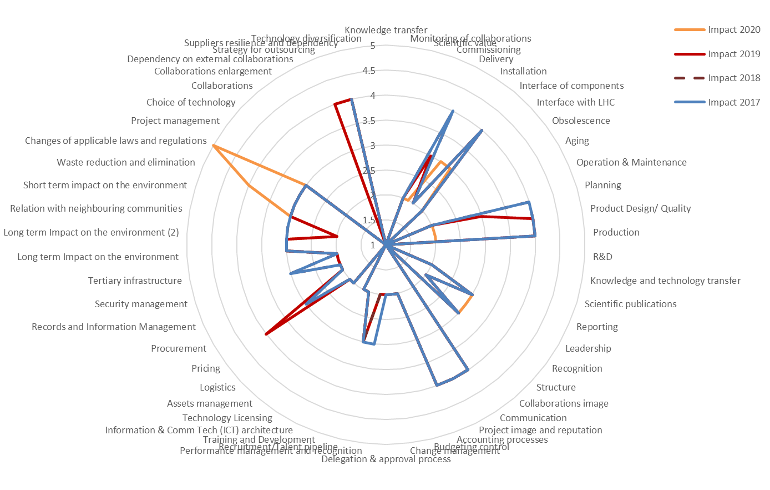
WP17

Slide 88
WP17 – MAIN ACTIONS
IxV | ID | Risk | Actions
From 12 to 12 | 23 | Communication | The main risk concerning communication is during any crisis that could happen during an accident/incident. This will be covered by the emergency reaction sheets to be prepared for the "crisis management cell"
From 12 to 12 | 25 | Accounting processes | Continue the usage of SMRs. Next year when the design of the buildings is finished, it will be strongly reduced. From the end of the design a new methodology will be used (rolling SMRs).
From 12 to 12 | 53 | Suppliers resilience and dependency | Maintain monitoring of the invitation to tender for CV to make sure that the strategy does not have a cost impact. Monitoring of the framework contracts of EL with special HL work volume packages
From 9 to 12 | 44 | Short term impact on the environment | Continue analysing the incident and increase the noise detection system threshold.
From 9 to 20 | 46 | Changes of applicable laws | No action required now, follow-up closely
From 12 to 12 | 36 | Pricing | Active campaign to motivate companies to answer MS. More information for ILOs to reach more companies
From 12 to 12 | 52 | Strategy for outsourcing | See 53
From 4 to 12 | 20 | Recognition | Identify with SCE the new allocation/repartition of 4 FTEs needed for the next year
From 6 to 9 | 21 | Structure | Monitor the delays and revaluate the risk
From 6 to 12 | 45 | Waste reduction and elimination | As the level of pollution is small, define and negotiate with the Contractor a new category of spoil which can reduce the cost impact.

Slide 89
WP2 and WP10 – WPs with mainly Manpower (No Hardware)
Main risks: Accounting processes since the resources for R&D projects are not completely guaranteed. Other noticeable risks are related to Recruitment as personnel are the basis of these WPs, and Scientific publications, which constitute a very important outcome.
Average I*V → 2.87

Slide 90
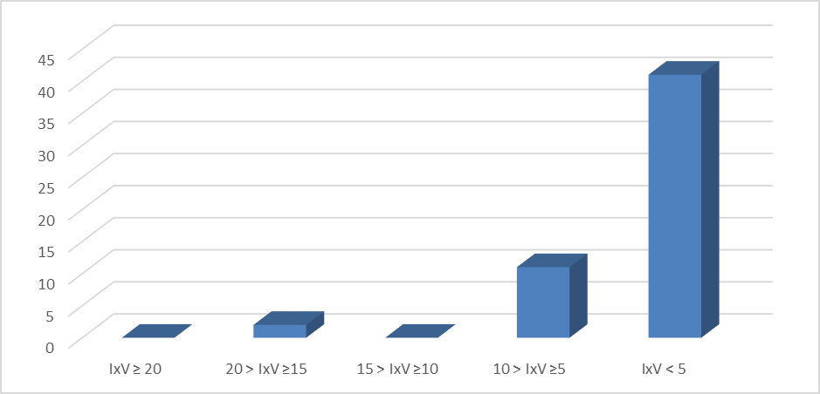
WP2

Slide 91
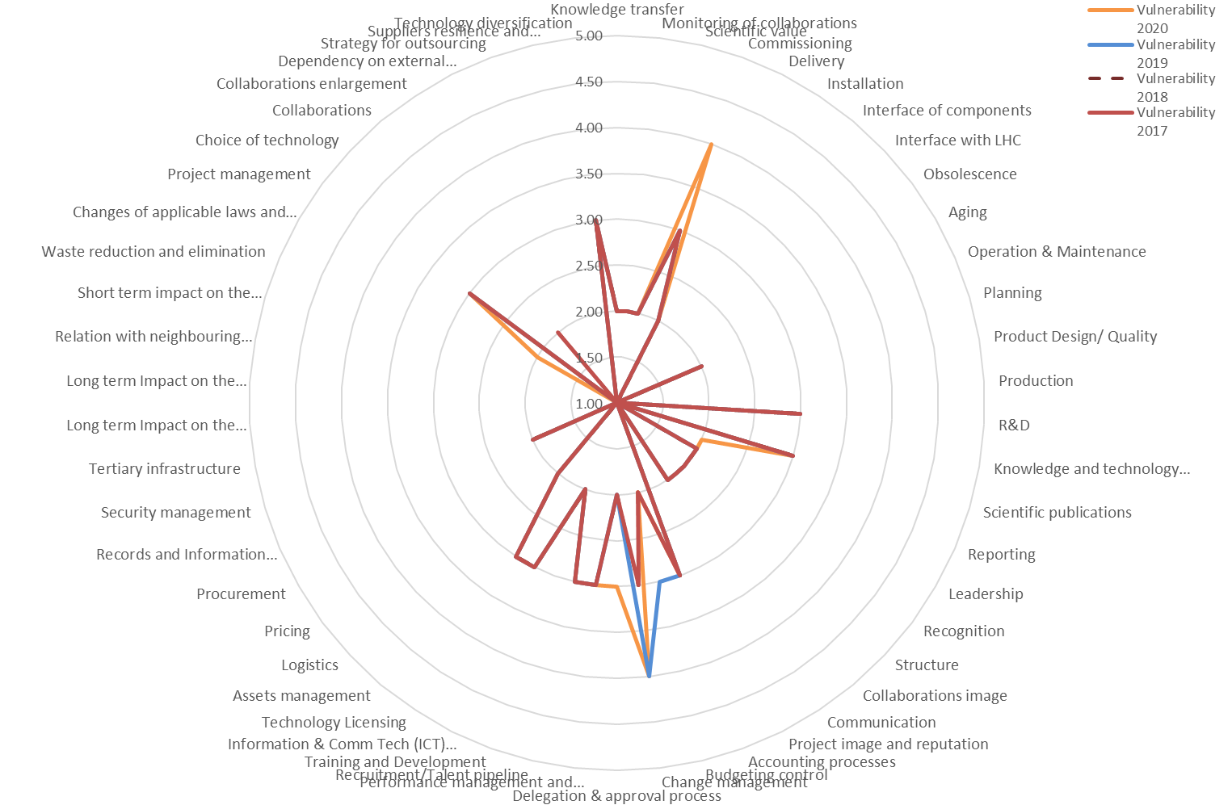
WP2

Slide 92

WP2

Slide 93
WP2 – MAIN ACTIONS
IxV | ID | Risk | Actions
From 12 to 16 | 4 | Commissioning | Discussion with PL and with new DH.
From 9 to 9 | 15 | R&D | Still no resources beyond baseline. Moved to WP1
From 9 to 9 | 17 | Scientific publications | Adequate time and resource allocation for documentation and validation. Definition of distribution list of KEY approvers (avoid large approval lists) and responsible for approval. The approval of the document should be conditional to the approval of these key people. Will be rediscussed with former WPL.
From 9 to 9 | 25 | Accounting processes | Continue defending the 1/3 contribution from the department.
From 16 to 16 | 27 | Change management | Discussion with the new PL and with the new DH and DDH to obtain the budget again
From 9 to 9 | 29 | Performance management and recognition | Reduce number of projects and studies and focus effort.
From 9 to 9 | 30 | Recruitment/Talent pipeline | Try to obtain a new EU grant/Swiss grant to increase attractiveness (mobility and extra resources). Make contact with Serbian community. Possible PhD from University in applied mathematics.
From 9 to 9 | 47 | Project management | Review of WP1 of all the potential options still open so that we can "close" them or give a deadline before the end of the year.
From 9 to 9 | 54 | Technology diversification | See Risk 47
From 4 to 9 | 28 | Delegation & approval process | Explore some automatic control tools

Slide 94

WP10

Slide 95

WP10

Slide 96

WP10

Slide 97
WP10 – MAIN ACTIONS
IxV | ID | Risk | Actions
From 9 to 12 | 34 | Assets management | Acceptance that there will be no testing in 2021
From 1 to 12 | 25 | Accounting process | Transferred to WP1. HL PL has to actively support that the R2E project is extended
From 8 to 8 | 13 | Product Design/ Quality | Guideline on how the radiation tolerant systems should be qualified and quality controlled. Involvement of WP10 in the engineering review of critical systems with active electronics exposed to radiation (e.g. WP6B, WP7, WP13, WP18)

Slide 98
Since 2019
Quantitative approach added to the qualitative approach

Slide 99
The difficulty of quantifying risks
Literature is very rich on risks quantification methodologies. A lot of them address one objective (insurance, liability, contingency definition, ….). Some of them are based on a list of foreseen adverse events, other in general risk topologies
HL-LHC is a project without contingency and therefore risk management has been always considered as a tool to increase resilience and to anticipate and minimize the effect of adverse events.
First approach: to use our present Risk register based on the risk map to obtain a “topological risk”
In a later stage for each risk with an action to explore its fault tree and quantify if its consequences are covered by the general exercise or if an addition “over cost” has to be considered.

Slide 100
From qualitative to quantitative: Impact on cost
Impact assessment | Catastrophic Extreme | Major | Moderate | Minor | Negligible
Assessment scale | 5 | 4 | 3 | 2 | 1
Impact | Minimum | Most likely | Maximum
5 | 30% | 50% | 60%
4 | 15% | 20% | 40%
3 | 0% | 10% | 20%
2 | -5% | 5% | 15%
1 | -10% | 0% | 10%
Financial loss | Reputation | Legal/ Regulatory | Safety | Environment | Objectives

Slide 101
From qualitative to quantitative:
Vulnerability - Probability
Vulnerability assessment | Severe vulnerability | High vulnerability | Moderate vulnerability | Mild vulnerability | No evidence of vulnerability
Assessment scale | 5 | 4 | 3 | 2 | 1
Vulnerability | Probability
5 | 100 %
4 | 80 %
3 | 50 %
2 | 50 %
1 | 50 %
INTERNAL CONTROL | PREVIOUS RISK EXPERIENCE | CAPABILITY | RATE OF CHANGE

Slide 102

Distribution of the Risk
The risk pattern will take in consideration the impact profile (PERT distribution based on the most likely, minimum and maximum)
The probability that the event happens based on the vulnerability of the event
The relative weight of each family of risks (ex. Production risk for WP3 will have 200 times more weight than the risks on lack of scientific publications)

Slide 103

Distribution of the Risk
Then all is normalized so that the final value is expressed in percentage of residual value.
There is a Monte Carlo simulation for each one of the risks and a global computation for all the risks together

Slide 104
Next step
The Montecarlo will be run again in 2021 before the next cost and schedule review
As proposed, a few WPs will be identified to make an “adverse event” list.
For the Risks with the biggest Cost or Schedule impact a list of “what can go wrong” and the consequences will be done. This will allow the preparation of more detailed actions and will modulate the results of the Montecarlo analysis

Slide 105
Outline
Risk assessment. Main approach
Methodology
Risk Register – How is it done?
Main Outcomes from last exercise
Conclusions

Slide 106
Main conclusions
Risk is very subjective and the values given by WPLs are linked to their risk appetite
With more than 50% of our budget already engaged and most of big procurements launched, our risk is every time less linked to the maturity level/pricing and more to production nonconformities, contract/collaboration management and non detected design problems.
If there are time delays those can create extra costs
We have not added yet the result of analysing the impact of the worst adverse events
The perception of the risk from the collaborations is indirect and while they do not have “direct cost” (full in-kind contributions) impact they can have an strong indirect impact (retake the activities, procurement of components, rework if nonconformities, delay on other activities, transport, storage, …)
The restructuring has caused some uncertainty and the need for adaptation but will hopefully be a temporary risk.
The situation due to COVID has had important effects on a lot of WPs, mainly complicating the monitoring of collaborations and production due to restricted travelling, as well as requiring adaptations to the work in-house.
The Project has already put in place Mitigation Actions based on the risk assessment: Production of equipment in-house to mitigate Delays in industrial/collaborations production, extension of Collaboration agreements due to COVID-19, Feasibility studies before the Call for Tender, etc…

Slide 107

Many Thanks for your attention
Any Question?
Creating a risk-conscious culture within an organization is the first step to protect the organization against the risks consequences
Many Thanks to Isabel Bejar who has put in place the risk assessment in the Project and has been carrying-out and monitoring this non-negligible activity up to now.

Slide 108
Spare Slides

Slide 109
Rest of WPs

Slide 110

WP6A

Slide 111

WP6A

Slide 112

WP6A

Slide 113
WP6A – MAIN ACTIONS
IxV | ID | Risk | Actions
From 9 to 4 | 16 | Knowledge and technology transfer | Finalise the investigation
From 9 to 9 | 2 | Monitoring of collaborations | Maintain the actions and revaluate once the work with the Russian collaboration begins.
From 9 to 9 | 7 | Interface of components | Work to be done on the integration of the link in the DD and tunnel
From 9 to 12 | 51 | Dependency on external collaborations | Maintain close monitoring. Action escalated to WP1 to push for the start of manufacturing in Russia.
From 1 to 9 | 50 | Collaborations enlargement | Revaluate when the collaborations are defined.

Slide 114

WP6B

Slide 115

WP6B

Slide 116

WP6B

Slide 117
WP6B – MAIN ACTIONS
IxV | ID | Risk | Actions
From 12 to 12 | 7 | Interface of components | Action required at WP1 level to obtain answers and ease the approval process. Continue the Interface meetings
From 9 to 16 | 47 | Project management | A new staff has to be hired even though the new engineer will most likely not be able to help with project management
From 9 to 16 | 12 | Planning | The new GL/DGL will have to rearrange the work to fill the gap in the short term.
From 4 to 12 | 27 | Change management | The new GL/DGL will have to rearrange the work to fill the gap in the short term.
From 6 to 9 | 28 | Delegation & approval process | Request support from the Project Office to handle the approval process
From 6 to 9 | 30 | Recruitment/Talent pipeline | Anticipate recruitment process to be able to relaunch the process if no candidates are found
From 4 to 9 | 36 | Pricing | Improve industry/market knowledge and perhaps launch tendering early enough to allow retendering if the price is far from the budget allocated
From 6 to 9 | 46 | Changes of applicable laws and regulations | Action transferred to WP1

Slide 118

WP7

Slide 119

WP7

Slide 120

WP7

Slide 121
WP7 – MAIN ACTIONS
IxV | ID | Risk | Actions
From 12 to 12 | 25 | Accounting processes | Finalise the EL cost assessment. The tenders for CLIQ and EE system pre-series production will further reduce the uncertainty of the unit price for the different systems

Slide 122


WP11
The risk exercise was not carried out with WP11 in 2020 as it was considered completed. The data shown hereafter corresponds to the previous exercise.

Slide 123

WP11

Slide 124

WP11

Slide 125
WP11 – MAIN ACTIONS
IxV | Risk ID | Risk | Actions
From 20 to 20 | 5 | Delivery | The production and installation schedule of the 11T dipole magnets for LS2 is under control, however with very little margin, hence it needs strict monitoring. In case of delays implying impossibility to install the magnets during LS2, these could be installed during an extended technical stop after LS2
From 12 to 4 | 39 | Security management | Actions are not required any more
From 10 to 4 | 53 | Suppliers resilience and dependency | Actions are not required any more
From 9 to 1 | 37 | Procurement | Actions are not required any more
From 9 to 4 | 47 | Project management | Actions are not required any more
From 12 to 12 | 14 | Production | The production and installation schedule of the 11T dipole magnets for LS2 is under control, however with very little margin, hence it needs strict monitoring. In case of delays implying impossibility to install the magnets during LS2, these could be installed during an extended technical stop after LS2 Maintain strict control on the activities. The risk is mainly on the unknown.

Slide 126

WP12

Slide 127

WP12

Slide 128

WP12

Slide 129
WP12 – MAIN ACTIONS
IxV | ID | Risk | Actions
From 16 to 16 | 53 | Suppliers resilience and dependency | Relax the specification, anticipate the production of raw material. Moved to WP1. Concern transferred during last PSM.
From 9 to 6 | 25 | Accounting processes | AL43 will be renewed and the new tender will be done only in 2 years. No more actions required
From 9 to 6 | 30 | Recruitment/Talent pipeline | The needs in terms of personnel should be anticipated as much as possible to allow us to do the announcements to the Institutes with enough time. In parallel, training of CERN staff on specific HL-LHC competencies is going on when possible.
From 1 to 12 | 50 | Collaborations enlargement | Produce the thermal links at CERN and look for an alternative for the interconnect (around 400k CHF)
From 9 to 12 | 14 | Production | Find a producer or a plan B for the bellows

Slide 130

WP13

Slide 131

WP13

Slide 132

WP13

Slide 133
WP13 – MAIN ACTIONS
IxV | ID | Risk | Actions
From 12 to 12 | 25 | Accounting processes | Main risk is associated with the cost of the final solution as there is uncertainty related to the cost forecast. There is a clear monitoring of the feasibility of the R&D via prototypes and optimization of the cost of the prototypes
From 12 to 12 | 36 | Pricing | Maintain and study in particular the “decabling” and “recabling” cost for old equipment that will remain operational for HL-LHC.
From 9 to 9 | 49 | Collaborations | Periodic meetings at high level to ensure that the commitment of the collaboration is maintained with Russia
From 12 to 12 | 53 | Suppliers resilience and dependency | Continue for all equipment and maintain actions such as asking for prototypes to qualify alternative suppliers.
From 12 to 12 | 54 | Technology diversification | See Risk 53 and 15
From 9 to 9 | 15 | R&D | Maintain the action. There is the impression that with the maturity of the existing collaborations their risk has reduced. But the overall level is maintained due to the addition of the new Russian collaboration.
From 12 to 12 | 14 | Production | Early qualification of suppliers for critical components. Investigation of alternative technologies for critical components. Collaboration with European industry to widen the choice of companies available to manufacture critical components.

Slide 134

WP14

Slide 135

WP14

Slide 136

WP14

Slide 137
WP14 – MAIN ACTIONS
IxV | ID | Risk | Actions
From 6 to 9 | 53 | Suppliers resilience and dependency | Investigate a potential second supplier for the MKI ceramic chamber as the production of the present supplier has an anomalous number of nonconformities, none in spec and only 16 over 22 were accepted with a potential concession.
From 6 to 9 | 49 | Collaborations | This action is moved to WP1 as the collaborations have to be “activated” so that not only the contact person, but the teams are defined in Russia
From 6 to 8 | 25 | Accounting processes | No real action required yet but monitoring on the final estimate of the cost of the dump during 2021

Slide 138

WP15

Slide 139

WP15

Slide 140

WP15

Slide 141
WP15 – MAIN ACTIONS
IxV | ID | Risk | Actions
From 12 to 12 | 32 | Information & Comm Tech (ICT) architecture | Follow up: Request to have a representative in the CAEC to give the project input in the replacement of CATIA and smart team and on the impact of the migration.
From 12 to 12 | 33 | Technology Licensing | Same as for risk 32.
From 12 to 9 | 7 | Interface of components | Finalize the integration study for the new baseline components
From 10 to 10 | 45 | Waste reduction and elimination | WP1 should address a Project on waste disposal
From 12 to 12 | 15 | R&D | Finalise the validation of the alignment table and perform transfer to Fermilab. Place the contract to Titans supplier. Start technical discussions with Serbia.
From 9 to 12 | 30 | Recruitment/Talent pipeline | Escalated to WP1
From 6 to 12 | 18 | Reporting | Escalated to WP1
From 4 to 12 | 19 | Leadership | Escalated to WP1
From 4 to 12 | 20 | Recognition | Escalated to WP1
From 6 to 16 | 21 | Structure | Escalated to WP1
From 8 to 12 | 46 | Changes of applicable laws and regulations | Push group to complete evaluation of the compression of the planning and monitor COVID situation
From 2 to 9 | 49 | Collaborations | Launch technical discussions with the Serbian collaboration
From 6 to 12 | 28 | Delegation & approval process | Refer to risk 21
From 6 to 9 | 36 | Pricing | Reaction will depend on the results of the IT
From 1 to 9 | 2 | Monitoring of collaborations | See Risk 49
From 1 to 9 | 1 | Knowledge transfer | See Risk 49

Slide 142

WP16

Slide 143

WP16

Slide 144

WP16

Slide 145
WP16 – MAIN ACTIONS
IxV | ID | Risk | Actions
From 9 to 9 | 7 | Interface of components | The work of integration will be finalised during 2021
From 9 to 16 | 11 | Operation & Maintenance | An agreement at DH level is needed to find a solution for the lack of a -full time- operator, which may imply more than one person in order to work in shifts and be able to accommodate the full IT String operation in 2023 as requested by the project. See also action for the control room that will have to be adapted to the new COVID measures and also requiring improvements for sanitary conditions (ventilation)
From 9 to 9 | 14 | Production | Continue monitoring the arrival of the components
From 9 to 16 | 25 | Accounting processes | This year the action is maintained as we need to obtain the final cost linked to the final design. Aspects such as the handling and the interfaces have cost that have not been accounted for.
From 6 to 9 | 6 | Installation | A person for the installation was foreseen but now it is an external position that will not have the required experience. Action is required from WP1
From 1 to 12 | 46 | Changes of applicable laws and regulations | Review once the final cost of the modifications is known
From 1 to 16 | 50 | Collaborations enlargement | Study the advantages and disadvantages of the Pakistani collaboration carefully before taking the decision.

Slide 146

WP18

Slide 147

WP18

Slide 148

WP18

Slide 149
WP18 – MAIN ACTIONS
IxV< | ID | Risk | Actions
From 1 to 4 | 47 | Project management | Update the planning

