Slide 1






A new insight on mass hierarchy in heavy flavor suppression
Bojana Ilic, Magdalena Djordjevic
Institute of Physics Belgrade
University of Belgrade

Slide 2
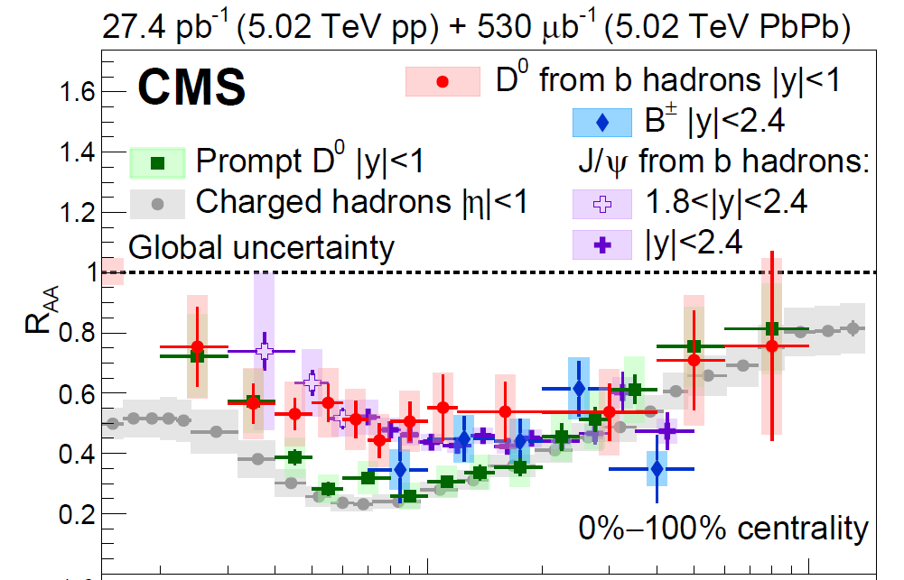
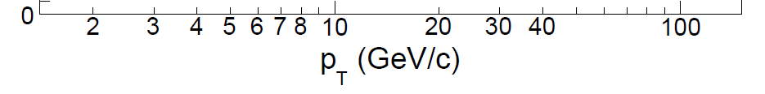
Mass hierarchy effect in energy loss mechanisms
The experimental observations of R_{AA} mass hierarchy (i.e., dead cone) analyzed within radiative models
PLB 519,199; PRD 85, 054012;
PRD 69, 114003; NPA 733, 265; PRC 77, 024905; PLB 763, 439;
PRL 93, 072301
At intermediate-p┴ range (𝑝_{Ʇ}≲10 GeV) charm and bottom collisional − comparable to (or larger) than radiative energy loss
NPA 784, 426; PRC 74, 064907; JPG 42, 075105; PLB 273, 128; PRC 72, 014905; APHA 22, 93
The mass hierarchy in collisional energy loss is not yet addressed
The upcoming RHIC and LHC measurements − employ high-p_{T} heavy flavor data for studying interaction mechanisms in QGP
PRL 123 (2019) 022001

Slide 3
Our goals
Utilizing complex R_{AA} patterns to differentiate between major energy loss mechanisms
Focusing on the region p_{T} <50 GeV and addressing:
  Which observable could isolate collisional from radiative energy loss
  Analytical derivation of an explicit relation between collisional suppression/energy loss and heavy quark mass
  Analytical and numerical derivation of the mass ordering in collisional energy loss through this observable

Slide 4
Numerical framework: DREENA-C
D. Zigic, I. Salom, J. Auvinen, M. Djordjevic and M. Djordjevic, J. Phys. G 46, no.8, 085101
Full-fledged DREENA-C (Dynamical Radiative and Elastic ENergy loss Approach, C stands for constant/average temperature profile) framework:
  Dynamical energy loss formalism:
    Complex, unique and realistic features
    Dominant ingredient for generating high-p_{Ʇ} suppression predictions
  Constant (average) Temperature profile:
    Excludes complications from details of medium evolution
    Analytical derivations feasible
    Insignificant loss of accuracy in R_{AA} predictions (compared to DREENA-B (PLB 791, 236) and DREENA-A (arXiv:2110.01544 ) ), low R_{AA} sensitivity to details of medium evolution
JPG 46, 085101; PLB 791, 236; PRC 99, 061902(R); PRC 85, 044903; NPA 932, 140
DREENA-C is an optimal framework for these studies (I and II), through R_{AA}, as it assumes
sophisticated energy loss model.
JPG 42, 075105

Slide 5
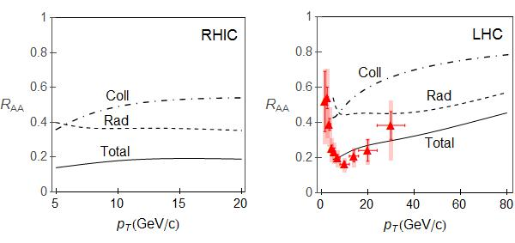
The dynamical energy loss formalism
Includes:
QCD medium of finite size and finite temperature
The medium consists of dynamical (i.e., moving) partons
Based on finite T field theory and generalized HTL approach
M. Djordjevic, PRC 74, 064907; PRC 80, 064909, M. Djordjevic, U. Heinz, PRL 101, 022302
The same theoretical framework for both radiative and collisional energy loss
Applicable to both light and heavy flavor M. Djordjevic and M. Gyulassy, Nucl. Phys. A 733, 265
Finite magnetic mass effects M. Djordjevic and M. Djordjevic, PLB 709, 229
Running coupling M. Djordjevic and M. Djordjevic, PLB 734, 286
Relaxed soft-gluon approximation B. Blagojevic, M. Djordjevic, M. Djordjevic, PRC 99, 024901
B.Blagojevic and M. Djordjevic, JPG 42, 075105
All ingredients necessary for reliable
high-p┴ R_{AA} predictions!

Slide 6
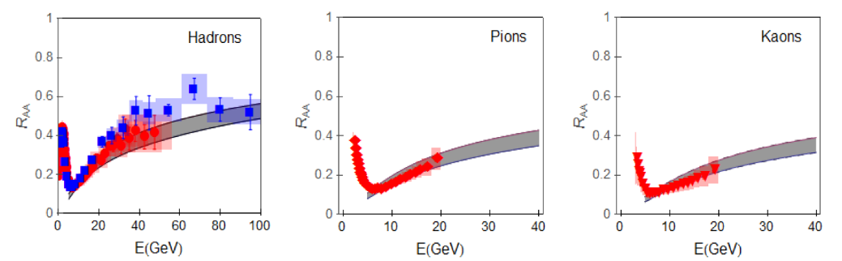
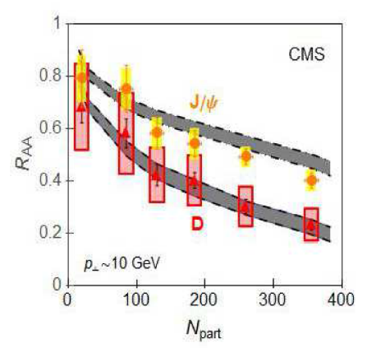
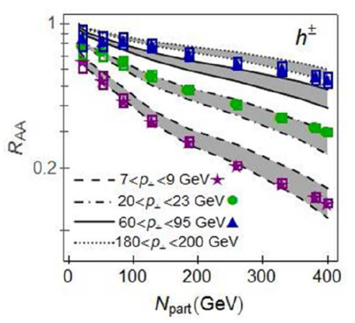
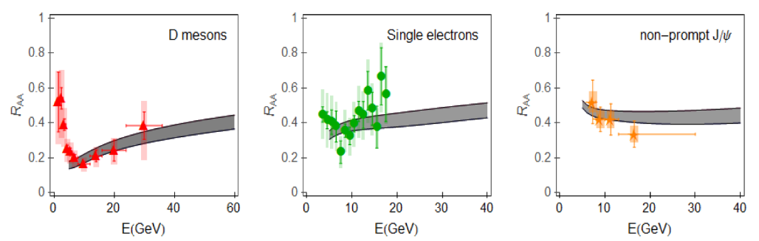
Experimental validation of DREENA-C framework
PLB 734, 286
Explains
high-p┴ R_{AA} data for different probes, collision systems (experiments), energies and centralities!
PRC 94, 044908
PLB 763, 439
Addresses heavy-flavor puzzle and has clear predictive power!
In generating all predictions we used:
The same numerical procedure (DREENA-C, D. Zigic, I. Salom, J. Auvinen, M. Djordjevic and M. Djordjevic, JPG 46, no.8, 085101)
The same parameter set
No fitting parameter
M. Djordjevic, B. Blagojevic and L. Zivkovic, PRC 94, 044908
JHEP 1704, 039
DREENA-C accurately addresses high-p┴ parton-medium interactions and is adequate for these studies.

Slide 7
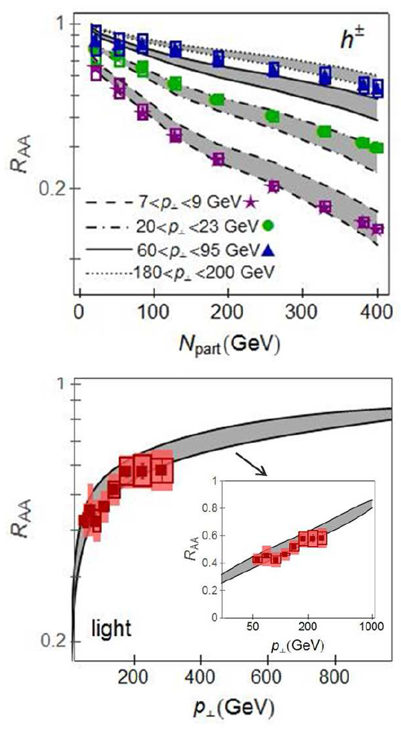

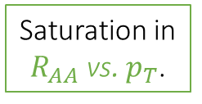
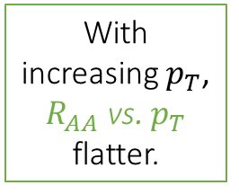

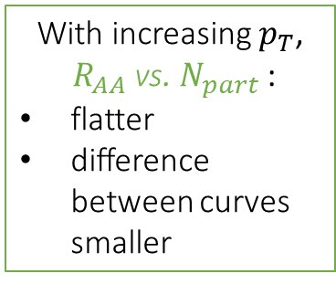
I. Nonintuitive suppression patterns (light or D probes)
With increasing $p_{T}$,
$R_{AA}$ vs. $N_{part}$ :
flatter
difference between curves smaller
Nonintuitive observations in agreement with our framework!
Saturation in
$R_{AA}$ vs. $N_{part}$.
Which energy loss mechanism is accountable for these observations?
With increasing $p_{T}$, $R_{AA}$ vs. $p_{T}$ flatter.
Saturation in $R_{AA}$ vs. $p_{T}$.
M. Djordjevic, PLB 763, 439
ATLAS: JHEP 09, 050; PRL 114, 072302

Slide 8
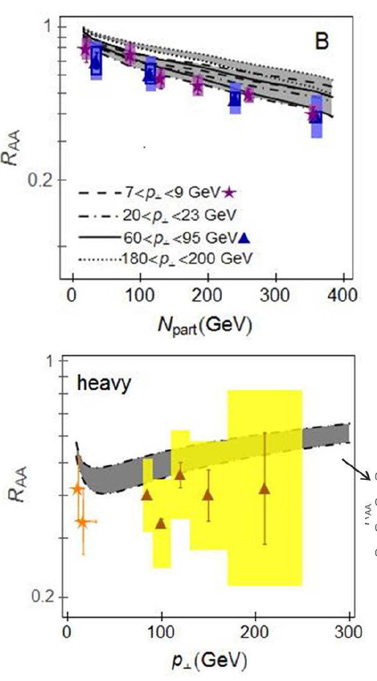
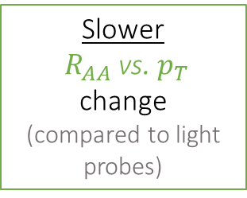
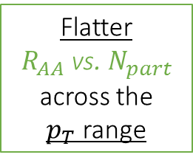
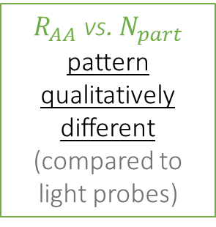
I. Nonintuitive suppression patterns (B probes)
$R_{AA}$ vs. $N_{part}$ pattern qualitatively different (compared to light probes)
Nonintuitive observation well reproduced within our framework!
Flatter
$R_{AA}$ vs. $N_{part}$
across the $p_{T}$range
Which energy loss mechanism is accountable for these observations?
Slower
$R_{AA}$ vs. $p_{T}$ change
(compared to light probes)
M. Djordjevic, PLB 763, 439
CMS: JHEP 05, 063; PRL 113, 132301

Slide 9
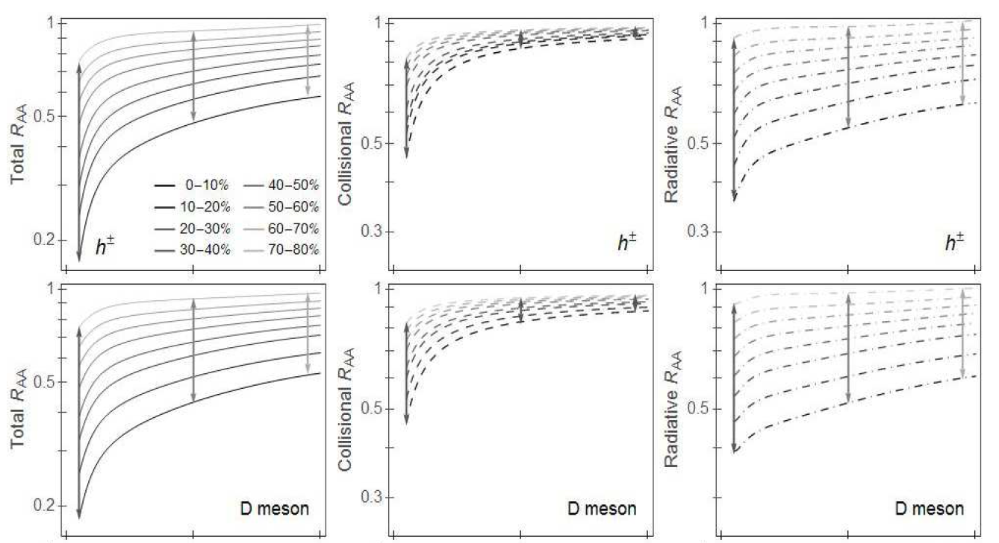
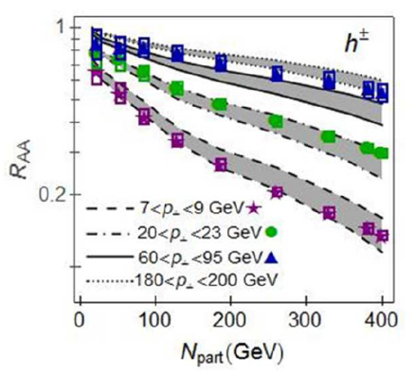
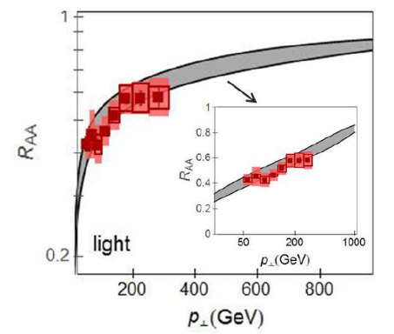
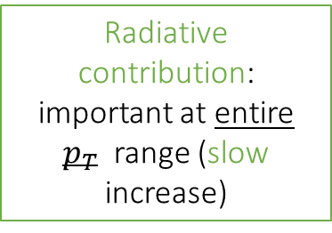
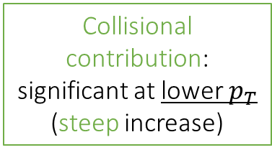
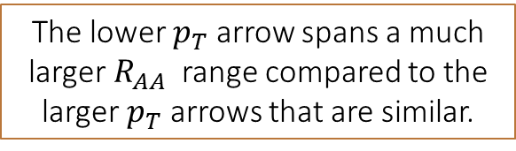
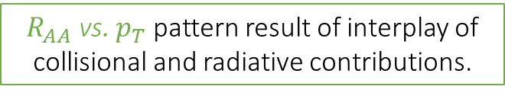
Qualitative explanation of the observations (light or D probes)
M. Djordjevic, PLB 763, 439
Radiative contribution: important at entire $p_{T}$ range (slow increase)
Collisional contribution: significant at lower $p_{T}$ (steep increase)
$R_{AA}$ vs. $p_{T}$ pattern result of interplay of collisional and radiative contributions.
The lower $p_{T}$ arrow spans a much larger $R_{AA}$ range compared to the larger $p_{T}$ arrows that are similar.

Slide 10
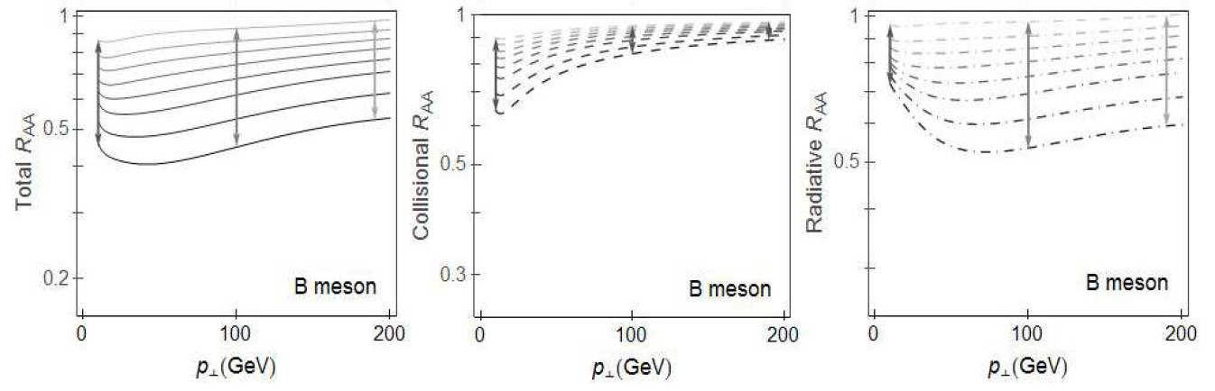
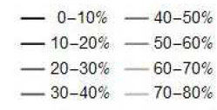
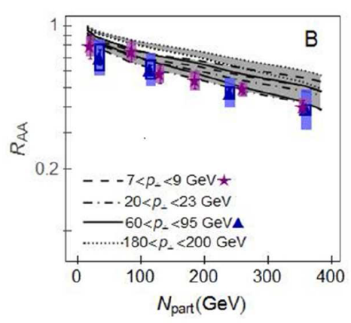
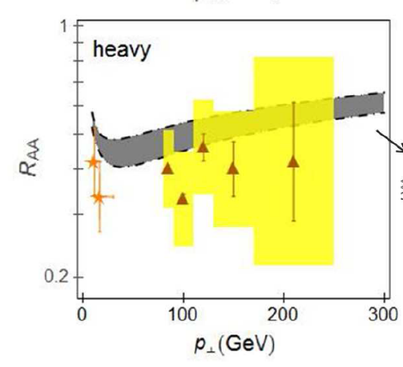
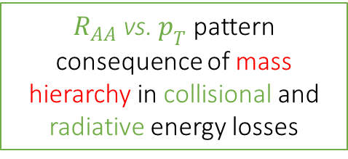
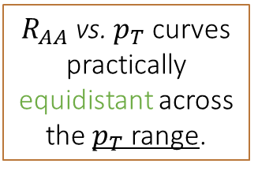
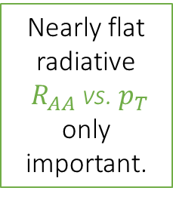


Qualitative explanation of the observations (B probes)
At lower $p_{T}:$
At higher $p_{T}:$
Both collisional and radiative contributions significant
(notably smaller than for light/D probes)
Nearly flat radiative
$R_{AA}$ vs. $p_{T}$ only important.
$R_{AA}$ vs. $p_{T}$ pattern consequence of mass hierarchy in collisional and radiative energy losses
$R_{AA}$ vs. $p_{T}$ curves practically equidistant across the $p_{T}$ range.
M. Djordjevic, PLB 763, 439

Slide 11
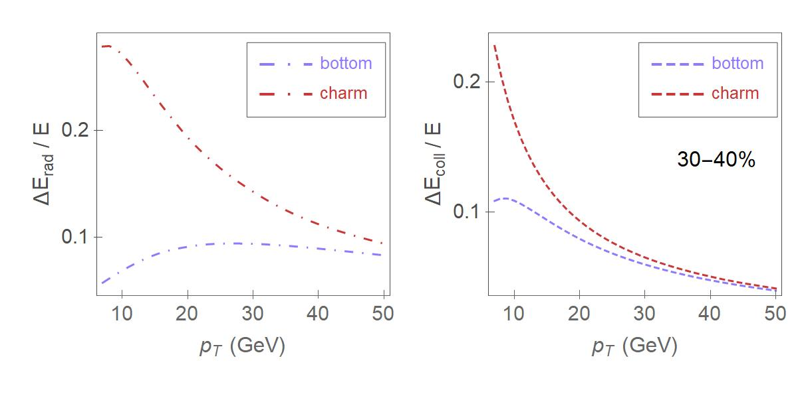

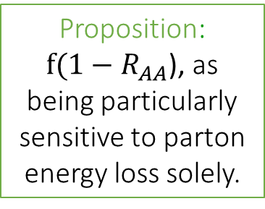
II. Mass hierarchy in energy loss mechanisms
Which observable could quantify this effect?
Proposition:
$f(1−R_{AA}$), as being particularly sensitive to parton energy loss solely.
M. Djordjevic, B. Blagojevic and L. Zivkovic, PRC 94, 044908
PRC 74, 064907; PRC 93, 014901; NPA 931, 581; arXiv:0812.0270
PRC 99, 061902(R); PRC 103, 024908
The dead-cone effect (DCE), i.e., the mass hierarchy in radiative energy loss.
Importantly: Obtained clear mass hierarchy in collisional energy loss also!
DCE: gluons’s radiation off heavy quark is suppressed at $θ<M/E$ compared to massless parton.

Slide 12
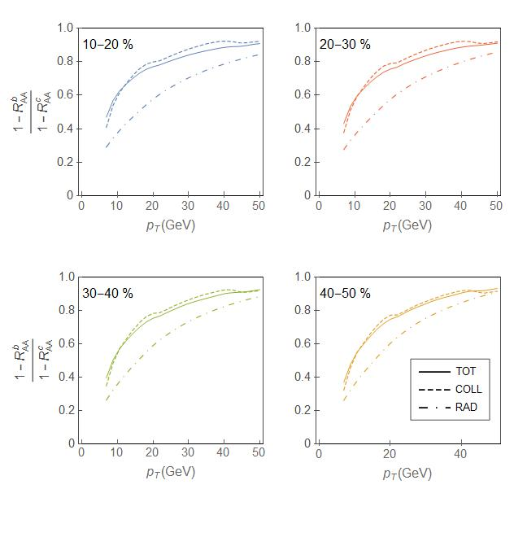
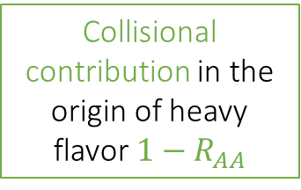
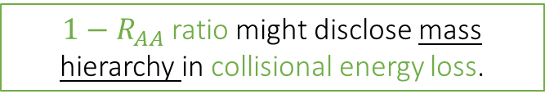
Search for an observable
Collisional contribution in the origin of heavy
flavor $1−R_{AA}$
Unexpectedly: For all centralities
TOT and COLL ratios
nearly overlapping!
$1−R_{AA}$ ratio might disclose mass hierarchy in collisional energy loss.

Slide 13
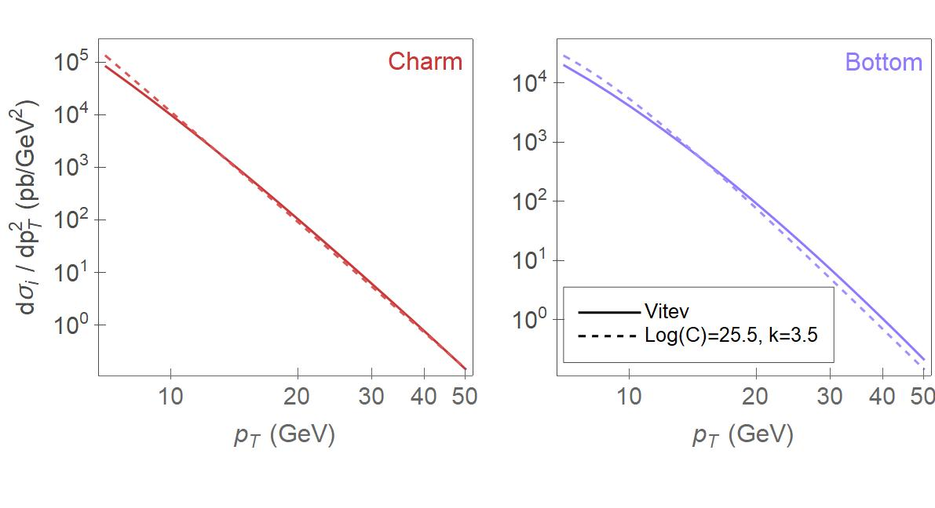
Analytical derivation: Which information does the new observable carry?
Convolution of initial parton p_{T} distribution and collisional energy loss:
JHEP 09, 033; PRC 72, 014905
Initial distribution parameterization:
The same C and k for bottom and charm.
PRC 71, 064904
PLB 718, 482; PRC 80, 054902

Slide 14

Analytical derivation: Which information does the new observable carry?
Suppression:
PRC 71, 064904
Carries information about mass hierarchy in collisional energy loss!
Collisional energy loss:
Mass dependence of collisional energy loss:
NPB 351 (3), 491
Mass dependence of $1−R_{AA}$ ratio:
New observable
Dominant terms

Slide 15
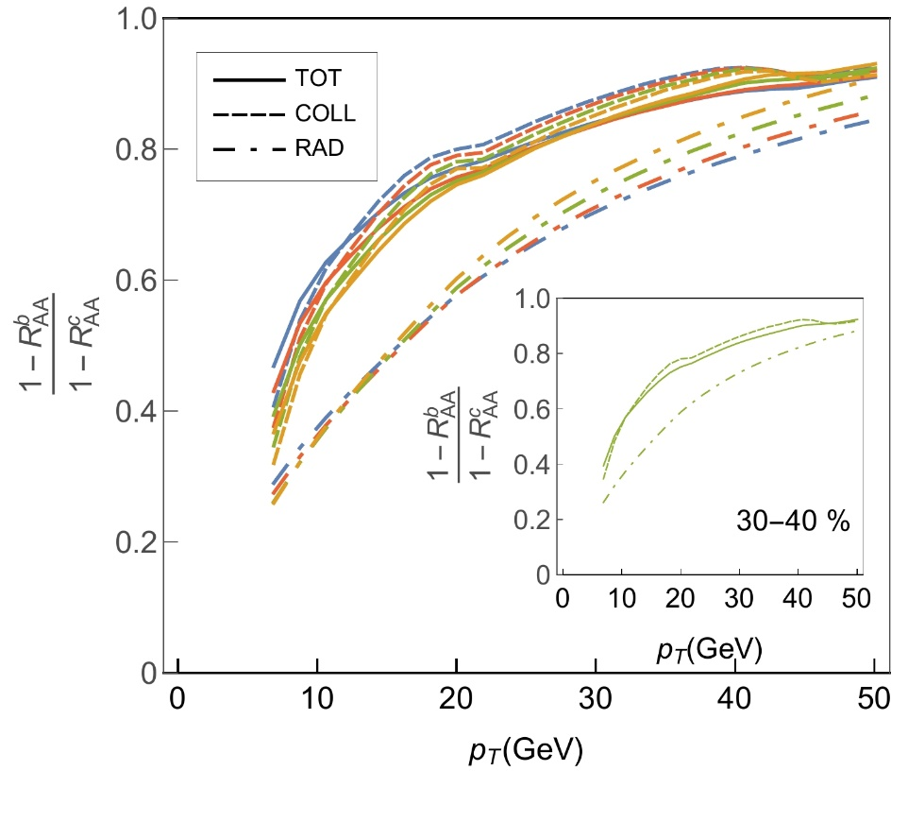
The new observable $\frac{1−R_{AA}^{b}}{1−R_{AA}^{c}}$
Unexpectedly simple relation:
It is independent of:
The collision centrality
The collision system (size)
The collision energy
The new observable - applicable to both the RHIC and the LHC experiments.
B. Ilic and M. Djordjevic, PRC 106, 014902

Slide 16
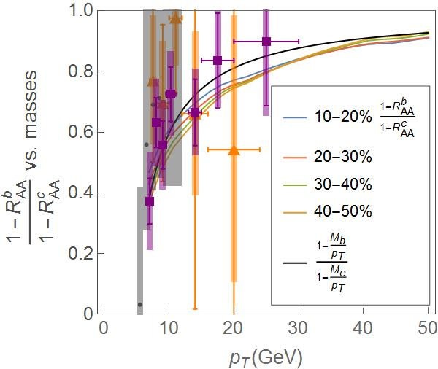
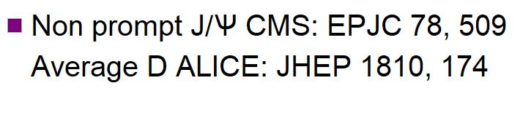
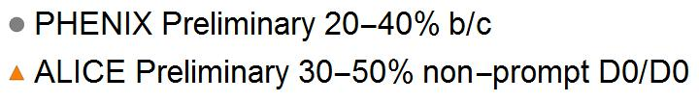
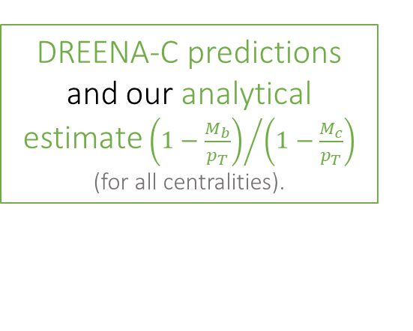
Testing the adequacy of new observable $\frac{1−R_{AA}^{b}}{1−R_{AA}^{c}}$
A good agreement between:
Data and our predictions (qualitatively and quantitatively)
Confirms adequacy of DREENA-C.
DREENA-C predictions and our analytical estimate${\left(1−\frac{M_{b}}{p_{T}}\right)}/{\left(1−\frac{M_{c}}{p_{T}}\right)}$
(for all centralities).
Implies validity of our analysis.
Data and our analytical mass estimate.
Supports adequacy of proposed observable.
Non-prompt J/ψ CMS: EPJC 78,509
Average D ALICE: JHEP 1810,174
NEW
PHENIX (arXiv:2203.17058) 20-40% b/c
ALICE Preliminary 30-50% non-prompt D0/D0
B. Ilic and M. Djordjevic, PRC 106, 014902

Slide 17
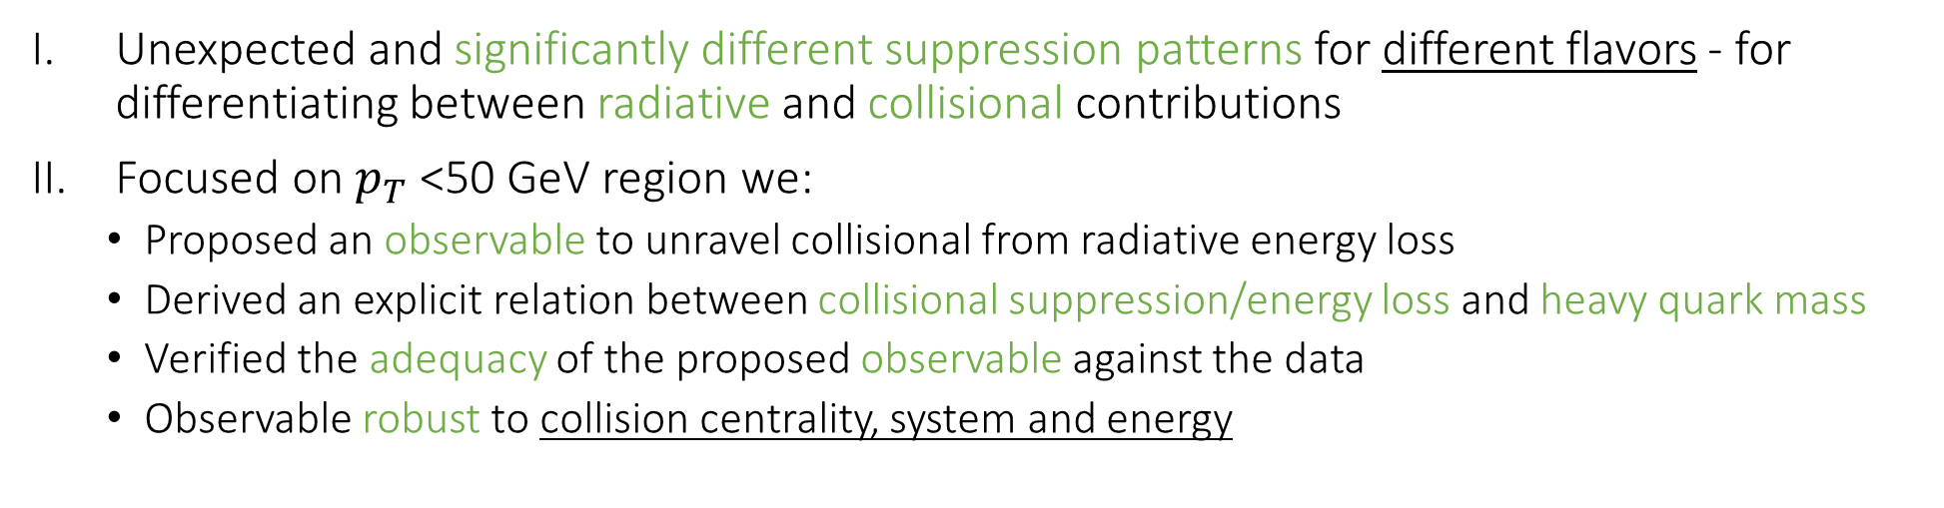
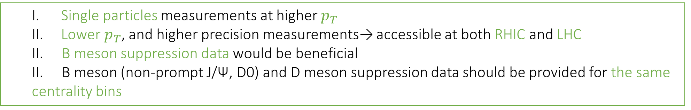
Summary
Unexpected and significantly different suppression patterns for different flavors - for differentiating between radiative and collisional contributions
Focused on $p_{T}$<50 GeV region we:
  Proposed an observable to unravel collisional from radiative energy loss
  Derived an explicit relation between collisional suppression/energy loss and heavy quark mass
  Verified the adequacy of the proposed observable against the data
  Observable robust to collision centrality, system and energy
Outlook: Specific guidelines for future experimental efforts
  Single particles measurements at higher $p_{T}$
  Lower $p_{T}$, and higher precision measurements→ accessible at both RHIC and LHC
  II. B meson suppression data would be beneficial
  II. B meson (non-prompt J/Ѱ, D0) and D meson suppression data should be provided for the same centrality bins
M. Djordjevic, PLB 763, 439

Slide 18


Thank you for your attention!
Acknowledgments:

Slide 19
Backup

Slide 20
DREENA-C: Numerical framework
Heavy flavor production
Z.B. Kang, I. Vitev, H. Xing, PLB 718, 482; R. Sharma, I. Vitev, and B. W. Zhang, PRC 80, 054902
Dynamical energy loss in a finite size QCD medium
M. Djordjevic and M. Djordjevic, PLB 734, 286
Multi-gluon fluctuations
M. Gyulassy, P. Levai, I. Vitev, PLB 538, 282
S. Wicks, W. Horowitz, M. Djordjevic, M. Gyulassy, NPA 784, 426
Path-length fluctuations
A. Dainese, EPJ C33, 495; S. Wicks, W. Horowitz, M. Djordjevic and M. Gyulassy, NPA 784, 426; D. Zigic, I. Salom, J. Auvinen, M. Djordjevic and M. Djordjevic, JPG 46, 085101

Slide 21
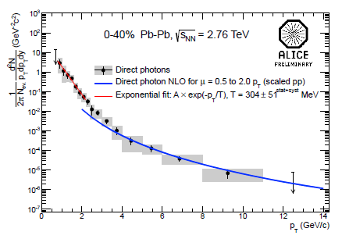




ALICE: NPA 904-905 573c
For each centrality region.
~
M. Gyulassy, P. Levai and I. Vitev, NPB 594 371
M. Djordjevic, M. Djordjevic and B. Blagojevic, PLB 737, 298
measured

Slide 22
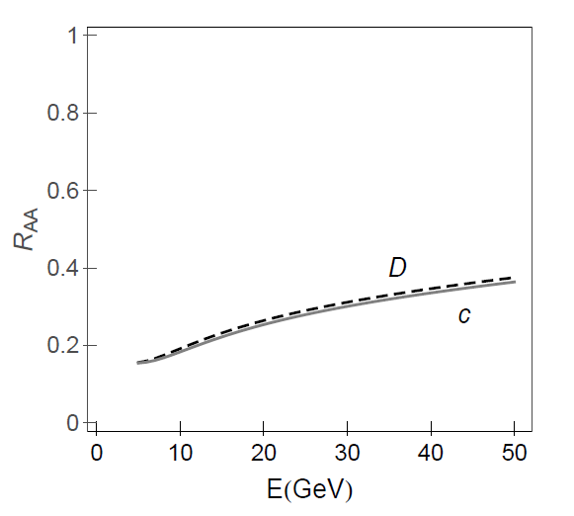
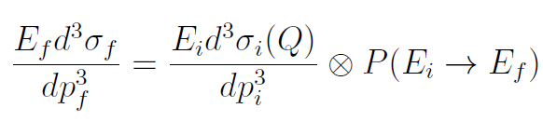
PRL 112, no.4, 042302 (2014)
  D and B mesons (non-prompt J/Ѱ….) R_{AA} present genuine charm and bottom probe’s suppression.
M. Djordjevic, M. Gyulassy, R. Vogt and S. Wicks, Phys. Lett. B 632, 81-86 (2006)
M. Djordjevic, Phys. Rev. Lett. 112, no.4, 042302 (2014)
M. Djordjevic, Phys. Lett. B 763, 439-444 (2016)

Slide 23
