Slide 1




Measuring Time-Like Compton Scattering at the EIC with Detector 1 and at JLAB with CLAS12
Kayleigh Gates
University of Glasgow, Scotland
Kayleigh Gates
University of Glasgow
27/08/2021

Slide 2
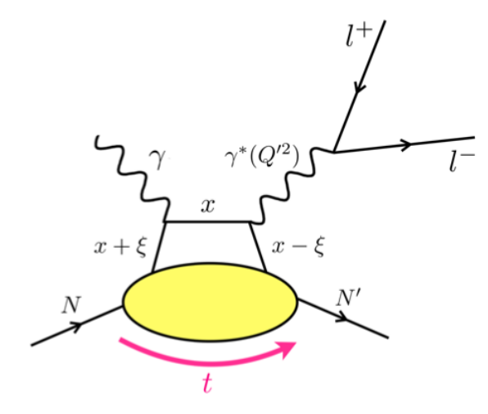
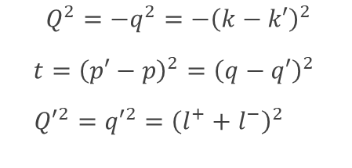
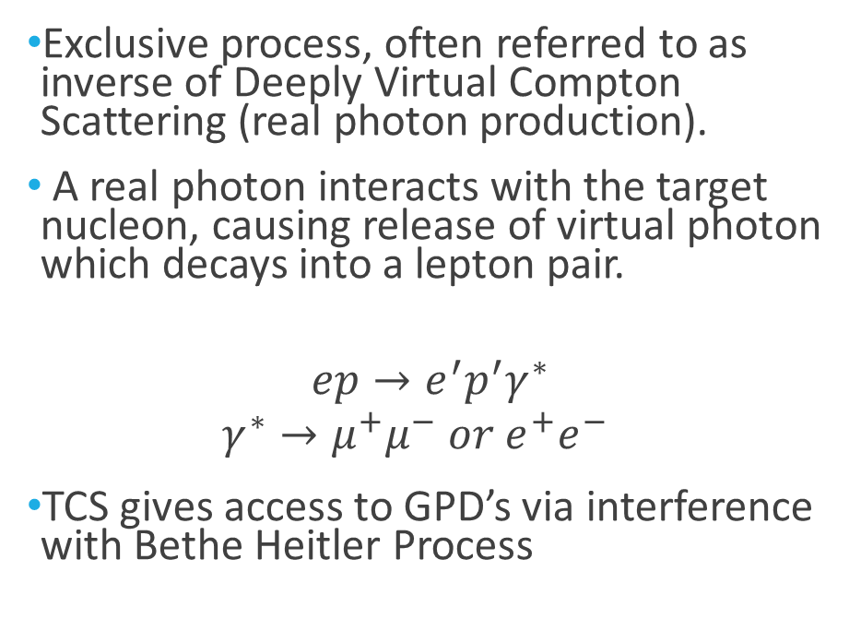
Time-Like Compton Scattering (TCS)
Exclusive process, often referred to as inverse of Deeply Virtual Compton Scattering (real photon production).
A real photon interacts with the target nucleon, causing release of virtual photon which decays into a lepton pair.
$$ep→e^{′}p^{′}γ^{∗}$$
  $$γ^{∗}→μ^{+}μ^{−} or e^{+}e^{−}$$
TCS gives access to GPD’s via interference with Bethe Heitler Process
[1]
$Q^{2}=−q^{2}=−{\left(k−k′\right)}^{2}$
$t={\left(p′−p\right)}^{2}={\left(q−q′\right)}^{2}$
${Q′}^{2}={q′}^{2}={\left(l^{+}+l^{−}\right)}^{2}$
[1] Science Requirements and Detector Concepts for the Electron-Ion Collider: EIC Yellow Report e-Print: 2103.05419 [physics.ins-det]
[2] Horn, T., Y. Illieva, F. J. Klein, P. Nadel-Turonski, R. Paremuzyan, and S. Stepanyan. 2011, AIP Conference Proceedings. Vol. 1374. Virginia. https://doi.org/10.1063/1.3647199

Slide 3
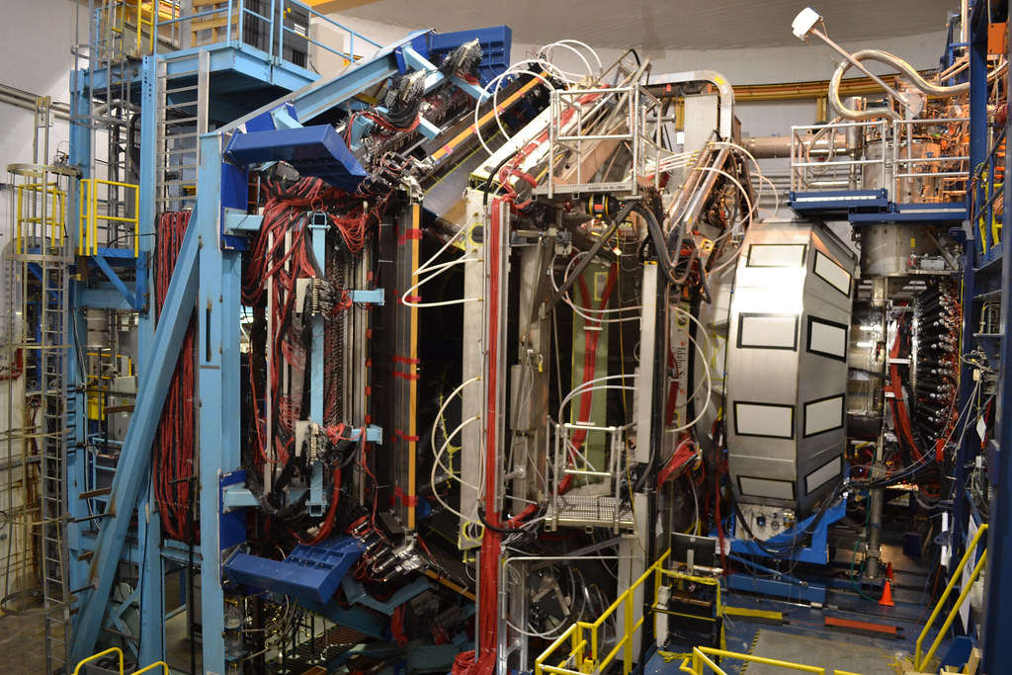
CLAS12 Detector – Jefferson Lab
2π azimuthal angular coverage
Polar angle θ coverage 35◦ − 125◦ provided by the central solenoid magnet and detector
Forward polar angle range > 35◦ provided by a forward superconducting torus magnet and forward detector.
Coverage allows for efficient detection of both charged and neutral particles.

Slide 4
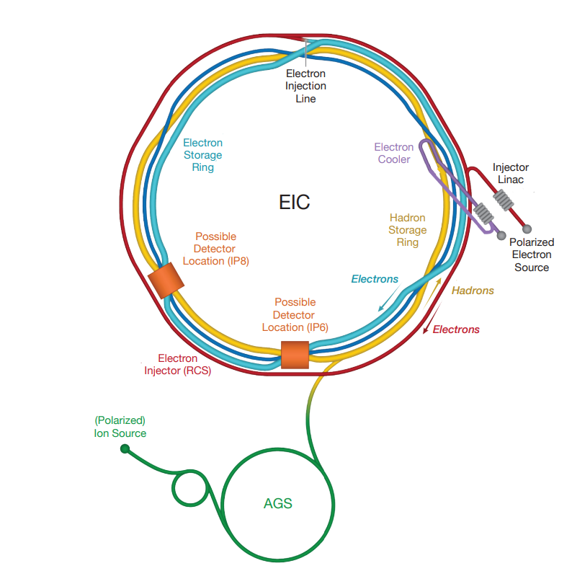
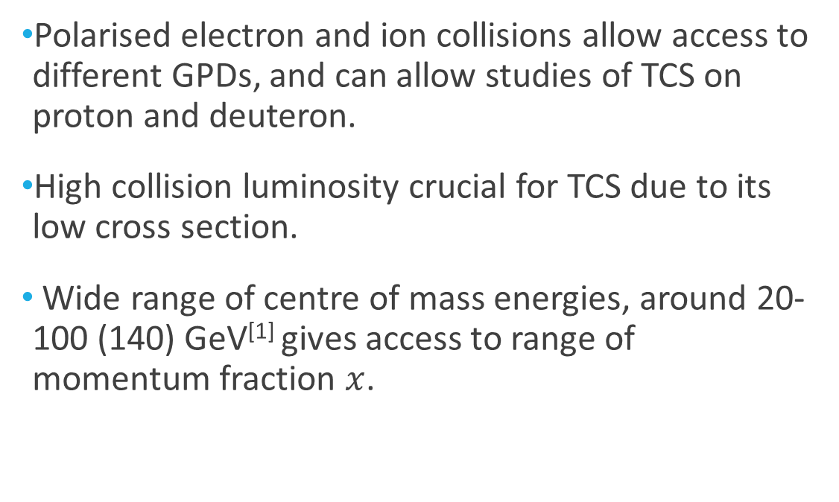
The Electron Ion Collider
[3]
Polarised electron and ion collisions allow access to different GPDs, and can allow studies of TCS on proton and deuteron.
High collision luminosity crucial for TCS due to its low cross section.
Wide range of centre of mass energies, around 20-100 (140) GeV^{[1]} gives access to range of momentum fraction $x$.
[1] Science Requirements and Detector Concepts for the Electron-Ion Collider: EIC Yellow Report e-Print: 2103.05419 [physics.ins-det]
[3] Newsroom Media & Communications Office. (2020). U.S. Department of Energy Selects Brookhaven National Laboratory to Host Major New Nuclear Physics Facility. Available: https://www.bnl.gov/newsroom/news.php?a=116996. Last accessed 15/04/2022.
Notes:
The Electron-Ion Collider (EIC) was approved in December 2019 to be built on the Brookhaven National Laboratory site which presently houses the Relativistic Heavy Ion Collider (RHIC).
one way to study nucleon structure is deeply virtual exclusive processes

Slide 5
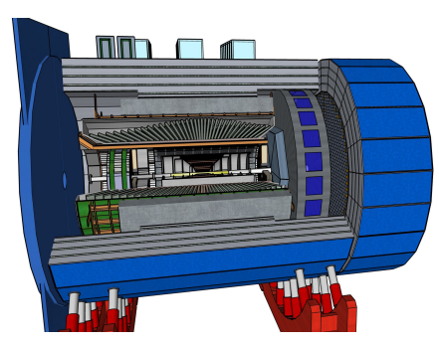
EPIC Detector
Repurposed BaBar superconducting solenoid providing 1.4T field
Hermetic detector necessary for exclusive reconstruction
Many detectors integrated in the beam line, e.g Roman Pots (RP), B0, Zero-Degree Calorimeter (ZDC)
[4]
[4] Tanja Horn CUA/JLab. ECCE Detector. Available: https://indico.bnl.gov/event/13614/contributions/58010/attachments/38779/64096/ECCE_Detector-nb.pdf.

Slide 6
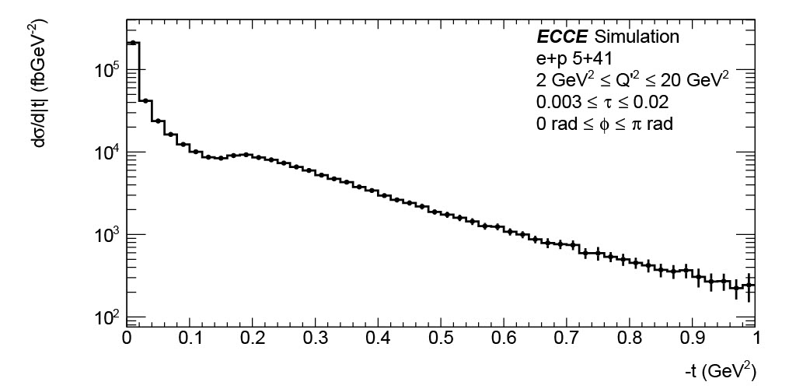
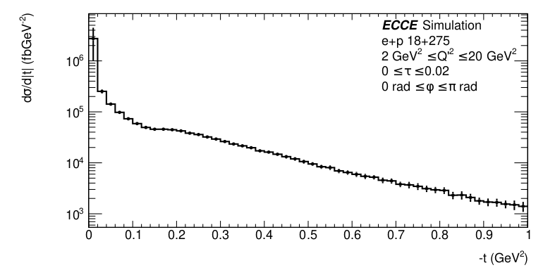
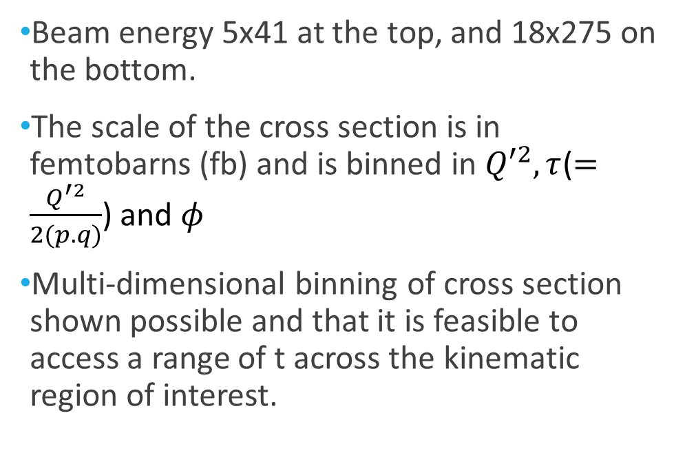

Preliminary $t$Cross Section
Beam energy 5x41 at the top, and 18x275 on the bottom.
The scale of the cross section is in femtobarns (fb) and is binned in ${Q′}^{2}, τ$($=\frac{Q^{′2}}{2(p.q)}$) and $φ$
Multi-dimensional binning of cross section shown possible and that it is feasible to access a range of t across the kinematic region of interest.

Slide 7

Thank you!
Please feel free to come and find me for questions, and go ahead and check out my poster!

Slide 8
References
TCS:
Time - like Compton scattering: Exclusive photoproduction of lepton pairs, Edgar R. Berger(Ecole Polytechnique)M. Diehl(DESY)B. Pire(Ecole Polytechnique)(Oct, 2001) Published in: Eur.Phys.J.C 23 (2002) 675-689, e-Print: hep-ph/0110062 [hep-ph]
Pierre Chatagnon. Nucleon Structure studies with CLAS12 at Jefferson Lab: Timelike Compton Scattering
and the Central Neutron Detector. PhD thesis, Paris-Saclay, Orsay, France, October 2020.
Horn, T., Y. Illieva, F. J. Klein, P. Nadel-Turonski, R. Paremuzyan, and S. Stepanyan. 2011. “Timelike Compton Scattering.” AIP Conference Proceedings. Vol. 1374. Virginia. https://doi.org/10.1063/1.3647199
Yellow Report:
Science Requirements and Detector Concepts for the Electron-Ion Collider: EIC Yellow Report: R. Abdul Khalek(Vrije U., Amsterdam and Nikhef, Amsterdam), A. Accardi(Hampton U. and Jefferson Lab), J. Adam(Brookhaven), D. Adamiak(Ohio State U.), W. Akers(Jefferson Lab)et al.(Mar 8, 2021) e-Print: 2103.05419 [physics.ins-det]
EpIC:
B. Berthou et al., PARTONS: PARtonic Tomography Of Nucleon Software: A computing platform for the phenomenology of Generalized Parton Distributions,
Eur. Phys. J. C78 (2018), 478, DOI: 10.1140/epjc/s10052-018-5948-0
Aschenauer, E.C., Batozskaya, V., Fazio, S., Gates, K., Moutarde, H., Sokhan, D., Spiesberger, H., Sznajder, P. and Tezgin, K., 2022. EpIC: novel Monte Carlo generator for exclusive processes. arXiv preprint arXiv:2205.01762.
ECCE:
C Pinkenburg. Fun4all - the eic software group website. URL:https://eic.github.953io/software/fun4all.html
Newsroom Media & Communications Office. (2020). U.S. Department of Energy Selects Brookhaven National Laboratory to Host Major New Nuclear Physics Facility. Available: https://www.bnl.gov/newsroom/news.php?a=116996. Last accessed 15/04/2022.
Tanja Horn CUA/JLab. ECCE Detector. Available: https://indico.bnl.gov/event/13614/contributions/58010/attachments/38779/64096/ECCE_Detector-nb.pdf.

