Slide 1
AWAKE at CLEAR
CLEAR Review, 16 March 2021
Edda Gschwendtner, CERN, with input from D. Cooke, S. Doebert, S. Mazzoni, J. Pucek

Slide 2
Outline
AWAKE Run 2
AWAKE at CLEAR
  Beam Diagnostics
  Plasma Source
  Electron Source

Slide 3

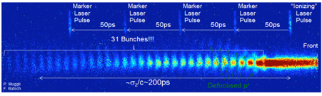
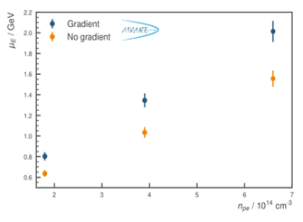
AWAKE at CERN
Advanced WAKEfield Experiment
Proof-of-Principle Accelerator R&D experiment at CERN to study proton driven plasma wakefield acceleration.
Collaboration of 22 institutes world-wide
Approved in August 2013
AWAKE Run 1 (2016-2018):
1st milestone: Demonstrate seeded self-modulation of the proton bunch in plasma (2016/17)
2nd milestone: Demonstrate electron acceleration in plasma wakefield driven by a self-modulated proton bunch. (2018)
AWAKE Collaboration, Phys. Rev. Lett. 122, 054802 (2019).
M. Turner et al. (AWAKE Collaboration), ‘Phys. Rev. Lett. 122, 054801 (2019).
M. Turner, P. Muggli et al. (AWAKE Collaboration), Phys. Rev. Accel. Beams 23, 081302 (2020)
F. Braunmueller, T. Nechaeva et al. (AWAKE Collaboration), Phys. Rev. Lett. July 30 (2020).
A.A. Gorn, M. Turner et al. (AWAKE Collaboration), Plasma Phys. Control Fusion, Vol. 62, Nr 12 (2020).
F. Batsch, P. Muggli et al. (AWAKE Collaboration), PRL (2021).
AWAKE Collaboration, Nature 561, 363–367 (2018)
AWAKE Run 2 (starting 2021 - 2028):
Accelerate an electron beam to high energies (gradient of 0.5-1GV/m) while preserving the electron beam quality and demonstrate scalable plasma source technology.
After 2028: First application of the AWAKE-like technology:
Once AWAKE Run 2 demonstrated: fixed target experiments for e.g. dark photon search.

Slide 4
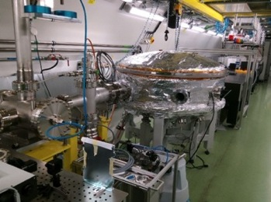
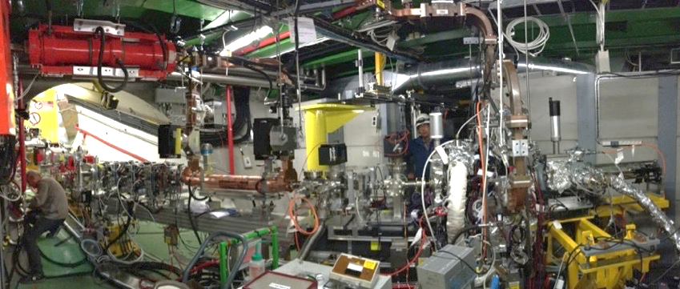
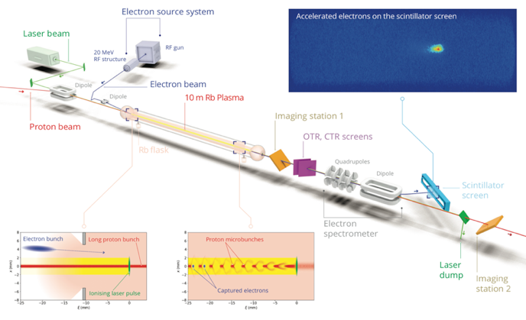
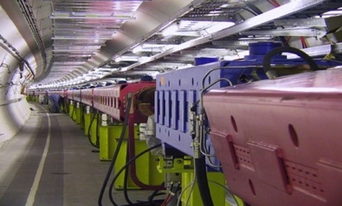
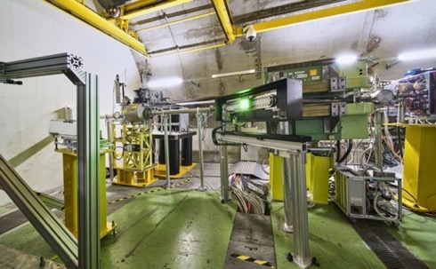
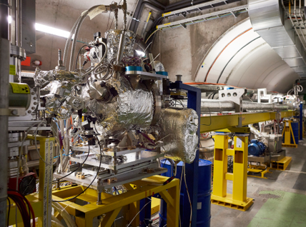
Key Ingredients of AWAKE
Laser line
Transfer line
Diagnostics and booster structure
Electron source
500mJ
120fs
20 MeV
4x10⁹ e
2ps
Laser, compressor in laser room
400 GeV
3x10¹¹ p
400ps
Diagnostics
750m proton beam line
10m Plasma cell in AWAKE tunnel

Slide 5
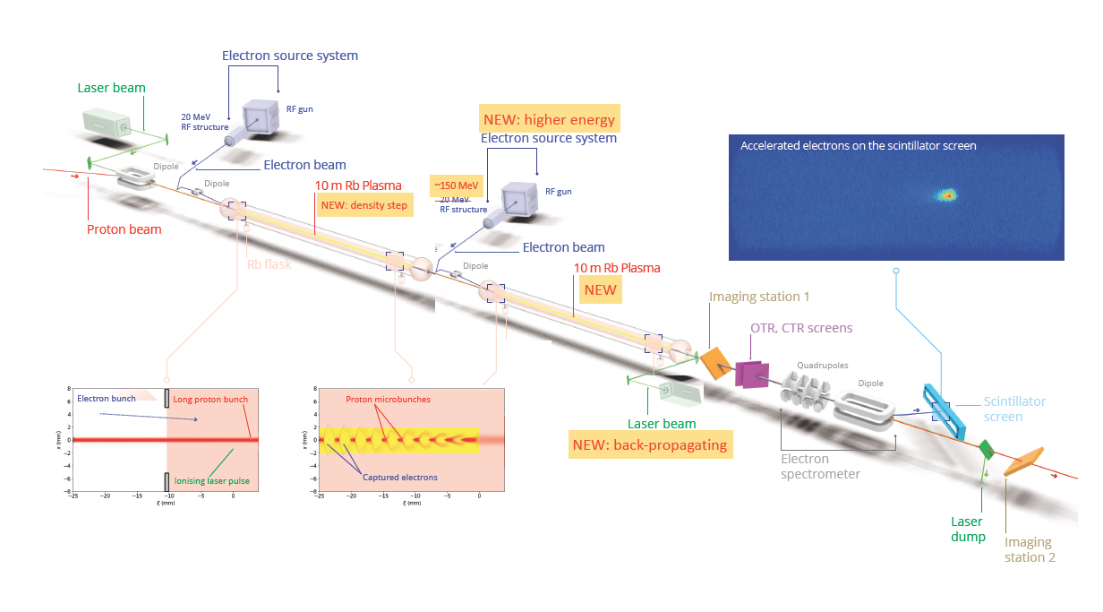



AWAKE Run 2
Demonstrate possibility to use AWAKE scheme for high energy physics applications in mid-term future!
Start 2021!
1st plasma cell: self-modulator
2nd plasma cell: accelerator
Goals:
Accelerate an electron beam to high energy (gradient of 0.5-1GV/m)
Preserve electron beam quality as well as possible (emittance preservation at 10 mm mrad level)
Demonstrate scalable plasma source technology (e.g. helicon prototype)

Slide 6
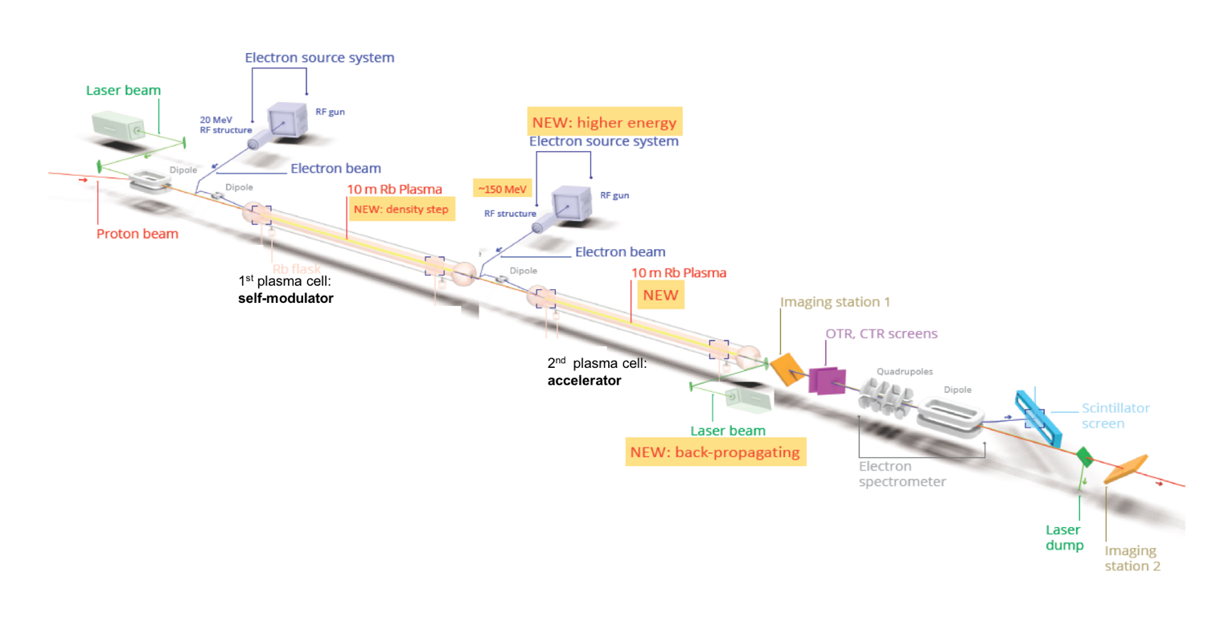
Run 2a: Demonstrate Electron Seeding of Self-Modulation in First Plasma Cell
Electron bunch seeding:
→ Modulates entire proton bunch with phase reproducibility
→ Run 2a: use the existing AWAKE Facility
→ Physics program in ~2021/2022

Slide 7
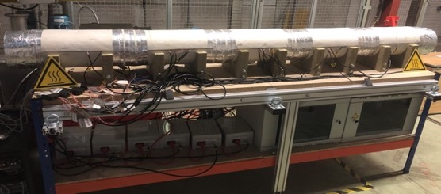
Run 2b: Demonstrate Stabilization of Micro-Bunches with a Density Step
In constant plasma, wakefield amplitude decreases after saturation.
In a plasma with density step within the SM grow: wakefield amplitude maintains larger after saturation.
Installation:
new plasma source with density step capability
novel plasma diagnostics to allow measurement of plasma ‘wave’ directly
Zone 1
Zone 2
Zone 3
Zone 4
Zone 5
THz diagnostics
Plasma source prototype with density step
→ Run 2b: use the existing AWAKE Facility
P. Muggli, J.Pucek, MPP & WDL, UK
→ Physics program in ~2023/2024

Slide 8
Run 2c: Demonstrate Electron Acceleration and Emittance Preservation
CNGS target area during installation
1st plasma cell: self-modulator
2nd plasma cell: accelerator
  New electron source and beam line
  New plasma cell (ACC cell)
  New laser to 2nd plasma cell
  New diagnostics
  Expand the experimental area (CNGS dismantling)

Slide 9




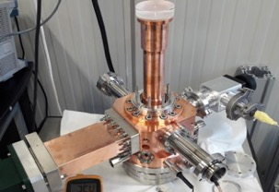
Run 2c: Demonstrate Electron Acceleration and Emittance Preservation
Accelerate an electron beam to high energy (gradient of 0.5-1GV/m)
Preserve electron beam quality as well as possible (emittance preservation at 10 mm mrad level)
  Need to work in blow-out regime and do beam-loading
  New electron beam:150 MeV, 200 fs, 100 pC, σ = 5.75 µm
1st plasma cell: self-modulator
2nd plasma cell: accelerator
CNGS target area during installation
E-gun assembly at INFN
CNGS target area during installation
Area extension and installation: 2025/26
Physics program: 2026/27/…
New electron line

Slide 10
AWAKE Run 2 Timeline
First applications to HEP beam dump experiments
  Demonstrate electron seeding of self-modulation in first plasma cell
  Demonstrate the stabilization of the micro-bunches with a density step
  Demonstrate electron acceleration to high energies and emittance preservation
  Demonstrate scalable plasma sources
➔ first applications to beam dump experiments (e.g. dark photon search) with ~50 GeV electron beam.

Slide 11
Outline
AWAKE Run 2
AWAKE at CLEAR
  Beam Diagnostics
  Diagnostics in Plasma Source
  Electron Source

Slide 12

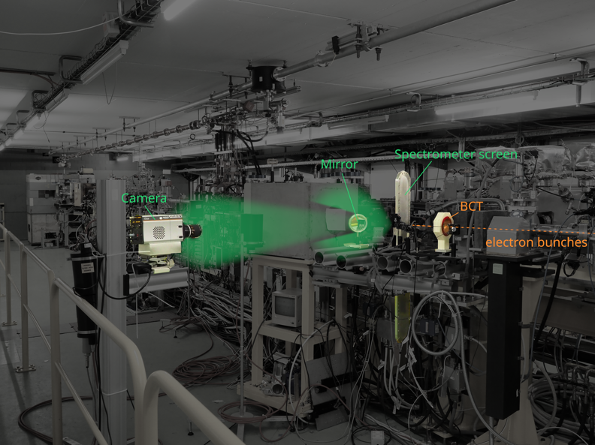
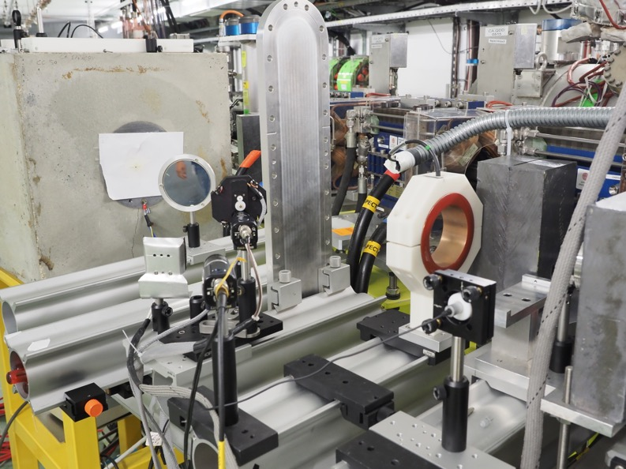
AWAKE Spectrometer Calibration
Charge calibration measurements of the AWAKE spectrometer scintillating screen/camera combination performed in 2017, 2018, 2019
  2017: test for scintillating screen uniformity using motorized translation stage
  2018: repeat charge calibration and study of scintillator decay time
  2019: repeat charge calibration after AWAKE Run 2, and study scintillator light curves/early time behaviour. →Also performed verification, after factor-of-ten error in CLIC charge reporting was discovered [C. Lindstrøm et al., Erratum: Emittance Preservation in an Aberration-Free Active Plasma Lens, PRL 121, 194801 (2018)]
Layout 2019

Slide 13
AWAKE Spectrometer Calibration
Charge calibration allow an absolute scale to be applied to AWAKE charge capture
  included in the Nature publication of the first report of electron acceleratin in a proton-driven plasma wakfield (~1.25pC accelerated to ~800 MeV). [AWAKE Collaboration, Nature 561, 363 (2018)]
Possible plans for future studies:
  2021: Two measurements (similar to those previously described) before and after AWAKE takes proton beam. → may not be necessary if beam charge measurement becomes possible at AWAKE
  Studies of alternative screens for AWAKE Run 2 spectrometer upgrade.

Slide 14
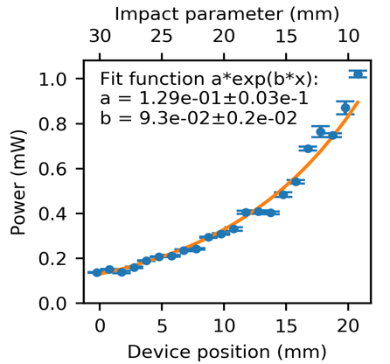
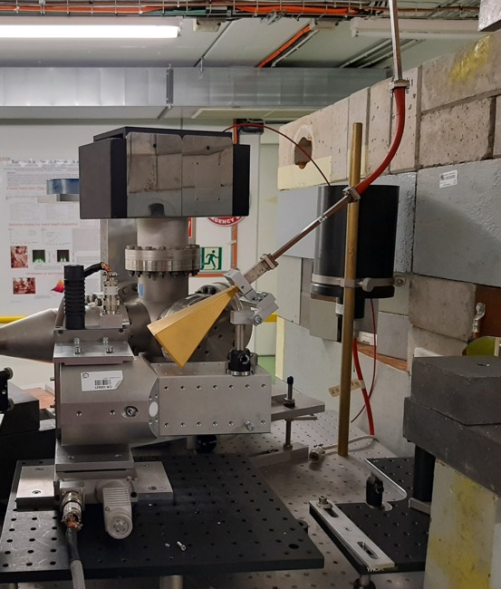
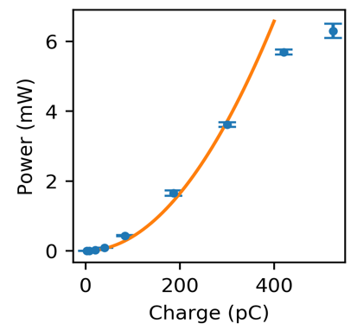
High Frequency BPM Test for AWAKE
E. Senes, M. Bergamaschi
T. Lefevre, S. Mazzoni
AWAKE needs a Beam Position Monitor (BPM) to measure the electron beam position when the intense proton beam is present.
POSITION
DEPENDENCE
Proof-of-principle demonstrated at CLEAR working at 30 GHz and based on dielectric inserts
Two experimental runs:
October-December 2019
Summer 2020
CHARGE
DEPENDENCE
BEAM
IN-AIR TEST @ CLEAR

Slide 15
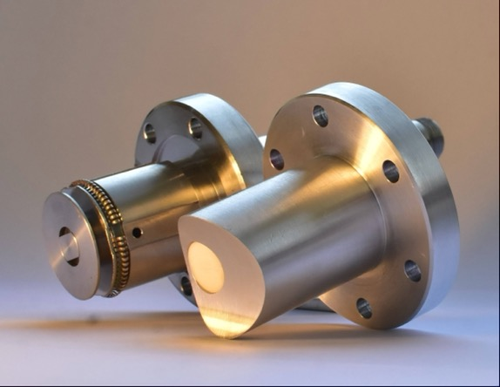
Future Tests for AWAKE BPMs
E. Senes, T. Lefevre, S. Mazzoni,
C. Pakuza, A. Schloegelhofer
Proof of principle demonstrated with PTFE inserts at CLEAR
Test of a new generation design devised to be installed in an operational accelerator
Vacuum compatible materials
Button-like design
Waveguide coupled
➔ To be installed for AWAKE Run 2a
Traditional vs. Dielectric insert button
Rich experimental program to study and develop the technology
5 - 6 weeks beam time requested for 2021
Necessary test to design the vacuum-tight version
Broadband emission studies for diagnostics application (edge effects, frequency cutoffs, RF front-end development)
In-air test at CLEAR allow
Fast prototyping
Flexible installation
Easy access
Similar beam condition
to AWAKE
IN-AIR TEST @ CLEAR

Slide 16
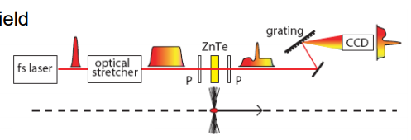
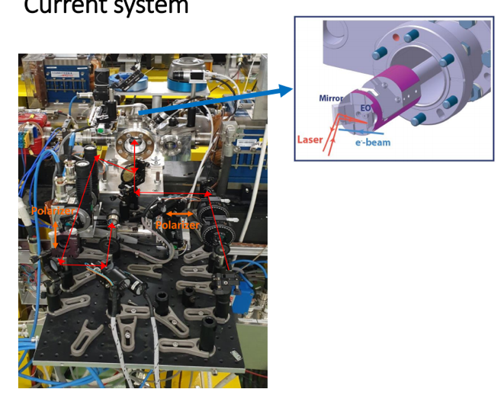
Bunch Length Monitors with EOSD
Short bunch length measurement via Electro-Optical Spectral Decomposition method.
Modulation of chirped laser pulse by EO crystal exposed to bunch electric field. Single bunch, non-invasive and high resolution
Tests in CLEAR to demonstrate sub-ps resolution, gain experience to assess utilization during AWAKE Run 2 operation.
➔ To be installed for AWAKE Run 2c
Project started summer 2019:
  First BL measurements Nov-Dec ’20 with 3 mm thick ZnTe crystal
  Present resolution around 1.2 ps. Gaining experience thanks to beam time availability
Plans for 2021:
  improve resolution to 0.2 ps (1 mm thick ZnTe already installed). Improve controls and setup (from expert to user tool)

Slide 17




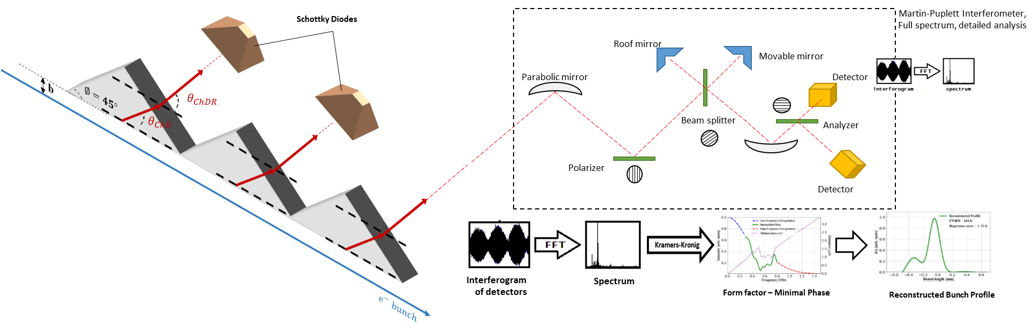
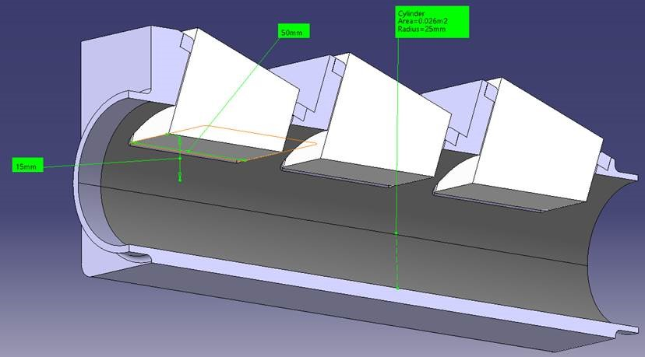
Bunch Length Monitors with ChDR
Status of the Project
Theoretical analysis of PCA to determine the most suitable Schottky diodes has been finished.
Mechanical design of the BL monitor has been discussed with the CERN Design Office. The proposed prototype is further examined with CST simulations.
Quotes to purchase 2 Schottky detectors and 4 channel detection system in GHz bandwidth will be inquired next week.
➔ To be installed for AWAKE Run 2c
Experiment and Beam Time Proposal
Test of the RMS bunch length measurement concept with 2 PTFE target in air to investigate:
  The elimination of beam position and angular jitter effects
  Dependence of ChDR spectra on impact parameters
2 sessions for the test:
  each session with 2 days for installation, 1 day for commissioning and 2 days for data collection.
Experiments can be carried out after the academic travel restrictions are lifted in the UK.

Slide 18
Outline
AWAKE Run 2
AWAKE at CLEAR
  Beam Diagnostics
  Diagnostics in Plasma Source
  Electron Source

Slide 19
Beam Screen Survival Tests in Rubidium
Motivation: Design of Vapor Source for Run 2c
J. Pucek, M. Bergamaschi, P. Muggli, E. Senes
2nd Rubidium vapor source
e⁻
p⁺
p⁺
laser
laser
e⁻ and p⁺ aligned
Electrical heater/ Heat exchanger
Potential screen position
Heat exchanger
AWAKE uses 10-meter-long vapor source, which is heated to 200°C in order to obtain nominal rubidium density.
We need to make sure that beam screens can survive this environment before installing them
  The reason for inserting screens into the vapor source: alignment of different beams at the 2nd plasma entrance (i.e., in the rubidium vapor source) is crucial for proper function of the experiment
Questions to be answered:
  Does operation at 200°C and heat cycling of the screens (OTR/YAG) affect the beam measurements
  Does the exposure of the screens to rubidium vapor affect the measurements in the short/long term

Slide 20
Tests of Beam Screens in Rb
J. Pucek, M. Bergamaschi, P. Muggli, E. Senes
2020: In CLEAR test of small vapor source system with different beam screens (OTR, YAG): at different temperatures (room and 200°C, no rubidium) to obtain reference data
Results:
YAG has higher yield when hot than when cold, OTR yields slightly less
Both screens can be used at temperatures below 230°C (no damage or other effects detected)
More analysis will be done regarding beam size measurement
Next steps: Expose screens to rubidium in EHN1 and measure again at CLEAR
Prepare DN40 valve and argon flushing system for safe operation with rubidium, Insert rubidium
Obtain safety approval for operation with Rb at CLEAR
Measure rubidium density at high temperature (no screens)
Measurements with OTR and YAG screens at CLEAR (2x day of measurements, at least 2 weeks in between + additional check later)
  The possibilities are the screens develop spots or defects which would make them useless, slow deterioration of the screen surface, nothing will change
Notes:
Recording images of electron beam passing through the screens
Measured the yield of the screens for different temperatures

Slide 21
Outline
AWAKE Run 2
AWAKE at CLEAR
  Beam Diagnostics
  Diagnostics in Plasma Source
  Electron Source

Slide 22
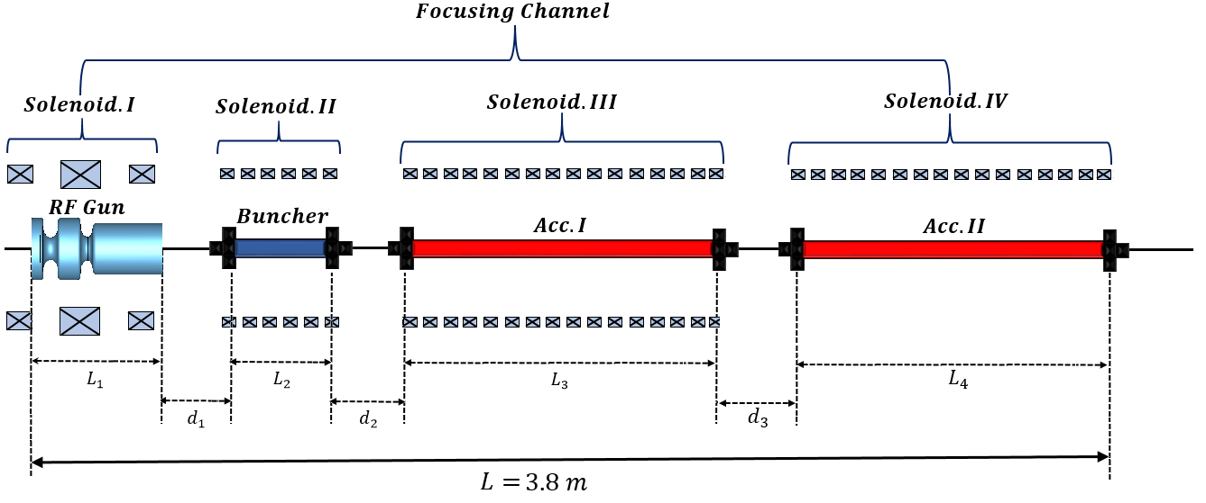
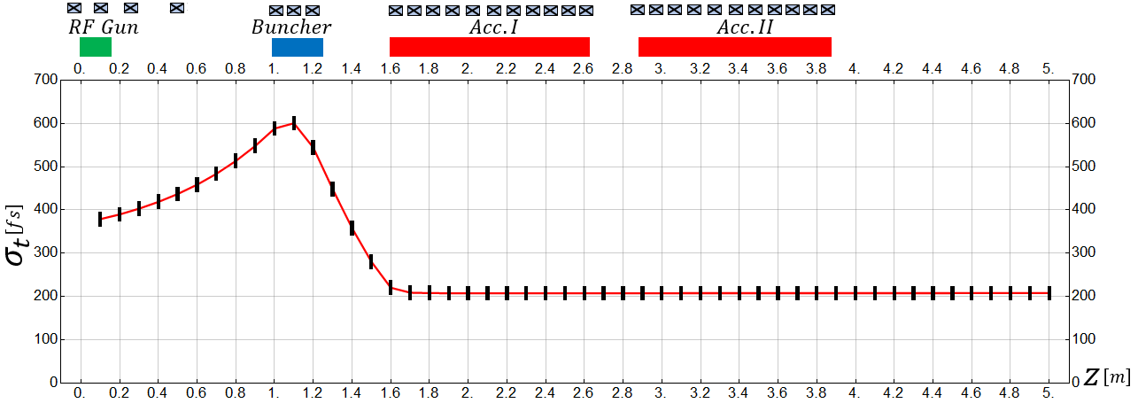
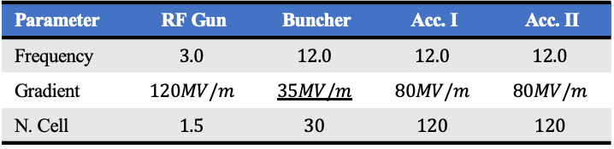
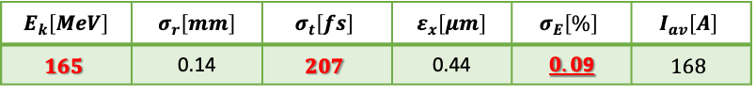
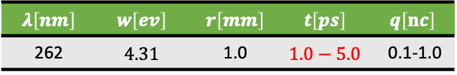
Electron Source for AWAKE Run 2
S. Doebert, L. Garolfi, M. Dayyani Kelisani, J. Arnesano
 | Beam Energy | Energy Spread | Energy stability | RMS Bunch Length | Bunch Charge | Emittance | Beam size plasma focus
Injector 1 | $$18.5 MeV$$ | $0.5 \%$ | 1 x 10⁻² | $$≈2−3 ps$$ | $$100 −600 pC$$ | 2 - 5$μm$ | $$\sim 190 µm$$
Injector 2 | $$150 MeV$$ | $0.2 \%$ | 1 x 10⁻³ ? | $$≈200−300 fs$$ | $$100 pC$$ | 2 $μm$ | $$5.75 µm$$
➔ Well advanced concept and beam dynamics design
$$E_{k}\left[MeV\right]$$ | $$σ_{r}\left[mm\right]$$ | $$σ_{t}\left[fs\right]$$ | $$ε_{x}\left[μm\right]$$ | $$σ_{E}\left[\%\right]$$ | $$I_{av}\left[A\right]$$
$$165$$ | 0.14 | $$207$$ | 0.44 | $0.0$9 | $$168$$
RF parameters
Parameter | RF Gun | Buncher | Acc. I | Acc. II
Frequency | $$3.0$$ | $$12.0$$ | $$12.0$$ | $$12.0$$
Gradient | $$120MV/m$$ | $$35MV/m$$ | $$80MV/m$$ | $$80MV/m$$
N. Cell | $$1.5$$ | $$30$$ | $$120$$ | $$120$$
Laser parameters
$$λ\left[nm\right]$$ | $$w\left[ev\right]$$ | $$r\left[mm\right]$$ | $$t\left[ps\right]$$ | $$q\left[nc\right]$$
262 | $$4.31$$ | 1.0 | $$1.0−5.0$$ | 0.1-1.0
Notes:
Based on X-band
Energy as high as affordable
Energy spread as low as possible
Energy stability as good as possible
Emittance reasonably low, no need for ultra-low

Slide 23
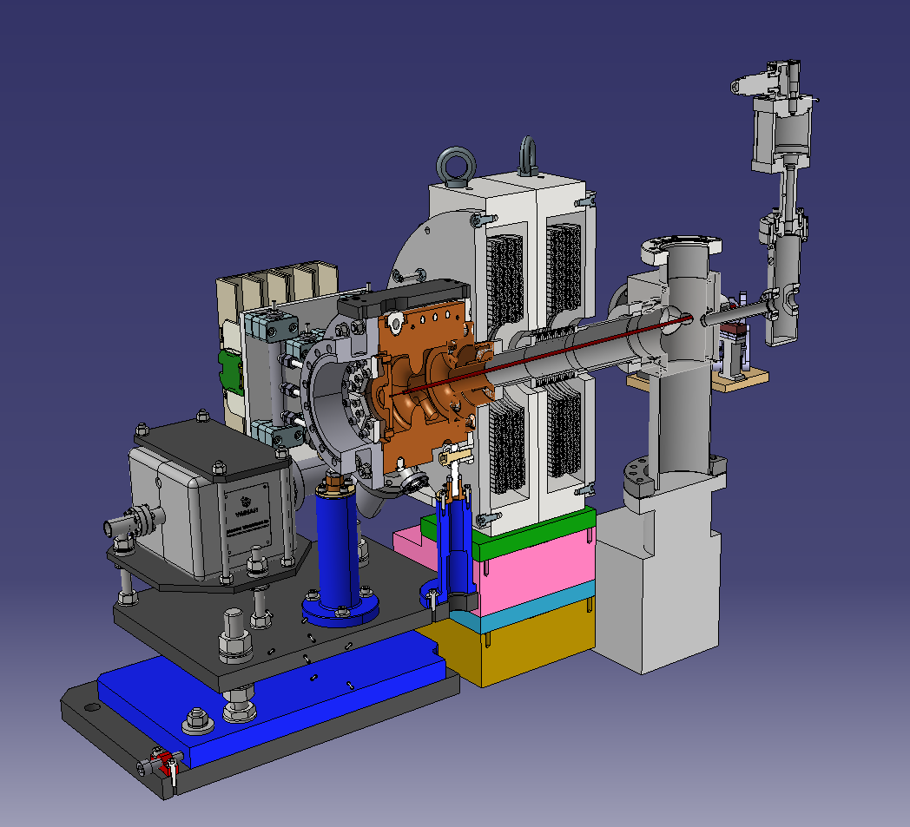
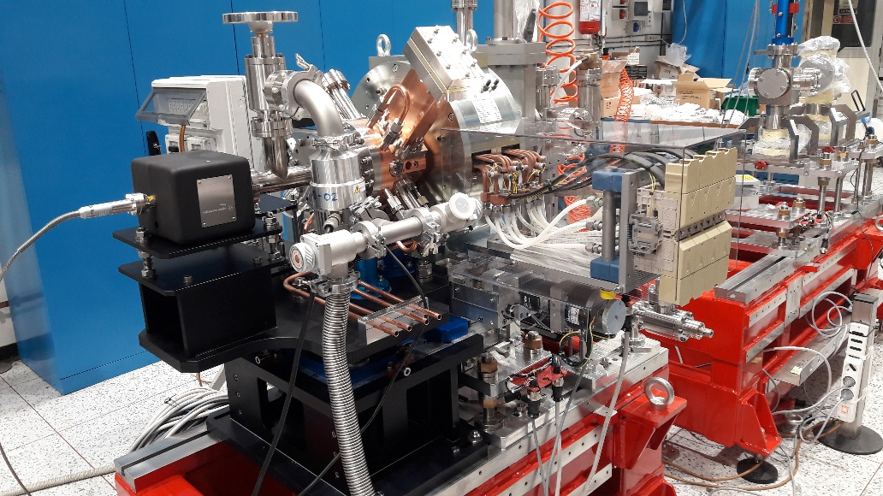
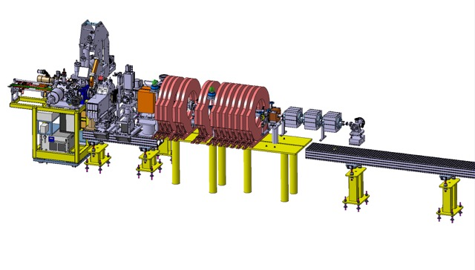
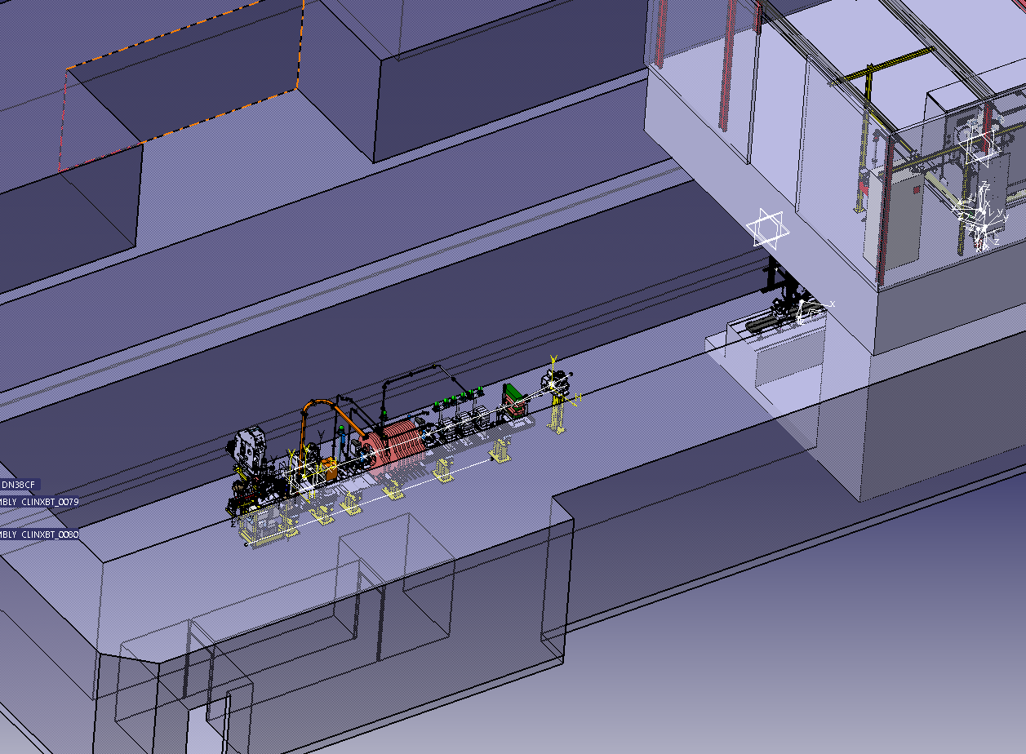
AWAKE/CLEAR Electron Injector Prototype
S. Doebert, L. Garolfi, M. Dayyani Kelisani, J. Arnesano
Injector Prototype for AWAKE Run 2c
INFN contribution to CLEAR in the framework of a CLIC collaboration agreement → great opportunity to profit from synergies with the CLIC/CLEAR team
Take advantage from existing infrastructure and hardware to add x-band structure to demonstrate velocity bunching and generation of ultra short bunches
Ideal test bed for challenging AWAKE bunch length diagnostics (emittance, short bunches, jitter)
Will allow to address challenges early on and saving money and commissioning time in tunnel
INFN Frascati RF gun setup, 120 MV/m
Gun assembly at INFN, David Alesini
Layout in CTF2
Prototype injector in CTF2:
60-70 MeV and typically 100 pC single bunch, bunch length 200-300 fs (goal), emittance ~ 1 um, Laser osc. frequency 75 MHz, rep. rate up to 3 kHz, Length: 5 m

Slide 24
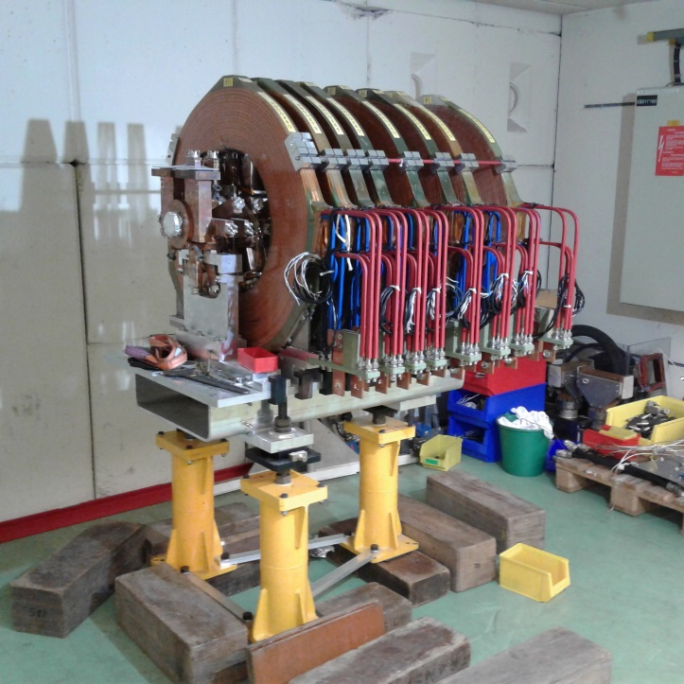
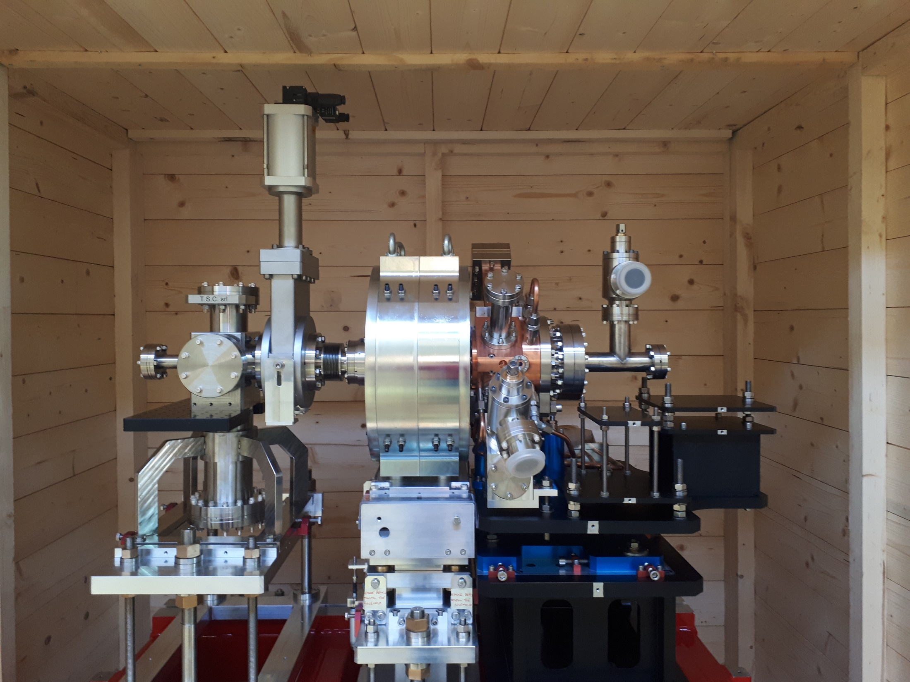
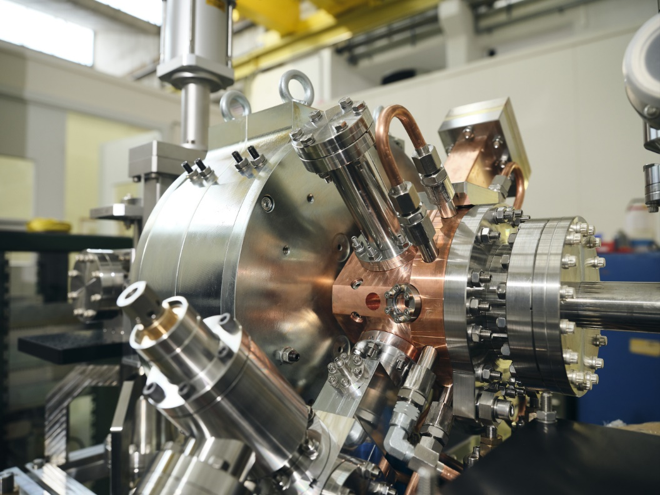
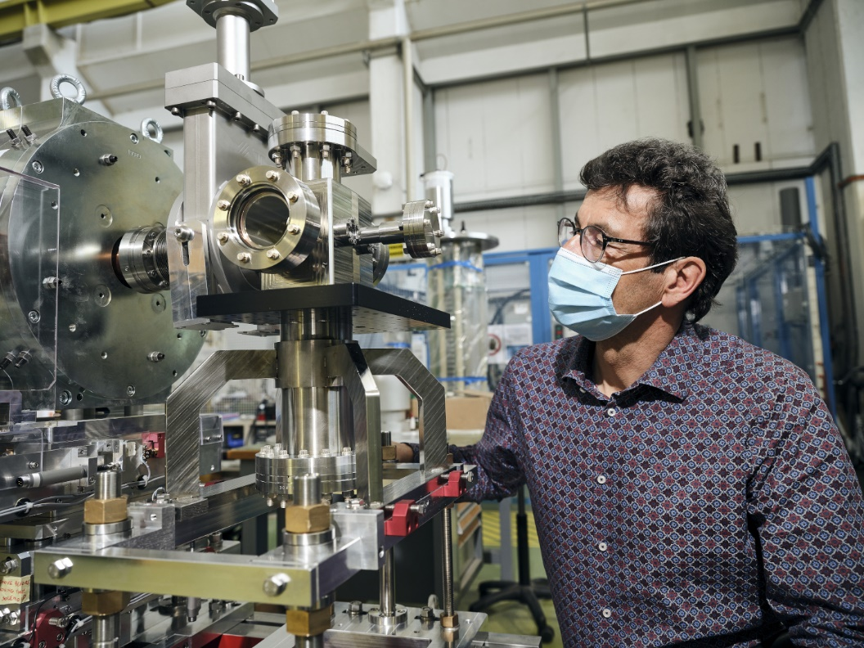
AWAKE/CLEAR Electron Injector Prototype
S. Doebert, L. Garolfi, M. Dayyani Kelisani, J. Arnesano
Goal for AWAKE/CLEAR prototype studies:
Demonstrate velocity bunching with x-band and emittance preservation/control
Show reliable high gradient x-band operation
Study mechanical/integration aspects
Test diagnostics
Optimise final design for AWAKE
Get team together, gain momentum for challenging AWAKE Run2 injector
Prototype at CERN
Recycling from CTF3, Stephane Curt
Budget considerations:
AWAKE paid for the klystron repair in 2020
CLIC for the LASER in 2020
Most design work was done with AWAKE supported resources (PJAS, FELL, Triumf institute)

Slide 25
AWAKE/CLEAR Electron Injector Prototype
Schedule Considerations:
→ Fits well to current AWAKE Run 2 and CLEAR schedule
Installation in CLEAR

Slide 26
Summary
Program of AWAKE Run 2 is well defined. Aim of AWAKE Run 2 starting 2021 after CERN’s Long Shutdown 2 is to achieve high-charge bunches of electrons accelerated to high energy, about 10 GeV, while maintaining beam quality through the plasma and showing that the process is scalable.
Physics program of AWAKE Run 2 has been recommended by the SPSC in the meeting of January 2021.
The entire AWAKE Run 2 has been staged in four phases over the next years, with the electron acceleration program starting in LS3.
  Challenging requirements on beam instrumentation, plasma source and new electron injector.
  CLEAR schedule fits well with AWAKE schedule
CLEAR has become an instrumental test bed for AWAKE!
  AWAKE Run 1: Calibration of electron spectrometer as input for Nature paper
  AWAKE Run 2:
  New design of beam diagnostics
  Key studies for plasma source design
  R&D for new electron source for AWAKE Run 2
Strong collaboration of AWAKE and CLEAR
  Similar beam conditions as AWAKE
  Flexible and easy access
  Synergy of expertise
  Sharing of equipment, facilities and budget

