Slide 1


Shaping the future of radiation oncology with CLEAR
Prof. Marie-Catherine Vozenin

Slide 2
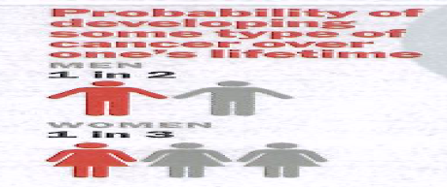
Surgery
Systemic treatments
Radiotherapy
50% of cancer patients are treated with RT
1/5 person will be treated with RT in a life-time

Slide 3
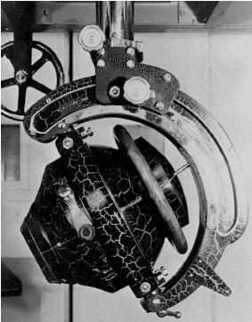
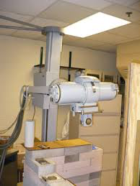
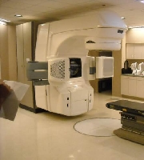
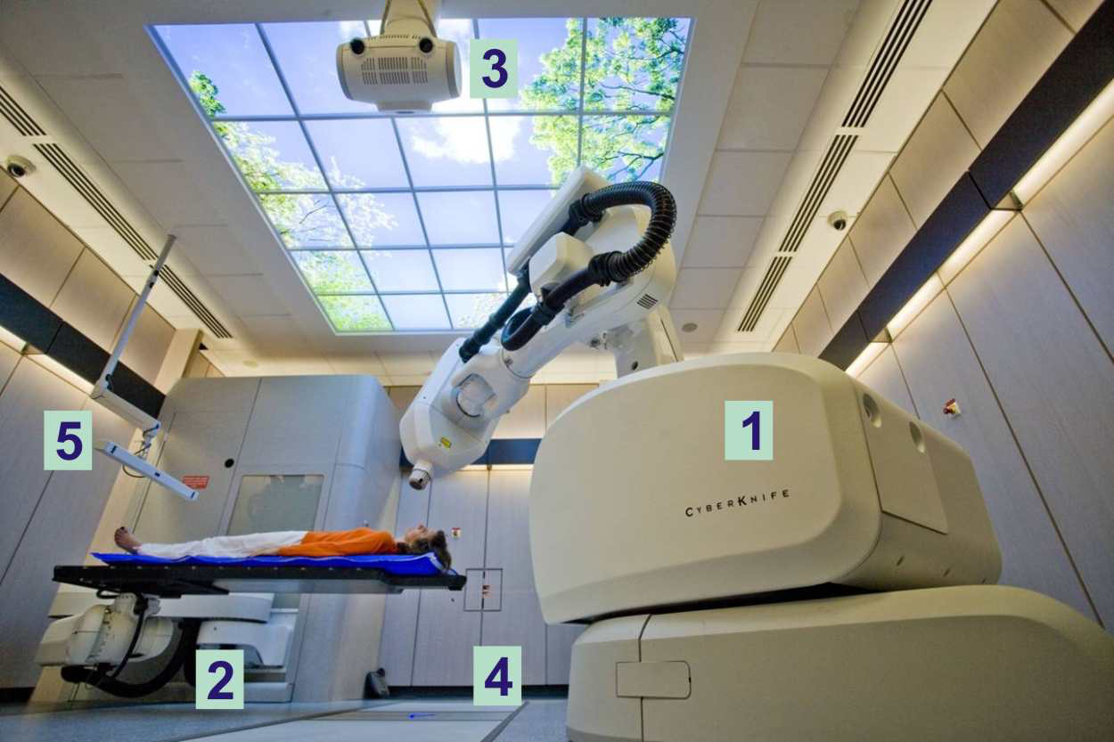
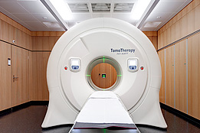
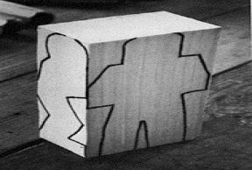
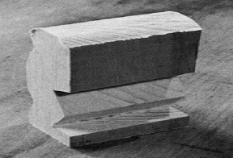
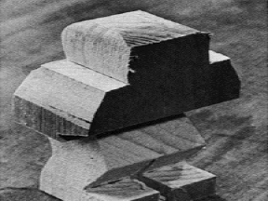
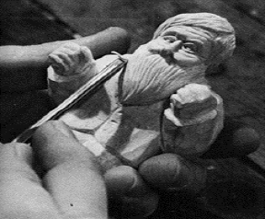
First radiotherapy: July 1896 by Victor Despeignes
Enhanced precision
1930-1970
1970-1990
1990-2000
2016
Stereo-RT
Target volume
2D planning
3D Conformal
High Precision
P. Montay-Gruel

Slide 4
Modalities of delivery are moving to hypo-fractionation
Radiotherapy technology has not really evolved in 50 years

Slide 5
Most Cancers are not cured
Local relapse
Metastasis

Slide 6


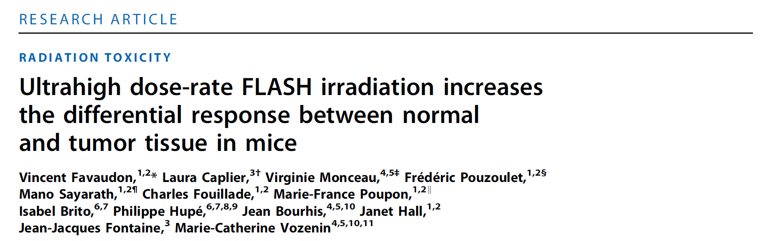
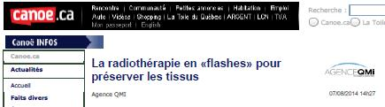
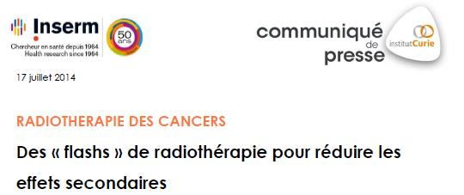
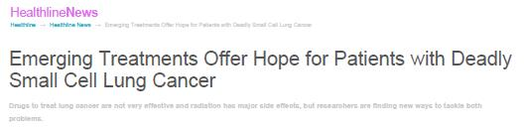
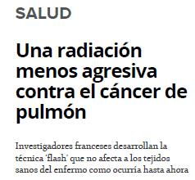

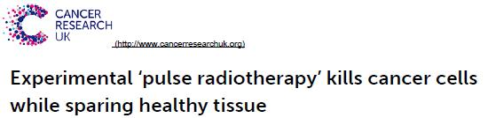
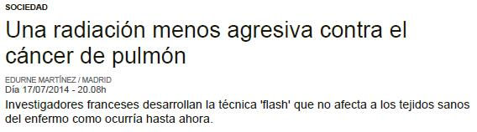
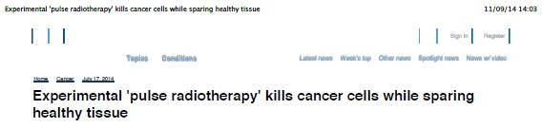
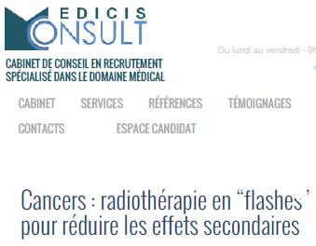
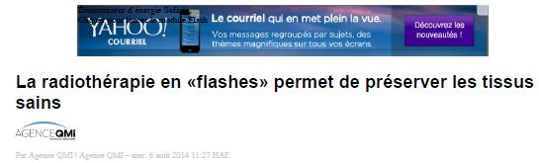
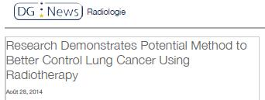
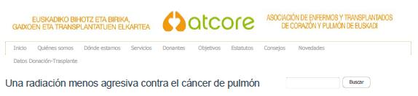
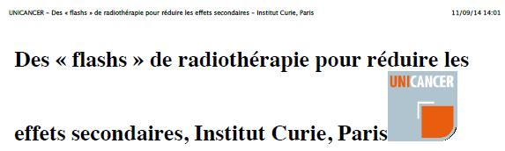
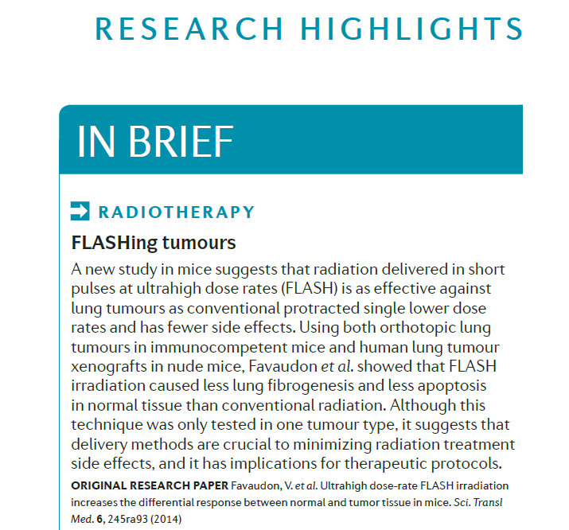
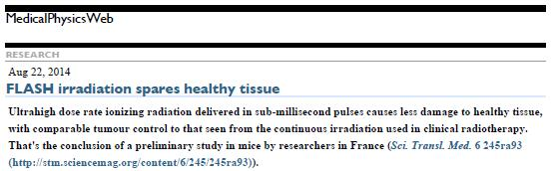

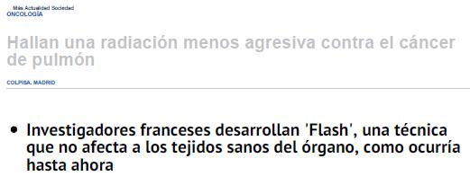
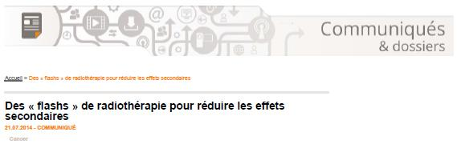

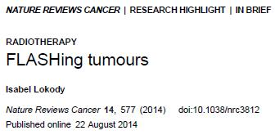
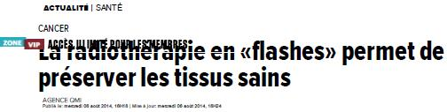
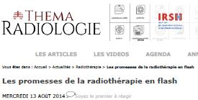
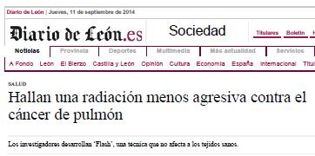
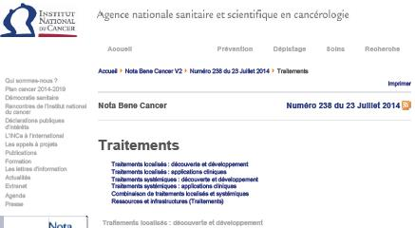

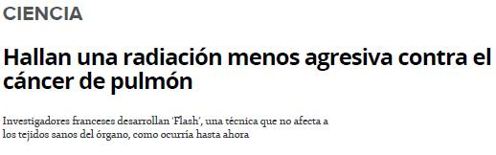
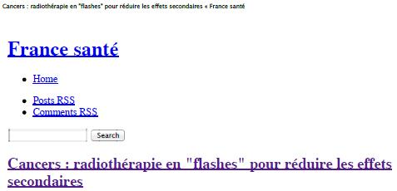

V Favaudon
2007/2008
2014

Slide 7
FLASH radiotherapy
Irradiation at ultra high dose rate
Very fast delivery of the dose
Shift from minute of exposure to milli- and even micro-second

Slide 8
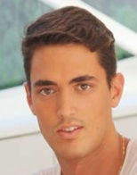
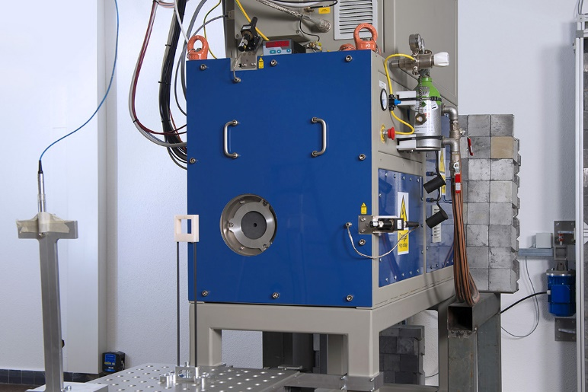
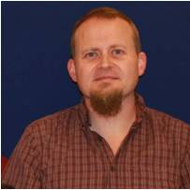
Balistic advantage of FLASH-RT
Freeze motion
Radiobiological advantage of FLASH-RT
THE FLASH EFFECT
P Montay-Gruel
eRT6 Oriatron PBM/Alcen
Electron beam, 5.5 MeV energy
Pulsed beam
C Bailat

Slide 9
THE FLASH EFFECT is
a biological effect
Normal tissue sparing
FLASH-RT does not induce Normal tissue toxicity
When CONV-RT does
And FLASH-RT is equally able to eradicate tumors compared to CONV-RT
Electron
Beyreuther et al., Radiother Oncol, 2021
Soto et al. Rad Res, 2020.
Fouillade C et al. CCR, 2019.
Simmons et al. Radiother Oncol. 2019.
Loo B et al. IJROBP, 2017, abst.
Hendry et al. Rad Res, 1982.
Proton
Cunningham et al., Cancers, 2021
Zhang et al. Rad Res, 2020.
Diffenderfer et al. IJROBP, 2020.
Girdhani et al. Can Res, 2019, abst.
Electron
Chabi et al. IJROBP2020
Montay-Gruel et al. Rad Res, 2020
Allen et al. Rad Res, 2020
Alaghban et al. Cancers, 2020
Bourhis J et al. Radiother Oncol. 2019.
Jorge PG et al. Radiother Oncol. 2019 Oct.
Montay-Gruel P et al. Proc Natl Acad Sci U S A. 2019.
Vozenin et al. Clin Can Res, 2019.
Montay-Gruel P et al. Radiother&Oncol., 2017.
Jaccard M et al. Med Phys, 2018.
Favaudon V et al. Sci Transl Med. 2014.
X-ray-synchrotron
Montay-Gruel P et al. Radiother Oncol. 2018.
Electron
Chabi et al. IJROBP, 2020.
Montay-Gruel P et al. CCR, 2020.
Bourhis J et al. Radiother Oncol. 2019.
Jorge PG et al. Radiother Oncol. 2019.
Favaudon V et al. Sci Transl Med. 2014.
Electron
Kim et al. IJROBP, 2020
Proton
Diffenderfer et al. IJROBP, 2020.
Girdhani et al. Can Res, 2019, abst.
X -ray synchrotron
Smyth et al. Sci Rep, 2018.
Proton
Beyreuther et al. Radiother Oncol. 2019.
Electron
Venkatesulu at al. Sc Rep, 2019.

Slide 10
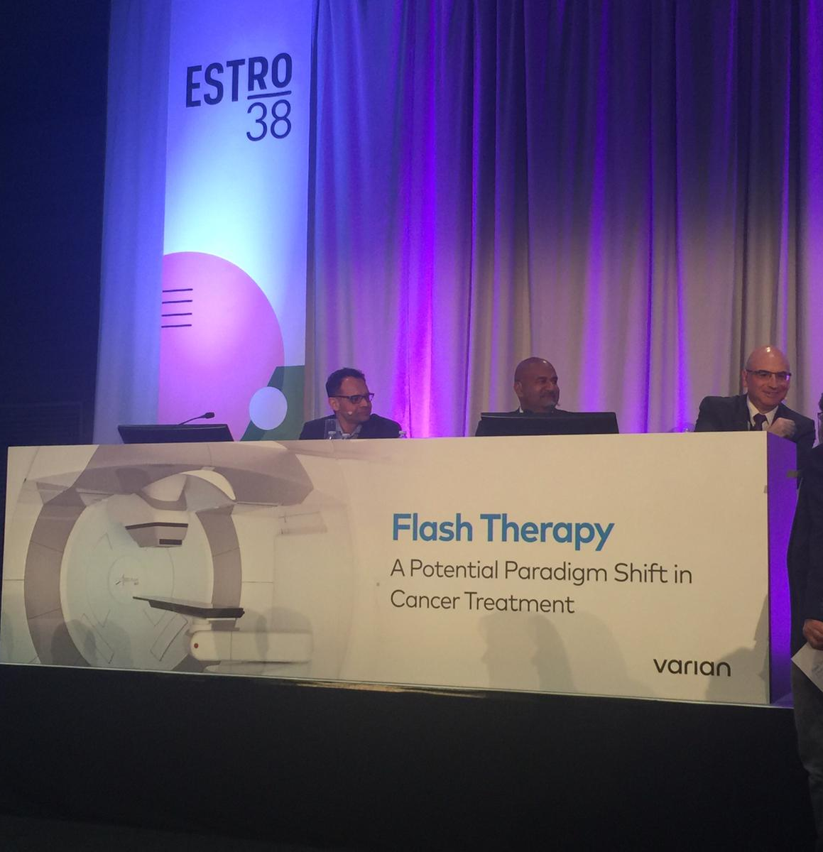

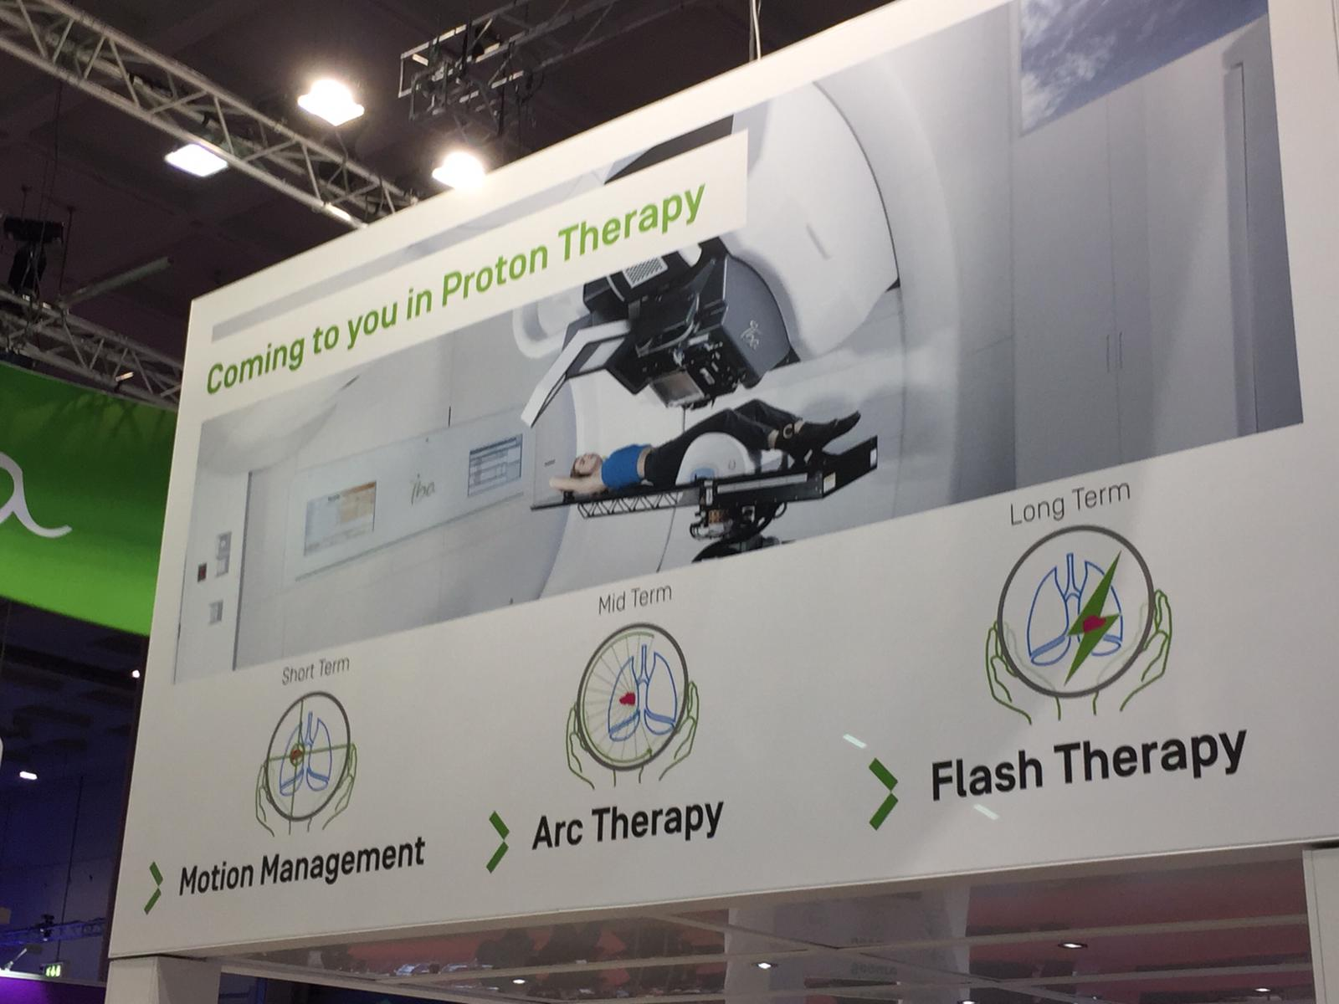
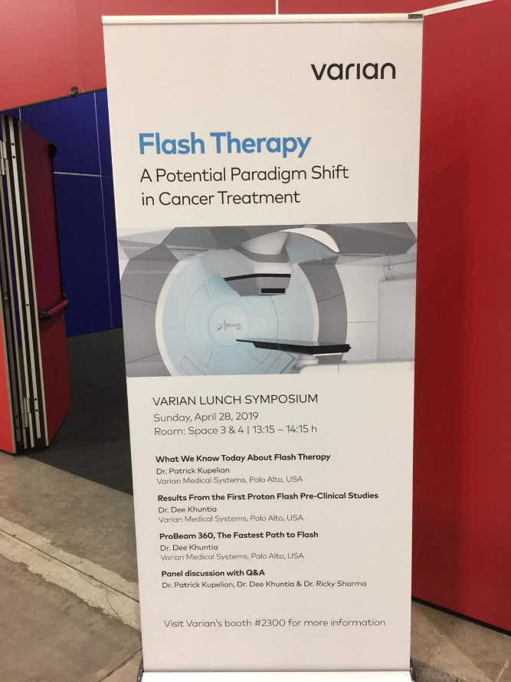



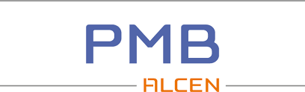
8 Mars 2019
Press Release
Flash Irradiation Delivered in a Clinical Treatment Room
Successful Flash Irradiation at Isocenter in IBA’s Proteus® Solution Gantry Room

Slide 11

J Bourhis
Varian and the Cincinnati Children's/UC Health Proton Therapy Center Announce Initial Patient Treated in the FAST-01 First Human Clinical Trial of FLASH Therapy for Cancer
Oncology
November 19, 2020
PALO ALTO, Calif., and CINCINNATI, Ohio, Nov. 19, 2020 /PRNewswire/ -- Varian (NYSE: VAR) and the Cincinnati Children's/UC Health Proton Therapy Center today announce the start of the first clinical trial of FLASH therapy as part of the recently opened FAST-01 study (FeAsibility Study of FLASH Radiotherapy for the Treatment of Symptomatic Bone Metastases). The clinical trial involves the investigational use of Varian's ProBeam® particle accelerator modified to enable radiation therapy delivery at ultra-high dose rates (dose delivered in less than 1 second) and is being conducted at the Cincinnati Children's/UC Health Proton Therapy Center with John C. Breneman M.D., Medical Director of the center, serving as principal investigator.
The first clinical trial patient was treated this week. The FAST-01 study is expected to enroll up to 10 patients with bone metastases to evaluate clinical workflow feasibility, treatment-related side effects, and efficacy of treatment as assessed by measuring pain relief of trial participants. The clinical trial, informed by years of preclinical work, was designed by experts at Varian and multiple centers in the FlashForward™ Consortium, including Cincinnati's Children's/UC Health Proton Therapy Center and the New York Proton Center.

Slide 12

JF Germond
Montay-Gruel P et al., CCR, 2020.

Slide 13

Technology
Structure pulsée d’un faisceau électron
Structure d’un faisceau proton
Structure d’un faisceau RX synchrotron
0.5-5μs
0.5-5μs
0.5-5μs
0.5-5μs
2.5-100ms
2.5-100ms
2.5-100ms
100 ms
0.8 – 30 ms
Débit de dose
Débit de dose
Débit de dose
Temps écoulé
Temps écoulé
Temps écoulé
1 – 10 pulses
Microstructure: 5000 bunches
Pulse repetition frequency 10-250Hz
1 pulse
Microstructure: 10⁷ bunches
Spot scanning (@1000Hz)
1 pulse = 1 stripe
Microstructure: 10⁷ bunches
Stripe scanning (60mm/s)
5-7mm
∼ cm
3-3.5 cm
50μm
200-400 μm

Slide 14

Time does matter
The shorter the better

Slide 15
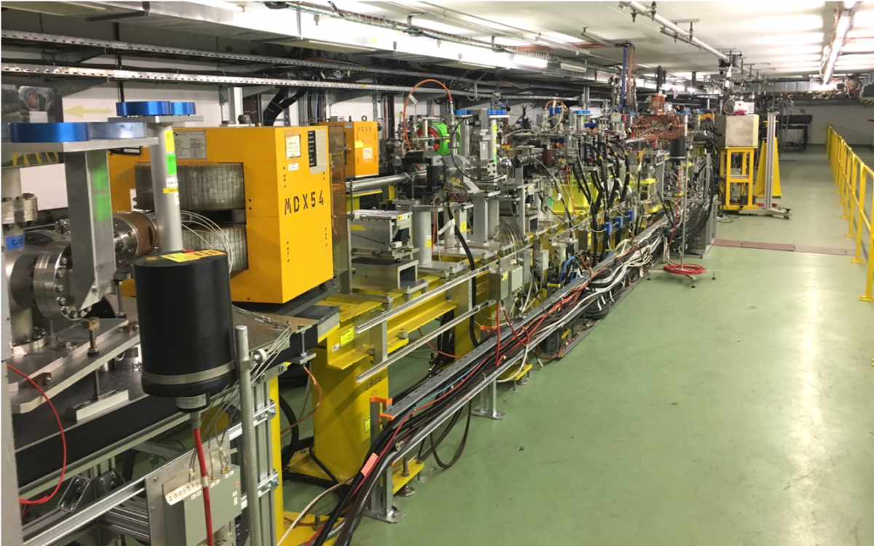
What CLEAR has
It can shorten the time of exposure like no other beam

Slide 16
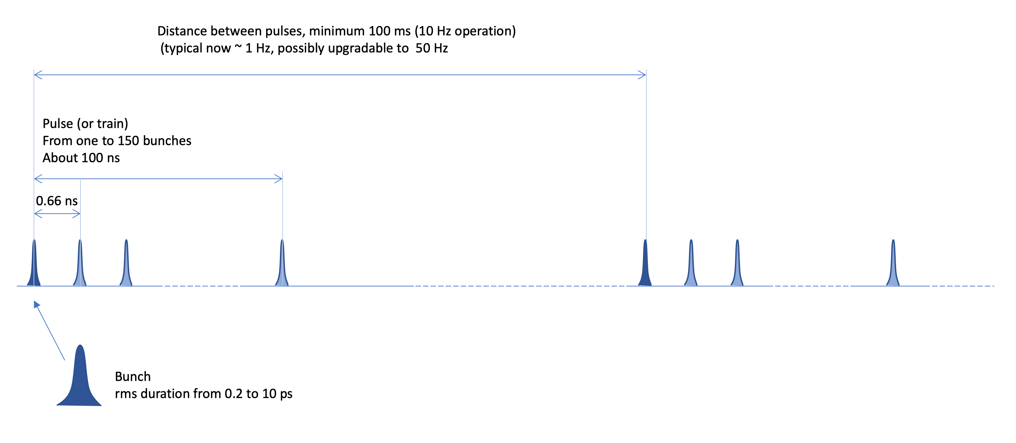
Time structure of CLEAR
Focusing and scanning

Slide 17
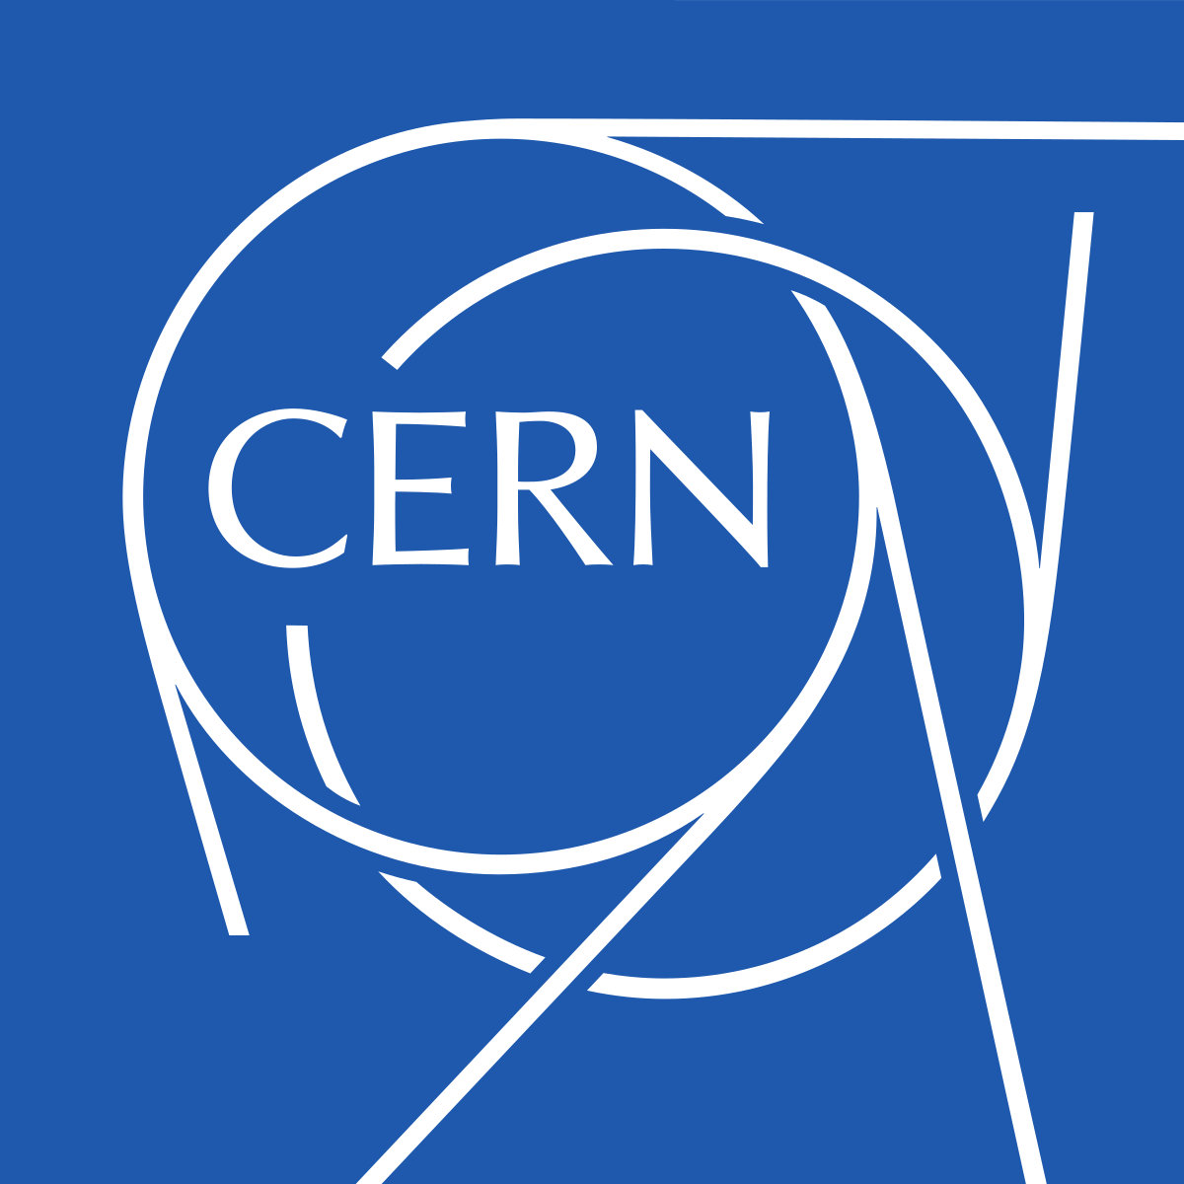
Medical applications
Accelerators
Models
Radio-Chemistry
Radio-Biology

Slide 18




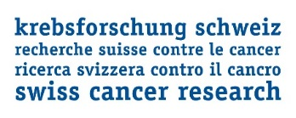


FLASH «dream» team
Biology team
P Montay-Gruel
B Petit
J Ollivier
I Petridis
R Leavitt
P Barrera
C Romero
Physics team
F Bochud
C Bailat
JF Germond
P Froidevaux
L Desorgher
P Jorge Goncalves
V Grilj
F Chappuis
D Patin
R Moeckli
T Buchillier
M Gondre
K Petersson
M Jaccard
G Boivin
H Kacem
N Cherbuin
V To
A Almeida
C Godfroid
A Martinotti
Clinical team
Radiation-Oncology
J Bourhis
W Jeanneret
M Oszahin
F Herrera
Surgery
N Demartines
D Clerc
C Simon
K Lambercy
Fond’action
FNS N°31003A_156892
FNS/ANR CR32I3L_156924
ISREC Foundation thank to Biltema donation

