Slide 1

R2E activities at CLEAR
Andrea Coronetti
With inputs from Rubén García Alía, Jean Kempf, Giuseppe Lerner, Vanessa Wyrwoll, Daniel Söderström, Florent Castellani
CLEAR Meeting – 16 Mar, 2021

Slide 2

Introduction
Electron-induced effects in electronics are not as well explored as those from ions, protons or neutrons
CLEAR facility is central to the investigation of these effects:
  Can allow exploring electron-induced single-event effects over a wider range of energy than what can be achived in medical LINACs.
  Can enable electron-induced displacement damage studies and their comparison to proton/neutron irradiations
  Quite diverse beam conditions achievable at VESPER/THz with gun dark current or laser-driven productions
  Characterization of electron-on-dump radiative field to explore further testing opportunities

Slide 3
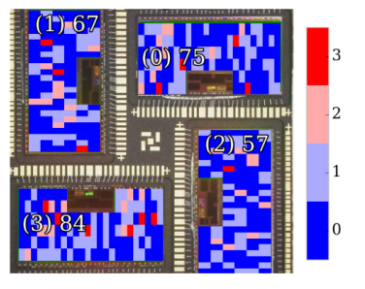
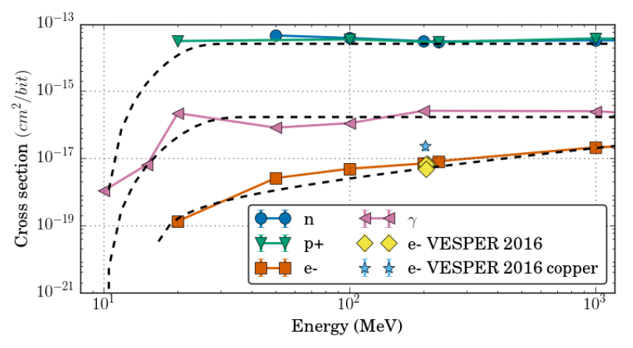
Remarkable results from the past
SEU
First electron-induced SEUs from low-energy electrons
Medical LINACs limited to 20 MeV
CLEAR enabled testing up to 220 MeV
Since then several tests:
  ESA Monitor (reference chip, 250 nm)
  More integrated technologies (Artix 28 nm)
  Tests from industrial partners (IROC and TRAD)
Interest for Jovian environment space missions (JUICE from ESA)
Main take-aways (M. Tali):
SEUs from high-energy electrons due to electro- and photo-nuclear reactions
Happening in devices with rather large critical charge
Higher HEE cross-sections wrt HEP cross-sections in more integrated technologies

Slide 4
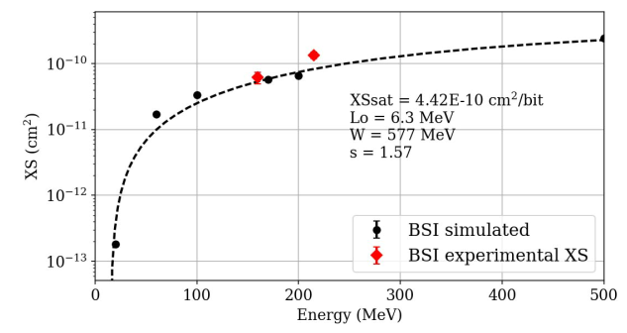
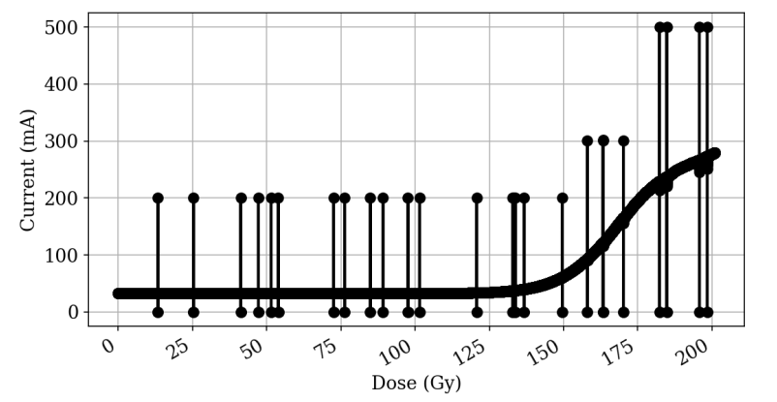
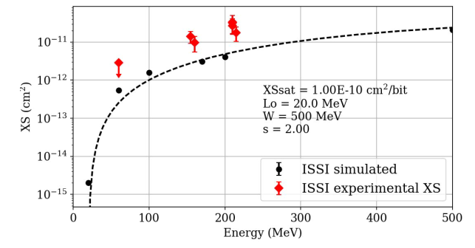
Remarkable results from the past
SEL (M. Tali)
Potentially destructive effect within a device
Typically, it requires much higher deposited charge than SEU
CLEAR enabled first ever observation and demonstration that HEE can trigger SEL in SRAM.

Slide 5
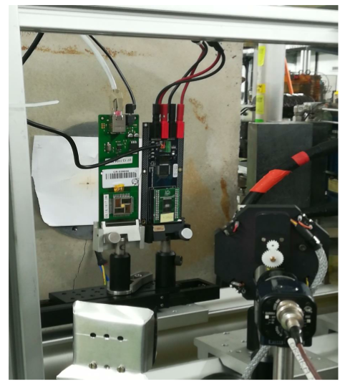
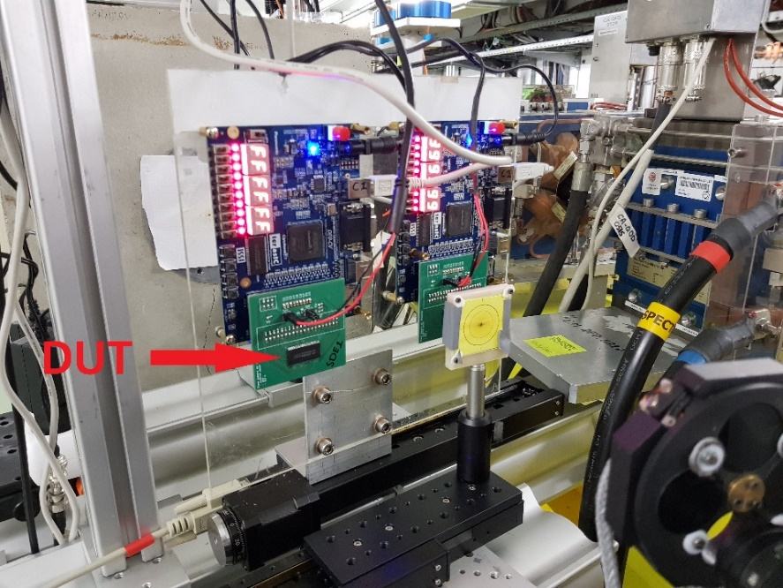
Latest R2E activities
SEE studies
Study of flash effects in SRAM (effects caused by very high pulsed fluxes)
Characterization of highly integrated SRAMs (40-90 nm) of the R2E inventory
First observations of stuck bits in DRAM
Displacement damage (and ionizing dose) studies
Determination of the electron hardness factor in silicon diodes
DD and TID Effects on CMOS image sensors
Electron-on-dump studies
Determination of the photon and HEH radiative field produced by the dump due to the impinging electron beams
Dosimetry
Liquid ion ionization chamber (not discussed here)

Slide 6
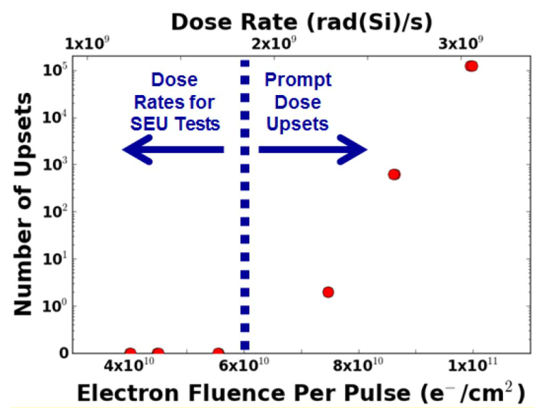
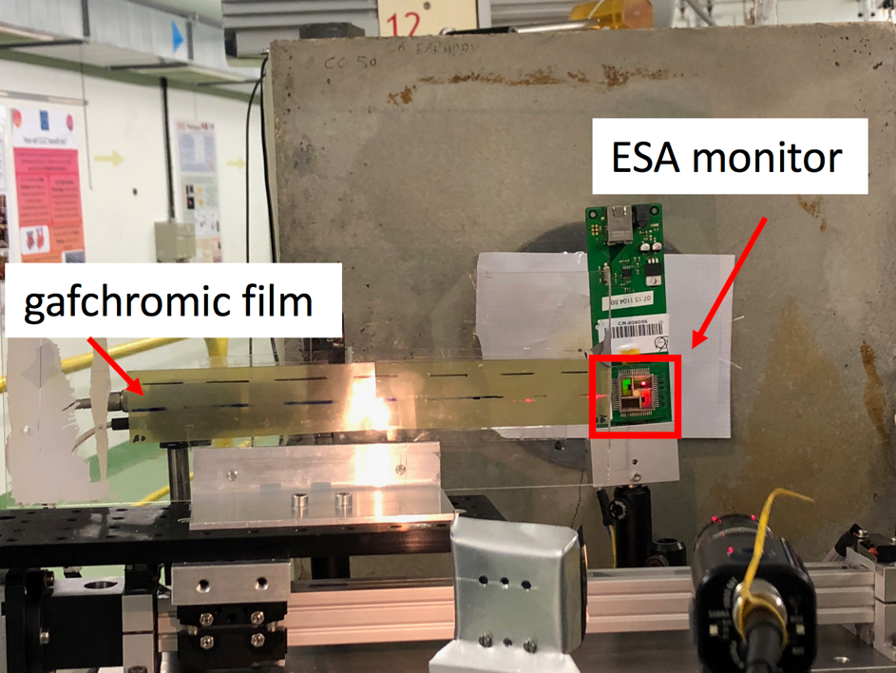
Flash effects (V. Wyrwoll)
Gadlage 2015, IEEE TNS
SEE testing is performed at an accelerated rate; however, one has to make sure that each SEE is due to the interaction of a single electron
Tests with ESA monitor show that for the same fluence the number of SEUs may differ for diverse beam conditions (e.g., bunch charge), which require further investigations.

Slide 7
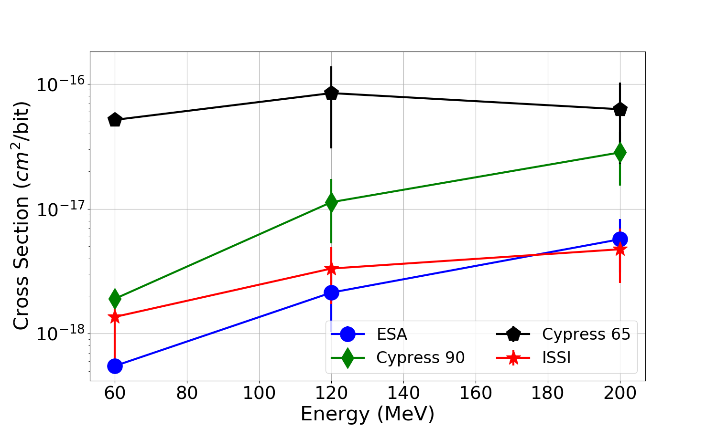
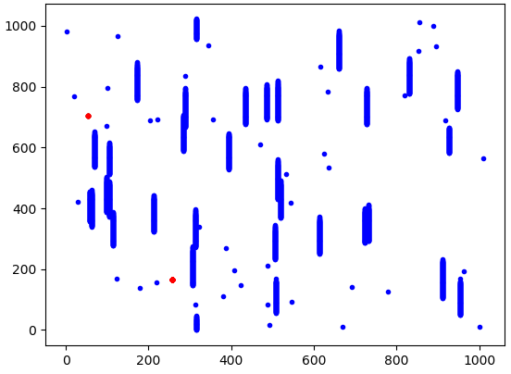
SEUs in highly-integrated SRAMs (F. Castellani)
Different behaviors observed (ISSI 40 nm XS very similar to ESA monitor X vs. Higher cross-sections for Cypress 65 and 90 nm)
Large collected data helps claiming that typically 3-4 orders of magnitude differences wrt to HEP are to be expected (though not proportional behavior with scaling)
Beam conditions can generate unwanted row or column SEFIs

Slide 8
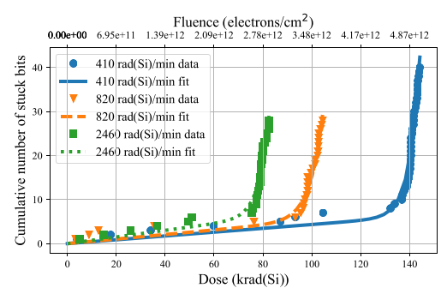
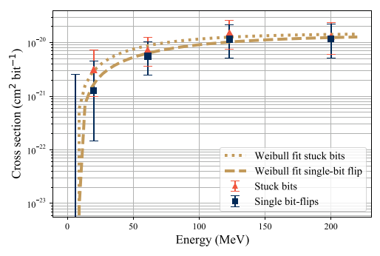
Stuck bits in DRAM (D. Söderström)
Stuck bit is a hard SEE caused by a single particle strike (it is no longer possible to rewrite a different value to the bit); it can be permanent or intermittent (latter related to DD effects)
Typically not many statistics until device fails due to TID (but no dose rate dependence)
Cross-sections similar to those of SEUs
Study complemented with experiments in medical LINAC

Slide 9
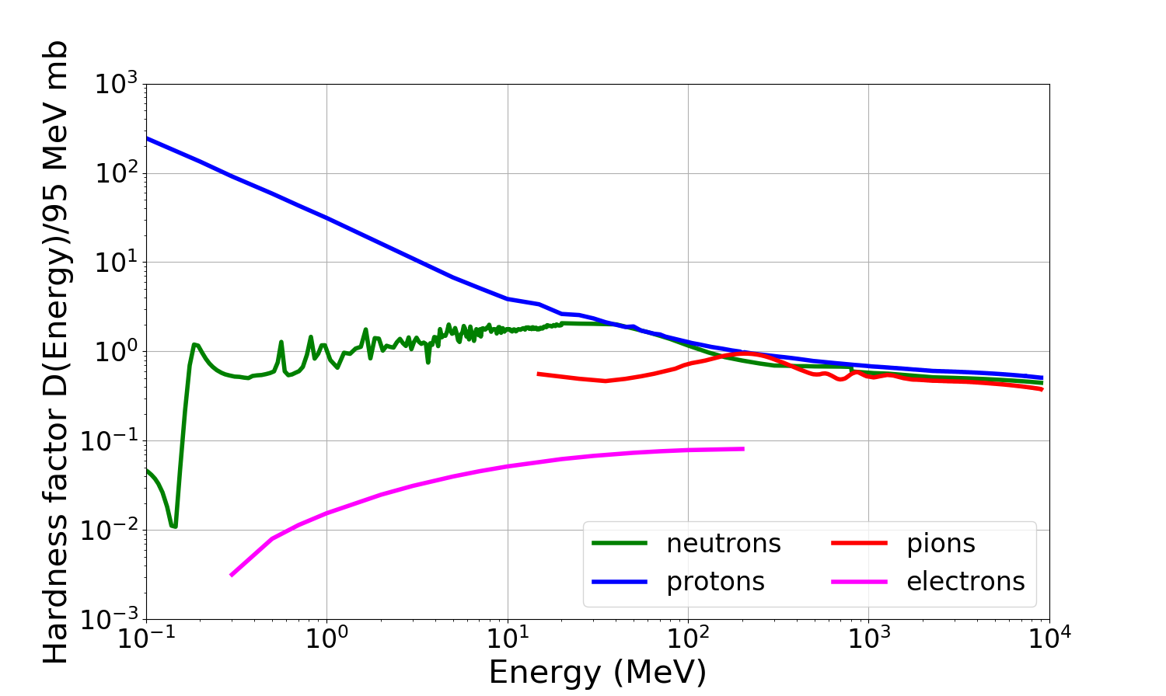
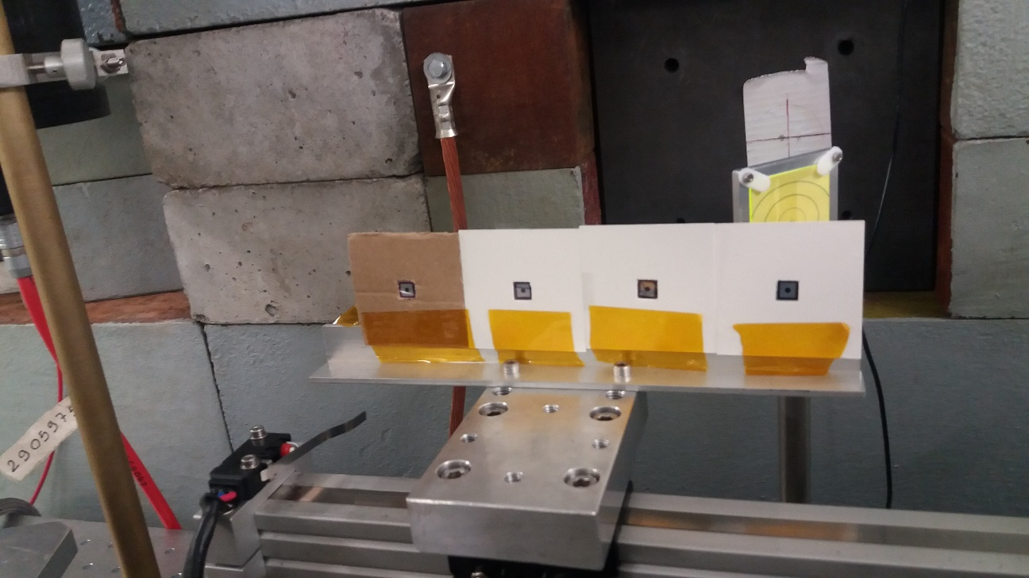
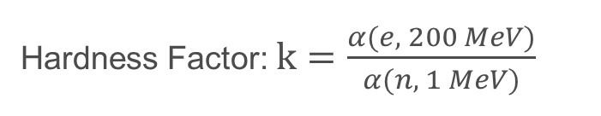
Displacement damage
Measurement of eletron hardness factor were made in the past. For 200 MeV electrons it was determined to be 0.08
First study performed measuring leakage current on EP diodes
Hardness Factor: $k=\frac{α(e, 200 MeV)}{α(n, 1 MeV)}$

Slide 10
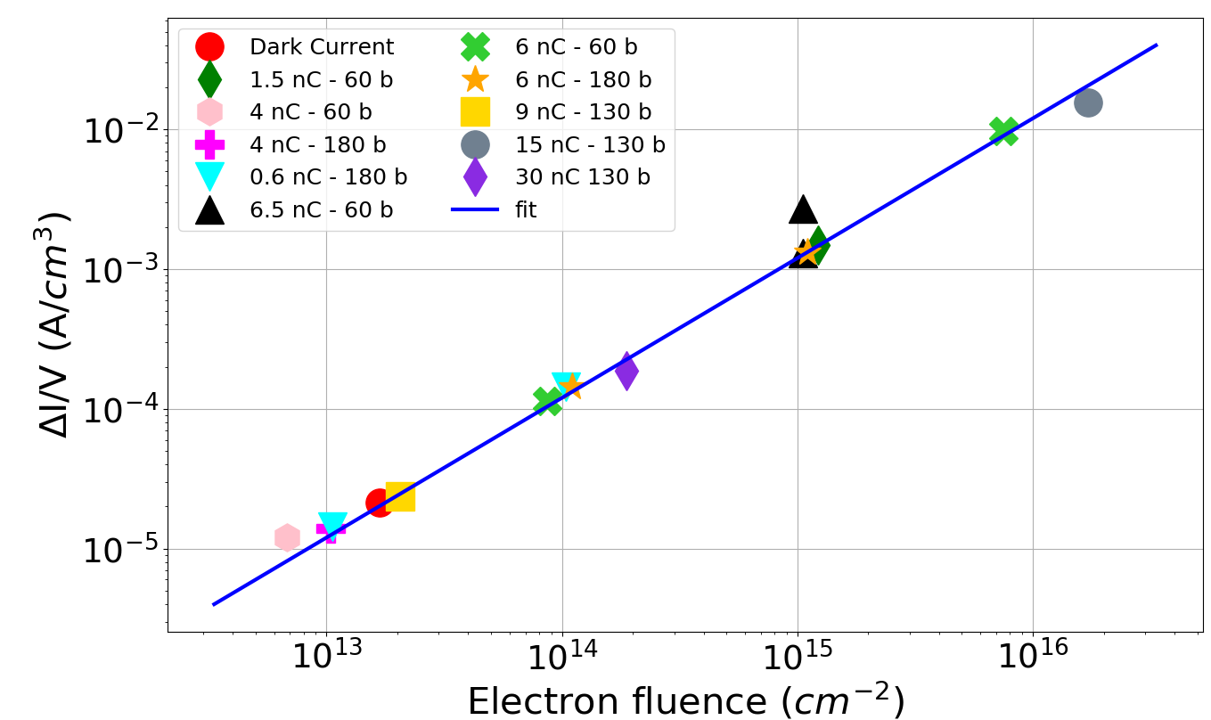
Displacement Damage
CLEAR enables displacement damage testing:
  It is possible to reach fluences of 10¹⁶ e/cm² in half a day.
Similar levels with protons can be reached in IRRAD (long shutdown)
  However, proton irradiation activates devices much more than electron irradiation
Several diodes were irradiated in different beam conditions (test linearity)
Measurements of leakage current and correlation with fluence
Calibration done solely on facility log data
Possible further (i) TCT and (ii) TSC measurements to determine (i) depleted voltage and (ii) defects concetration
Main take-aways
Hardness factor of 0.038
Linearity allows using these diodes for cross-calibration purposes

Slide 11
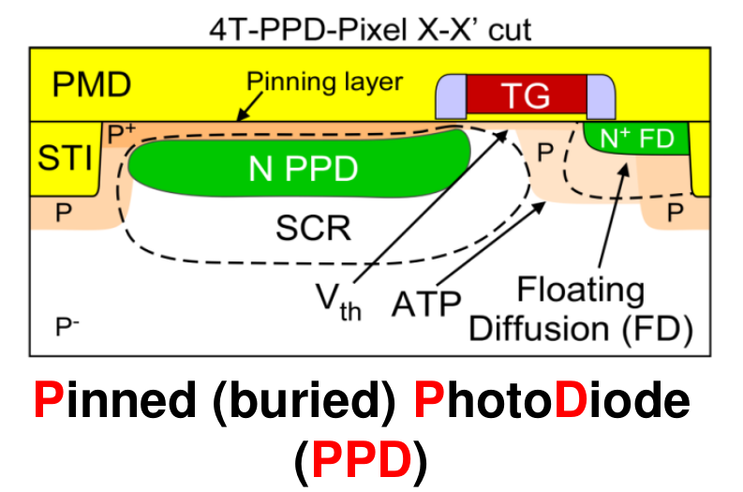
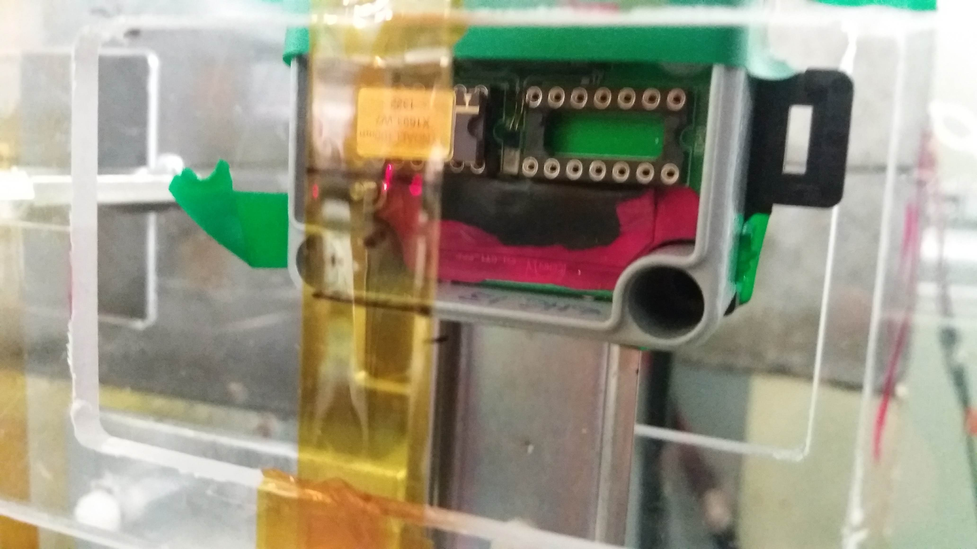

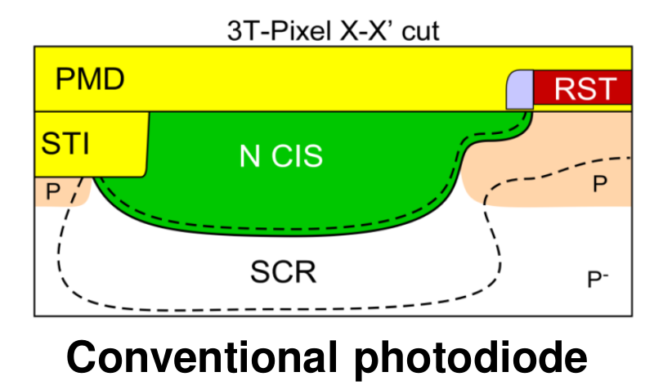
Displacement Damage (J. Kempf)
Thorougher study of DD in electronics by means of additional devices:
RadMon diode
CMOS Image sensors from ISAE Supaero (also TID study for Jovian environment)

Slide 12
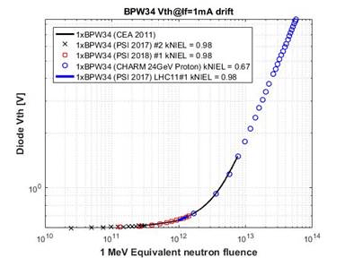
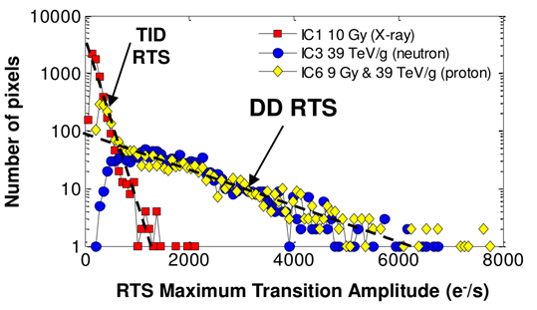
Displacement Damage (J. Kempf)
RadMon is a well calibrated device in HEH environments used for radiation monitoring purposes at CERN
CMOS image sensors effects:
  Dark current
  Random Telegraph Signal (RTS)

Slide 13
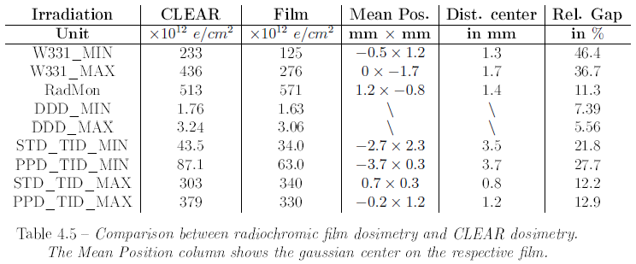
Displacement Damage (J. Kempf)
Very strong efforts on dosimetry (comparison of CLEAR facility logs wrt radiochromic film measurements)
Mixed results (sources of discrepancy not always clear)
  Typical goal would be to have difference of ±10%

Slide 14
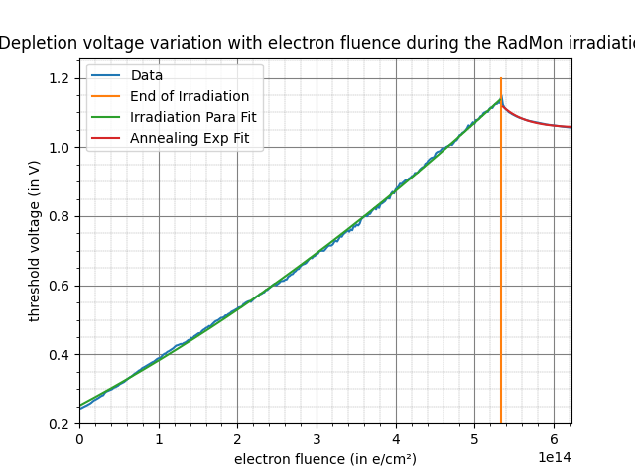
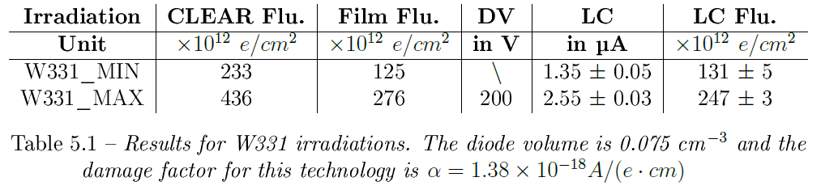
Displacement Damage (J. Kempf)
No data yet on CMOS Image Sensors
RadMon only live measurement of damage (threshold voltage variation)
Hardness factor for RadMon is 0.034 (good agreement with previous measurements on diodes)
EP diodes used for cross-calibration have better agreement with film measurements
Plenty of data yet to analyze (Defect spectroscopy, CMOS image sensor dark current and RTS)

Slide 15
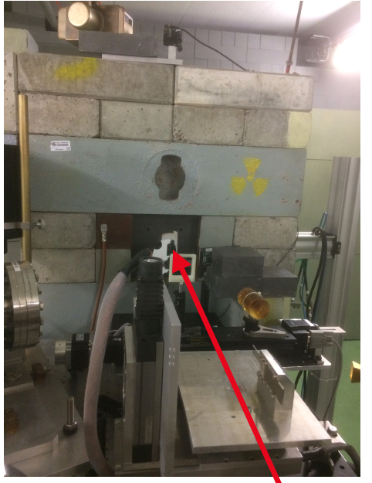
Electrons-on-dump (G. Lerner)
The experiment
Determination of the radiative field generated by the interaction of a high-intensity electron beam with the dump.
Characterization done by measuring SEUs in SRAMs placed all around the dump
Accomplished by directing high-intensity, small beams directly on the dump without material in the beamline
Effect of thermal neutron studied thanks to B₄C shielding
Comparison with FLUKA simulations thanks to the detailed description of the dump
Scope
Determining influence of the dump neutrons and photons on in-beam electron SEU measurements
In-house source of thermal and intermediate energy neutrons for testing (higher fluxes than Am-Be)
Evaluation of possible R2E effects for equipment around dump

Slide 16
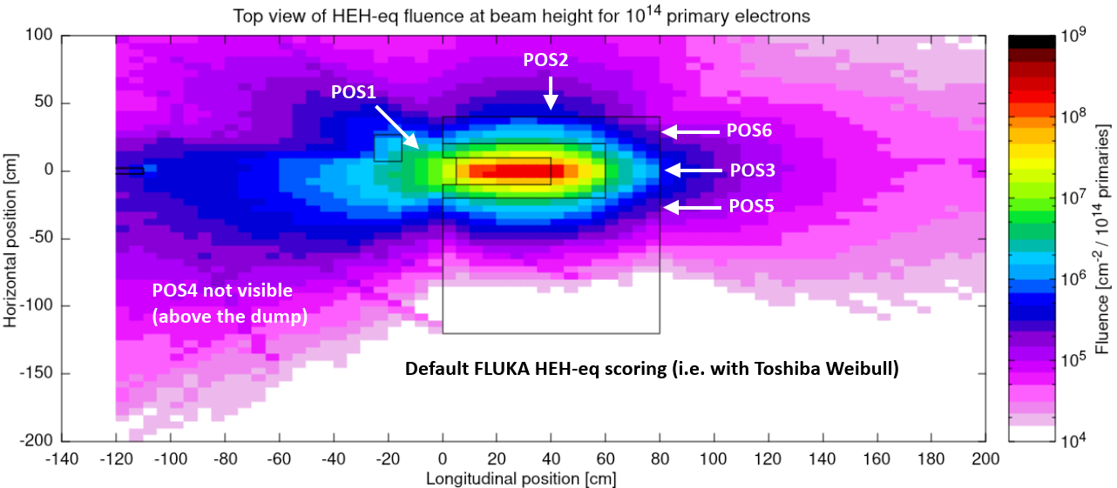
Electrons-on-dump (G. Lerner)

Slide 17
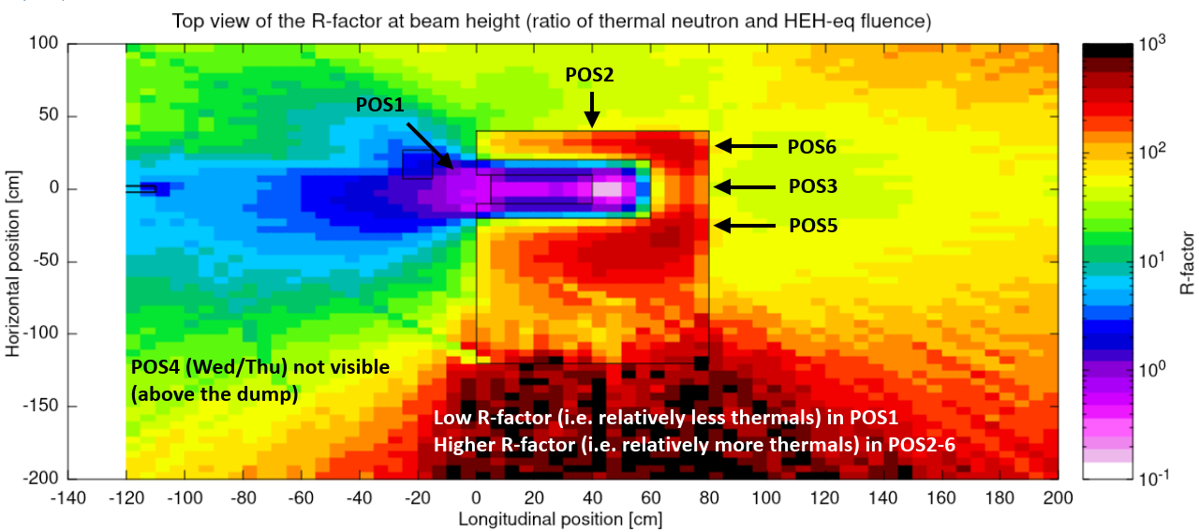
Electrons-on-dump (G. Lerner)

Slide 18
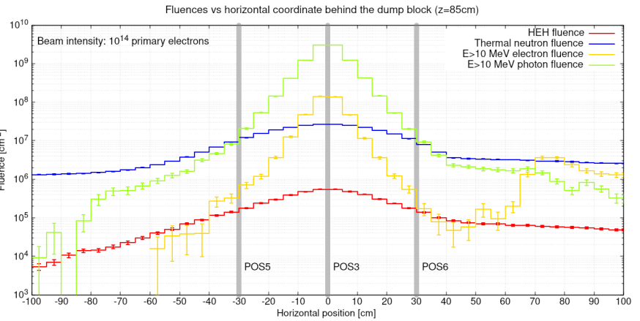
Electrons-on-dump (G. Lerner)
Thanks to radiative field predictions from FLUKA one can predict the number of SEUs in the SRAM because the thermal, intermediate and high-energy neutron experimental cross-sections are known
Photon cross-sections, however, are not known, but photon fluxes are very high
Main take-aways
Dump front-side: relatively high and not so stable SEU rate (low thermal neutron contribution) and strong dependency with the material in the beam
Dump top-side: lower and more stable SEU rate (more contribution from thermal neutrons)
Dump back-side in the center: relatively high and stable SEU rate, possible contribution of photons (considering FLUKA predictions on neutron response)
Dump back-side off-centered: similar to top-side.

Slide 19
Publications
M. Tali et al., "High-Energy Electron-Induced SEUs and Jovian Environment Impact," in IEEE Transactions on Nuclear Science, vol. 64, no. 8, pp. 2016-2022, Aug. 2017.
M. Tali et al., "Mechanisms of Electron-Induced Single-Event Upsets in Medical and Experimental Linacs," in IEEE Transactions on Nuclear Science, vol. 65, no. 8, pp. 1715-1723, Aug. 2018.
M. Tali et al., "Mechanisms of Electron-Induced Single-Event Latchup," in IEEE Transactions on Nuclear Science, vol. 66, no. 1, pp. 437-443, Jan. 2019.
M. Tali, " Single-Event Radiation Eﬀects in Hardened and State-of-the-art Components for Space
and High-Energy Accelerator Applications”, PhD Thesis, University of Jyväskylä, Finland, 2019.
A. Coronetti et al., “SEU Characterization of Commercial and Custom-designed SRAMs manufactured in 90 nm technology and below”, in IEEE Radiation Effects Data Workshop, Santa Fe, NM, USA, 2020.
D. Söderström et al., “Electron-induced Single Event Upsets and Stuck Bits in SDRAMs in the Jovian Environment”, accepted for publication in IEEE Transactions on Nuclear Science, 2021.
D. Poppinga et al., “VHEE beam dosimetry at CERN Linear Electron Accelerator for Research under ultra-high dose rate conditions”, Biomedical Physics Express, vol. 7, no. 1, 2021.
And more are coming...

Slide 20
Conclusions
CLEAR has been central to R2E activities over the last 5 years
  It enabled studying key radiation effects that it was not possible to study elsewhere
    HEE SEU, SEL, stuck bits
  It enabled studying displacement damage effects in a short time and with low level of activation
    Determination of hardness factor
    Defect spectroscopy
    Appliactions to CMOS image sensors
  New uses derived from electron-on-dump measurements
Dosimetry remains challenging
  Film calibrations could help
Several collaborations with academic and industrial partners
  Slowed-down by contingent pandemic situation

Slide 21
Outlook
Electronics testing/qualification
  Displacement damage
    Most of the R&D completed
    Synergistic TID effects on top of DD to be investigated (one drawback with respect to proton irradiation is the larger TID for same DD)
  Mixed-field generated from electrons-on-dump:
    Part of the R&D completed
    Further measurements with more sensitive devices (to measure energy deposition) are foreseen to determine HEHeq flux and thermal neutron flux
Radiation effects R&D
  Effects of pulsed electron/photon beams on electronics can be achieved at CLEAR
    FCC-ee R&D

Slide 22
Thank you for
your attention!

