Slide 1
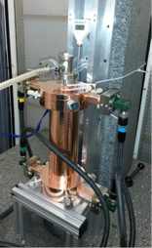
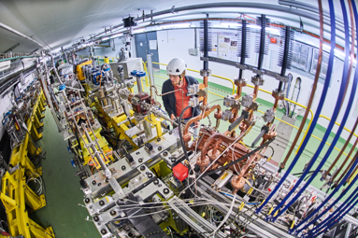
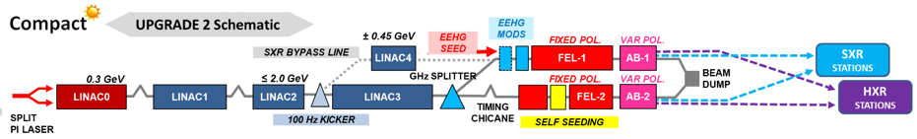
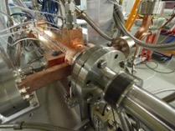
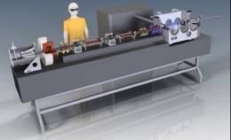
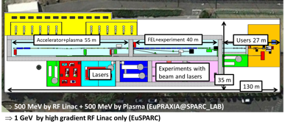
LC studies 2021-25
X-band technology:
Design and manufacturing of X-band structures and components
Study structures breakdown limits and optimization, operation and conditioning
Baseline verification and explore new ideas
Assembly and industry qualification
Structures for applications, FELs, medical, etc
Technical and experimental studies, design and parameters:
Module studies (beyond CLIC, see some targets for developments below)
Beamdynamics and parameters: Nanobeams (focus on beam-delivery), pushing multi TeV region (parameters and beam structure vs energy efficiency)
Tests in CLEAR (wakefields, instrumentation) and other facilities (e.g. ATF2)
High efficiency klystrons
Injector studies suitable for X-band linacs (coll. with Frascati)
Application of X-band technology (examples):
A compact FEL (CompactLight: EU Design Study 2018-21)
Compact Medical linacs (proton and electrons)
Inverse Compton Scattering Source (SmartLight)
Linearizers and deflectors in FELs (PSI, DESY, more)
1 GeV X-band linac at LNF
eSPS for light dark matter searches (within the PBC-project)

Slide 2
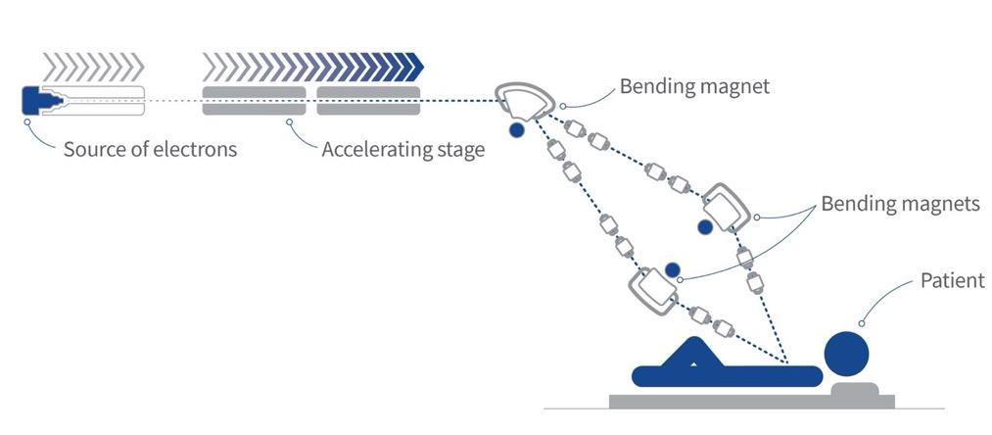
LC studies 2021-25
ILC related R&D:
Positron flux concentrator, ATF2/3, Hi-klystrons, various SRF topics, cryo, dumps, beam-dynamics (these are ILC and/or KEK collaborative R&D)
Not considered yet:
A so-called ILC Pre-lab effort, or Flash RT construction – both could require/benefit from CLEAR measurements (for hardware in addition to the work described by M

Slide 3
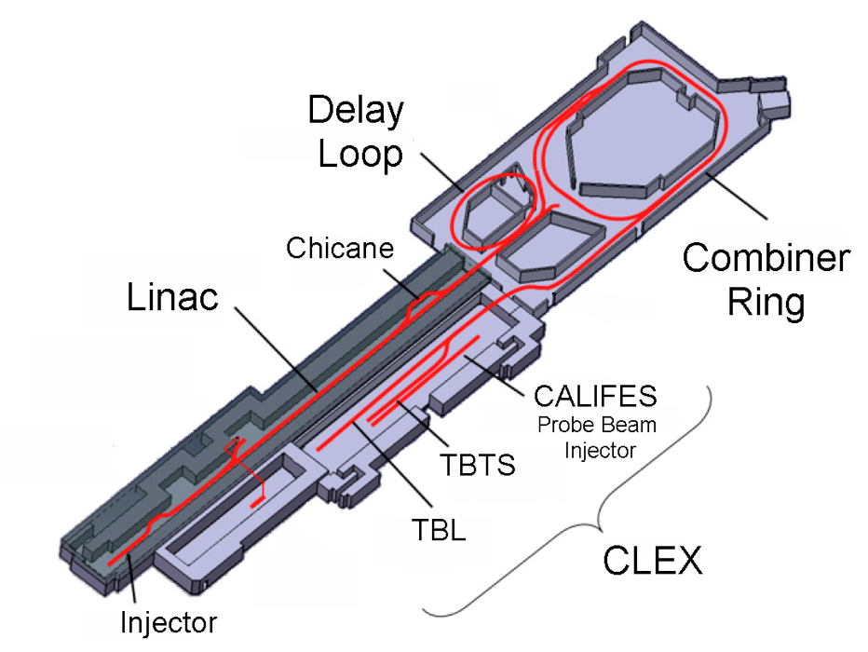
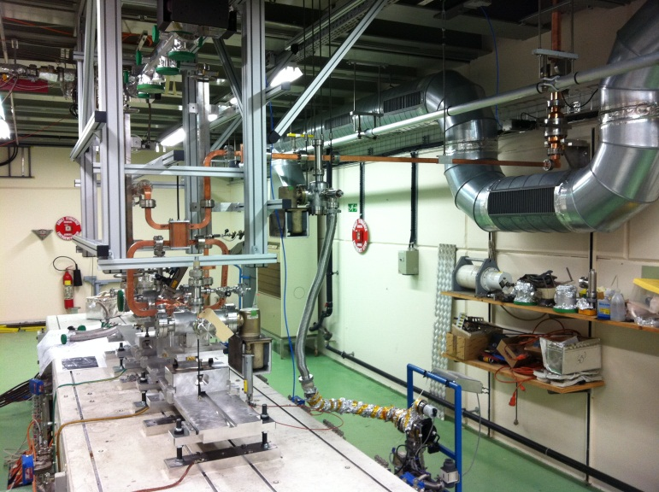
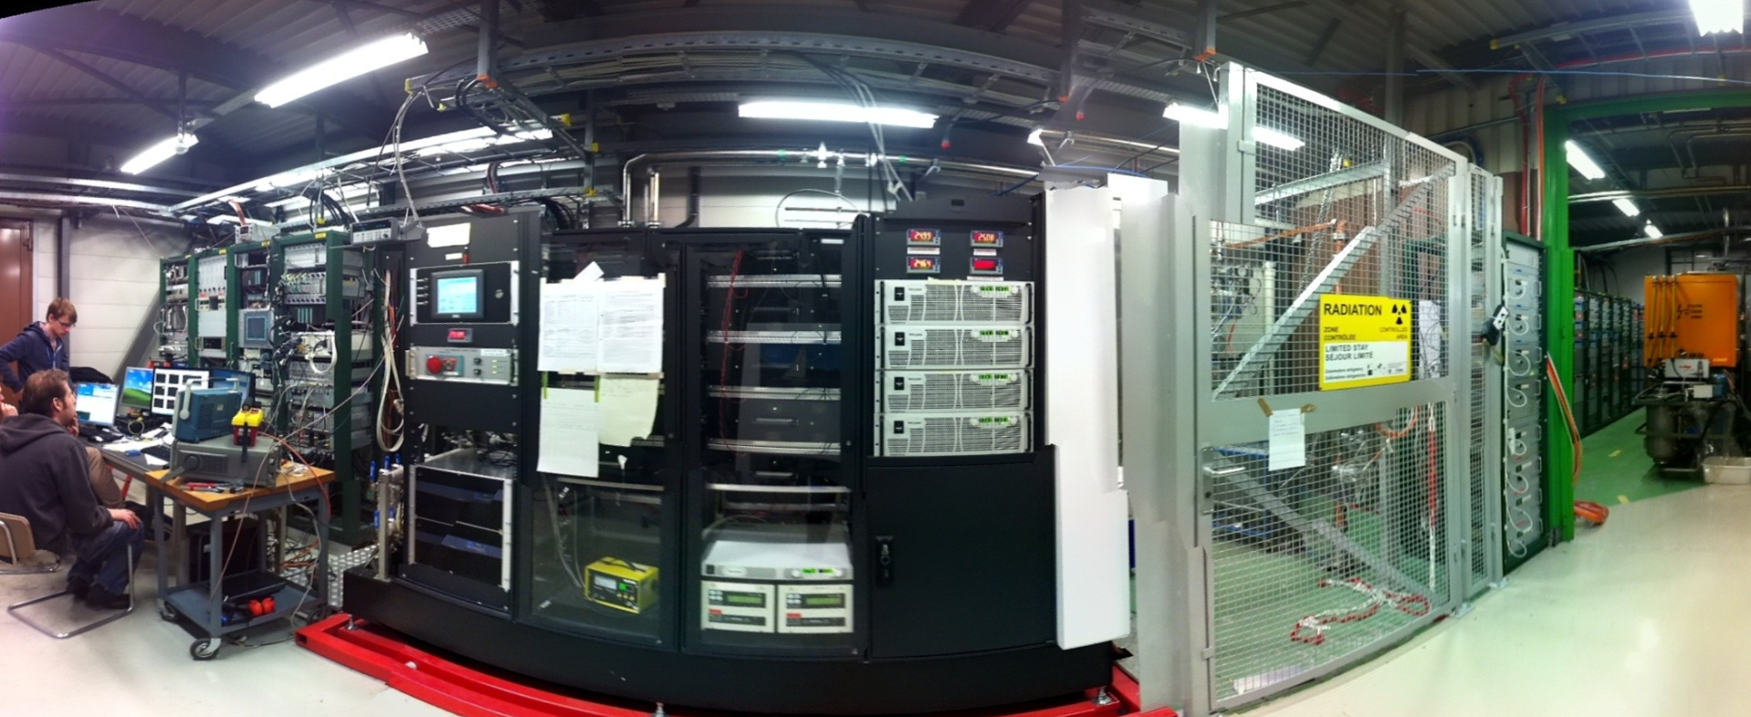
LC and CLEAR
We consider CLEAR together with the XBOX1 RF system, which is essential for several of the studies mentioned in the following
In many cases these activities involve collaborators in leading roles

Slide 4
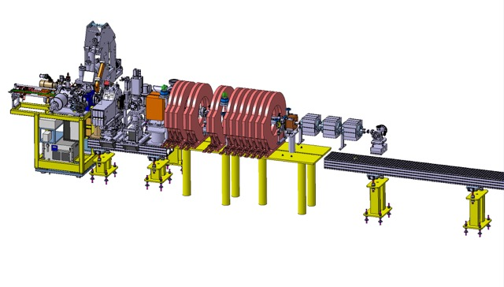
LC and CLEAR - I
1) Photo-gun/injector part of 2016-2020 INFN collaboration agreement.
For any X-band application from FEL to Flash, for CLEAR and AWAKE.
Assembled, tested, conditioned in CTF2. Much more in talk of Edda.
We consider further injector work with INFN (Flash RT) ?
Notes:
collano

Slide 5
LC and CLEAR-II
2) - 4) Structure performance studies (with RF power)
  Wakefields studies (important part of the CLIC luminosity performance strategy)
  Kicks, due to discharges (goes to heart of the breakdown rate limit) or imperfect alignments (wakefields)
  Long term operation, stability over time – demonstration
5) Instrumentation/diagnostics – relevant for CLIC and some cases ILC.
Primarily work on high resolution cavity BPMs, but also interests in other
technologies, e.g. coherent Cherenkov diffraction radiation (short bunches)
See earlier talk of Stefano
Notes:
collano

Slide 6
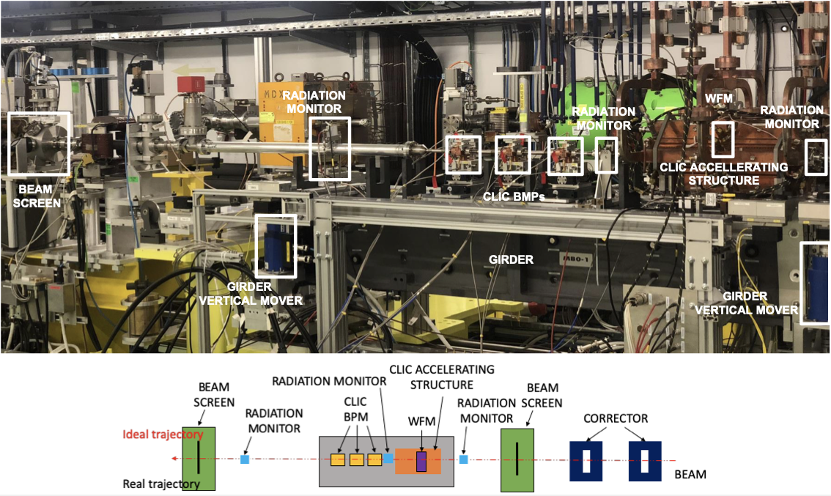

Slide 7
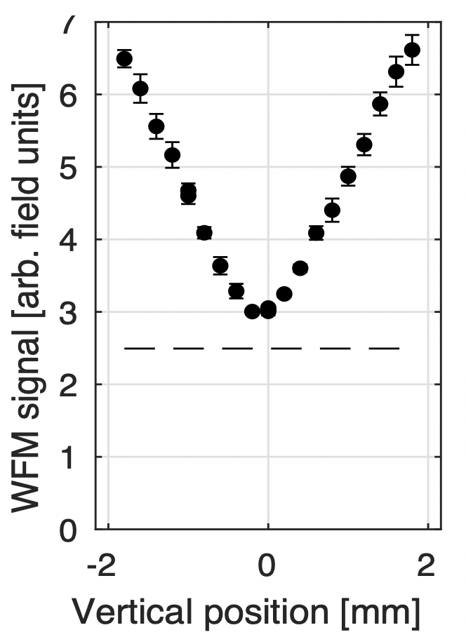
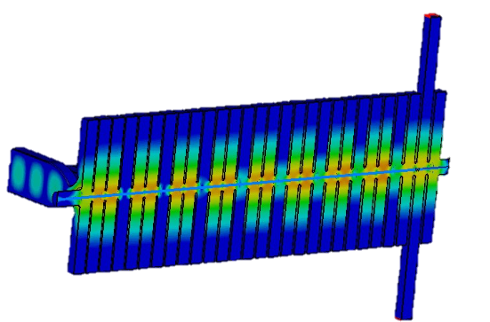
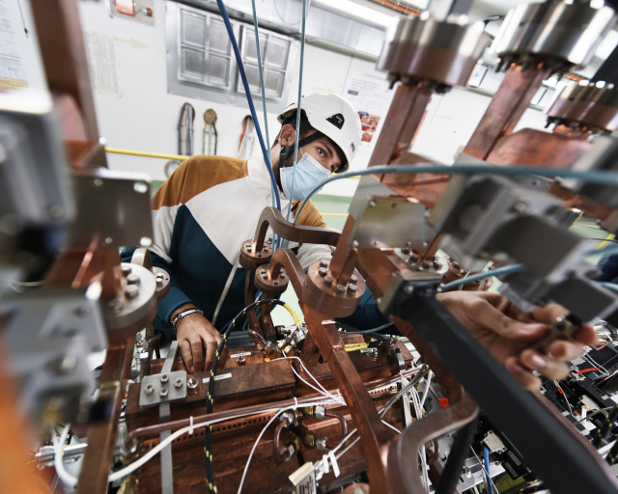
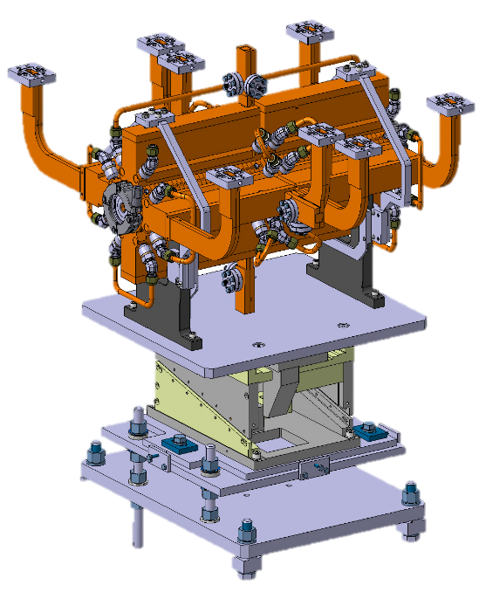
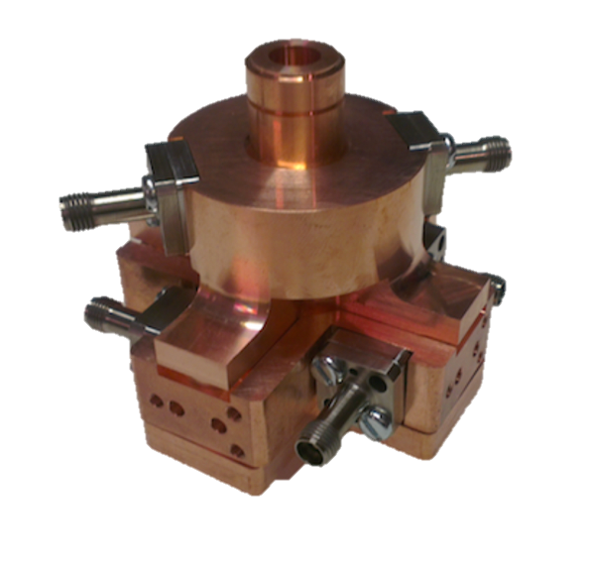
Key CLIC related activities
Experiments:
Wake-Field monitors
Wake-field kicks
CLIC cavity BPMs
Main collaborators
University of Oslo
CEA - Saclay
Università di Napoli Federico II
RHUL
Future step, connecting
the cavity to X-Box1
possible tests:
RF kicks
Breakdown kicks
RF effect on WFMs
Stability & reliability runs
A. Gilardi, K. Sjobaek, M. Wendt, A. Lyapin
Wake-Field monitors
response
Cavity BPM and X-band structure on movers

Slide 8
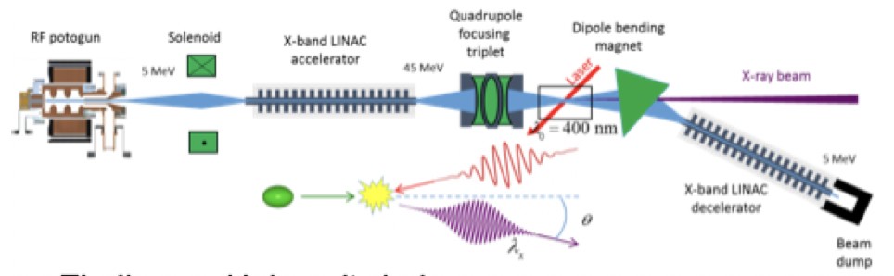
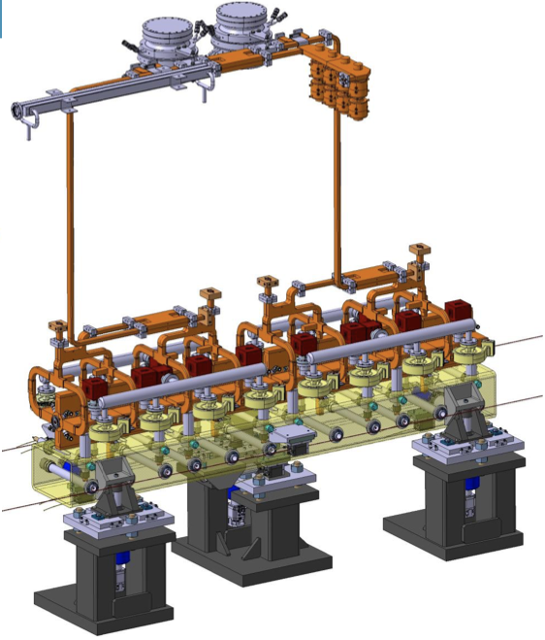
LC and CLEAR - III
6) X-band technology applications: VHEE studies, Flash RT including appropriate dosimetry, possibly inverse Compact Scattering studies
More general for Flash see talk of Marie-Catherine Vozenin
7) Possibly complete modules in CLEAR: Long term goal to construct a CLIC or
Flash RT module, beam-test considered
Notes:
collano

Slide 9
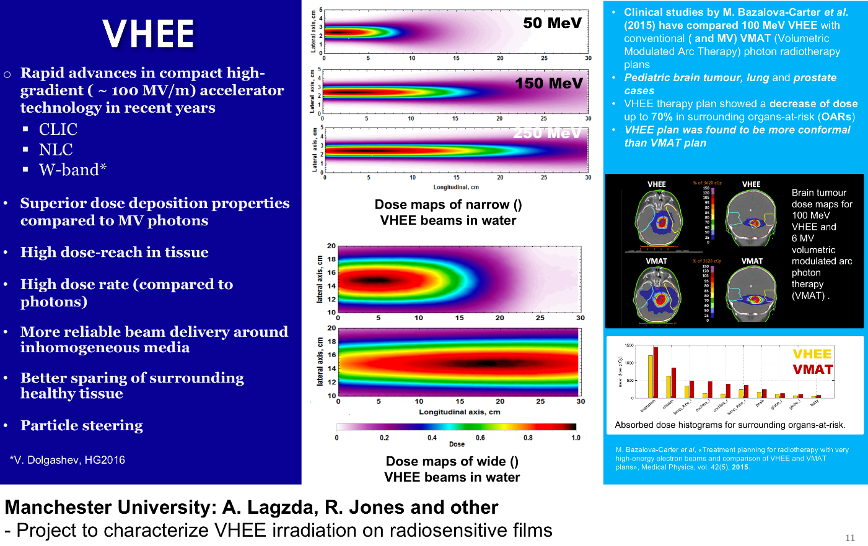
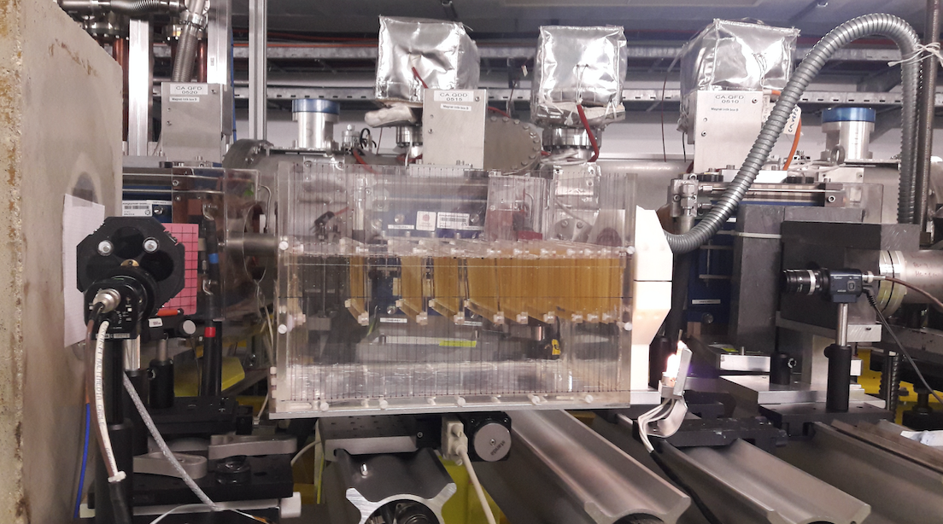
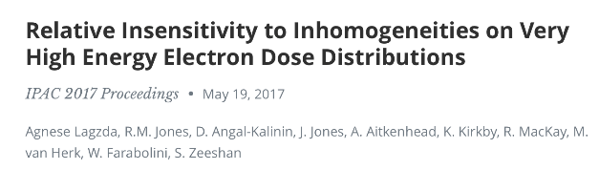
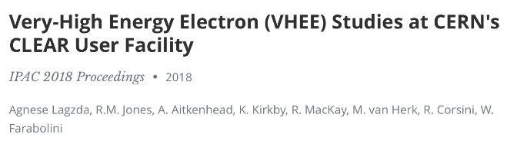
Medical irradiation tests - VHEE
Initial interest: Manchester Univ. (A. Langzda, R. Jones)
  Three measurements campaigns (2017-2018)
Further requests from:
Nat. Phys. Lab. UK (A. Subiel et al.)
  Two measurement campaigns (end 2018, spring 2019)
Strathclyde University (K. Kokurewicz et al.)
  One campaign completed (end 2018)
Oldenburg University and PTW (B. Poppe, D. Poppinga et al.)
  Two campaigns completed (end 2018, September 2019)
CHUV Lausanne (M.C. Vozenin, C. Bailat, R. Moeckli et al.)
  Preliminary tests (end 2018, spring 2019)
Activities:
Experimental verification of dose deposition profiles in water phantoms
Calibration of operational medical dosimeters – nonlinear effects with short pulses
Demonstration of “Bragg-like peak” deposition with focused beams

Slide 10
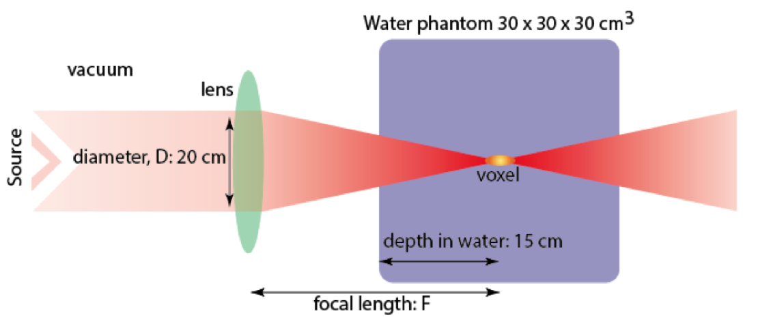
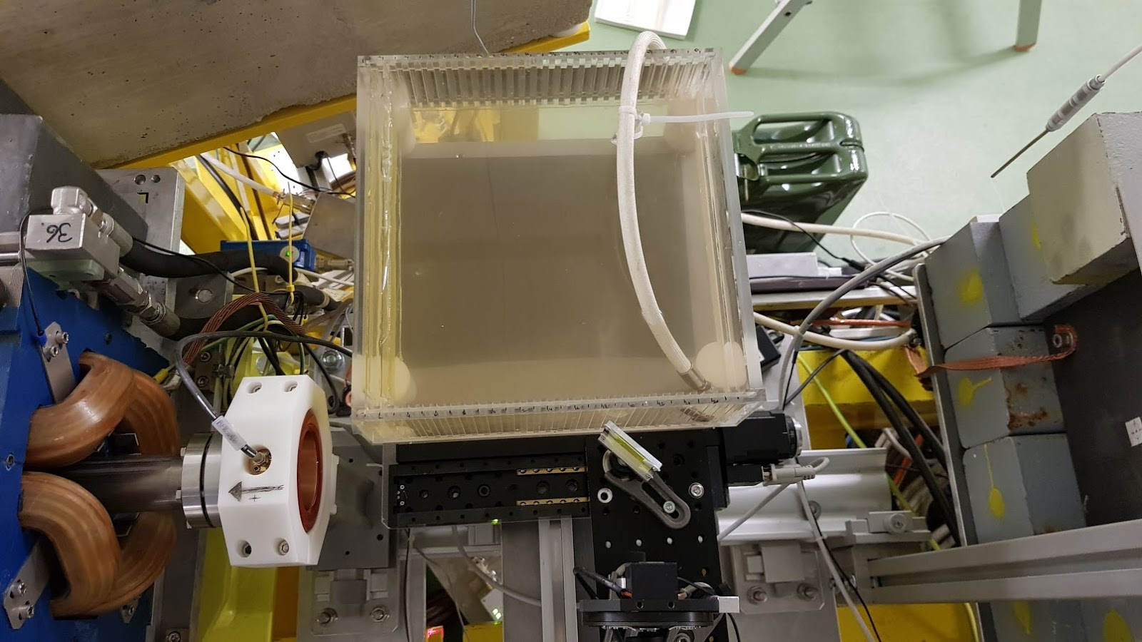
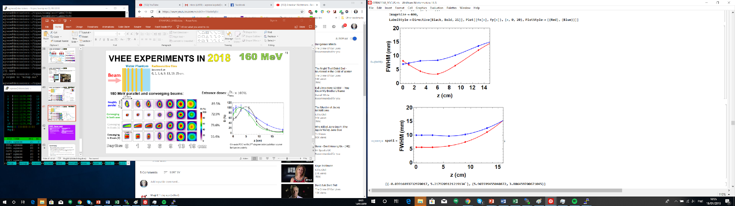
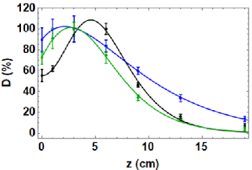
VHEE strong focusing
Aim:
Focus the beam on the tumour to minimize the dose on the nearby healthy tissues
Main activity in 2019
Two groups (Strathclyde and Manchester) Two full week of testing (plus installation and dismounting)
Required rearrangement of beamline, with a temporary dump.
Beam size
Exit Window
Parallel
Water
phantom
Vertical
Horizontal
Dose deposition
Radiosensitive films
Parallel
Conv. in both axes
Conv. in X-axis
YAG screen
Conv. in X-axis
Charge monitor
Vertical
Quadrupole
Camera
Horizontal
W. Farabolini, E. Senes, K. Kokurevicz
A. Lagzda, R.Jones

Slide 11
Other comments
Reminder:
A significant amount of relevant work for CLIC is happening at outside labs, linked to FEL systems and components using X-band, medical linacs as for Flash -> work in CLEAR related to these fields directly benefit the LC studies and visa versa
Finally:
The combination of CLEAR and XBOX1-3 in a transnational access scheme also opens up for supporting existing and new collaborators and ideas in the area of X-band technology. Being planned.
All slides from the CLIC/CLEAR team, in the expert audience -
MANY THANKS -

