Slide 1
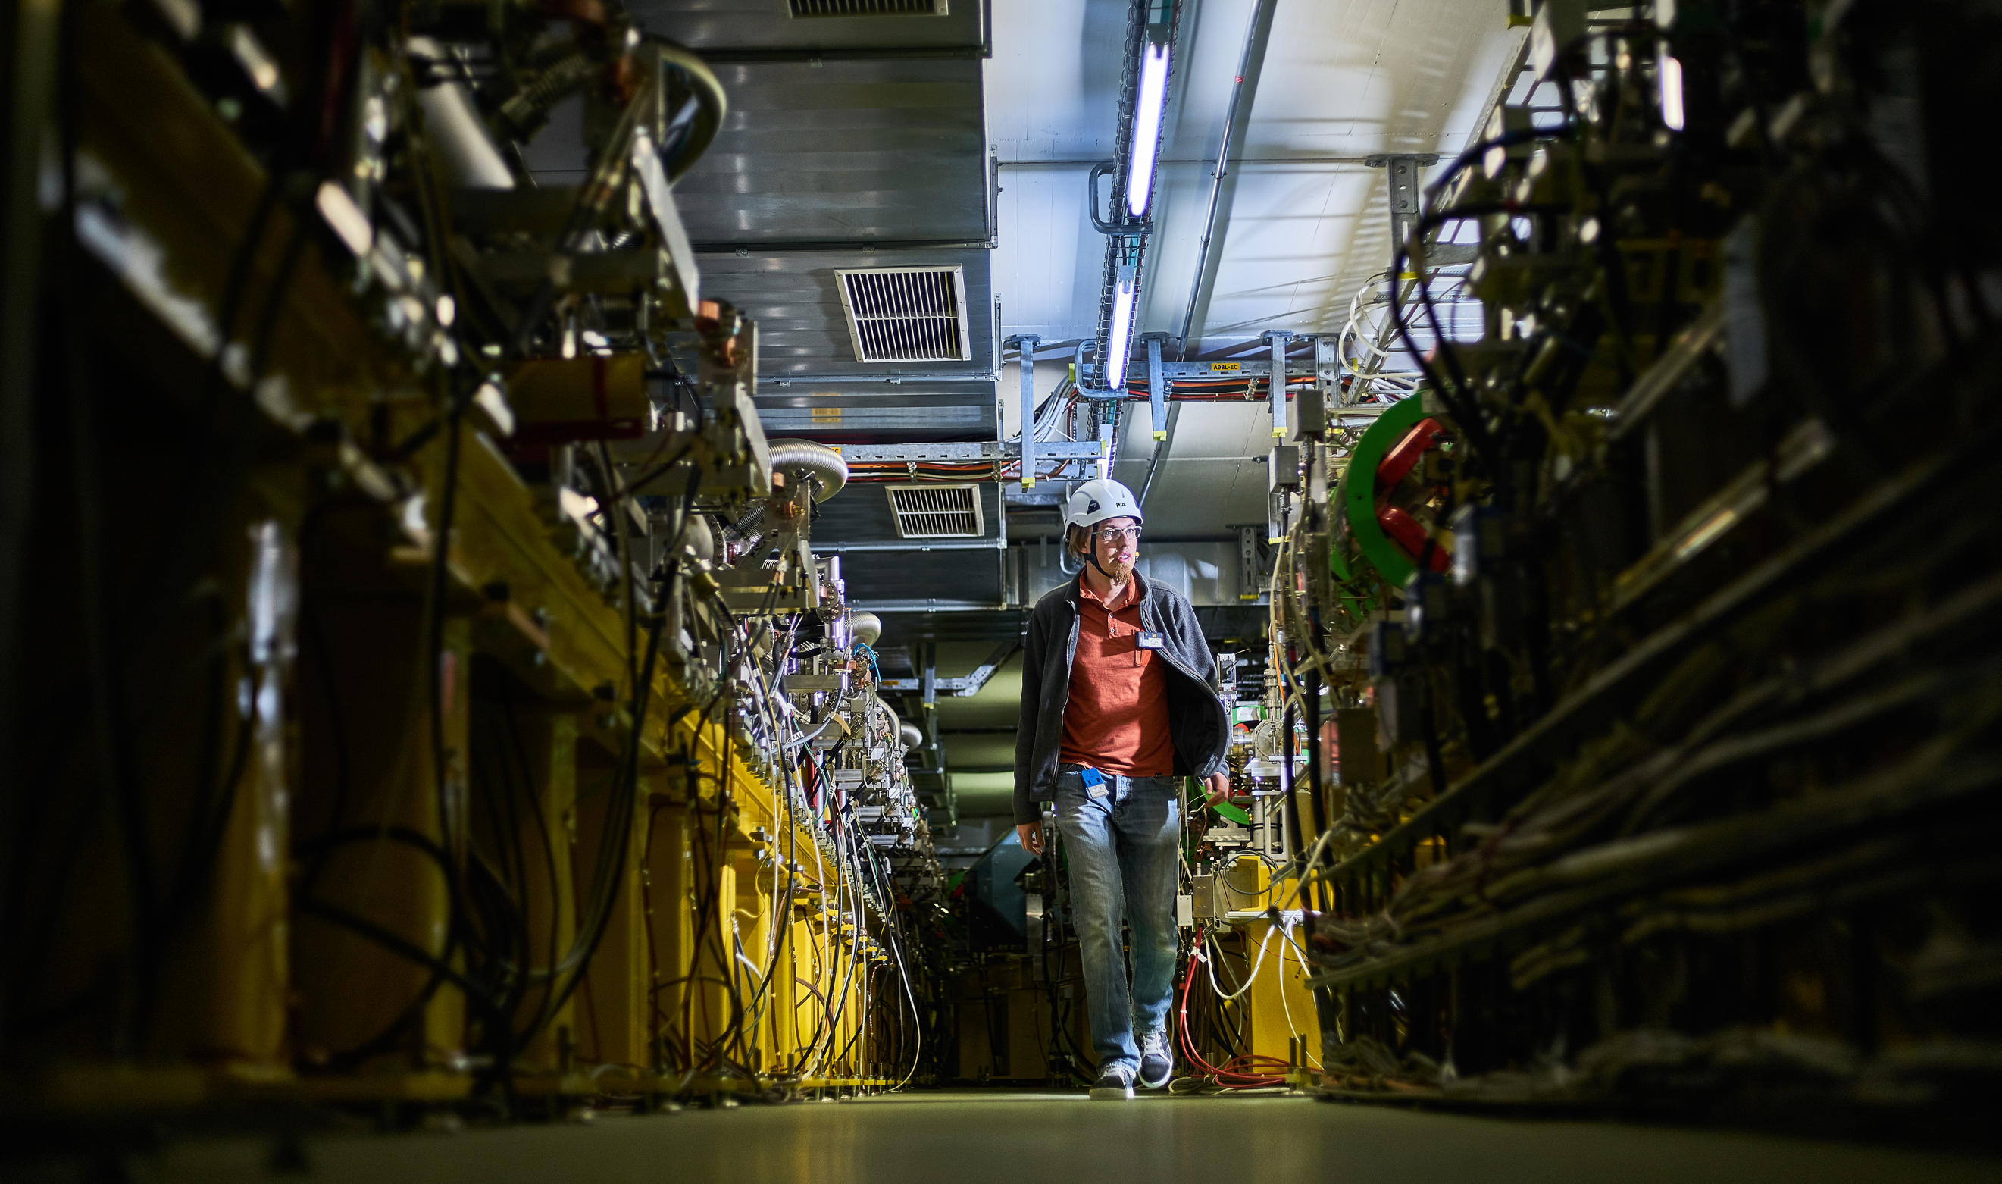
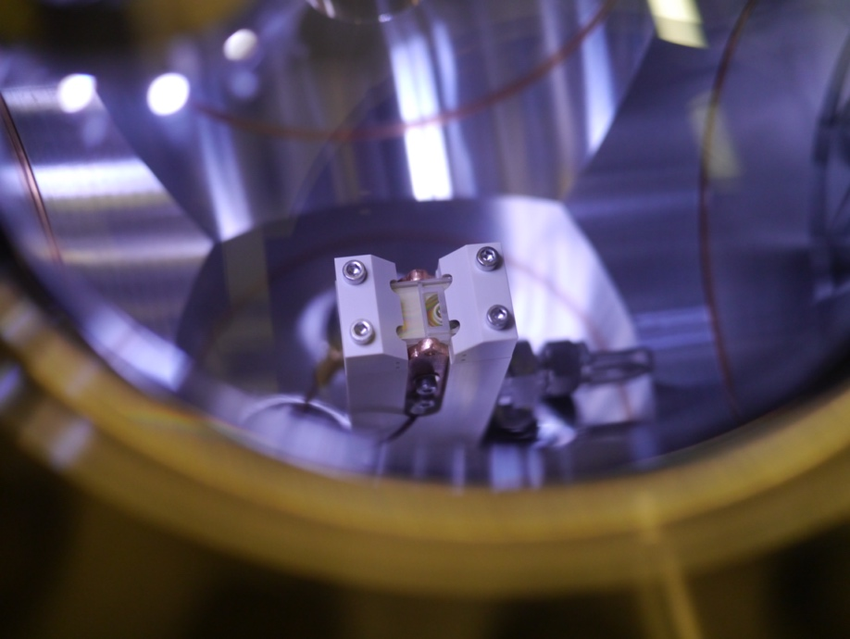
CLEAR future running, resources, consolidation and upgrades
R. Corsini
for the CLEAR Team
CERN Linear
Electron Accelerator
for Research

Slide 2
Outline
Update from last CLEAR review
Resources, an update
Outlook on future program
Possible upgrades - consolidation
Mode of operation in the next years
Some worries…

Slide 3
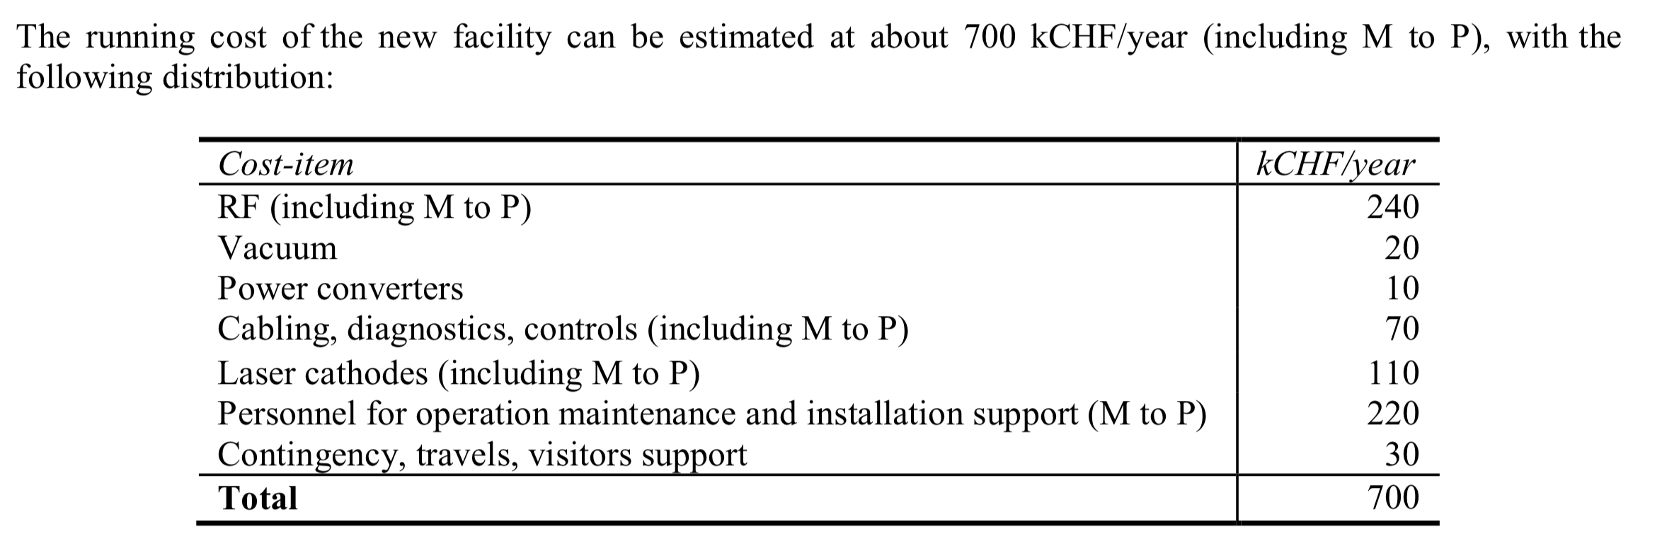
Resources: material (from 1st Review)
From the original CLEAR proposal
Actual expenses (kCHF)
2017 2018
RF 340 253
Vacuum 18 16
Power Converters 2 1
Cabling, diags, controls 10 80
Laser/cathodes 40 75
Personnel 200 255
Travels, etc. 5 5
TOTAL 595 685

Slide 4
Resources: material update
From the original CLEAR proposal
Actual expenses (kCHF)
2019 2020
RF 175 56
Vacuum 15 8
Power Converters 0 0
Cabling, diags, controls 67 71
Laser/cathodes 78 48
Personnel 295 265
Travels, etc. 9 1
TOTAL 639 449

Slide 5
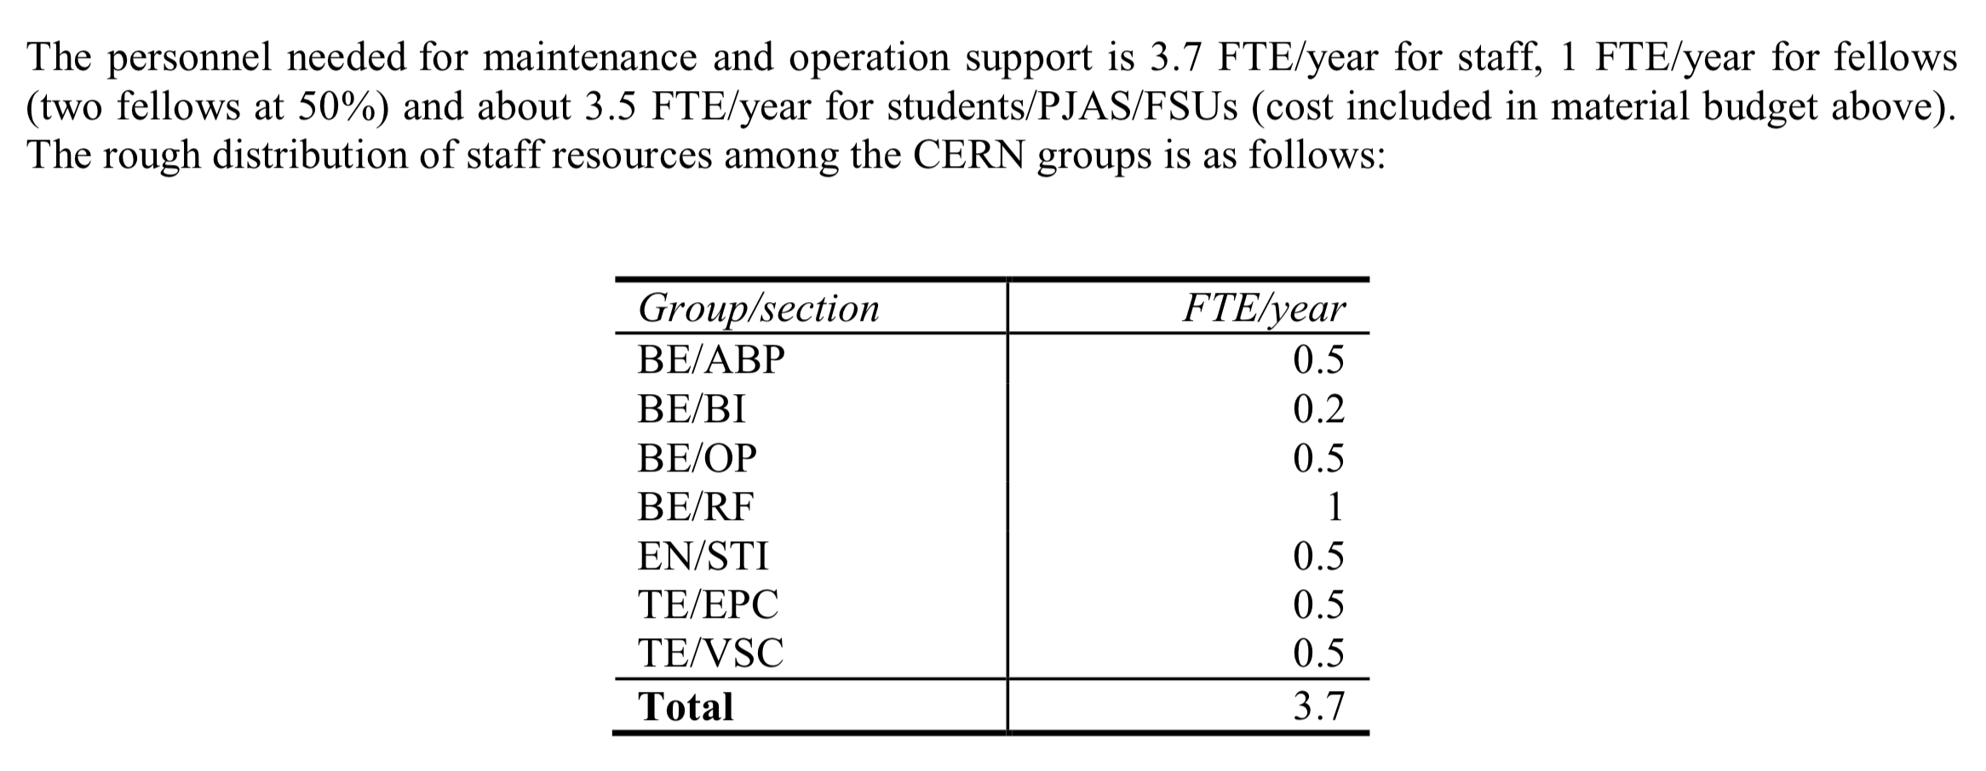
Resources: manpower (from 1st Review)
Present Status:
Group FTE/year
BE/ABP 0.5
BE/BI 0.2
BE/OP 0
BE/RF 1.2
BE/CO 0.2
EN/STI 0.8
EN/CV 0.1
EN/SMM 0.1
TE/VSC 0.5
TE/EPC 0.1
TOTAL 3.4 (3.7)
From the original CLEAR proposal
From APT
Assumed
Apart from staff, CLEAR manpower is currently covered by 2.5 FTE/year for Fellows
and about 3.5 FTE/year for students/PJAS/VISC/FSUs (cost included in material budget).

Slide 6
Resources: manpower update
Present Status:
Group FTE/year
BE/ABP 0.6
SY/BI 0.15
BE/OP 0
SY/RF 1.25
BE/CSS 0.2
SY/STI 0.9
EN/CV 0
EN/SMM 0
TE/VSC 0.25
TE/EPC 0
TOTAL 3.35
From the original CLEAR proposal
From APT
Apart from staff, CLEAR manpower is currently covered by 0.5 FTE/year for Fellows
and about 4 FTE/year for students/PJAS/VISC/FSUs (cost included in material budget).

Slide 7
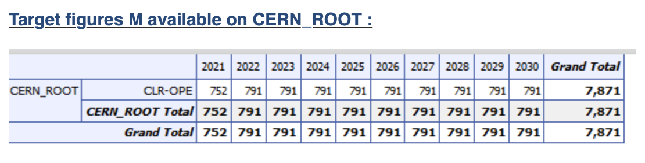
CLEAR Material Budget in MTP
Initial request (and initial allocation):
  800 kCHF/year = 700 kCHF/year “material” + 1 GET Fellow on average
Present allocation:
  750 – 790 kCHF/year
Should be OK, leaving space for one fellow at all times – but tight.

Slide 8
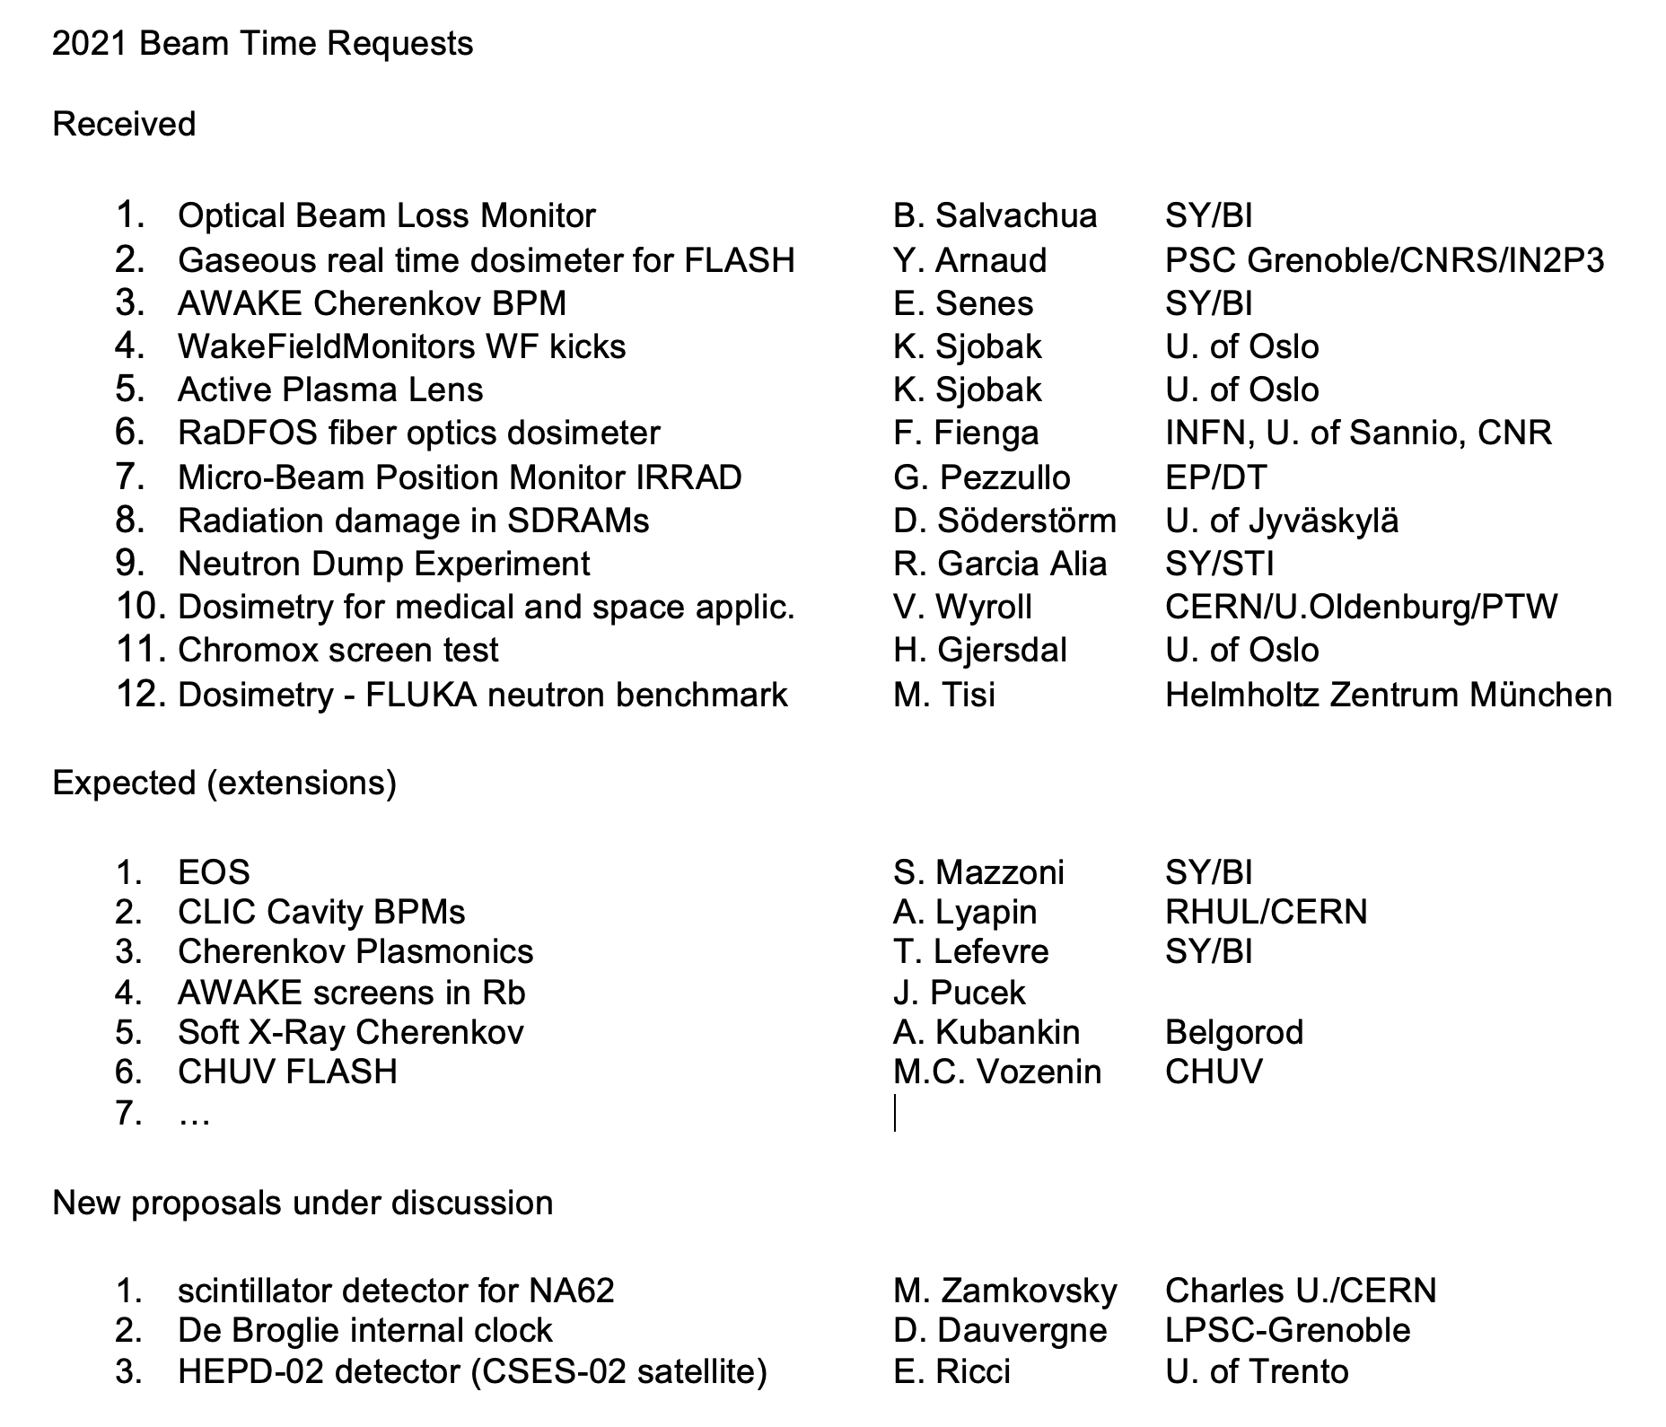
Future program - 2021
Main issue:
Access on site to external users
(Covid-19 situation)
We started discussing with external partners (e.g., CHUV) on the possibility to organize exp. material delivery and remotely supervised installation and data taking.
Interesting to extend scope and parameter range (low intensities)

Slide 9
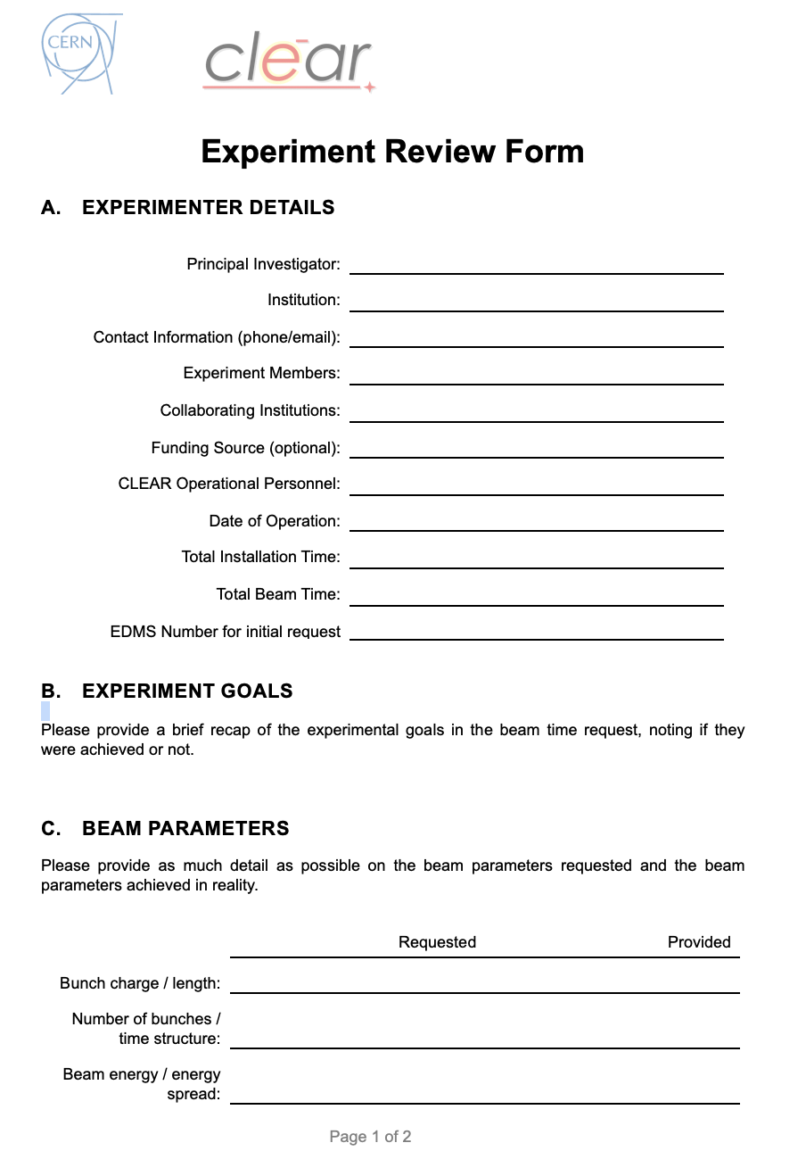
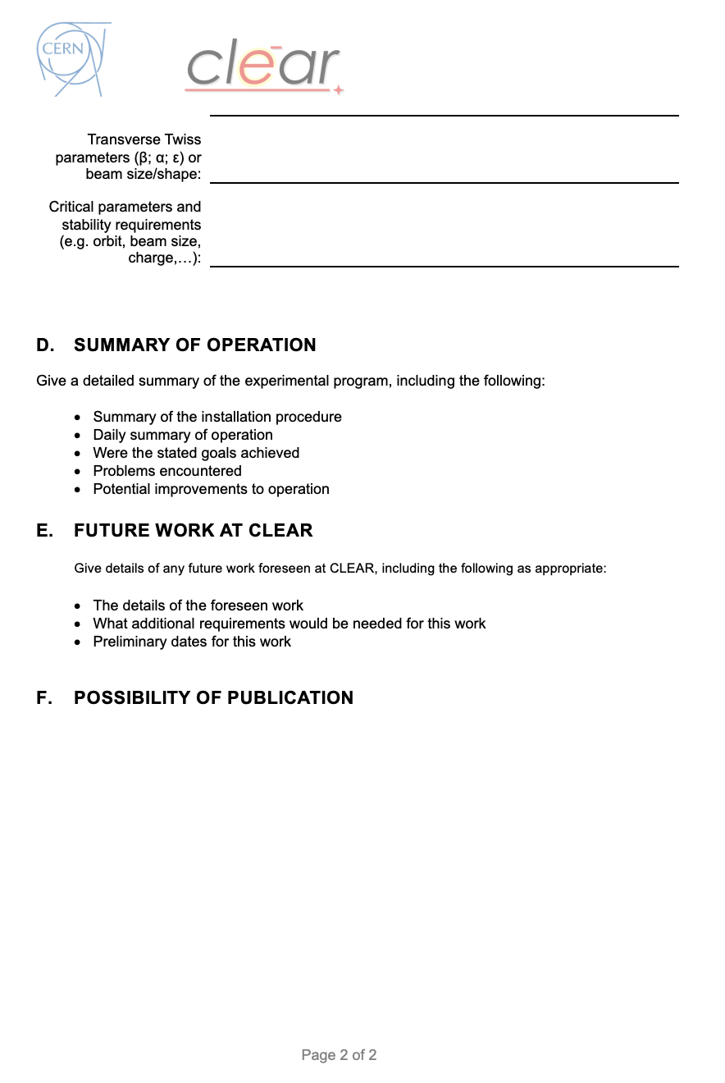
Operation Mode – new approval procedure and follow-up
We are putting in place a new approval procedure through EDMS (Gerry’s talk)
  Should help to keep track of requests
  in an easier way
  Will provide easier access
  to documentation, and better tracking
  Ensures all stakeholders are informed
We have also prepared a new follow-up form for users, to be filled-up after an experiment has taken place

Slide 10
Future program – main trends for next years
Main themes:
  VHEE/FLASH activities – very active, essential for CERN-CHUV FLASH collaboration
  Beam Diagnostics R&D – not just for CLIC/AWAKE
  Irradiation – extensive program outlined by Andrea
  Future accelerators – now CLIC (ILC) and AWAKE (see Steinar’s and Edda’s talks)
    continuation of Plasma Cell activities, possibly toward acceleration tests?
    (potential collaboration with SPARC – INFN/LNF)
    Extend to FCC-ee?
Some activities not fully followed-up at present
  THz power generation & use
  Impedance measurements with beam
Keep opportunities for other users from CERN and outside…

Slide 11
Future program – something more on VHEE/FLASH
Main points of present/future program on VHEE/FLASH
  Demonstrate FLASH sparing effect at high energies (> 50 MeV)
  Develop real time dosimetry at high doses
  Precise dose deposition studies for VHEE (e.g., nonuniformities…)
  Focusing and steering for VHEE and VHEE/FLASH
  Understand influence of beam time structure on FLASH effect
  Understand dependence from energy on FLASH effect
  Fractioning with VHEE/FLASH
  Clarify biological mechanisms (DNA, oxygen depletion)
  Comparison with proton and gamma FLASH
  Complement CERN-CHUV collaboration on future FLASH facility

Slide 12
Future program – transnational access
Discussion ongoing with M. Vretenar to include CLEAR in the next EU call for TransNational Access (TNA) funds
Aim: 350 kEuros over 4 years
Mainly support for visitors – possibly including operation support by collaborators
CERN does not charge beam time, but some potential for improvements of beam lines
Include potential access for external users to X-Boxes, or S-band testing
Will keep exploring possibilities of external funding – e.g., for VHEE/FLASH

Slide 13
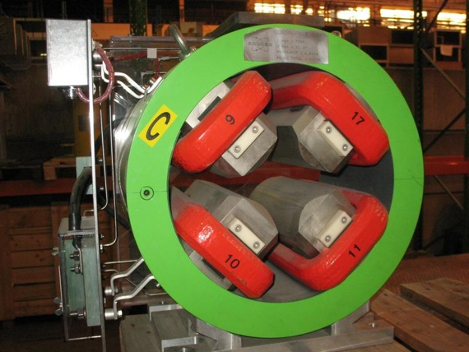
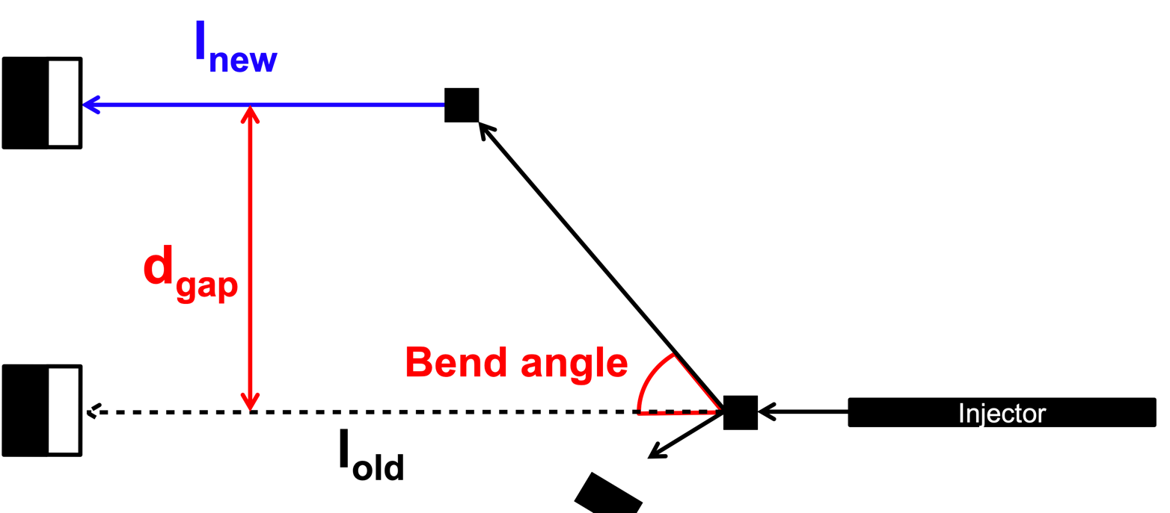
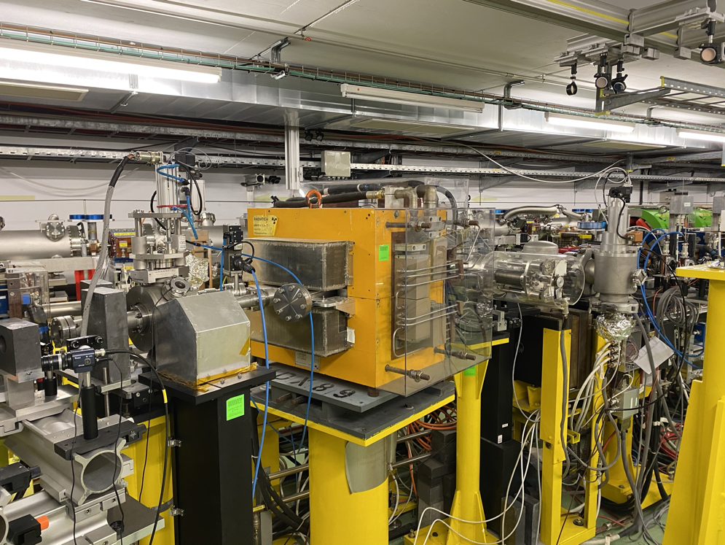
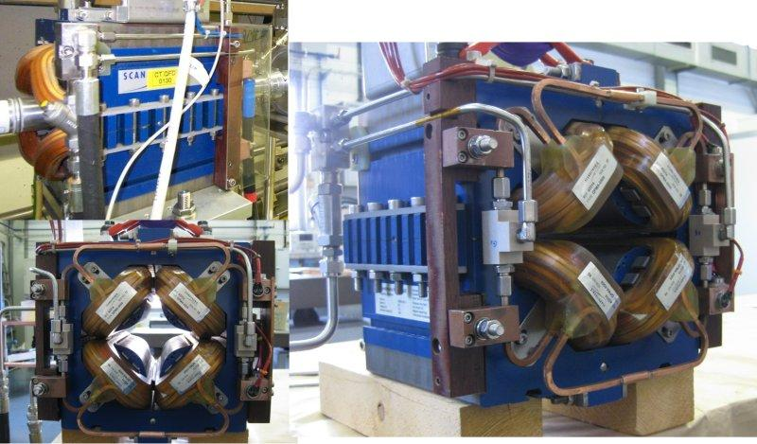
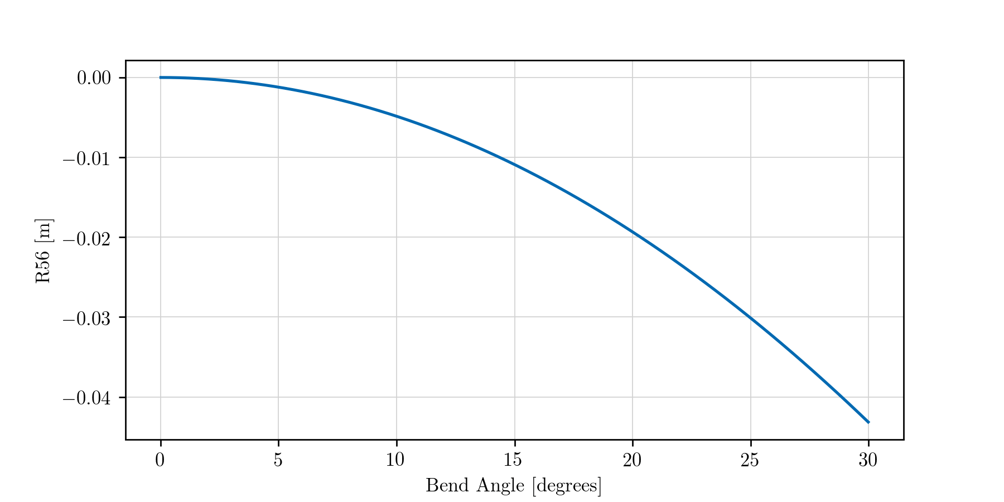
Upgrades – dog-leg beam line
We recently restarted studies on an additional dog-leg beam line (L. Dyks)
L = 8 m
1.5 m
20 degrees
Some of the available quads
L = 12 m
MDX Magnet
Converging on a simple achromat solution, branching off at VESPER location, angle ~ 20 deg
Should preserve bunch length or allow for moderate compression (sub-ps bunches as a requirement)
Re-use CTF3 dipole and quads, existing power supplies…
If a solution is found, we will produce a precise costing

Slide 14
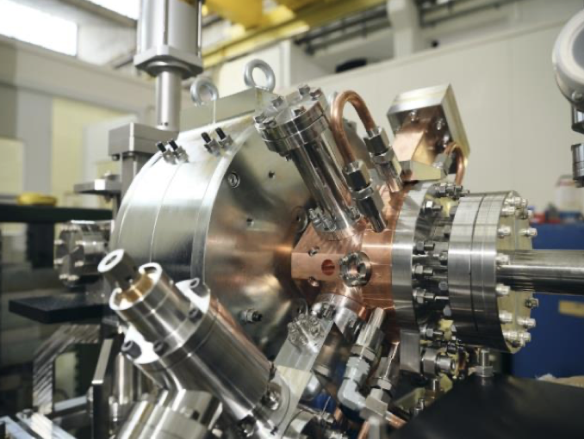
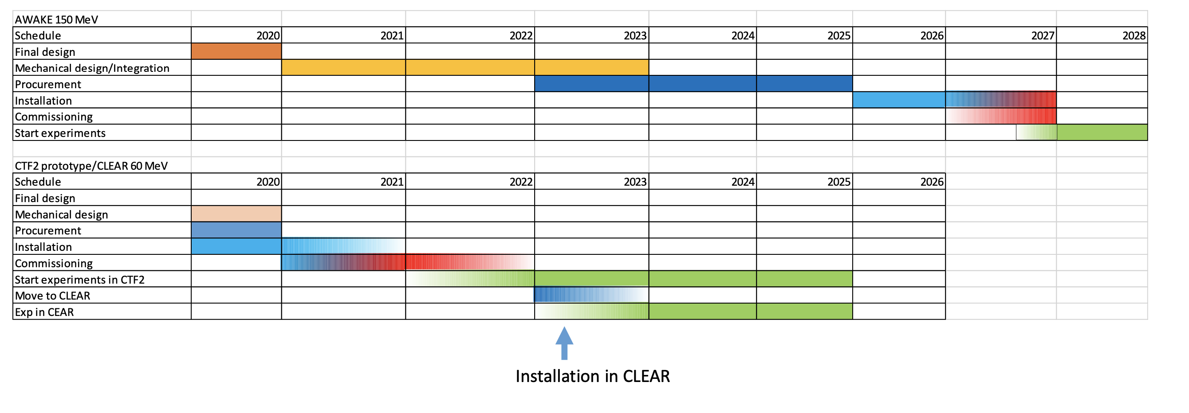
Upgrades – new source
Described in Edda’s talk
Commissioned in CTF2 area from 2021 to 2022
Eventually moved to AWAKE for second run in 2026
Two options for CLEAR:
  Move after commissioning to CLEAR, use in 2023-2025
  Use after commissioning in CTF2 as independent beamline
Resources in CLIC/AWAKE – CLEAR resources will eventually cover operation and move to CLEAR

Slide 15
A few considerations on consolidation needs
Laser: main consolidation carried out – should explore potential for an higher rep rate option (interest for FLASH experiment)
Vacuum – most of the needed consolidation has been already carried out
Controls – some done in past years – what remains is still to be evaluated
Modulator/Klystrons – we have a few spares, but not enough for 5 years
– issue: distribute corresponding spending evenly

Slide 16
Future mode of operation and some worries
Keep operation mode similar to the present one > maintain operation flexibility
While having a more formal beam time allocation process (to cope with more requests?)
  Risk of loading too much the operation team.
  If not able to satisfy all requests > need scientific evaluation.
  Periodic review by Scientific Committee?
  Keep reserve beam time available for pre-approval tests?
> suggestions welcome
Small operation team, made-up by not permanent staff > risk to fall under the critical mass and/or loose continuity.
Some vulnerable point in technical support expertise (e.g., cathode production and, to a lower extent, laser.)
Ensure continuity for retiring staff > e.g., Experimental Safety Officer…
Technical support is now adequate, but only marginally

Slide 17
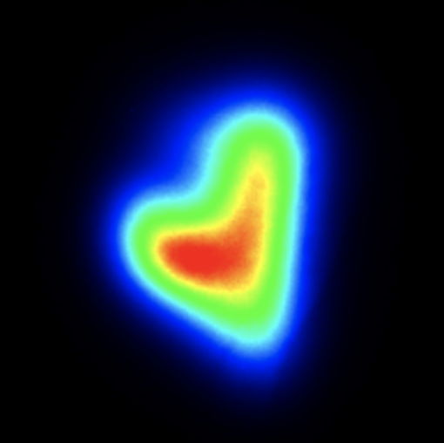
Thanks for your attention!

