Slide 1
Beam Diagnostics R&D
S. Mazzoni on behalf of the beam instrumentation teams
CLEAR review, 16 March 2021

Slide 2
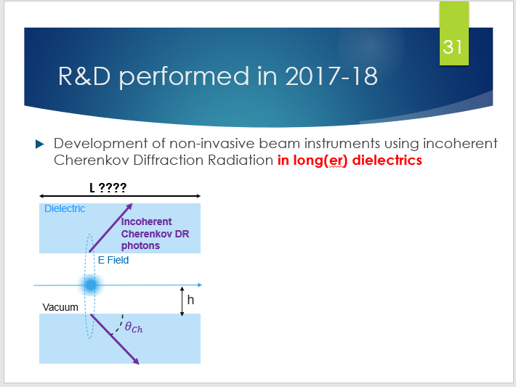
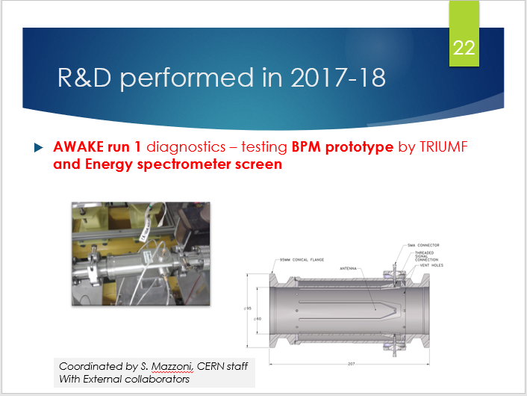
CLEAR as a BI test facility in 2019
CLEAR review 2019. Focus on BI R&D:
  First tests of coherent and incoherent ChDR for BI applications.
  Fundamental BI R&D
  CLEAR as a platform for sub-THz R&D
BI tests for future / current facilities
  First tests for AWAKE (e- BPMs, EOSD)
  cavity BPMs for CLIC

Slide 3
A BI R&D programme at CLEAR
Many concepts became protoype instruments / techniques for AWAKE, HL-LHC, FCC:
  ChDR BPMs
  ChDR bunch length
  ChDR / EO bunch length
  EO BPMs
Continuation of R&D on advanced concepts
CLEAR review 2019. Focus on BI R&D:
  First tests of coherent and incoherent ChDR for BI applications.
  Fundamental BI R&D
  CLEAR as a platform for sub-THz R&D
BI tests for future / current facilities
  First tests for AWAKE (e- BPMs, EOSD)
  cavity BPMs for CLIC

Slide 4
A BI R&D programme at CLEAR
CLEAR review 2019. Focus on BI R&D:
  First tests of coherent and incoherent ChDR for BI applications.
  Fundamental BI R&D
  CLEAR as a platform for sub-THz R&D
BI tests for future / current facilities
  First tests for AWAKE (e- BPMs, EOSD)
  cavity BPMs for CLIC
At present five BI tests for AWAKE Run 2
BI tests for SPS, HL-LHC, FCC, CLIC

Slide 5
CLEAR BI test facility in 2021
Tests on prototype instruments / techniques:
  Screens in Rb (CERN / MPP)
  Bunch length using EOSD (CERN)
  Charge calibration (UCL)
  ChDR Bunch Length tests (U man, RHUL)
  ChDR BPMs (CERN, Oxford, TRIUMF)
  SPS Optical BLMs tests
  CLIC Cavity BPMs
  BL tests for FCC/ HL-LHC
  Test of LHC EO BPM (CERN/RHUL)
Continuation of R&D activity
  Validation of ChDR theoretical model
  X- ray Cherenkov Radiation (Belgorod)
AWAKE (see Edda’s pres.)

Slide 6
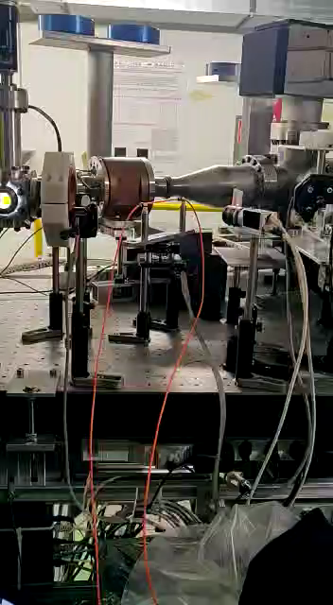
BI tests - status
Optical BLM tests (CERN)
  Test of new optical BLM. Loss signal: Cherenkov Radiation produced in fibres.
  2020: measurement of ChR as a function of angle to benchmark simulations
  2021: improved read-out electronics and new sensors (SiPM, PMT, PD) test with low intensity bunches / trains
  Complement to BL tests in SPS
CLIC cavity BPM tests (RHUL / CERN)
  15 GHz cavity BPMs for high resolution, sub um position measurement
  2021: reinstall three CBPM pickups, and improved front end electronics: integrated analog/digital solution (including analog+digital+FPGA+CPU+EPICS/Tan go) using with an industrial partner (Instrument technologies)

Slide 7
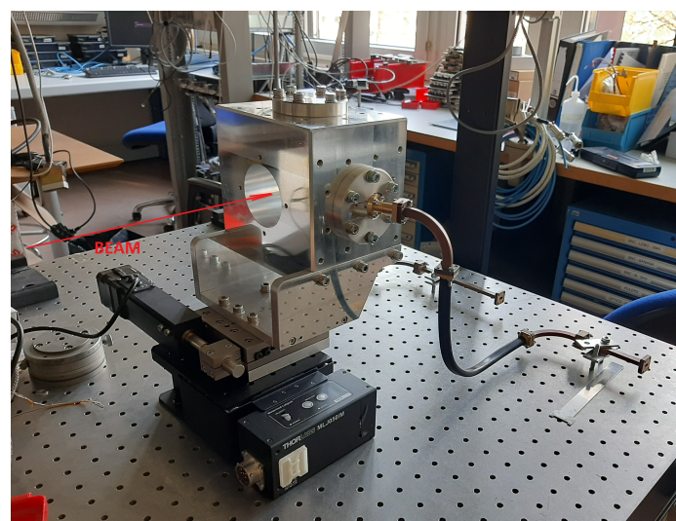
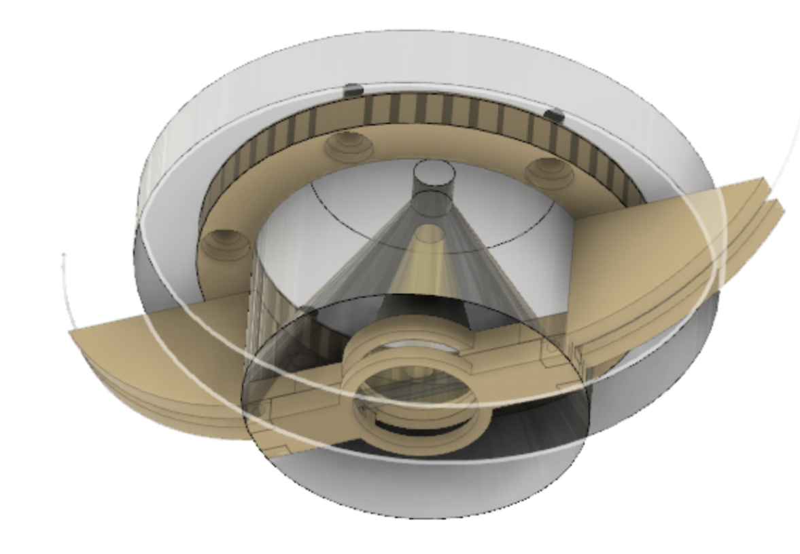
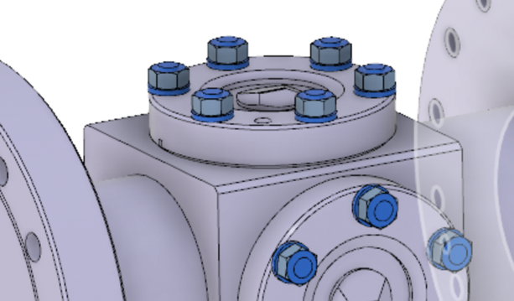
BI tests
Longitudinal profile ChDR / EO tests
  Test of vacuum ChDR pickups for longitudinal profile measurement with ns / tens of ps resolution
  Detection scheme using 20 – 40 GHz electro-optical modulators and 780/1550 nm laser at CLEAR. Other EM probes to test
  Proof of principle at CLEAR, then tests in HRM. Long term study for FCC
Test of LHC EO buttons (CERN/RHUL)
  Beam validation of a technology being developed in collaboration with RHUL for HL-LHC
  Using fiber-coupled electro-optical waveguide coupled to a 50 Ohms terminated electrostatic button

Slide 8
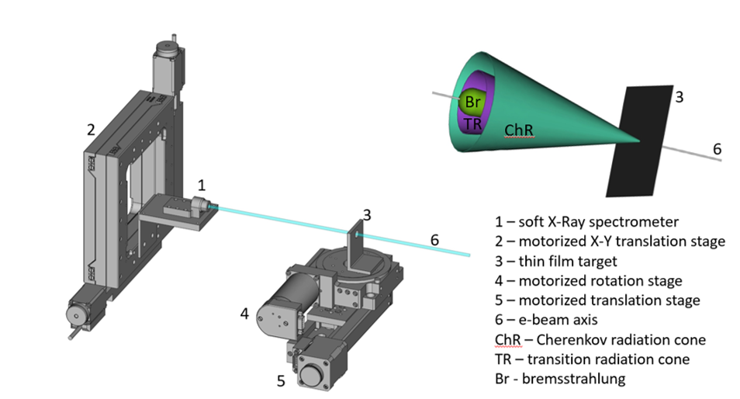
R&D
X-ray Cherenkov test (Belgorod)
  Study of ChR in soft X-rays regime.
  Absolute light yield and angular distribution as a function of target angle
  Preparation affected by COVID. Foreseen 2nd half of 2021
Validation of ChDR theoretical model (CERN)
  Models for ChDR still not fully validated. Basic tests to measure ChDR spectrum in the range 100-300 GHz
  Verification needed for applications to high energy beams (FCC)
  Radiation produced by dielectric conical target, tests in Summer 2021

Slide 9
CLEAR as an ideal BI test facility
Ease of access: weekly access (Mondays), low levels of radiations allow frequent access, in-air test section for simple HW design
Interesting beam parameters: low emittance (3-10 um), sub-ps bunch length, can be easily tuned. Close to AWAKE Run 2d electron line (160 MeV, hundreds of pC per bunch, 200 fs BL). Electrons interesting for future e-p colliders (FCCee, CLIC)
Multiple test-stands: two in-vacuum, 1 metre long in- air. VESPER used for charge calibration tests

Slide 10
Community
User community is expanding presently besides CERN BI group (4 staff, 5 fell/PhD) six institutes involved (Max Planck Institut, University College of London, Royal Holloway University of London, University of Manchester, University of Oxford, Belgorod State University)
Education (PhDs / postdocs a few numbers) several fellows and PhD students trained at CLEAR. Hands-on, comprehensive training, no long shutdowns. In line with CERN goal of “Inspiration and Education”
Recent Publications
  A. Curcio et al, “Diffractive shadowing of coherent polarization radiation”, Phys. Lett. A 391, 127135 (2021)
  A. Curcio et al, “Noninvasive bunch length measurements exploiting Cherenkov diffraction radiation”, PRAB 23 (2020)
  A. Curcio et al. “Beam-based sub-THz source at the CERN linac electron accelerator for research facility”, PRAB 22 (2019)
  R. Kieffer et al, “Experimental Observation of “Shadowing” in Optical Transition Radiation”, Phys. Rev. Lett. 120 (2018)
  Yearly reporting to conferences (IBIC, IPAC, LCWS, …)

