Slide 1
A-Z Walkthrough of the Hardware Installation Process
Olivier Barriere, Ioan Kozsar & Eve Fortescue

Slide 2
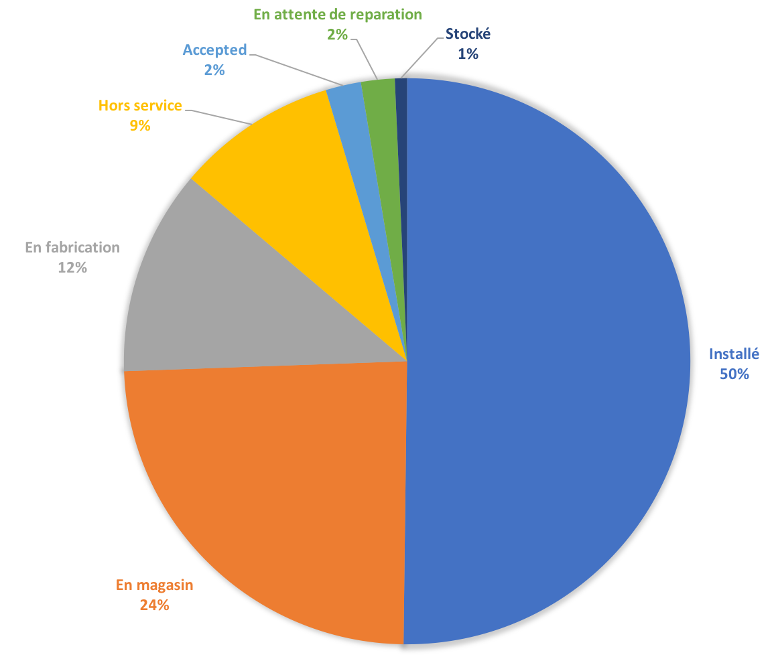
Some Figures
~45,500 CCIB Assets
~3700 Operational Front-Ends declared in CCDB
~15,000 Operational modules declared in CCDB
Notes:
CCDB computers : Just CO ones ? How o differentiate?

Slide 3
Prerequisites

Slide 4
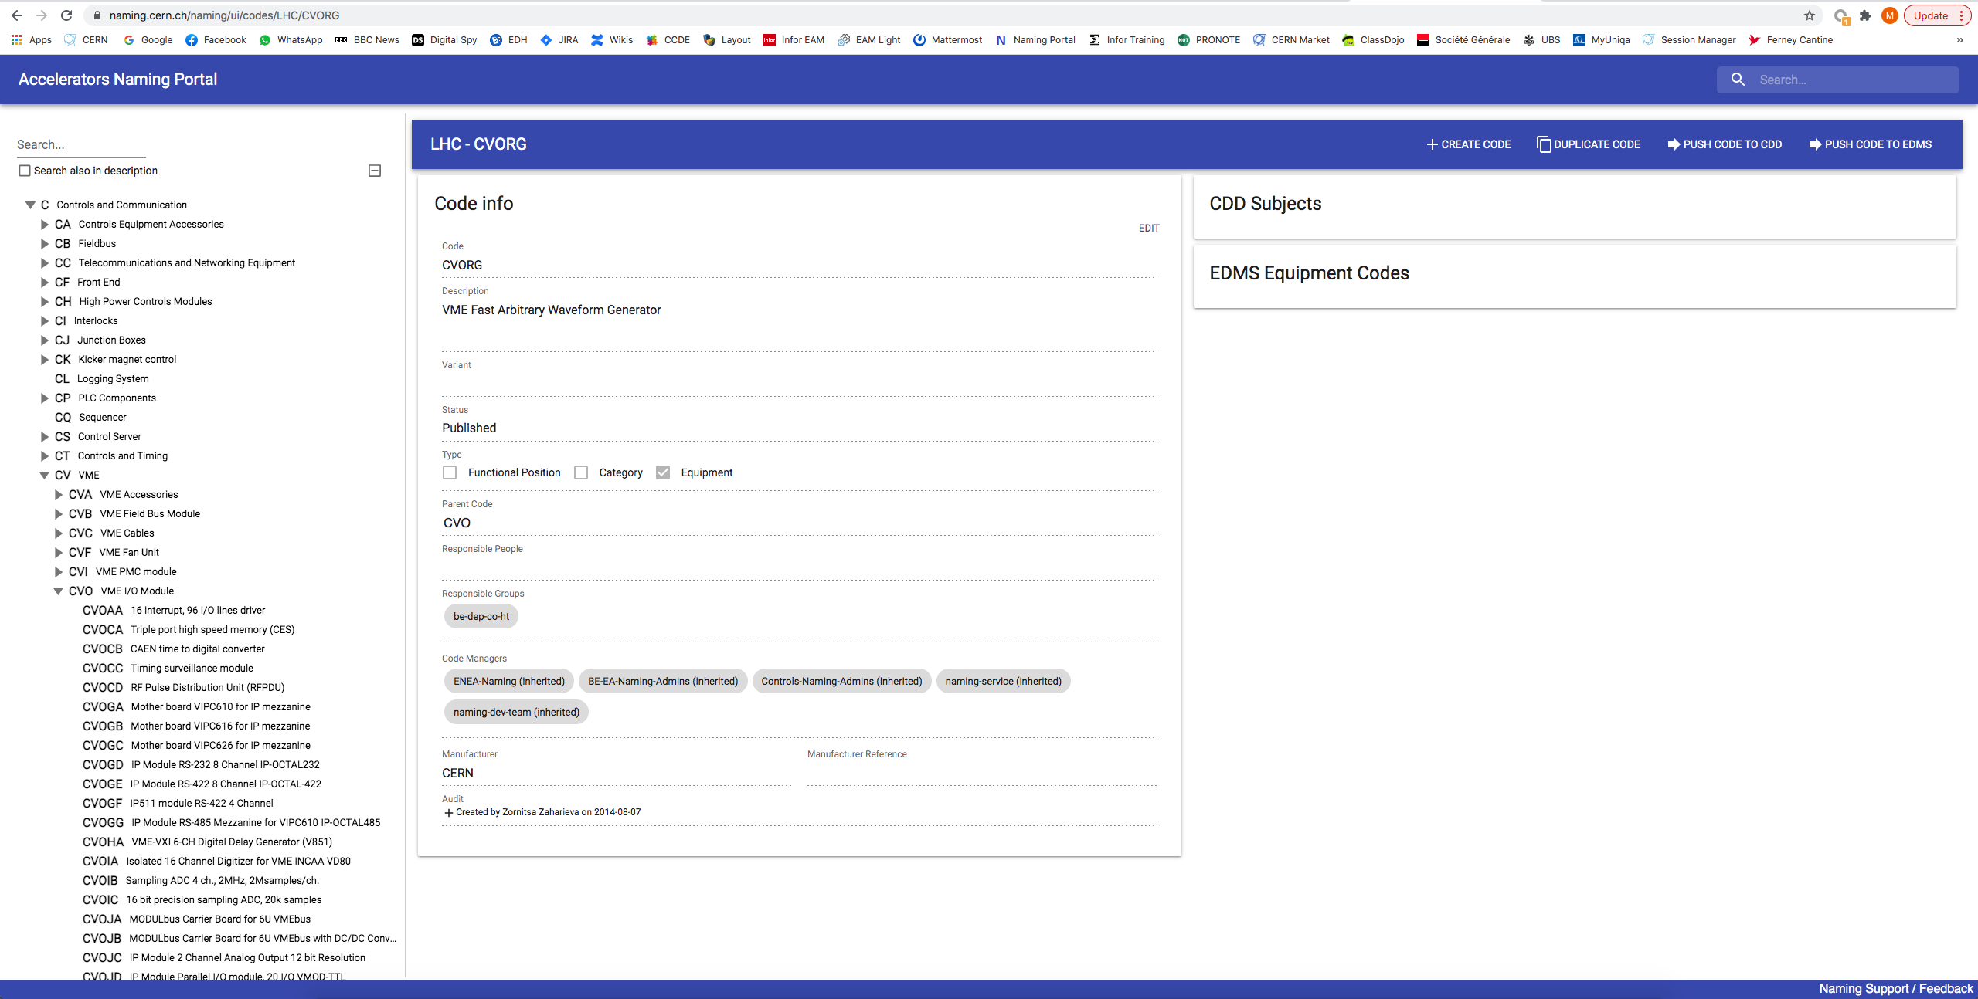
1. Naming Codes defined in Naming DB

Slide 5
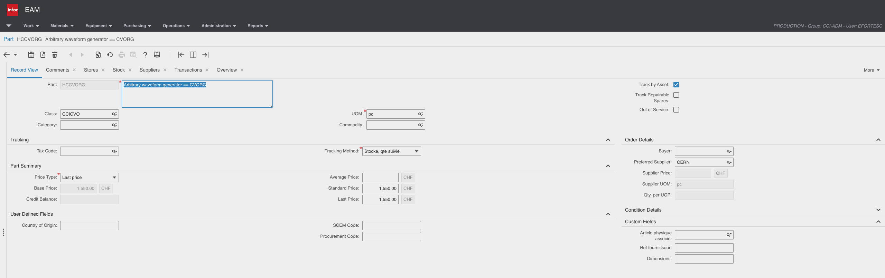
2. Parts created in InforEAM

Slide 6
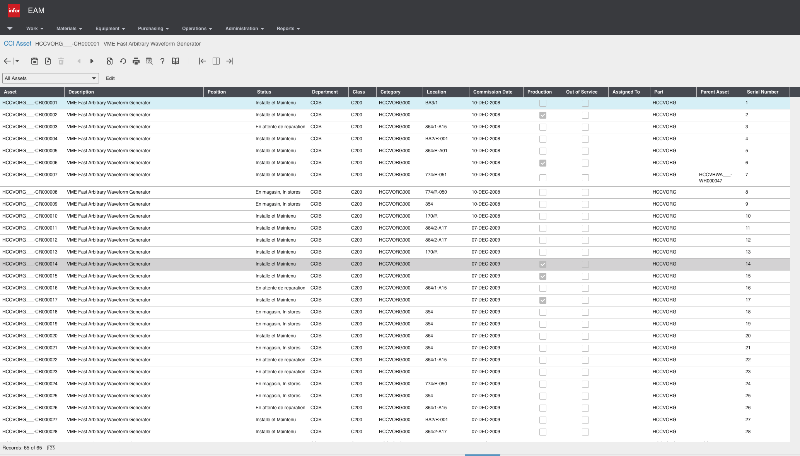
3. Assets created in InforEAM

Slide 7
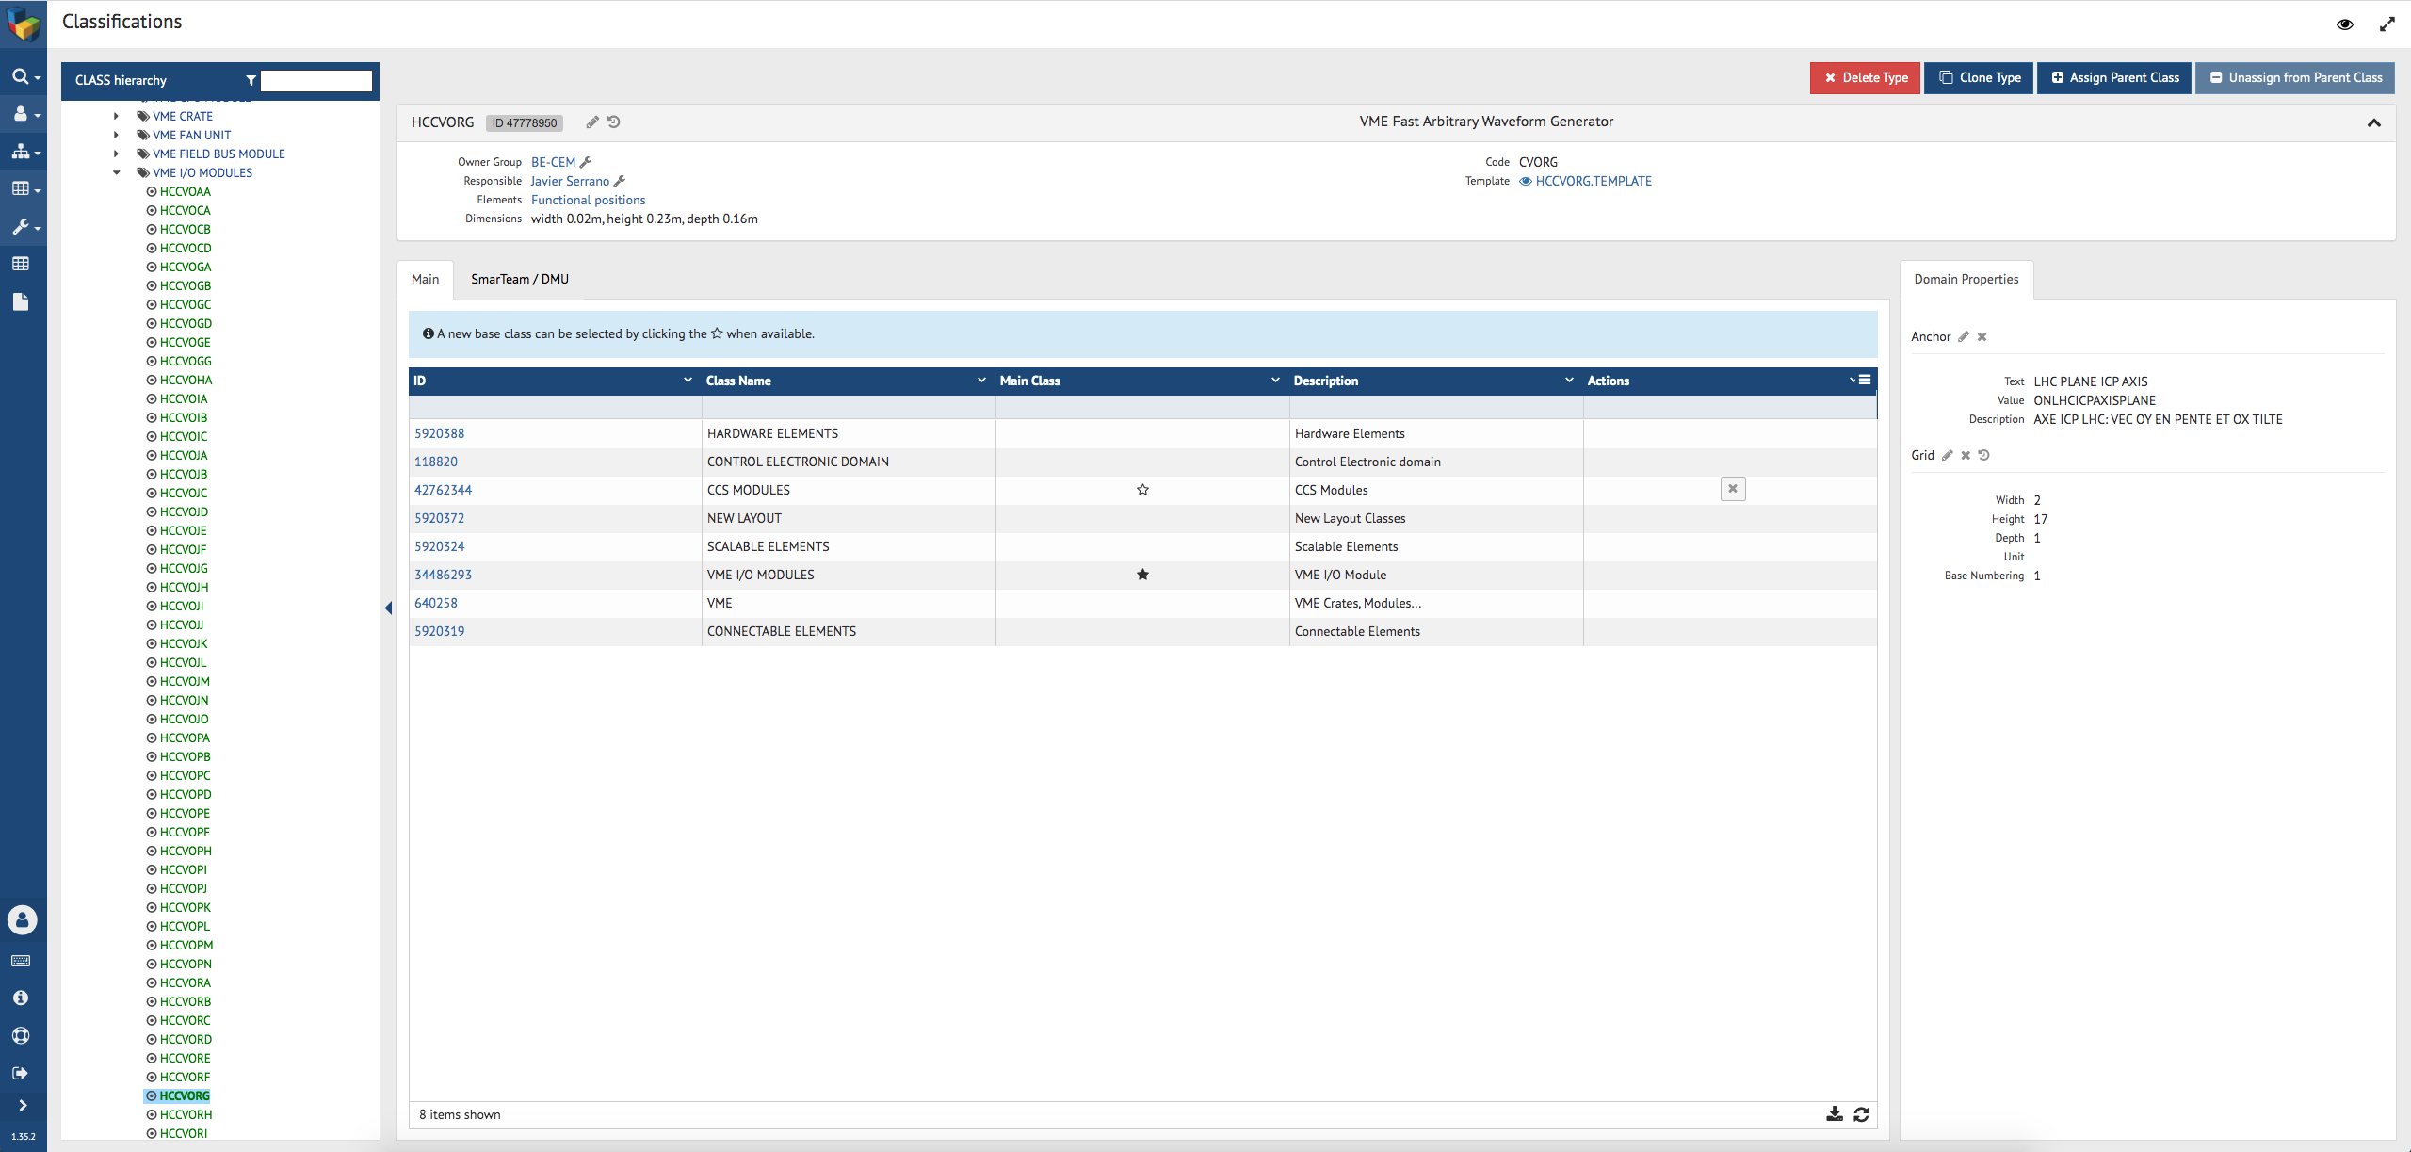
4. Equipment Types defined in Layout

Slide 8
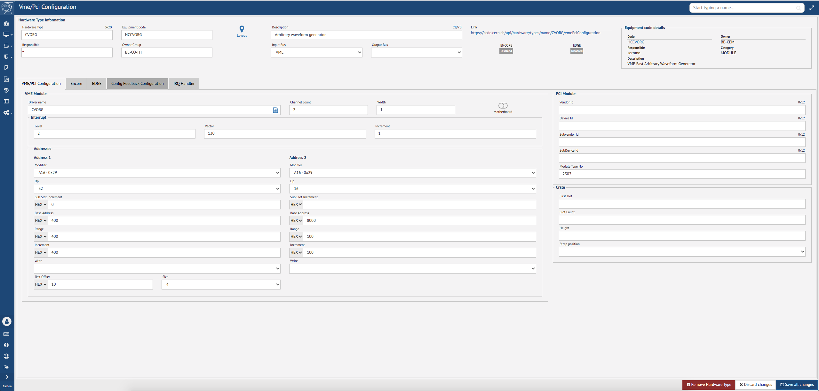
5. Hardware Types defined in CCDB

Slide 9
Installation

Slide 10
An Overview of the Installation Process
1. WT Installation
1
RQF
InforEAM / Kiosq
2
2’
2’’
LanDB
CCDB
Layout
2. WT Asset
3
3. WT Finance
4
InforEAM
SNOW
RQF – ReQuest Fulfilment (SNOW ticket)
WT – Work Task
EDH

Slide 11
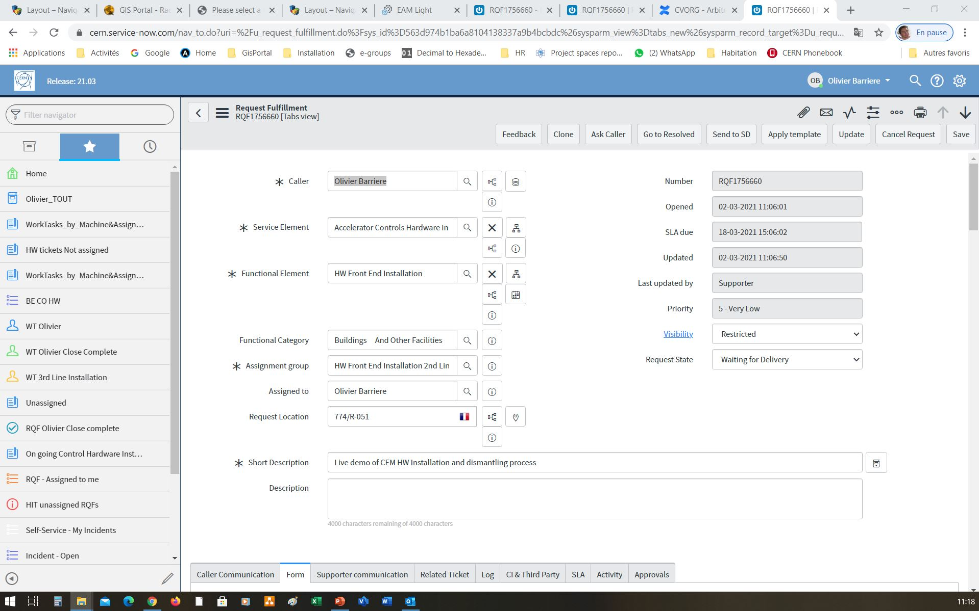
1. Reception of a HW installation Request (SNOW RQF)

Slide 12
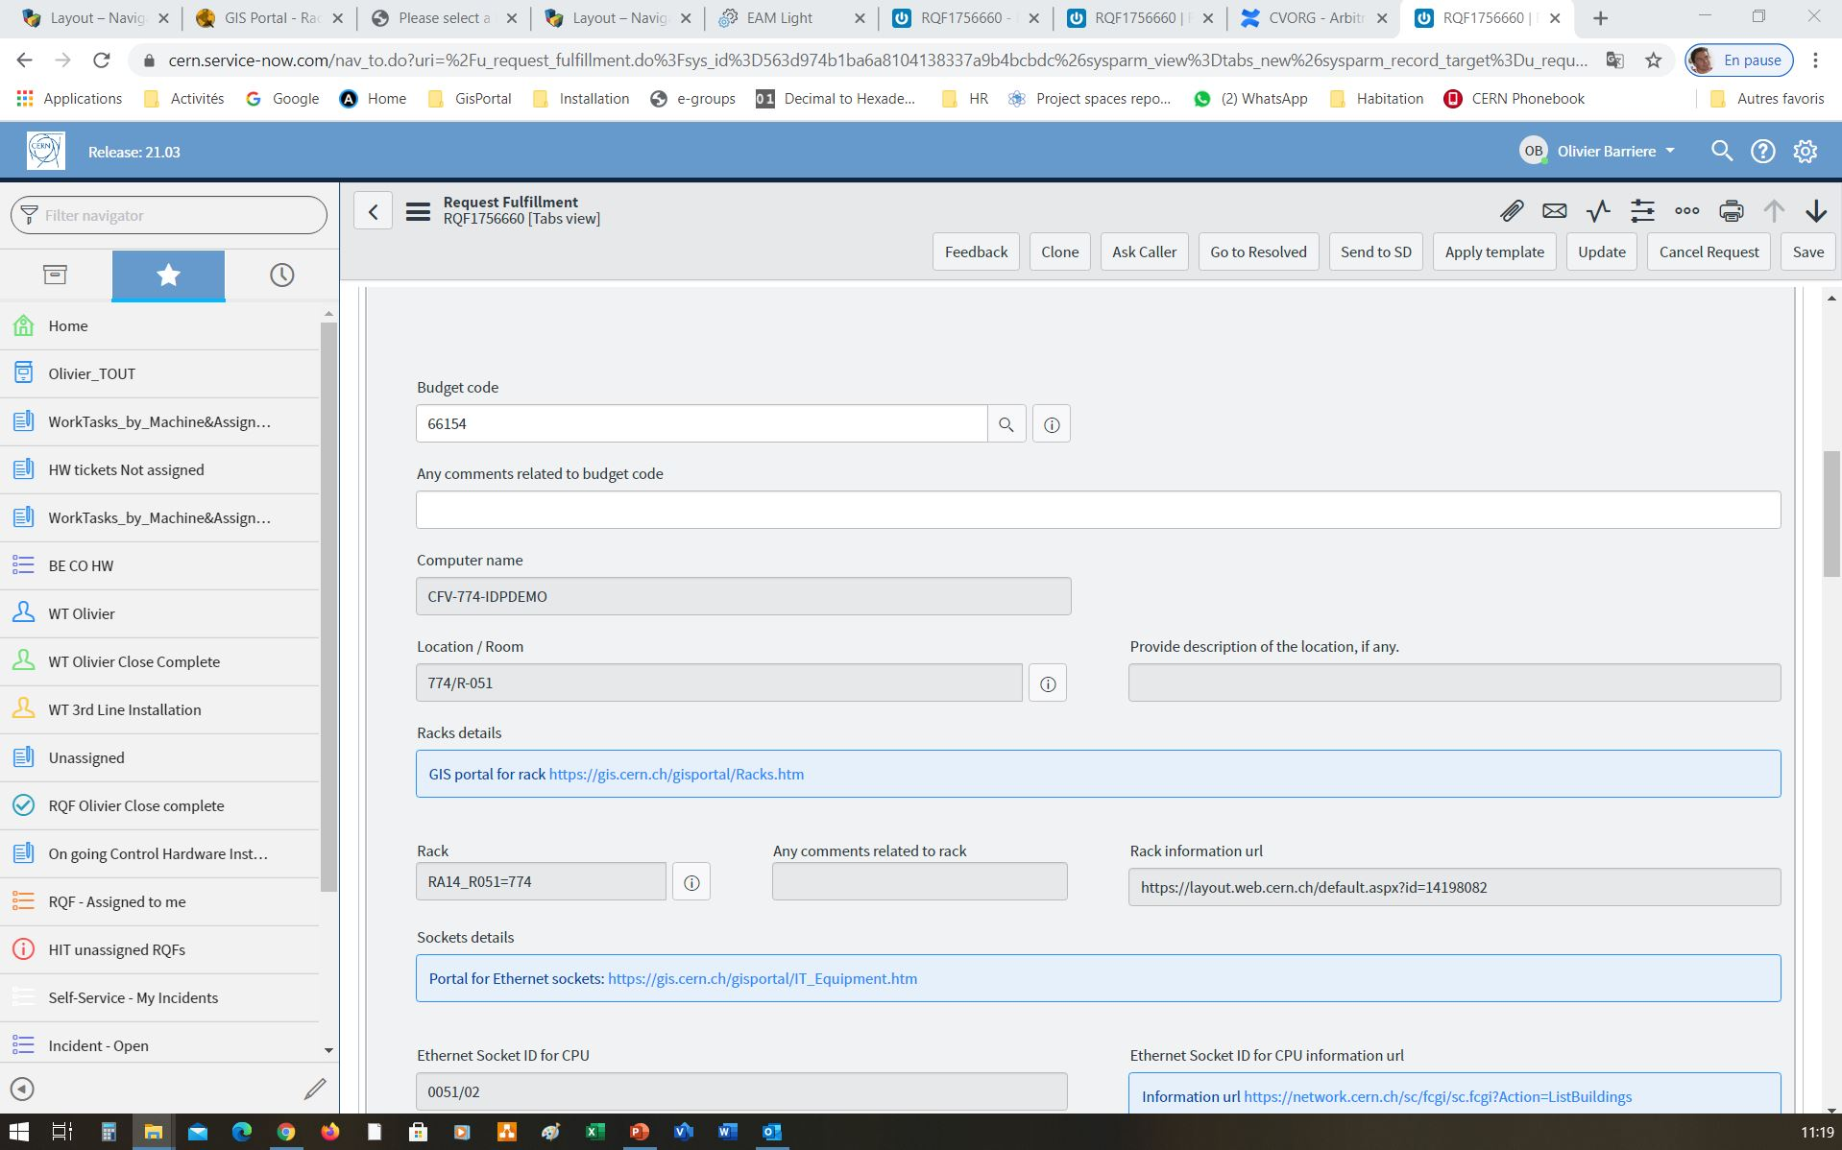
1. Reception of a HW installation Request (SNOW RQF)

Slide 13
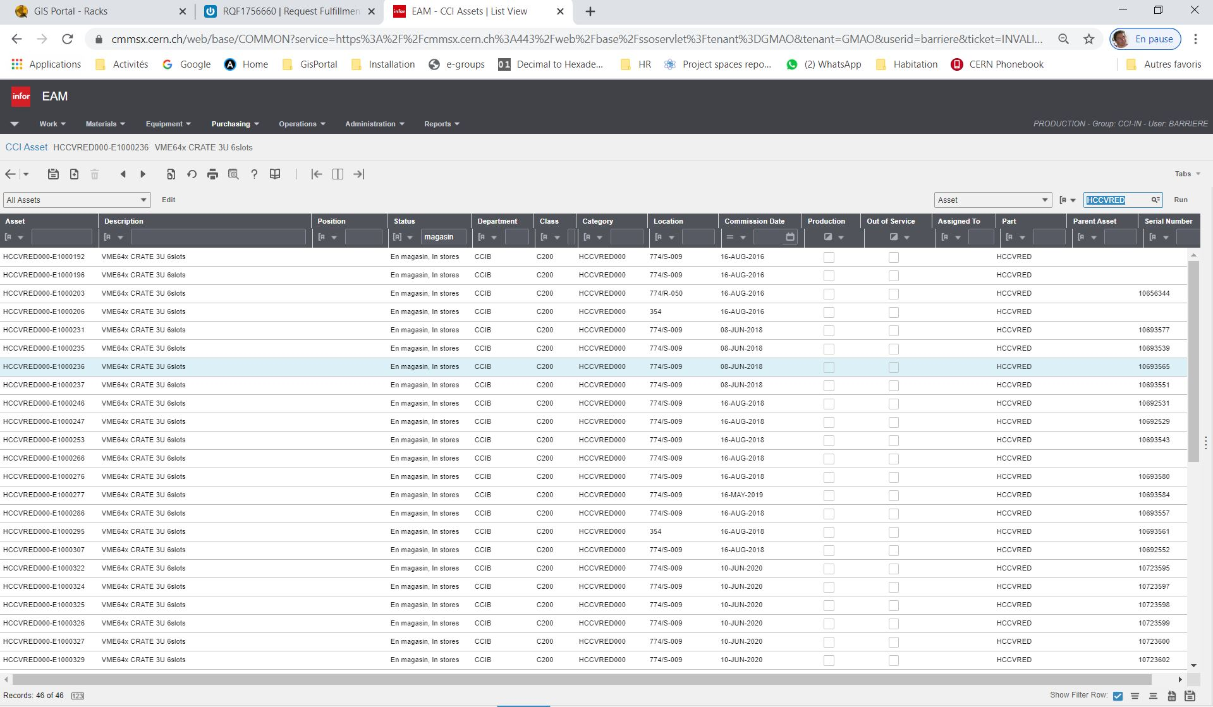
2. Verify in InforEAM in which stores and bins the required equipment can be found
All of the HCCVRED assets available in the stores

Slide 14
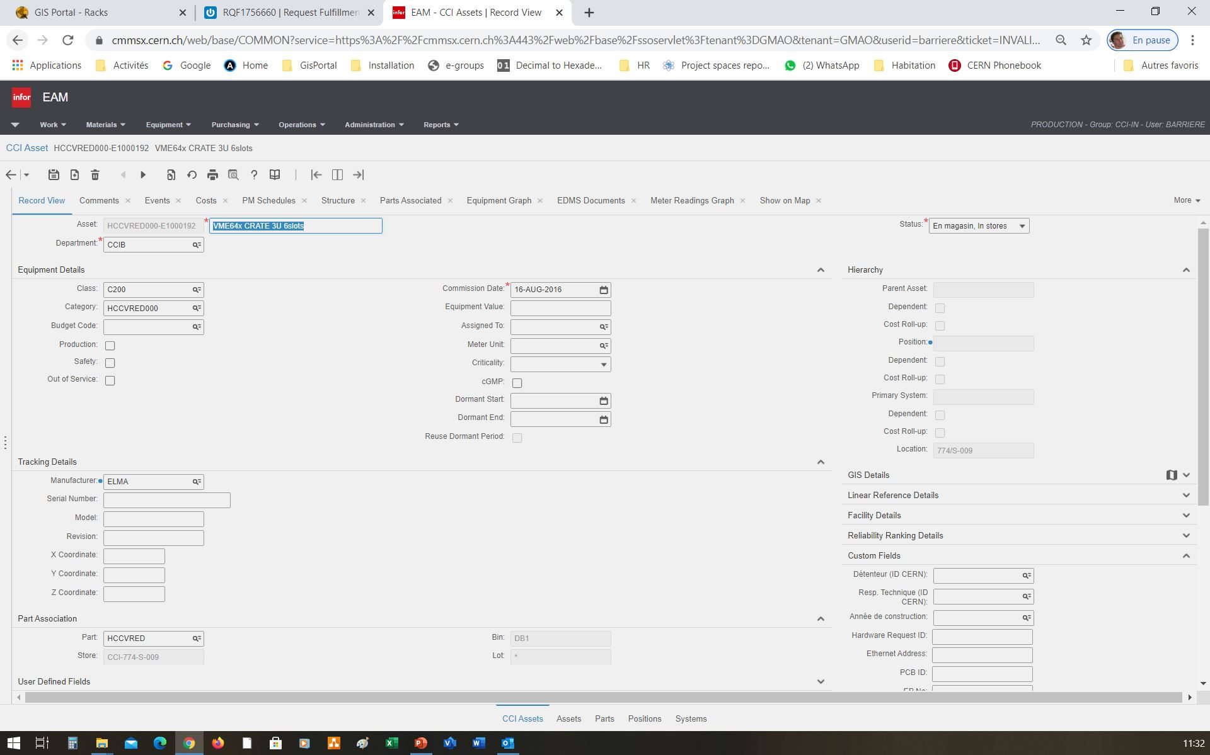
2. Verify in InforEAM in which stores and bins the required equipment can be found
Chassis Asset
“HCCVRED000-E1000192”
Status
“In Stores”
Location “774/S-009”
Store
“CCI-774-S-009”
Bin “DB1”

Slide 15
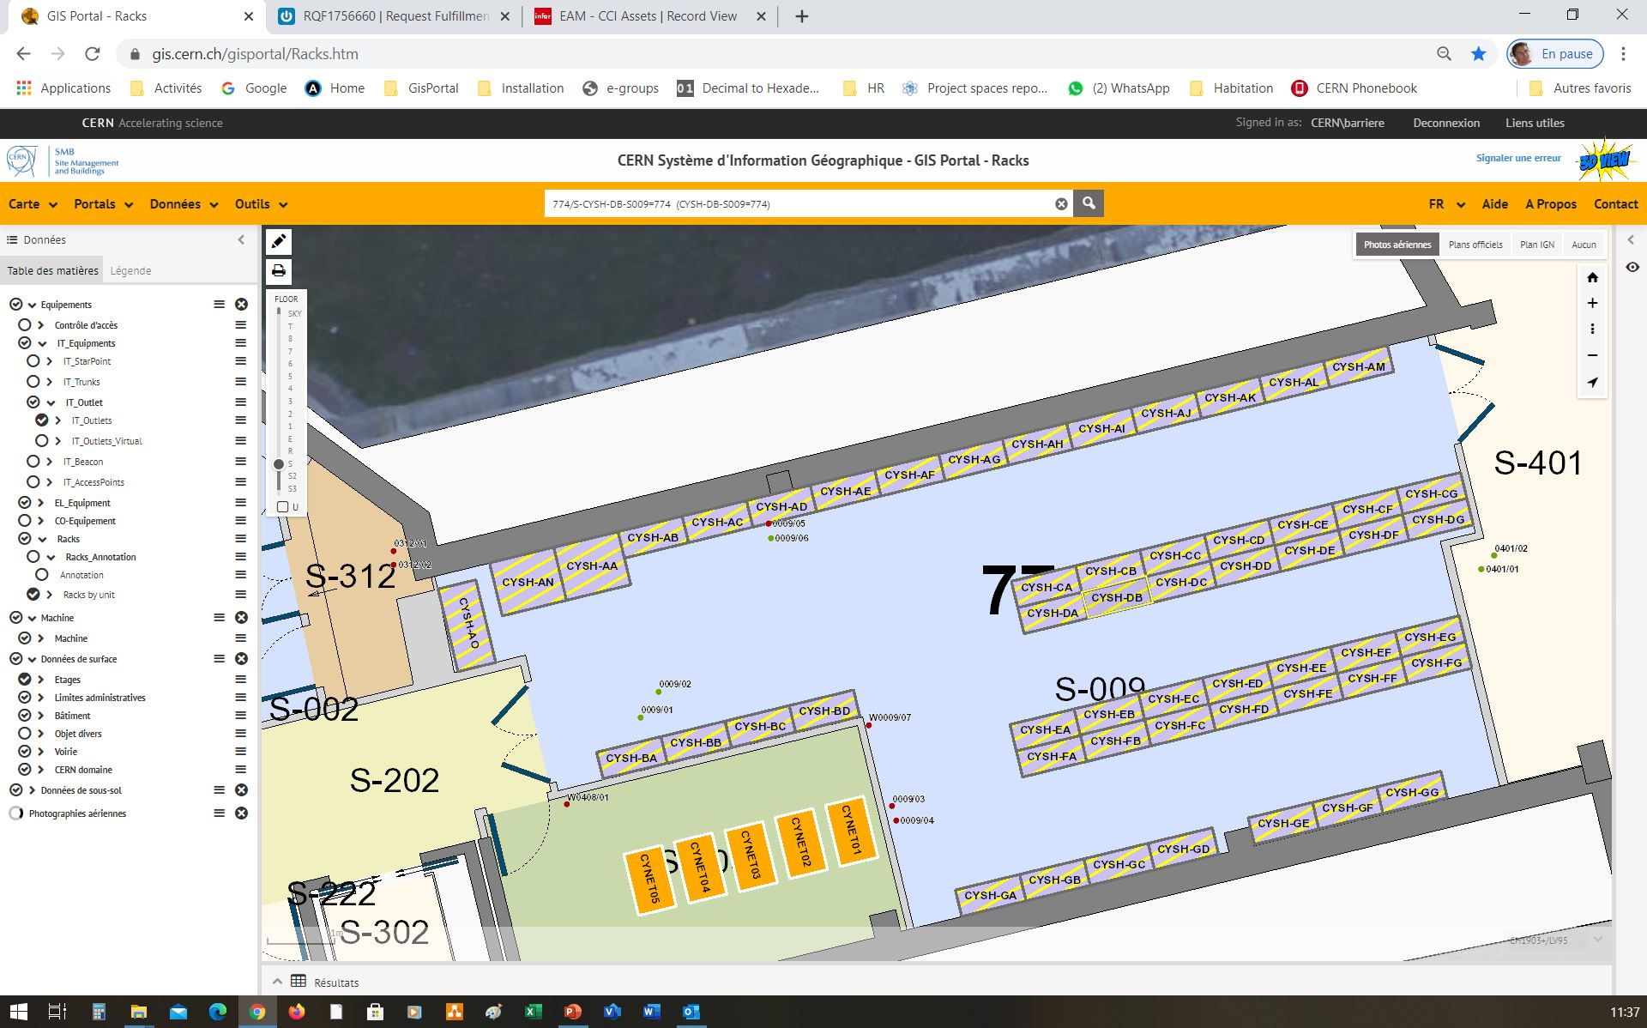
3. Check where the storage racks are in the GIS
Storage Rack “CYSH-DB”

Slide 16
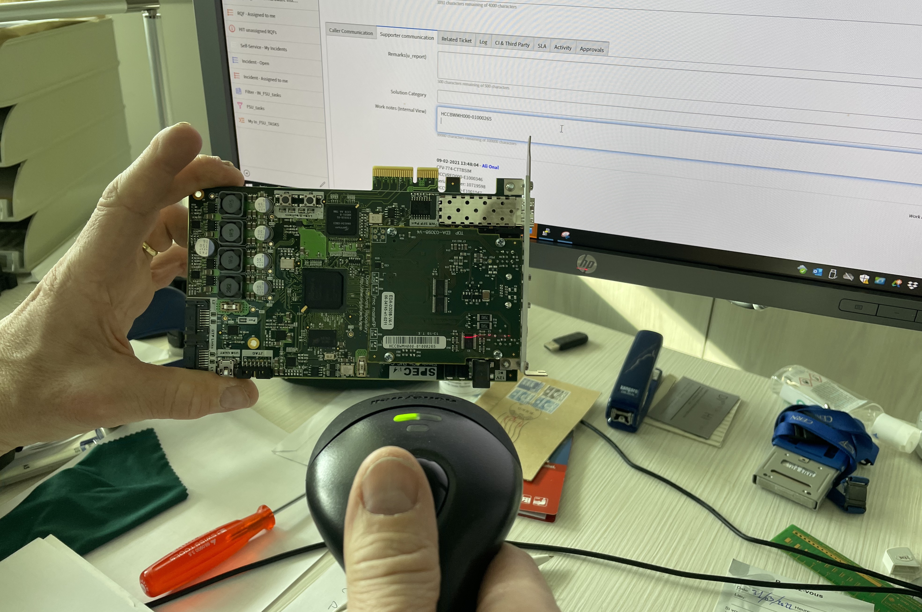
4. Physically remove the equipment from the store and record the assets in the RQF by scanning

Slide 17
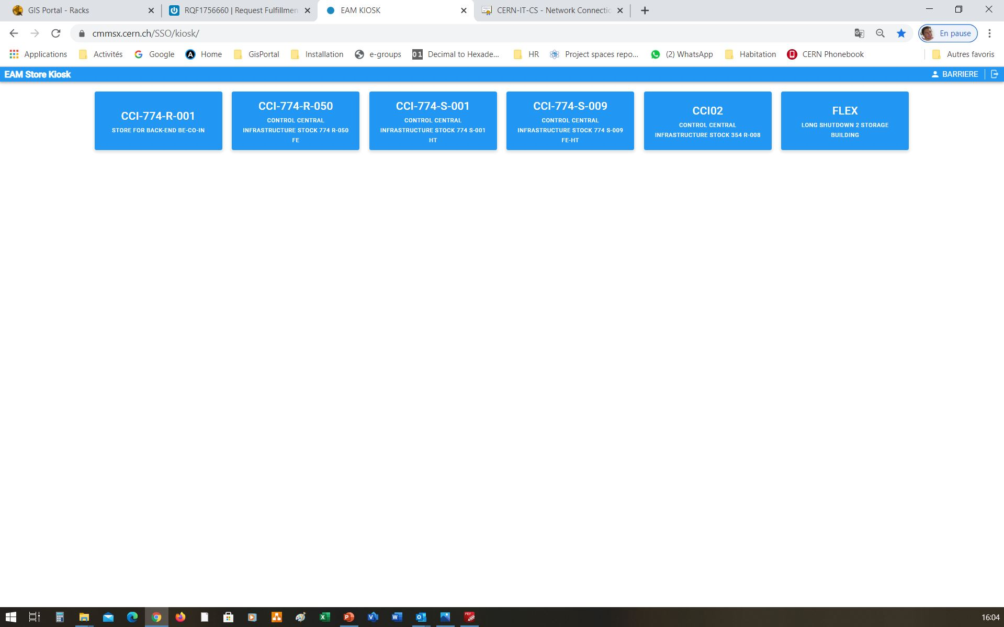
5. Check out the assets from Kiosk
Select the store from which the equipment was taken

Slide 18
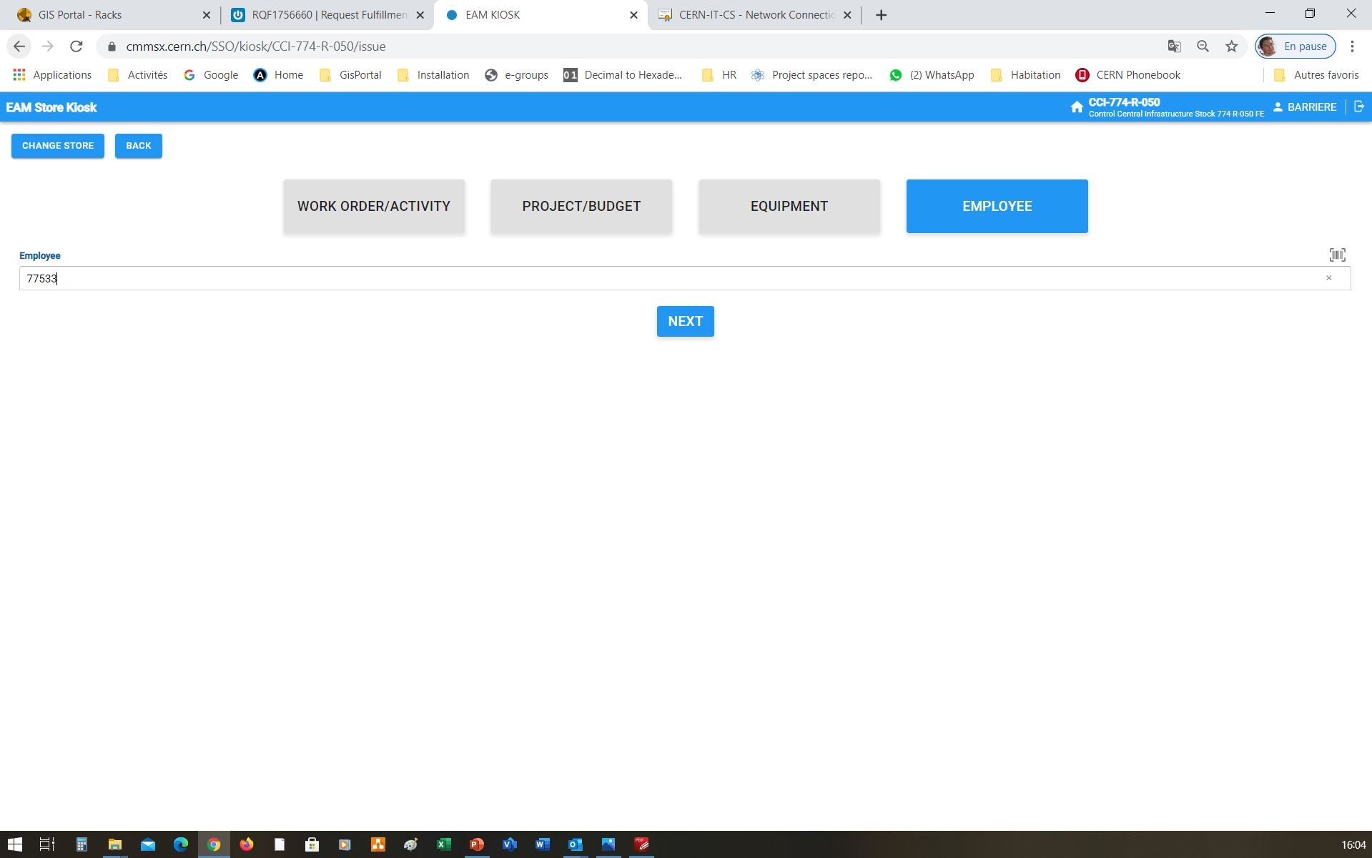
5. Check out the assets from Kiosk
Specify the person who removed the equipment

Slide 19
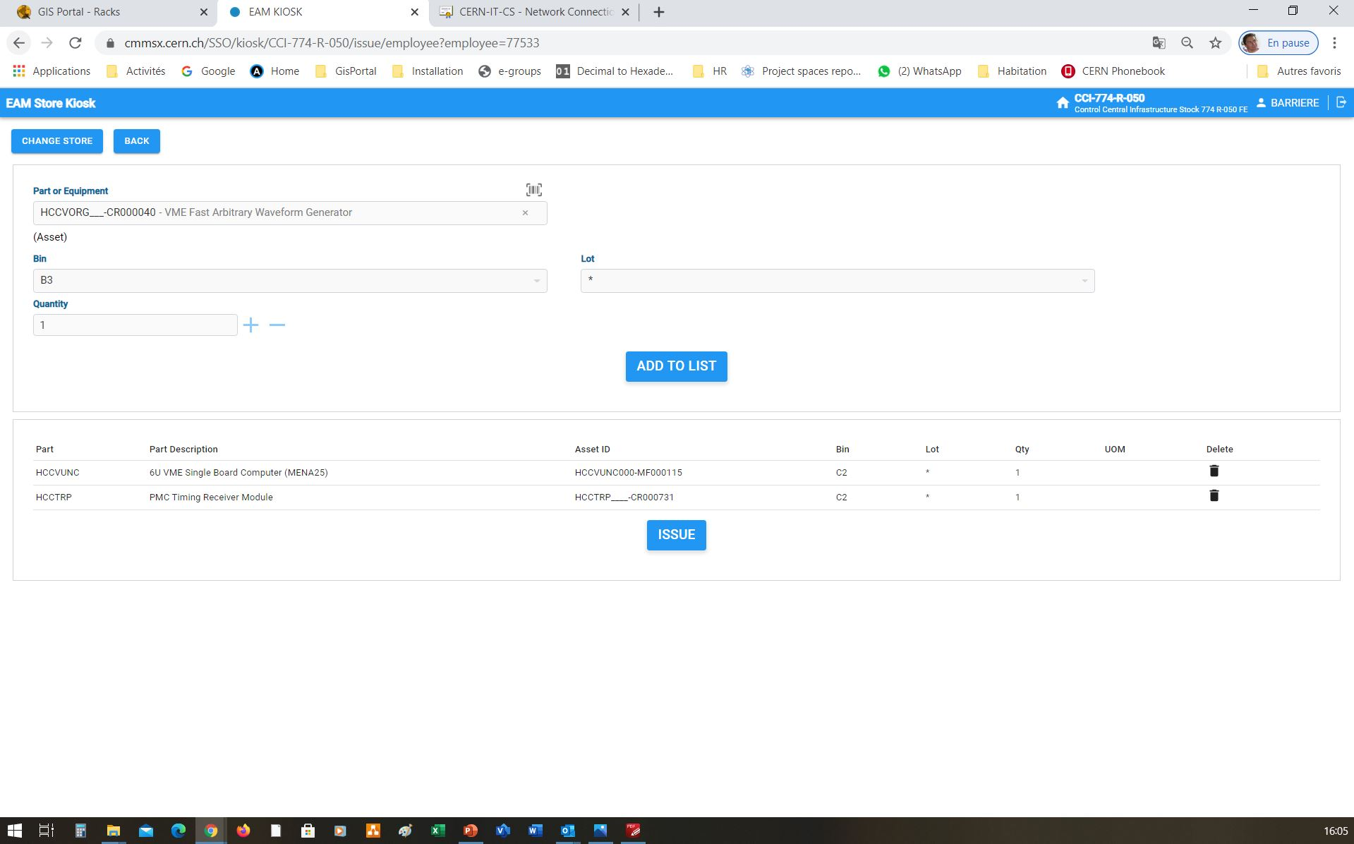
5. Check out the assets from Kiosk
Search Part ID by copying from RQF or rescanning
“Add to list”, then repeat for all assets removed from selected store
“Issue” to check out all of the assets on the list

Slide 20
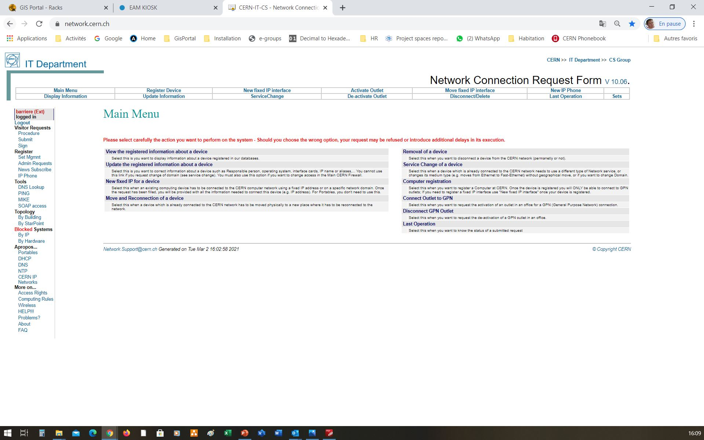
6. Register the devices in the Network DB
Register Device

Slide 21
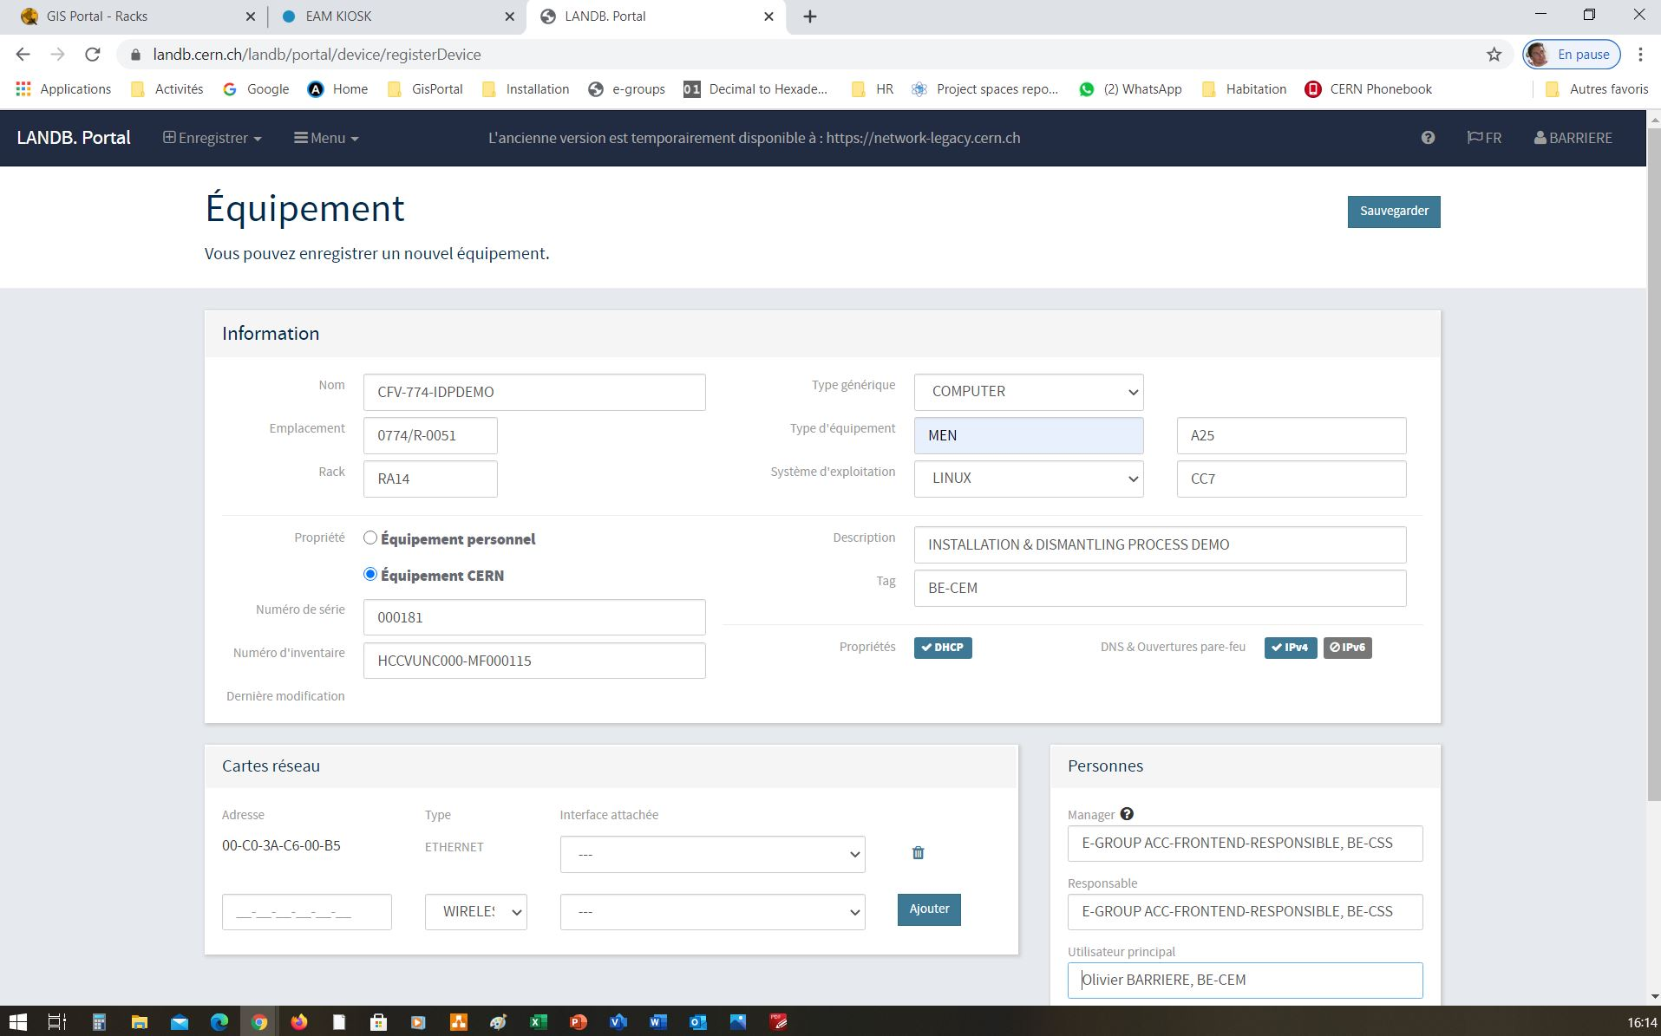
6. Register the devices in the Network DB

Slide 22
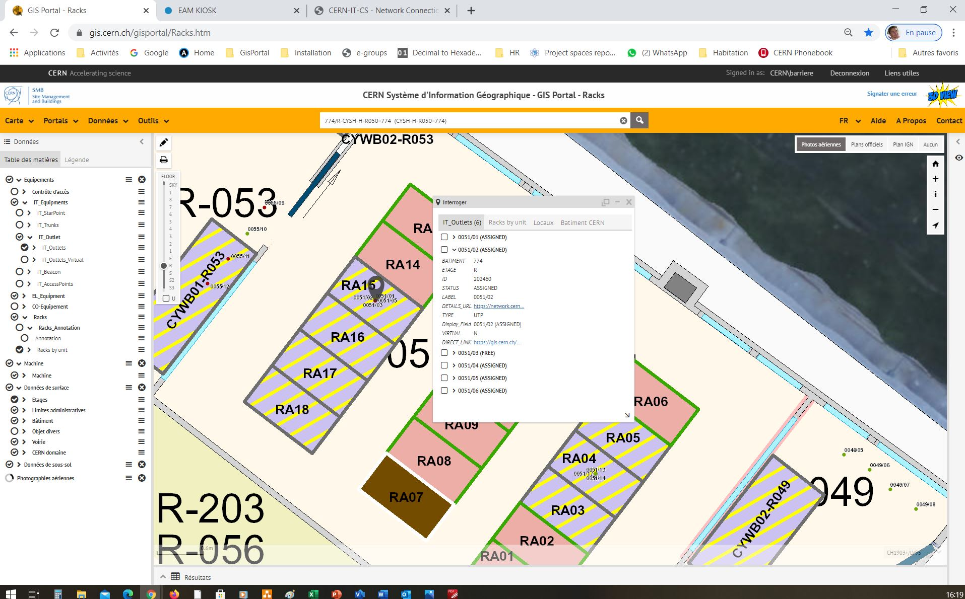
7. Localise the outlets in the GIS

Slide 23
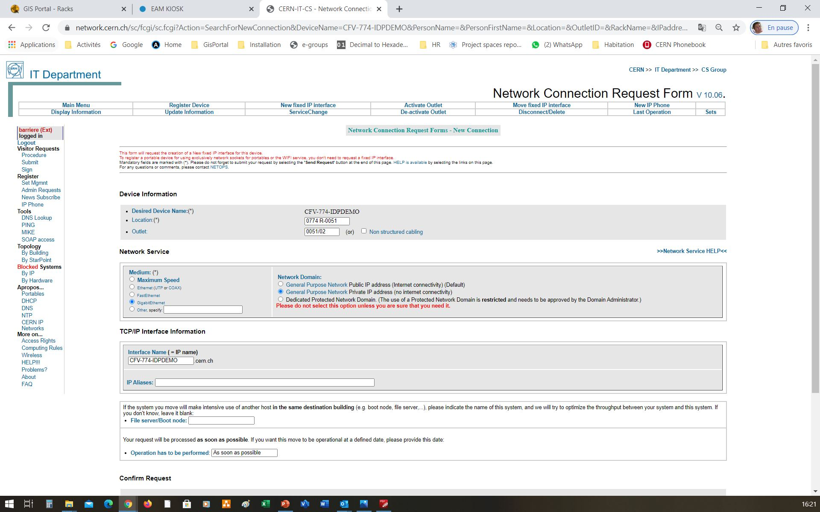
8. Request a new fixed IP interface connection in the Network DB

Slide 24
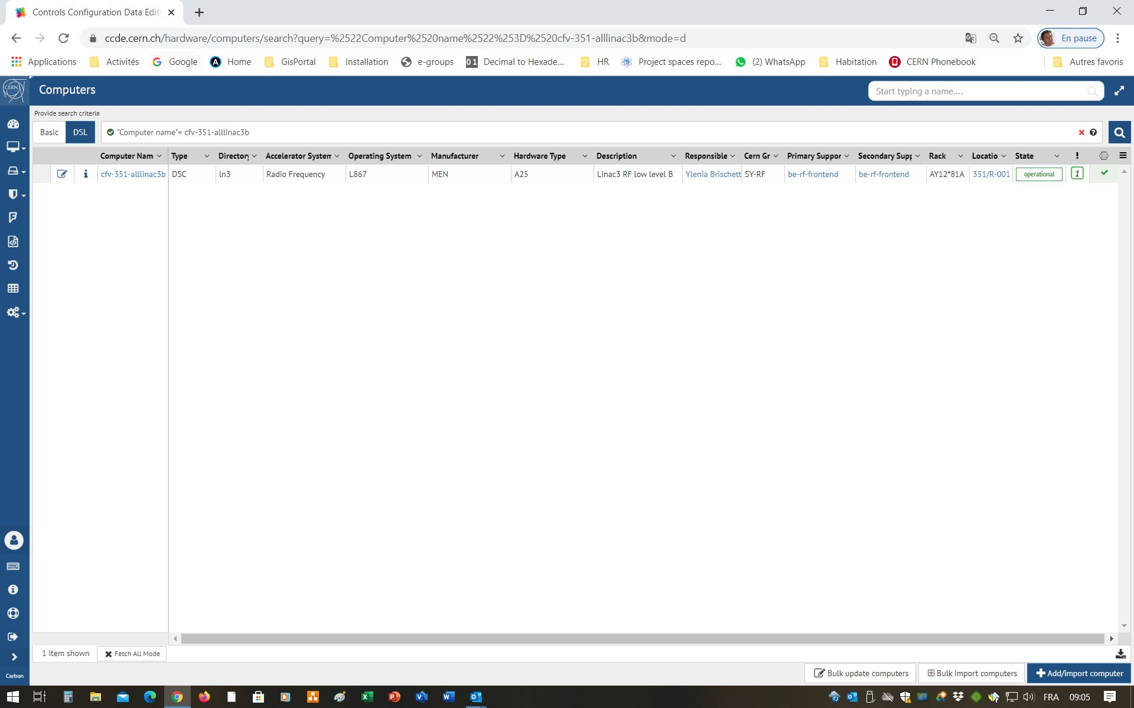
9. Define the computer in the CCDB
Click on
“Add/Import Computer”

Slide 25
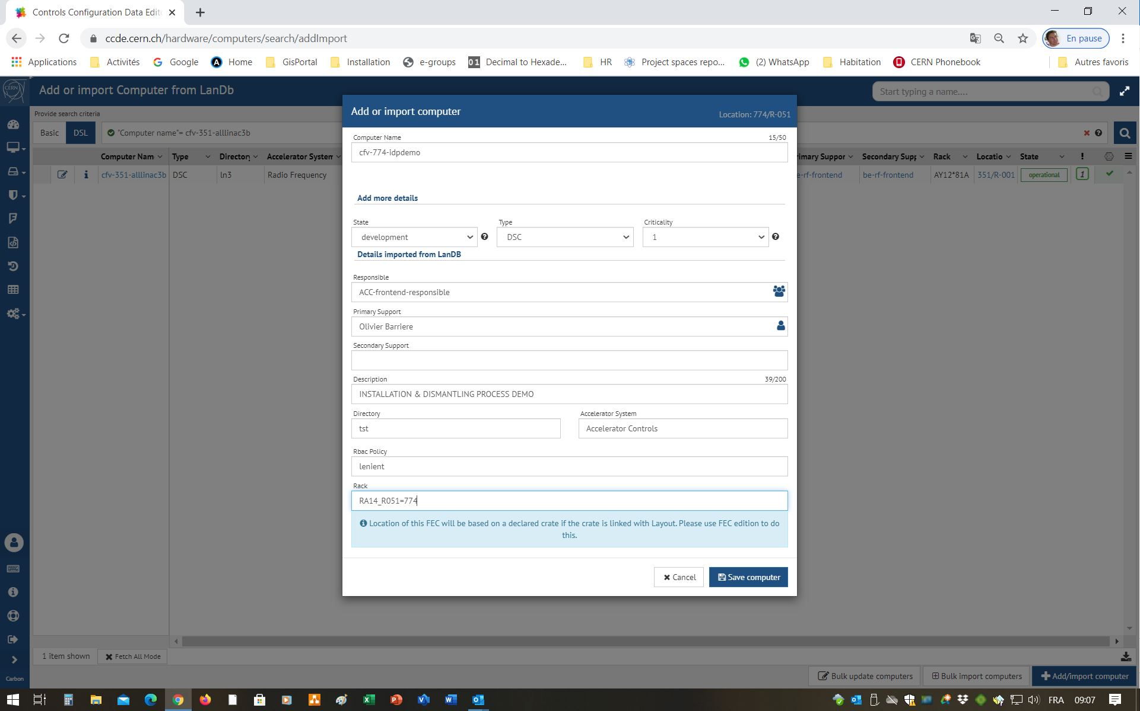
9. Define the computer in the CCDB
Complete the form with the definition of the computer and save

Slide 26
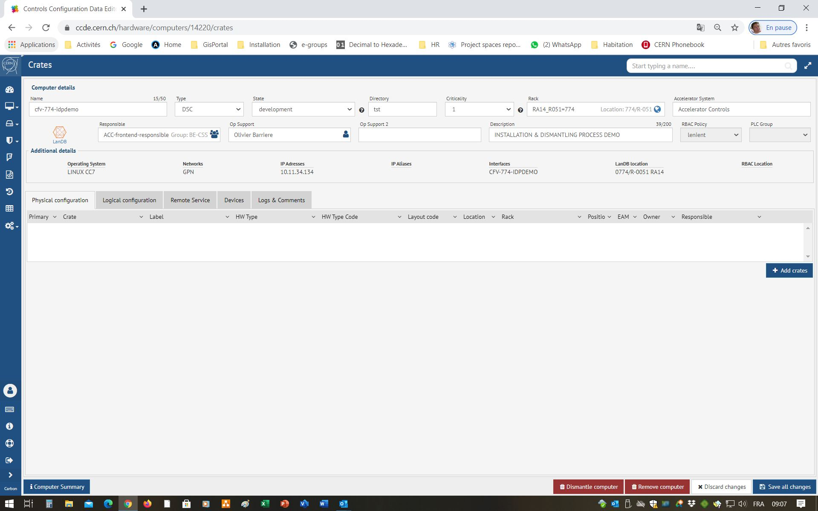
10. Add a crate to the computer using the CCDE
Click on
“Add Crates”

Slide 27
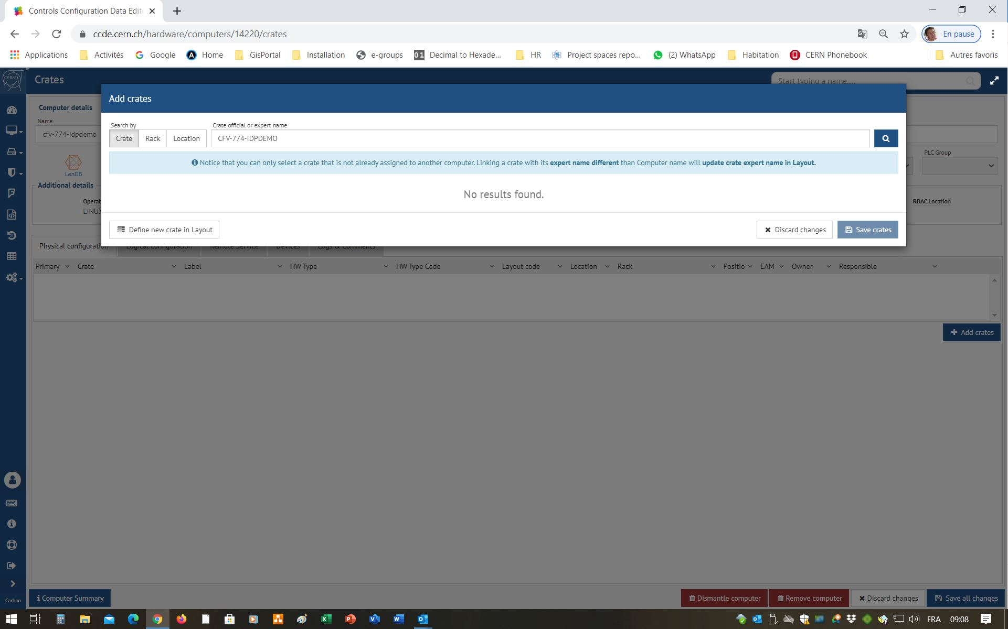
10. Add a crate to the computer using the CCDE
Click on
“Define new crate in Layout”

Slide 28
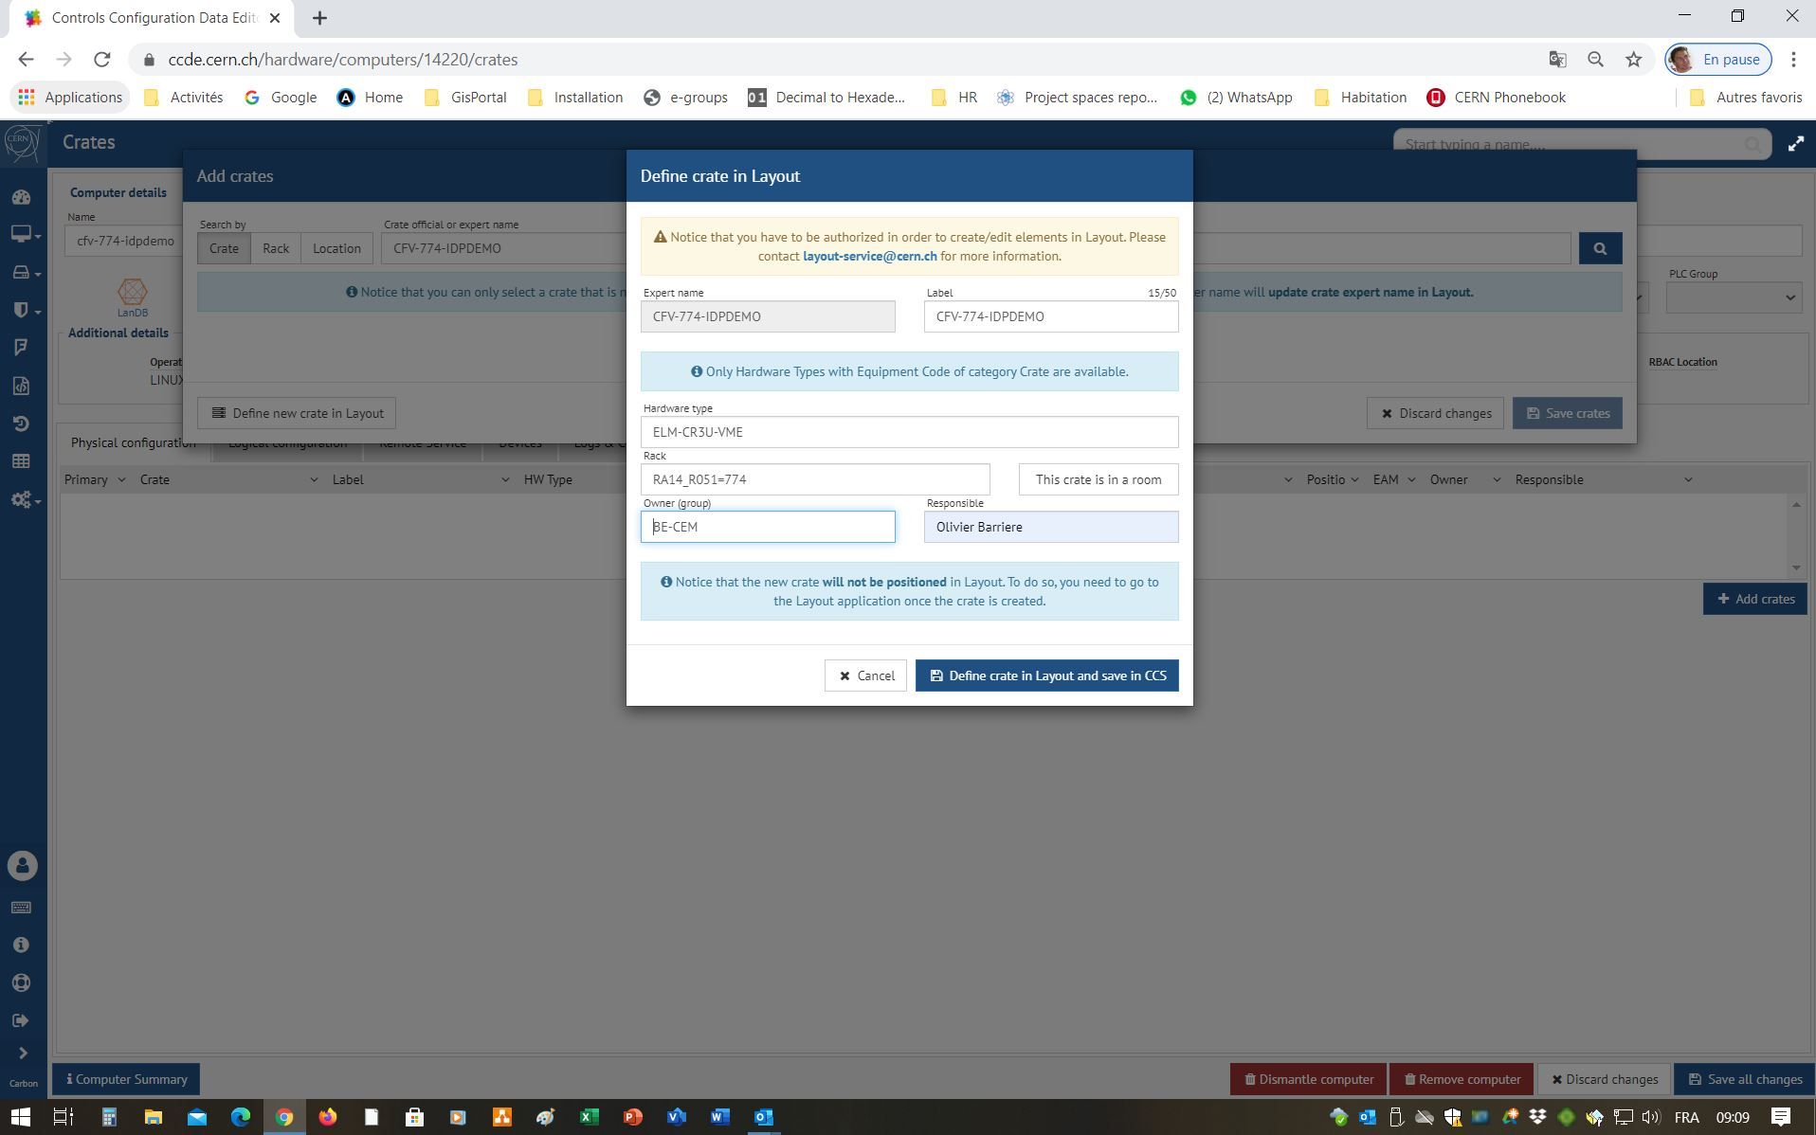
10. Add a crate to the computer using the CCDE
Complete the form with the crate definition information and save
The crate is stored in the Layout DB as a Functional Position and made visible in the CCDE

Slide 29
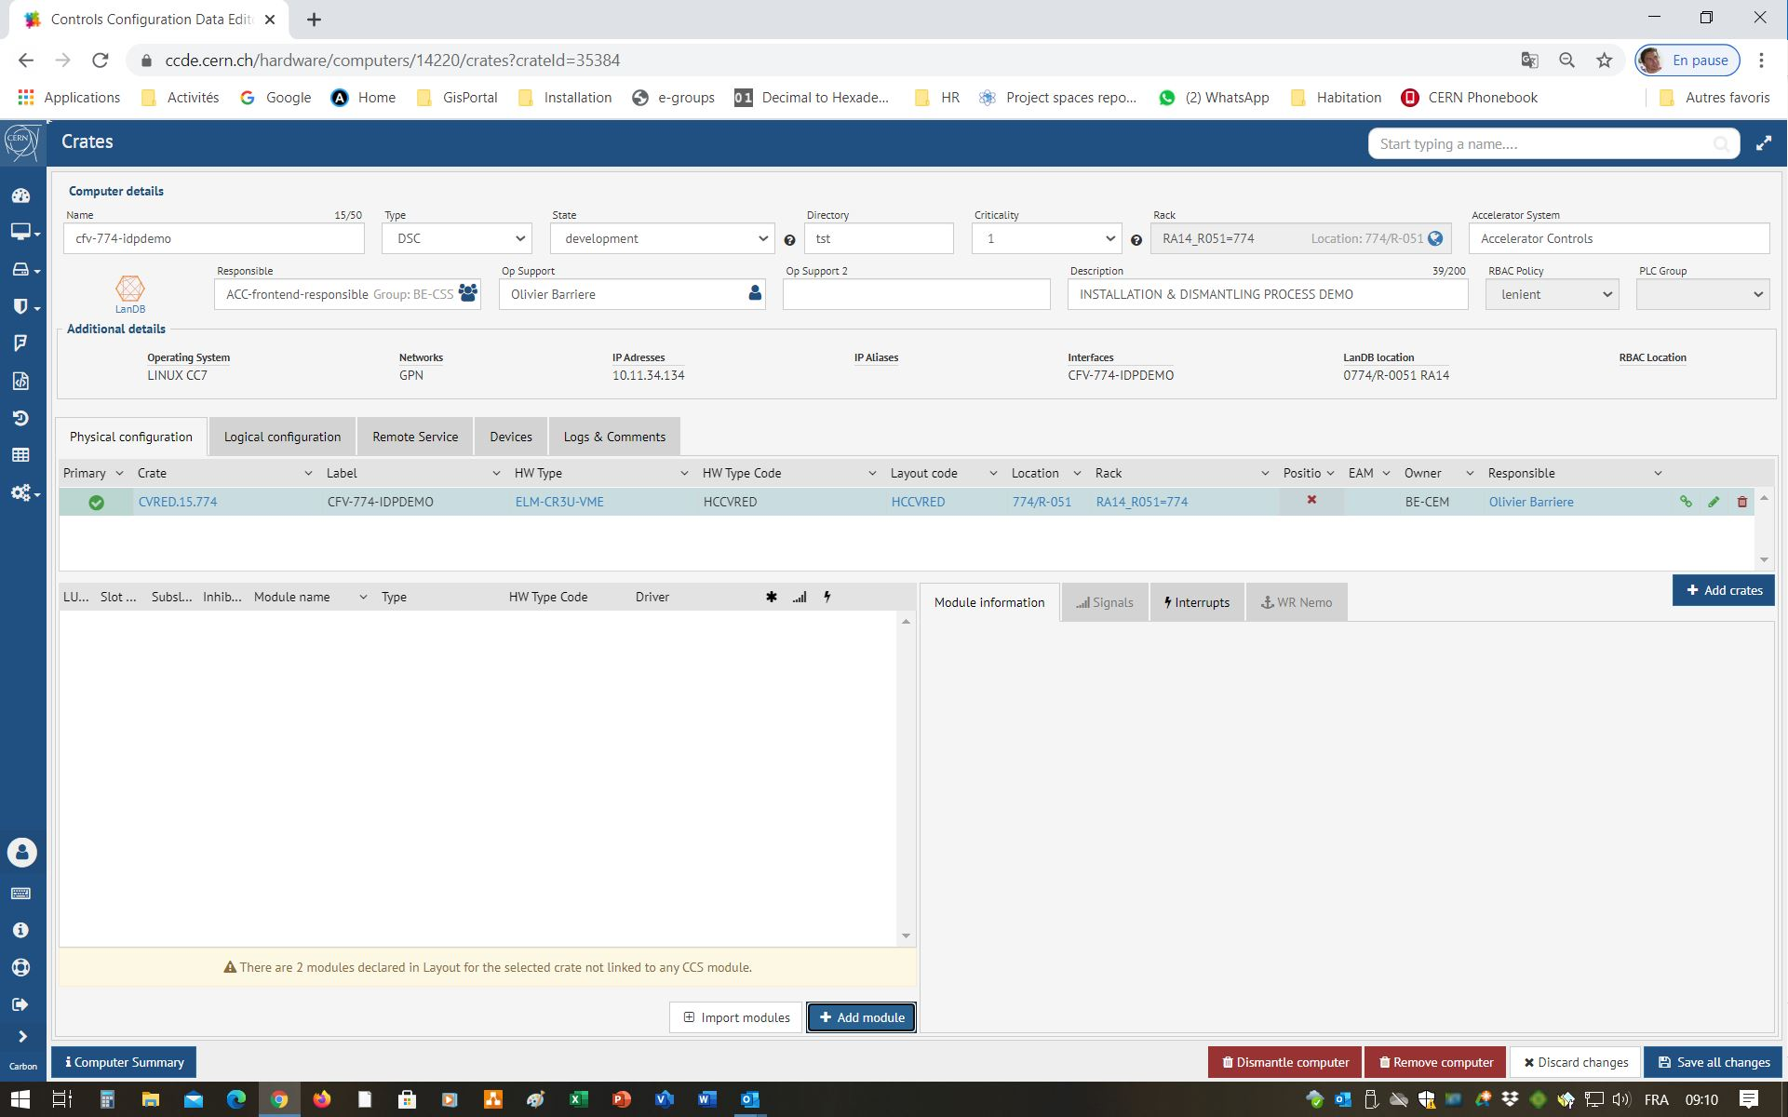
11. Add modules to a crate using the CCDE
The information about the Functional Position of the crate appears in the CCDE
To define modules click on “Add Module”

Slide 30
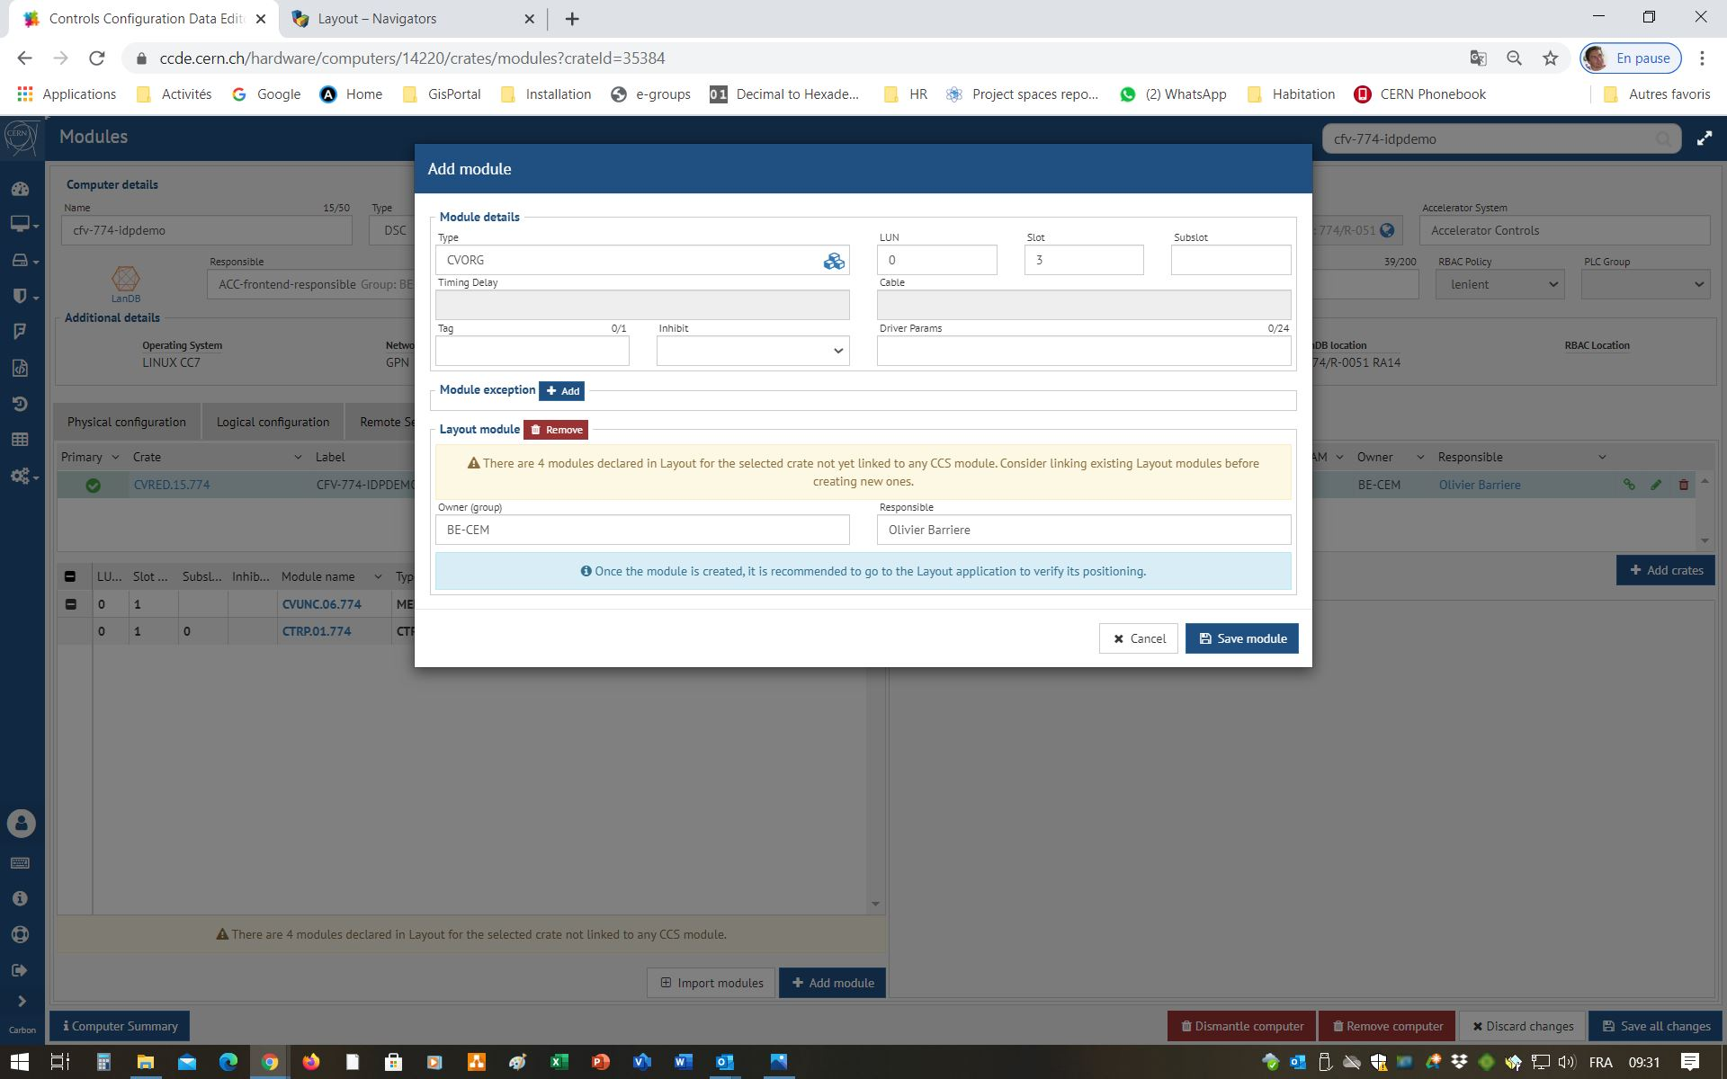
11. Add modules to a crate using the CCDE
Complete the form with the module definition information and save
Optionally, the modules can also be recorded in the Layout DB as Functional Positions by clicking “Add”

Slide 31
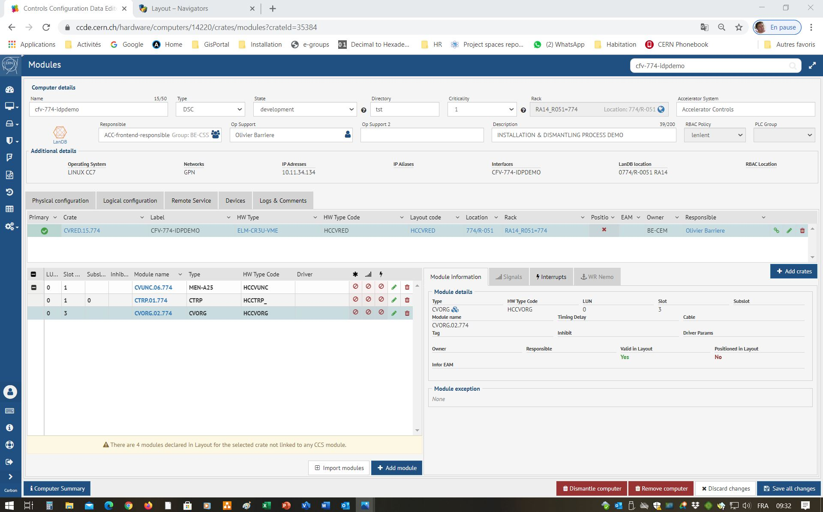
11. Add modules to a crate using the CCDE
The information about the physical configuration of the modules appears in the CCDE

Slide 32
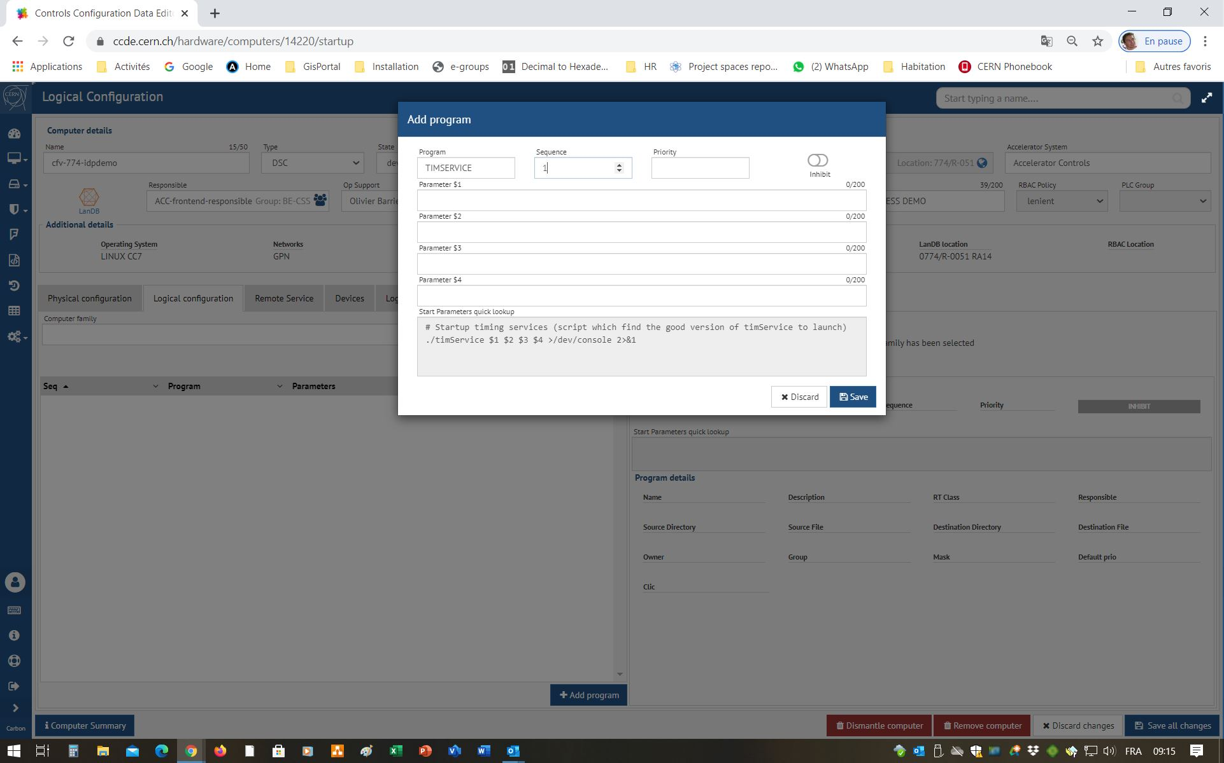
12. Add a program to a module in the CCDE
Complete the form with the definition of the program and save
Select the “Logicial Configuration” tab, then click “Add Program”

Slide 33
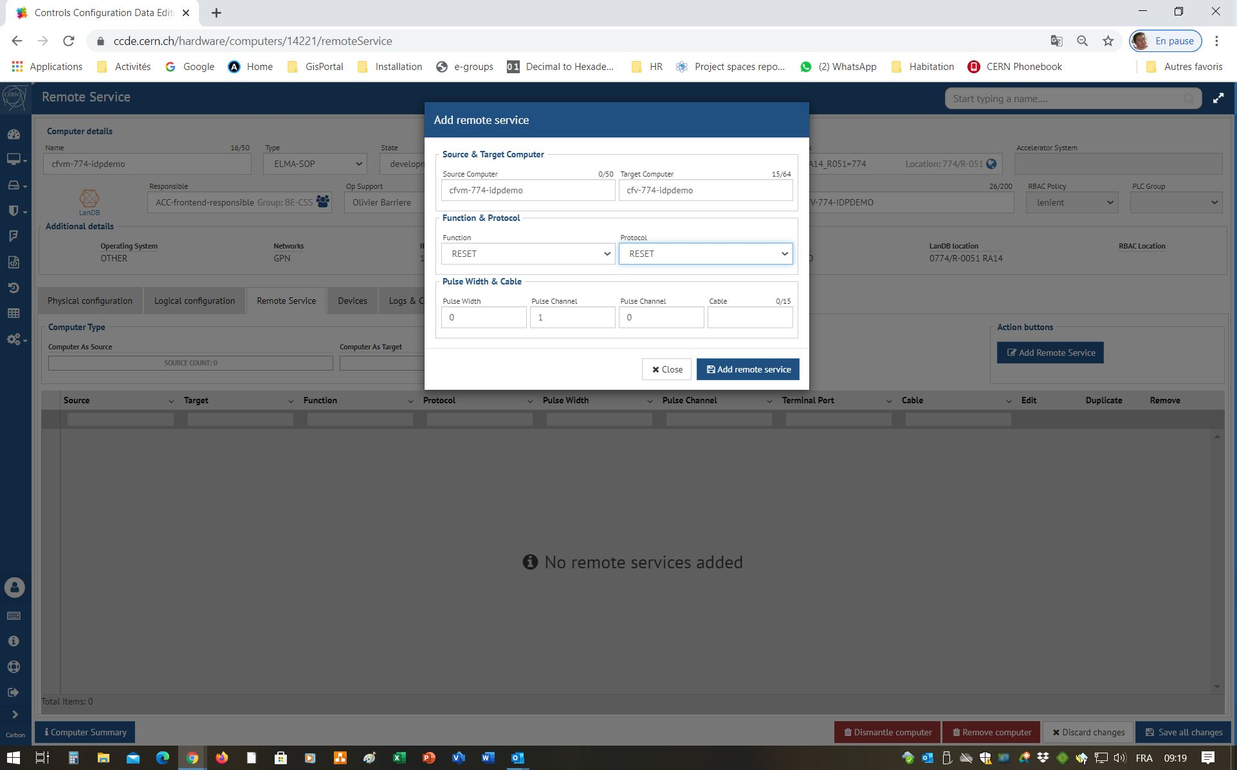
12. Add a Remote Service to a module in the CCDE
Complete the form with the definition of the remote service and save
Select the “Remote Service” tab, then press “Add Remote Service”

Slide 34
13. Configuration of the CO Server
Via the Command Line:
Boot select
Make DSC
Make transfer.ref
Update Conserver
Update firmware version - MEN-A25 only

Slide 35
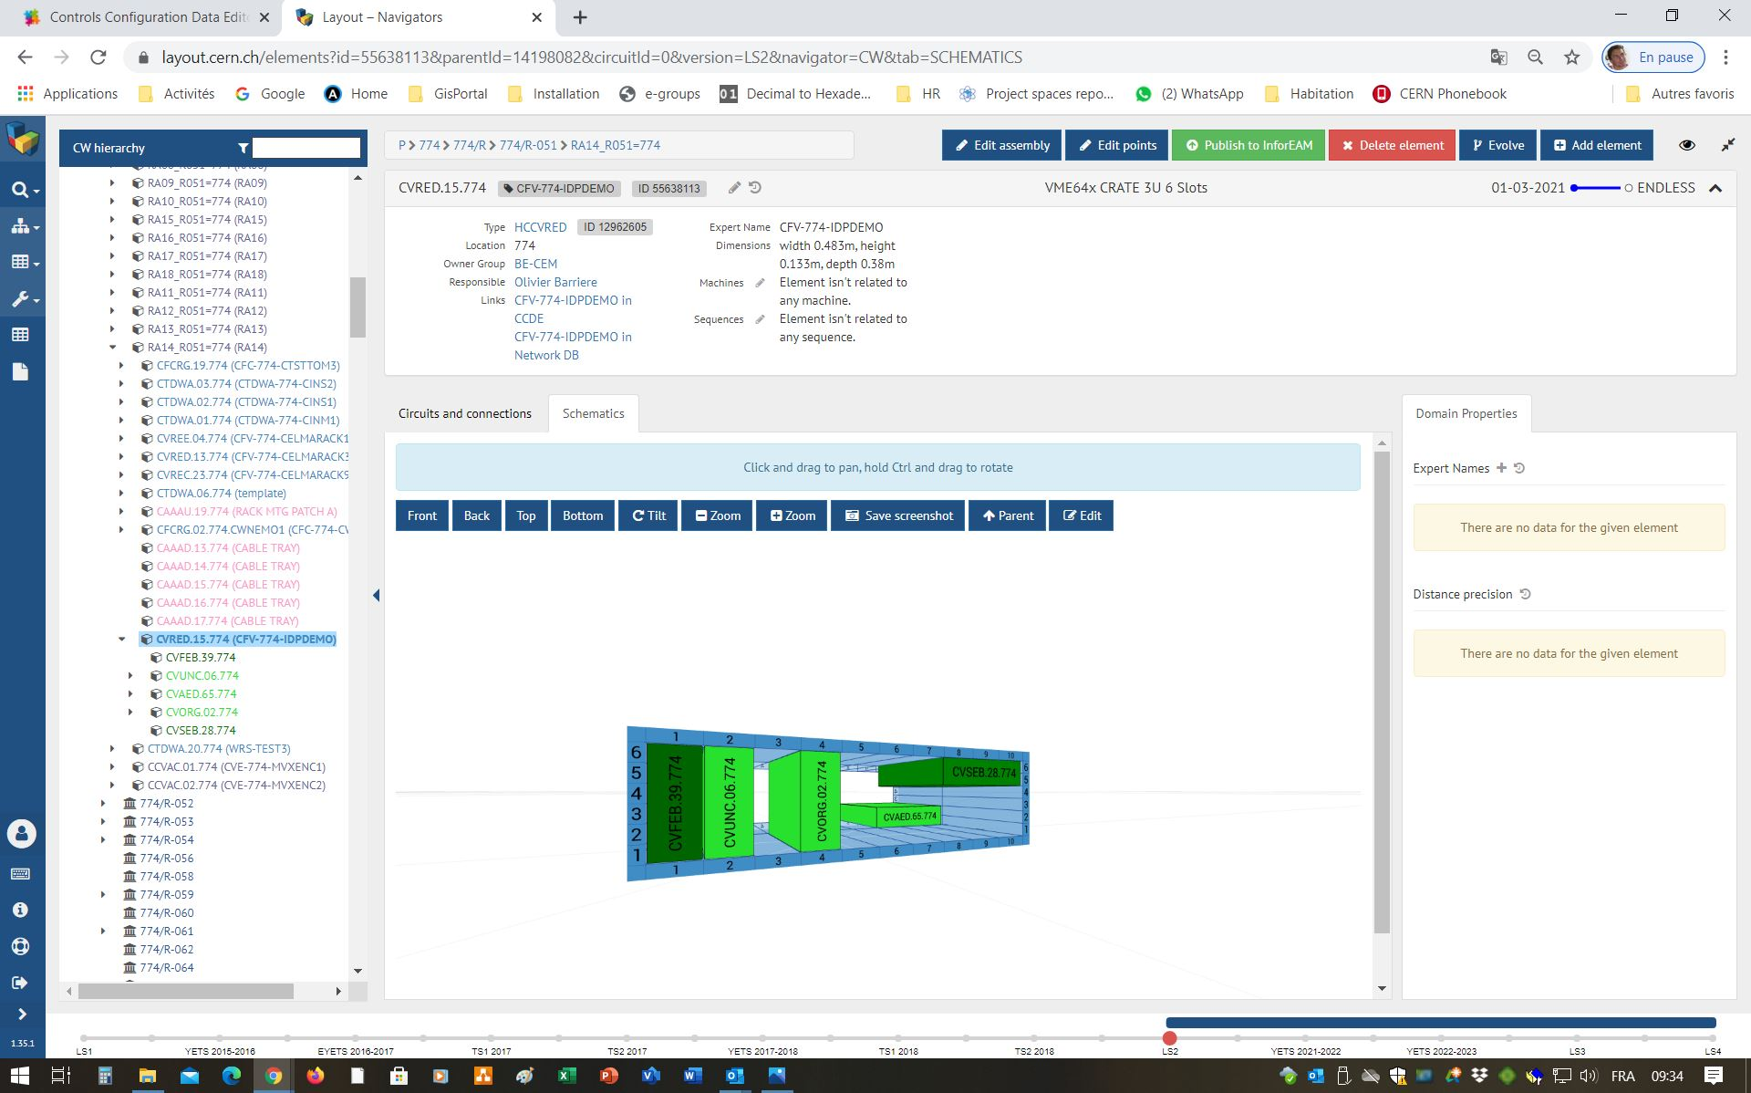
14. Position the modules in the crate using Layout
Navigate to the crate in the Layout DB. Select the Schematics tab then press “Edit” to modify the positioning of the modules within the crate

Slide 36
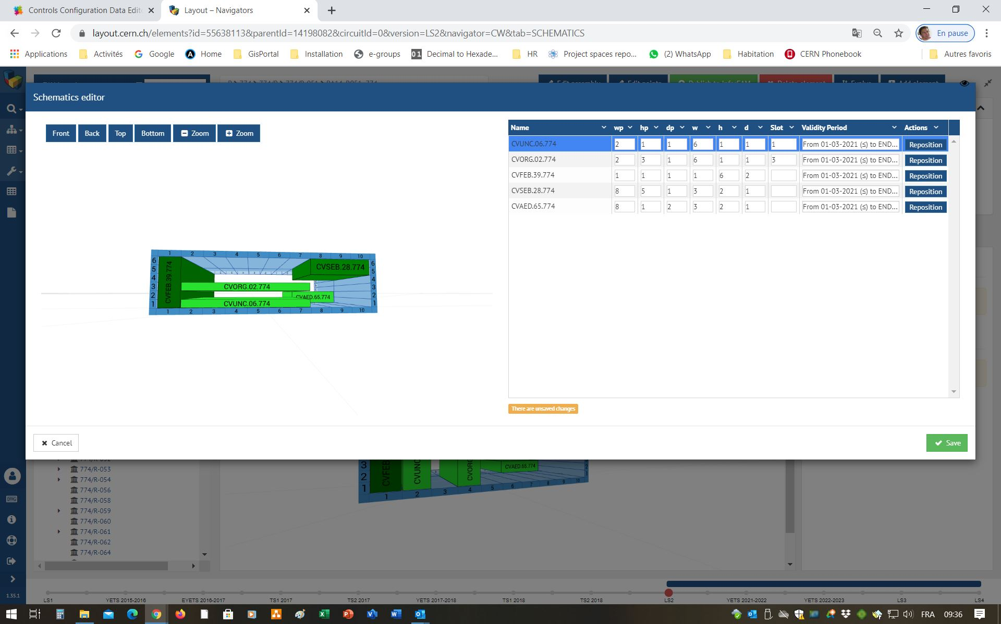
14. Position the modules in the crate using Layout
Modify the coordinates and dimensions of each module then save (or drag and drop the modules in the image)

Slide 37
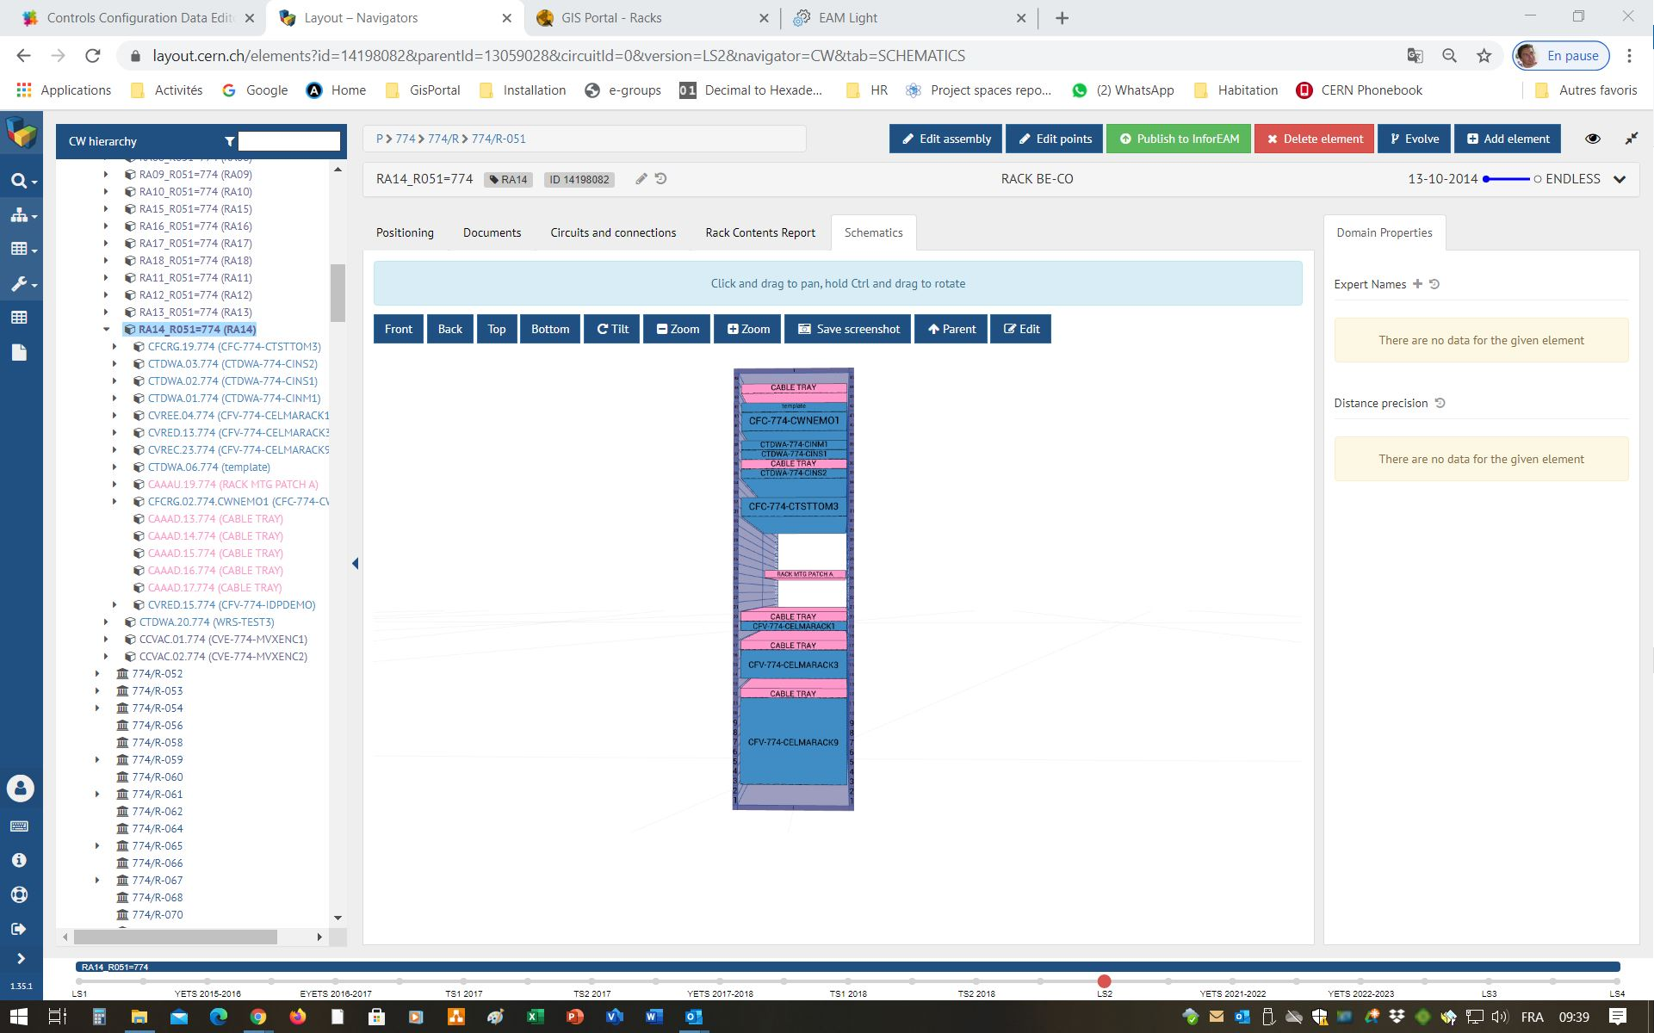
15. Position a crate in the rack using Layout
Navigate to the rack in the Layout DB. Select the Schematics tab then press “Edit” to modify the positioning of the crates within the rack

Slide 38
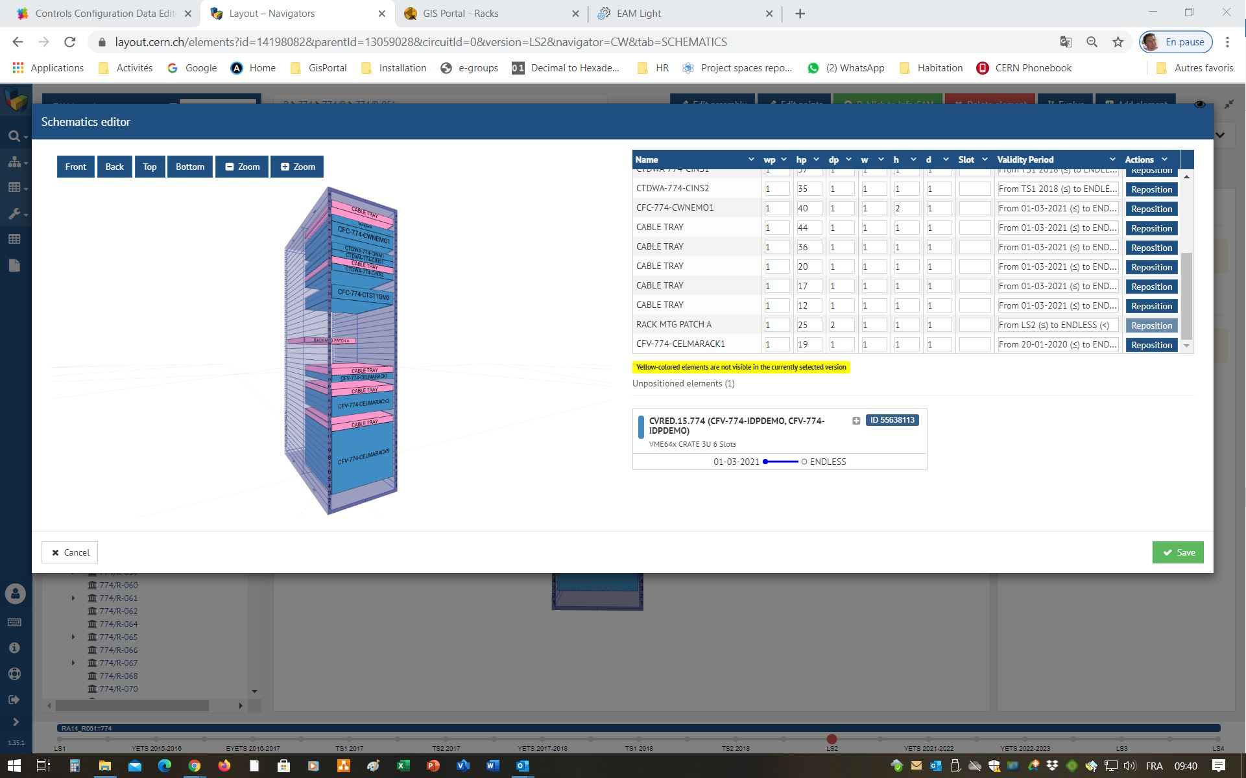
15. Position a crate in the rack using Layout
Add the new crate to the rack, then modify the coordinates and dimensions before saving

Slide 39
16. Publish the hierarchy of Functional Positions to InforEAM
At the level of the Rack (or crate without rack), click on Publish to InforEAM

Slide 40
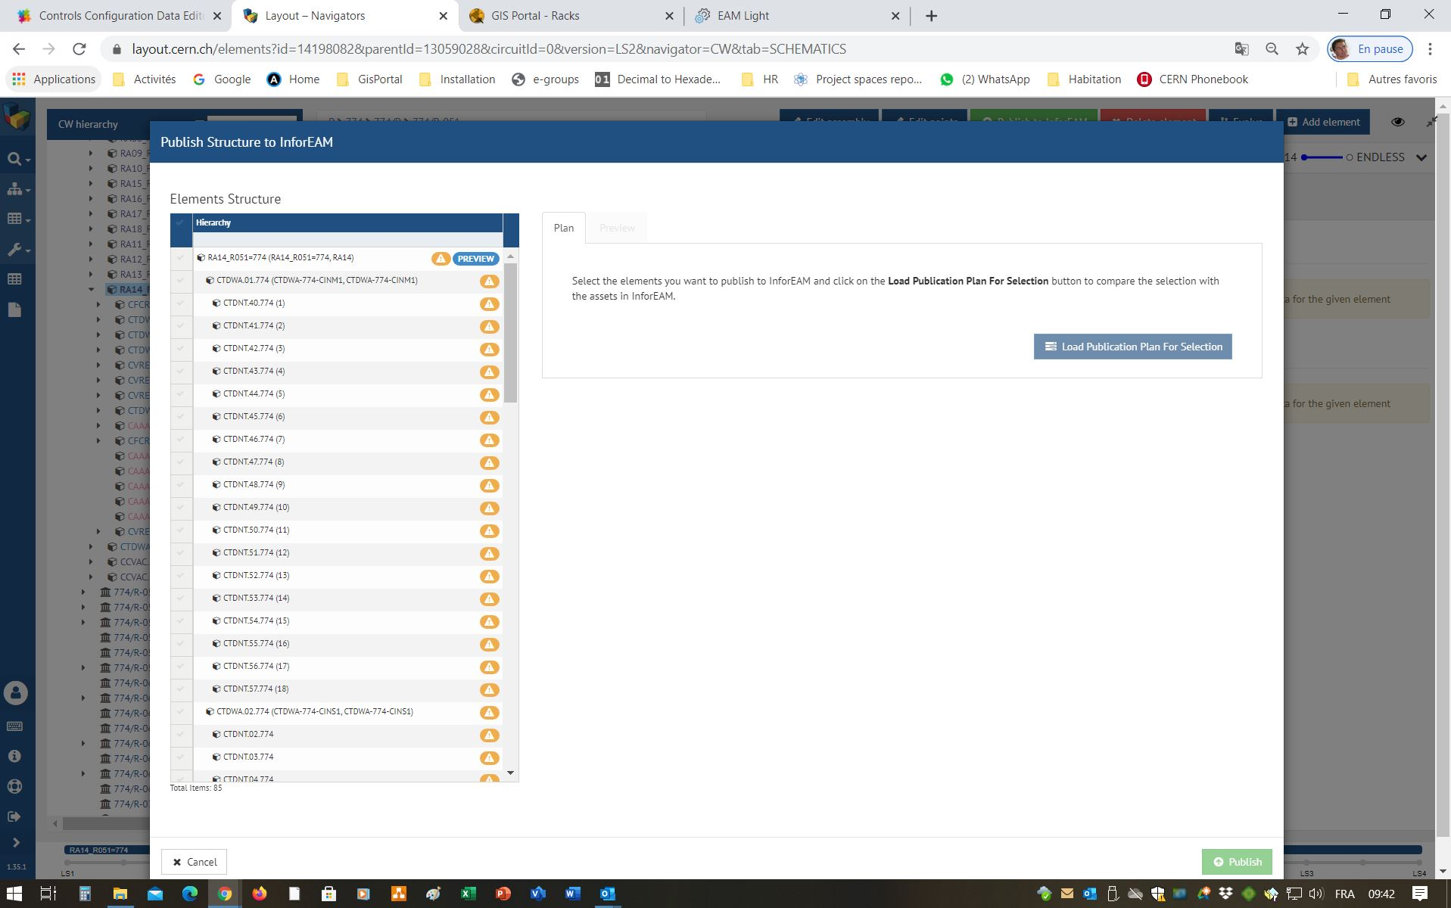
16. Publish the hierarchy of Functional Positions to InforEAM
Select the Functional Positions to be published then “Load Publication Plan”

Slide 41
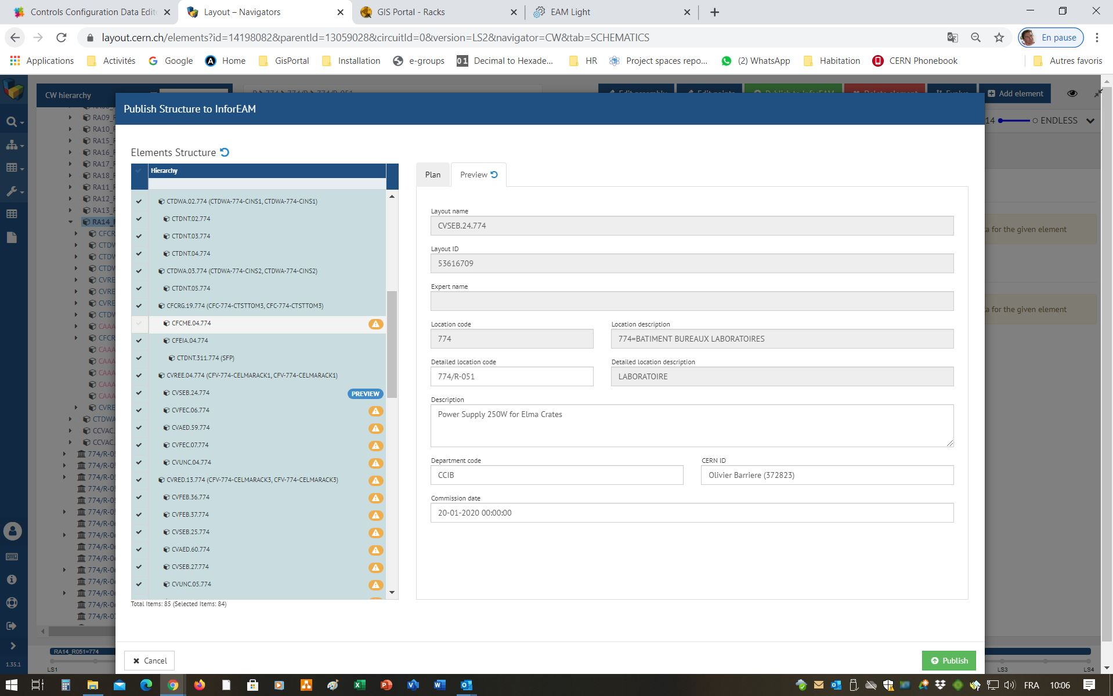
16. Publish the hierarchy of Functional Positions to InforEAM
Correct any errors In the publication plan, using the “Preview” tab, then press “Publish”

Slide 42
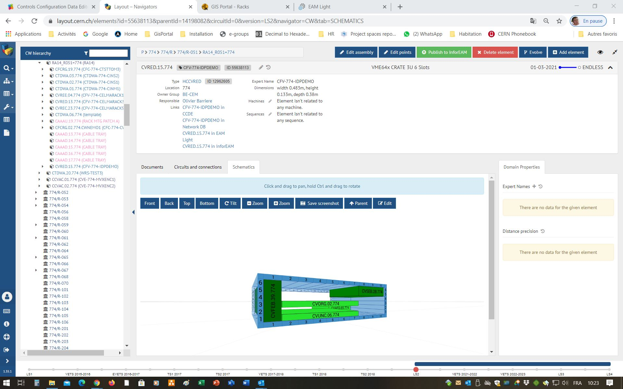
16. Publish the hierarchy of Functional Positions to InforEAM
Links to CCDE and InforEAM appear in the Layout Interface

Slide 43
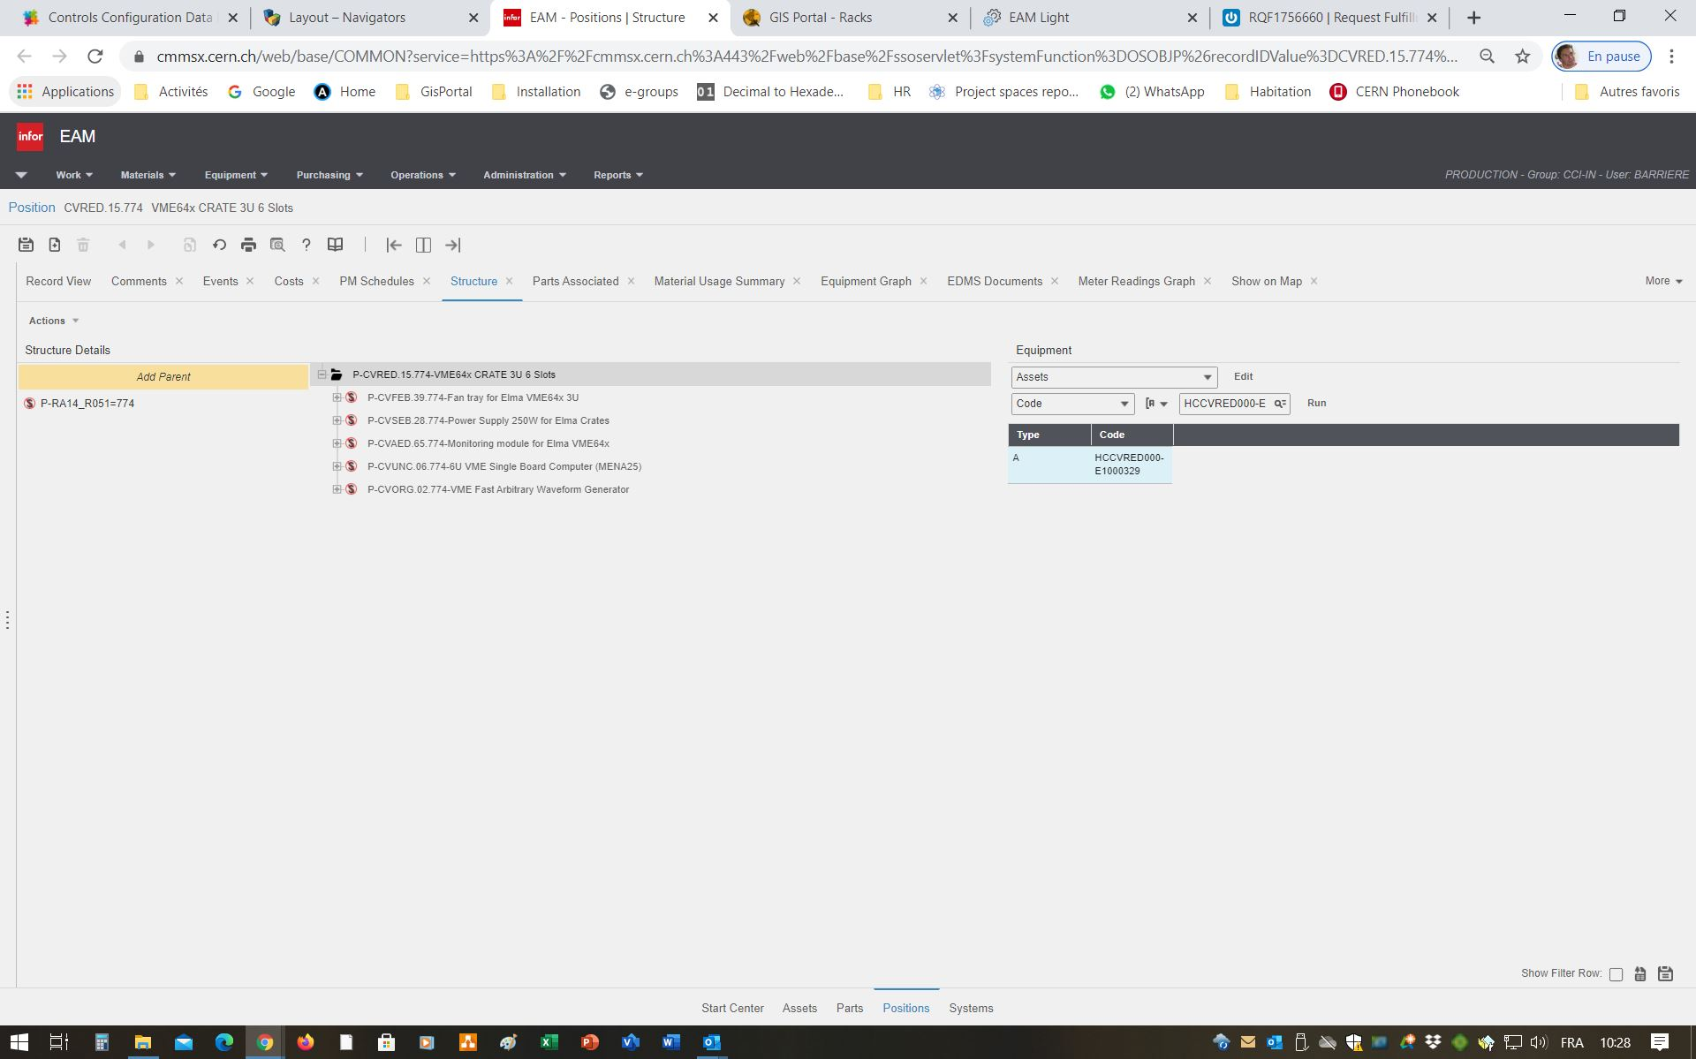
17. Attach assets to the Functional Positions in InforEAM
Search for the assets to be attached to the structure, either by copying and pasting the serial numbers from the RQF or by rescanning
Navigate to the Functional Position of the crate in InforEAM. Select the “Structure” tab

Slide 44
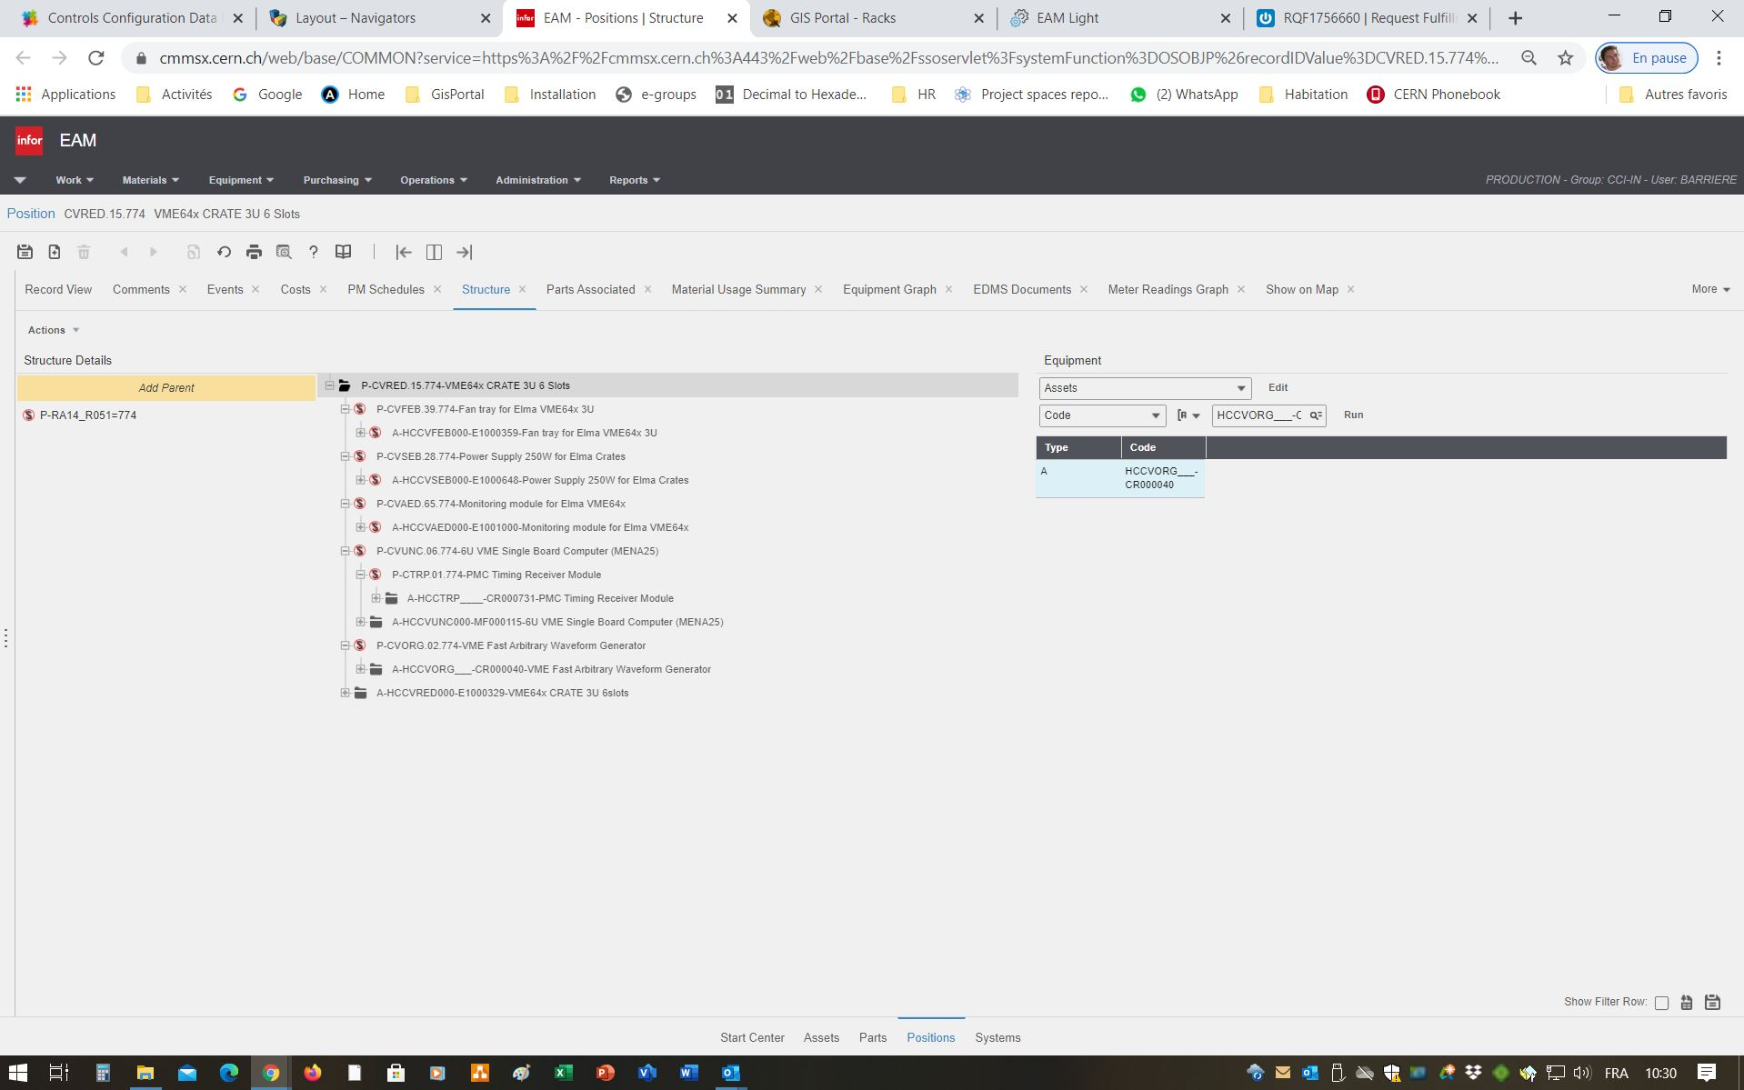
17. Attach assets to the Functional Positions in InforEAM
Drag and drop the assets into the correct positions

Slide 45
Dismantling

Slide 46
1. Detach the assets from their Functional Positions in InforEAM
Navigate to the Functional Position of the crate in InforEAM. Select the “Structure” tab
Right-click on the asset and select “Unlink” from the popup menu, to detach it from the Functional Position
Set all positons into the Status ”Hors Service Definitif”

Slide 47
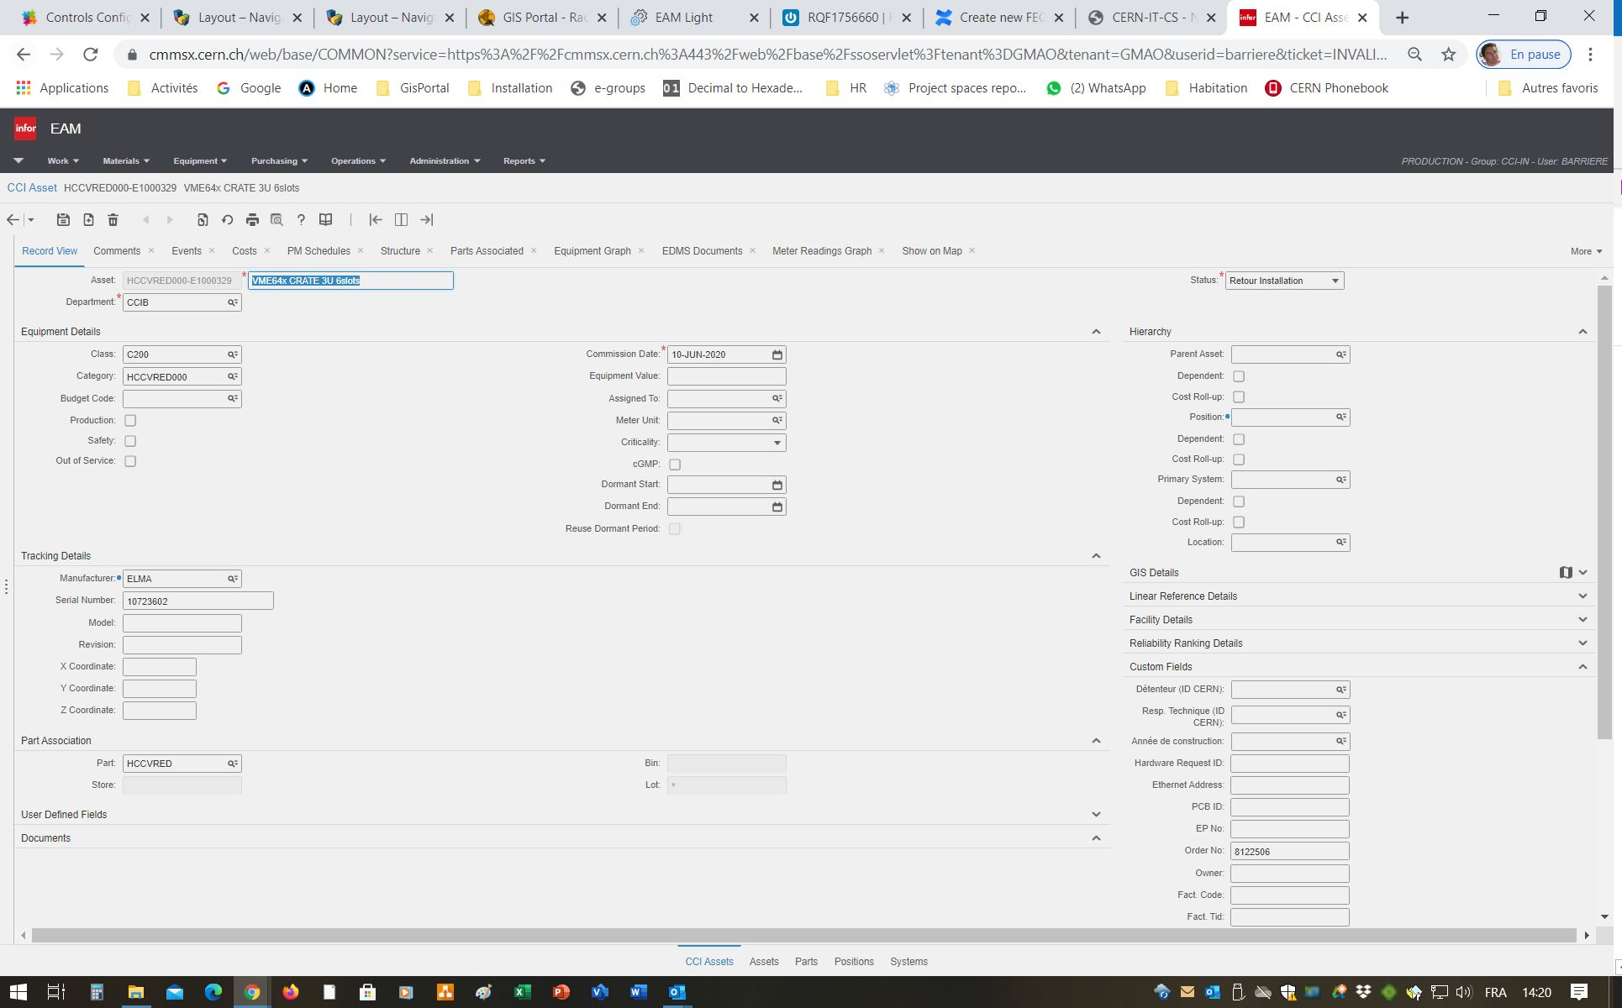
2. Change the status of the assets to “Retour Installation”

Slide 48
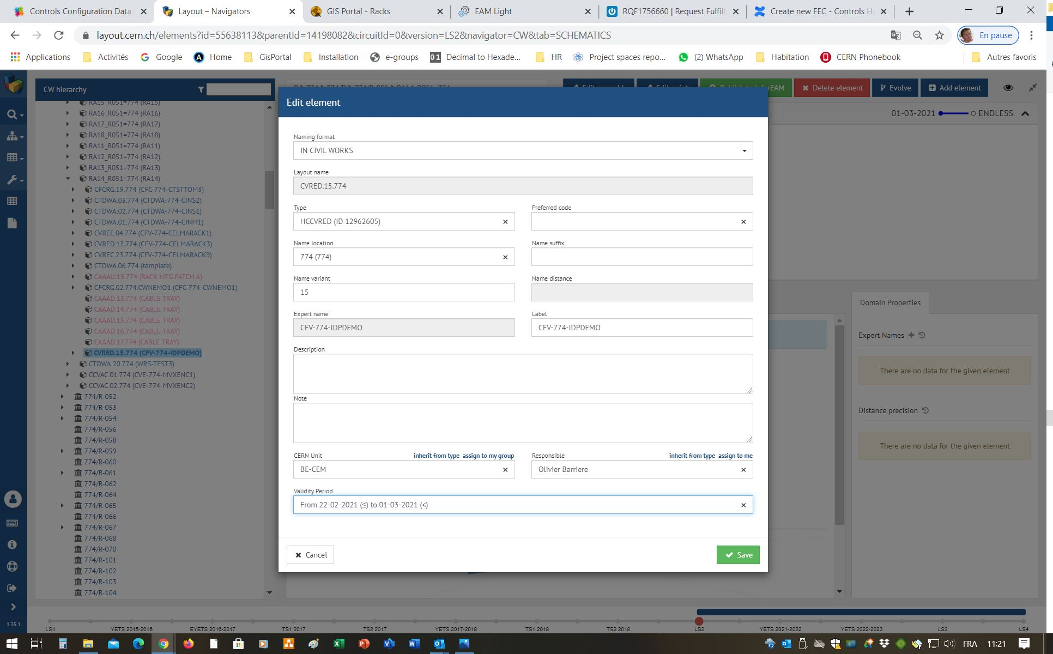
3. Expire the Functional Positions in Layout
Navigate to the Functional Position of the crate in Layout. Edit the record and change the expiry date of the validity period. The modules will be expired automatically

Slide 49
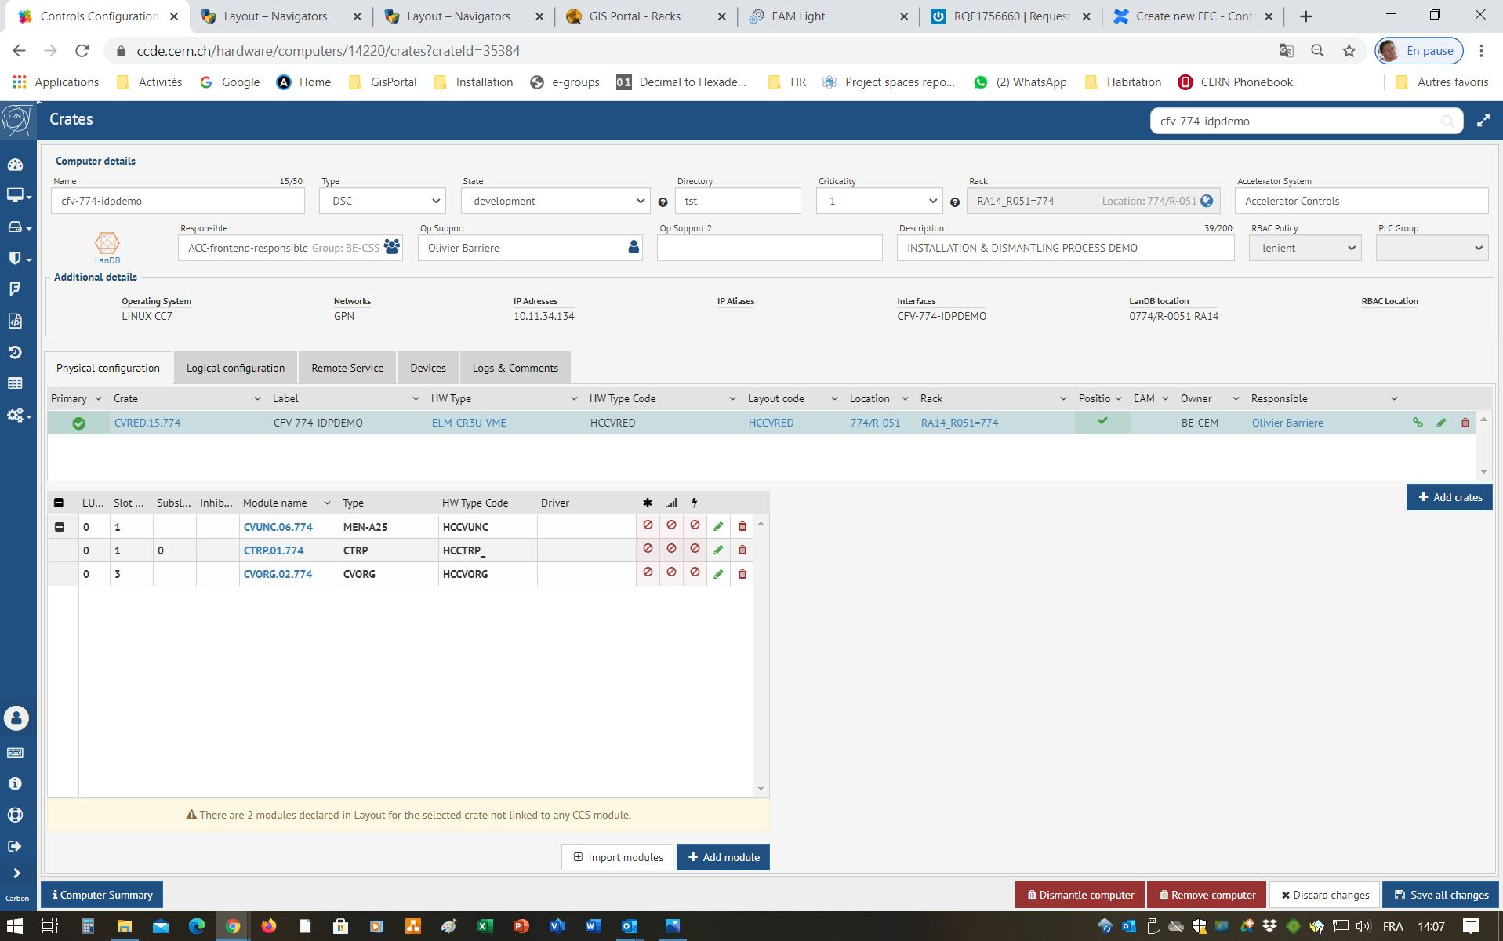
4. Delete the computer from the CCDB
Navigate to the computer in using the CCDE. Click “Dismantle Computer”

Slide 50
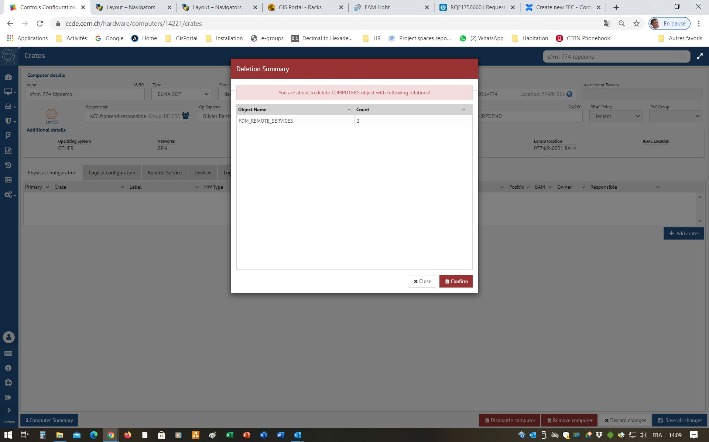
4. Delete the computer from the CCDB
Verify and confirm the deletion

Slide 51
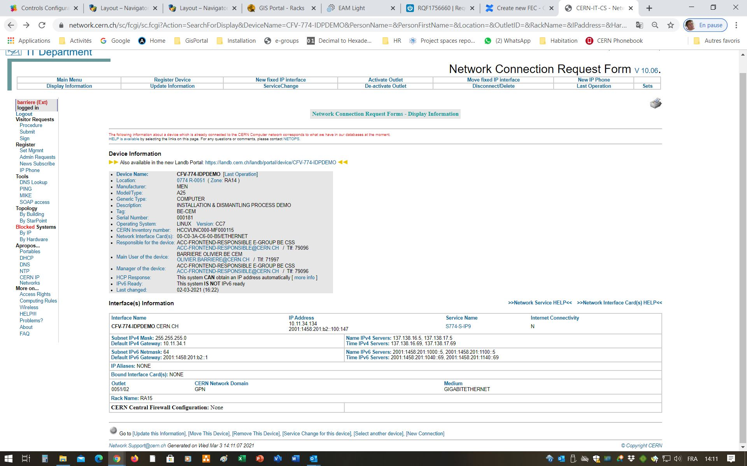
5. Delete the device from the Network DB
Navigate to the device in the Network DB. Click sur “Remove this device” and confirm the deletion

