Slide 1


Possible Synergies with upcoming Physics Proposals at CERN
Workshop on Muon Collider Testing Opportunities
Johannes Bernhard (BE-EA)
24.03.2021

Slide 2
Content
  Synergies with proposed and existing facilities
  Beam-induced background
  Magnetic collimation
  Service measurements and benchmarking
  LHC forward experiments
  Crystal collimation
  Non-conventional muon sources
  Far-fetched ideas
  Not covered today: Detector R&D

Slide 3
nuSTORM
  nuSTORM is a proposed facility within the Physics Beyond Colliders framework (CERN-PBC-REPORT-2019-003)
  Originally planned as a short baseline neutrino project based on a low-energy muon decay ring, synergies with the muon collider study have been identified, for instance as a possible demonstrator for cooling, targetry and as a test facility for R&D activities for muon collider components.
  In addition, combination with the ENUBET proposal for tagged neutrino-beams seems interesting as well as the high intensity on the primary beam dump (4e13 protons / extraction) that might be useful for further experiments.
  See the following talk by Chris Rogers and Anna Holin for more details.

Slide 4
ENUBET and nuSTORM
F. Terranova, PBC Annual Meeting, March 2021

Slide 5
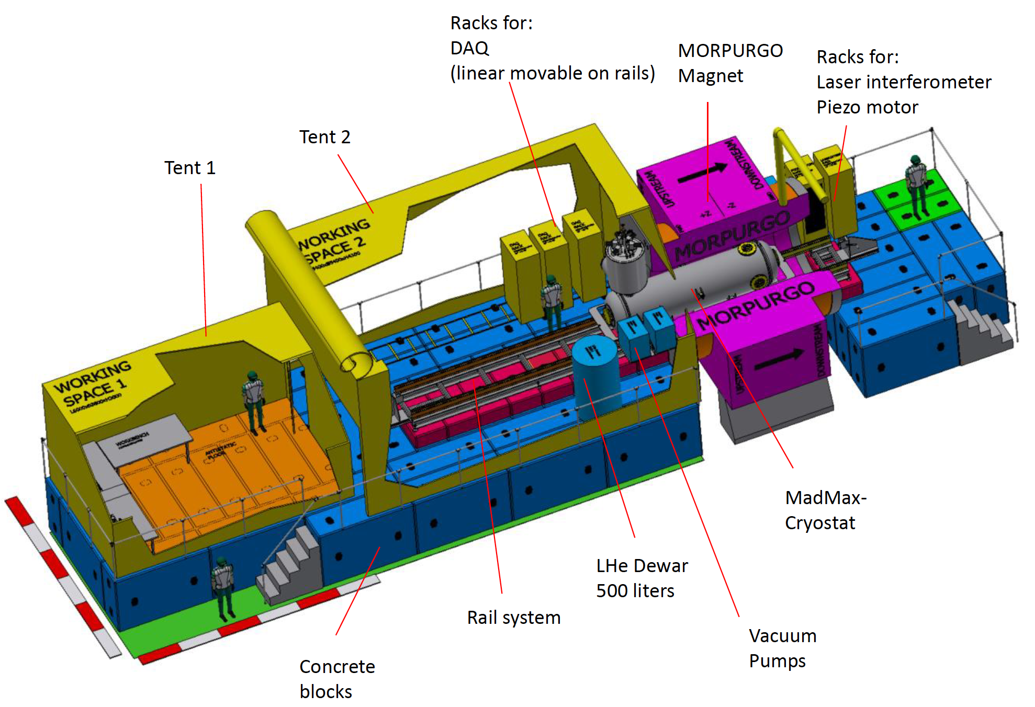
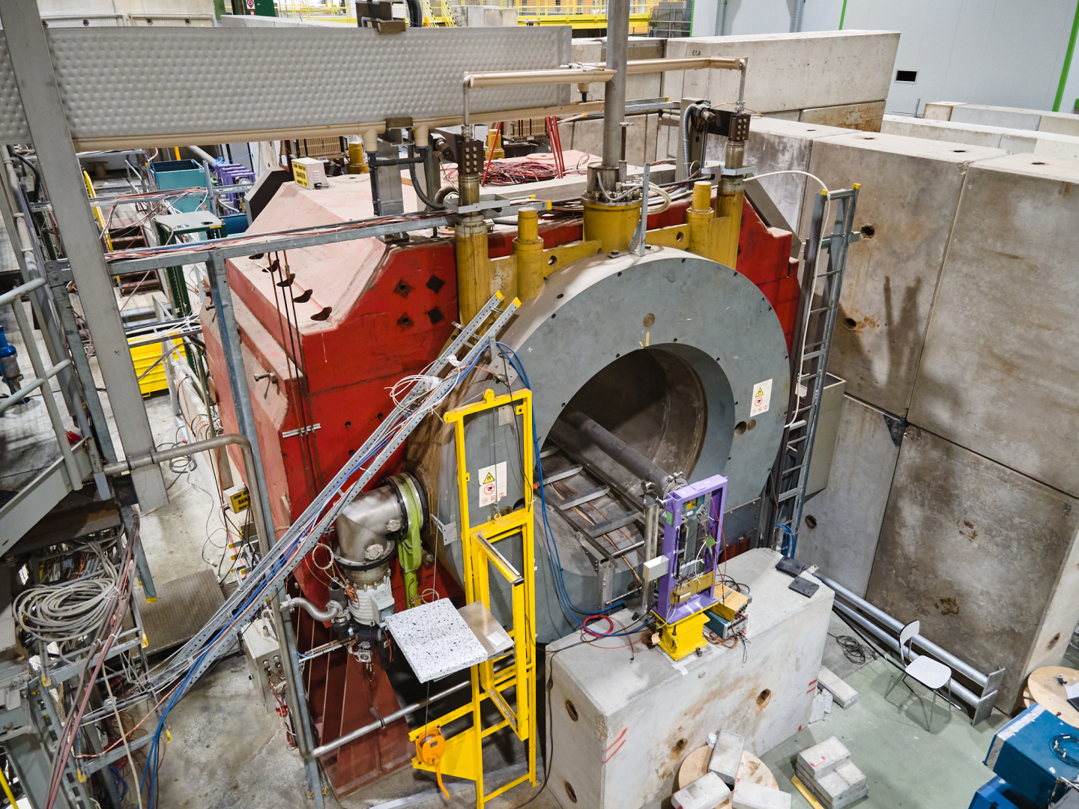
MADMAX
  MADMAX/P-366 is a proposed test of a dielectric haloscope for dark-matter axion detection in the Morpurgo magnet in the H8 beam line outside in the YETS periods.
  The experiment makes use of RF-cavity like equipment and will be operated in the 1.6T dipole field of the magnet with all necessary infrastructure available on request, including liquid helium for the superconducting magnet.
  This could be in principle envisaged for testing RF cavities in magnetic fields as possibly required for the cooling section (thanks to S. Gilardoni for pointing this out, see e.g. here).

Slide 6
Beam-induced backgrounds
  Several fixed-target experiments require a control of beam-induced background (mostly muons) to a level that seemed to be unrealistic before, e.g. NA62 and NA64 both requiring understanding of their sources of background to a level below 10⁻¹¹.
  Dedicated studies have been performed with the help of several simulation codes for these experiments, such as Fluka, Geant4, G4beamline and BDSIM. The experiments and involved CERN groups would be happy to share their experience.
  In addition, active mitigation of these backgrounds is more and more important:
    Magnetic collimation in the M2 and K12 beamlines for COMPASS and NA62.
    Muon shields for proposed beam dump experiments, e.g. SHiP and SHADOWS.

Slide 7
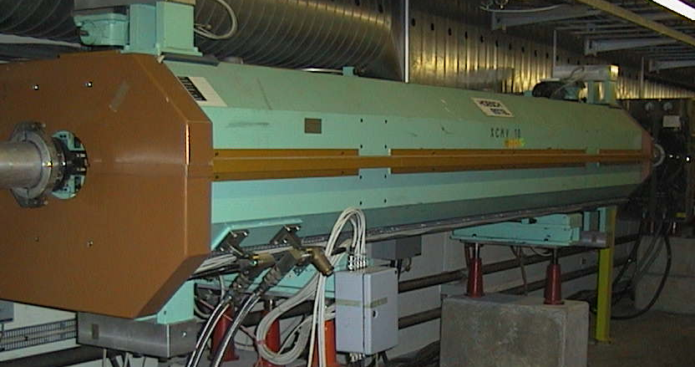
Excursion: Magnetic Collimation (1/2)
Adjustable magnetic collimators (“scrapers”): Toroidal magnets with adjustable gaps, 5 m length.
Field in iron of about 1.5 T (saturated at 100 A).
Negligible quadrupolar field component in the centre.

Slide 8
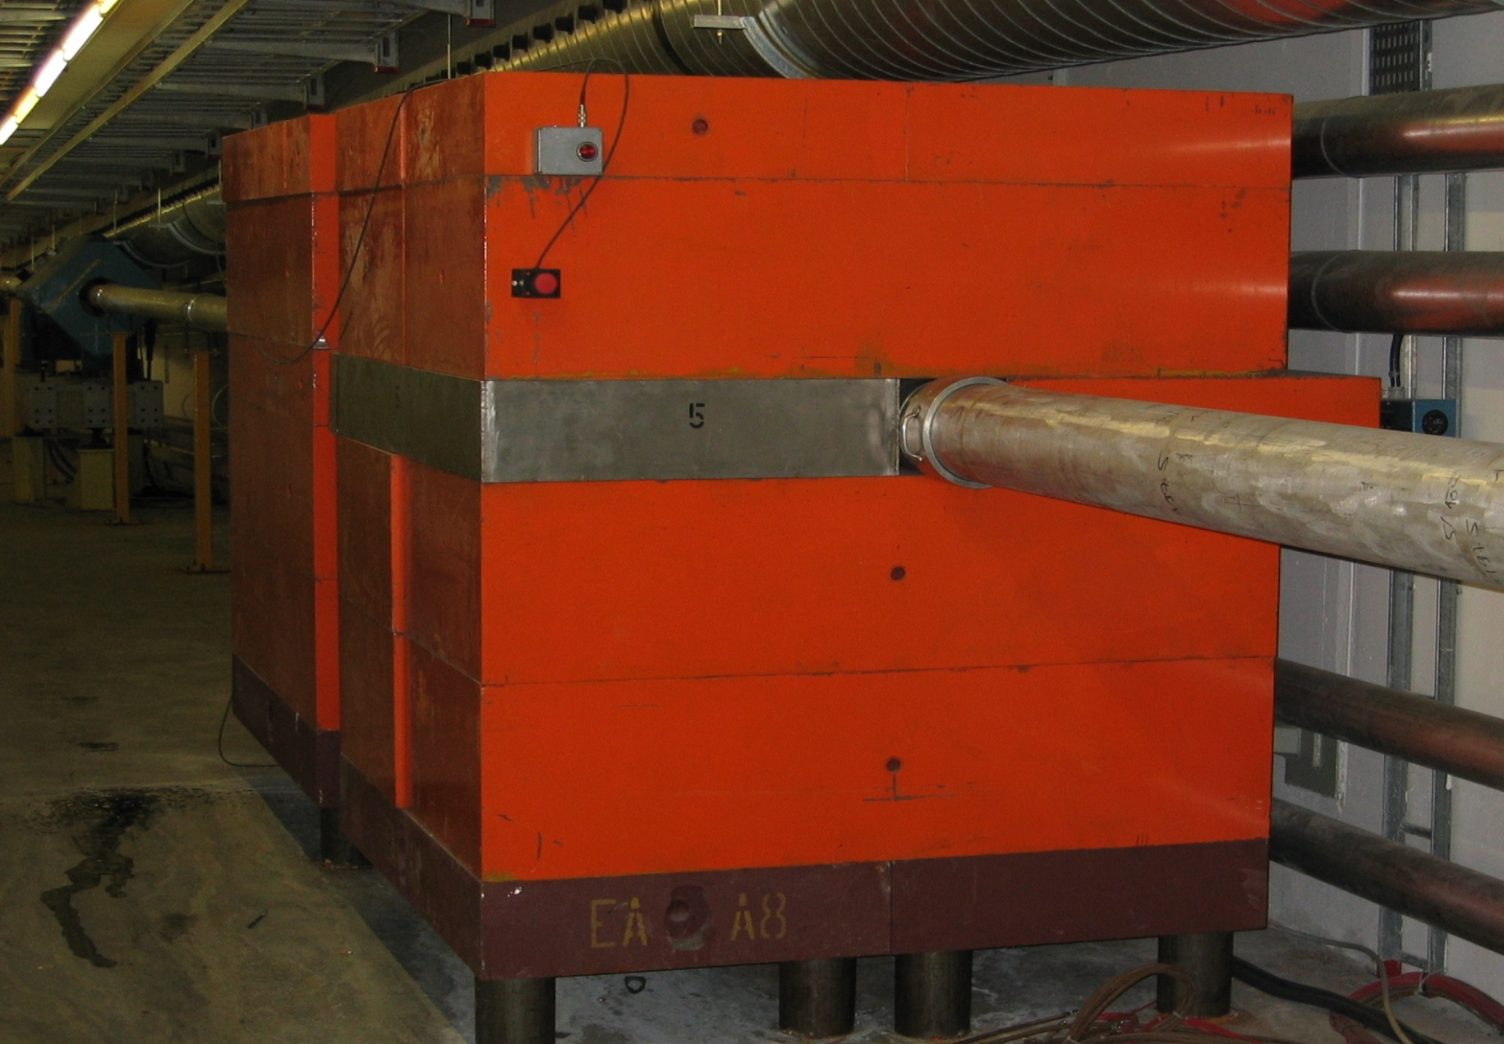
Excursion: Magnetic Collimation (2/2)
Deflection
B
Fixed magnetic collimators: Toroidal magnets with fixed gaps.
Field in iron of about 1.5 T (saturated at 100 A).
Length between 3.2 m to 8 m, minimising scattering in the yoke (proportional to √L) with respect to the magnetic deflection (proportional to L).

Slide 9
Muon Shields: SHiP
A. Golutvin, PBC Annual Meeting, March 2021
Tests beams planned in the North Area to measure field maps inside of the material with the help of muons.

Slide 10
Service measurements and benchmarking
  Besides their main objective for dense matter QCD physics, the NA61 experiment specialises in measurement of hadron production for neutrino physics at low energies, where existing data is sparse, but high statistics and high-quality data are needed.
  Several requests for neutrino detector tests came up in the last years, also mostly focused on low energies. With the H2 and H4 low energy beams in the North Area and the newly renovated beams of the East Area, these experiments can also contribute to hadron production studies.
M. Kuich, PBC Annual Meeting, March 2021
WCTE, CERN-SPSC-2019-042
ARIADNE, https://arxiv.org/abs/1910.03406

Slide 11

Service measurements and benchmarking
  The M2 beam in the North Area is a high energy muon beam at 100 GeV – 200 GeV and with relatively high intensities (few 10⁸ µ / extraction). In principle, it can be used to check collimation etc. at higher energies.
  The MuonE collaboration plans to measure the hadronic vacuum polarisation to a very precise level with the help of the M2 beam and deploying 40 thin Beryllium targets. For them, precise knowledge of multiple scattering (including tails) is key to the experiment. There might be possibilities for collaboration on these aspects.
MuonE

Slide 12
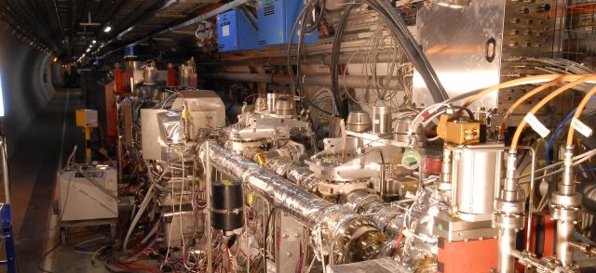
LHC forward experiments
  The TOTEM collaboration measures the elastic cross section at the highest energies with high precision. In principle, the experiment could be upgraded with muon detectors and have access to very forward muons.
  Several new detectors either have been planned or have been already set on the forward direction with respect to the LHC interaction points (e.g. FASER, SND). These detectors are usually shielded by about 100 m of rock in between the IP and the detector, but still have access to high energy muons.
FASER location
TOTEM

Slide 13
LHC forward experiments
  The idea of an Forward Physics Facility has been brought up at the last PBC workshop. The proposal includes a muon sweeping magnet, which could be used for direct access to highest energy muons without having rock in between (CE works necessary however).
J. Feng, PBC Annual Meeting, March 2021
Forward Physics Facility - Kickoff Meeting:
https://indico.cern.ch/event/955956/
Muon sweeping magnet

Slide 14
Crystal collimation
  The UA9 experiment studies deflection of charged particles in crystals since many years, both in the accelerators as well as in the H8 beam.
  Crystals offer very high fields within relatively small dimensions and thus could be potentially interesting for collimation of beams (mostly for positive beams, still potentially also for negative ones).
  Some applications have been already studied for the LHC fixed target proposals, making use of the deflected proton halo to feed gaseous and solid targets.
  Crystal collimation is now also part of the LHC upgrade baseline for the collimation system.
M. Ferro-Luzzi, PBC Annual Meeting, March 2021

Slide 15
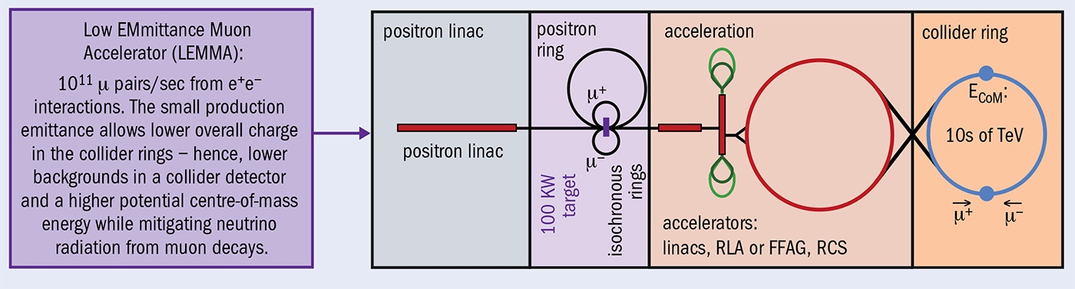
Non-conventional muon sources: LEMMA
  LEMMA is an approach to provide a low-emittance source for muon colliders by exploiting production of muons from e⁺e⁻ → 𝜇⁺𝜇⁻ at the production threshold with a 45 GeV/c positron beam on a thin target (Nucl. Instrum. Meth. A 807 (2016))
  See talk by M. Zanetti for details.

Slide 16
Non-conventional muon sources: Gamma Factory
  Proposal to use a beam of partially stripped ions as a light source.
M. W. Krasni, PBC Annual Meeting, March 2021

Slide 17
Far-fetched ideas
  Investigate Plasma Wakefield Acceleration in collaboration with AWAKE? However what about positive muons? Some further ideas seem to be also discussed.
  The NA61 experiment possibly is interested to deploy Gabor Lenses in the H2 beamline. Is that possibly interesting?

Slide 18
Conclusion
  The landscape of experiments, facilities and beams at CERN offers a wide range of possible synergies with the R&D program for a future muon collider.
  The ideas presented today are just an example of this, and with the plenty new ideas coming from Physics Beyond Colliders and other initiatives, there will be surely many more in the upcoming years.
  As much as there are possible synergies for the muon collider R&D, there are also at the same time opportunities for using new R&D facilities also for experiments, e.g. for tagged neutrino beams and dark matter searches. If this is well aligned with the European Strategy for Particle Physics, there is a strong argument for both facility and experiment.

Slide 19
Thank you very much for your attention!

