Slide 1
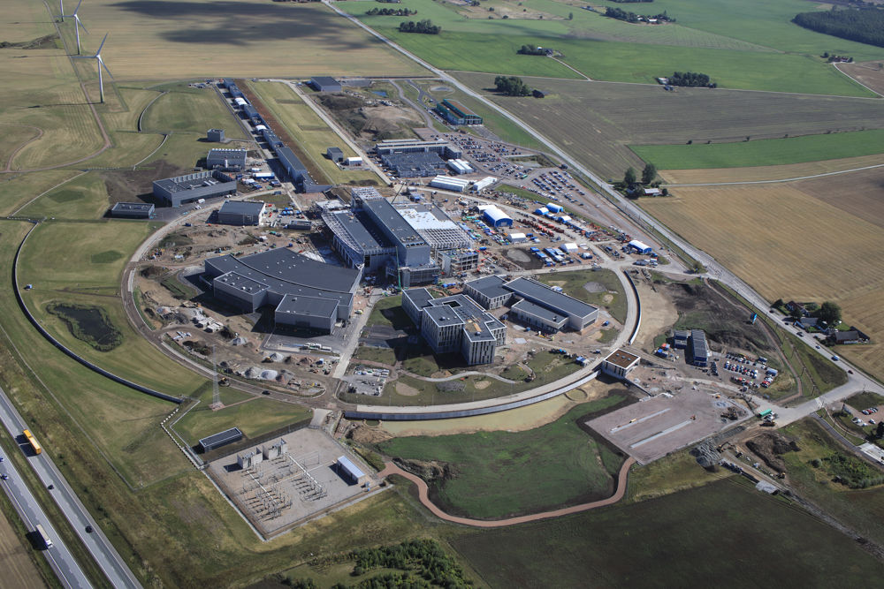
Muon Cooling Test Facility at ESS
Photo 8 October 2020
CERN Muon Collider Workshop on Testing Opportunities 24-25 March 2021
Tord Ekelof
Uppsala University

Slide 2
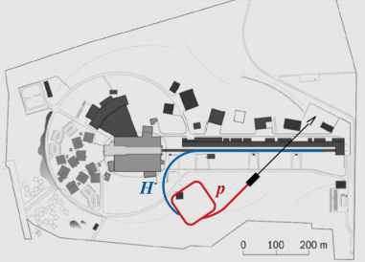
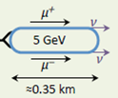
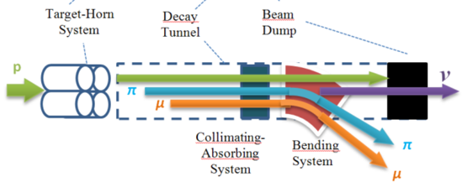
Prospects for Intensity Frontier Particle Physics
with Compressed Pulses from the ESS Linac
High Intensity Frontier Initiative
HIFI
Open workshop at Uppsala University
2-3 March 2020
Program and registration at:
https://indico.cern.ch/event/849674/
2.7x10²³ p.o.t./year
Short neutron pulses
ESS 5 MW proton accelerator
ν_{μ} or ‾ν_{μ}
Long
Baseline
Detector
ESSnuSB
π decay
Target
µ⁺⁻
Test Facility
Muon Test Facility
Accumulator Ring
ν_{μ} + ‾ν_{e}
Short
Baseline
Detector
nuSTORM
Decay
channel or ring
ν_{e} + ‾ν_{μ}
4x10²¹ muons/year of average energy ~0.5 GeV at the level of the beam dump
Front end
Recyling Linerar Acc.
Storage
ring
Cooling
Long
Baseline
Detector
Neutrino
Factory
Rapid Cycling
Synchrotron
Muon Collider
Higgs Factory
62.5 GeV
Collider
ring
→ ←
μ⁺ μ⁻

Slide 3
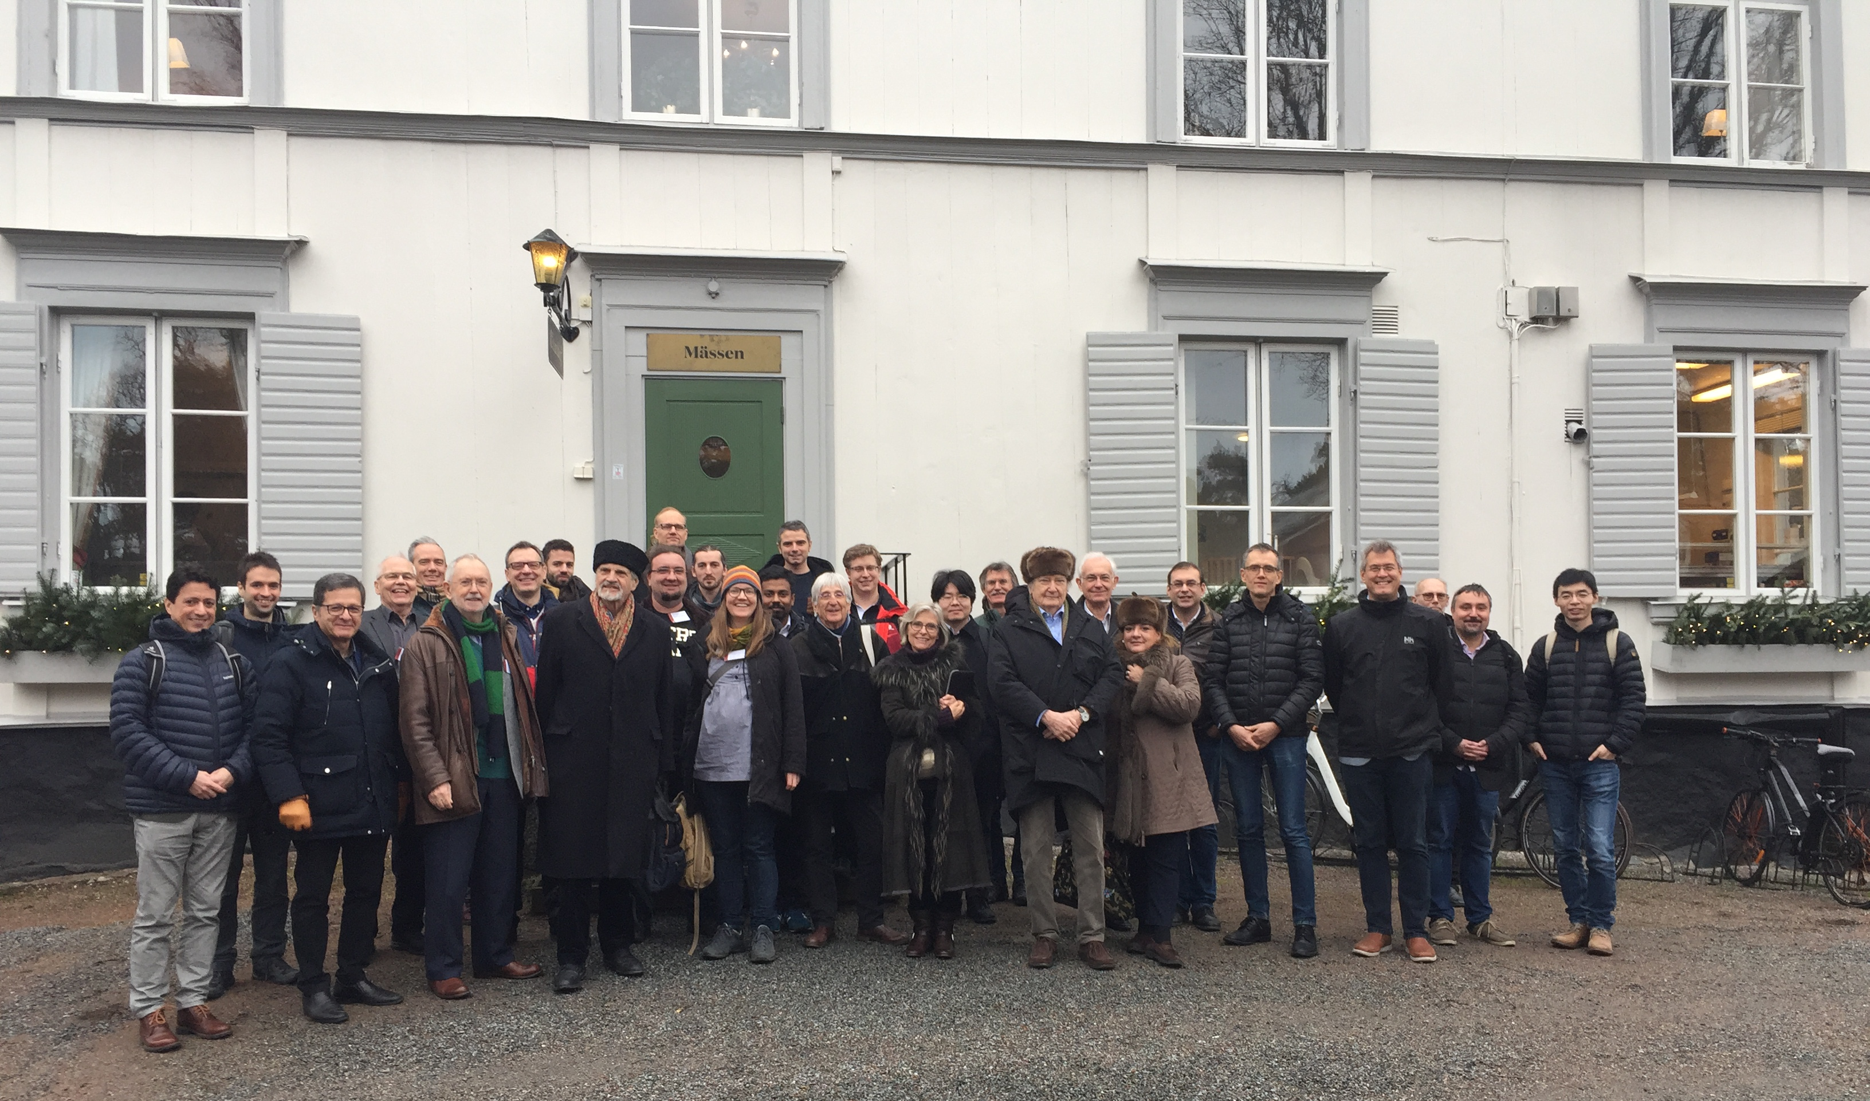
The participants in the HIFI Uppsala Workshop 2-3 March 2020

Slide 4
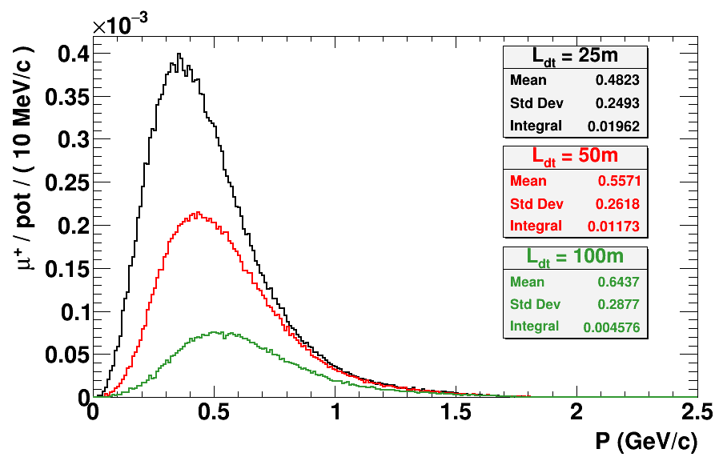
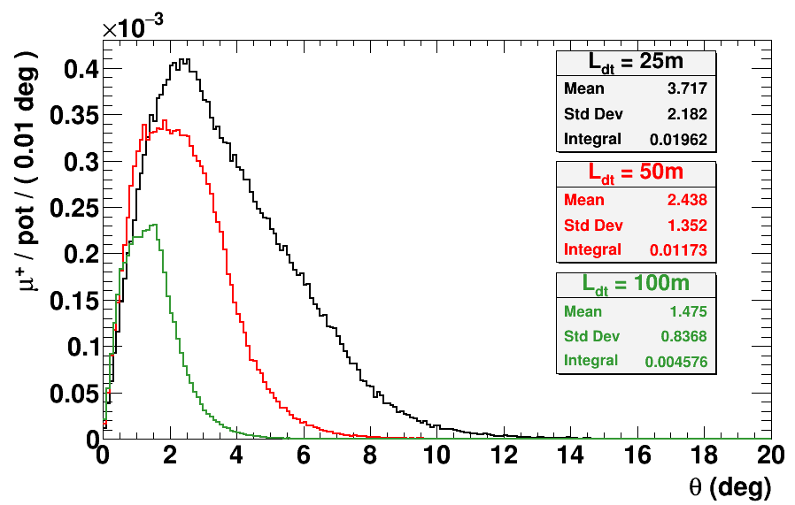
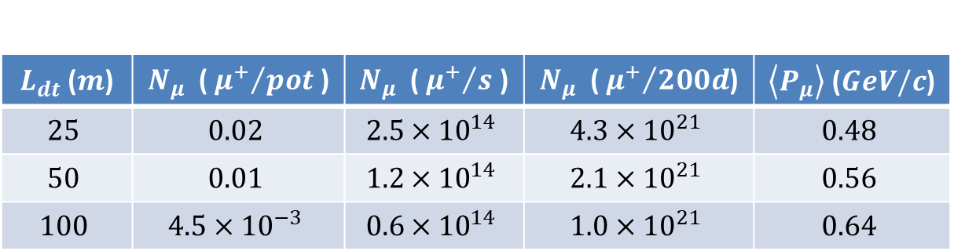
Muon momentum and angular distribution in a 4m x 4m aperture
$L_{dt}$ ($m$) | $N_{μ}$ ( ${μ^{+}}/{pot}$ ) | $N_{μ}$ ( ${μ^{+}}/s$ ) | $N_{μ}$ ( ${μ^{+}}/{200d}$) | $\left\langle P_{μ}\right\rangle$ ($GeV/c$)
$$25$$ | $$0.02$$ | $$2.5×{10}^{14}$$ | $$4.3×{10}^{21}$$ | $$0.48$$
$$50$$ | $$0.01$$ | $$1.2×{10}^{14}$$ | $$2.1×{10}^{21}$$ | $$0.56$$
$$100$$ | $$4.5×{10}^{−3}$$ | $$0.6×{10}^{14}$$ | $$1.0×{10}^{21}$$ | $$0.64$$
Prepared by Loris D’Alessi IPHC

Slide 5
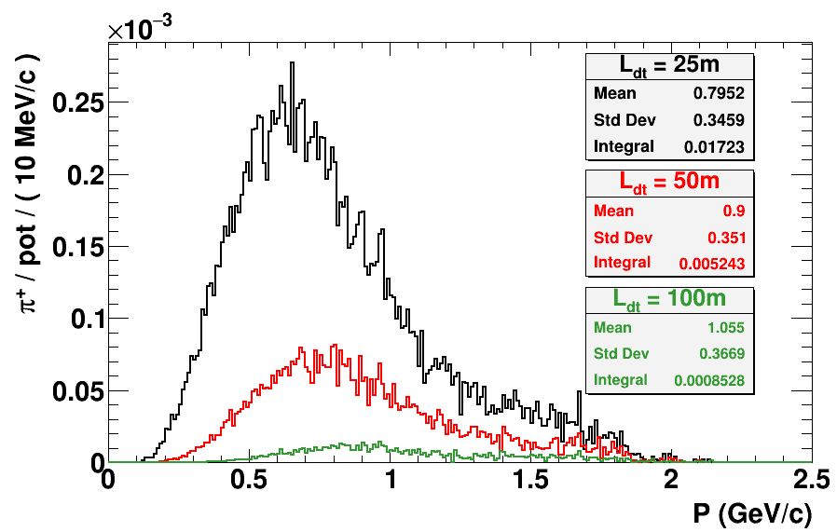
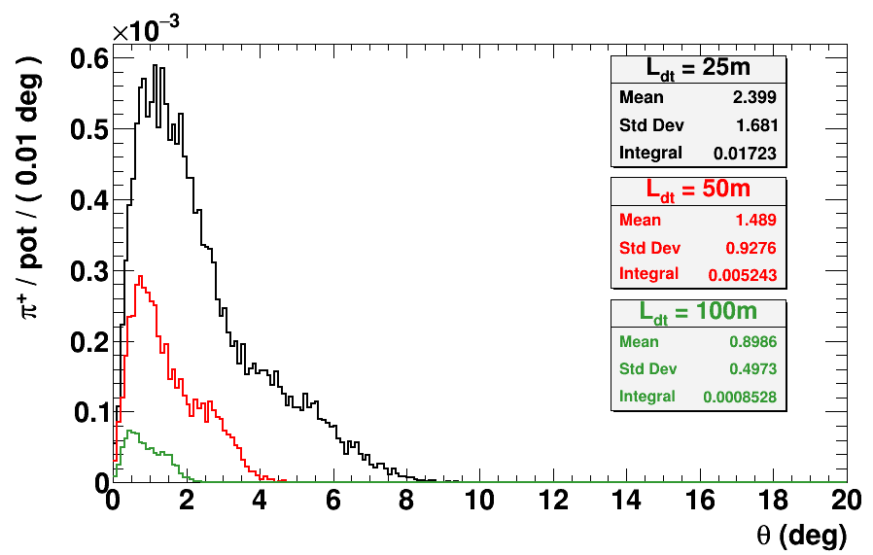
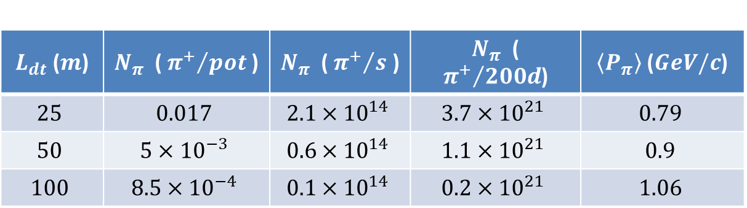
Pion momentum and angular distribution in a 4m x 4m aperture
$L_{dt}$ ($m$) | $N_{π}$ ( ${π^{+}}/{pot}$ ) | $N_{π}$ ( ${π^{+}}/s$ ) | $N_{π}$ ( ${π^{+}}/{200d}$) | $\left\langle P_{π}\right\rangle$ ($GeV/c$)
$$25$$ | $$0.017$$ | $$2.1×{10}^{14}$$ | $$3.7×{10}^{21}$$ | $$0.79$$
$$50$$ | $$5×{10}^{−3}$$ | $$0.6×{10}^{14}$$ | $$1.1×{10}^{21}$$ | $$0.9$$
$$100$$ | $$8.5×{10}^{−4}$$ | $$0.1×{10}^{14}$$ | $$0.2×{10}^{21}$$ | $$1.06$$
Prepared by Loris D’Alessi IPHC

Slide 6
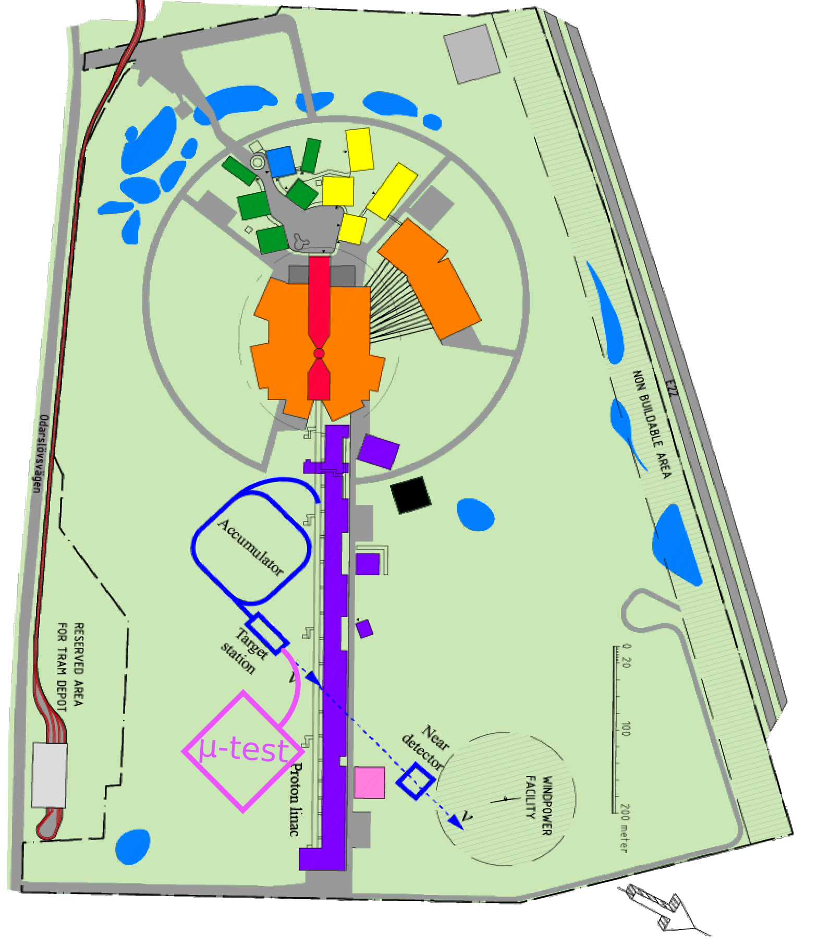
Conceptual sketch illustrating ideas for the Muon Test Facilty implementaion at the ESS site
Need to avoid passing the muons in a beam tunnel under the linac tunnel

Slide 7
EU funding opportunities from 2021
Destination 1.1 RI Concept Development
for new infrastructure or for major upgrades of existing infrastructures.
How much? 3 MEUR per project Dead-line: 24 March 2022
Destination 4 Next generation of scientific instrumentation, tools and methods
to enable new discoveries and keep Europe’s RIs at the highest level of excellence Requirement: providing R&D for at least 2 Research Infrastructures/Laboratories
How much? 10 MEUR per project Dead line: 24 March 2022
ERC Synergy Grants
Who can apply? Between 2 and 4 renowned PIs.
Criterion: scientific excellence.
How much? 10-14 MEUR per project Dead-line: probably in late 2022

Slide 8
Outlook
ESSnuSB Design Study well advanced
- Conceptual Design Report (CDR) by end 2021,
- Demonstrating feasibility of superior ESS neutrino Super Beam
High Intensity Frontier Initiative (HIFI):
- widening of the ESSnuSB Design Study scope
-including first Muon Cooling Facility, later nuSTORM facility, Neutrino Factory and eventually of a Muon Collider Higgs Factory.
First: Initial Muon Cooling Program synergetic with CERNs Muon Collider program
- muon momentum range 0.2 - 1.2 GeV/c, mean 0.64 GeV/c
- 10²¹ muons per year (depending on phase-space volume).
Applying for Horizon Europe support for a Destination 1 Design Study 2022-2025 – Goal: Technical Design Report (TDR) for ESSnuSB and Conceptual Design Report for the Muon Cooling Program and the other projects by 2025.

Slide 9
Backup slides

Slide 10
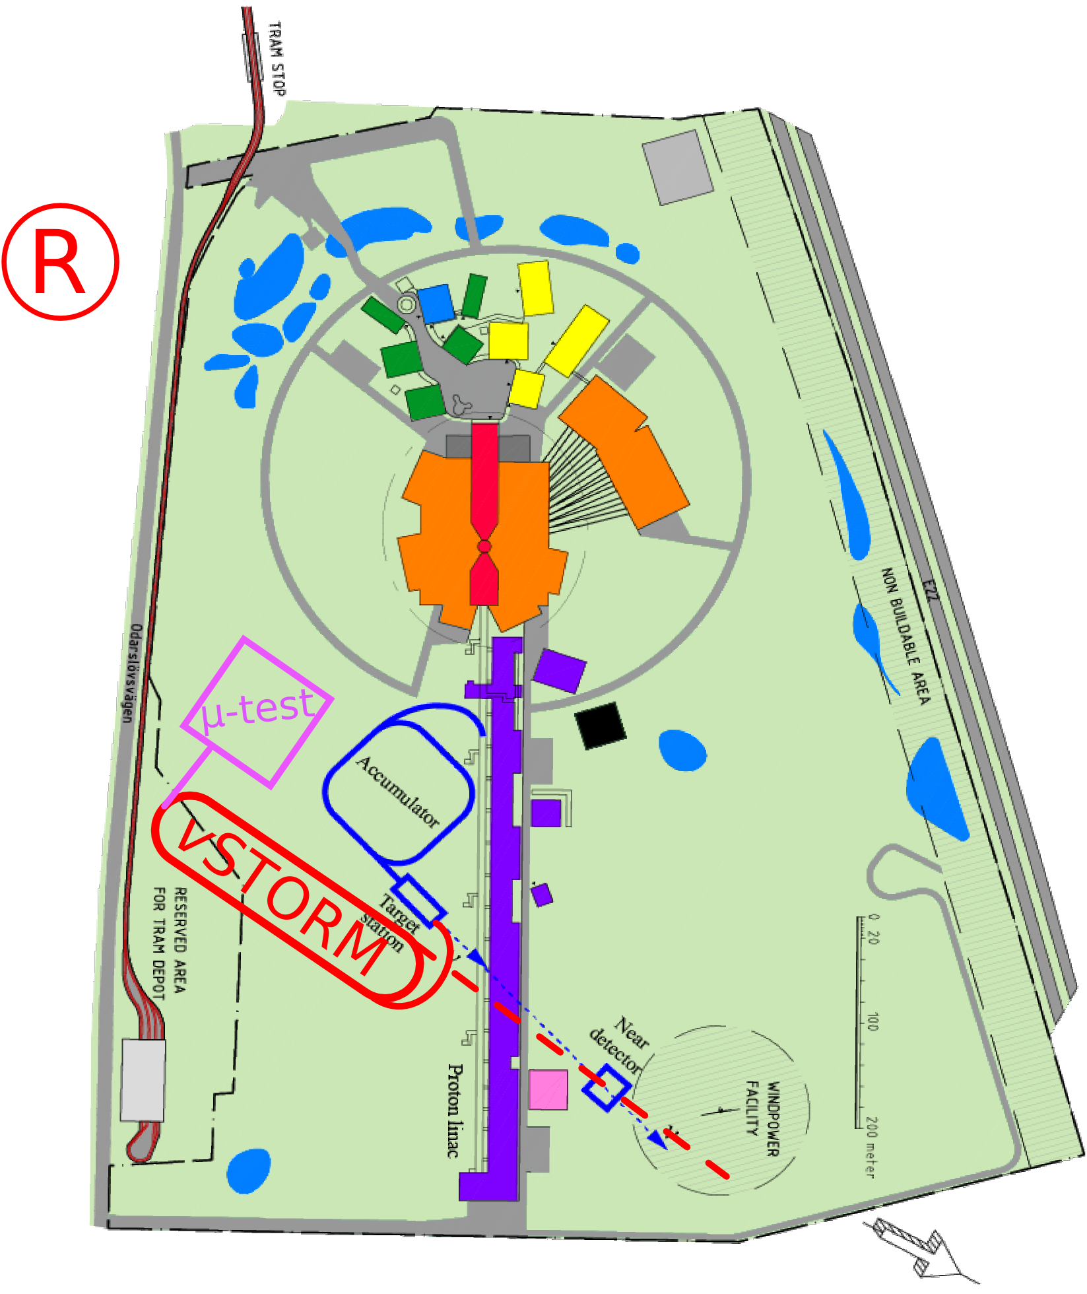
Conceptual sketch illustrating ideas for nuSTORM + Muon Test Facility layout at the ESS site
Need to avoid passing the muons in a beam tunnel under the linac tunnel

Slide 11
nuSTORM generic lay-out
π->μ+ν_{μ}
ν_{e} and ν_{μ}
π
ν_{e} cross-sections
Sterile neutrinos
; μ->e+ν_{e}+ν_{μ}

Slide 12
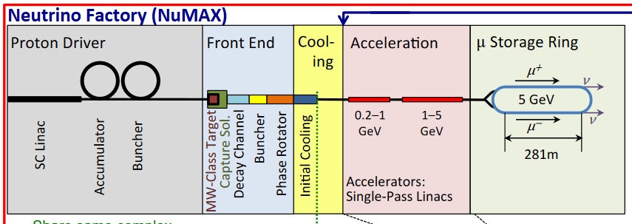
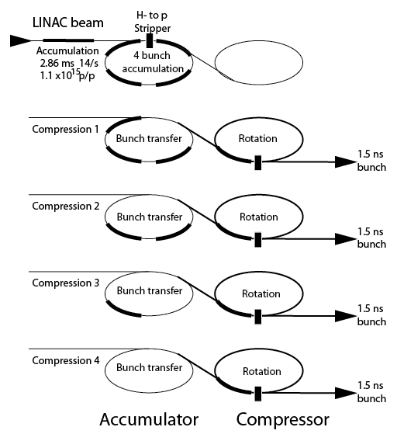
HIFI Neutrino Factory generic layout
Then cooling,
acceleration
and storage in
a μ decy ring
Accumulation and bunching
Phase rotation

Slide 13
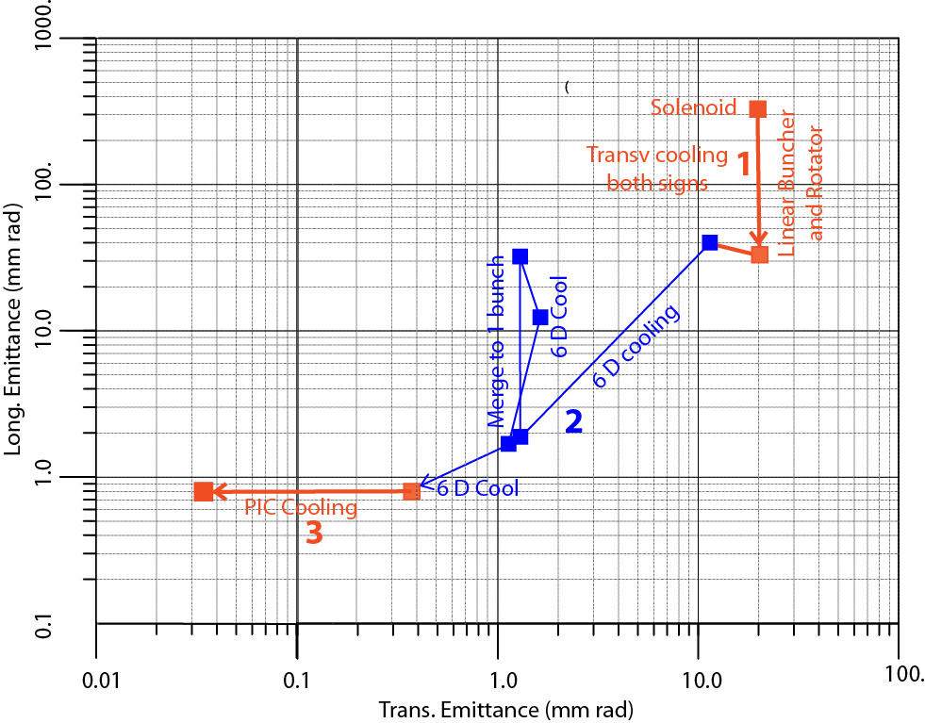
Muon Collider Higgs Factory at ESS generic layout
62.5 GeV
Higgs
Factory
  Muon cooling in 3 steps:
  1. Linear transverse cooling
  2. 6D cooling
  3. Parametric Resonance Cooling
  Then acceleration to
  62.5 GeV and collisions

