Slide 1
PSI Muon Facilities
Daniela Kiselev :: ASA/GFA :: Paul Scherrer Institut
Workshop on Muon Collider test opportunities, 24.3.2021

Slide 2
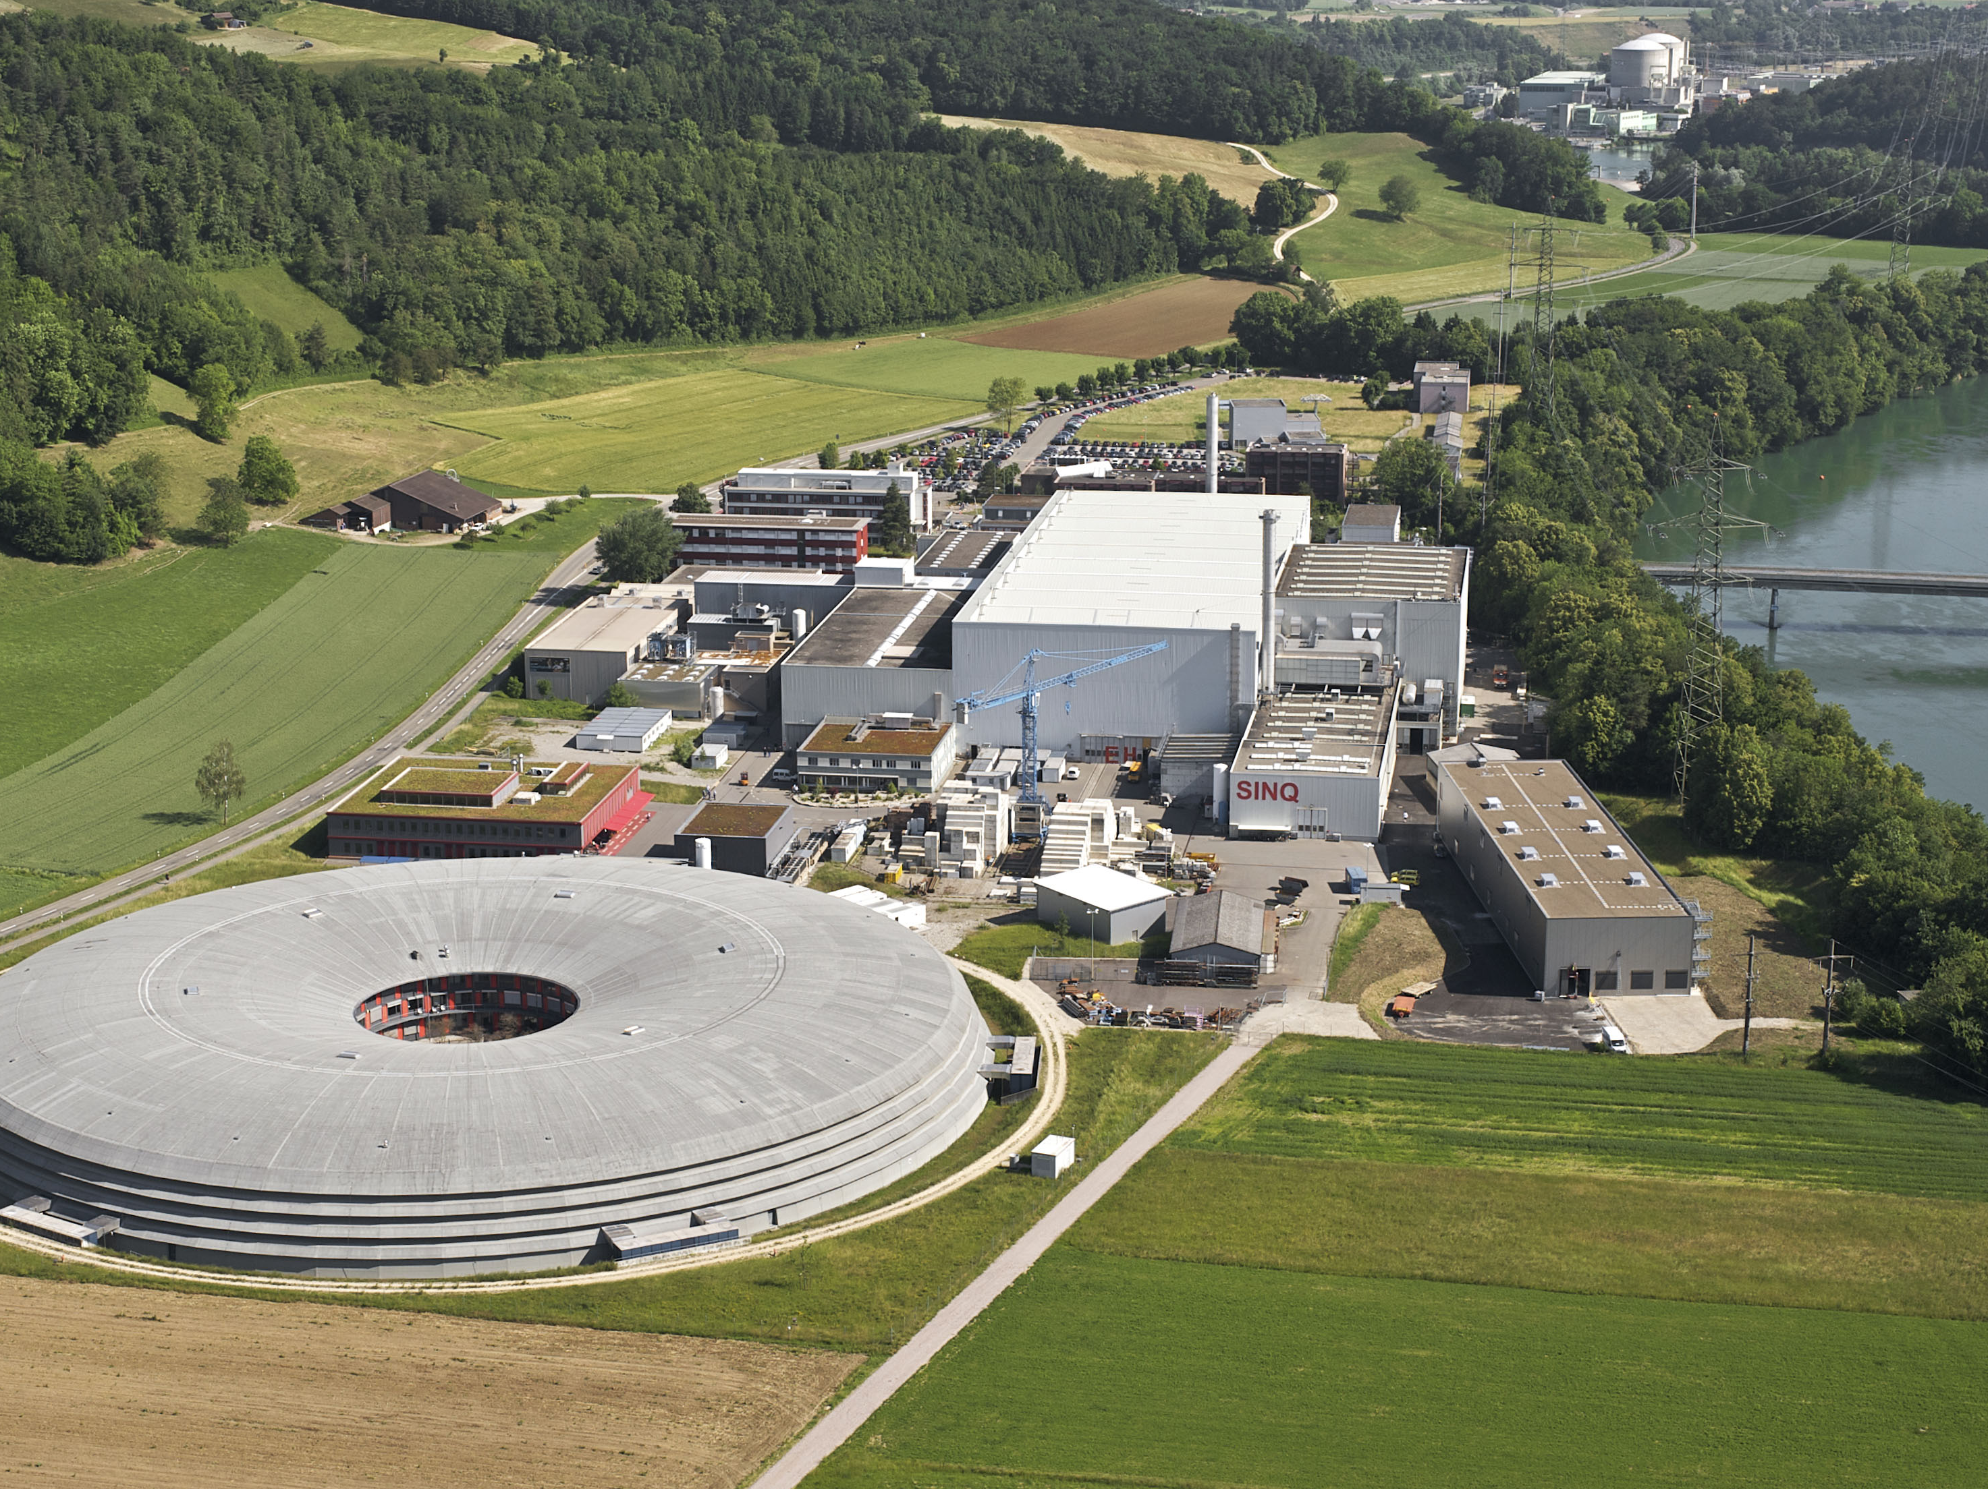
Accelerator Facilities at PSI
SINQ Spallation Neutron Source
UCN
p-Therapy
250MeV, <1μA
Central control room
SWISSFEL
5.8 GeV
High Intensity Proton Accelerator
590 MeV, max. 2.4mA
Swiss Light Source
2.4GeV, 400mA

Slide 3
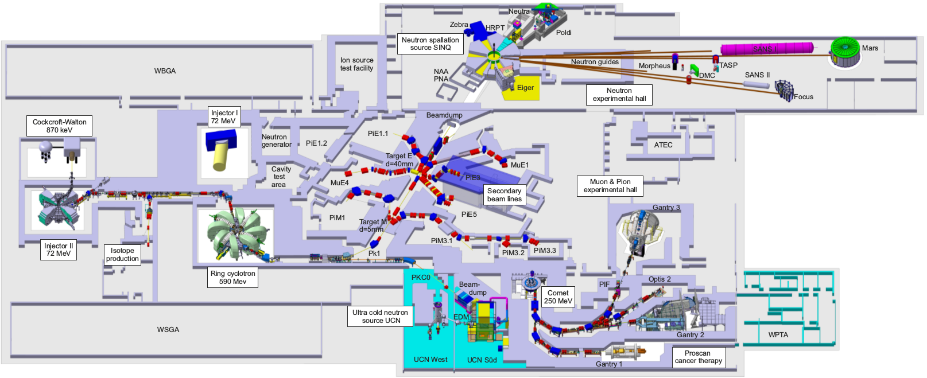
The PSI Proton Accelerator Facilities
Spallation neutron source SINQ
ECR-source &
Cockroft-Walton
Injector I
Target E
hot cell HIPA
Secondary
Beam Lines
OPTIS
Injector II
Comet
Gantry 1, 2 3
Ring
Target M
PIF
UCN
HIPA (High Intensity Proton Accelerator)
- CW (50.63 MHz), 590 MeV,
- up to 2.4 mA(1.44 MW)
2 meson production targets
7 secondary beam lines
- SINQ and UCN spallation source
PROSCAN (Proton therapy): since 2007
Comet: superconducting cyclotron
CW, 250 MeV, up to 1 μA protons
medical treatment:
3 Gantries, 1 Eye Cancer Treatment Station
Irradiation Station: PIF
Page 3

Slide 4
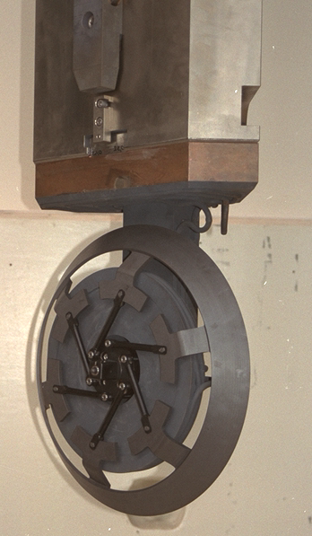
Challenges for meson production targets
Power deposition:
at 2.4 mA, 590 MeV protons ~ 50 kW on Target E
→ cooling
→ high temperature resistant material
→ thermal stress
Radiation damage:
→ embrittlement
→ deformation (also due to heating)
→ loss of conductivity
Target E
Approach:
distribute power:
rotating wheel with 1 Hz → needs bearings
cooling by radiation:
- independent of conductivity
- local shielding (Cu) is cooled by water
p-beam

Slide 5
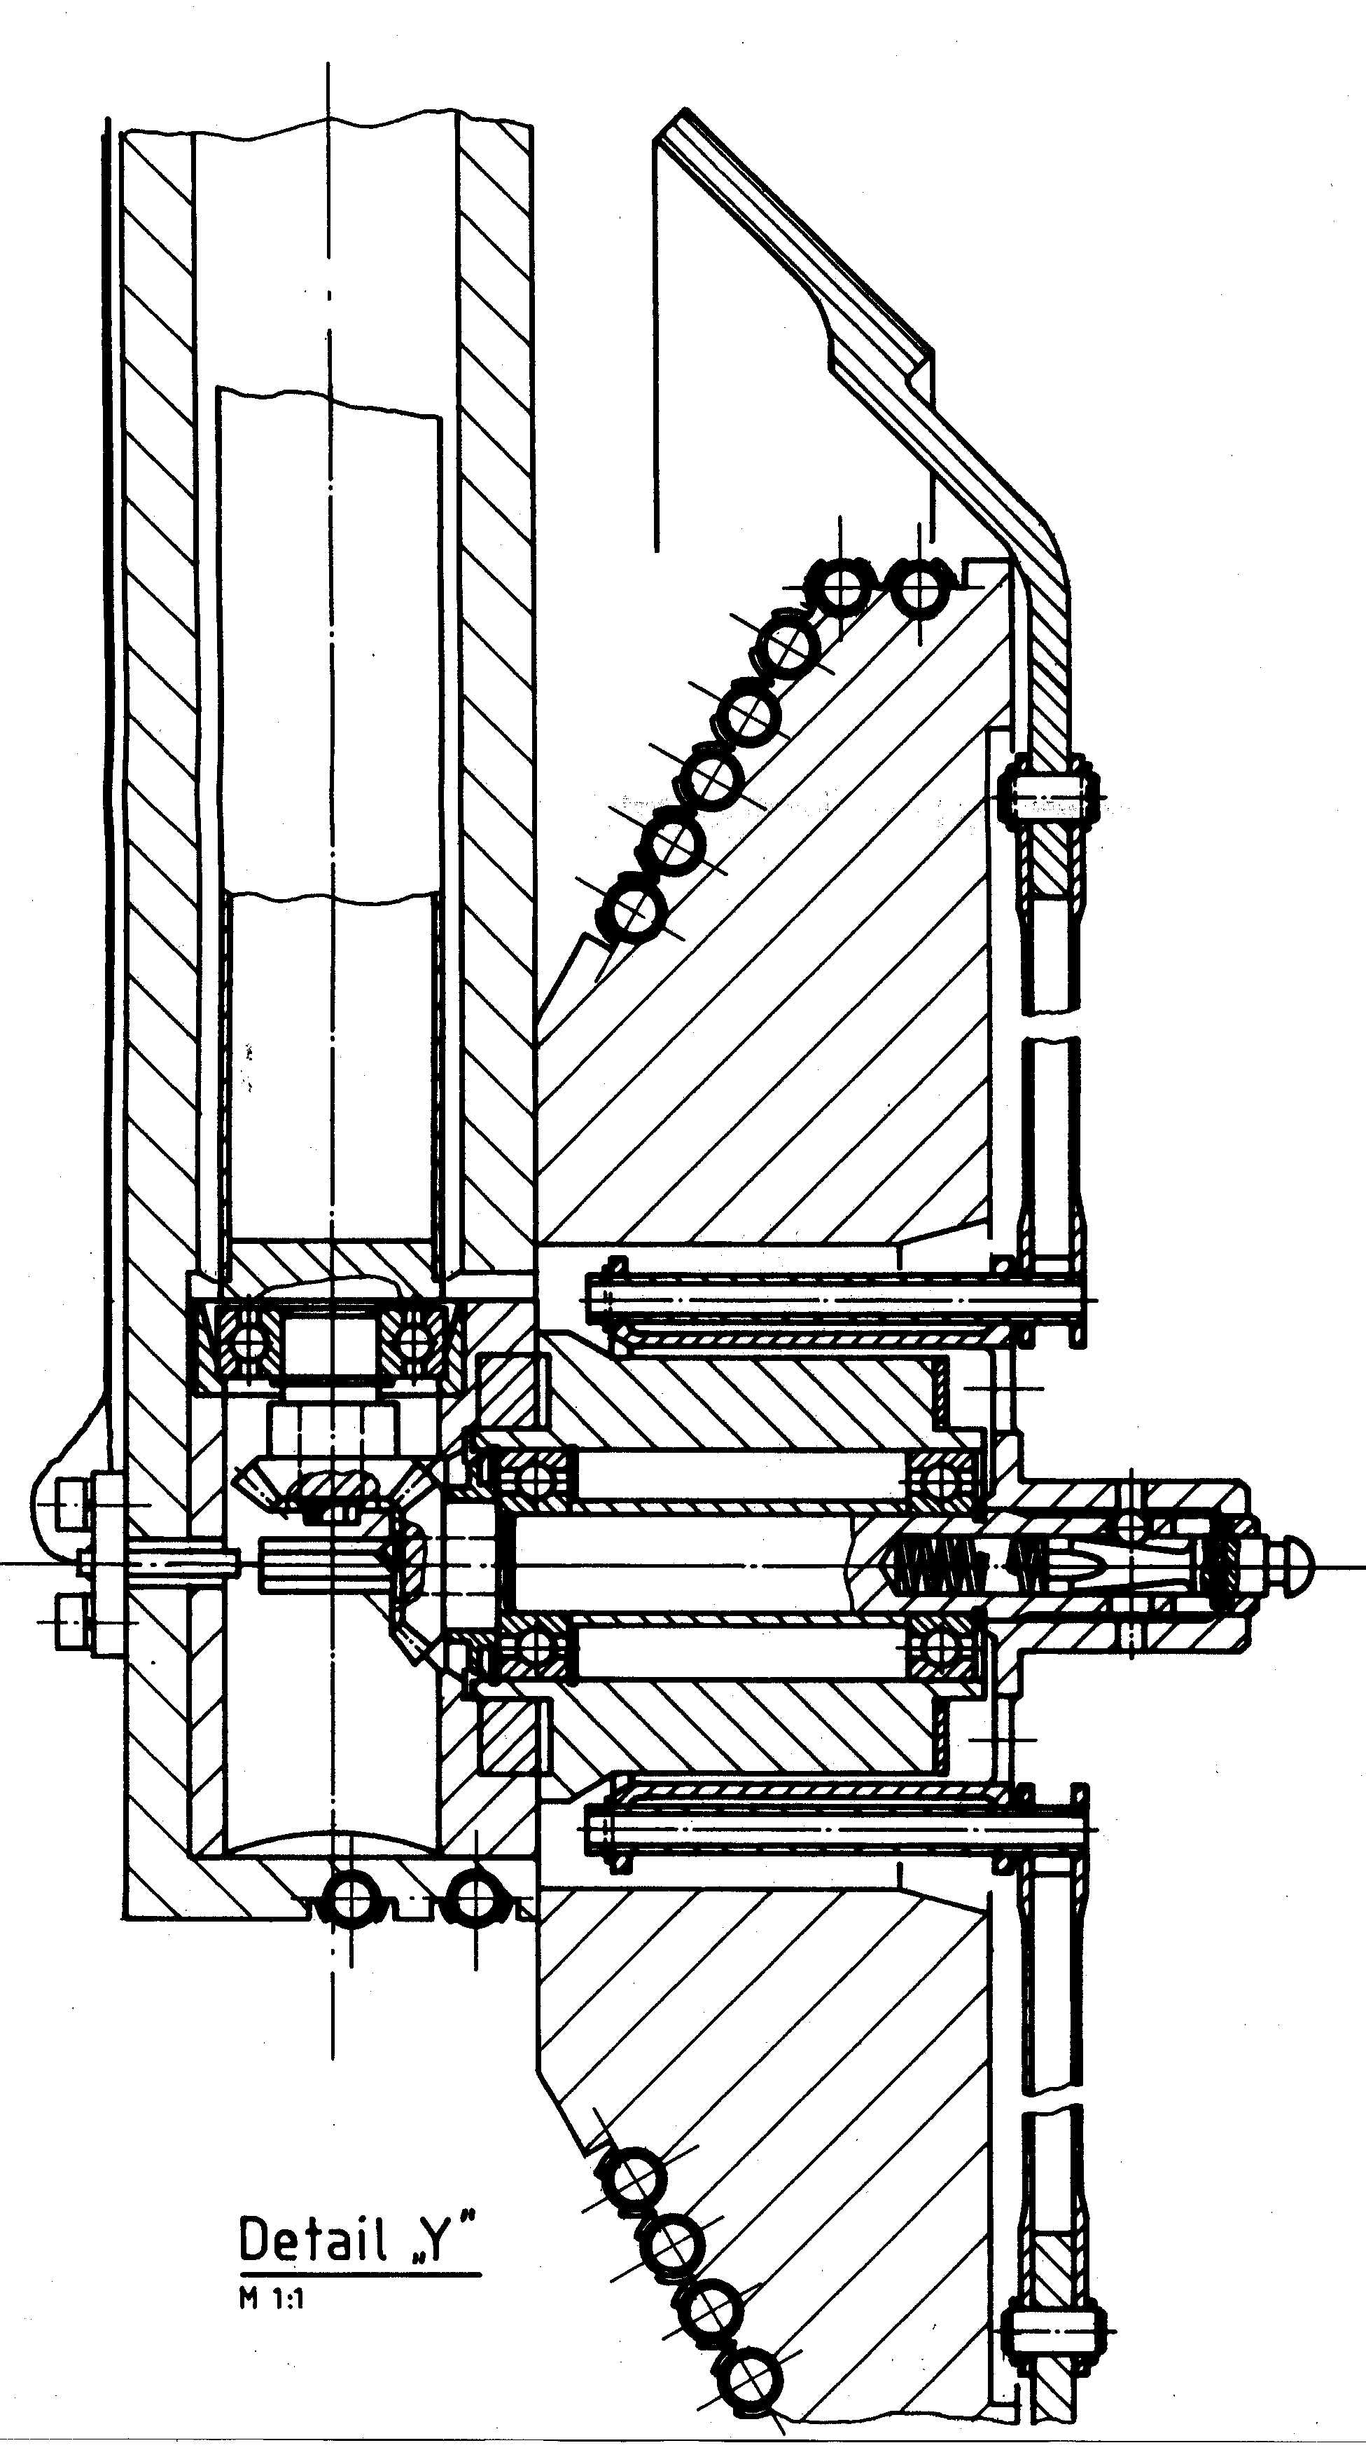
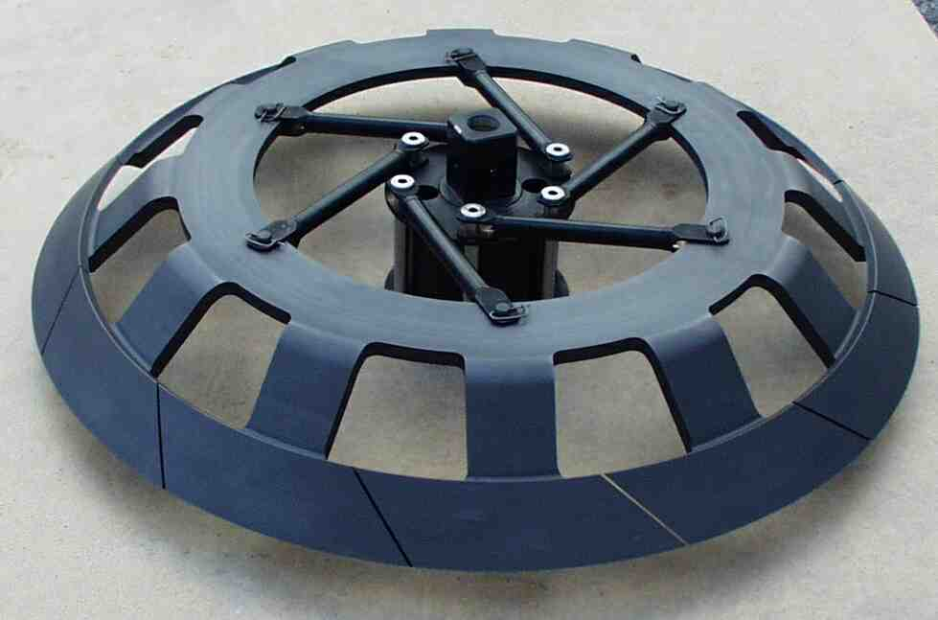
Challenges for meson production targets
Drive shaft
Motor
Wheel deformation reduced by
- polycrystalline graphite → isotropic properties
- slits in wheel rim für thermal expansion
- spokes: allows thermal expansion of target cone
hollow to avoid high temperature at bearing
Target
wheel
Water
cooling
Local
shielding
1700 K
140 ºC
12 segments with 1 mm slit
50 ºC
Motor:
2.5 m above the beam line
Functioning is not affected by irradiation
life time ~ 5 – 8 years
angular contact
ball bearings
deep groove
ball bearings
Notes:
deep groove ball bearing: Rillenkugellager: Die vorderen sind Radiallager, können wenig axiale Last aufnehmen
angular contact bearings: Schrägkugellager: Kugeln liegen um 23o geneigt, nehmen axiale und radiale Last auf, wirken noch etwas zentrierend
deep groove ball thrust bearing: Axial-Rillenkugellager, für Axiallast, haben wir nicht. Man könnte ein Schrägkugellager durch ein Axial- und Radiallager ersetzen.

Slide 6
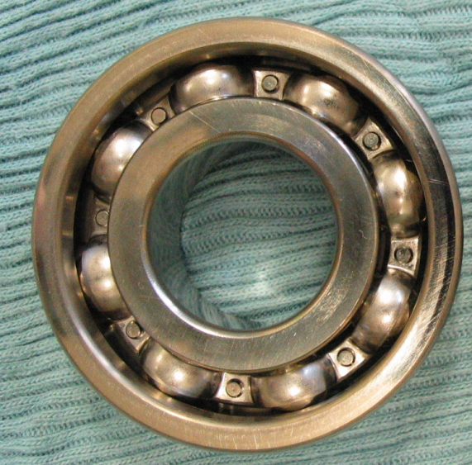
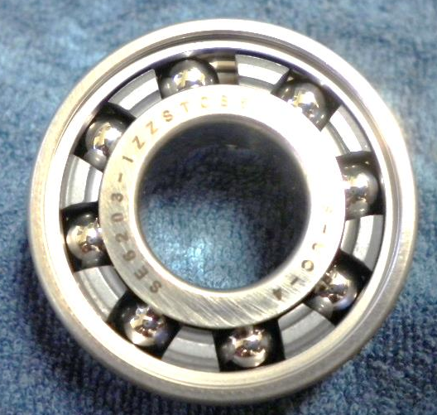
Critical components: Bearings
Ball bearings:
No grease as lubrication! → brittle due to hard irradiation
so called radiation hard grease does not help → proofed
in use:
in test:
Shun Makimura
(JPARC)
Balls Si₃N_{4,} GMN, Germany
Coating: MoS_{2,} Ag for ring & cage
1 -2 x exchange/year
←→ Graphite wheel lasts much longer: ~ 4Years
(39 Ah record)
Balls stainless steel + WS₂ blocks
Koyo, Japan
Test (without radiation): > 420 days
Test in beam at PSI planned this year
Notes:
Dosis an Target E: 10000 Gy/h bei 1 mA (nach Gerd’s Abschätzung)

Slide 7
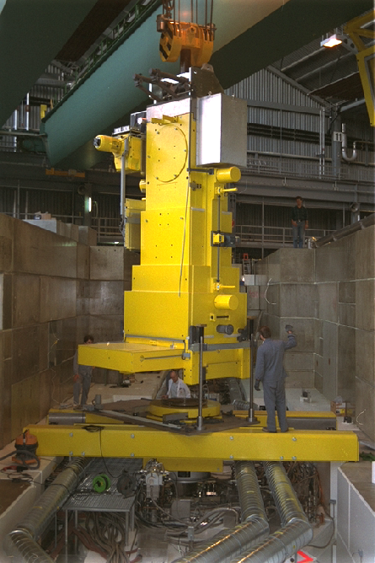
Exchange of the high-activated components
Exchange flask:
45 t, shielded with 40 cm steel
remotely operated
"Bridge":
contains contamination protection
door to close lifting hole
sticks for positioning of the flask
Working platform:
~ 2m above beamline, shielded with steel
Accessible after removing 3 – 4 m of concrete

Slide 8
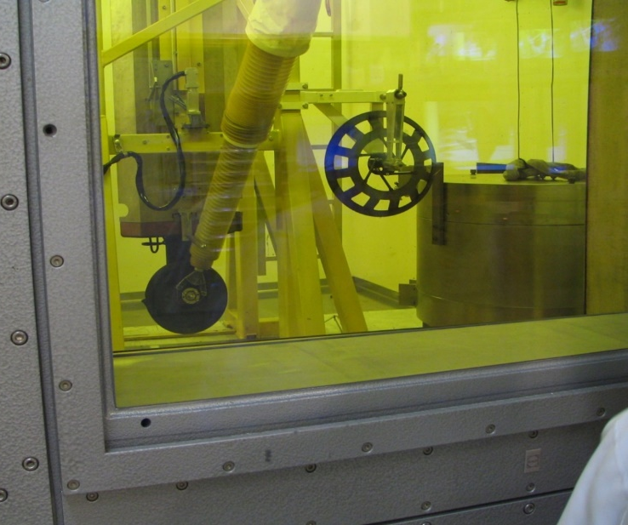
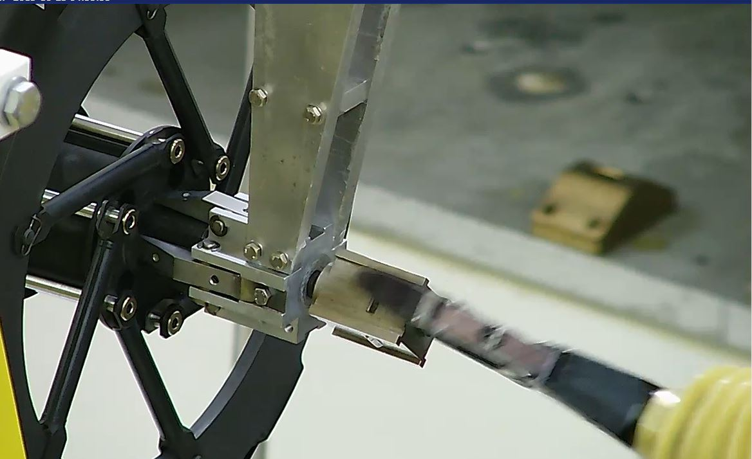
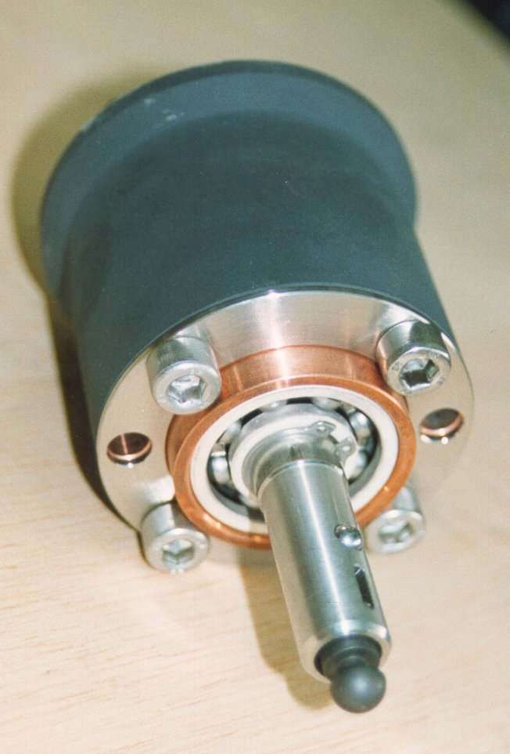
Transport to hotcell PSI West (ATEC)
View into hotcell of ATEC
Exchange of bearings with manipulator
Remote handling necessary: up to 3 Sv/h
Handing over from flask to hotcell via sluice
Usually only the hub needs to be exchanged
→ not much radioactive waste (up to 200 mSv/h)
Hub

Slide 9
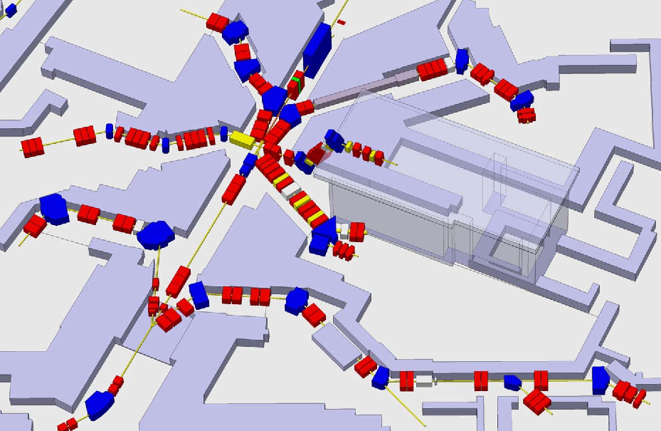
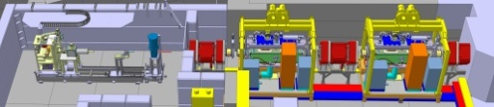
μ/π Secondary Beam Lines
πE1
Target E
μE4
μE1
πE3
πM1
Spin rotator
p-Beam
πE5
Target M
πM3
Target E:
πE1: 10 - 500 MeV/c High Intensity Pions und Muons μE1: Polarized Muon Beam
πE3: 28MeV/c Surface polarized Muons
μE4: 30 - 100 MeV/c High Intensity Polarized Muons πE5: 10 - 120 MeV/c High Intensity Muons
Target M:
πM1: 100-500 MeV/c Pions
πM3: 28 MeV/c Surface Muons
Seite 9

Slide 10

Overview of Secondary Beam Lines
 | PiM1 | PiE5 | PiE1 | PiE3 | PiM3 | MuE4 | MuE1
Target | M | E | E | E | M | E | E
Particle Type | π/e/μ/p | μ/π | π/μ/p | μ, π | μ | μ | μ (cloud)
Momentum Range | 10-500 MeV/c (max 300 MeV/c for positive particles) | 20-120 MeV/c | 10-500 MeV/c ustream ASK 10-120 MeV/c downstream ASK | μ:10-40 MeV/c π: 50 – 250 MeV/c | 10-40 MeV/c | 10-40 MeV/c | 60-120 MeV/c
Typical Momentum | 15-300 MeV/c | 28-85 MeV/c | PP: 10-50 MeV/c μSR: 28 MeV/c Irrad: 300 MeV/c | 28 MeV/c | 28 MeV/c | 28 MeV/c | 60-125 MeV/c
Max Rate [mA⁻¹ s⁻¹] | @ 350 MeV/c π+::2x10⁸ | @120MeV/c π⁺:2x10¹⁰ μ⁺:5x10⁸ | @ 300 MeV/c π⁺:4x10⁹ | μ⁺:3x10⁷ π⁺ :2x10⁹ @ 170 MeV/c | μ⁺:3x10⁶ | μ⁺:4x10⁸ | @ 300 MeV/c μ⁻:6x10⁷
Typical Use | Particle Physics Test Experiments, Detector/Material Irradiation | Particle Physics Experiments | μSR Dolly Particle Physics Experiment, Detector Irrad. | μSR HAL 9500 (High Field) | μSR GPS and LTF | μSR LEM Facility | μSR GPD Facility
Particle physics: (CHRISP facility)
μSR (Muon Spin Rotation),
SμS (Swiss Muon Source)

Slide 11
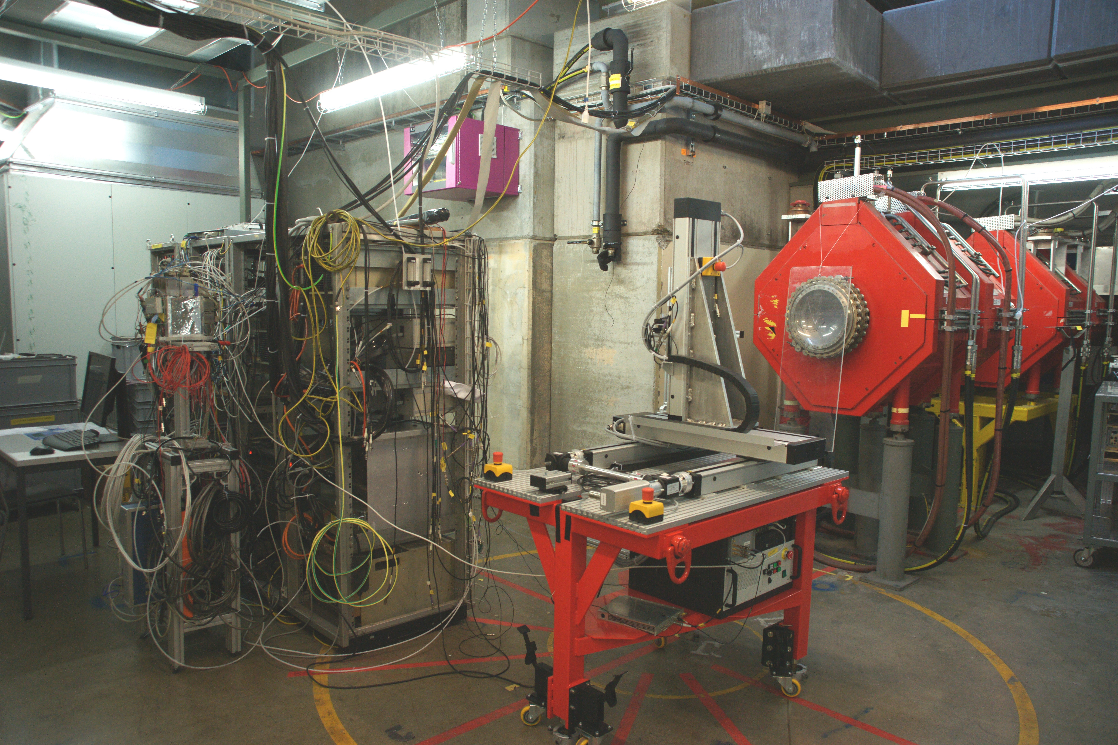
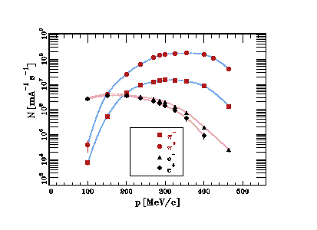
PiM1 Beamline
Often used as Test Beam line at PSI
e/μ/π/p momentum range 20 – 500 MeV/c
Particle separation by energy loss in material & momentum selection
Momentum < 115 MeV/c: dominated by e
115 - 280 MeV/c Beam dominated by μ/π
> 280 MeV/c Beam dominated by π/p
Beam scanner
Measured Particle Rates
(R.A. Schumacher, U. Sennhauser, 1987)
p- acceptance: 2.9 %
p-resolution: 0.1 %
Size at Target: hor: 15 mm,
vert: 10 mm
Divergence : hor: 35 mrad
vert: 75 mrad

Slide 12
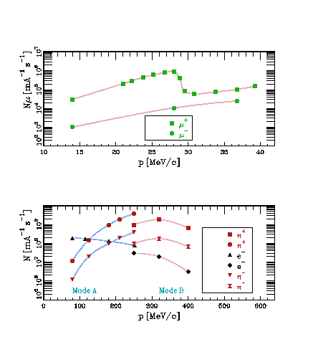
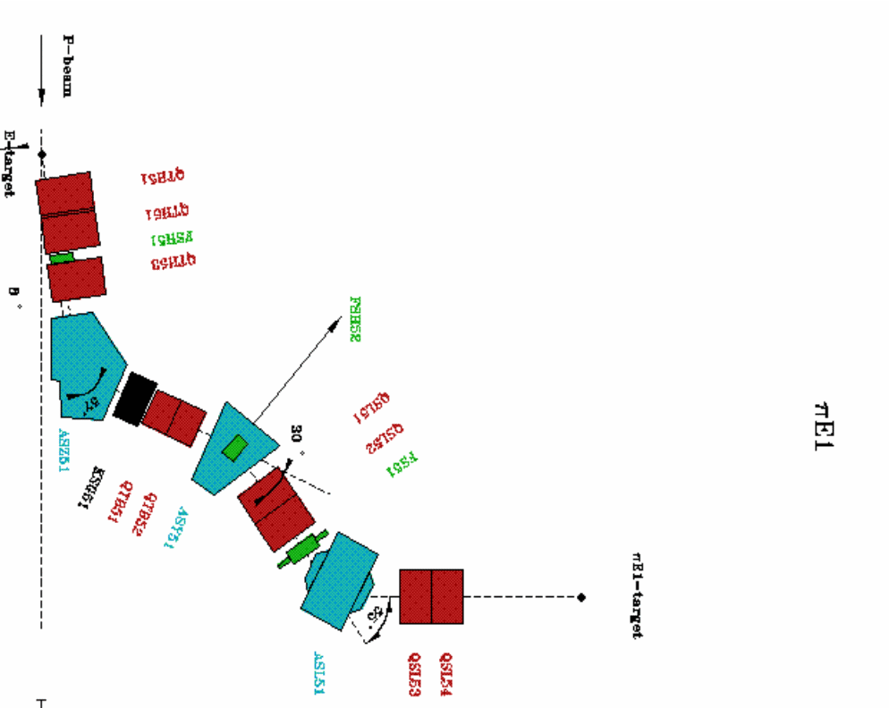
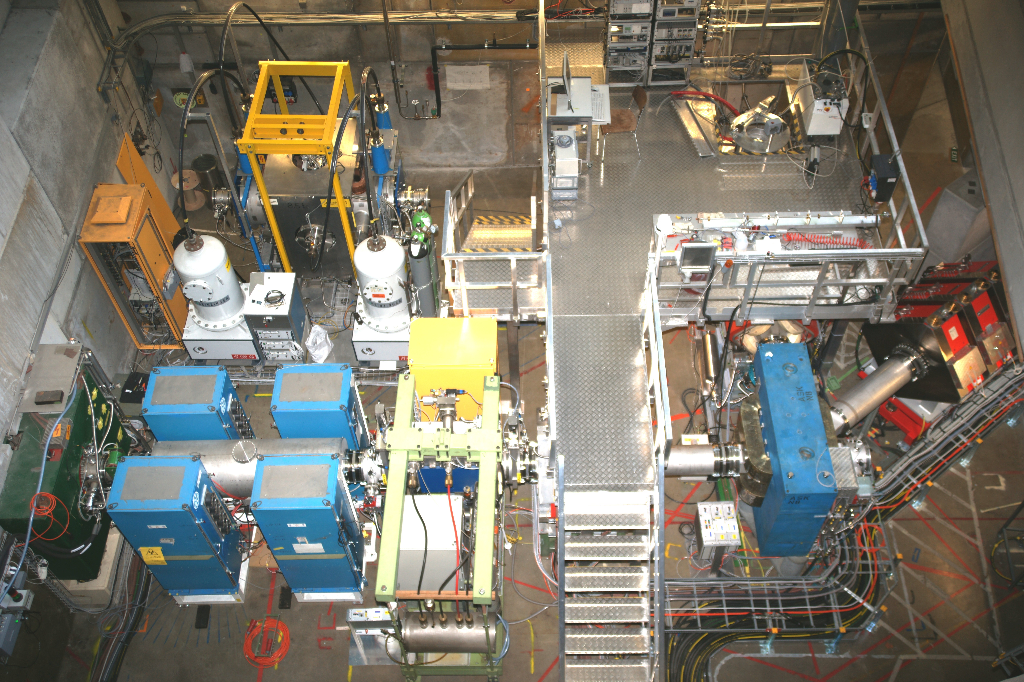
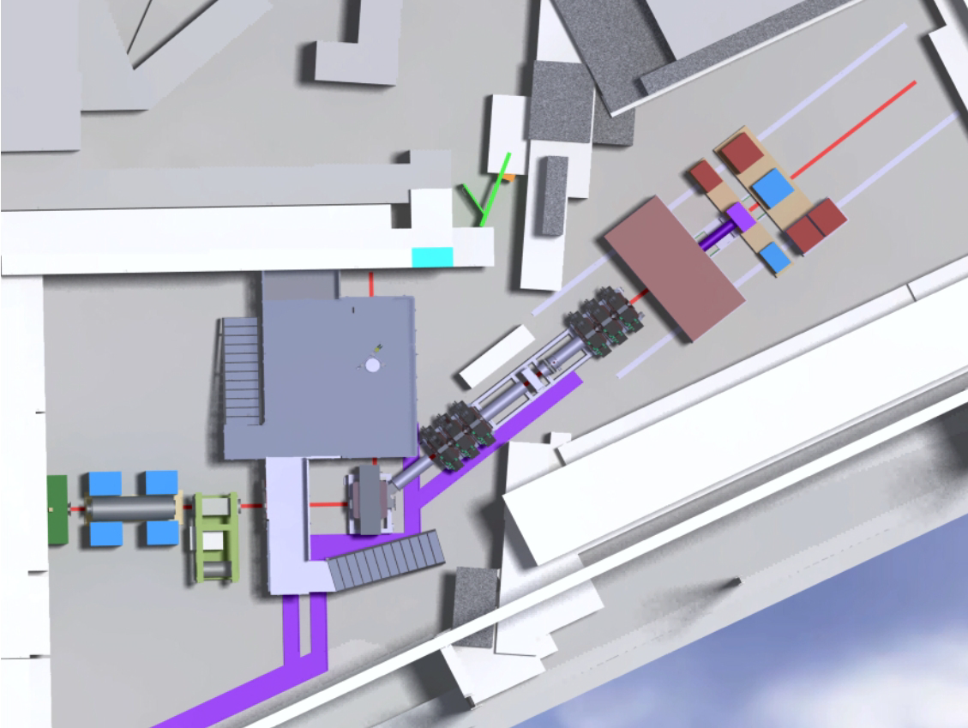
PiE1 Beamline
High intensity μ/π beam line at TE
< 120 MeV/c: Beam dominated by e/μ
120 - 280 MeV/c Beam dominated by μ/π
> 280 MeV/c Beam dominated by π/p
Momentum acceptance (1σ): 4%
Max. particle flux: 4x10⁹ π⁺ @ 300 MeV/c
Beam spot (RMS): 7mm (x), 4mm (y)
at 10°forward angle
Dolly (µSR)
Pion Irradiation
surface μ
SpinRot (45° @ 28 MeV/c)
Mode B
Particle Physics
Mode A
ASK
Wien Filter
ASK Dipole

Slide 13
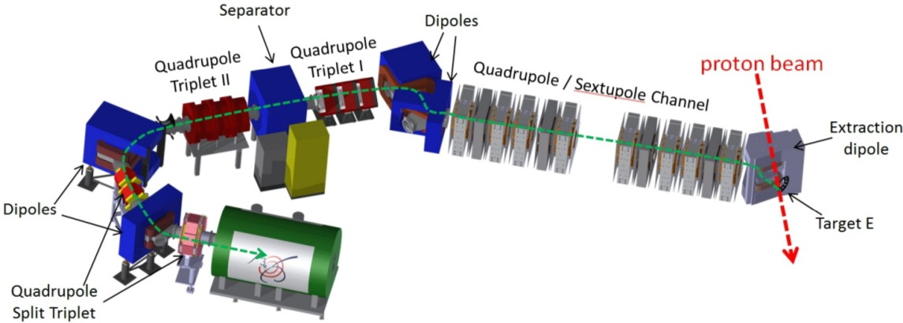
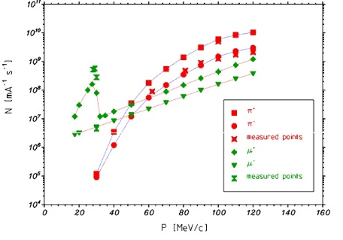
PiE5 Overview
Experimental Area
Fixed Part of the Beam Line
AST
2. beam line
Low energy (10-120 MeV/c), high intensity μ/π beam line at TE (175° backward angle)
Momentum acceptance (1σ): 5%
Max. particle flux: 6x10⁹ π+ @ 120 MeV/c
Spot size after triplet I (RMS): 8mm (x), 10mm (y)
High neutron background (150 n/mA/s/cm²
Wien Filter (or Muon Spin Rotator)
XY Beam Scanner

Slide 14
mucool: compression of μ phase space
Aim: to improve the quality of the μ beam
lower density He
E = 50V/cm
~5 mbar He
5 T magnetic field
Due to He density gradient m collide
with He less on the top
than on the bottom.
Energy loss compensated
by electric field
predominately drift in ExB direction
12.5 MeV/c
muons
higher density He
E x B
E_{x} = E_{y}= 1kV/cm
muon drift
Transverse compression:
vertically 14 mm was reduced to a 0.25 mm size (rms) within 3.5 μs.
Longitudinal compression:
20 cm long muon stop distribution
reduced to a sub-mm extent within 2 μs
A. Antognini et al (muCool Collaboration), Phys. Rev. Lett. 125, 164802 (2020)
Belosevic et al, (muCool Collaboration),
Eur. Phys. J. C 79, 430 (2019)
Longitudinal and transverse phase space reduction of a μ⁺ beam
by a factor of 10¹⁰ with 10⁻³ efficiency.
Contacts: A. Antognini, K. Kirch, A. Knecht, A. Papa

Slide 15
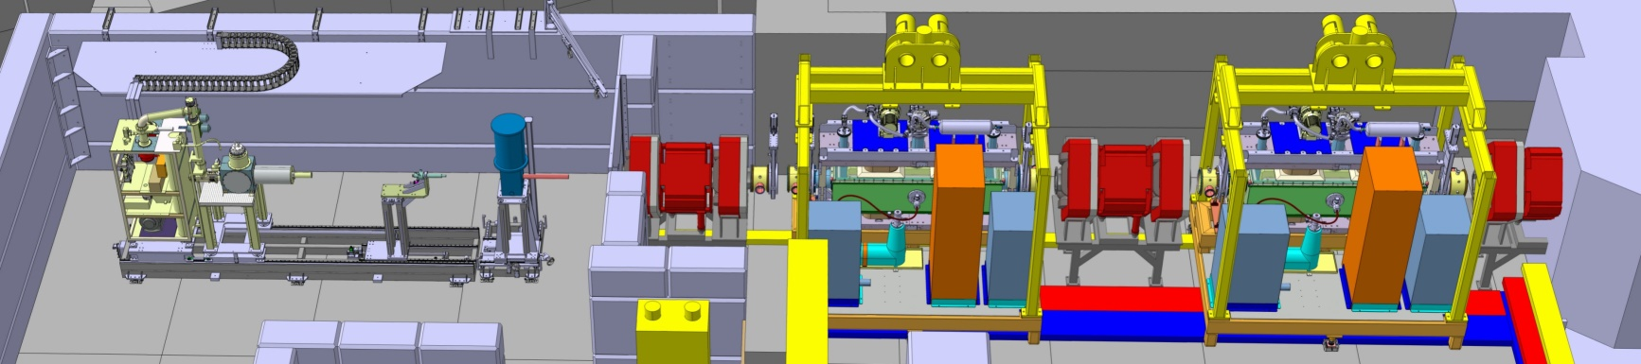
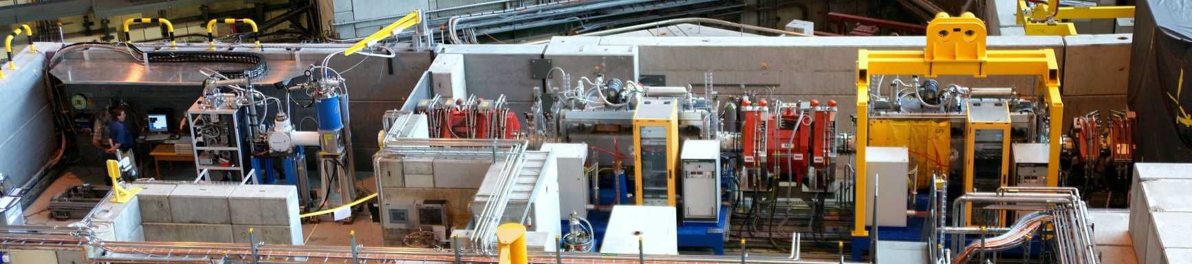
πE3 Extension for the High-Field μSR Facility (2011)
  ‏ Worldwide unique 9.5T External Field
  Sample extremely small
Material T range: 0.02 K - 320K
Transverse beam polarization
at the sample material:
→ 2 Spin rotators required!
High Field μSR (Muon Spin Rotation/Relaxation/Resonance)
Beam Line
Beam size at sample: σ_{x,y} ≈ 15mm
Large beam transmission
Momentum Bite at sample:
Δp/p ≈ 2%
Sample
surface
muons

Slide 16
Possibilities for testing at PSI
Detector tests
- convenient in PM1 (test area)
- beam scanner available
Test of diagnostics
mucool: a cooling method at low energy
No possibility of testing the target with high intense proton beam
2027: Likely no beam because of HIMB (High Intense Muon Beam)
→ Redesign of PiM1
→ Use for particle physics program

Slide 17
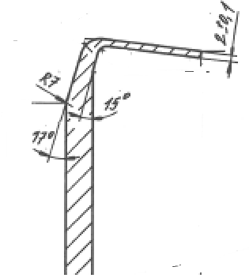
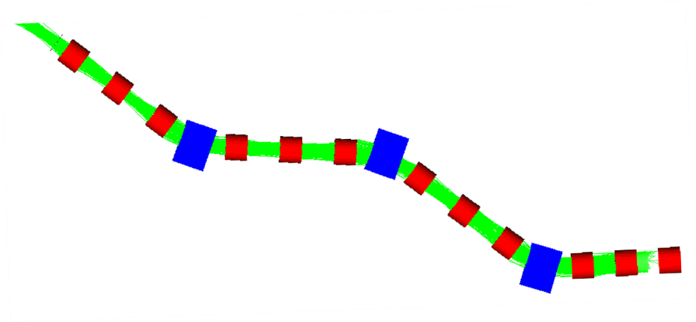
HIMB in short
PiM1
PiM3
22.5º
22.5º
TgM (5 mm) → TgM* (20 mm)
Old type → Slanted type
present TgM
Large acceptance due to large capture solenoids close to target
2 mm
Slanted target type
→ Tested
successfully at
Target E
Central field of solenoids ~0.35 T
Field at target ~0.1 T
Muon/pion beamline out of
large diameter solenoids
5-8º
Factor ~100 more
Surface muons
A. Knecht

Slide 18
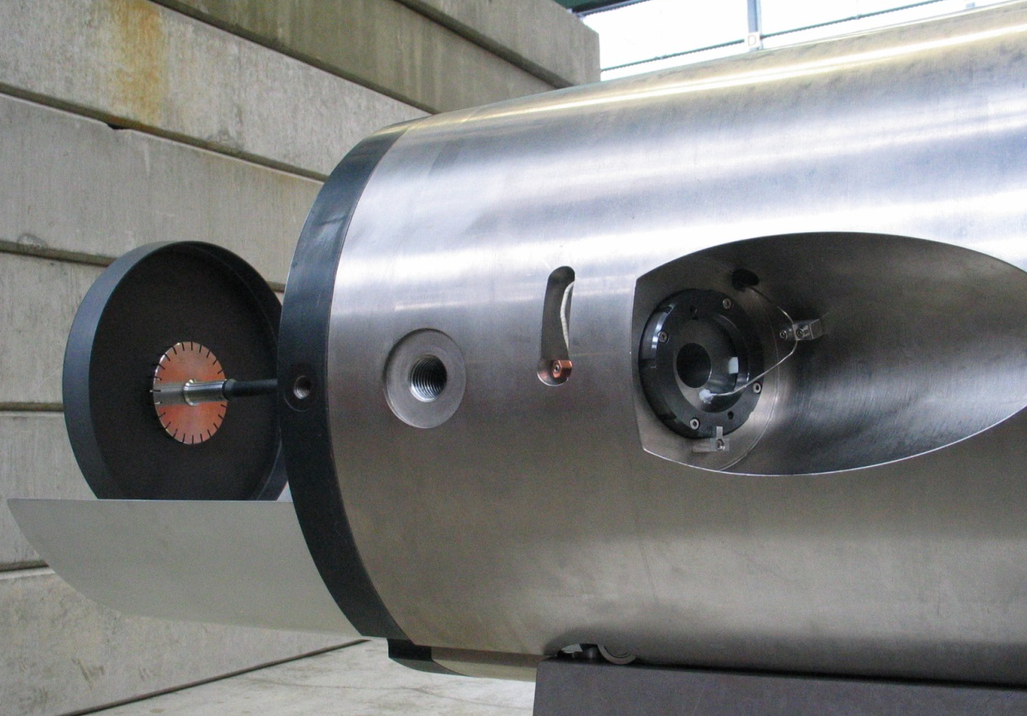
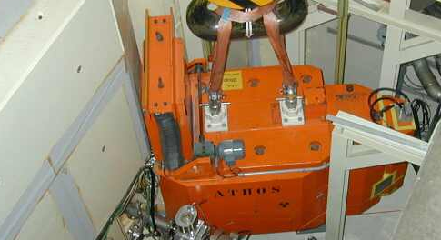
Present Target-M
Target M:
Mean diameter: 320 mm
Target thickness: 5.2 mm
Target width: 20 mm
Graphite density: 1.8 g/cm³
Beam loss: 1.6 %
Power deposition: 2.4 kW/mA
Temperature: 1100 K
Irradiation damage: 0.1 dpa/Ah
Rotational Speed: 1 Hz
Current limit: 5 mA
Life time: up to several years
up to ~ 60 Ah ~ 6 DPA
Improved design
(2013)
P-BEAM
.
Notes:
beam loss target: 0.5 %
collimators/region: 1.6 %

Slide 19
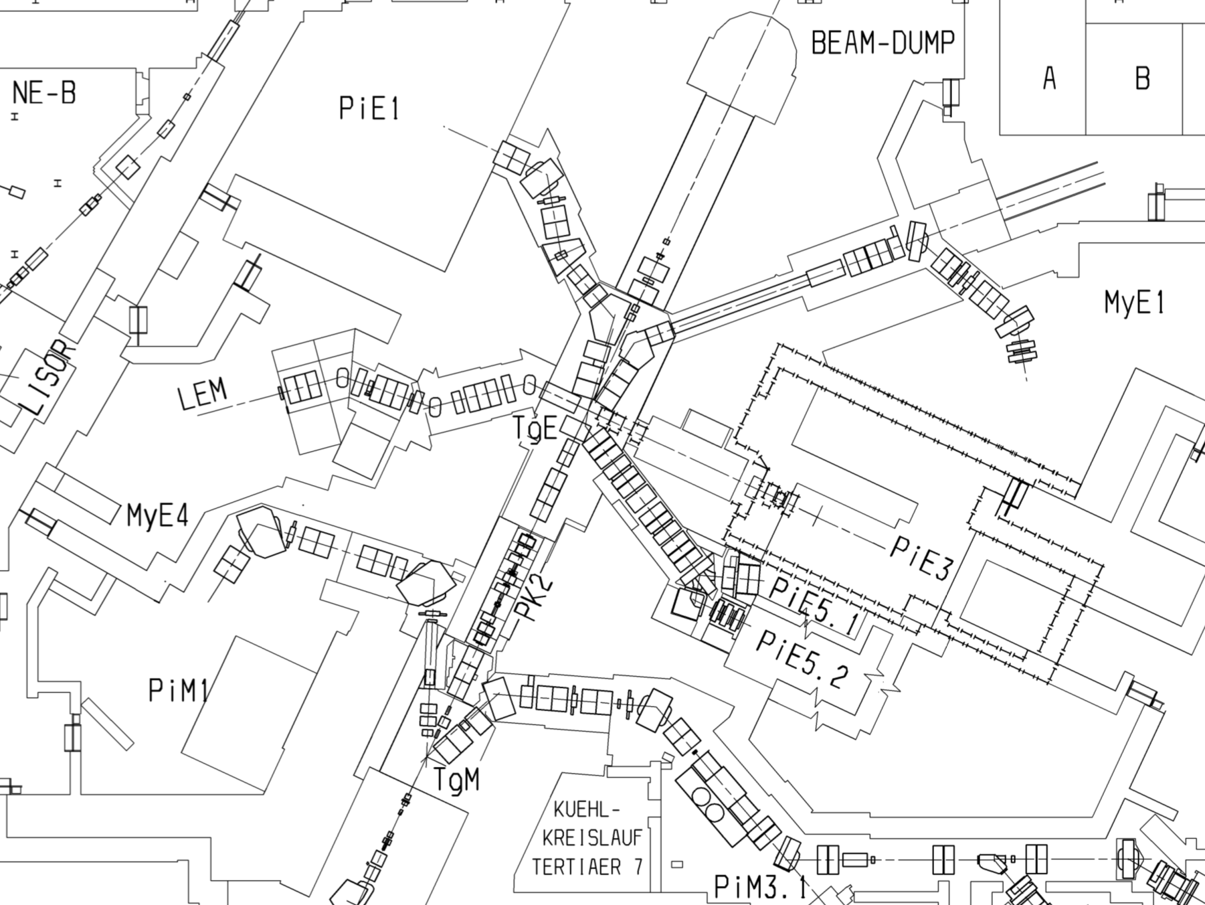
Slanted/Standard (for TargetE 40 mm)
Slab Tg E (standard)
Slanted TgE
+60%
Significant increase of
surface muon rate
Simulation confirmed
by measurement (2019):
40 – 50 % increase
TgE
+30%
+35%
+30%
Seite 19

Slide 20
Preliminary layout
MuH2
(PiM1)
BDSIM, Turtle, MCNP, ZGOUBI
water cooling &
cryogenics
Spinrotator
Geant4, Transport, COSY Infinity
MuH3 (PiM3)
Water cooling cycle and liquid He filling platform have to be removed.

Slide 21
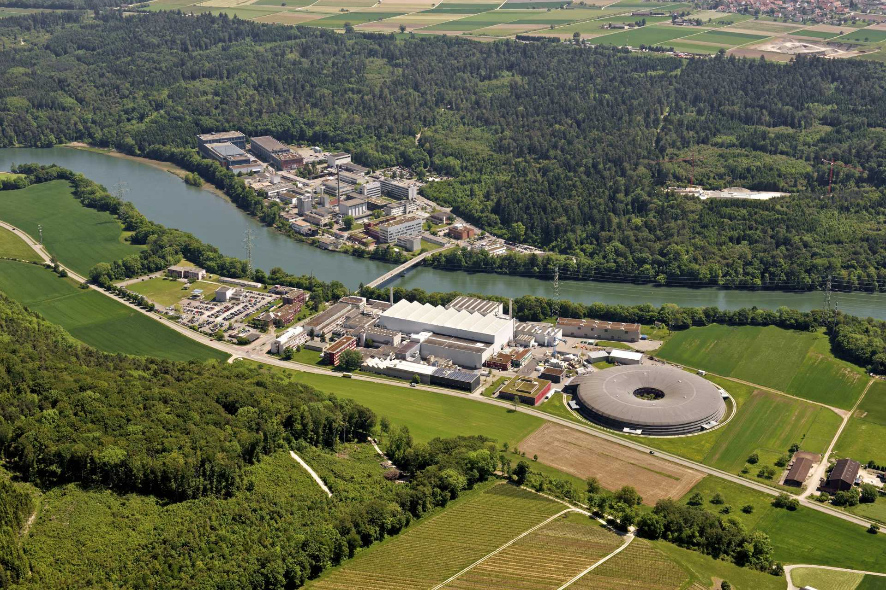
Summary
Challenges for the muon target at 50 kW:
- Cooling, Deformation, Bearings still need to be improved!
Some test opportunities at PiM1: pions,muons, electrons, (protons)
Feasibility study HIMB for Swiss Roadmap
100 x more surface muons
Introduction to the PSI High Intensity Proton Accelerator (HIPA)
Extraction from the Ring Cyclotron
Beam transfer to the meson production targets M/E and SINQ spallation source
Beam diagnostics for setup & optimization
Feasibility study of beam rotation for SINQ
Beam switchover to the UCN source
Conclusion
Page 21

Slide 22
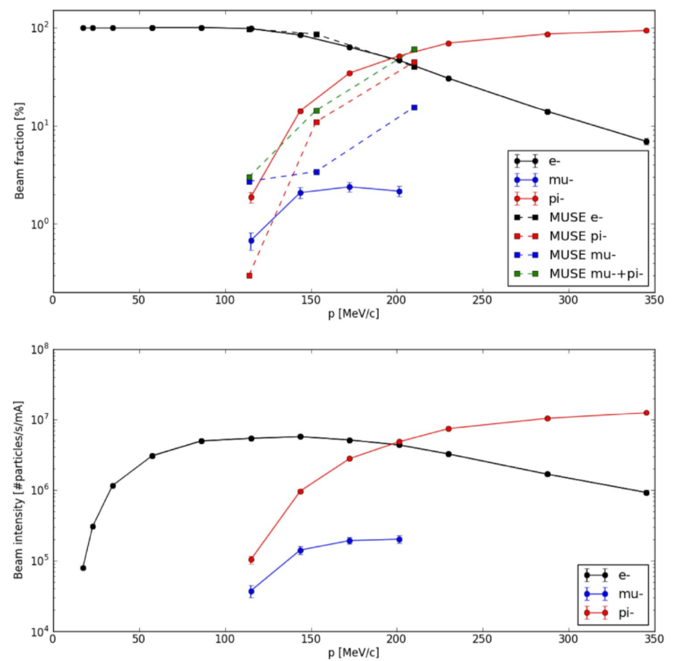
PiM1 beam fractions

Slide 23
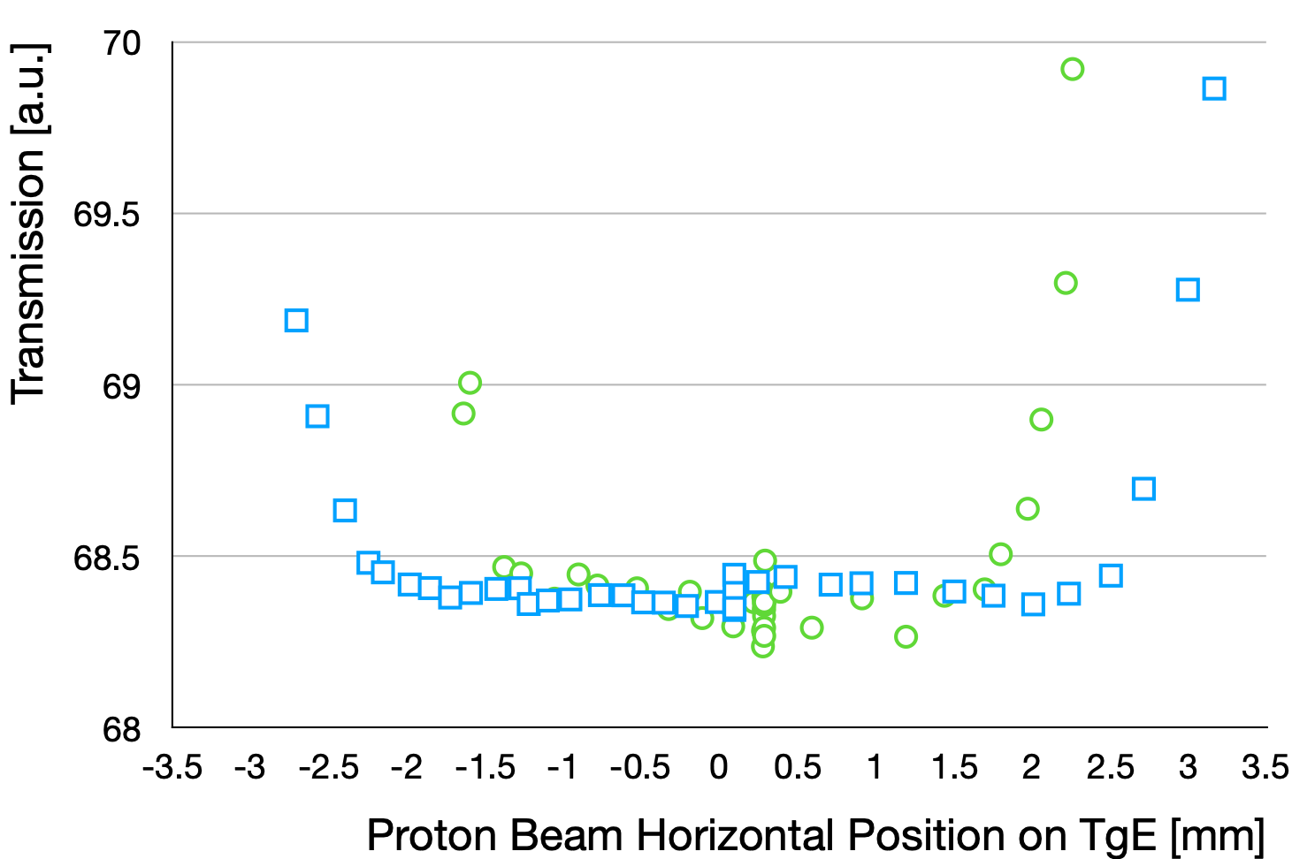
HiMB Slanted Target Tests
HiMB 40 mm slanted target installed on November 25
Muon beam rates:
30-60% increase in surface muon rate expected
First measurements confirm this increase for μE4, πE5, πE3 and πE1 (μE1 not affected as it relies on pion collection)
40 mm slanted target as good as 60 mm
standard target!
Proton beam impact:
Setup of proton beam well under control
Increased safety margins confirmed
Future:
To be seen: Impact of higher thermal stress on long term stability of target wheel
We are looking forward to continue this work within the recently CROSS-funded HiMB study to increase surface muon rates by almost two orders to 10¹⁰ μ⁺/s!
+60%
TgE
+30%
+35%
+30%
slanted
standard

Slide 24
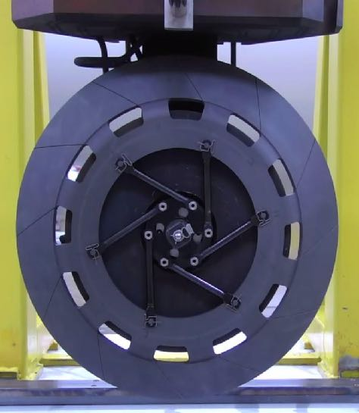
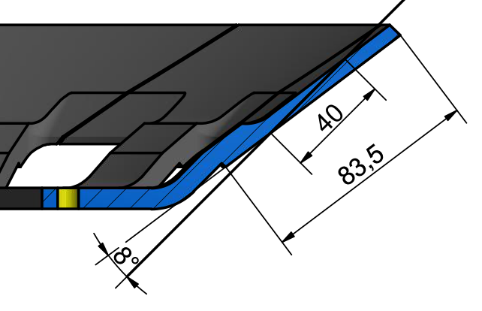
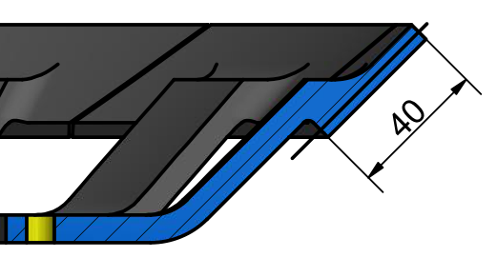

HiMB Slanted Target Design
Involved people:
NUM: P.-R. Kettle, A. Knecht, A. Papa, T. Rostomyan,
P. Schwendimann
GFA: P. Baumann, S. Joray, D. Kiselev, D. Laube, R. Sobbia,
D. Reggiani
Goals:
Change of geometry of TgE to increase surface muon rates for all connected beam lines
Increase safety margin for “missing” TgE with the proton beam
protons
protons
Standard 40 mm TgE
Slanted 40 mm TgE

Slide 25
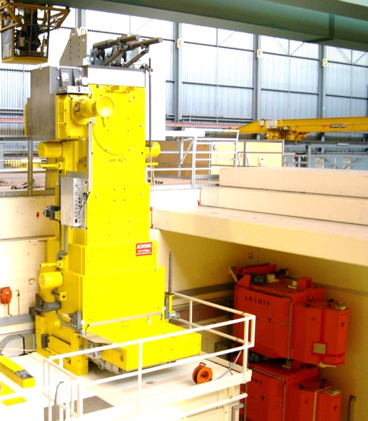
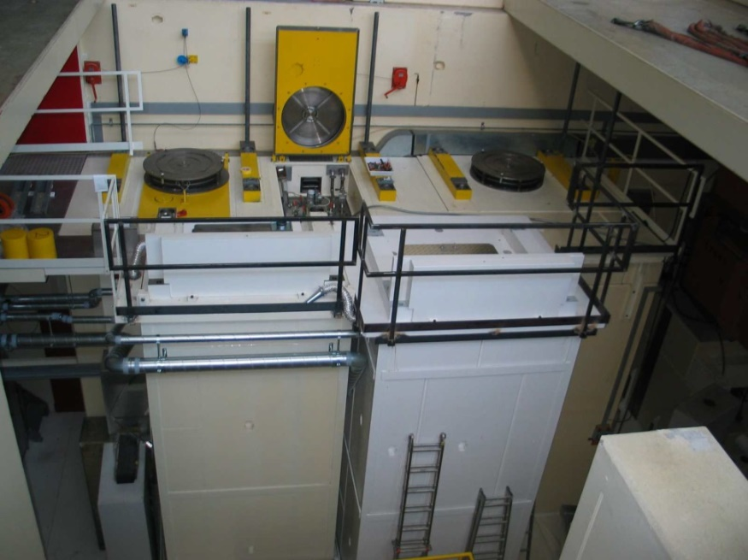
Transport of 2. target insert to beamline
parking lot
Exchange flask on parking lot
sluice to hotcell
open
closed
To save time:
Spare Target E insert is taken out from the parking lot
At the same time:
Reparing of the insert from beamline in hotcell

Slide 26
Design of the hotcell ATEC
ATEC: 2. service cell in 2019
wall in between can be opened vertically
Sluice in between
Sluice for Target E
Sluice pulled up by external crane
Moved by
ATEC crane
2. Service cell
1. Service cell
Room for personal
Advantage:
in case of unavoidable access to one service cell (in case of failure),
radioactive components are moved to the other service cell.
less personal dose rate during cleaning:
drums with rad. waste can be moved temporarly to the other service cell.

Slide 27
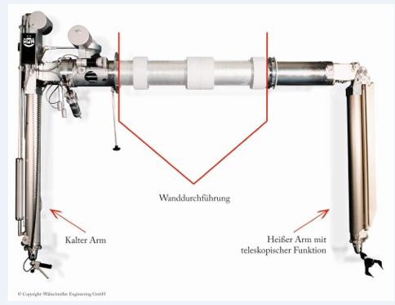
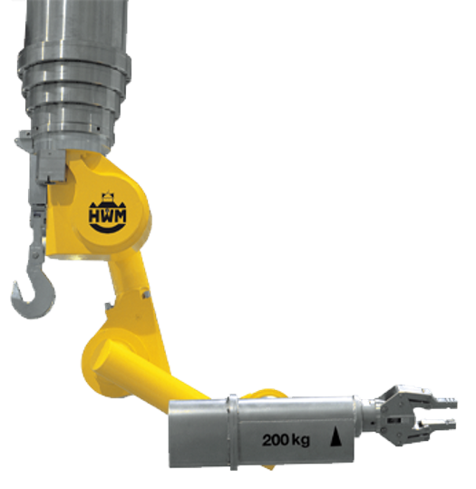
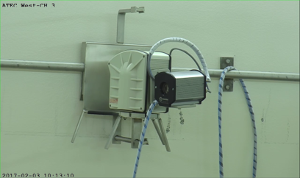
Standard equipment of hotcell ATEC
1 power manipulator/
service cell
for wall shielding
"cold" hand
in control room
"hot" hand
in service cell
6 high-resolution cameras/service cell
+ 1 leadglass window
+ 1 dosimeter
+ a trolley to move things around
(up to 60 t)
+ 1 crane/cell
movable over 2 service cells
(important, if 1 crane fails)
Grip
for camera

Slide 28
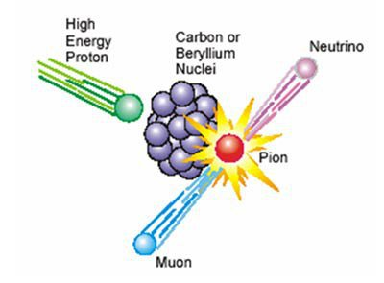
Meson production targets: Target E and Target M
Production of muons:
Surface muons:
produced from pion decay at rest at the
surface of the target (d < 1 mm)
π⁺
μ⁺
ν
590 MeV
- almost monochromatic:
max. at 28 MeV/c (= 3.7 MeV)
- 100% polarized
(spin in opposite direction to momentum)
in reality: 90 – 95 % polarization due to
pion decays in flight
World’s highest intensity surface muon beams > 10⁸ µ/s
Cloud muons: decay of pions in flight
Low energy muons (LEM): 0.5 -30 keV
moderated by a cryogenic target
Besides this, there are pions, positrons (and sometimes protons)
Notes:
surface muons are 100 % polarized (if the neutrino has no mass(!)). The point is that I had the real muon beam in mind. Here one has contributions from muons, which originate from a pion decay in flight. The polarization of the muon beam at the experimental stations is 90-95% as I know from Thomas Prokscha.
E=0.1 - 4 MeV energy distribution of surface muons
range width in matter ~180 mg/cm2
LEM: Einfang von e, muonium

