Slide 1
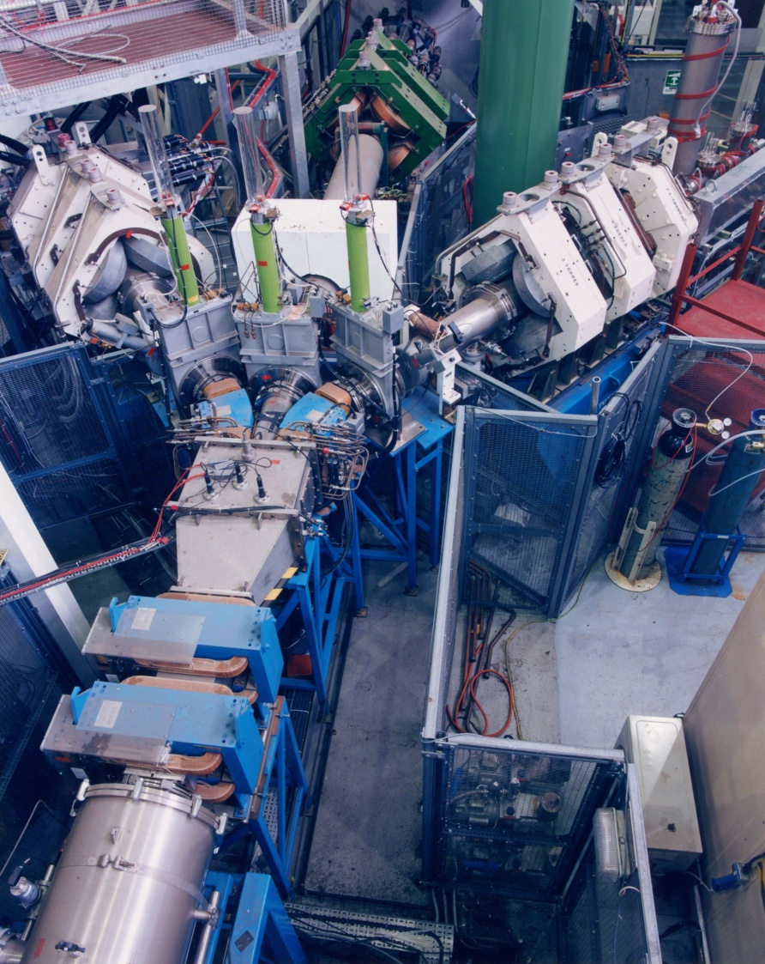

Muon Collider Workshop 24-25 May 2021
ISIS Muons
Adrian Hillier
ISIS Muons

Slide 2
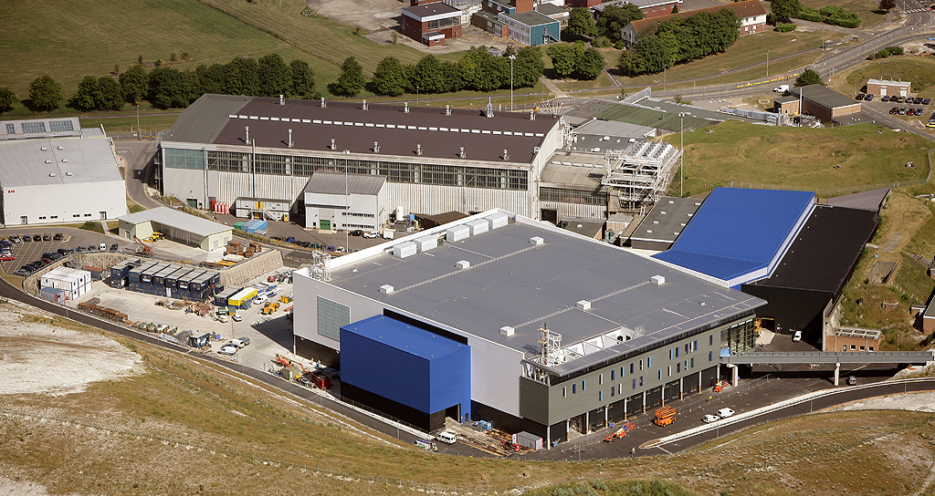
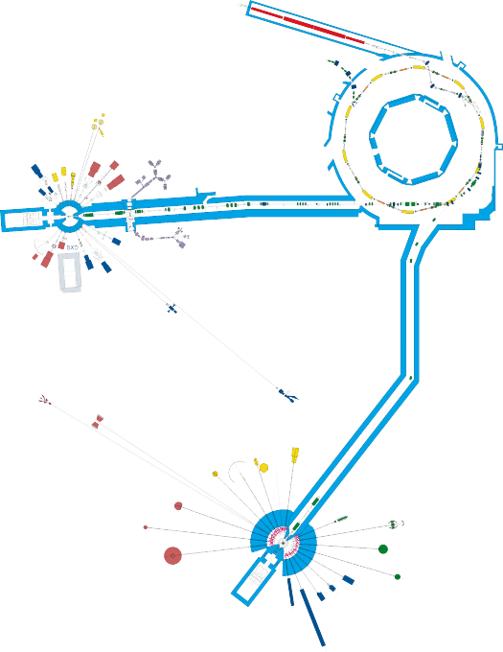
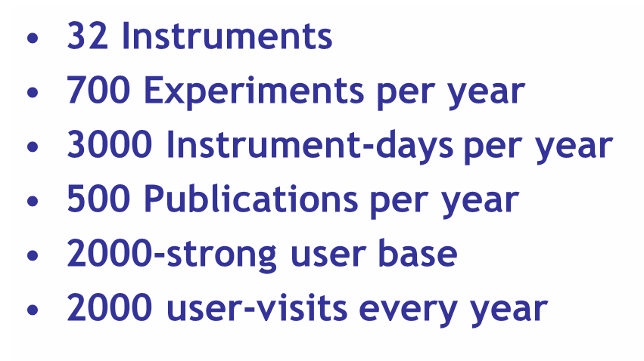
The ISIS Pulsed Neutron and Muon Source
Accelerators
Instruments
Instruments
A World Centre for Condensed Matter Science with Neutrons and Muons

Slide 3
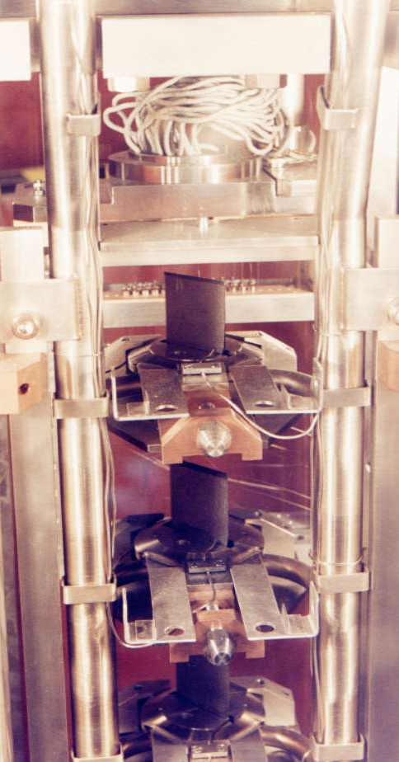
Muon Production Target
Made of graphite
Takes ~5% of the proton beam
40 pulses per second
The Muon Target
Beam focus
Protons
Target
Pions and muons

Slide 4
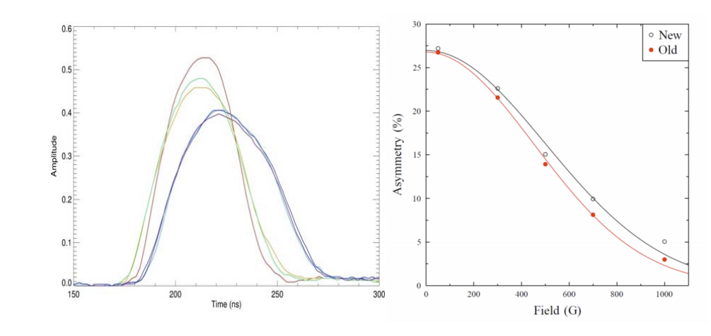
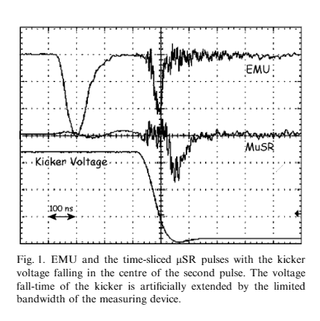
Muon Production Target
40 pulses per second
  (50 Hz one missing)
Muon pulse width ~60 ns
The Muon Target
Proton
Beam focus
Protons
Muon
Target
Pions and muons
Hillier et al Physica B, 2003
Hillier et al J. Phys. Conf Ser 2014

Slide 5
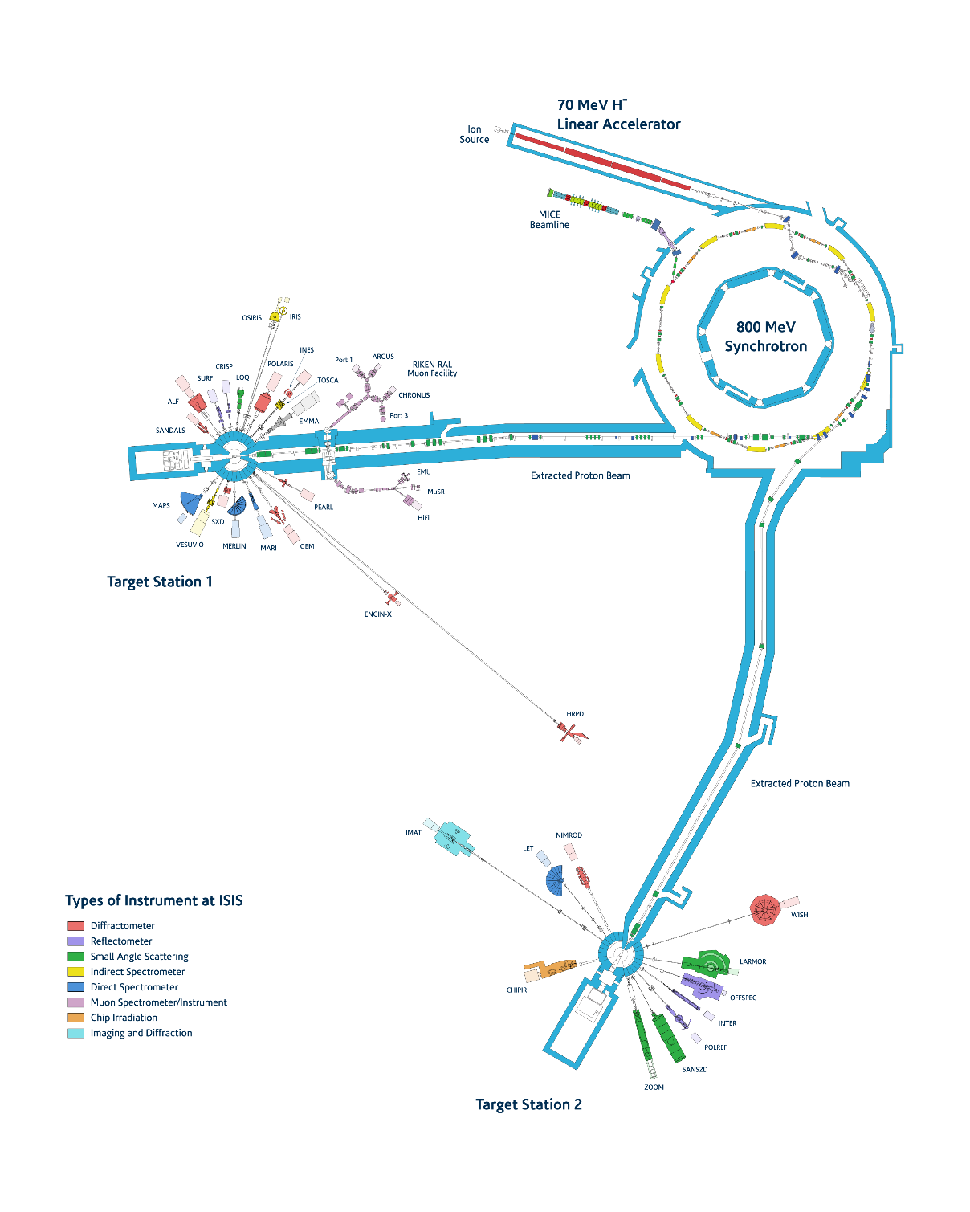
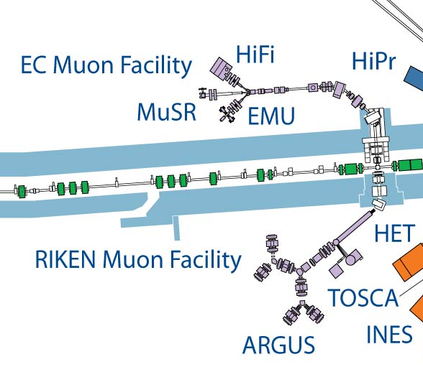

Muons at ISIS
23rd March 1987 at 11am
Since then 3 ISIS Instruments
4 beam ports on RIKEN Side
Over 1200 publications

Slide 6
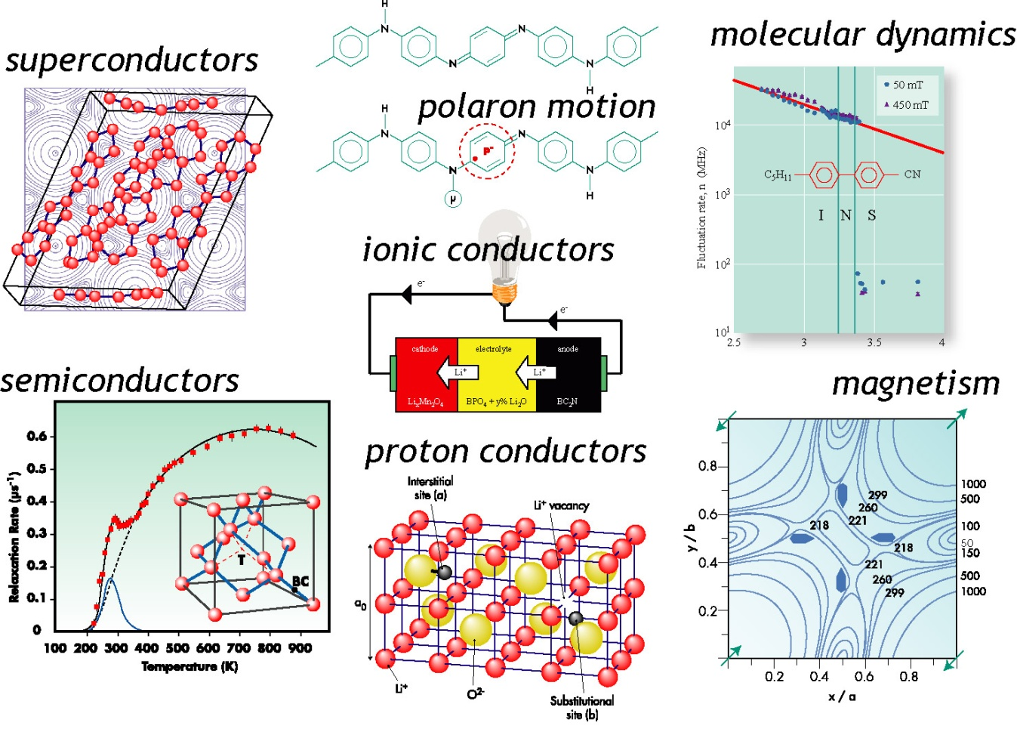
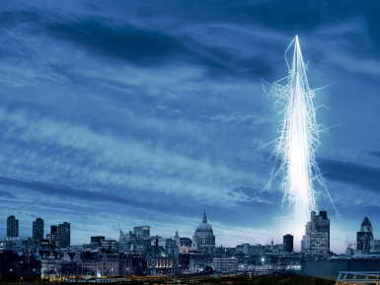
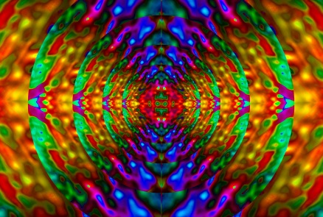
Muons
Muons as passive probes in superconductivity, magnetism, molecular dynamics, charge transport.
Muons as active probes: proton analogues in semiconductors, proton conductors, light particle diffusion, etc.
Electronic irradiation
Elemental Analysis

Slide 7

The European Muon Facility
Surface muon channel

Slide 8
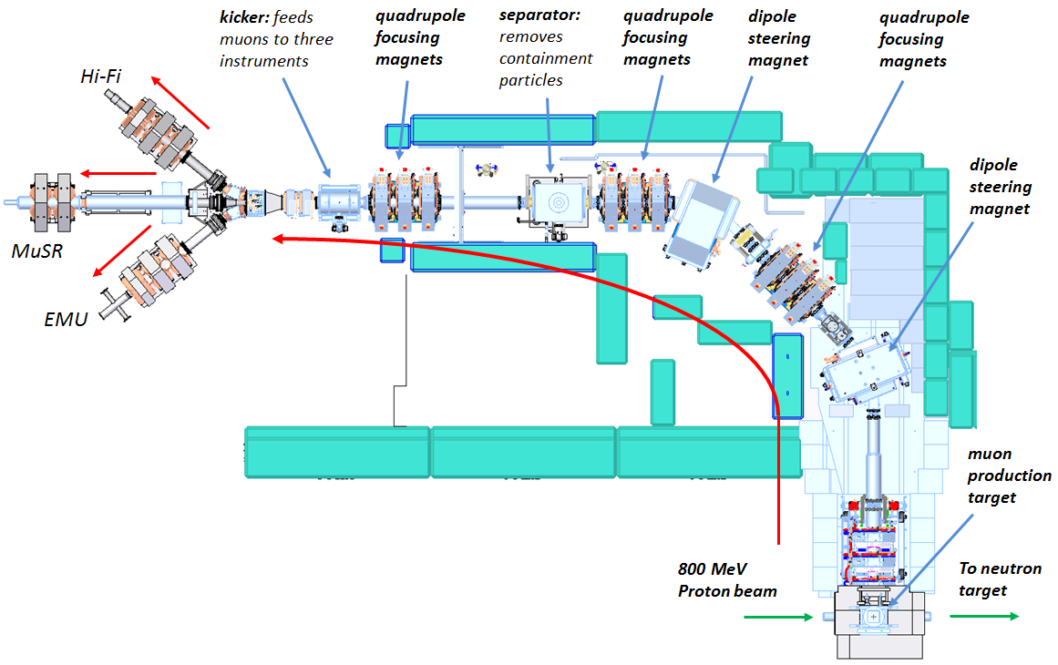
The EC Muon Facility
contaminant

Slide 9
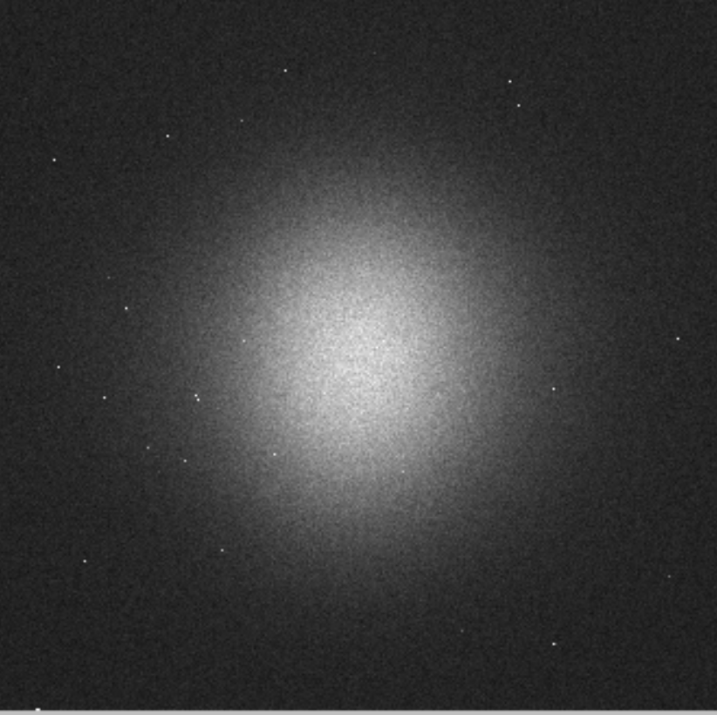
Muon Characteristics
Positive Muons
Muon Energy fixed at 4.1 MeV (~28 MeV/c)
set for peak flux
2% momentum bite
0- 5 T longitudinal field
longitudinal field
Transverse field
MuSR:
4 x10⁶ muons per second
~1 x10⁵ per pulse
EMU/Hi-Fi
2x10⁶ muons per second
~0.5 x10⁵ per pulse
0-0.5 T longitudinal field
Spot size ~ FWHM vertical ~8 mm
horizontal ~8 mm+

Slide 10
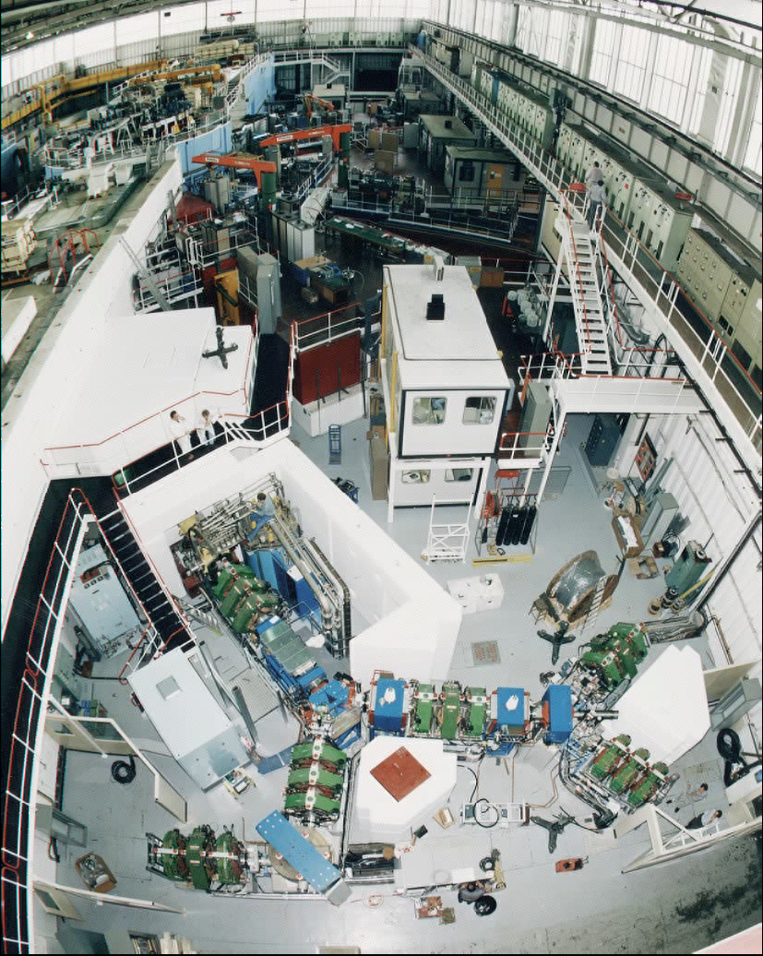
RIKEN-RAL Muon Facility
Decay muon Channel
Long UK-Japan science collaboration
First muons 1994
4 experimental areas
condensed matter
other uses of muons
  Muon catalysed fusion
  Ultra Slow Muons (g-2)
  Proton Radius Puzzle
  Transmutation
  Effects of muons on electronics
  Muonic atoms

Slide 11

RIKEN

Slide 12
RIKEN

Slide 13
RIKEN

Slide 14
RIKEN

Slide 15
RIKEN

Slide 16
RIKEN

Slide 17
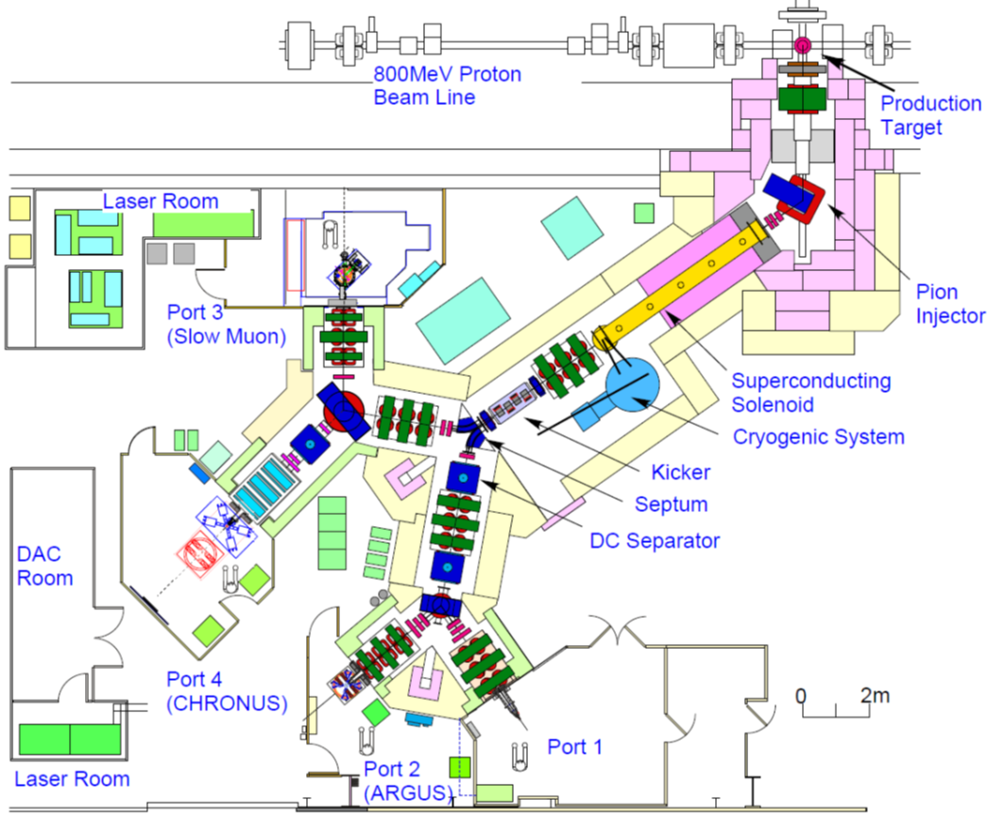
RIKEN

Slide 18
Muon Characteristics
Positive and Negative Muons
Energy Range at 1.5 to 33 MeV
4% momentum bite
Range of collimators 10 – 40 mm

Slide 19
Current Projects
Super–MuSR: a new instrument for muon spectroscopy
- Muon pulse slicer
- Large area detector array
- spin rotator
MuX: a new instrument for muonic X-ray measurements
- Large area HPGe detector array
FAMU experiment:
- muonic hydrogen high precision spectroscopy
Future Projects:
- smaller spot focusing
- superconducting solenoid replacement

Slide 20
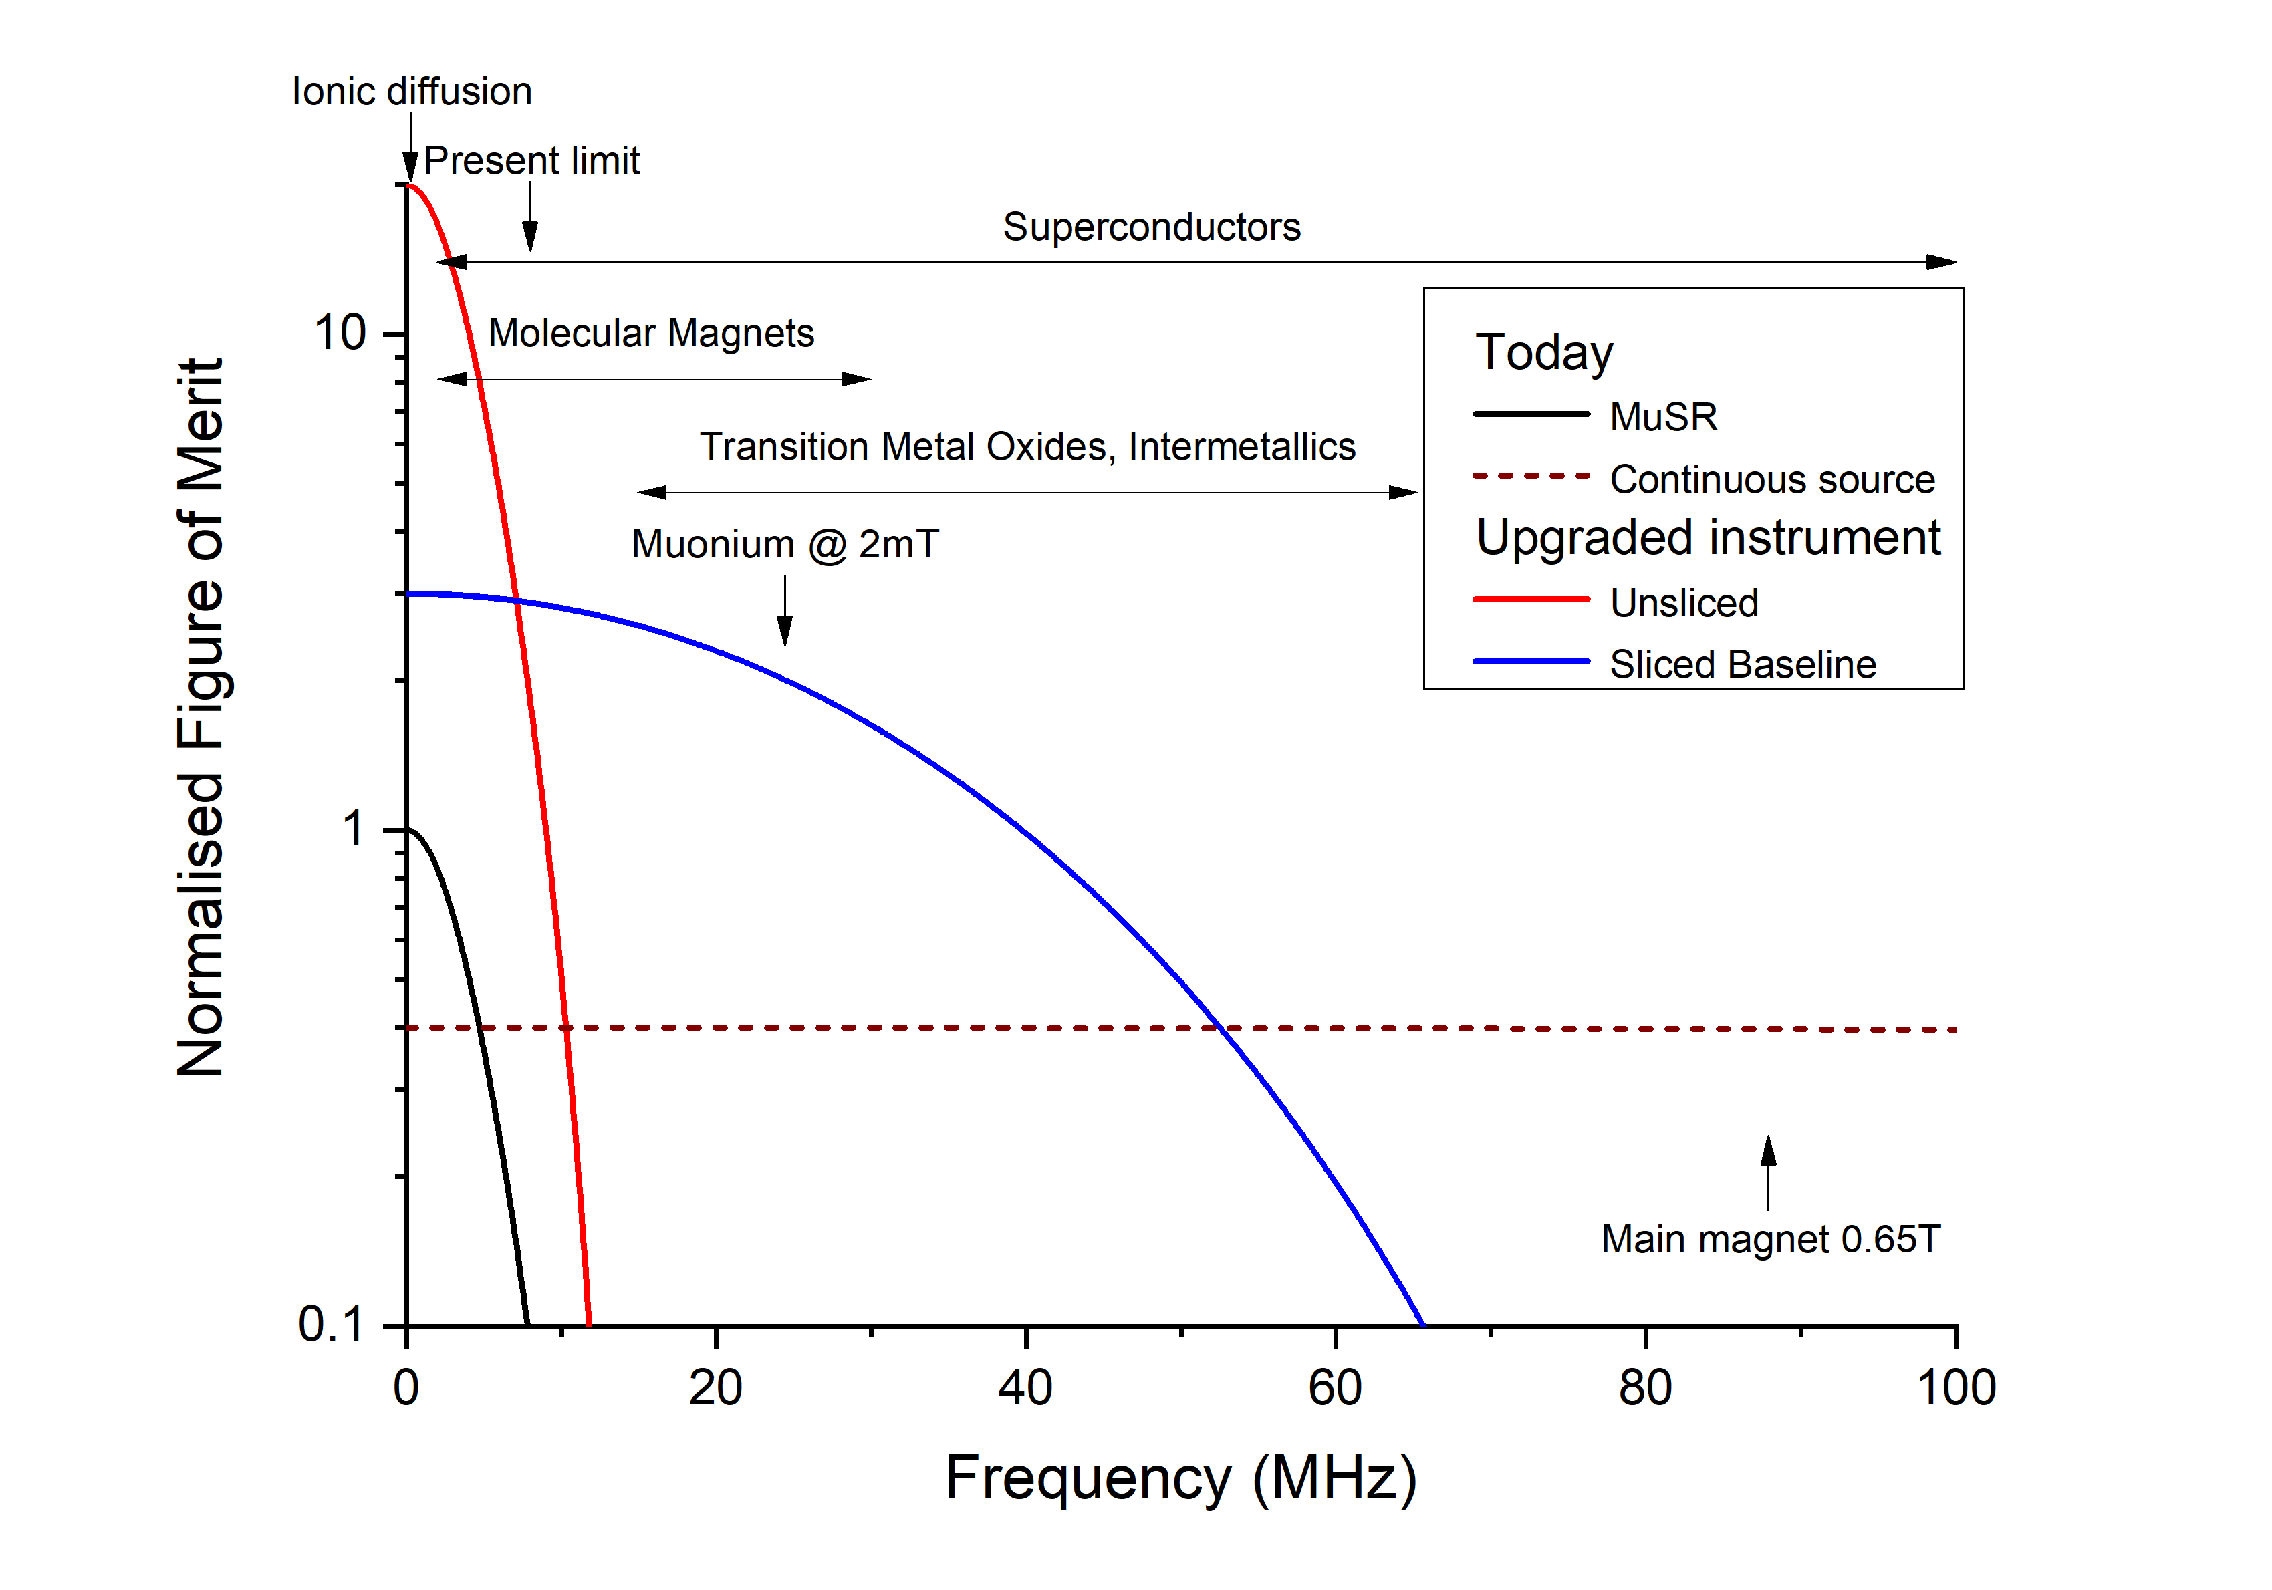
MuSR Upgrade: Super-MuSR
Beamline improvements
Detector Improvements
~10x increase in frequency resolution
Access higher magnetic fields
15-20x increase in count rate
~2.5x more information per muon
↑
Capacity
Capability →

Slide 21
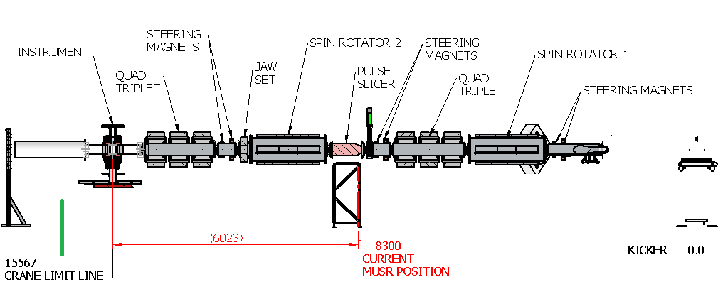
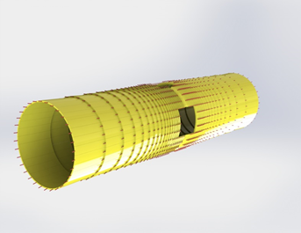
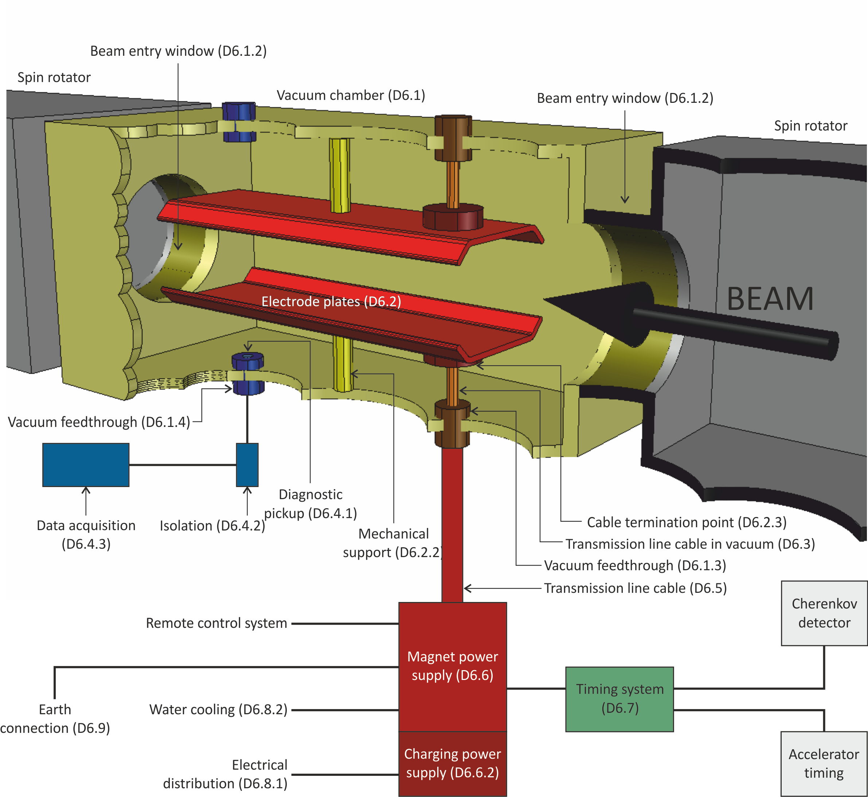
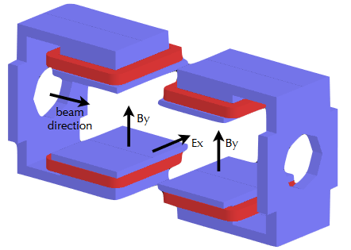
20x data rate
High density array
(for muons)
Increases data quality
10x resolution
Extends TF measurements

Slide 22
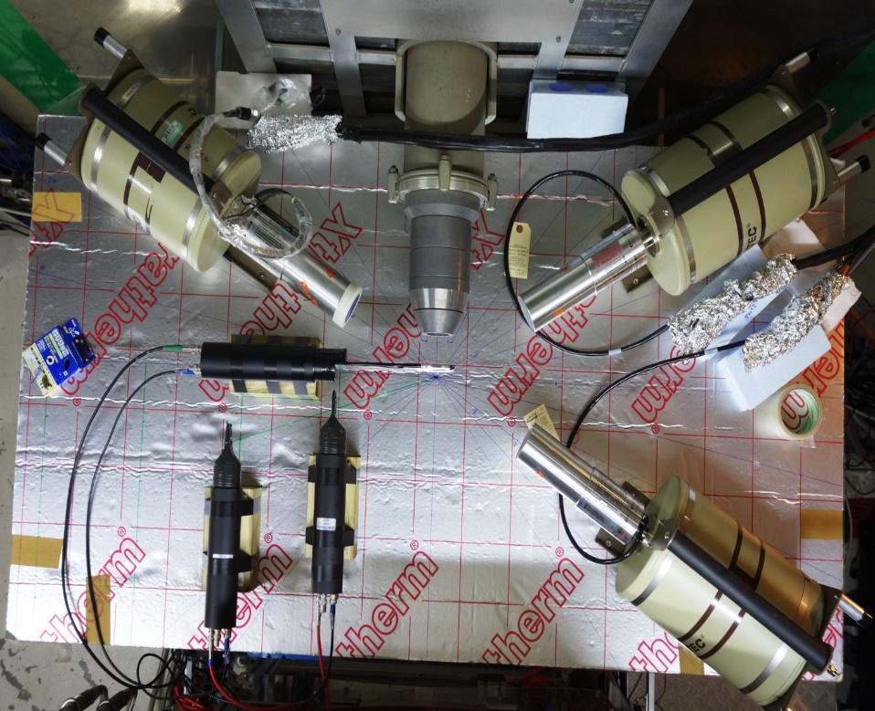
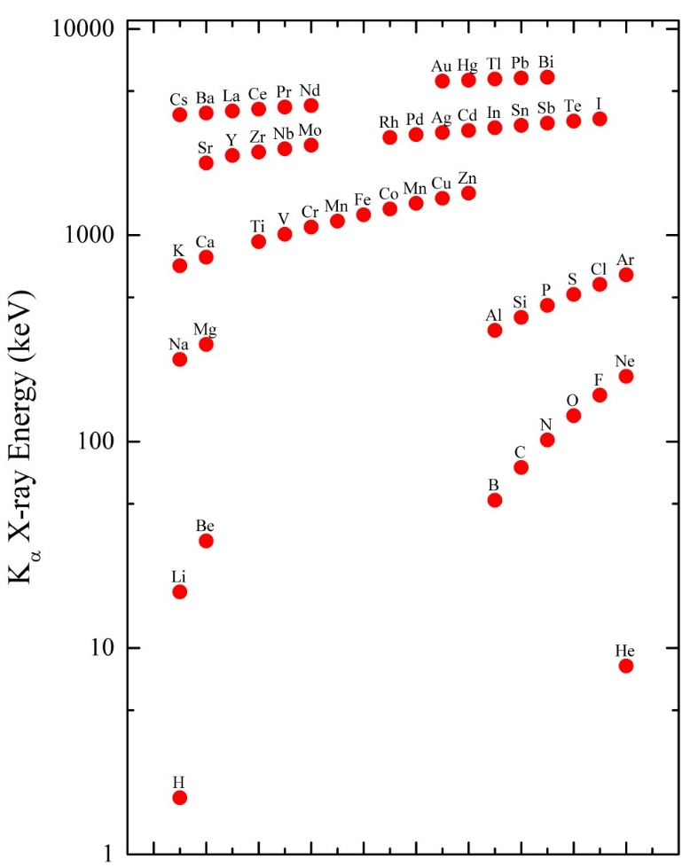
Current Projects – MuX
Ge X-ray detector
0.1-10 MeV
Low Energy
Ge X-ray detector
μ⁻ beam
Sample
position
Electron counters
Ge X-ray detector
0.1-10 MeV
High Energy X-rays emitted
Energy dependent of the atom which captures the muon
0.1-10MeV – mass of the muon is 200x that of the electron
Real space imaging demonstrated
Larger solid angle coverage required
Hillier et al Microchemical 2016

Slide 23
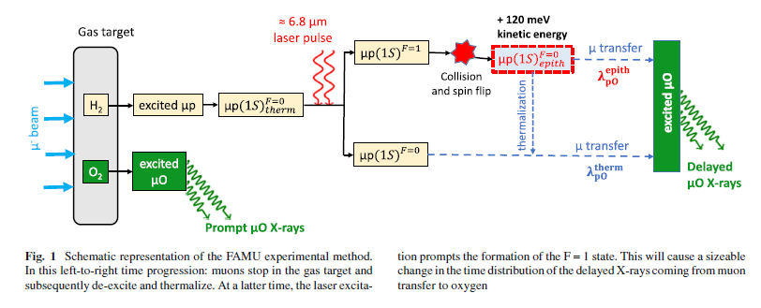
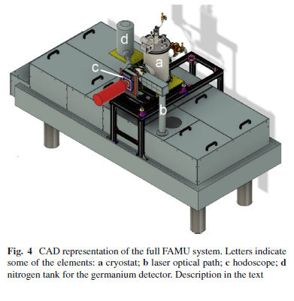

Current Projects – FAMU experiment
muonic hydrogen high precision spectroscopy studies
First time measuring the hyperfine splitting of the muonic hydrogen ground state
The proton Zemach radius can be derived
Shed light on the determination of the proton charge radius

Slide 24
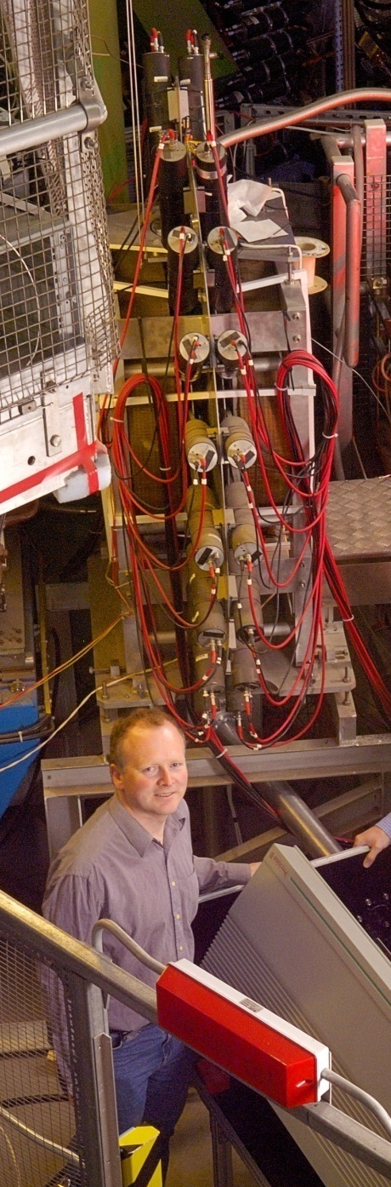
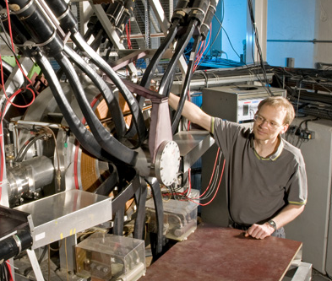
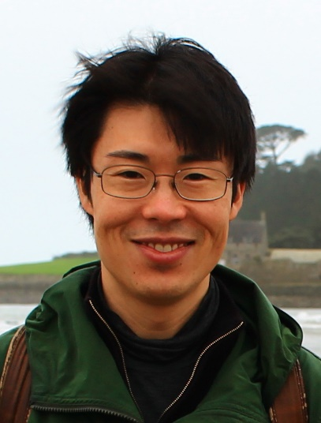
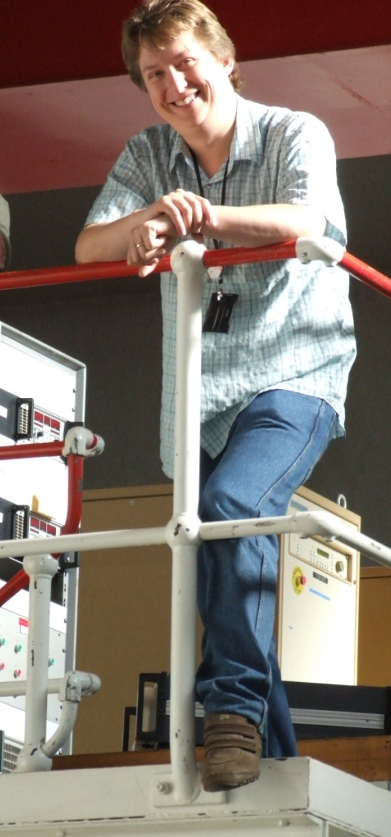
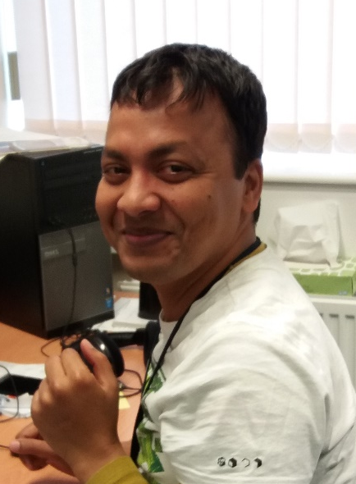
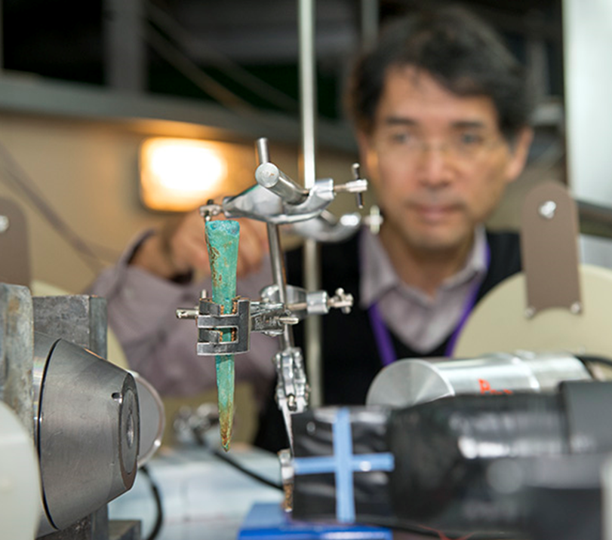
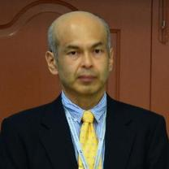
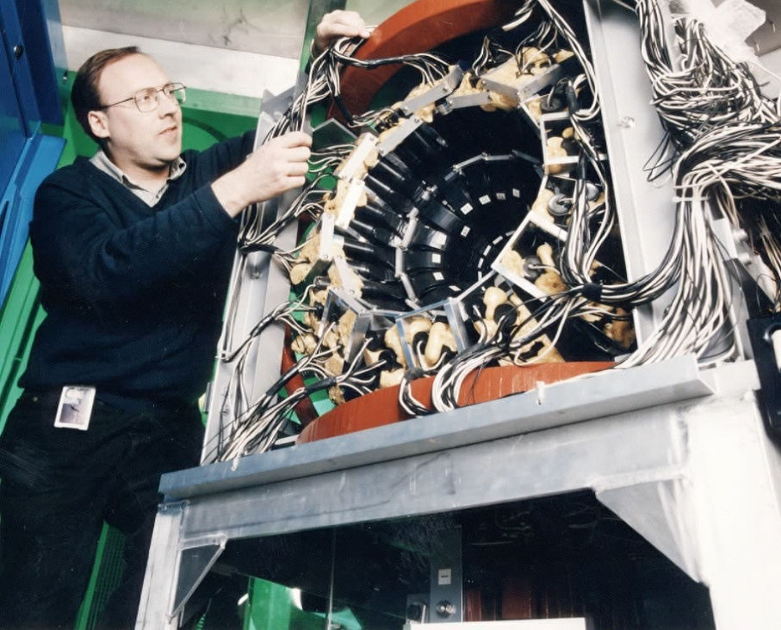
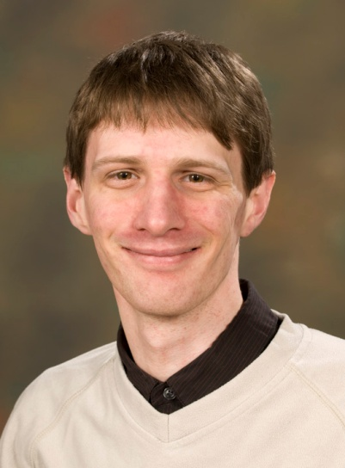
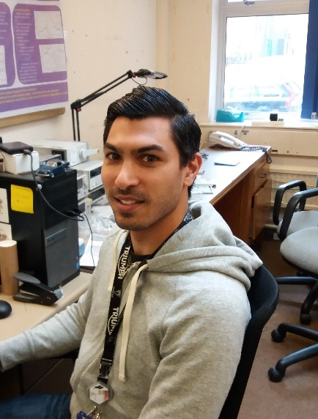
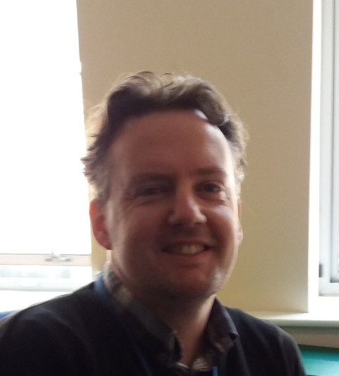
Surface and decay muon beams are available
Momentum Range (~16 MeV/c – 90 MeV/c (poss 120 MeV/c)
Regular Proposals calls
Rapid access for urgent studies
if approved run as soon as possible
Pabitra Biswas
Koji Yokoyama
Steve Cottrell
Adrian Hillier
Katsu Ishida RIKEN
Isao Watanabe RIKEN
James Lord
Adam Berlie
Francis Pratt
Mark Telling
Peter Baker

Slide 26
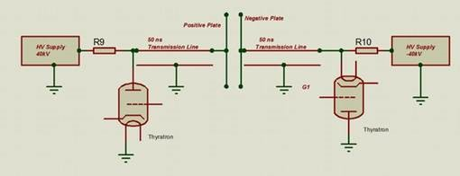
Three main work packages
MuSR Upgrade: Super-MuSR
Pulse Slicer
Priority 1
10x resolution
Builds on experience of existing muon kicker
Increases range of superconducting, magnetic, and chemical samples that can be studied at ISIS

Slide 27
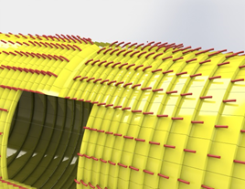
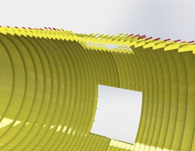
Three main work packages
MuSR Upgrade: Super-MuSR
Detectors
Priority 2
20x data rate
High density array
(for muons)
Increases data quality
New experiments such as cycling battery cells on the beamline

Slide 28
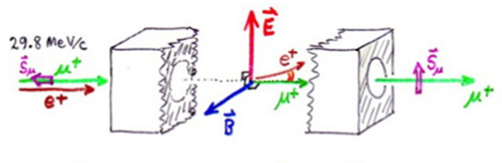
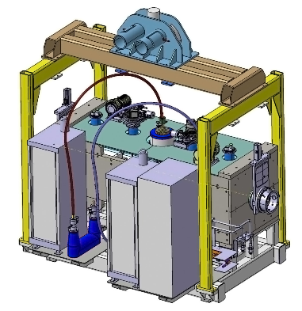
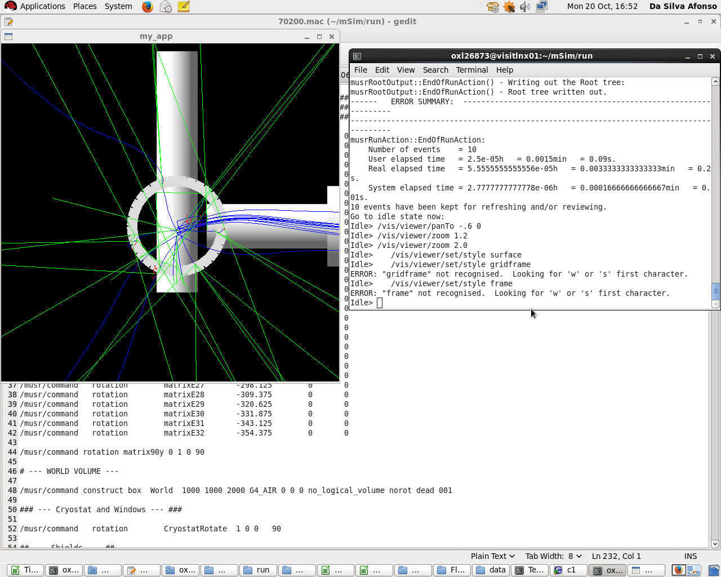
Three main work packages
MuSR Upgrade: Super-MuSR
Spin Rotators
Priority 3
Extends measurements of superconductors and chemical reactions to higher magnetic fields
Need two in series to generate necessary rotation with feasible voltages

