Slide 1
RF R&D for muon collider needs and opportunities
Alexej Grudiev (CERN)
25/02/2021
Workshop on Muon collider testing opportunities

Slide 2
Outline
Muon collider layout and RF
  MAP scheme: proton driven muon source
  LEMMA scheme: positron driven muon source
RF system for proton driver
RF system for positron driver
RF system for muon cooling
RF system for acceleration and collider

Slide 3
Muon Colliders and RF systems
Proton driven Muon Collider Concept (MAP collaboration)
Acceleration and collider rings
Muon cooling
RF
RF
RF
RF
RF
RF
RF
RF
RF
RF
RF
RF
RF
RF
RF
Positron driven Muon Collider concept (LEMMA)
Positron Driver
RF
RF
RF
22 GeV
RF

Slide 4
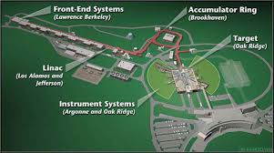
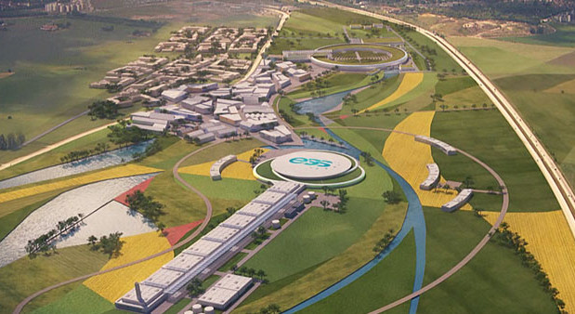
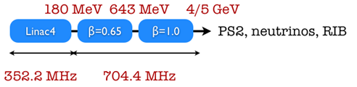
Challenges:
Few MW beam power
….
---------------------------------------------------------
State of the art RF technology (SNS, ESS, SPL, …)
RF
RF
RF
RF
Required RF Test facility for feasibility demonstration
NO
SPL@CERN

Slide 5
Challenges:
Positron production
Target
Muon accumulation and merging
….
----------------------------------
State of the art RF technology for electron positron linacs:
Normal conducting: S-, C-band (LCWS, SwissFEL,…)
Superconducting: L-band (XFEL, ILC,…)
Positron Driver
Required RF Test facility for feasibility demonstration
NO

Slide 6
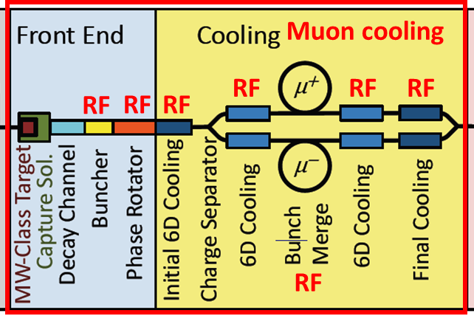
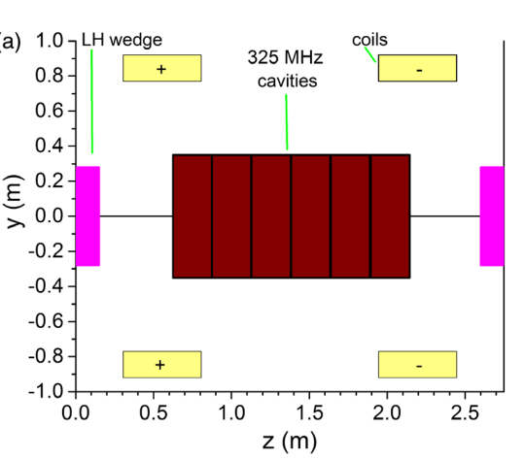
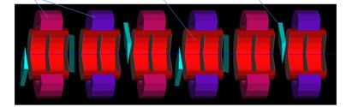
RF system for muon capture and cooling
Summarized from:
David Neuffer
Chris Rogers
Region | Length [m] | N of cavities | Frequencies [MHz] | Peak Gradient [MV/m] | Peak RF power [MW/cav.]
Buncher | 21 | 54 | 490 - 366 | 0 - 15 | 1.3
Rotator | 24 | 64 | 366 – 326 | 20 | 2.4
Initial Cooler | 126 | 360 | 325 | 25 | 3.7
Cooler 1 | 400 | 1605 | 325, 650 | 22, 30
Bunch merge | 130 | 26 | 108 - 1950 | ~ 10
Cooler 2 | 420 | 1746 | 325, 650 | 22, 30
Final Cooling | 140 | 96 | 325 - 20
Total | ~1300 | 3951 |  |  | => ~12GW
It is a very large and complex RF system with high peak power
Very high bunch charge: (40->4)e12 => Collective effects (?)

Slide 7
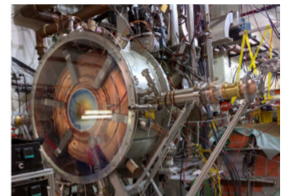
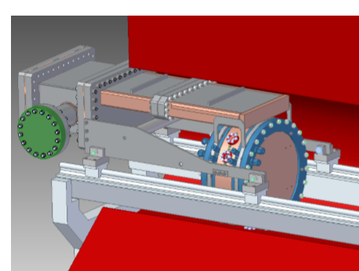
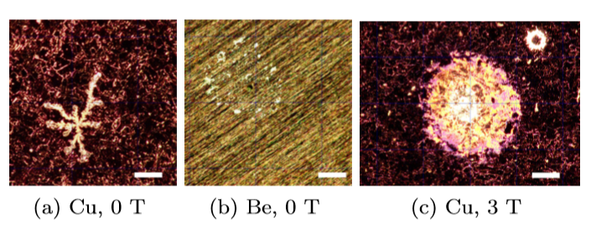
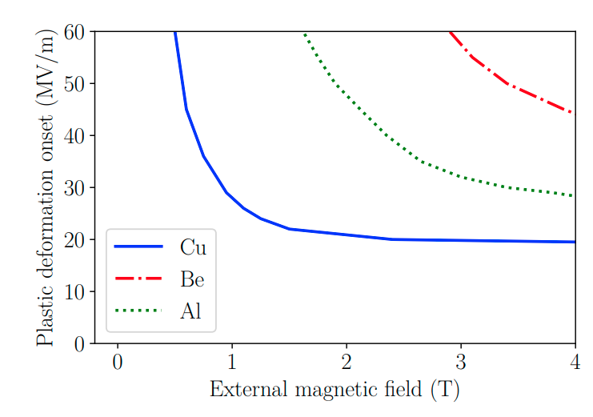
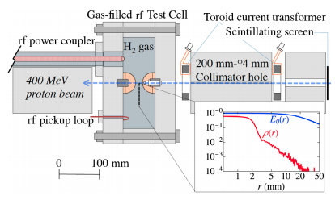
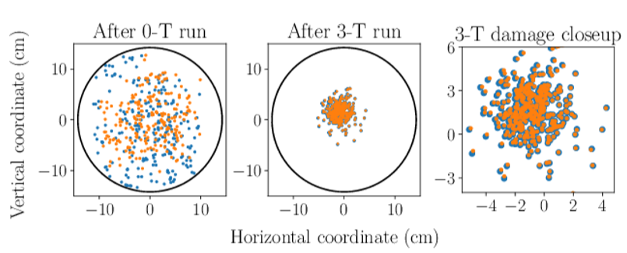
RF cavities for muon cooling
Challenges:
High Gradient
High magnetic field
High radiation
Technology far from been common
---------------------
State of the art :
MICE 200 MHz RF module prototype: 4T, 10 MV/m, 1ms@1Hz
800 MHz beryllium RF cavity:
3T, >50 MV/m, 30us@10Hz
800 MHz Gas filled RF cavity:
Small gap, 3T, >50 MV/m
PRAB23, 072001 (2020)
PRAB19, 062004 (2016)

Slide 8
R&D directions and test facilities
High gradient RF test facility with magnetic field up to ~10T (NO BEAM)
Stage 1: Test cavities for technology development
  Frequency: 200 - 800 MHz
  Magnetic field: 0 - 10T, different field configurations
  Different materials: Cu, Be, Al, …
  Different temperatures: 300K -> 70K ->…
  Different gases and pressure
Stage 2: Prototype(s) for muon cooling test facility
  Design of realistic cavity prototypes: frequency, beam aperture, integration
  Parameters defined based on the results of Stage 1 and the design of the muon cooling test facility
  Validation of high gradient in magnetic field performance
Muon cooling test facility
  Validates performance with the beam
Required RF Test facility for feasibility demonstration
YES

Slide 9
What kind of facility we need
Superconducting magnet infrastructure
Magnet
Cryogenics
RF infrastructure
Power converter
RF modulator
RF power source
RF cavity

Slide 10
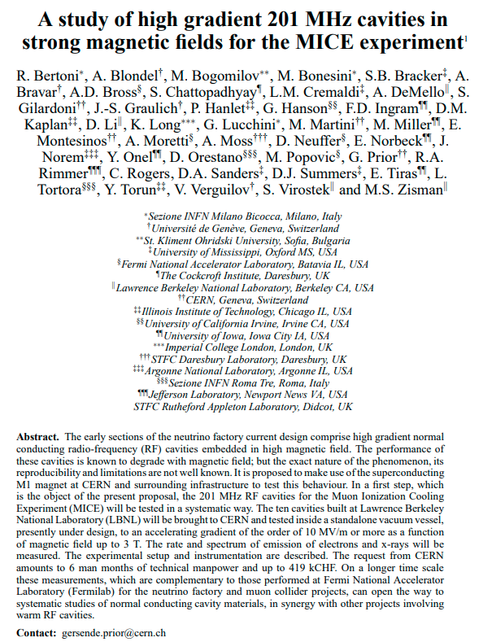
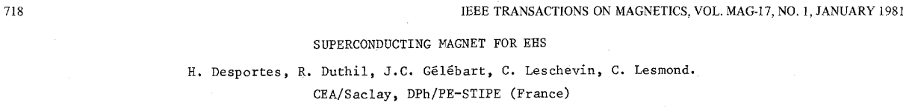
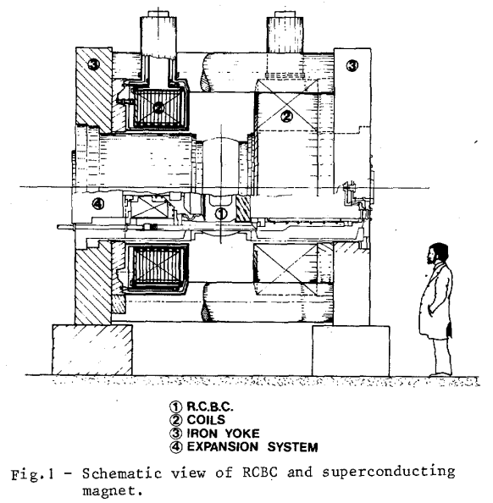
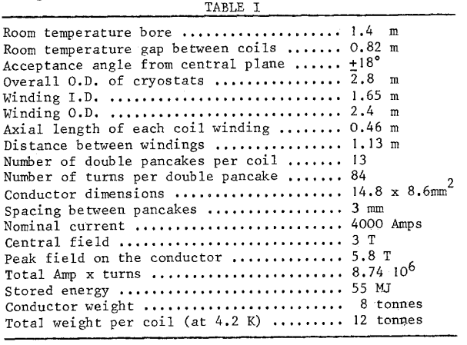
Proposal mentioned by Johannes Bernhard
proposal_rf.dvi (inspirehep.net)
Proposal might be reconsidered
RF must be brought to the magnet
Cost estimate 2010: ~0.5MCHF

Slide 11
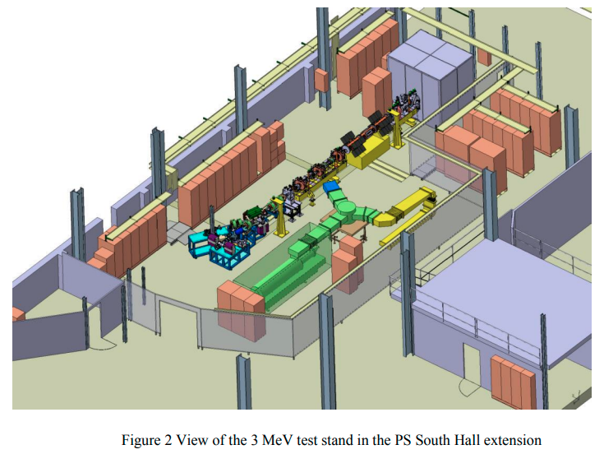
RF test infrastructure at CERN: an example
CERN 3 MeV test stand with L4-RFQ RF station
Commissioned in 2014
L4-RFQ 352 MHz fed by
LEP klystron 1.2 MW
Dismounted after
L4-RFQ Spare project – a new project initiated in 2020
Short-term goals:
  Construct a spare copy of L4-RFQ (2021 – 2022)
  Commission new RFQ with RF and beam in reinstalled 3 MeV test stand (2022 – 2023)
  Make L4-RFQ spare available for replacement in L4
Long-term goals: Develop a new RFQ with better expected performance in terms of
  beam acceptance
  resilience to RF breakdowns under H- irradiation
There is a potential for synergies:
  High gradient under irradiation (p, H-)
  Different material (Cu, CuCrZr, CuBe, Ta, Nb, Ti6Al4V)
  Resources, infrastructure
NO MAGNET, NO CRYOGENICS
NO RADIATION SCHELDING
CERN-ACC-2013-0259.pdf

Slide 12
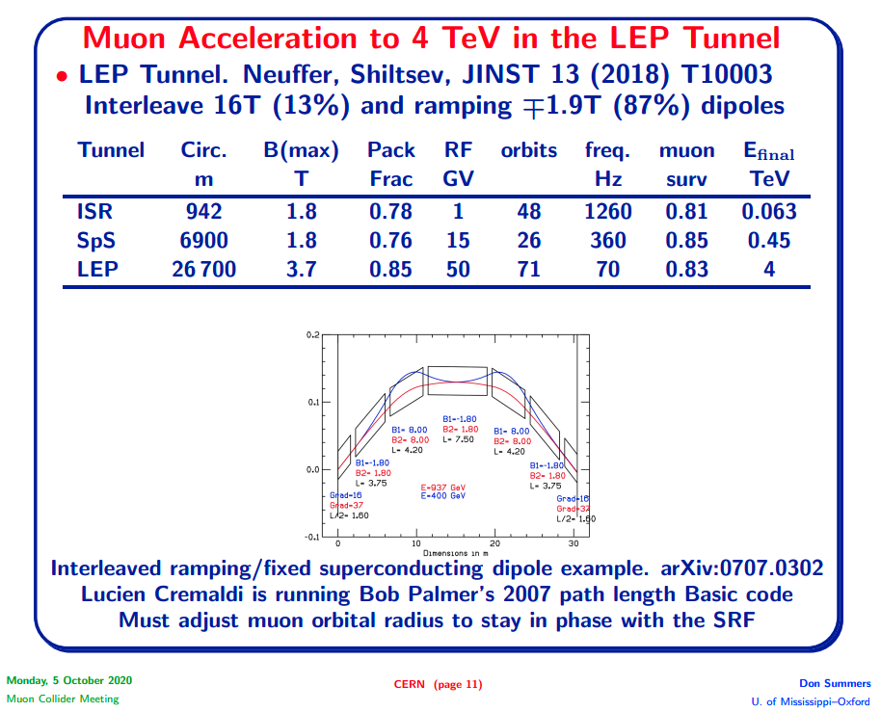
Acceleration
Limited muon lifetime requires highest possible acceleration rate
Although the rate is defined mainly by the magnets ramping rate, the SRF must follow with required (very high) voltage
Small number of turns (~100) for very high collision energy ~10 TeV requires very high voltage: ~100 GV
It operates in quasi pulsed mode;
  RF is on only during acceleration (~ 10 ms)
  Transients
Longitudinal bunch compression/manipulation require additional voltage
Highest gradient for ‘compact’ RF system

Slide 13
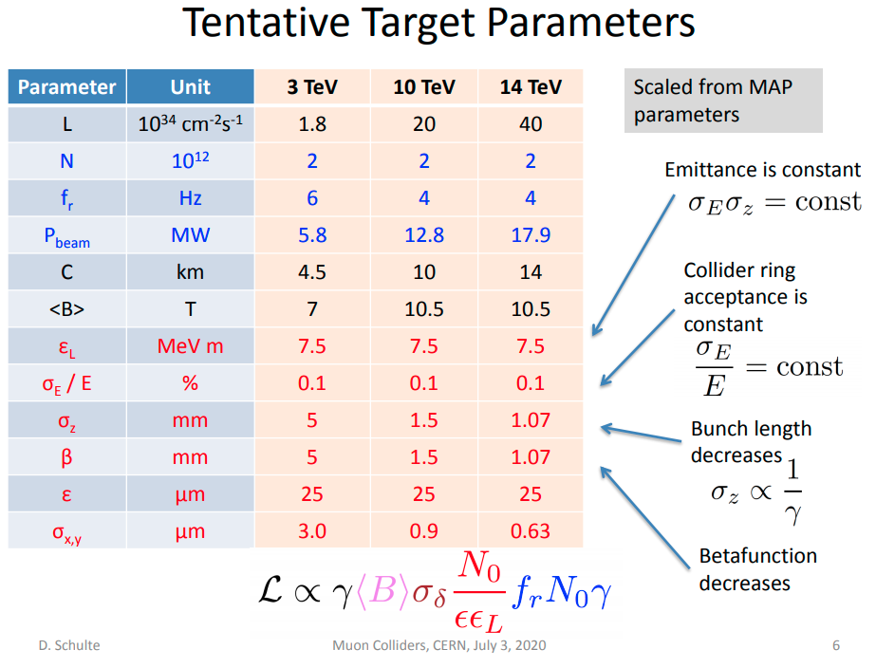
Acceleration (cont.)
Very large bunch charge:
  In collider ring: 2x10¹²
  In accelerators: (4->2)x10¹²
Short bunch length: 1 mm
Cause strong collective effects which must be mitigated
  Large Aperture
  Highest possible gradient
  Novel designs
FCC-ee
0.2
2.4
Single bunch beam loading (energy spread):
Energy spread ~ Loss factor x Bunch charge

Slide 14
R&D directions for SRF for muon acceleration
Highest possible gradient
  Pulsed operation of ~0.1ms (LA) -> ~10ms (RCS) may help
Large aperture, low loss factor
Design of the cavities combining the above (contradicting) points must be driven by
  High gradient considerations
  Longitudinal beam dynamic requirements
  Overall design of the RF system
  Efficiency and Cost
The design might need (must have) high gradient validation
Required RF Test facility for feasibility demonstration
MAYBE (YES)

Slide 15
Acknowledgements
I would like to acknowledge usage of material from:
  MAP collaboration: Muon Accelerator Program
  International Muon Collider Collaboration: Accelerator Design
Thank you !

Slide 16
Spare slides

Slide 17
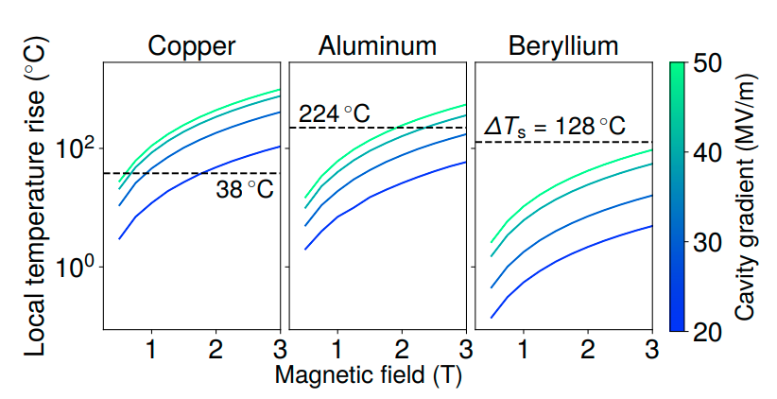
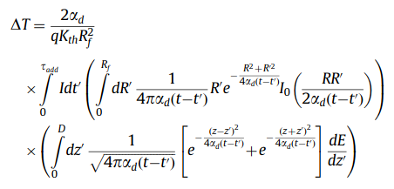
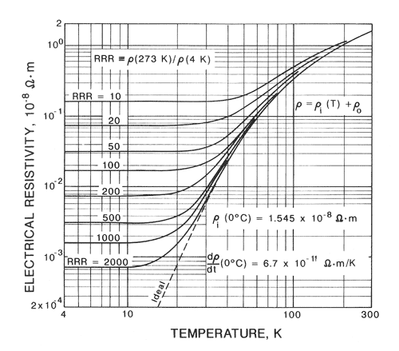

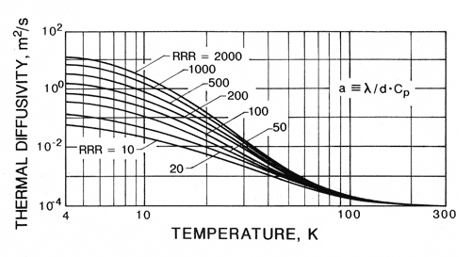
Cryogenic operation of NC cavities
RF technology challenges discussion, MC workshop, 2019 (cern.ch)
Cavities are already in the cryogenic environment of the SC solenoids
Higher gradients require even higher RF power:
  V=const, G x 2 => P x 2
Low temperature reduce ohmic losses: P x 1/3 or even lower
RF breakdown (BD) strength in high magnetic field depends on thermo-mechanical properties
Field emission induced pulsed heating model predicts (PRAB 23, 072001):
Local temperature rise
Threshold: (38K for Cu@300K)
Cu
Low temperature improves thermal and mechanical properties
=> Higher BD strength
Cu

Slide 18
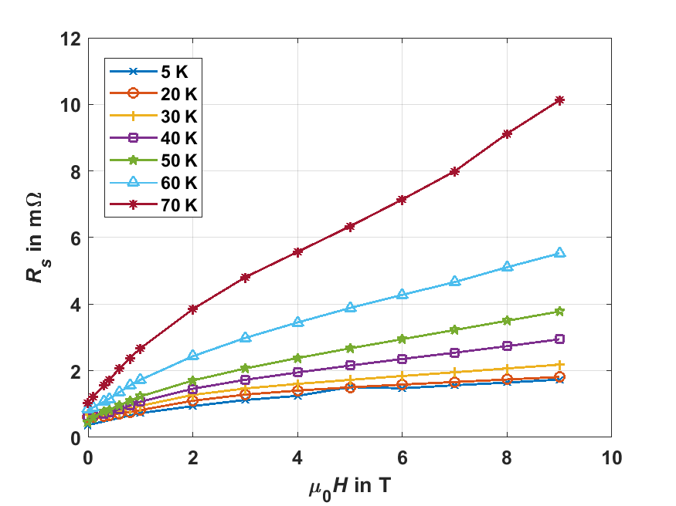
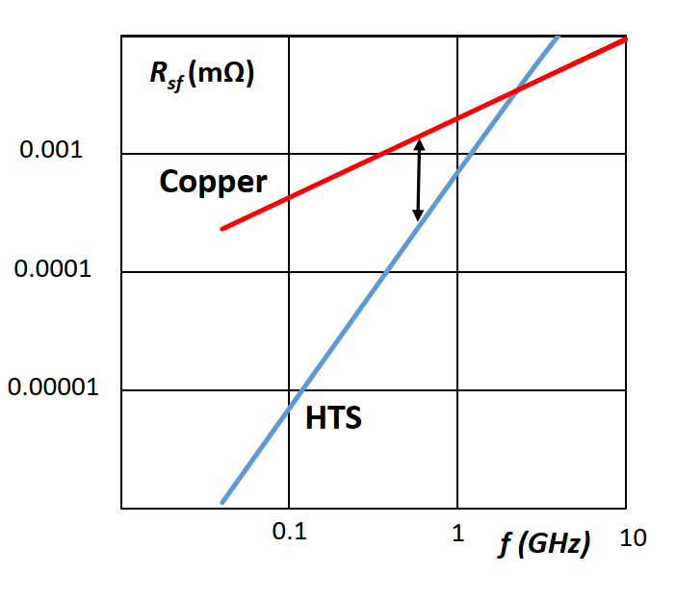

HTS for RF applications
HTS coated conductor at 8 GHz
Frequency scaling HTS vs Cu at 9 T
Cu RRR=100 @ 300 K: 25 mΩ
Cu RRR=100 @ 70 K
Cu RRR=100 @ 20 K
From: Teresa Puig – ICMAB. Developments of HTS Coated Conductors for the FCC-hh beam screen impedance mitigation

Slide 19
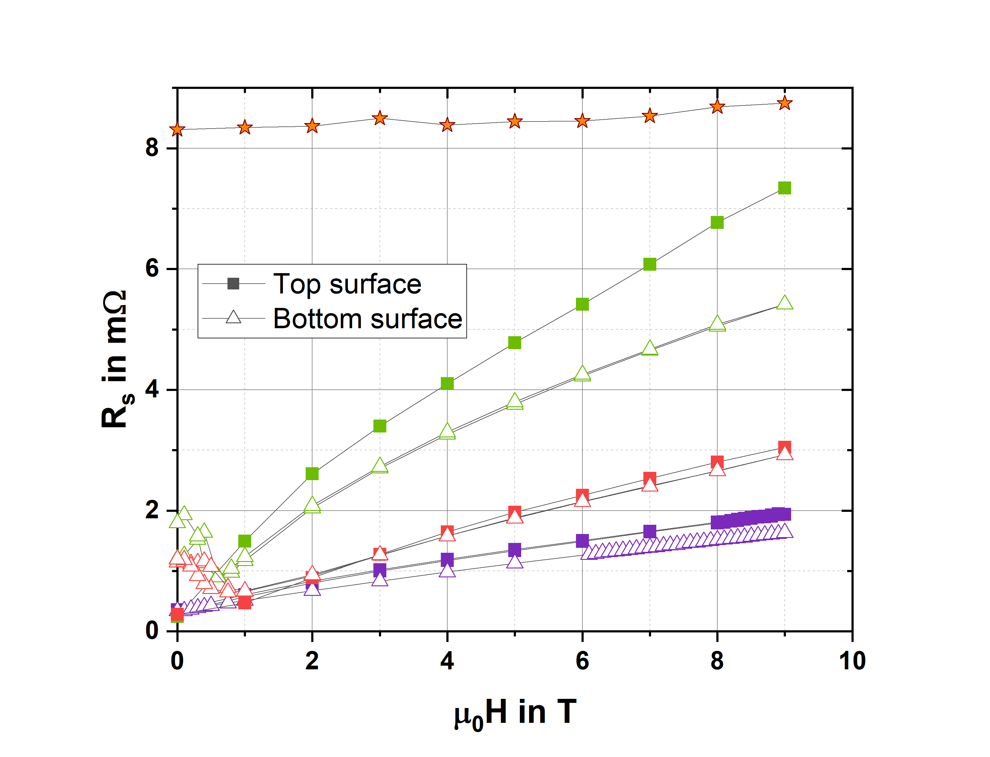
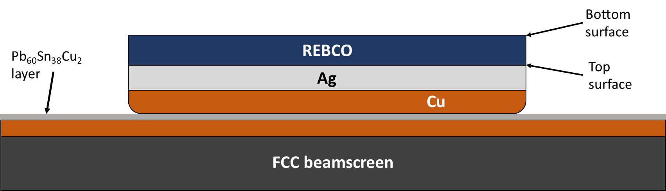
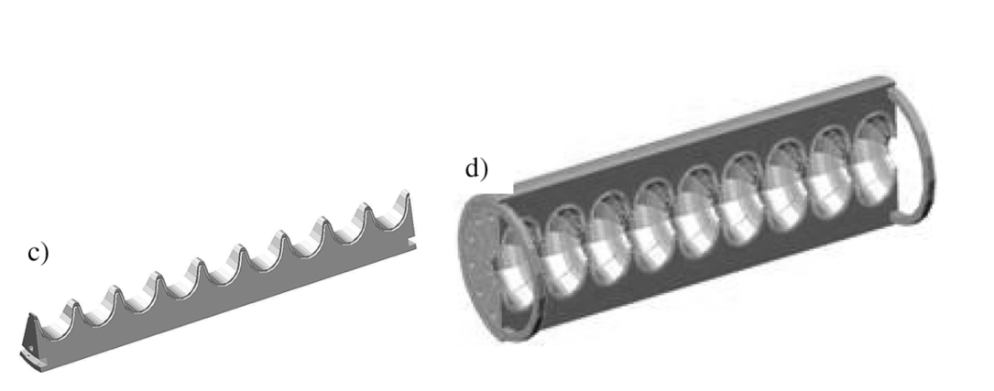

Soldering of HTS coated conductors
T = 50 K, $ν=8$ GHz
FCC Cu
CC 2
Soldered sample
Soldering mostly preserves properties
This could be used in a cavity made in sectors
Standard sample
CC 4
CC 5

Slide 20
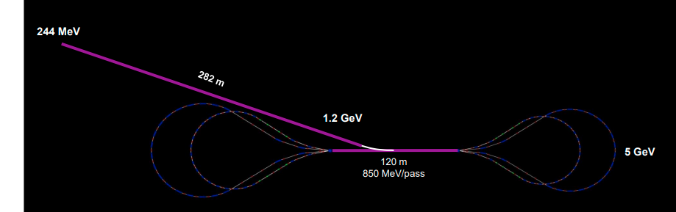
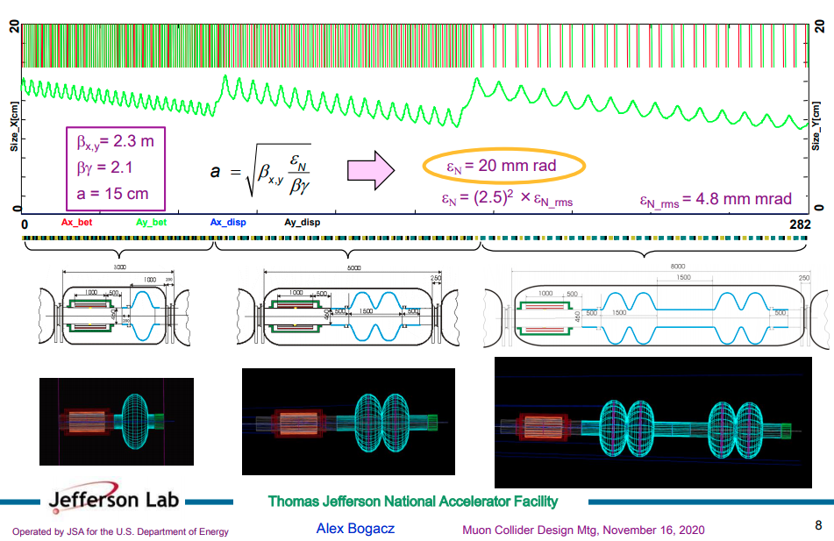
Initial acceleration
Limited muon lifetime requires highest possible accelerating gradient to reach higher energies
Large emittance require large acceptance
  Additional voltage
  Low frequency
  Large aperture
Very large bunch charge: ~5x10¹² causes collective effects which must be addressed
Transmission and decay beam losses
Strong focusing magnets with large apertures
  Stray magnetic fields
  Low filling factor
  Cryogenic NC RF might help in the linac

