Slide 1
Deep neural networks in the group
Saúl Alonso-Monsalve
9 March 2021

Slide 2
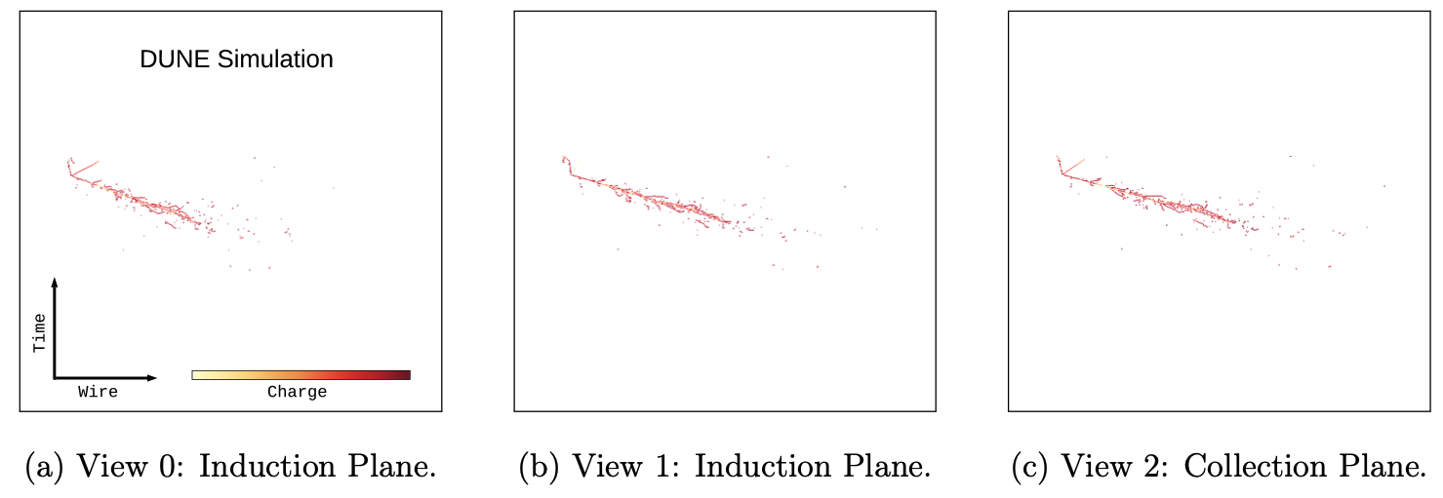
DUNE CVN
Primary output:
Flavour identification
Secondary outputs:
Particle counting for exclusive final states
Paper: 10.1103/PhysRevD.102.092003
Working on the final particle counting outputs.
The network is being used for vertical drift studies.
Neutrino / antineutrino

Slide 3
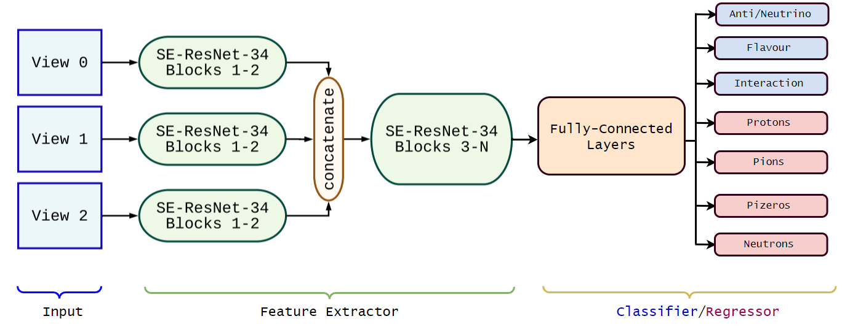
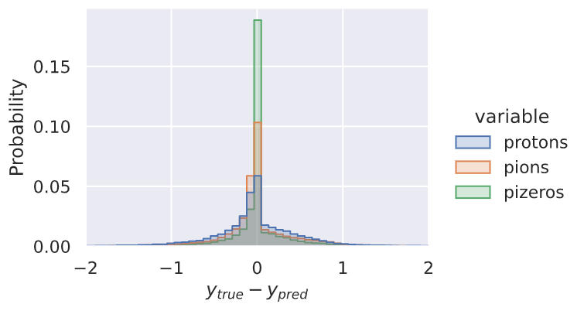
DUNE CVN
The CVN has 4 final state particle counting outputs shown in red
These outputs were trained using pretrained weights of the DUNE CVN* – so here only the feature extractor part remains unchanged
Framed as an integer regression task
Error between the predicted and true value of particles within an event before rounding the prediction to the nearest integer
*Available here: DUNE CVN 2020 Code Release (github.com)
Radi Radev

Slide 4
Vertical Drift Detector (VD)
The readout via strips on a multilayer printed circuit boards allows for more flexibility than the wire-planes design of the horizontal drift (HD) detector tested with PortoDUNE-SP, and to be used in the first DUNE Module:
HD readout geometry: three views with wires oriented at +54, 90, -54 deg from the projection of neutrino beam direction
VD baseline: 0 and 90 deg orientation (as in ProtoDUNE-DualPhase design), with the addition of a third set oriented at 48 deg
VD alternative designs include +48, -48 deg orientations (two views), and -30, +30, 90 deg (three views)
Initial studies based on the CVN network developed for neutrino oscillation studies have shown a limited loss of performance when one or two views are removed from data simulated for the HD configuration.
About the 0 deg orientation:
larger fraction tracks projected on the readout plane at small angle from the strip (degraded measurement -> disadvantage);
(b) larger angular separation between tracks in the projected plane nearly normal to the interaction axis (advantage in event identification because of reduced overlap between tracks/showers).
Next studies: simulate VD geometry and assess performance of different schemes.
Sandro Palestini

Slide 5
y
VD detector: orientation of readout wires as in ProtoDUNE-DP detector
y
VD detector: with addition of a 3rd view
z
z
x
Nu beam direction
x
HD detector:
orientation of readout wires
Nu beam direction
VD detector: alternative 2-views and 3-views schemes
Sandro Palestini

Slide 6
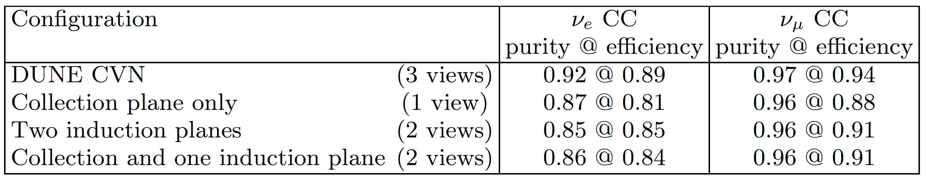
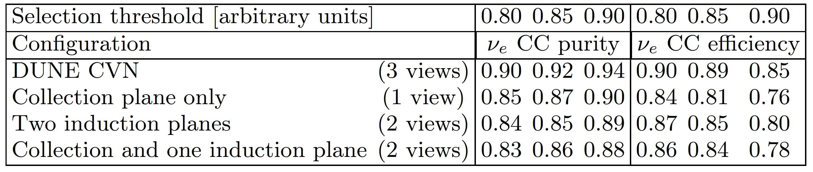
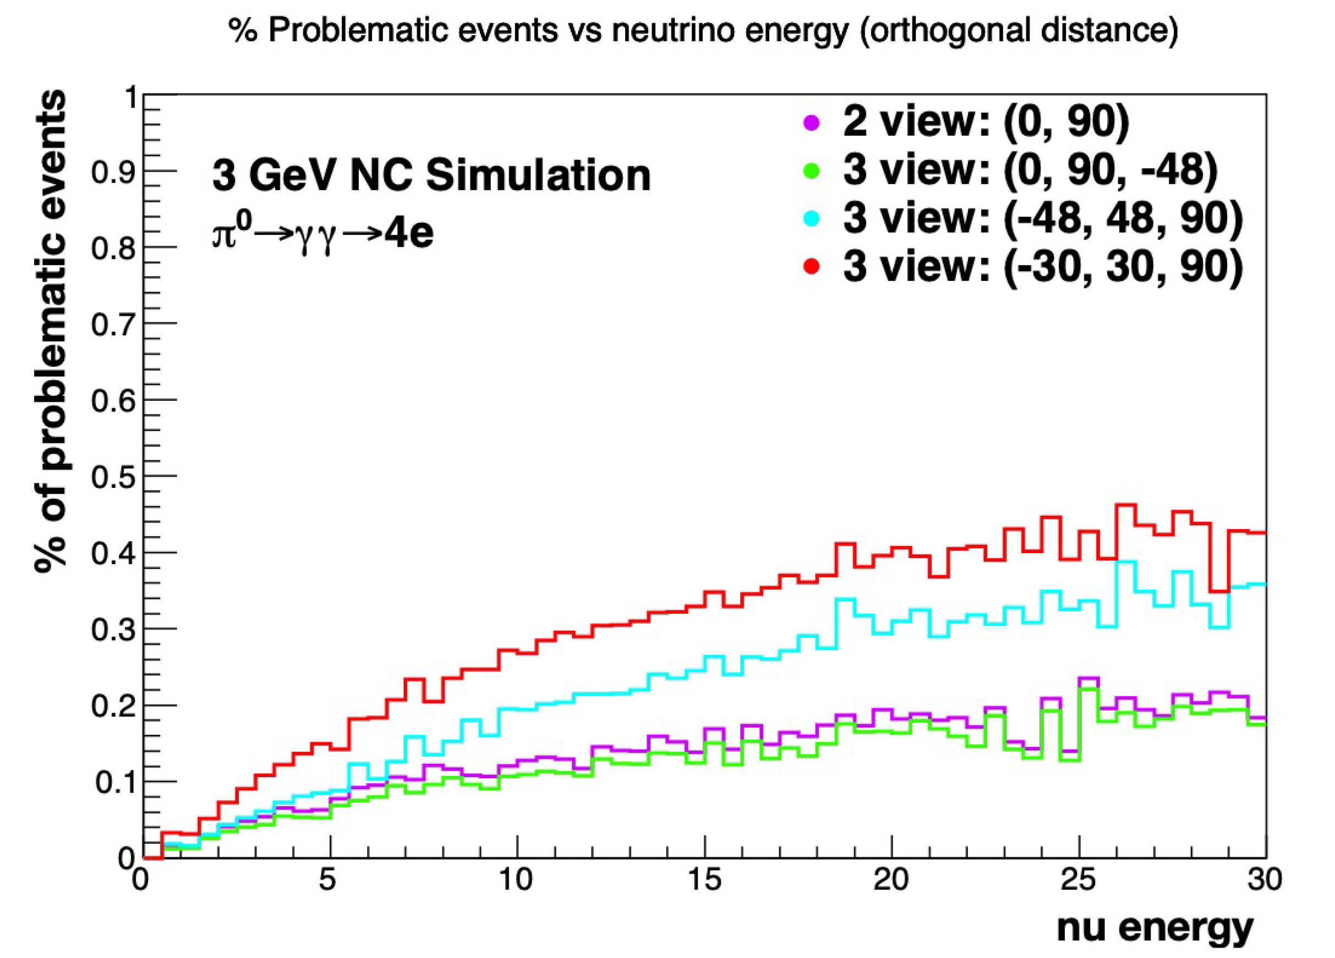
NC interactions: overlap of conversion point of gamma from π₀ with a charged track. When the distance is less than 1 cm or the angular separation is less than 20 deg in all views the event is declared problematic (since
Sandro Palestini

Slide 7
DEALING WITH SPARSE DATA
How can we profit from the sparsity of our data?
Instance segmentation allow us to identify all the hits that belongs to the same particle
Graph Neutral Networks (GNN) are a commonly used approach to do it
Working together to develop a solution that allow us to explore those networks
Only 1.79% of the image is signal.

Slide 8
Deep neural networks in the group
Saúl Alonso-Monsalve
9 March 2021

