Slide 1
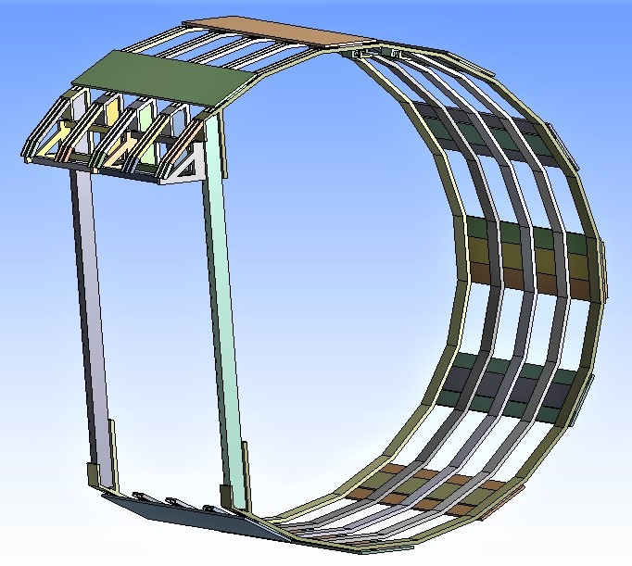
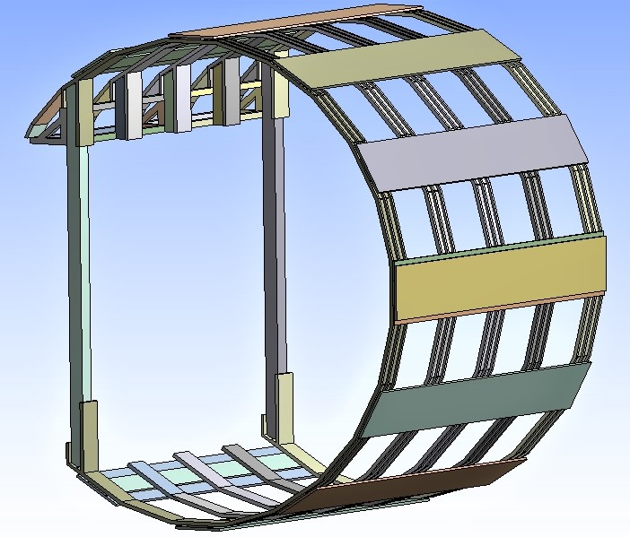
Sand LAr +SST Supporting Spaceframe

Slide 2
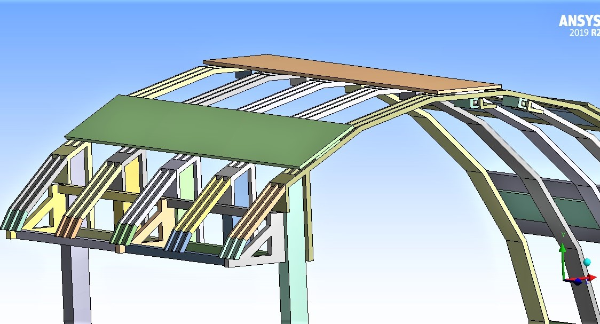
LAr Cryostat Support structure
SST Supermodule Supporting Rails

Slide 3
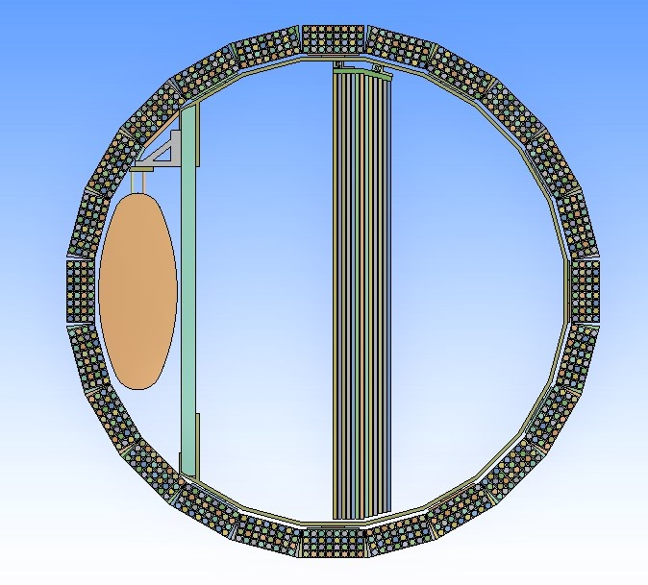
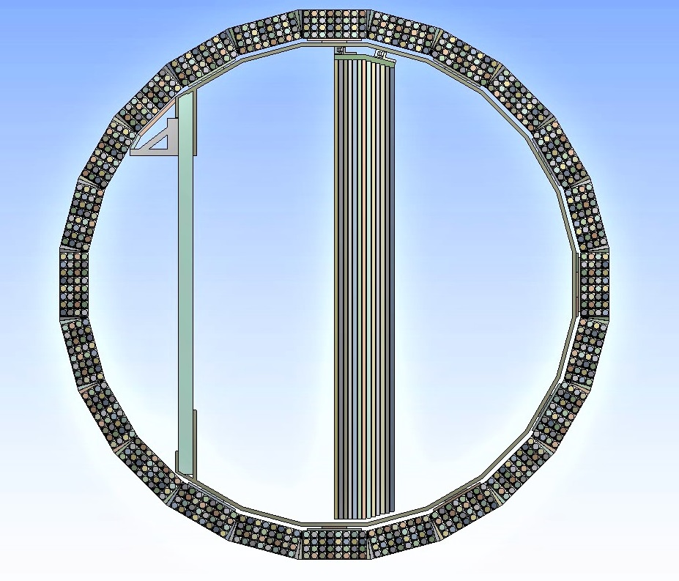
Lar Cryostat & SST Supermodules Indipendently installed

Slide 4
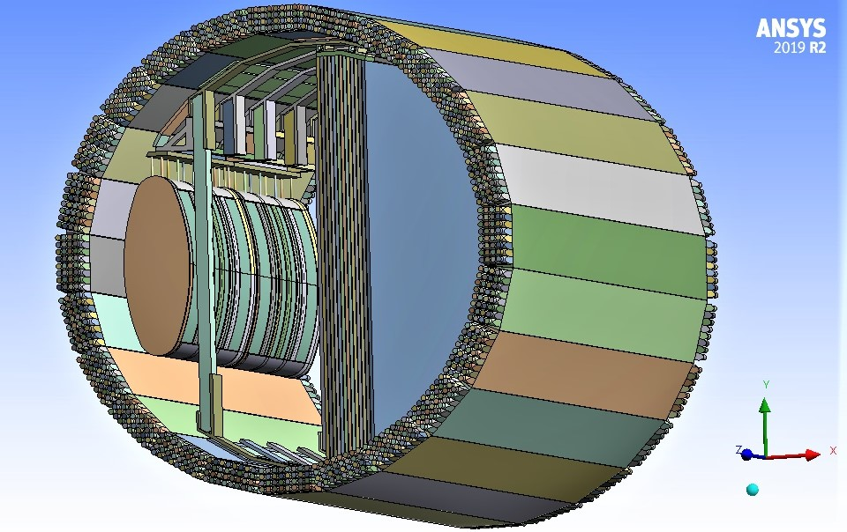
Lar Cryostat &
SST Supermodule
Inside Barrel Calorimeter

Slide 5
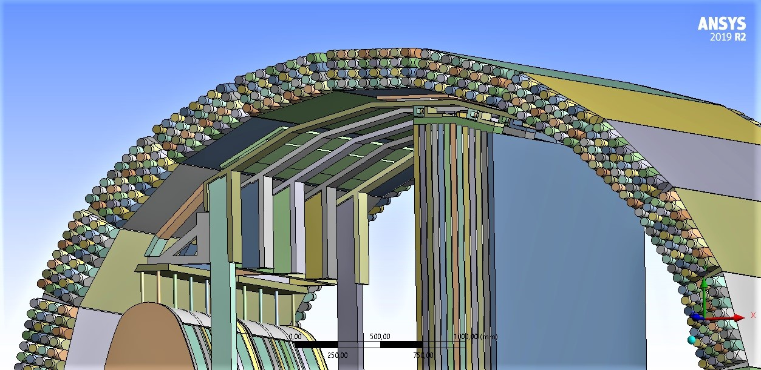
Upper Part View
SST Supermodule Supporting Rails

