Slide 1
WP3 task 3.4: review of the activities in preparation of the FCC injector review
Riccardo Zennaro:: Paul Scherrer Institute
24.03.2021 zoom meeting

Slide 2
Experimental area
Goal: have a comparative study between direct and hybrid scheme
Diagnostic not yet defined
Crystal in/out
AMD+target
RF cavities + solenoids
spectrometer
e-
e+
light
Circulator
Circulator
6 GeV e-
Simplified beam stopper + permanet dipole
e- beam dump or beam stopper + beam dump?
(huge e- energy distribution)
Klystron 35 MW 3.5 10^-6 s?
NB: both e- and e+ have huge energy spread, beam dump design and shielding problems. Option: operate with extremly low beam charge <<200 pC, <<100 Hz

Slide 3
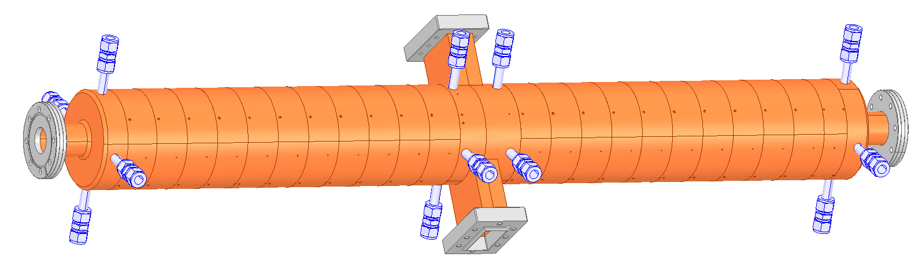
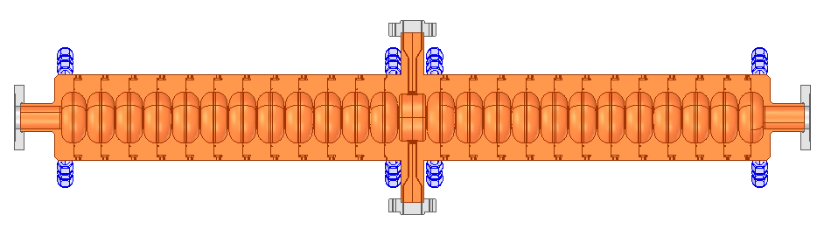
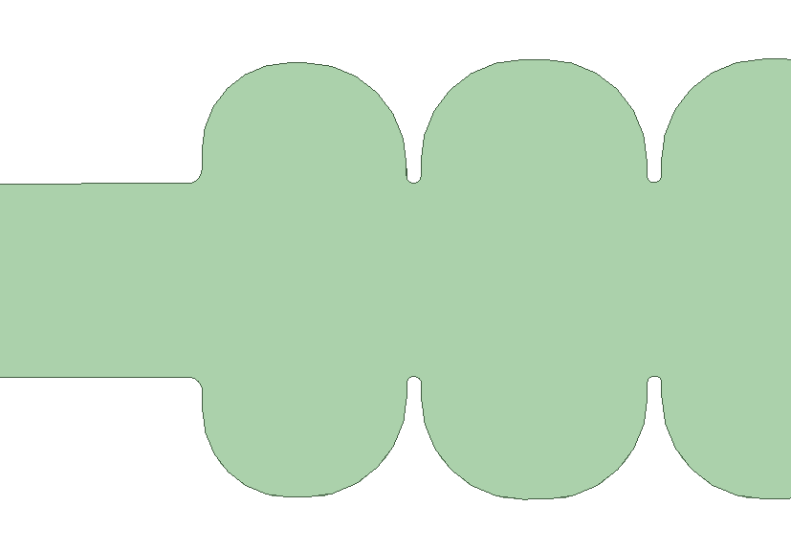
S-band SW π mode cavity
25 cells max.
2998.5 MHz
Q= 21000
β= to be defined, in this example 2
R/Q=939 (for β=2)
mode separation 3.8 MHz R/Q=939 (for β=2)
18 MV/m @ 15 MW (for β=2)
Status:
RF design nearly ready (for β=2) (lambda/4 wg impedance matching missing)
mechanical design well advanced
“conventional PSI” brazing design
Ready for ordering the OFE copper
3
40
89.7
50
150
1400

Slide 4
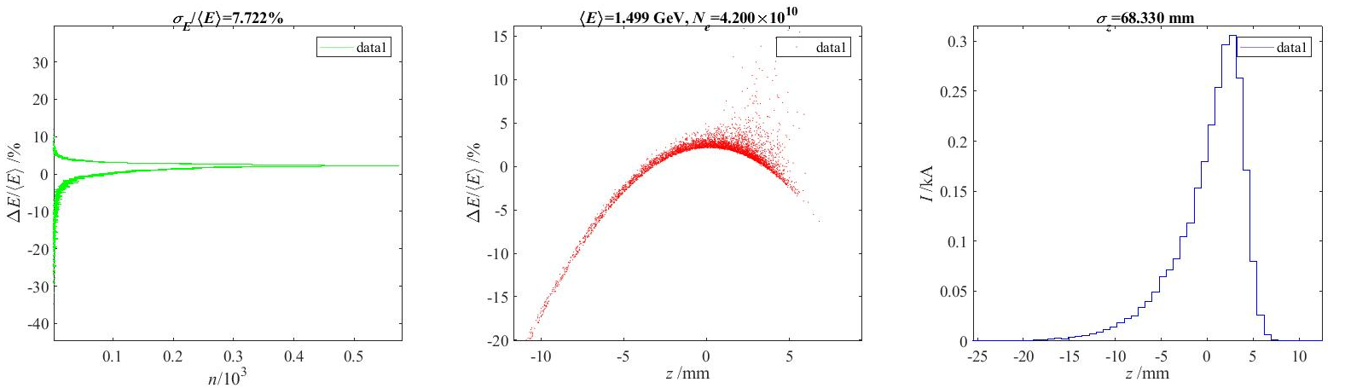
Preliminary results (Astra up to 200 MeV, LiTrack up to 1.5 GeV) as validation of the superconducting AMD+ S-band SW cavities
e+ distribution at target (from Iryna);
Positron Yield at target = 13.8 e+/e-
Conventional scheme,
tungsten target-converter 5X0 (~ 1.75 cm)
e- energy = 6 GeV; Bunch length (rms) = 1 mm
Beam divergece (rms) = 1e-5
Energy spread (rms) = 1e-3
Beam size on target (rms) = 1.5 mm
10+52 SW 3 GHz cavities 18 MV/m, 1st and 2nd AS @-30°
7 T peak field for the SMD
27% e+ in the CLIC DR longitudinal acceptance.
(±3.8% dE/E; ±8.9 mm σz,??)
Total Yield 13.8*0.27= 3.7

Slide 5
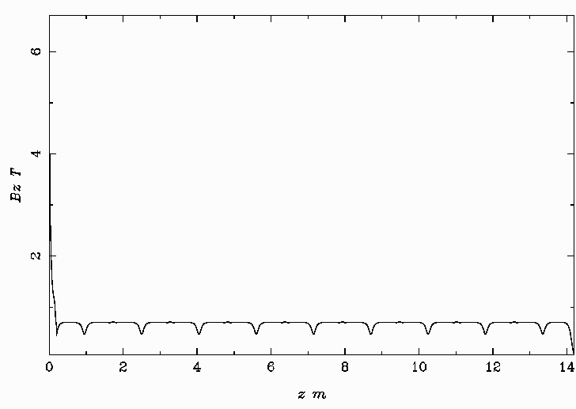
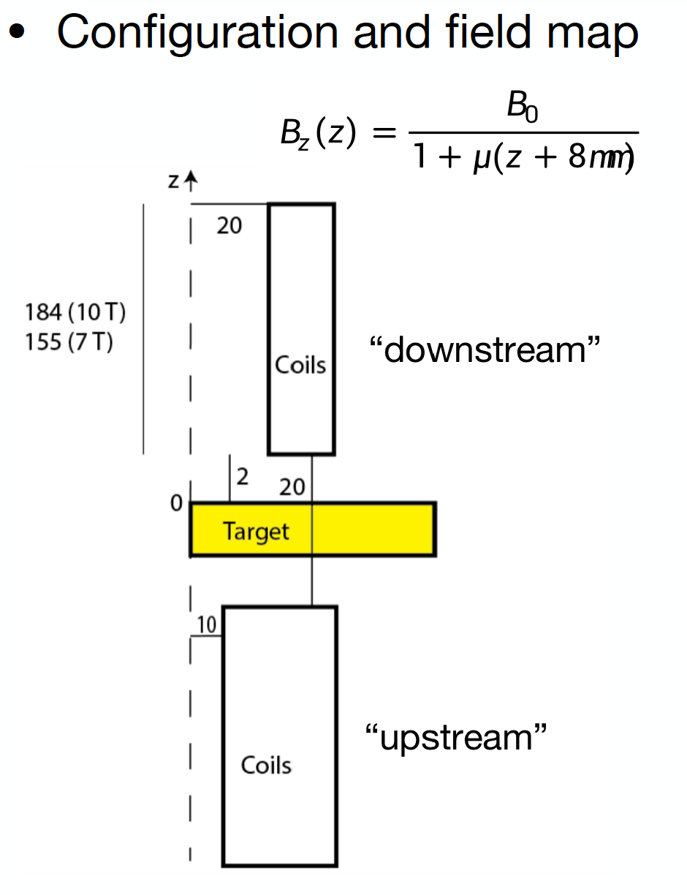
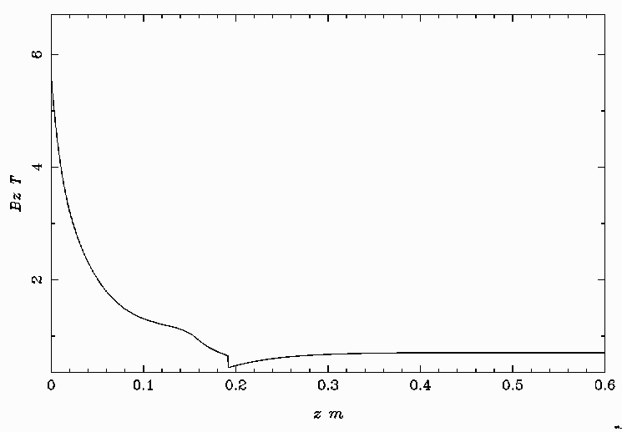
Field profile
Magnetic field profile:
0.15 m (flange to flange) between accelerating structures
Flange of the first cavity 0.25 m from target output face
20 individual solenoids 2/cavity Bz= 0.7 T
NB: all 1D field profiles (RF and magnets)

Slide 6
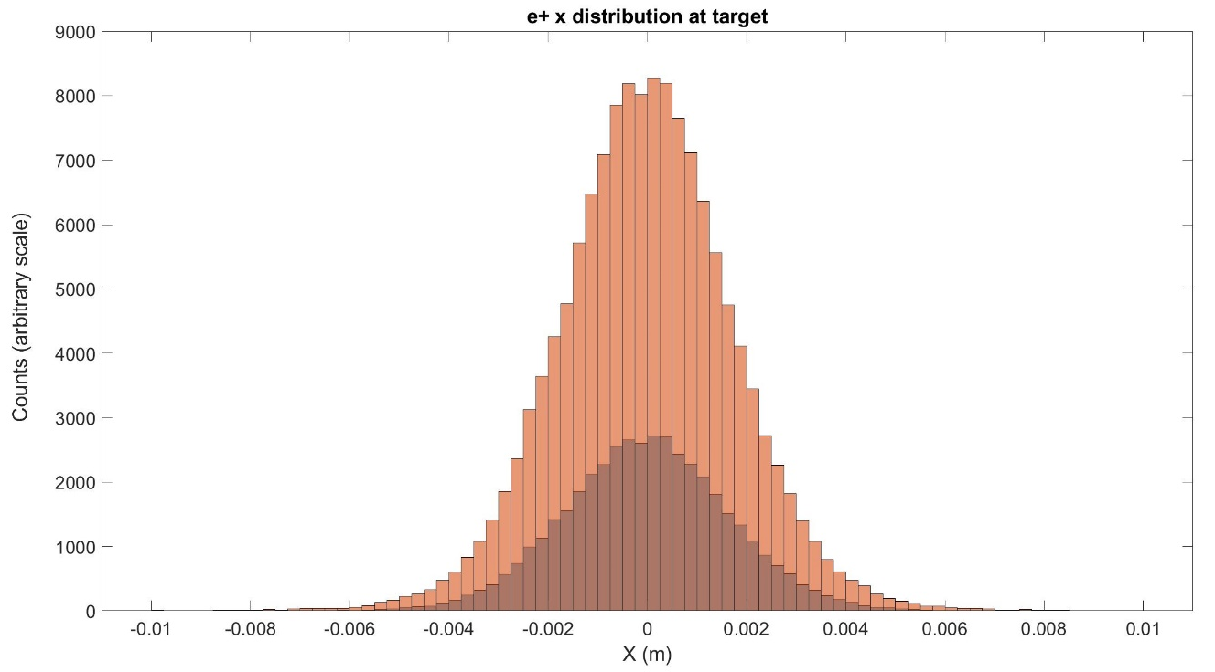
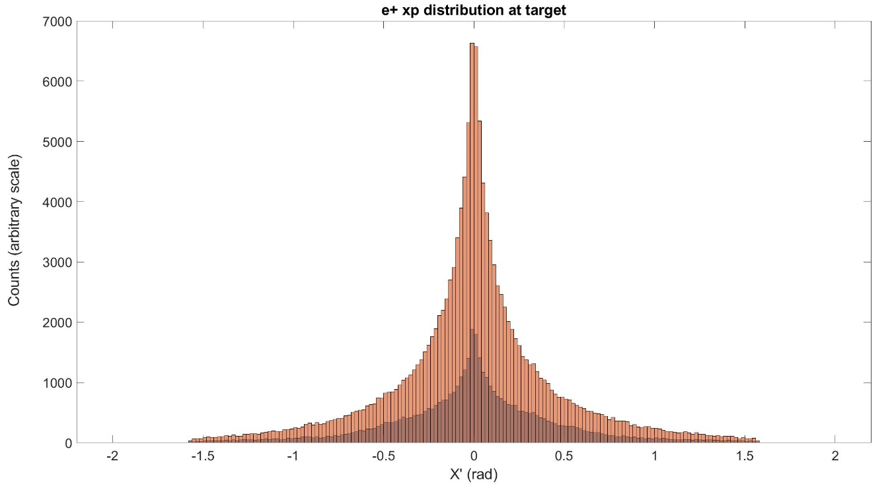
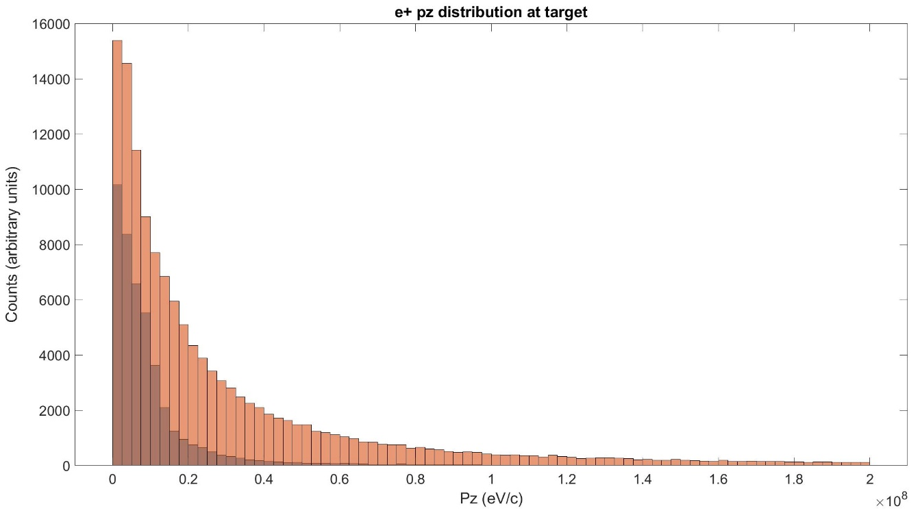
e+ distribution at target
e+ at the target output face:
Total e+ distribution
Only e+ that will reach the capture linac output (200 MeV)

Slide 7
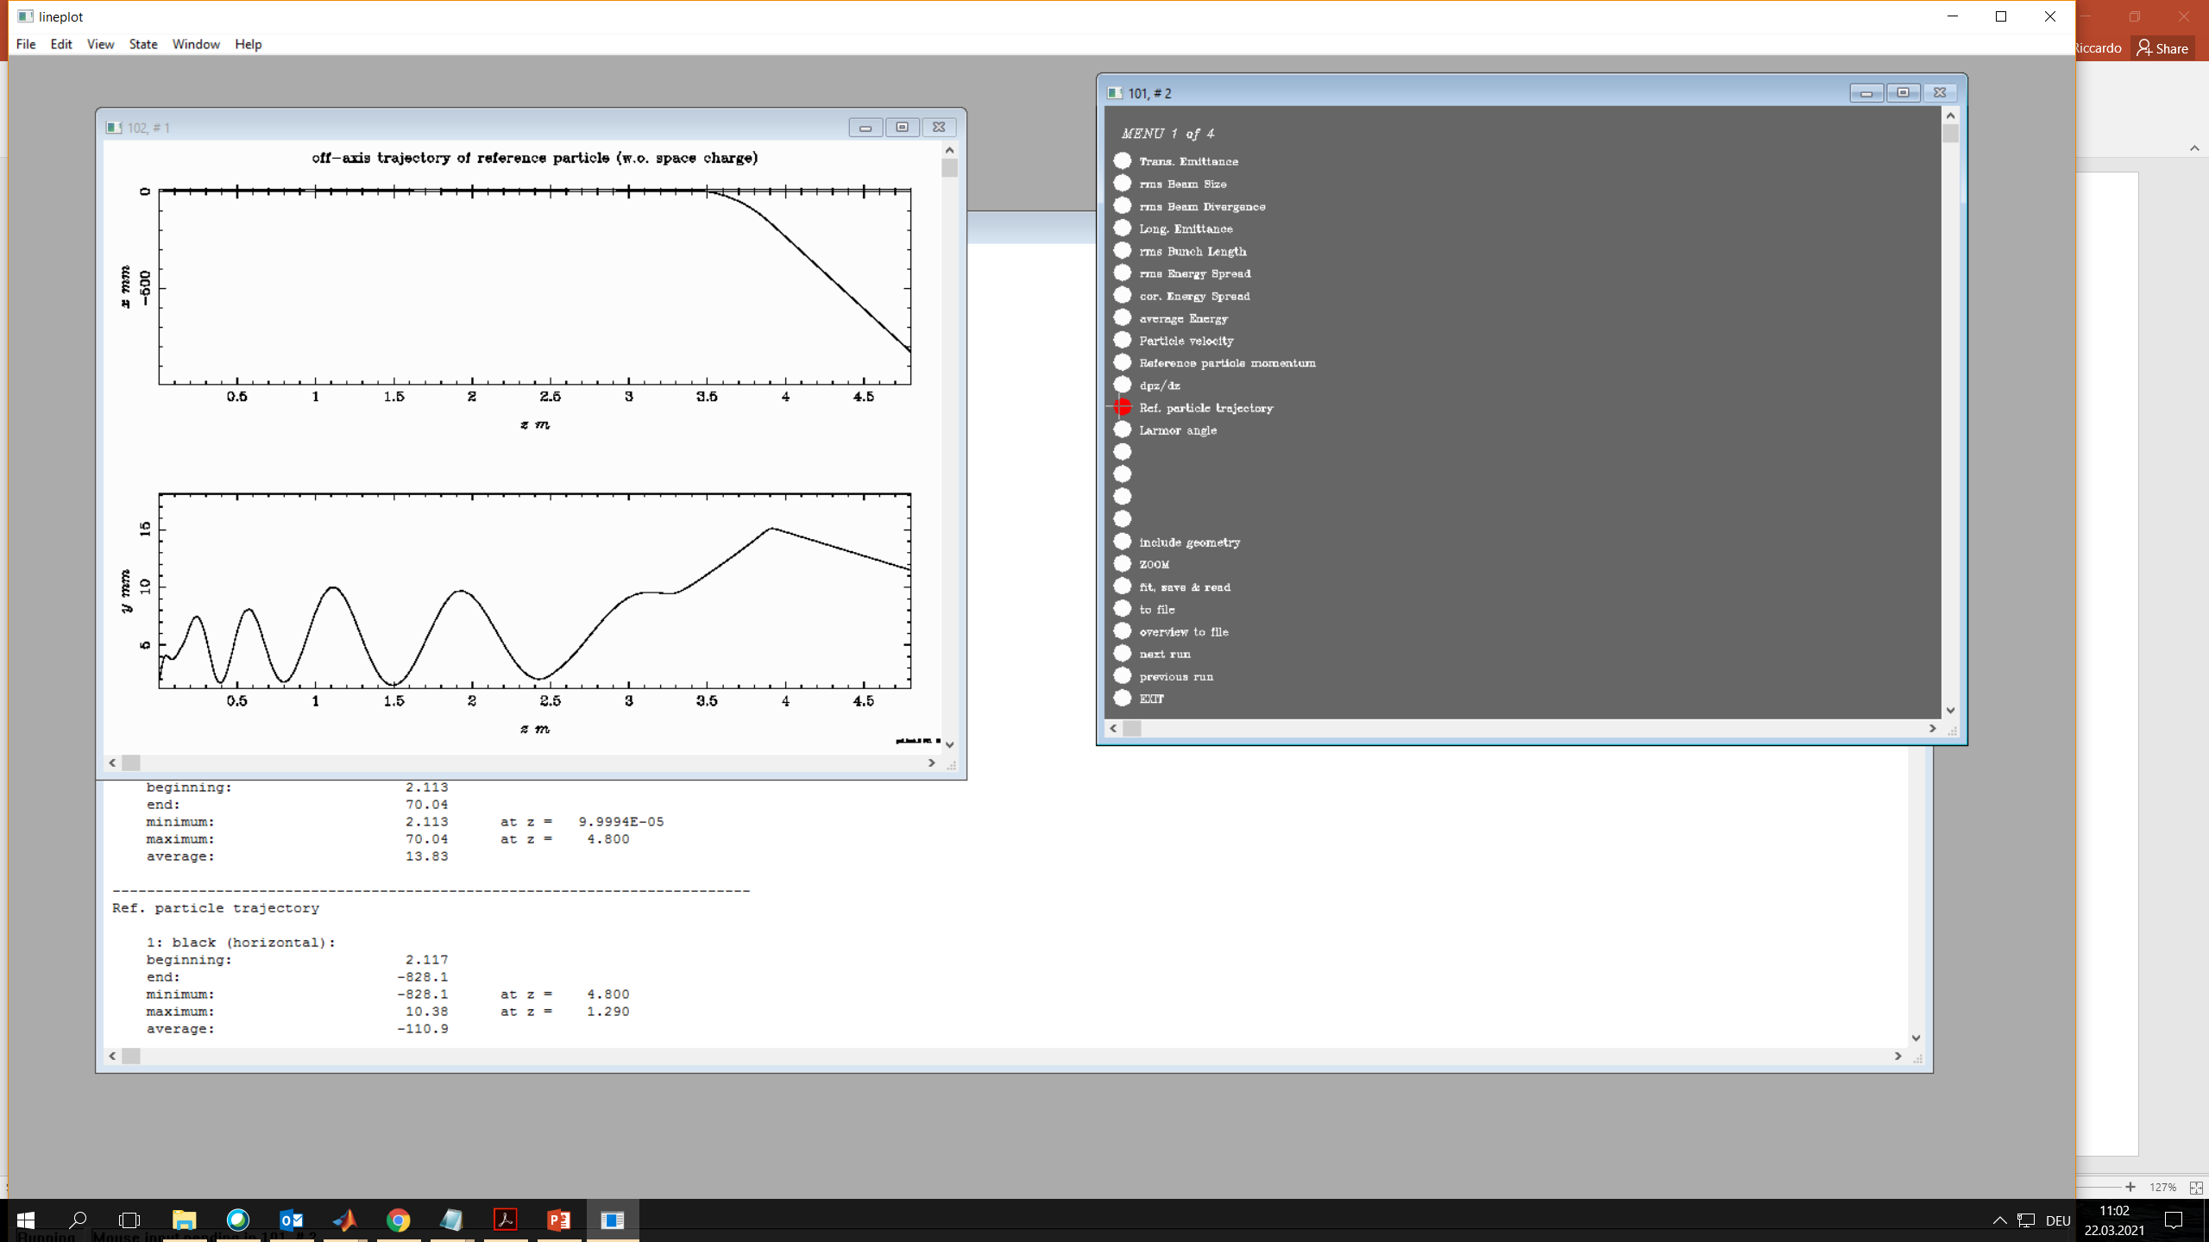
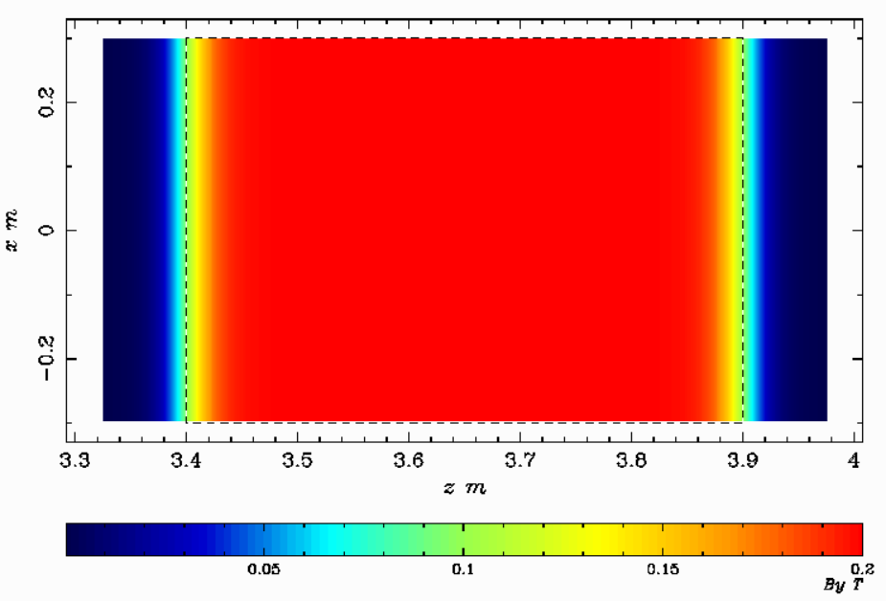
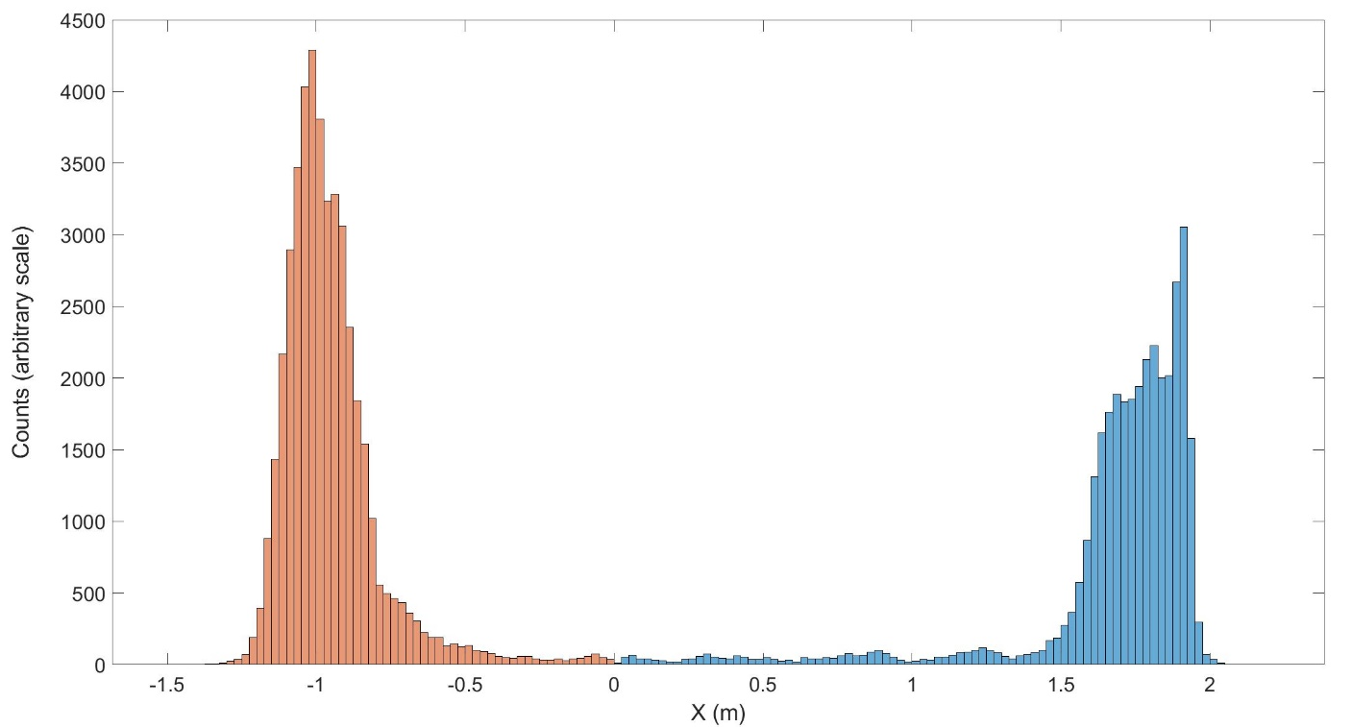
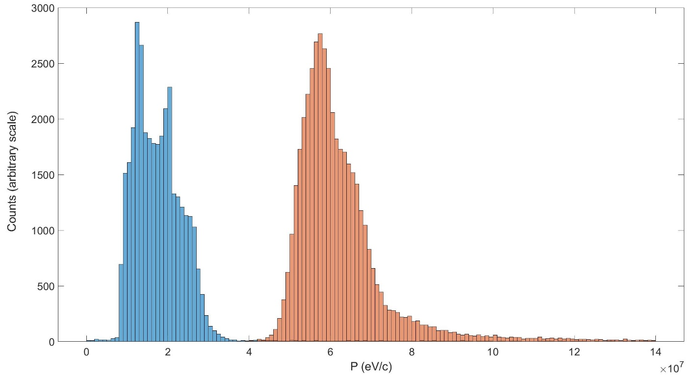
e+/e- separation by spectrometer
Spectrometer:
0.2 T;
0.5 m(z)X 0.6 m (x);
gap =0.1 m
Diagnostic in vacuum or in air? Scintillation fiber?
Special faraday cup?
Just for discussion: https://aip.scitation.org/doi/pdf/10.1063/5.0001980
e⁺
e⁻
e⁺
e⁻

Slide 8
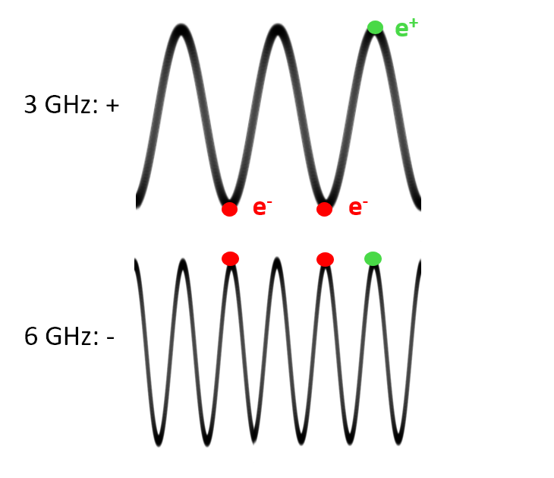
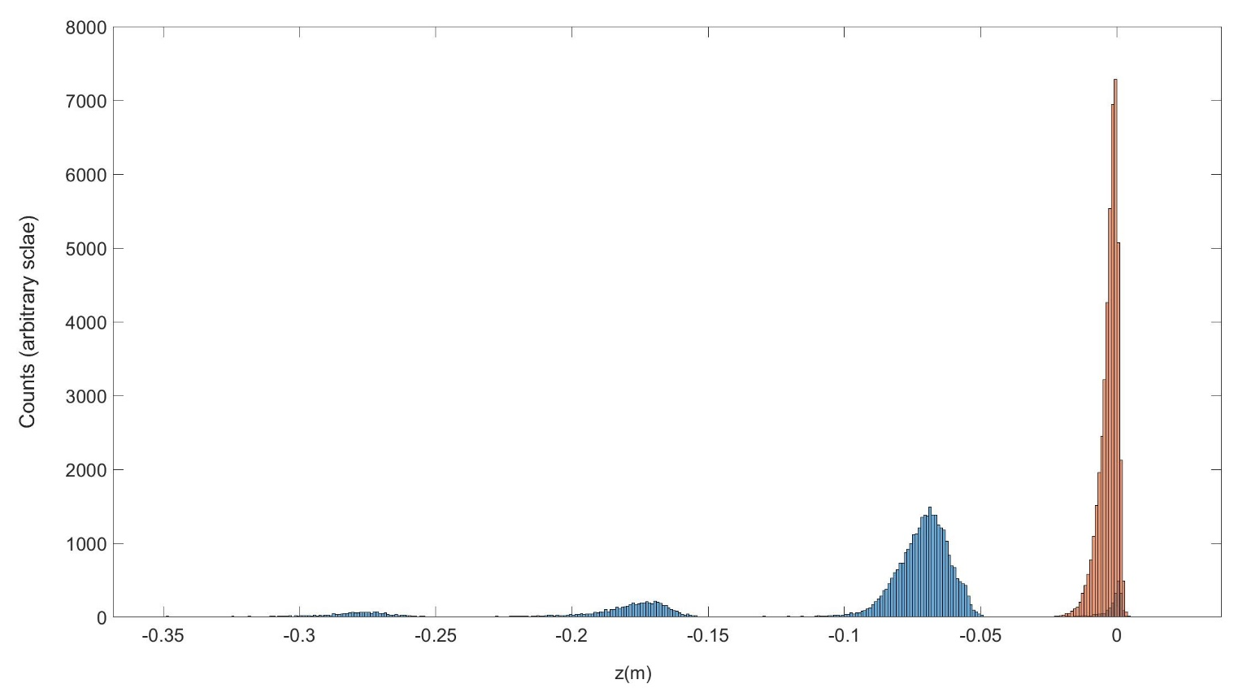
e+/e- separation by time resolution
Two resonant cavities at 3 and 6 GHz (or a double mode single cavity) to get sum and subtraction of e+ and e- charges.; problem of the form factor to be determined
e⁺
3 GHz period
e⁻

Slide 9
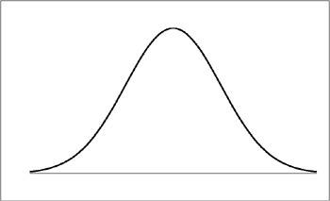
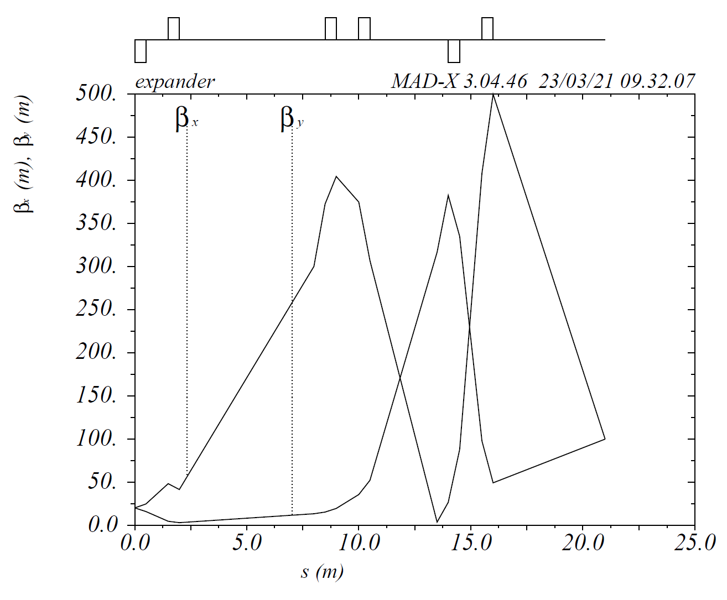
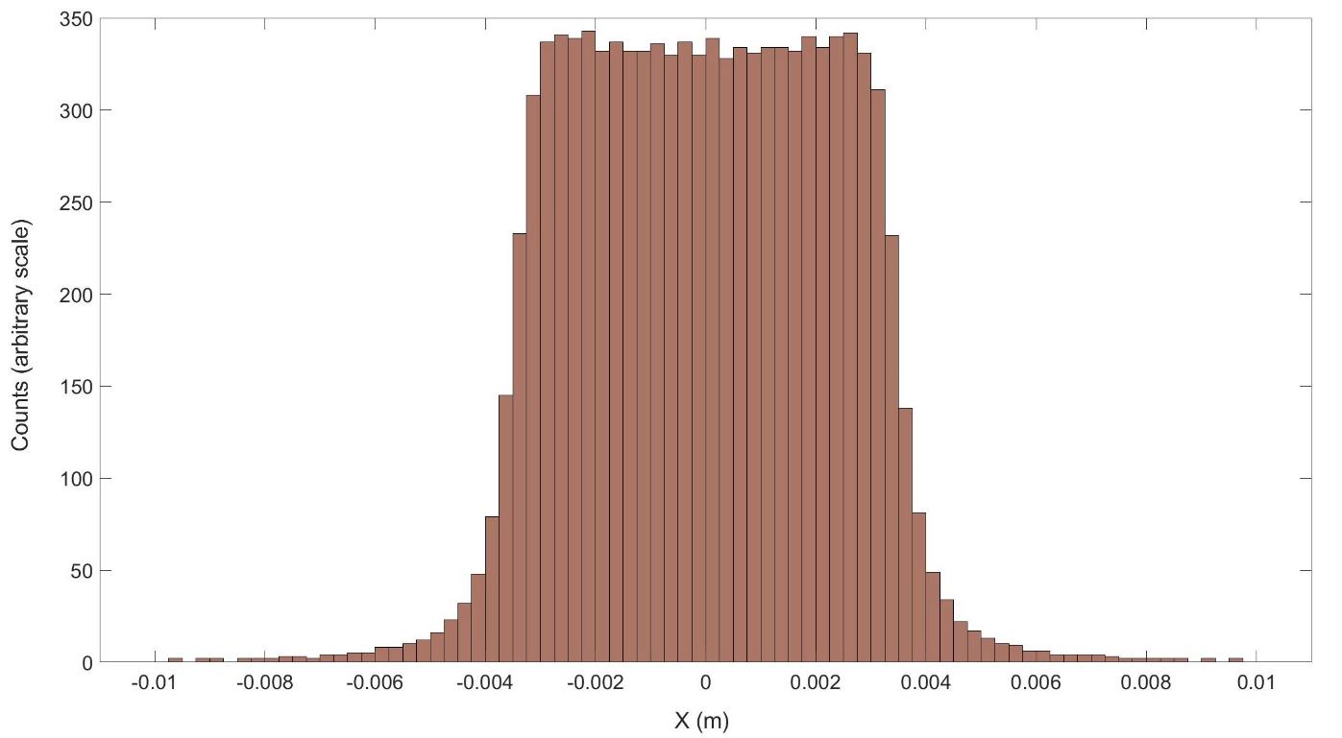
Gaussian vs. uniform
Octupole:
Aperture 20 mm D
L 400 mm
Gradient 8*10^4 T/m^3
Field at pole 0.08 T
Dodecapole
Aperture 20 mm D
L 400 mm
Gradient 1.12*10^9 T/m^5
Field at pole 0.112 T
The yield basically depends on the ratio emittance/acceptance of the AMD+ cavity system
PEDD depends on the peak of e- distribution at the target.
The type of e- distribution can affect both of these parameters
Octupole + dodecapole
Target
6 GeV e-
12 m
A combination of an octupole, dodecapole and drift can change the distribution from Gaussian to uniform in one plane.
Classic solution for high intensity proton beams on targets
O+D x
O+D y
Preliminary quick optic study

Slide 10
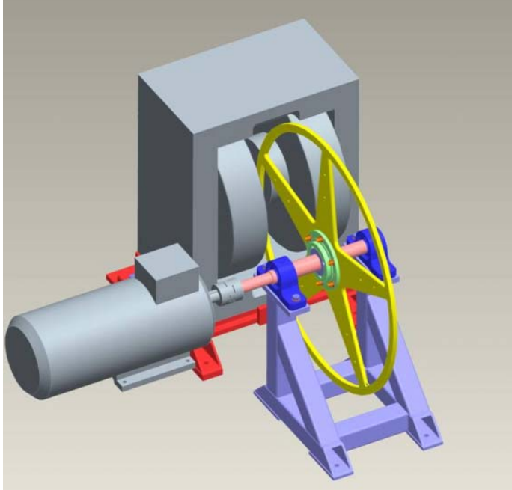
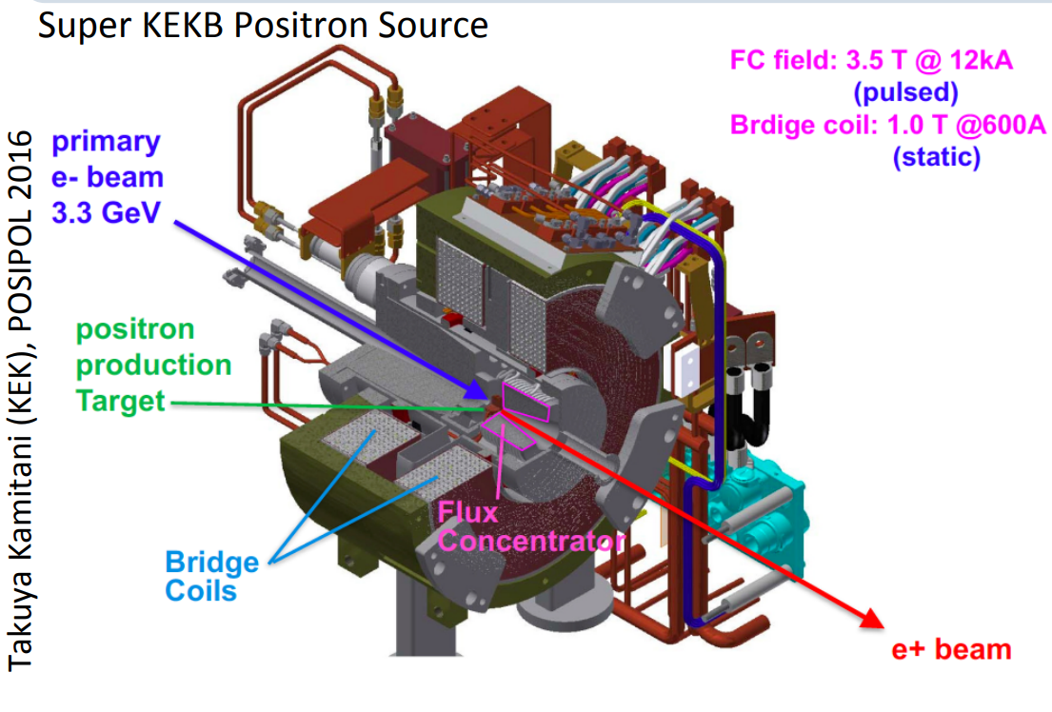
FCC injector review:
Positron source advantages/disadvantages of single bunch vs multi-bunch operation.
verify and update this table
Assumptions up to now (to be validated):
Limit of Peak Energy Deposited Density (PEDD) for a Tungsten-Rhenium alloy (W74Re26) is 35 J/g
Target Heat Load (THL) is not higher than 15 kW
PEDD time constant (?): 10⁻⁶ s<t<<10⁻³ s
independent from rep. rate, proportional to #bunch/pulse
Single/double bunch – multi-bunch impact on the e+ production:
Target (PEDD, P)
Linac (depends on TW or SW design, with or without pulse compressor)
Gun (probably not a topic of WP3/6)
Others?
?
Multi-bunch
Single bunch
Rotating target
Fixed target

