Slide 1
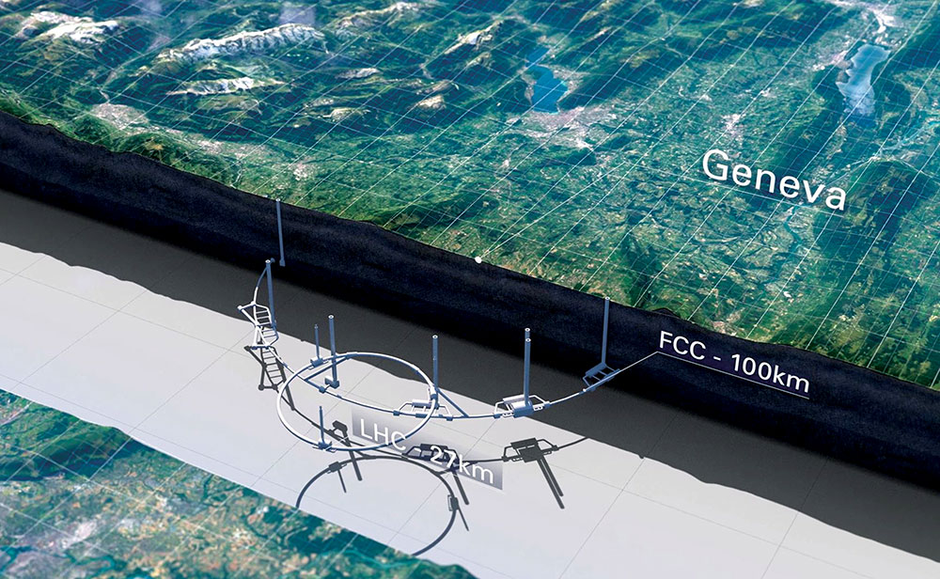




Future Circular Colliders –
Possibilities for Plasmas, Lasers, Dielectric Structures and Crystals
Frank Zimmermann, CERN
European Expert Panel, 30 March 2021
WARNING - this talk does not necessarily reflect the view of CERN or FCC study management !
many thanks to Roy Aleksan, Ralph Assmann, Michael Benedikt, Iryna Chaikovska, dda Gschwendtner, Michael Hofer, Thibaut Lefèvre, Nikolai Muchnoi, Anke-Susanne Müller et al.
http://cern.ch/fcc
Image: Polar Media/ FCC Study Office

Slide 2

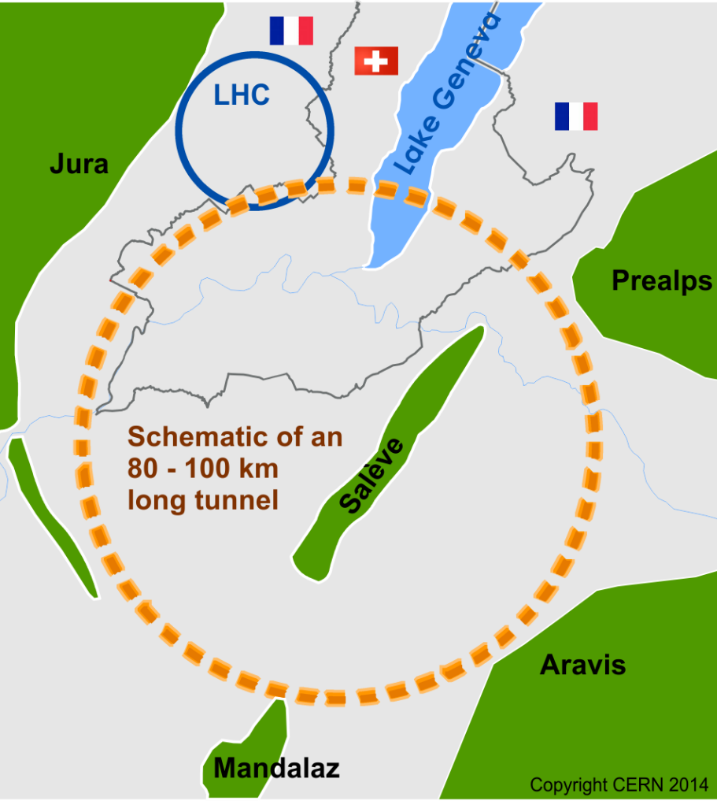
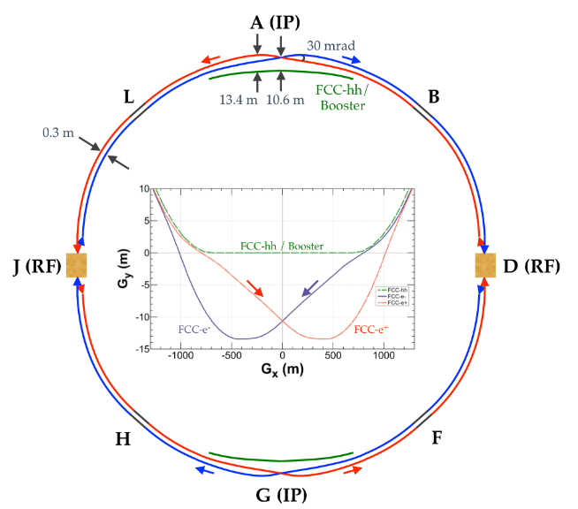
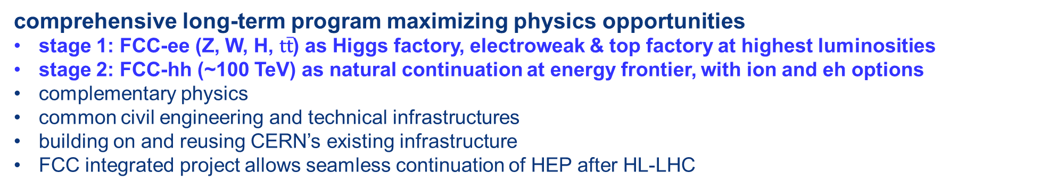
The FCC integrated program
inspired by successful LEP – LHC programs at CERN
comprehensive long-term program maximizing physics opportunities
stage 1: FCC-ee (Z, W, H, $\text{t}\overline{\text{t}}$) as Higgs factory, electroweak & top factory at highest luminosities
stage 2: FCC-hh (~100 TeV) as natural continuation at energy frontier, with ion and eh options
complementary physics
common civil engineering and technical infrastructures
building on and reusing CERN’s existing infrastructure
FCC integrated project allows seamless continuation of HEP after HL-LHC
FCC-ee
~2040
FCC-hh
~2065

Slide 3
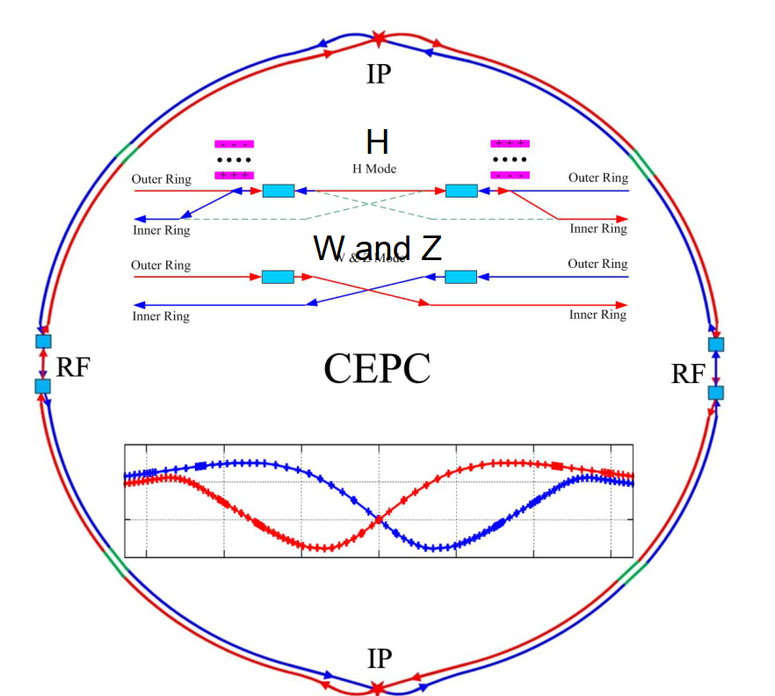
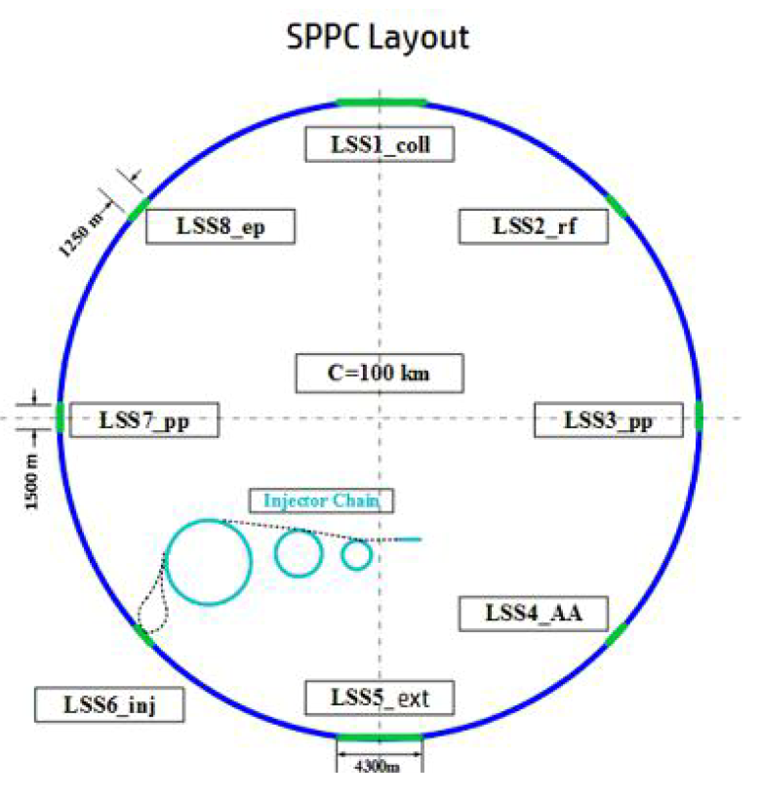
similar proposal in China: CEPC / SppC
CEPC
~2034?
SppC
~2050?

Slide 4
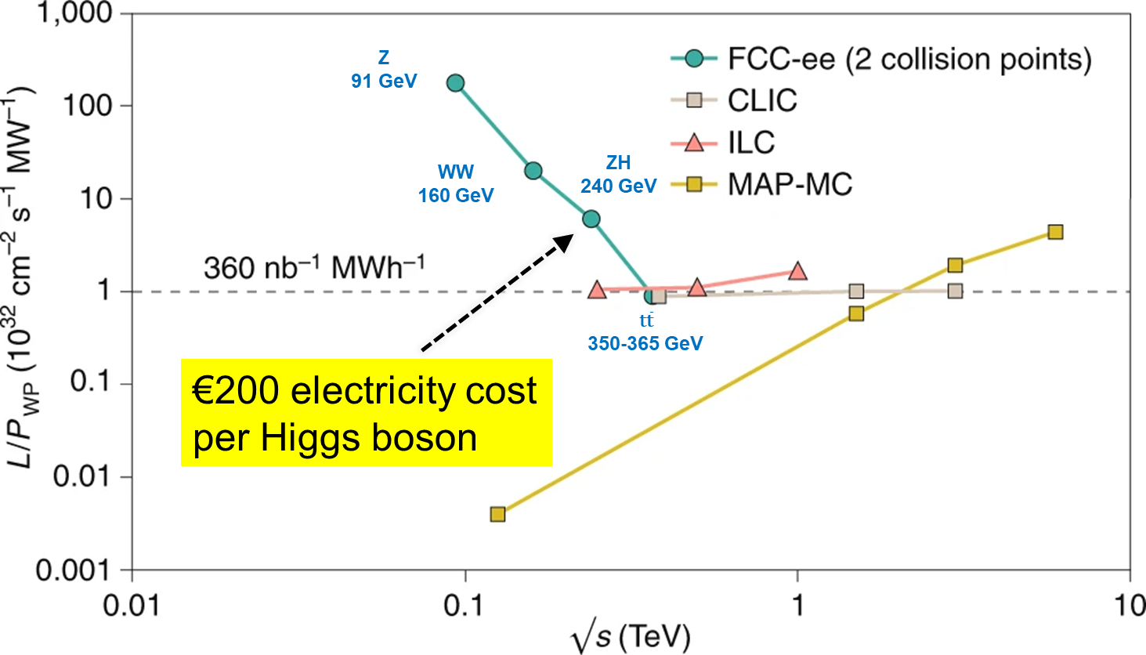
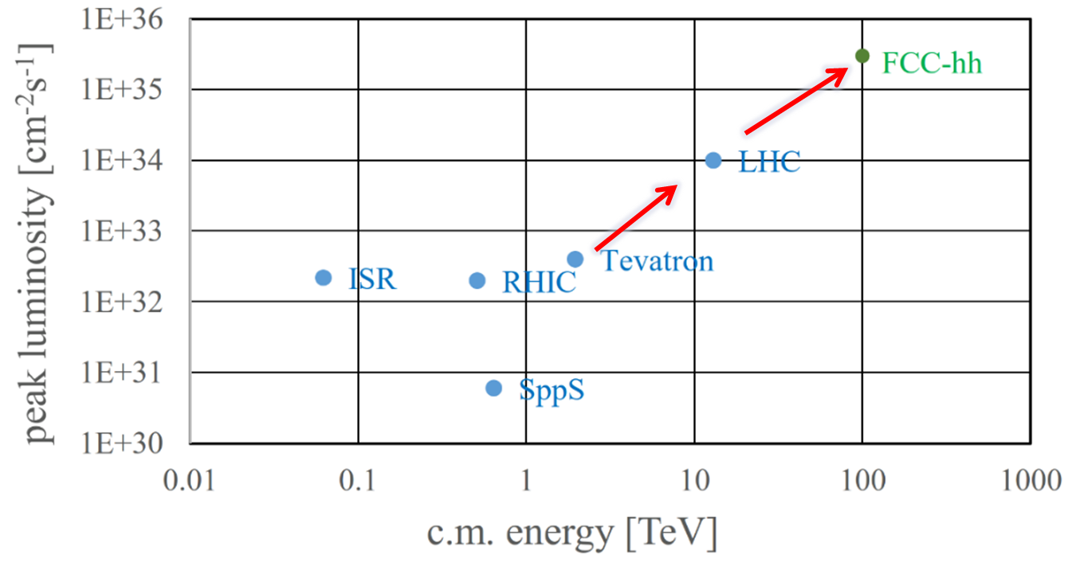
The FCC integrated program
projected baseline performance
e⁺e⁻ Higgs/electroweak
Factory – energy efficiency
energy efficiency frontier hadron collider
both colliders breaking new grounds in luminosity and energy
feasibility study 2020-2025 as requested by ESPPU 2020

Slide 5
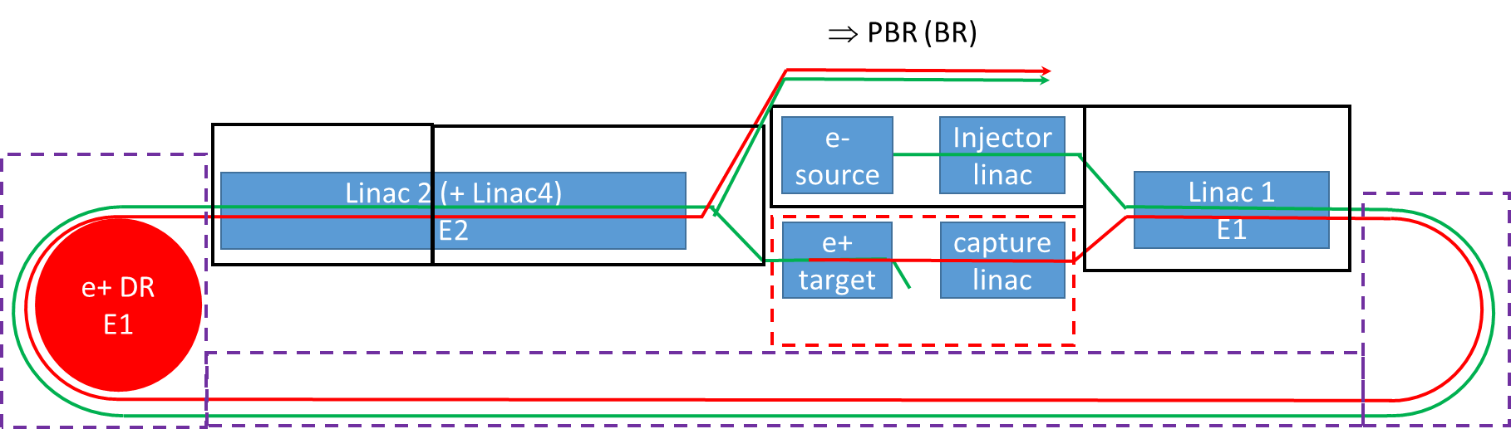
FCC-ee injector
Paolo Craievich, Alexej Grudiev, Salim Ogur, Hans Braun, Katsunobu Oide et al.
up to 182.5 GeV
baseline: 6 or 20 GeV S- or C-band linac + full energy booster
option: plasma wigglers
10.1109/JQE.1987.1073557
6 or 20 GeV
options: plasma acceleration
(e⁻ and e⁺!),
dielectric or laser acceleration
crystal hybrid
target (baseline)
e.g. Z. Y. Xu et al.,
PRAB 23, 091301
baseline: laser for e⁻ photo RF gun, 6.5 nC, 0.6 μm
option: low-emittance plasma gun
option: plasma based e⁺ target
e.g. D.K. Johnson, UCLA 2006
e.g. PhysRevSTAB.11.070703
PRAB 12, 111302
SLAC-PUB-7378
options: plasma energy spread compensation, plasma collimation, plasma bunch compression
collider needs > 10¹² e± per second
J. Seeman,
FCC Week 2017

Slide 6
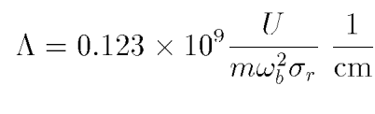
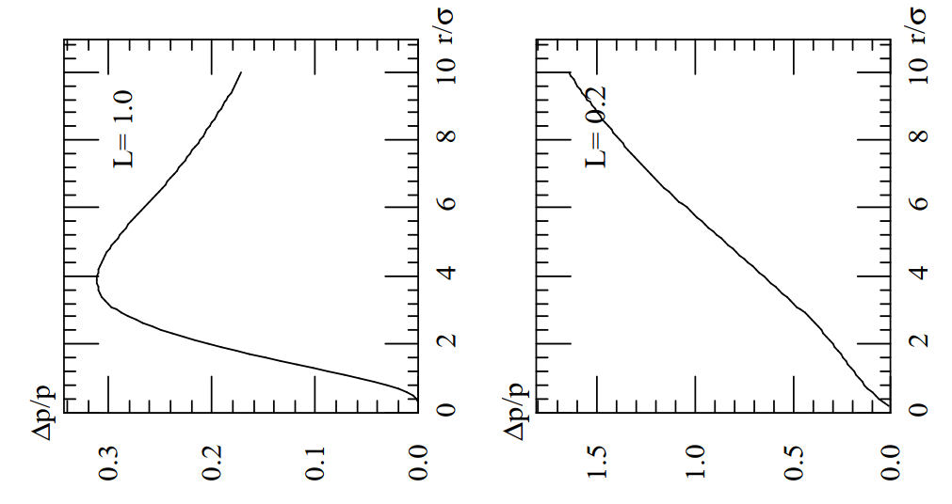
plasma collimation
SLAC-PUB-7378
radial
kick
radial
kick
Λ
Λ
S. Heifets, T. Raubenheimer, 1996

Slide 7
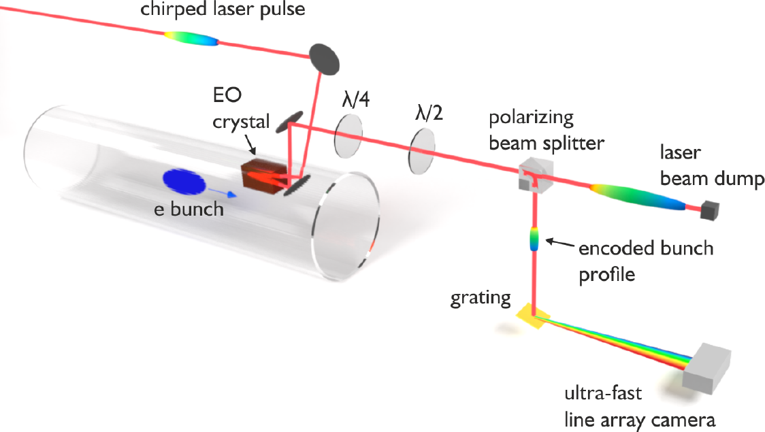
FCC-ee collider rings
baseline: bunch-by-bunch profile
measurement based on
electrooptical sampling (crystal &
laser)
baseline: Compton
lasers for
polarimetry
and energy
calibration
PRAB 22, 022801,
PRAB 21, 102803
option:
laser wires
for transverse
beam size
measurement
option: crystal collimators
alternative option: plasma collimators
option: plasma-based beam dump

Slide 8
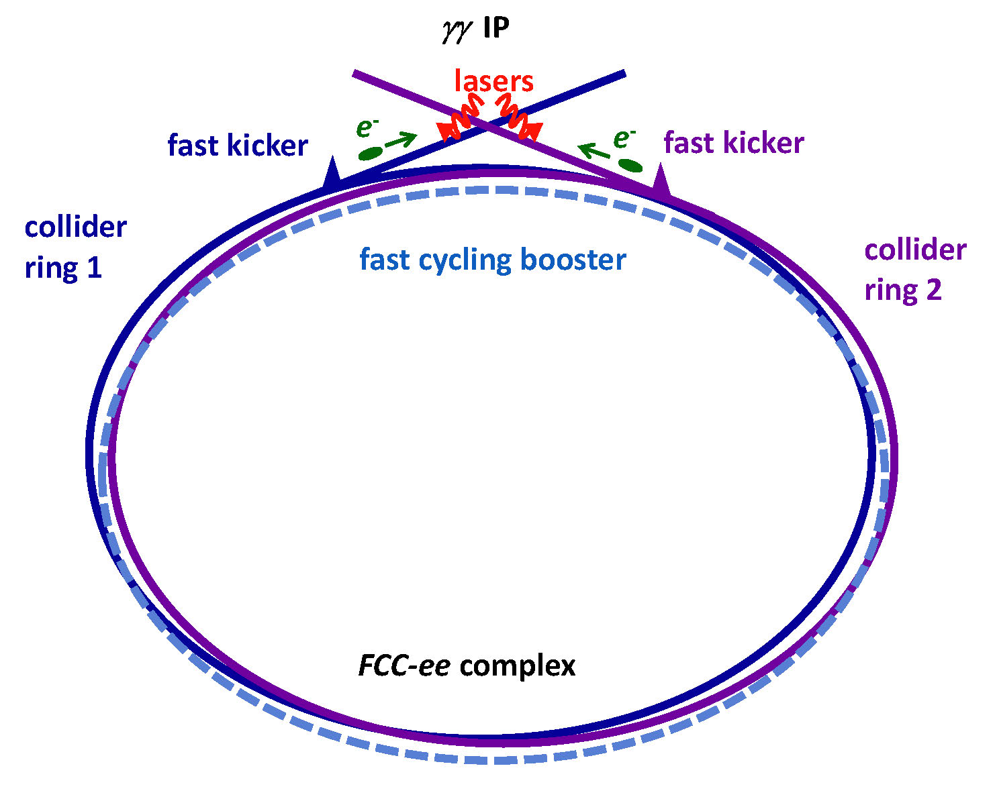
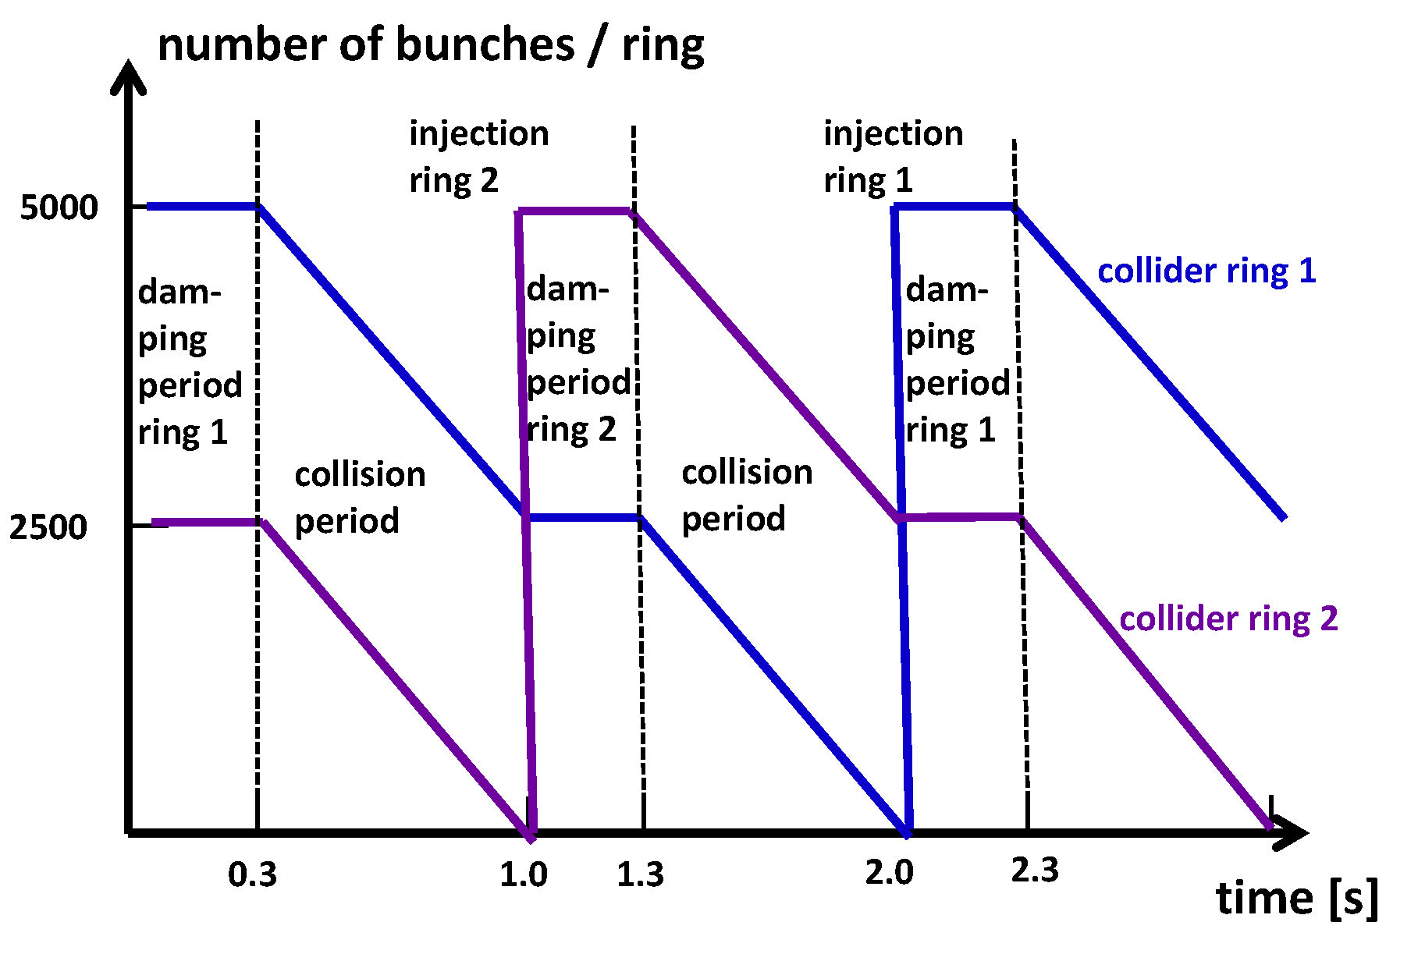
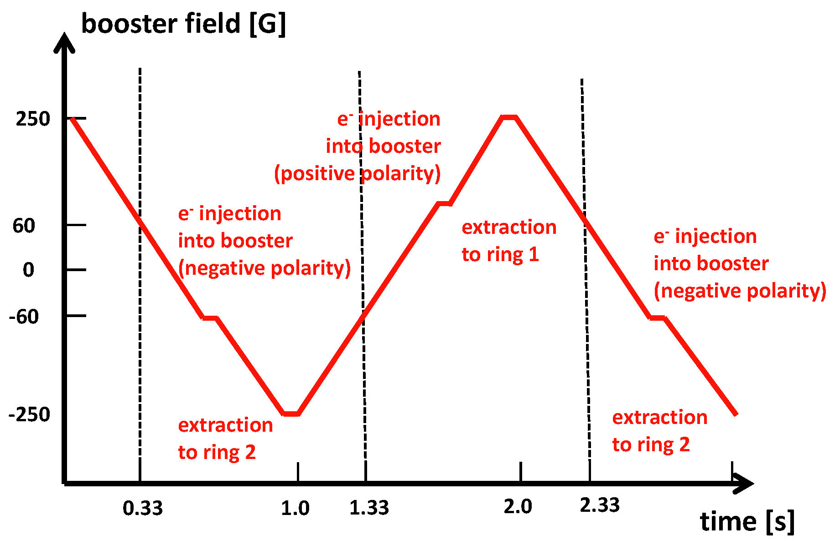
FCC-ee γγ option
cycle pattern for the two collider rings
80 GeV e⁻ beams
γγ Higgs factory
IPAC2015,
TUPTY057
option: plasma lens
& plasma-based bunch compression
cycle pattern for the booster (inj. at 20 GeV)
Part. Acc, 1987,
Vol. 20, pp. 171-182
Schematic γγ collider based on filling the two FCC-ee collider rings with e⁻ bunches and extracting one bunch per beam and per turn into a dedicated γγ line.
R. Aleksan, F. Zimmermann et al., 2015

Slide 9
FCC-hh – the hadron collider
baseline: beam from plasma
ion sources,
for H⁻ (RF-ICP) and
heavy ions (ECRIS)
question: crystals or plasma to replace the high-field bending magnets??
PhysRevSTAB.4.091301
option: crystal collimators
alternative option: plasma collimators
option: plasma-based beam dump
with integrated “AWAKE/SHIP” facility

Slide 10
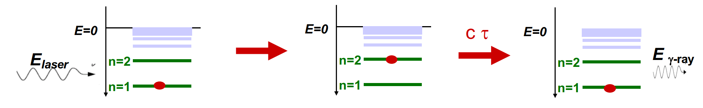
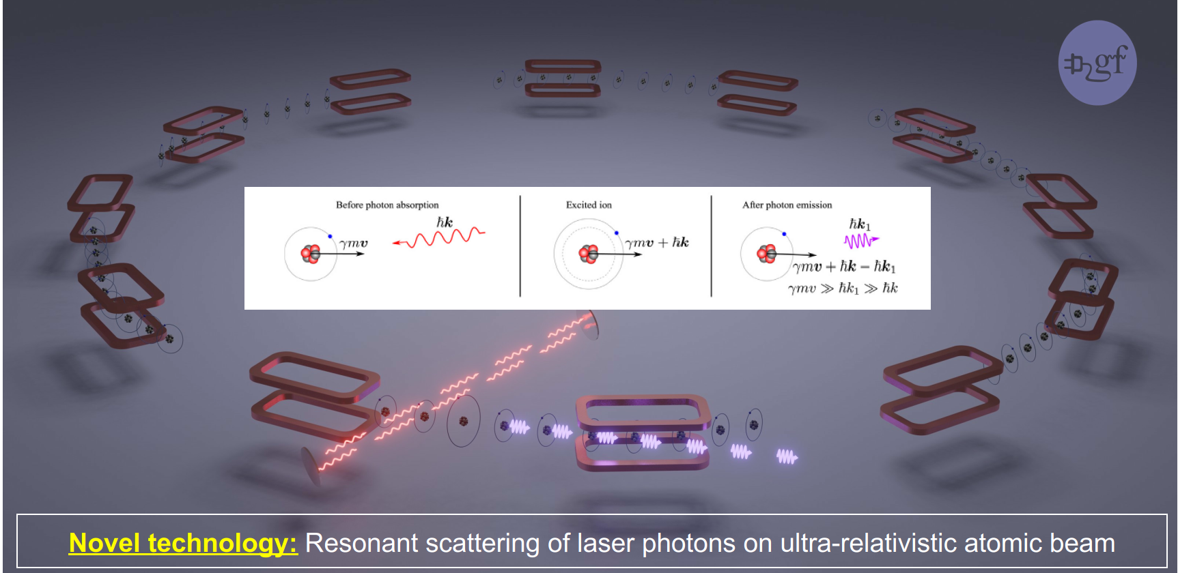

FCC-hh – Gamma Factory option
partially stripped heavy-ion (PSI) beam in FCC-hh:
high-stability laser-light-frequency converter
arXiv:1511.07794
proposed applications:
intense source of e⁺ (10¹⁶-10¹⁷/s) , π, μ etc
doppler laser cooling of high-energy beams
FCC w. laser-cooled isocalar ion beams
options: plasma target, plasma acceleration of secondary beams?

Slide 11
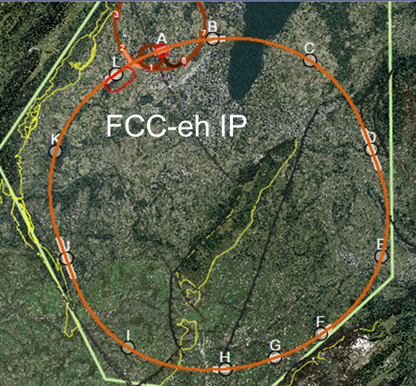
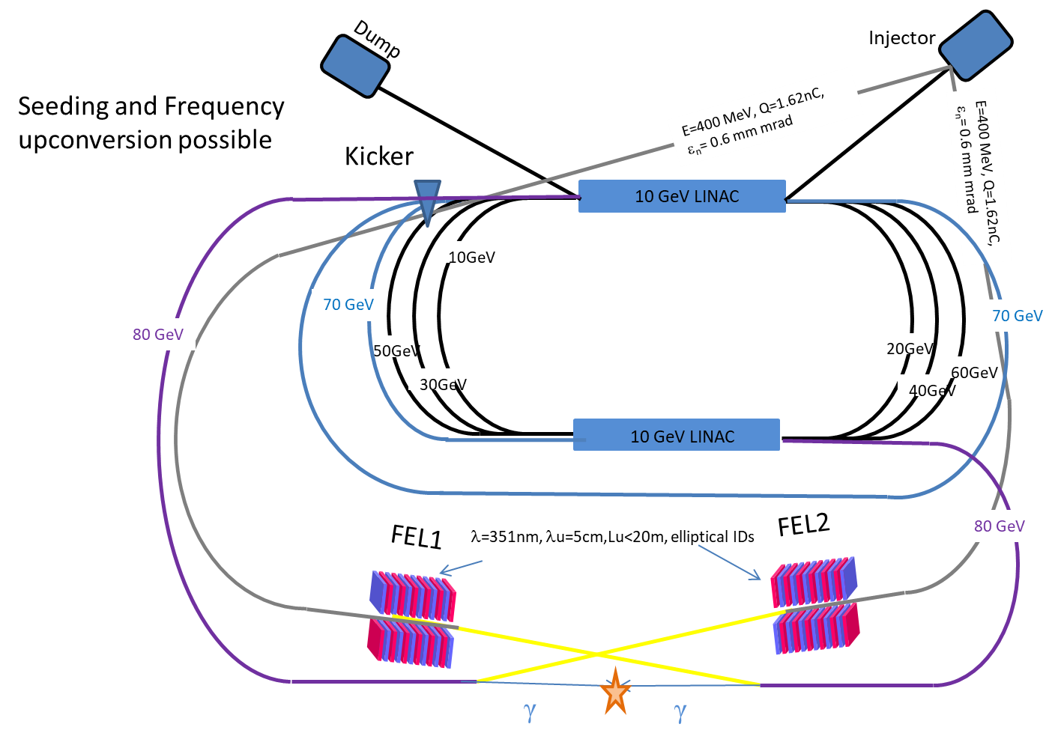
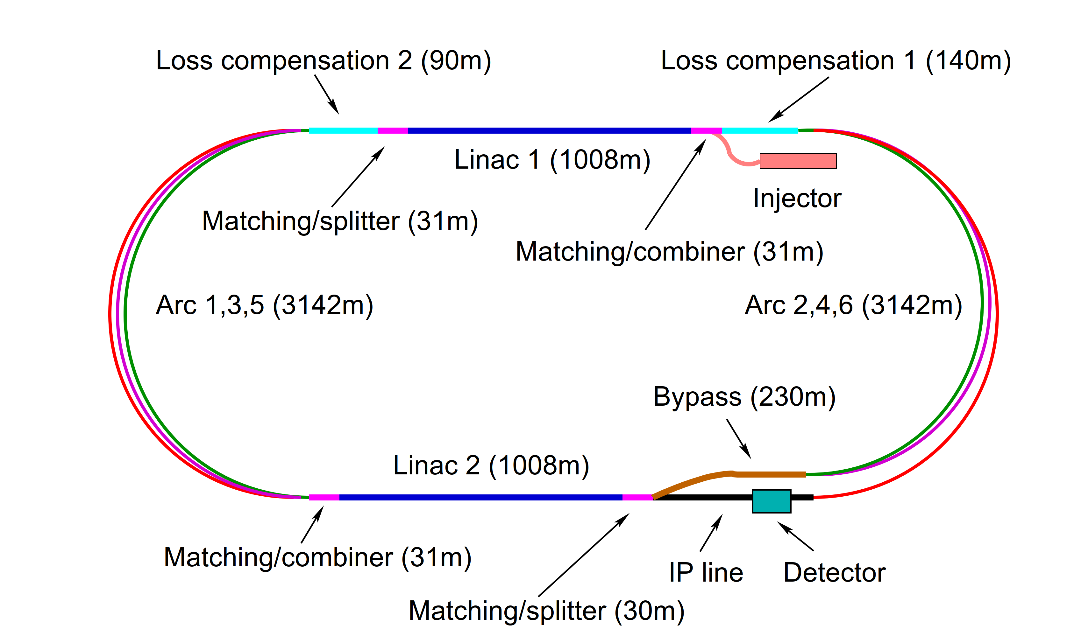
FCC-eh – lepton-hadron & γγ collider
option: replace 9 km ERL by plasma acc. of AWAKE type!
option: γγ collider based on lasers
arXiv:1208.2827
10.1140/epjc/s10052-016-4316-1
3-pass ERL
option: γγ collider based on FELs
Meseck,
ARIES Photon Beams
option: plasma lens
& plasma-based bunch compression

Slide 12
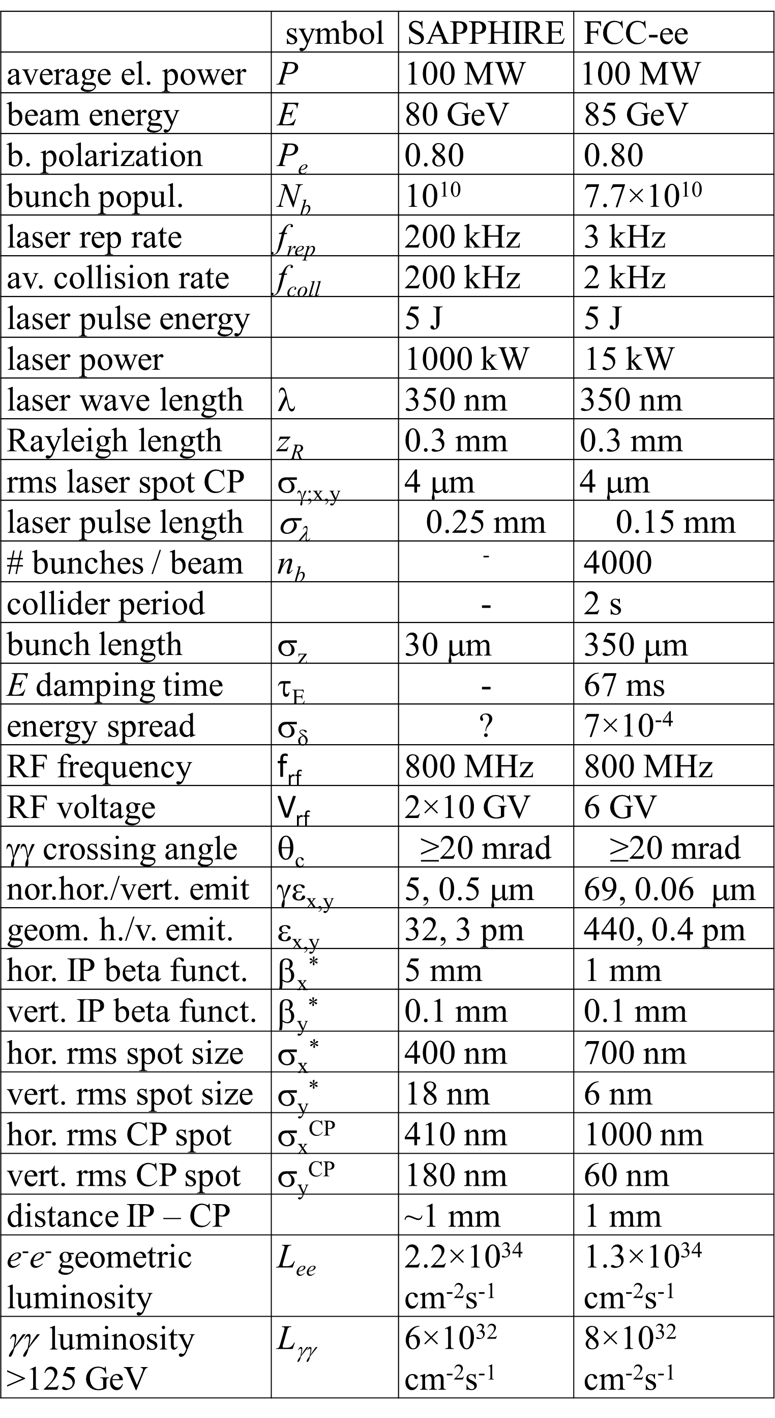
laser/FEL for FCC-eh Sapphire & FCC-ee γγ option

Slide 13

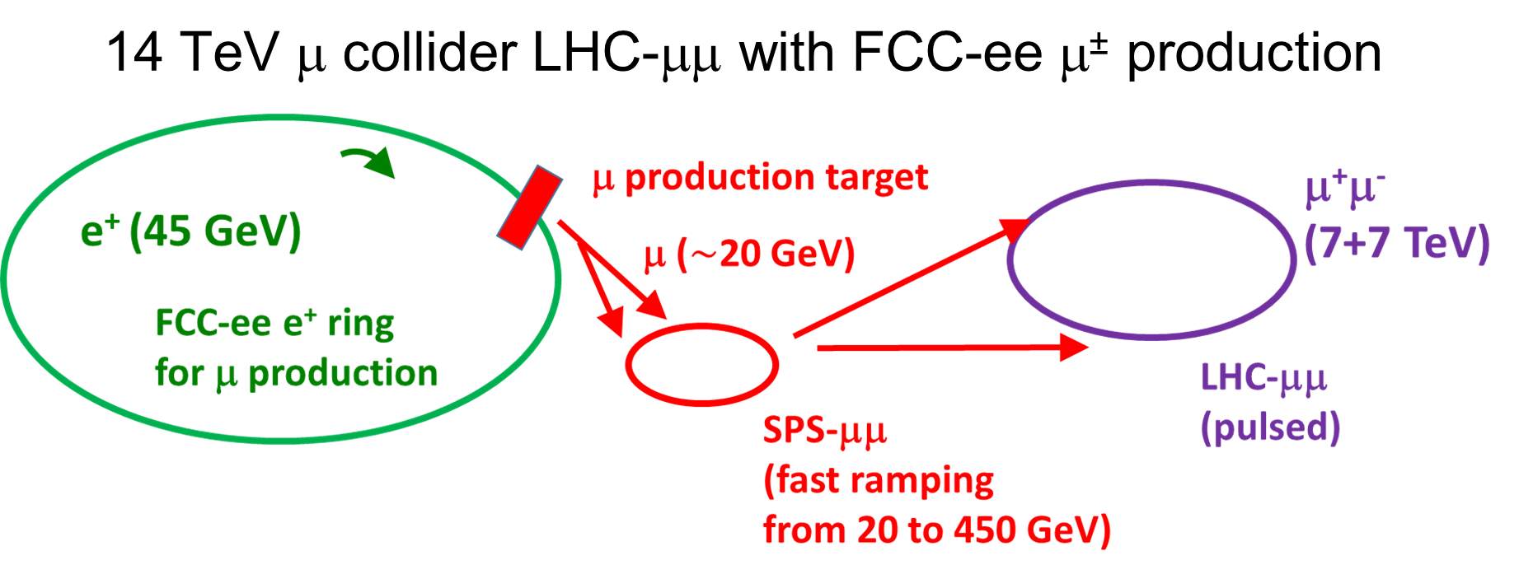
14 TeV μ collider based on FCC-ee & LHC
options: plasma acceleration
(e⁻ and e⁺!), or
dielectric or laser acceleration,
plasma lenses
IOP J. Phys.: Conf. Ser. 1067 022017

Slide 14
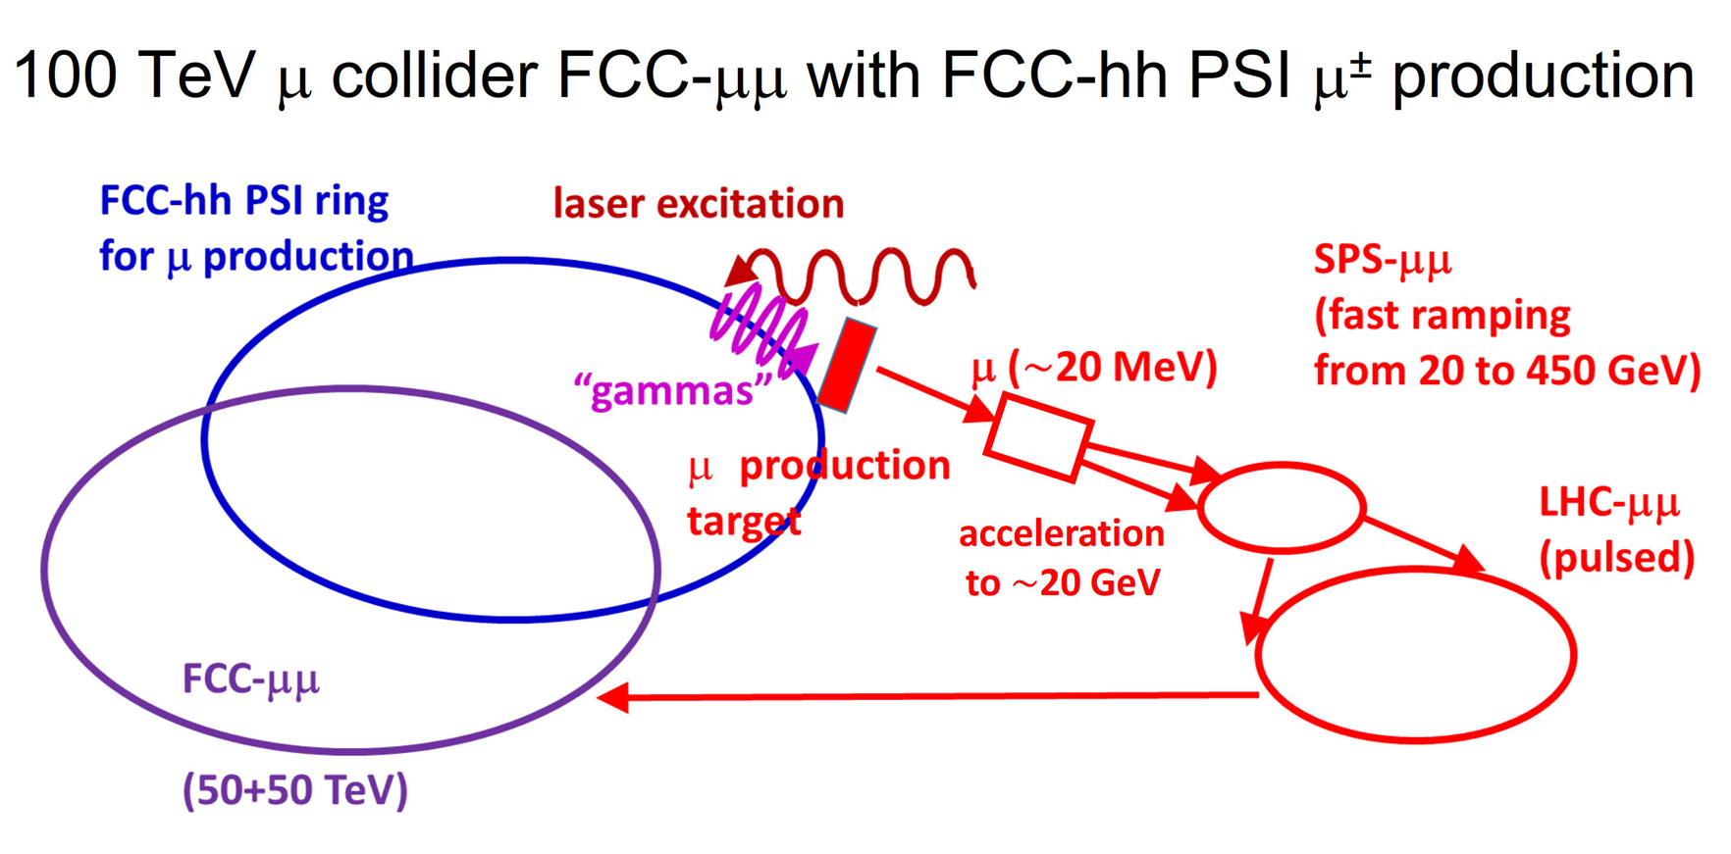
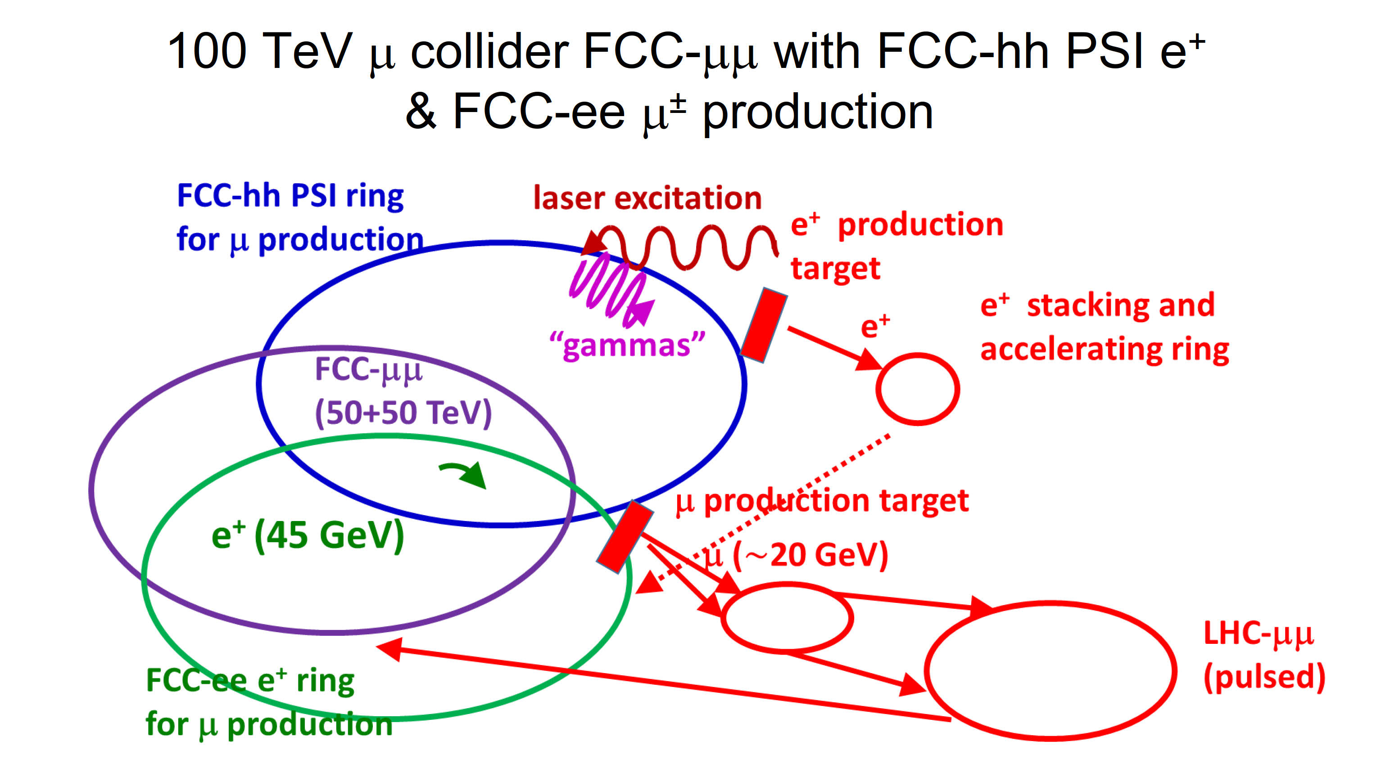
100 TeV μ collider based on FCC-ee & hh
IOP J. Phys.: Conf. Ser. 1067 022017
options: plasma acceleration
(e⁻ and e⁺!), or
dielectric or laser acceleration;
plasma lenses

Slide 15
the ultimate challenge
synchrotron radiation (SR)
FCC-ee: 100 MW SR power
FCC-hh: 5 MW SR power at cold → 100 MW cryo power
can we use crystals or plasma to shield and to suppress the photon emission ?

Slide 16
FCC – take home messages
FCC baseline is conservative and can be built based on existing technologies
however, the FCC collider complex offers enormous wealth of opportunities for applying advanced acceleration concepts to achieve better performance and/or greatly reduce cost
dedicated studies are needed - CEPC is pursing these…
“Make a small effort soon to investigate possibilities” (John Seeman, 2017)
we are counting on your help !

Slide 17
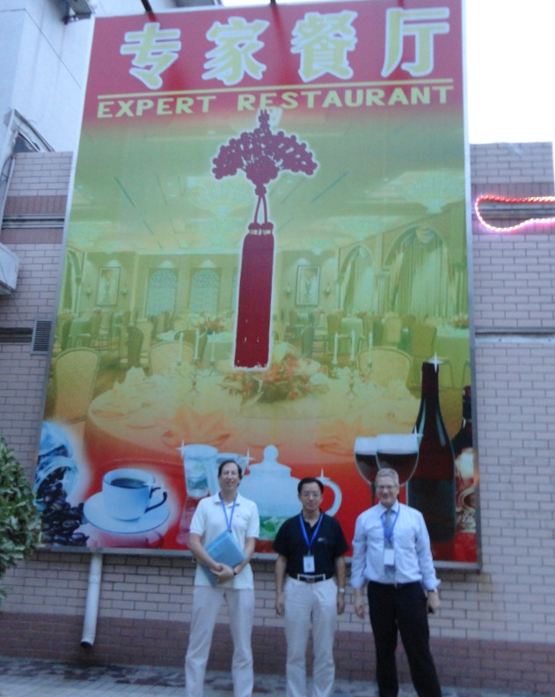
a pity that today’s expert panelists
cannot share a meal
in the “expert restaurant”
Frank
Zimmermann
thank you!
Mike
Koratzinos
Qing
Qin
2013

Slide 18
spare slides

Slide 19


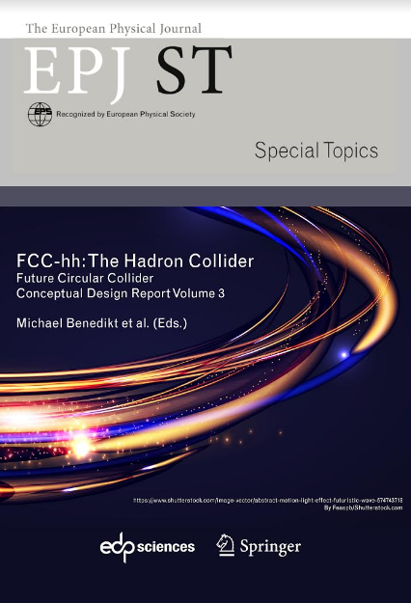

FCC CDR & Study Documentation
FCC-Conceptual Design Reports:
  Vol 1 Physics, Vol 2 FCC-ee, Vol 3 FCC-hh, Vol 4 HE-LHC
  CDRs published in European Physical Journal C (Vol 1) and ST (Vol 2 – 4) [Springer]
  EPJ C 79, 6 (2019) 474 , EPJ ST 228, 2 (2019) 261-623 ,
  EPJ ST 228, 4 (2019) 755-1107 , EPJ ST 228, 5 (2019) 1109-1382
EPJ is a merger and continuation of Acta Physica Hungarica, Anales de Fisica, Czechoslovak Journal of Physics, Fizika A, Il Nuovo Cimento, Journal de Physique, Portugaliae Physica and Zeitschrift für Physik. 25 European Physical Societies are represented in EPJ, including the DPG.
Summary documents provided to EPPSU SG
  FCC-integral, FCC-ee, FCC-hh, HE-LHC
  Accessible on http://fcc-cdr.web.cern.ch/
>1350 contributors from > 350 institutes,
a truly global effort as suggested by EPPSU 2013

Slide 20
Beneficiaries
H2020 DS FCC Innovation Study 2020-24
Partners
D.R.R.T. (F)
Etat de Geneve (CH)
DOE (US)
BINP (Ru)
U Oxford (UK)
Beneficiaries
recently accepted for funding by the European Commission with the highest achievable score
Design optimisation, construction planning, environmental impact assessment, management of
excavation materials, user community building and public engagement, socio-economic impact,…

Slide 21
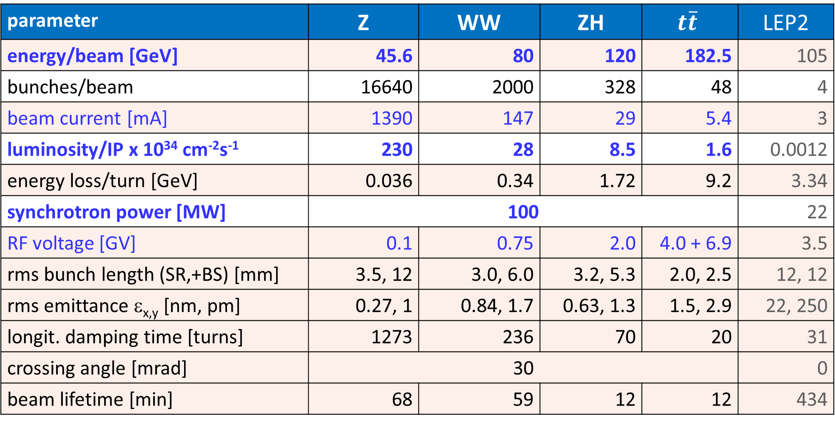
FCC-ee CDR baseline parameters
parameter | Z | WW | ZH | $$t\overline{t}$$ | LEP2
energy/beam [GeV] | 45.6 | 80 | 120 | 182.5 | 105
bunches/beam | 16640 | 2000 | 328 | 48 | 4
beam current [mA] | 1390 | 147 | 29 | 5.4 | 3
luminosity/IP x 10³⁴ cm⁻²s⁻¹ | 230 | 28 | 8.5 | 1.6 | 0.0012
energy loss/turn [GeV] | 0.036 | 0.34 | 1.72 | 9.2 | 3.34
synchrotron power [MW] | 100 |  |  |  | 22
RF voltage [GV] | 0.1 | 0.75 | 2.0 | 4.0 + 6.9 | 3.5
rms bunch length (SR,+BS) [mm] | 3.5, 12 | 3.0, 6.0 | 3.2, 5.3 | 2.0, 2.5 | 12, 12
rms emittance ε_{x,y} [nm, pm] | 0.27, 1 | 0.84, 1.7 | 0.63, 1.3 | 1.5, 2.9 | 22, 250
longit. damping time [turns] | 1273 | 236 | 70 | 20 | 31
crossing angle [mrad] | 30 |  |  |  | 0
beam lifetime [min] | 68 | 59 | 12 | 12 | 434

Slide 22
FCC-hh (pp) collider parameters
parameter | FCC-hh |  | HL-LHC | LHC
collision energy cms [TeV] | 100 |  | 14 | 14
dipole field [T] | 16 |  | 8.33 | 8.33
circumference [km] | 97.75 |  | 26.7 | 26.7
beam current [A] | 0.5 |  | 1.1 | 0.58
bunch intensity [10¹¹] | 1 | 1 | 2.2 | 1.15
bunch spacing [ns] | 25 | 25 | 25 | 25
synchr. rad. power / ring [kW] | 2400 |  | 7.3 | 3.6
SR power / length [W/m/ap.] | 28.4 |  | 0.33 | 0.17
long. emit. damping time [h] | 0.54 |  | 12.9 | 12.9
beta* [m] | 1.1 | 0.3 | 0.15 (min.) | 0.55
normalized emittance [mm] | 2.2 |  | 2.5 | 3.75
peak luminosity [10³⁴ cm⁻²s⁻¹] | 5 | 30 | 5 (lev.) | 1
events/bunch crossing | 170 | 1000 | 132 | 27
stored energy/beam [GJ] | 8.4 |  | 0.7 | 0.36

