Slide 1
Re-commissioning and changes of the LHC vacuum system
Machine Protection Panel Meeting (LHC), 26th March 2021
G. Pigny on behalf of TE-VSC

Slide 2
Outline
Overview of Vacuum activities during LS2
New vacuum sectorizations and interlock logic
Vacuum system testing and commissioning
  Commissioning in the LHC arcs and LSS Standalones
  Commissioning in the LHC LSSs beam vacuum
Summary and future actions

Slide 3
Vacuum activities overview during LS2

Slide 4
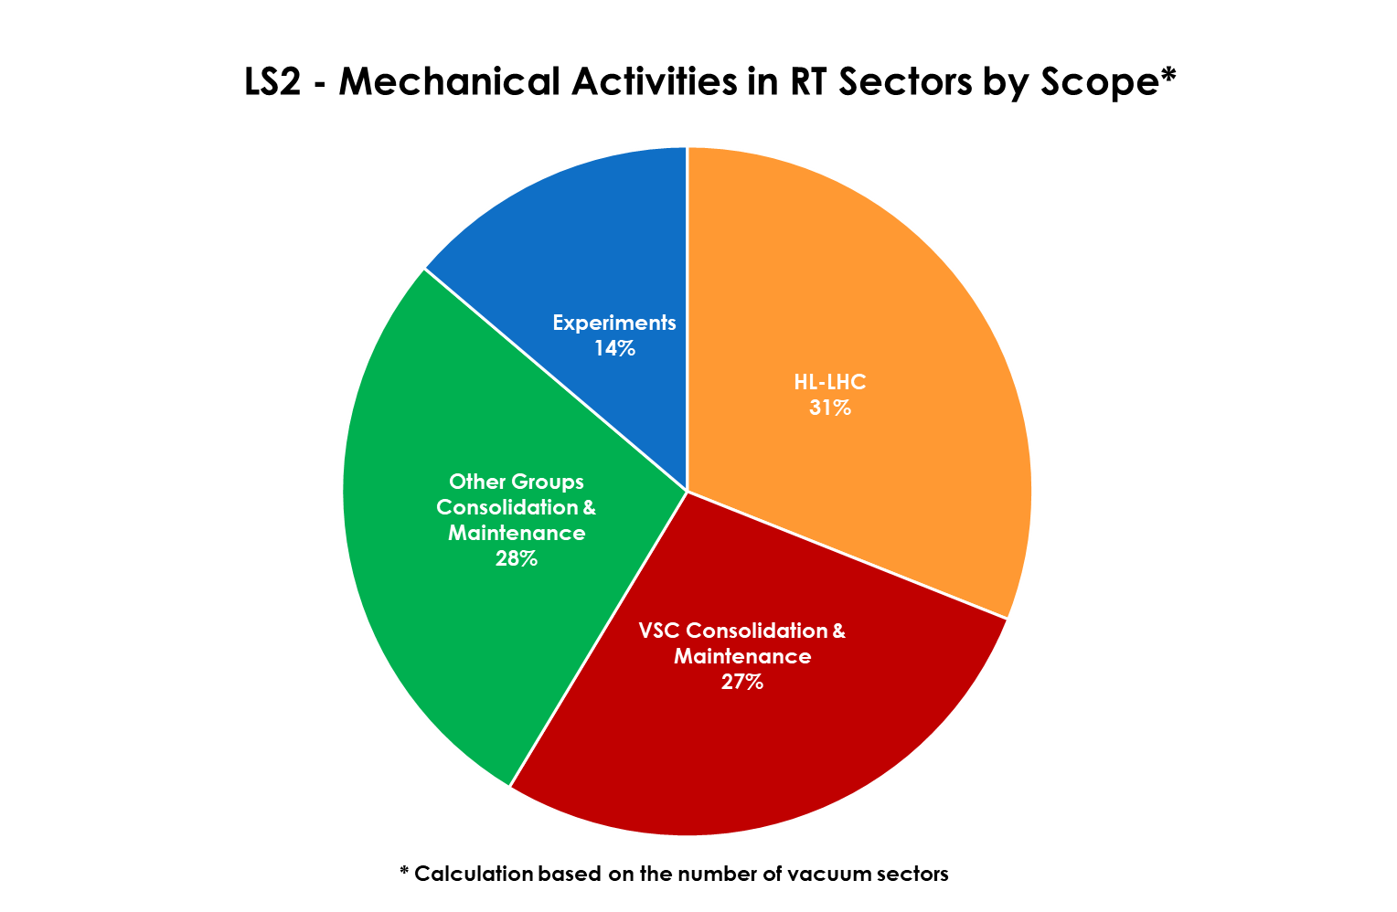
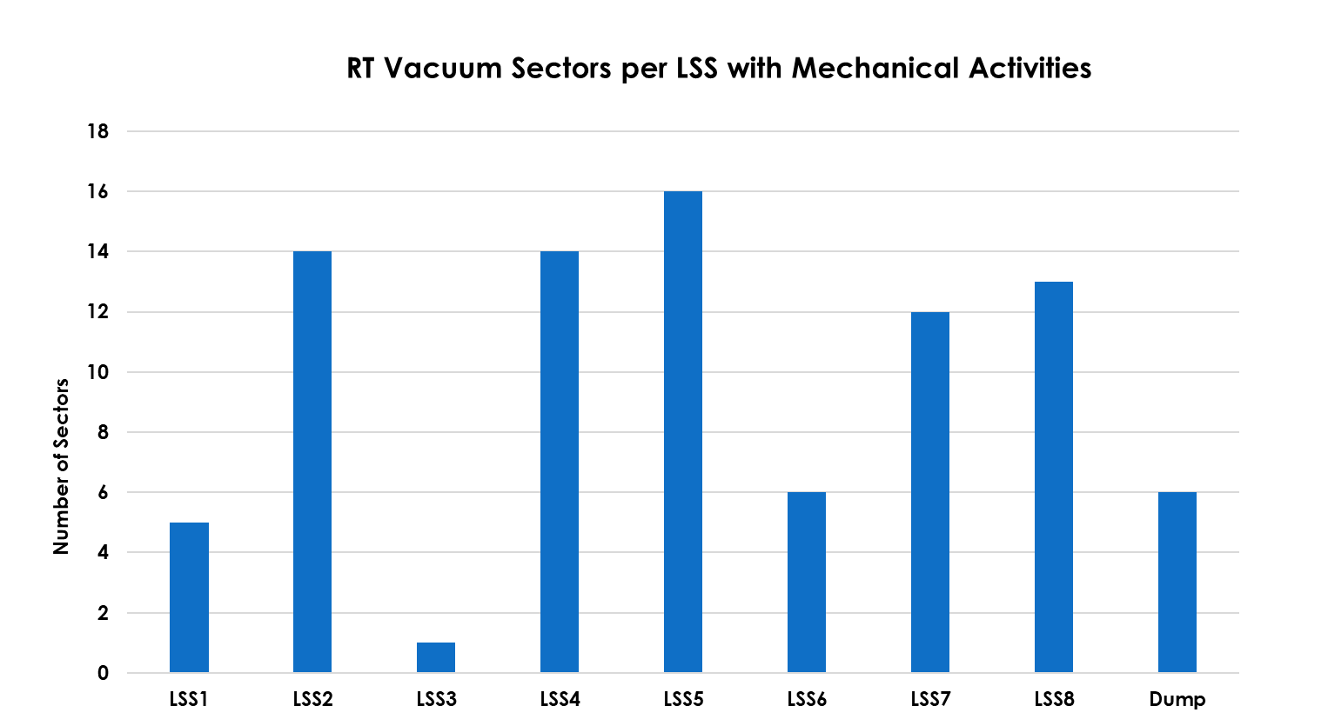
Overview of Room Temperature Tunnel Activities
In LS2 45% of RT vacuum sectors have been opened for mechanical activities (87 of 192) . These make up nearly 3km of beam vacuum!

Slide 5
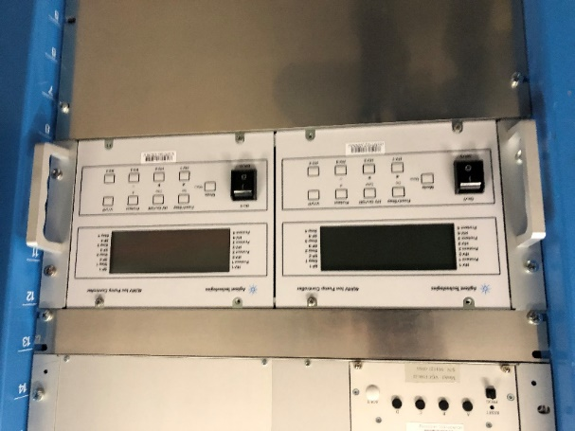
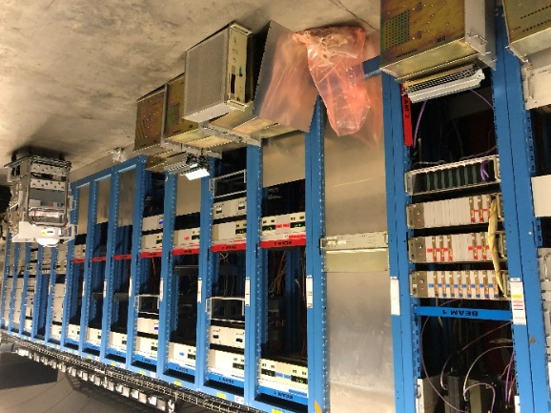
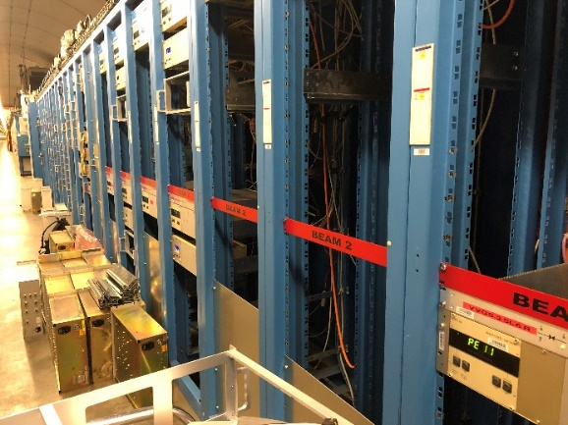
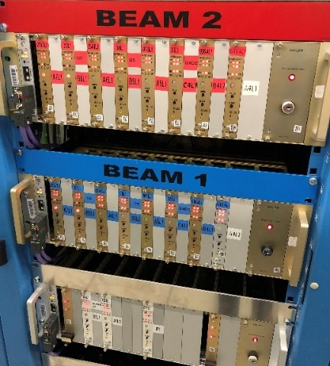
Racks consolidation and new controllers installation
160 racks mechanically re-arranged and consolidated (BV)
(all service areas)
200 new industrial ion pump controllers installed
  Most of the ion pump controllers interlocking the sector valves
  400 HV connectors modified
  400 interlock connectors modified

Slide 6
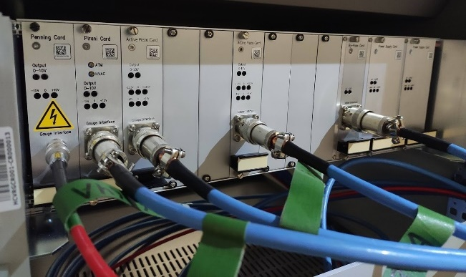
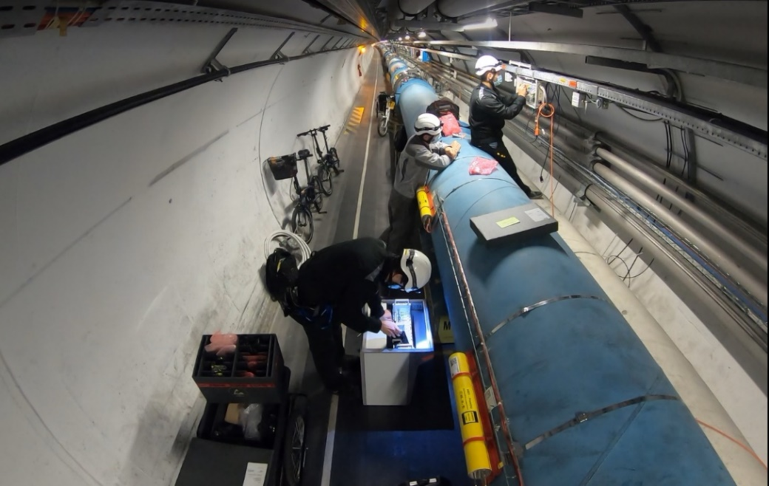
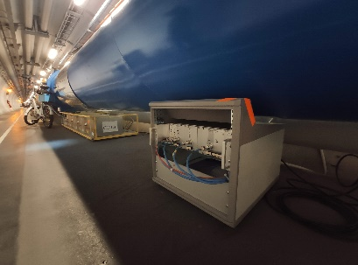
Racks consolidation and new controllers installation
Radiation tolerant electronics (gauges in DS areas)
  48 mini-racks and crates
  208 new electronic cards installation
  224 terminal electrical boxes modifications

Slide 7
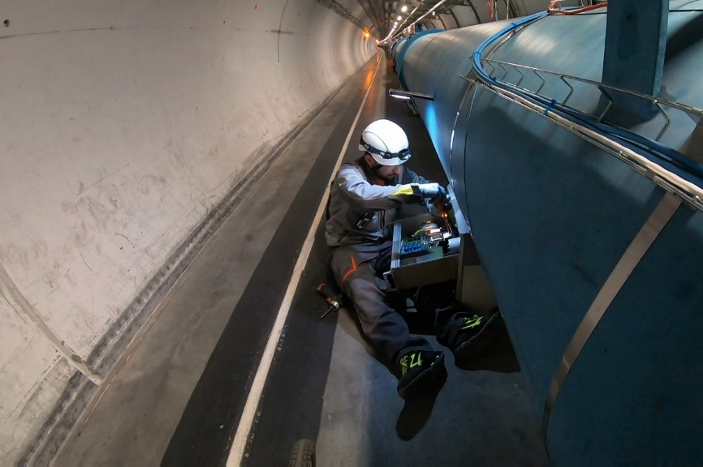
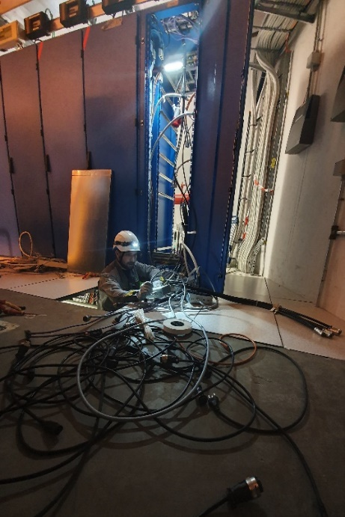
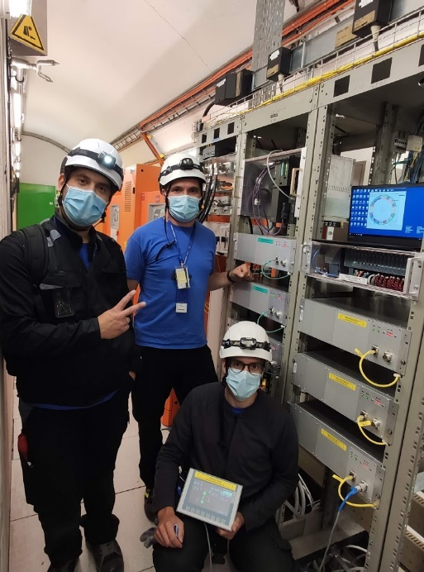
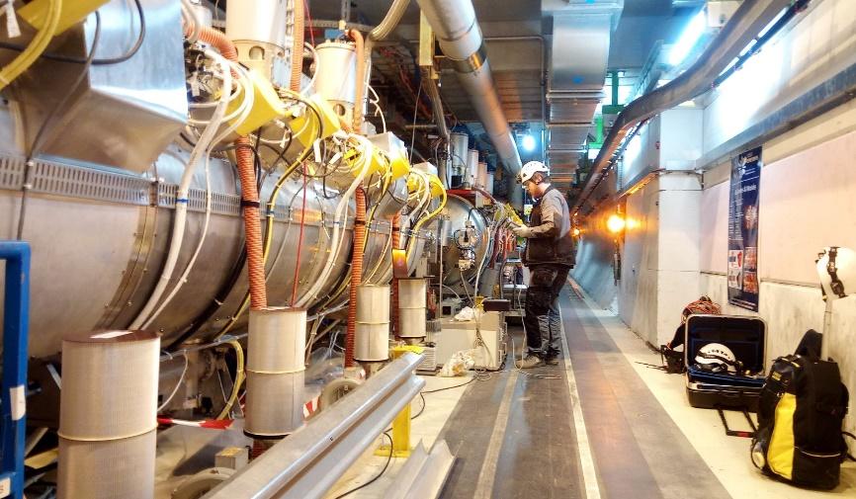
Racks consolidation and new controllers installation
Fixed pumping group controllers (IV)
  240 new PLC crates
  74 new local crates production and installation
  132 existing local crates modifications
  80 racks re-arranged

Slide 8
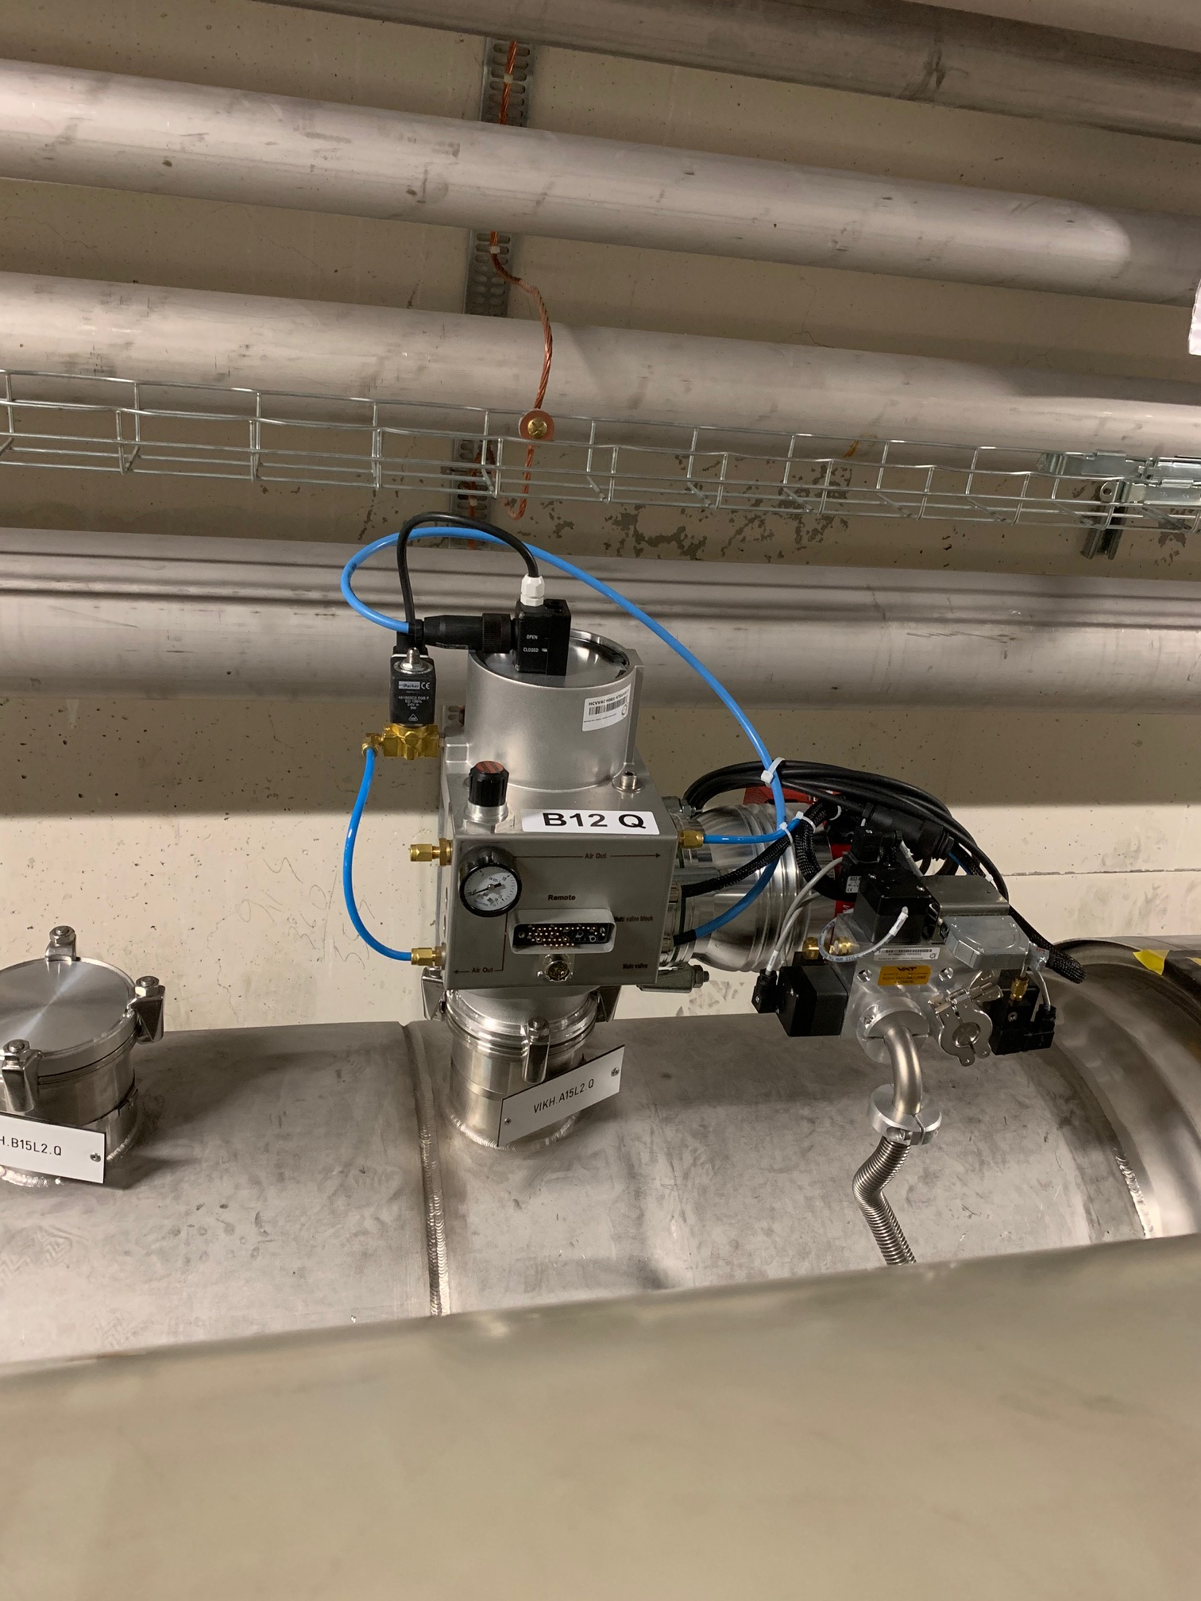
Pumping groups consolidation/maintenance (IV)
Standalones magnets (LSS)
  Consolidation of 70 turbo pumping groups
Inner Triplets
  Installation of 5 additional pumping groups
Arc S12
  Consolidation of all (12) fixed turbo pumping groups
B12.Q
  Installation of 2 additional pumping groups to increase pumping capacity around a known internal leak
Preventive Maintenance
  ~60 turbo pumps exchanged
  All the primary pumps

Slide 9
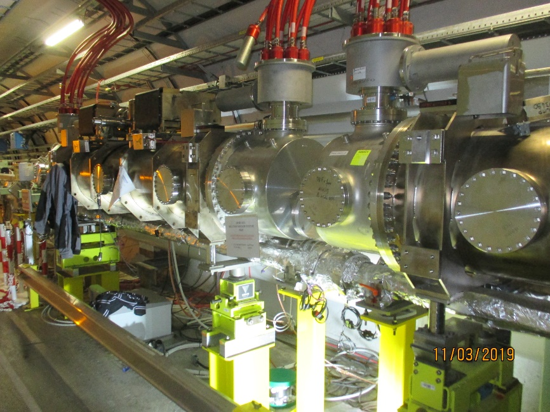
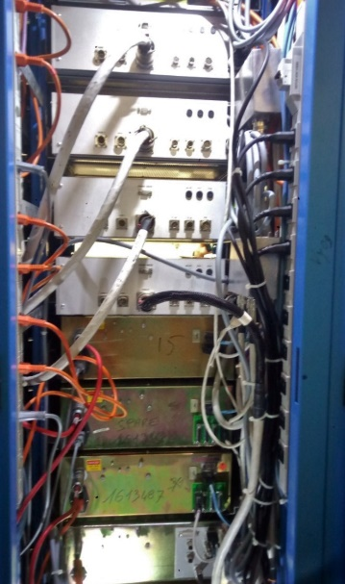
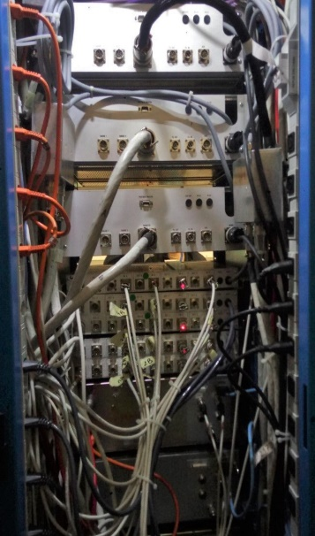
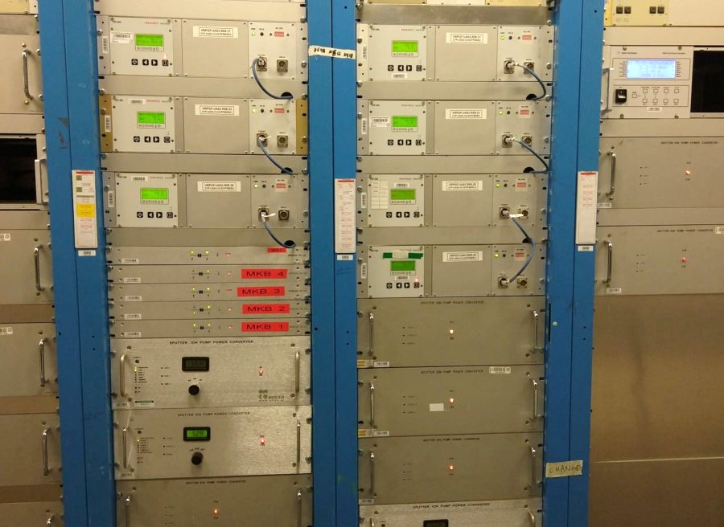
Dump lines TD62 and TD68
Additional fixed pumping groups on MKB tanks 1 & 5
New fixed pumping group controllers installed
MKB vacuum racks re-arrangement

Slide 10
New vacuum sectorizations and interlock logic

Slide 11
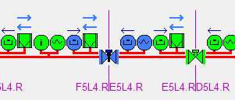
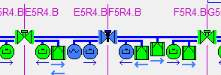
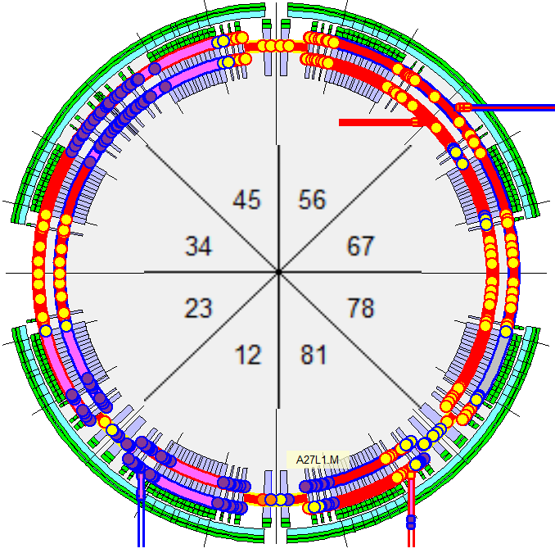
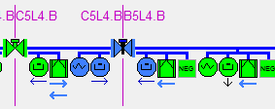
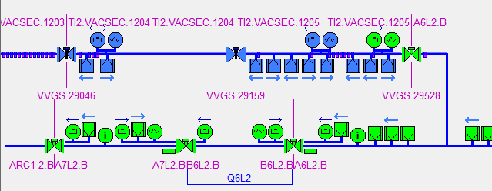
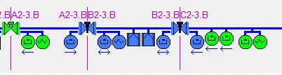
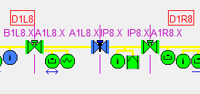
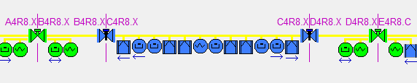
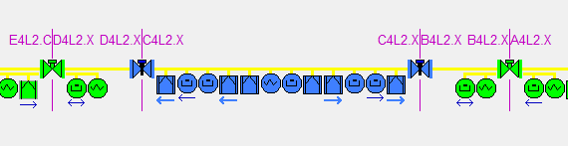
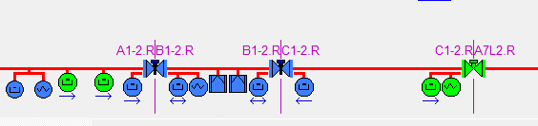
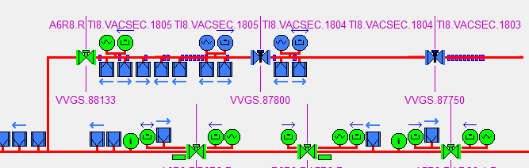
Overview of new LHC vacuum sectors during LS2
BWS E5L4.R, F5L4.R
BWS E5R4.B, F5R4.B
BGC C5L4.B, B5L4.B
LSS4
ARC23
LSS8
TI2 1203, 1204, 1205
TCLD B2-3.B
New valve A1L8.X, IP8.X
TDIS B4R8.X, C4R8.X, D4R8.X
ARC12
LSS2
TDIS D4L2.X, C4L2.X, B4L2.X
TCLD B1-2.R
TI8 1805, 1804, 1803

Slide 12
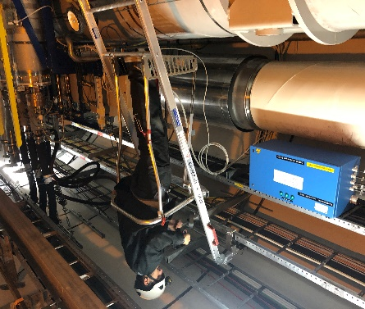
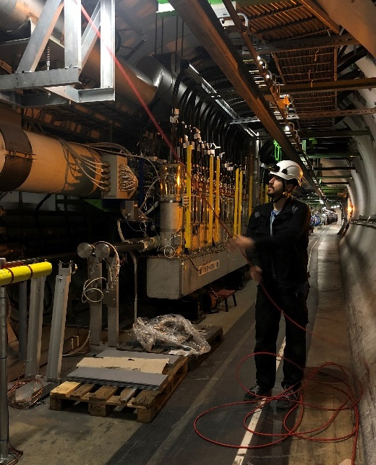
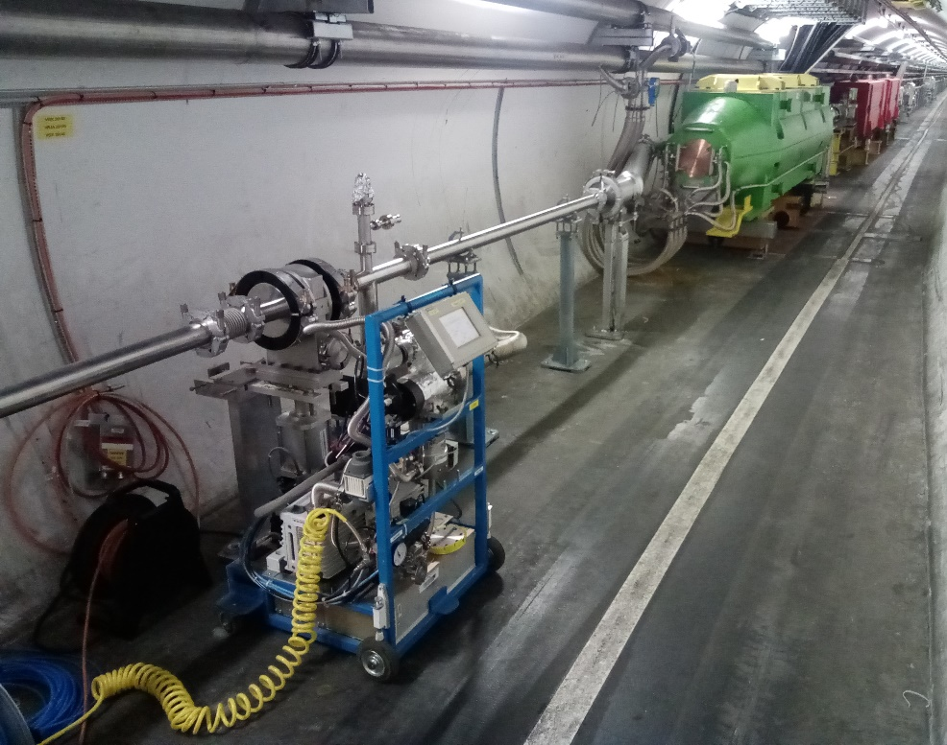
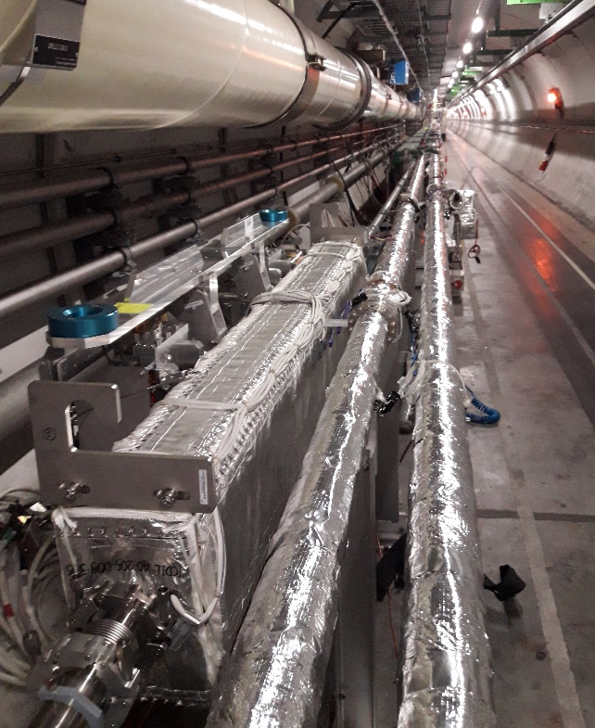
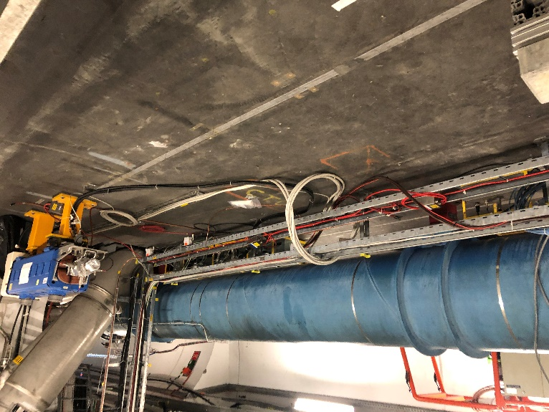
TI2 and TI8
New sectorization of the TED
New collimators on LHC side
New Ion pumps and gauges as interlock sources
Interlock cables between SPS and LHC

Slide 13
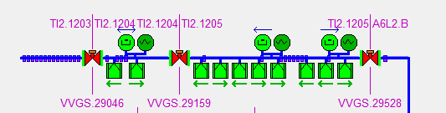
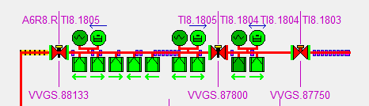
TI2 and TI8
TI2
TI2/TI8
  First 3 valves (from LHC side) are controlled from LHC
  Interlock sources of the 2 first sector valves are fully controlled from LHC
  Interlock sources of the third sector valve are provided by LHC (LHC side) and by SPS (SPS side)
  The status of third valve is transmitted to the SPS BIC to enable the injection.
SPS
TED
LHC
TI8
SPS
TED
LHC

Slide 14
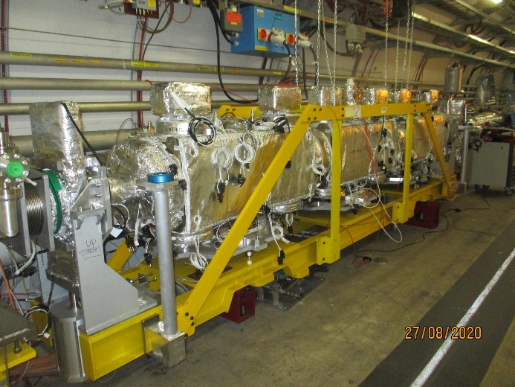
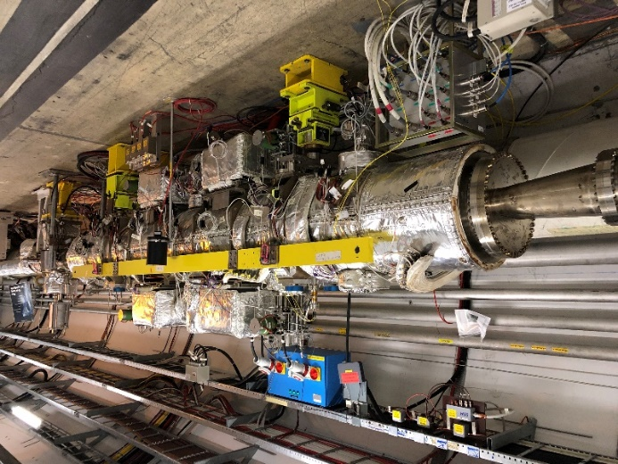
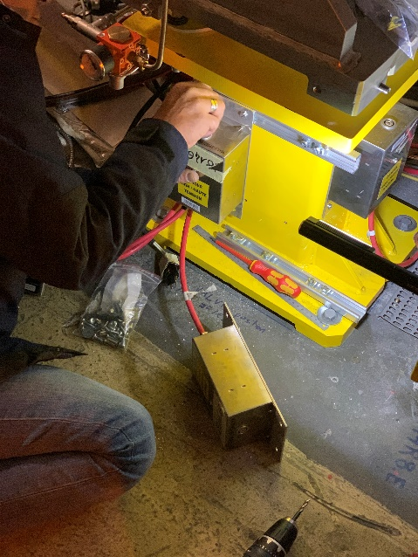
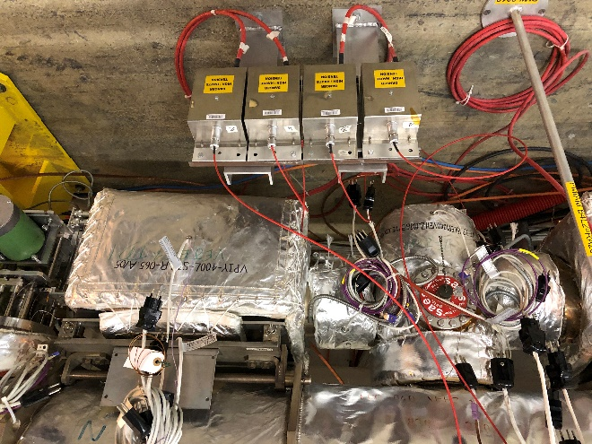
TDIS
TDI removal and de-cabling
TDIS baked-out at the surface
Installation of the new TDIS
  Layout modification, 2 new sectors
  New interlock sources and controllers

Slide 15
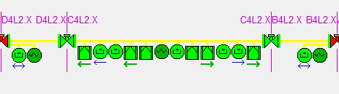
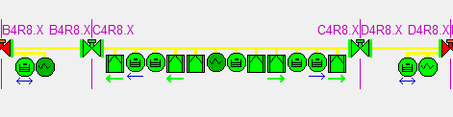
TDIS
TDIS LSS2
Short sectors D4L2.X, B4L2.X and B4R8.X, D4R8.X
Only one Penning gauge
3 interlocking devices for the TDIS adjacent sector valves
Close if 2 out of 3 > 2.10⁻⁶ mbar
Closes previous and next sector valves in case of pressure interlock
1
2
3
1
2
3
TDIS LSS8
1
2
3
1
2
3

Slide 16
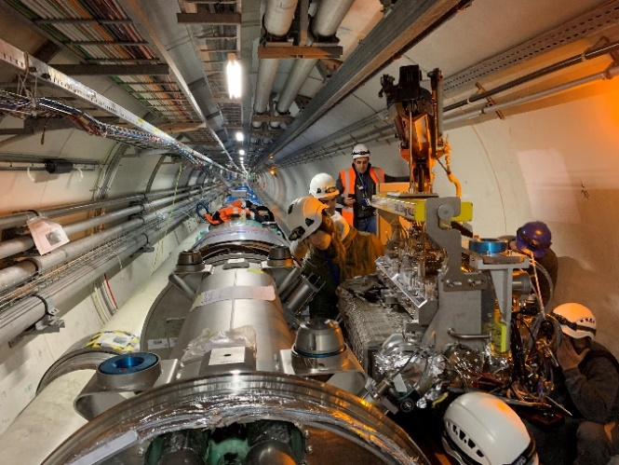
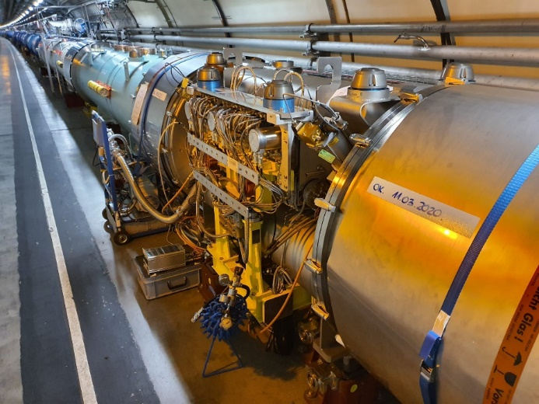
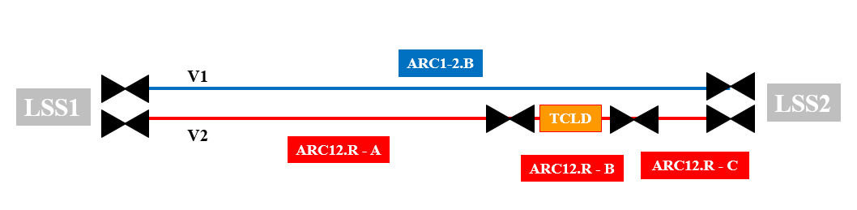
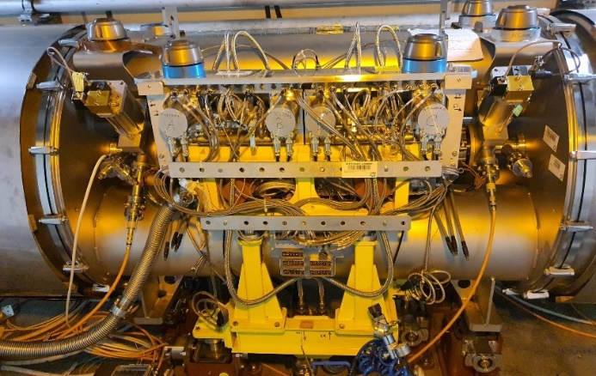

TCLD
New arc sectorization
Controls integration and cabling in UA23 and UA27
Specific interlock configuration in arc12 and 23
ARC12
ARC23

Slide 17
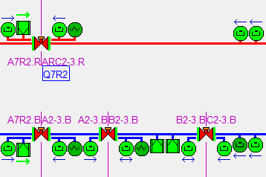
New TCLD vacuum valves interlock logic (ARC)
Example of right side of LSS2 (arc23)
Same logic for the red beam
Different logic for the blue beam due to the TCLD sectorization
VVGS1 in Q7R2
VVGS2 and 3 in Q11R2
VVGS0 previous valve LSS2
VVGS4 next valve in Q7L3
VVGS0 (LSS2)
VVGS1
VVGS2
VVGS3
VVGS4
(LSS3)
1
2
3
4
5
6
7
Q12
Q13
TCLD ARC23

Slide 18
New TCLD vacuum valves interlock logic (ARC)
VVGS1 interlock sources:
  N = 3 devices (1, 2, 3)
  VGP in Q12, Q13
  VVGS0 pressure interlock
  VVGS2 pressure interlock
VVGS1 pressure interlock:
  N-1 devices > 2.10⁻⁶ mbar
  OR Q12 AND Q13 > 2.10⁻⁶ mbar
Closes previous (VVGS0) and next (VVGS2) sector valves in case of pressure interlock
VVGS0 (LSS2)
VVGS1
VVGS2
VVGS3
VVGS4
(LSS3)
1
2
3
4
5
6
7
Q12
Q13
TCLD ARC23

Slide 19
New TCLD vacuum valves interlock logic (ARC)
VVGS2 interlock sources
  N = 3 devices (4, 5, 6)
  VGP in Q12, Q13
  VVGS1 pressure interlock
  VVGS3 pressure interlock
VVGS2 pressure interlock:
  N-1 devices > 2.10⁻⁶ mbar
  OR Q12 AND Q13 > 2.10⁻⁶ mbar
Closes previous (VVGS1) and next (VVGS3) sector valves in case of pressure interlock
VVGS0 (LSS2)
VVGS1
VVGS2
VVGS3
VVGS4
(LSS3)
1
2
3
4
5
6
7
Q12
Q13
TCLD ARC23

Slide 20
New TCLD vacuum valves interlock logic (ARC)
VVGS3 interlock sources
  N = 3 devices (5, 6, 7)
  VGP in Q12, Q13
  VVGS2 pressure interlock
  VVGS4 pressure interlock
VVGS3 pressure interlock:
  N-1 devices > 2.10⁻⁶ mbar
  OR Q12 AND Q13 > 2.10⁻⁶ mbar
Closes previous (VVGS2) and next (VVGS4) sector valves in case of pressure interlock
VVGS0 (LSS2)
VVGS1
VVGS2
VVGS3
VVGS4(LSS3)
1
2
3
4
5
6
7
Q12
Q13
TCLD ARC23

Slide 21
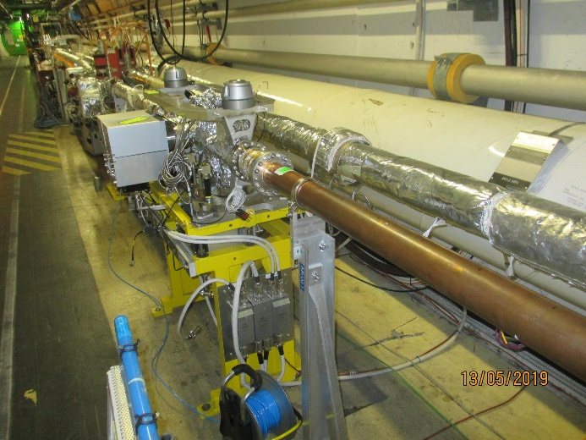
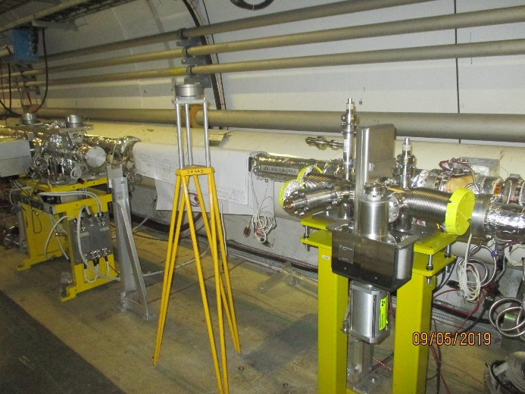
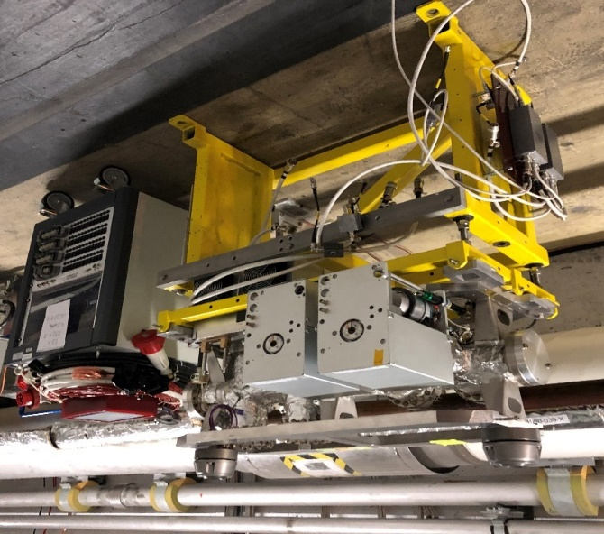


Beam Wire Scanner (BWS)
2 new sectors for the BWS in C5L4 and C5R4
Avoid to vent the 37m vacuum sector for each BWS intervention
New configuration in C5L4
New configuration in C5R4

Slide 22


Beam Wire Scanner (BWS)
BWS F5L4.R, E5L4.R
Standard 4 interlocking devices (2 Pennings, 2 Ion Pumps)
Closes if 3 out 4 are > 2.10⁻⁶ mbar
Closes the previous and next sector valves in case of pressure interlock
BWS E5R4.B, F5R4.B

Slide 23



Beam Gas Curtain (BGC)
One new sector for the Beam Gas Curtain installation (phase 1)
Existing gas injection system moved from E5L4 to C5L4
BGC Phase 1 with gas injection system

Slide 24

Beam Gas Curtain (BGC)
BGC C5L4.B, B5L4.B
Standard 4 interlocking devices (2 Pennings, 2 Ion Pumps)
Closes if 3 out 4 are > 2.10⁻⁶ mbar
Closes the previous and next sector valves in case of pressure interlock

Slide 25

Additional vacuum sector upstream of the VELO detector
Allow the installation of experimental equipment during YETS of RUN3 without the need for venting the IP8.X sector (including VELO)
Manual valve (not interlocked)
Open enable given by previous Penning gauge and next Ion pump
Valve status monitored, included in the BIS

Slide 26



VELO
Completely new Control System for the VELO Vacuum System
Major focus on safety, reliability, and user experience enhancements
μm thick aluminium foils: keep differential pressure < 10mbar between beam and detector volumes

Slide 27
Vacuum system testing and commissioning

Slide 28
Vacuum system testing and commissioning
5 teams for LSS Beam Vacuum
  Gauges
  NEG cartridges
  Ion Pumps and sublimators
  Sector valves, interlocks and alarms
  Vacuum instrumentation in the experiments
2 teams for Beam and insulation vacuum in the arcs + insulation vacuum in the LSSs:
  Fixed pumping groups
  Gauges
  By-pass valves
  Cryogenics alarms
  Test procedure for each instrument type described in EDMS 1405440

Slide 29

Commissioning in the LHC arcs and LSS Standalones
Commissioning planning & cooperation with LHC coordination team, TE-VSC activities and cryogenics group
Fixed pumping groups testing and commissioning before Pressure Tests
BV + IV Gauges testing and commissioning before each cool-down
Finished in December 20 with S23
Started in June 20 with S45

Slide 30



Commissioning in the LHC arcs and LSS Standalones
Fixed pumping groups tests and commissioning
  primary & turbo pump, valves, gauges & automation process (206 VPGs)
Official validation with Cryogenics Group (400 alarms)
  EDMS 2432078 : cool-down permit and test results
  EDMS 2378513 : procedure

Slide 31
Commissioning in the LHC LSSs beam vacuum
All vacuum sectors are under vacuum except:
  ATLAS: A1L1.X, IP1.X and A1R1.X
    Temporary re-installation and pump down (without bake-out) for the pilot beam
    Possibility to test and actuate the valves ~1 week before the pilot beam
    Bake-out foreseen in January 2022
  ALICE: B1L2.X, A1L2.X, IP2.X and A1R2
    Bake-out foreseen in June 2021 (W24 and W25)
  CMS: A1L5.X, IP5.X and A1R5.X
    Bake-out foreseen in May 2021
  LHCb: A1L8.X, IP8.X, A1R8.X
    Temporary re-installation and pump down (without bake-out) for the pilot beam
    Possibility to test and actuate the valves ~1 week before the pilot beam
    No date approved yet for the Bake-out
  CTD62 which is under pump-down after the new window installation
  Sector 67: warmed-up. Cool-down foreseen in April-May 2021. Already tested before the first cool-down.

Slide 32


Commissioning in the LHC LSSs beam vacuum
On-going activities March 2020. Completion foreseen end of March
Started in December 2020

Slide 33
Commissioning in the LHC LSSs beam vacuum
Experiments excluded
Sector valves not actuated yet. Only the commands and interlocks have been tested (with simulators). Will be checked after the cool-down of S67.

Slide 34
Summary and future actions
The LHC vacuum controls system testing and re-commissioning is almost finished
Vacuum instrumentations of the experiments have not been tested:
  ALICE and CMS will be tested respectively in June and May 2021
  ATLAS and LHCb will be tested only one week before the pilot test beam
User alarms have been checked only for MKIs (and cryogenics system)
  Remains ADT, ACS, MKB
Considering the amount of modifications in the vacuum racks performed during LS2, a full validation of the vacuum user permits must be performed in every points
  The planning is not defined yet
The automatic test script following the MPS commissioning procedure described in EDMS 896391 has to be updated to take into account all the modifications (new sectorizations, interlocks and controllers)
The machine checkout (vacuum) for the pilot beam is foreseen to start W37 (agreed with J. Wenninger)

Slide 35
Thank you for your attention

