Slide 1
Cooling R&D needs for future detectors
ECFA-WG8, 31 March 2021
Bart Verlaat, CERN

Slide 2
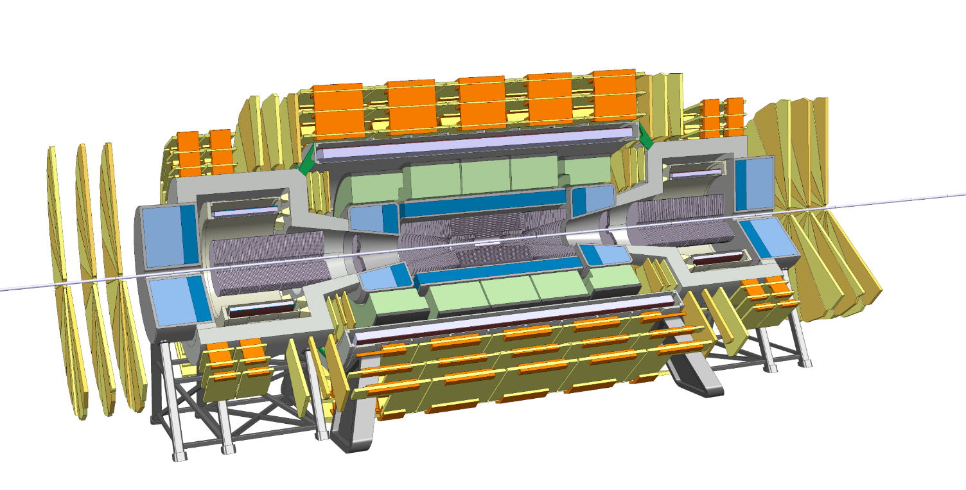
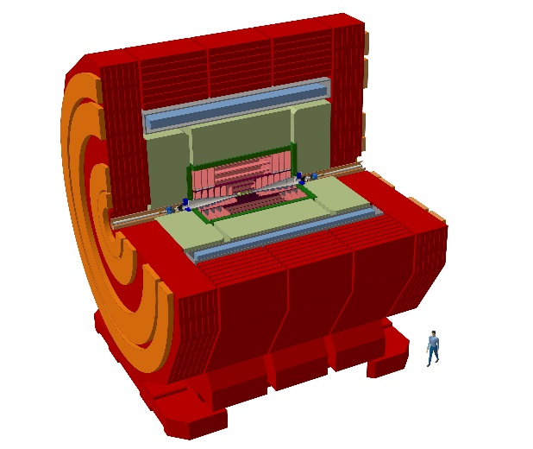

What are the cooling need trends for future?
Cooling demand input was given in the 2 input sessions
  https://indico.cern.ch/event/994685/
  https://indico.cern.ch/event/994687/
Global tendency for future cooling needs:
  Lepton-Lepton, Lepton-Hadron and Ion colliders all seems to have in common a warm temperature domain and relatively low heat load densities.
  Hadron-Hadron colliders, have the tendency for a colder cooling at increased power densities.
  Other presented experiments did not show extreme cooling demands requiring special long term R&D, exceptions to this statement are:
    Silicon Photomultiplier detectors are considered as technology in many detectors and require very cold temperatures
    The AMBER detector is considering a cryogenic tracker with temperatures below 1.8K
FCChh, HE-LHC,…
CLIC, FCCee, ILC, CEPC,…
hh collisions e⁺e⁻ collisions
  High radiation dose (~ 100 MGy/10years)
  Very high integrated dissipated power
  Low temperature
  Unprecedented spatial resolution (1-5 µm point resolution)
  Low dissipated power (<50mW/cm²)
  Room temperature
  Low material budget

Slide 3
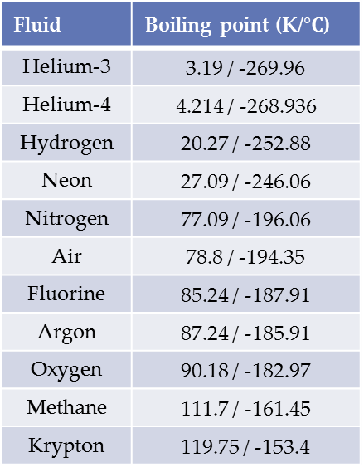
Cooling & Refrigeration versus Cryogenics
There are many differences in the definition and application of cooling versus cryogenics. For the future we are approaching the intermediate space requiring long term R&D.
Cryogenics is often declared as temperatures below 120K / -153°C being referenced to liquid Krypton at atmospheric pressures
The “Standard” Cooling / Refrigeration domain is above -60°C. Limited choice of industrial applications are present for colder temperatures, without using cryogenic technologies.
Another very important difference between refrigeration and cryogenics:
  Refrigeration has the goal is to remove large heat numbers at medium low temperatures using pressurized gasses in piping systems
  Cryogenics has the goal to make very cold temperatures at reduced heat numbers often around atmospheric pressure systems in pool boiling cryostats.
The widely used CO₂ cooling for detectors has an application range of 20°C / -40°C
For future detector cooling we need to explore the unknown intermediate space (-150°C /-40°C) approaching cryogenic temperatures with relative large heat loads to cool.
  With 1 very challenging application: The AMBER experiment, <1.8 K with 10Watt dissipation!
Fluid | Boiling point (K/$°C$)
Helium-3 | 3.19 / -269.96
Helium-4 | 4.214 / -268.936
Hydrogen | 20.27 / -252.88
Neon | 27.09 / -246.06
Nitrogen | 77.09 / -196.06
Air | 78.8 / -194.35
Fluorine | 85.24 / -187.91
Argon | 87.24 / -185.91
Oxygen | 90.18 / -182.97
Methane | 111.7 / -161.45
Krypton | 119.75 / -153.4

Slide 4
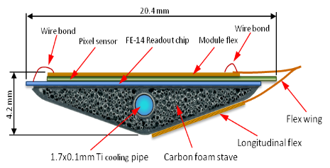
Detector cooling explained
To keep the detectors cold and away from thermal runaway, 2 things are important:
  The cooling fluid low temperature
  The Thermal Figure of Merit (cm²*K/W),
    TFoM = The thermal resistance from source to sink (sensor to cooling)
    TFoM: A thermal resistance chain including: material conductance, interface resistance, fluid heat transfer coefficient and pressure drop (2-phase systems) or caloric heating (Single phase systems)
  As the gradients are heat load depended a higher TFoM requires a colder fluid temperature. The relation is non-linear (An accelerating cold temperature is needed at a worse TFoM)
The selection of the TFoM and hence cooling temperature is a mass saving optimization
TFoM and cooling temperature
Cooling system gradients

Slide 5
Cooling fluid choices
A good method to compare different fluids at different operational temperatures is to plot the optimal pipe volume per achieved conductance (Volumetric heat transfer in W/cm³K).
The volumetric heat transfer takes the losses by pressure drop and convective heat transfer into account
This approach shows that the closer you are to the critical point, the better the performance
Tip @ critical point
High heat load density cooling (>0.3 W/cm²)
  A fluid with a high volumetric heat transfer is needed to maintain a low contribution to the TFoM.
  Preferred choice is 2-phase evaporative cooling, with relative high pressure
Low heat load density cooling (<0.3 W/cm²)
  Volumetric heat transfer less of an issue, more fluids can be considered for practical reasons
  Single phase and air cooling can be considered
Extended domain for warm cooling applications
Extended domain for SiPM operation
Extended domain for LHC/FCC experiments
Active development domain (CO₂)
CO₂
N₂O
Oxygen
Ethane
Methane
Ethylene
R23
Argon
Ammonia
Nitrogen
Krypton
CF₄
Xenon
C₂F₆
C₃F₈

Slide 6
System Cycles
2PACL cycle
Good heat transfer due to low vapor quality
Limited cold use due to liquid freezing (>-40°C)
Cold transfer lines
2PACL method:
(LHCb, ATLAS, CMS)
Pumped liquid system, cooled externally
Compressor
Pump
Liquid
Chiller
Liquid circulation
Cold transfer
Gas
Freezing line
Cooling plant
Detector
Pressure
L+G
S+L
Refrigeration method:
(CO₂ primary / Atlas ID)
Vapor compression system
S+G
Sublimation line
Compressor
Warm transfer
Enthalpy
Vapor compression cycle
Reduced heat transfer due to high vapor quality
Can run colder than 2PACL (-53°C)
Can have warm transfer lines (Integration benefit)
Heatexchanger
Cooling plant
Detector

Slide 7
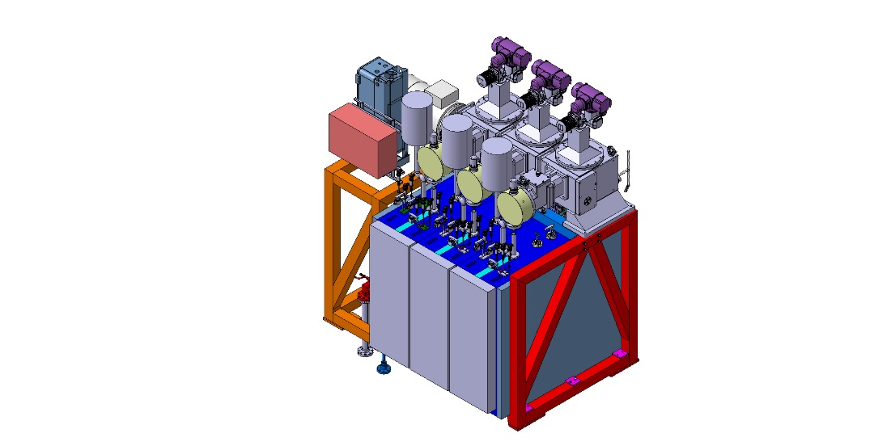
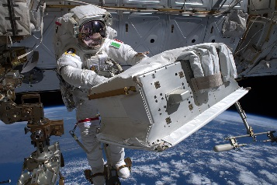
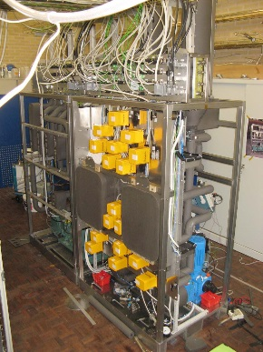
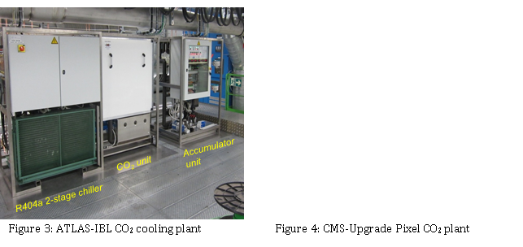
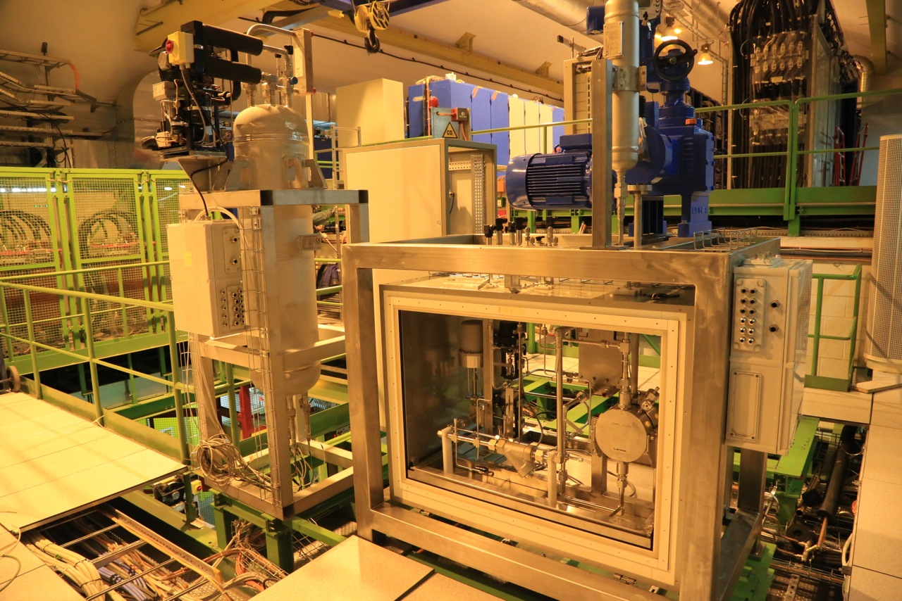
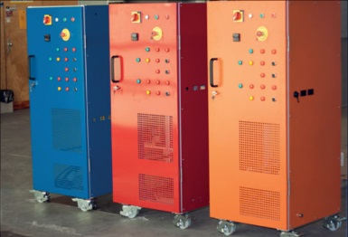
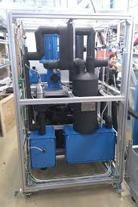
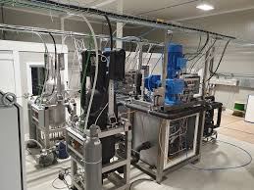
Currently active cooling domain
(-40°C / +20°C)
In this temperature domain the leading choice is evaporative CO₂ cooling using the 2PACL cycle technology
Well known technology, still R&D needed in specific domains
  Larger heat flux domains (>1W/cm² sensor flux)
  By use in complex evaporator geometries like micro-channels or 3D print heatsinks.
  Warm cooling behaviour for services cooling
Alternative fluid candidates are single phase Novec or water (+°C)
Fluorocarbons (single or 2-phase are not being considered for future use due to their bad environmental properties and their potential ban by future regulations)
CO₂ is used at CERN in the following applications:
AMS@ISS
2011-
LHCb-Velo
2008-2018
ATLAS-IBL
2014-
CMS-Pixel
2015-
Traci
2011-2015
Lucasz
2016-
LHCb-Mauve
2019-
ATLAS & CMS Ph2 Upgrade (2025)

Slide 8
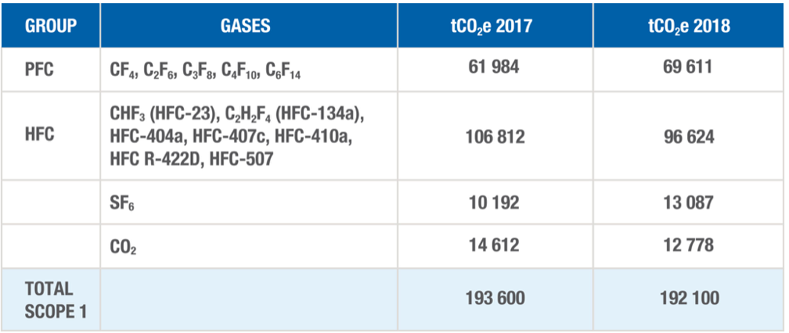

CERN official environment Report
«CERN’s emissions are equal to a large cruise liner»
https://physicsworld.com/a/cerns-emissions-equal-to-a-large-cruise-liner-says-report/
«Greenhouse gas emissions at CERN arise from the operation of the Laboratory’s research facilities. The majority of emissions come from CERN’s core experiments and more than 78% are fluorinated gases. With climate change a growing concern, the
Organization is committed to reducing its direct greenhouse gas emissions.» https://hse.cern/environment-report-2017-2018/emissions
CERN management accepted and financed an objective to reduce CERN’s direct greenhouse gas emissions by 28% by the end of 2024. Among the actions being taken to achieve this, CERN has for several years been developing environmentally-friendly cooling systems that have potential for applications in other domains.“

Slide 9
Cooling fluids used at CERN (with room temperature reference)
 | Normal boiling conditions P=1atm or T=20 °C |  | 2-Phase properties at 20°C | Critical point |  | Properties at normal conditions T=20 °C, P=1atm or normal boiling pressure in case of liquefied gas |  |  | Other properties
Fluid | Boiling temperature (°C) | Boiling pressure (bar) | Latent heat (kJ/kg) | Critical temperature (°C) | Critical pressure (bar) | Density (kg/m3) | Heat capacity (kJ/kg*K) | Viscosity (μPa*s) | GWP | Prize €/kg
Water | 100 | 0.023 | 2453 | 373.9 | 220.6 | 998 | 4.18 | 1001.6 | - | 0
Novec 649 ¹ | 49.1 | 0.326 | 96.2 | 168.7 | 18.7 | 1617 | 1.10 | 756.6 | 1 | 47,-
C6F14 | 56.9 | 0.236 | 94.0 | 175.9 | 18.3 | 1703 | 1.03 |  | 9300 | 30,-
C5F12 | 29.8 | 0.695 | 95.0 | 147.4 | 20.5 | 1632 | 1.07 | 497.6 | 9160
C4F10 | -2.2 | 2.29 | 88.9 | 113.2 | 23.2 | 1516 | 1.07 | 230.9 | 9200 | 138,-
C3F8 | -36.8 | 7.56 | 79.1 | 71.9 | 26.4 | 1352 | 1.15 | 180.6 | 8900 | 38,-
C2F6 | -78.1 | Super critical |  | 19.88 | 30.5 | Super critical |  |  | 11100 | 100,-
CO2 | -78.4 | 57.29 | 152.0 | 30.97 | 73.8 | 773.4 | 4.3 | 66.1 | 1 | 0.015
No future
¹ Not well understood radiation and material compatibly issues

Slide 10
Extended domain for Hadron collider experiments (-80°C / -40°C)
Future detectors with increased radiation doses require colder cooling beyond the current CO₂ capacities (<-40°C )
There are not many existing technologies in this temperature domain
Serious R&D is needed in this temperature domain exploring new technologies
Candidate fluids and cycle technologies:
  Krypton (evaporative and super critical),
    A new cycle technology is needed as cooldown from ambient starts in the gas phase
    Trans-critical cooldown needed to avoid thermal shocks
  Carbon Tetrafluoride (CF4)
    The only fluorocarbon candidate which could be considered due to the limited choice of candidates in the high temperature area of this domain
    Same cycle challenges as Krypton
  N₂O/CO₂ mixtures (100% CO₂ > -55°C / 100% N₂O @ -90°C)
    N₂O has nearly the same properties as CO₂, but a much lower freezing temperature. Can be used as a mix with CO₂ acting as an anti-freeze or pure if ultra low temperatures are needed (>-90°C)
    Due to the lower efficiency at cold temperatures, N₂O/CO₂ mixtures are best to be considered for low heat flux applications like SiPM cooling.
  Ethane or Ethylene would be good thermal candidates, but not preferred because of their flammable properties.
CO₂
N₂O
Slow cooldown
Currently VELO-3 is seriously looking into this temperature domain
Future high radiation experiments (eg. FCC) are expected to need colder cooling than the current CO₂ range
Thermal shock
Krypton cycle start
CO₂ cycle start

Slide 11
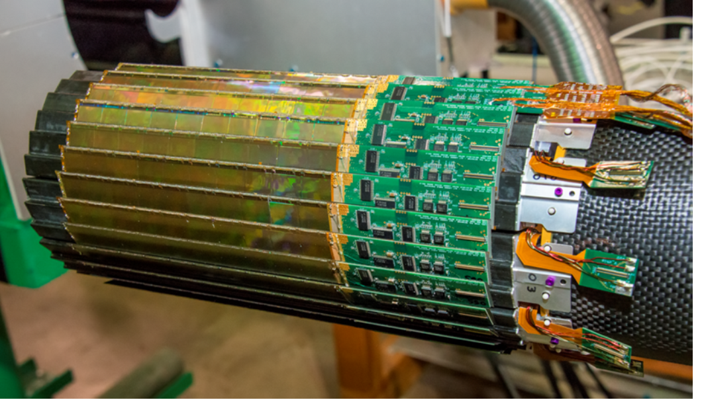
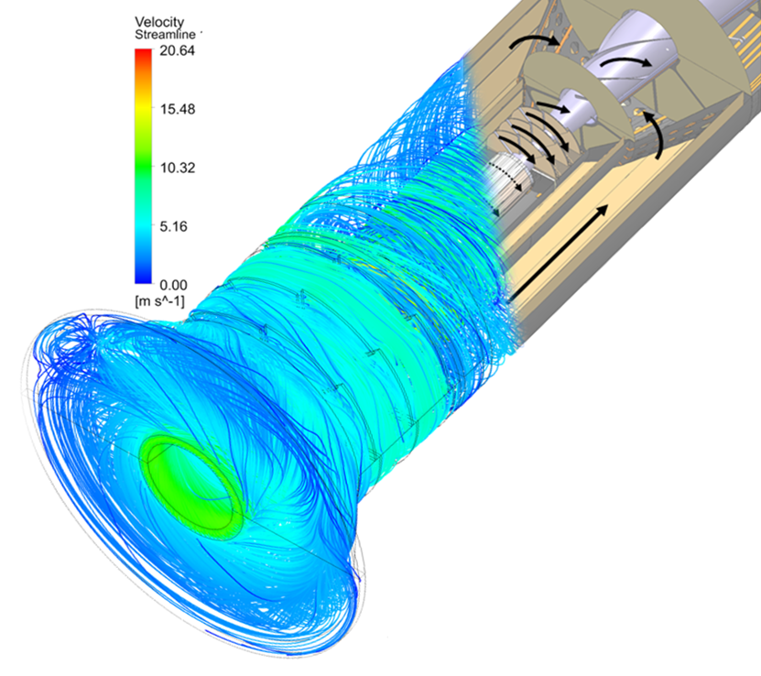
Warm cooling domain
(Room temperature and above)
Lepton and Ion collider experiments require ultra light detectors which can be cooled at room temperature.
Candidate technologies:
  Direct air cooling using an air draft through the detector,
    Special designed layout to facilitate convective air flow
    Considered for Alice upgrade
  Water or Novec cooling (Novec if dielectric fluids are needed)
    Low pressure solution for ultra thin plastic piping
  Warm evaporative or super critical CO₂
    In case very small cooling channels are needed (eg. micro channels)
    Good solution for services cooling like cables and DAQ boxes in the detector vicinity
Air-cooling example PXL/STAR HFT @ RHIC
    0.17 W/cm², dT=13°C, Wind speed: 10.1 m/s (Windforce 5 Beaufort)
    Thermal figure of merit: 70 K*cm²/W
CLIC study
PXL/STAR

Slide 12
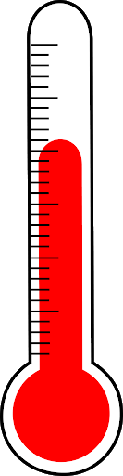
Evaporative CO₂ vs Water and Novec649
T=15°C
Heated length = 2m
D=1.5mm
Q=150 watt
2-phase CO₂
MF=2g/s
dP=0.8 bar
dT_{fluid}=0.6°C
dT_{total}=1.6°C
Liquid Water
MF=5 g/s
dP=2.3 bar
dT_{fluid}=7.2°C
dT_{total}=8.2°C
Liquid Novec (graph not shown)
MF=7.5g/s
dP=2.6 bar
dT_{fluid}=18.2°C
dT_{total}=22.1°C
Liquid Water
(temperature increase)
CoBra calculator
Evaporative CO₂
(temperature drop)
Liquid speed <3m/s

Slide 13
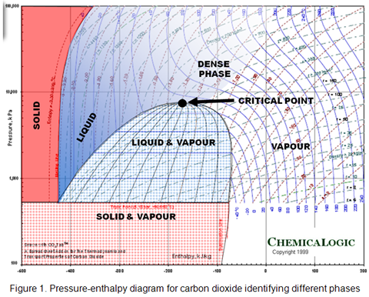
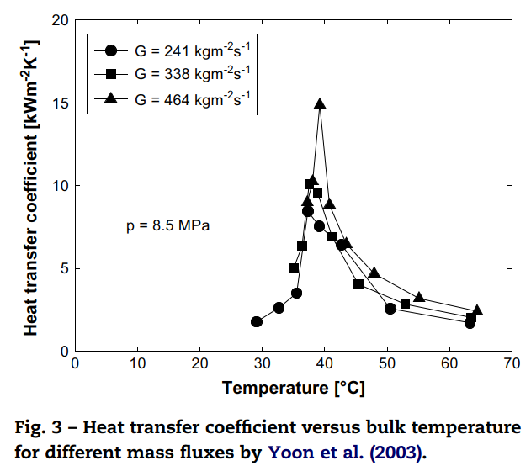
Supercritical cooling, a special mono-phase cooling case
The super critical region is a mono-phase region with very favourable properties for heat and mass transfer
  Very high heat capacity, Cp=J/kg*K
  Very low viscosity, μ=Pa*s
High heat transfer capability
SC-CO₂ is interesting to explore for warm cooling applications (31°C / 45°C)
For cold temperature applications the use of super critical Krypton cooling (SC-Kr) can be considered (-63°C / -50°C)
Super critical heat capacity of CO₂ compared to water
Critical point
Tcrit=30.96°C
Pcrit=73.8 bar
74 bar
Heat Capacity (J/g*K)
Water
Super critical zone
B-Art
Temperature (°C)

Slide 14
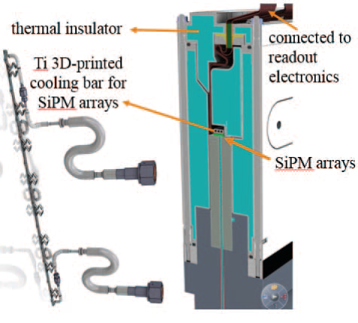
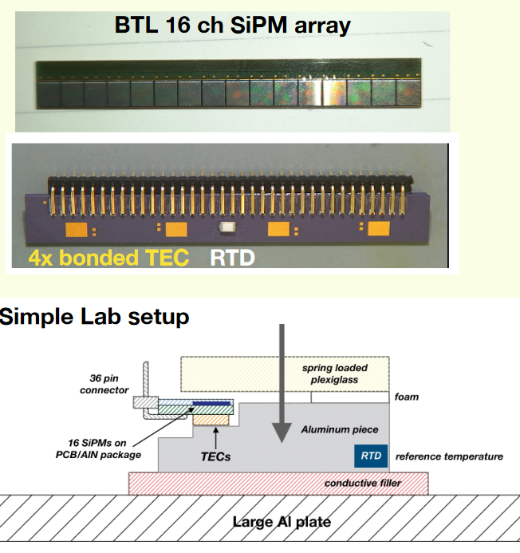
Silicon Photomultipliers (SiPM)
Many future detectors are considering SiPM detectors.
  Current : LHCb-SciFi, CMS-EC upgrade
  Future : Calorimeters, scintillator trackers
Cooling temperature depends on noise allowance and radiation level
Temperatures in the range of -50°C to -150°C are being considered
SiPM have a low heat dissipations
Main contribution for cooling system is heat leak due to the difficulty to make good insulation (Direct mounting on scintillator material)
The wish for cryogenic temperatures have a large challenge as the detectors are not suitable to fit in standard cryostats.
Cooling method candidates:
  Integrated Thermal Electric Cooler (TEC or Peltier) with CO₂ or Novec cooling
  CO₂/N₂O mixtures in a vapor compression cycle potentially with warm in and outlet lines (ATLAS ID cooling concept)
  Krypton based cooling like slide 10
R&D involves:
  Cooling fluid use
  Cooling cycle
  Insulation / mechanical structure design concept
CMS SiPM with TEC cooling

Slide 15
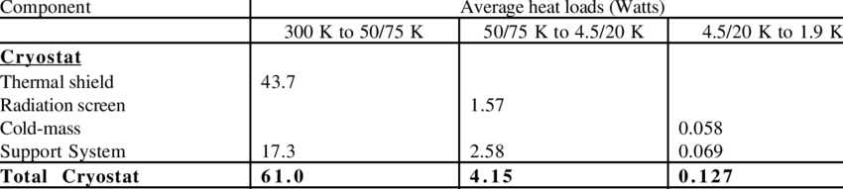
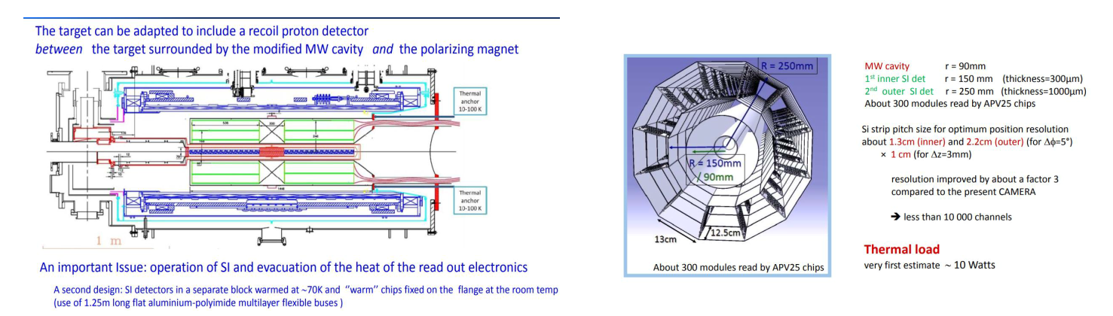
Cryogenic detectors
The central tracker of AMBER has very challenging cryogenic requirements.
  It needs to be cooled below 1.8K with significant heat loads.
    10 Watt in a Ø500mm*630mm volume
    Comparison: LHC magnet is 0.13 Watt
  According cryo-experts this is unprecedented
  Very serious R&D is needed to cool in this temperature and heat load domain
Nobel liquid detectors with embedded electronics
  Calorimeters (See Martin Aleksa talk)
  Neutrino experiments
  Needs better understanding or this is challenging cryogenic technologies
LHC magnet loads

Slide 16
Summary
For future detector cooling the following R&D areas have been localized:
  High heat density cooling in the temperature domain below CO₂ (-40°C / -80°C)
    Super and sub critical Krypton cooling using a trans critical cool down cycle
    CF₄ is a non-green back-up solution
  Low heat density cooling in the temperature domain below CO₂ (-40°C / -80°C)
    CO₂/N₂O mixtures (or pure N₂O) in an oil free vapor compression cycle (With warm transfer lines) or 2PACL cycle
  High heat density warm cooling applications (15°C / 35°C)
    Super and sub critical CO₂ cooling
  Low heat density warm cooling applications (15°C / 35°C)
    Super and sub critical CO₂ cooling
    Water and Novec single phase cooling
    Direct air cooling solutions
A special attention to the following specific detectors is needed
  SiPM cooling including thermal housing design (-40°C / -150°C), using technologies mentioned above
  Cryogenic AMBER tracker using very low temperatures with relative large heat dissipation

