Slide 1



Machine Detector Integration
Manuela Boscolo (INFN-LNF & CERN)
Acknowledgements: H. Burkhardt, F. Hartmann, W. Riegler, M. Sullivan, F. Zimmermann
Task Force 8 Integration Symposium
ECFA Detector R&D Roadmap
Zoom, 31 March, 2021

Slide 2
Introduction
Key challenges for the machine detector integration of future colliders:
  e⁺e⁻ circular: SuperKEKB (in operation), FCC-ee, CEPC
  e⁺e⁻ linear: CLIC, ILC
  pp: FCC-hh
  e⁻ ion: EIC (approved), LHeC, FCC-eh
  μ⁺μ⁻ (still too early to be on the same foot)
Different projects are at different level of maturity, have different time scales, either under commissioning, approved or for the far future.
Rich field with mutual influence and interplay in accelerators design as well as in R&D on the various technologies and systems.

Slide 3
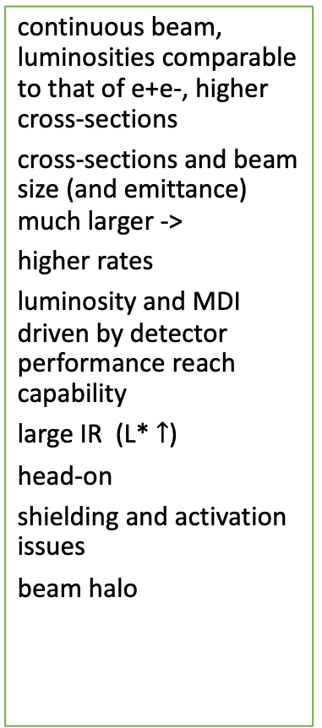
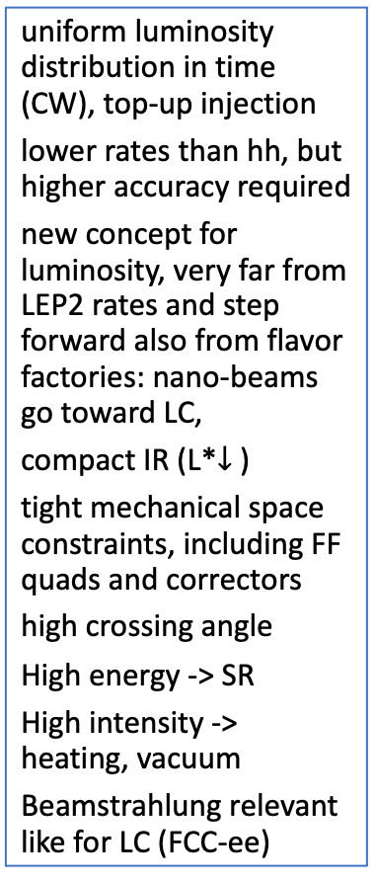
Future Colliders IR Overview
e⁺e⁻ Linear
e⁺e⁻ Circular
hh Circular
e⁻ ion Circular
high instantaneous luminosity within bunch train (low O(10Hz rep rate)
higher occupancy at the same ave Luminosity
no hope to mitigate with a fast readout, cannot resolve within a bunch train
very low-β demands for the ultimate final focus quads design
smallest beam size ever demands for tightest alignment specs, and fast feeback for beam steering
IP bkgs, radiative beam-beam (beamstrahlung), pairs
uniform luminosity distribution in time (CW), top-up injection
lower rates than hh, but higher accuracy required
new concept for luminosity, very far from LEP2 rates and step forward also from flavor factories: nano-beams go toward LC,
compact IR (L*$↓$ )
tight mechanical space constraints, including FF quads and correctors
high crossing angle
High energy -> SR
High intensity -> heating, vacuum
Beamstrahlung relevant like for LC (FCC-ee)
continuous beam, luminosities comparable to that of e+e-, higher cross-sections
cross-sections and beam size (and emittance) much larger ->
higher rates
luminosity and MDI driven by detector performance reach capability
large IR (L*$↑$)
head-on
shielding and activation issues
beam halo
e- beam like that of e+e- circular future colliders:
high current issues
SR
4π solid angle detectors,
very low angle is required for the physics (for e+e- 50-100 mrad typical physics cone)
enormous beam apertures required,
FF quads and IR magnets very difficult

Slide 4
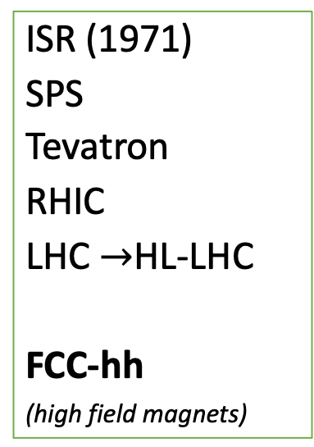
Future Colliders IR Overview
e⁺e⁻ Linear
e⁺e⁻ Circular
hh Circular
e⁻ ion Circular
SLC (1989)
ILC
CLIC
(AdA,1962)
long history
LEP
Factories
(high current)
  PEP-II
  KEKB
  DAFNE
  ..
Super factories (nanobeam concept)
  SuperKEKB
  FCC-ee
  CEPC
ISR (1971)
SPS
Tevatron
RHIC
LHC $→$HL-LHC
FCC-hh
(high field magnets)
HERA (1992)
EIC
LHeC
FCC-eh
Please note:
Not exhaustive list

Slide 5
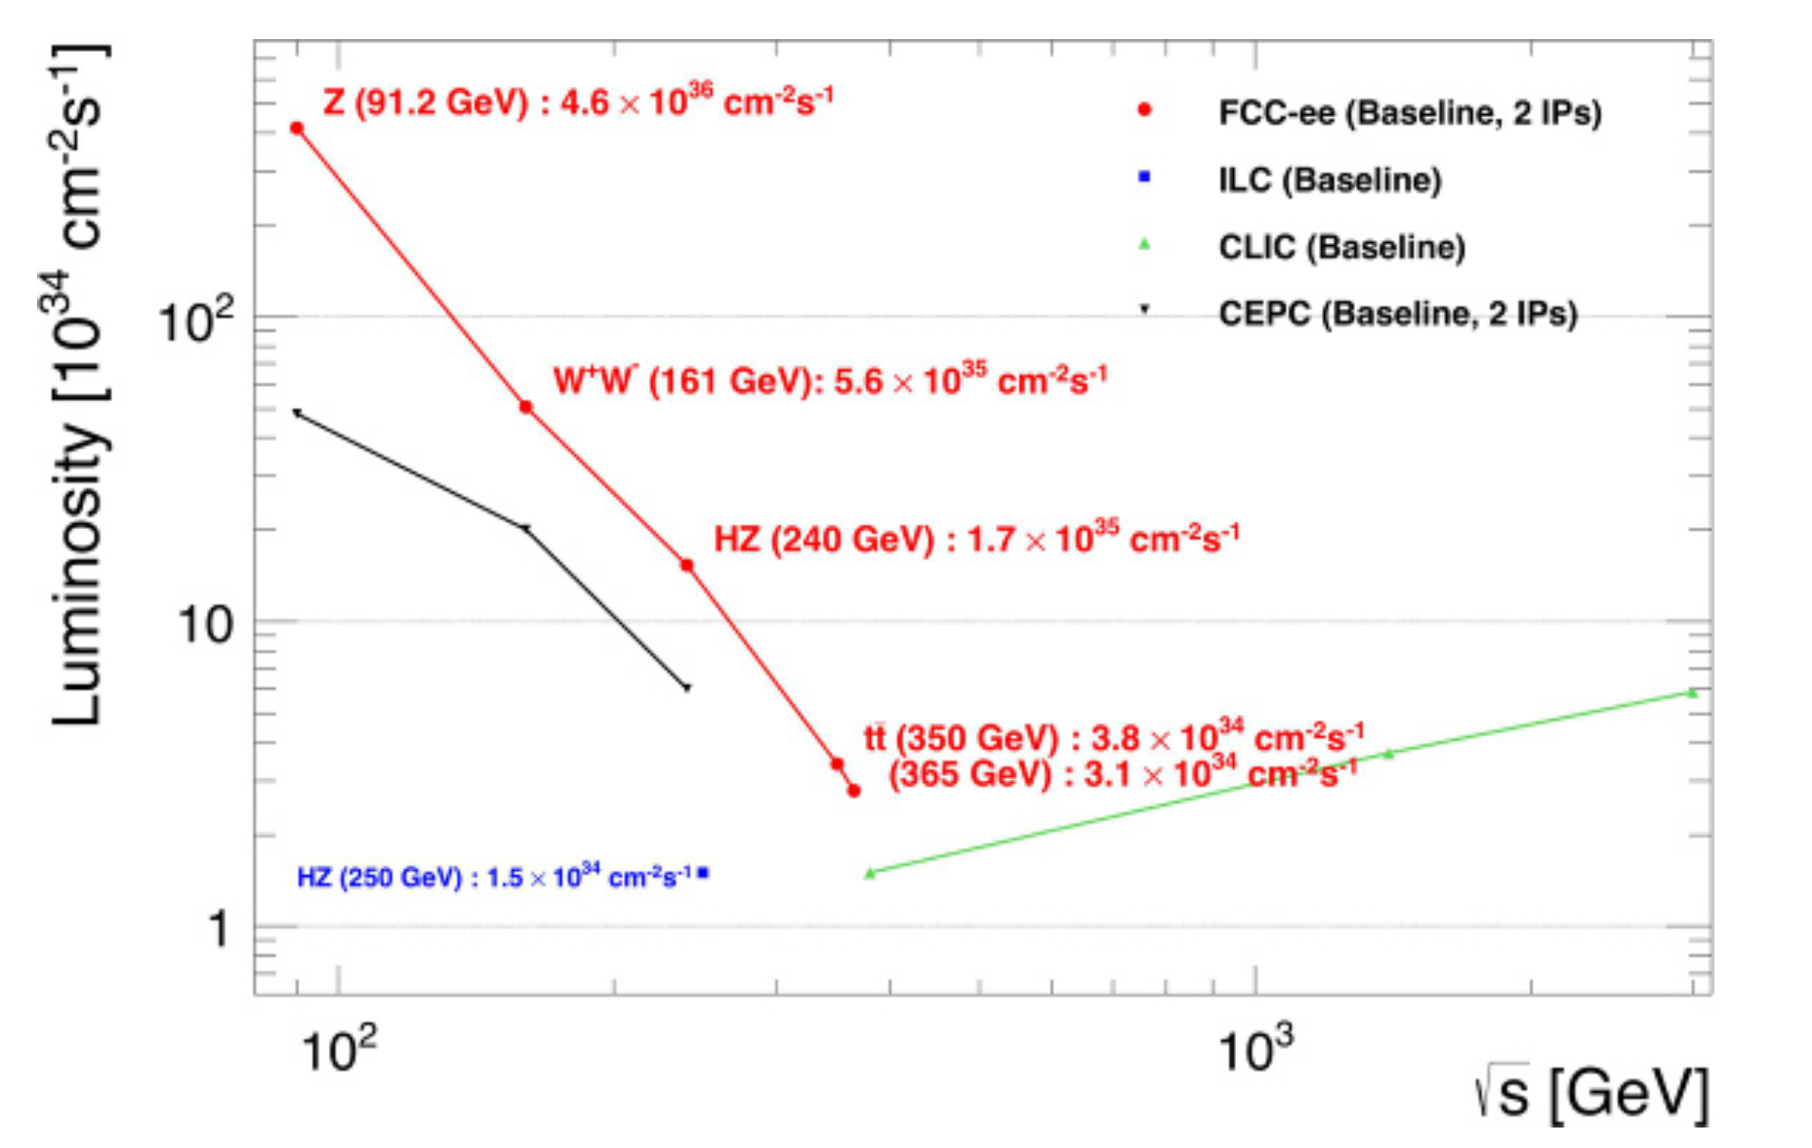
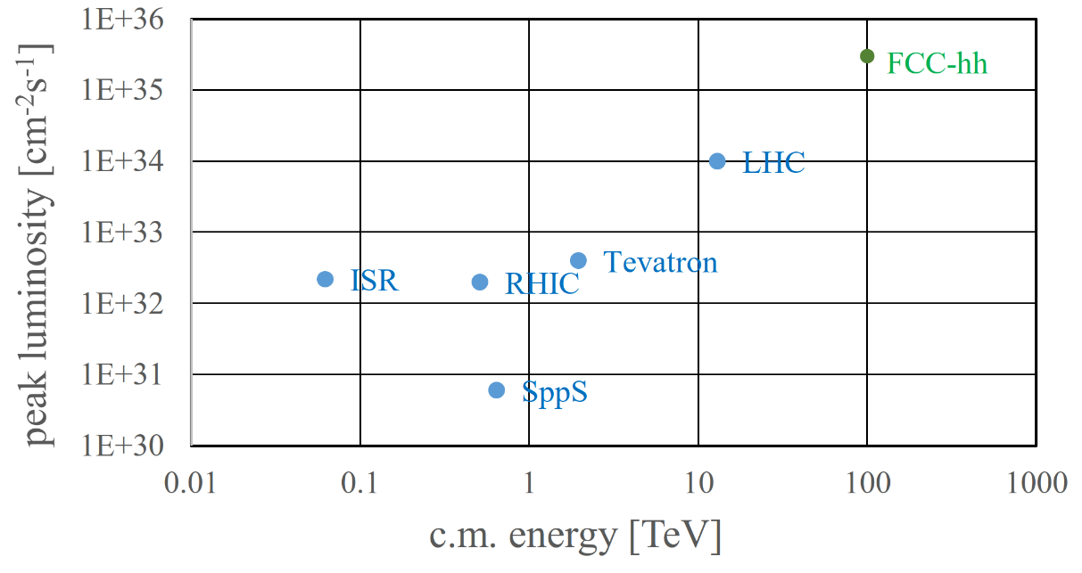
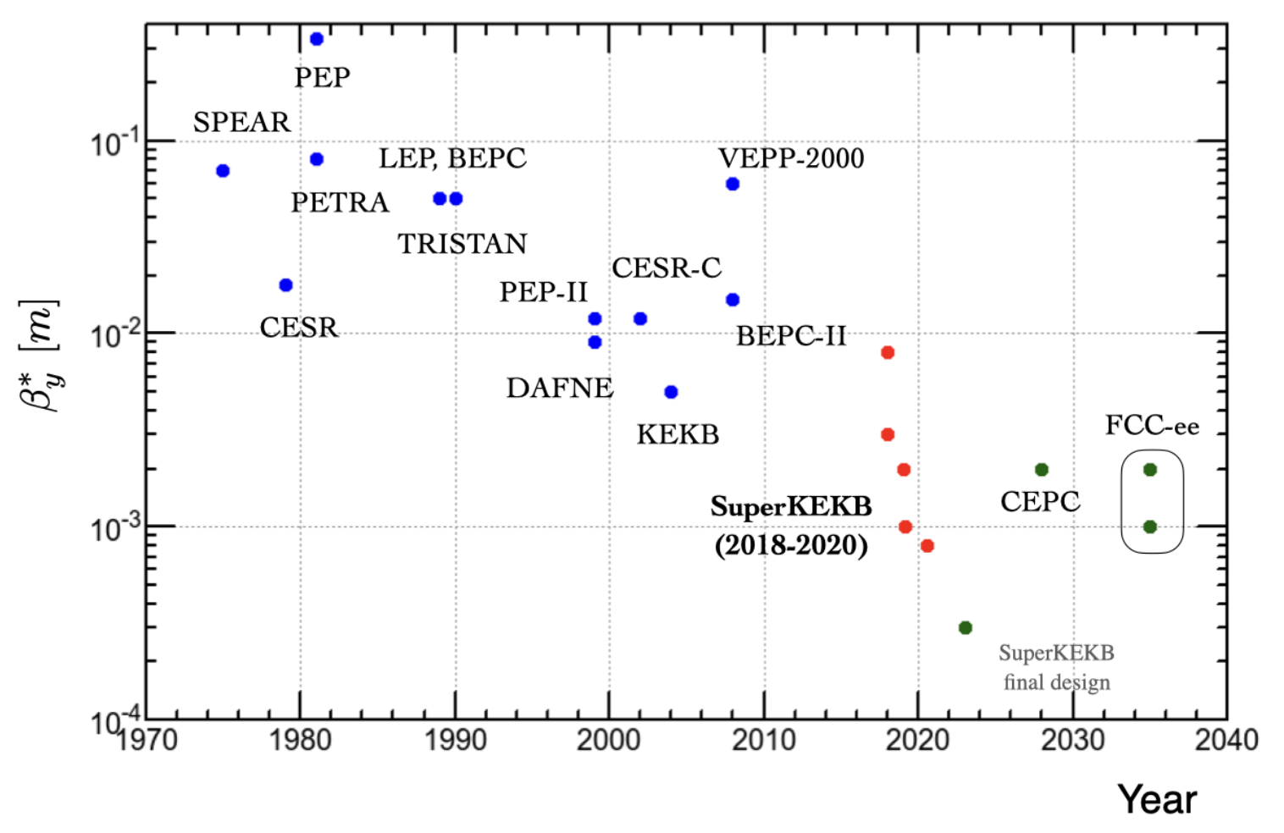
Future Colliders Performance
e+e-
[FCC-ee CDR]
hh
e+e- circular: vertical squeeze at IP
order of magnitude performance increase in both energy & luminosity
100 TeV cm collision energy (vs 14 TeV for LHC)
20 ab⁻¹ per experiment collected over 25 years of operation (vs 3 ab⁻¹ for LHC)
similar performance increase as from Tevatron to LHC
key technology: high-field magnets
mm
μm
[Y.Ohnishi, ICHEP 2020]

Slide 6
IR future colliders Parameter Table
particle |  | e⁺e⁻ |  |  |  | pp |  |  | e⁻ - ion
type |  | circular |  | linear |  | circular |  |  | circular/ ERL
collider name |  | SuperkekB | FCC-ee | ILC | CLIC | LHC | HL-LHC | FCC-hh | EIC | LHeC
Beam Energy | GeV | LER (e+) 4 HER (e-) 7 | 45.6, 120,182.5 | 125, 250 | 190 / 1500 | 7000 | 7000 | 50000 | (e-) 10 (h) 275 | (e-) 49.19 (p) 7000
𝓛 (peak) | 10³⁴cm⁻²s⁻¹ | 80 | 230, 8.5, 1.6 | 1.4, 1.8 | 1.5, 6 | 2.1 | 5 | 5-30 | 1 | 23
crossing angle | mrad | 83 | 30 | 14 | 16.5, 20 | 0.26 | 0.5 |  | 25 | 0
Bunch spacing | ns | 4 | 20 | 554, 5Hz train | 0.5, 50Hz 312 train | 25 | 25 | 25 | 10 | 50
L* (free region) | m | L 0.77 H 1.22 | 2.2 | 4.1 | 6 | 23 | 23 | 40 | 4.5 | 10
β_{x}* | cm | L 3.2 H 2.5 | 15,30, 100 | 1.3, 2.2 | 80 / 70 | 25 | 15 | 110-30 | 45 80 | (e-) 6.45 (p) 10
β_{y}* | mm | L 0.27 H 0.3 | 0.8, 1, 1.6 | 0.41, 0.8 | 0.1 / 0.12 | 250 | 150 | 1100-300 | 56 72 | (e-) 64.5 (p) 100
Normalised emittance x | μm | L 25 H 63 | 24, 148, 479 | 5, 10 | 0.95/ 0.66 | 3.5 | 2.5 | 2 | (e-) 391 (h) 3.3 | (e-) 50 (p) 2.5
Normalised emittance y | nm | L 68 H 177 | 89, 235, 1000 | 35, 35 | 30/20 | 3500 | 2500 | 2000 | (e-) 25400 (h) 290 | (e-) 50000 (p) 2500
B_{det} | T | 1.5 | 2 | 5 (SiD) | 3.5-5 | Atlas 2T, CMS 4T |  |  | 1.4 | 3.5
central pipe radius | cm | 1 | 1.5 (1) | 1 | 3 | 2.35 Atlas, 2.1 CMS | 2.35 Atlas, 2.1 CMS | 2.5 | elliptical | elliptical
Notes:
At FCC-ee Significant luminosity increase compared to LEP (0.01 x 10³⁴ cm⁻² s-1 @ 208 GeV)
Smaller emittances, beta-functions, larger power consumption

Slide 7
Some References
FCC WEEK2020 and FCC-IS Kick-off meeting (2020)
FCC-ee: The Lepton Collider, Eur. Phys. J. Spec. Top. 228, 261–623 (2019)
FCC-hh: The Hadron Collider, Eur. Phys. J. Spec. Top. 228, 755-1107 (2019)
K. Oide et al., Phys. Rev. Accel. Beams 19, 111005 (2016)
Crab-waist collision scheme: ArXiv.070233
The Compact Linear e+e- Collider (CLIC): Project Implementation Plan (2018), ArXiv:1903.08655
The Compact Linear e+e- Collider (CLIC): Accelerator and detector, A. Robson (2018)
CLIC MDI arXiv:1202.6511.pdf (2011)
The International Linear Collider A global Project, ArXiv:1903.01629v3 (2019)
ILC TDR
EIC CDR, doi:10.2172/1765663 (2021)
The LHeC at the HL-LHC, LHeC and FCC-eh study group, CERN-ACC-Note-2020-0002, ArXiv: 2007.14491 (2020)
LHeC CDR, J. Phys. G: Nucl. Part. Phys. 39 075001, arXiv:1206.2913 (2012)
Muon collider design meetings: https://indico.cern.ch/category/12762/
The future prospects of muon colliders and neutrino factories, RAST 10, 189 (2019), ArXiv:1808.01858 and Refs. therein

Slide 8
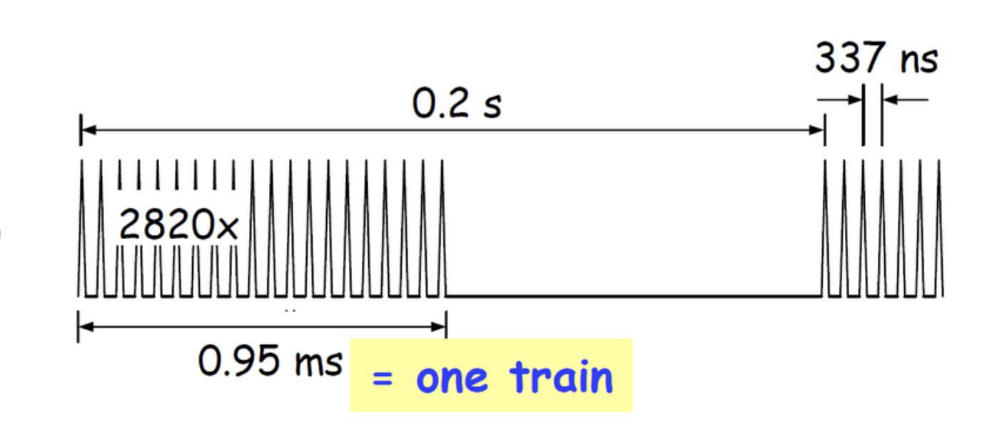
MDI for e⁺e⁻ Linear Colliders
Very squeezed beams at the IP
  Possible thanks to extreme final focus quads gradient, R&D performed
  (first CLIC FF QD0 design aimed at values as high as 575 T/m)
  Extreme mechanical precision mandatory to reach goal luminosity, two necessary ingredients:
    active and passive alignment system, R&D activity
    fast feedback (beam steering at nm precision level)
  Beam-induced backgrounds -> constraints on beam pipe radius and geometry, vertex detector radius
  (γγ -> hadrons)
Challenge on MDI mechanics, electronics, services, minimal tolerances
Low mass tracker supports with integrated cooling –R&D performed through past years
The very different bunch structure between LC (bunch trains) (even if ILC/CLIC are different wrt each other) and circular (uniform fill) leads to very different detector solutions:
  In-time pile-up of hadronic backgrounds, sufficient granularity for topological rejection
  At CLIC: ns-level timing in many detectors systems (0.5 ns micro-bunch spacing, 312 bunches)
  Power pulsing of front-end electronics, reduced power consumption
micro-bunch
macro-bunch
1 train
LC bunch structure

Slide 9
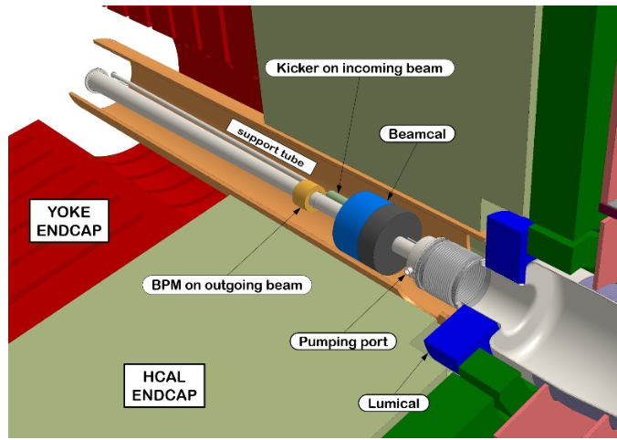
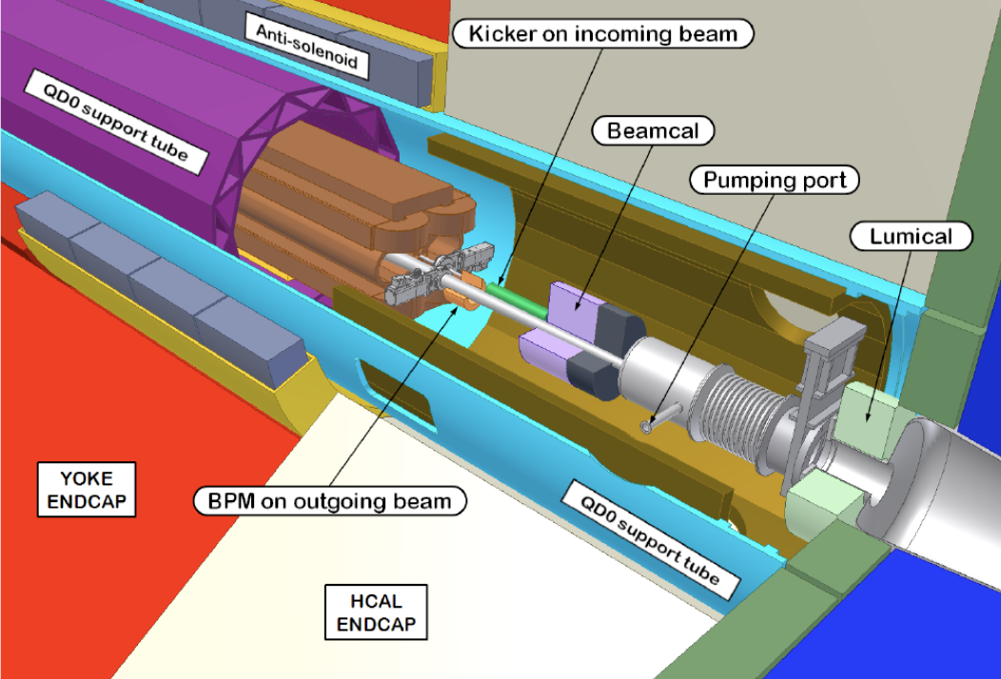
CLIC MDI
ArXiv:1903.08655 (2018)
simpler design
ArXiv:1202.6511 (2011)
σ_{x}*= 0.144 μm
σ_{y}*= 2.97 nm
@380 GeV
L* = 4.3 m at 500GeV
L* = 3.5 m at 3TeV
L* = 6 m both 380 GeV and 3 TeV
QD0 outside the detector at 380 GeV and 3 TeV
QD0 mounted on the tunnel floor (much smaller vibrations)
no pre-absorber, no cantilever support for QD0
divided in three parts, much smaller gradient (25T/m), large aperture radius (25 mm)
no anti-solenoid needed
Notes:
two ocupoles introduced to correct 3rd order chromatic and geometric aberrations.
imperfections applied to the FFS lattice

Slide 10
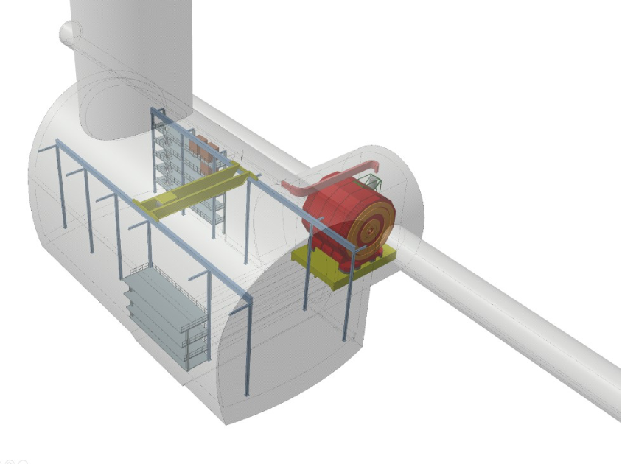
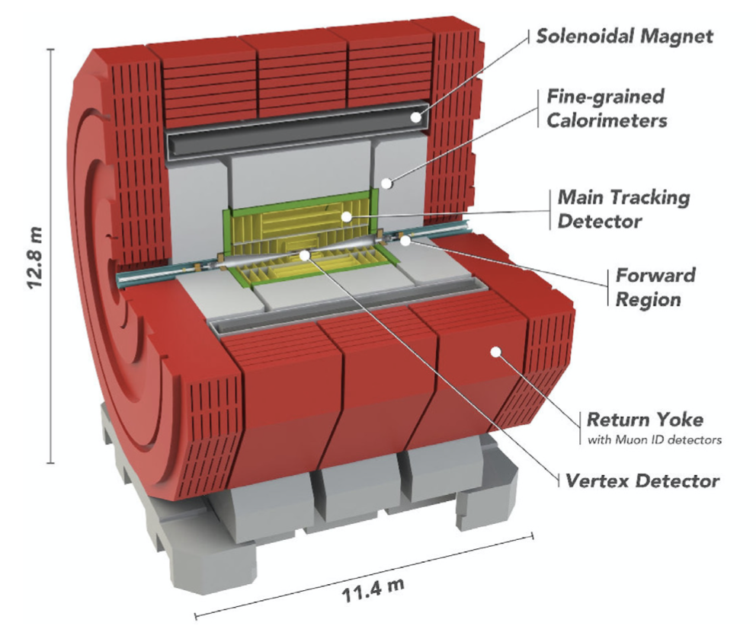
CLIC MDI
new cavern
(Most of the detector elements unchanged)
Key issues:
Minimization of radiation:
  Collimators and masking to suppress bkg from beam-beam and beam dumps
  Background suppression and radiation shielding
Lower backgrounds from incoherent pairs at 380 GeV allow for a smaller central vacuum chamber, and thus a smaller radius of the innermost vertex detector layer
Radiation effects and beam-beam at 3 TeV determine the design constraints
NIM A 983 (2020) 164522 link

Slide 11
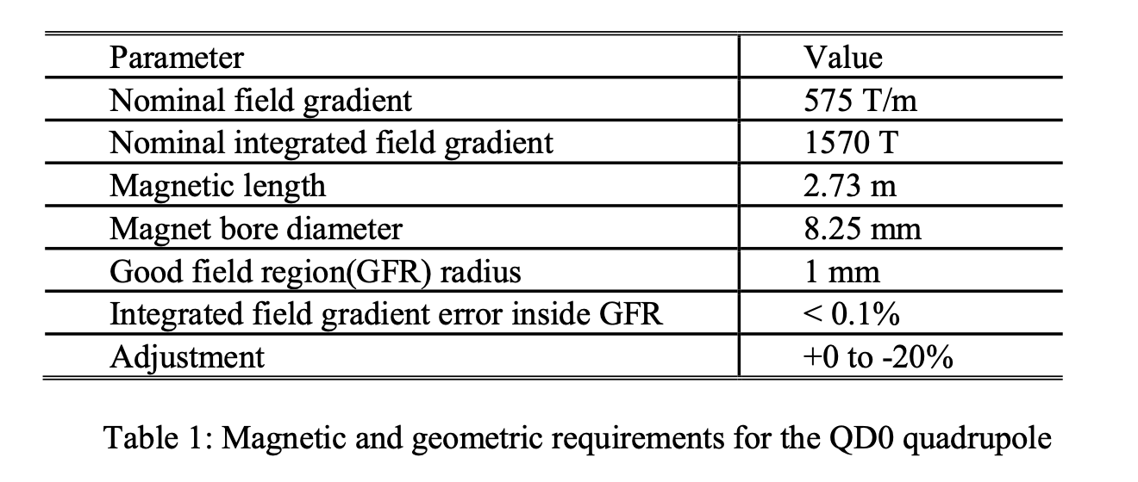
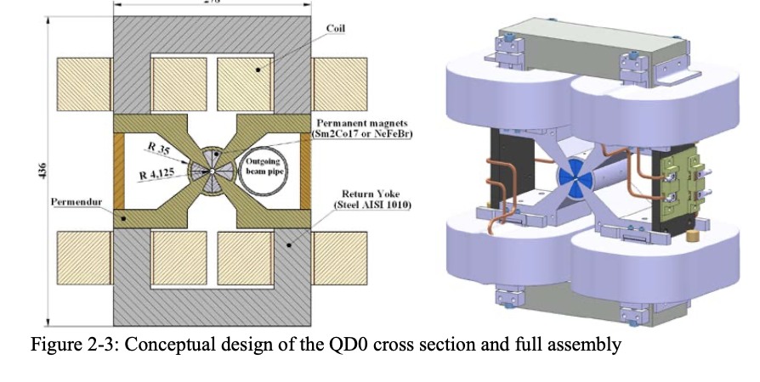
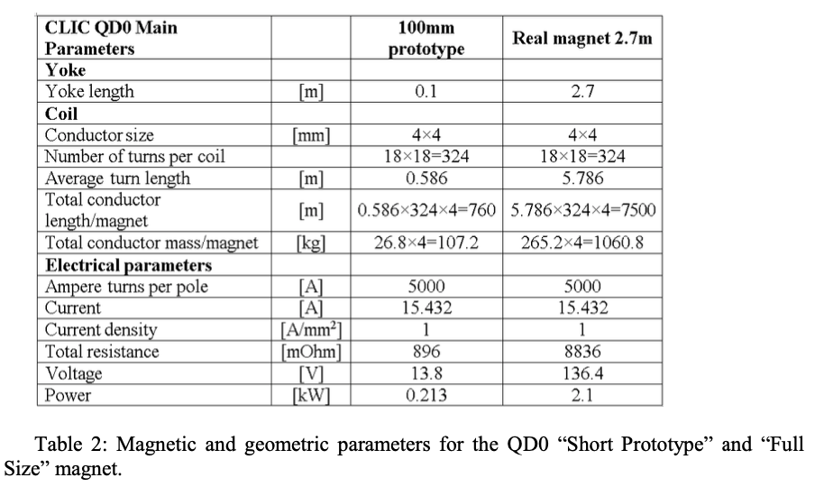
CLIC QD0 Prototype
https://arxiv.org/pdf/1202.5952.pdf
QD0 requirements (2009) L*=3.5, 4.3 m, inside detector
The magnetic requirements for the QD0 are quite severe: the extremely high gradient needed, the small aperture of the magnet bore, the length of the magnet, the required tunability.
Distance between post collision line beam pipe and beam axis ~35 mm
Active stabilisazion of the quadrupole: sufficient rigidity and with a well known dynamic behaviour (vibration eigenmodes, no source of vibration (ex. coil coolant flux)

Slide 12
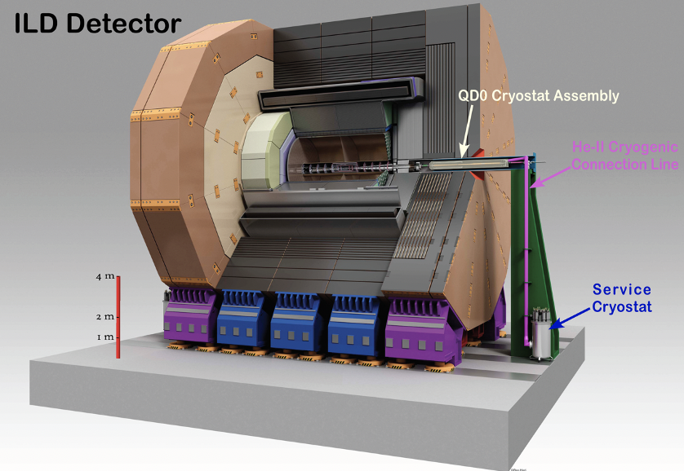
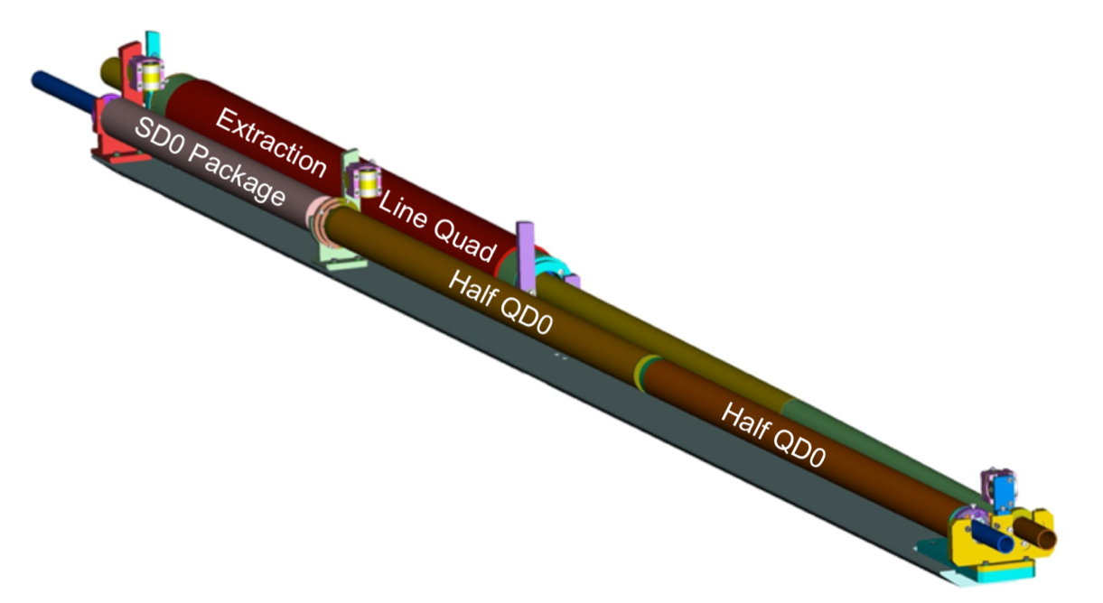
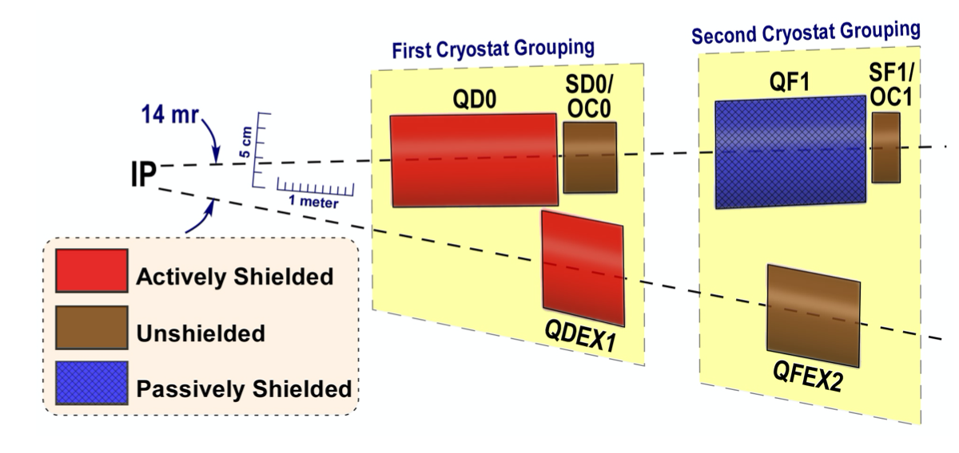
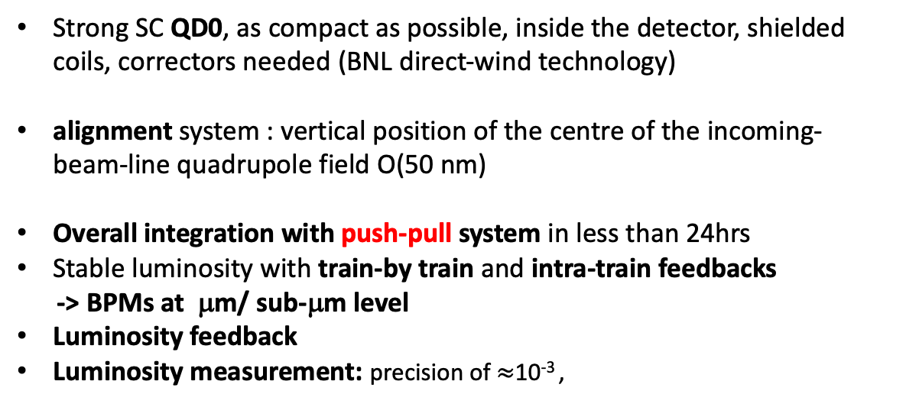
ILC IR and MDI
Very small beams at IP - determine a challenging MDI design
σ_{x}*= 0.52 μm
σ_{y}*= 7.7 nm
[Arxiv_2019]
[TDR (2013)]
squeezed beams can be obtained with strong FF quads
4.5 m (ILD)
3.51m (SiD)
L* = 4.1 m
L*
Strong SC QD0, as compact as possible, inside the detector, shielded coils, correctors needed (BNL direct-wind technology)
alignment system : vertical position of the centre of the incoming-beam-line quadrupole field O(50 nm)
Overall integration with push-pull system in less than 24hrs
Stable luminosity with train-by train and intra-train feedbacks
-> BPMs at μm/ sub-μm level
Luminosity feedback
Luminosity measurement: precision of $≈$10⁻³ ,
R&D
[see B. Parker, LCWS2021]
3D-view
challenging
QD0 split in two for energy flexibility
Two independent cryostats, with QD0 cryostat almost entirely into the detector. Only the QD0 cryostat is moved together with detector during push-pull operation.
Lumical: Bhabha rate in the 30-90mrad polar angle region in front the FF quads @500Ecm 10 bhabhas/bunch train; 1.5k pairs/BX for fast lumi diagnostics at 5-30mrad
2D-top view
Notes:
IR magnets: SC adjustable magnets, BNL direct-wind technology (closely spaced coil layers of superconducting multi-strand cable), extremely compact, cooling by superfluid He at 2K. The technology of the superconducting final-focus magnets has been demonstrated by a series of short prototype multi-pole coils. The QD0 is inside the detector solenoidal field, it cannot have magnetic-flux-return yokes. Cross talk is avoided by shielded coils and local correctors.

Slide 13
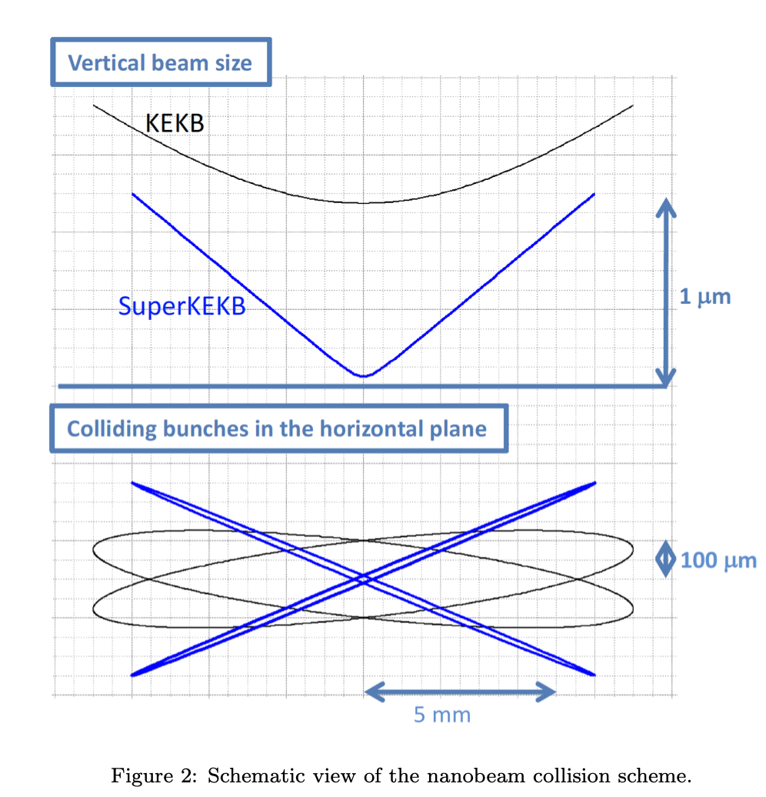
New collision scheme adopted by all future e⁺e⁻ circular colliders
Crab-waist based on two ingredients:
  concept of nano-beam scheme (vertical squeeze of the beam at IP and horizontal crossing angle increased, reducing the instantanous overlap area, allowing for a lower β_{y}*)
  crab-waist sextupoles
Smaller beams at IP → higher 𝓛 & higher backgrounds (IP bkgs and beam losses in the FF quads due to the very high β-function)
First Successful validation test performed at DAFNE (2008) link
In summer 2020 SuperKEKB successfully implemented the FCC-ee virtual crab-waist, crab waist w/o new sextupoles (but reducing the strength of an existing FF sextupole) [K. Oide]
https://arxiv.org/pdf/1809.01958.pdf
IMPACT on MDI design:
Tight and packed interaction region → small L*, QD0 inside detector, mechanical constraints,
Beam pipe design, as splitting in two pipes is very close to the IP
Robustness against machine backgrounds (from IP and environment)
Radiation damage and occupancy and fake hits
Higher rate trigger, DAQ and computing
Commissioning of SuperKEKB is
very precious experience for FCC-ee
It allows experience on topics where
R&D is not straightforword w/o beams,
i.e. backgrounds modeling

Slide 14
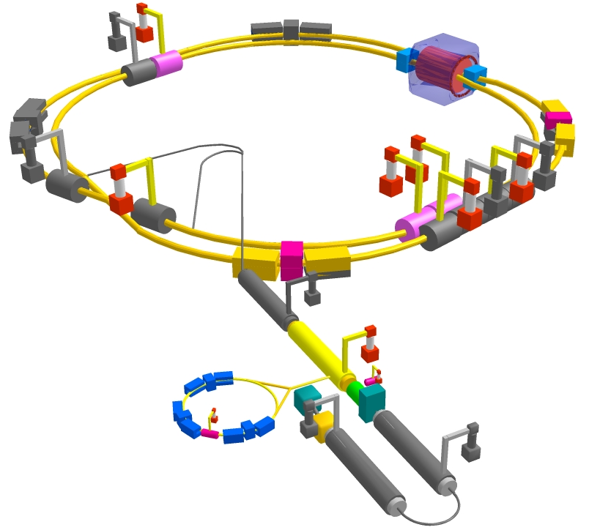
KEKB and SuperKEKB IR relevant parameters
Parameters | unit
Luminosity | 10³⁴ cm⁻²s⁻¹
Circumference | m
Energy | GeV
I (beam) | A
I (bunch) | mA
ε_{x}/ ε_{y} transv. rms | nm /pm
σ_{x}/σ_{y}(IP) | μm /nm
KEKB
LER(e+) | HER(e-)
2.11
3014
3.5 | 8.0
1.64 | 1.2
1.0 | 0.75
18 / 150 | 24 / 150
150 / 940 | 170 / 940
SuperKEKB
LER(e+) | HER(e-)
80
3014
4 | 7.007
3.6 | 2.6
1.4 | 1.04
3.2 / 8.64 | 4.6 / 12.9
10 / 48 | 11 / 62
SuperKEKB is demonstrating FCC-ee key concepts

Slide 15
SuperKEKB FF magnets and detector
σ_{x}*= 10.7 μm
σ_{y}*= 62 nm
σ_{x}*= 10.1 μm
σ_{y}*= 48 nm
B=1.5 T
e-
L*= 1.22 m
L*= 0.77 m
e+

Slide 16
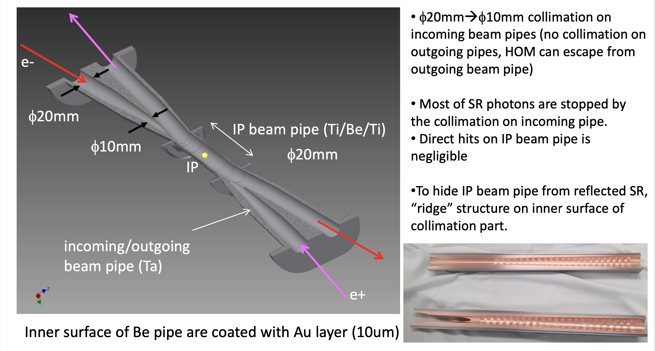
SuperKEKB beam pipe & synchrotron radiation
Inner surface of Be pipe are coated with Au layer (10 μm) to protect detectors from SR

Slide 17
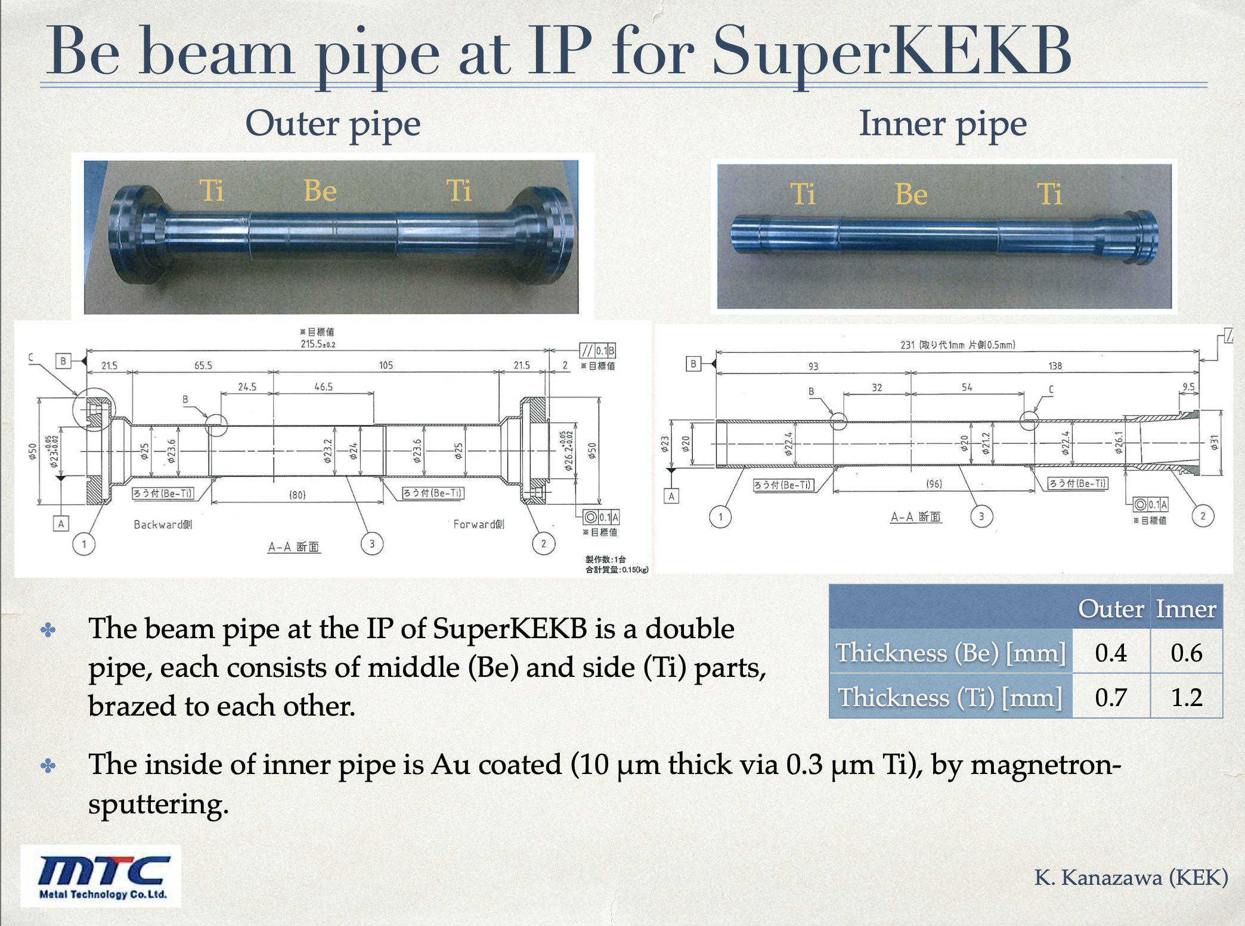
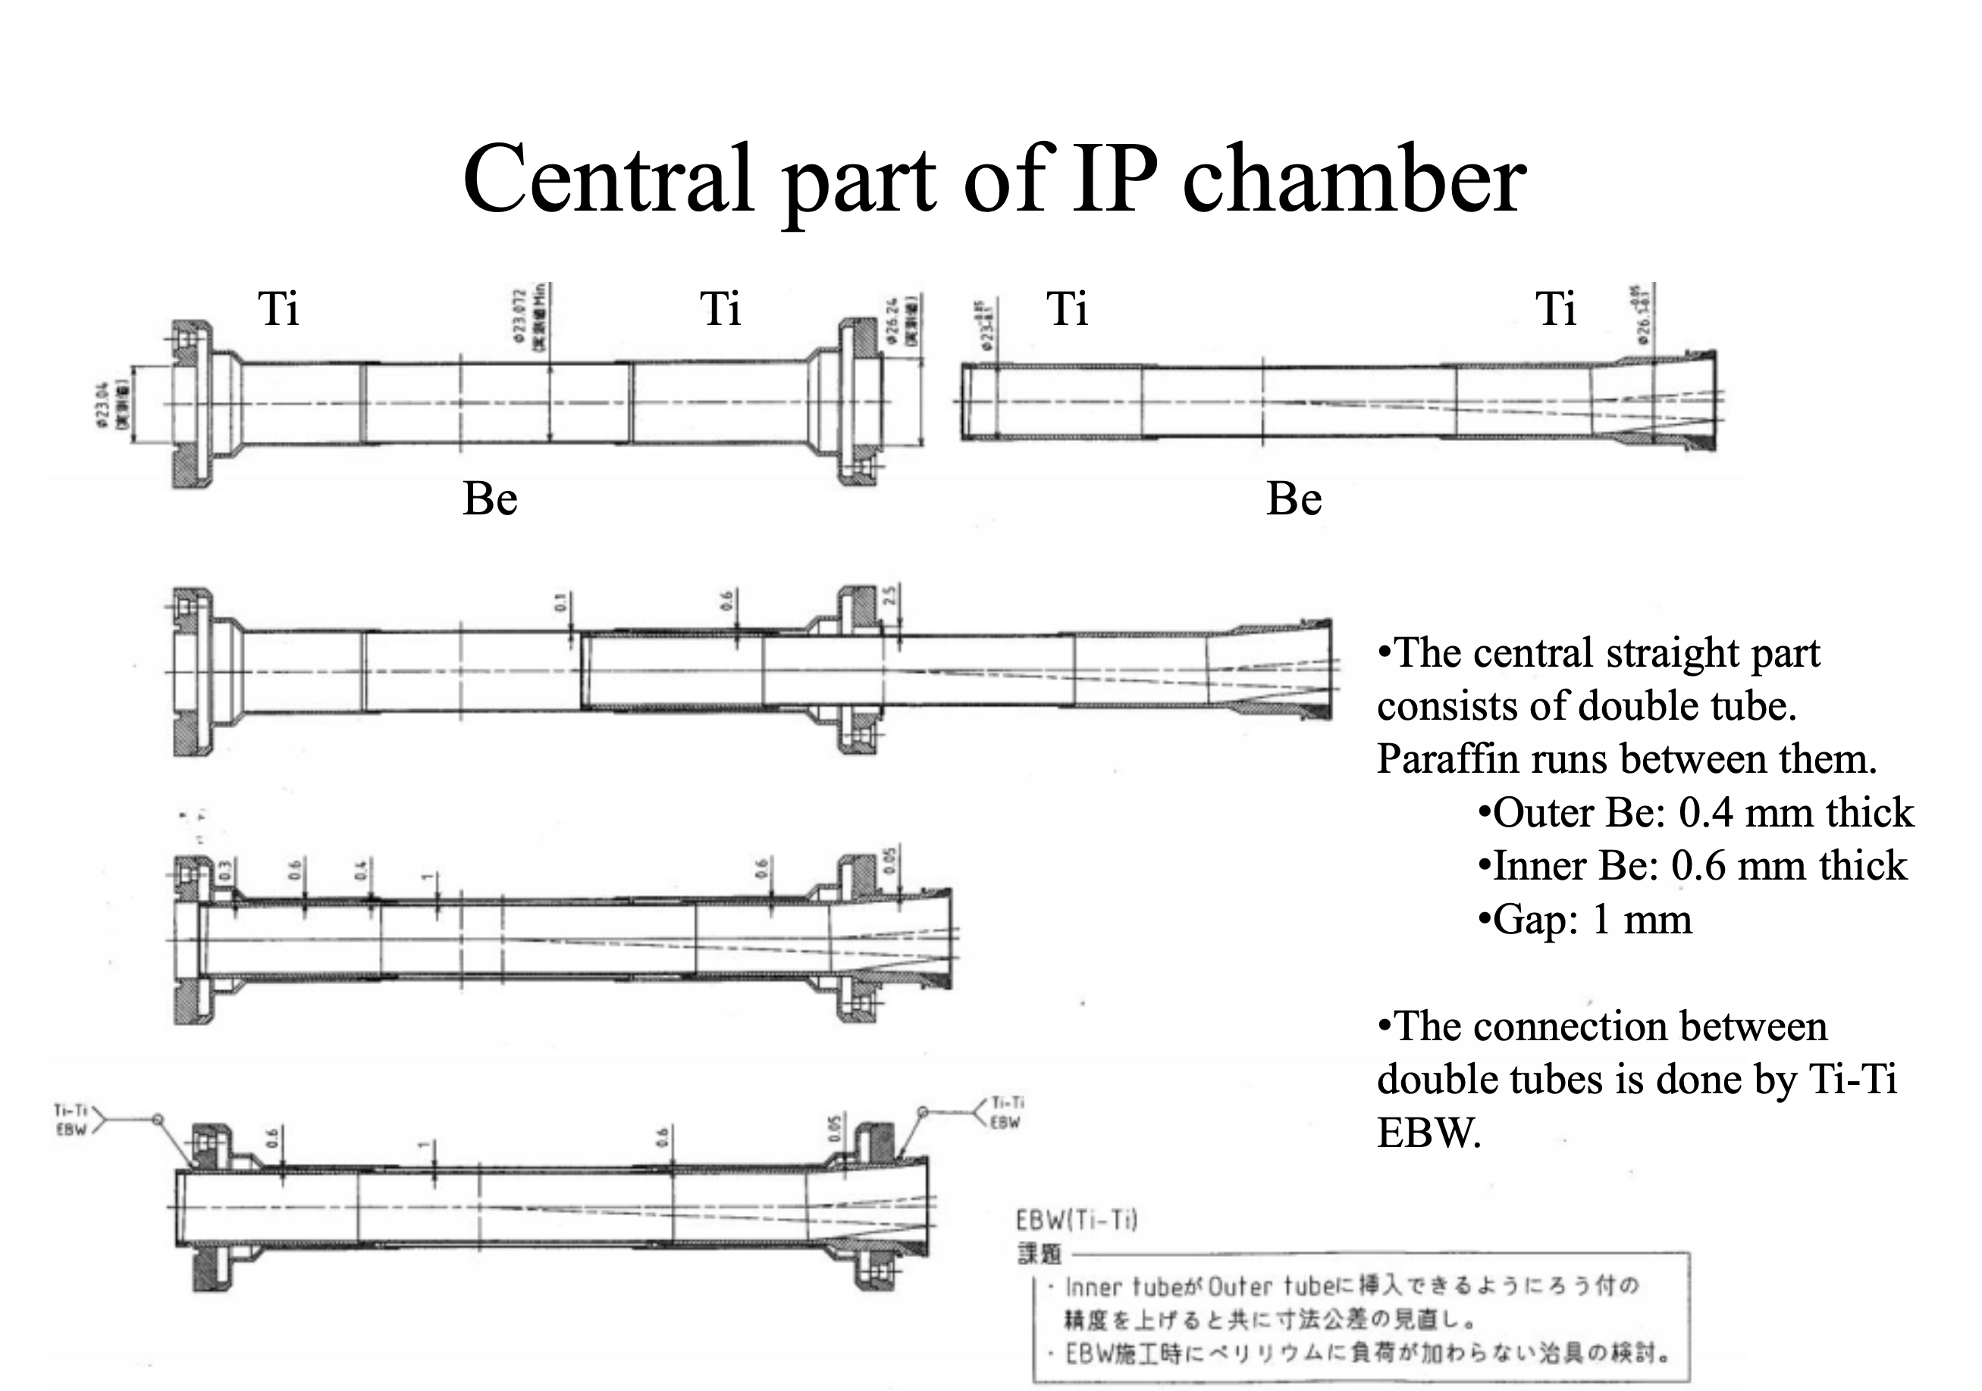
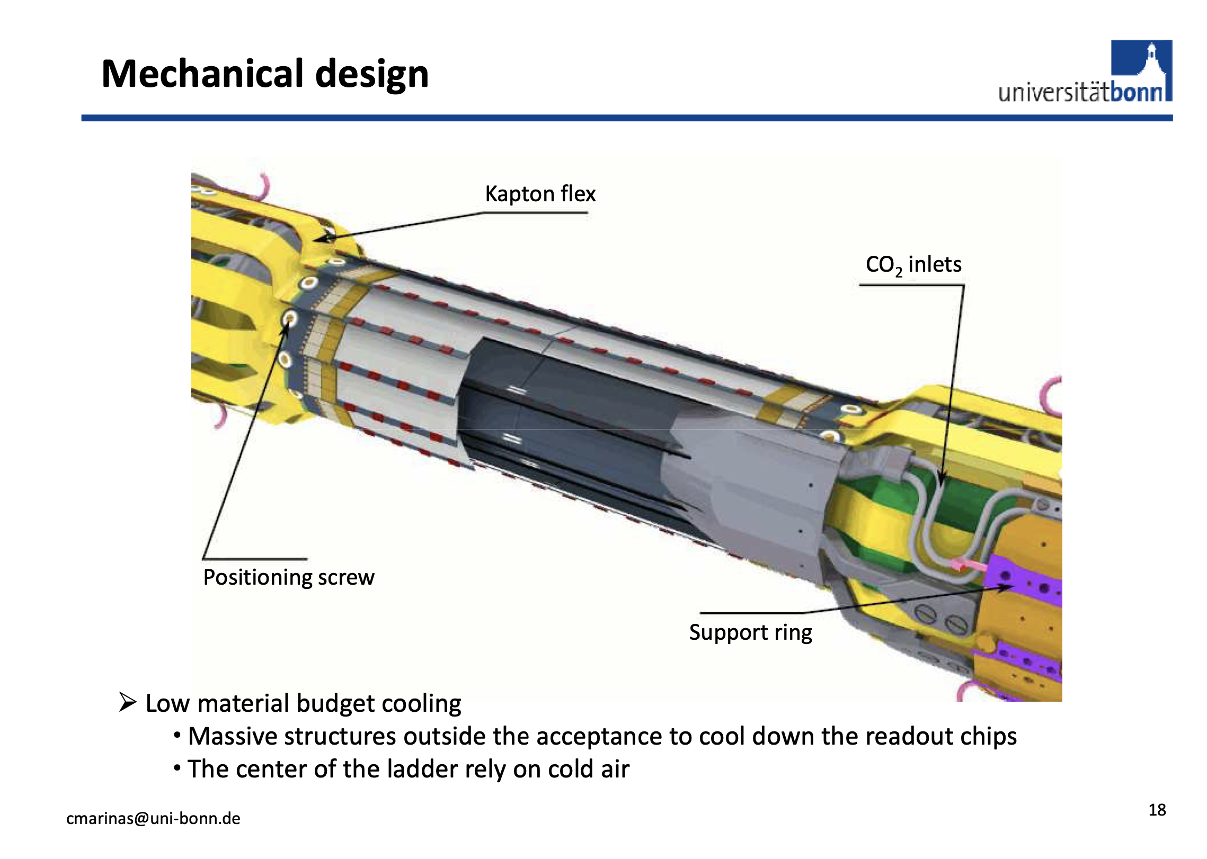
SuperKEKB Be beam pipe at IP
The beam pipe at the IP is a double pipe, each consists of middle (Be) and side (Ti) parts, brazed to each other.
The inside of inner pipe is Au coated (10 μm thickness via 0.3 μmTi) by magnetonsputtering
Paraffin runs between them
K. Kanazawa
Light material (Be) inside detector acceptance
Paraffin (C₁₀H₂₂) flow to remove heat from image charge (~80 W)
Gold plating on inner wall protects detectors

Slide 18
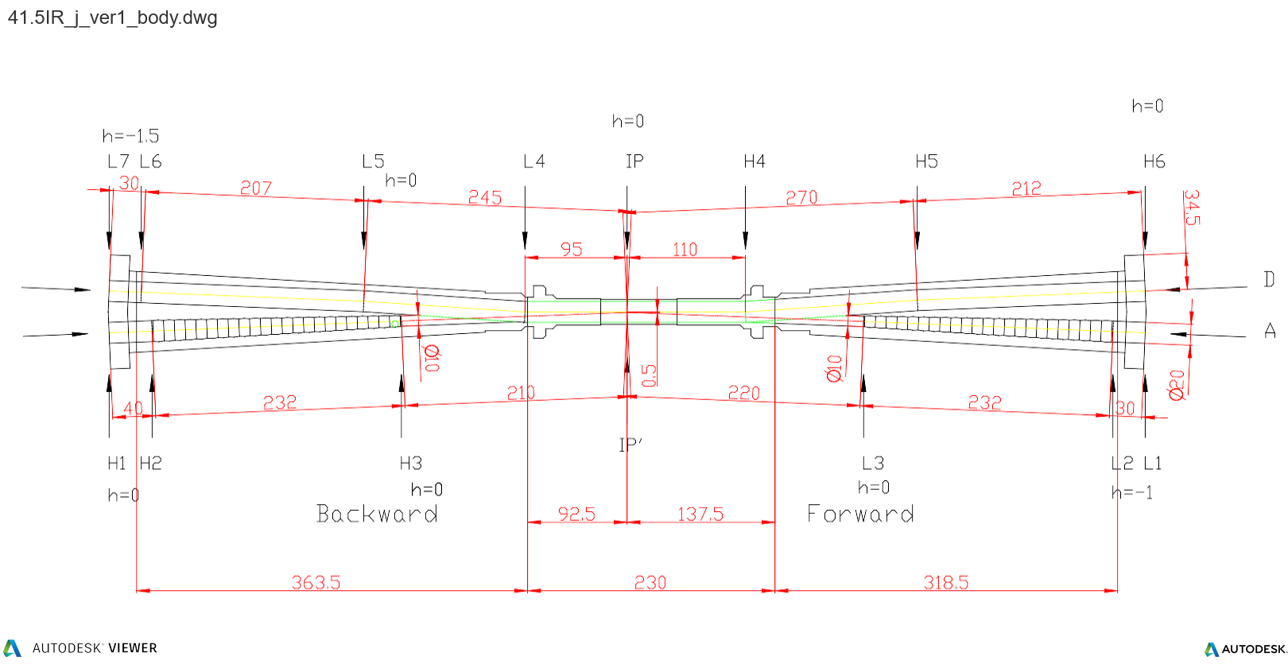
IR beam pipe
The smallest aperture is about 20 cm from the IP and has a diameter of 10 mm. The last tip has a 9 mm diameter.
At this location, a 4.5mm radius equals about 60 σ_{x} and 100 σ_{y}
SR mask tips
e-
e+

Slide 19
SuperKEKB backgrounds experience
Data/MC signals now within a factor of 2-3 with many down to the 20% level or better
This includes detector background signals for large radius detector subsystems i.e. calorimeter, TOP (Cherenkov particle ID), drift chamber,…
great job modeling the various backgrounds!
Vacuum scrubbing still major background source, Touschek is very important source for Belle II (highly dependent on the beam size, for them on the vertical size)
SR hit pattern on PXD forward: At the beginning of the run (2018) an unexpected background was found in the partially installed first layer of the vertex detector (PXD). It was explained as backscattered photons from downstream of the beam pipe that bounced back into the Be section producing hits in the pixel detector. This could be explained increasing the beam tails distribution in the model. (not critical, but under observation)
Injection background: Belle II needs trigger veto after each injection, ~7-8% deadtime
Possible upgrades for backgrounds mitigation and reach full 𝓛
  Collimators: add new ones and move some
  Additional shield around QCS bellow (2022)
  QCS modification,( 2026?): wider beam pipe aperture -> less beam losses, less overlap of solenoid and quads
  > 2030 possible luminosity upgrades

Slide 20
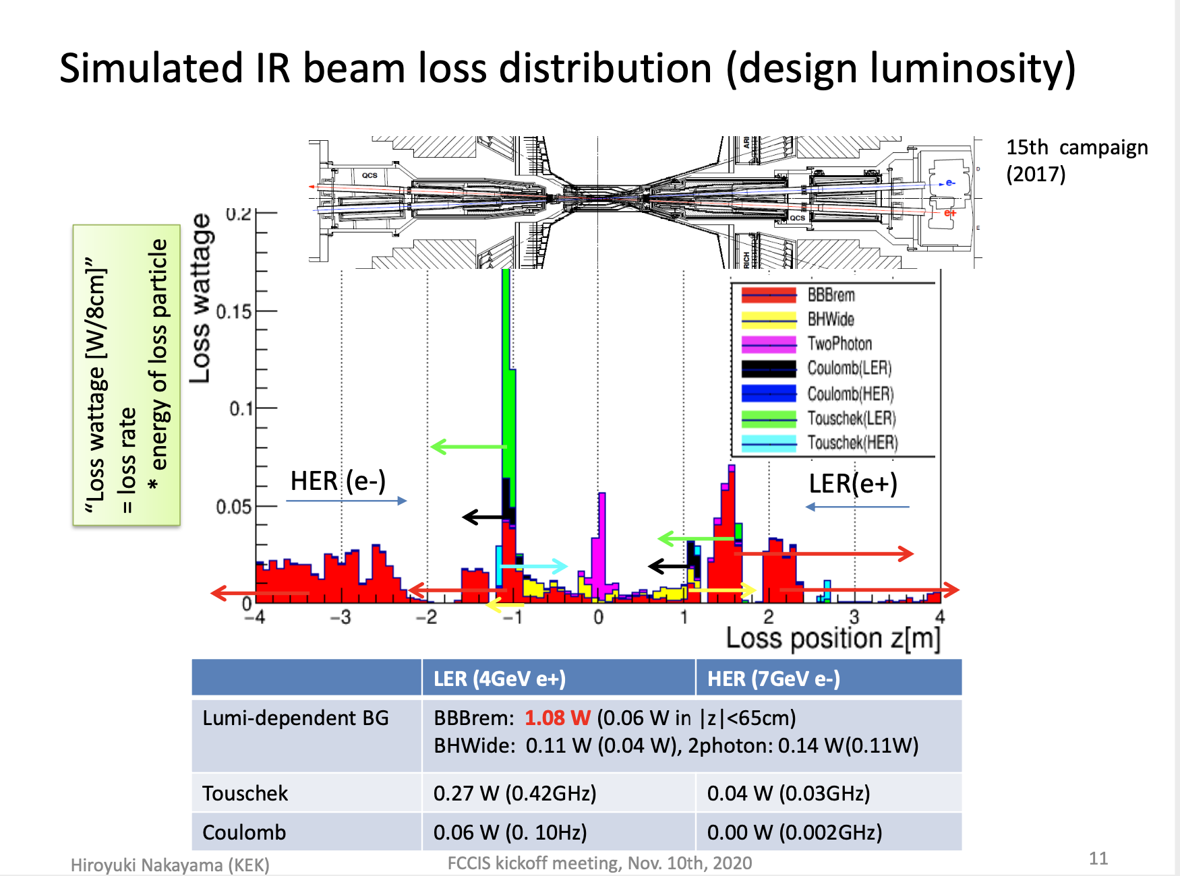
measured IP bkgs consistent with prediction –will dominate at full luminosity
H. Nakayama

Slide 21
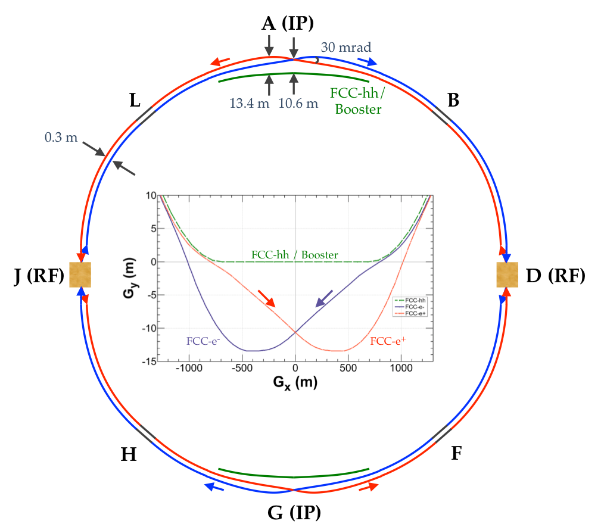
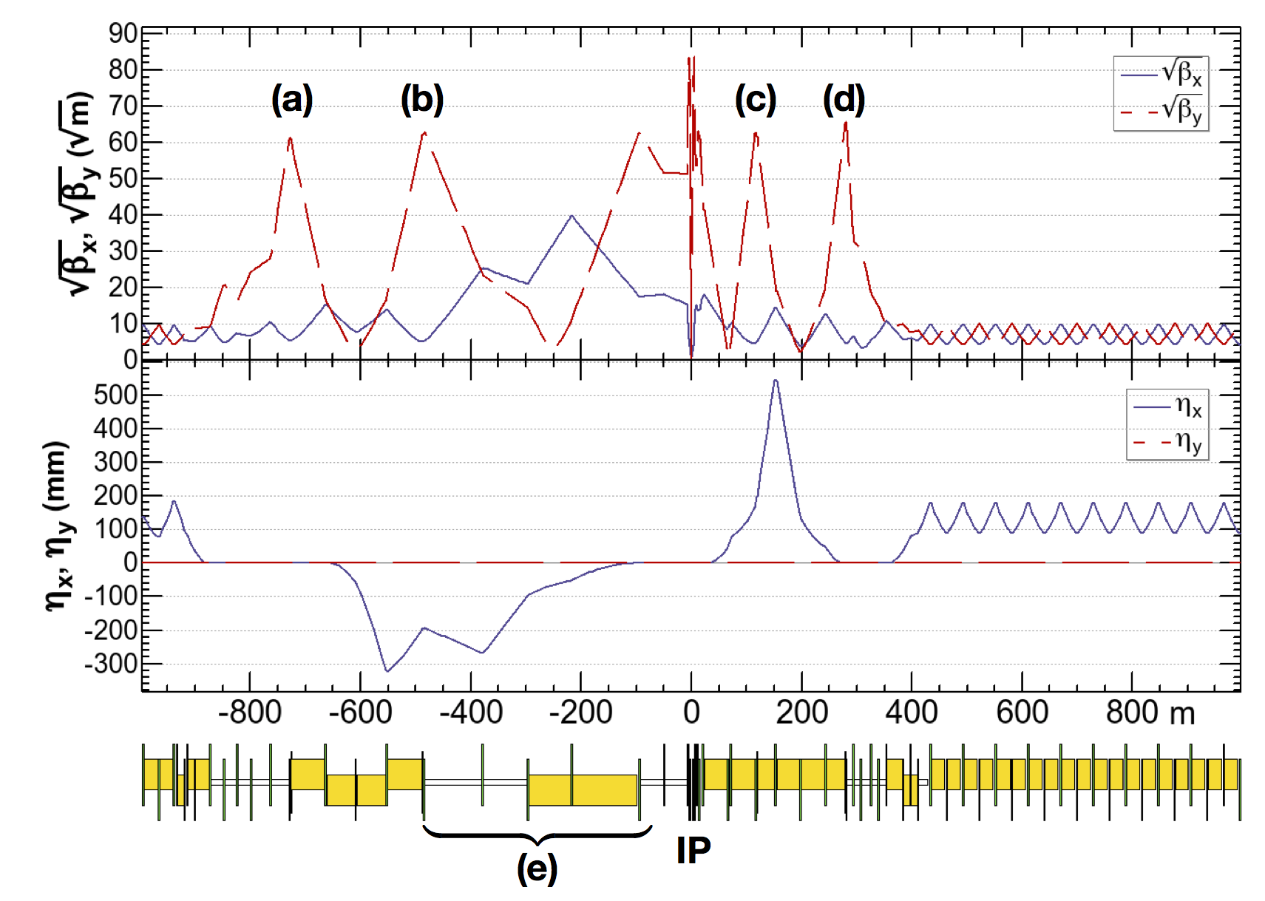
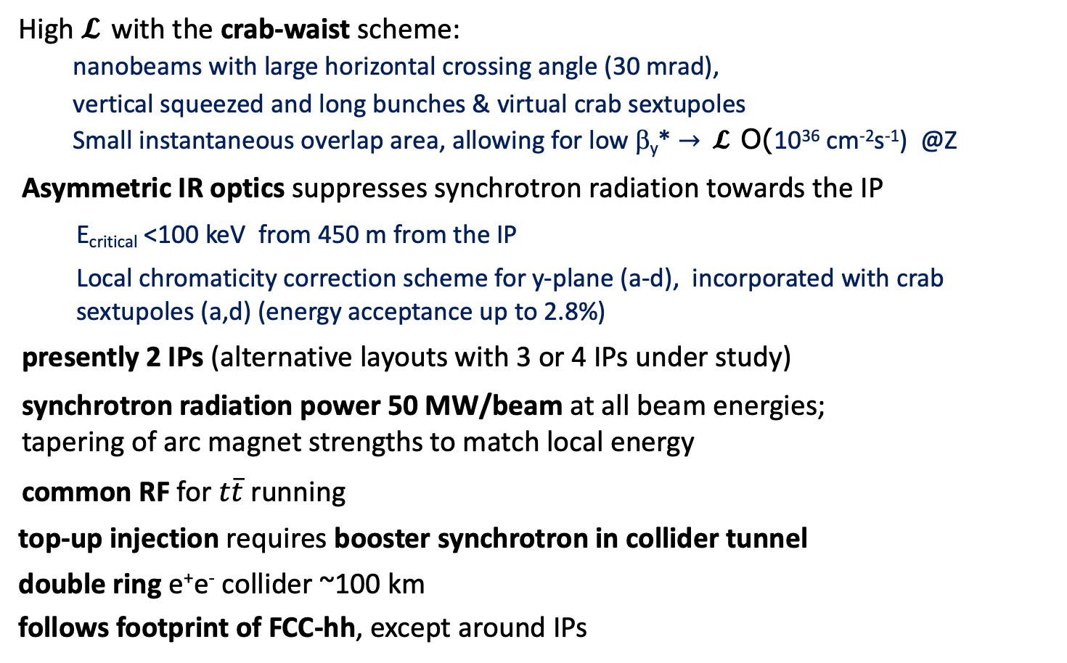
FCC-ee basic design choices
Determines the MDI layout
High 𝓛 with the crab-waist scheme:
  nanobeams with large horizontal crossing angle (30 mrad),
  vertical squeezed and long bunches & virtual crab sextupoles
  Small instantaneous overlap area, allowing for low β_{y}* $→$ 𝓛 O(10³⁶ cm⁻²s⁻¹) @Z
Asymmetric IR optics suppresses synchrotron radiation towards the IP
  E_{critical} <100 keV from 450 m from the IP
  Local chromaticity correction scheme for y-plane (a-d), incorporated with crab sextupoles (a,d) (energy acceptance up to 2.8%)
presently 2 IPs (alternative layouts with 3 or 4 IPs under study)
synchrotron radiation power 50 MW/beam at all beam energies; tapering of arc magnet strengths to match local energy
common RF for $t\overline{t}$ running
top-up injection requires booster synchrotron in collider tunnel
double ring e⁺e⁻ collider ~100 km
follows footprint of FCC-hh, except around IPs
182.5 GeV
yellow boxes:
dipole magnets

Slide 22
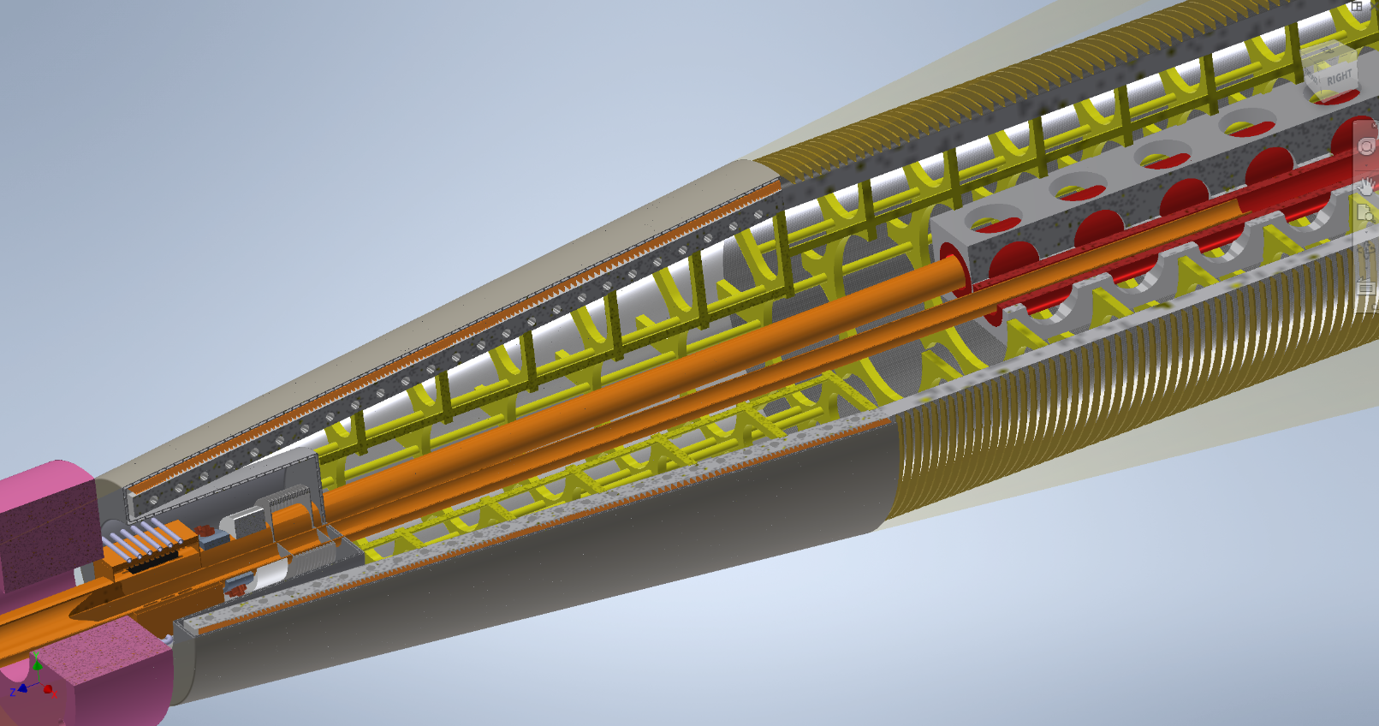
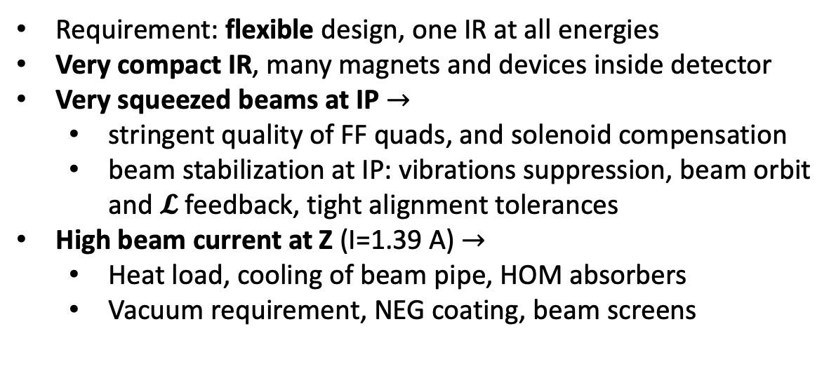
FCC-ee Interaction region & MDI – Integration challenge
Baseline MDI layout (CDR)
Requirement: flexible design, one IR at all energies
Very compact IR, many magnets and devices inside detector
Very squeezed beams at IP $→$
  stringent quality of FF quads, and solenoid compensation
  beam stabilization at IP: vibrations suppression, beam orbit and 𝓛 feedback, tight alignment tolerances
High beam current at Z (I=1.39 A) $→$
  Heat load, cooling of beam pipe, HOM absorbers
  Vacuum requirement, NEG coating, beam screens
L*=2.2 m
B=2 T
  Solenoid compensation scheme to preserve ε_{y}≈ pm
  Luminosity detector @Z: absolute meas. to 10⁻⁴ (low angle Bhabha), acceptance to 1 μm level, tight requirements on alignmement
  Synchrotron radiation: detector sustainability top priority
  Robustness against machine bkgs, occupancy
  Optimization of the central beam pipe design, material, thickness
  Keep low material budget: minimise mass of electronics, cables, cooling
Compensating
Solenoid
QC1
LumiCal
Winding
Flange
Beam Pipe
HOM absorber
3D modeling effort

Slide 23
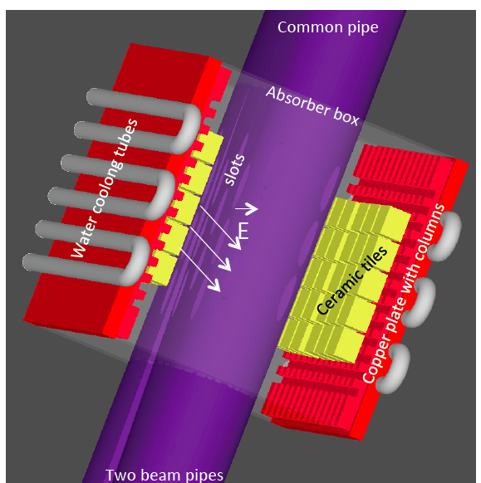
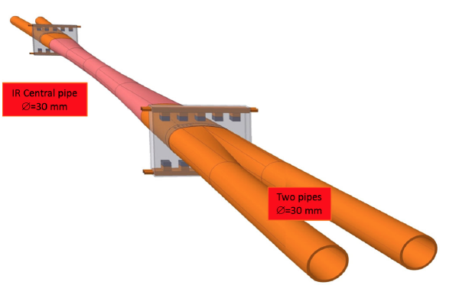
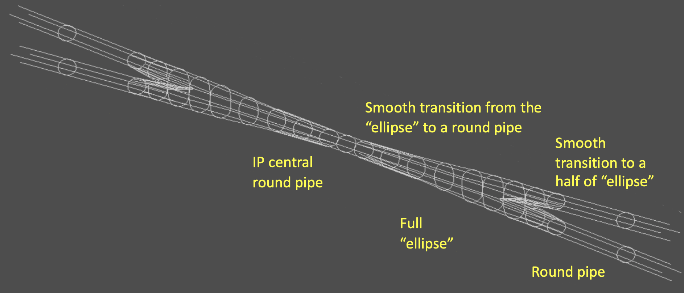
FCC-ee central beam pipe
Baseline design (CDR):
Warm pipe
Incoming and central beam pipes have a constant diameter of 30 mm
Central part in Beryllium (in the lumical window acceptance)
Shape determines low impedance
Very good vacuum, low bkgs: SR masks, coating
Remote vacuum connection (same concept as SuperKEKB)
HOM absorber
(from PEP-II experience)
[A. Novokhatski et al. PRAB 20, 111005 (2017)]
General concept for minimizing the impedance of an IR beam pipe. Smooth transitions in the pipe connection.
The transition from two beam
pipes to a common central pipe
requires HOM absorbers, due to trapped modes and propagating waves.
Liquid cooling needed due to the beam heat load, needed also in the central pipe (as for SuperKEKB).
few μm Au coating required in the central pipe (it can decrease the heat load by 30% but also for the low conductivity of Be)
-> one compromise to assure the best possible physics could be to foresee a different pipe for the Z and ttbar runs
(for SR shielding at ttbar, for heating from image currents at Z)
Notes:
Thickness depends on mainly engineer constraints, determined by stiffness , as for FCC-ee is long (wrt SuperKEKB) it will be thicker.

Slide 24
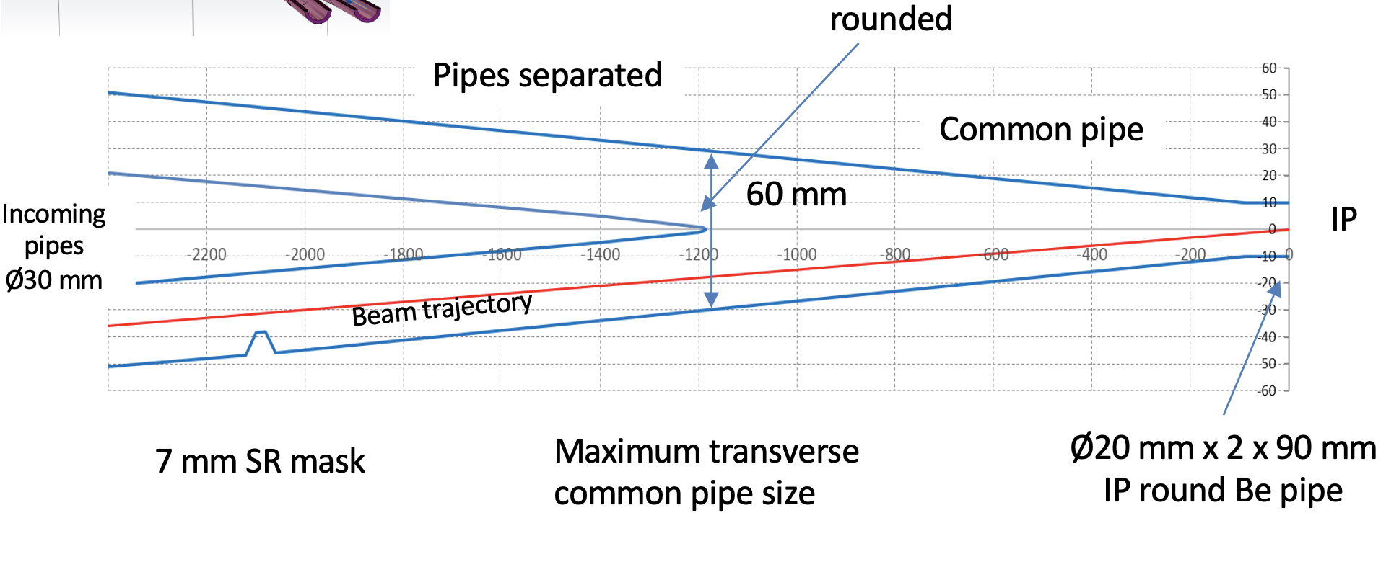
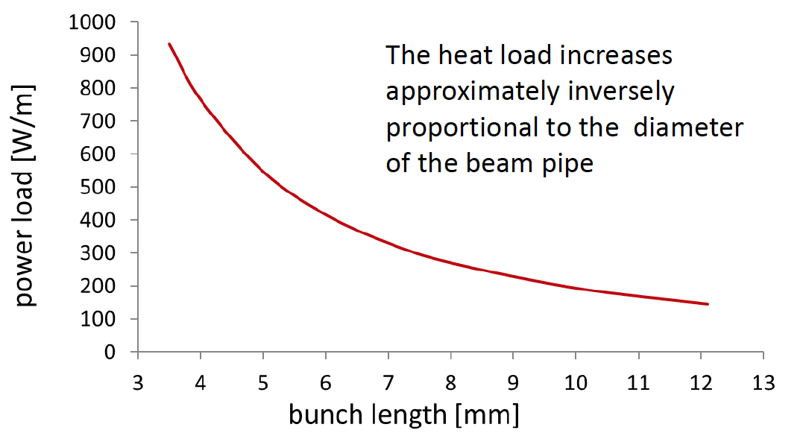
New FCC-ee central beam pipe with low impedance
Smaller central beam pipe 20 mm diameter
Novel improved design with no need of HOM absorbers
IR heat load unavoidable: em fields excited by the beams are due to the finite conductivity of the metal walls of the IR beam pipe
Beryllium pipe takes 150 W/m from a 12 mm bunch
The heating power strongly increases with shortening the bunch length
Heat load for 20 mm beam pipe
[A. Novokhatski, FCCWEEK 2020]
We are considering AlBeMet instead of Be (~same X0)
A trade-off between better physics and worse backgrounds is needed (by simulation),
given the relevance of the beam pipe choice, in terms of the success of the collider
Prototyping recommended

Slide 25
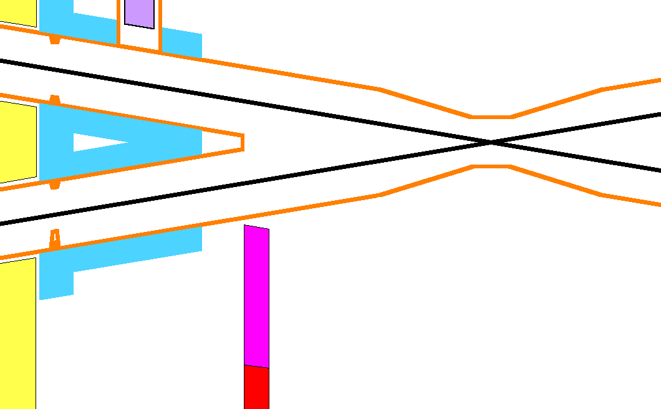
Synchrotron Radiation with smaller central beam pipe – Z case
M. Sullivan
Central pipe with 20 mm diameter and cylindrical length shorten from ±12.5cm to ±9cm
The bend radiation can be masked away by reducing the mask radius at -2.1 m from 10 mm to 7 mm from the beam line.
The quadrupole radiation cannot be totally masked away even with a 5 mm radius mask at -2.1 m
FF SR strikes here with 903 photons > 10 keV.
With the 7 mm mask tip this number becomes 18 >10 keV.
  On-axis beam, non-Gaussian beam tails to 20 σ_{x} and 60σ_{y}
Without changing the mask tip, this surface gets 8.9 W of SR power and 3.64e5 incident photons > 10 keV.
With the mask tip at 7 mm this number goes to 0.2 photons >10 keV.
Smaller beam pipe:
impact on the vertex detector study on-going
also to optimize pipe thickness
Mask tip increased to shield the tapered section

Slide 26
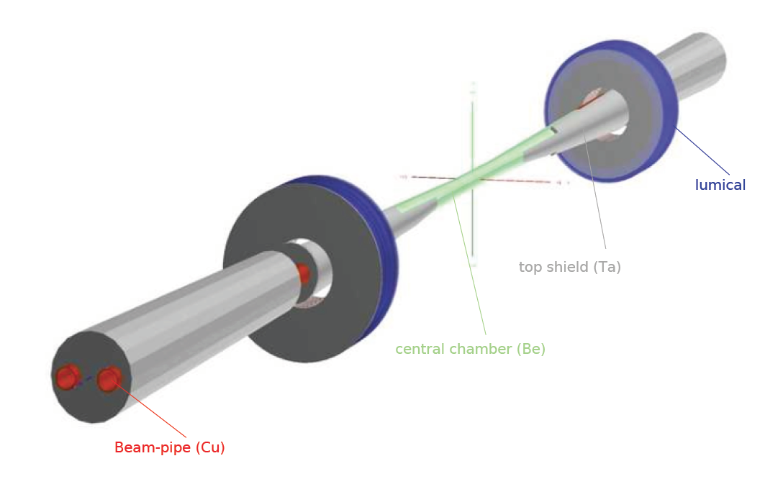
FCC-ee Background studies
Synchrotron radiation background
  different codes used on the accelerator side for collimation and masking (MDISim, Synch_bkg, SynRad+) and impact on detector (Geant4) -> effort on-going to optimize beam pipe, masks, shielding
Generation of background sources
  IP backgrounds
  Single beam backgrounds:
Tracking beam scattered particles
  to produce IR loss map → and track into detectors (CLD and IDEA)
  to produce loss maps around the ring → for collimation study
  Multiturn tracking for IP and single beam bkgs to be continued and strenghtened with more details, especially with non-ideal lattice (energy tapering with radiation, imperfections)
  Collimation scheme
  Beam tail
Backgrounds are found maneagable in detector as documented in the CDR,
it is essential to continue and refine these studies for more and more realistic simulations

Slide 27
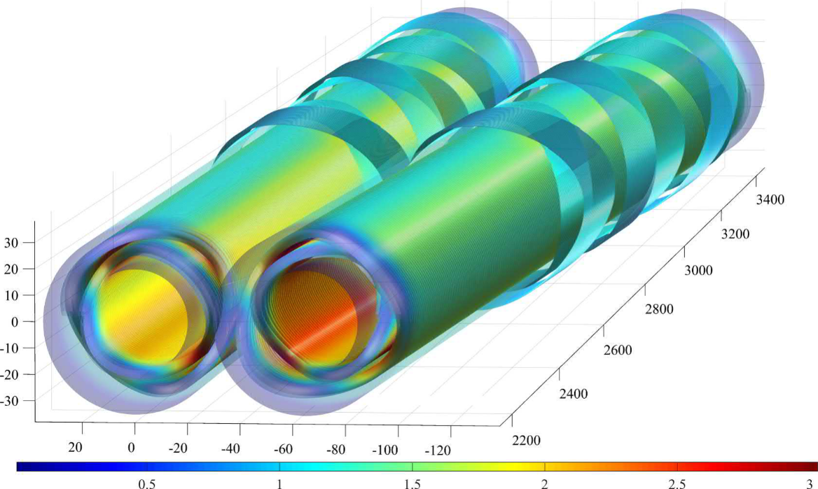
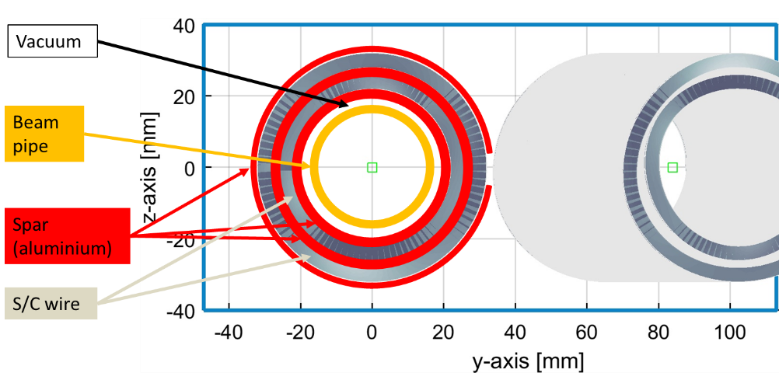
FCC-ee Final Focus quadrupole QD0 CCT design
Final Focus quadrupoles CCT design, design with many advantages.
The quadrupole is operated at 4.2 K, SC wires.
The maximum field gradient is 100 T/m.
The inner diameter of the beam pipe in the vicinity of QC1 is 30 mm; around QC2 it is 40 mm. The FF quadrupoles have an inner diameter of 40 mm and an outer diameter of 68 mm (truncated to 66 mm for the first FF element, QC1L1).
Study of proper shielding to avoid quench to be done
First study of a CCT approach for a similar application:
E. Paoloni, P. Fabbricatore et al. for the SuperB project
Prototyping and testing essential.
Small prototype was done, warm test recently performed.

Slide 28
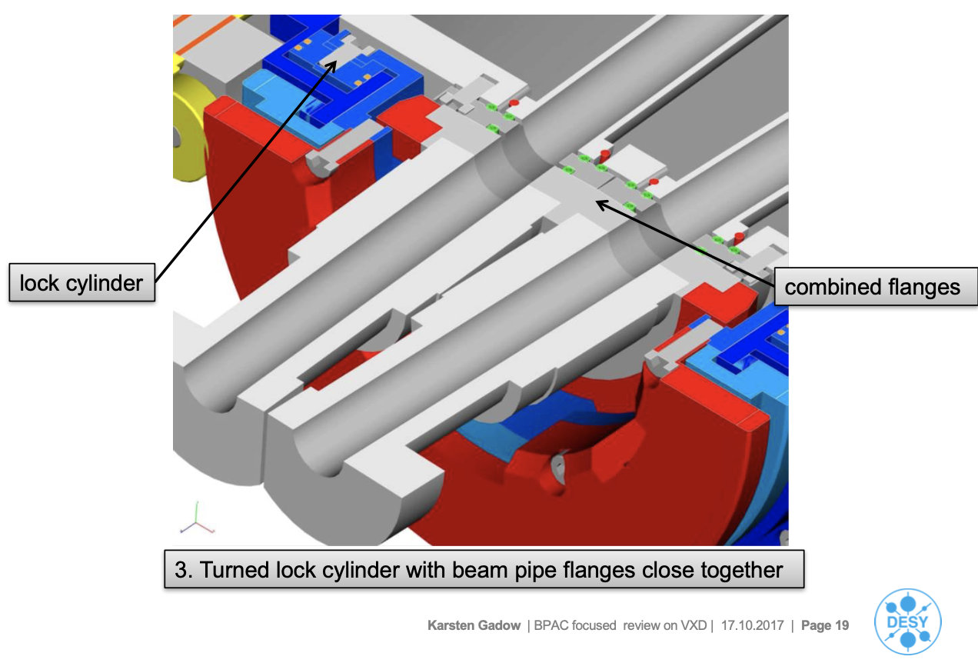
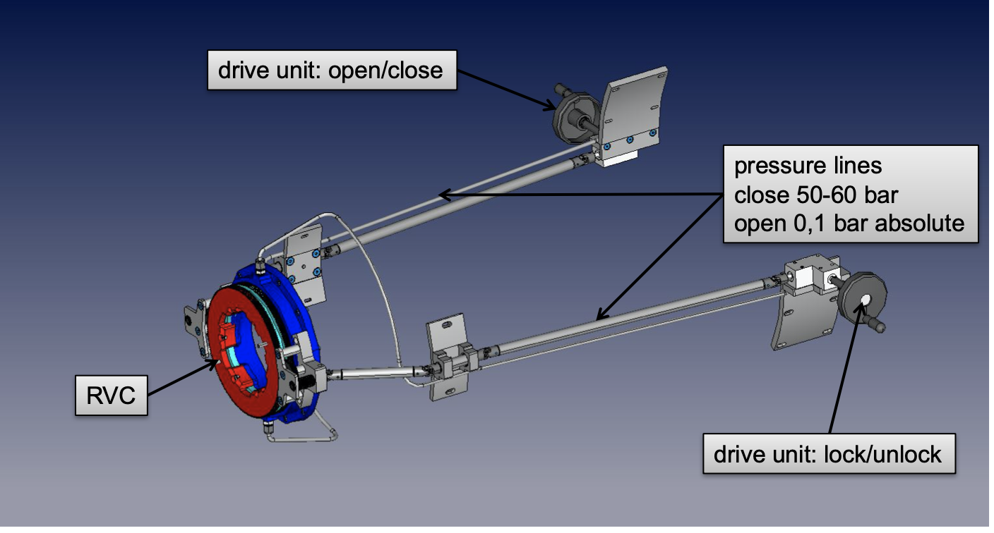

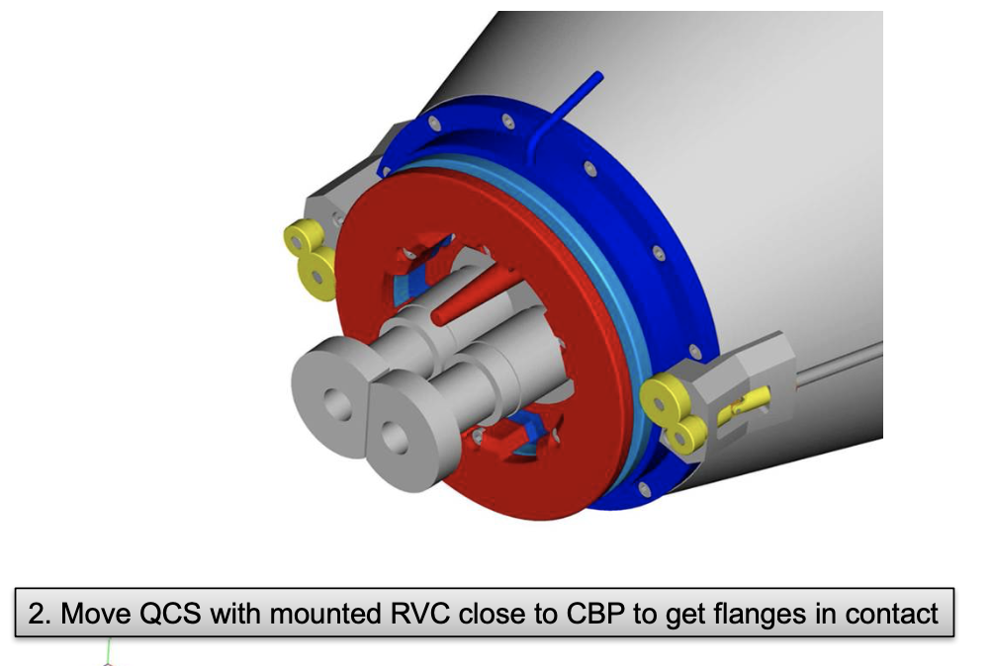

Remote Vacuum connection
The foreseen strategy for the vacuum connection after installation follows the one developed for SuperKEKB proposed by DESY (Karsten Gadow)
R&D advisable for FCC-ee

Slide 29
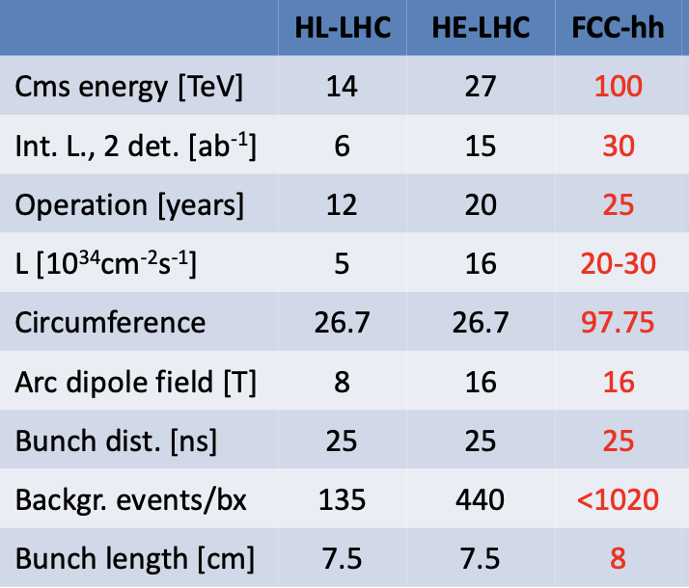
FCC-hh
31 GHz of pp collisions
Pile-up 1000
4 THz of tracks
L* [m] 23 40
Unprecedented particle flux and radiation levels
10 GHz/cm2 charged particles
≈ 10¹⁸ cm⁻² 1 MeV-n.eq. fluence for 30ab⁻¹ (first tracker layer, fwd calo)
signal events from “Light” SM particles produced with increased forward boost
–> spreads out particles by 1-1.5 units of rapidity
Two main IP’s in A, G for both machines
Two High Luminosity IPs A/G
Two Lower Luminosity IPs L/B
Similar to layout at LHC

Slide 30
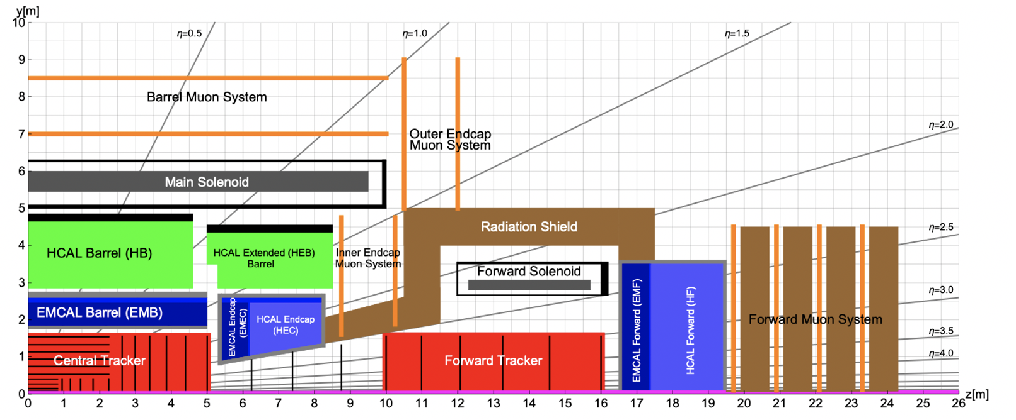
FCC-hh MDI
50m long, 20m diameter
Cavern length 66m
L* of FCC 40m.
additional protection
TAS
Triplet
Hall half length 33 m
before triplet 7 m
Detector half length 23.5 m
space 9.5 m
L* 40 m
500 kW power into detector and accelerator (CNGS target!)
radiation in magnets requires some improvements of radiation hardness, considered feasible

Slide 31
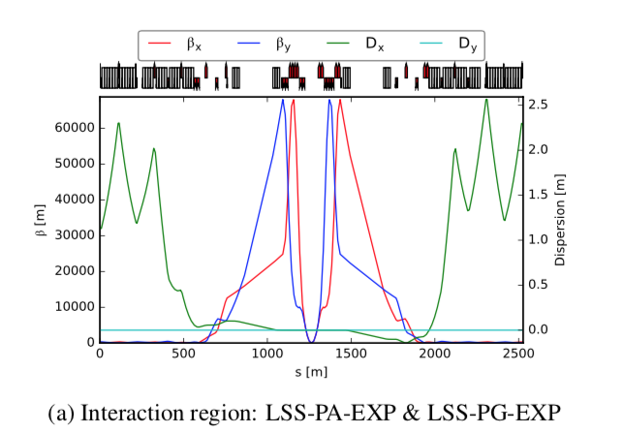
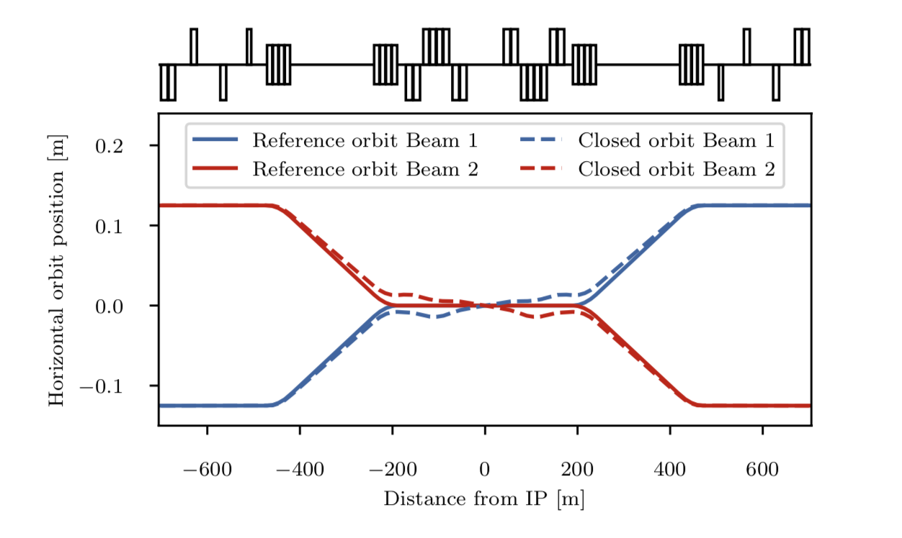
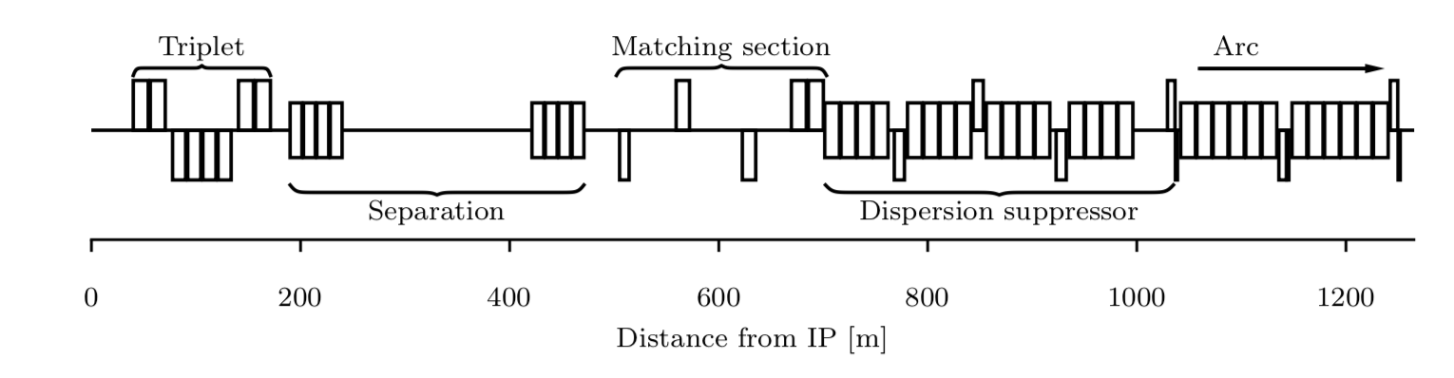
FCC-hh IR optics
Design follows the structure of the LHC IR
small β* at IP (∝1/√E): demanding IR optics design & large aperture in final focus triplet
Challenge for magnet, protection design and collimation system (to intercept tail particles that could hit the triplet)
1.4 km required
Final focus is a triplet (superconducting magnets) with a single aperture followed by normal conducting dipoles that separate the beams in individual aperture
Design of the final focus system is driven by energy deposition from collision debris from the IP: short drift between IP and quad and large aperture in FF quads
20 m reserved for crab cavities

Slide 32
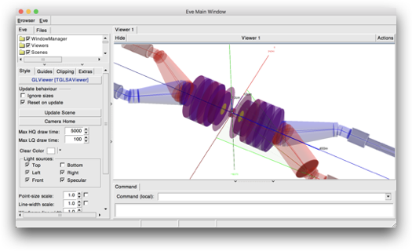
MDISim Toolkit
[Ref. MDISim]
Synchrotron Radiation from 50 TeV protons has been simulated into the MDI, finding a negligible contribution

Slide 33
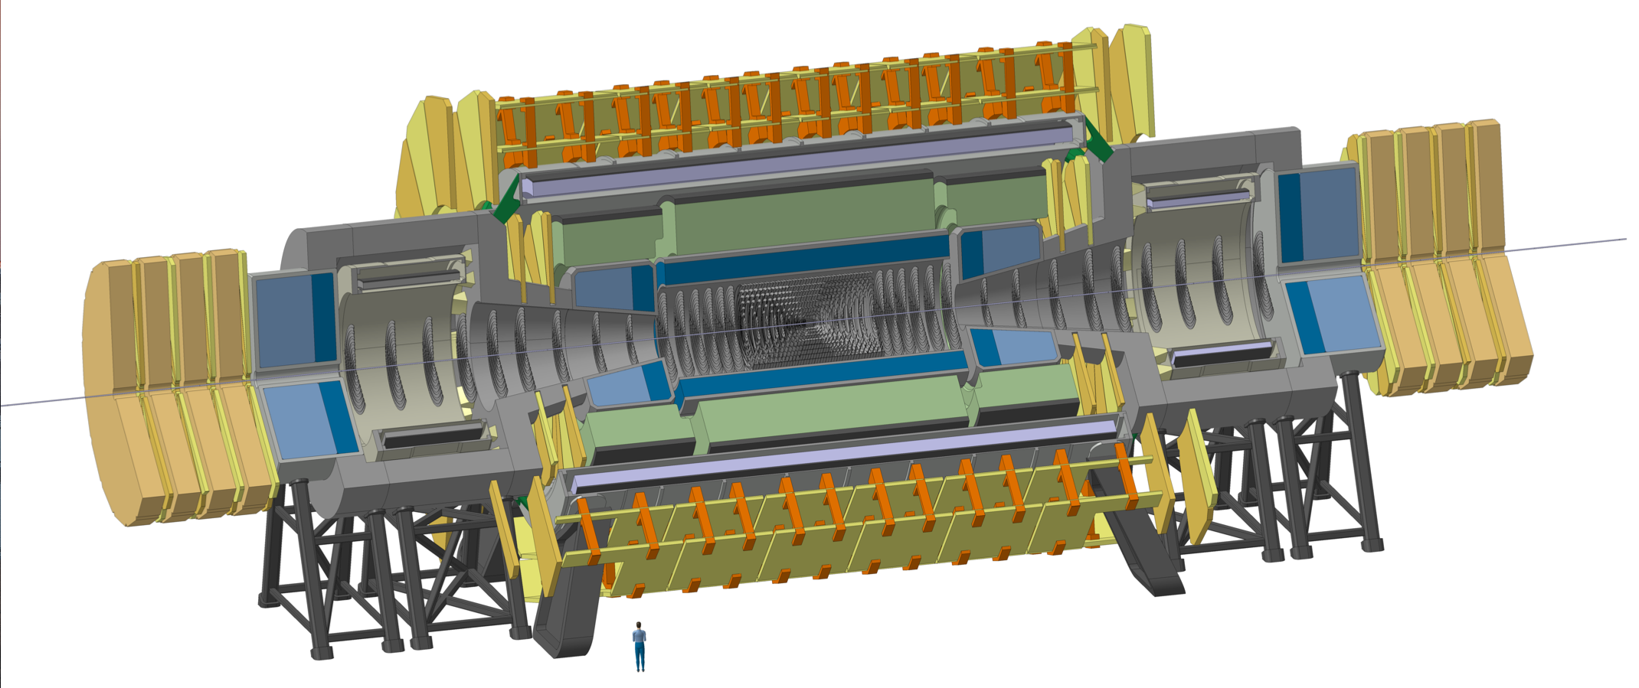
FCC-hh Reference Detector
4T, 10m solenoid, unshielded
Forward solenoids, unshielded
Silicon tracker
Barrel ECAL LAr
Barrel HCAL Fe/Sci
Endcap HCAL/ECAL LAr
Forward HCAL/ECAL LAr
50m length, 20m diameter
similar to size of ATLAS
Stored energy 12.5 GJ (det.), 13 GJ cold mass + cryostat 2000tons

Slide 34

FCC-hh Radiation Studies for L=3x10³⁵ cm⁻²s⁻¹ and 30ab⁻¹
Maximum of 10kHz/cm² of charged particle rate in the Barrel and Forward Muon System, similar to HL-LHC Muon Systems.
In the tracker volume the charged particle rate is just a function of distance from the beampipe with rather small dependence on z.
Hadron fluence in the order of 10¹⁸ /cm² close to the beampipe and 10¹⁵ -10¹⁶ /cm² (HL-LHC levels) for r>40cm.
Extreme fluences in the forward calorimeter …
Triplet (z=40m), Triplet shielding TAS (z=35m) and related radiation are nicely ‘buried’ inside the tunnel.

Slide 35



Comparison to ATLAS & CMS

Slide 36

EIC IR & MDI
E_{cm}=104.9 GeV (h275/e-10)
𝓛 =10³⁴ cm⁻²s⁻¹
N [10¹⁰]= 6.9 h/ 17.2 e-
L*= 4.5 m
Rear Direction
Forward Direction
Top view
IR Design integrates
FF magnets
luminosity and neutron detectors
e- taggers
spectrometer
near-beam detectors (Roman pots for h)
crab cavities
spin rotators both beams
  B=1.4 T
h
e-
Squeezed beams, esp. vertically, small βy* : small L* & strong FF quads (esp. hadron beam)
Chromaticity needs to be compensated by nonlinear sextupoles which in turn reduce dynamic aperture
Large acceptance of protons scattered off the IP required: very large apertures also for FF quads, scattered protons and neutrons are detected far downstream the IP
Near-beam-detectors, placed along the forward hadron beam pipe
Crossing angle (25 mrad): trade-off between the space for neutron detector at zero degree (forward direction) and luminosity monitor (e- exit) and crab cavities (small voltage for beam dynamics issues)

Slide 37
EIC IR & MDI
Rear Direction
Forward Direction
Top view
  ZDC 60cm x 60cm x 2m @~30 m
h
e-
(HERA experience)
Requirements for hadron beam direction
  B0pF: Forward Spectrometer (6 - 20 mrad)
  Neutron Detector (+/-4 mrad)
  Roman pots (sensitive 1 to 5 mrad)
Mostly interleaved magnets
  Exception: B0 and Q1BpF/Q1eF
Large apertures of proton forward magnets
Synchrotron radiation background
  No bending upstream for leptons (up to ~35m from IP)
  Rear lepton magnets: aperture dominated by sync fan
Lepton magnet aperture 15 σ beam size aperture (determined by the Syn. Rad cone)
Hadron magnets: 10σ beam size aperture

Slide 38


EIC
EIC CDR (2021)

Slide 39

Central vacuum chamber
High electron beam current 2.5 A -> (related issues: vacuum, photodesorption, heat load)
Small diameter, thin walled Be in center region.
Smooth tapers and transitions to limit energy deposited by beam in trapped modes (wakes).
Considering HOM absorbers

Slide 40


LHeC IR
ArXiv:2007.14491 (2020)
Head-on electron-proton collisions with dipoles in IR
On one side the beams should be fast separated, but this enhances the SR in the detector region, as a trade-off L* is increased and compromise for the β* values found (same achromatic telescopic squeezing implemented for HL)
To be incorporated in the HL-LHC lattice -> some constraints
non focused beam bypasses the interaction
focused interacting proton beam
L*(proton) = 15 m (was 10 m in CDR)
e- beam from ERL
E(e-) = 49.19 GeV, I=20mA
P_{SR} = 38 kW
E_{critical} =283 keV
Challenge from the SR in the IR is a bit relaxed with longer L*
Challenge on beam current > 20 mA
sub-μm level stability at IP required
The beam pipe radius is an experimental challenge coping with strong SR and the forward tagging acceptance (similar to LHC challenges but there there is no pile-up in ep)
A dipole (B0) of 0.21 T separates e-/p at the entrance of the first quad
Nb₃Sn CS for the proton triplet quads
Intense e+ source would be needed for LHeC, R&D on e+ sources as joined effort for LC and LEMMA would be of interest

Slide 41




LHeC
ArXiv:2007.14491 (2020)
Detector concept
Solenoid and dipoles system housing in a common cryostat
inner barrel tracker layers around the beam pipe
free bore 1.8 m extending along the detector for 10 m
elliptical shape chosen for the beam pipe to allocate the three beams envelopes
(15σ for p beam, 20σ for e- beam)

Slide 42


MDI challenge at Muon Colliders
Far future collider. MAP project: a design study was done, with experiment on cooling (MICE), proton target (MERIT)
𝓛 ~ 10³⁵cm⁻²s⁻¹ obtained with O(10¹²μ/bunch) inducing radiation hazard due to the neutrino production, fast muon decay. The MDI design is challenging.
Dedicated backgrounds simulation were performed +/-200 m from the IP, Ecm@1.5 TeV
muon decay induced backgrounds
To protect SC magnets and detector, 10 and 20 cm W masks with 5σ_{x,y} elliptic openings are placed in the IR magnet interconnection regions and a sophisticated W cone inside the detector. (nozzles – crucial role)
μ
[N. Mokhov]
Recently these studies are being revisited by the International Muon Collider collaboration, forming after the EPPSU
Positron-driven source MC would have the great advantage of aiming at high luminosity with low-emittance muon beams, allowing to reduce the muons/bunch, reducing the backgrounds, relaxing the challenge on the MDI (but the main challenge for high luminosity is on high e+ production rate)

Slide 43

M. Palmer
Muon Collider Parameters
Exquisite Energy Resolution
Allows Direct Measurement
of Higgs Width
Success of advanced cooling concepts
a several × 10³² [Rubbia proposal: 5×10³²]

Slide 44
Conclusion
MDI can be the key for success/unsuccess for any collider -> it is really mandatory to dedicate the proper R&D and effort in the optimization of its design.
Some of the main challenges and R&D discussed for different projects:
  strong SC magnets, compact and high field magnets design
  experience in synchrotron radiation mitigation, including vacuum chambers technology,
  low impedance vacuum chamber, material and thickness optimization, radius (great impact on vertex detector!)
  vacuum chamber cooling due to heat load
  alignment systems inside the detector
  BEAM INDUCED BACKGROUNDS & SYNCHROTRON RADIATION BKG: correct and reliable modeling essential for a successful MDI design, R&D not easy, experience on present (and past) colliders really important.

Slide 45
Spare slides

Slide 46


Slide 47
ILC collimators
The collimation apertures required are approximately ∼6–9σx in the x plane and ∼40–60σy in the y plane. These correspond to typical half-gaps of the betatron spoiler of ∼1 mm in the x plane and ∼0.5 mm in the y plane.
The spoilers are 0.5–1 X₀ (radiation length) thick, the absorbers are 30 X₀, and the protection collimators are 45 X₀.
Electromagnetic showers created by primary beam particles in the collimators produce penetrating muons that can easily reach the collider hall. The muon flux through the detector is reduced by a 5 m-long magnetised iron shield 330 m upstream of the collision point that fills the cross-sectional area of the tunnel and extends 0.6 m beyond the ID of the tunnel ((with B= 1.5 T), also as radiation protection.

Slide 48


Slide 49





Superkekb FF quads
The SC quadrupole magnet consists of the two layer SC coils (double-pancake structure). For the coils, the Rutherford type NbTi cables were used. The cable consists of 10 strand wires of φ0.5 mm. SC corrector magnets had been developed from 2011 in BNL, and 43 corrector magnets were completed in February 2015. The winding of the SC coil was performed by the computer controlled winding robot, and the SC wire of φ0.35 mm was directly stuck on the outer surface of the sup- port bobbin as the helium inner vessel.

Slide 50


SR spectra and outgassing loads
Z-Pole: very high photon flux (→ large outgassing load);
Z-pole: compliance with scheduled operation (integrated luminosity first 2 years), requires quick commissioning to I_{NOM}=1.390 A;
t-pole (182.5): extremely large and penetrating radiation, critical energy 1.25 MeV;
t-pole (and also W and H): needs design which minimizes activation of tunnel and machine components;
W, H-pole: intermediate between Z and T; still E_{crit} > Compton edge (~100 keV)

Slide 51


ALICE 3 – MDI R&D and Challenges
Fast and ultra-thin detector with precise tracking and timing
Fast -> for higher luminosity
R&D on vertex layers
Inner tracker
  (futuristic) retractable detector for minimal distance from IP
  ultra-thin layout MAPS sensors
  small pixel pitch fro position resolution O(1 μm)
Outer tracker
  low material budget, lightweight mechanics, cooling and services
  cost-effective sensors & modules
Dedicated forward detector for soft photon, low p_{T}

Slide 52

Radiation Studies for L=3x10³⁵ cm⁻²s⁻¹ and 30ab⁻¹
Dose of 300MGy in the first tracker layers.
<10kGy in HCAL barrel and extended barrel.
Dose from activation towards the end of FCC operation, 1 week of cooldown, so significant decrease for 1month, 1 year.

Slide 53

EIC MDI – IR Challenging Integration
Requirements:
  Large rapidity coverage, -4 < eta < 4 and behond especially in far-forward detectors
  small micro-vertex and large radius tracking
  Detector hermeticity
Challenge: large acceptance for diffraction, tagging, neutrons from nuclear breakup ->
Integration challenge: many ancillary detectors integrated in the beamline: low-Q2 tagger, Roman Pots, Zero-Degree Cal.,
Luminosity meas.: hadron control of systematics, also for e- and hadron polarimetry
Vertex: small micro-vertex: MAPS, options: 6-layer barrel, 5+5 disks Si, option GEM for the most external. Hybrid option: SiV+TPC (barrel), 7 Si disks, opt1 TPC+ext.l.MPGD; opt2 coaxial layers of microRW. 20 mu m pitch (10 mu m considered)

Slide 54





LHeC
[ArXiv:2007.14491 (2020)]
IR
e-: doublet that optimises SR

Slide 55


Slide 56

ILC BDS
Ref. TDR
The main subsystems of the BDS are (beam direction):
• a section containing emittance measurement and matching (correction) sections, trajectory feedback, polarimetry and energy diagnostics;
• a collimation section which removes beam-halo particles that would otherwise generate unacceptable background in the detector, and also contains magnetised iron shielding to deflect and/or absorb muons generated in the collimation process;
• the final focus (FF), which uses strong compact superconducting quadrupoles to focus the beam at the IP, with sextupoles providing local chromaticity correction;
• the interaction region, containing the experimental detectors. The final-focus quadrupoles closest to the IP are integrated into the detector to facilitate detector “push-pull”;
• the extraction line, which has a large enough bandwidth to transport the heavily disrupted beam cleanly to a high-powered water-cooled dump. The extraction line also contains important polarisation and energy diagnostics.
The beam-delivery optics provides demagnification factors of typically several hundreds in the beam size, resulting in very large beta functions (several thousand kilometres) at critical locations, leading to the tightest alignment tolerances in the entire machine. In addition, careful correction of the strong chromaticity and geometric aberrations requires a delicate balance of higher-order optical terms. The tight tolerances on magnet motion (down to tens of nanometres), makes continuous trajectory correction and the use of fast beam-based feedback systems mandatory. Furthermore, several critical components (e.g. the final focusing doublet) may well require mechanical stabilisation.

Slide 57
Parameter Tables

Slide 58
FCC-ee collider parameters (stage 1)
parameter | Z | WW | H (ZH) | ttbar
beam energy [GeV] | 45 | 80 | 120 | 182.5
beam current [mA] | 1390 | 147 | 29 | 5.4
no. bunches/beam | 16640 | 2000 | 393 | 48
bunch intensity [10¹¹] | 1.7 | 1.5 | 1.5 | 2.3
SR energy loss / turn [GeV] | 0.036 | 0.34 | 1.72 | 9.21
total RF voltage [GV] | 0.1 | 0.44 | 2.0 | 10.9
long. damping time [turns] | 1281 | 235 | 70 | 20
horizontal beta* [m] | 0.15 | 0.2 | 0.3 | 1
vertical beta* [mm] | 0.8 | 1 | 1 | 1.6
horiz. geometric emittance [nm] | 0.27 | 0.28 | 0.63 | 1.46
vert. geom. emittance [pm] | 1.0 | 1.7 | 1.3 | 2.9
bunch length with SR / BS [mm] | 3.5 / 12.1 | 3.0 / 6.0 | 3.3 / 5.3 | 2.0 / 2.5
luminosity per IP [10³⁴ cm⁻²s⁻¹] | 230 | 28 | 8.5 | 1.55
beam lifetime rad Bhabha / BS [min] | 68 / >200 | 49 / >1000 | 38 / 18 | 40 / 18

Slide 59


PDG 2020
https://pdg.lbl.gov/2020/reviews/rpp2020-rev-accel-phys-colliders.pdf

Slide 60

KEKB and SuperKEKB

Slide 61




ILC TDR

Slide 62

ILC 2019

Slide 63

FCC-hh

Slide 64

Parameter Table
First tracking layer:
10GHz/cm² charged particles
10¹⁸ hadrons/cm² for 30ab⁻¹
Increased Boost at 100TeV ‘spreads out’ light SM physics by 1-1.5 units of rapidity.

Slide 65

Heavy Ions
The general purpose detector will also be able to perform well for PbPb collisions at the predicted Luminosities.
Continuous readout, PID from TOF with the timing detectors are good features for Heavy Ion Physics.
Operating at a lower field than 4T would of course be desirable (calibration questions to be worked out …)
The significantly lower radiation requirement allows of course optimized detector solutions that can outperform a general purpose detector.
We definitely have to keep the door open for a dedicated HI experiment setup.

