Slide 1
Local cooling
Paolo Petagna (CERN)
Marcel Vos (IFIC)
OUTLINE
Basic concepts
Future detector challenges
R&D needs
Final considerations

Slide 2
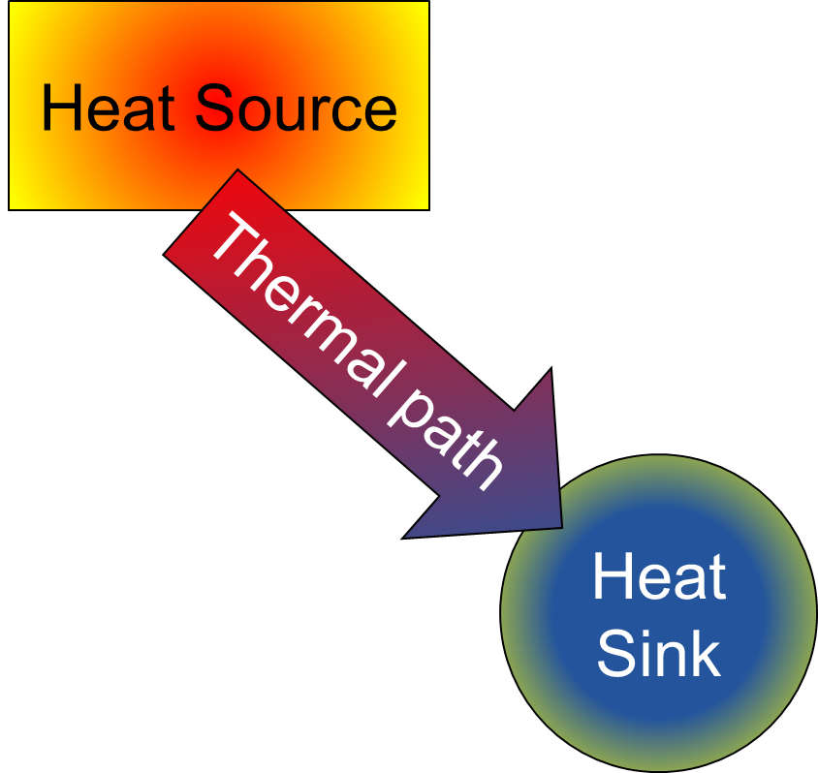
Thermal management of electronics
Engineer questions: Amount of heat produced by the Heat Source?
Max temperature of the Heat Source?
Uniformity requirements?
Stability requirements?
Temperature constraints on the Heat Sink?
Position of the Heat Source?
Heat Source / Heat Sink interface?
Space available?
Material issues (quantity & location)?
Environmental issues?
Cost issues?
Reliability?
Lifespan?

Slide 3
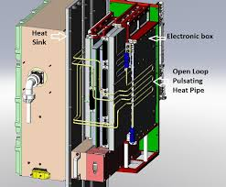
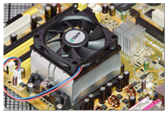
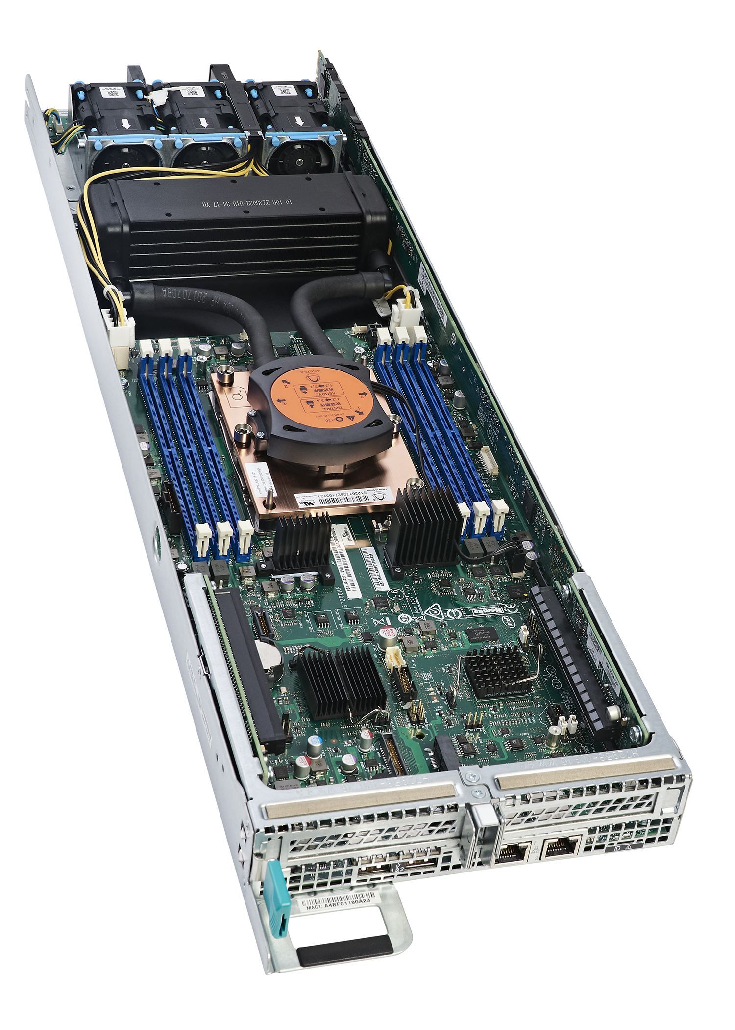
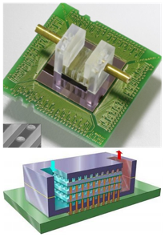
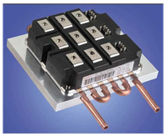
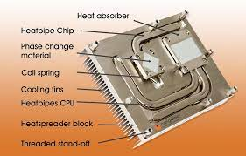
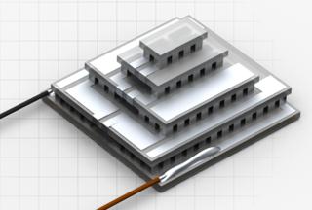
Thermal management of electronics
Based on the answers to the above questions, you can find different approaches to the thermal management of electronics (examples shown for high power computing chips, one of the most demanding applications in commercial electronics):
Forced air cooling
Pulsating heat pipe
Liquid assisted air cooling
Mechanically pumped
Heat pipe
Thermoelectric
Multi-micro-channel

Slide 4


Peculiarities of detector cooling
Low power density, but (usually) large surfaces
Moderate to very high radiation
Radiation length minimization
Cold operation
High uniformity in space
High stability in time
Magnetic field
Extreme reliability
Long lifetime
Two reference parameters
(usually competing)
$$TFM= \frac{∆T_{sensors−fluid}}{Surface Power Density}$$
(Varying weight of each parameter depending on the specific application)

Slide 5
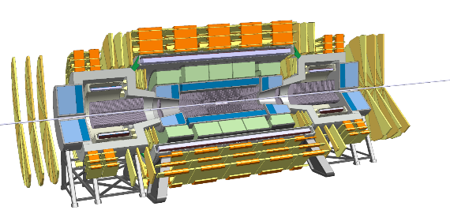
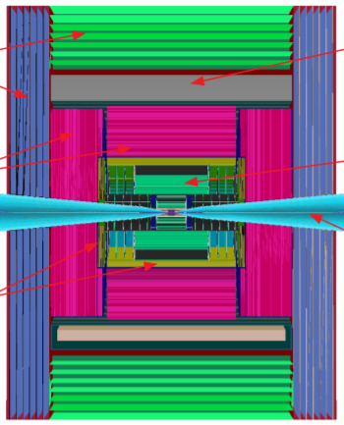
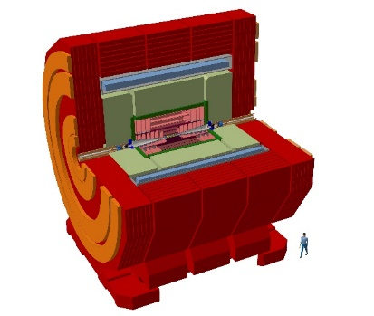
Future trends in cooling needs
HL-LHC, HE-LHC, FCC-hh
Tracker and Vertex: very cold and low TFM
ECAL: Lar? Digital Si/W? Analog Si/W?
Timing layers?
(Rare decays: Kaons, Tau)
Tracker and Vertex: a bit in-between
ECAL: Digital Si/W
Muon colliders
Strong interaction (fixed target or collider)
Linear e+e-, Circular e+e-
Tracker and Vertex: remove heat at minimum X₀
ECAL: Si? SciFi + SiPMs? Gaseous?
Timing layers?
(Rare decays: Mu->e+e+e-, Mu->e-)

Slide 6
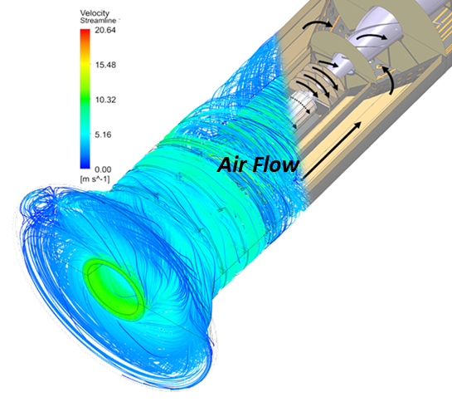
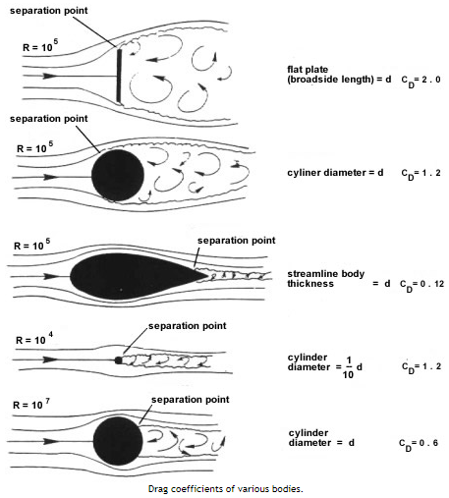
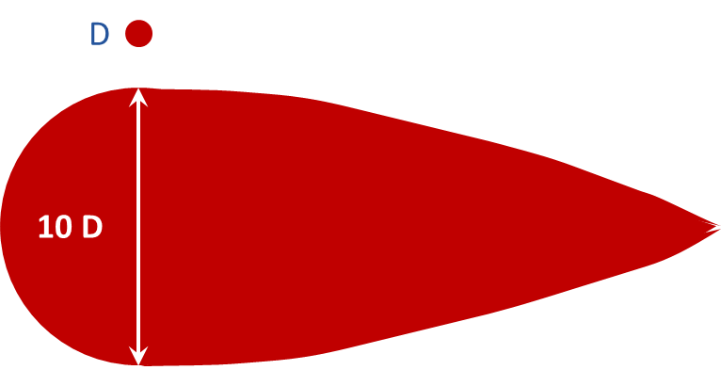
Air cooling: fears of a former aerodynamicist
Any fluid-structure interaction it’s “work” and dissipates energy (also) Fluids try to minimise work if they can
In “internal” (or “confined”) flows, the fluid is guided and constrained within a structure: a duct, a channel, a pipe: its only possible revenge is to “lose pressure” and force you (or your pump) to work more;
In “external” (or “free”) flows, the fluid is constrained by a structure on one side only and is free to decide what it wants to do: you must be gentle and smart and guide it where you want.
Detached flow: in the wake of this cylinder you have NO convective heat transfer
EXAMPLE: THESE TWO CYLINDERS HAVE THE SAME DRAG COEFFICIENT
Attached flow: in the wake of this cylinder you may still have a decent convective heat transfer

Slide 7
Air cooling: fears of a former aerodynamicist
In order to have an effective air cooling the geometrical design of the structure must be entirely finalized to this goal from the beginning
The air path must always be guided to avoid that small changes from “as design” to “as built” may have unforeseeable, potentially catastrophic and likely unrecoverable consequences on the performance
Additional challenge: bringing large quantities of air in well controlled condition of temperature and velocity distribution may prove to be more tricky and space consuming than one could imagine
I am not saying – nor I want to say – that “it will not work”, rather than it may very well prove to be way more difficult and risky than what many people think now: the concept must be well conceived in all details and fully integrated in the detector design from the beginning.
Push on R&D on realistic smaller scale cases now for hopes of success in the future!

Slide 8
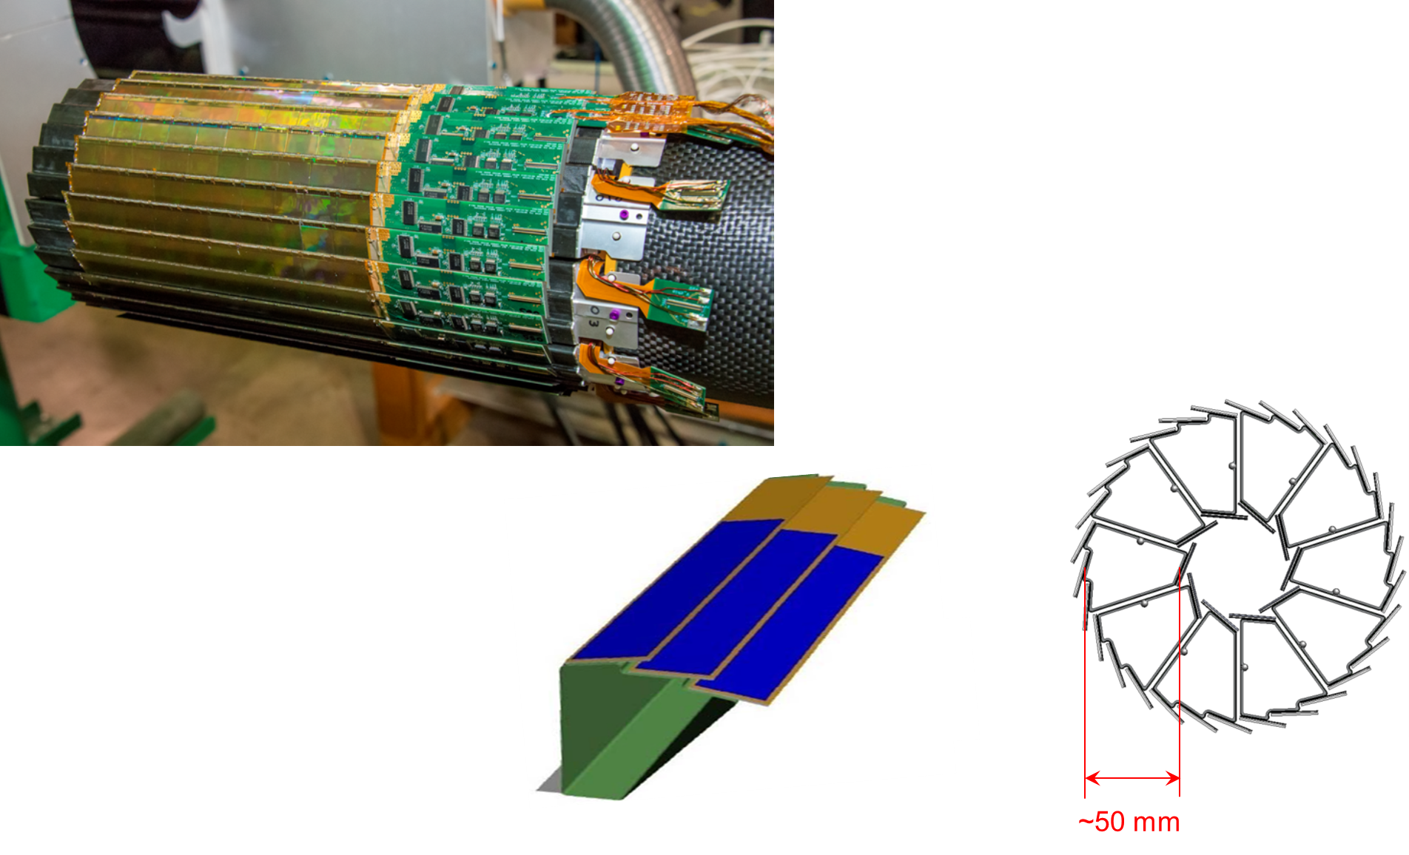
Air cooling: the STAR case
The PXL subdtetector of the STAR HFT @ RHIC is the first silicon detector operating on a collider successfully cooled by air…
But there are very specific conditions for this to work (e.g. studies on the ALICE ITS upgrade failed to provide satisfactory performance).
Details: G. Contin et al., The STAR MAPS-based PiXeL detector, NIM A907, 60-80 (2018)
CMOS MAPS technology
Goal X/X₀ = 0.37% per layer
Room temperature operation
Max T on sensor = 40 ˚C
Radiation tolerance up to 90 kRad/year
Fluence 2x10¹¹ to 10¹² 1MeV n_{eq}/cm²
1st to 2nd layer gap: 50 mm (!)
Chip dissipation = 0.17 W/cm²
Total power ~350 W (chips + drivers)
Air flow T = 23 ±1 ˚C
Air speed = 10.1 m/s
DT air-detector = 12 - 13 ˚C
TFM ~70 K cm²/W

Slide 9
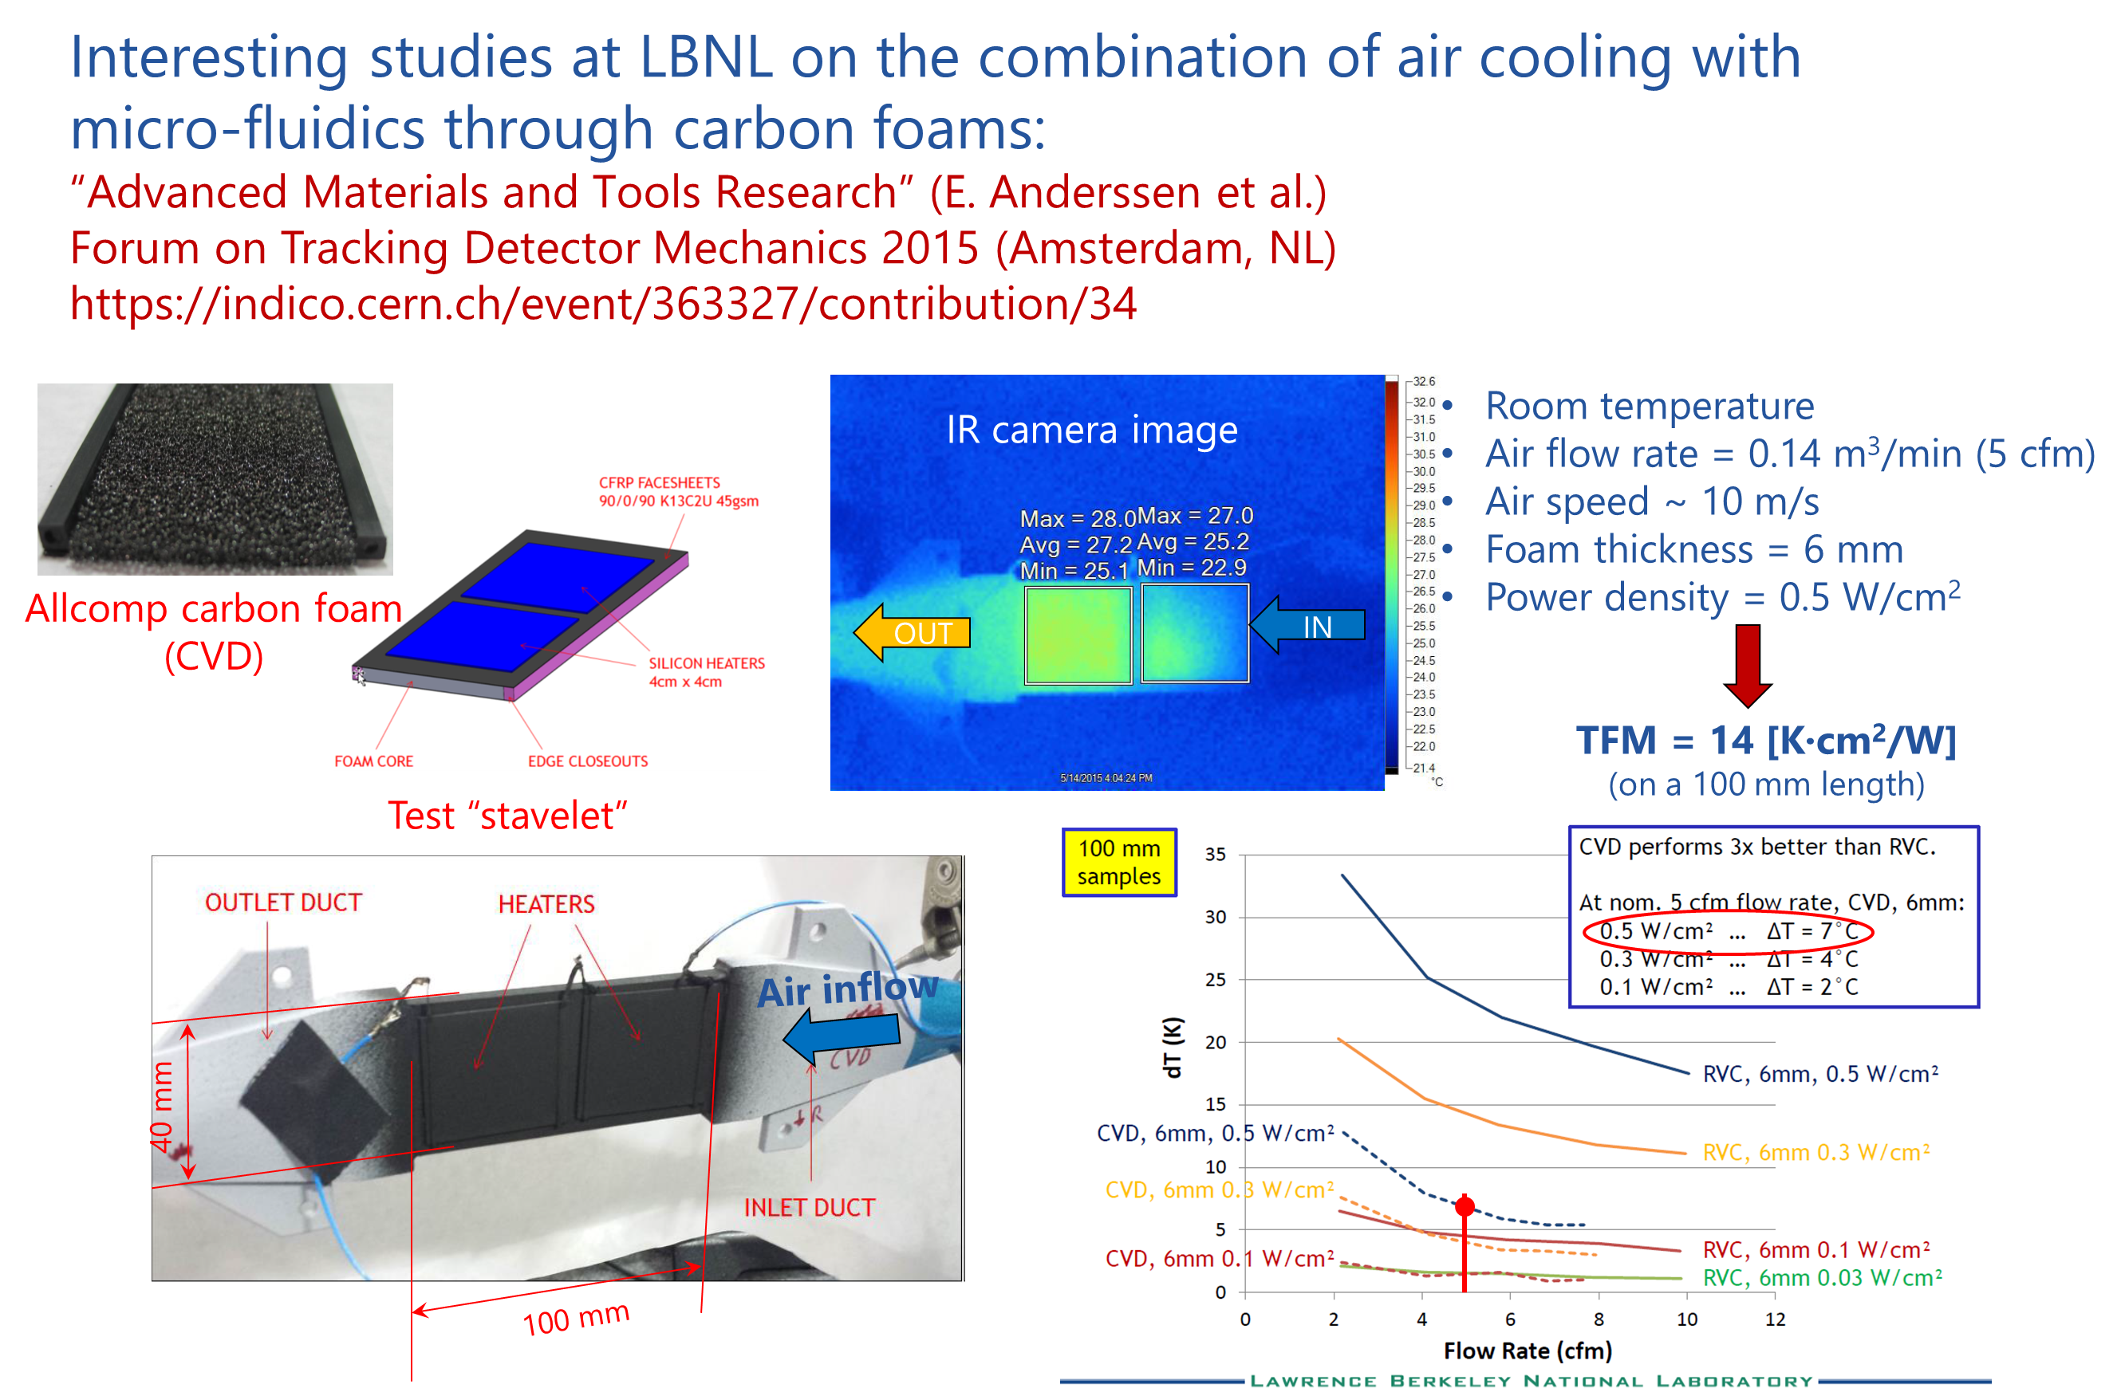
Air cooling: porous carbon foam as interface
Length limitation!

Slide 10
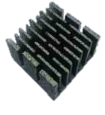
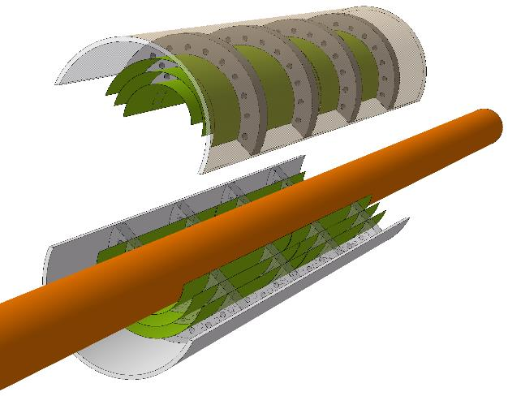
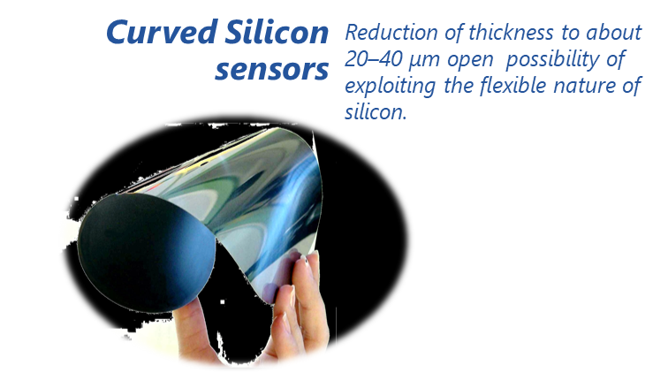

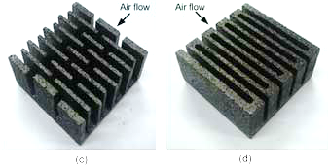
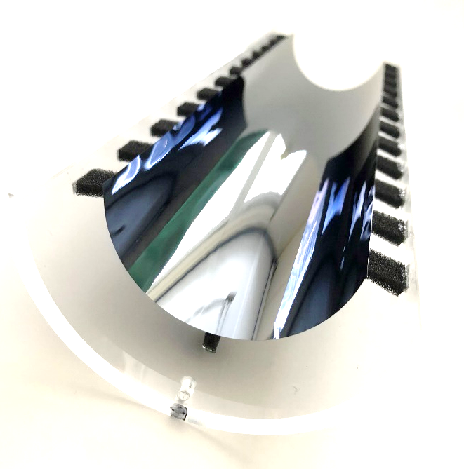
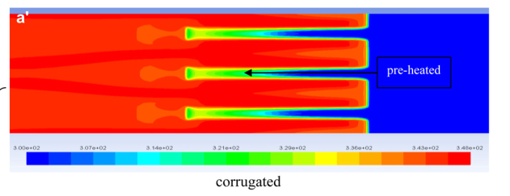
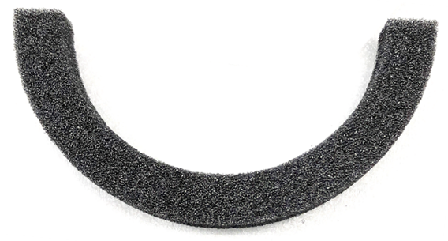
Air cooling: porous carbon foam as radiator
Air Flow
Foam in thermal contact with silicon acts as a radiator.
Porous carbon foam structures as air cooling radiators
Foams have a very accessible surface area (> 4 m2/g) and are open celled. As result, the overall heat transfer coefficients of foam-based heat exchangers can be up to two orders of magnitude greater than conventional air heat exchangers.
ALICE study
Lin, Wamei & Sunden, Bengt & Yuan, Jinliang. (2013). A performance analysis of porous graphite foam heat exchangers in vehicles. Applied Thermal Engineering. 50. 1201-1210. 10.1016/j.applthermaleng.2012.08.047.
Slide courtesy of C. Gargiulo

Slide 11
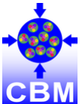

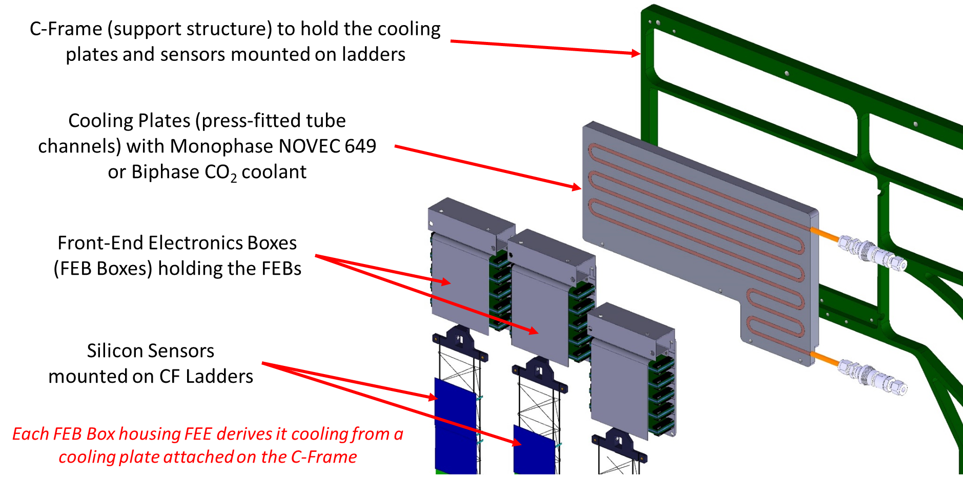
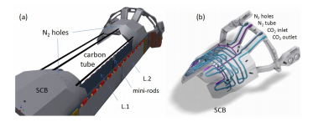
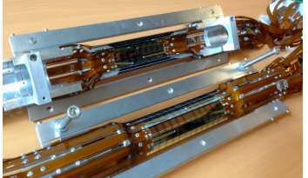
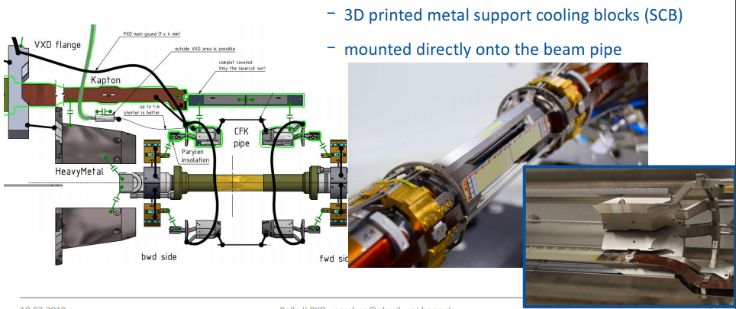
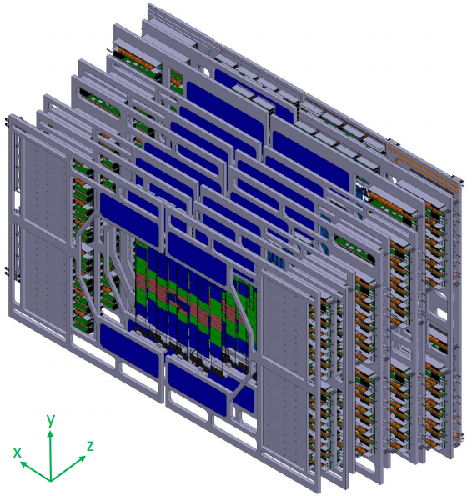
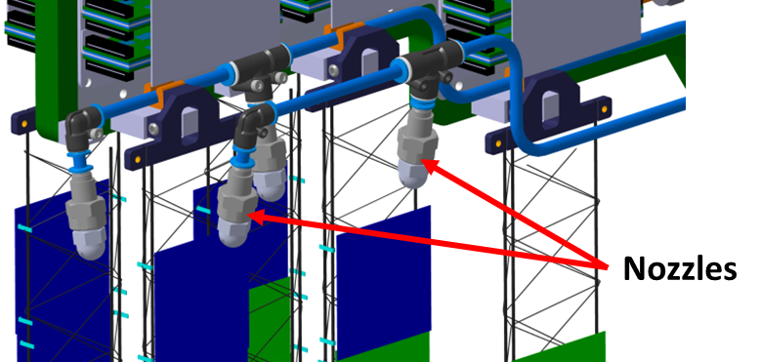
Liquid assisted air cooling
Cold fluid (CO₂ or Novec) for the thermal management of the electronics, air for the sensors
(easier for detector with limited acceptance)
Belle II PXD @ KEK
CBM STS @ FAIR
H. Ye et al., NIM A, Volume 896, 11 July 2018, Pages 82-89
B. Paschen, Vienna Conference of Instrumentation 2019
K. Agarwal, Forum on Tracking Detector Mechanics 2019

Slide 12
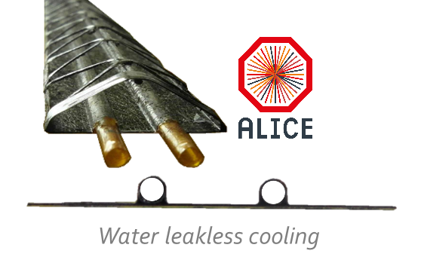
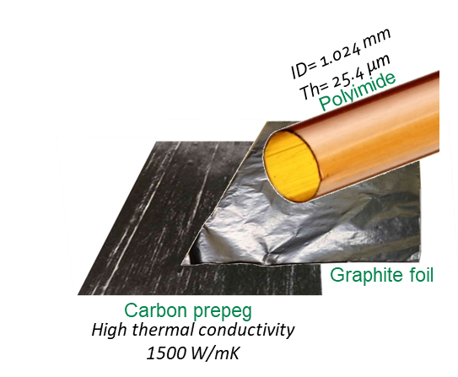
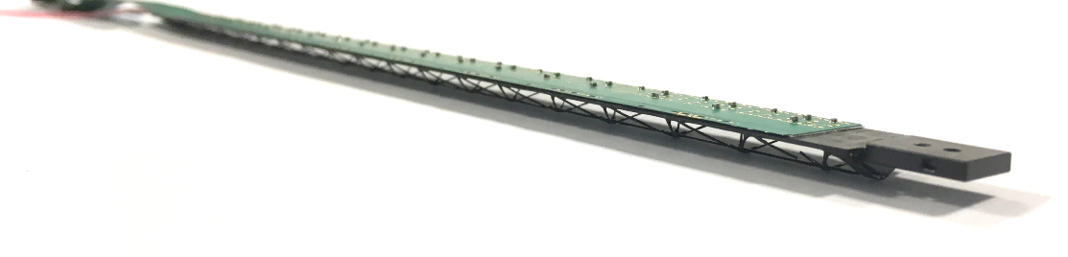
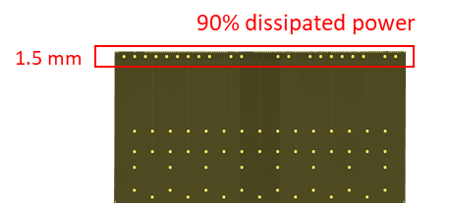
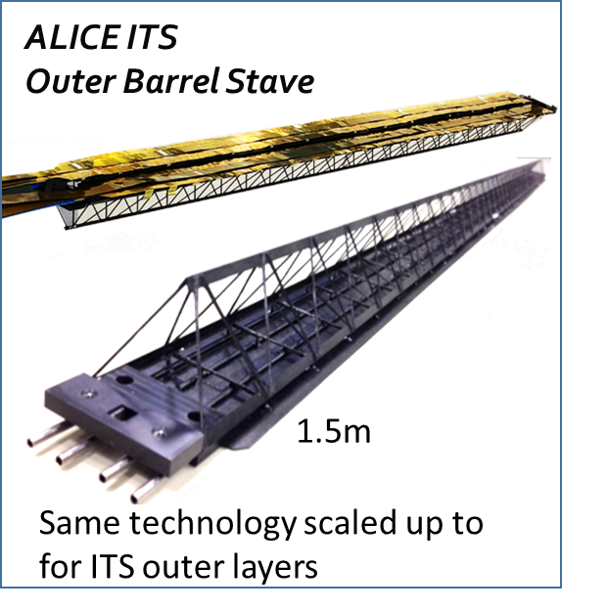
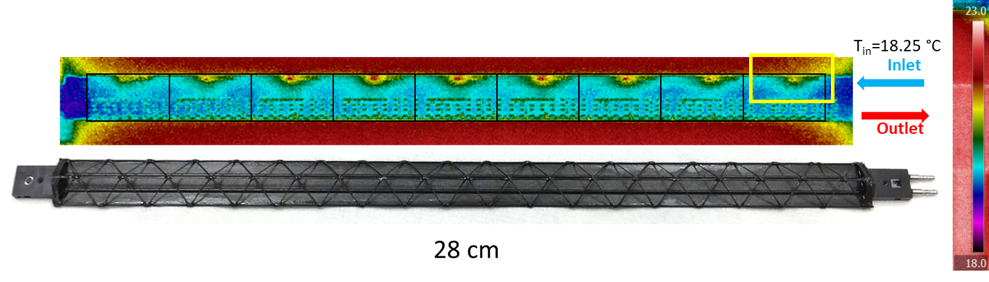
Ultra-lightweight liquid cooling
High conductivity carbon plate with embedded Kapton pipes
ALICE ITS
Inner Barrel Stave
Inner Tracking System
Active area: 9.4 m²
N chips: 24120
Chips heat flux: 40 mW/cm²
Total Power: ~5 kW
NIEL: ~1.7x10¹² 1MeV neq/cm2
Working temperature ~ 23°C
Fluid: Water (leak-less) ~ 0.6 l/h
Coolant temp: 18°C
TFM > 100 K∙cm²/W
On digital chip area
TFM ~ 50 K∙cm²/W
On sensor area
Slide courtesy of C. Gargiulo

Slide 13


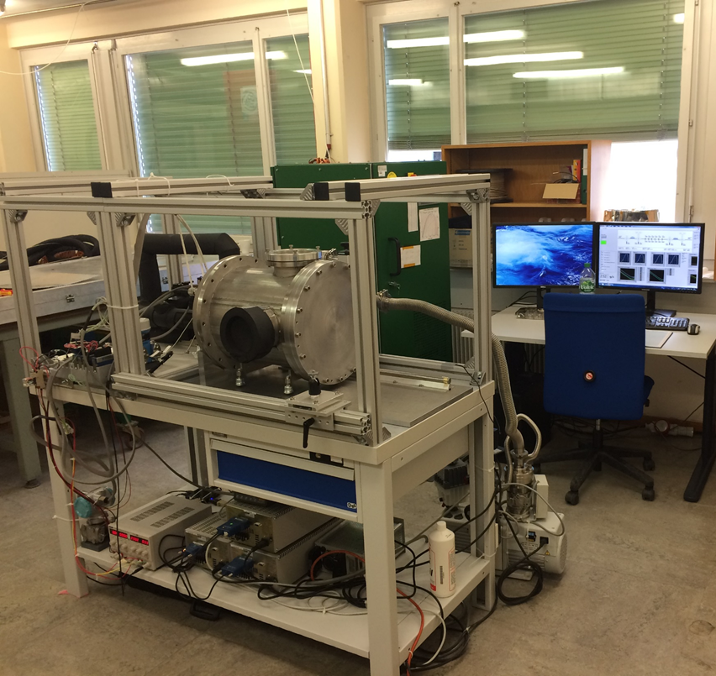
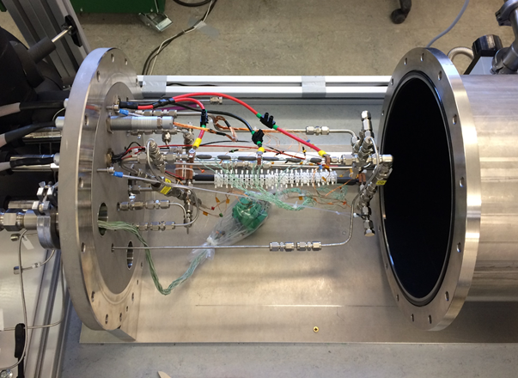
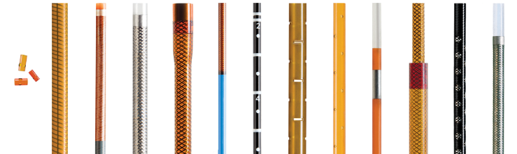
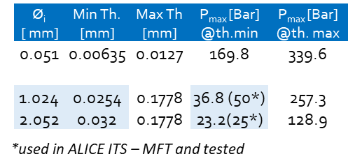
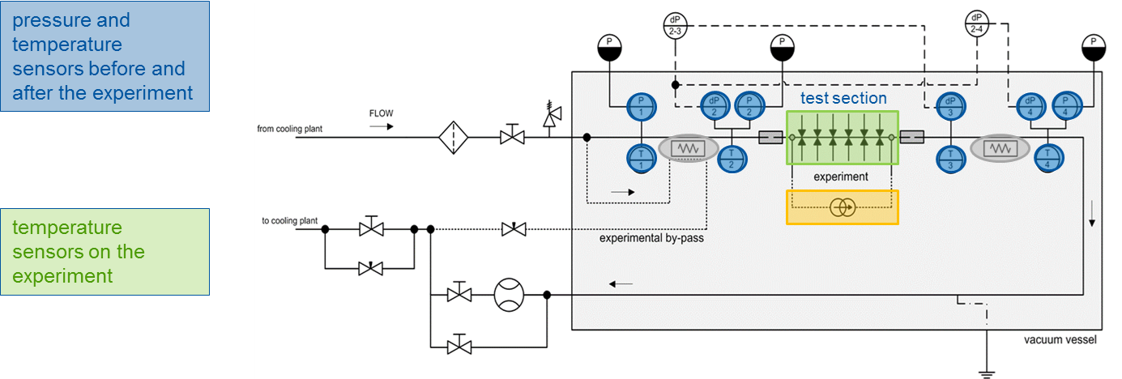
Can this approach be used for cold CO2?
Planned 2021
Hydraulic connections (cycling)
Deformation under pressure
Heat Transfer Coefficient
Wall thermal resistance

Slide 14
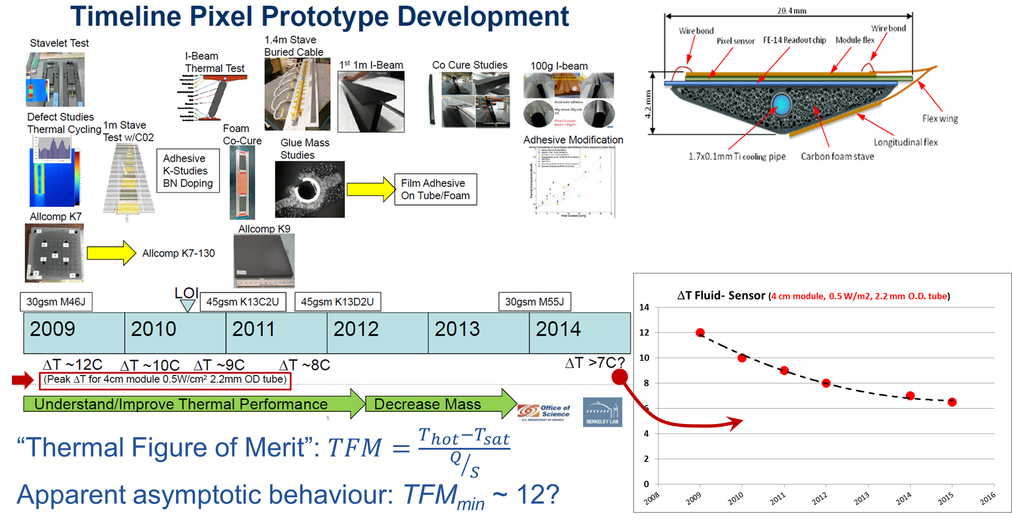
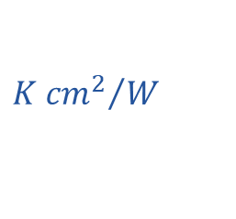
Low T cooling: why “colder than CO₂”?
Asymptotic trend of ΔT
e.g. for a power dissipation of 1 W/cm² if you look for T_{MAX} <-30 °C on your sensor, the saturation temperature in the evaporator must be T_{Sat} <-42 °C (maybe -40 if an optimal design for CO₂ allows for higher HTC)
$${K {cm}^{2}}/W$$

Slide 15
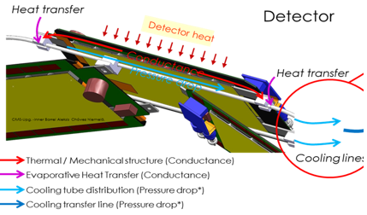
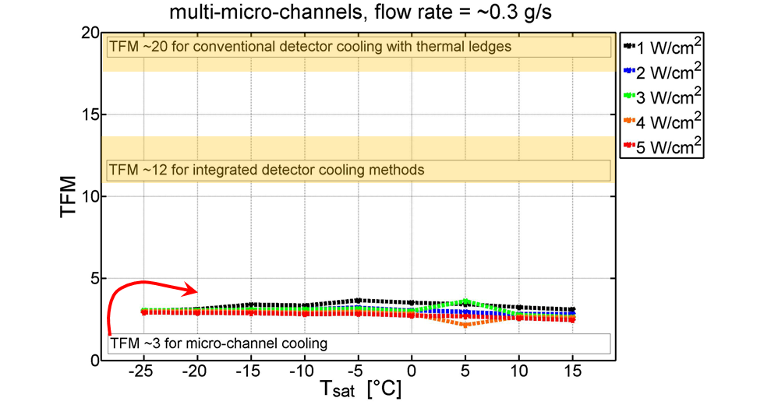
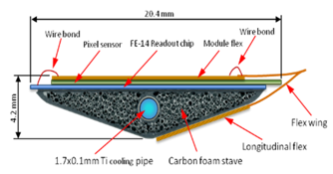
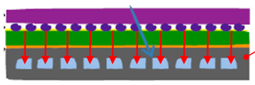
How to get minimal TFM with very low X₀?
Going colder is not the only way…
Plot from D. Hellenshmidt et al. New insights on boiling carbon dioxide flow in mini- and micro-channels for optimal silicon detector cooling, NIM A Volume 958, 1 April 2020, 162535
Micro-channel device
Not only the TFM of a microchannel cold plate is much lower than TFM of any other technology, but it stays relatively constant with T_{sat} (i.e. the HTC is not largely dependent on T_{sat})

Slide 16
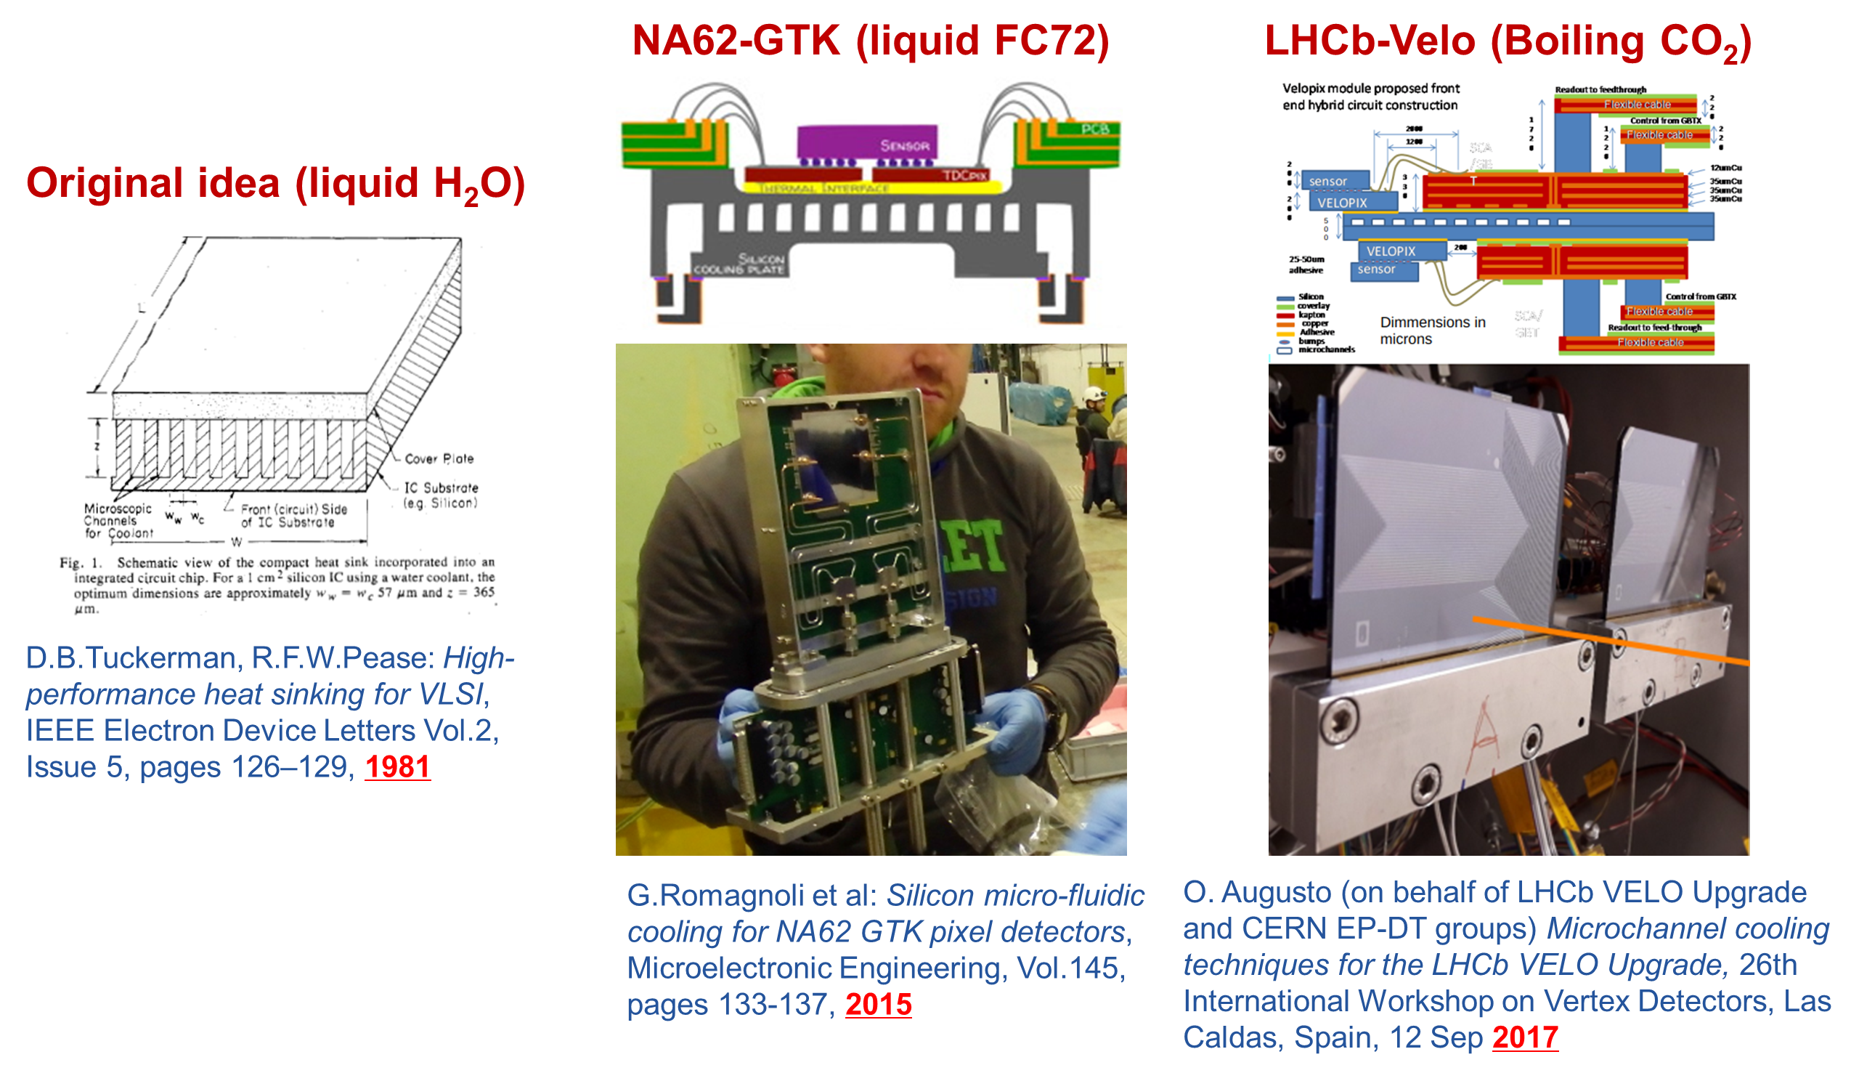
How to get minimal TFM with very low X₀?

Slide 17
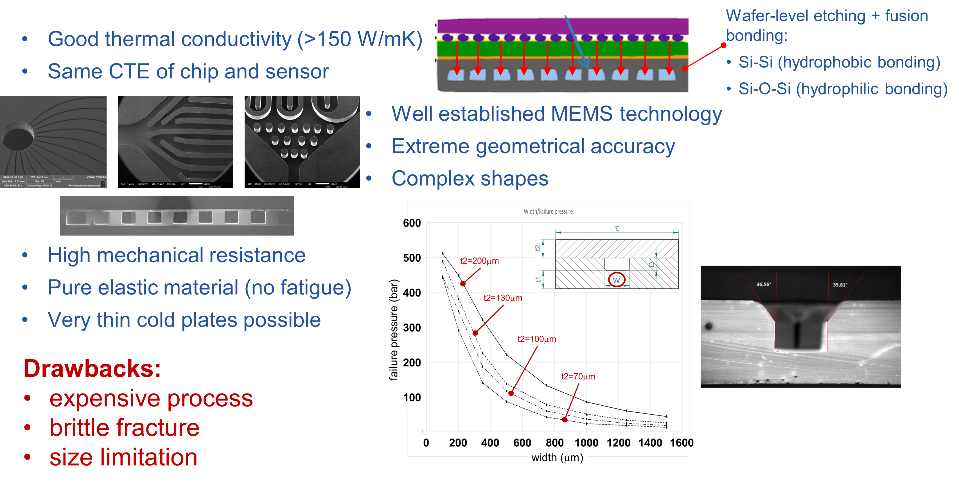
Si microchannels: present limitations

Slide 18

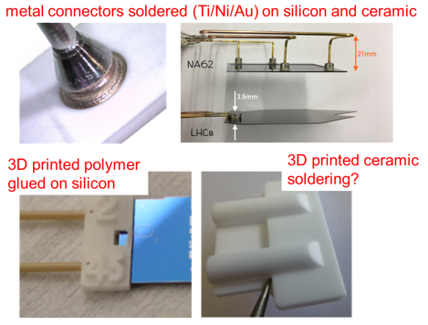





Microchannels: status from AIDA2020
Progress on micro hydraulic connectors
Alternative productions
Microchannels integrated in active DEPFET sensor
CMOS-compatible process to embed channels in Si

Slide 19



Microchannels: AIDAInnova and EP-RDT

Slide 20







Microchannels: micro-Pulsating Heat Pipes?
PHP: no need of wick/capillary for the return flow
350
Liquid motion starts above 2W
Si Micro-Oscillating (Pulsating) Heat Pipe
300
250
Equivalent thermal conductivity[W/m∙K]
ISSUE: requires power
Reducing power may not always be beneficial…
200
150
100
50
T. Frei, AIDA2020 Annual Meeting, WP9 session 2019
2
4
6
8
10
12
Power input [W]

Slide 21



Microchannels: PHP potential
Secondary
circuit
Multiple “Quad size” PHP cold plates (not necessarily in Si: can be 3D printed) thermally connected to a common cooling line connected to the primary heat sink, all pre-integrated in a ultra-light support structure
Secondary
circuit
Primary
circuit
Secondary
circuit
The primary heat sink might also be an air flow?
Cooling plant
Secondary
Primary
+ Might eliminate the problem of multiple micro-hydraulic connections
- Might require a minimum power input incompatible with low power electronics

Slide 22



Thermoelectric coolers
Mainly bismuth tellurium compounds since 60 years
Termoelectric Coolers (TECs)
No moving parts
Compact size
No maintenance
High temperature stability
Precise temperature control
Poor efficiency (10-15%)
Limited DT (requires pile-up)
High X0
Still require a heat sink
R&D Indications
Optimal voltage for selected T
Radiation resistance
2019

Slide 23


Thermal Interface Materials
A MARKET IN RAPID EXPANSION
Recent Developments
In September 2020, Parker Hannifin Corporation launched THERM-A-GAP GEL 37, new single component, thermally conductive dispensable materials.
In July 2020, Dow Corning Corporation launched a new product DOWSIL TC-3065 thermal gel. It is a thermally conductive gel used to dissipate heat from electronic components.
In June 2020, Dow Corning Corporation launched a new TIMs, DOWSIL TC-4040. This gap filler is easy to dispense, possess high thermal conductivity, and resist slumping.
In June 2020, Henkel AG & Co. KGaA launched new TIM Bergquist Gap Filler TGF 7000. It is used for various applications, such as automotive ADAS systems, power conversion systems, electric pumps, and others.
In April 2020, Henkel AG & Co. KGaA launched Loctite EA 9536 magnet bonding tape, which provides high materials expansion for electric motors. This epoxy-based adhesive film can fix the magnet securely in position, fill gaps, and compensate for manufacturing tolerances in the electric motor.
In August 2020, Henkel AG & Co. KGaA established a new facility at Salisbury, North Carolina, for the production of UV-curable acrylic pressure-sensitive adhesives (PSA).
In February 2020, Henkel AG & Co. KGaA started a new production facility in Pune, India.
In May 2019, 3M signed a definitive agreement to acquire Acelity Inc. (US) and its subsidiaries.
SOURCE:

Slide 24



Thermal Interface Materials
NEED FOR SYSTEMATIC CHARACTERIZAZION: ORPHAN R&D!!!
Typical subjects:
Doping: type / quantity
Optimum temperature range
Aging
Radiation resistance
Applicability / flowability
Gap filling capacity
Carbon nanotubes?
Thermal pads
Thermal greases
Thermal adhesives
Phase Change Materials
Creation of a shared database?

Slide 25
Final considerations
No single thermal management scheme is by definition better suited than the others for all configurations: careful analysis of the design parameters and of priorities (the “engineer questions”) must guide towards the optimal choice
While the goals and challenges for the next future (say, 2026) are relatively clear and on target, the longer terms perspectives are very quite diverging for detectors conceived for hh collisions or for e⁺e⁻ collisions. The others lay somewhat in-between
Direction #1: need to start from challenging, possibly small-size, concrete cases: solving the problems of the “small ones” now brings to maturity the technology for the “big ones” in the future
Direction #2: both "ultra-lightweight" and "highly integrated” cooling are key techniques that require focused R&D, appropriately funded and coordinated among the different experiments. It makes no sense to try and solve the same problem several times on isolated little islands. The CERN R&D program and AIDAInnova can help, but wouldn’t be wise to think (again) about a dedicated R&D collaboration?

