Slide 1
Welcome and
Rules of the Game
Symposium ECFA R&D Roadmap - TF8 “Integration”
Werner & Frank
Corrado Gargiulo, Filippo Resnati, Herman Ten Kate, Bart Verlaat, Marcel Vos

Slide 2
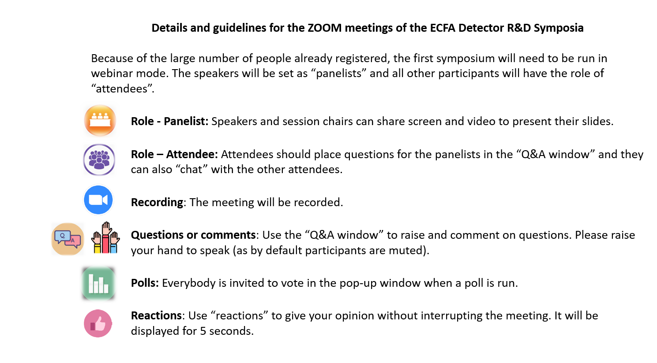
Welcome! - Dear Audience
We need YOUR HELP! You also have the responsibility to make sure everything is covered!
Full symposium is recorded
Audience is expected to be large
  We have 10 minutes after each talk – please pose your questions already during the talk in the Q&A sections!
  People with ‘raised hands’ will be unmuted one-by-one!
Today’ symposium largely seeds the write-up
  But it will further be informed by the other 8 TF symposia
And, this symposium is not the end of the consultation of TF8
  Additional feedback is welcome until the last symposium on 7 May
  Send your comments to: ECFA-DetectorRDRoadmap-TF8Integration-Input@cern.ch

Slide 3

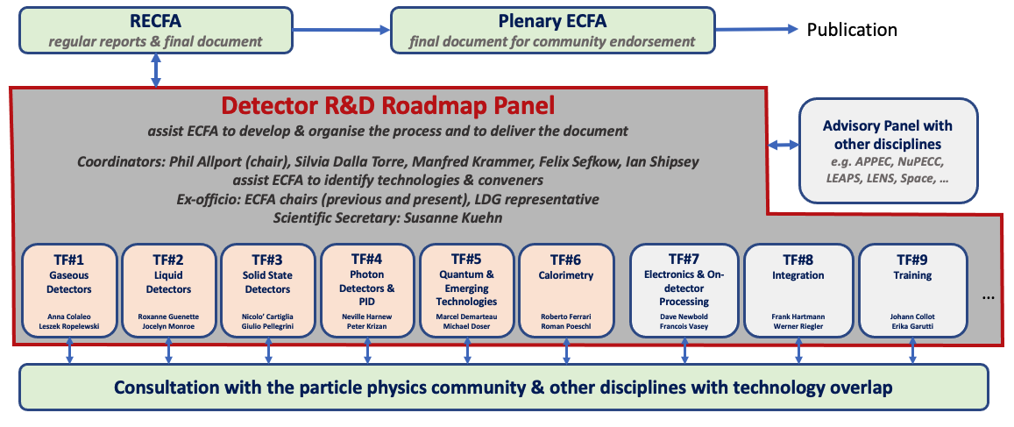
Detector R&D Roadmap
Organization for Consultation of Relevant Communities
Today
https://indico.cern.ch/e/ECFADetectorRDRoadmap
3

Slide 4
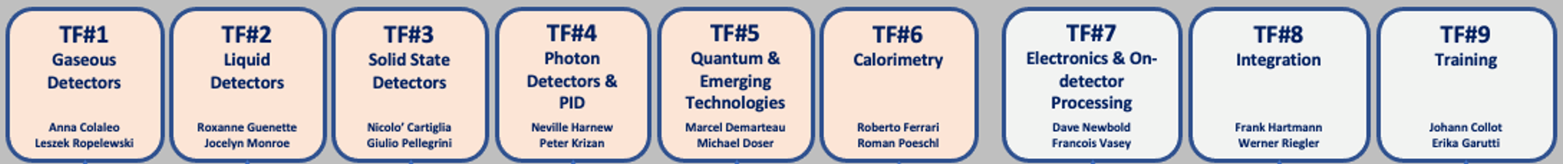
Detector R&D Roadmap
Integration as transverse Task Force
Every Task Force has a connection to TF8: transverse Task Force
Our methodology was to group topics where applicable and spanning many facilities
  Lightweight mechanics, local cooling, cooling systems, magnet systems, MDI. Monitoring, Robotics
Discuss Integration challenges of specific systems
  Calorimeter, Neutrino, Dark Matter
After first fact findings and the Input Symposia, the experts/speakers reached out further

Slide 5
R&D vs. Engineering/Prototyping
Speakers will distinguish between R&D topics vs engineering challenges and prototyping.
That’s the reason why you might miss topics!
For example, we consider the following topics not genuine R&D:
  Dry gas supply, e.g. membrane plant from industry to provide oxygen depleted air.
  Dewpoint measurement – sniff and measure with commercial DP meters outside volume; leak cables
  Survey, 3D laser scanning, Virtual/Augmented reality
  Neutron moderator
  Cooling transfer lines (tripple-jacketed vacuum pipes, capilaries)
  Thermal shields, thermal insulation
  Some aspects of fibre-bragg grating (FBG), though we have have a talk to cover the remaining items
  Alignment; we cover opening closing scenarios but not internal alignment traditionally track-based!
  Large Movement systems for the Neutrino Near Detectors
  Safety systems
We do not cover R&D of the accelerators but try to address the interfaces to the detectors
For facilities tradititionaly not in ECFA, we concentrate on synergies

Slide 6
And potential integration items covered in other TFs
Gas Recuperation – TF1 Gaseous Detectors
Cryo (largely) – TF2 Liquid Detectors
Hybridization – TF3 Solid State Detectors
Lightguide, WLS – TF4 Photo Detectors
Powering & DCDC – TF7 Electronics

Slide 7
Timeline
Put the R&D onto perspective!
  There is also the corresponding accelerator R&D ongoing!
    Detector R&D should not delay the accelerator projects
  What can be informed by earlier ‘approved’ projects/facilities?
    Which R&D informs the next detectors/facilities?
  What is the lead time? What can be started much later?
ILC
CePC
SppC
FCC-ee
FCC-hh
CLIC
HL-LHC
Belle-2
EIC
DUNE
HyperK

Slide 8

Have Fun, discuss lively and ask questions

Slide 9
Backup

Slide 10
TF 8 Matrix of topics vs. Facilities
  https://docs.google.com/spreadsheets/d/1-b4sKdtpCD-7rqV4WnoHvozpr6Jxns8pbxtOLfhNnZ8/edit#gid=944048056

Slide 12
Broad Topic Areas
Organization for Consultation of Relevant Communities
Focus on the technical aspects of detector R&D requirements given the EPPSU deliberation document listed “High-priority future initiatives” and “Other essential scientific activities for particle physics” as input and organise material by Task Force.
Task Forces start from the future science programmes to identify main detector technology challenges to be met (both mandatory and highly desirable to optimise physics returns) to estimate the period over which the required detector R&D programmes may be expected to extend.
Within each Task Force create a time-ordered technology requirements driven R&D roadmap in terms of capabilities not currently achievable.
Grouped targeted facilities/areas emerging from the EPPSU
Detector requirements for full exploitation of the HL-LHC (R&D still needed for LS3 upgrades and for experiment upgrades beyond then) including studies of flavour physics and quark-gluon plasma (where the latter topic also interfaces with nuclear physics).
R&D for long baseline neutrino physics detectors (including aspects targeting astro-particle physics measurements) and supporting experiments such as those at the CERN Neutrino Platform.
Technology developments needed for detectors at e⁺e⁻ EW-Higgs-Top factories in all possible accelerator manifestations including instantaneous luminosities at 91.2GeV of up to 5×10³⁶cm⁻²s⁻¹.
The long-term R&D programme for detectors at a future 100 TeV hadron collider with integrated luminosities targeted up to 30ab⁻¹ and 1000 pile-up for 25ns BCO.
Specific long-term detector technology R&D requirements of a muon collider operating at 10 TeV and with a luminosity of the order of 10³⁵ cm^{–2} s^{–1}.
12

Slide 13
Broad Topic Areas
Grouped targeted facilities/areas emerging from the EPPSU
Detector developments for accelerator-based studies of rare processes, DM candidates and high precision measurements (including strong interaction physics) at both storage rings and fixed target facilities, interfacing also with atomic and nuclear physics.
R&D for optimal exploitation of dedicated collider experiments studying the partonic structure of the proton and nuclei as well as interface areas with nuclear physics.
The very broad detector R&D areas for non-accelerator-based experiments, including dark matter searches (including axion searches), reactor neutrino experiments, rare decay processes, neutrino observatories and other interface areas with astro-particle physics.
Facilities needed for detector evaluation, including test-beams and different types of irradiation sources, along with the advanced instrumentation required for these.
Infrastructures facilitating detector developments, including technological workshops and laboratories, as well as tools for the development of software and electronics.
Networking structures in order to ensure collaborative environments, to help in the education and training, for cross-fertilization between different technologically communities, and in view of relations with industry.
Overlaps with neighbouring fields and key specifications required for exploitation in other application areas
Opportunities for industrial partnership and technical developments needed for potential commercialisation
13

Slide 14
Process and Timeline
Organisation
Expert & Community Consultation
Drafting Roadmap & Feedback
May 2020
EPPSU mandate to ECFA to develop a roadmap for detector R&D efforts in Europe
May 2021
Task Forces collate input from symposia
Feb 2021
Collection of requirements of future facilities & projects
May-June 2021 Drafting sessions
opening session with all experts involved
plenary & parallel sessions with Task Force members
final session of Roadmap Panel
Feb/March 2021
Questionnaires of Task Forces to national contacts
Sep 2020
Structure in place with Detector R&D Roadmap Panel
July 2021
Near final draft shared with RECFA*
30 July 2021
Presentation at Joint ECFA-EPS session
Until Sep 2021 Collect final community feedback*
Task Forces liaise with experts in
ECFA countries
adjacent disciplines
industry
Dec 2020
Task Forces active
Website: https://indico.cern.ch/e/ECFADetectorRDRoadmap
Oct 2021
Detector R&D Roadmap Document submission to RECFA and afterwards to PECFA and Council
March-May 2021
Open Symposia
*community feedback via RECFA delegates and National Contacts
*community feedback via RECFA delegates and National Contacts
March to May 2021
14
ECFA Detector R&D Roadmap

Slide 15
Links for Roadmap Process
https://indico.cern.ch/e/ECFADetectorRDRoadmap
https://indico.cern.ch/event/957057/page/21633-mandate (Panel Mandate document)
https://home.cern/resources/brochure/cern/european-strategy-particle-physics
https://arxiv.org/abs/1910.11775 (Briefing Book)
https://science.osti.gov/-/media/hep/pdf/Reports/2020/DOE_Basic_Research_Needs_Study_on_High_Energy_Physics.pdf
https://ep-dep.web.cern.ch/rd-experimental-technologies (CERN EP R&D)
http://aida2020.web.cern.ch/aida2020/ (linking research infrastructures in detector development and testing)
https://attract-eu.com/ (ATTRACT: linking to industry on detection and imaging technologies)
https://ecfa-dp.desy.de/public_documents/ (Some useful documents from the ECFA Detector Panel)
15

