Slide 1
WP5 – Collimation & Beam Losses
Ralph Assmann & Adriana Rossi
Topics:
  Design of modified IR collimation system for the 2020-21 high luminosity upgrade.
  IR loss-maps and support for background studies.
  Impact of upgrades (e.g. crab cavities, off-momentum beta beat) on the collimation system.
  Collimators, absorbers, … for the high luminosity upgrade.
  Does not include the high intensity upgrade of the collimation system presently foreseen to be completed in 2017.
Participants (already active collaborations LARP/EuCARD)
  CERN
  LARP/FNAL (N. Mokhov), SLAC (T. Markiewicz)
  RHUL (G. Blair)
  University Valencia (A. Faus-Golfe)
  …

Slide 2
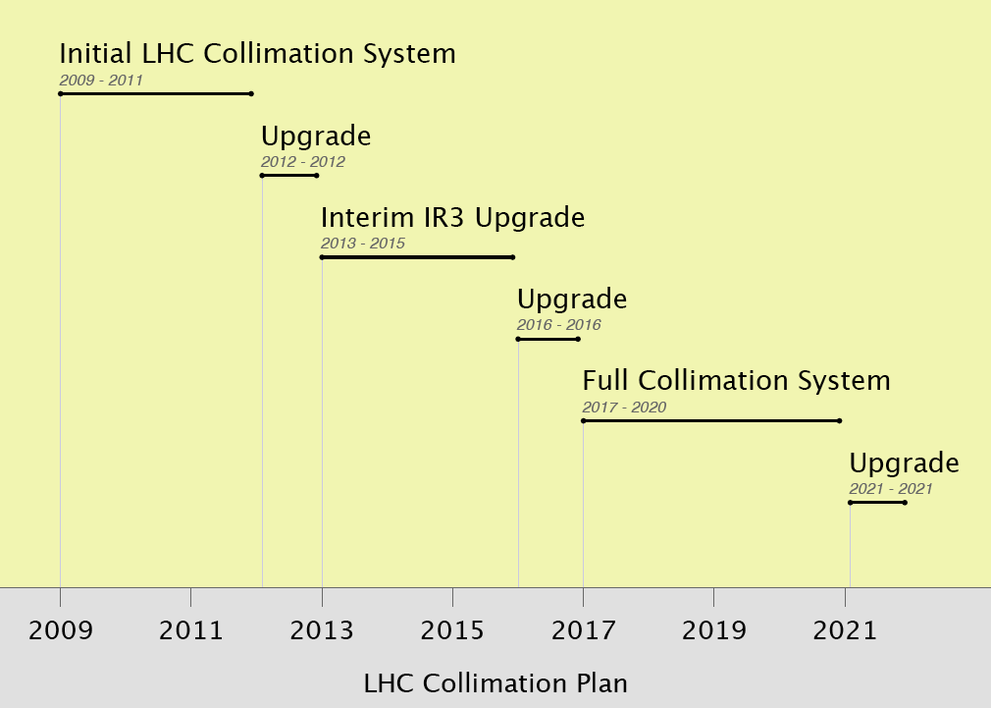
≤ 50% I_{nom} @ 3.5 TeV
β* ≈ 2m
≤ 100% I_{nom} @ 7.0 TeV
β* ≈ 1m
≥ 160% I_{nom} at
7.0 TeV
β* ≈ 55cm

Slide 3
≤ 50% I_{nom} @ 3.5 TeV
β* ≈ 2m
HL-LHC WP5:
Upgrades as required for HL-LHC upgrade
≤ 100% I_{nom} @ 7.0 TeV
β* ≈ 1m
≥ 160% I_{nom} at
7.0 TeV
β* ≈ 55cm

Slide 4
Expected Impacts from HL Upgrade
Collimation upgrades until ~2017 handled by LHC collimation project (with EuCARD/ColMAT). Full completion: OK for ultimate beam intensity at 7 TeV (2808 bunches of 1.7 × 10¹¹ p per bunch).
However, the LHC collimation system can be affected by several parts of the HL upgrade:
  Lower β*: Necessarily higher losses in the IR’s, can occur before existing tertiary collimators → new IR collimation with possible impact on SC parts.
  Crab cavities: Transverse/longitudinal phase space is mixed → efficiency can suffer.
  If beam intensity is increased above ultimate LHC parameters → efficiency, impedance.
Collimation impacts from HL upgrade addressed in HL-LHC WP5.

Slide 5
Example: Phase I Upgrade Optics
IR1 Aperture after Triplet Upgrade
Status June 09
-5.5σ
Upstream of TCT
below 15σ :
BPMWB, MBRC,
MCBY, MQY,
MCBCV, MQML
TAN
TAN
s from IP3 [m]

Slide 6
Example: Phase I Upgrade Optics
Zoom into IR1 H Losses
TCT
Nominal
Upgrade
MQML
MQ22
MB17
MB30
MB15
TCL

Slide 7
Work to be Done
Simulation of loss maps for new optics, with and without crab cavities:
  Ideal and imperfections.
  Collimation-induced, beam-gas induced, collision-induced losses…
Background estimates with experiments (see WP …).
Design of modified IR collimation to achieve acceptably small losses (same or lower than before).
Integration, construction, installation, commissioning of new IR collimation.
Study of impact on collimation in cleaning insertions. Implementation of any adaptations found necessary.

Slide 8
WP5 – Collimation & Beam Losses
Ralph Assmann & Adriana Rossi
Topics:
  Design of modified IR collimation system for the 2020-21 high luminosity upgrade.
  IR loss-maps and support for background studies.
  Impact of upgrades (e.g. crab cavities, off-momentum beta beat) on the collimation system.
  Collimators, absorbers, … for the high luminosity upgrade.
  Does not include the high intensity upgrade of the collimation system presently foreseen to be completed in 2017.
Participants (already active collaborations LARP/EuCARD)
  CERN
  LARP/FNAL (N. Mokhov), SLAC (T. Markiewicz)
  RHUL (G. Blair)
  University Valencia (A. Faus-Golfe)
  …

