Slide 1
Update on neutron efficiency
Lea Di Noto
12th March 2021

Slide 2
Info
Muon anti-neutrino interactions in STT
Geometry as in DocDB
  new fluka files vs Bing files used for DocDB plots
Analysis
The fluka files were converted to edepsim output
the analysis code is the same for both the simulations
Threshold on deposited energy in the cell (100 keV) (as in the past)

Slide 3
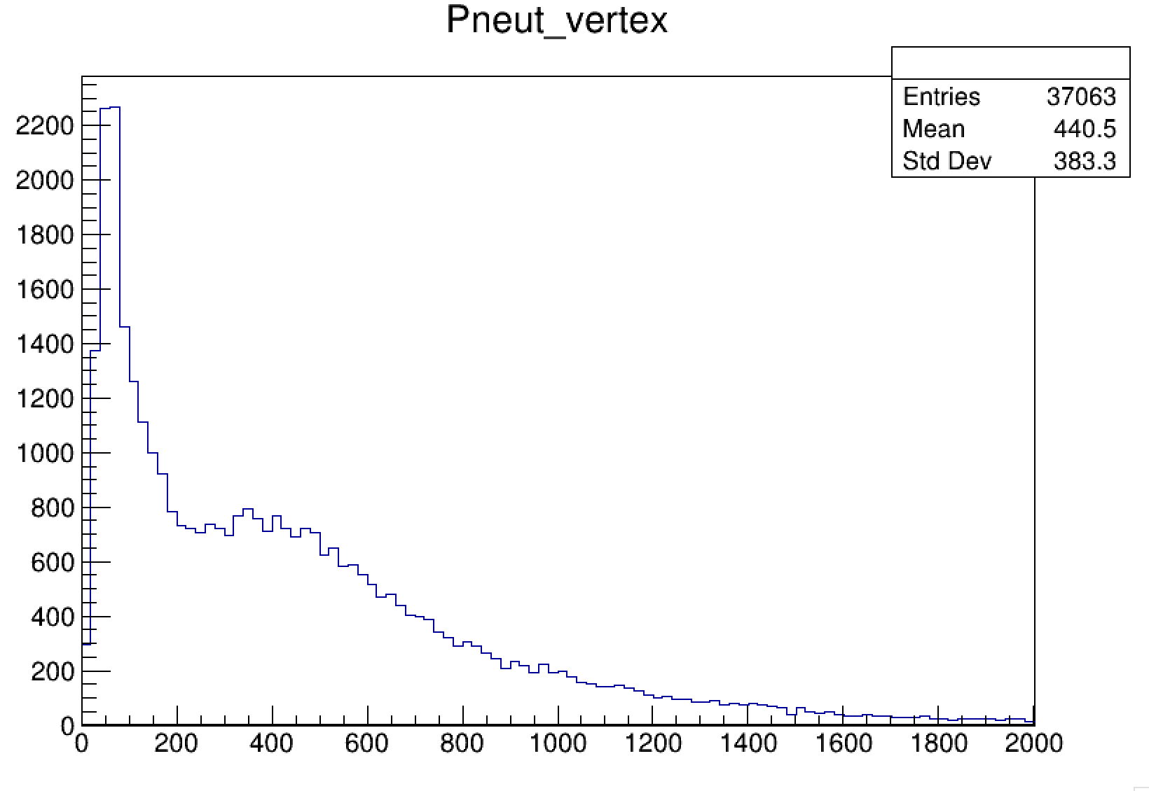
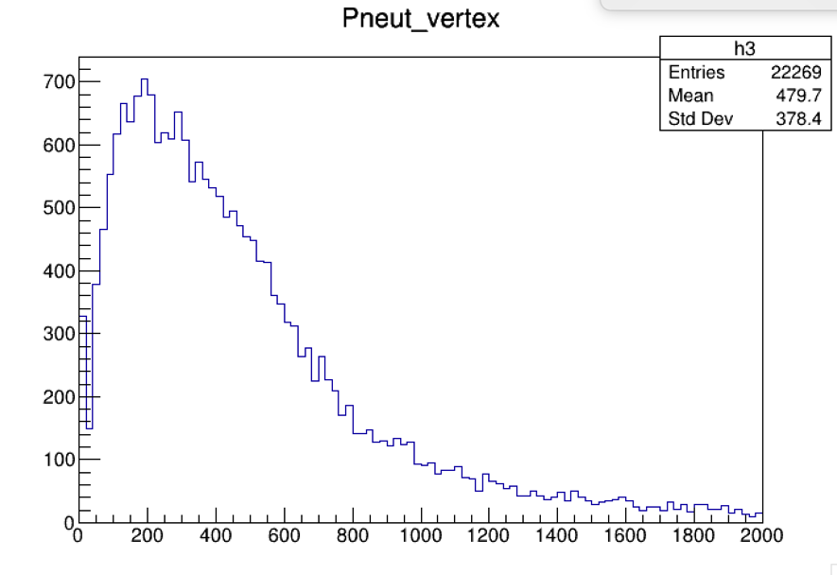
Momentum distribution at vertex
FLUKA
GEANT4

Slide 4
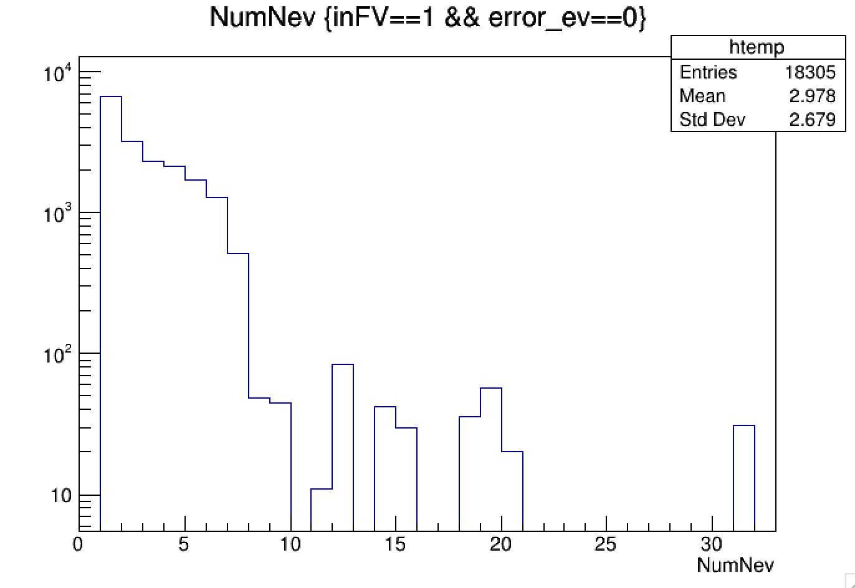
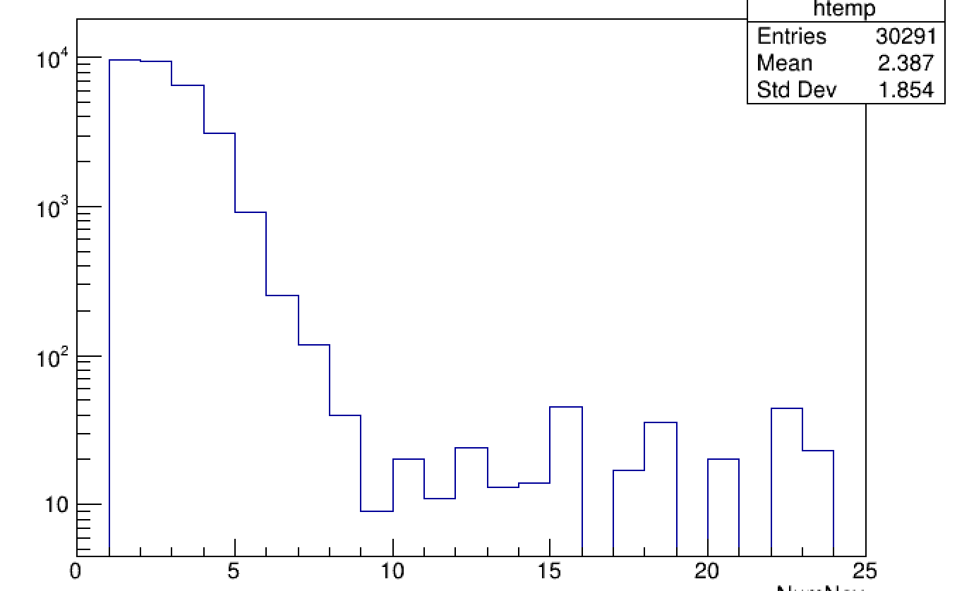
Number of neutrons for each neutrino interaction
FLUKA
GEANT4

Slide 5
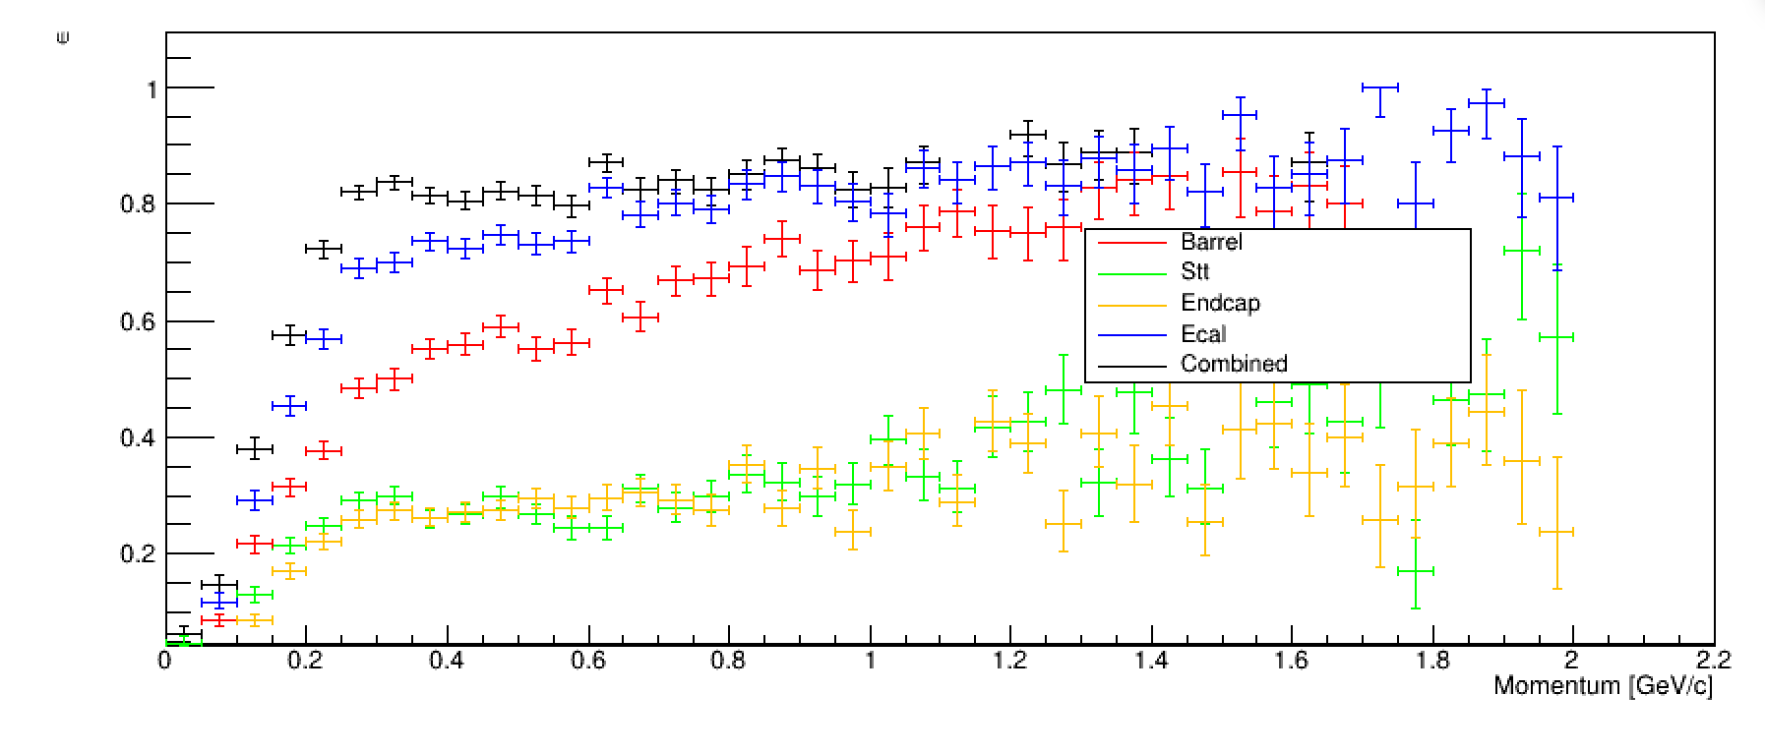
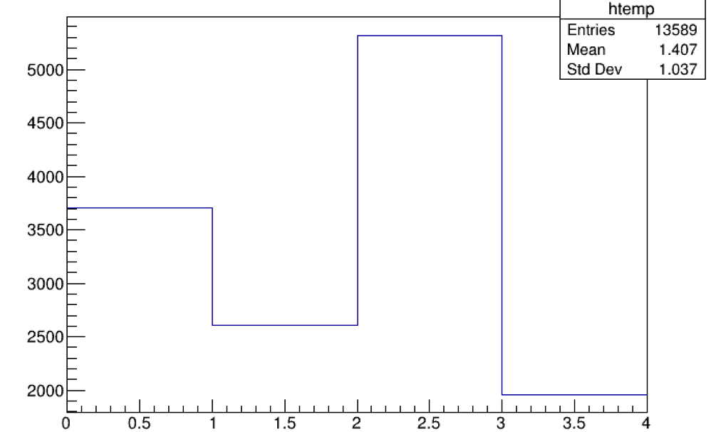
geant4
Efficiency vs P
Distribution of the first detection
First detection in STT 19%
First detection in Barrel 39%
Not detected
27%
First detection in Endcap 14%
Detection efficiency for P in 0-2.2 GeV/c
eff stt: 0.26
eff barrel: 0.50
eff endcap: 0.24
eff ecal 0.64
eff combined: 0.72

Slide 6
Direct comparison (geant4-geant4)
In DocDB
This analysis

Slide 7
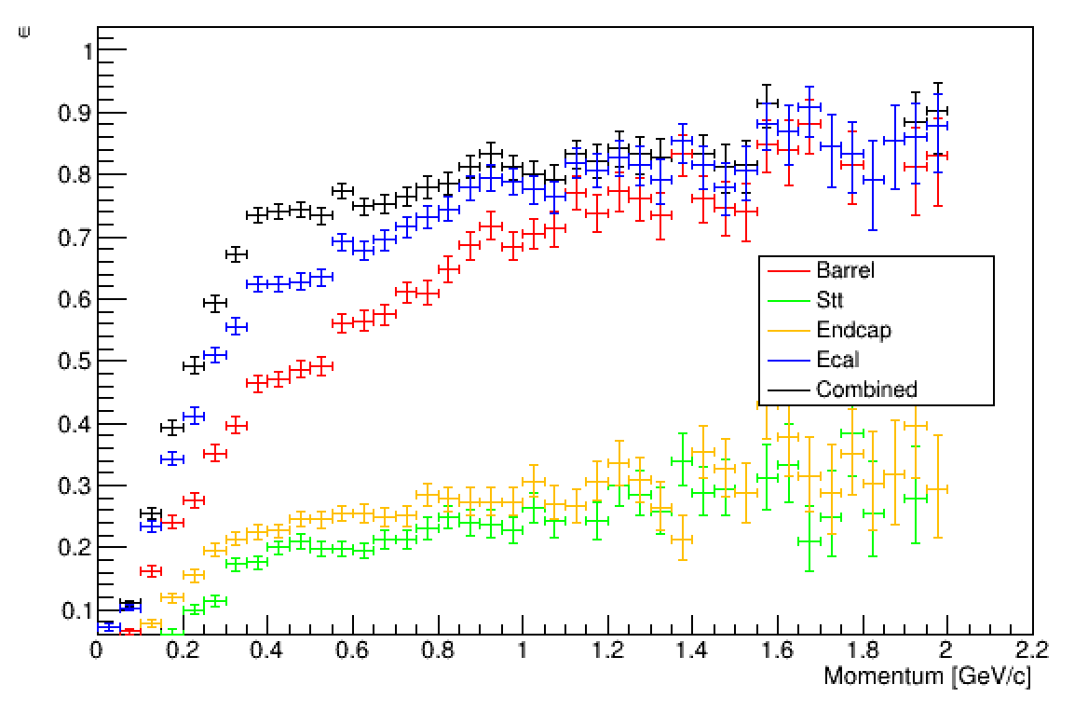
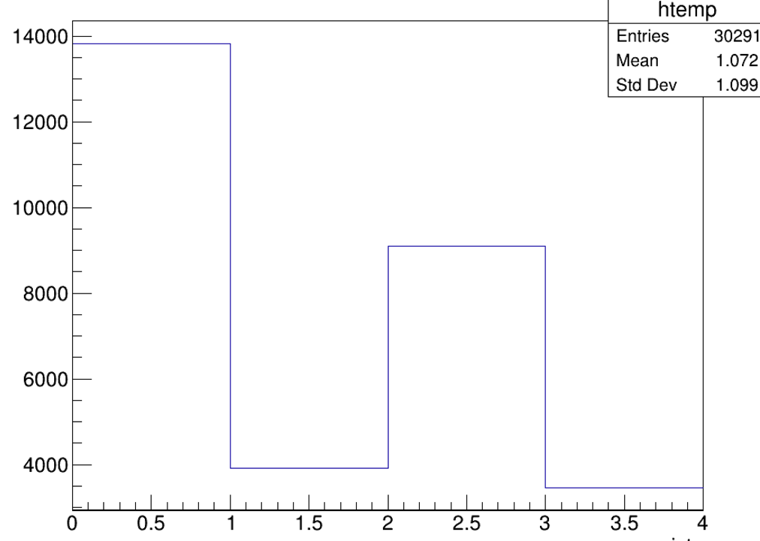
Fluka: Detection efficiency
Efficiency vs P
Distribution of the first detection
Not detected
45%
First detection in STT 13%
First detection in Barrel 30%
First detection in Endcap 12%
Detection efficiency for P in 0-2.2 GeV/c
eff stt: 0.14
eff barrel: 0.39
eff endcap: 0.18
eff ecal 0.48
eff combined: 0.54
55% is the total detection efficiency in whole energy range

Slide 8
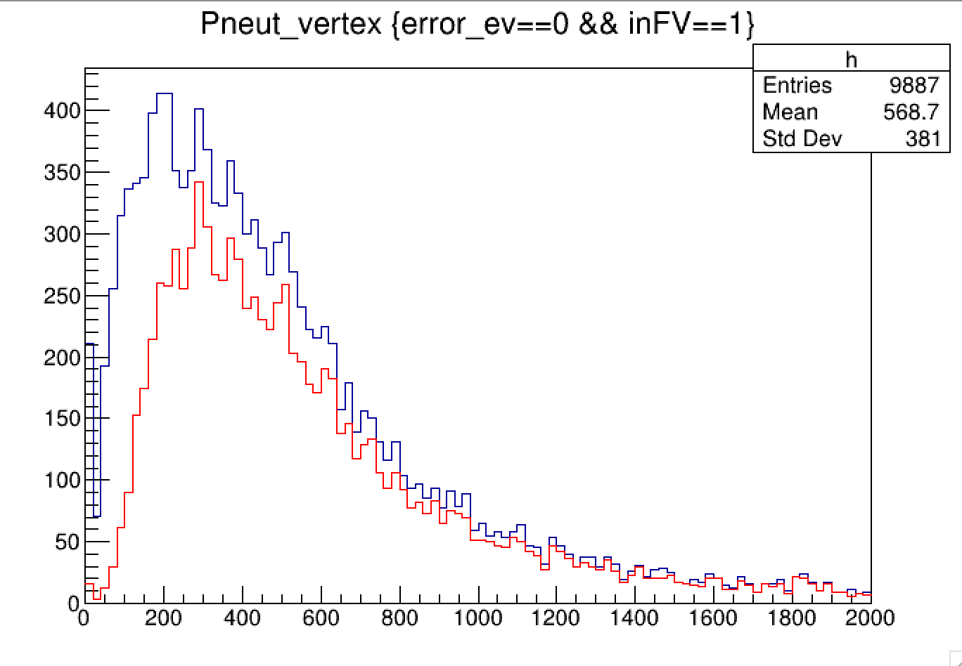
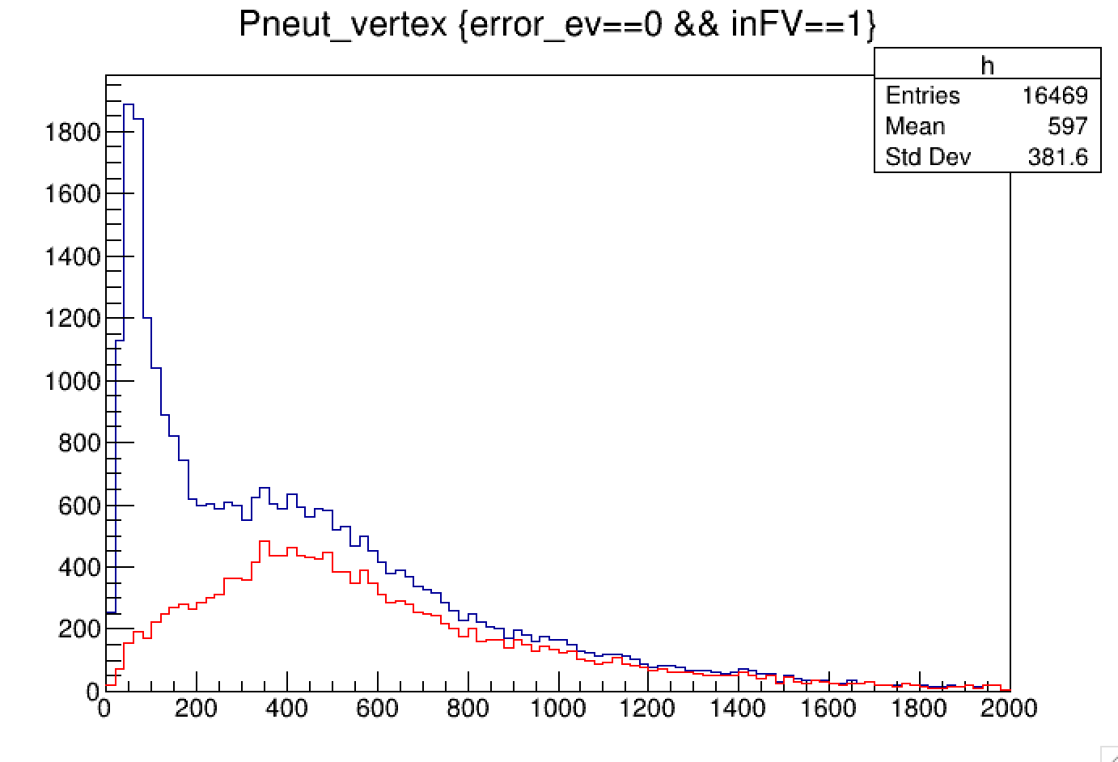
momentum distribution of detected neutrons
FLUKA
GEANT4
at vertex 30291 (in FV)
Detected 16469
at vertex 13589 (in FV)
Detected 9887

Slide 9
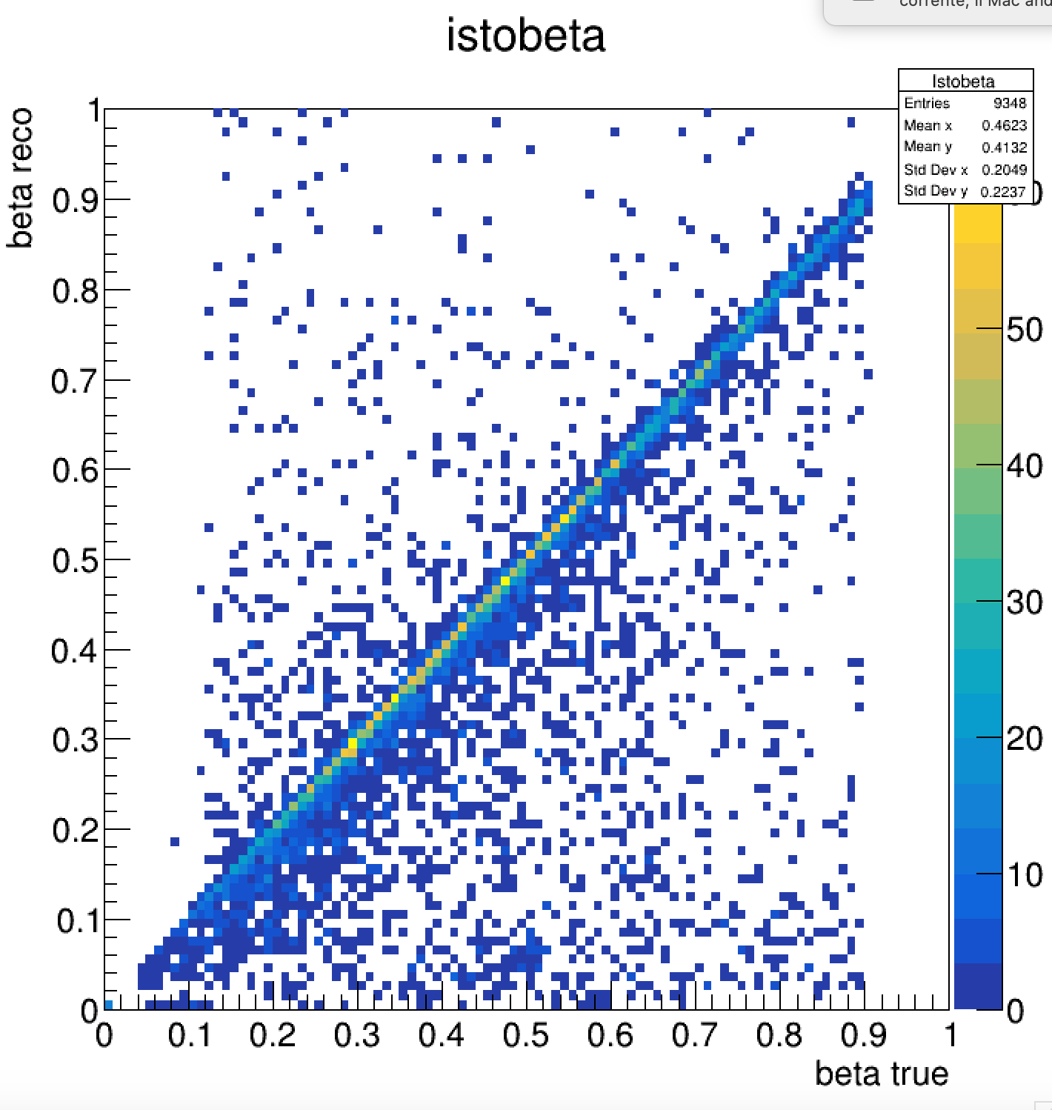
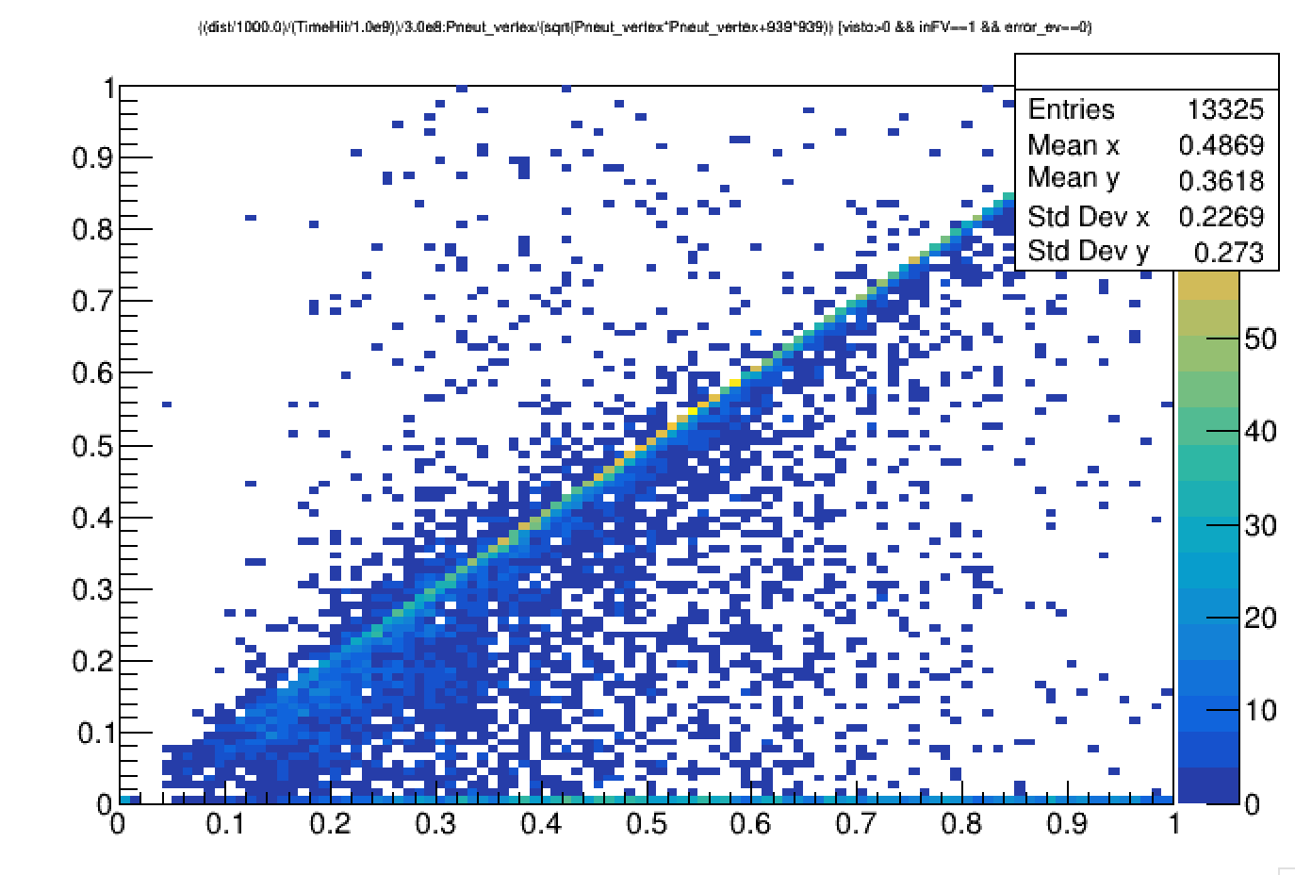
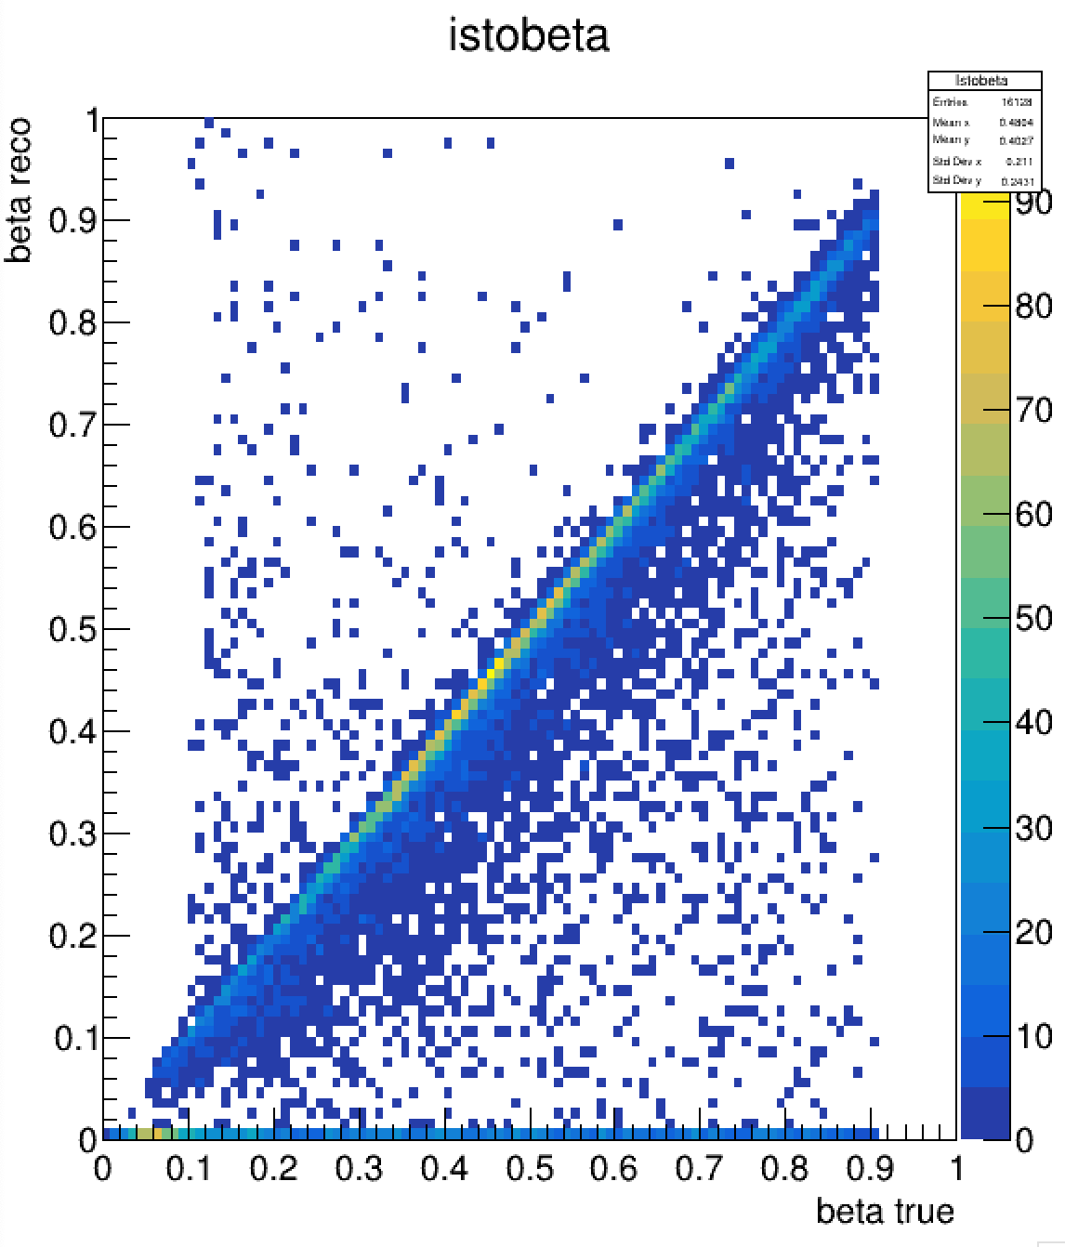
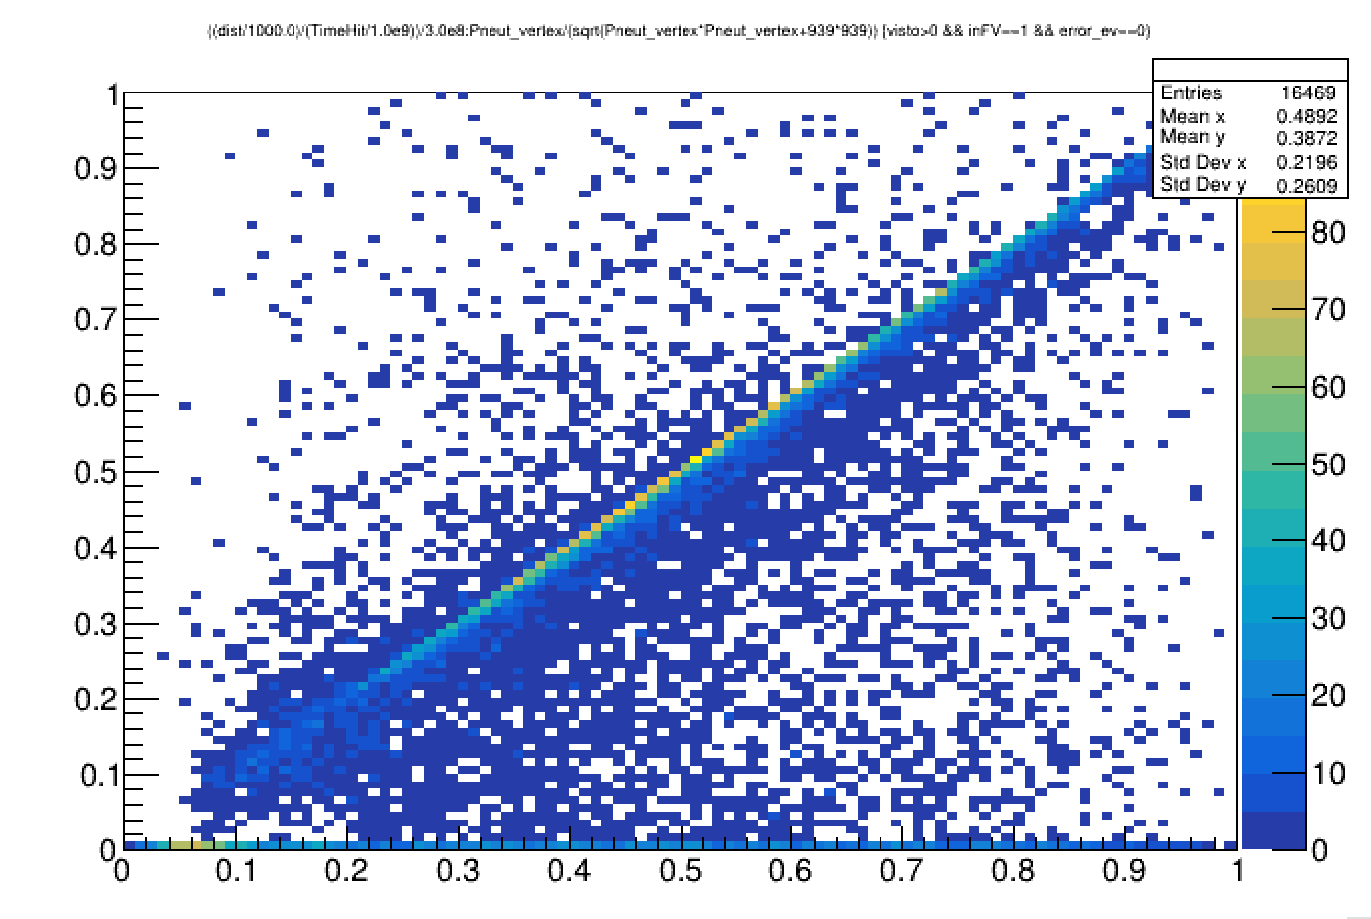
Beta reconstruction (without smearing)
GEANT4
FLUKA

Slide 10
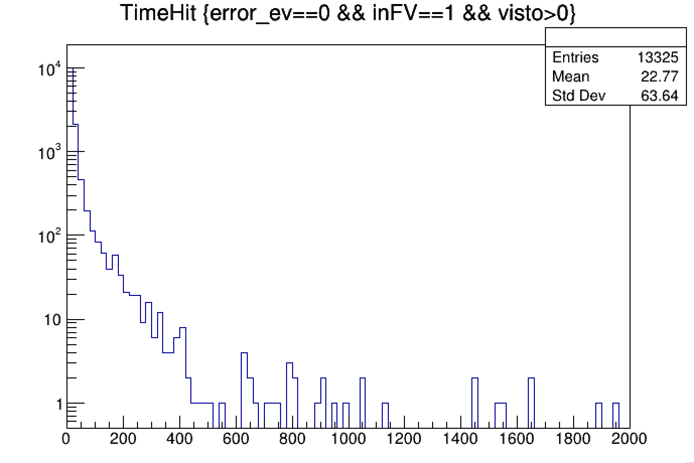
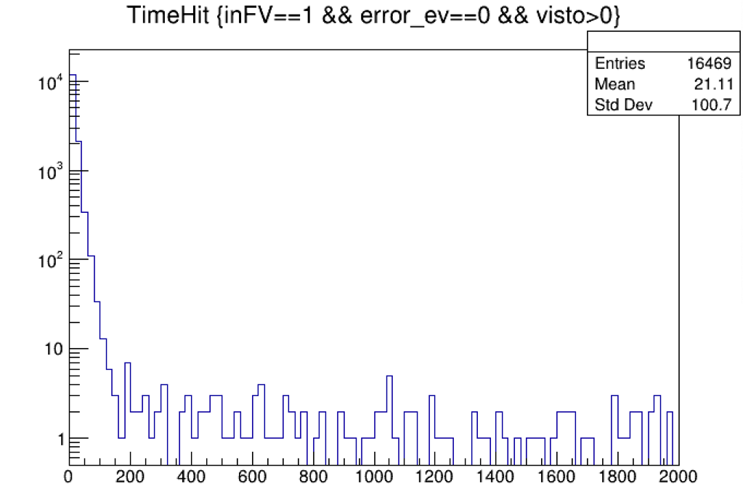
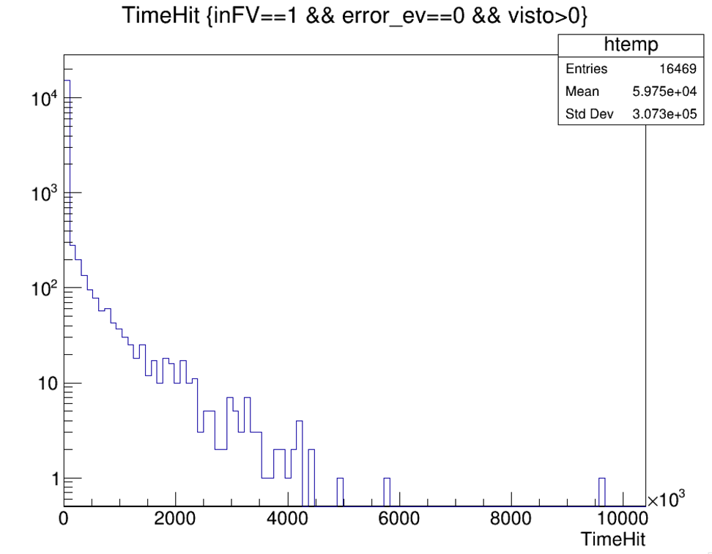
Time distribution of the first hit
FLUKA
GEANT4
No entry with time> 10 us
ns
ns
ns

Slide 11
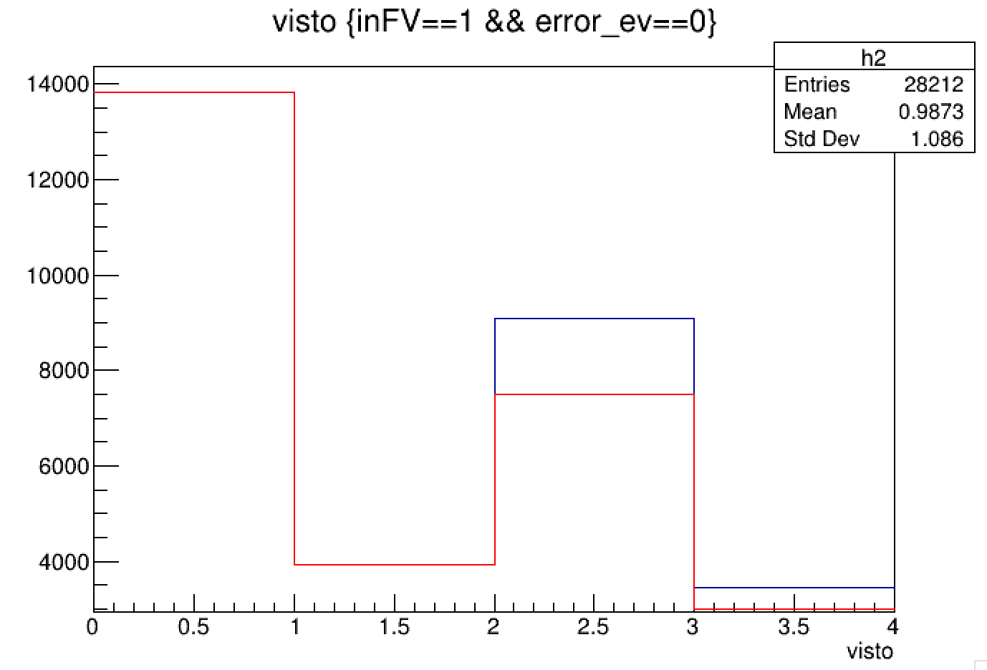
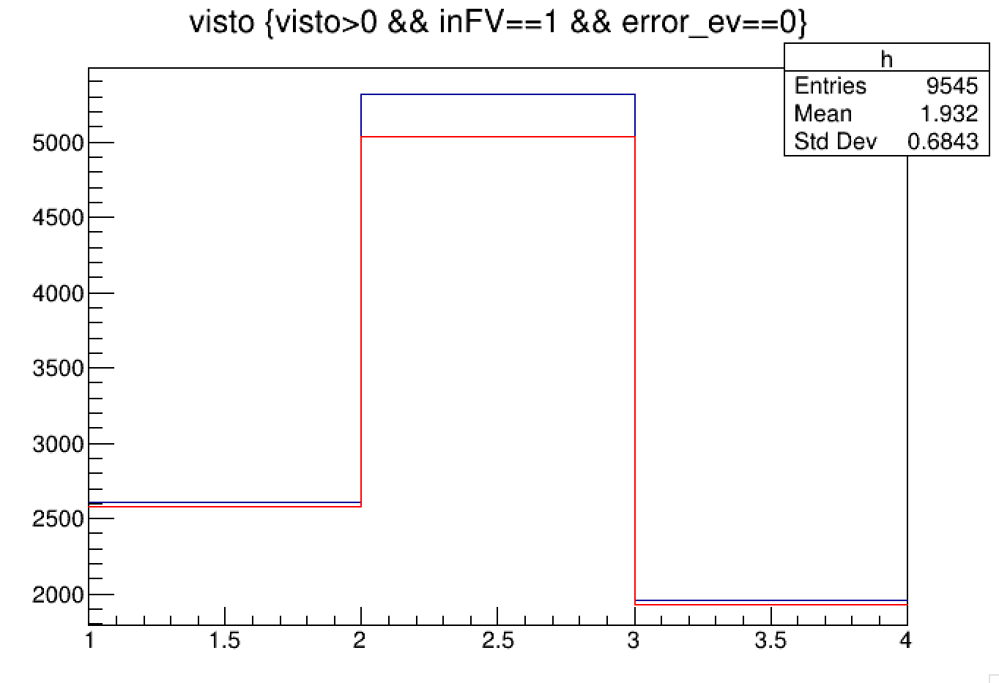
Detection efficiency with a time cut of 100 ns
FLUKA
Detected
Detected with time <100 ns
GEANT4
Detected
Detected with time <100 ns
barrel
barrel
stt
stt
endcap
endcap
96% of detected neutrons have time<100 ns
87% of detected neutrons have time<100 ns

