Slide 1
3rd KE4738 Technical Meeting
March 24th, 2021
General information
&
Feedback from the US-MDP
Davide Tommasini, CERN

Slide 2
Newcomers in the CERN Team
Christian Scheuerlein : Staff, material scientist.
Thermo-mechanical characterization, irradiation programme.
Barthi Verma : Fellow, chemist.
Characterization of adhesion strength of impregnation systems.
Parameters to explore: configuration, geometry, materials (copper, stainless steel, polyimide, glass fabrics, mica) as a function of the impregnation resin.
I also remind
Sébastien Clément
Staff, plastic technologist. In charge of the operation of the polymer lab.
Irradiation programme
We intend to explore the radiation ageing (thermo-mechanical and dielectric properties) of different impregnation resins as a function of irradiation type, dose, and environment (air, vacuum, low temperatures). We are preparing the programme, which we intend to present and discuss in a next meeting.

Slide 3
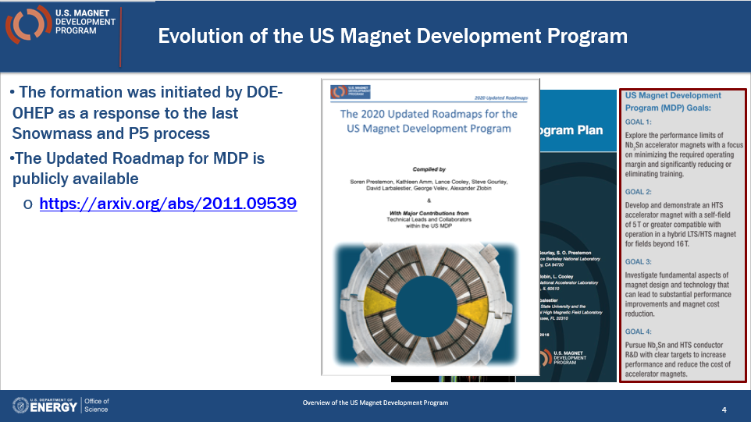
News from the US-MDP Meeting (1-5 March)
Courtesy Soren Prestemon, LBNL

Slide 4
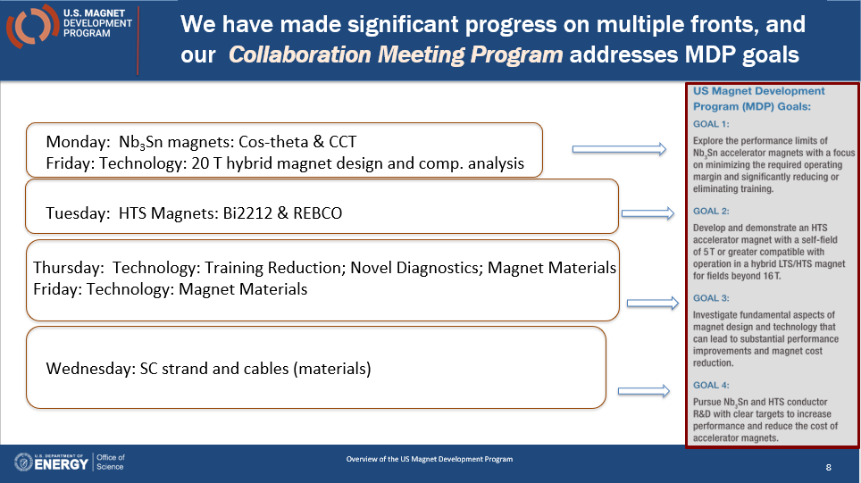
News from the US-MDP Meeting (1-5 March)
Courtesy Soren Prestemon, LBNL

Slide 5
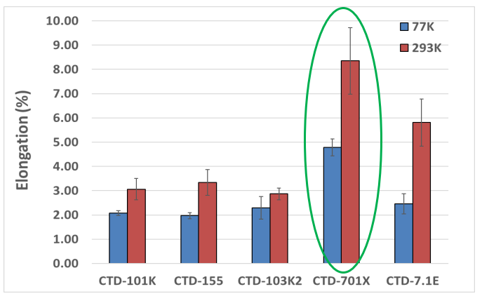
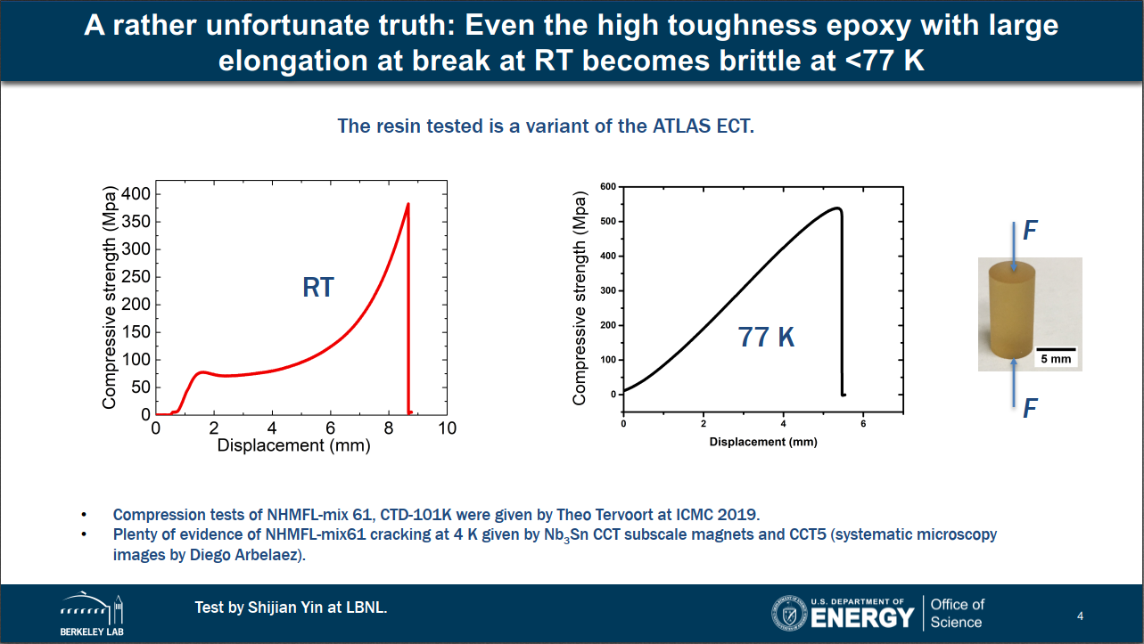
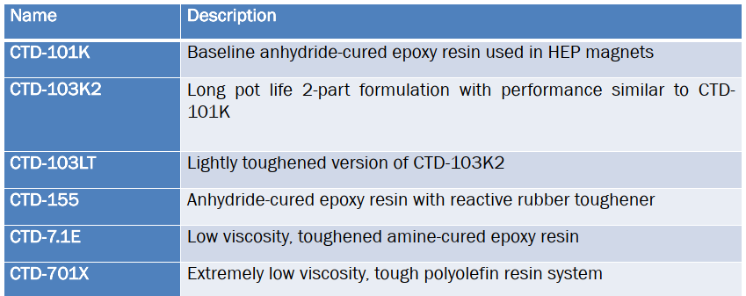
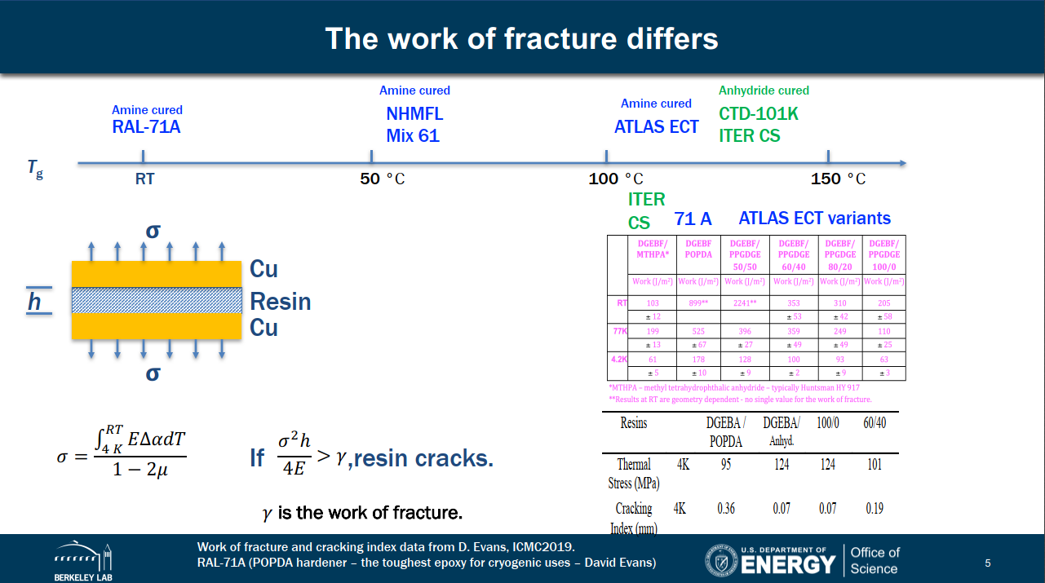
From Tengming Shen, LBNL 2019

Slide 6
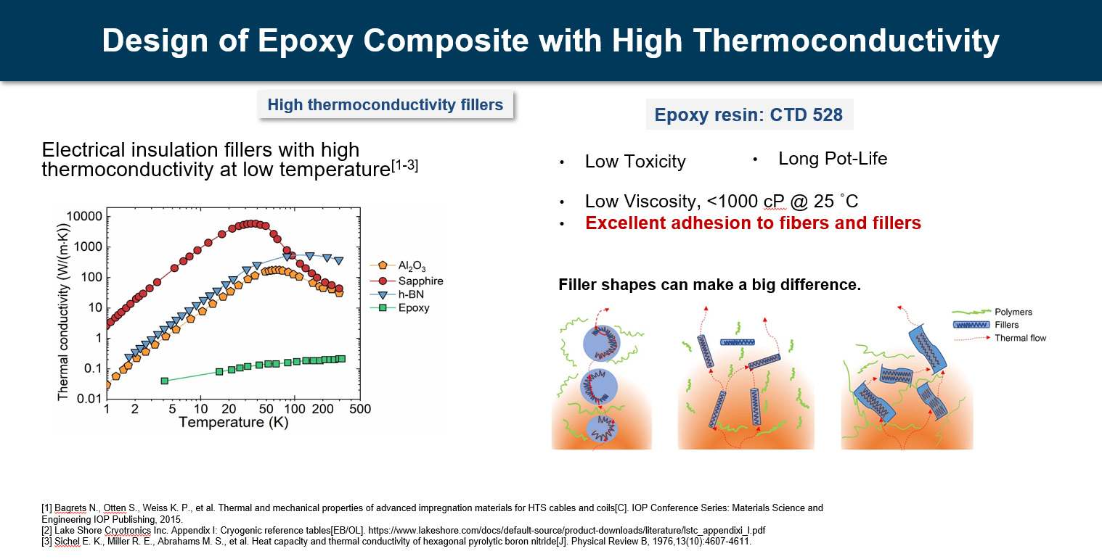
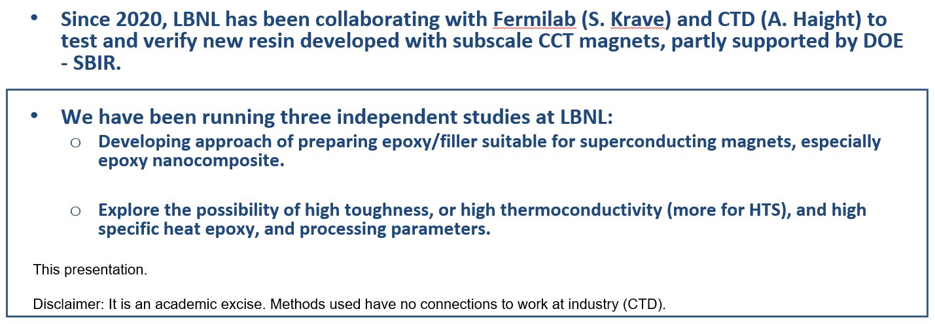
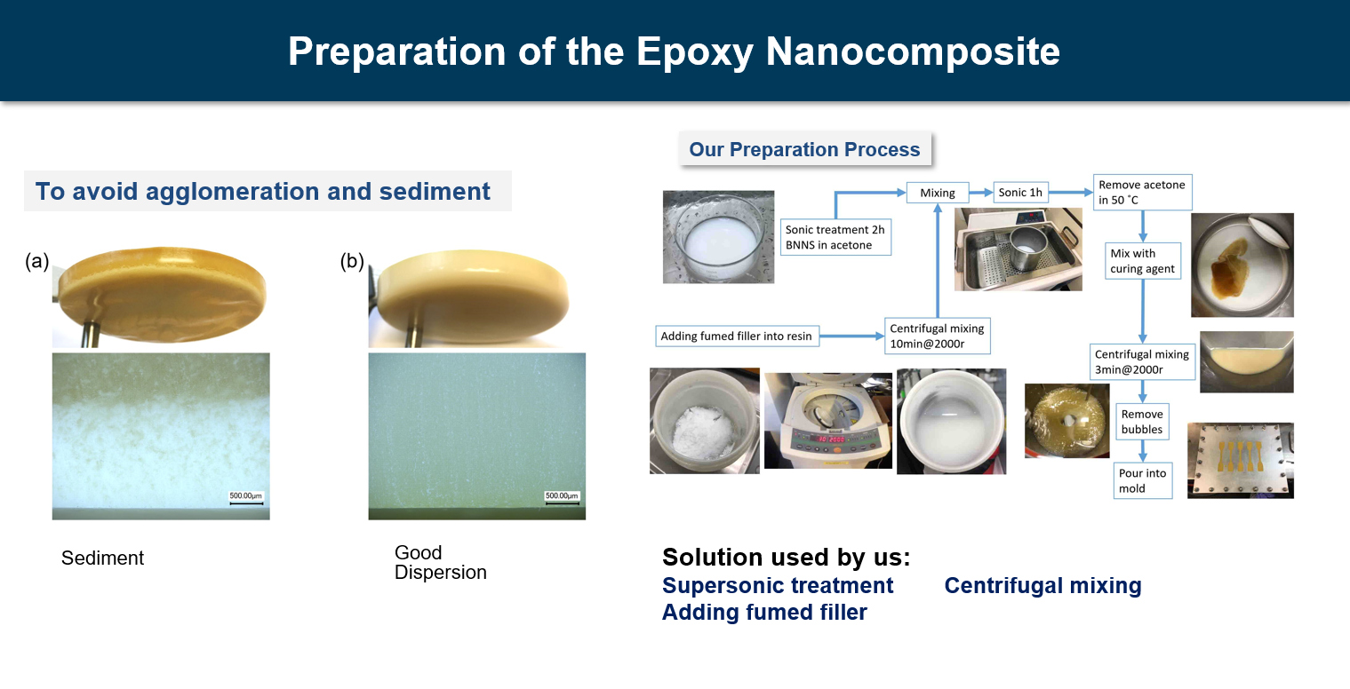
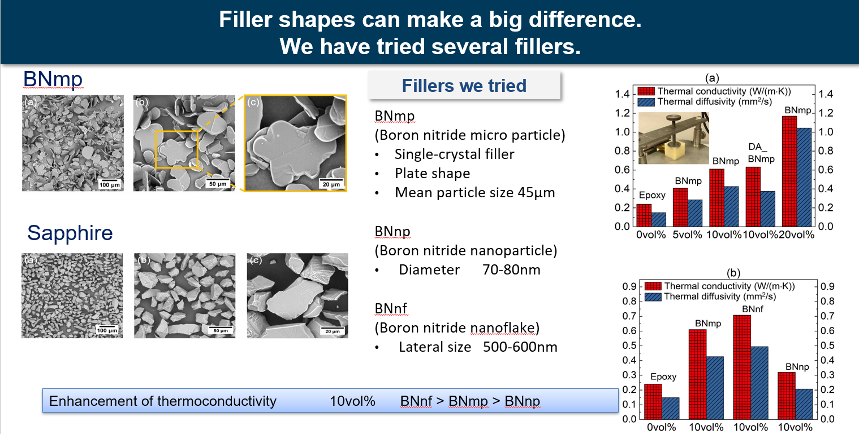
Recent studies at LBNL (Tengming Shen)

Slide 7
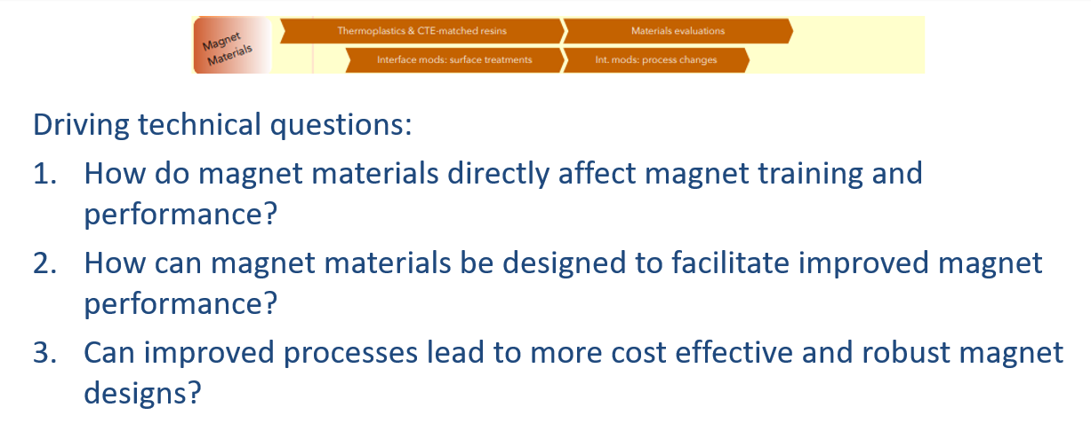
Recent studies at FNAL (Steve Krave)

Slide 8
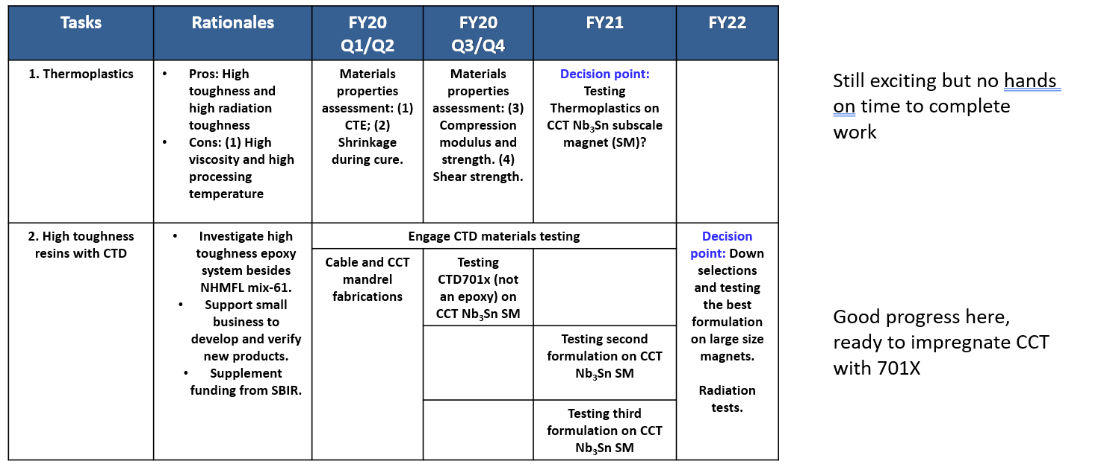
Recent studies at FNAL (Steve Krave)

Slide 9
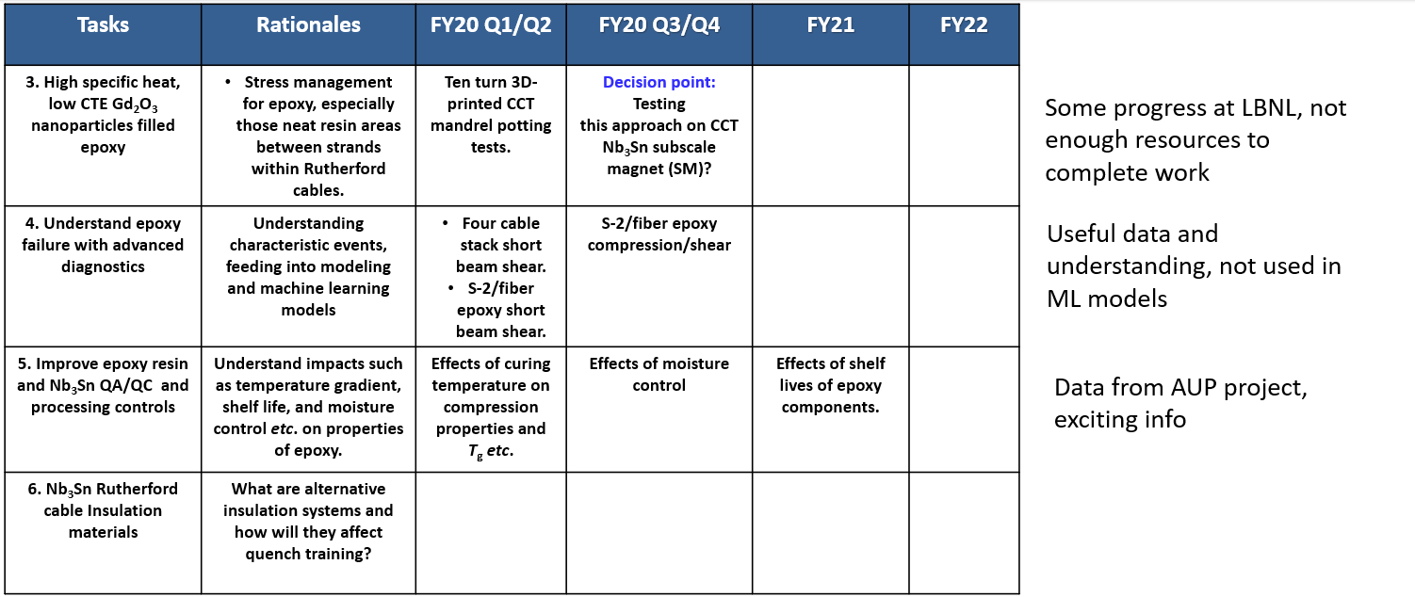
Recent studies at FNAL (Steve Krave)

Slide 10
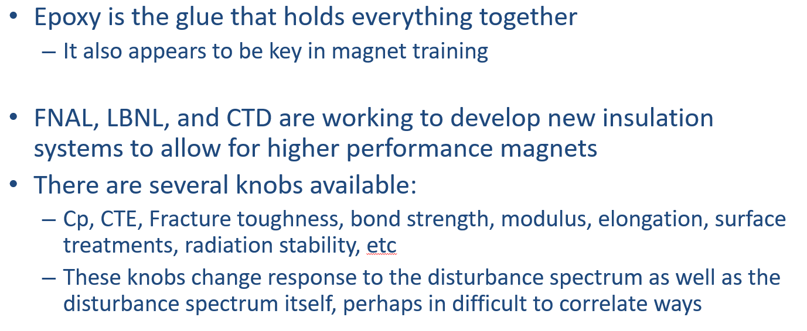
Recent studies at FNAL (Steve Krave)

Slide 11
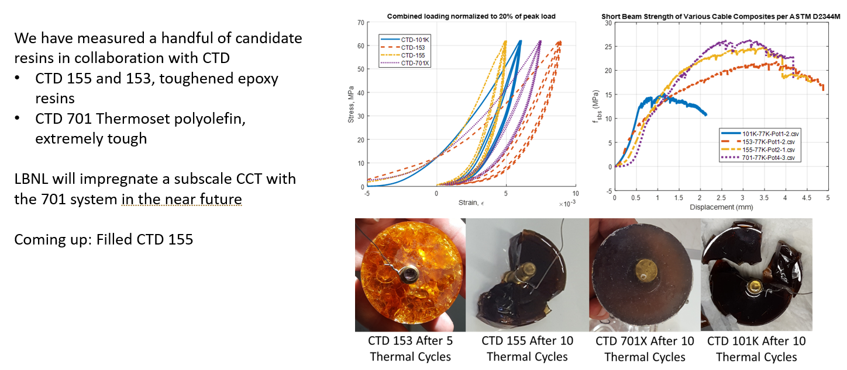
Recent studies at FNAL (Steve Krave)

Slide 12
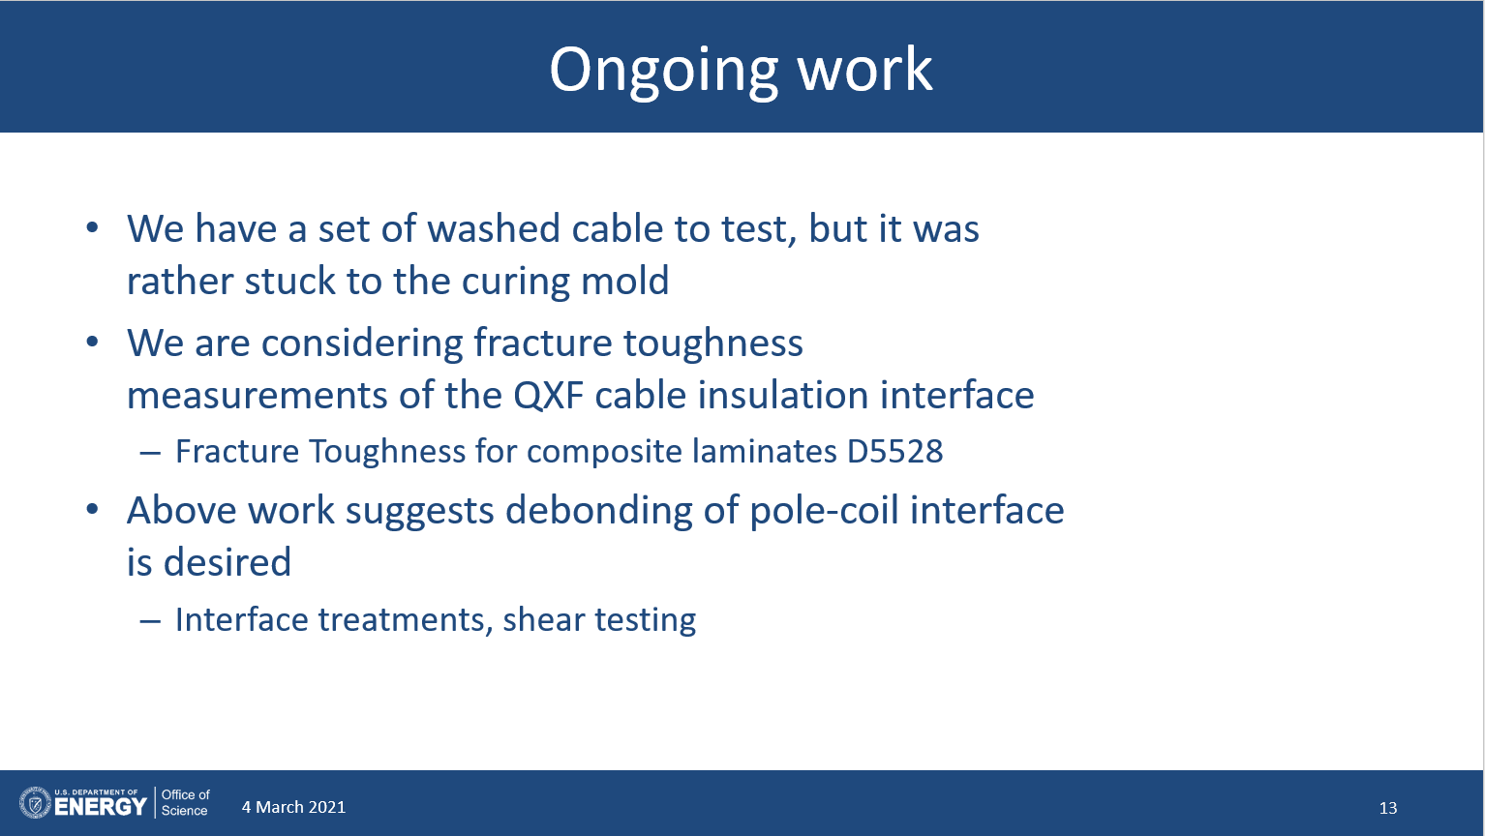
Recent studies at FNAL (Steve Krave)

Slide 13

Recent studies at CTD (Andrea Haight)

Slide 14
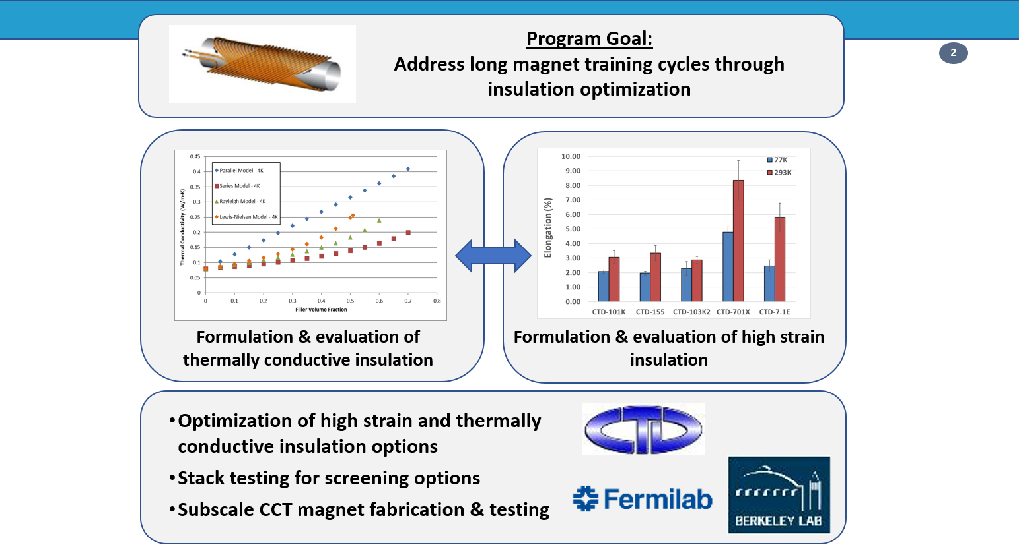
Recent studies at CTD (Andrea Haight)

Slide 15
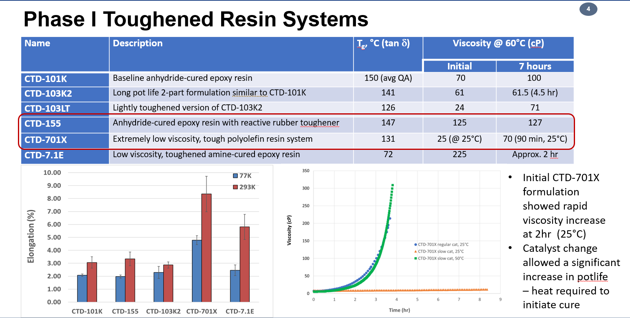
Recent studies at CTD (Andrea Haight)

Slide 16
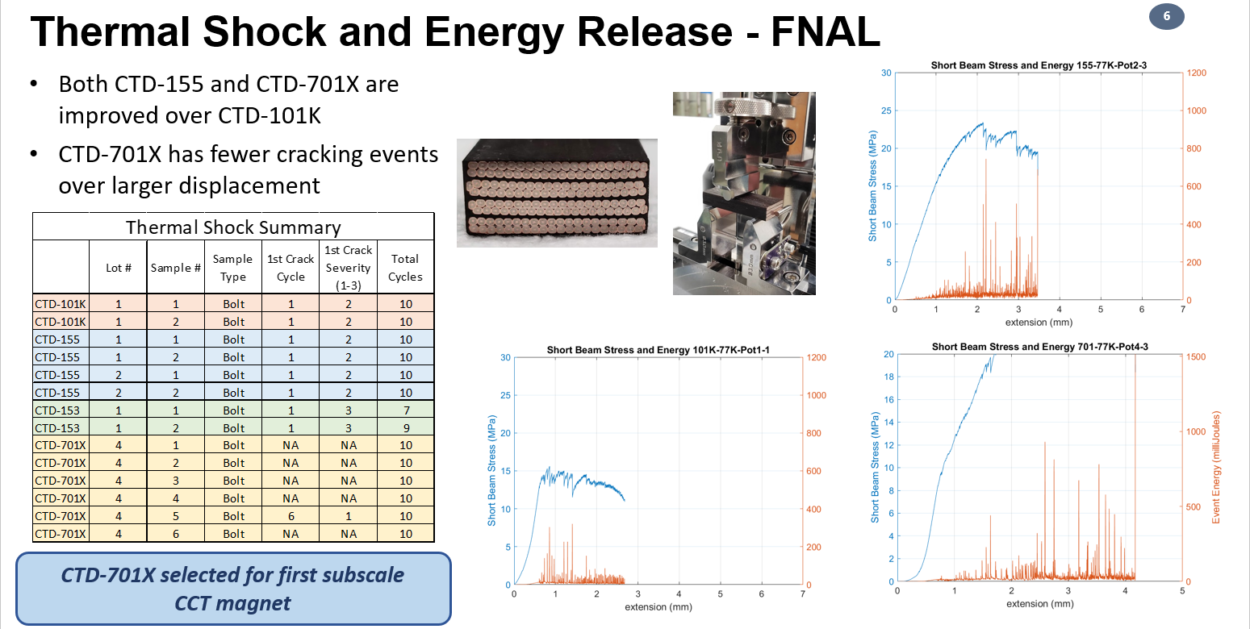
Recent studies at CTD (Andrea Haight)

Slide 17
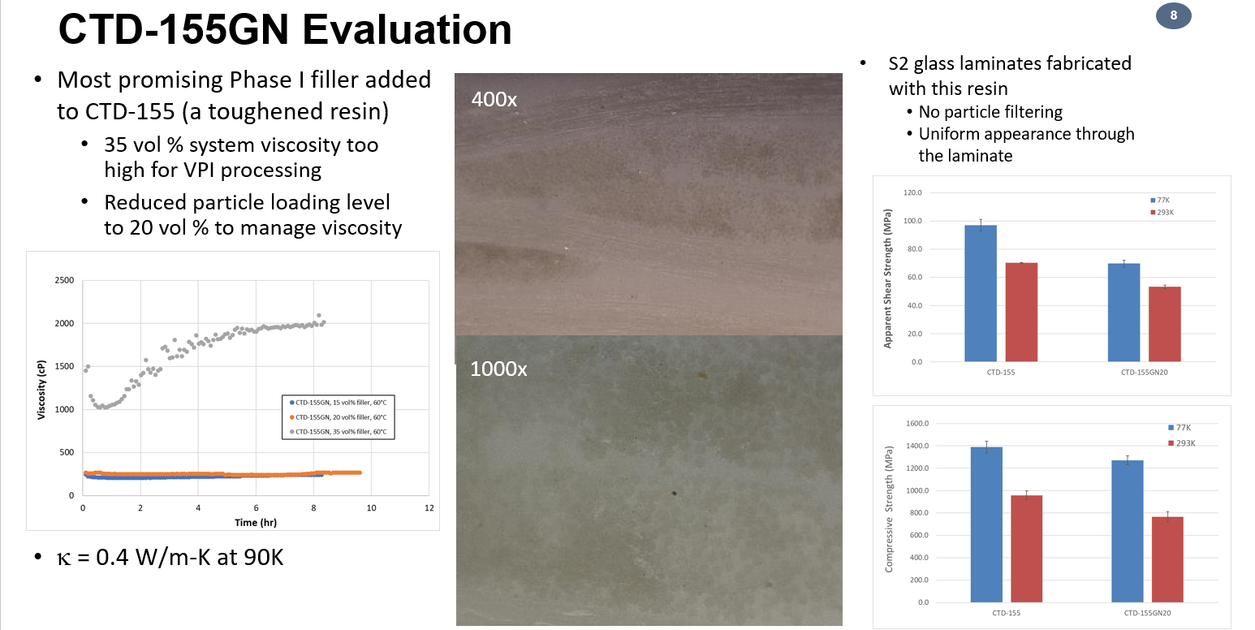
Recent studies at CTD (Andrea Haight)

Slide 18
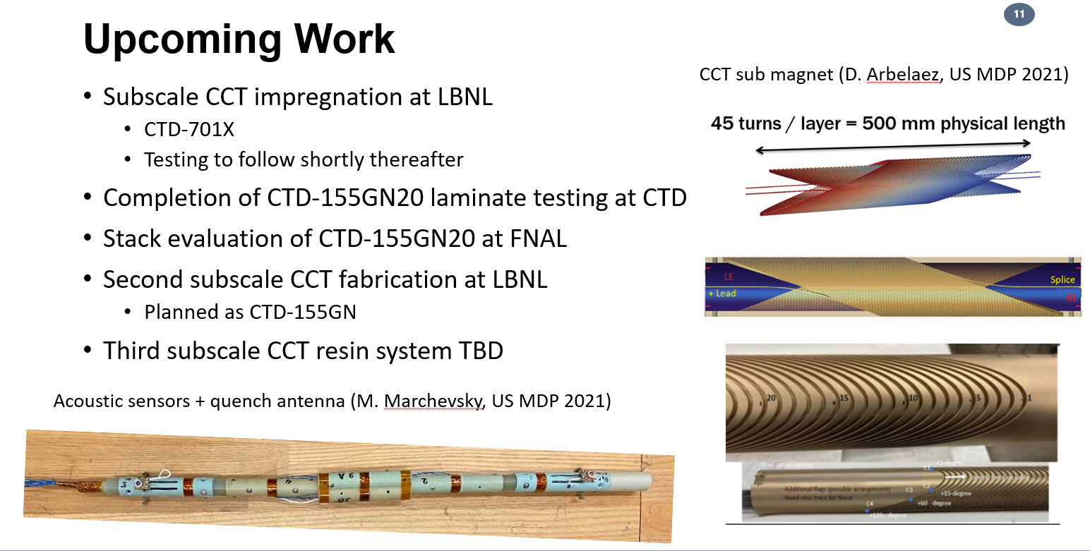
Recent studies at CTD (Andrea Haight)

