Slide 1
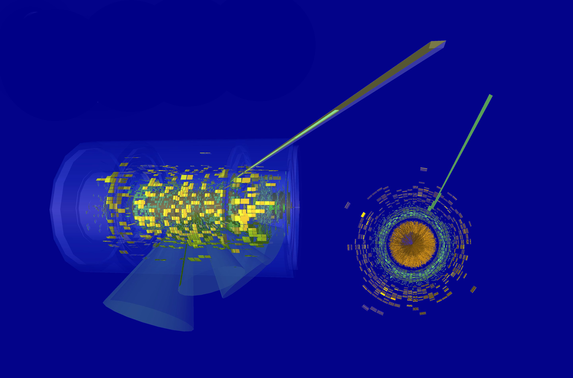



Jet classification in t-tbar decays of heavy BSM resonances using ML
Jorge J. Martínez de Lejarza Samper
Julio Lozano Bahilo
José Salt Cairols

Slide 2
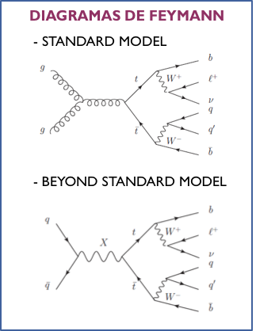
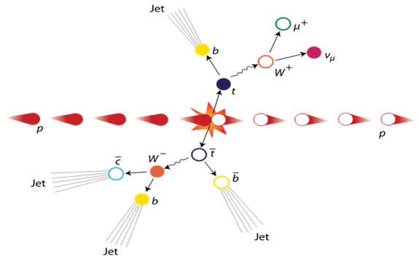
Resonance studies
X
Subject of study
Events with resonance particles production disintegrated in top quarks pairs
X could be Z’TC2, GKK o gKK (different masses and widths)
Goal
Jet classification to get a good resolution in the mass of the resonance

Slide 3
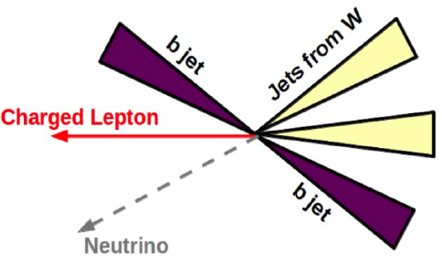
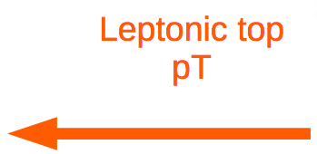
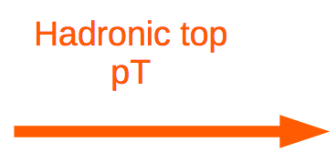
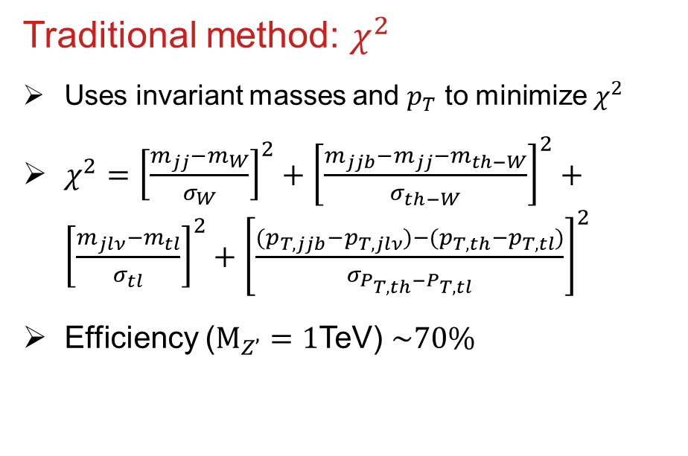
Jet classification
Traditional method: $χ^{2}$
Uses invariant masses and $p_{T}$ to minimize $χ^{2}$
$χ^{2}={\left[\frac{m_{jj}−m_{W}}{σ_{W}}\right]}^{2}+{\left[\frac{m_{jjb}−m_{jj}−m_{th−W}}{σ_{th−W}}\right]}^{2}+{\left[\frac{m_{jlν}−m_{tl}}{σ_{tl}}\right]}^{2}+{\left[\frac{(p_{T,jjb}−p_{T,jlν})−(p_{T,th}−p_{T,tl})}{σ_{P_{T,th}−P_{T,tl}}}\right]}^{2}$
Efficiency ($M_{Z’}=1$TeV) $\sim 70\%$
New methods: ML
MC events with Z’ particles disintegrated in top quarks pairs for ML algorithm training
Jets classified according to matching variables as :
  Jet b from the hadronic decay of t/tbar quark : bh
  Jet from W decay of hadronic decay of t/tbar quark : wh
  Jet b from the semileptonic decay of ttbar/t quark : bl
  Jet which is not produce in Z’ resonance: oth
bl
wh
wh
bh

Slide 4
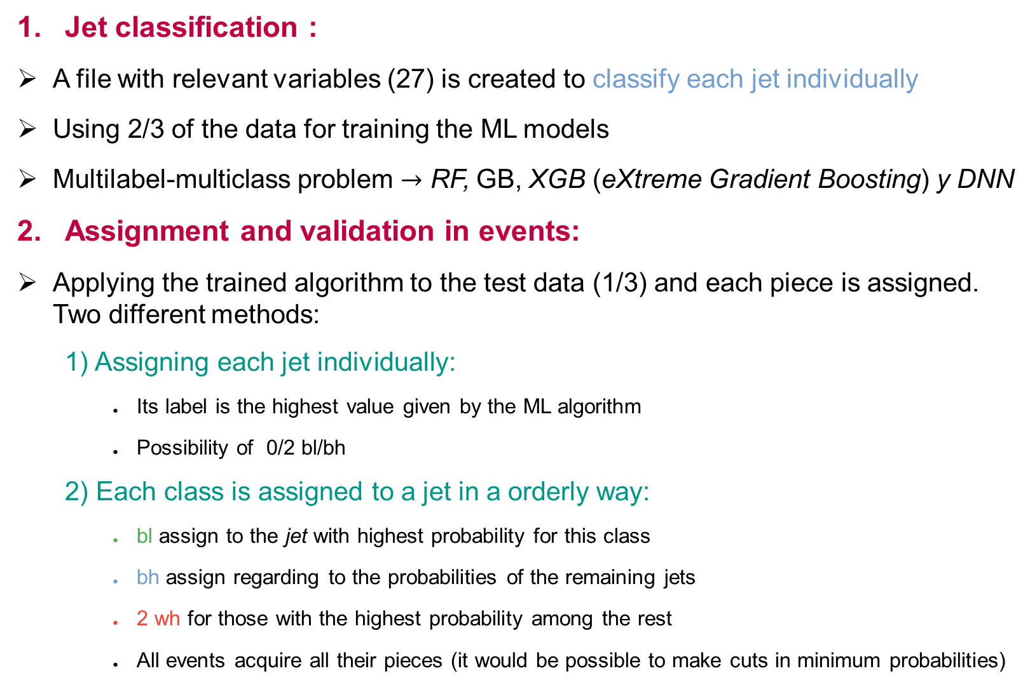
Methodology: Jet and event tagging
Jet classification :
A file with relevant variables (27) is created to classify each jet individually
Using 2/3 of the data for training the ML models
Multilabel-multiclass problem $→$ RF, GB, XGB (eXtreme Gradient Boosting) y DNN
Assignment and validation in events:
Applying the trained algorithm to the test data (1/3) and each piece is assigned. Two different methods:
  Assigning each jet individually:
    Its label is the highest value given by the ML algorithm
    Possibility of 0/2 bl/bh
  Each class is assigned to a jet in a orderly way:
    bl assign to the jet with highest probability for this class
    bh assign regarding to the probabilities of the remaining jets
    2 wh for those with the highest probability among the rest
    All events acquire all their pieces (it would be possible to make cuts in minimum probabilities)

Slide 5
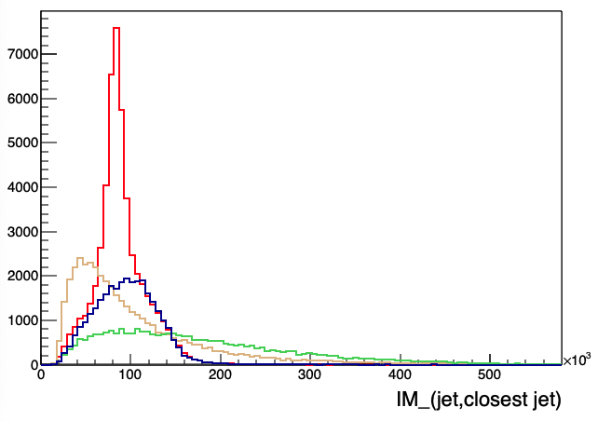
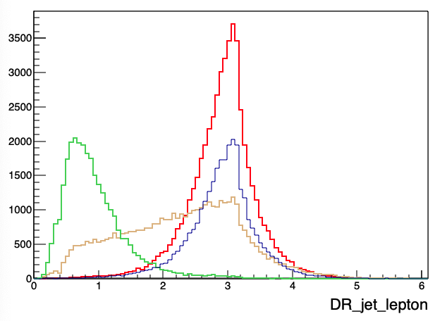
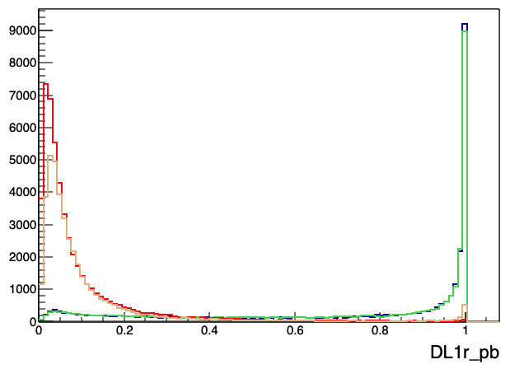
Methodology: Discriminatory variables
Variables
Different features that allows us to separate among the distinct types of jets: bh, bl, wh y oth
Different kind of variables: kinematic, angular and tagging
Invariant mass (jet, closest jet)
ΔRjl
DL1r_pb

Slide 6
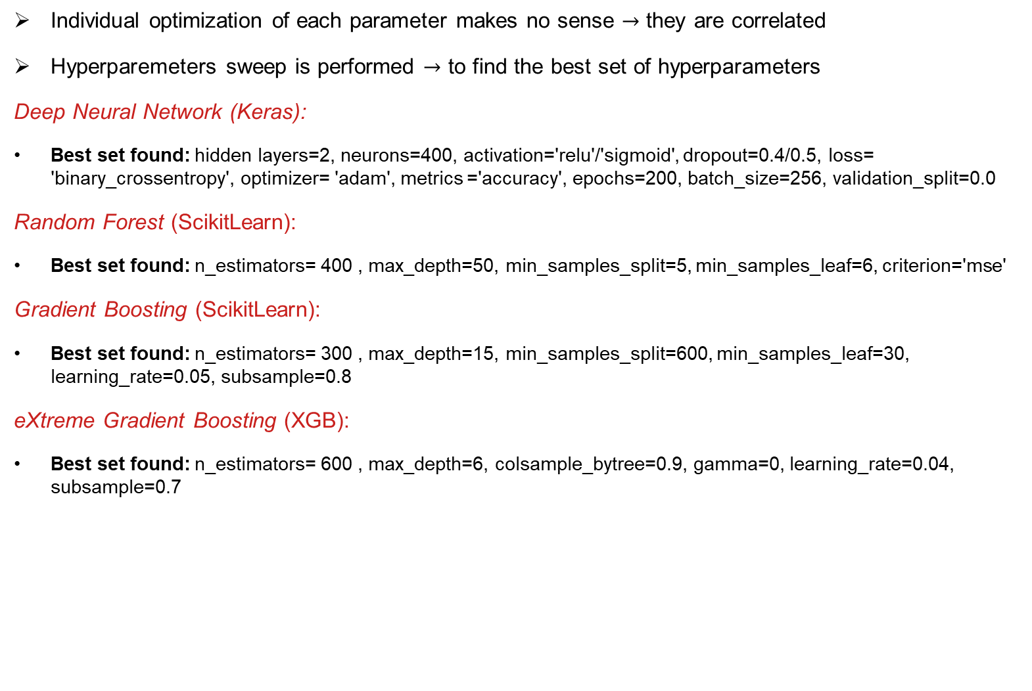
Results: Hyperparameters optimization for $M_{Z^{′}}$=1TeV
Individual optimization of each parameter makes no sense $→$ they are correlated
Hyperparemeters sweep is performed $→$ to find the best set of hyperparameters
Deep Neural Network (Keras):
Best set found: hidden layers=2, neurons=400, activation='relu'/'sigmoid', dropout=0.4/0.5, loss= 'binary_crossentropy', optimizer= 'adam', metrics ='accuracy', epochs=200, batch_size=256, validation_split=0.0
Random Forest (ScikitLearn):
Best set found: n_estimators= 400 , max_depth=50, min_samples_split=5, min_samples_leaf=6, criterion='mse'
Gradient Boosting (ScikitLearn):
Best set found: n_estimators= 300 , max_depth=15, min_samples_split=600, min_samples_leaf=30, learning_rate=0.05, subsample=0.8
eXtreme Gradient Boosting (XGB):
Best set found: n_estimators= 600 , max_depth=6, colsample_bytree=0.9, gamma=0, learning_rate=0.04, subsample=0.7
 | DNN | RF | GB | XGB
Default Efficiency (%) | 75.1 | 75.6 | 74.9 | 75.4
Optimized Efficiency (%) | 76.4 | 76.6 | 77.3 | 77.0
Time execution (s) | 1406 | 184 | 559 | 71

Slide 7
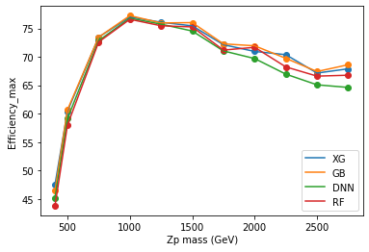
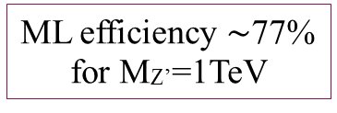
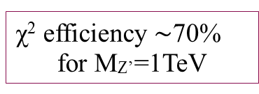
Results: Efficiency vs $M_{Z^{′}}$
χ² efficiency $\sim$70%
for MZ’=1TeV
ML efficiency $\sim$77%
for MZ’=1TeV
Reconstruction efficiency vs. M_{Z’}:
Each mass involves its own dataset of training and testing data
The hyperparameter optimization is performed for each mass individually

Slide 8
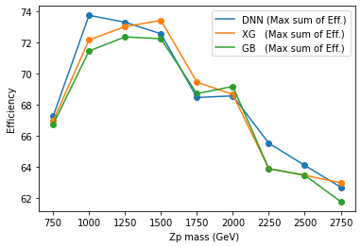
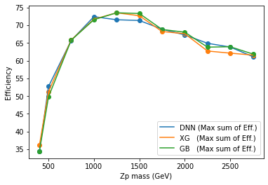
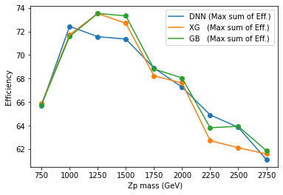

Results: Mass parametrization
Reconstruction efficiency vs. M_{Z’}:
All the dataset for each mass is joined in a larger dataset, and the mass $M_{Z^{′}}$ is added as an additional variable
The hyperparameters optimization is performed maximizing the sum over all the efficiencies for each mass
Keeping all the masses
Removing lowest masses

Slide 9
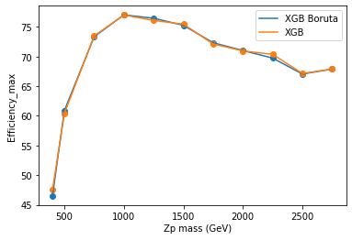
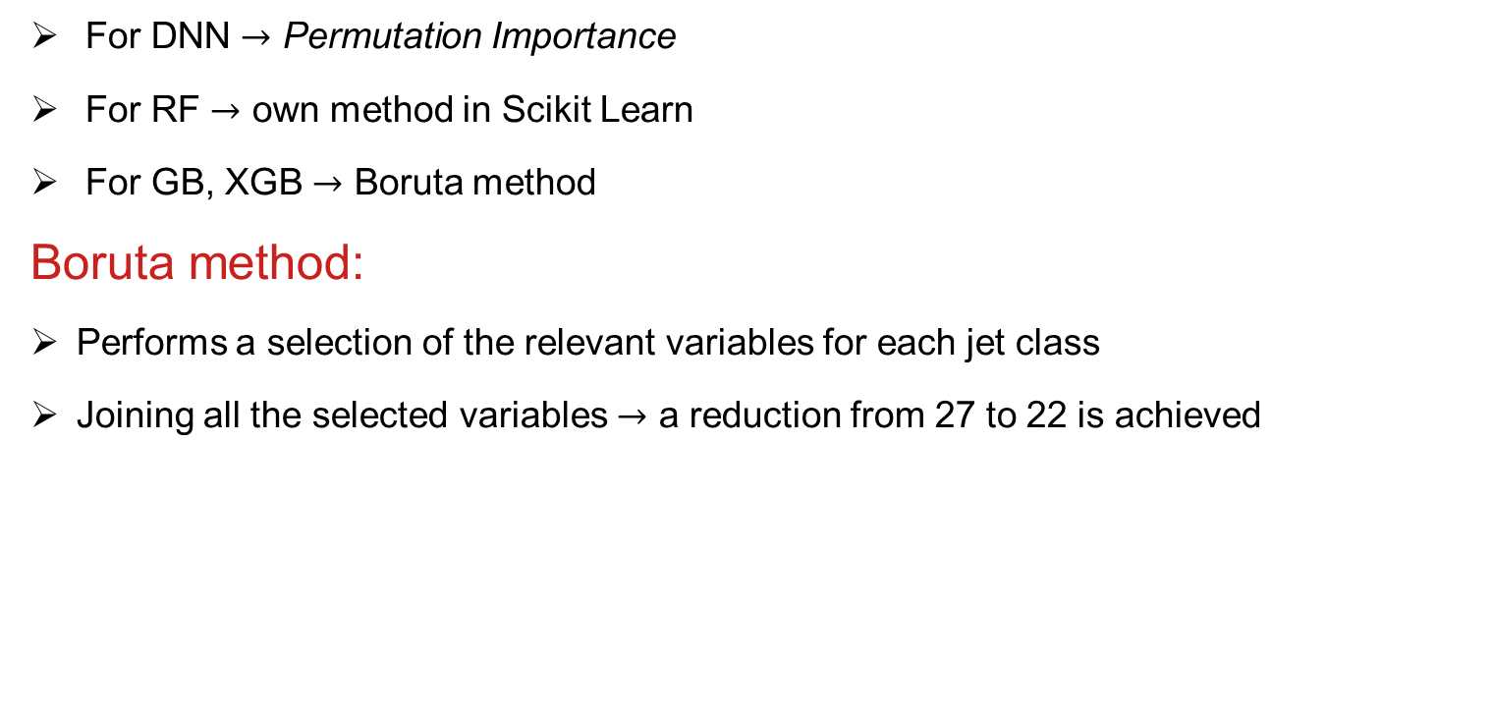
Results: Feature selection
For DNN $→$ Permutation Importance
For RF $→$ own method in Scikit Learn
For GB, XGB $→$ Boruta method
Boruta method:
Performs a selection of the relevant variables for each jet class
Joining all the selected variables $→$ a reduction from 27 to 22 is achieved
Same efficiency, but lower computational cost!

Slide 10
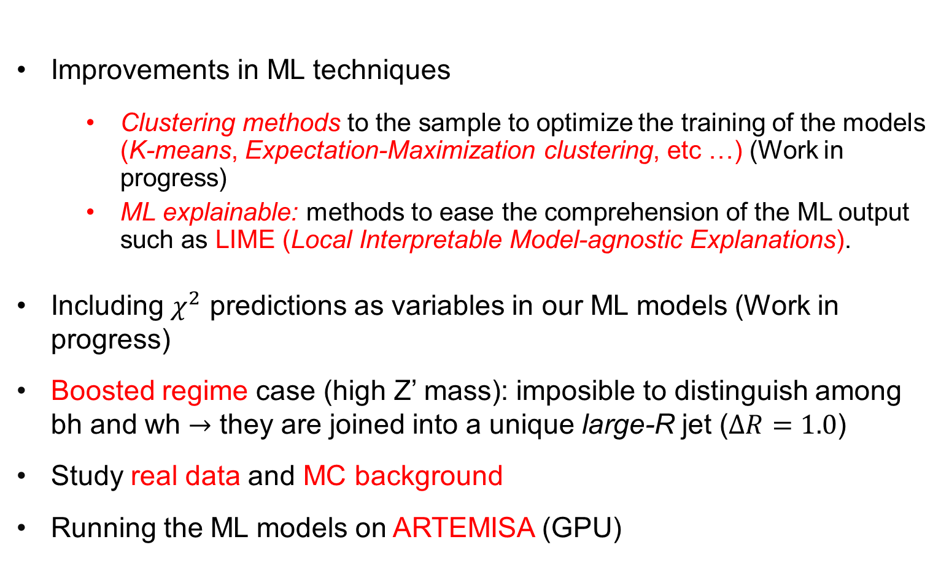
Further work
Improvements in ML techniques
  Clustering methods to the sample to optimize the training of the models (K-means, Expectation-Maximization clustering, etc …) (Work in progress)
  ML explainable: methods to ease the comprehension of the ML output such as LIME (Local Interpretable Model-agnostic Explanations).
Including $χ^{2}$ predictions as variables in our ML models (Work in progress)
Boosted regime case (high Z’ mass): imposible to distinguish among bh and wh $→$ they are joined into a unique large-R jet ($∆R=1.0$)
Study real data and MC background
Running the ML models on ARTEMISA (GPU)

Slide 11
Thank you for your attention!

Slide 12
BACKUP

Slide 13
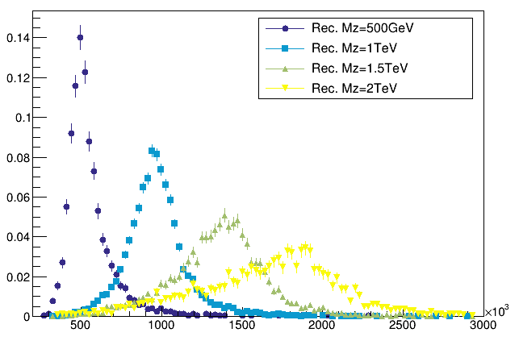
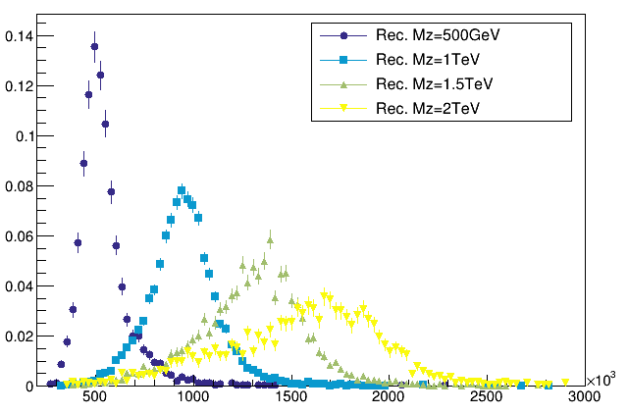
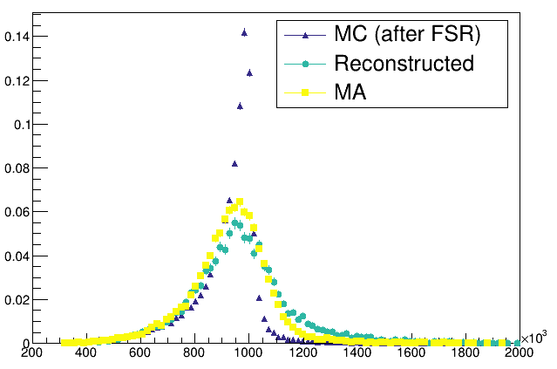
Mass invariant spectrum
Comparation with
MC y Matching
MW lep constrain pν Without correction in pν
Notes:
13

Slide 14
Probabilities in each model
 | DNN | RF | GB | XGB
bh | 76.82 | 76.92 | 77.74 | 77.27
bl | 90.28 | 90.23 | 91.46 | 91.03
wh | 82.28 | 83.46 | 83.80 | 84.17
oth | 79.28 | 78.54 | 78.91 | 78.08

Slide 15
ACADEMIC EXAMPLE:
Method 1:
Method 2:
 | bh | bl | wh | oth
jet1 | 70.82 | 31.92 | 77.74 | 67.27
jet2 | 90.28 | 90.23 | 71.46 | 61.03
jet3 | 82.28 | 83.46 | 63.80 | 54.17
jet4 | 59.28 | 78.54 | 68.91 | 48.08
jet5 | 39.28 | 38.54 | 63.31 | 78.08

