Slide 1
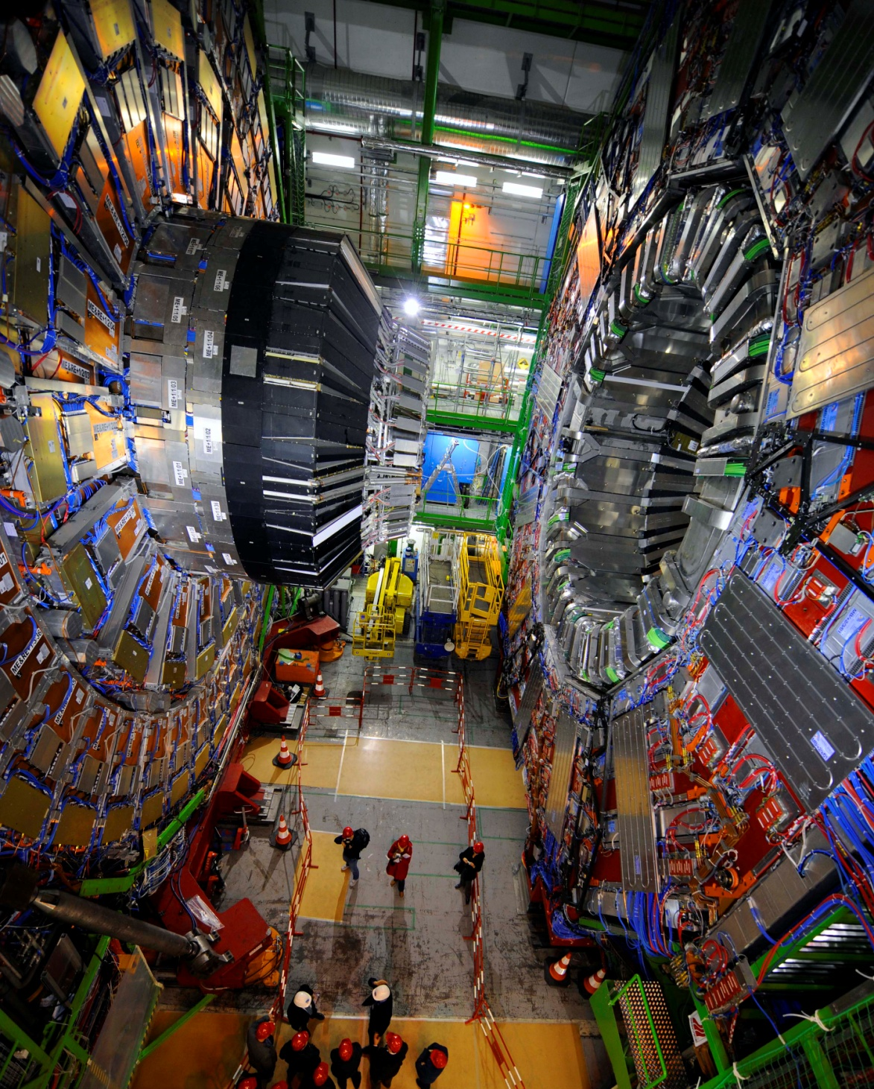
CMS experiment group at TAMU
-- PI: Prof. Safonov, kamon, eusebi
-- research: Jason Gilmore, Evaldas juska

Slide 2
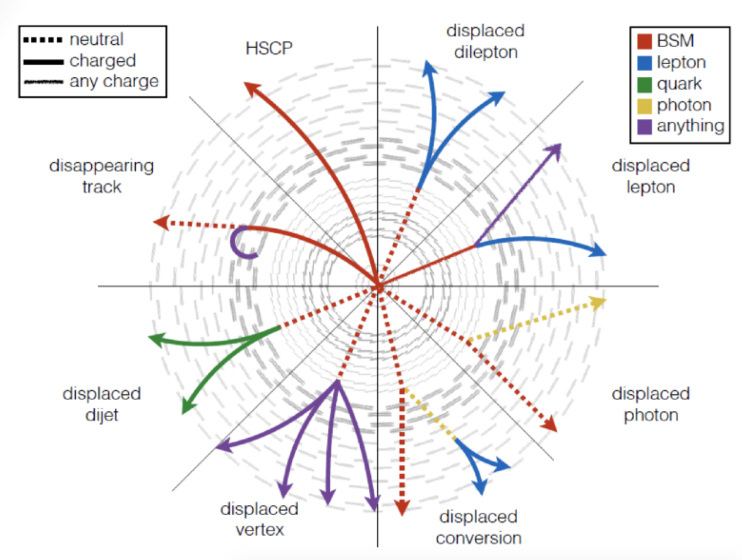
The Grand Purpose of our Research
It’s all about high statistics
And better detectors
The upgraded LHC (x10 collision rate) is truly a Higgs factory: it will produce over 150M Higgs bosons
  Including ~120k of pair produced events
  Enables a broad program:
    Precision O(1-10%) measurements of coupling
      potential to reveal new, hidden particles in loops
    Yukawa to 2nd generation, e.g. H→ μμ
    BSM Higgs searches
      extra scalars, resonances, exotic decays…
and the potential of New Physics
  Long Lived Particles
  Supersymmetry
  Dark Matter
  Extra Dimensions
Dark matter = MET
Please, can one of you find DM for me!!
Need
precise & ‘flexible’ detector
SM: Standard Model BSM: Beyond Standard Model
MET: Missing transverse energy
Notes:
Remind LHC is a top pair factory 10Hz
LHC: Top pair rate is > 10 Hz (LHC is a Top factory), enabling us to address much more precise questions
Single, double, and triple differential cross sections
Rare (FCNC) decays
CP violation (a beginning)
Width and more complex methods for measuring the mass

Slide 3
particle physics and the standard model
But let’s back up for a moment and see how we get there…

Slide 4

Standard Model of Particle Physics
Physical content:
  12 basic particles
    Each has an antiparticle
  Interact via force carriers called gauge bosons
  Higgs boson giving mass to all other particles
Includes 2.5 forces:
  Electroweak=“electromagnetic + weak” combined force
    All basic particles participate, transmitted by W/Z/γ bosons
    Responsible for radioactive decays and electromagnetic interactions
  Strong force:
    Only quarks participate, transmitted by gluons
    Holds proton and other composite hadrons together
  Dark Matter is unexplained at all
  Discovery of neutrino oscillations makes Standard Model at least “not quite right”
  Gravity is not included

Slide 5
LHC: the one ring to collide them all
Located at CERN in Geneva, Switzerland
14 TeV Proton-proton collisions
Operates since 2009
  Will run for the next 20 years
CMS
E_{beam}=7 TeV
p
p
LHCb
ATLAS
ALICE

Slide 6
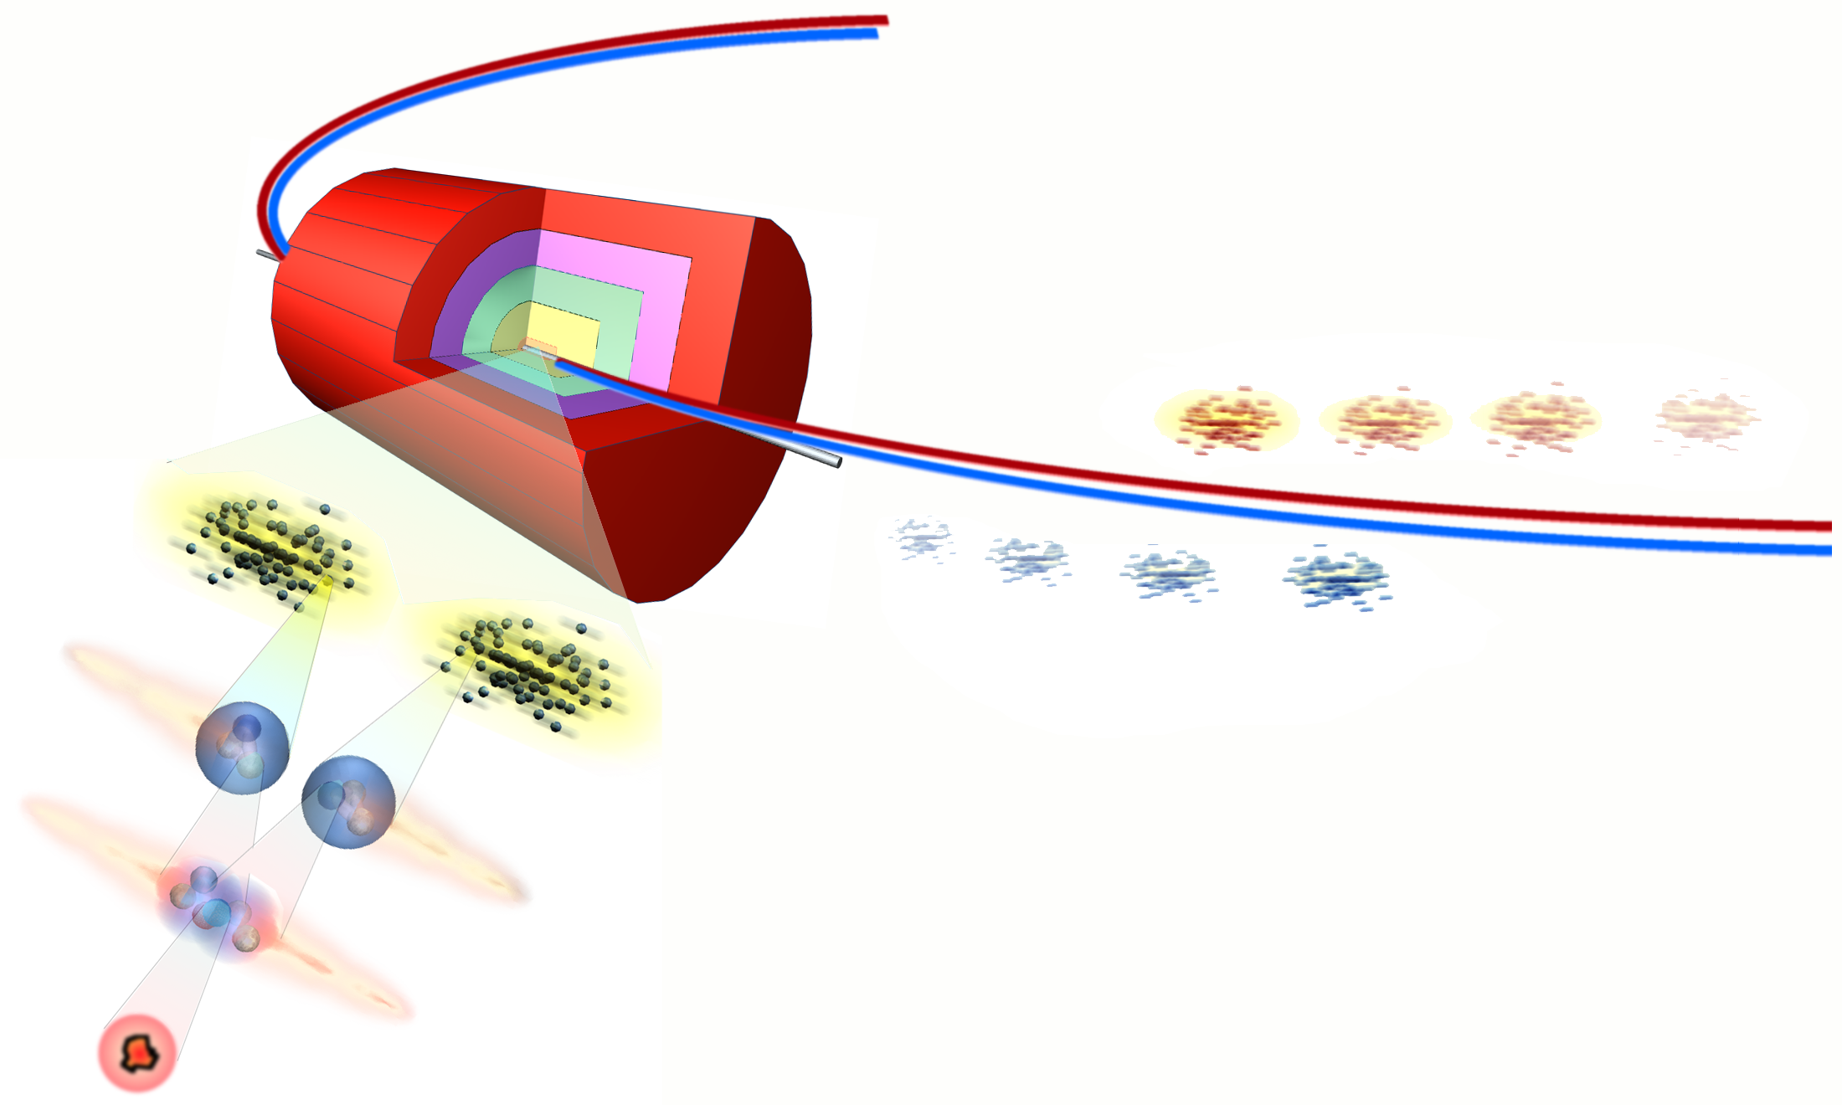
Collisions at LHC
14 000 x mass of proton (14 TeV) = Collision Energy
Protons fly at 99.999999% of speed of light
2808 = Bunches/Beam
100 billion (10¹¹) = Protons/Bunch
7.5 m (25 ns)
7 TeV
Proton
Proton
colliding beams
Bunch Crossing 40 million (10⁷) Hz
Proton Collisions 10 billion (10¹⁰) Hz
e
-
ν
e
Parton Collisions
µ
+
q
-
µ
-
~
χ
1
q
Z
~
q
New Particles 1 Hz to 10 micro (10⁻⁵) Hz
p
H
p
p
g
p
(Higgs, SUSY...)
~
µ
Z
q
μ
+
+
q
~
μ
−
µ
-
χ
2
0
~
χ
1
0
One “discovery” event in 10,000,000,000,000
Our goal is to find that one event!

Slide 7

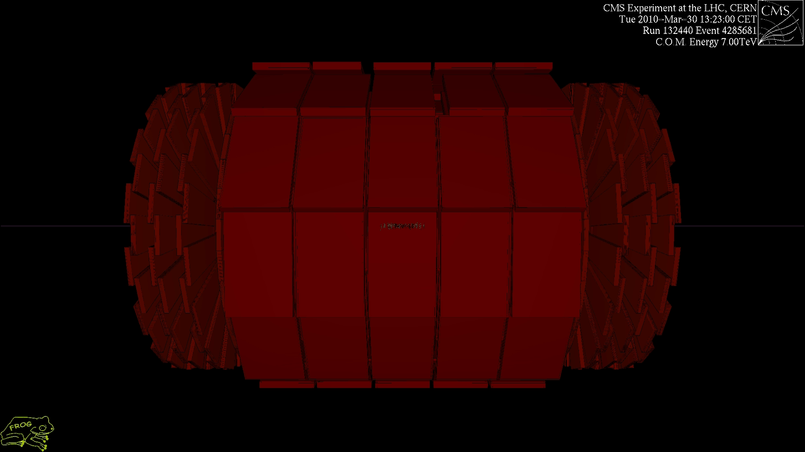
A pp collision at CMS
This is where our data is coming from!

Slide 8
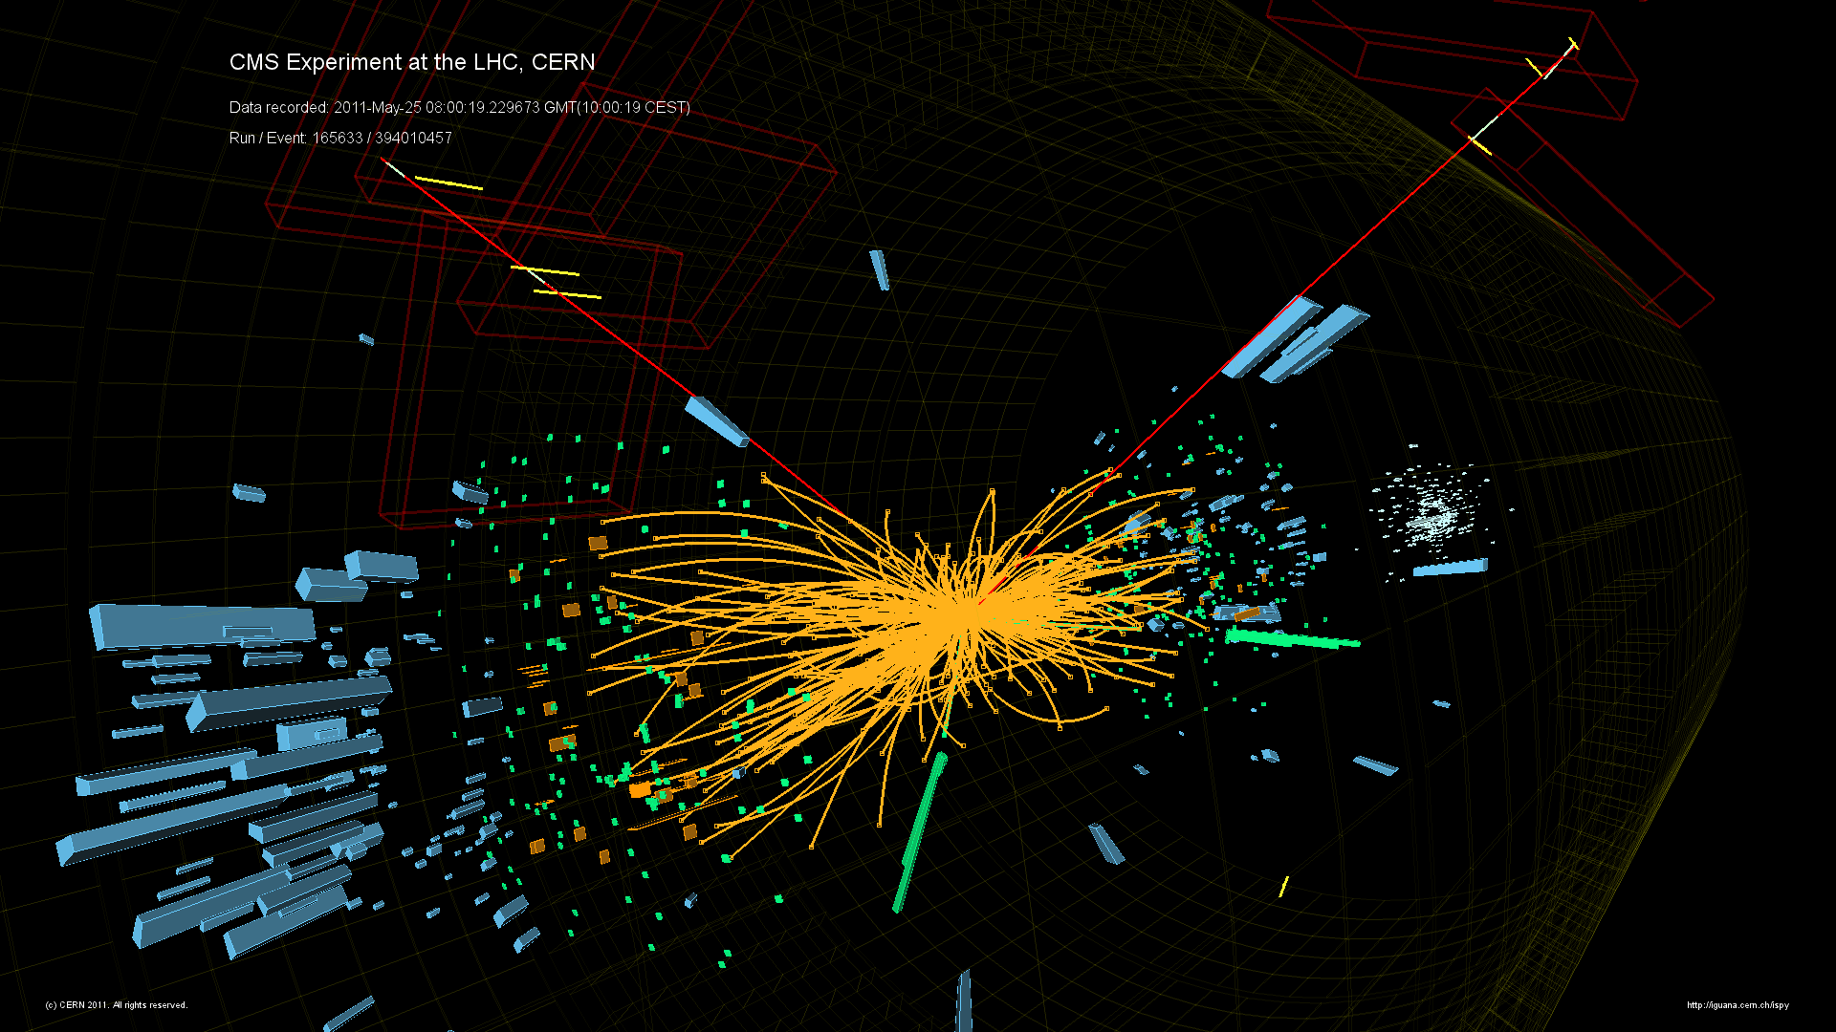
Identifying components of events
And the muon tracks
Tracker and pixel – the orange stuff
Calorimeter – the blue stuff

Slide 9
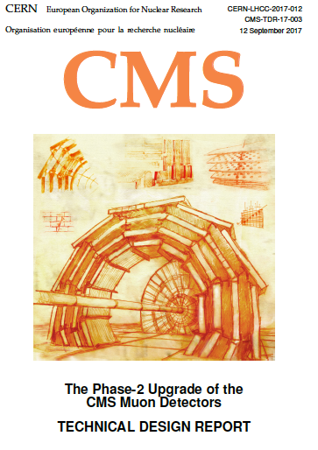
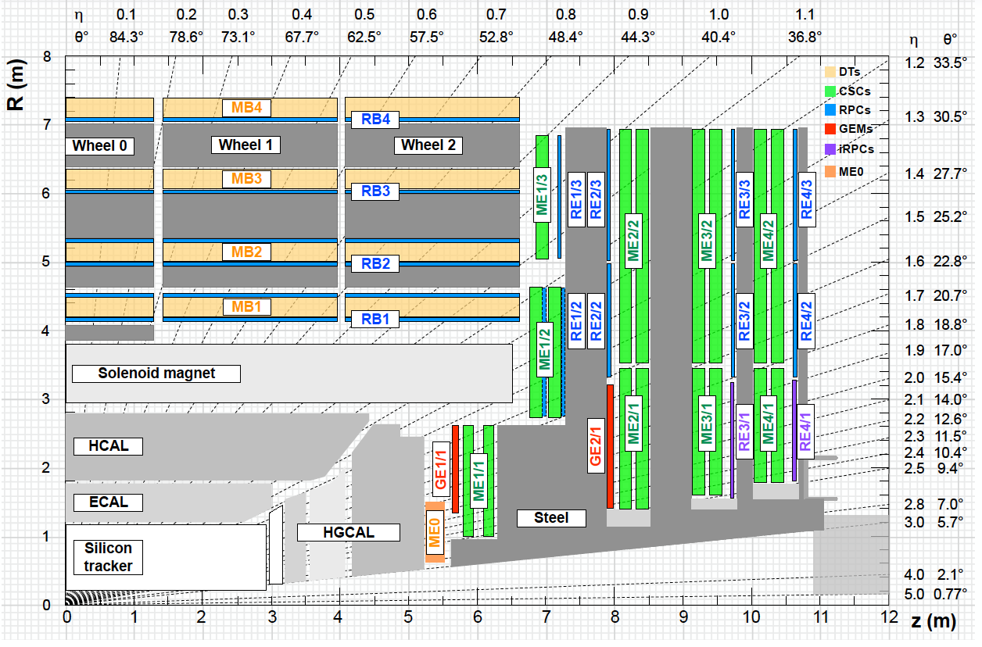
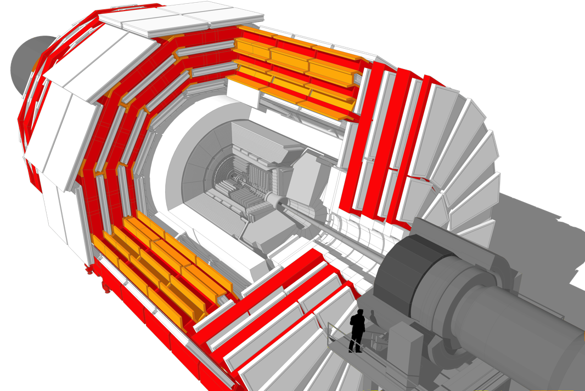
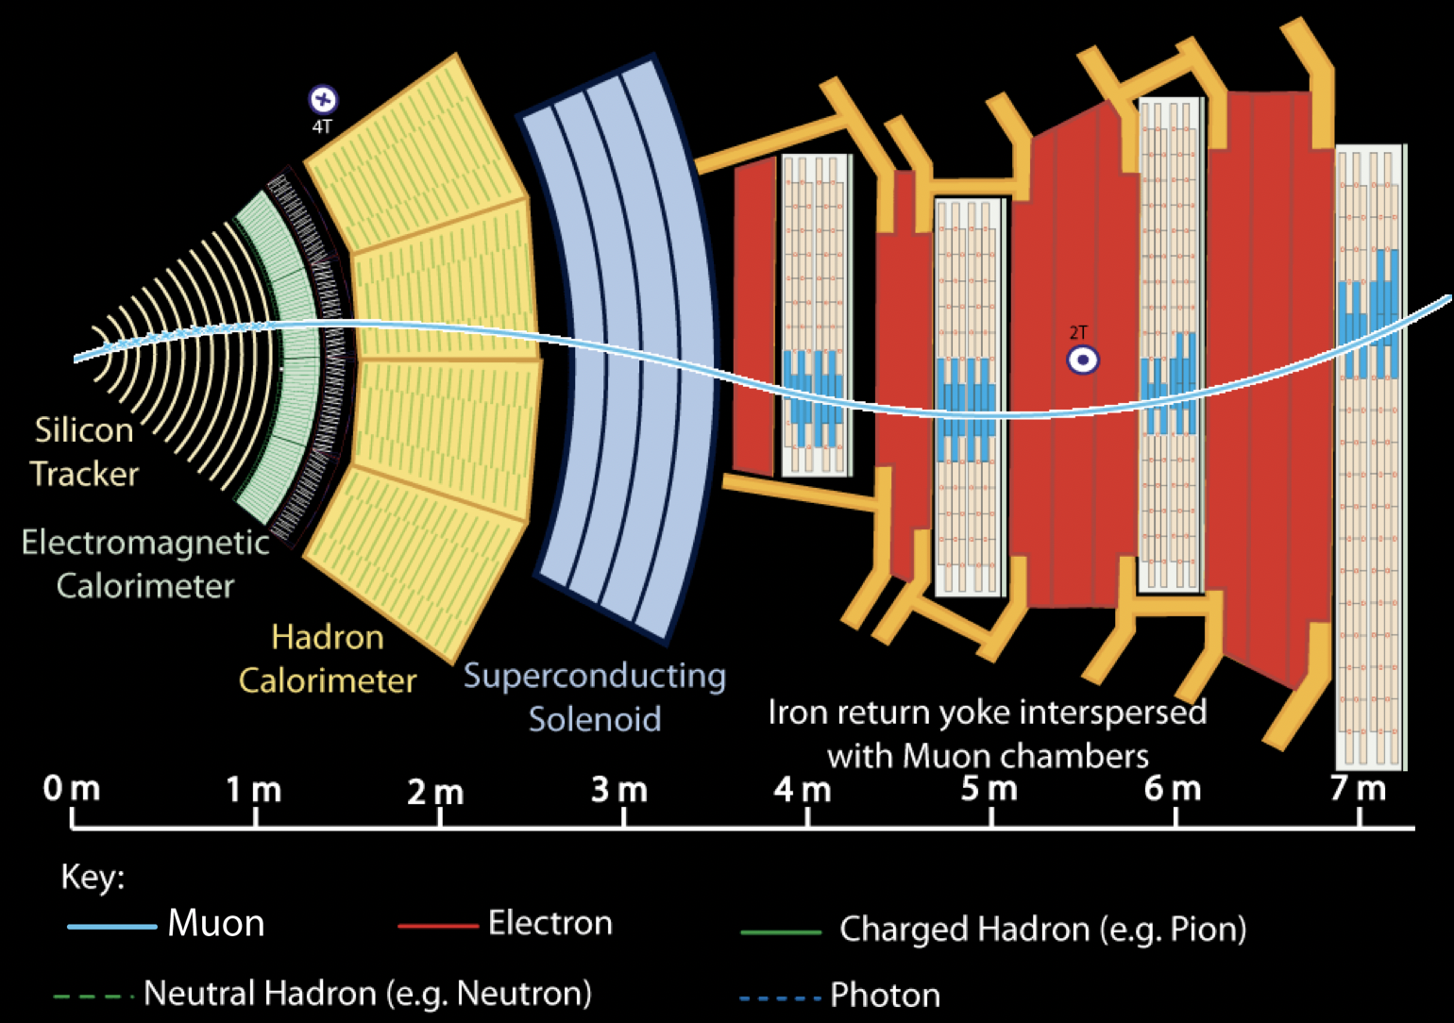
The Muon Detectors
We upgraded the green part (CSC) and installed ½ the red (GE1/1) in the past year!
NEW
New electronics everywhere
to cope with 10-fold rates
  Extract many, many chambers and re-install
Add new detectors in very-forward region
  New technologies (Gas Electron Multiplier GEM)
    Better resolution; much higher rates (MHz/cm²)
Complete installation by 2026; a lot is already started
CERN-LHCC-2017-012 CMS-TDR-016
Notes:
Remind, much higher rates in forward direction
Remind LS3 2024-26

Slide 10
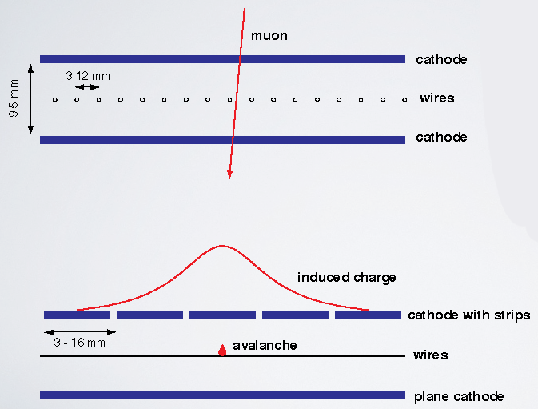
CMS Cathode Strip Chambers (CSC)
540 trapezoidal chambers in CMS endcaps
6 layers: precision φ from cathode strips,
coarse r and timing from anode wires
Electrons drift to wires, induce opposite charge on perpendicular cathode strips
Precise ~2% interpolation of cathode charge
on ~cm strips gives ~200 μm accuracy

Slide 11
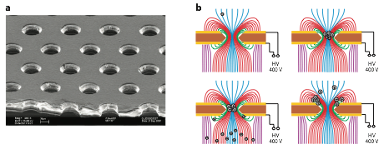
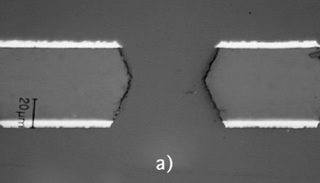
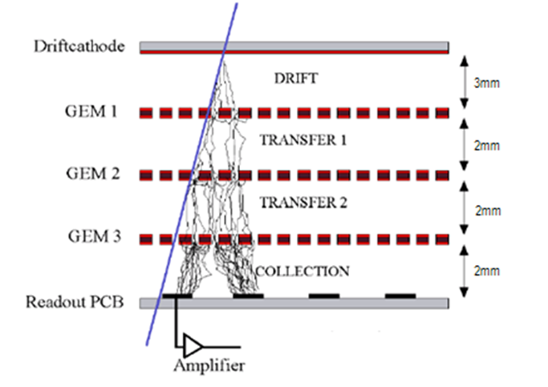
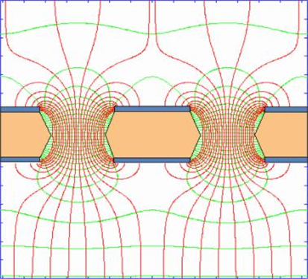


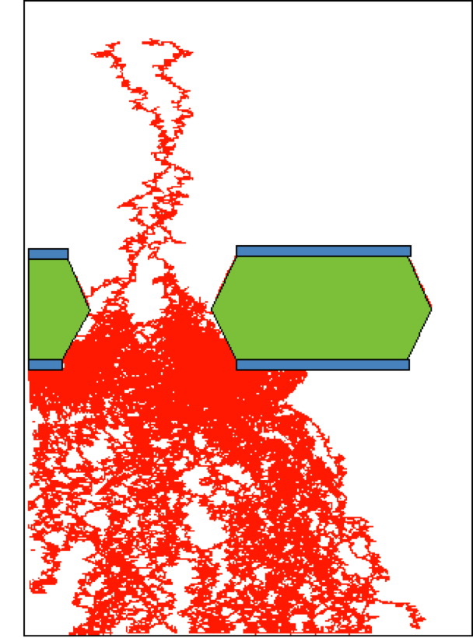
Gas Electron Multiplier (GEM)
Improve radiation resistance by decoupling amplification and detection structures:
  The gas volume is separated into a drift gap and an induction gap by a GEM foil. E.g. an MSGC or any other structured detection plane plane is underneath
  The foil (e.g. 50 µm thickness) is metalized on both sides and has a pattern of micro-holes (e.g. 70 µm with a 140 µm pitch).
  A high voltage (~ 400 V) applied on the two faces of the foil creates a high field inside the holes → electron multiplication takes place in the holes
DOUBLE CONICAL
“HOURGLASS”
Avalanche across a GEM
V=const.
~50μm
~400 V

Slide 12
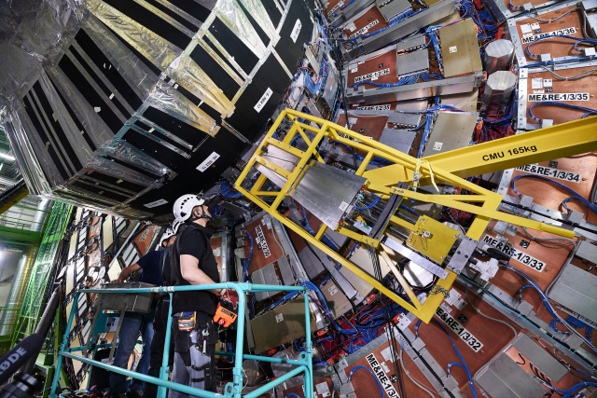
Installation of a GEM Chamber
https://youtu.be/fU0ujGWbeQ0

Slide 13
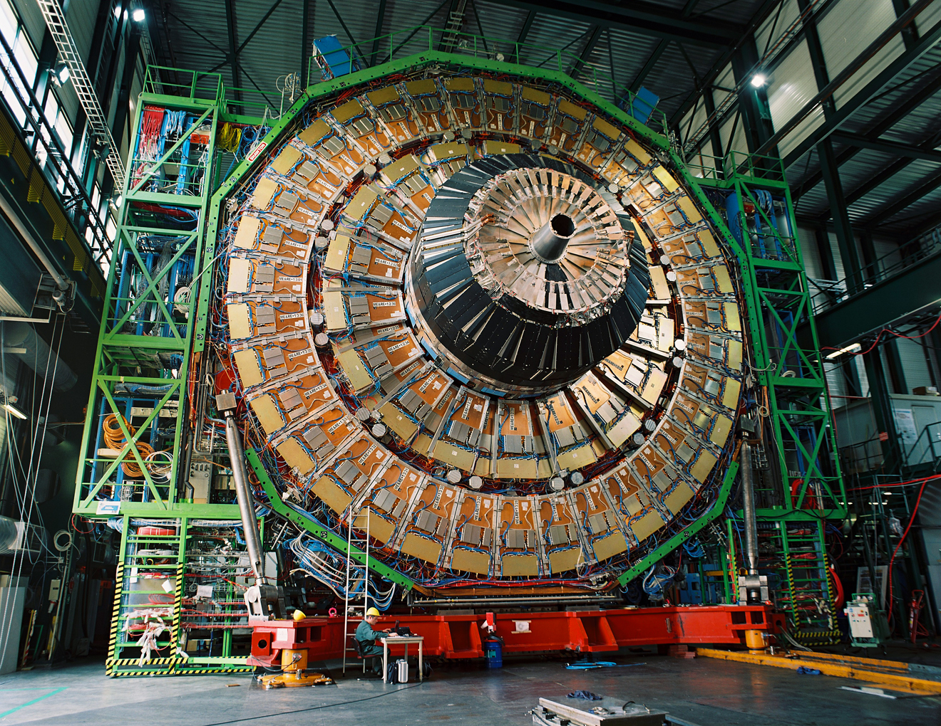
Endcap Muon Station 1
15

Slide 14
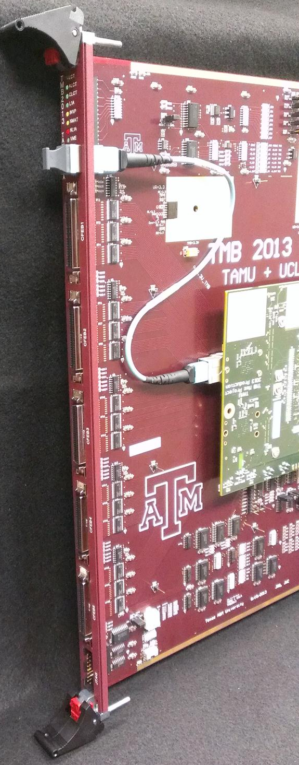
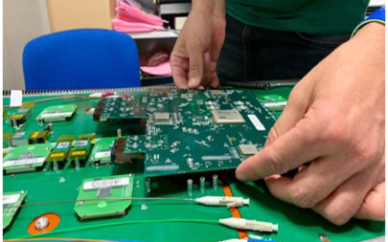
Using muon detectors in CMS
Triggering* the muon trigger at CMS is crucial:
  Impossible to read out all of CMS data from 40 MHz LHC crossings
  Must apply logical algorithms in fast electronics to identify the most interesting events: multiple muons and high transverse momentum (P_{T})
  Muon Level 1 trigger rate is ~50 kHz, a factor O(1000) reduction, before high-precision detector data is read out to computer farm
The TAMU group designs and builds electronics for the CMS Muon system
  Trigger and data acquisition development
  Algorithm design and implementation
  Software and firmware to control the detector electronics

Slide 15
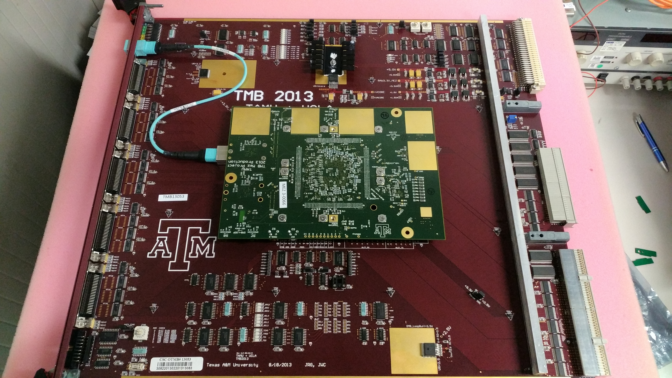
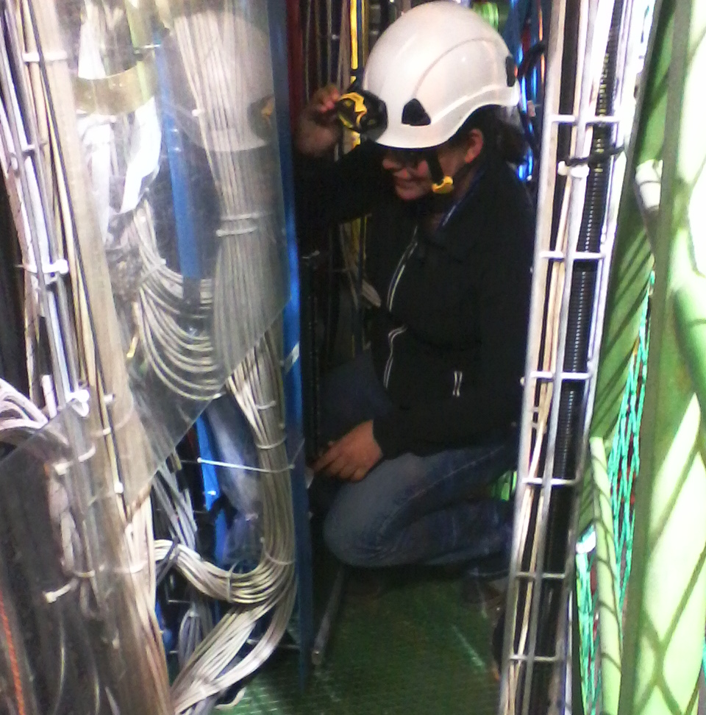
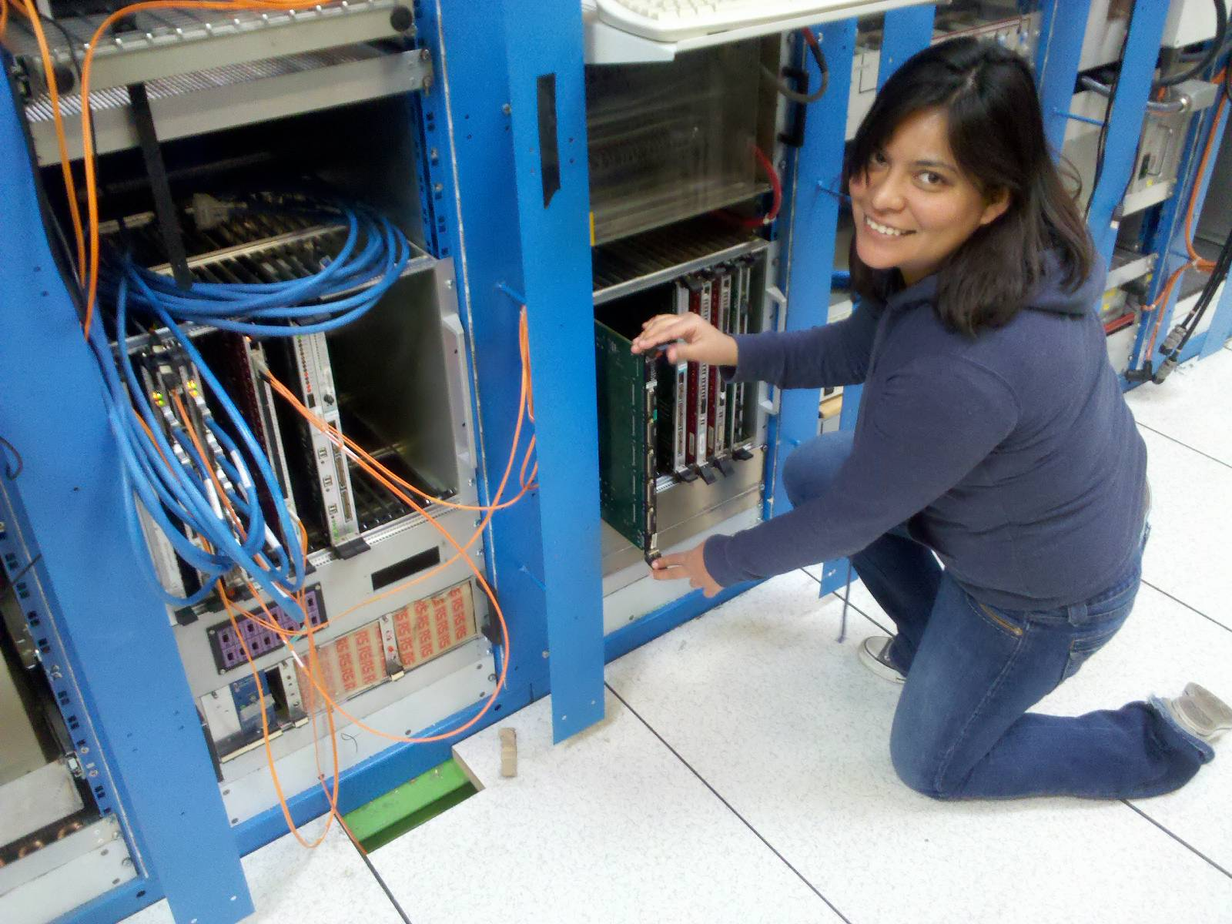
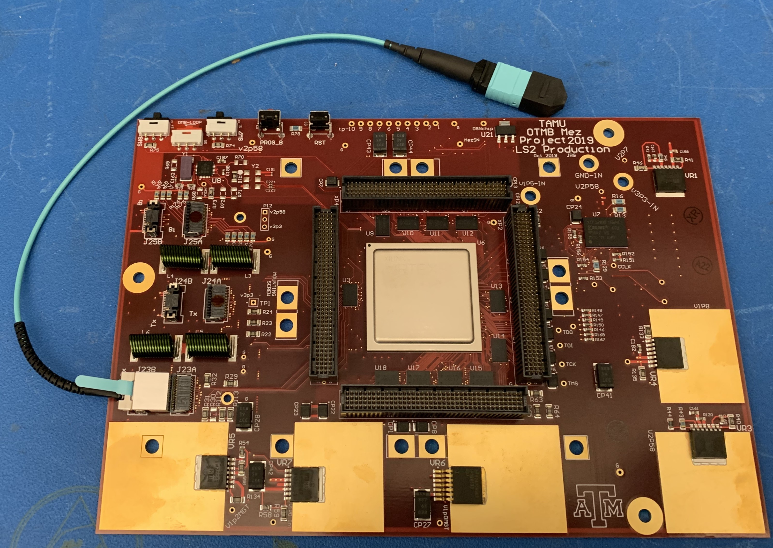
TAMU Electronics Development
Optical Trigger Motherboard for CMS CSC detector, built at TAMU (multi-Gbps optical links, Virtex-6 FPGA)
3 years of design and testing, 1 year for production (2013)
Additional production later (2019-2020)
Electronics test-stand at TAMU, integration tests at Rice and CERN
A lot of hard work by graduate and undergraduate students
Circuit board design using CAD tools
Firmware development and debugging
Algorithm development and implementation
Testing and operating software environment
Installation and commissioning at CERN

Slide 16
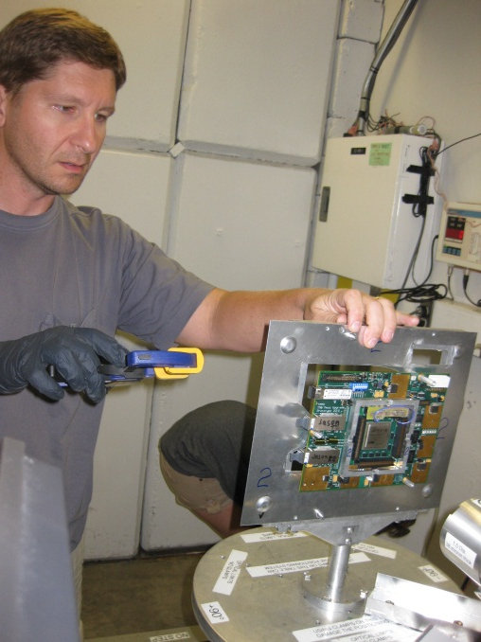
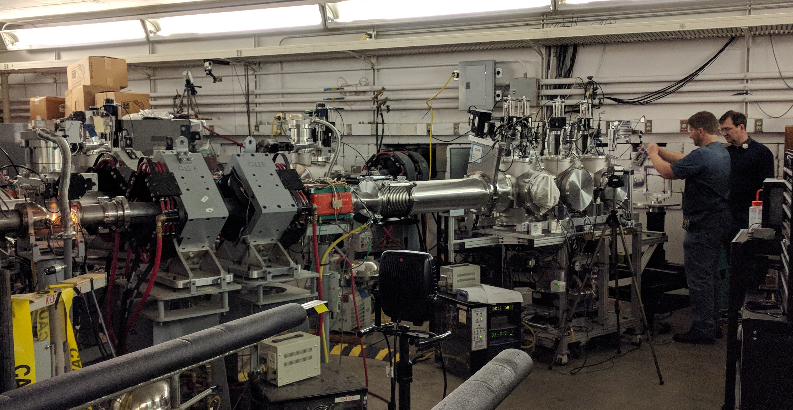
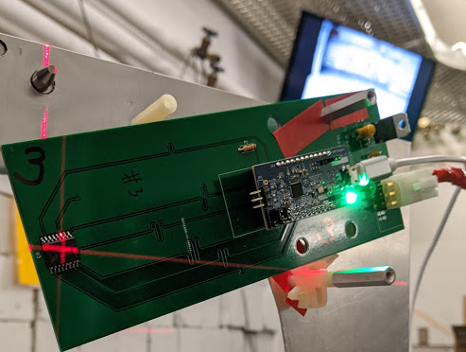
Radiation Effects Studies at TAMU
The TAMU group has taken the lead on testing GEM and CSC on-detector electronics to verify they are reliable for use in radioactive areas of CMS
FPGAs, optical devices, digital logic, memory chips, voltage regulators, etc.
Radiation tests on commercial electronics are performed at TAMU facilities
TAMU Cyclotron Facility K150 proton beam
TAMU Nuclear Science Center reactor
Studies performed for Total Ionizing Dose tolerance as well as Single Event Upset effects

Slide 17
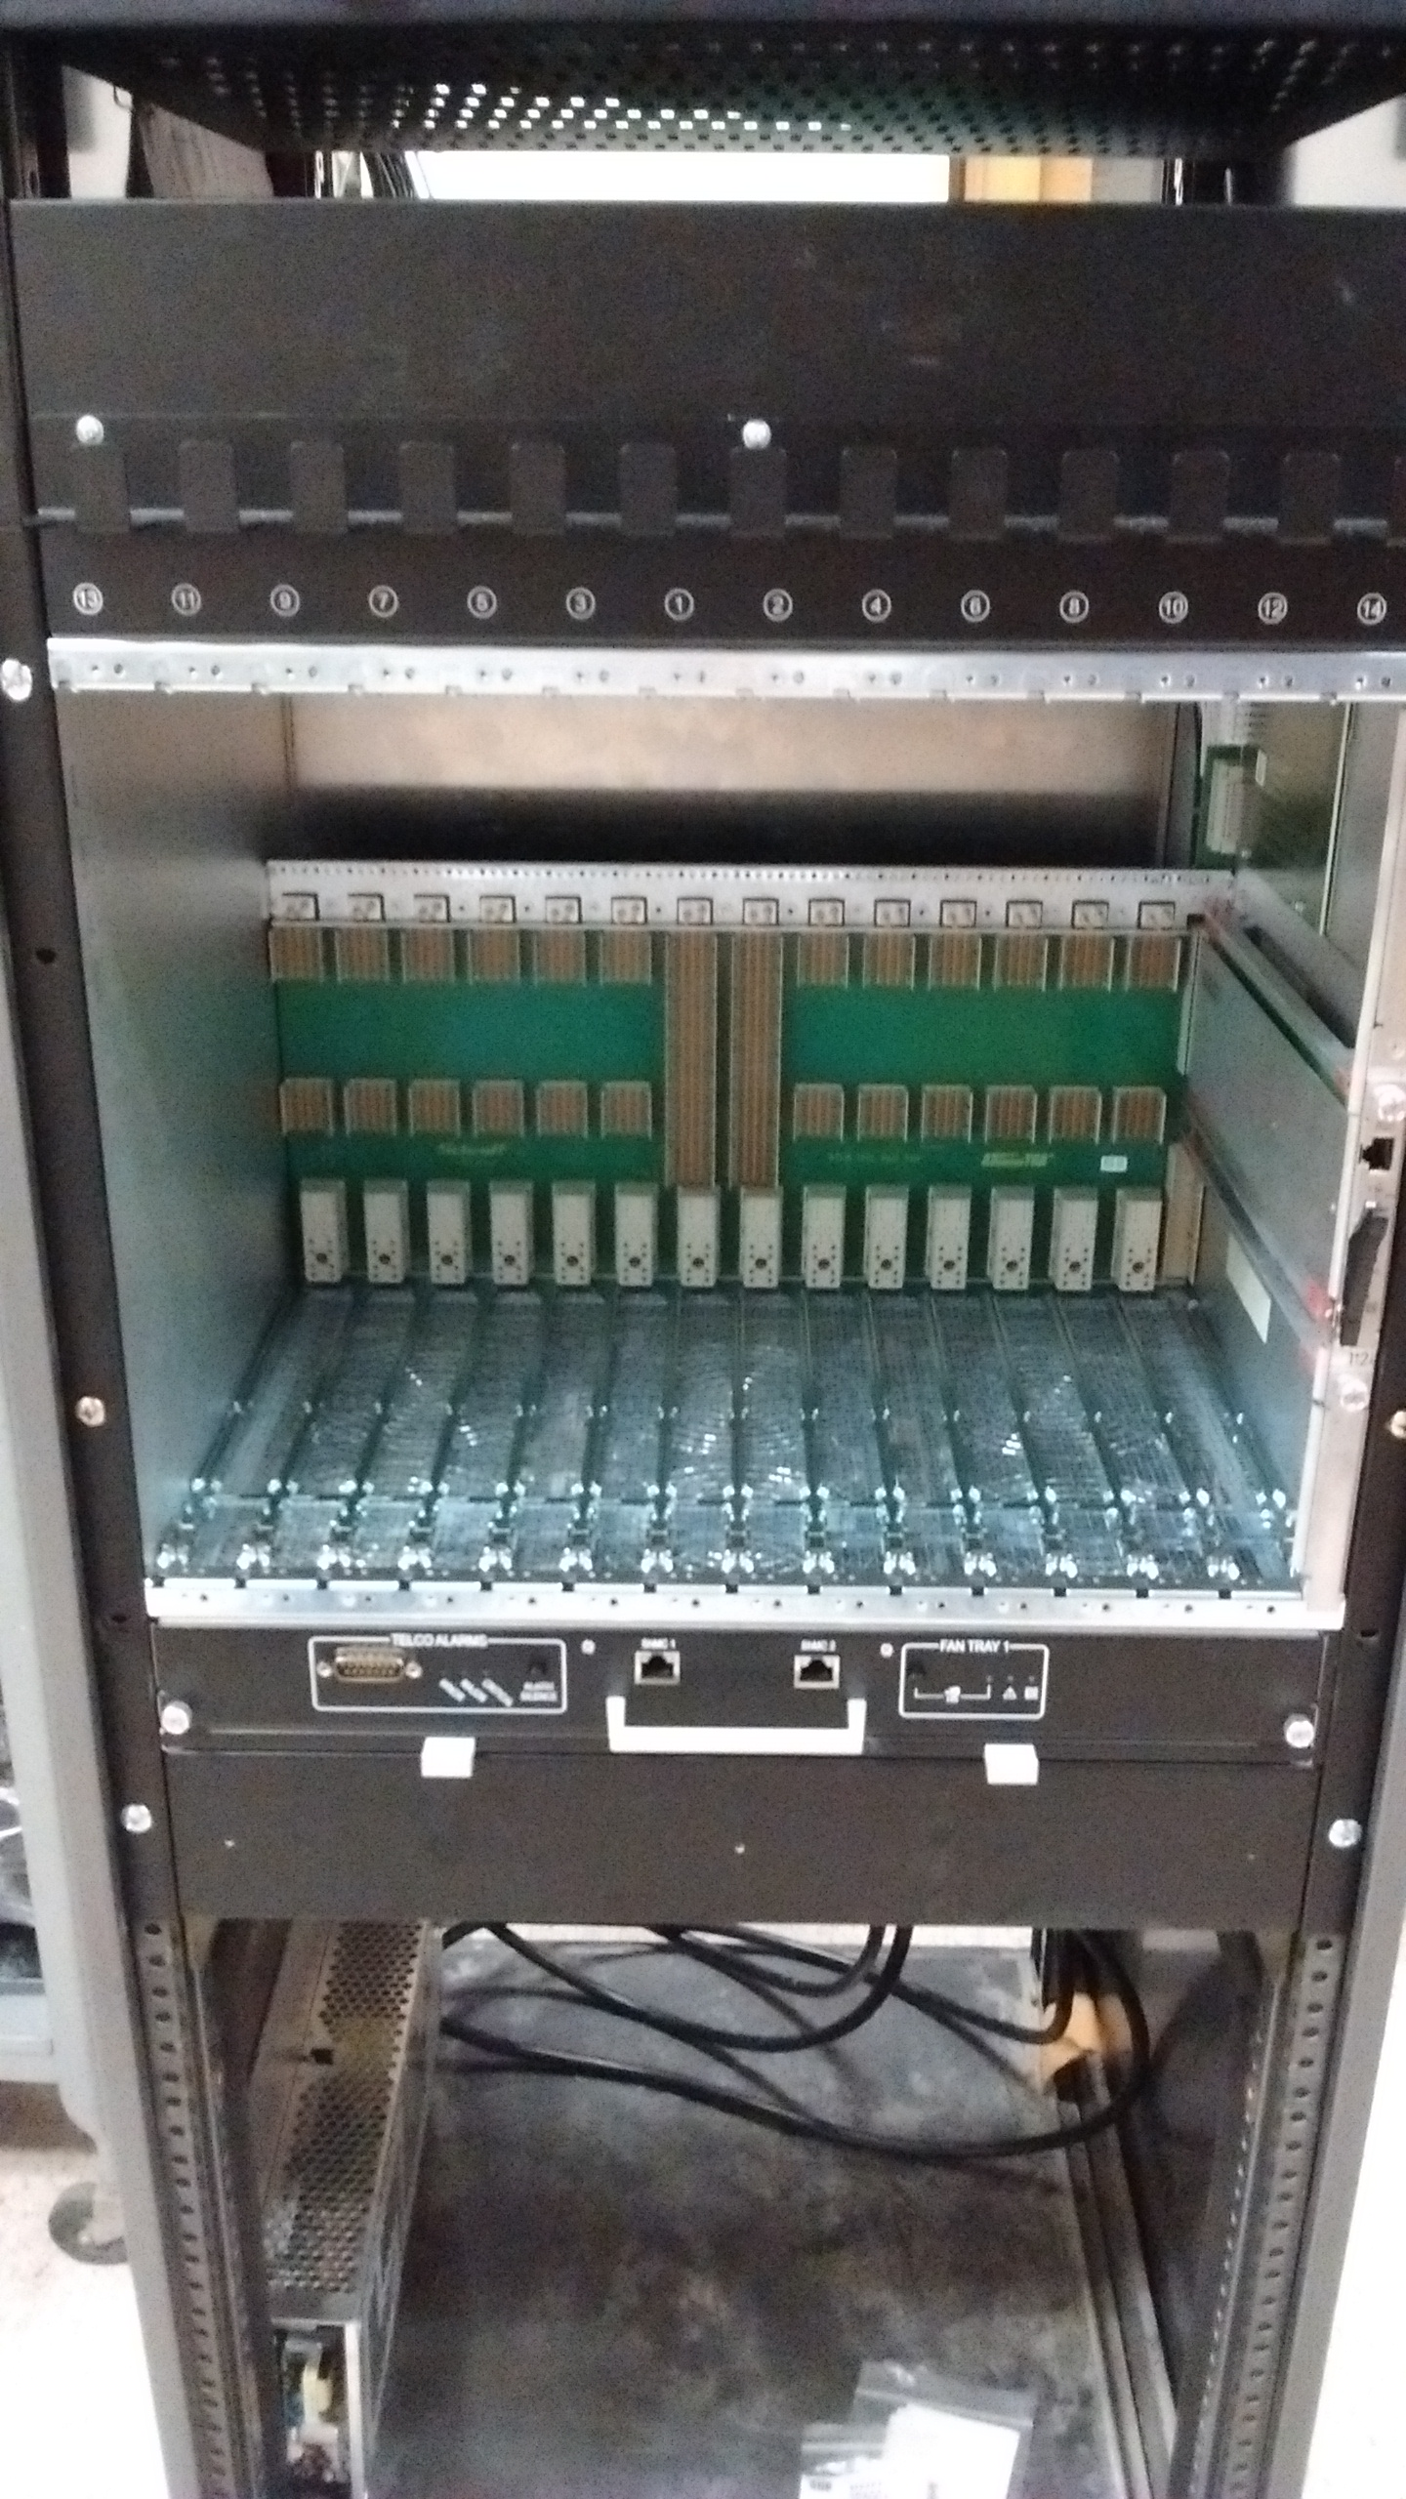
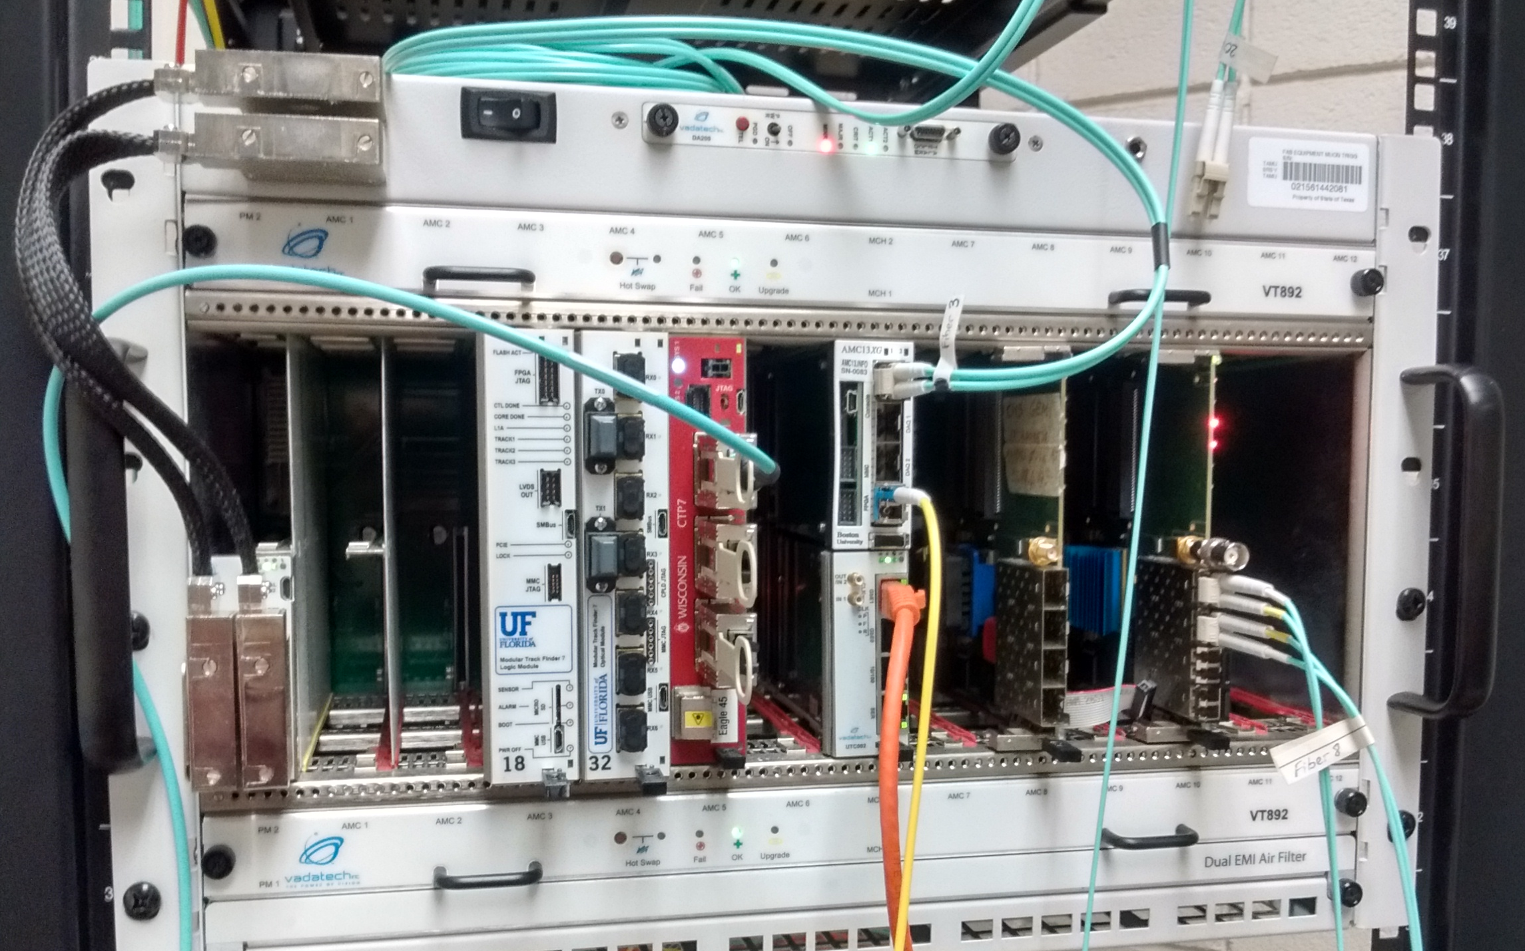
TAMU Off-detector Electronics
Back-end systems for CSC and GEM detectors
Both trigger and data acquisition functions
Current GE1/1 and GE2/1 GEM development
Future CSC and ME0 development
ΑTCA crate for future
GEM and CSC development
μTCA crate with CTP7 for GEM and CSC studies

Slide 18
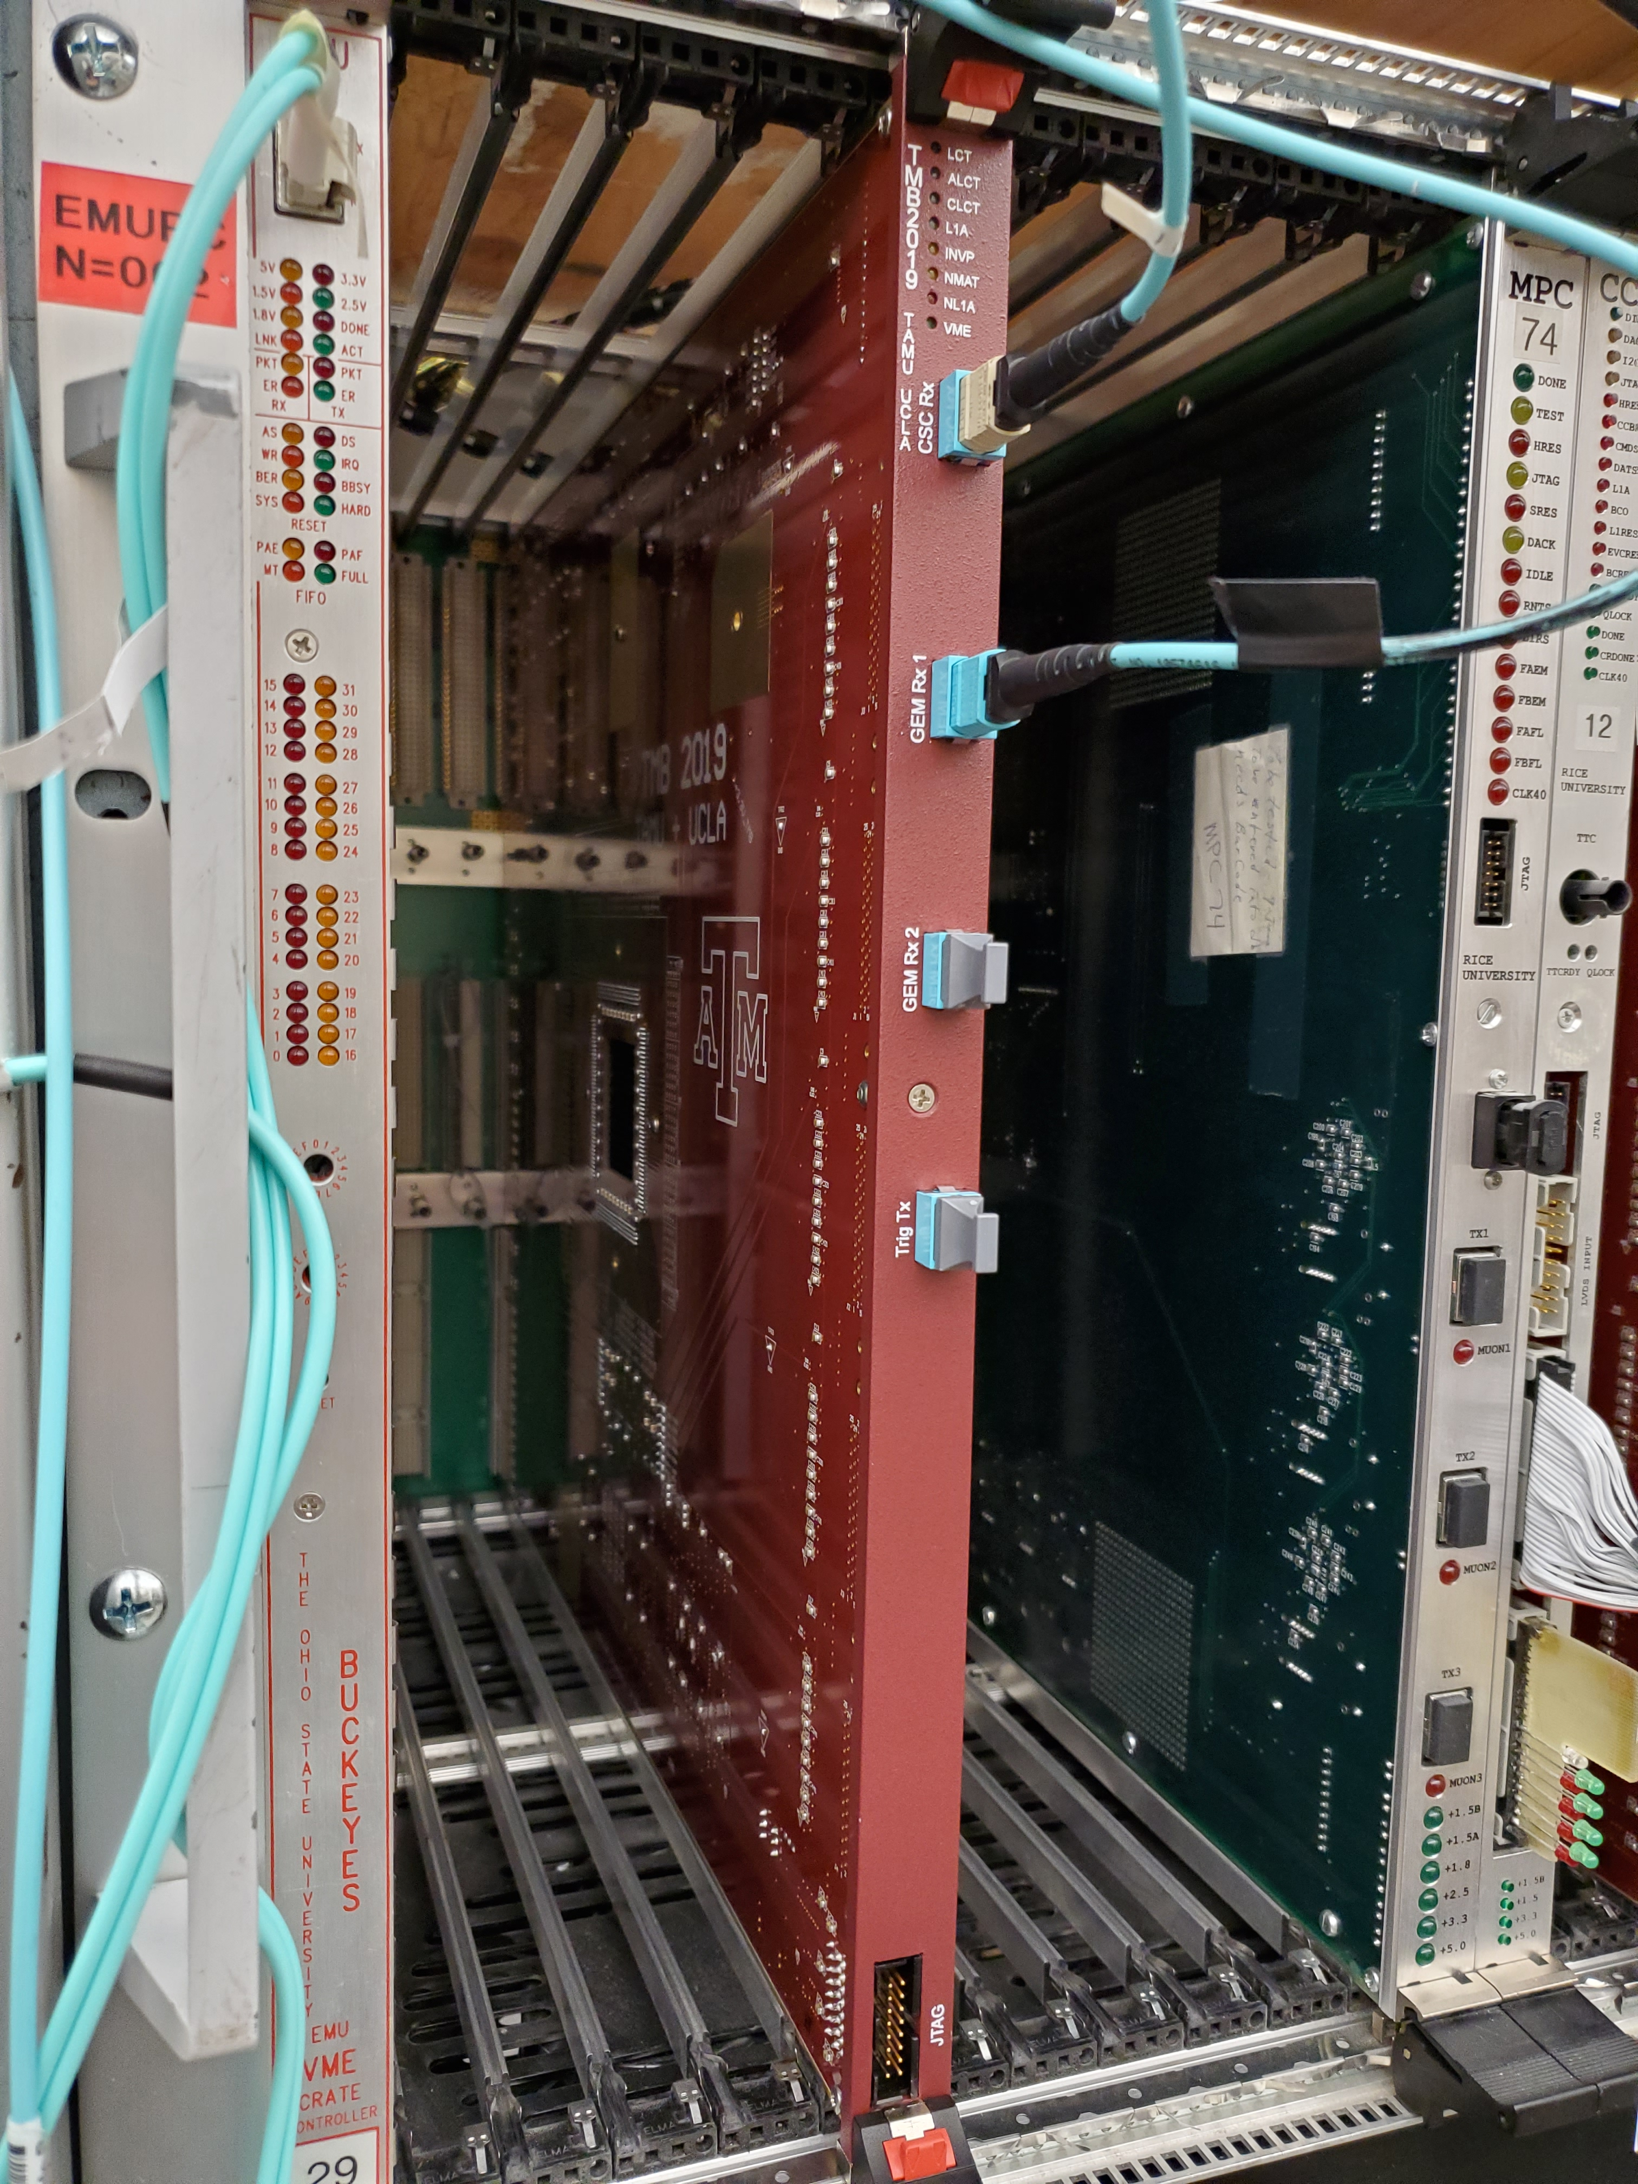
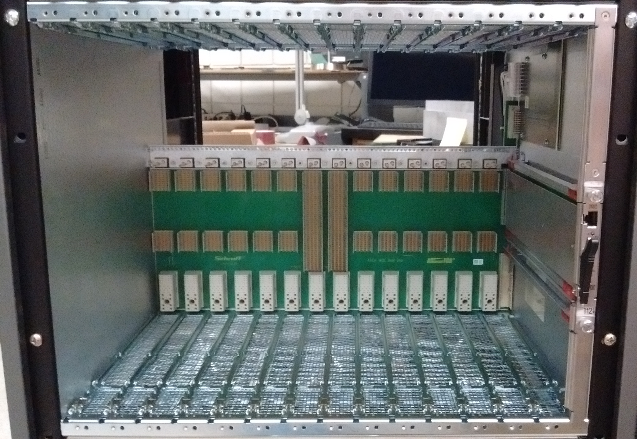
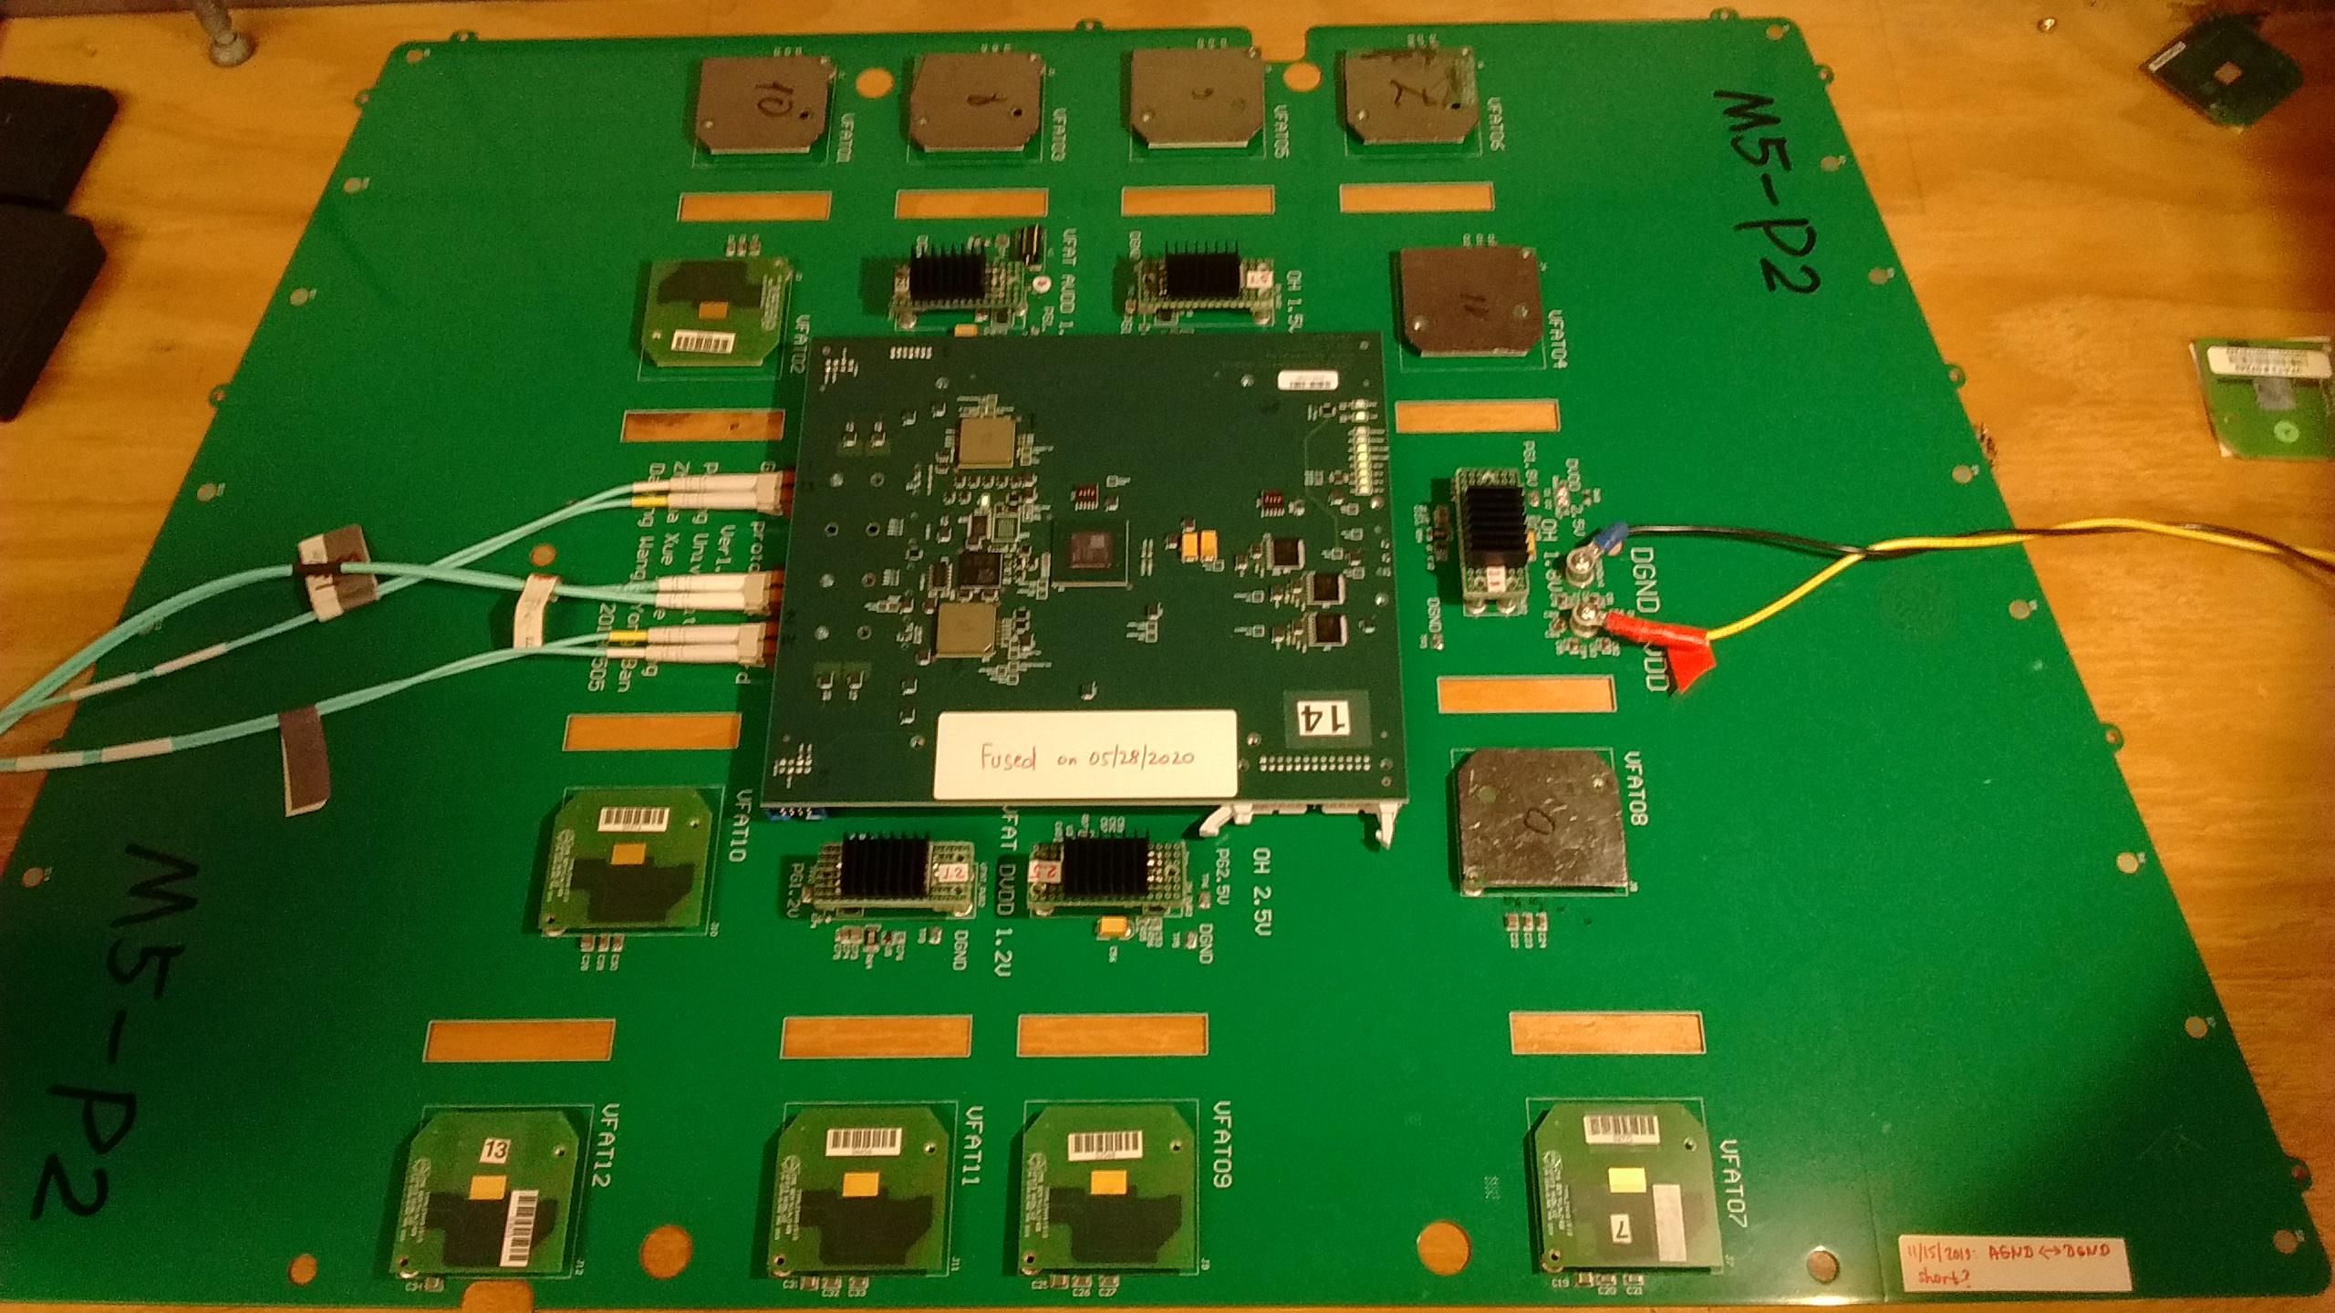
TAMU Electronics Test Stands
CSC test stand for ongoing trigger algorithm improvements
Integrating GEM + CSC trigger capability
Back-end test stands for CSC and GEM development
μTCA and ATCA systems with support for 25 Gpbs fiber links
GE2/1 test stand for testing new electronics from the factory
All boards must pass functionality tests before shipment to Cern
Expected production of ~350 boards this year

Slide 19
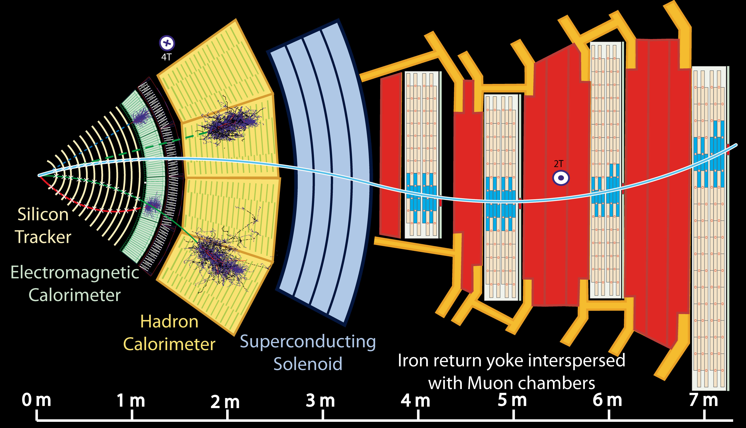
How well does it work? A muon example

Slide 20
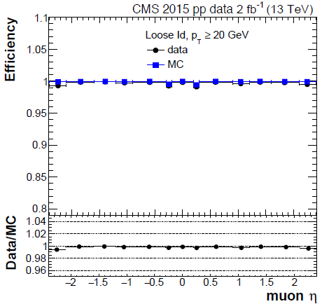
Muon trigger and offline efficiencies
versus momentum
versus pseudorapidity
High-Level
trigger
Example: CSC segment efficiency, per chamber
Reconstruction +
ID efficiency vs η
-- simulation
Loose ID
Notes:
Tracker does not deliver L1 Trigger
This will change for phase II in ~2025
Tracking is heavily used in HLT - Reduced set of same/similar tracking algorithm as offline code

Slide 21
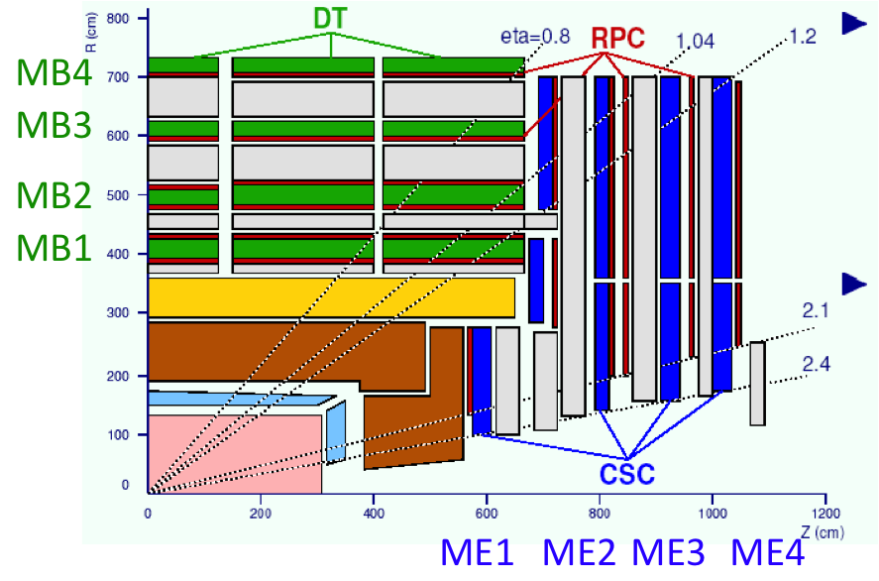
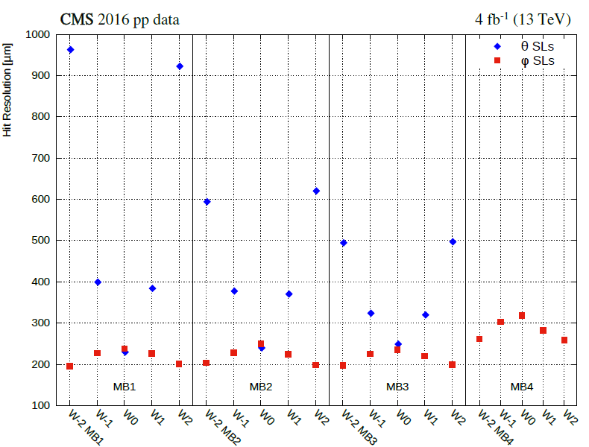
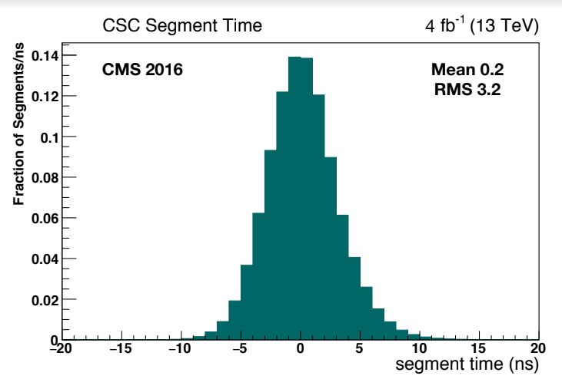
Local muon performance
Source http://dx.doi.org/10.1088/1748-0221/8/11/P11002:
The spatial resolution per chamber was
  80-120 μm in the DTs
  40-150 μm in the CSCs
The time resolution achieved was 3 ns or better per chamber
CSC Time resolution
DT single hit spatial resolution

Slide 22
Muons in action: dimuon mass spectrum
Trigger CMS readout on muon pairs of various types
Verify high muon quality by matching muon hits with silicon tracker tracks; use momentum vectors from the silicon tracker fitting
From invariant mass of muon pair
Several Nobel prizes in this one plot:
Various triggers:
High-p_{T} plus specific triggers for J/Ψ, B_{s}, Υ plus “volunteers” at lowest masses

Slide 23
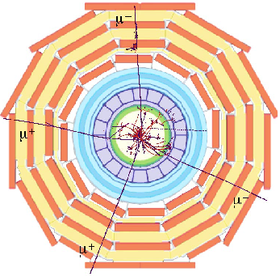
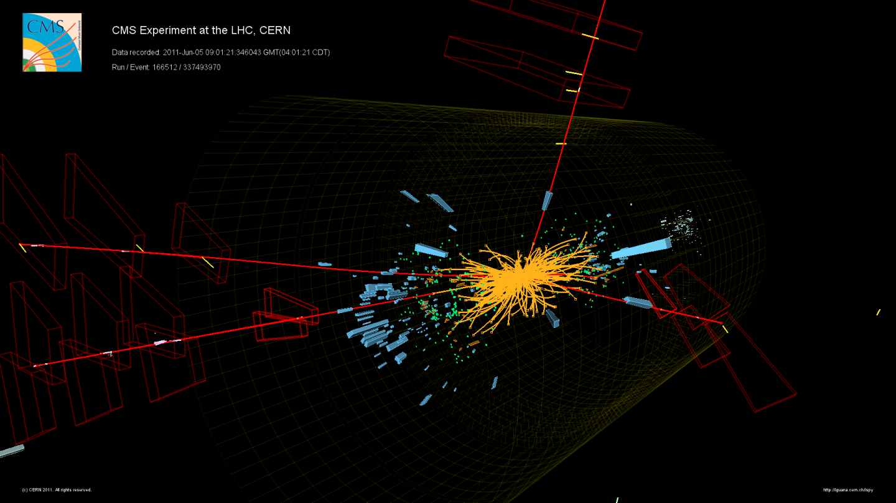
All together Resulting in
A possible Higgs boson decaying to four muons in CMS

Slide 24
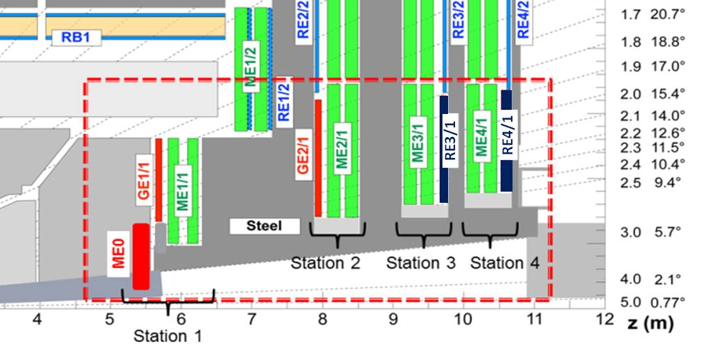
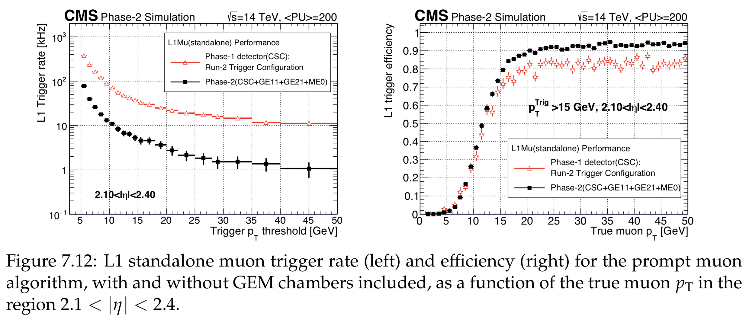
CMS Muon Detectors: The Future
2019
and
2024
Forward muon upgrades
Some installations already underway
2019-20 Added GEM to station 1/1
  Big L1 trigger improvement
2024 to station 2/1 and at ME0
  Add lever arm & redundancy for high η
Goal: Improve muon efficiency and keep rates under control
Leads to improved performance by 2026

Slide 25
Conclusions
CMS at TAMU is an exciting adventure
  At the detector and simulations level
  At the electronics level
  At the software level
  At the physics analyses level
We have a lot of work to do!

Slide 26
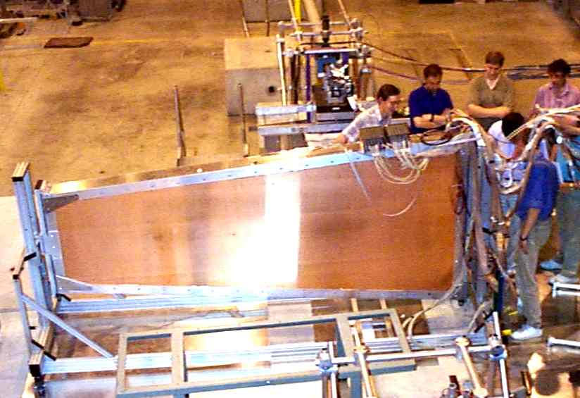
CSC Chambers - 1998 test beam
468 CSCs of 7 different types/sizes
> 2,000,000 wires (50 μm)
6,000 m² sensitive area
1 kHz/cm² rates

Slide 27
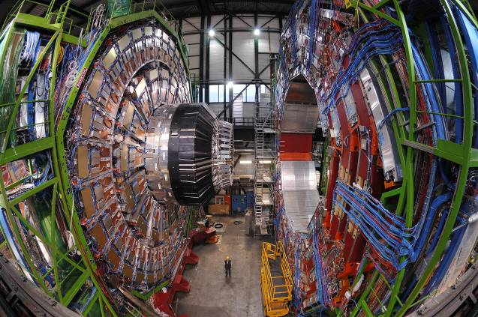
Another pretty muon picture

Slide 28
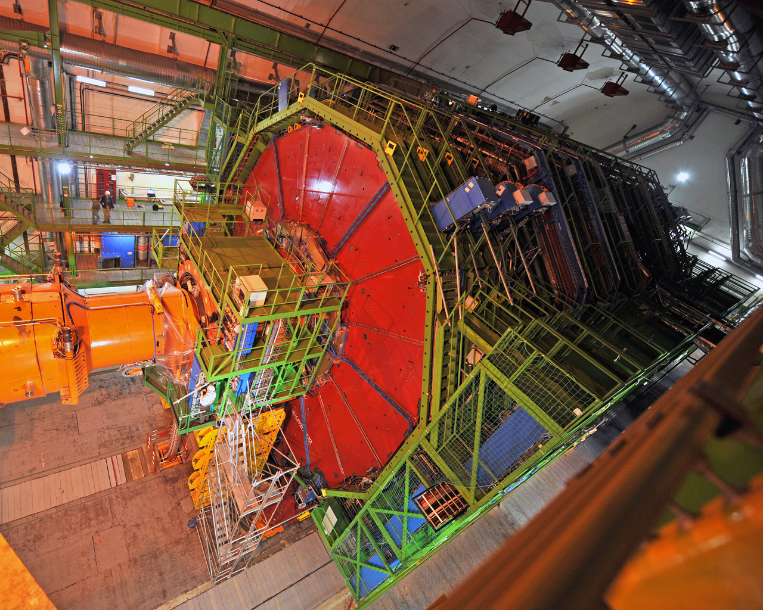
Rare Photo: CMS All Closed Up

Slide 29
The End

Slide 30
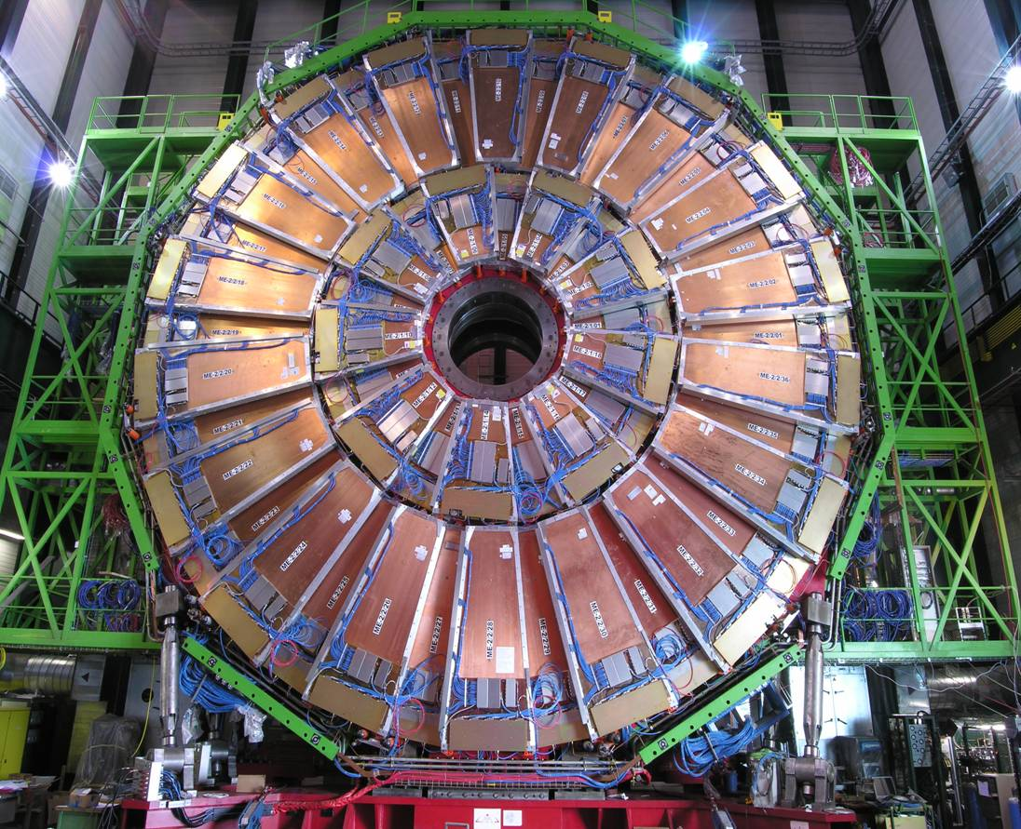
10º and 20º CSC chambers (2nd station)

Slide 31
Pixel – seeding & vertexing
Muons
→ Tracking & Momentum
Tracking
→ Momentum & Energy
L1 Trigger
High Level Trigger
Particle ID together in
combination with calorimeter

Slide 32
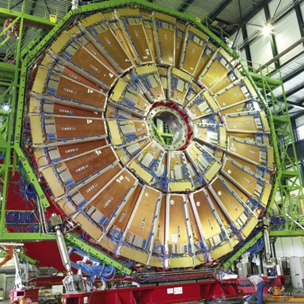
The Layers of CMS: MUON
To identify muons (essentially heavy electrons) and measure their momenta, CMS uses three types of detector:
drift tubes - DT, in the barrel
cathode strip chambers - CSC
new: Gas Electron Multipliers (GEM)

Slide 33
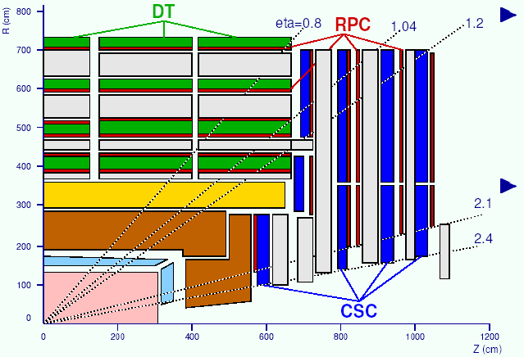
Cross section of CMS (r-z)
Three types of detector:
  Precise position measurement and triggering by Drift Tubes (DT) in the barrel, and Cathode Strip Chambers (CSC) in the endcap
  Redundant triggering by Resistive Plate Chambers (RPC)
Barrel: 0 < | η| < 1.2
MB4
5 wheels / 4 stations instrumented with DTs
and RPCs
MB3
MB2
MB1
Endcap: 0.9 < | η| < 2.4
3 discs / 4 stations instrumented with CSCs and RPCs
ME1
ME2
ME3
ME4
Spatial precision 75-150 μm /station

Slide 34
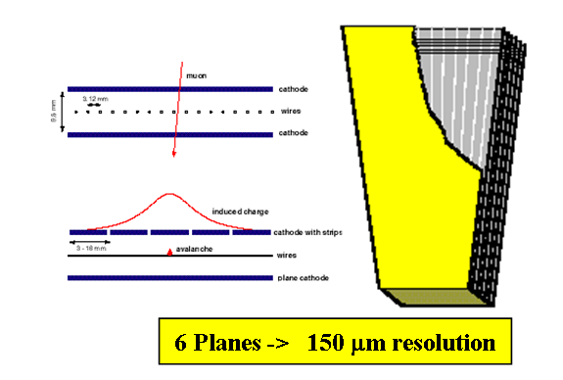
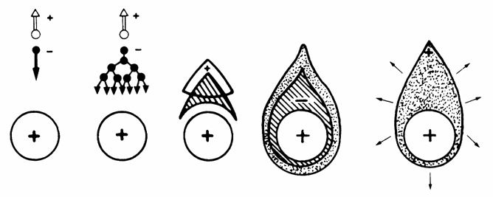
Muon detector basics: CSC and GEM
Muon detectors are on the outside, so must be large
Economics: use gas detectors to cover a large surface area
  Need amplification of the electron ionization signal within the gas volume
High rates in forward region, so detectors must have fast response!
CSC and GEM are great detector choices
Cathode Strip (CSC) chambers:
~10² primary electrons
Wire chambers:
~ 10⁵ – 10⁷ gas amplification
~10⁷ – 10⁹ electrons
~1-100 pC

Slide 35
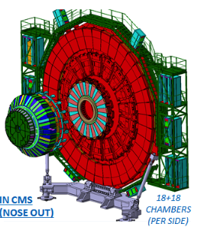
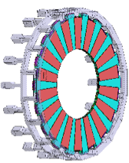


New - Micro-Pattern Gas Detectors (MPGD):GEM
GEM: Gas Electron Multiplier
Lots of fun for LS2
Muon
Endcap
Station 1
GEM
GE1/1
superchambers
10º
short
long
Triple GEM
Decouple amplification and detection
High spatial and good time resolution
  Long (1.5<|η|<2.2) and short (1.6<|η|<2.2) version
  36 superchambers in each endcap
Installation in LS2 – first half installed in October 2019!

Slide 36

What is the task of these detectors?
(5) With even better 3D resolution and lower occupancy (pixels)
- identify origin (vertex)
(2) Magnetic field bends the tracks
Momentum
(3) With good resolution and low occupancy
– isolate tracks in this mess
Measure track POINTs where charged particles traverses
Reconstruct tracks (interpolate points)
(4) In conjunction with calorimeter identify particle (more later)

