Slide 1
Panel Discussion:
Graduate Life in College Station

Slide 2
The Society for the Under-represented in Physics & Astronomy (SUPA)
space for people who identify with traditionally under-represented (UR) groups
community, share experiences, and talk about challenges faced as UR peoples
  Website: tx.ag/supa
some of our members do not identify with these groups
  they come instead to respectfully learn about these issues and offer support
to keep the discourse respectful and productive, adopted the policies
of the Facebook "Equity and Inclusion in Physics & Astronomy" group.

Slide 3
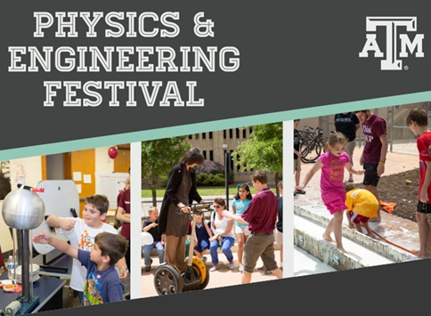
DEEP
Discover, Explore,
& Enjoy Physics!

Slide 4
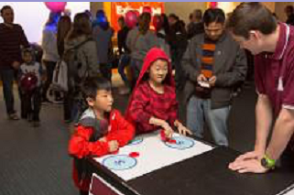
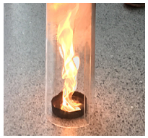
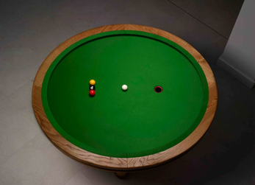
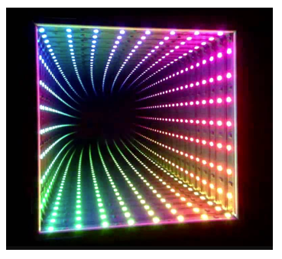
DEEP
Fire Tornado
Elliptical pool table
Air Hockey
Infinity mirror

Slide 5

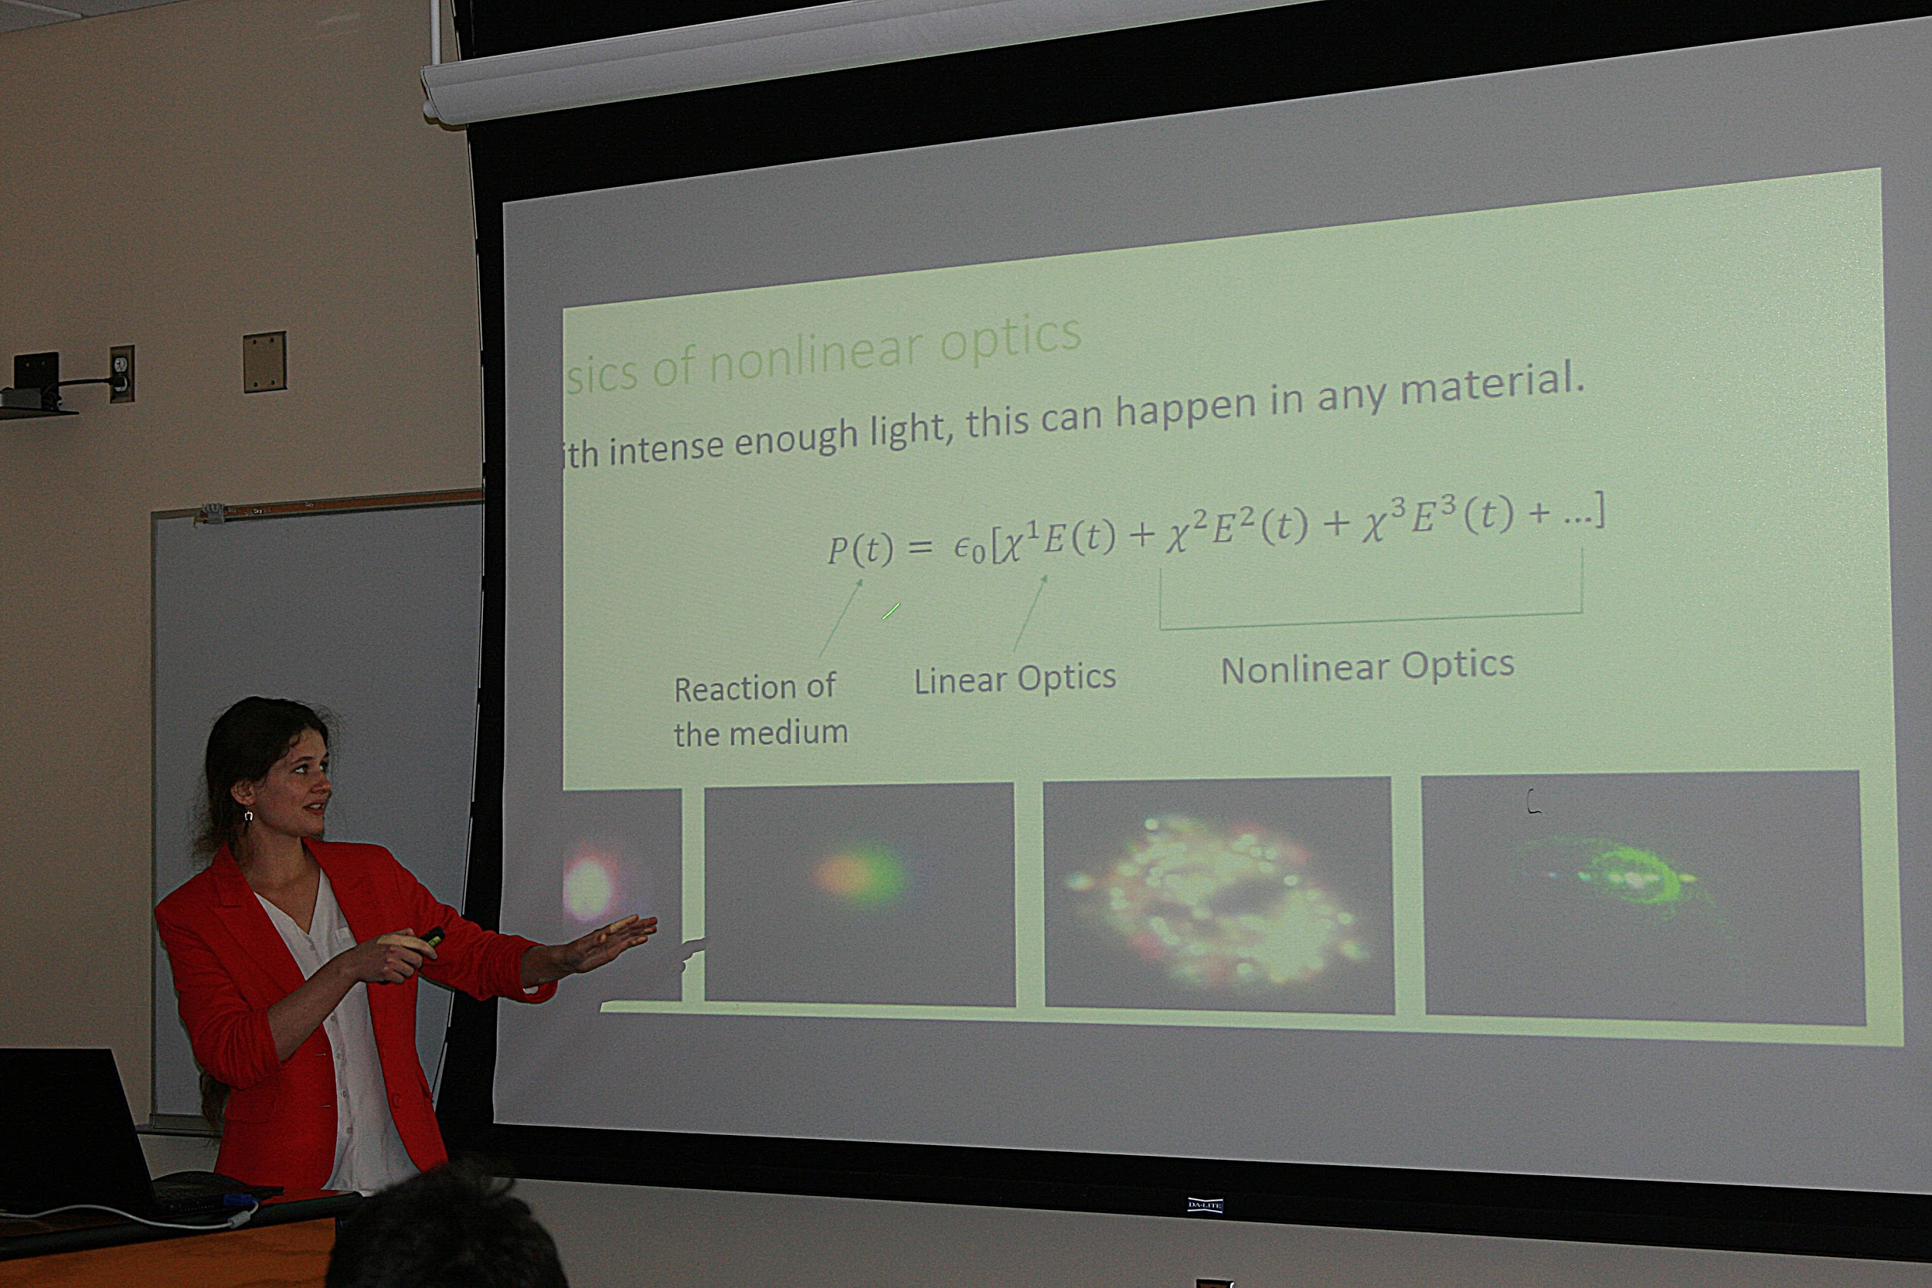
OSA - The Optical Society
A Professional Organization for Optics and Laser Physics!
Weekly Seminars with the latest advancements in optical science and ongoing research.
Seminars are open to everyone!
Pizza and Drinks at every seminar!

Slide 6
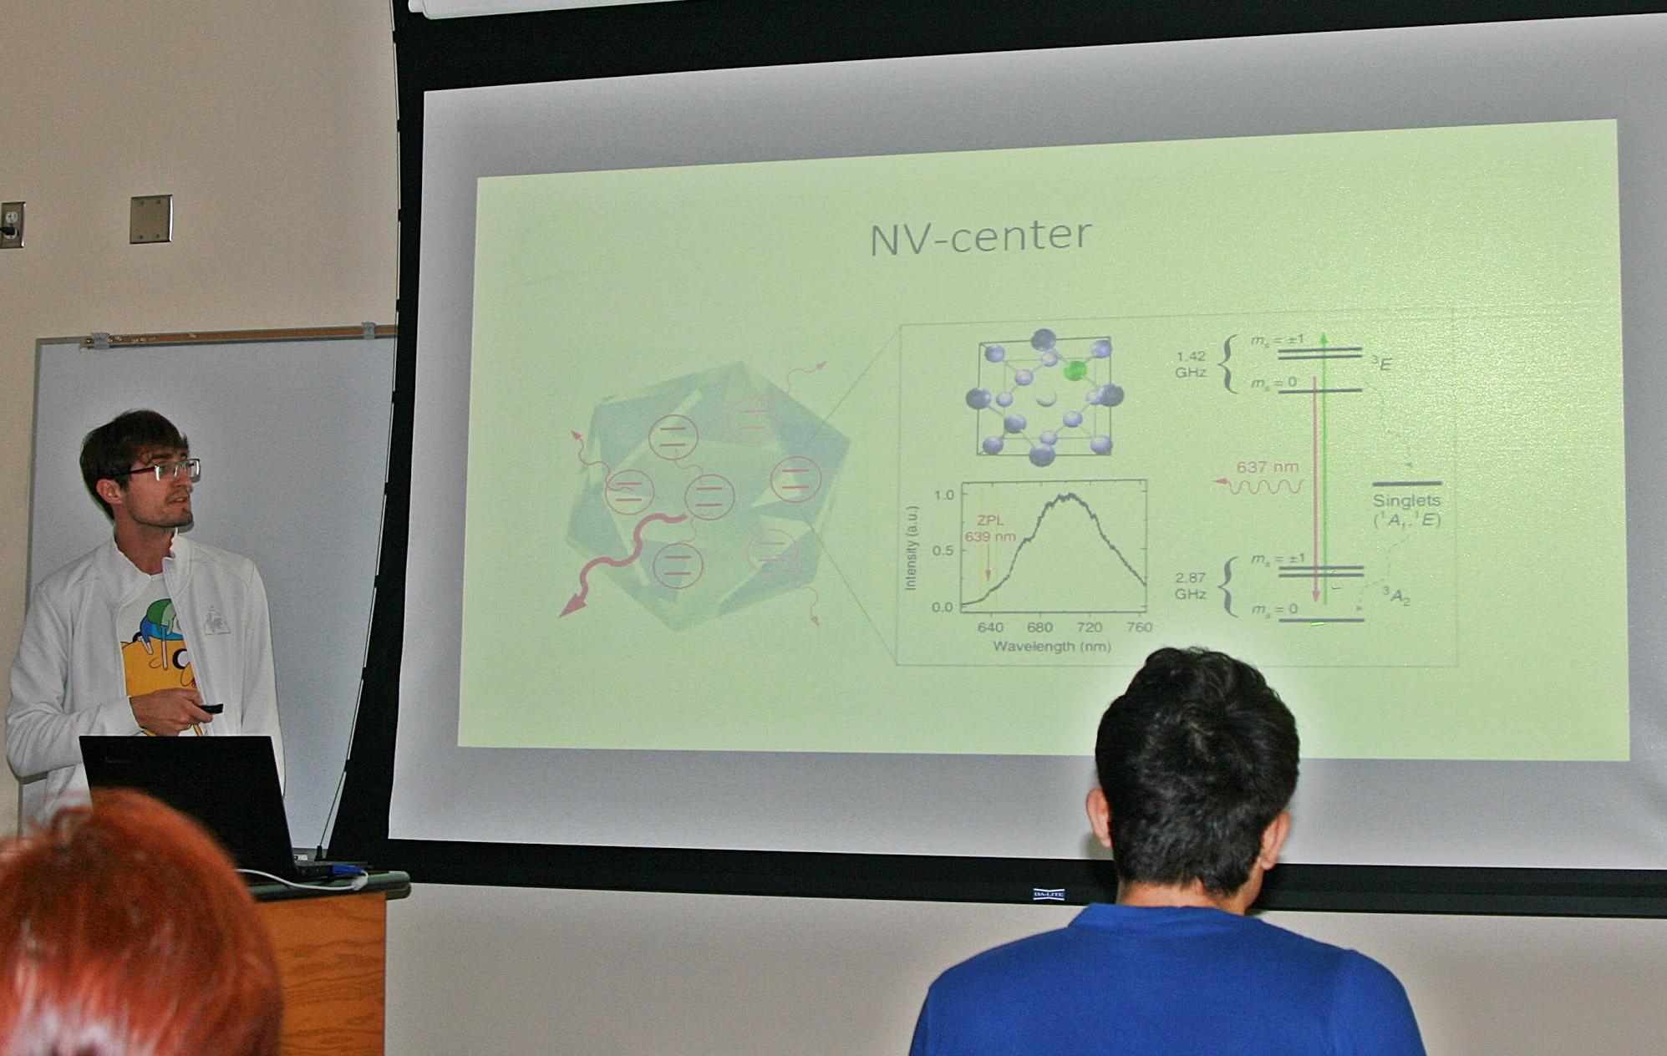
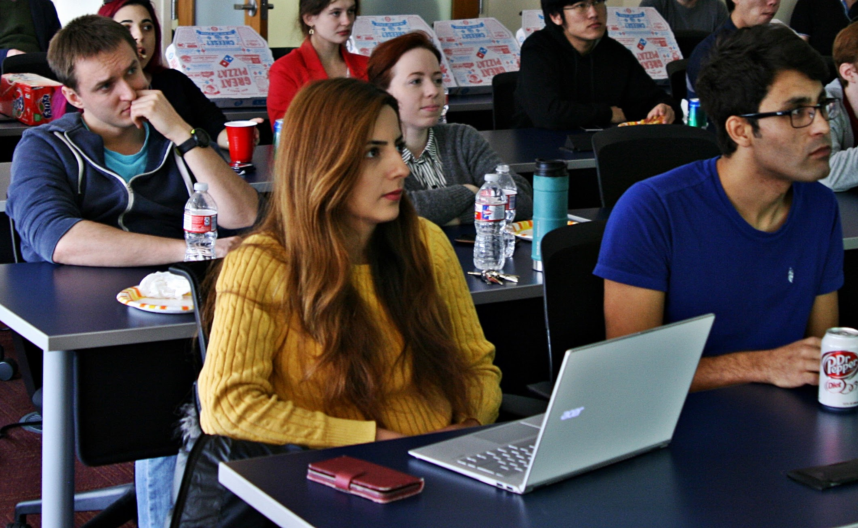
Presentations by graduate students, post-docs, professors!
OSA News
OSA Research Talks
Special seminar weeks where visiting faculty from across the world present at our meetings!
Joint seminars involving Quantum Optics as well as novel experimental applications with the Institute for Quantum Science and Engineering (IQSE)!

Slide 7

Graduate Student Assembly
Physics and Astronomy (P&A)
March 22nd, 2021
http://tx.ag/PandAGSA

Slide 8
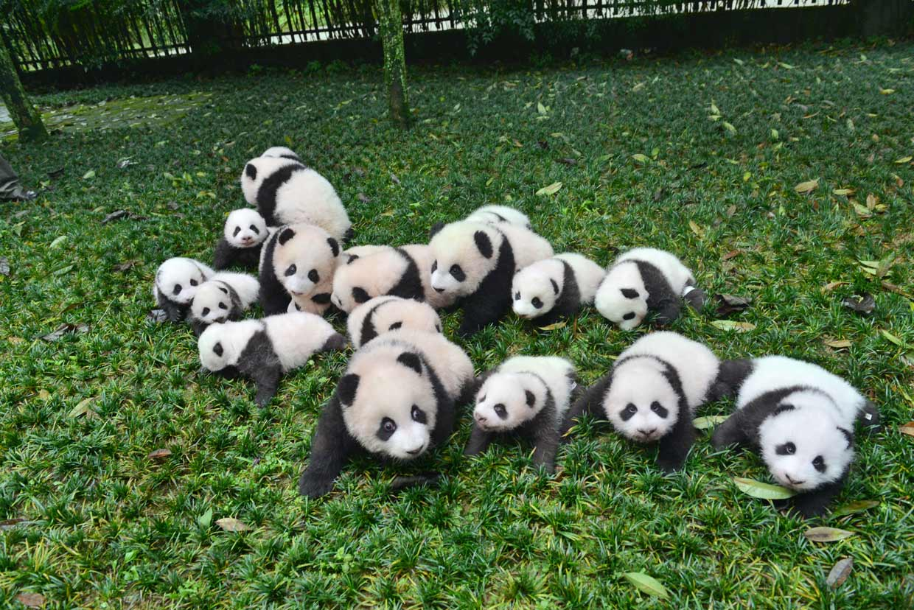
An Introduction To GSA
A dedicated P&A Graduate organization (think SPS)
Committed to building a vibrant P&A graduate community
  Social – provides formal means to organize social events
  Service – provides services to directly address P&A needs
  Representation – provides a forum for discussion and formal representation
http://tx.ag/PandAGSA

Slide 9

What to do in BCS...
Hours from any major city…
Humid…
Surrounded by Physicists…
Even this slide is boring...

Slide 10
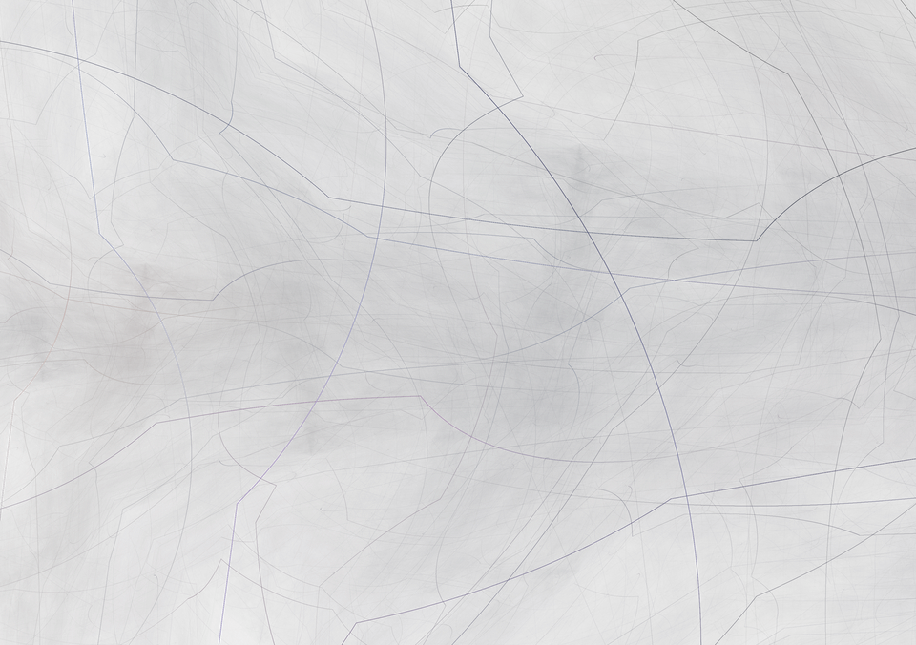

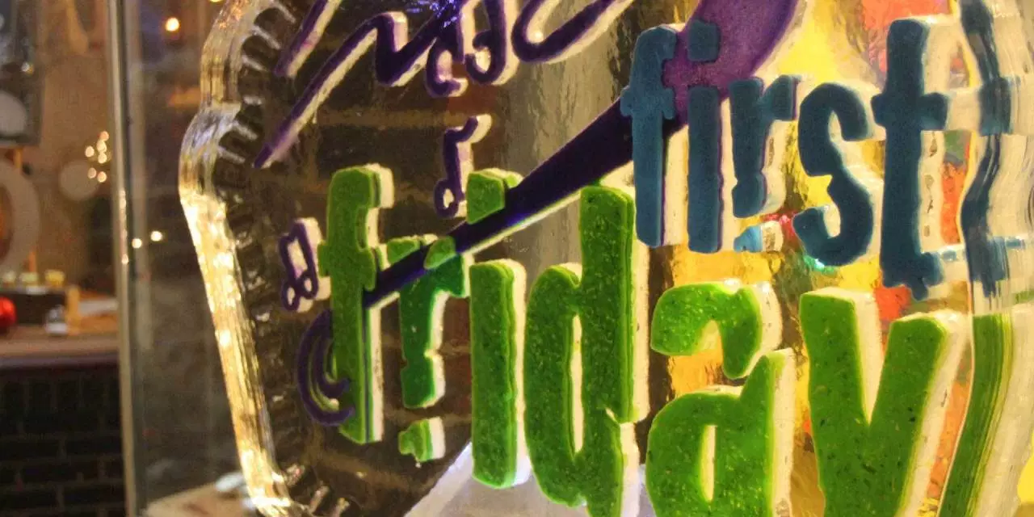
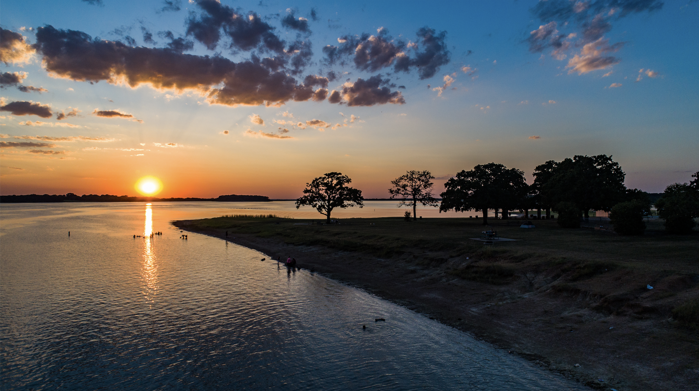
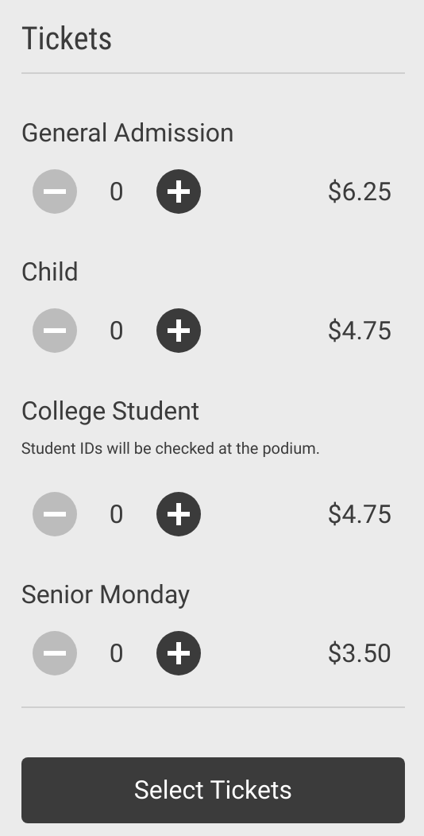
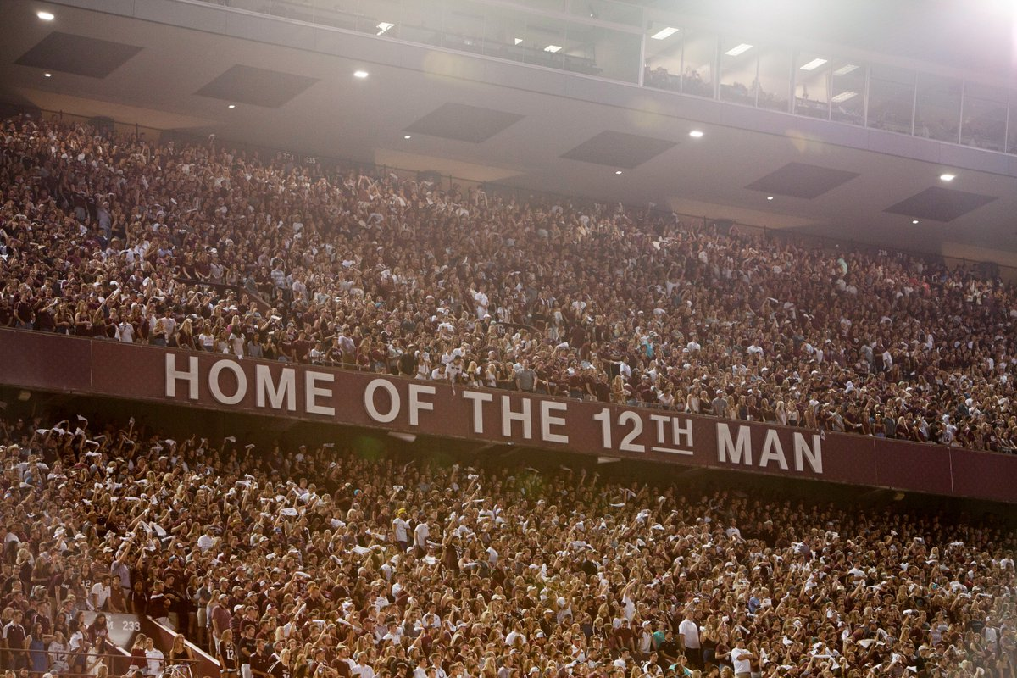
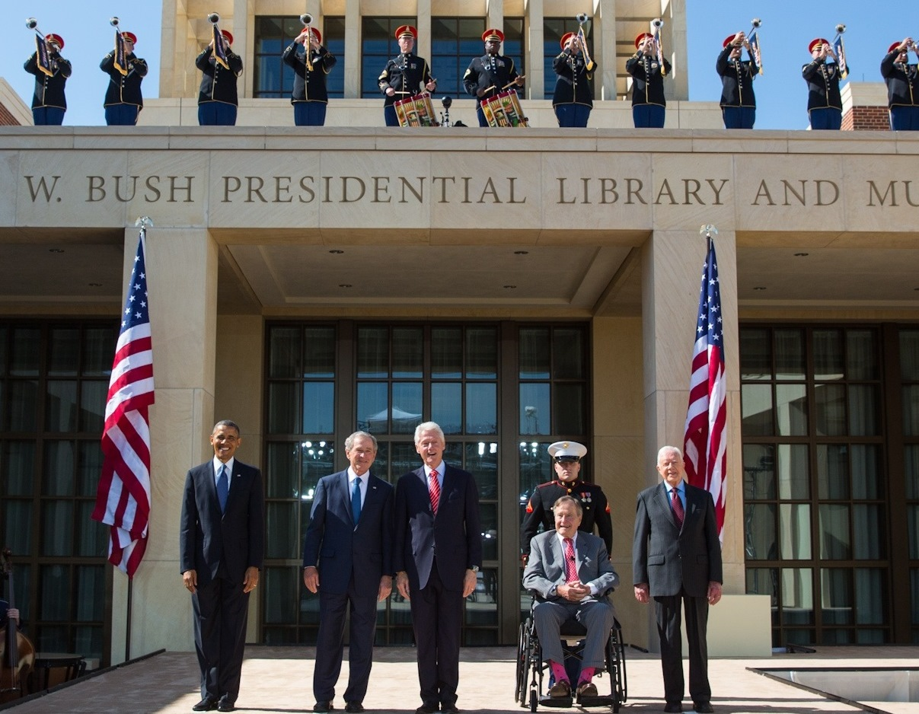
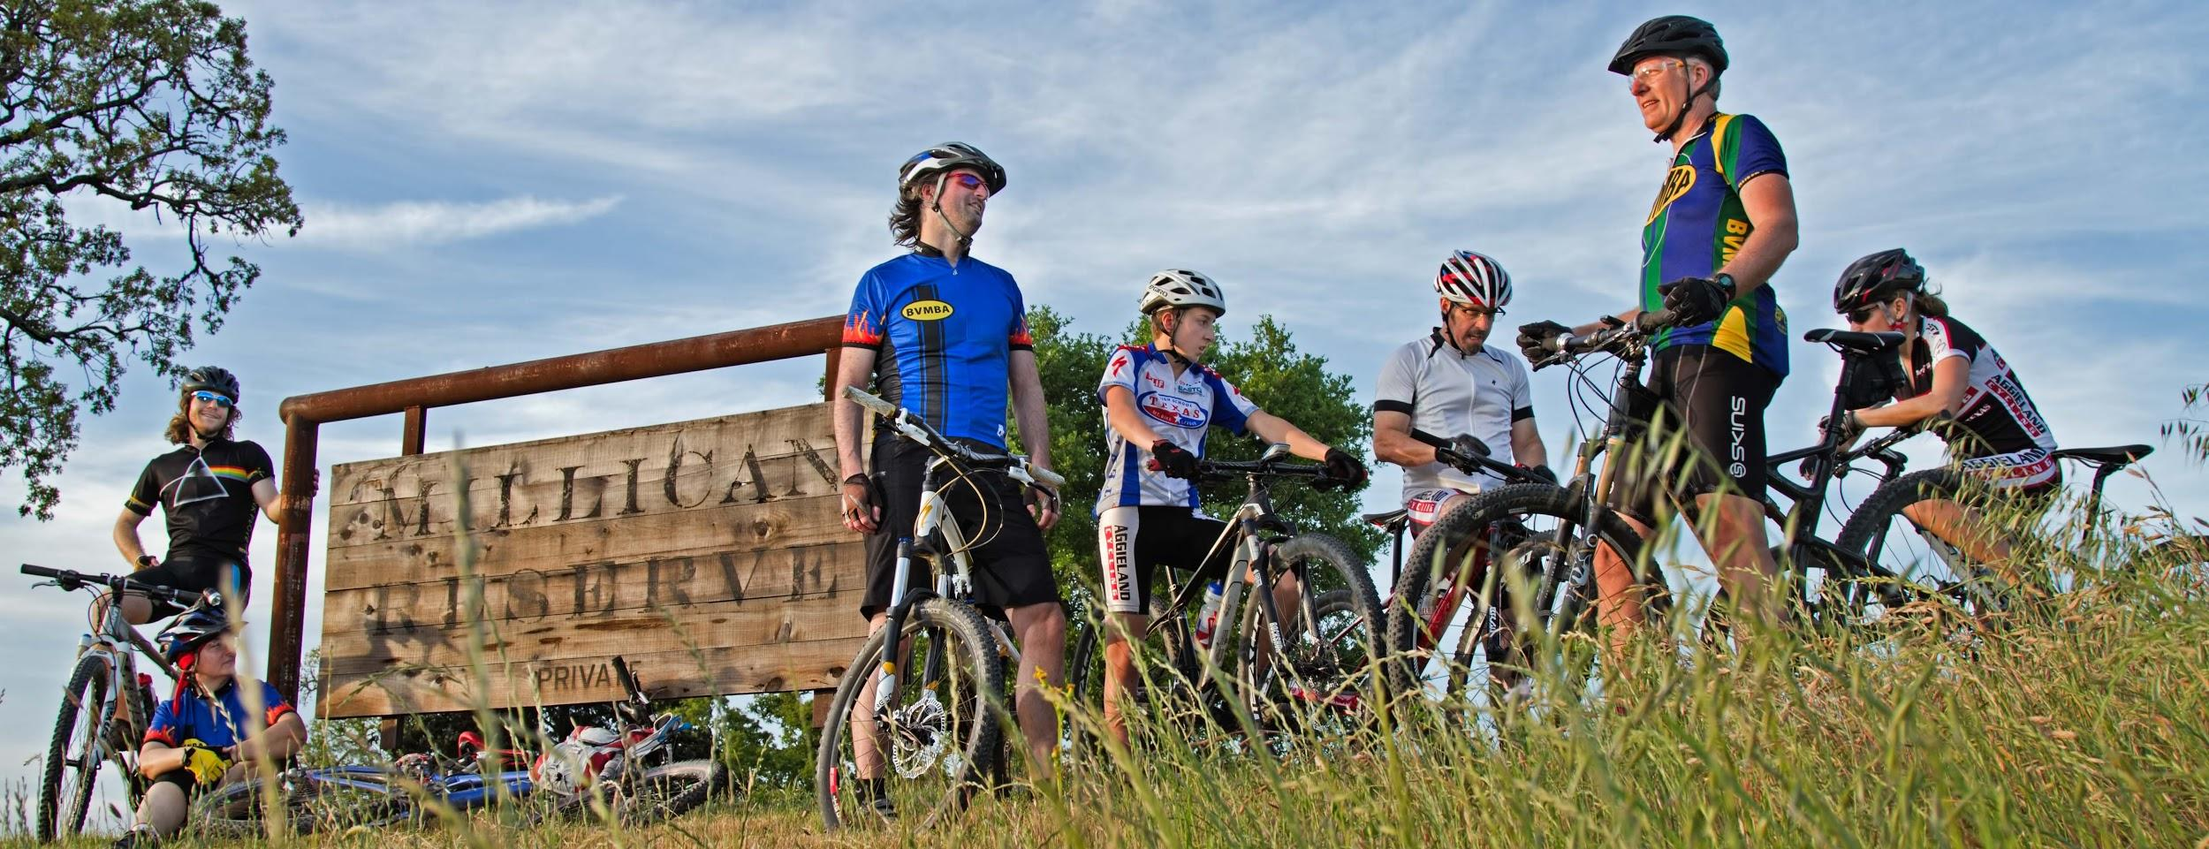

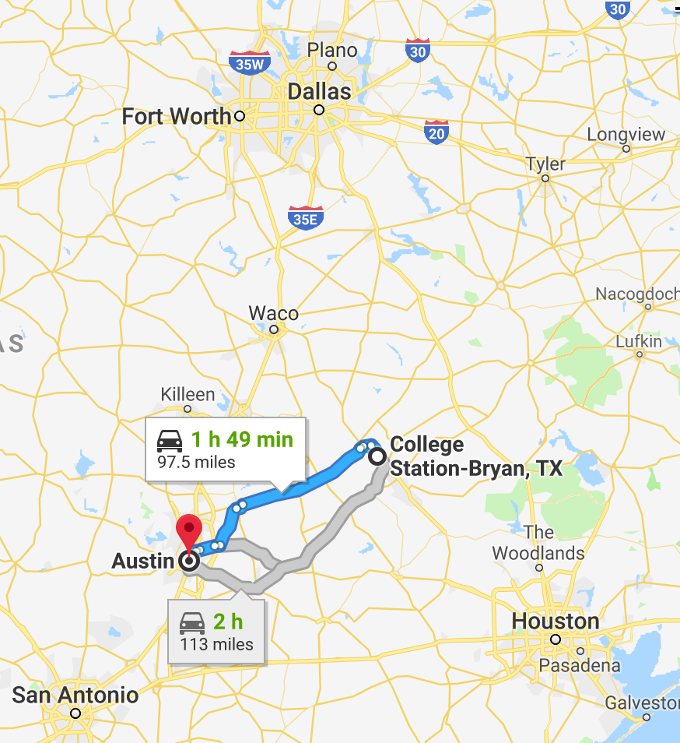
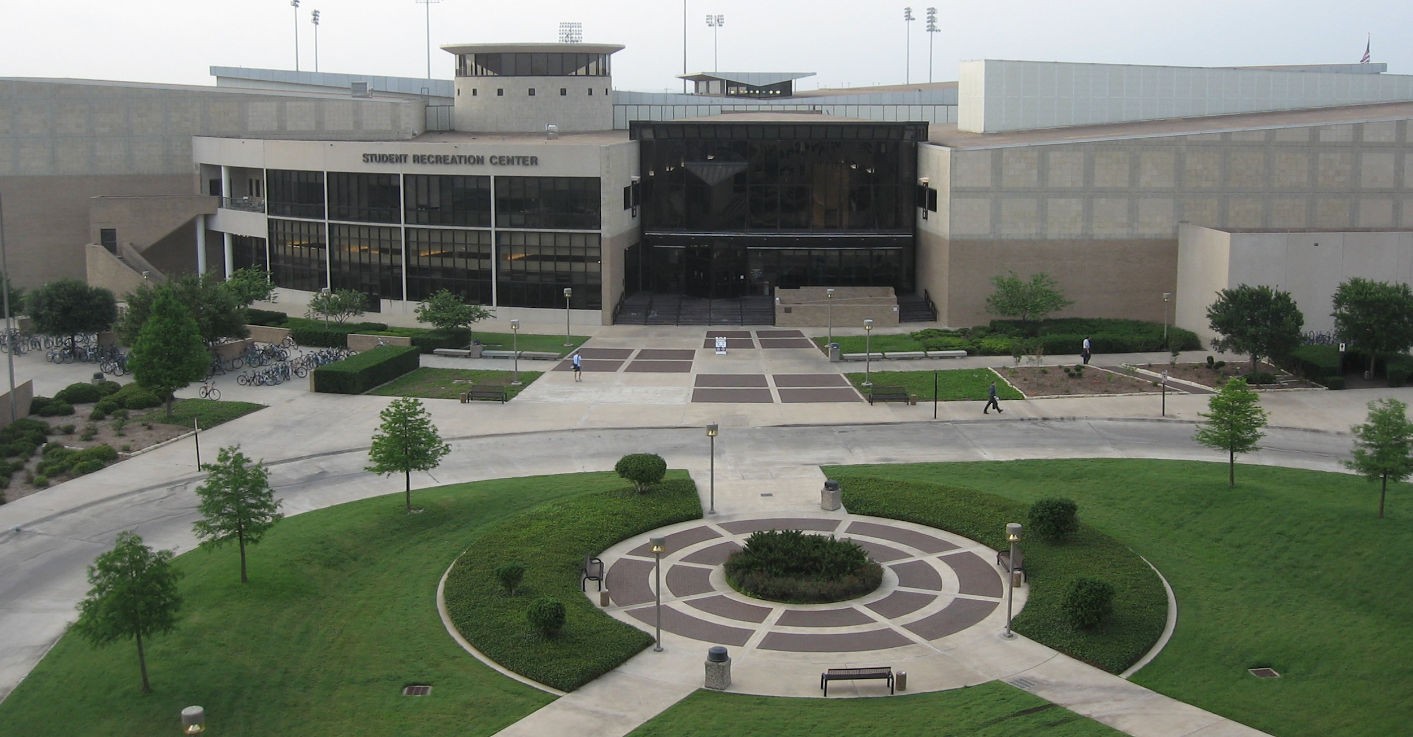
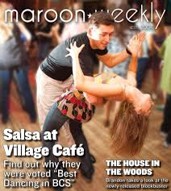


It depends
upon you!

Slide 11
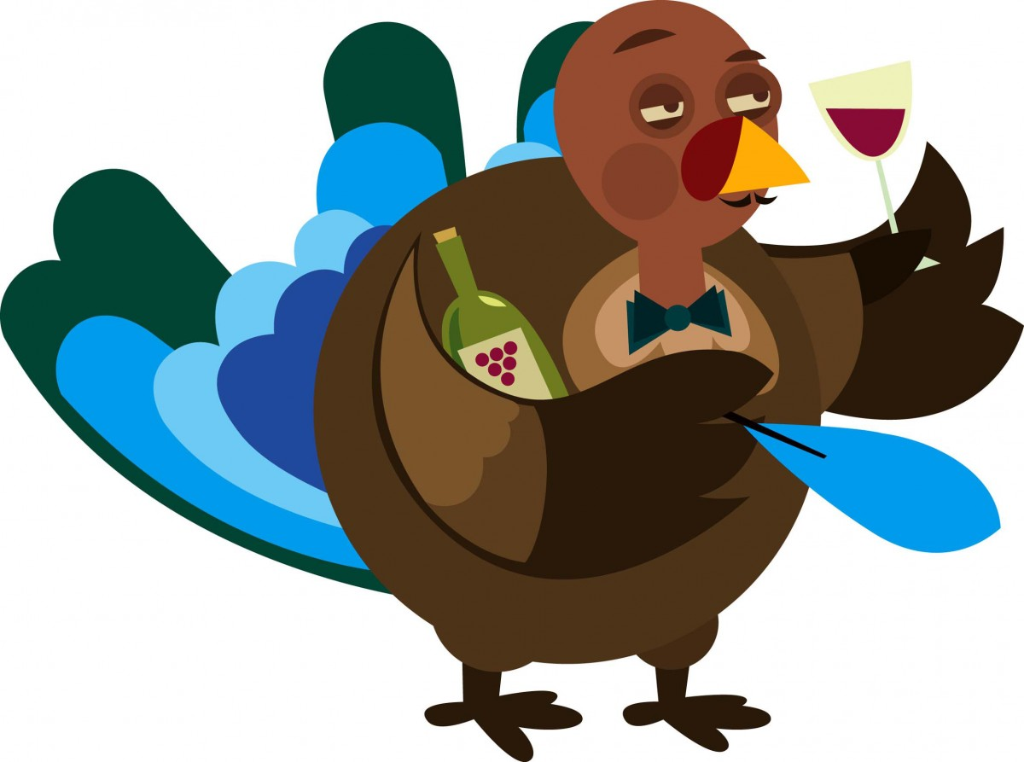
Liquid
Physics
Physics and Astronomy (P&A)

Slide 12
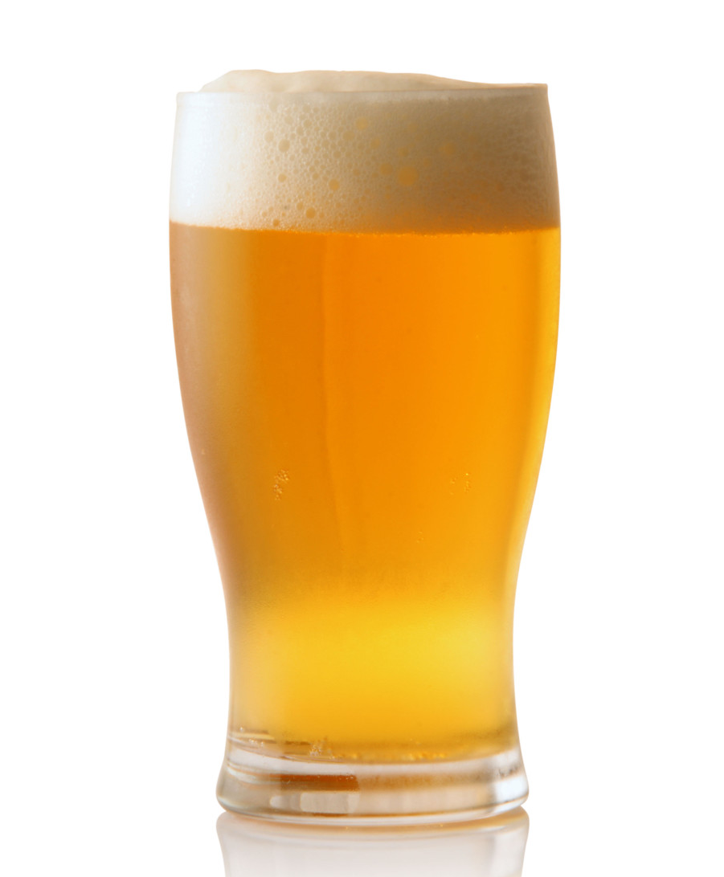
An Introduction To LP
An aggie tradition!
  Every Friday at 5:30 pm to get together at our favorite local bars
  on gather.town!
A great way to start interacting with current P&A graduates
  (once back in person) Also fosters great relationships with local businesses
  (and we have T-Shirts!)

Slide 13
discussion!

