Slide 2
LIU PS Transverse Feedback IST
D. Glenat, W. Höfle, G. Kotzian, R. Louwerse, P. Solvang
Acknowledgements:
D. Landre, K. Marecaux, J. C. Oliveira

Slide 3
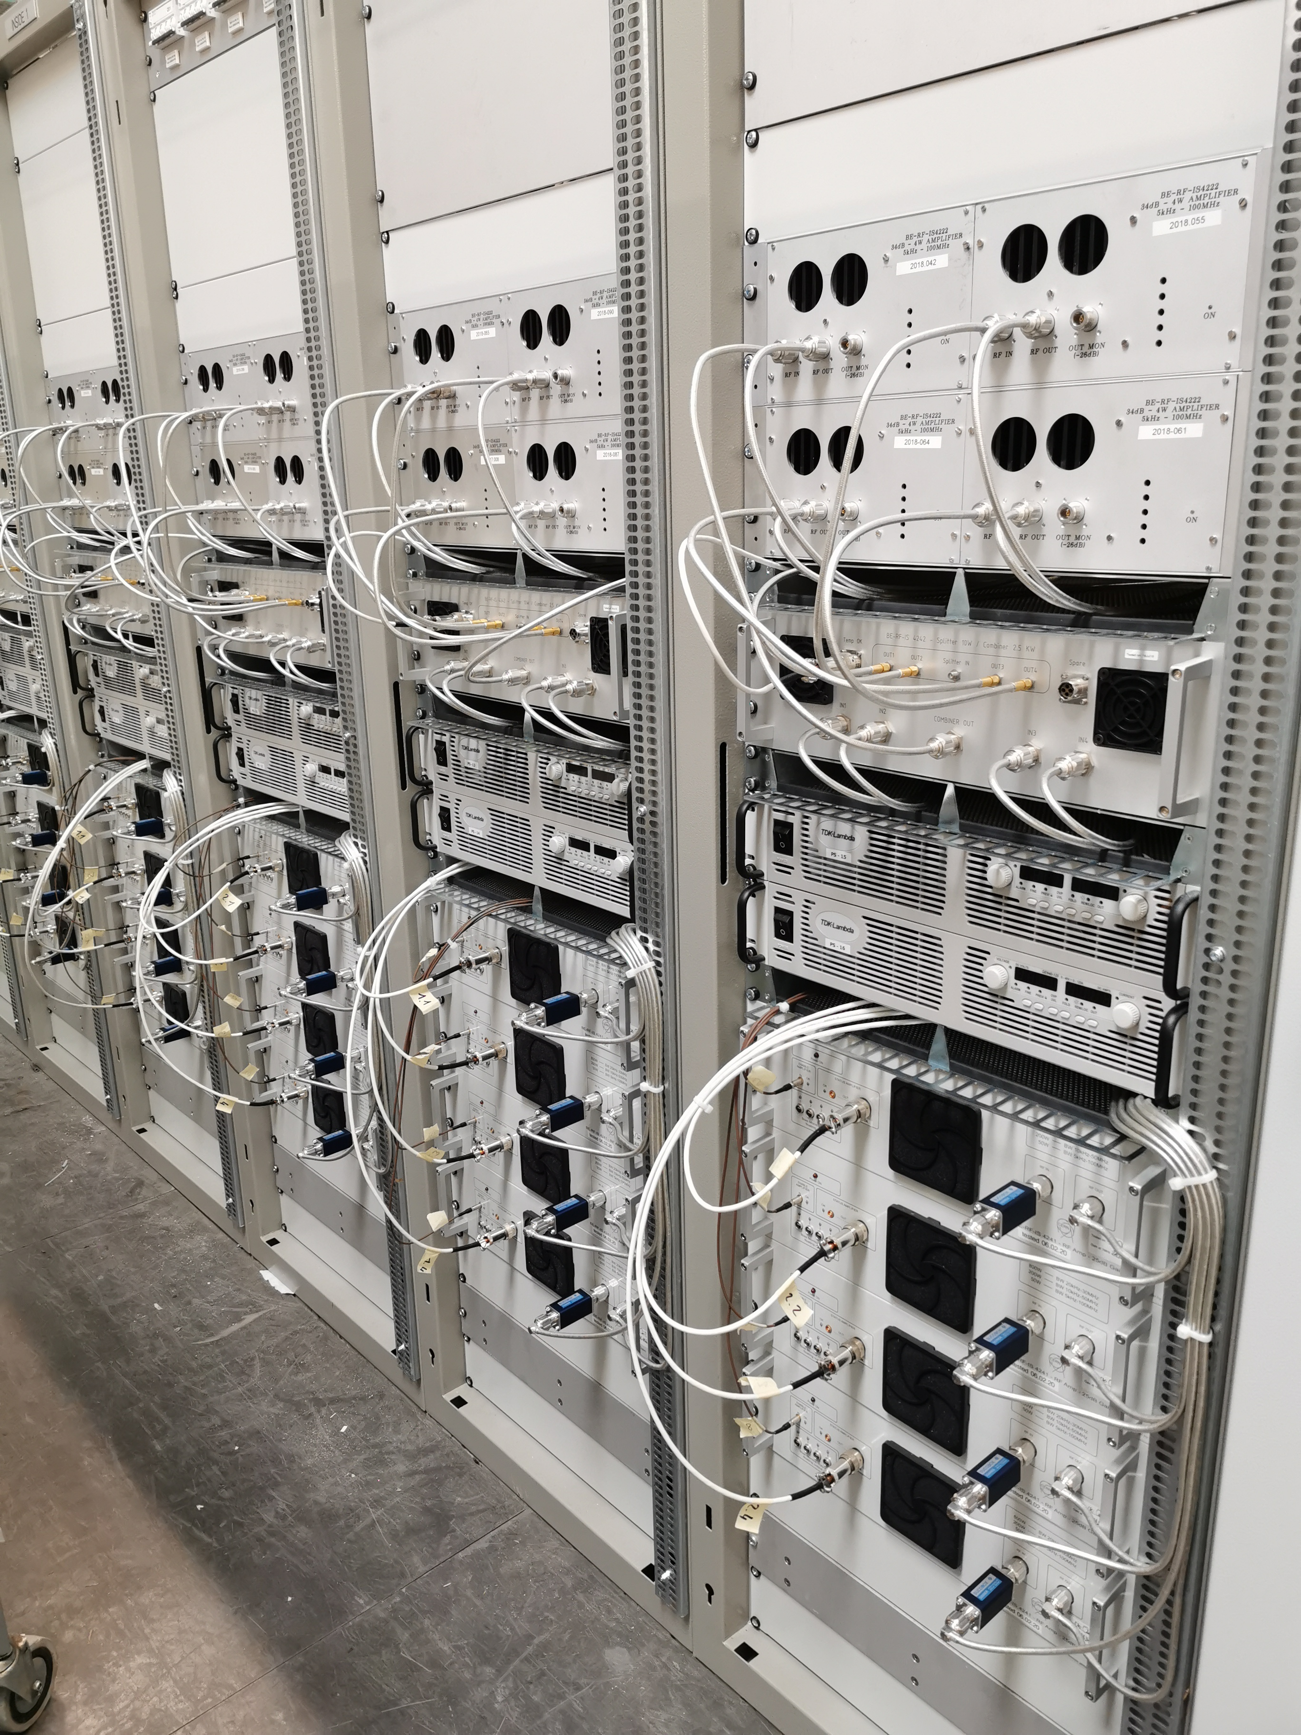
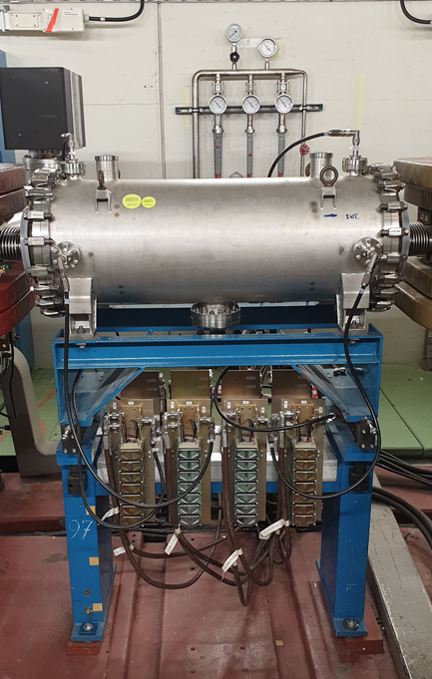
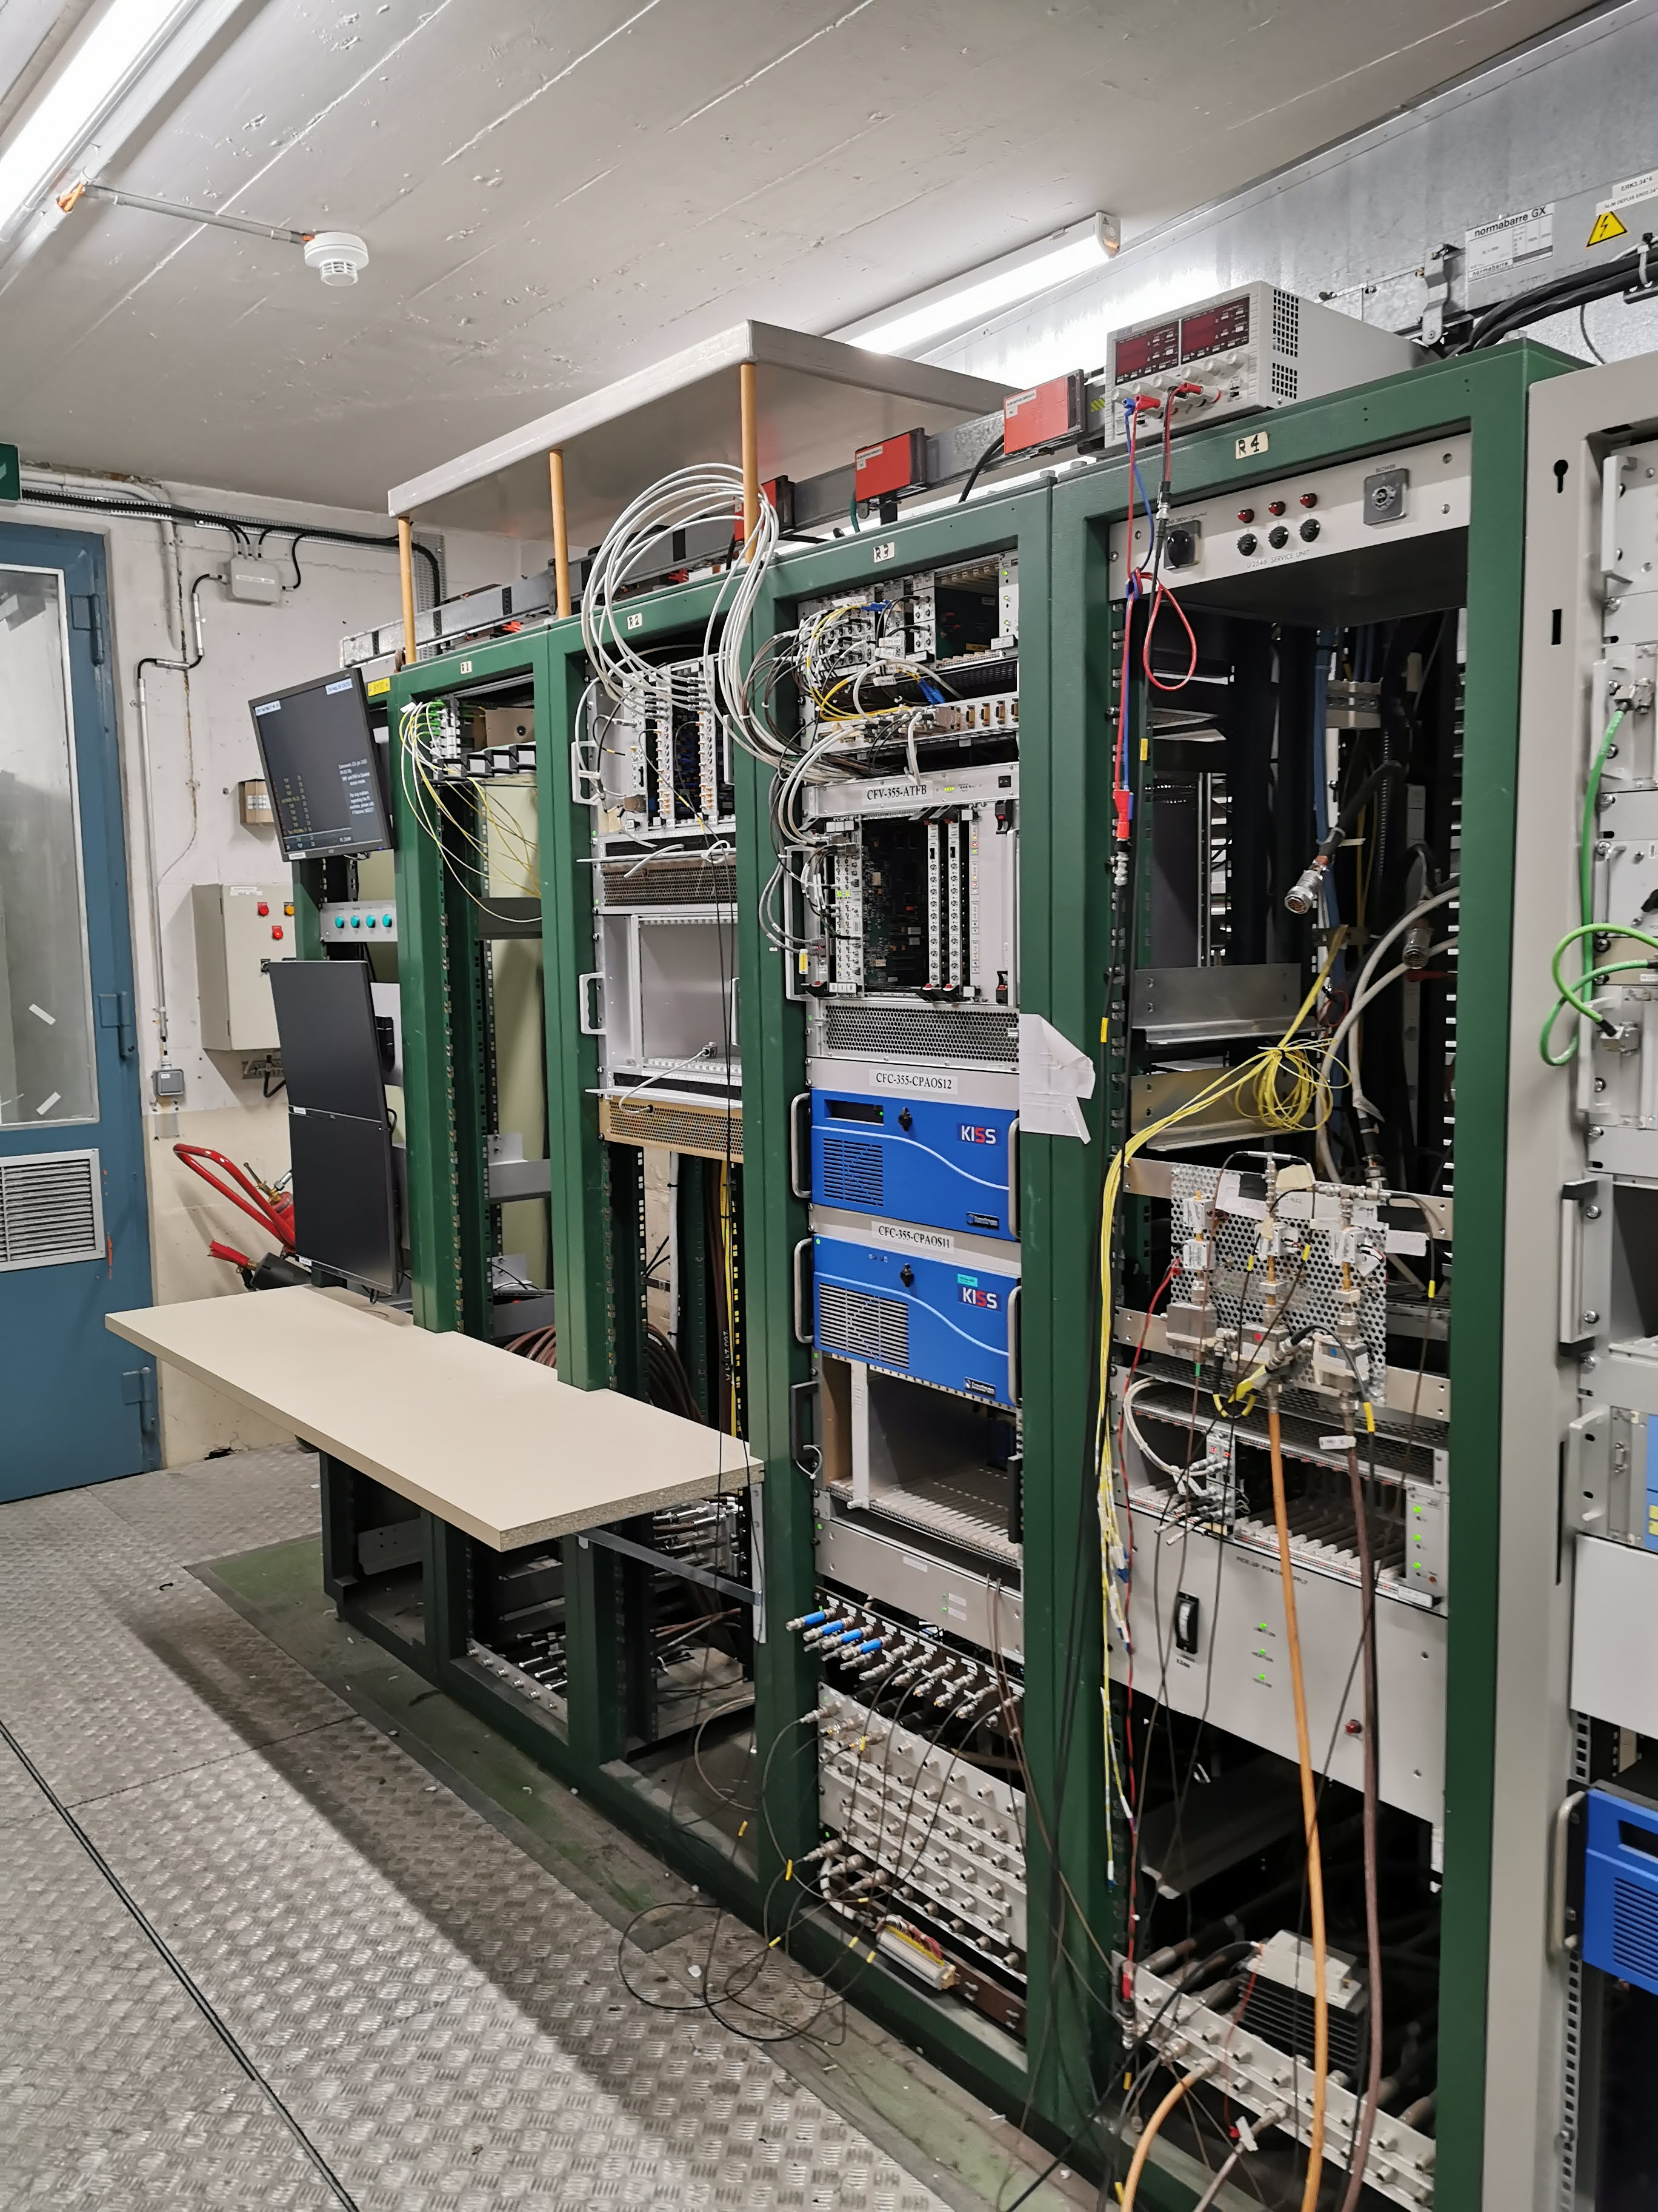
IST tests of PS Transverse feedback
The LIU upgrade of the PS TFB consists of an upgrade of the power system to 5 kW per electrode to cope with the increased beam energy at injection from 1.4 GeV to 2 GeV;
The power of 32 individual RF amplifiers of 800 W is combined to provide 5 kW to each of the four kicker plates installed in the tank in SS97
The power system is installed in building 355/R-009
SS97 Kicker tank
355/R-017 LLRF
355/R-009, new power system

Slide 4
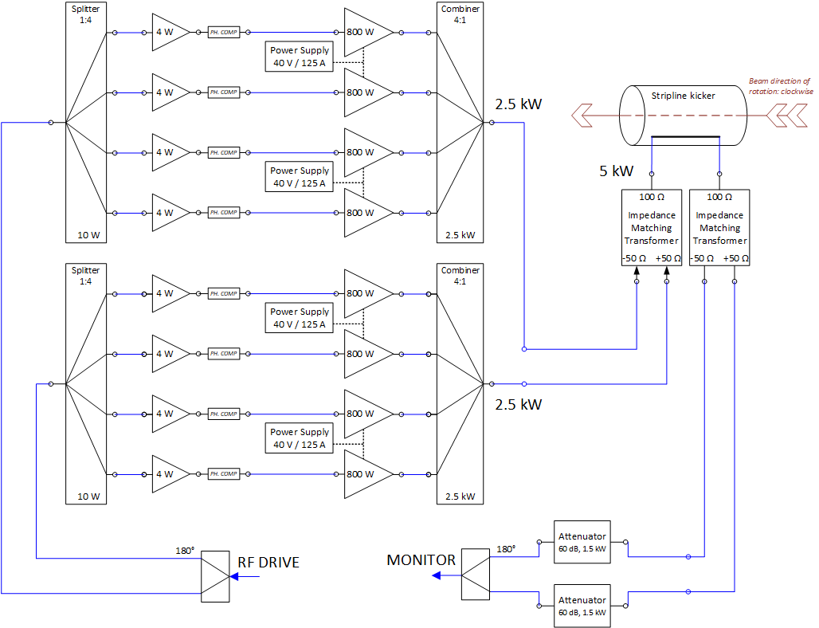
5kW RF amplifier power per electrode (x4)
5 kW amplifier set-up

Slide 5
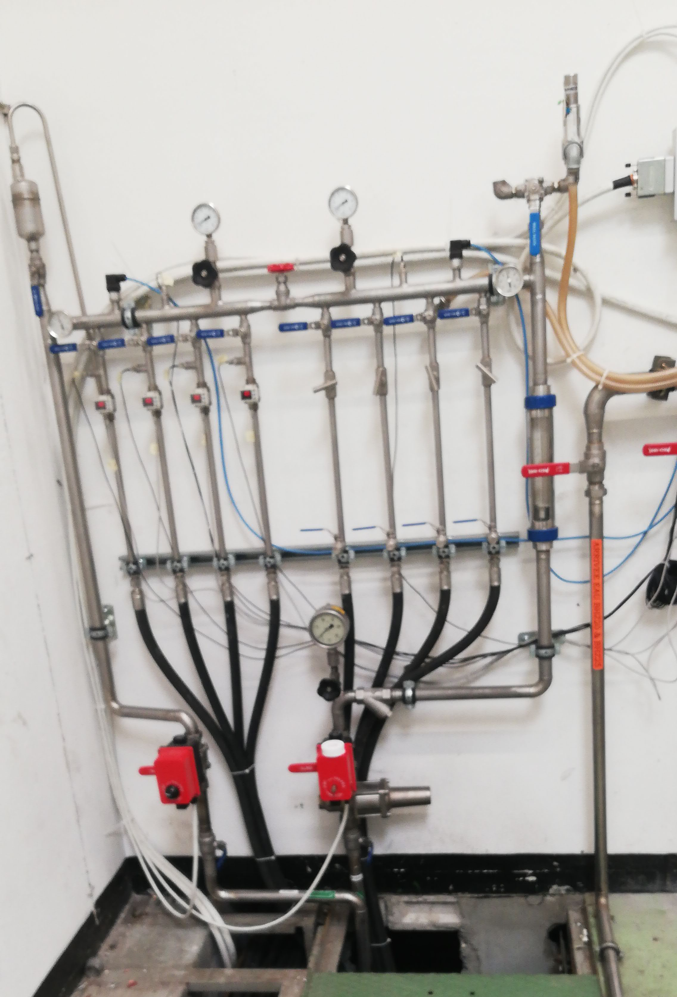
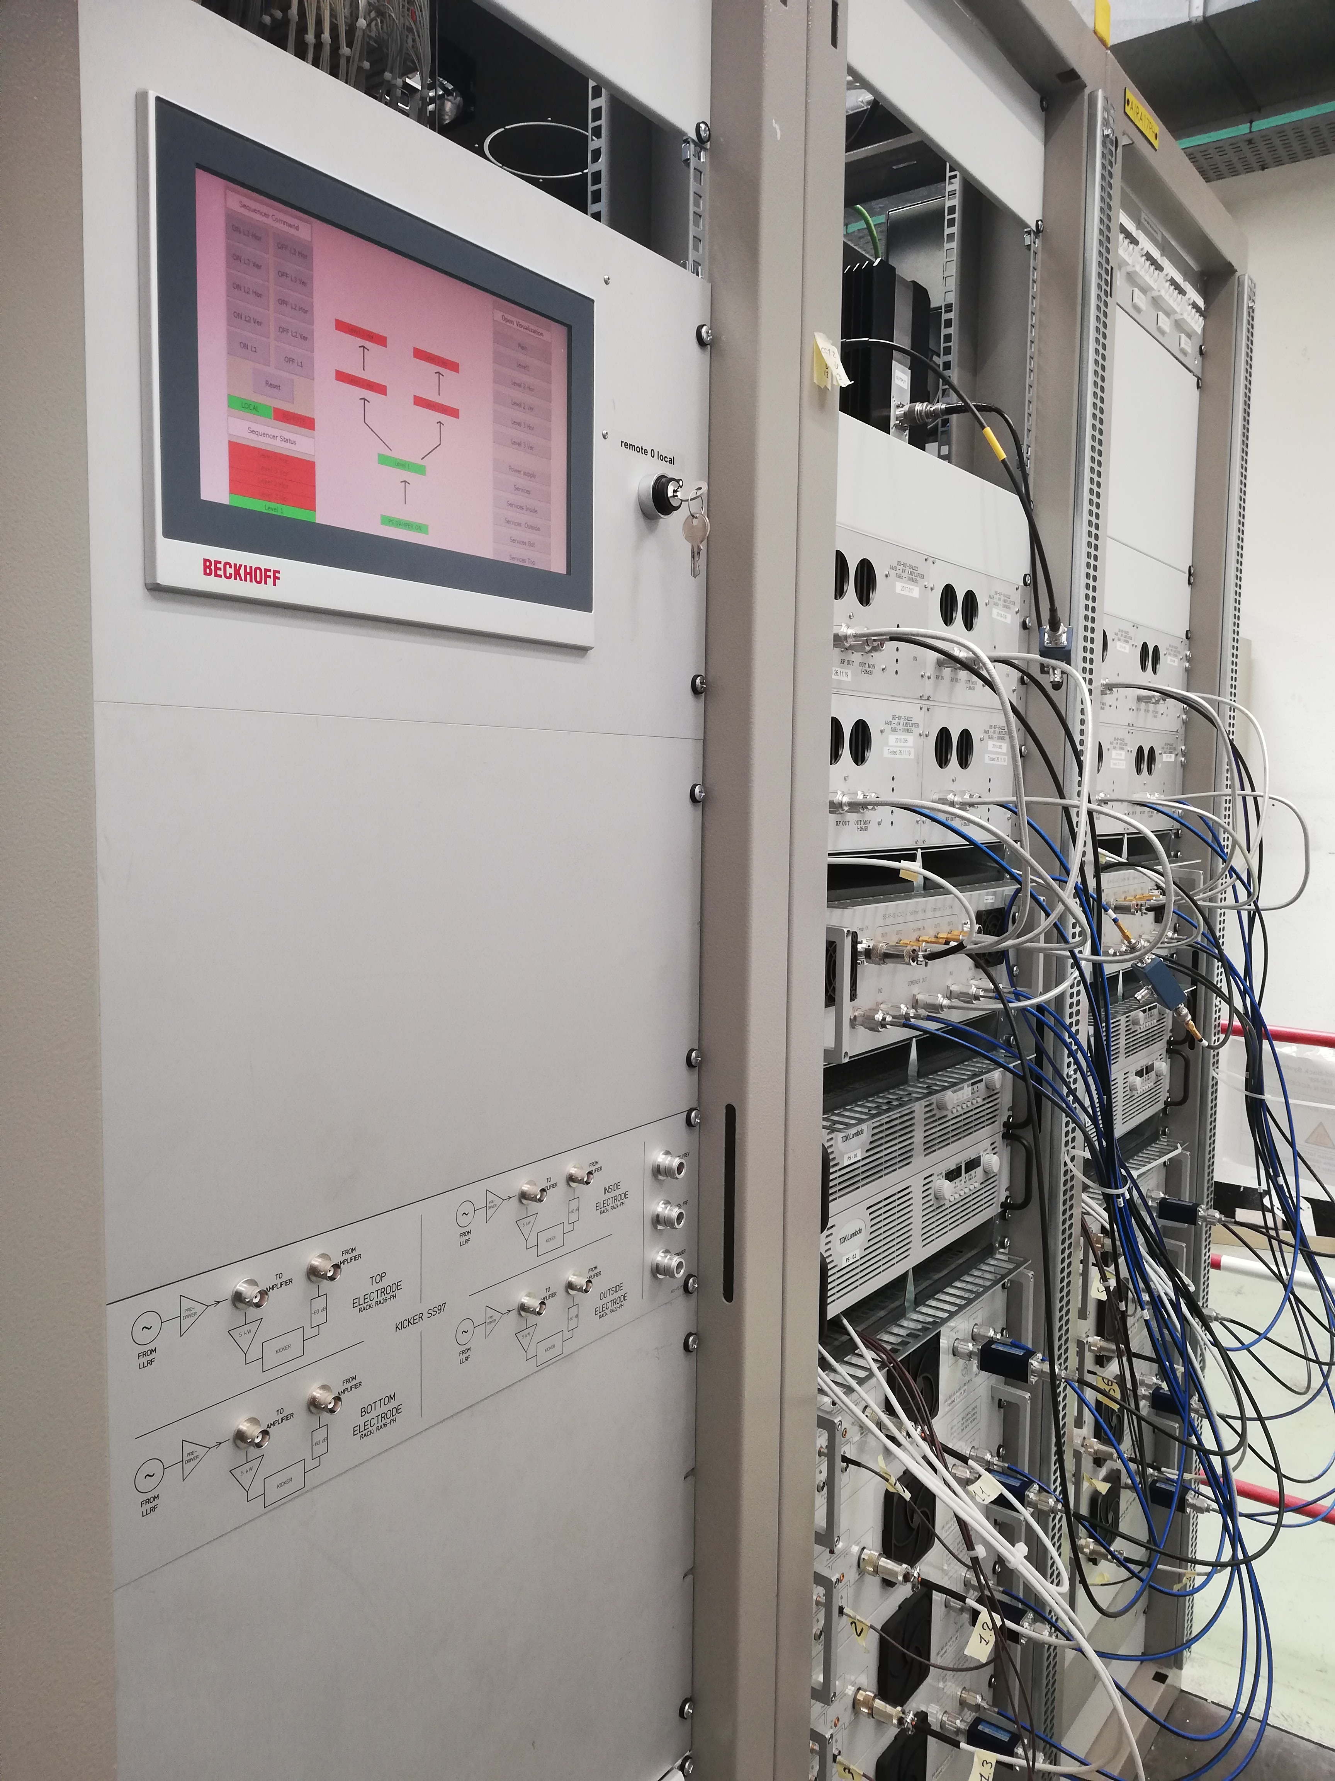
Planned activities for IST
Test PLC control, interlocks and cooling
RF power tests with and without kickers
Necessary conditions:
  Cooling water
  Electricity in 355
  Vacuum in SS97
PLC rack and HMI display
Water cooling circuits 355/R009

Slide 6
Activities performed during IST
Water cooling
  ΔT ≈ 9.6 °C, @4.3 l/min for each of the 4 branches, amplifiers in standby with bias current
PLC controls
  Debugging
RF power tests without kickers
  Measurements of 32x 4 W amplifiers
    Gain variation corrected by Reinier
  Measurements of 32x 800 W amplifiers
RF power test with kickers
  Frequency domain measurements of full path on 1 electrode
  Time domain measurements of full path on all 4 electrodes

Slide 7
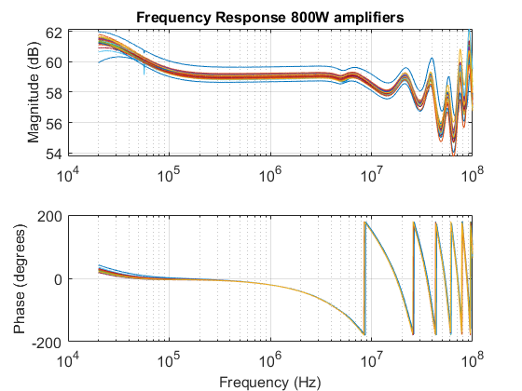
Frequency response 4 W + 800 W amplifiers

Slide 8
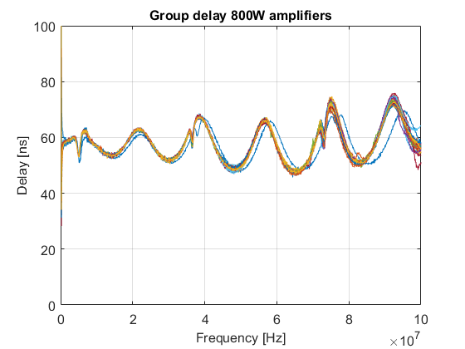
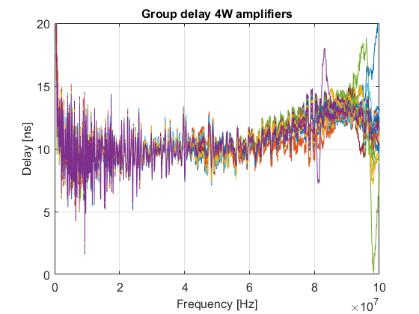
Group delay measurements

Slide 9
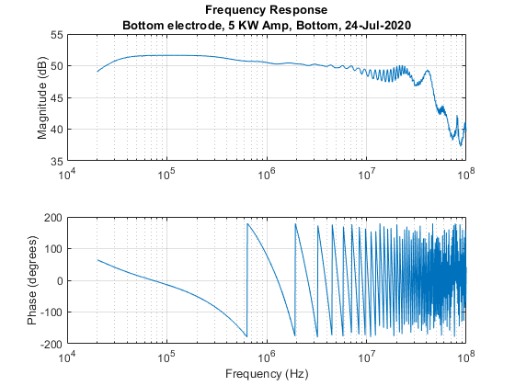
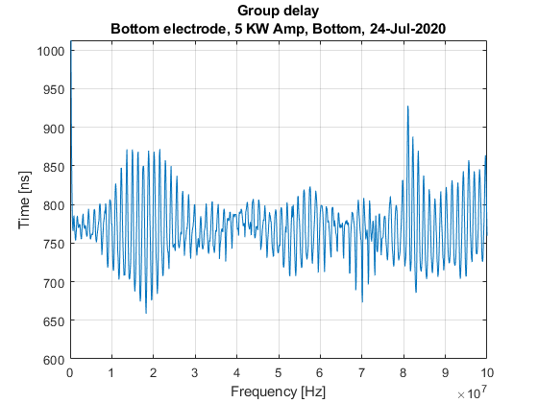
Bottom electrode frequency domain measurements

Slide 10
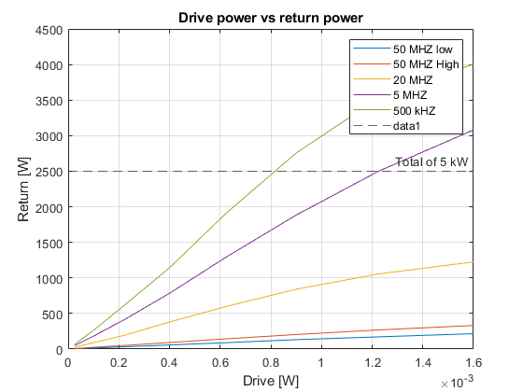
Bottom electrode time domain measurements

Slide 11
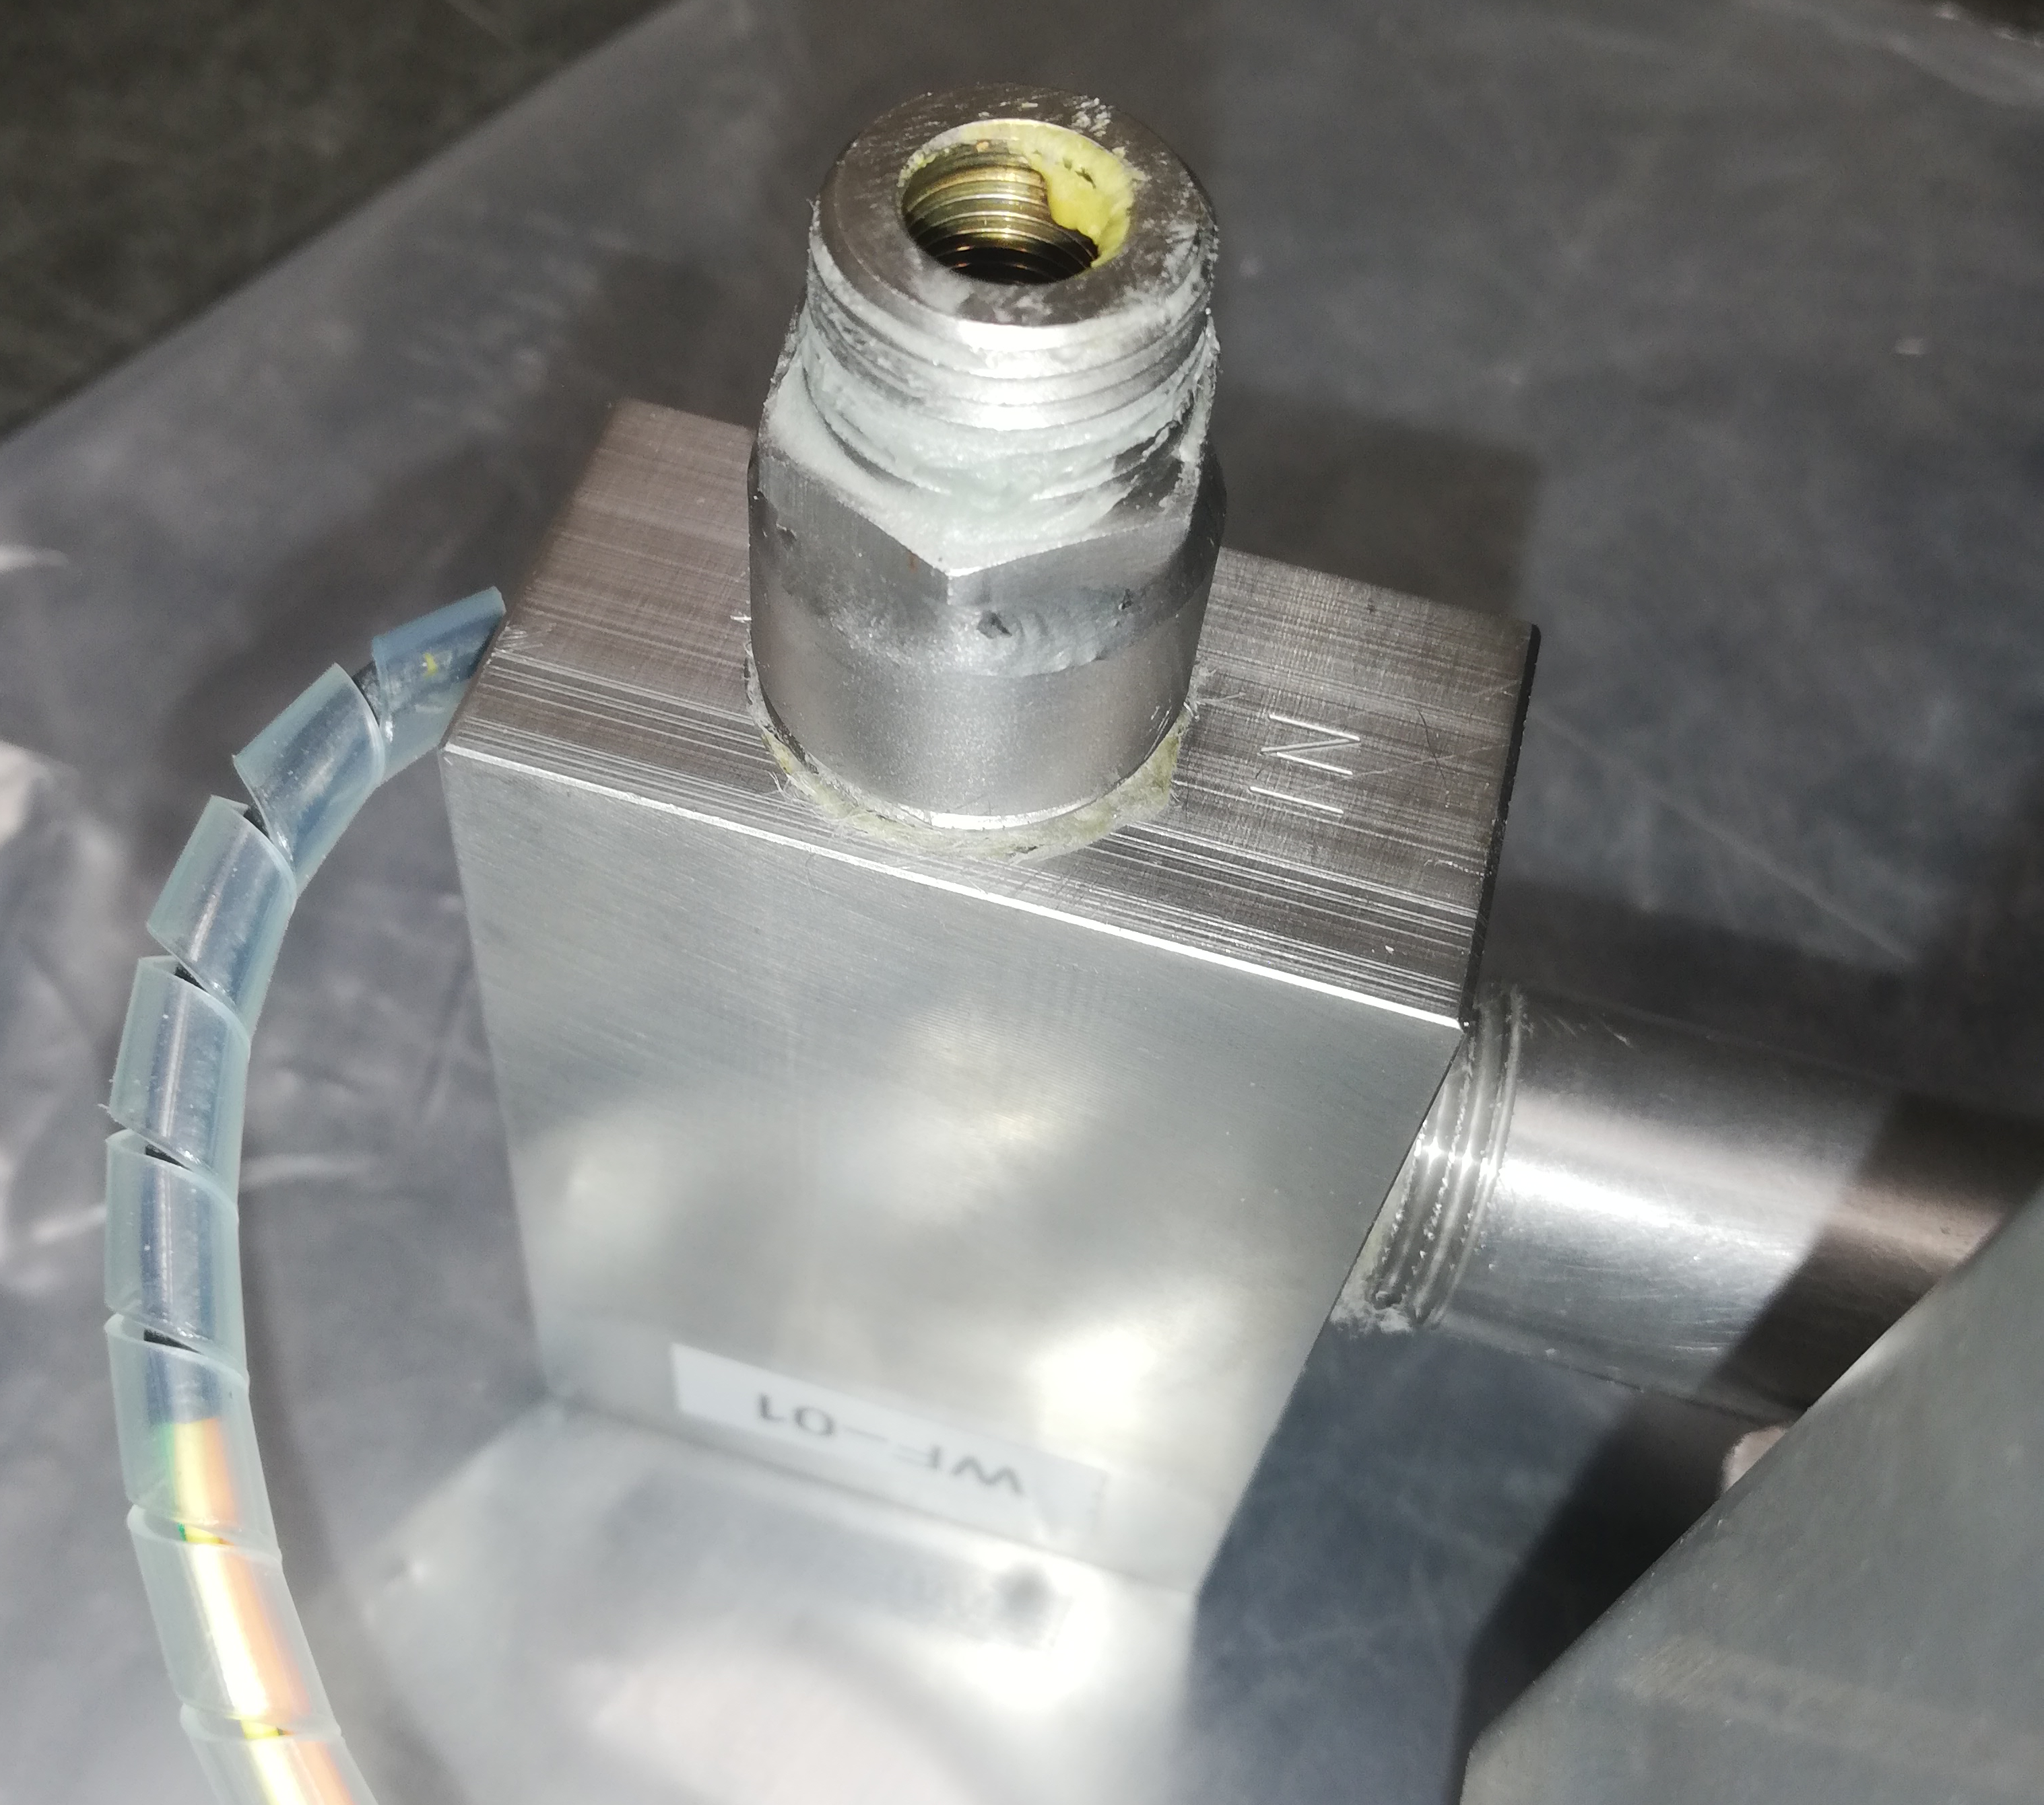
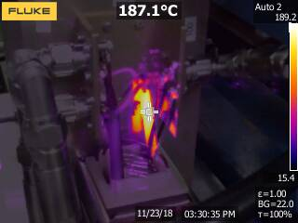
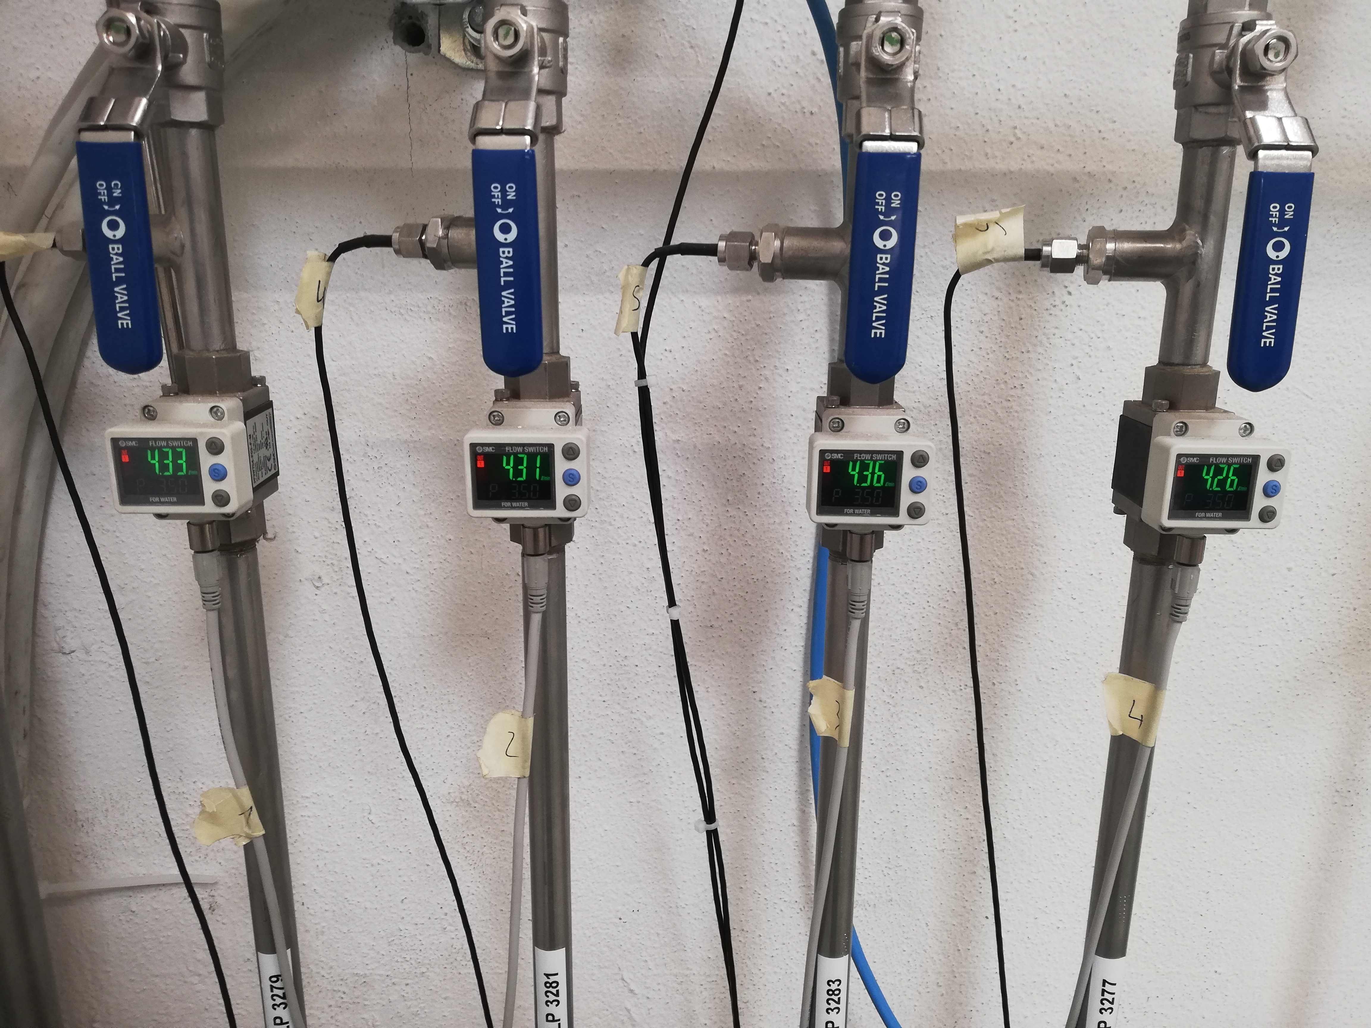
Unresolved
Heat in impedance matching transformers and protection
PLC and HMI panel: Still some bugs
Impedance matching between 4 W and 800 W amps
Additional amplification between LLRF and power system
Variation of delay and phase with frequency
Water cooling: Protection against insufficient flow
  Flow meters: Remote output limited to 4 l/min, display → 5 l/min
  Flow switches: Erratic behavior due to suspended impurity in water Replace?
Flow switch
Flow meters
Impedance matching transformer, 50 MHz full power

Slide 12
Plan for next IST
Ahead of IST
  Improve matching between 4 W and 800 W amplifiers
  Investigate 2 deviating 800 W amplifiers
  Investigate heat in impedance matching transformer. Measurements in lab. Proposal for protection.
Verification of final patch cables installed after last IST with power
Verification of cable lengths to tunnel in search of delay variation
Verification of measurement results
Verification of PLC interlocks after update of software
Remaining measurements
Further investigate ripple in phase and delay. Faulty connector?
Determine the need for alternative interlock for the water-cooling circuit
  Effect of new water filter

Slide 13
Conclusion
Water cooling is sufficient to cool the 800 W amplifiers
Interlock and flow measurement needs to be addressed
PLC controls needs to be updated and re-checked
Gain of 4 W driver amplifiers are satisfactory after equalization
The system can deliver 5 kW of rf power
  Maximum frequency limited by digital part to below 40 MHz
Unforeseen issues require additional expenditure

Slide 15
5kW RF amplifier power per electrode (x4)
230 V / 400 V
Demineralized Water 1.25 l/min
Amplifier Rack 1
PLC Remote Control
RF ON
RF OFF
Amplifier Rack 2
Demineralized Water 1.25 l/min

Slide 16

Hardware in tunnel
Kickers
Combined function impedance transformer and combiner
  combines 2 x 2.5 kW
  input impedances 50 Ω
  output impedance 100 Ω
  maximum power handling is frequency dependent
full power tests only when tank is under vacuum (feedthrough breakthrough limit unknown)
125 Ω cable to connect to kicker
  power and voltage limit

Slide 17
Improvements required 1st look
water filter (Y-type) with 200 um ordered
  waiting for CV, also waiting for answer to a question concerning filtering of the circuit
  manufacturer says filter needs to be 200 um
  hysteresis of interlock switch
replacement of flow switches by new system including individual temperature measurement in each branch?
matching 4 W / 800 W
temperature interlock combiners in tunnel
PLC
Clean-up and next IST, when?

Slide 18
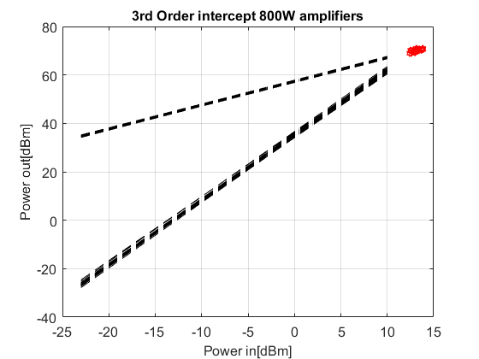
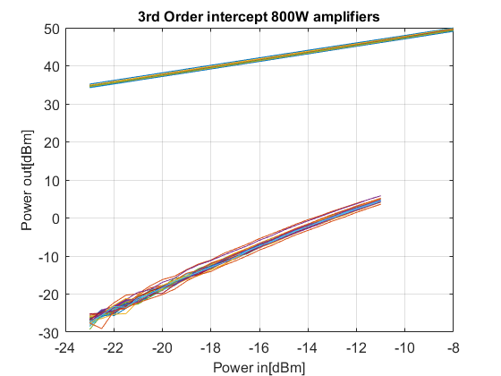
3rd order intercept measurement
800 W amplifiers

Slide 19
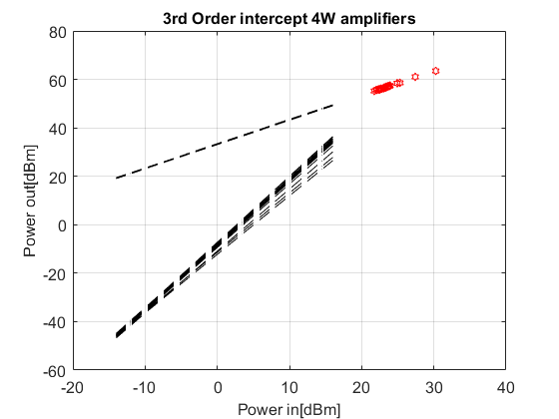
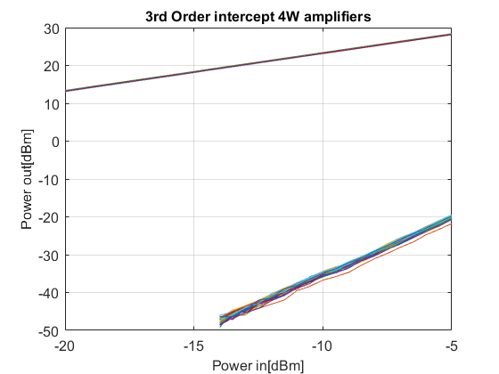
3rd order intercept measurement
4 W amplifiers

Slide 20
Group delay bottom electrode

Slide 21
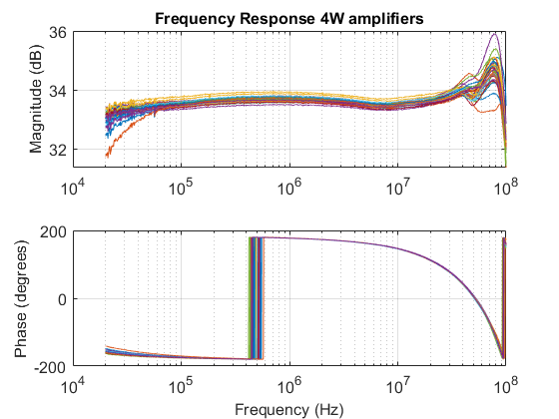
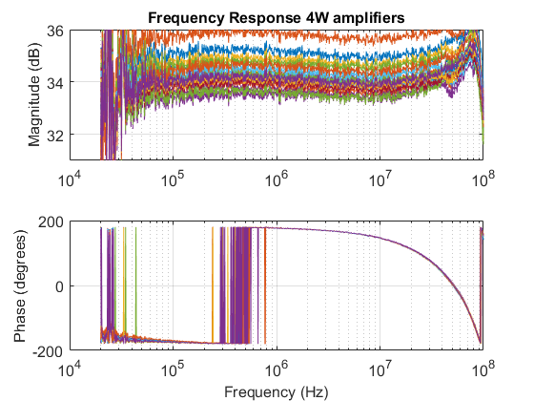
Frequency response 4 W amplifiers

Slide 22
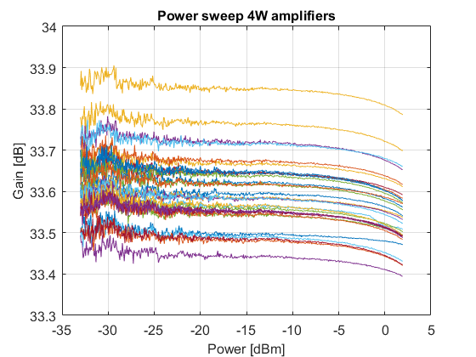
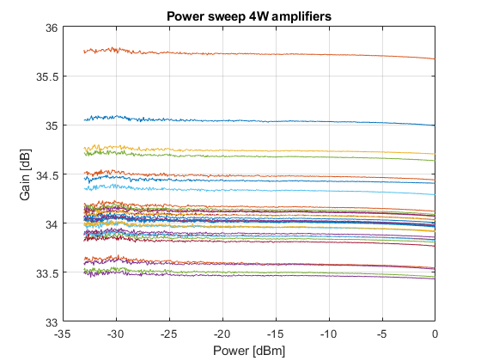
Power sweep 4 W amplifiers

Slide 23
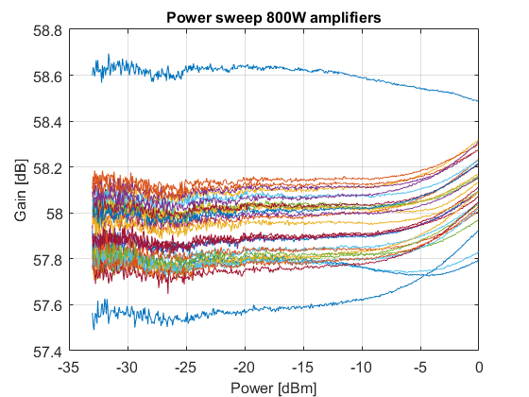
Power sweep 800 W amplifiers

Slide 24
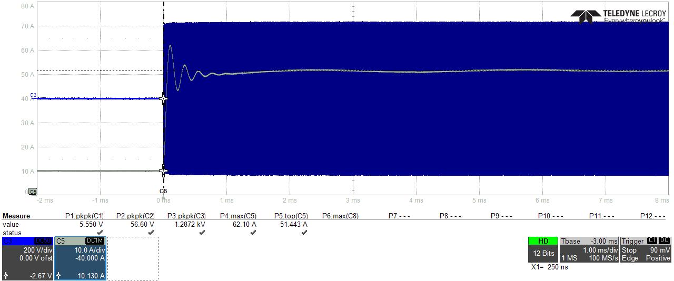
Amplifier BOTTOM 1 (2.5 kW line)
CH3 (blue) – Voltage envelope 1.2872 kVpp → 4 kW in 50 Ohms (>2.5 kW)
CH5 (gray) – DC current of one 800W amplifier: 62.10 A peak, 51 A steady state
Similar performance on all amplifiers

Slide 25
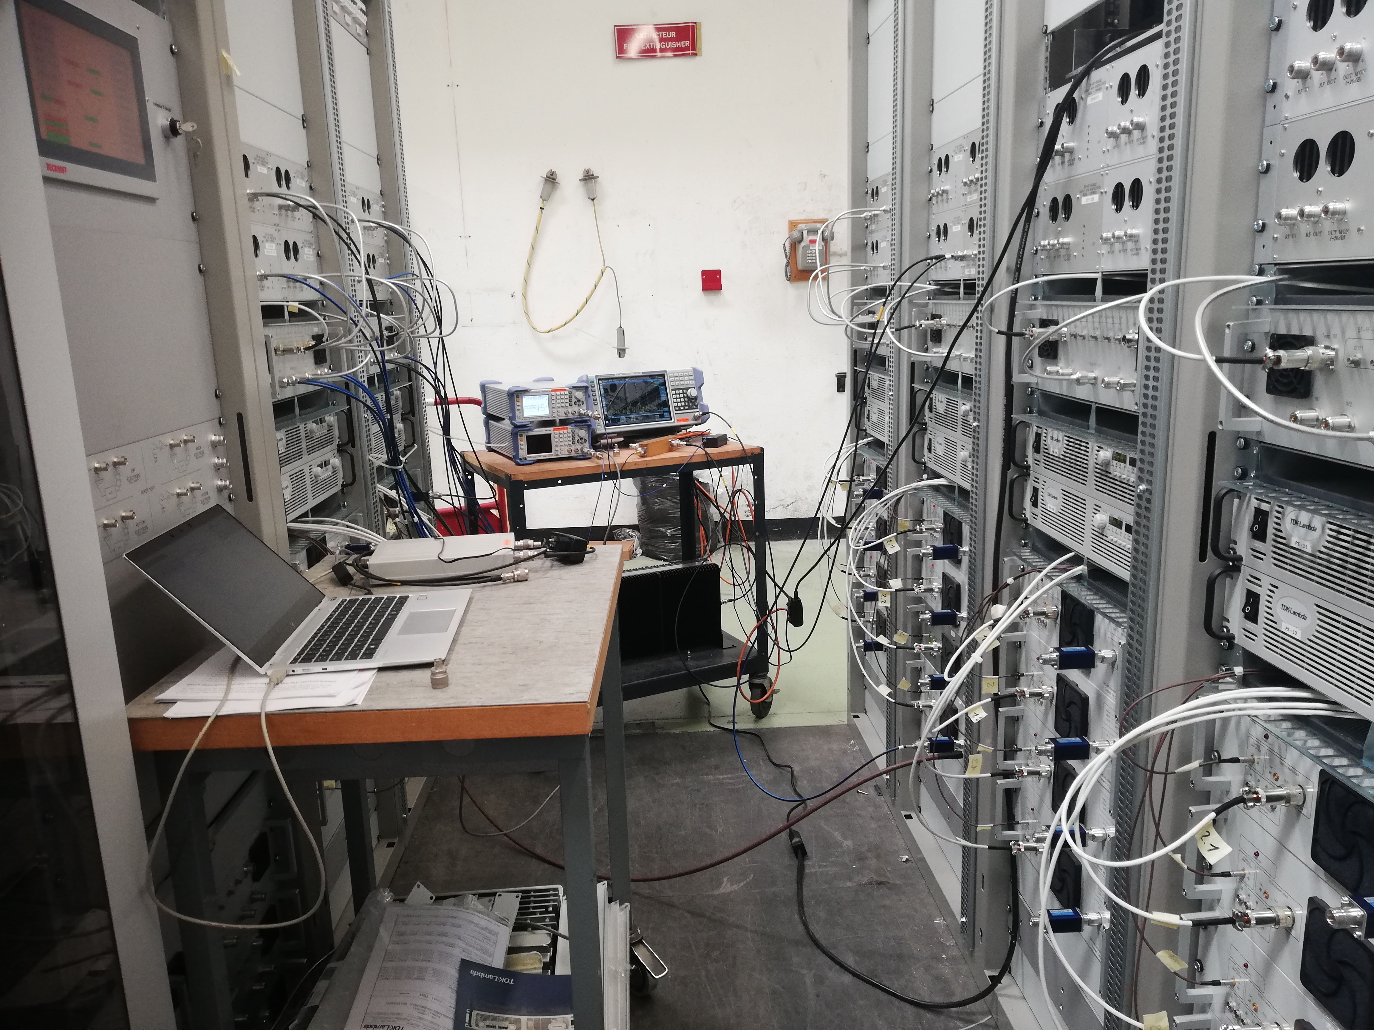
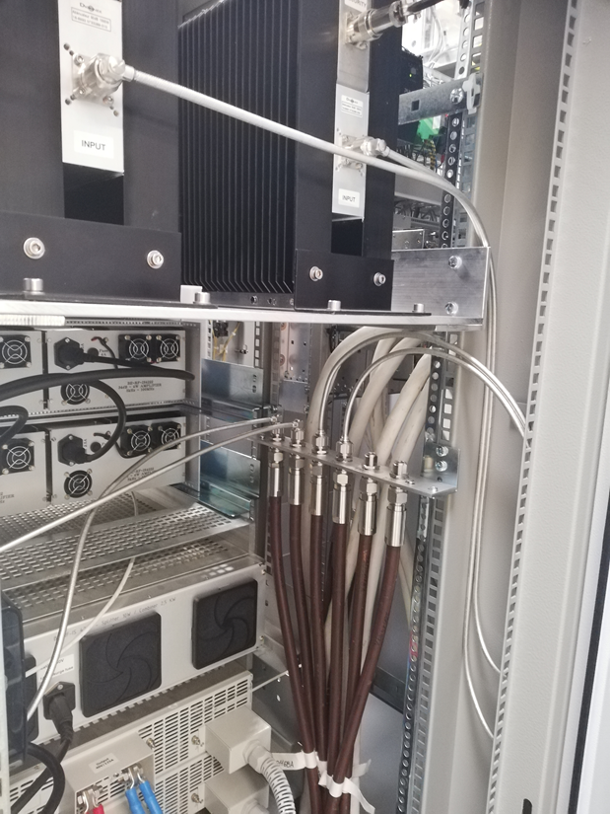

Slide 26
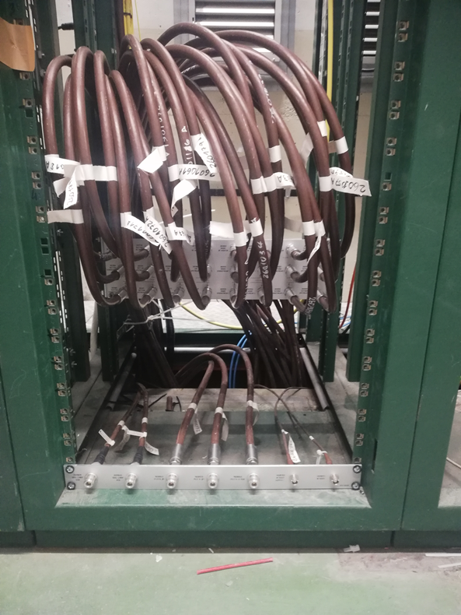
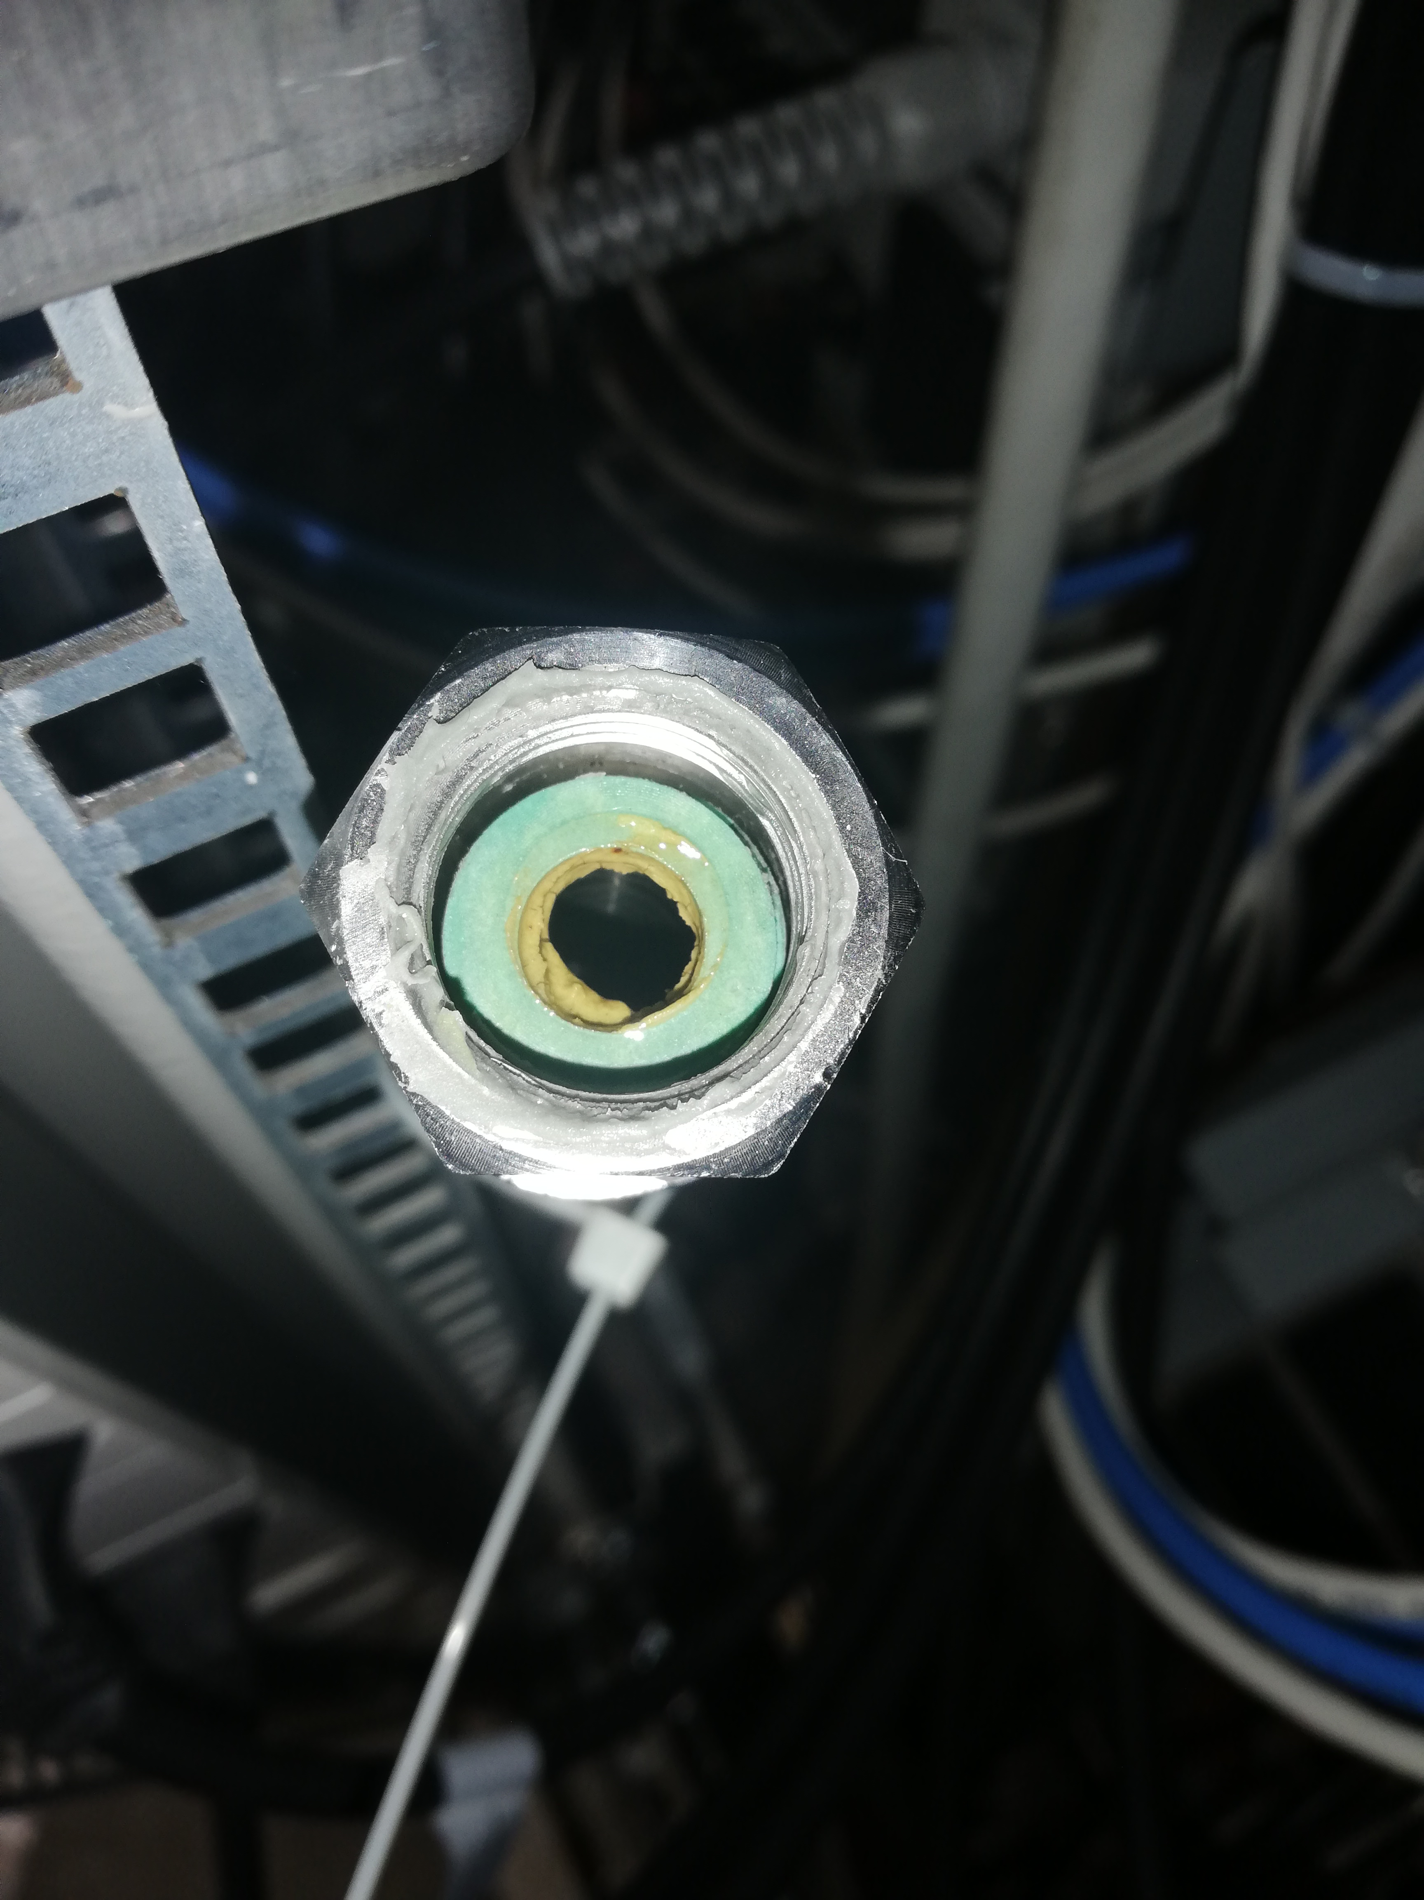
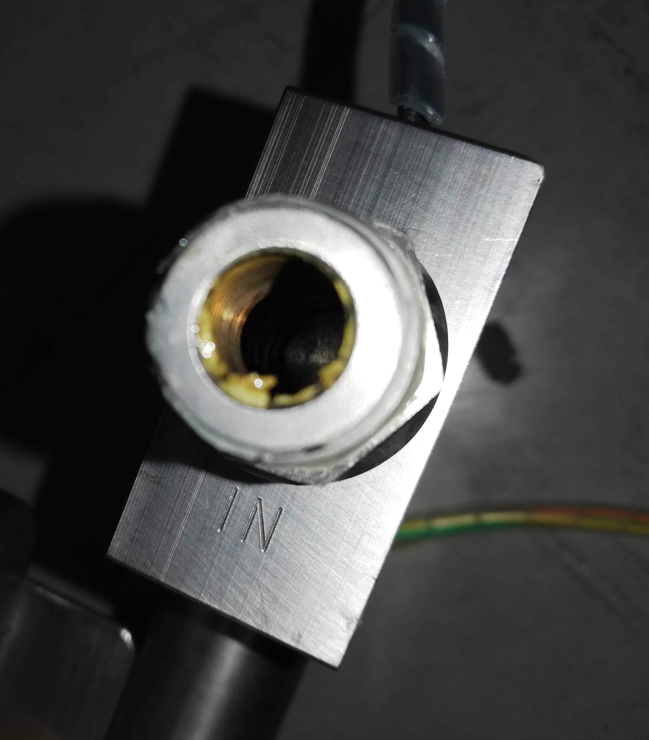

Slide 27
