Slide 1

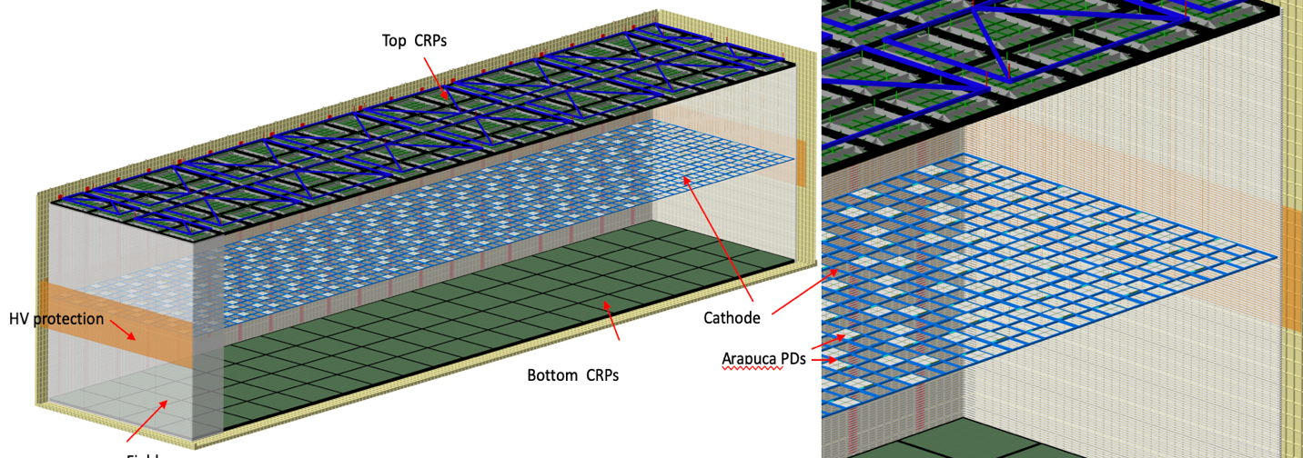
​Vertical Drift: Project Planning
Steve Kettell, BNL
Vertical Drift Meeting
18 March 2021

Slide 2
Outline
Overview of US DOE project approval process
Conceptual Design (CD-1) - more details

Slide 3
Current Planning for US approval process
Complete conceptual design (CDR) + …
CD-1rr [alternatives analysis] (DOE Review ~10/1/2021, Director’s Review ~8/1/2021)
Complete Key R&D, complete Preliminary Design (PDR), define national contributions and project baseline
CD-2 [project baseline] (~October 2022)
Complete Module-0, complete Final Design (TDR)
CD-3 [construction allowed] (~April 2023?)

Slide 4
Approval of Conceptual Design
Advance and complete conceptual design
  Continue design improvement
  Continue R&D
  Further develop production and installation plans
  Internal DUNE Technical reviews (CDReviews) this spring
  LBNC technical review 28 April
Conceptual Design Report (working with LBNC to define scope and process)
  Describe baseline and alternatives
  Agreement by DUNE collaboration
  Preliminary assessment by LBNC (need by ~9/15/2021)
    Review of CDReport – give to LBNC by ~June/July?
    LBNC review of simulations ~May 10 and review of production/installation plans
Develop remaining project documents:
  Finish SPVD WBS Dictionary
  Refine full international core cost estimate
  Complete high-level activity based P6 schedule and full DUNE-US cost.
  full Basis of Estimate for US part.
  Complete Requirements Document
  Update Risk Register
  Start interface documents?

Slide 5
More on approval of Conceptual Design
Need to continue with each consortia on WBS and P6
Need to start the Conceptual Design Reviews
  Want to start with CRP, PDS and HV/Cathode (before LBNC technical Review)
  LBNC technical review (April 28)
  Finish conceptual design reviews later in spring
  Review designs (powerpoint)
  Review requirements document
Conceptual Design Report
SPVD Risk Workshop in mid-April
Need updated Core Cost
Need basis of estimate (BoE) for full cost of at least US part

Slide 6
Project Plans
CDR (Summer 2021): edms-2509103 (current pdf)
Editors: Anne Heavy, Marvin Marshak, Sandro Palistini
Wiki: https://wiki.dunescience.org/wiki/DUNE_FD_Vertical_Drift_Proposal-Report
Overleaf: https://www.overleaf.com/project/5ff88c5ef3c28f9daffb2f74
WBS/Schedule (May 2021): edms-CERN-0000214493 , edms-2444331
Risk: Risk Register, plan SPVD Risk Workshop in mid-April (see slides #12-16)
DUNE Conceptual Design Reviews (Spring 2021):
Requirements: Proposed SPVD modifications for EB consideration (see slide #8), Proposed TB requirements, Consortia Requirements
Design: current status of DUNE FD-2 design
Prototyping: plans for prototypes

Slide 7
Backup

Slide 8
Vertical Drift Requirements
Do we want to propose these requirement modifocations to EB?
  EB-held requirements are at https://edms.cern.ch/document/2346091
  Draft DUNE VD requirements at https://edms.cern.ch/project/CERN-0000214368
ID | Subsystem | Name | Values | Comments
1 | HVS | Minimum drift field intensity | >300 V/cm (goal: 500 V/cm) | The minimum E-field requirement for the vertical drift (VD) is set at 300 V/cm (5.2 ms maximum drift time in VD) based on the experience of the ProtoDUNE-SP; the goal is set at 500 V/cm as in the horizontal drift (HD) and dual-phase(DP) far detector requirements. This gives a 4.2 ms maximum drift time in the VD. In ProtoDUNE-SP, a value of 500 V/cm was routinely maintained. In the last days of operation, the E- Field was increased to 650 V/cm and kept stable for several days.
2 | HVS | Electric field uniformity | 1% | Same as for HD. The E-field stability and uniformity at the 1% level is required to guarantee energy scale determination as the same 1% level. E-field variation can be due to uncertainty on drift distance and to the planarity of the Cathode and Anode planes: the overall uncertainty has to be kept within 6.5 cm.
3 | HVS | HV Power supply ripple | better then 10⁻⁵ | Same as for HD. The HV ripple requirement on the cathode is dV < 1mV at 10-100 kHz, comparable to that of the HD. This is achieved by appropriate RC filtering along the warm cable from the HV-Power Supply to the HV Feed-through (HVFT) as demonstrated with NP04. For the 2-view configuration, the 1st view strip length is about ¼ of the HD wire length, but there is no shielding from the grid plane wires. A more stringent requirement (by a factor of ~3) is expected for the 3-view configuration compared to the HD due to the wider strip width and longer lengths.
4 | TPC | Liquid argon purity | > 6 ms electrons lifetime (goal: a few tens ms) | Free electron lifetime (Liquid Argon purity): >6 ms (50 ppt O2 equivalent) This requirement derives from the equivalent one for the HD far detector, scaling the 3 ms HD requirement by the ratio of the drift distances (3.5 m versus 6.5 m). With this requirement, the survival probability for any electron cloud to be recorded at the anode would never be below 50% at 500 V/cm and 42% at 300 V/cm. As a reminder, the free electron lifetime in NP04 and NP02 exceeded many tens of milliseconds.
5 | TPC Electronics | Minimal S/N | S/N>10 (collection); S/N>5 (induction) (goal: AHARA) | Same as for HD. Required minimal S/N values compatible with a drift field of 300V/cm and 6ms electron lifetime (1) and (4)
6 | PDS | PD argon purity requirement | nitrogen<2ppm w/o Xe, nitrogen<10ppm w/ Xe~10ppm | Stringent oxygen and water requirements set by TPC. Up to ~10 ppm nitrogen can be fully recovered with Xenon (demonstrated in ProtoDUNE-SP)
7 | PDS | photo-sensor S/N | S/N>5 | demonstrated in ProtoDUNE-SP
8 | PDS | photo-detector Efficiency | >3% | demonstrated in ProtoDUNE-SP and tests

Slide 9
Vertical Drift near-term schedule
Milestones for 2021
    TPC 50L anode 2-view 2020
    TPC 50L anode 3-view March 2021
      Further 50L tests planned
    New HV extender tests (FNAL/CERN) May 2021
    Full CRP TPC test (anode, cathode, PD) November 2021
      Further cold box tests in 2021 possible
    300kV HV system test (in NP02) December 2021
Milestones for 2022
    TPC 50L studies 2022
    Cold box studies 2022
    Begin module-0 construction March 2022

Slide 10
Installation schedule
Proposal presented to LBNC: 2−4 December Done
Proposal presented to full DUNE Collaboration: 7 December Done
50L R&D Ongoing
2021 technology demonstrators (CRP in cold box, 300kV test in NP02)
If approved as 2nd far detector: 2022−23 Module-0 in NP02
2024−26 production; 2027 installation at SURF; 2028 cool down and filling
Preliminary
12/11/2020

Slide 11
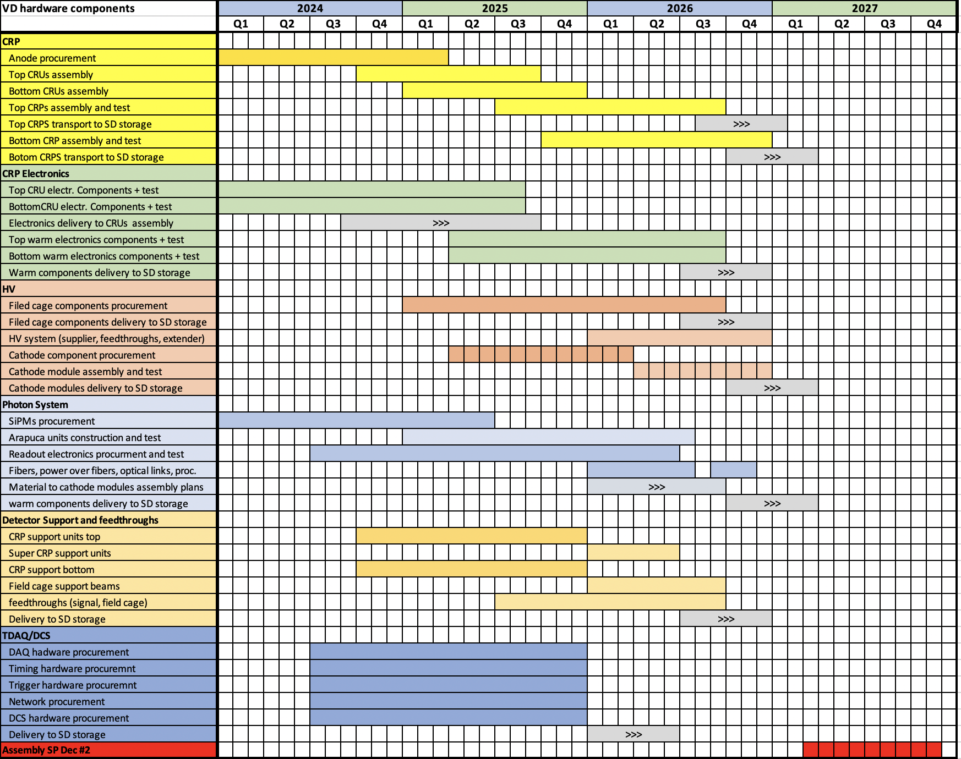
Very preliminary draft Vertical Drift production schedule

Slide 12
Risks (response to LBNC question)
CHARGE QUESTION 5
(16) What do you consider to be the highest technical and schedule risks? (Steve)
HV test with 300kV extender is critical, but we are quite confident of success as we believe that we understand the problem in ProtoDUNE-DP and have a solid solution
PoF to power SiPMs seems in hand, but the optical drivers for the readout are a technical challenge. We are developing an alternative scenario in case of problems.
The rest of the technical challenges seem manageable
Schedule for vertical drift development in 2021, in parallel with ProtoDUNE-SP2 and Covid-19 is a worry. The ProtoDUNE-SP2 might suffer more than VD demonstrators which is at a different scale in cost and integration complexity
Good management of the entire project is critical to help motivate all actors/FAs
Similar situation to the beginning of the ProtoDUNEs. We need to motivate and manage the project, taking decisions which are not always easy to implement. Nobody believed we would have a working ProtoDUNE before LS2 a few years ago. We have strong and capable collaborators, well motivated
We have just implemented a risk register : https://edms.cern.ch/document/2444332

Slide 13
HV Risks
CHARGE QUESTION 5
ID | Risk | Stage | Threat vs. Opportunity | Threat vs. Opportunity | Description | prob. | impact | planned mitigation | Comment
 | HV
1 | Power supply is not stable at 300kV | R&D #1 |  | threat | power supply has been extensively tested at 300kV with feedthrough. Possible concern about stability will full cathode/field cage load. | very low | minimal delay if resolved before module-0 test | work with both vendors | The load of the FC (cathode does not draw current) is 1/4mA, well under the capacity of the HVPS of 0.5 to 1 mA
2 | Feedthrough does not hold 300kV | R&D #1 |  | threat | New feedthrough design does not hold 300kV in HV test stand in early 2021 and needs rework. | low | delay of 6 months, $0.5M | pursue both ProtoDUNE and UCLA feedthrough designs | NP04 feedthrough demonstrated to >180kV for months and >240kV for days and in test stand operations at 300kV for several days.
3 | HV extender does not hold 300kV | R&D #1 |  | threat | Previous ProtoDUNE-DP extender failed at 250kV. Risk that new design does not hold 300kV in test stand in early 2021. | medium | delay of 3 months, $100k | Alternative design smilar to ProtoDUNE-DP but with different insulating material (possibly with resistive surfaces) will be pursued as backup solution | Successful test at FNAL or CERN required before NP02 cryostat test
4 | HV system test unsuccessfull | R&D #2 |  | threat | 2021 test not approved or financed. | medium | 1 y delay | pursue support from CERN, FNAL and DOE | This is a system test in NP02 which can not take place because of missing Collaboration common funds
5 | Full HV system does not hold 300kV | R&D #2 |  | threat | Complete HV system test in NP02 does not hold 300kV | low | 1 year delay, $1M | test components in R&D #1. Ensure module-0 FC/cathode test is as rigorous as needed for DUNE #2, but still safe | This is a system test in NP02 which shows technical problems
6 | Unable to reach 500V/cm | R&D #2 |  | threat | available HVPS and filter force cathode voltage well under 300kV | low / medium | minimal physics loss at 400-450V/cm | reevaluate the 500V/cm drift field goal, 450V/cm is safe. Work with vendors on 350kV supply | DUNE requirement is 250V/cm (more light)
7 | Field cage | module-0 |  | threat | Complete HV system test in NP02 does not hold 300kV | low | If module-0 test fails, identify where in the FC that it occurs | NP04-II will test new FC design | design module-0 test to be at least as rigorous as DUNE #2.
8 | cathode planarity | R&D #1 |  | threat | Contraction and creep effects of suspension from superstructure and mounting procedure affecting cathode planarity | medium | redisgn during R&D phase has minimal impact | Dedicated (2-ton) small scale mockup representative of superstructure geometry and material properties implementable in 2-ton cryostat | test several materials
9 |  | module-0 |  | threat | too much mechanical deformation, need a new approach | low | 1 y delay | modify design, rebuild, refill

Slide 14
CRP Risks
CHARGE QUESTION 5
 | Charge Readout Plane
10 | CRU production | R&D #1 | threat | limited number of vendors leads to increased production cost and delay | low | 4-5 months | arrange for early production runs to firm up cost estimate
11 | Readout electronics | R&D #2 | threat | cold box 2021 test takes longer to demonstrate S/N>15 result | low | 1-2 months delay | improve possible grounding issues in the new cold-box test setup | additional noise sources associated with anode? with cabling?
12 | Anode interconnects | R&D #1 | threat | anode pcb strip interconnect has high failure rate from handling and thermal cycle | low | 2-3 months | conduct extensive stress test on the interconnects. Implement alternative solutions
13 | Perforated anode | R&D #1 | threat | 2 or 3 view solution are simple, but may have delays associated with drilling holes | low | 0.5M$ | explore multiple production sources to avoid single point failure.
14 | 3 view anode production | R&D #1 | Technical threat | cannot find a commercial vendor for a 4-layer large PCB production | high | low | extensive search of production sources | A 4-layer PCB anode for the 3rd view simplifies construction/interconnect. May be cheaper to build double sided w/ multiple adapter boards. VE choice.
15 |  | R&D #1 | financial opportunity | switch to alternative design with lower overall cost | low | low |  | It may be cheaper to build as double sided with multiple adapter boards. This might be a VE choice.
16 | electronics boiling LAr | R&D #1 | threat | lower electronics may boil LAr | negligible |  | tests for HD demonstrate significant margin against boiling at 13m depth
17 | cable length | R&D #1 | threat | longer cables reduce S/N of top CRPs? | low | low | Tests in the 50L setup, in early 2021
18 | Boundary effects between CRPs | R&D #1 | threat | Boundary effects between anodes of different CRPs not addressedable by cold-box test | low | low | Perform measurements in a dedicated test setup in the 50l cryostat. create vertical misalignment of 3mm to verify performance? | Mechanical deformation tests. CRPs are at least 5mm apart
19 | grounding & shielding | DUNE | threat | system wide noise sources are difficult to mitigate | low | months | Mitigated by cold box and NP02 tests | The cold box provides critical system test to prepare for full scale NP02 test with confidence.
20 | Front-end ASIC | RD #1-2 | threat | FE ASIC input is sensitive to ESD damage | low / medium | low | Apply strict ESD protection procedure for handling FEMB. Use CE box as planned for DUNE SP LArTPC. Explore ESD enhancement in the FE ASIC design.
21 | Cold cable support | RD #1-2 | threat | Cold cable mounting and support around FEMB. For 3-view configuration, half crossing tubes (20) for the bottom drift will have to handle cold cables support for 3 CE flanges. | low | low | Use CE box as planned for DUNE SP LArTPC for cold cable strain relief of FEMB. Examine and update the design of crossing tube cable support to allow cables to 3 CE flanges, plus PD cables.
22 | Microphonics | RD #1-2 | threat | widespread microphonic noise in anode readout | low | low | Tests in the 50L setup, in early 2021 | mostly related to the 3-view scenario

Slide 15
Photon Risks
CHARGE QUESTION 5
We plan to add mitigation related to #25 photon readout at 300kV, which will include altered designs to allow photon to operate at ground potential
ID | Risk | Stage | Threat vs. Opportunity | Description | prob. | impact | planned mitigation | Comment
 | Photon
23 | Arapuca power | R&D #1-2 | threat | Problems related to excessive power lost in LAr | low | 3m delay | Plan for additionanl units.
24 | Arapuca power | R&D #1-2 | threat | Lifeteime of PoF receivers not suitable for 20-year lifetime | low | low | May need to consider replacement or redundancy options to guarantee 20 years. | Lifetime issue - already tested (succesfully) in LAr
25 | Arapuca readout | R&D #1 | threat | Problems found related to fiber technology for the readout. 2021 R&D not successful | medium / high | 6m/1yr delay | Work out during 2021 an alternative scenario
26 | Arapuca optimization | R&D #1 | threat | More R&D necessary for Xe light read-out | low | 6m delay. Possible cost increase.
27 | Cold electronics | R&D #1-2 | opportunity | Wireless data transmission may reduce electronics/fiber installation | low | Reduce electronic cost and complexity | invest R&D effort
28 | Cold electronics | R&D #1-2 | threat | cannot find suitable commercial digital electronics with projected 20-year lifetime in LAr | high | high | reevaluate the need for digital cold electronics (see "optical output" below) | ASIC development would take too long
29 | Optical output | R&D #1-2 | threat | cannot maintain stable optical transmission of SiPM output through optical transceiver/fiber in the cold | medium | high | implement analog transmission method insensitive to transmission loss.
30 | PoF calibration | RD#1-2 | opportunity | PoF may provide a path for simplified calibration | low | improve physics performance | PoF may provide an opportuinity to place calibration around HV regions.
31 | PoF fieldcage | RD#1-2 | threat | power distribution requires modified Arapuca design | low | low | Will pursue multiple ARAPUCA layouts
32 | PoF module generates bubbles | R&D #1-2 | threat | PoF modules have too high power-density, create argon bubbles near field cage | low | 6m/1yr delay | custom designed PoF module to reduce power density | most likely at the top of FC where pressure and field is low.

Slide 16
Infrastructure Risks
CHARGE QUESTION 5
ID | Risk | Stage | Threat vs. Opportunity | Description | prob. | impact | planned mitigation | Comment
 | Infrastructure
33 | Cryostat funding |  | opportunity | Vertical Drift offers promising path towards funding second cryostat (planning ongoing) | medium | Save US project $100M
34 | Integration & Installation |  | opportunity | Simpler support system and installation | medium | Save US project $20M
35 | Slow purging of cryostat |  | threat | new purging pipe locations cause ineffective piston purging | low / medium | 1 month | extend the purging period to reach expected gAr purity
36 | Survey |  | threat | survey of cold detector locations is inadequate | low | low | design continues, level meters may locate top CRP vertically well, …
37 | LAr purity |  | threat | active volume is more sealed than HD and may reduce purification | low | low | perforated anode is 50% open, FC is 20% open. E. Voiren is working on CFD
38 | Cryostat design |  | threat | Need too many ports and cryostat cost goes up | low | $1M

Slide 17
Summary
Good progress in developing new cost-effective detector: Vertical Drift
    Proposal (reference layout) at: https://edms.cern.ch/document/2429382
    Requirements at https://edms.cern.ch/document/2454611
    Schedule at https://edms.cern.ch/document/2444331
    Risk register at https://edms.cern.ch/document/2444332
Organizing detailed 2021 R&D plan aiming to construct module-0 in 2022−23 after US-DOE baselining
Vertical Drift looks to be performant, less expensive and is attracting new international funding
Layout similar to ProtoDUNE-DP. Most components make use of work and technology from DUNE consortia tested in ProtoDUNE.
    New elements are perforated PCB anodes and photon detectors operating at HV
    Production and installation schedule look favorable

