Slide 1
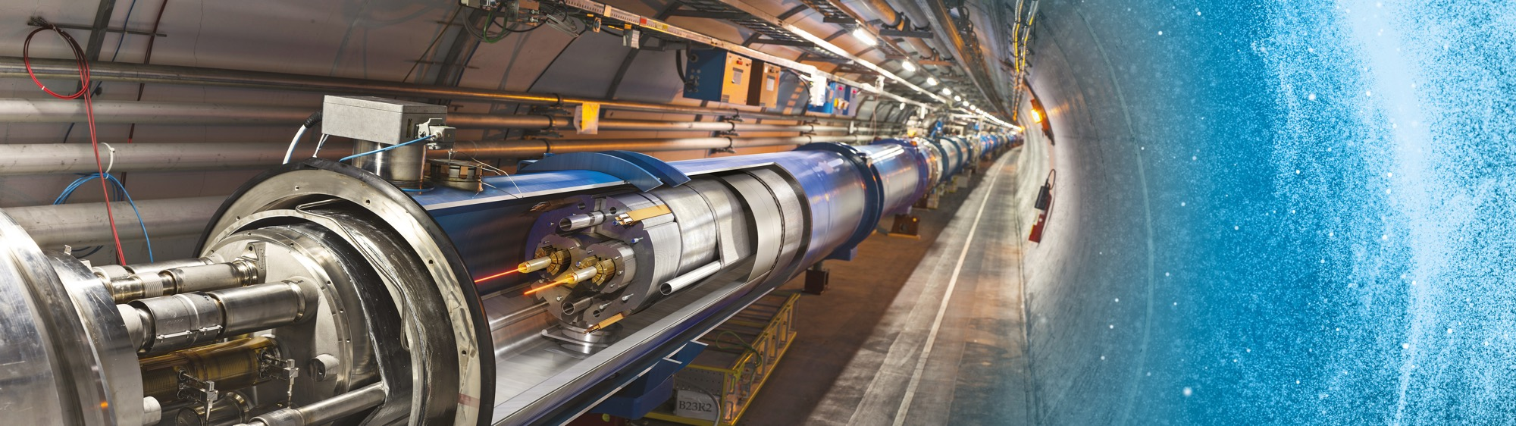
Doing Business with CERN
Nederland@CERN
2021
Floris Bonthond

Slide 2
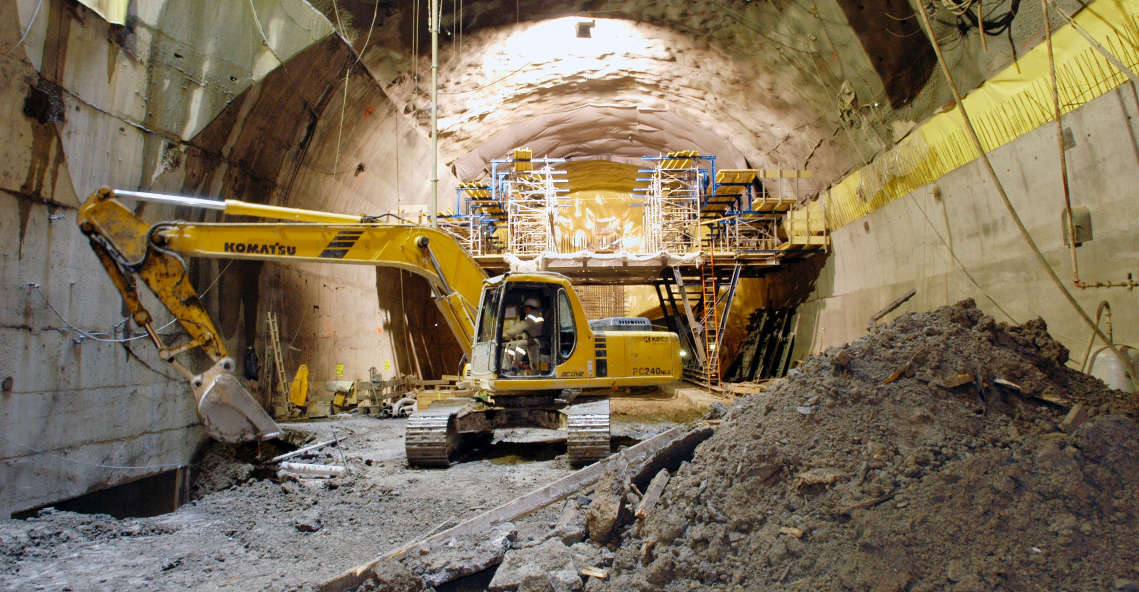
What do we buy?
Civil engineering:
  Construction
  Renovation of buildings
  Metallic structures
  Earthworks
  Roads
Cooling and ventilation
equipment

Slide 3
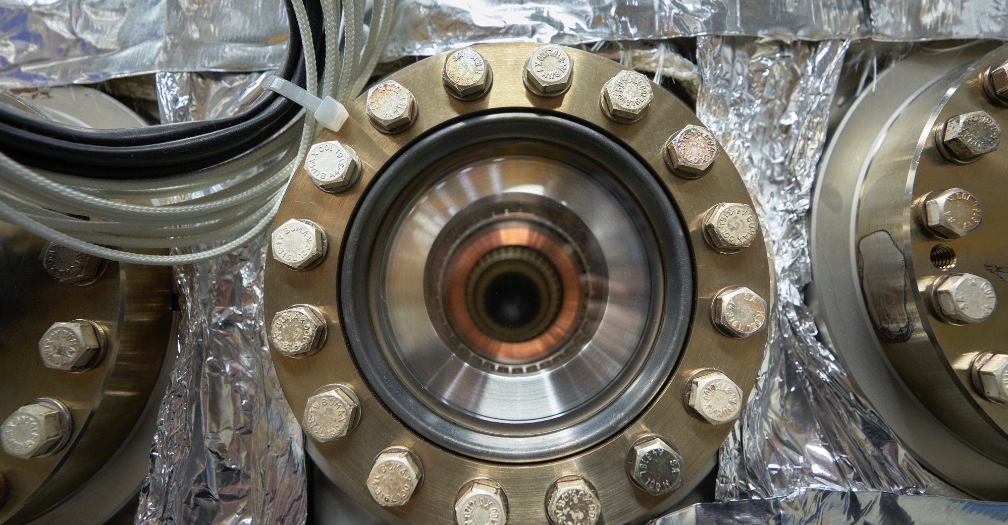
What do we buy?
Electrical engineering and magnets
  Transformers
  Switchboards and switchgears
  Cables
  Automation
  Power supplies
  Magnets

Slide 4
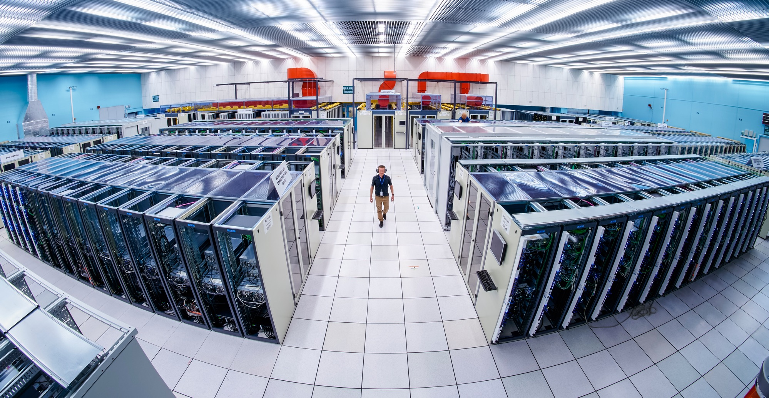
What do we buy:
Information Technology
  Computing systems
  Servers
  Software
  Network equipment
  Personal computer equipment

Slide 5
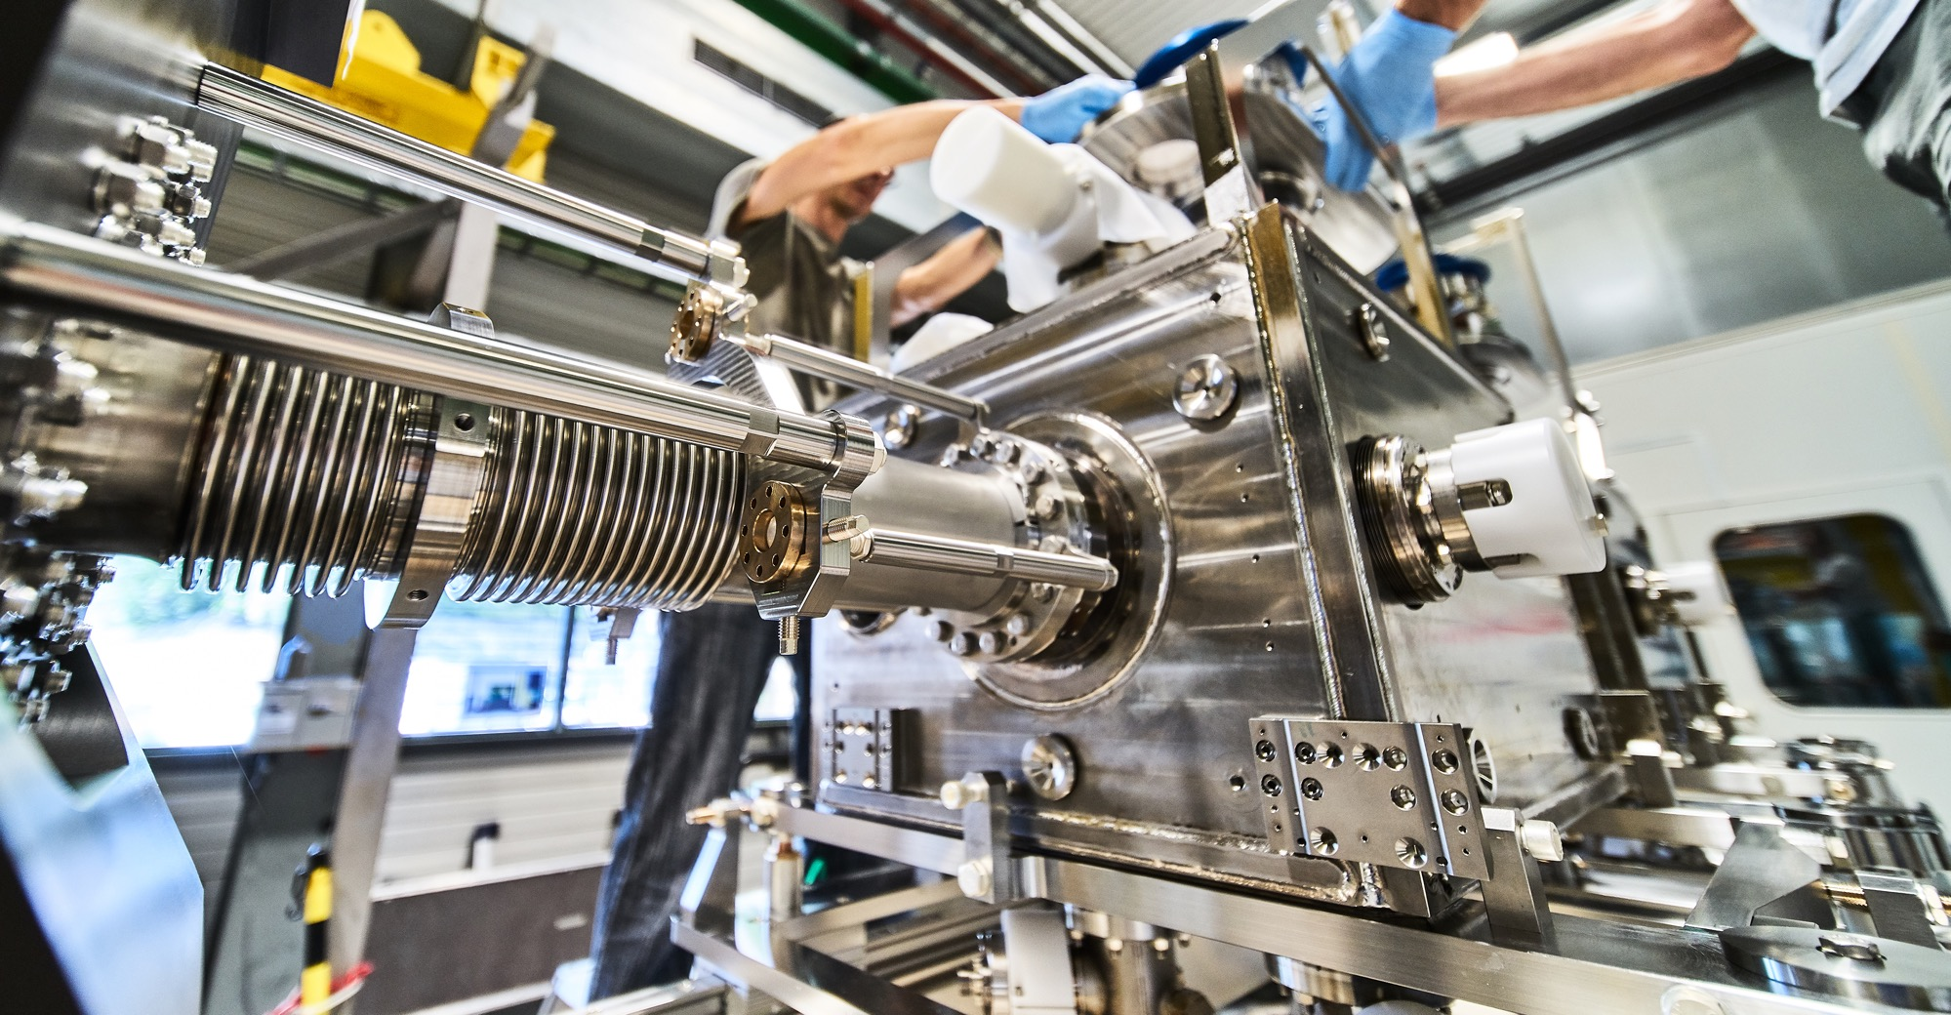
What do we buy?
Mechanical engineering and raw materials:
  Machining
  Sheet metal work and arc welding
  Special fabrication techniques
  Raw materials, finished and semi-finished products (plates, pipes, etc.)
  Offsite engineering and testing

Slide 6
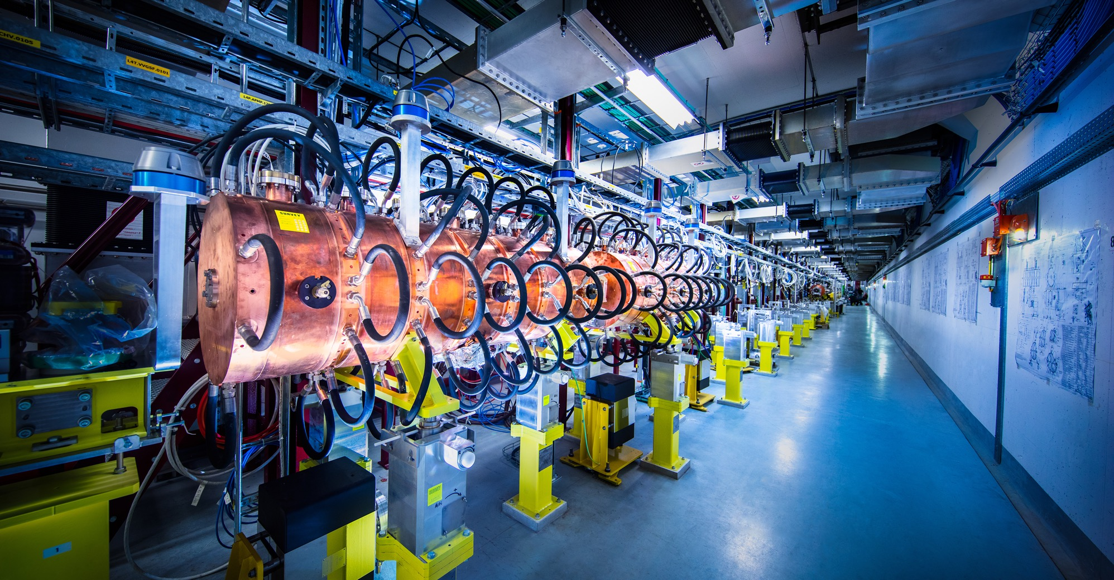
What do we buy?
Electronics and radiofrequency:
  Electronic components (active, passive)
  PCBs and assembled boards
  LV and HV power supplies
  Radiofrequency plants
  Amplifiers

Slide 7
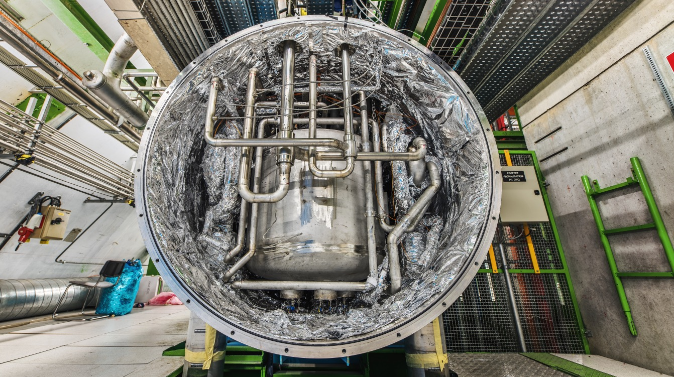
What do we buy?
As well as:
  Cryogenic and vacuum equipment
  Optics and photonics
  Particle and photon detectors
  Health and safety equipment
  Transport and handling equipment
  Office supplies, furniture
  Industrial services on the CERN site

Slide 8
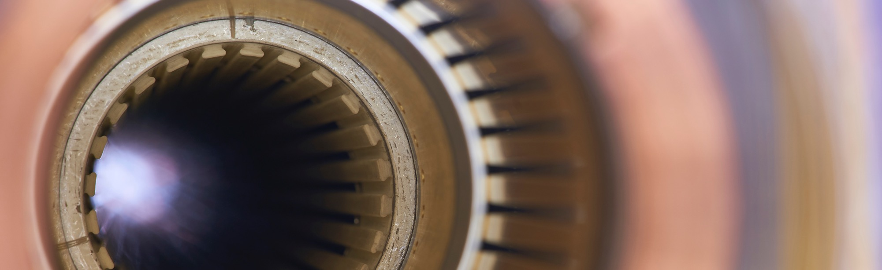
Current project - upgrade of the LHC to High Luminosity
Hi-Lumi will provide greater precision and discovery potential
Hi-Lumi will start operating in 2026 and run until 2035
CERN is already looking beyond 2035, with several projects in R&D or study stages

Slide 9
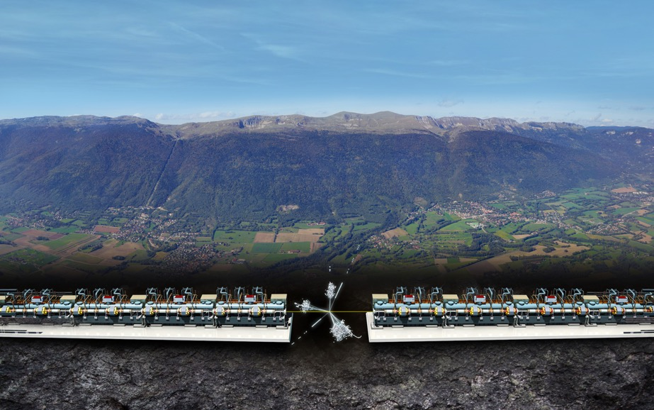


Possible projects for the future of particle physics
Future Circular Collider (FCC)
New technology magnets 100 TeV pp collisions in 100km ring
e⁺e⁻ collider (FCC-ee) as 1st step?
FCC
Compact Linear Collider (CLIC)
Linear e⁺e⁻ collider √s up to 3 TeV
LHC

Slide 10
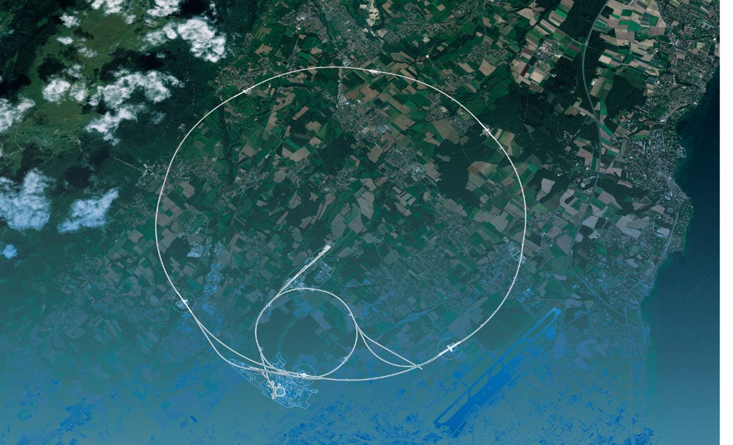
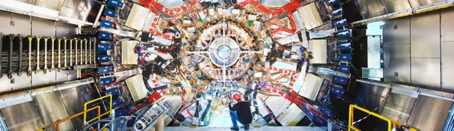
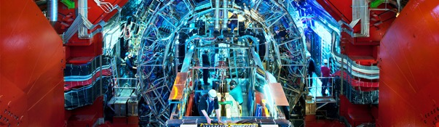
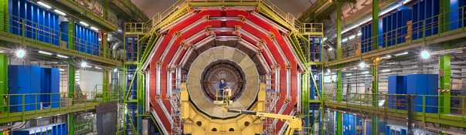
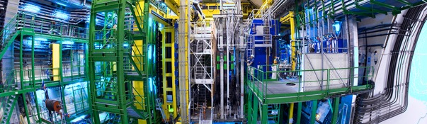
We also buy for the LHC experiments
CMS
ALICE
ATLAS
LHCb

Slide 11

What do we buy?
  Off-the shelf or non-standard products which can be produced with existing manufacturing techniques or technologies:
  Functional specification
  Non-standard products where industry has neither the required know-how nor the interest to develop and design the products:
  Build-to-Print specification
Prototypes and / or Pre-series might be required

Slide 12
Yearly Budget (2021 contributions)

Slide 13
Procurement Expenditure

Slide 14
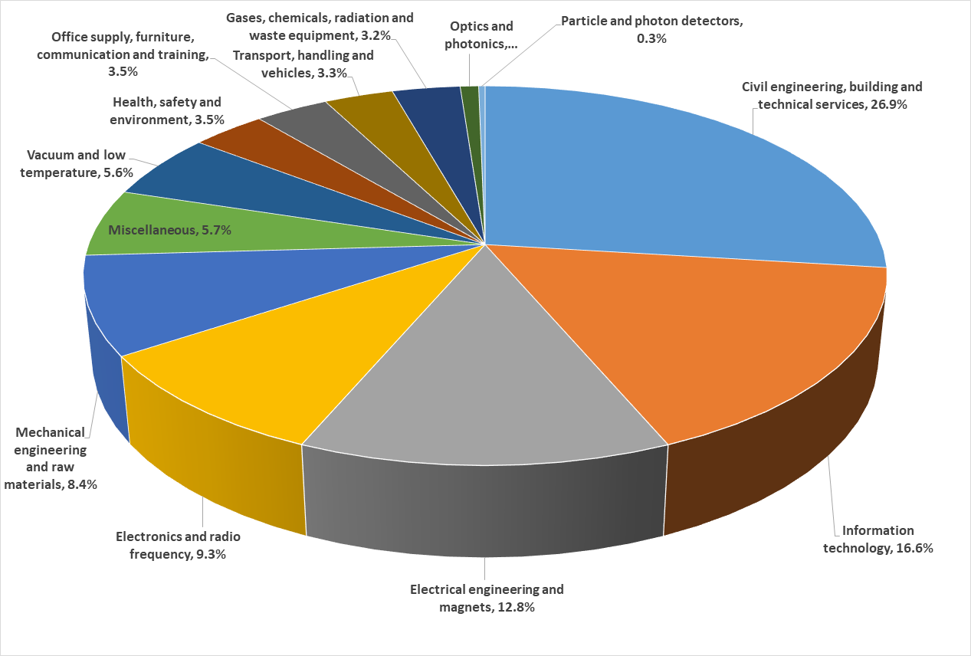
Supplies (235 MCHF spent in 2020 – CERN budget only)

Slide 15

CERN is entitled to establish its own internal rules necessary for its proper functioning, including:
Procurement Rules
Safety Rules
Staff Regulation of its own personnel

Slide 16


PROCUREMENT @CERN
the rules

Slide 17
The Procurement Service
Mission:
The Procurement Service (PS) procures all supplies and services for CERN
Meeting the specified and contractual technical, performance and delivery
requirements
At the lowest possible overall cost
While achieving a balanced industrial return for CERN Member States
Respecting CERN
Procurement Rules

Slide 18
Principles of the Procurement Rules (1/4)
1
Transparency and Impartiality
2
Tenders open to Member State firms only
3
Objectivity and equal treatment: tendering packages are objective and impartial

Slide 19
Principles of the Procurement Rules (2/4)
Selective tendering procedures: CERN’s tendering procedures are not open to all interested firms
Confidentiality: Opening and evaluation of bids as well as negotiations are not public

Slide 20
Principles of the Procurement Rules (3/4)
Award for supplies (and services, exceptionally) based on:
Lowest compliant bid
Technical
Financial
2
Delivery

Slide 21
Principles of the Procurement Rules (4/4)
Award for industrial services based on:
Best Value For Money
2
No alignment rule

Slide 22

Enquiries between 10’000 and 200’000 CHF
“Price enquiry” (Demande d’Offre - DO)
Submission deadline: 4 weeks from date of dispatch;
All price enquiries above 50’000 CHF are also sent to the
Industrial Liaison Officers (ILOs) for information;
Price enquiries consist of:
  Technical specification and annexes;
  Tender form (and a technical annex - optional);
  CERN’s General Conditions (contracts, invitations to tender, safety, etc.).

Slide 23

Enquiries exceeding 200’000 CHF (1/2)
“Market Survey” (MS)
Prior announcement in CERN’s procurement website, see
“Business Opportunities”
  At this stage, interested firms are encouraged to contact CERN in
  order to have a clear understanding of the requirement, allowing
  them to begin their organization ahead of the tendering process.
Market surveys consist of:
  Technical Description and;
  Qualification Questionnaire (financial and technical).
Submission deadline: 4 weeks, or more if the MS is still online.

Slide 24

Enquiries exceeding 200’000 CHF (2/2)
“Invitation to tender” (IT)
Sent to qualified and selected firms only;
Submission deadline: 4 weeks from date of dispatch (with a longer period for more complex requirements);
Firms may ask all necessary technical, legal, commercial questions in writing to understand all requirements and prepare a bid that best matches CERN’s needs;
All invitations to tender are sent to the ILOs for information;
Bids shall be submitted via CERN’s e-tendering interface.
Notes:
Invitations to tender consist of:
Technical specification and annexes;
Tender form (and a technical annex - optional);
General Conditions of CERN (contracts, invitations to tender, Safety, etc.)

Slide 25
Country of origin
SUPPLIES
“Country(ies) where the supplies (including their components and sub-assemblies) are manufactured or undergo the last major transformation by the contractor or its sub-contractor”
If at least 60% of the total amount of the bid comes from (a) poorly balanced MS, then the whole bid will be treated as that from a bidder from a poorly balanced MS.
SERVICES
“Country(ies) in which the bidder is established.”
If at least 40% of the total amount of the bid comes from (a) poorly balanced MS, then the whole bid will be treated as that from a bidder from a poorly balanced MS.

Slide 26
Alignment rule
Applicable for:
1
Contracts awarded on the lowest
compliant basis (mainly supply contracts)
2
With a total amount exceeding
100’000 CHF
Under certain conditions, as defined in CERN’s Procurement Rules, a bidder offering goods originating* in poorly balanced Member States is allowed to align its price to that of the
lowest bidder and thereby be awarded the contract.
RULE
* At least 60% for supply contracts or; at least 40% for service contracts awarded on the lowest compliant basis.

Slide 27

Industrial return coefficient
Industrial return
coefficient
Over a 4-year period:
Very poorly balanced : < 0.40
Poorly balanced (PB) : 0.40 ≥ x < 1
Well balanced (WB): ≥ 1
For Supply contracts and for a
12-month period starting on
1st March, defined as:
“The ratio between a Member State's percentage share of the value of all Supply contracts and that Member State's percentage contribution to the CERN Budget over the same period”.
Status definition
% expenditure in the MS
Return Coef.=
% contribution to CERN budget for this MS

Slide 28
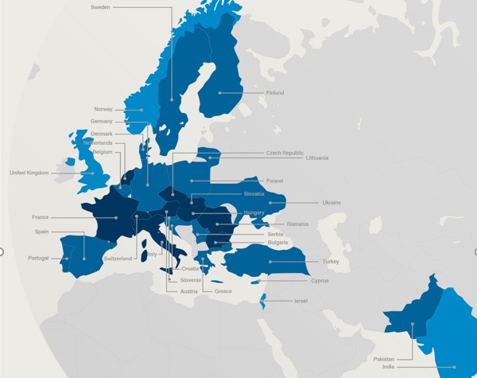

Poorly balanced Member States (Supplies)
(1st March 2021 – 28 February 2022, based on the previous 4 calendar years):
Well Balanced | Poorly Balanced | Very Poorly Balanced
Austria Bulgaria Czech Republic France Hungary Italy Netherlands Romania Slovakia Switzerland | Belgium Croatia* Cyprus* Denmark Finland Germany Greece Lithuania* Pakistan* Poland Portugal Serbia* Slovenia* Spain Sweden Turkey* Ukraine* | Estonia* India* Israel Norway United Kingdom
*Associate Member States

Slide 29
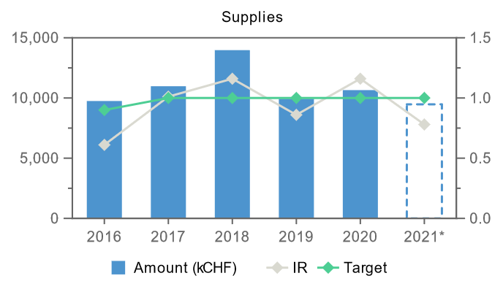
Industrial Return for The Netherlands (supplies)
* provisoire

Slide 30
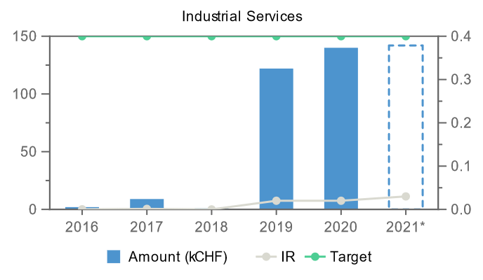
Industrial Return for The Netherlands (services)
* provisoire

Slide 31
Some Dutch suppliers
2020-2021

Slide 32

Impact of
Doing business with CERN

Slide 33
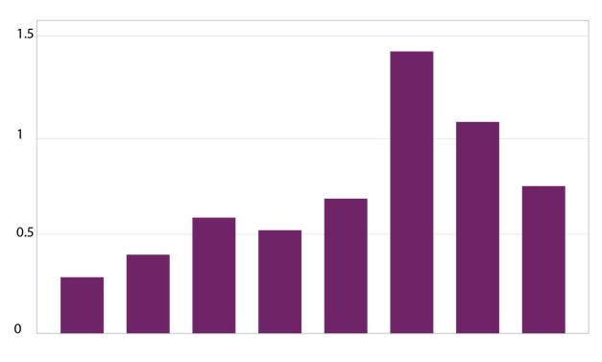
The economical impact of CERN Procurement on supplier’s performance (Castelnovo et al, 2018)
Empirical studies (by the analysis of financial data from 1995 to 2008 from 365 CERN suppliers for the LHC) show that after working with CERN on high-tech contracts, CERN suppliers
out-perform their peers by:
Investing more in R&D and filing more patents
Higher productivity, revenue and profitability
Order/contract received from CERN
Increase in R&D
Innovation
Productivity growth
increase revenues & profitability
Patents per firm
More than
2 years before
2-1 years before
Date of order
1,2 years later
3,4 years later
5,6 years later
7,8 years later
More than
8 years later
Notes:
Average number of patents filed before and after the beginning of the procurement relationship with CERN
The X-axis shows the «relative years», that are the difference between a given year and the year the first order is received. Therefore, CERN(0) is, for each company, the year of beginning of the procurement relationship.

Slide 34
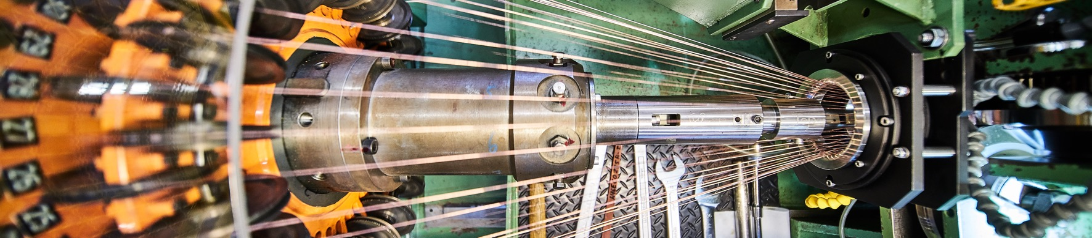
Doing business with CERN: the facts
Supplier survey (669 suppliers in 33 countries, 2017):
48%
improved products and services
42%
developed new products
55%
improved technical knowledge
in their field
18%
found or opened a new market to address
62%
used CERN as a marketing reference
Most firms experienced
no financial loss
Notes:
The key message here is that CERN is an open institution: open to its neighbours, and open to citizens from across the globe. We welcome them to CERN and go out to meet them
This slides summarises the outreach activities carried out by CERN.
It also includes a mention of CERN’s fundraising activities, for projects that are not part of CERN’s core activity. These fall into three categories: education & outreach, culture and creativity, innovation and knowledge exchange

Slide 35
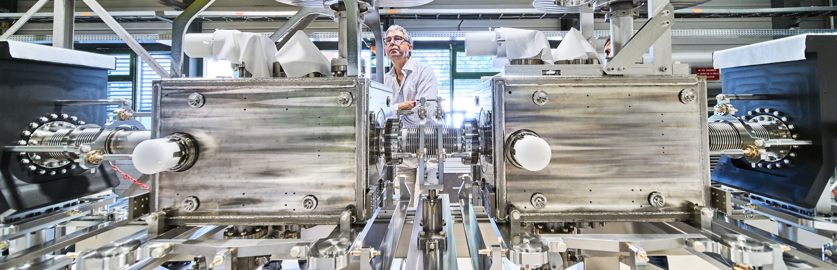
Doing business with CERN: the facts
Using CERN as a marketing reference improves
the reputation as suppliers

Slide 36

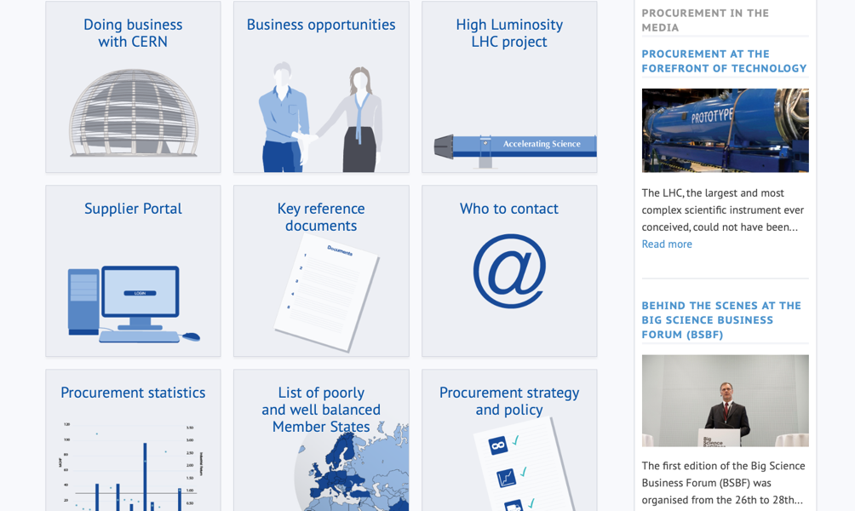
Procurement
website

Slide 37
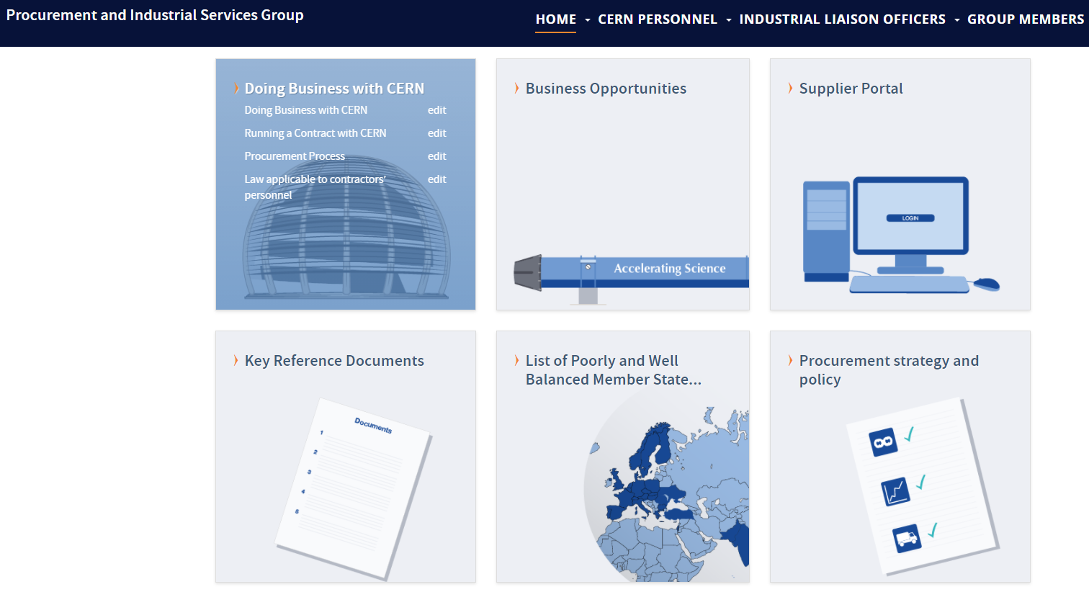
Website of the Procurement Service
http://procurement.web.cern.ch

Slide 38
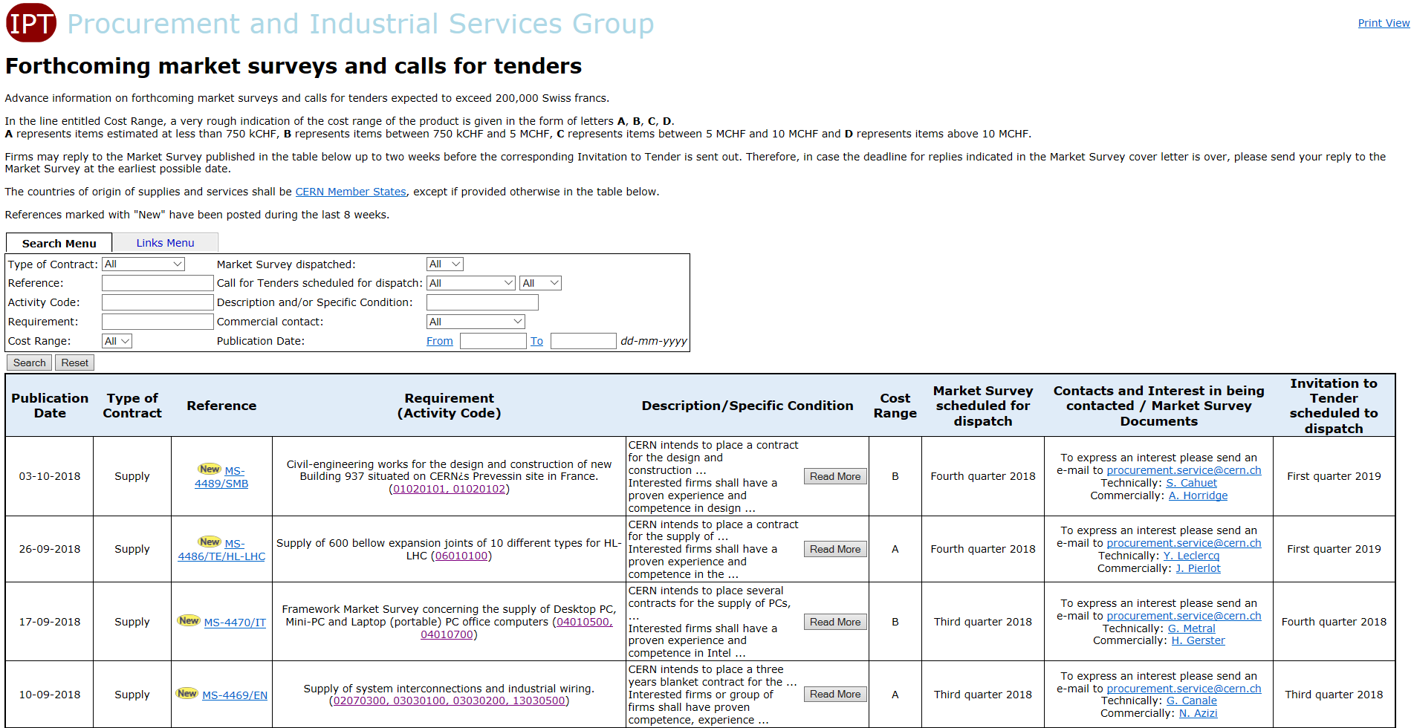
CERN Shopping List
https://found.cern.ch/java-ext/found/CFTSearch.do

Slide 39
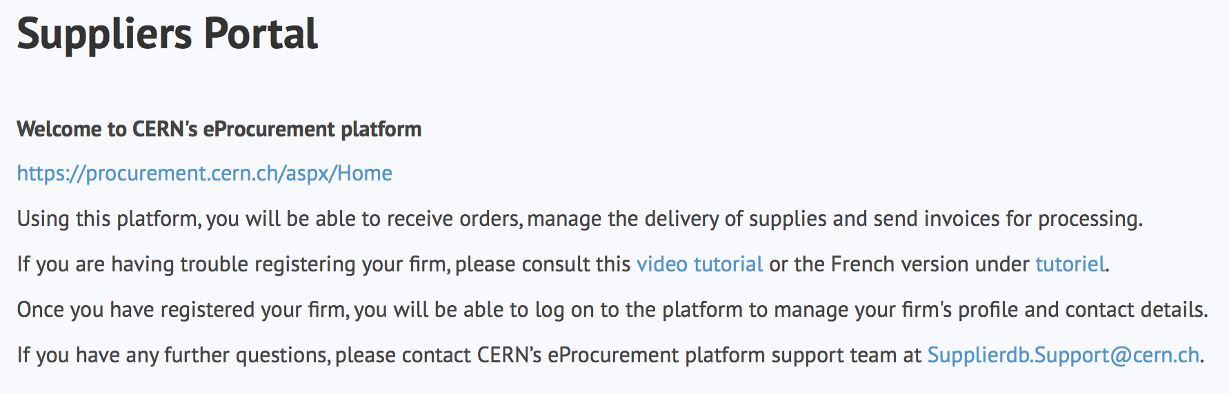
Register in the Suppliers Portal
for all exchanges with CERN, in particular to:
Be visible for future opportunities
(with the procurement codes you have indicated);
Receive and follow-up orders;
Send invoices.
MANDATORY

Slide 40
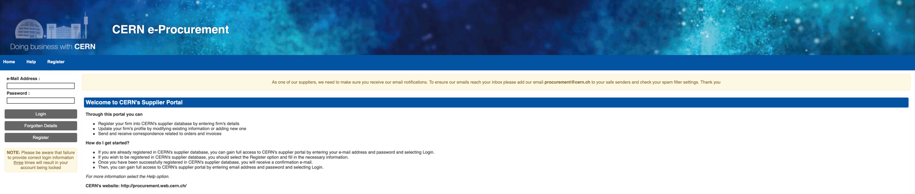
CERN e-Procurement
To ensure our emails reach your inbox please add our email procurement@cern.ch to your safe senders and check your spam filter settings.

Slide 41

Contacts at CERN (Procurement and Technical)

Slide 42
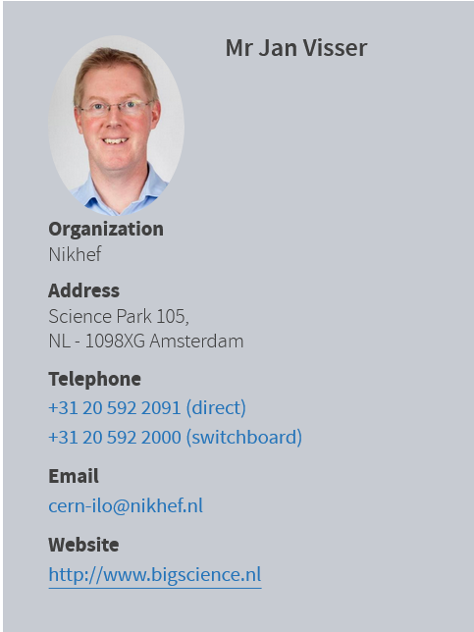
Who to contact in your country
ILO: Industrial Liaison Officer
    Industrial Liaison Officers (ILO's) are appointed by CERN's Member States to facilitate the flow of communication between CERN and its suppliers. ILO's can provide advice on the opportunities available for doing business with CERN and the support available to firms in their local regions.

Slide 43
Bedankt voor uw aandacht

