Slide 1


CERN Knowledge Transfer
Han Dols
Section Leader Business Development
Knowledge Transfer Group
CERN

Slide 2

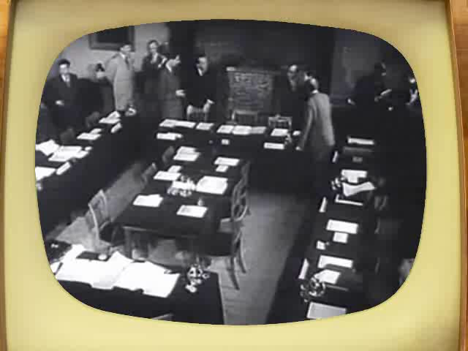
Council meeting in Amsterdam when the CERN convention was signed (1953).
Notes:
Ask the audience what they think «CERN» acronym stands for before showing the answer.
After WW II, fundamental research in Europe was not leading anymore.
Many scientists were flying away to the United States.
In order to stop this movement, eminent scientists gathered in meetings to setup a structure to continue fundamental research in physics in Europe.
They were gathered as a «Council» which means there were just holding meetings and they did not (yet) had a lab or led experiments.
The images are from Amsterdam meeting in 1953 when the CERN convention was signed.

Slide 3
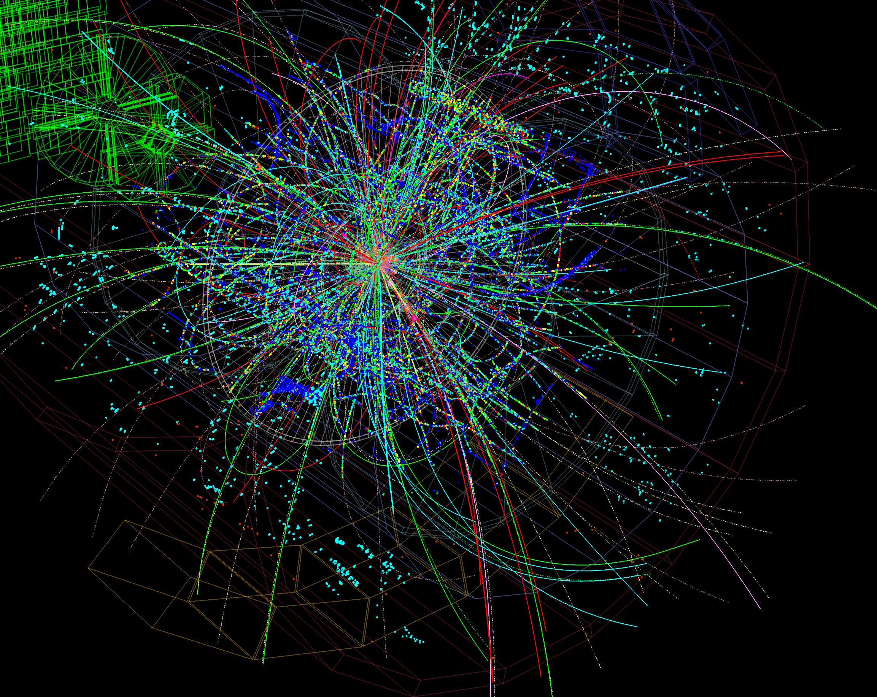

Slide 4
Machine Learning and Deep Learning
Industrial Controls and Automation
Metrology
High and Ultra High Vacuum Systems
Data Analytics
Health, Safety and Environment Management
Cryogenics
Optoelectronics and Microelectronics
High Volume Data Management & Storage
Superconducting Magnets
Particle Acceleration and Control
Radiation Protection and Monitoring
Particle Tracking and Calorimetry
Sensors
Material Science
Cooling and Ventilation
Robotics
Collaboration Tools
Radio Frequency Technology
Manufacturing and Mechanical Processes

Slide 5
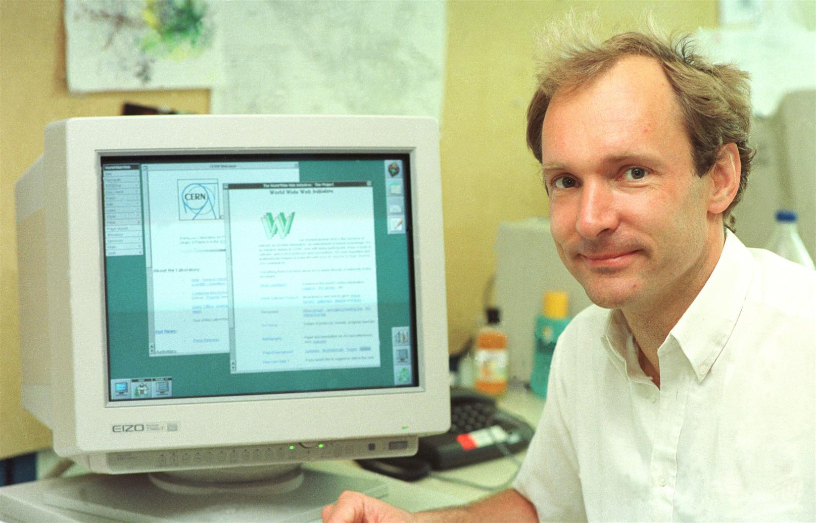
The World Wide Web born at CERN, later used by everyone…
Notes:
The most known example of technological impact on society is the WWW. How many here knew that the WWW was invented at CERN?
Open source culture…
Stories of Innovation:
Where the World Wide Web was born
Probably the technology that has most changed society in the last 100 years.
Tim Berners Lee.
Proposal "Vague but interesting"
Difficult to predict what impact things will have.
KT strength: Vision to recognise, liberty to just try. Advantage of a research institute over industry.
Keywords:
www = at the heart of the Third Industrial Revolution ( = digital revolution) [The industrial revolutions are: 1) Steam, 2) Electricity/Mass production 3) Digital 4) Internet of Things]
www at the heart of the Information Age.
Open.
Revolution.
Disruption of entire sectors of economy, media, society & even how science is done.
Exponential change.

Slide 6
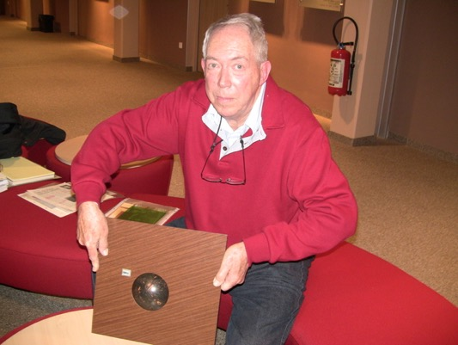
Trackball with optical encoders, used later in the mouse of a PC…

Slide 7
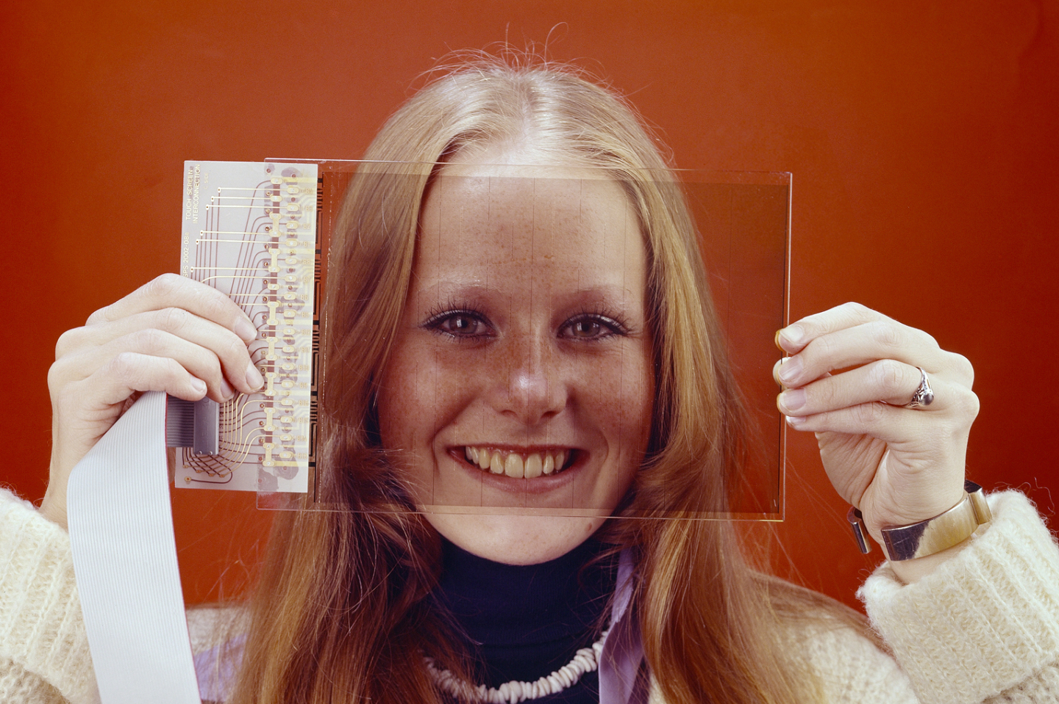
The first touchscreen to exist was at CERN, later used everywhere…
Notes:
Touchscreen’s and Track balls.
Soundbite: “The first touchscreen to exist was at CERN”
Try and keep a positive spin, e.g. Just so many exciting things happening at CERN with potential for incredible impact on society.
Goal of KT "recognize potential in technology & people"
Fragments of the Bulletin’s article on touchscreens
(full text at: http://cdsweb.cern.ch/record/1248908)
CERN has often been the incubator for the development of innovative technologies but very few people know about the capacitive touch screens invented for the consoles of the SPS Control Room in 1973. The Bulletin interviewed their inventor, Bent Stumpe, who also developed the CERN tracker ball and the computer-programmable knob.
Back in the 1970s, the SPS was being built and its control room required the installation of thousands of buttons, knobs, switches and oscilloscopes to operate the machine. Frank Beck, newly recruited from the DD Division to be in charge of the central control hub in the SPS control room, asked Bent Stumpe for solutions to the following problem: how to build the hardware for an ‘intelligent’ system which, in just three console units, would replace all those conventional buttons, switches, etc.
In just a few days, the Danish engineer, also from the DD Division, came up with a (hand-written) proposal to build a touch screen with a fixed number of programmable buttons, a tracker ball to be used as computer-controlled pointing device and a programmable knob. Following this proposal, Bent Stumpe was recruited by the SPS Controls Group to develop the hardware.
(…)
The SPS control consoles also included a tracker ball, (…) “The tracker ball we developed in 1973 worked on the same principle as the mice that industry developed later in the 1980s”.

Slide 8
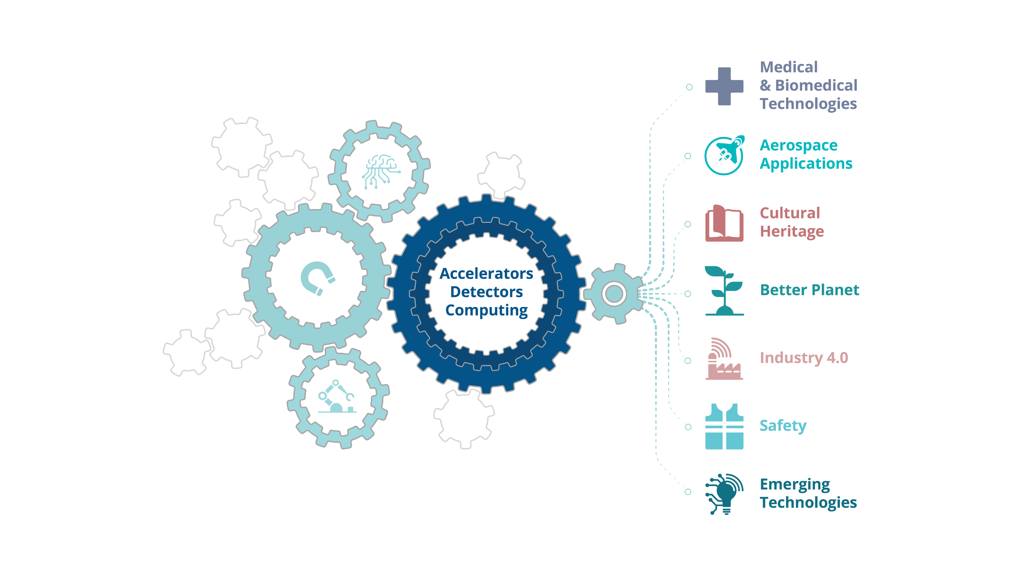
Notes:
…it looks something like this. Our expertise ranges from cryogenics to ultra-high vacuums, from super conductivity to particle tracking, radiation protection, testing facilities. The list goes on and on. These are things that are obvious necessities in a research facility like CERN. But how do they affect society and everyday life?

Slide 10
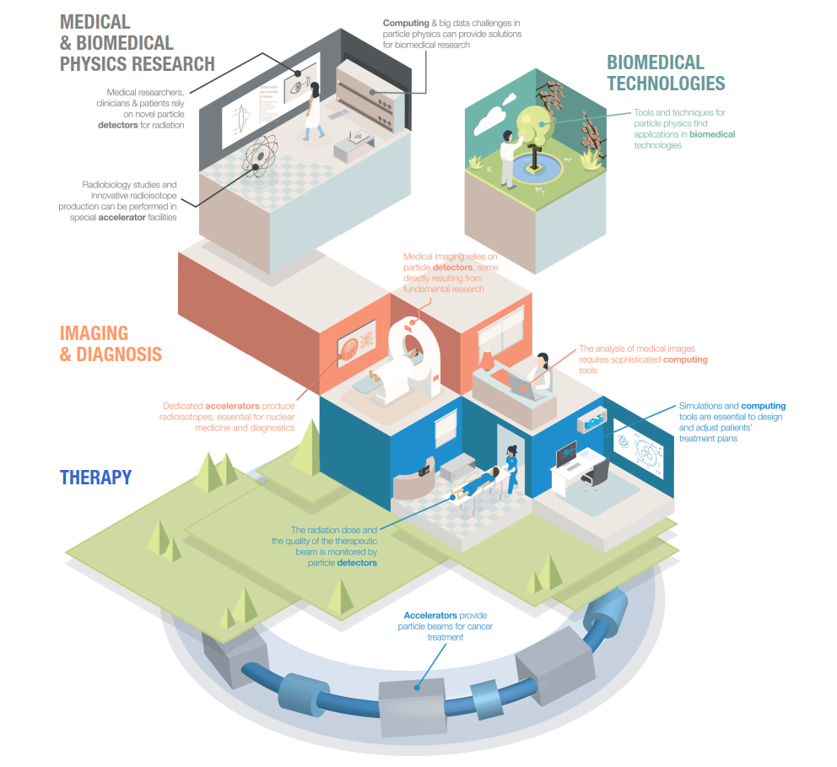
Medical & Biomedical Technologies
Notes:
There’s always been a tight link between high-energy physics and the medical and biomedical field. That’s because they’re both dependent on accelerators, detectors and computing. For instance, accelerators provide particle beams for cancer treatment. Particle detectors monitors the radiation dose and the quality of the therapeutic beam. And analysing medical images requires sophisticated computing tools.

Slide 11
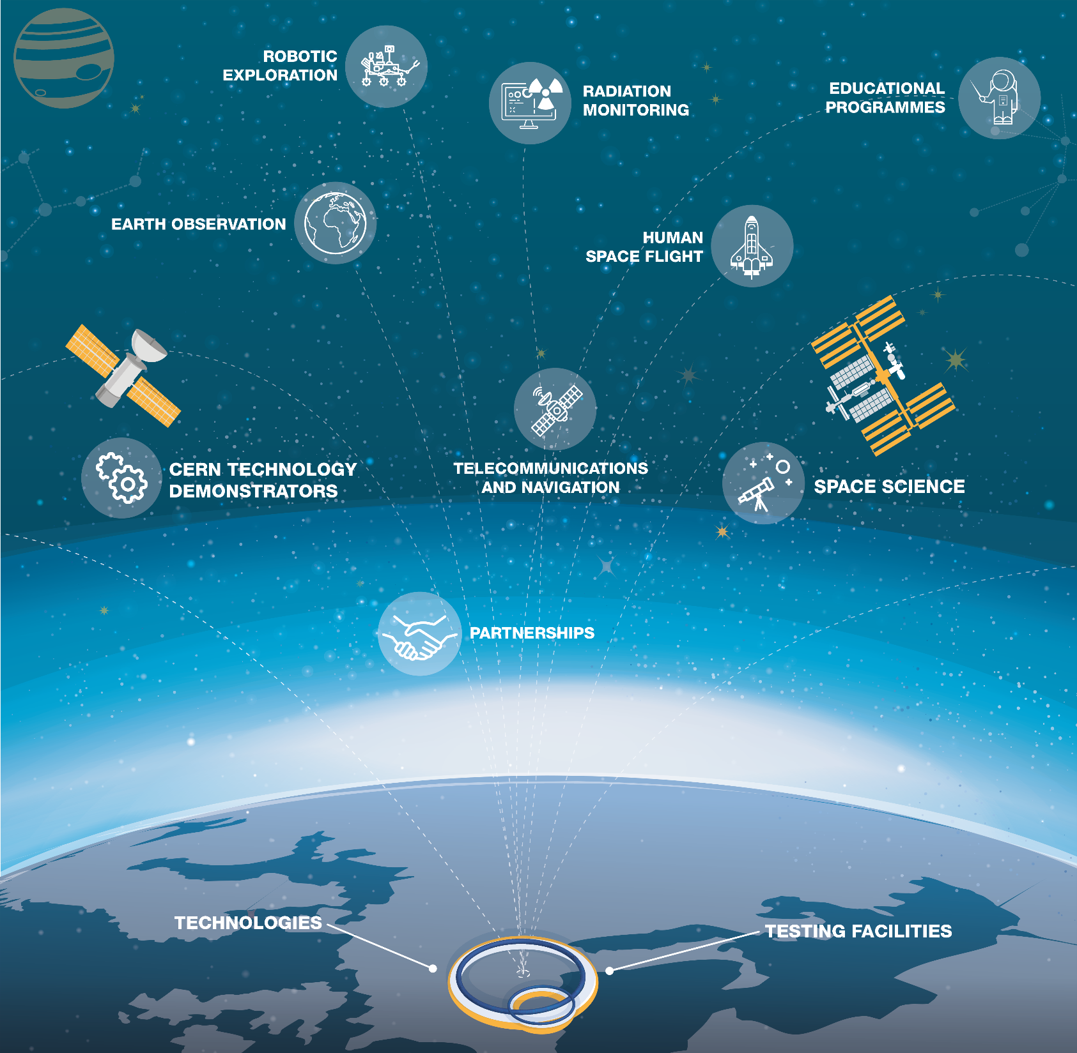
Aerospace Applications
Notes:
CERN technologies are not bound to planet Earth. For example, CERN technology is used for astronaut dosimetry on the International Space Station and for magnetic shield studies in space. We also host and provide computing support to UNOSAT, the United Nations Operational Satellite Applications Programme.

Slide 12

Bundesdruckerei (Berlin) works with CERN on next generation ideas for identity management and cryptography and data handling

Slide 13
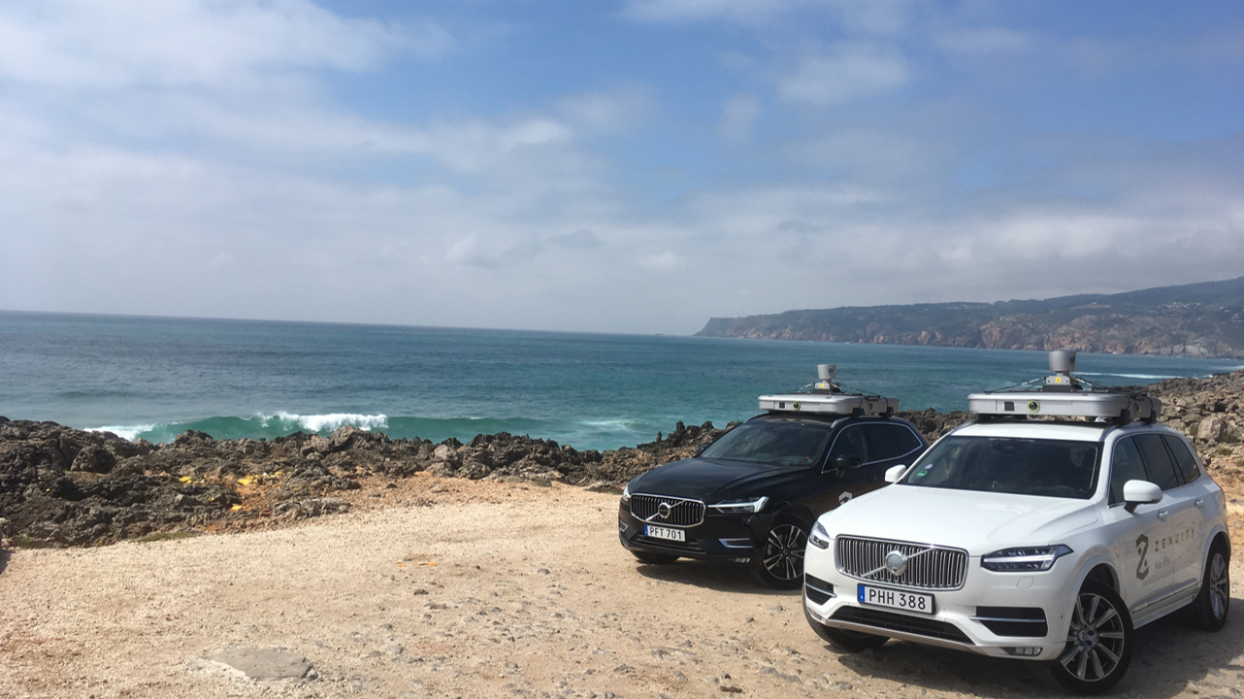
ZENSEACT (Volvo Cars Company) teams up with CERN on fast machine learning using FPGAs.

Slide 14
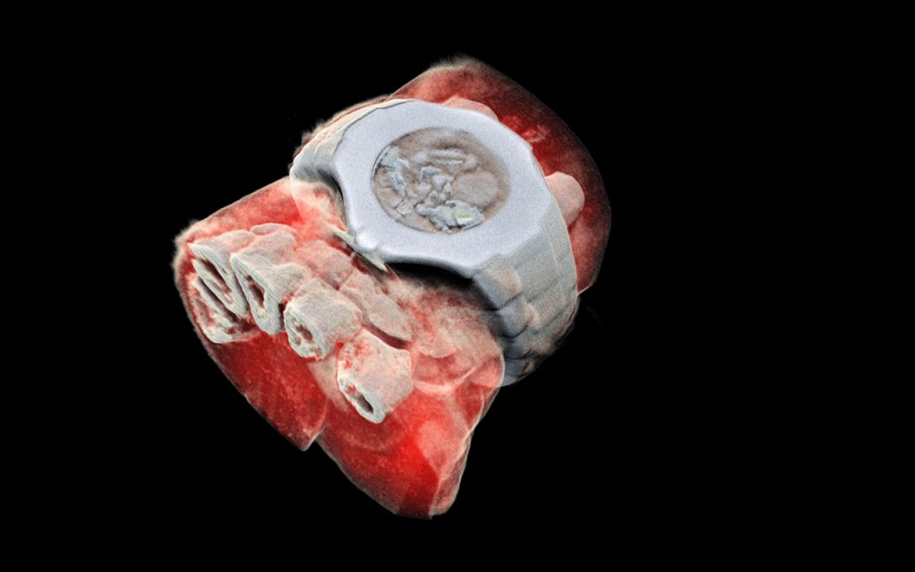
Next generation X ray finally in color (MARS Bio Imaging).

Slide 15


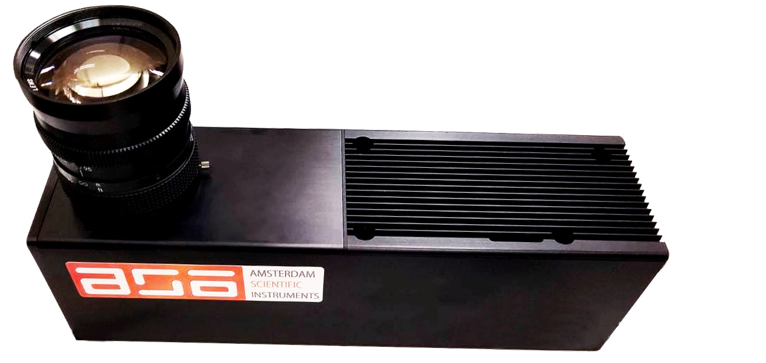
TPX3Cam fast optical photon camera (ASI)

Slide 16

Collaboration with CORMEC and WUR to support national banks and regulators to detect trading anomalies in stock market

Slide 17

Project with CBS to help understand socio-economic challenges using agent based modelling techniques

Slide 18

Exploring with QuTech (TNO and TU Delft) how CERN knowhow can be used to help realize ambitions in quantum computing, sensing and communication.

Slide 19
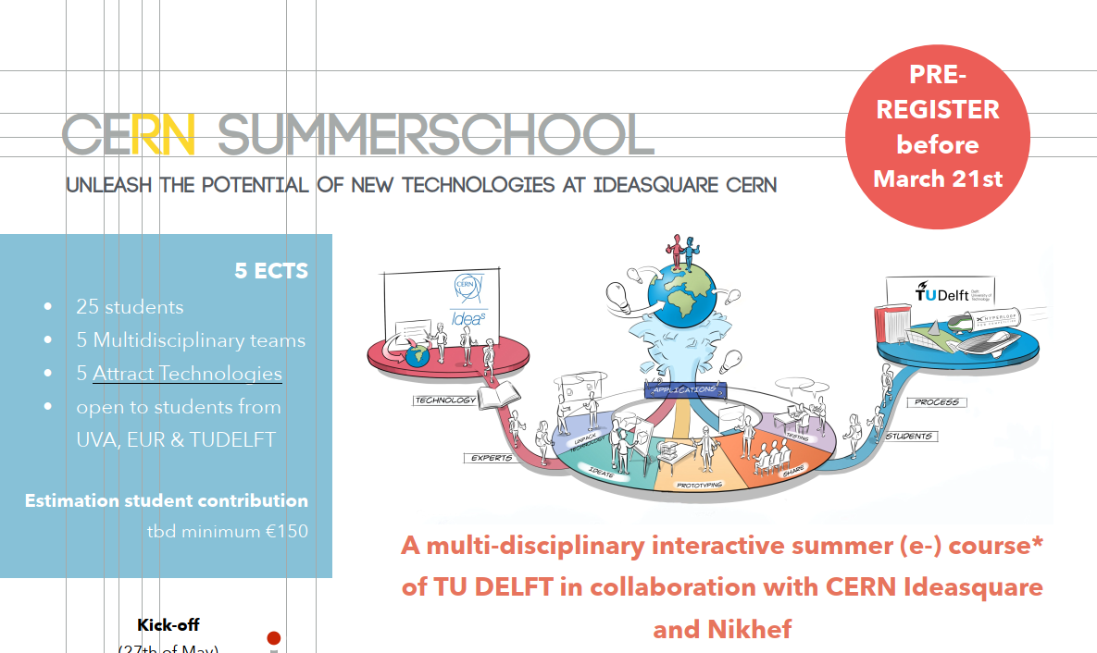

Slide 20
Business Incubation Centers (BICs) help accelerate innovation in the CERN Member States.
Notes:
CERN has established an international network of nine Business Incubation Centres (BICs) throughout its Member States, to assist entrepreneurs and small businesses in taking CERN technologies and expertise to the market.
Additional resources:
https://kt.cern/bic-network

Slide 21
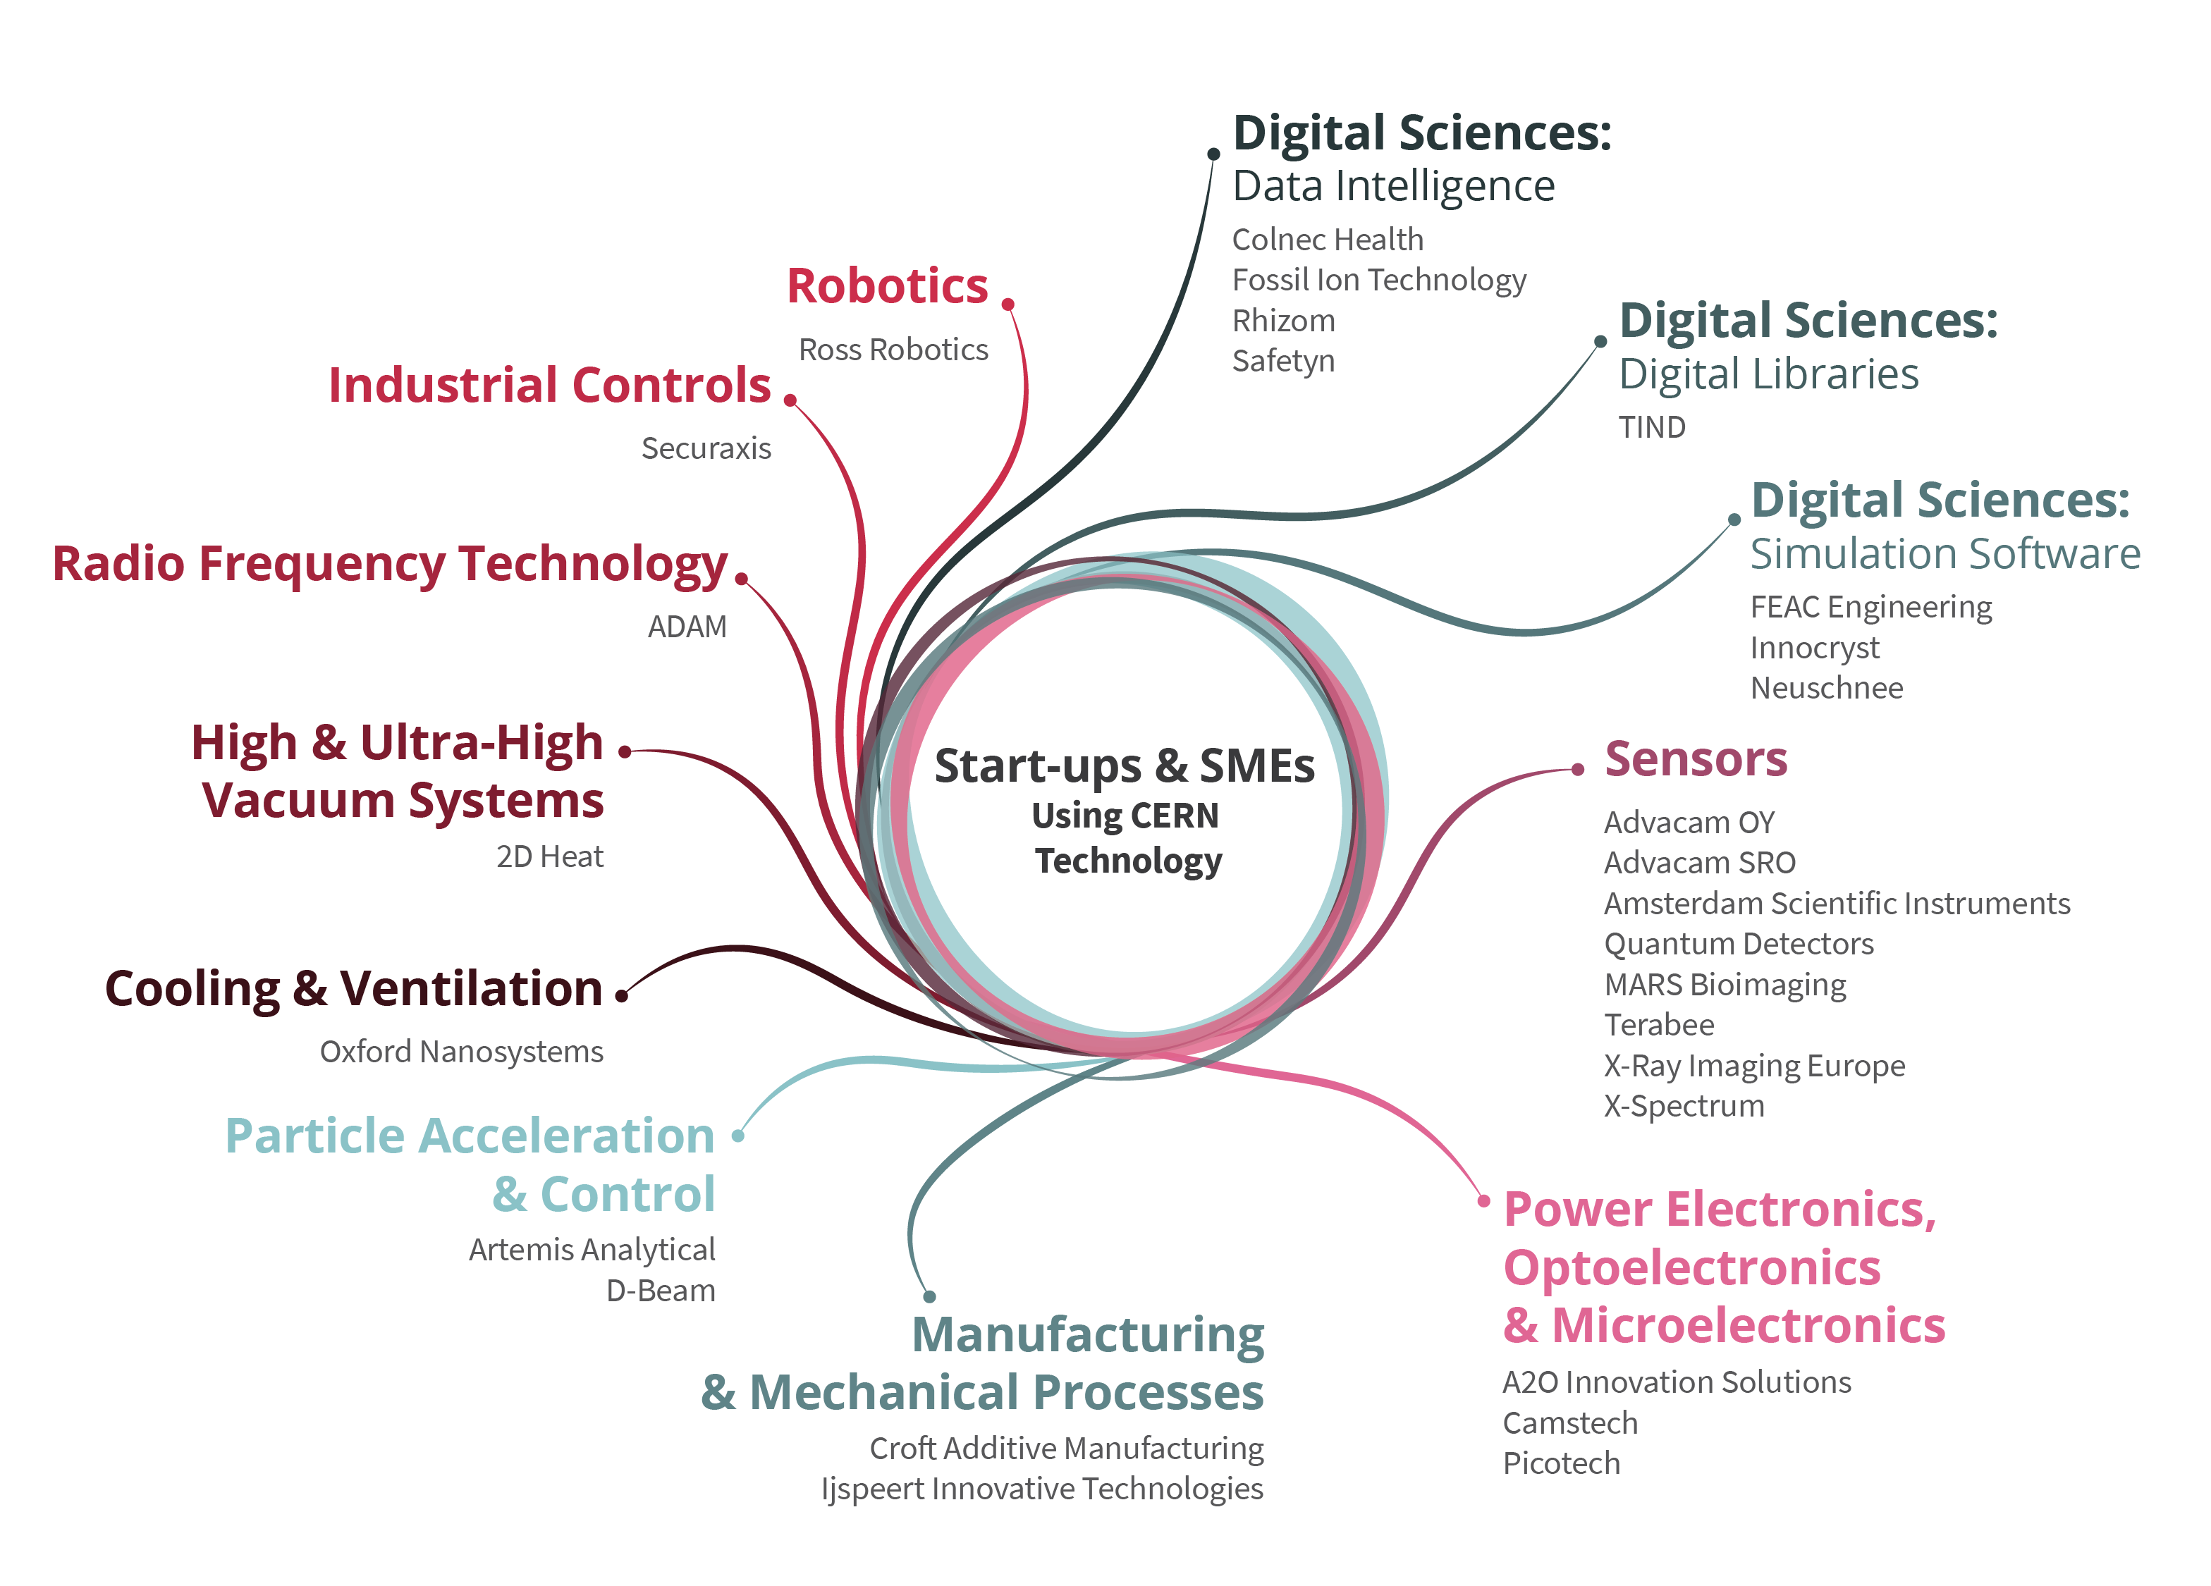
Notes:
CERN encourages the creation of start-up companies and offer support to CERN personnel and external entrepreneurs seeking to establish a business using technology and/or know-how from CERN.
Additional resources:
https://kt.cern/cern-tech-your-start

Slide 22
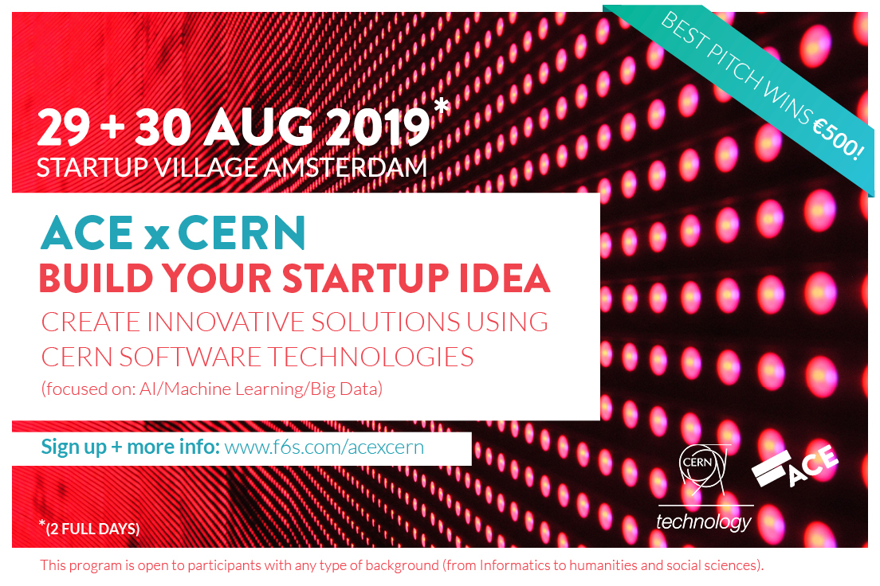

Slide 23
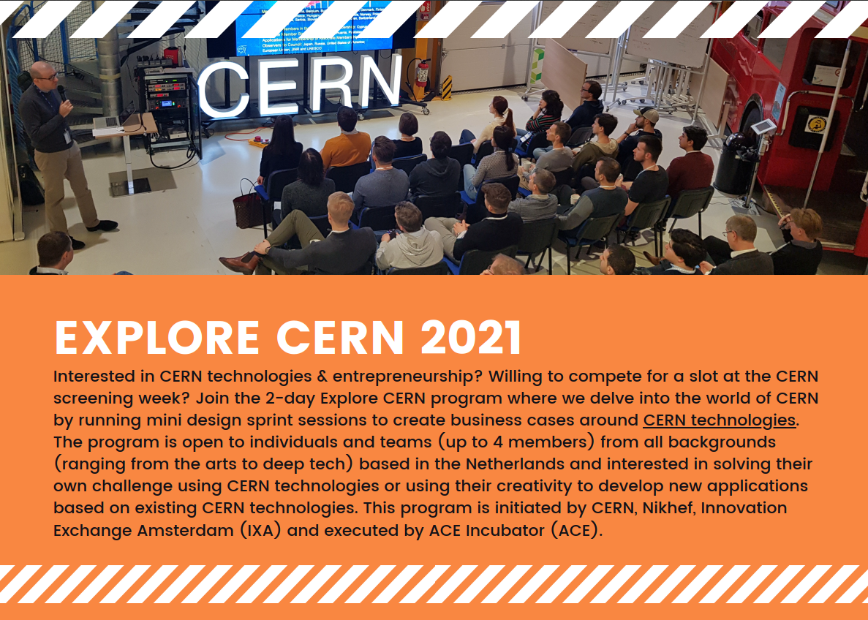


Slide 24
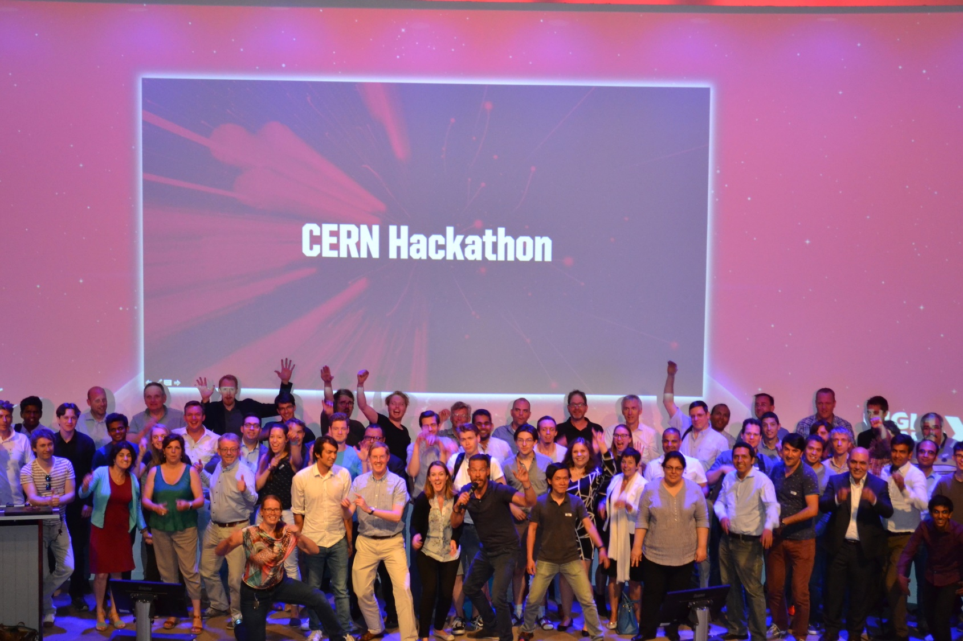

Slide 25


FSO 5G co-creation project discussions running with Nokia, Ericsson and Huawei
InPhocal offers lasers solutions targeting waste free, high speed accurate printing.

Slide 26
Lessons learned
  Serendipity pays off
  You need passionate experts on both sides to make it work
  Start with a concrete project and business need
  Mind the gap – in language, culture, goals
  Knowledge transfer is hard work
  Be aware… magic may happen!

Slide 27
THANK YOU!
han.dols@cern.ch

